Slide 1
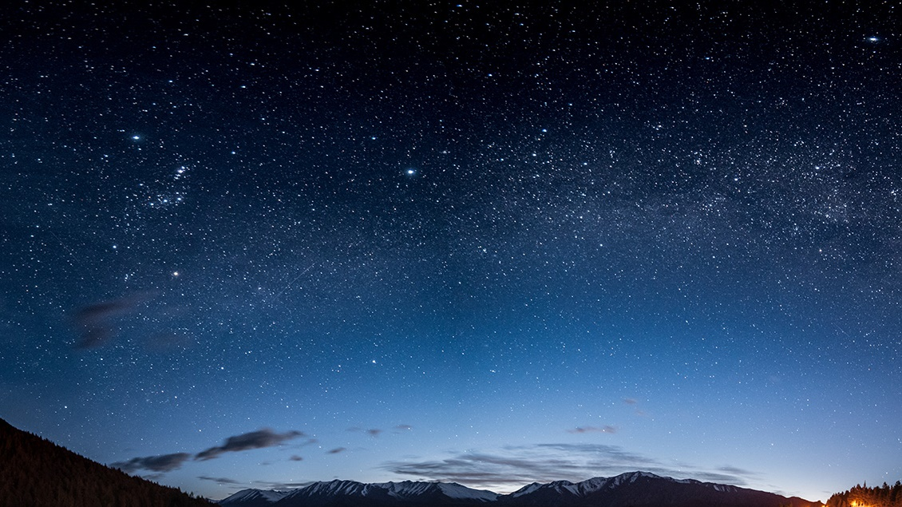
Jesus Wins – Satan Loses
Revelation 12
Lesson 1, 2nd Quarter 2023

Slide 2
Memory Text: Revelation 12:17
¹⁷ And the dragon was wroth with the woman, and went to make war with the remnant of her seed, which keep the commandments of God, and have the testimony of Jesus Christ.

Slide 3
From the Introduction to the Quarter,
SDA Quarterly
The three angels’ messages are, in a sense, the marching orders of the Seventh-day Adventist Church. And at their core, they are the gospel, pure and simple, but the gospel presented in the context of “present truth” (2 Pet. 1:12).
¹² Wherefore I will not be negligent to put you always in remembrance of these things, though ye know them, and be established in the present truth.
And this, the three angel’s messages, is our study for the quarter.

Slide 4
A Note on “Present Truth”
SDABC V. 7 p. 599
The “present truth” or “the truth that is present [with you],” that is, in the truth which the readers have been taught. The word “truth” (alētheia) refers to the whole body of Christian teaching in which the believers had already been instructed and which they “know.”

Slide 5
A Note on “Present Truth”
SDABC V. 7 p. 599, 2 Peter 2:5-8
Peter is prepared to fulfill his spiritual responsibility by continuing to teach the truths presented in the preceding verses (v. 3-11). He realizes the necessity of maintaining a firm faith in the truths of the kingdom, and the faithful practice of the duties involved, e.g.:
⁵ And beside this, giving all diligence, add to your faith virtue; and to virtue knowledge;

Slide 6
A Note on “Present Truth”
2 Peter 1:6-8
⁶ And to knowledge temperance; and to temperance patience; and to patience godliness;
⁷ And to godliness brotherly kindness; and to brotherly kindness charity.
⁸ For if these things be in you, and abound, they make you that ye shall neither be barren nor unfruitful in the knowledge of our Lord Jesus Christ.

Slide 7
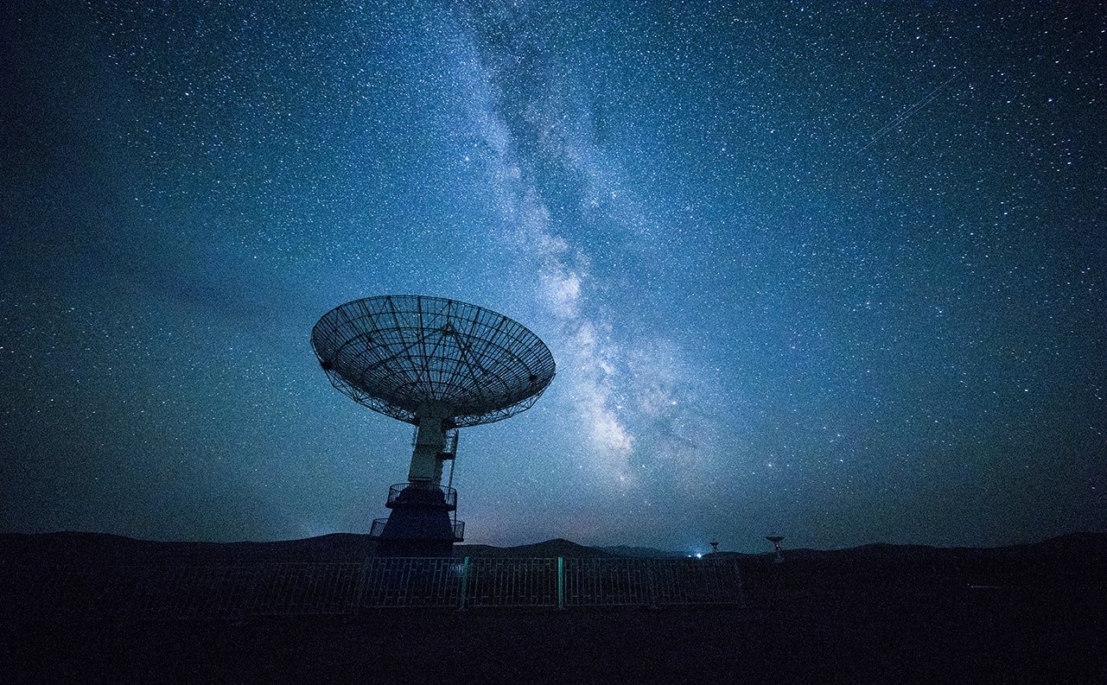
A Note on “Present Truth”
Thus we see that “present truth” specifically does not represent new, modern, radical, or unknown truth, as some would represent it.
Instead, “present truth” refers to Bible truths that are established, known, and present with us, and which must be continuously renewed in our minds as we become more Christlike.

Slide 8
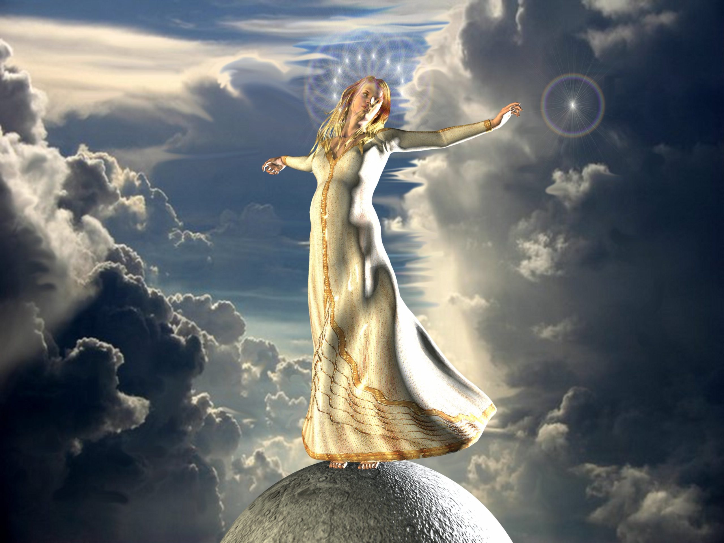
Revelation 12:1-17
12 And there appeared a great wonder in heaven; a woman clothed with the sun, and the moon under her feet, and upon her head a crown of twelve stars:

Slide 9
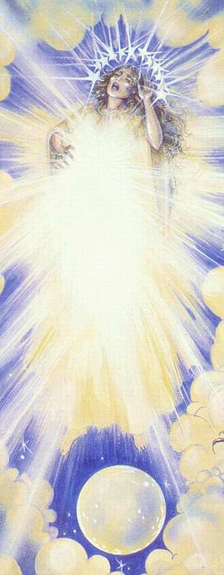
Revelation 12:1,
SDABC V. 7 p. 807
In OT figure the true church is at times represented by a woman.
⁵ For thy Maker is thine husband; the Lord of hosts is his name; and thy Redeemer the Holy One of Israel… For the Lord hath called thee as a woman… (Isaiah 54:5, 6)
² I have likened the daughter of Zion to a comely and delicate woman. (Jeremiah 6:2)

Slide 10
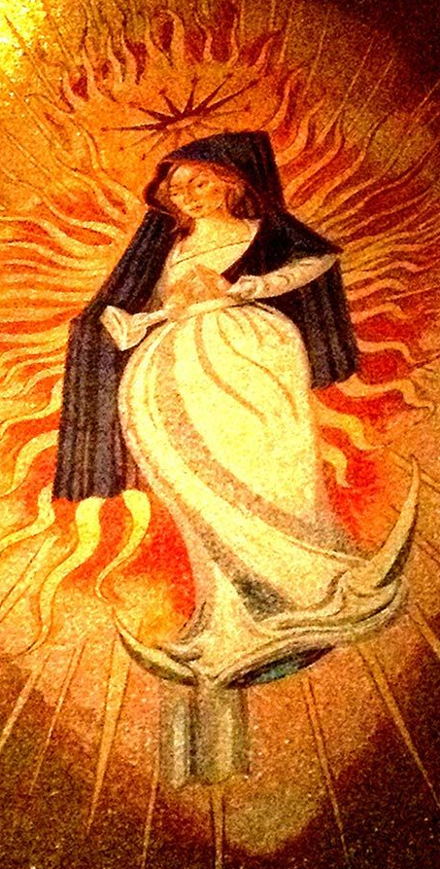
Revelation 12:1,
SDABC V. 7 p. 807
Clothed with the sun:
This may be thought of as representing the glory of God, especially as revealed in the gospel.
…These are they which came out of great tribulation, and have washed their robes, and made them white in the blood of the Lamb. (Revelation 7:14)

Slide 11
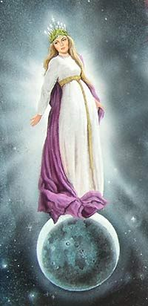
Revelation 12:1,
SDABC V. 7 p. 807
The moon under her feet:
This symbol is understood by many commentators as representing the system of types and shadows of OT times, which were eclipsed by the greater revelation that came through Christ. The ceremonial law, being fulfilled in the life and death of Christ, could well be represented by the moon, which shines with light borrowed from the sun.

Slide 12
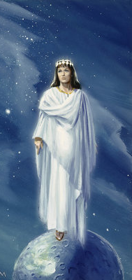
Revelation 12:1,
SDABC V. 7 p. 807
A crown of twelve stars:
This is a victor’s crown (stephanos). The stars have been applied to either the 12 patriarchs or the 12 apostles or to both. Since the principal emphasis in ch. 12 is to the NT church, the emphasis is doubtless on the 12 apostles. At the same time, the picture of 12 tribes is also carried over into the NT church.

Slide 13
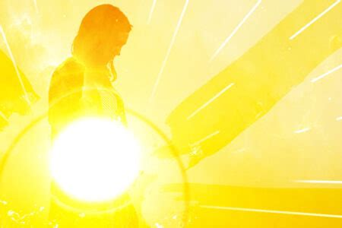
Revelation 12:2
² And she being with child cried, travailing in birth, and pained to be delivered.

Slide 14
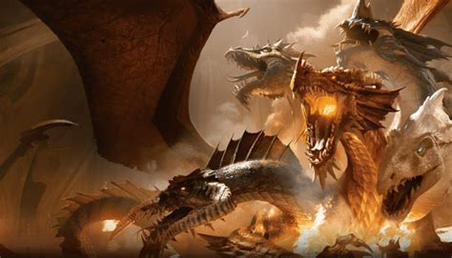
Revelation 12:3
³ And there appeared another wonder in heaven; and behold a great red dragon, having seven heads and ten horns, and seven crowns upon his heads.

Slide 15
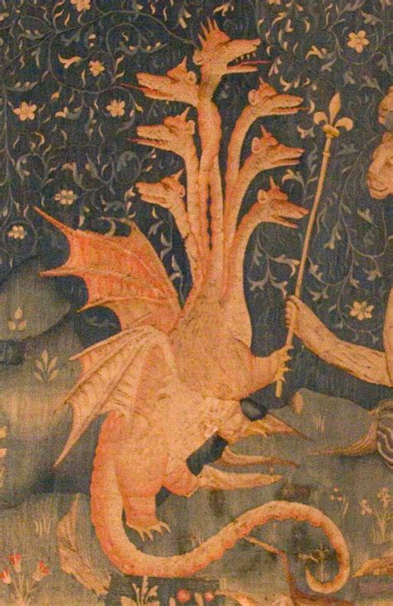
Revelation 12:3, SDABC V. 7 p. 807
A great red dragon:
In v.9 the power thus represented is identified as “that old serpent, called the Devil, and Satan.” Here the symbol represents Satan as working through pagan Rome, the power ruling the world when Jesus was born. The dragon is described as “red,” probably because of the fact that in all his connection with the church of God he has appeared in the role of persecutor and destroyer. It has been his studied purpose to destroy the children of the Most High.

Slide 16
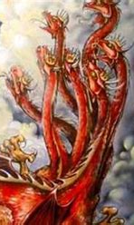
Revelation 12:3, SDABC V. 7 p. 807-8
Seven heads:
Seven heads appear also on the beast John saw rising from the sea (Rev. 13:1) [the one who had “a mouth speaking great things and blasphemies” and continued 42 months], and on the scarlet-colored beast (Rev. 17:3). The heads in ch. 17:9-10 are identified as “seven mountains” and “seven kings.” It seems reasonable to conclude that the seven heads of the dragon represent political powers that have championed the cause of the dragon, and through which the dragon has exercised his persecuting power.

Slide 17
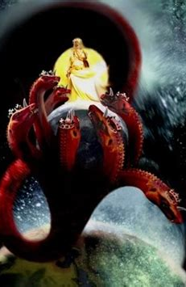
Revelation 17:9-10
⁹ And here is the mind which hath wisdom. The seven heads are seven mountains, on which the woman sitteth.
¹⁰ And there are seven kings: five are fallen, and one is, and the other is not yet come; and when he cometh, he must continue a short space.

Slide 18
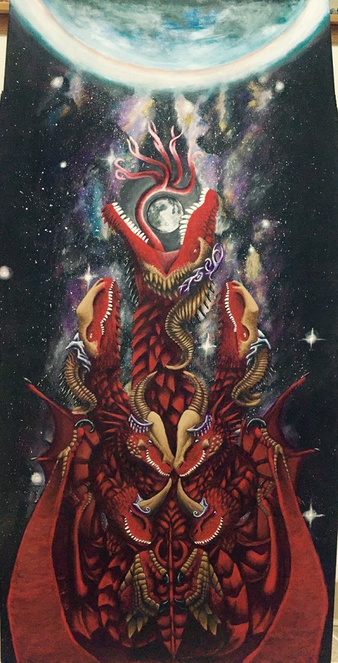
Revelation 12:3, SDABC V. 7 p. 808
Ten horns:
The beast of ch. 13 and ch. 17 also had ten horns each. Some hold the ten horns of the dragon to be identical with those of the two beasts, and the latter to be identical with the ten horns of the fourth beast of Daniel 7. Others see a more general designation for the minor political powers through which Satan has operated, in contrast with the seven heads, which may be regarded as representing the major political powers.

Slide 19
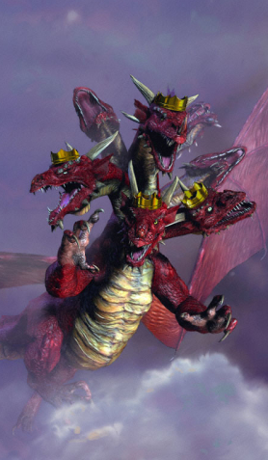
Revelation 12:3, SDABC V. 7 p. 808
Crowns
These are “diadēmata,” literally, “something bound around.” The word was used to describe the Persian badge of kingship, a blue ribbon trimmed with white, worn on the turban. Hence the word came to be used as a badge of royalty. It is contrasted with stephanos, the crown or garland of victory adorning the woman.

Slide 20
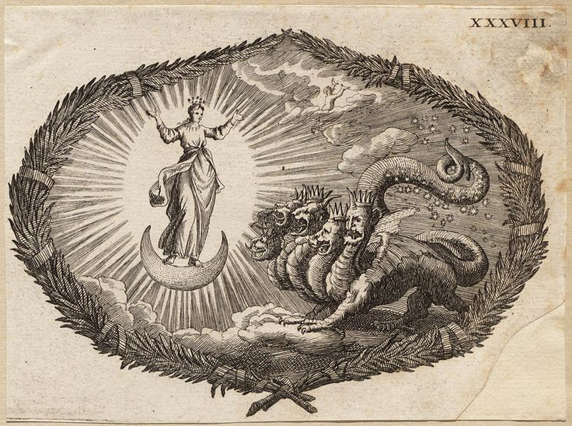
Revelation 12:4
⁴ And his tail drew the third part of the stars of heaven, and did cast them to the earth: and the dragon stood before the woman which was ready to be delivered, for to devour her child as soon as it was born.

Slide 21
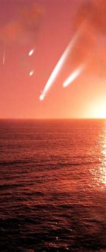
Revelation 12:4, Testimonies to the Church
Satan in his rebellion took a third part of the angels. They turned from the Father and from His Son, and united with the instigator of rebellion. -3T 115
When Satan became disaffected in heaven, he did not lay his complaint before God and Christ; but he went among the angels who thought him perfect and represented that God had done him injustice in preferring Christ to himself. The result of this misrepresentation was that through their sympathy with him one third of the angels lost their innocence, their high estate, and their happy home. -5T 291

Slide 22
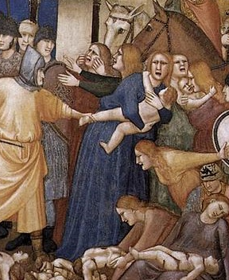
Revelation 12:4, Matthew 2:16
¹⁶ Then Herod, when he saw that he was mocked of the wise men, was exceeding wroth, and sent forth, and slew all the children that were in Bethlehem, and in all the coasts thereof, from two years old and under, according to the time which he had diligently inquired of the wise men.

Slide 23
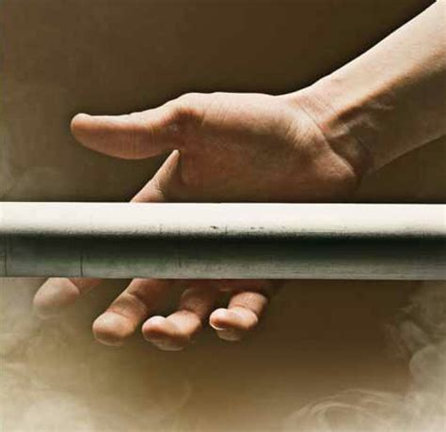
Revelation 12:5
⁵ And she brought forth a man child, who was to rule all nations with a rod of iron: and her child was caught up unto God, and to his throne..

Slide 24
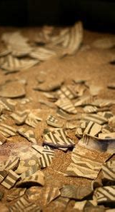
Revelation 12:5,
Psalm 2:8-9
⁸ Ask of me, and I shall give thee the heathen for thine inheritance, and the uttermost parts of the earth for thy possession.
⁹ Thou shalt break them with a rod of iron; thou shalt dash them in pieces like a potter's vessel.

Slide 25
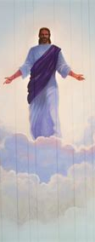
Revelation 12:5, Hebrews 1:1-3
1 God, who at sundry times and in divers manners spake in time past unto the fathers by the prophets,
² Hath in these last days spoken unto us by his Son, whom he hath appointed heir of all things, by whom also he made the worlds;
³ Who being the brightness of his glory, and the express image of his person, and upholding all things by the word of his power, when he had by himself purged our sins, sat down on the right hand of the Majesty on high:

Slide 26
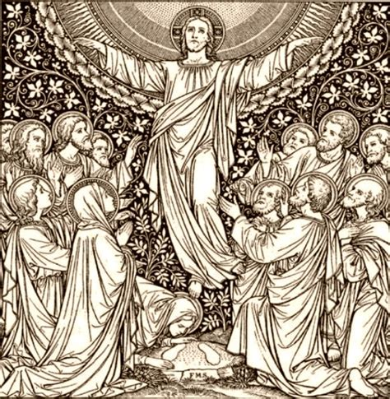
Revelation 12:5,
Hebrews 10:12
¹² But this man, after he had offered one sacrifice for sins for ever, sat down on the right hand of God;

Slide 27
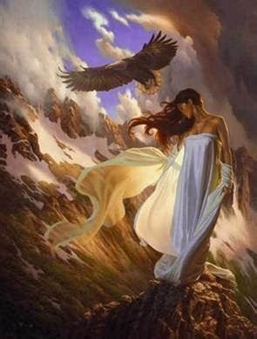
Revelation 12:6
⁶ And the woman fled into the wilderness, where she hath a place prepared of God, that they should feed her there a thousand two hundred and threescore days.

Slide 28
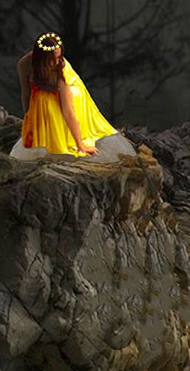
Revelation 12:6, SDABC V. 7 P. 808
Here “wilderness” or erēmos, “a forsaken desert,” “empty place,” “an uninhabited place” represents a place of seclusion or obscurity, an area or condition in which the church would be in a place of obscurity, away from the public gaze.
The protection and sanctuary in obscurity here found by the woman were divinely appointed and prepared. God cares for His own. Even though the church is persecuted and driven into exile, the Lord nourishes it.

Slide 29
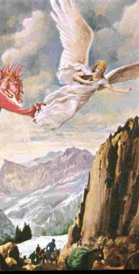
Revelation 12:6, GC p. 54
In the sixth century the papacy had become firmly established. Its seat of power was fixed in the imperial city, and the bishop of Rome was declared to be the head over the entire church. Paganism had given place to the papacy. And now began the 1260 years of papal oppression foretold in the prophecies of Daniel and the Revelation. Christians were forced to choose either to yield their integrity and accept the papal ceremonies and worship, or to wear away their lives in dungeons or suffer death by the rack, the fagot, or the headsman's ax… Persecution opened upon the faithful with greater fury than ever before, and the world became a vast battlefield. For hundreds of years the church of Christ found refuge in seclusion and obscurity.

Slide 30
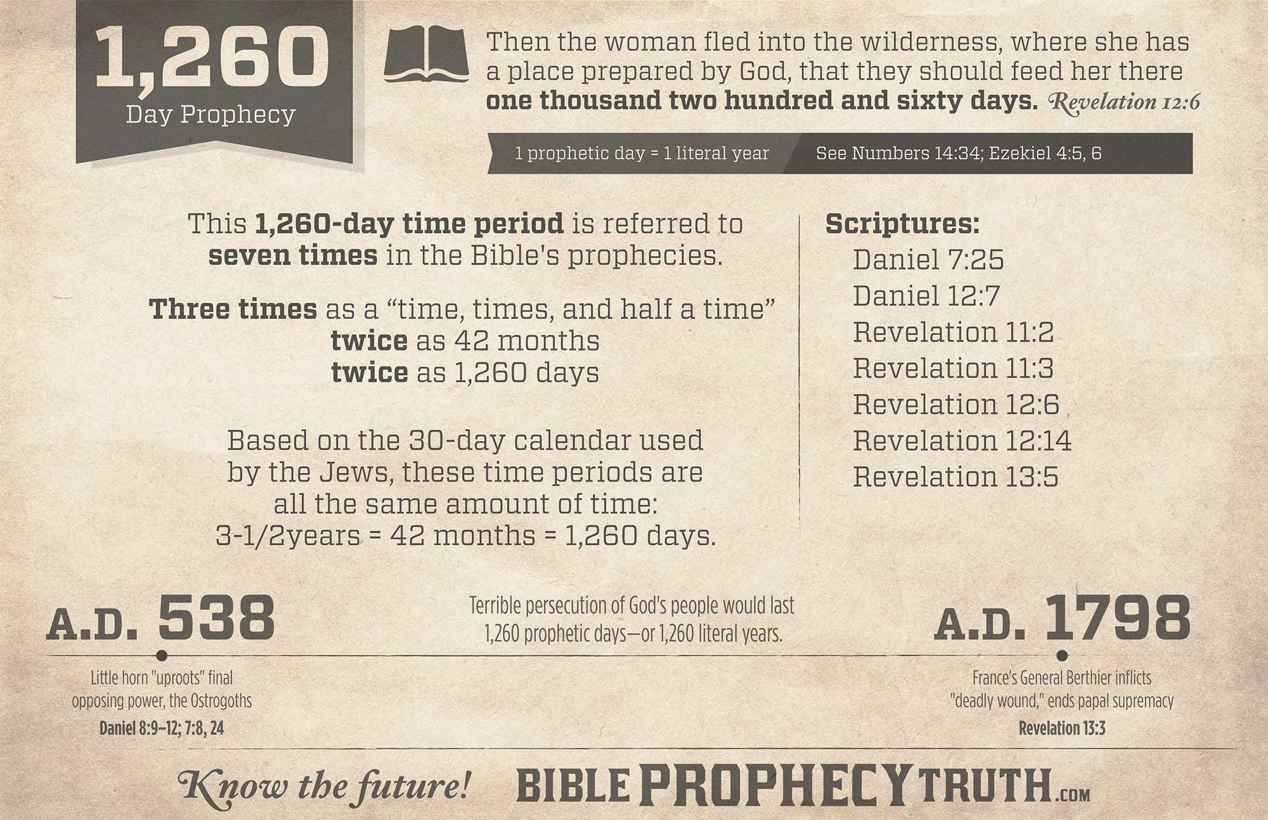

Slide 31
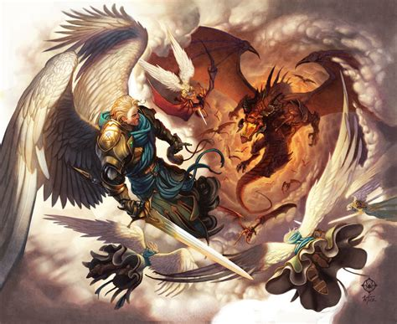
Revelation 12:7-8
⁷ And there was war in heaven: Michael and his angels fought against the dragon; and the dragon fought and his angels,
⁸ And prevailed not; neither was their place found any more in heaven.

Slide 32
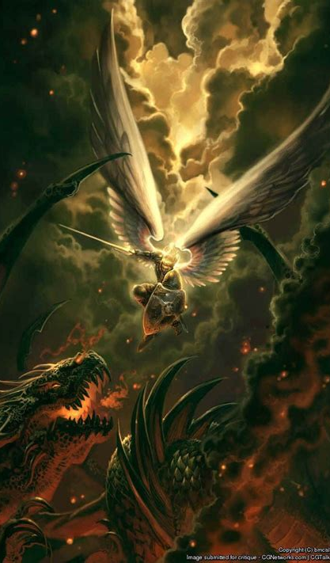
Revelation 12:7-8, SDABC V. 7 p. 809
John now presents briefly the history of the great controversy between Satan and Christ in heaven, from its origin to the time of Christ’s victory at the cross (v. 7-9), the final casting out of Satan at that time to this earth (v. 10-12), and the course of the controversy on earth down to the time of the end (v. 13-16). This brief survey stands as a background for the extended delineation of developments in the conflict during the time of the end, by means of which it is finally and successfully terminated.

Slide 33
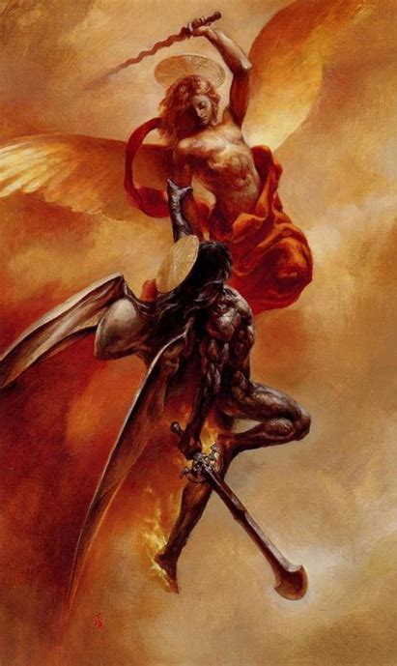
Revelation 12:7-8, GC P. 499
With one accord, Satan and his host threw the blame of their rebellion wholly upon Christ, declaring that if they had not been reproved, they would never have rebelled. Thus stubborn and defiant in their disloyalty, seeking vainly to overthrow the government of God, yet blasphemously claiming to be themselves the innocent victims of oppressive power, the archrebel and all his sympathizers were at last banished from heaven.

Slide 34
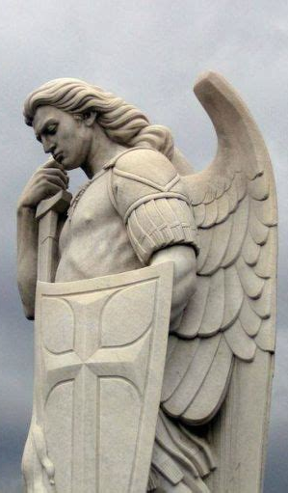
Revelation 12:7-8, 2 Timothy 1:8-9
⁸ Be not thou therefore ashamed of the testimony of our Lord, nor of me his prisoner: but be thou partaker of the afflictions of the gospel according to the power of God;
⁹ Who hath saved us, and called us with an holy calling, not according to our works, but according to his own purpose and grace, which was given us in Christ Jesus before the world began,

Slide 35
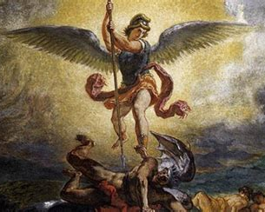
Revelation 12:9
⁹ And the great dragon was cast out, that old serpent, called the Devil, and Satan, which deceiveth the whole world: he was cast out into the earth, and his angels were cast out with him.

Slide 36
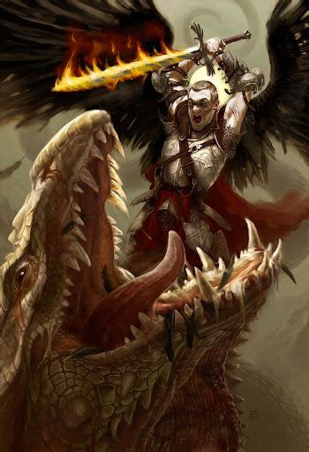
Revelation 12:9, SDABC V. 7 p. 810
Satan and his angels were cast out of heaven in ages past, prior to the creation of this world. Nevertheless, it seems that until the cross he had access to heavenly beings, and to a limited extent, possibly as “prince of this world,” but not as an inhabitant of heaven, to the precincts of heaven. However this may be, a decisive casting out occurred at the cross, as our Lord Himself declared.

Slide 37
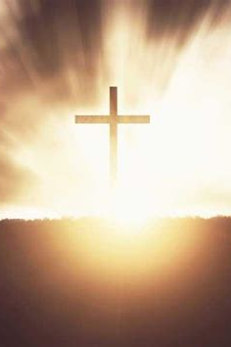
Revelation 12:9, John 12:30-32
³⁰ Jesus answered and said, This voice came not because of me, but for your sakes.
³¹ Now is the judgment of this world: now shall the prince of this world be cast out.
³² And I, if I be lifted up from the earth, will draw all men unto me.

Slide 38

Revelation 12:9, SDABC V. 7 p. 810
In Revelation 12:9, it appears that John refers most particularly to events connected with Christ’s triumph on the cross, which we may observe from the context, in verses 10-13.

Slide 39
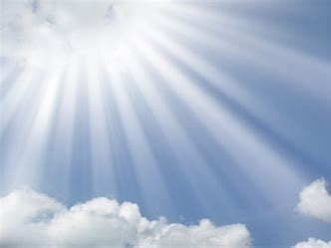
Revelation 12:10
¹⁰ And I heard a loud voice saying in heaven, Now is come salvation, and strength, and the kingdom of our God, and the power of his Christ: for the accuser of our brethren is cast down, which accused them before our God day and night.

Slide 40

Revelation 12:10, SDABC V. 7 P. 810
The proclamation in verses 10-12 by a “loud voice… in heaven” is more or less parenthetical, its purpose being to explain the significance of the casting down of Satan in v. 9, first with respect to the inhabitants of heaven and then to those of this earth. Following this explanatory parenthesis, v. 13 takes up the narrative of Satan’s activities at the point where it was left in verse 9. Accordingly, vs. 10-12 constitute a statement concerning the status of the plan of salvation at the point of time when Satan was “cast out into the earth.

Slide 41
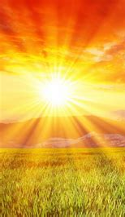
Revelation 12:10, SDABC V. 7 P. 810
The first declaration by the “loud voice” consists of a series of facts relative to Christ’s triumph over Satan on the cross –the plan of salvation was made sure, “strength” was provided for resisting the wiles of Satan, Christ’s “kingdom” was made sure, and His “power,” literally, “authority,” to be man’s Savior, high priest, and king was confirmed.
The reason assigned for this fourfold achievement is specifically said to be that “the accuser of our brethren is cast down.” This clearly links these accomplishments with the casting down of verse 9.

Slide 42
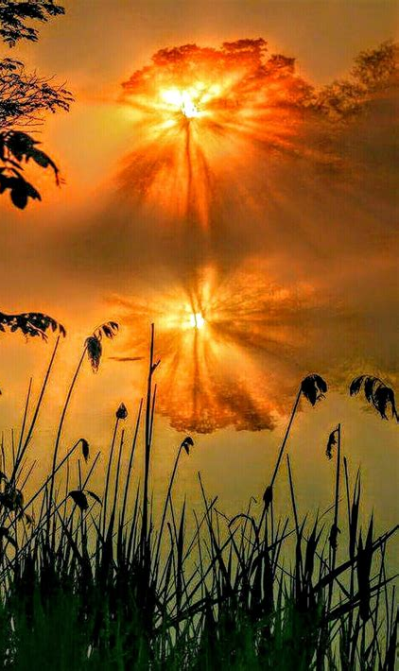
Revelation 12:10, SDABC V. 7 P. 810
At the time of the casting down of vs 9, 10, 13, “the accuser of our brethren” had already been actively accusing them before our God day and night.” Obviously, the fall here referred to came after a period during which Satan had been accusing “the brethren,” and it would therefore appear that this cannot be the original casting out of Satan prior the creation of the earth.

Slide 43
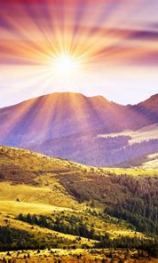
Revelation 12:10, SDABC V. 7 P. 810
Verse 11 specifically states that it was “the blood of the Lamb”—the death of Christ upon the cross—that made victory over the “accuser of our brethren” possible.

Slide 44
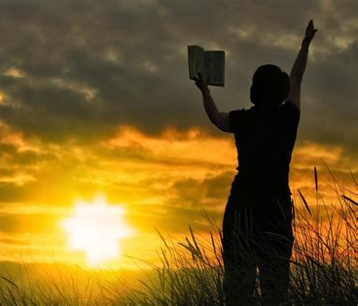
Revelation 12:11-12
¹¹ And they overcame him by the blood of the Lamb, and by the word of their testimony; and they loved not their lives unto the death.
¹² Therefore rejoice, ye heavens, and ye that dwell in them. Woe to the inhabiters of the earth and of the sea! for the devil is come down unto you, having great wrath, because he knoweth that he hath but a short time.

Slide 45
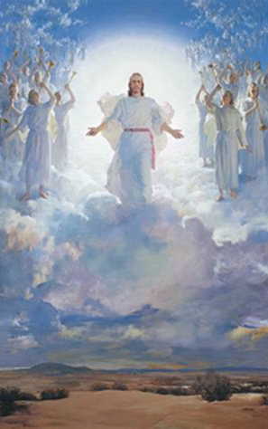
Revelation 12:11-12, SDABC V. 7 p. 811
It may appear that the 2000 years since the crucifixion, during which Satan has been actively at work against the church, is hardly a “short time” either absolutely or when compared with all the time from Adam to the cross. However, this expression should be understood against the background of the whole tenor of the book of Revelation, which presents the second coming of Christ as near. If Jesus is coming “quickly” then the time for Satan to work is “short.” Against the scope of eternity, by which sinless beings judge time, then all of Satan’s life will indeed be short!

Slide 46
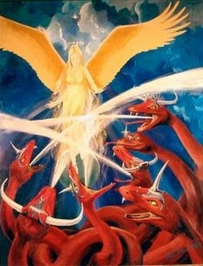
Revelation 12:13
¹³ And when the dragon saw that he was cast unto the earth, he persecuted the woman which brought forth the man child.

Slide 47
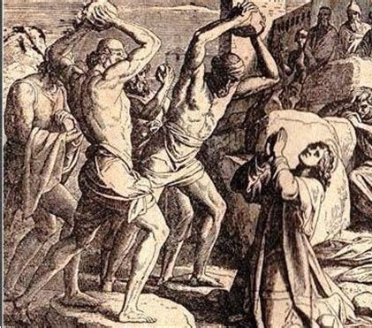
Revelation 12:13,
SDABC V. 7 P. 812
Being now unable to attack the Son of God directly, the dragon attempts to hurt the Son through the mother, by persecuting the mother of the man-child, the church.

Slide 48
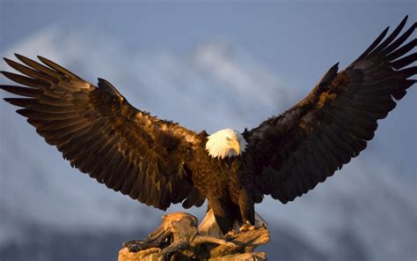
Revelation 12:14
¹⁴ And to the woman were given two wings of a great eagle, that she might fly into the wilderness, into her place, where she is nourished for a time, and times, and half a time, from the face of the serpent.

Slide 49
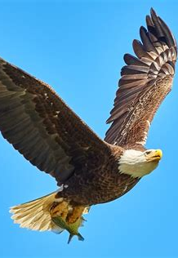
Revelation 12:14, Exodus 19:3-4
³ And Moses went up unto God, and the Lord called unto him out of the mountain, saying, Thus shalt thou say to the house of Jacob, and tell the children of Israel;
⁴ Ye have seen what I did unto the Egyptians, and how I bare you on eagles' wings, and brought you unto myself.

Slide 50
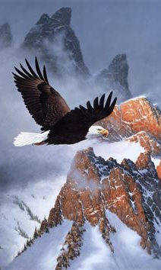
Revelation 12:14, Deuteronomy 32:10-12
¹⁰ He found him in a desert land, and in the waste howling wilderness; he led him about, he instructed him, he kept him as the apple of his eye.
¹¹ As an eagle stirreth up her nest, fluttereth over her young, spreadeth abroad her wings, taketh them, beareth them on her wings:
¹² So the Lord alone did lead him, and there was no strange god with him.

Slide 51
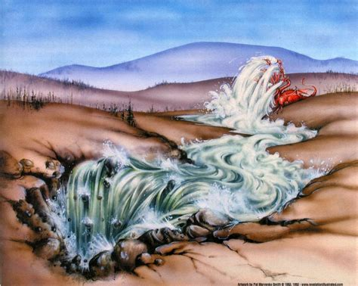
Revelation 12:15
¹⁵ And the serpent cast out of his mouth water as a flood after the woman, that he might cause her to be carried away of the flood.

Slide 52
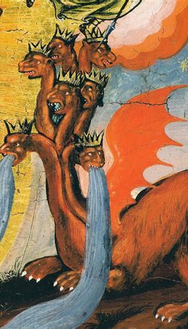
Revelation 12:15,
Psalm 74:12-14
¹² For God is my King of old, working salvation in the midst of the earth.
¹³ Thou didst divide the sea by thy strength: thou brakest the heads of the dragons in the waters.
¹⁴ Thou brakest the heads of leviathan in pieces, and gavest him to be meat to the people inhabiting the wilderness.

Slide 53
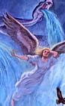
Revelation 12:15, Ezekiel 29:3
³ Speak, and say, Thus saith the Lord God; Behold, I am against thee, Pharaoh king of Egypt, the great dragon that lieth in the midst of his rivers, which hath said, My river is mine own, and I have made it for myself.
⁴ But I will put hooks in thy jaws, and I will cause the fish of thy rivers to stick unto thy scales, and I will bring thee up out of the midst of thy rivers, and all the fish of thy rivers shall stick unto thy scales.

Slide 54
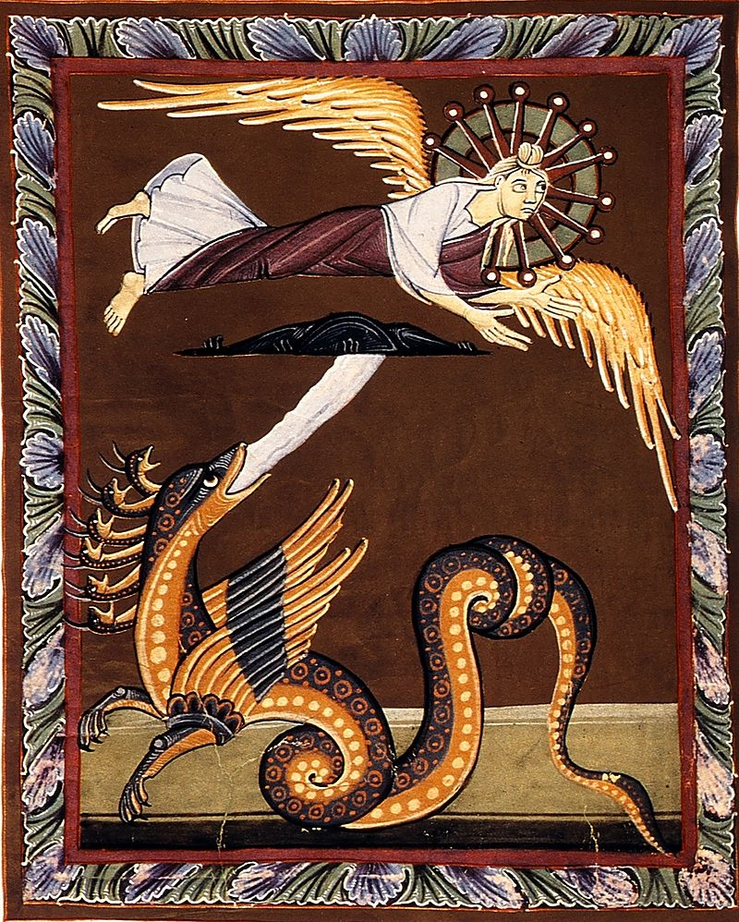
Revelation 12:15,
SDABC V. 7 P. 812
A dragon is identified in Psalm 74 and Ezekiel 29 as a water animal, hence, probably, the figure of water as a symbol of destruction. Satan sought to destroy the Christian church by the inundation of false doctrines as well as by persecution.

Slide 55
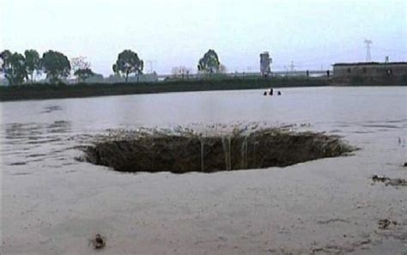
Revelation 12:16
¹⁶ And the earth helped the woman, and the earth opened her mouth, and swallowed up the flood which the dragon cast out of his mouth.

Slide 56
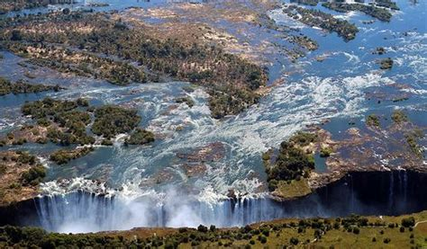
Revelation 12:16, SDABC V. 7 P. 812
Some hold that the “earth” here represents areas where there was a scarcity of peoples, in contrast with “waters” which sometimes represent “peoples,” “nations,” and “tongues.” They point out that at the time of the Reformation there were multitudes of people in Europe and the Far East, but that the North American continent was very sparsely populated.

Slide 57
Revelation 12:16, SDABC V. 7 P. 812
Thus they point to this land as the “earth” that brings relief to the persecuted church of the Old World. The Protestant lands of Western Europe, which became a haven from persecution, may also be included. Others point to the Protestant Reformation itself as the major factor in breaking the spell of the apostate church.

Slide 58
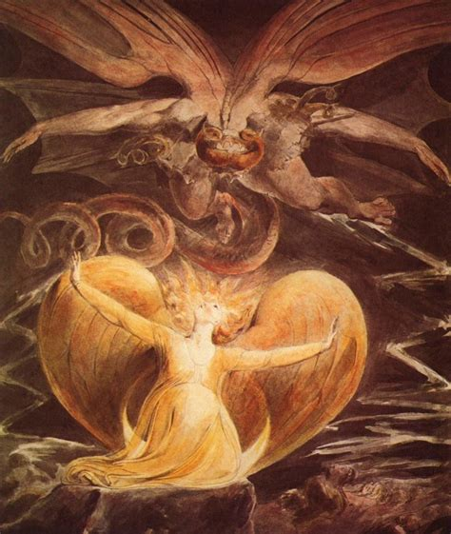
Revelation 12:17
¹⁷ And the dragon was wroth with the woman, and went to make war with the remnant of her seed, which keep the commandments of God, and have the testimony of Jesus Christ.

Slide 59

Revelation 12:17,
SDABC V. 7 P. 812
Failure to destroy the church in the wilderness intensifies the wrath of the dragon, so much so that he sets about with great determination to wage war upon the people of God, particularly the “remnant of her seed.”

Slide 60
The Remnant of Her seed
The three Hebrew words most commonly used for “remnant” are:
Peletah (or palet, palit): “what escapes,” “those who escape,” or the verb forms “to escape,” or “to deliver.”
She’erith (or she’ar) “the rest,” “what remains,” “remnant,” and its verb form “to leave over,” “to be left over,” “to remain.”
Yether, “what remains,” “remainder,” “remnant,” and from yathar, “to leave over,” “to be left over.”

Slide 61
The Remnant of Her seed
Instances of the use of these words with respect to God’s chosen people may be classified as follows:
Members of Jacob’s family preserved under Joseph’s care in Egypt are spoken of as “a posterity,” literally, “a remnant.” (she’erith; Gen. 45:7). Here, emphasis is on the fact of preservation.
In the midst of general apostasy, Elijah protested, “I, even I only, remain [yathar] a prophet of the Lord” (1 Kings 18:22). But God declared “I have left [sha’ar] me seven thousand in Israel, all the knees which have not bowed unto Baal” (1 Kings 19:14, 18).

Slide 62
The Remnant of Her seed
A small “remnant” (peletah ) of the ten tribes “escaped [sha’ar] out of the hand of the kings of Assyria,” who had led the vast majority of the nation into captivity, and remained in Palestine (2 Chron. 30:6). By 722 B.C. Judah alone was “left” (sha’ar) to function as a nation (2 Kings 17:18). Accordingly, it became the “remnant” (she’ar) of the twelve tribes and sole heir to the covenant promises, privileges, and responsibilities that originally belonged to all twelve (Isa. 10:22; see Vol. IV, pp. 26-32).

Slide 63
The Remnant of Her seed
A few years later Sennacherib conquered all of Judah except Jerusalem, which, in turn, is spoken of as a “remnant.” This “remnant [peletah] that is escaped [ sha’ar ] of the house of Judah” was to “take root downward,” to “bear fruit upward,” and to “go forth” as the “remnant” (she’erith) of God’s chosen people, His appointed instrument for the salvation of the world (2 Kings 19:4, 30, 31; Isa. 37:4, 31,32; cf. Isa. 4:2; 10:20). God also purposed to “recover” a “remnant” (she’ar) of the Israelites and Judahites that had gone captive into Assyria, and to prepare a “highway” for this “remnant [she’ar] of his people,” as He formerly had when their ancestors left the land of Egypt (Isa. 11:11, 12, 16 ).

Slide 64
The Remnant of Her seed
When the “king of Babylon” invaded Palestine a century later, he too “left [yether; sha’ar in 2 Kings 25:22; cf. eh. 24:14] a remnant [peletah; she’ar in 2 Kings 25:22]”(Eze. 14:22; cf. Jer. 40:11; Jer. 42:2), which was to “escape” (palat), that is, survive, the sword, pestilence, and famine that accompanied the siege of Jerusalem (Eze. 7:16). But Jeremiah warned that even some of this “remnant” (yether; ch. 39:9), or “residue [ sha’ar ]of Jerusalem,” that God desired should “remain [ sha’ar ] in this land,” would later be “removed into all the kingdoms of the earth” (ch. 24:8, 9). Most of this “remnant” fled to Egypt, but Jeremiah warned that “none of the remnant [ she’erith ] of Judah, which are gone into the land of Egypt to sojourn there,” should “escape [palit ] or remain, that they should return into the land of Judah” (ch. 44:14).

Slide 65
The Remnant of Her seed
The Lord promised to “leave a remnant” (yathar) of those taken captive by Nebuchadnezzar, which would “escape the sword” and “remember” God in the lands of their captivity (Eze. 6:8, 9). A “remnant” ( she’erith ) of those in captivity (Jer. 23:3; cf. ch. 31:7) would eventually “escape [palat ] out of the land of Babylon” (ch. 50:28). Nehemiah speaks of the returned captives as “the Jews that had escaped [peletah] ,” “the remnant [peletah ] that are left [sha’ar] of the captivity” (ch. 1:2, 3). To this “remnant”(she’erith) God entrusted all the covenant responsibilities and promises (Zech. 8:12; cf. Vol. IV, pp. 30-32), but warned that if they should again break God’s commandments He would consume them, “so that there should be no remnant [ she’erith ] nor escaping [peletah]” (Ezra. 9:14).

Slide 66
The Remnant of Her seed
Many references to the “remnant” occur in a context that clearly anticipates the Messianic kingdom (see Isa. 4:2, 3; 11:11, 16; cf. ch. 11:1-9; Jer. 23:3; cf. ch. 23:4-6; Micah 4:7; cf. ch. 4:1-8; 5:7, 8; cf. ch. 5:2-15; Zeph. 3:13).

Slide 67
The Remnant of Her seed
A composite description of the “remnant” in these and other OT passages identifies the group thus designated as composed of Israelites who survived calamities such as war, captivity, pestilence, and famine, and who were spared in mercy to continue as God’s chosen people. Repeatedly, this “remnant” was “left [she’ar] but a few of [from] many.”

Slide 68
The Remnant of Her seed
Remembering the true God and turning to Him (2 Chron. 30:6; Isa. 10:20; Eze. 6:8, 9), they renounced the authority of false religious systems (1 Kings 19:18) and refused to do iniquity (Zeph. 3:13). Loyal to God’s commandments (Ezra. 9:14), they were “called holy” and were “written among the living in Jerusalem” (Isa. 4:3). Accepting anew the responsibilities and privileges of God’s everlasting covenant, they “take root downward, ... bear fruit upward,” and “go forth” to declare His glory among the Gentiles (2 Kings 19:30, 31; Isa. 37:31,32; 66:19).

Slide 69
The Remnant of Her seed
The “remnant” of OT times is thus composed of successive generations of Israelites—God’s chosen people. Again and again the majority apostatized, but each time there was a faithful “remnant” that became exclusive heirs to the sacred promises, privileges, and responsibilities of the covenant originally made with Abraham and confirmed at Sinai. This “remnant” was the formally appointed group to which God purposed to send the Messiah and through which He proposed to evangelize the heathen; it did not consist of scattered individuals as such, however faithful they might be, but was a corporate entity, God’s visible, divinely commissioned organization on earth.

Slide 70
The Remnant of Her seed
It should also be noted that the various Hebrew terms translated “remnant” do not connote the last of any thing or group of people, except in the sense that, in each instance, those who “remain” are temporarily, in their generation, the last existing link in the chosen line. Ever since the days of Abraham there has been “a remnant” according to God’s “grace.”

Slide 71
The Remnant of Her seed
God warned those who returned from Babylonian captivity that there would be “no remnant nor escaping” should they again prove disloyal to Him. Accordingly, when the Jews rejected the Messiah and renounced their allegiance to the covenant (DA 737, 738), the “kingdom of God” was to be taken from them as a people and “given to a nation bringing forth the fruits thereof’. This meant the permanent, irrevocable cancellation of their special standing before God as a nation and the transfer of the promises, privileges, and responsibilities of the covenant relationship to the Christian church.

Slide 72
The Remnant of Her seed
In Rom. 9:27 Paul declares that “though the number of the children of Israel be as the sand of the sea, [only] a remnant [ kataleimma ] shall be saved.” He is here applying the term “remnant” of Isa. 10:22 to Jews of his day who, as individuals, had accepted Christ as the Messiah. But it was as members of the Christian church, and no longer as Jews, that they had a right to this title. In Rom. 11:5 he speaks of these Christian Jews as “a remnant [ leimma ] according to ... grace.”

Slide 73
The Remnant of Her seed
In chs. 9 to 11 Paul presents the Christian church as heir to the promises, privileges, and responsibilities of the everlasting covenant. Thus it is the divinely commissioned successor to Judaism as trustee of the revealed will of God, as the corporate representative of His purposes on earth, and as His chosen instalment for the proclamation of the gospel for the salvation of men. Aside from Rom. 9:27; 11:5; Rev. 12:17, the term “remnant” in the NT is not significant with respect to God’s people. In Rev. 3:2, however, the expression “which remain” is from loipos, the same word translated “remnant” in ch. 12:17.

Slide 74
The Remnant of Her seed
A few centuries after Christ the church experienced the great papal apostasy. For some 1260 years papal power more or less effectively suppressed and scattered God’s true representatives on earth. Through the Reformation of the 16th century, God purposed once more to lead forth a “remnant,” this time from mystical Babylon. Various Protestant groups served as Heaven’s appointed harbingers of truth, point by point restoring the glorious gospel of salvation. But group after group became satisfied with its partial concept of truth and failed to advance as light from God’s Word increased. With each refusal to advance, God raised up another group as His chosen instrument for the proclamation of truth.

Slide 75
The Remnant of Her seed
Finally, with the passing of the 1260 years of papal supremacy and the arrival of the “time of the end,” the time when Heaven’s last message was to be proclaimed to tire world, God raised up another “remnant,” the one designated in Rev. 12:17. This is the “remnant” of the long and worthy line of God’s chosen people that has survived the fierce onslaughts of the dragon down through history, most particularly the darkness, persecution, and error of the “time, and times, and half a time,” or 1260 “days” of vs. 6, 14. It is God’s last “remnant” by virtue of the fact that it is the appointed herald of His final appeal to the world to accept the gracious gift of salvation (ch. 14:6-12).

Slide 76
The Remnant of Her seed
From the very first, Seventh-day Adventists have boldly proclaimed the three messages of ch. 14:6-12 as God’s last appeal to sinners to accept Christ, and have humbly believed their movement to be the one here designated as the “remnant.” No other religious body is proclaiming this composite message, and none other meets the specifications laid down in ch. 12:17. Hence none other has a valid, scriptural basis for claiming to be “the remnant” of v. 17.

Slide 77
The Remnant of Her seed
However, Adventists repudiate emphatically and unequivocally any thought that they alone are children of God and have a claim upon heaven. They believe that all who worship God in full sincerity, that is, in tenns of all the revealed will of God that they understand, are presently potential members of that final “remnant” company mentioned in ch. 12:17. Adventists believe that it is their solemn task and joyous privilege to make God’s last testing truths so clear and so persuasive as to draw all of God’s children into that prophetically foretold company that is making ready for the day of God.

Slide 78

Thank You!
Happy Sabbath!!

