Slide 1
A Moment of Destiny
Matthew 24, Revelation 14:14-20, Jeremiah 25
Lesson 2, 2nd Quarter 2023

Slide 2
Memory Text: Revelation 14:14-15
¹⁴ And I looked, and behold a white cloud, and upon the cloud one sat like unto the Son of man, having on his head a golden crown, and in his hand a sharp sickle.
¹⁵ And another angel came out of the temple, crying with a loud voice to him that sat on the cloud, Thrust in thy sickle, and reap: for the time is come for thee to reap; for the harvest of the earth is ripe.

Slide 3
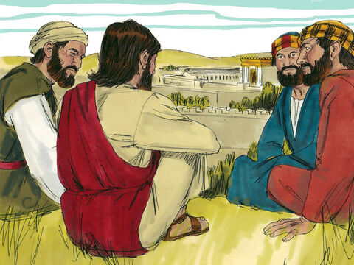
Before the End: Matthew 24:3-16
³ And as he sat upon the mount of Olives, the disciples came unto him privately, saying, Tell us, when shall these things be? and what shall be the sign of thy coming, and of the end of the world?

Slide 4
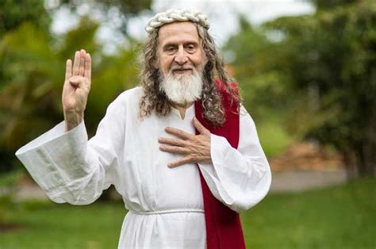
Before the End: Matthew 24:4-16
⁴ And Jesus answered and said unto them, Take heed that no man deceive you.
⁵ For many shall come in my name, saying, I am Christ; and shall deceive many.

Slide 5

Before the End: Matthew 24:6-16
⁶ And ye shall hear of wars and rumours of wars: see that ye be not troubled: for all these things must come to pass, but the end is not yet.

Slide 6
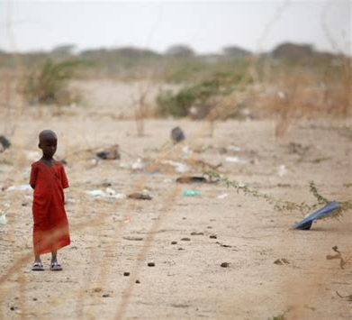
Before the End: Matthew 24:7-16
⁷ For nation shall rise against nation, and kingdom against kingdom: and there shall be famines, and pestilences, and earthquakes, in divers places.
⁸ All these are the beginning of sorrows.

Slide 7
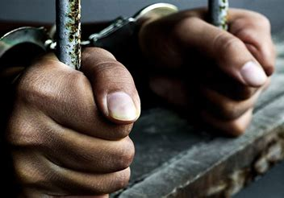
Before the End: Matthew 24:9-16
⁹ Then shall they deliver you up to be afflicted, and shall kill you: and ye shall be hated of all nations for my name's sake.

Slide 8
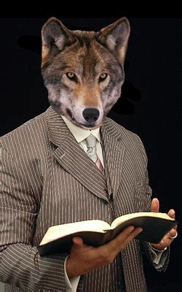
Before the End: Matthew 24:10-16
¹⁰ And then shall many be offended, and shall betray one another, and shall hate one another.
¹¹ And many false prophets shall rise, and shall deceive many.

Slide 9

Before the End: Matthew 24:12-16
¹² And because iniquity shall abound, the love of many shall wax cold.
¹³ But he that shall endure unto the end, the same shall be saved.

Slide 10

Before the End: Matthew 24:14-16
¹⁴ And this gospel of the kingdom shall be preached in all the world for a witness unto all nations; and then shall the end come.

Slide 11
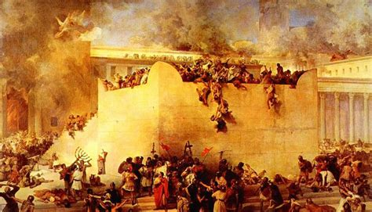
Before the End: Matthew 24:15-16
¹⁵ When ye therefore shall see the abomination of desolation, spoken of by Daniel the prophet, stand in the holy place, (whoso readeth, let him understand:)
¹⁶ Then let them which be in Judaea flee into the mountains:

Slide 12
The Abomination of Desolation:
Daniel 9:27
²⁷ And he shall confirm the covenant with many for one week: and in the midst of the week he shall cause the sacrifice and the oblation to cease, and for the overspreading of abominations he shall make it desolate, even until the consummation, and that determined shall be poured upon the desolate.

Slide 13
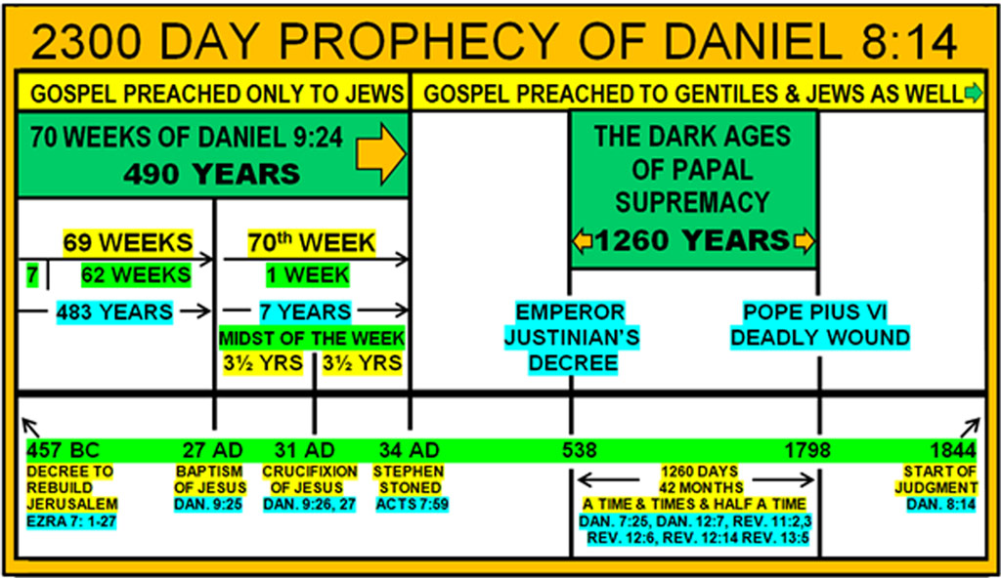
The Abomination of Desolation:
Daniel 9:27

Slide 14
The Abomination of Desolation:
Daniel 11:30-31
³⁰ For the ships of Chittim shall come against him: therefore he shall be grieved, and return, and have indignation against the holy covenant: so shall he do; he shall even return, and have intelligence with them that forsake the holy covenant.
³¹ And arms shall stand on his part, and they shall pollute the sanctuary of strength, and shall take away the daily sacrifice, and they shall place the abomination that maketh desolate.

Slide 15
The Abomination of Desolation:
Daniel 12:9-11
⁹ And he said, Go thy way, Daniel: for the words are closed up and sealed till the time of the end.
¹⁰ Many shall be purified, and made white, and tried; but the wicked shall do wickedly: and none of the wicked shall understand; but the wise shall understand.
¹¹ And from the time that the daily sacrifice shall be taken away, and the abomination that maketh desolate set up, there shall be a thousand two hundred and ninety days.

Slide 16
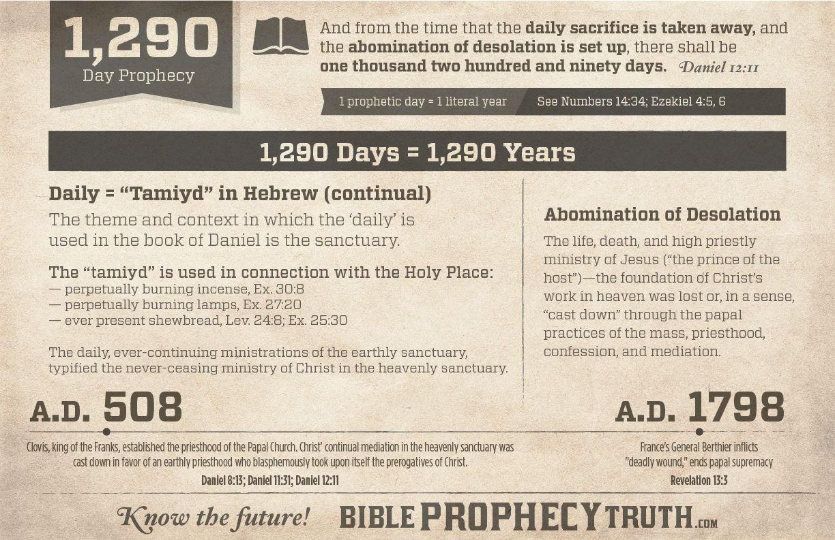
The Abomination of Desolation:
Daniel 12:9-11

Slide 17
A.D. 508
In 496 Clovis, king of the Salian or Merovingian Franks, became the first of the pagan barbarians to adopt Catholicism. The Anglo-Saxons were still pagan, but all the other Germanic kingdoms had accepted the Arian form of Christianity. In the conversion of Clovis, the Catholic Church acquired a champion upon whose military might would hang the theological future of Europe.

Slide 18
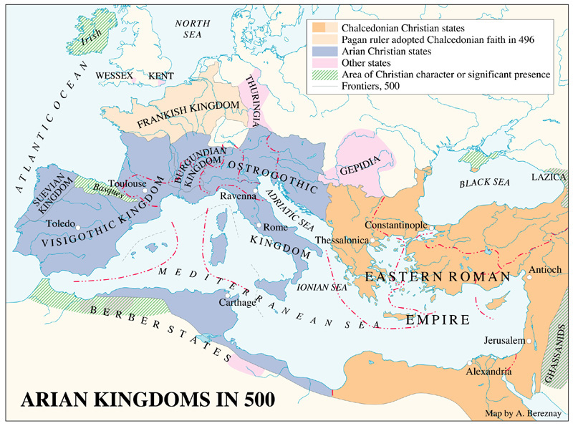

Slide 19
A.D. 508
"With the conversion of Clovis, there was at least one barbarian leader with whom the Bishop of Rome could negotiate as with a faithful son of the Church. It is from the orthodox Gregory of Tours that most of our knowledge of Clovis and his successors is derived. In Gregory's famous History of the Franks, the cruel and unscrupulous king appears as God's chosen instrument for the extension of the Catholic faith. Certainly Clovis quickly learned to combine his own interests with those of the Church, and the alliance between the pope and the Frankish kings was destined to have a great influence upon the history of western Europe." James Harvey Robinson, An Introduction to the History of Western Europe, pp. 35, 36.

Slide 20
A.D. 508
"Although the Goths refused to believe as the church of Rome did, and as a consequence have been branded as Arians, Romanism actually meant little to them. In fact, it meant little to Ulfilas, their great leader. The Goths refused to go along with the mounting innovations being introduced into the church of the Caesars, which church quickly branded any competitor as Arian." Benjamin Wilkinson, Truth Triumphant, p. 141.

Slide 21
A.D. 508
"Since his ancestors were from Asia Minor (the province where the apostle Peter had been especially instructed by God to plant the gospel), Ulfilas was undoubtedly influenced by the doctrines of the apostle to the Jews; and he rejected the liberal and unscriptural teachings which had flooded many western churches. He was a believer in the divine revelation of the Old Testament, as well as that of the New Testament. He impressed upon the Gothic people a simple, democratic Christianity. Like Patrick and Columba, he apparently kept the seventh day as the Sabbath." Ibid., p. 143.

Slide 22
A.D. 508
It was in the year 507 that Clovis and his Frankish army met the army of the Visigoths under their king, Alaric II. Alaric, realizing his weakness, tried to delay the confrontation, hoping help would come from Theodoric, king of the Ostrogoths. But no help came, and soon the Visigoths were in flight, and Alaric was slain.
"The victorious Franks pursued them as far as Bordeaux, where Clovis passed the winter, while Theoderic, his son, was overrunning Auvergne, Quincy, and Rovergne. The Goths, whose new king was a minor, made no further resistance; and in the following year the Salian chief took possession of the royal treasure at Toulouse. He also took the town of Angouleme." Walter C. Perry, The Franks, p. 87.

Slide 23
A.D. 508
"A. D. 508. A short time after these events, Clovis received the titles and dignity of Roman Patricius and Consul from the Greek Emperor Anastasius." Walter C. Perry, The Franks, p. 88.
"In 508 Clovis received at Tours the insignia of the consulship from the eastern emperor Anastasius." Encyclopaedia Britannica, 11th ed., art. "Clovis," Vol. VI, p. 563.
"Thus when Clovis and the Franks defeated the Arian Visigoths and drove them into Spain, it was also a theological victory for the bishop of Rome." William H. Shea, Bible Amplifier - Daniel 7-12, p. 220.

Slide 24
A.D. 508
"Nor was his a temporary conquest. The kingdom of the West Goths and the Burgundians had become the kingdom of the Franks. The invaders had at length arrived, who were to remain. It was decided that the Franks, and not the Goths, were to direct the future destinies of Gaul and Germany, and that the Catholic faith, and not Arianism, was to be the religion of these great realms." Richard W. Church, The Beginning of the Middle Ages, pp. 38, 39.
"Thus in A.D. 508 terminated united resistance to the development of the papacy. The question of supremacy between Frank and Goth, between the Catholic and Arian religions, had then been settled in favor of the Catholics." Daniel and the Revelation, 1944 ed., p. 330.

Slide 25
A.D. 508
"Thus was the bloody course of Clovis glorified by the Catholic writers, as the triumph of the orthodox doctrine of the Trinity over Arianism." A. T. Jones, The Two Republics, p. 528.

Slide 27
Still Work to Do
Matthew 24:14
¹⁴ And this gospel of the kingdom shall be preached in all the world for a witness unto all nations; and then shall the end come.
Revelation 14:6
⁶ And I saw another angel fly in the midst of heaven, having the everlasting gospel to preach unto them that dwell on the earth, and to every nation, and kindred, and tongue, and people,

Slide 28
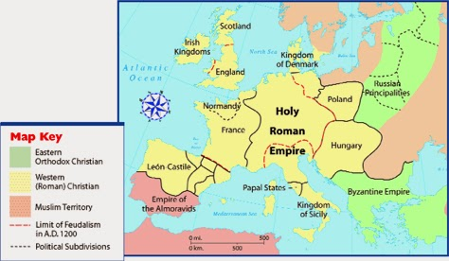
Europe circa A.D. 1200

Slide 29
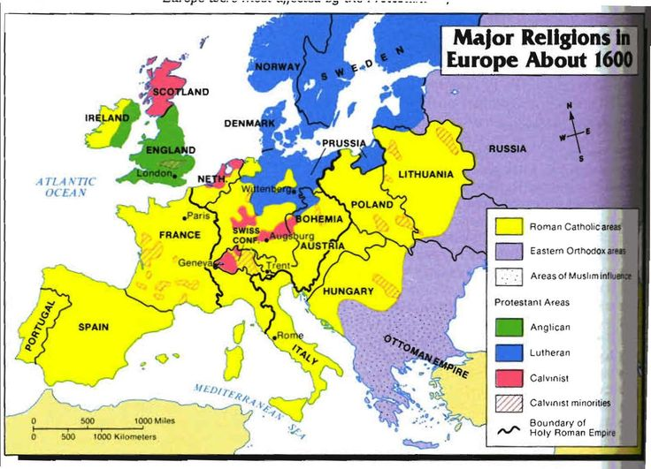

Slide 30
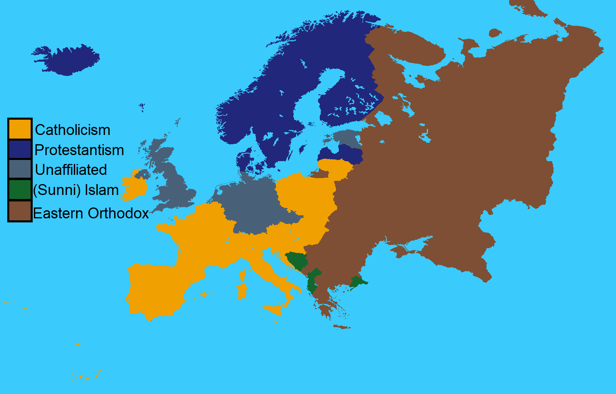

Slide 31
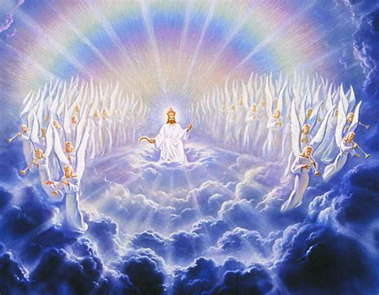
The Reaping: Revelation 14:14-20
¹⁴ And I looked, and behold a white cloud, and upon the cloud one sat like unto the Son of man, having on his head a golden crown, and in his hand a sharp sickle.

Slide 32
Clouds: Acts 1:9-11
⁹ And when he had spoken these things, while they beheld, he was taken up; and a cloud received him out of their sight.
¹⁰ And while they looked stedfastly toward heaven as he went up, behold, two men stood by them in white apparel;
¹¹ Which also said, Ye men of Galilee, why stand ye gazing up into heaven? this same Jesus, which is taken up from you into heaven, shall so come in like manner as ye have seen him go into heaven.

Slide 33
The Son of Man: Daniel 7:13-14
¹³ I saw in the night visions, and, behold, one like the Son of man came with the clouds of heaven, and came to the Ancient of days, and they brought him near before him.
¹⁴ And there was given him dominion, and glory, and a kingdom, that all people, nations, and languages, should serve him: his dominion is an everlasting dominion, which shall not pass away, and his kingdom that which shall not be destroyed.

Slide 34
The Son of Man: Matthew 24:27, 30
²⁷ For as the lightning cometh out of the east, and shineth even unto the west; so shall also the coming of the Son of man be.
…
³⁰ And then shall appear the sign of the Son of man in heaven: and then shall all the tribes of the earth mourn, and they shall see the Son of man coming in the clouds of heaven with power and great glory.

Slide 35
The Son of Man: Matthew 25:31-32
³¹ When the Son of man shall come in his glory, and all the holy angels with him, then shall he sit upon the throne of his glory:
³² And before him shall be gathered all nations: and he shall separate them one from another, as a shepherd divideth his sheep from the goats:

Slide 36
The Son
A Golden Crown: SDA Quarterly Wed. April 5
John describes Jesus as the “Son of Man, having on His head a golden crown, and in His hand a sharp sickle” (Rev. 14:14, NKJV). The word for “crown” is stephanos. It is a victor’s crown. When an athlete won an important contest, he was given a stephanos, a crown of honor, of glory, of victory.

Slide 37
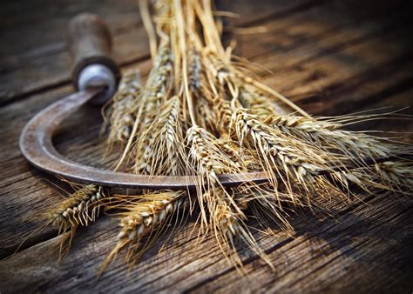
The Reaping: Revelation 14:15-20
¹⁵ And another angel came out of the temple, crying with a loud voice to him that sat on the cloud, Thrust in thy sickle, and reap: for the time is come for thee to reap; for the harvest of the earth is ripe.

Slide 38
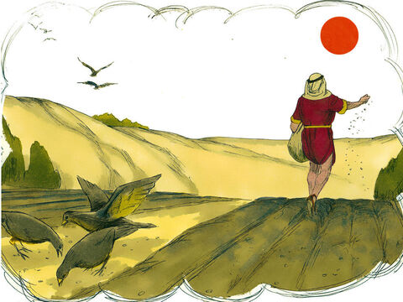
The Sickle: Mark 4:26-29
²⁶ And he said, So is the kingdom of God, as if a man should cast seed into the ground;

Slide 39
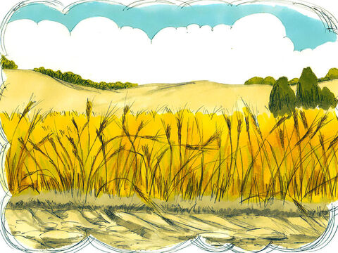
The Sickle: Mark 4:27-29
²⁷ And should sleep, and rise night and day, and the seed should spring and grow up, he knoweth not how.

Slide 40

The Sickle: Mark 4:28-29
²⁸ For the earth bringeth forth fruit of herself; first the blade, then the ear, after that the full corn in the ear.

Slide 41
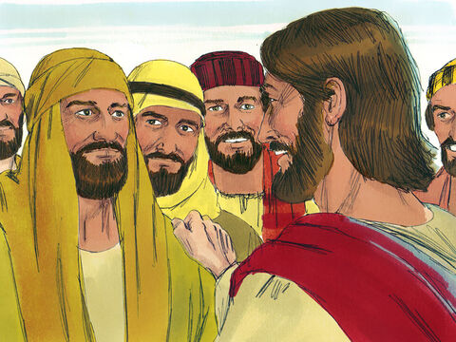
The Sickle: Mark 4:29
²⁹ But when the fruit is brought forth, immediately he putteth in the sickle, because the harvest is come.

Slide 42
The Sickle: Christ’s Object Lessons, p. 65-66.
The germination of the seed represents the beginning of spiritual life, and the development of the plant is a beautiful figure of Christian growth. As in nature, so in grace; there can be no life without growth. The plant must either grow or die. As its growth is silent and imperceptible, but continuous, so is the development of the Christian life. At every stage of development, our life may be perfect; yet if God’s purpose for us is fulfilled, there will be continual advancement. Sanctification is the work of a lifetime. As our opportunities multiply, our experience will enlarge, and our knowledge increase.

Slide 43
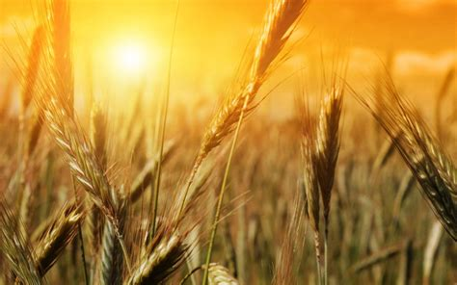
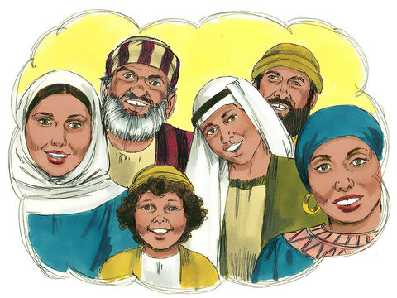
The Reaping: Revelation 14:16-20
¹⁶ And he that sat on the cloud thrust in his sickle on the earth; and the earth was reaped.

Slide 44
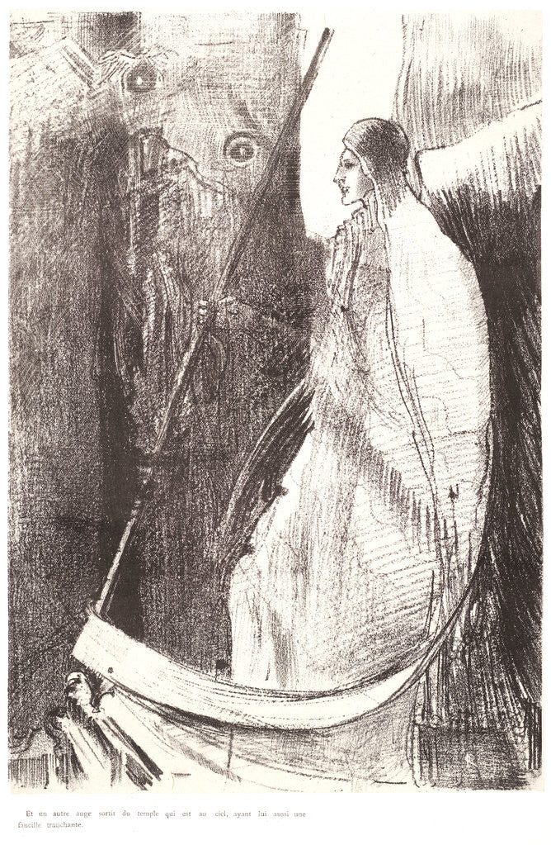
The OTHER Reaping: Revelation 14:17-20
¹⁷ And another angel came out of the temple which is in heaven, he also having a sharp sickle.

Slide 45
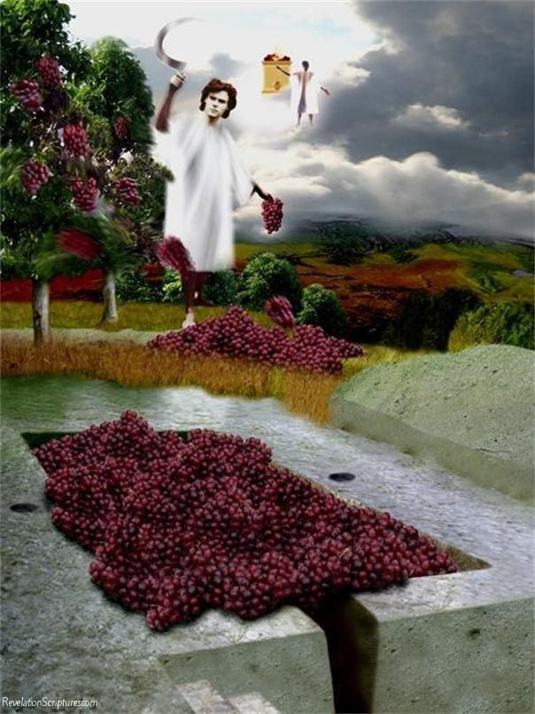
The OTHER Reaping: Revelation 14:18-20
¹⁸ And another angel came out from the altar, which had power over fire; and cried with a loud cry to him that had the sharp sickle, saying, Thrust in thy sharp sickle, and gather the clusters of the vine of the earth; for her grapes are fully ripe.

Slide 46
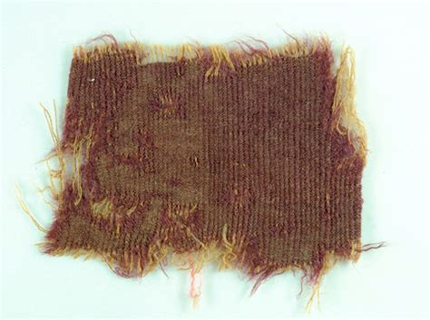
The Winepress: Isaiah 63:1-6
63 Who is this that cometh from Edom, with dyed garments from Bozrah? this that is glorious in his apparel, travelling in the greatness of his strength? I that speak in righteousness, mighty to save.
Rare 2,000-year-old dyed cloth, found in Israeli Cave

Slide 47
The Winepress: Isaiah 63:1-6
Edom here stands for the enemies of God and His people. The Edomites were descendants of Esau and had taken an attitude of persistent hostility toward Israel.
63 Who is this that cometh from Edom, with dyed garments from Bozrah? this that is glorious in his apparel, travelling in the greatness of his strength? I that speak in righteousness, mighty to save.
Rare 2,000-year-old dyed cloth, found in Israeli Cave

Slide 48
The Winepress: Isaiah 63:1-6
63 Who is this that cometh from Edom, with dyed garments from Bozrah? this that is glorious in his apparel, travelling in the greatness of his strength? I that speak in righteousness, mighty to save.
Rare 2,000-year-old dyed cloth, found in Israeli Cave

Slide 49
The Winepress: Isaiah 63:1-6
63 Who is this that cometh from Edom, with dyed garments from Bozrah? this that is glorious in his apparel, travelling in the greatness of his strength? I that speak in righteousness, mighty to save.
Isaiah points out the dual nature of the work Messiah was to do. He would reveal Himself “in the greatness of His strength” to destroy His enemies, but “mighty to save” His children.
Rare 2,000-year-old dyed cloth, found in Israeli Cave

Slide 50
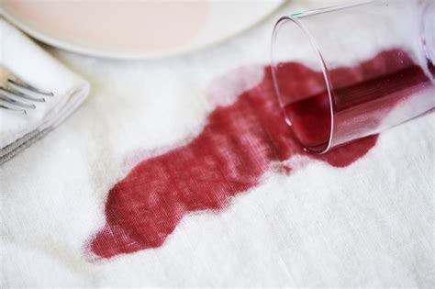
The Winepress: Isaiah 63:2-6
² Wherefore art thou red in thine apparel, and thy garments like him that treadeth in the winefat?

Slide 51
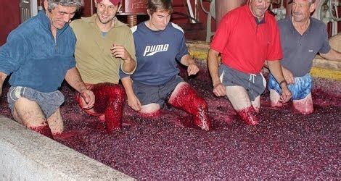
The Winepress: Isaiah 63:3-6
³ I have trodden the winepress alone; and of the people there was none with me: for I will tread them in mine anger, and trample them in my fury; and their blood shall be sprinkled upon my garments, and I will stain all my raiment.

Slide 52
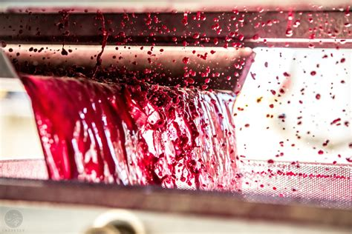
The Winepress: Isaiah 63:4-6
⁴ For the day of vengeance is in mine heart, and the year of my redeemed is come.

Slide 53
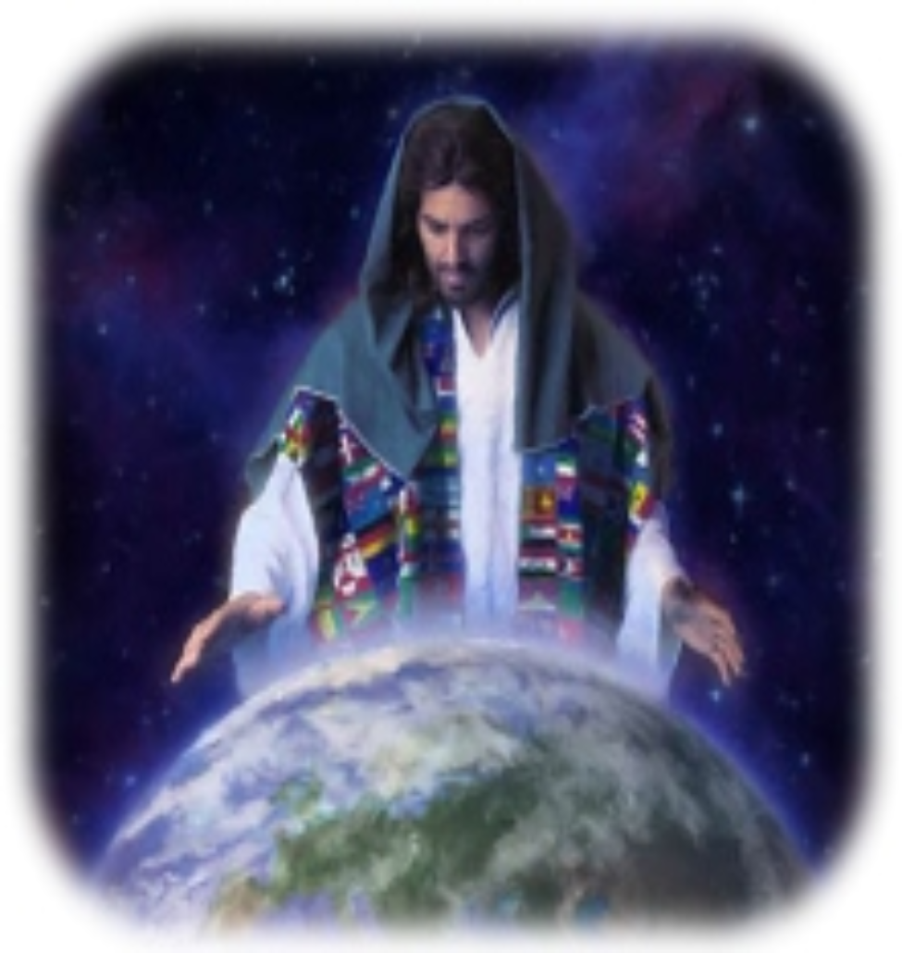
The Winepress: Isaiah 63:5-6
⁵ And I looked, and there was none to help; and I wondered that there was none to uphold: therefore mine own arm brought salvation unto me; and my fury, it upheld me.

Slide 54
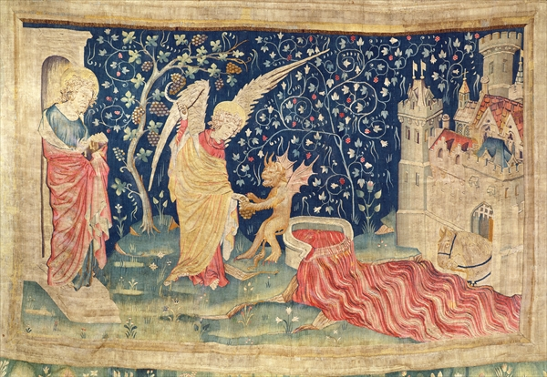
The Winepress: Isaiah 63:6
⁶ And I will tread down the people in mine anger, and make them drunk in my fury, and I will bring down their strength to the earth.

Slide 55
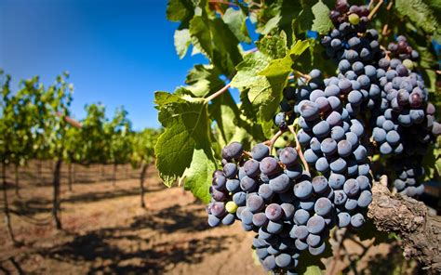
The OTHER Reaping: Revelation 14:19-20
¹⁹ And the angel thrust in his sickle into the earth, and gathered the vine of the earth, and cast it into the great winepress of the wrath of God.

Slide 56
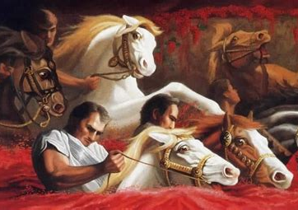
The OTHER Reaping: Revelation 14:20
²⁰ And the winepress was trodden without the city, and blood came out of the winepress, even unto the horse bridles, by the space of a thousand and six hundred furlongs.

Slide 57
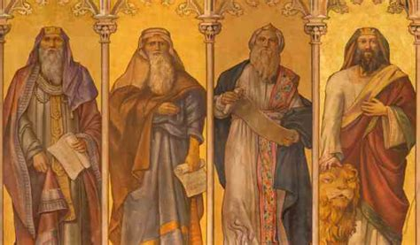
A Historical Winepress (605 or 604 BC):
Jeremiah 25:4-33
⁴ And the Lord hath sent unto you all his servants the prophets, rising early and sending them; but ye have not hearkened, nor inclined your ear to hear.

Slide 58

A Historical Winepress:
Jeremiah 25:5-33
⁵ They said, Turn ye again now every one from his evil way, and from the evil of your doings, and dwell in the land that the Lord hath given unto you and to your fathers for ever and ever:

Slide 59
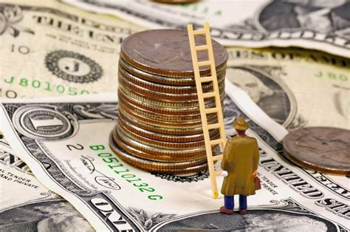
A Historical Winepress:
Jeremiah 25:6-33
⁶ And go not after other gods to serve them, and to worship them, and provoke me not to anger with the works of your hands; and I will do you no hurt.

Slide 60
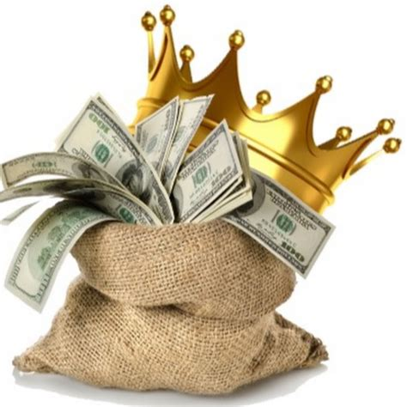
A Historical Winepress:
Jeremiah 25:6-33
⁶ And go not after other gods to serve them, and to worship them, and provoke me not to anger with the works of your hands; and I will do you no hurt.

Slide 61
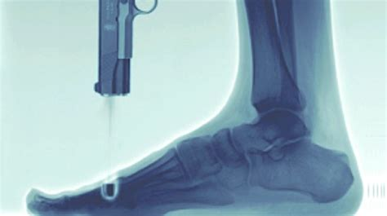
A Historical Winepress:
Jeremiah 25:7-33
⁷ Yet ye have not hearkened unto me, saith the Lord; that ye might provoke me to anger with the works of your hands to your own hurt.

Slide 62
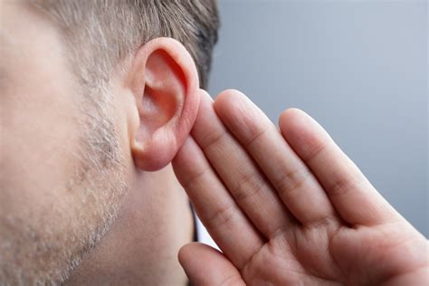
A Historical Winepress:
Jeremiah 25:8-33
⁸ Therefore thus saith the Lord of hosts; Because ye have not heard my words,

Slide 63
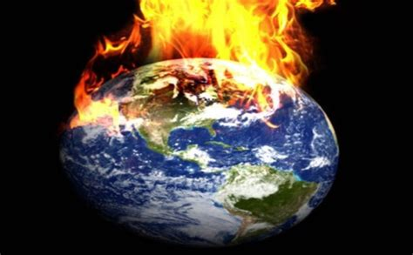
A Historical Winepress:
Jeremiah 25:9-33
⁹ Behold, I will send and take all the families of the north, saith the Lord, and Nebuchadrezzar the king of Babylon, my servant, and will bring them against this land, and against the inhabitants thereof, and against all these nations round about, and will utterly destroy them, and make them an astonishment, and an hissing, and perpetual desolations.

Slide 64
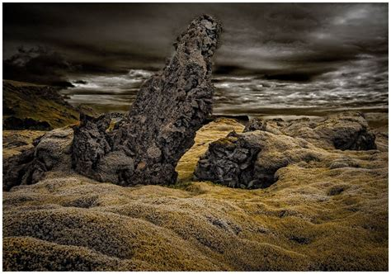
A Historical Winepress:
Jeremiah 25:10-33
¹⁰ Moreover I will take from them the voice of mirth, and the voice of gladness, the voice of the bridegroom, and the voice of the bride, the sound of the millstones, and the light of the candle.

Slide 65
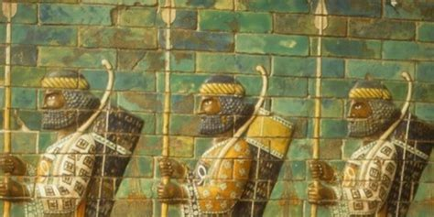
A Historical Winepress:
Jeremiah 25:11-33
¹¹ And this whole land shall be a desolation, and an astonishment; and these nations shall serve the king of Babylon seventy years.

Slide 66
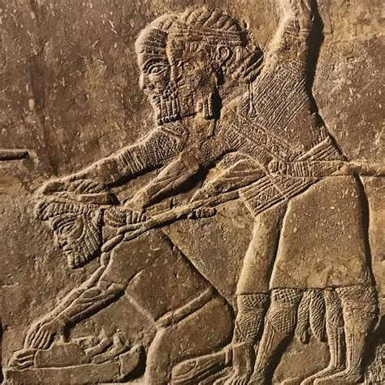
A Historical Winepress:
Jeremiah 25:12-33
¹² And it shall come to pass, when seventy years are accomplished, that I will punish the king of Babylon, and that nation, saith the Lord, for their iniquity, and the land of the Chaldeans, and will make it perpetual desolations.

Slide 67
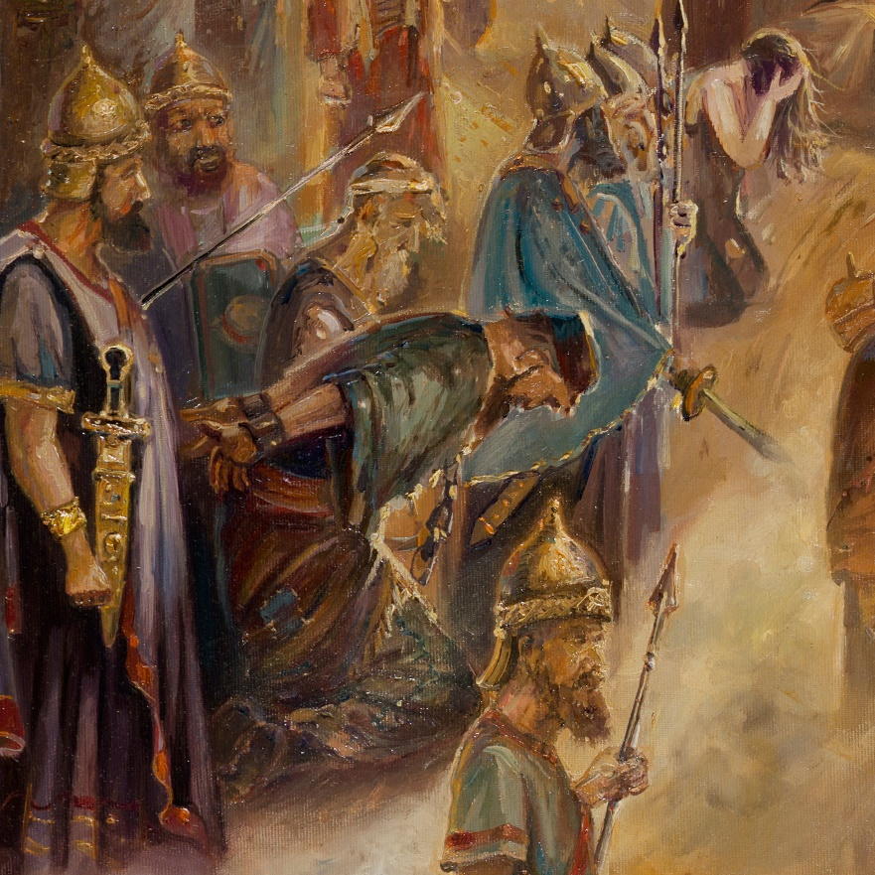
A Historical Winepress:
Jeremiah 25:13-33
¹³ And I will bring upon that land all my words which I have pronounced against it, even all that is written in this book, which Jeremiah hath prophesied against all the nations.

Slide 68
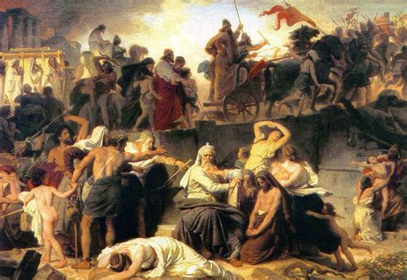
A Historical Winepress:
Jeremiah 25:14-33
¹⁴ For many nations and great kings shall serve themselves of them also: and I will recompense them according to their deeds, and according to the works of their own hands.

Slide 69
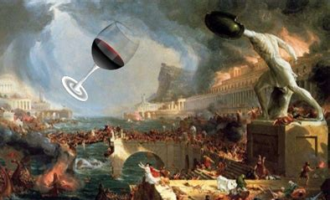
A Historical Winepress:
Jeremiah 25:15-33
¹⁵ For thus saith the Lord God of Israel unto me; Take the wine cup of this fury at my hand, and cause all the nations, to whom I send thee, to drink it.

Slide 70
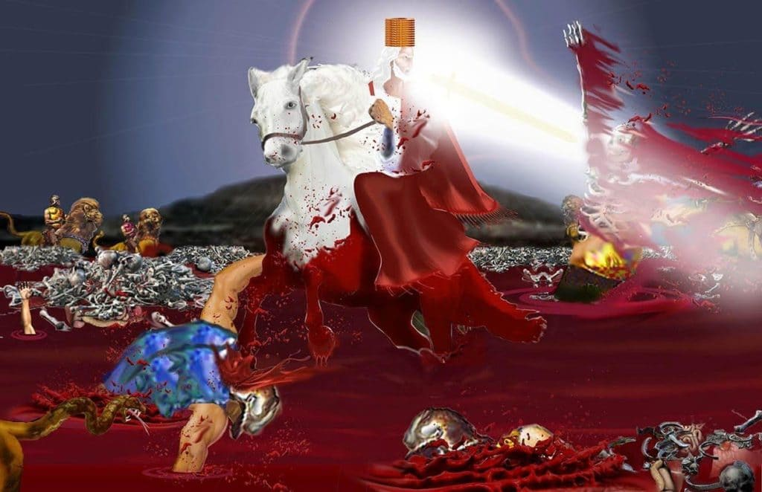
A Historical Winepress:
Jeremiah 25:16-33
¹⁶ And they shall drink, and be moved, and be mad, because of the sword that I will send among them.

Slide 71
A Historical Winepress:
Jeremiah 25:16-33
A graphic portrayal of the panic and terror experienced by the various nations as the Babylonian conqueror advances upon them. The wine of God’s wrath will intoxicate them, as it were, with dread and despair. Like drunken men they react violently and irrationally.
¹⁶ And they shall drink, and be moved, and be mad, because of the sword that I will send among them.

Slide 72
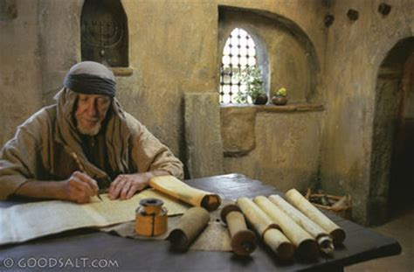
A Historical Winepress:
Jeremiah 25:17-33
¹⁷ Then took I the cup at the Lord's hand, and made all the nations to drink, unto whom the Lord had sent me:

Slide 73
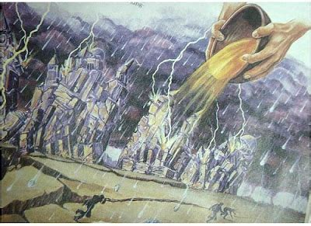
A Historical Winepress:
Jeremiah 25:18-33
¹⁸ To wit, Jerusalem, and the cities of Judah, and the kings thereof, and the princes thereof, to make them a desolation, an astonishment, an hissing, and a curse; as it is this day;

Slide 74
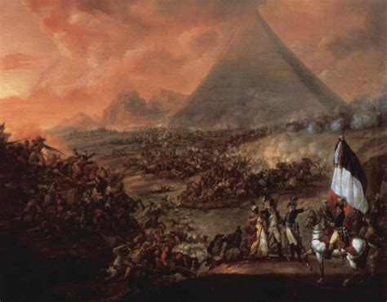
A Historical Winepress:
Jeremiah 25:19-33
¹⁹ Pharaoh king of Egypt, and his servants, and his princes, and all his people;
²⁰ And all the mingled people, and all the kings of the land of Uz, and all the kings of the land of the Philistines, and Ashkelon, and Azzah, and Ekron, and the remnant of Ashdod,

Slide 75
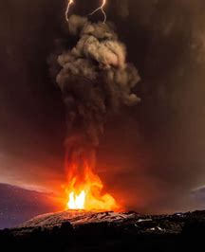
A Historical Winepress:
Jeremiah 25:21-33
²¹ Edom, and Moab, and the children of Ammon,
²² And all the kings of Tyrus, and all the kings of Zidon, and the kings of the isles which are beyond the sea,
²³ Dedan, and Tema, and Buz, and all that are in the utmost corners,

Slide 76
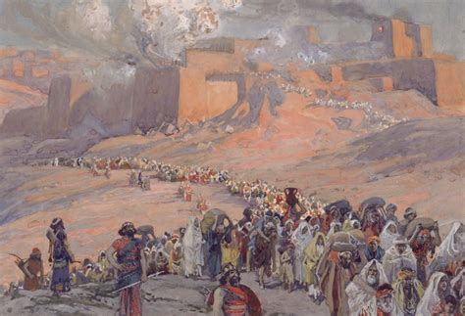
A Historical Winepress:
Jeremiah 25:24-33
²⁴ And all the kings of Arabia, and all the kings of the mingled people that dwell in the desert,
²⁵ And all the kings of Zimri, and all the kings of Elam, and all the kings of the Medes,

Slide 77
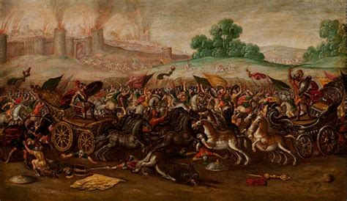
A Historical Winepress:
Jeremiah 25:26-33
²⁶ And all the kings of the north, far and near, one with another, and all the kingdoms of the world, which are upon the face of the earth: and the king of Sheshach shall drink after them.

Slide 78
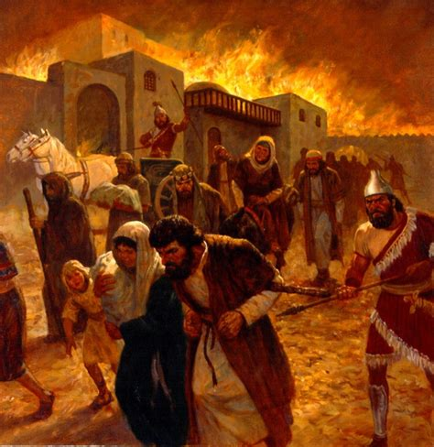
A Historical Winepress:
Jeremiah 25:27-33
²⁷ Therefore thou shalt say unto them, Thus saith the Lord of hosts, the God of Israel; Drink ye, and be drunken, and spue, and fall, and rise no more, because of the sword which I will send among you.

Slide 79
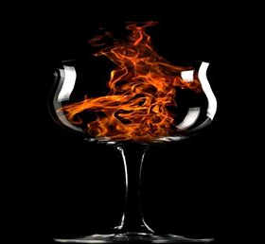
A Historical Winepress:
Jeremiah 25:28-33
²⁸ And it shall be, if they refuse to take the cup at thine hand to drink, then shalt thou say unto them, Thus saith the Lord of hosts; Ye shall certainly drink.

Slide 80

A (LESS) Historical Winepress:
Jeremiah 25:29-33
²⁹ For, lo, I begin to bring evil on the city which is called by my name, and should ye be utterly unpunished? Ye shall not be unpunished: for I will call for a sword upon all the inhabitants of the earth, saith the Lord of hosts.

Slide 81

A (LESS) Historical Winepress:
Jeremiah 25:30-33
³⁰ Therefore prophesy thou against them all these words, and say unto them, The Lord shall roar from on high, and utter his voice from his holy habitation; he shall mightily roar upon his habitation; he shall give a shout, as they that tread the grapes, against all the inhabitants of the earth.

Slide 82

A (LESS) Historical Winepress:
Jeremiah 25:31-33
³¹ A noise shall come even to the ends of the earth; for the Lord hath a controversy with the nations, he will plead with all flesh; he will give them that are wicked to the sword, saith the Lord.

Slide 83

A (LESS) Historical Winepress:
Jeremiah 25:32-33
³² Thus saith the Lord of hosts, Behold, evil shall go forth from nation to nation, and a great whirlwind shall be raised up from the coasts of the earth.

Slide 84

A (LESS) Historical Winepress:
Jeremiah 25:33-33
³³ And the slain of the Lord shall be at that day from one end of the earth even unto the other end of the earth: they shall not be lamented, neither gathered, nor buried; they shall be dung upon the ground.

Slide 85
A Choice: SDA Quarterly Thurs. April 6
Here is the urgent prophetic message of Revelation 14. Every seed has gone to harvest. The grain is fully ripe, and the grapes are fully ripe. The people of God reveal His image of grace, compassion, mercy, and love before the universe. The children of the evil one reveal greed, lust, jealousy, and hate. The character of Jesus is revealed in one group and the character of Satan in the other.

Slide 86
A Choice: SDA Quarterly Thurs. April 6
The universe will see in the people of God a revelation of righteousness that, perhaps, no generation before it has ever witnessed. In contrast to the righteousness of Christ revealed in His people, the universe will see the full results of rebellion against God. Wickedness, evil, sin, and lawlessness will be on full display before men and angels. The contrast between good and evil, right and wrong, obedience and disobedience, will be apparent to all the universe, to both humans and angels.

Slide 87

An URGENT Choice:
Revelation 22:10-12
¹⁰ And he saith unto me, Seal not the sayings of the prophecy of this book: for the time is at hand.
¹¹ He that is unjust, let him be unjust still: and he which is filthy, let him be filthy still: and he that is righteous, let him be righteous still: and he that is holy, let him be holy still.
¹² And, behold, I come quickly; and my reward is with me, to give every man according as his work shall be.

Slide 88

An OBEDIENT Choice:
1 John 5:2-4
² By this we know that we love the children of God, when we love God, and keep his commandments.
³ For this is the love of God, that we keep his commandments: and his commandments are not grievous.
⁴ For whatsoever is born of God overcometh the world: and this is the victory that overcometh the world, even our faith.

Slide 89

A MATURE Choice:
Hebrews 5:12-14
¹² For when for the time ye ought to be teachers, ye have need that one teach you again which be the first principles of the oracles of God; and are become such as have need of milk, and not of strong meat.
¹³ For every one that useth milk is unskilful in the word of righteousness: for he is a babe.
¹⁴ But strong meat belongeth to them that are of full age, even those who by reason of use have their senses exercised to discern both good and evil.

Slide 90
A CONSISTENT Choice:
The Great Controversy, p.555
It is a law both of the intellectual and the spiritual nature that by beholding we become changed. The mind gradually adapts itself to the subjects upon which it is allowed to dwell. It becomes assimilated to that which it is accustomed to love and reverence. Man will never rise higher than his standard of purity or goodness or truth.

Slide 91
A PERMANENT Choice:
Last Day Events, p.295
If you would be a saint in heaven you must first be a saint on earth. The traits of character you cherish in life will not be changed by death or by the resurrection. You will come up from the grave with the same disposition you manifested in your home and in society. Jesus does not change the character at His coming.

Slide 92
A PERMANENT Choice:
Last Day Events, p.295
The work of transformation must be done now. Our daily lives are determining our destiny. Defects of character must be repented of and overcome through the grace of Christ, and a symmetrical character must be formed while in this probationary state, that we may be fitted for the mansions above.

Slide 93
The RIGHT Choice: SDA Quarterly Sun. April 2
Of course, every day, by our choices even in the so-called “little things,” we are choosing either for or against Jesus. It’s not likely that someone constantly making the wrong choices in their life now, will suddenly, at the final crisis, come down on the side of Jesus, especially when the force of the whole evil world is against them. Now, today, and every day we must choose to be faithful to Christ and to His commandments.

Slide 94
Happy Sabbath!
… and Thank You!!

