Slide 1
The Everlasting Gospel
Revelation 14:6-12, 1 Peter 1,
1 Corinthians 15, Romans 3 & 5
Lesson 3, 2nd Quarter 2023

Slide 2
Memory Text: Revelation 14:6
⁶ And I saw another angel fly in the midst of heaven, having the everlasting gospel to preach unto them that dwell on the earth, and to every nation, and kindred, and tongue, and people,

Slide 3
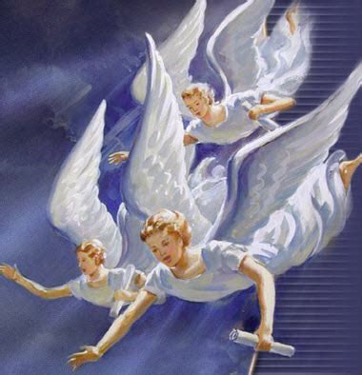
Three Angels’ Messages: Revelation 14:6-12
⁶ And I saw another angel fly in the midst of heaven, having the everlasting gospel to preach unto them that dwell on the earth, and to every nation, and kindred, and tongue, and people,

Slide 4
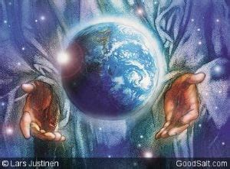
Three Angels’ Messages: Revelation 14:7-12
⁷ Saying with a loud voice, Fear God, and give glory to him; for the hour of his judgment is come: and worship him that made heaven, and earth, and the sea, and the fountains of waters.

Slide 5
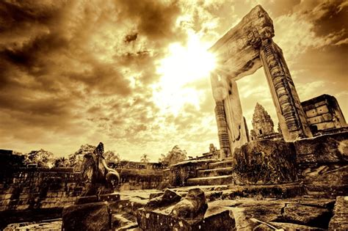
Three Angels’ Messages: Revelation 14:8-12
⁸ And there followed another angel, saying, Babylon is fallen, is fallen, that great city, because she made all nations drink of the wine of the wrath of her fornication.

Slide 6
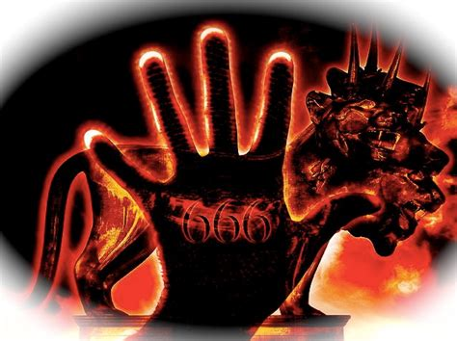
Three Angels’ Messages: Revelation 14:9-12
⁹ And the third angel followed them, saying with a loud voice, If any man worship the beast and his image, and receive his mark in his forehead, or in his hand,

Slide 7
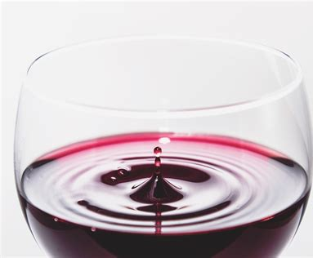
Three Angels’ Messages: Revelation 14:10-12
¹⁰ The same shall drink of the wine of the wrath of God, which is poured out without mixture into the cup of his indignation; and he shall be tormented with fire and brimstone in the presence of the holy angels, and in the presence of the Lamb:

Slide 8
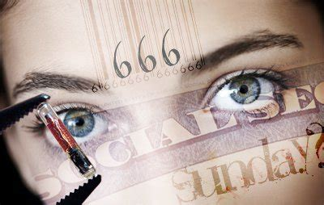
Three Angels’ Messages: Revelation 14:11-12
¹¹ And the smoke of their torment ascendeth up for ever and ever: and they have no rest day nor night, who worship the beast and his image, and whosoever receiveth the mark of his name.

Slide 9
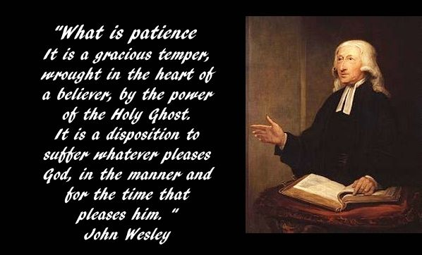
Three Angels’ Messages: Revelation 14:12
¹² Here is the patience of the saints: here are they that keep the commandments of God, and the faith of Jesus.

Slide 10
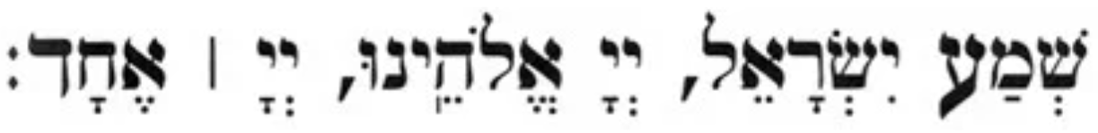
SDA Quarterly: The Shema
Shema Yisrael (“Hear, O Israel”) are the first two words of a section of the Torah that is the centerpiece of the morning and evening prayer services, encapsulating the monotheistic essence of Judaism:
Hear, O Israel: God is our Lord, God is one…
In its entirety, the Shema consists of three paragraphs: Deuteronomy 6:4-9, 11:13-21, and Numbers 5:37-41.

Slide 11
SDA Quarterly: Sabbath, April 8th
Throughout the centuries, the chanting of the Shema (the name of the prayer, based on the Hebrew word for “hear”) reminded the Jews of the spiritual vision that united them as a people and that strengthened their resolve to maintain their unique identity as worshipers of the one true God.

Slide 12
SDA Quarterly: Sabbath, April 8th
For Seventh-day Adventists, the three angels’ messages in Revelation 14 are our Shema. They are our identifying statement of faith. They define who we are as a people and describe our mission to the world. In short, our unique prophetic identity is outlined in Revelation 14:6-12, and it is here that we find our passion to proclaim the gospel to the world.
In this week’s lesson, we will begin a detailed study of Revelation 14:6-12, but will do so through the eyes of grace as we listen to God speaking to our hearts.

Slide 13
Memory Text: Revelation 14:6
⁶ And I saw another angel fly in the midst of heaven, having the everlasting gospel to preach unto them that dwell on the earth, and to every nation, and kindred, and tongue, and people,

Slide 14
Memory Text: Revelation 14:6
⁶ And I saw another angel fly in the midst of heaven, having the everlasting gospel to preach unto them that dwell on the earth, and to every nation, and kindred, and tongue, and people,

Slide 15
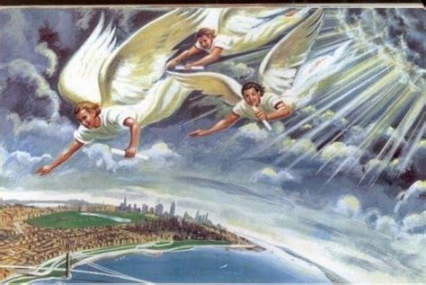
And I saw…
A new scene begins. Chronologically the events represented in this vision precede those represented by the events in verses 1-5, so this is a completely distinct section.

Slide 16
Memory Text: Revelation 14:6
⁶ And I saw another angel fly in the midst of heaven, having the everlasting gospel to preach unto them that dwell on the earth, and to every nation, and kindred, and tongue, and people,

Slide 17
Memory Text: Revelation 14:6
⁶ And I saw another angel fly in the midst of heaven, having the everlasting gospel to preach unto them that dwell on the earth, and to every nation, and kindred, and tongue, and people,

Slide 18
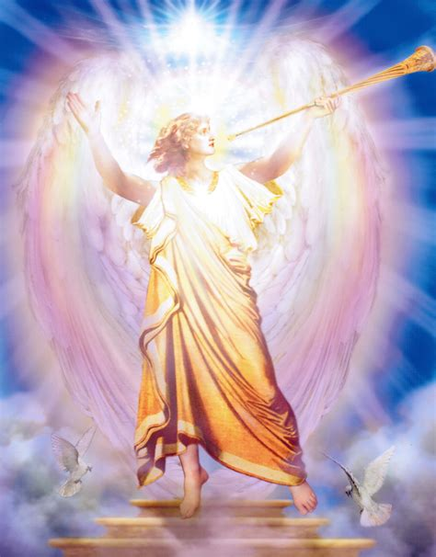
Another angel
“Angel,” from the Greek aggelon, literally “messenger.” Such a messenger may be either celestial or human in nature. Aggelon (or the plural aggeloi) is applied to human beings in:
Matthew 11:10 ⁷ And as they departed, Jesus began to say unto the multitudes concerning John, What went ye out into the wilderness to see? A reed shaken with the wind? … ¹⁰ For this is he, of whom it is written, Behold, I send my messenger before thy face, which shall prepare thy way before thee.

Slide 19
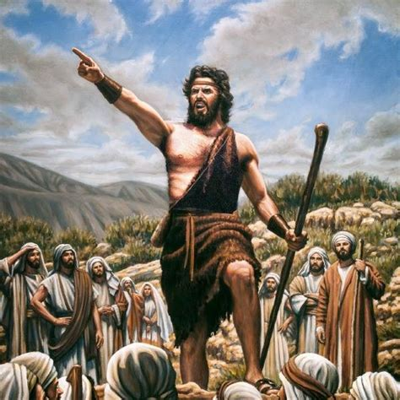
Another angel
Mark 1:2 ² As it is written in the prophets, Behold, I send my messenger before thy face, which shall prepare thy way before thee.³ The voice of one crying in the wilderness, Prepare ye the way of the Lord, make his paths straight.

Slide 20
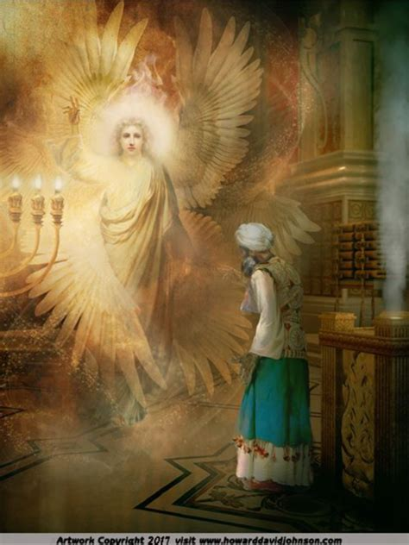
Another angel
Luke 9:52 ⁵¹ And it came to pass, when the time was come that he should be received up, he stedfastly set his face to go to Jerusalem,⁵² And sent messengers before his face: and they went, and entered into a village of the Samaritans, to make ready for him.

Slide 21
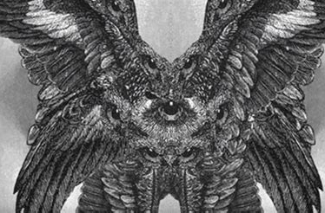
Another angel
2 Corinthians 12:7 ⁷ And lest I should be exalted above measure through the abundance of the revelations, there was given to me a thorn in the flesh, the messenger of Satan to buffet me, lest I should be exalted above measure.

Slide 22
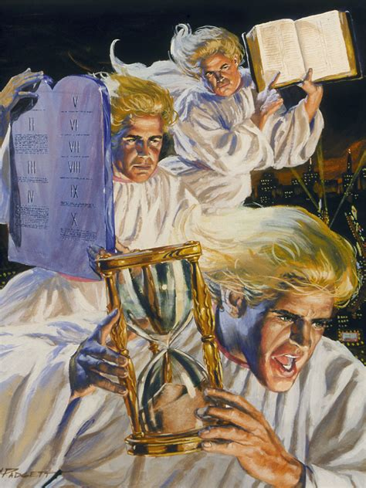
Another angel
This is a symbolic vision. The angel represents God’s saints engaged in the task of proclaiming the everlasting gospel, especially the features mentioned in this verse, at a time when the “judgment is to come” (v. 7). It is, of course, also true that celestial angels assist men in the task of proclaiming the gospel, but this is not the predominant idea here.

Slide 23
Memory Text: Revelation 14:6
⁶ And I saw another angel fly in the midst of heaven, having the everlasting gospel to preach unto them that dwell on the earth, and to every nation, and kindred, and tongue, and people,

Slide 24
Memory Text: Revelation 14:6
⁶ And I saw another angel fly in the midst of heaven, having the everlasting gospel to preach unto them that dwell on the earth, and to every nation, and kindred, and tongue, and people,

Slide 25
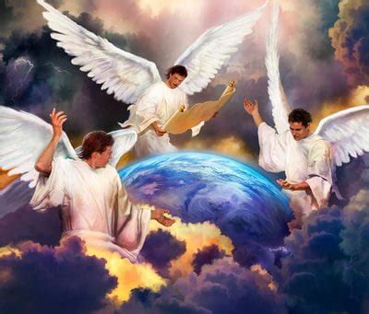
In the midst of heaven
The angel of ch. 8:13 was also seen flying through the midst of heaven. The area of flight indicates the worldwide nature of the angel’s work and message. The work grows and develops until it is brought to the sight and hearing of all mankind.

Slide 26
Memory Text: Revelation 14:6
⁶ And I saw another angel fly in the midst of heaven, having the everlasting gospel to preach unto them that dwell on the earth, and to every nation, and kindred, and tongue, and people,

Slide 27
Memory Text: Revelation 14:6
⁶ And I saw another angel fly in the midst of heaven, having the everlasting gospel to preach unto them that dwell on the earth, and to every nation, and kindred, and tongue, and people,

Slide 28
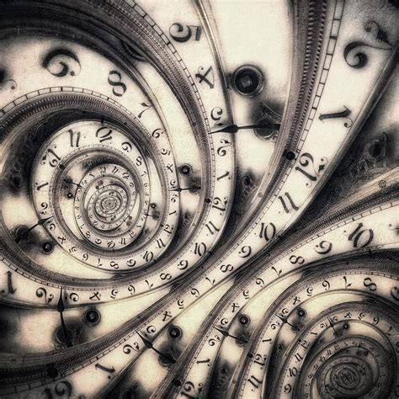
The Everlasting Gospel
“Everlasting” is translated from the Greek word, aiōnios. It’s the same word used in Matthew 25:41:
⁴¹ Then shall he say also unto them on the left hand, Depart from me, ye cursed, into everlasting fire, prepared for the devil and his angels:

Slide 29
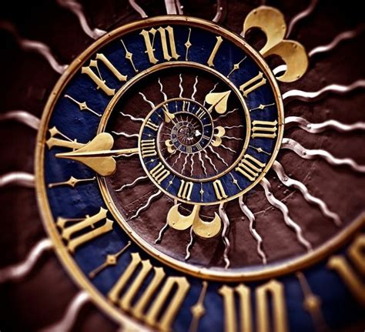
The Everlasting Gospel
The Scriptures elsewhere speak of the “glorious” gospel (2 Cor. 4:4; 1 Tim. 1:11), but only here is the word “everlasting” used in connection with the gospel of the grace of God. There is but one gospel to save men. It will continue as long as there are men to be saved. There never will be another gospel.

Slide 30
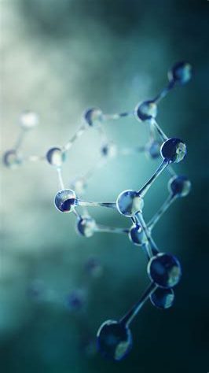
The Everlasting Gospel: Revelation 13:7-8
⁷ And it was given unto him to make war with the saints, and to overcome them: and power was given him over all kindreds, and tongues, and nations.
⁸ And all that dwell upon the earth shall worship him, whose names are not written in the book of life of the Lamb slain from the foundation of the world.

Slide 31
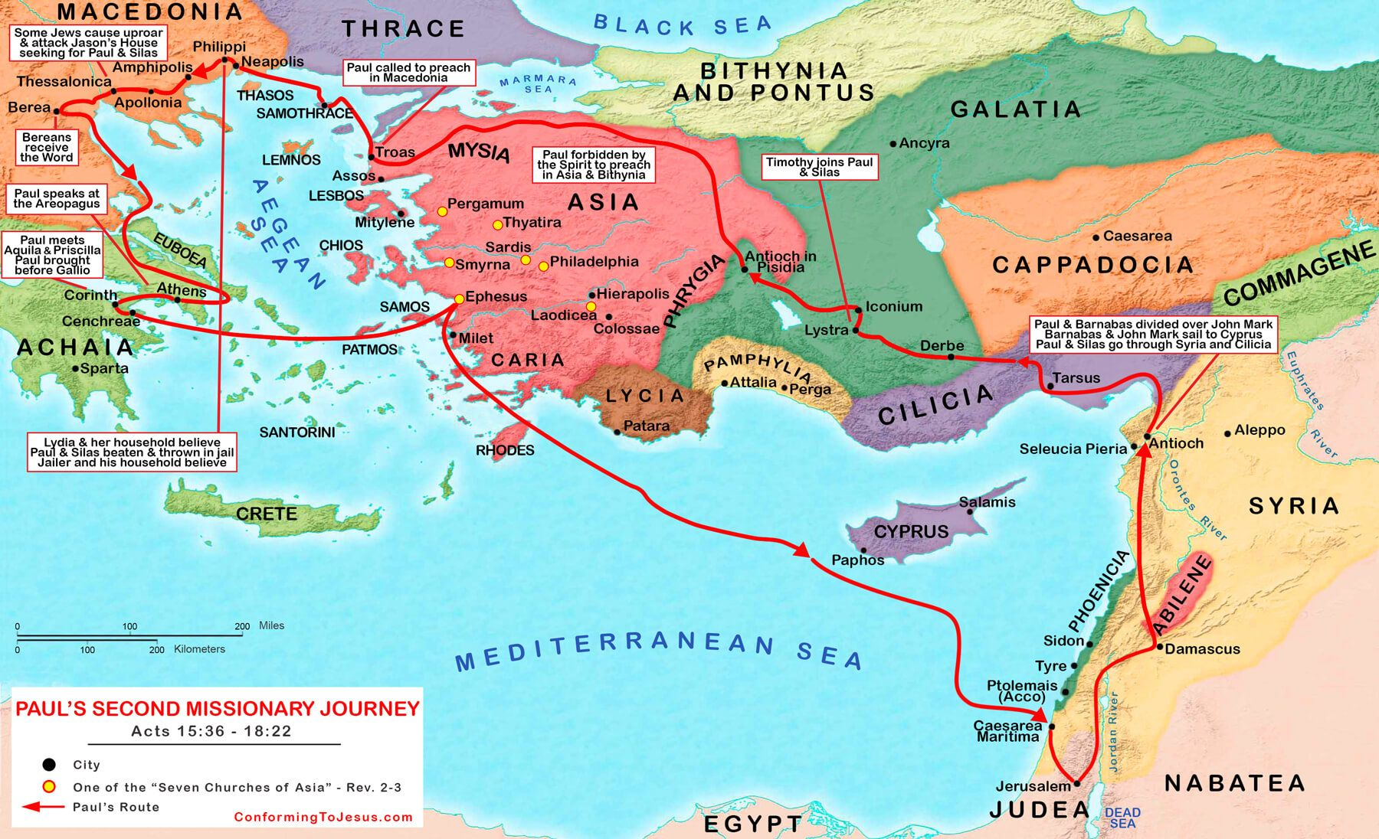
The Everlasting Gospel: 1 Peter 1:1-25
1 Peter, an apostle of Jesus Christ, to the strangers scattered throughout Pontus, Galatia, Cappadocia, Asia, and Bithynia,

Slide 32

The Everlasting Gospel: 1 Peter 1:2-25
² Elect according to the foreknowledge of God the Father, through sanctification of the Spirit, unto obedience and sprinkling of the blood of Jesus Christ: Grace unto you, and peace, be multiplied.

Slide 33
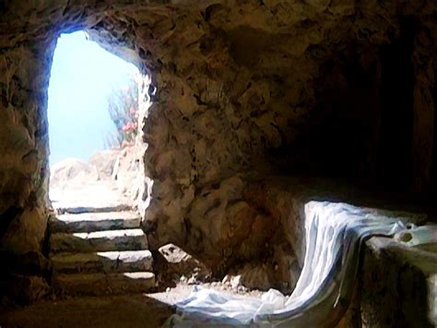
The Everlasting Gospel: 1 Peter 1:3-25
³ Blessed be the God and Father of our Lord Jesus Christ, which according to his abundant mercy hath begotten us again unto a lively hope by the resurrection of Jesus Christ from the dead,

Slide 34
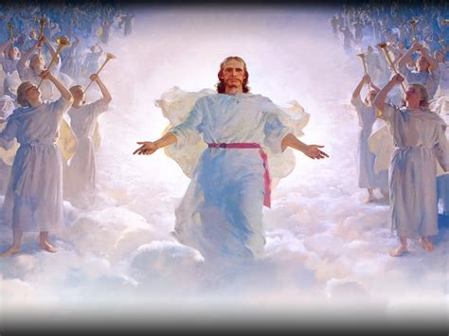
The Everlasting Gospel: 1 Peter 1:4-25
⁴ To an inheritance incorruptible, and undefiled, and that fadeth not away, reserved in heaven for you,
⁵ Who are kept by the power of God through faith unto salvation ready to be revealed in the last time.

Slide 35
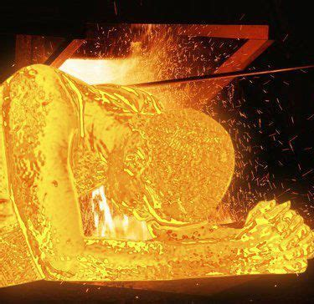
The Everlasting Gospel: 1 Peter 1:6-25
⁶ Wherein ye greatly rejoice, though now for a season, if need be, ye are in heaviness through manifold temptations:
⁷ That the trial of your faith, being much more precious than of gold that perisheth, though it be tried with fire, might be found unto praise and honour and glory at the appearing of Jesus Christ:

Slide 36

The Everlasting Gospel: 1 Peter 1:8-25
⁸ Whom having not seen, ye love; in whom, though now ye see him not, yet believing, ye rejoice with joy unspeakable and full of glory:
⁹ Receiving the end of your faith, even the salvation of your souls.

Slide 37
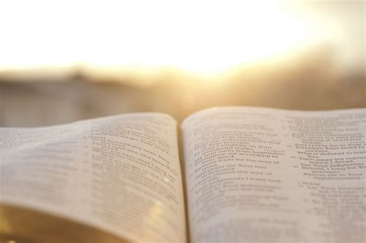
The Everlasting Gospel: 1 Peter 1:10-25
¹⁰ Of which salvation the prophets have enquired and searched diligently, who prophesied of the grace that should come unto you:

Slide 38
The Everlasting Gospel: 1 Peter 1:10-25
¹⁰ Of which salvation the prophets have enquired and searched diligently, who prophesied of the grace that should come unto you:
Prophetic vision does not necessarily imply complete understanding! (Consider Daniel’s confusion.) Prophets of ages past have carefully compared their own prophecies with those of their contemporaries and predecessors, attempting to understand the plan of salvation. What had once been a subject of study and prophecy to these visionaries has become a dynamic reality to those living since Christ’s death.

Slide 39
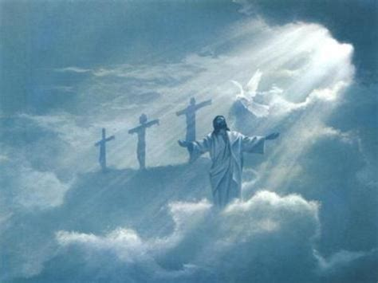
The Everlasting Gospel: 1 Peter 1:11-25
¹¹ Searching what, or what manner of time the Spirit of Christ which was in them did signify, when it testified beforehand the sufferings of Christ, and the glory that should follow.

Slide 40
The Everlasting Gospel: 1 Peter 1:11-25
¹¹ Searching what, or what manner of time the Spirit of Christ which was in them did signify, when it testified beforehand the sufferings of Christ, and the glory that should follow.
The prophets were informed of some aspects of the promised incarnation of the Redeemer, even as the church today is informed of the second coming of Christ. However, they did not know the exact time of the first advent, though they diligently studied to discover all possible indications of the Messiah’s arrival. Through the prophets, the Spirit frequently added further knowledge of Christ’s work, so that God’s plan became increasingly clear. Although the Jews mistook the import of such prophecies, early Christians readily grasped their true significance.

Slide 41
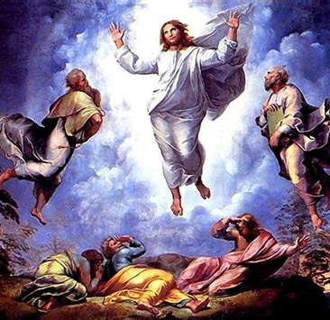
The Everlasting Gospel: 1 Peter 1:12-25
¹² Unto whom it was revealed, that not unto themselves, but unto us they did minister the things, which are now reported unto you by them that have preached the gospel unto you with the Holy Ghost sent down from heaven; which things the angels desire to look into.

Slide 42
The Everlasting Gospel: 1 Peter 1:12-25
Every prophet realized that the coming of the world’s Redeemer was yet future and that the ultimate solution to the problem of sin lay beyond his own day. The OT prophets, in addition to serving their own generation, also served the men of Peter’s day through the prophecies that had so recently been fulfilled in the ministry of Christ and were still finding fulfillment in the growth of the Christian church.
¹² Unto whom it was revealed, that not unto themselves, but unto us they did minister the things, which are now reported unto you by them that have preached the gospel unto you with the Holy Ghost sent down from heaven; which things the angels desire to look into.

Slide 43
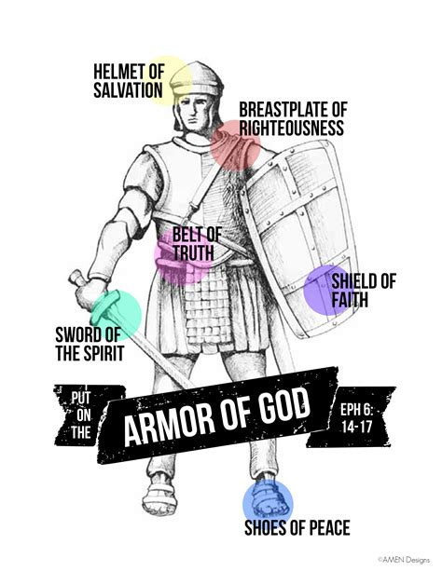
The Everlasting Gospel: 1 Peter 1:13-25
¹³ Wherefore gird up the loins of your mind, be sober, and hope to the end for the grace that is to be brought unto you at the revelation of Jesus Christ;
¹⁴ As obedient children, not fashioning yourselves according to the former lusts in your ignorance:

Slide 44
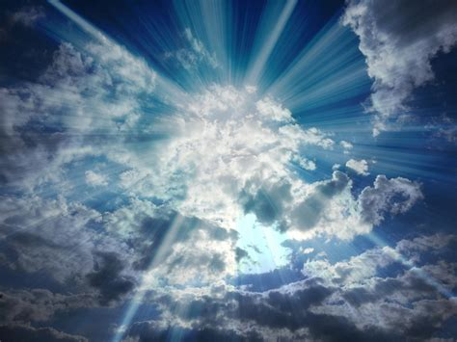
The Everlasting Gospel: 1 Peter 1:15-25
¹⁵ But as he which hath called you is holy, so be ye holy in all manner of conversation;
¹⁶ Because it is written, Be ye holy; for I am holy.

Slide 45
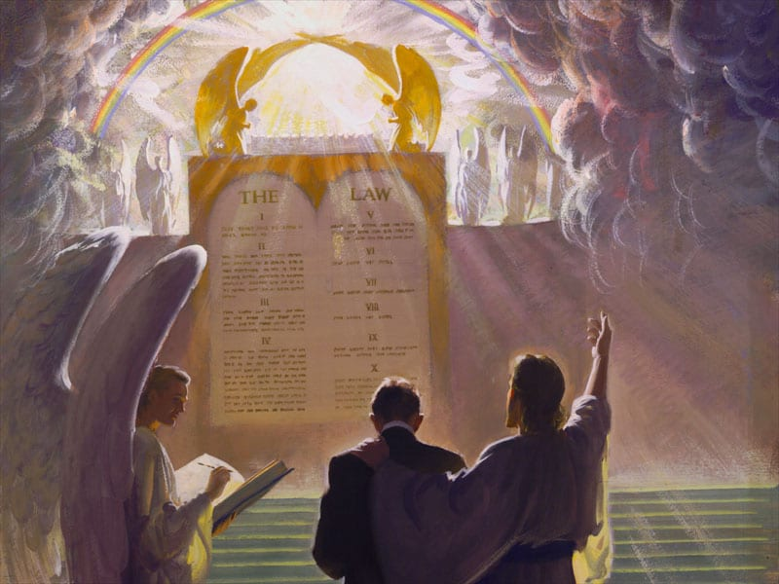
The Everlasting Gospel: 1 Peter 1:17-25
¹⁷ And if ye call on the Father, who without respect of persons judgeth according to every man's work, pass the time of your sojourning here in fear:

Slide 46
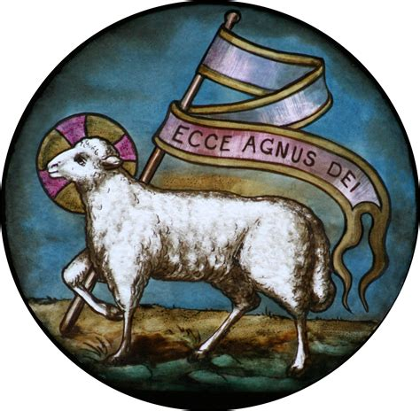
The Everlasting Gospel: 1 Peter 1:18-25
¹⁸ Forasmuch as ye know that ye were not redeemed with corruptible things, as silver and gold, from your vain conversation received by tradition from your fathers;
¹⁹ But with the precious blood of Christ, as of a lamb without blemish and without spot:

Slide 47
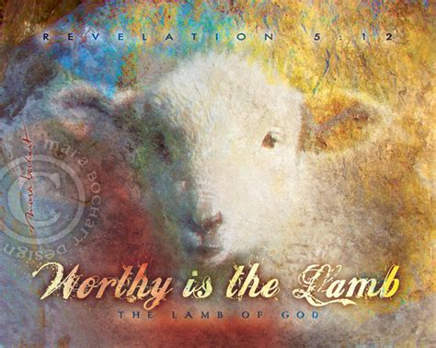
The Everlasting Gospel: 1 Peter 1:20-25
²⁰ Who verily was foreordained before the foundation of the world, but was manifest in these last times for you,
²¹ Who by him do believe in God, that raised him up from the dead, and gave him glory; that your faith and hope might be in God.

Slide 48

The Everlasting Gospel: 1 Peter 1:22-25
²² Seeing ye have purified your souls in obeying the truth through the Spirit unto unfeigned love of the brethren, see that ye love one another with a pure heart fervently:

Slide 49

The Everlasting Gospel: 1 Peter 1:23-25
²³ Being born again, not of corruptible seed, but of incorruptible, by the word of God, which liveth and abideth for ever.
²⁴ For all flesh is as grass, and all the glory of man as the flower of grass. The grass withereth, and the flower thereof falleth away:

Slide 50
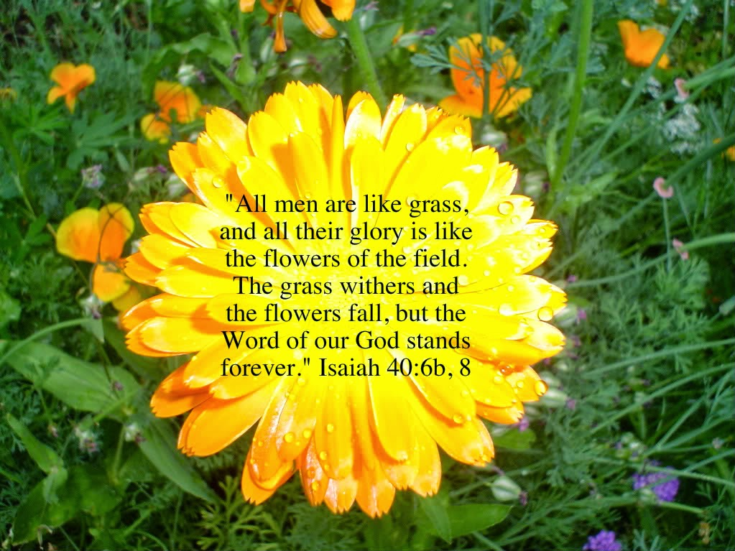
The Everlasting Gospel: 1 Peter 1:25
²⁵ But the word of the Lord endureth for ever. And this is the word which by the gospel is preached unto you.

Slide 51
The Everlasting Gospel:
The Desire of Ages p. 22
The plan for our redemption was not an afterthought, a plan formulated after the fall of Adam. It was a revelation of “the mystery which hath been kept in silence through times eternal.” Romans 16:25, R. V. It was an unfolding of the principles that from eternal ages have been the foundation of God's throne. From the beginning, God and Christ knew of the apostasy of Satan, and of the fall of man through the deceptive power of the apostate.

Slide 52
The Everlasting Gospel:
The Desire of Ages p. 22
God did not ordain that sin should exist, but He foresaw its existence, and made provision to meet the terrible emergency. So great was His love for the world, that He covenanted to give His only-begotten Son, “that whosoever believeth in Him should not perish, but have everlasting life.” John 3:16.

Slide 53
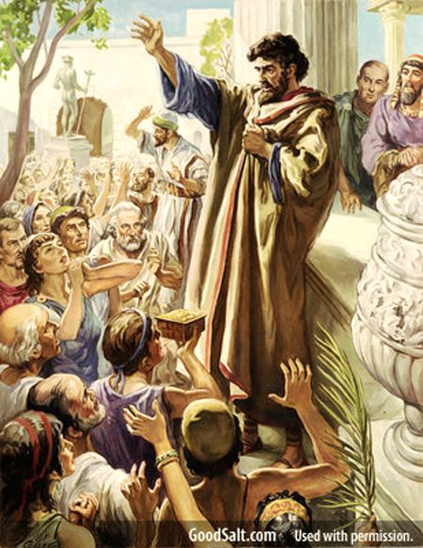
The Everlasting Gospel: 1 Corinthians 15:1-11
15 Moreover, brethren, I declare unto you the gospel which I preached unto you, which also ye have received, and wherein ye stand;
² By which also ye are saved, if ye keep in memory what I preached unto you, unless ye have believed in vain.

Slide 54
The Everlasting Gospel: 1 Corinthians 15:1-11
15 Moreover, brethren, I declare unto you the gospel which I preached unto you, which also ye have received, and wherein ye stand;
² By which also ye are saved, if ye keep in memory what I preached unto you, unless ye have believed in vain.
There was nothing wrong with the message that had been preached, but the quality of the Corinthian belief in that message may have been open to question. If their belief was halfhearted, it would have little value. If their faith was firm, then they would find Paul’s doctrine sufficient to guide them into the way of salvation. Having said that, the apostle proceeds to assure them that he had indeed given them the true gospel.

Slide 55
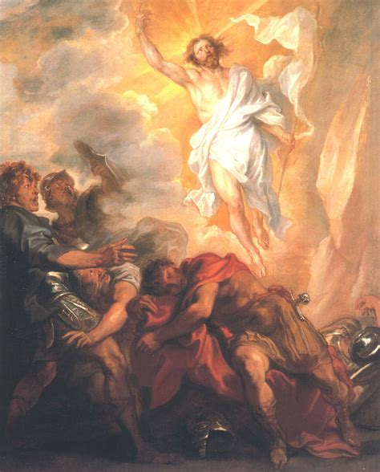
The Everlasting Gospel: 1 Corinthians 15:3-11
³ For I delivered unto you first of all that which I also received, how that Christ died for our sins according to the scriptures;
⁴ And that he was buried, and that he rose again the third day according to the scriptures:

Slide 56
The Everlasting Gospel: 1 Corinthians 15:3-11
³ For I delivered unto you first of all that which I also received, how that Christ died for our sins according to the scriptures;
⁴ And that he was buried, and that he rose again the third day according to the scriptures:
Paul never claims authorship for the gospel he is preaching. He makes clear that he is passing on a message that had been given to him by the Lord. This stresses the divine origin of the doctrine he is preaching, thus exalting his message and making its observance imperative.

Slide 57
The Everlasting Gospel: 1 Corinthians 15:3-11
³ For I delivered unto you first of all that which I also received, how that Christ died for our sins according to the scriptures;
⁴ And that he was buried, and that he rose again the third day according to the scriptures:
The apostle lists four “first” facts that he had given to the believers: (1) Christ died for our sins, (2) Christ was buried, (3) Christ was resurrected, and (4) Christ appeared (vs. 3-5). Some have suggested that these form the basis for the earliest known Christian creed.

Slide 58
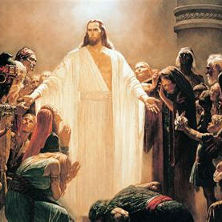
The Everlasting Gospel: 1 Corinthians 15:5-11
⁵ And that he was seen of Cephas, then of the twelve:
⁶ After that, he was seen of above five hundred brethren at once; of whom the greater part remain unto this present, but some are fallen asleep.
⁷ After that, he was seen of James; then of all the apostles.

Slide 59
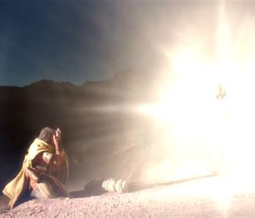
The Everlasting Gospel: 1 Corinthians 15:8-11
⁸ And last of all he was seen of me also, as of one born out of due time.
⁹ For I am the least of the apostles, that am not meet to be called an apostle, because I persecuted the church of God.

Slide 60
The Everlasting Gospel: 1 Corinthians 15:8-11
⁸ And last of all he was seen of me also, as of one born out of due time.
⁹ For I am the least of the apostles, that am not meet to be called an apostle, because I persecuted the church of God.
Gr. ektrōma, “the abortion,” “the stillborn embryo.” The apostle is implying that, compared with the other apostles, he is no better than a stillborn babe. The other disciples grew and matured into their ministry, whereas he, Paul, was abruptly launched into his apostleship.

Slide 61
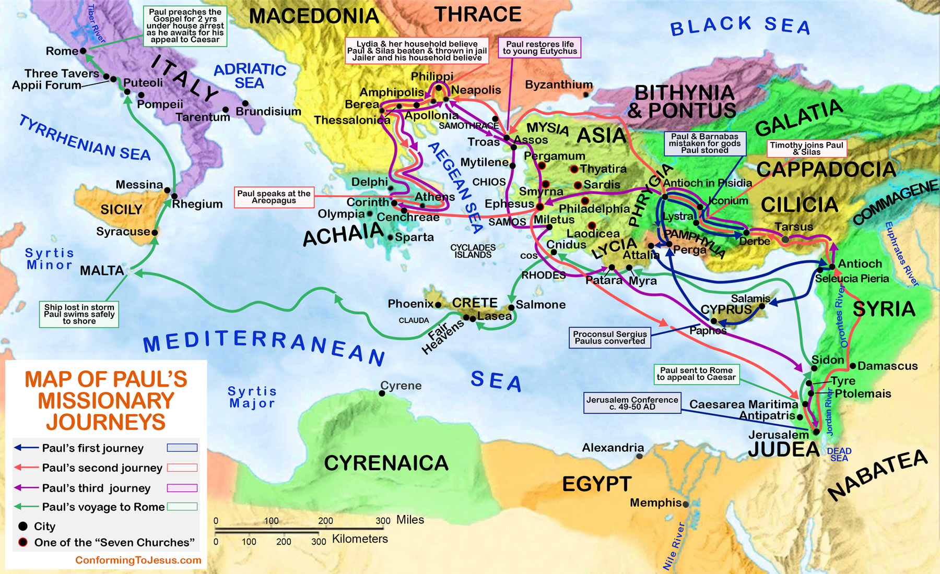
The Everlasting Gospel: 1 Corinthians 15:10-11
¹⁰ But by the grace of God I am what I am: and his grace which was bestowed upon me was not in vain; but I laboured more abundantly than they all: yet not I, but the grace of God which was with me.

Slide 62
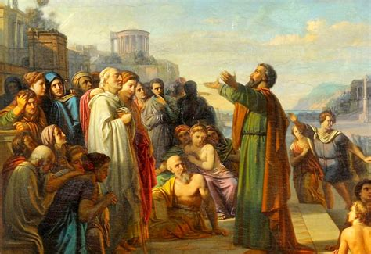
The Everlasting Gospel: 1 Corinthians 15:11
¹¹ Therefore whether it were I or they, so we preach, and so ye believed.

Slide 63
The Everlasting Gospel: 1 Corinthians 15:11
¹¹ Therefore whether it were I or they, so we preach, and so ye believed.
Here Paul closes the comparison between himself and the other apostles (vs. 9, 10), and concludes that since all valid Christian testimony derives its power from God, the identity and personality of the human witness is relatively unimportant.

Slide 64
The Everlasting Gospel: 1 Corinthians 15:11
¹¹ Therefore whether it were I or they, so we preach, and so ye believed.
What a bold affirmation of the unity of apostolic witness! All the apostles gave the same testimony about the resurrection of Christ; hence it was immaterial which of them had brought the message to the Corinthians.

Slide 65
The Everlasting Gospel: 1 Corinthians 15:11
¹¹ Therefore whether it were I or they, so we preach, and so ye believed.
This principle is of universal application, and may be usefully remembered in the modern church. The human agent is merely a mouthpiece used by the Holy Spirit to convey truth to men, and if success crowns his efforts, the credit belongs to God.

Slide 66
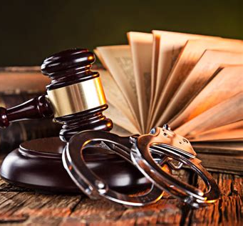
The Everlasting Gospel: Romans 3:19-28
¹⁹ Now we know that what things soever the law saith, it saith to them who are under the law: that every mouth may be stopped, and all the world may become guilty before God.
²⁰ Therefore by the deeds of the law there shall no flesh be justified in his sight: for by the law is the knowledge of sin.

Slide 67
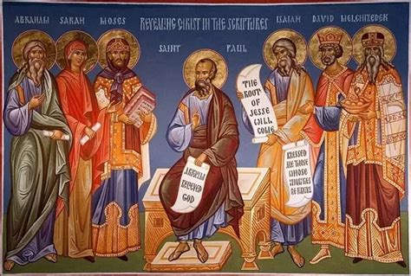
The Everlasting Gospel: Romans 3:21-28
²¹ But now the righteousness of God without the law is manifested, being witnessed by the law and the prophets;

Slide 68
The Everlasting Gospel: Romans 3:21-28
²¹ But now the righteousness of God without the law is manifested, being witnessed by the law and the prophets;
In contrast with the universal sinfulness of man and his futile attempts to gain righteousness by works of law, Paul proceeds to describe the righteousness of God, a righteousness that God is ready to bestow on all who have faith in Jesus Christ.

Slide 69
The Everlasting Gospel: Romans 3:21-28
²¹ But now the righteousness of God without the law is manifested, being witnessed by the law and the prophets;
These words stand in contrast with “by the deeds of the law” in ch. 3:20. They emphasize that God’s righteousness has been disclosed without any reference to law. That is, the righteousness of God has been manifested quite apart from the whole principle of law and the whole idea of legal obedience as a way of obtaining righteousness, or quite apart from the legalistic system the Jews presented as the basis of righteousness.

Slide 70
The Everlasting Gospel: Romans 3:21-28
²¹ But now the righteousness of God without the law is manifested, being witnessed by the law and the prophets;
There is no contradiction between the OT and NT. Although this manifestation of God’s righteousness is apart from law, it is not in any opposition to the law and the prophets. On the contrary, it was anticipated by them. The OT is in substance prophetic of the righteousness to be revealed in Christ and received by faith, as recorded in the NT.

Slide 71
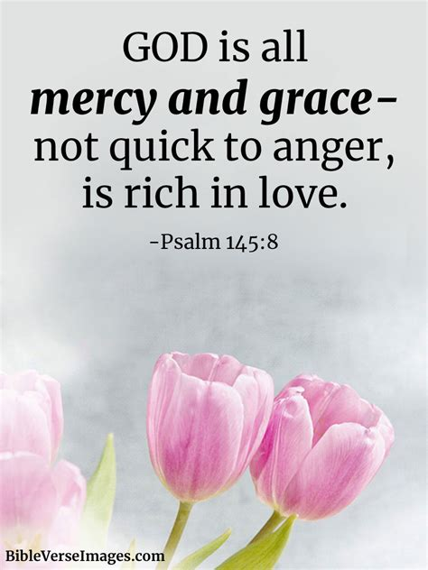
The Everlasting Gospel: Romans 3:22-28
²² Even the righteousness of God which is by faith of Jesus Christ unto all and upon all them that believe: for there is no difference:
²³ For all have sinned, and come short of the glory of God;
²⁴ Being justified freely by his grace through the redemption that is in Christ Jesus:

Slide 72

The Everlasting Gospel: Romans 3:25-28
²⁵ Whom God hath set forth to be a propitiation through faith in his blood, to declare his righteousness for the remission of sins that are past, through the forbearance of God;
²⁶ To declare, I say, at this time his righteousness: that he might be just, and the justifier of him which believeth in Jesus.

Slide 73

The Everlasting Gospel: Romans 3:27-28
²⁷ Where is boasting then? It is excluded. By what law? of works? Nay: but by the law of faith.
²⁸ Therefore we conclude that a man is justified by faith without the deeds of the law.

Slide 74
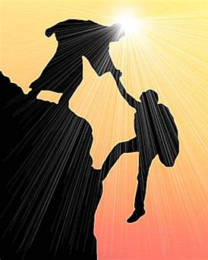
The Everlasting Gospel: Romans 5:6-11
⁶ For when we were yet without strength, in due time Christ died for the ungodly.
⁷ For scarcely for a righteous man will one die: yet peradventure for a good man some would even dare to die.
⁸ But God commendeth his love toward us, in that, while we were yet sinners, Christ died for us.

Slide 75
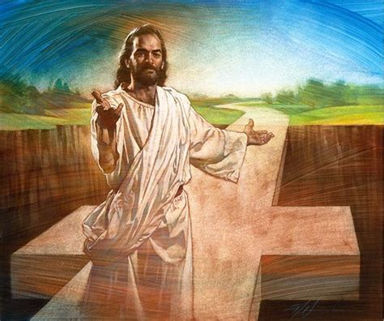
The Everlasting Gospel: Romans 5:9-11
⁹ Much more then, being now justified by his blood, we shall be saved from wrath through him.
¹⁰ For if, when we were enemies, we were reconciled to God by the death of his Son, much more, being reconciled, we shall be saved by his life.

Slide 76
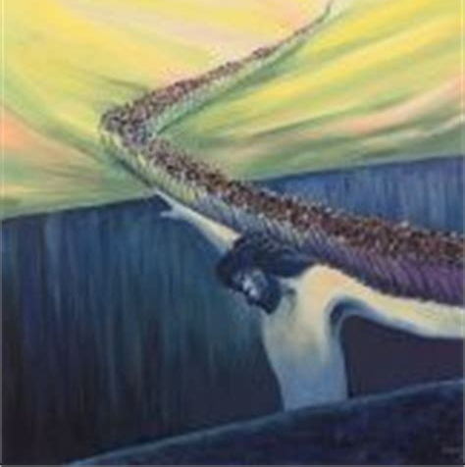
The Everlasting Gospel: Romans 5:11
¹¹ And not only so, but we also joy in God through our Lord Jesus Christ, by whom we have now received the atonement.

Slide 77
The Everlasting Gospel:
SDA Quarterly, Monday, April 10th
The gospel is the incredibly good news of Christ’s death for our sins, His glorious resurrection, and His ever-present love and concern for us. By faith in His shed blood and His resurrection power, we are delivered from both sin’s penalty and power. Christ absorbed the apostle Paul’s thoughts and was at the center of his teaching and preaching. The crucified Christ redeemed him from the condemnation and guilt of his past. The resurrected Christ gave him power for the present, and the returning Christ gave him hope for the future.

Slide 78
The Everlasting Gospel:
SDA Quarterly, Monday, April 10th
Notice four points in these passages in Romans:
We are justified freely by grace.
Grace is a declaration of God’s righteousness.
Grace justifies those who by faith accept Jesus.
God’s love was demonstrated for us while we were yet sinners.

Slide 79
The Everlasting Gospel:
SDA Quarterly, Monday, April 10th
Christ’s grace is unmerited, undeserved, and unearned. Jesus died the agonizing, painful death that lost sinners will die. He experienced the fullness of the Father’s wrath, or judgment, against sin. He was rejected so that we could be accepted. He died the death that was ours, so we could live the life that was His.
Any wonder, then, that salvation must be by faith, and without the deeds of the law? What could we possibly add, what could our works, even the best-intentioned, Holy Spirit-filled works, add to what Christ had done for us at the cross?

Slide 80
Memory Text: Revelation 14:6
⁶ And I saw another angel fly in the midst of heaven, having the everlasting gospel to preach unto them that dwell on the earth, and to every nation, and kindred, and tongue, and people,

Slide 81
Memory Text: Revelation 14:6
⁶ And I saw another angel fly in the midst of heaven, having the everlasting gospel to preach unto them that dwell on the earth, and to every nation, and kindred, and tongue, and people,

Slide 82
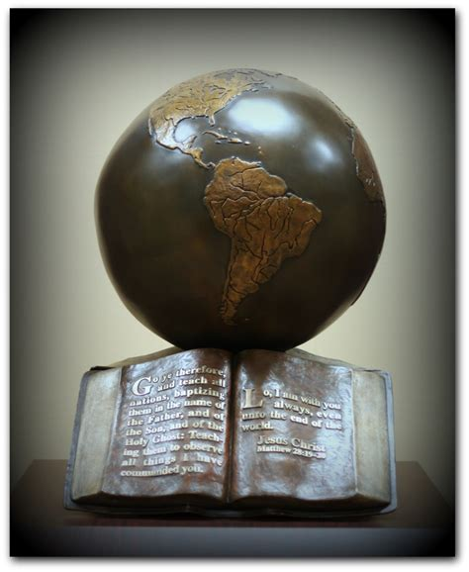
To Every Nation: Matthew 28:18-20
¹⁸ And Jesus came and spake unto them, saying, All power is given unto me in heaven and in earth.
¹⁹ Go ye therefore, and teach all nations, baptizing them in the name of the Father, and of the Son, and of the Holy Ghost:

Slide 83
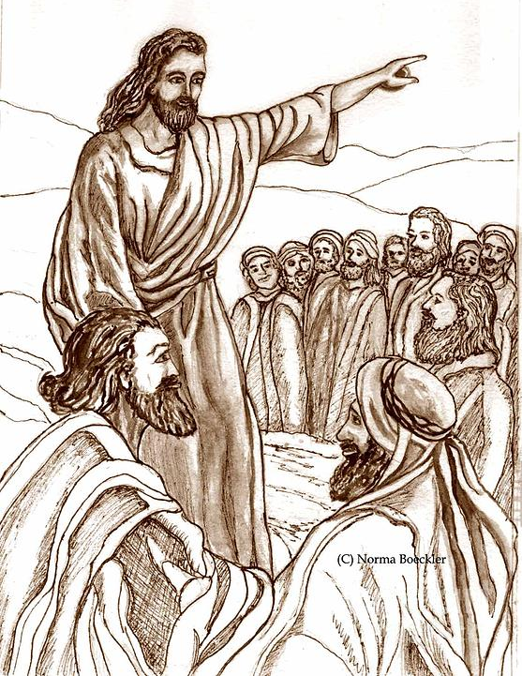
To Every Nation: Matthew 28:18-20
²⁰ Teaching them to observe all things whatsoever I have commanded you: and, lo, I am with you always, even unto the end of the world. Amen.

Slide 84
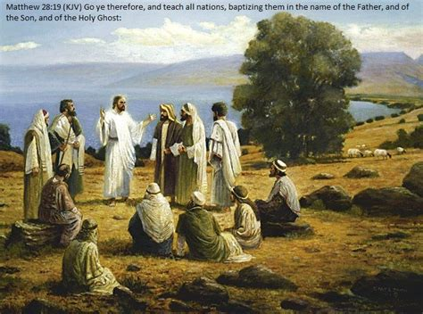
To Every Nation: Matthew 24:14
¹⁴ And this gospel of the kingdom shall be preached in all the world for a witness unto all nations; and then shall the end come.

Slide 85
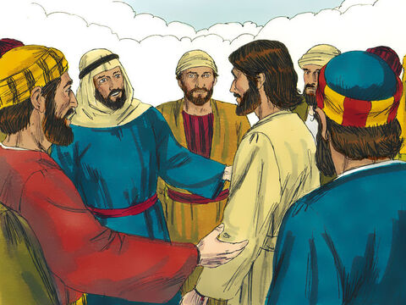
To Every Nation: Acts 1:6-9
⁶ When they therefore were come together, they asked of him, saying, Lord, wilt thou at this time restore again the kingdom to Israel?

Slide 86
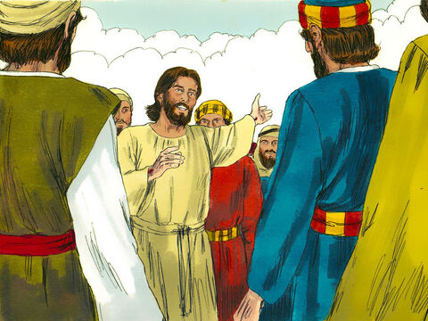
To Every Nation: Acts 1:6-9
⁷ And he said unto them, It is not for you to know the times or the seasons, which the Father hath put in his own power.

Slide 87
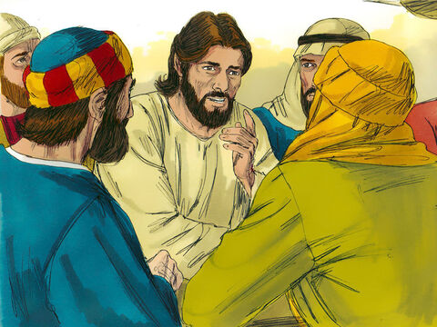
To Every Nation: Acts 1:6-9
⁸ But ye shall receive power, after that the Holy Ghost is come upon you: and ye shall be witnesses unto me both in Jerusalem, and in all Judaea, and in Samaria, and unto the uttermost part of the earth.

Slide 88
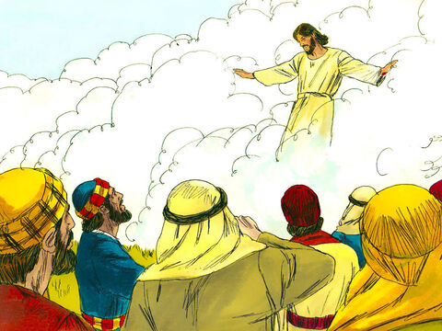
To Every Nation: Acts 1:6-9
⁹ And when he had spoken these things, while they beheld, he was taken up; and a cloud received him out of their sight.

Slide 89
To Every Nation:
The Great Controversy, p. 612
Servants of God, with their faces lighted up and shining with holy consecration, will hasten from place to place to proclaim the message from heaven. By thousands of voices, all over the earth, the warning will be given. Miracles will be wrought, the sick will be healed, and signs and wonders will follow the believers. Satan also works, with lying wonders, even bringing down fire from heaven in the sight of men. Revelation 13:13. Thus the inhabitants of the earth will be brought to take their stand.

Slide 90
To Every Nation:
The Great Controversy, p. 612
The message will be carried not so much by argument as by the deep conviction of the Spirit of God. The arguments have been presented. The seed has been sown, and now it will spring up and bear fruit. The publications distributed by missionary workers have exerted their influence, yet many whose minds were impressed have been prevented from fully comprehending the truth or from yielding obedience.

Slide 91
To Every Nation:
The Great Controversy, p. 612
Now the rays of light penetrate everywhere, the truth is seen in its clearness, and the honest children of God sever the bands which have held them. Family connections, church relations, are powerless to stay them now. Truth is more precious than all besides. Notwithstanding the agencies combined against the truth, a large number take their stand upon the Lord's side.

Slide 92
Thank you!!
And HAPPY SABBATH!

