Slide 1
Fear God and Give Glory to Him
Revelation 14:7
Genesis 6&7, 2 Peter 3, Philippians 2
Lesson 4, 2nd Quarter 2023

Slide 2
Memory Text: Revelation 14:12
¹² Here is the patience of the saints: here are they that keep the commandments of God, and the faith of Jesus.

Slide 3
Revelation 14:6-7
⁶ And I saw another angel fly in the midst of heaven, having the everlasting gospel to preach unto them that dwell on the earth, and to every nation, and kindred, and tongue, and people,
⁷ Saying with a loud voice, Fear God, and give glory to him; for the hour of his judgment is come: and worship him that made heaven, and earth, and the sea, and the fountains of waters.

Slide 4
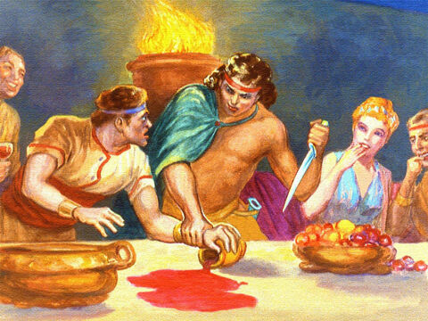
Early Warning: Genesis 6:5-8:4
⁵ And God saw that the wickedness of man was great in the earth, and that every imagination of the thoughts of his heart was only evil continually.

Slide 5
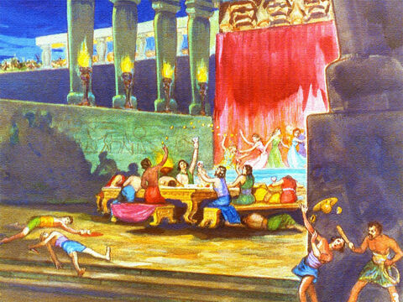
Genesis 6:6-8:4
⁶ And it repented the Lord that he had made man on the earth, and it grieved him at his heart.

Slide 6
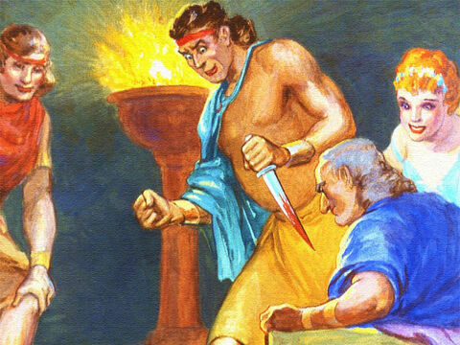
Early Warning: Genesis 6:7-8:4
⁷ And the Lord said, I will destroy man whom I have created from the face of the earth; both man, and beast, and the creeping thing, and the fowls of the air; for it repenteth me that I have made them.

Slide 7
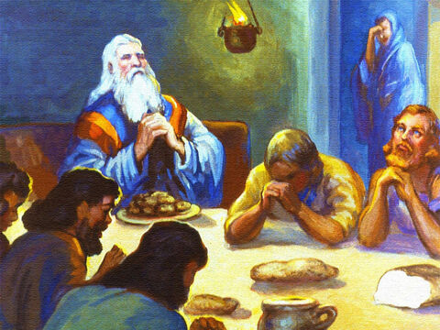
Early Warning: Genesis 6:8-8:4
⁸ But Noah found grace in the eyes of the Lord.
⁹ These are the generations of Noah: Noah was a just man and perfect in his generations, and Noah walked with God.

Slide 8
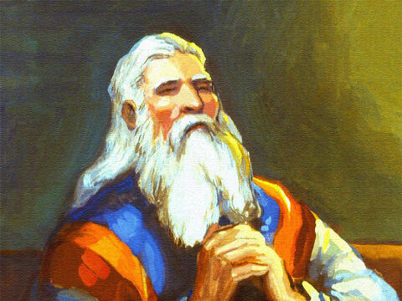
Early Warning: Genesis 6:10-8:4
¹⁰ And Noah begat three sons, Shem, Ham, and Japheth.
¹¹ The earth also was corrupt before God, and the earth was filled with violence.

Slide 9
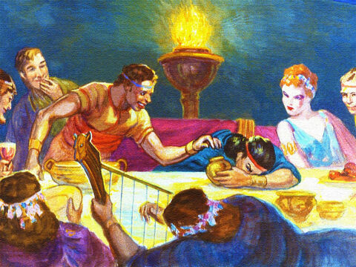
Early Warning: Genesis 6:12-8:4
¹² And God looked upon the earth, and, behold, it was corrupt; for all flesh had corrupted his way upon the earth.

Slide 10
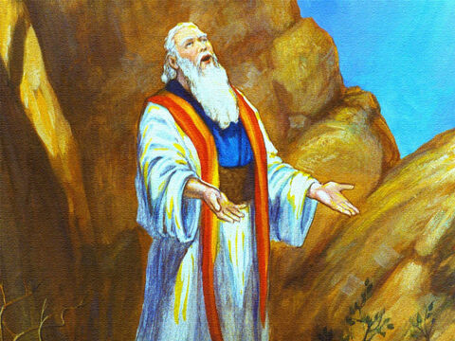
Early Warning: Genesis 6:13-8:4
¹³ And God said unto Noah, The end of all flesh is come before me; for the earth is filled with violence through them; and, behold, I will destroy them with the earth.

Slide 11
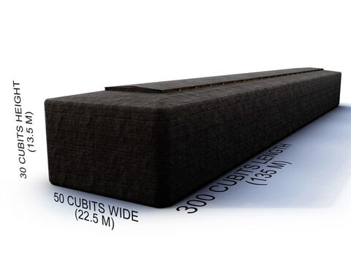
Early Warning: Genesis 6:14-8:4
¹⁴ Make thee an ark of gopher wood; rooms shalt thou make in the ark, and shalt pitch it within and without with pitch.

Slide 12
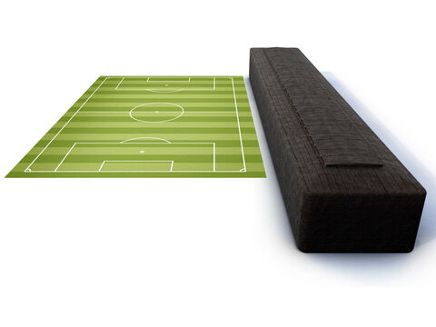
Early Warning: Genesis 6:15-8:4
¹⁵ And this is the fashion which thou shalt make it of: The length of the ark shall be three hundred cubits, the breadth of it fifty cubits, and the height of it thirty cubits.

Slide 13
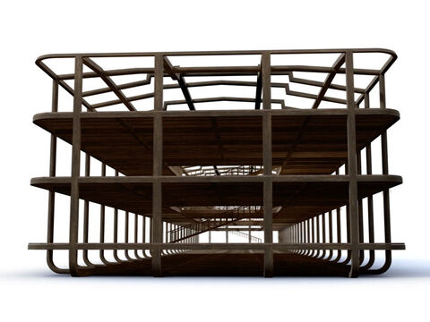
Early Warning: Genesis 6:16-8:4
¹⁶ A window shalt thou make to the ark, and in a cubit shalt thou finish it above; and the door of the ark shalt thou set in the side thereof; with lower, second, and third stories shalt thou make it.

Slide 14
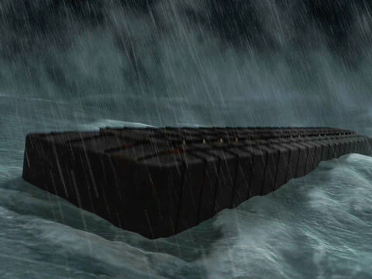
Early Warning: Genesis 6:17-8:4
¹⁷ And, behold, I, even I, do bring a flood of waters upon the earth, to destroy all flesh, wherein is the breath of life, from under heaven; and every thing that is in the earth shall die.

Slide 15
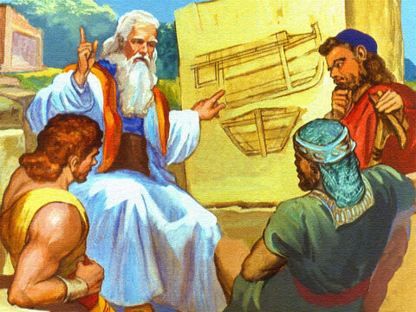
Early Warning: Genesis 6:18-8:4
¹⁸ But with thee will I establish my covenant; and thou shalt come into the ark, thou, and thy sons, and thy wife, and thy sons' wives with thee.

Slide 16
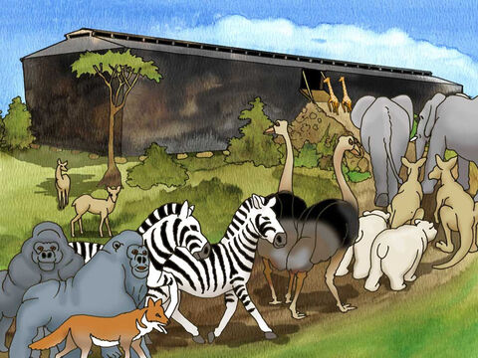
Early Warning: Genesis 6:19-8:4
¹⁹ And of every living thing of all flesh, two of every sort shalt thou bring into the ark, to keep them alive with thee; they shall be male and female.

Slide 17
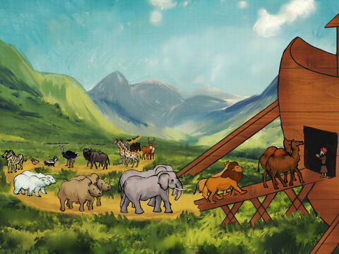
Early Warning: Genesis 6:20-8:4
²⁰ Of fowls after their kind, and of cattle after their kind, of every creeping thing of the earth after his kind, two of every sort shall come unto thee, to keep them alive.

Slide 18
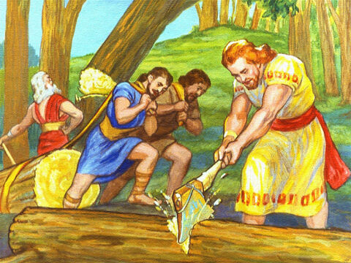
Early Warning: Genesis 6:21-8:4
²¹ And take thou unto thee of all food that is eaten, and thou shalt gather it to thee; and it shall be for food for thee, and for them.
²² Thus did Noah; according to all that God commanded him, so did he.

Slide 19
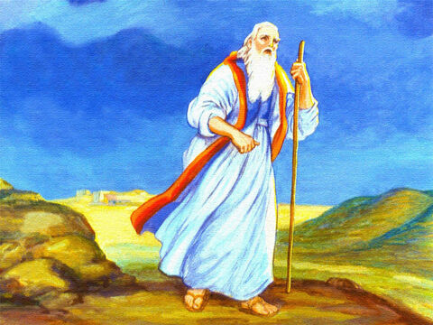
Early Warning: Genesis 7:1-8:4
7 And the Lord said unto Noah, Come thou and all thy house into the ark; for thee have I seen righteous before me in this generation.

Slide 20
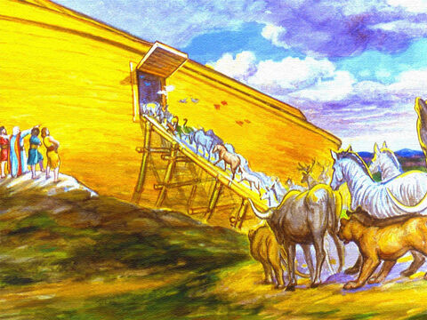
Early Warning: Genesis 7:2-8:4
² Of every clean beast thou shalt take to thee by sevens, the male and his female: and of beasts that are not clean by two, the male and his female.

Slide 21
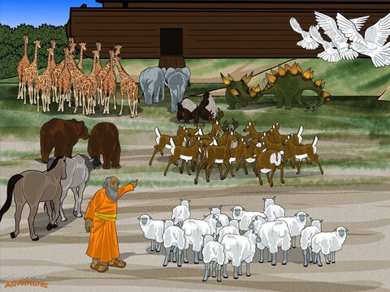
Early Warning: Genesis 7:3-8:4
³ Of fowls also of the air by sevens, the male and the female; to keep seed alive upon the face of all the earth.

Slide 22
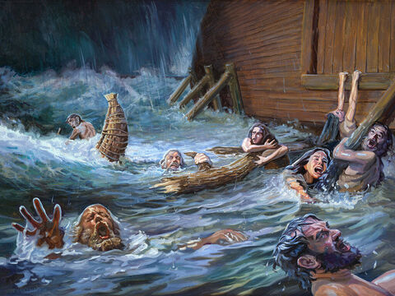
Early Warning: Genesis 7:4-8:4
⁴ For yet seven days, and I will cause it to rain upon the earth forty days and forty nights; and every living substance that I have made will I destroy from off the face of the earth.
⁵ And Noah did according unto all that the Lord commanded him.

Slide 23
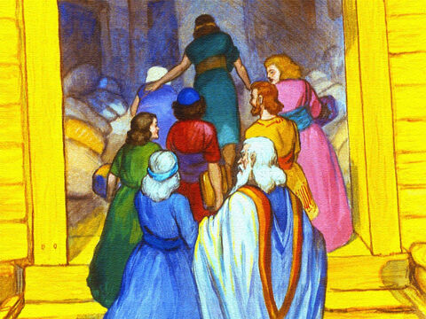
Early Warning: Genesis 7:6-8:4
⁶ And Noah was six hundred years old when the flood of waters was upon the earth.
⁷ And Noah went in, and his sons, and his wife, and his sons' wives with him, into the ark, because of the waters of the flood.

Slide 24
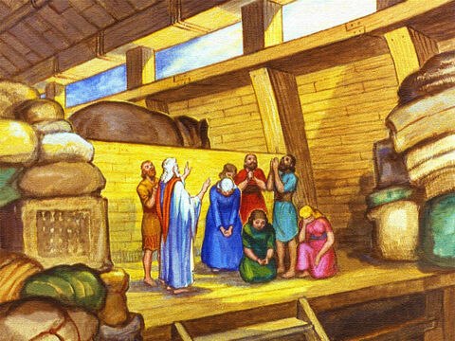
Early Warning: Genesis 7:8-8:4
⁸ Of clean beasts, and of beasts that are not clean, and of fowls, and of every thing that creepeth upon the earth,
⁹ There went in two and two unto Noah into the ark, the male and the female, as God had commanded Noah.

Slide 25
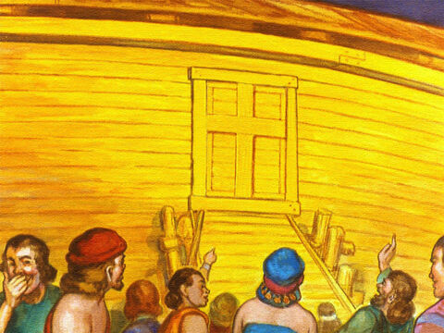
Early Warning: Genesis 7:10-8:4
¹⁰ And it came to pass after seven days, that the waters of the flood were upon the earth.

Slide 26
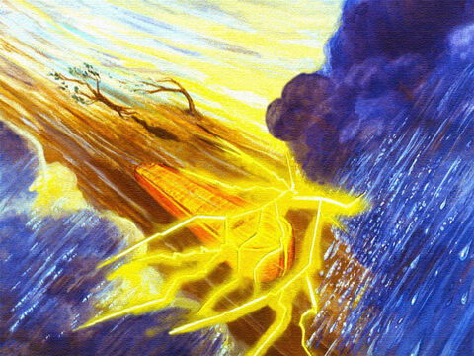
Early Warning: Genesis 7:11-8:4
¹¹ In the six hundredth year of Noah's life, in the second month, the seventeenth day of the month, the same day were all the fountains of the great deep broken up, and the windows of heaven were opened.

Slide 27
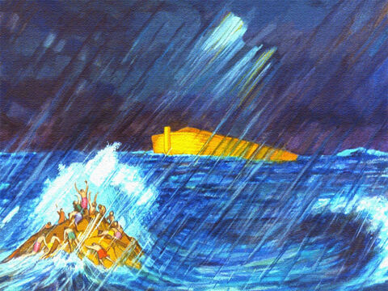
Early Warning: Genesis 7:12-8:4
¹² And the rain was upon the earth forty days and forty nights.
¹³ In the selfsame day entered Noah, and Shem, and Ham, and Japheth, the sons of Noah, and Noah's wife, and the three wives of his sons with them, into the ark;

Slide 28
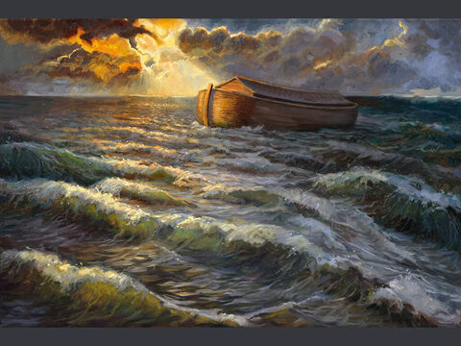
Early Warning: Genesis 7:14-8:4
¹⁴ They, and every beast after his kind, and all the cattle after their kind, and every creeping thing that creepeth upon the earth after his kind, and every fowl after his kind, every bird of every sort.

Slide 29
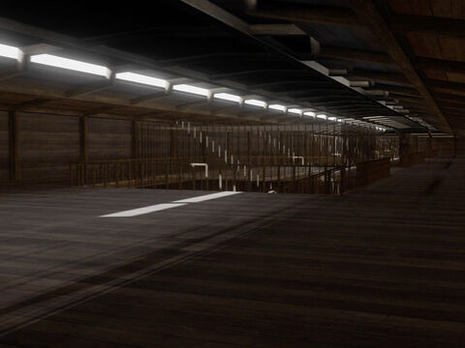
Early Warning: Genesis 7:15-8:4
¹⁵ And they went in unto Noah into the ark, two and two of all flesh, wherein is the breath of life.
¹⁶ And they that went in, went in male and female of all flesh, as God had commanded him: and the Lord shut him in.

Slide 30
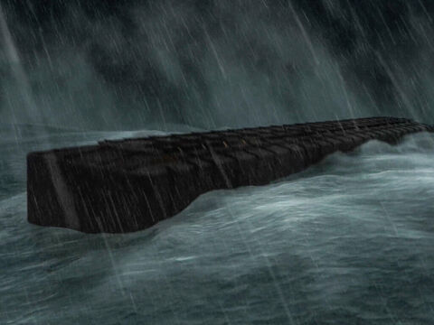
Early Warning: Genesis 7:17-8:4
¹⁷ And the flood was forty days upon the earth; and the waters increased, and bare up the ark, and it was lift up above the earth.
¹⁸ And the waters prevailed, and were increased greatly upon the earth; and the ark went upon the face of the waters.

Slide 31
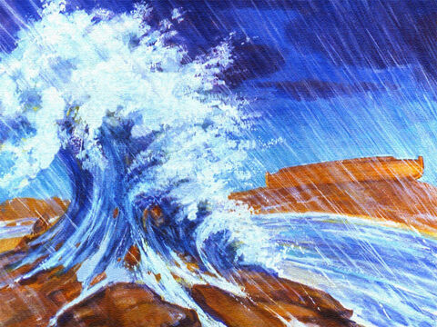
Early Warning: Genesis 7:19-8:4
¹⁹ And the waters prevailed exceedingly upon the earth; and all the high hills, that were under the whole heaven, were covered.
²⁰ Fifteen cubits upward did the waters prevail; and the mountains were covered.

Slide 32
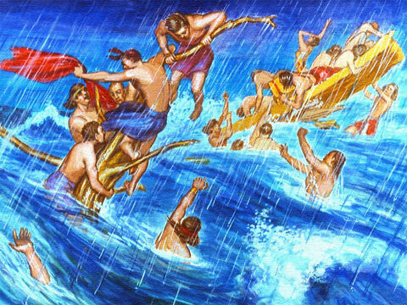
Early Warning: Genesis 7:21-8:4
²¹ And all flesh died that moved upon the earth, both of fowl, and of cattle, and of beast, and of every creeping thing that creepeth upon the earth, and every man:
²² All in whose nostrils was the breath of life, of all that was in the dry land, died.

Slide 33
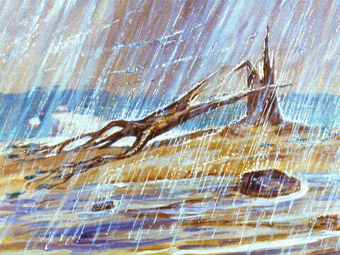
Early Warning: Genesis 7:23-8:4
²³ And every living substance was destroyed which was upon the face of the ground, both man, and cattle, and the creeping things, and the fowl of the heaven; and they were destroyed from the earth: and Noah only remained alive, and they that were with him in the ark.

Slide 34
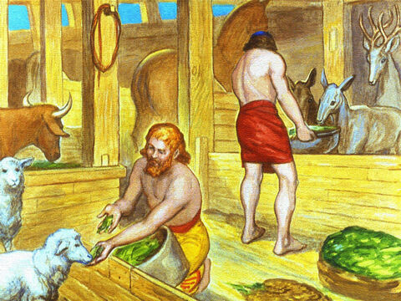
Early Warning: Genesis 7:24-8:4
²⁴ And the waters prevailed upon the earth an hundred and fifty days.

Slide 35
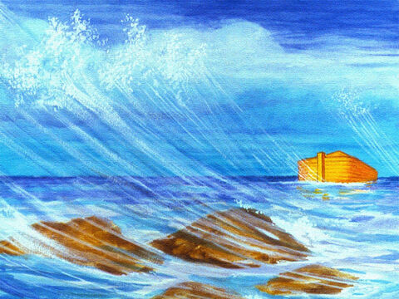
Early Warning: Genesis 8:1-8:4
8 And God remembered Noah, and every living thing, and all the cattle that was with him in the ark: and God made a wind to pass over the earth, and the waters assuaged;

Slide 36
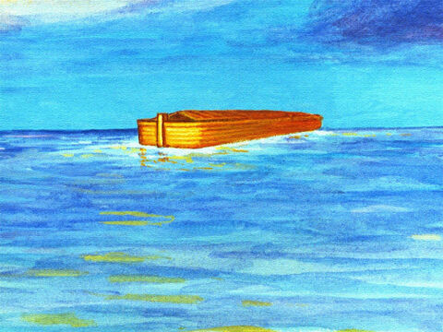
Early Warning: Genesis 8:2-8:4
² The fountains also of the deep and the windows of heaven were stopped, and the rain from heaven was restrained;

Slide 37
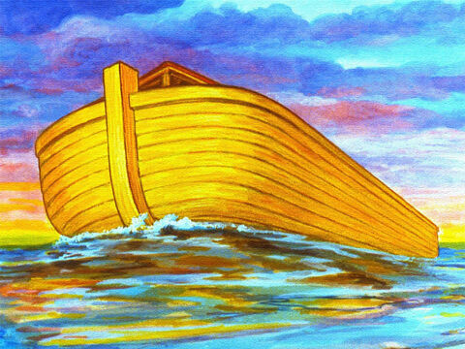
Early Warning: Genesis 8:2-8:4
³ And the waters returned from off the earth continually: and after the end of the hundred and fifty days the waters were abated.

Slide 38
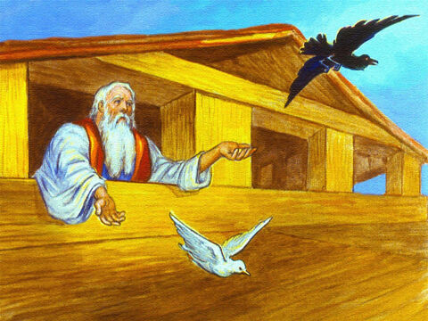
Early Warning: Genesis 8:2-8:4
⁴ And the ark rested in the seventh month, on the seventeenth day of the month, upon the mountains of Ararat.

Slide 39
The world was in its infancy; yet iniquity had become so deep and widespread that God could no longer bear with it; and He said, “I will destroy man whom I have created from the face of the earth.” He declared that His Spirit should not always strive with the guilty race.
Early Warning: Patriarchs and Prophets pg. 92

Slide 40
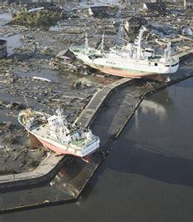
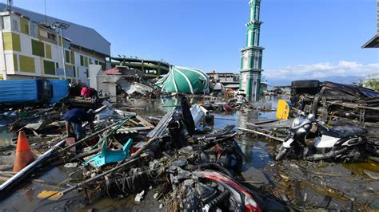
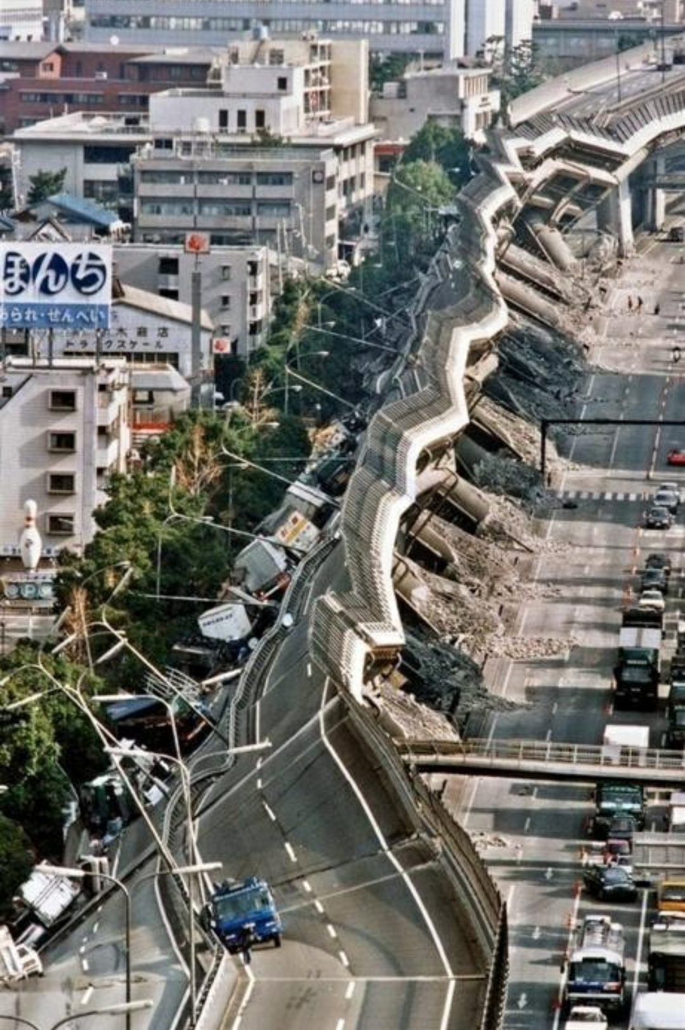
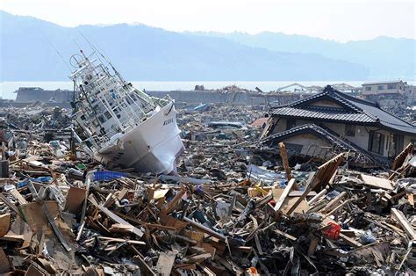
If they did not cease to pollute with their sins the world and its rich treasures, He would blot them from His creation, and would destroy the things with which He had delighted to bless them; He would sweep away the beasts of the field, and the vegetation which furnished such an abundant supply of food, and would transform the fair earth into one vast scene of desolation and ruin.
Early Warning: Patriarchs and Prophets pg. 92

Slide 41
Amid the prevailing corruption, Methuselah, Noah, and many others labored to keep alive the knowledge of the true God and to stay the tide of moral evil. A hundred and twenty years before the Flood, the Lord by a holy angel declared to Noah His purpose, and directed him to build an ark. While building the ark he was to preach that God would bring a flood of water upon the earth to destroy the wicked.
Early Warning: Patriarchs and Prophets pg. 92

Slide 42
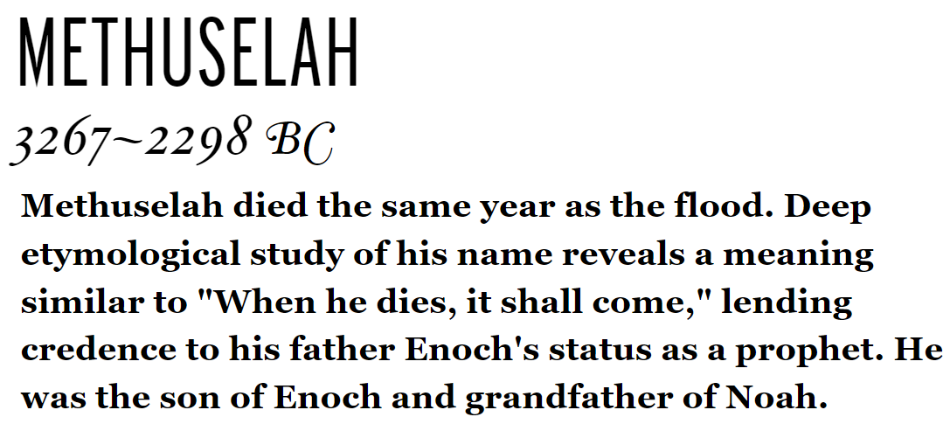

Slide 43
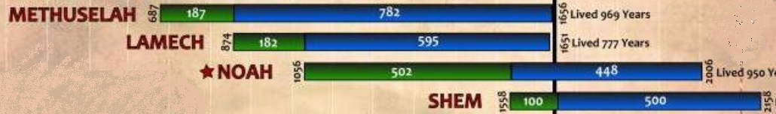
Early Warning: Timeline
FLOOD

Slide 44
Those who would believe the message, and would prepare for that event by repentance and reformation, should find pardon and be saved. Enoch had repeated to his children what God had shown him in regard to the Flood, and Methuselah and his sons, who lived to hear the preaching of Noah, assisted in building the ark.
Early Warning: Patriarchs and Prophets pg. 92

Slide 45
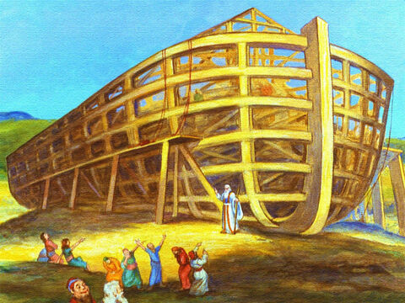
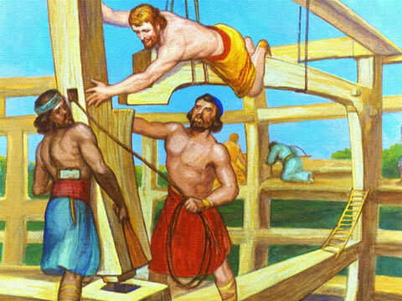
Those who would believe the message, and would prepare for that event by repentance and reformation, should find pardon and be saved. Enoch had repeated to his children what God had shown him in regard to the Flood, and Methuselah and his sons, who lived to hear the preaching of Noah, assisted in building the ark.
Early Warning: Patriarchs and Prophets pg. 92

Slide 46
“By faith Noah, being warned of God of things not seen as yet, moved with fear, prepared an ark to the saving of his house; by the which he condemned the world, and became heir of the righteousness which is by faith.” Hebrews 11:7. While Noah was giving his warning message to the world, his works testified of his sincerity. It was thus that his faith was perfected and made evident.
Early Warning: Patriarchs and Prophets pg. 95

Slide 47
He gave the world an example of believing just what God says. All that he possessed, he invested in the ark. As he began to construct that immense boat on dry ground, multitudes came from every direction to see the strange sight and to hear the earnest, fervent words of the singular preacher. Every blow struck upon the ark was a witness to the people.
Early Warning: Patriarchs and Prophets pg. 95

Slide 48
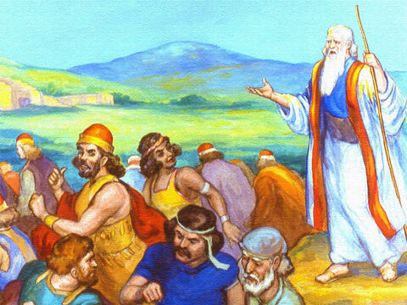
Many at first appeared to receive the warning; yet they did not turn to God with true repentance. They were unwilling to renounce their sins. During the time that elapsed before the coming of the Flood, their faith was tested, and they failed to endure the trial.
Early Warning: Patriarchs and Prophets pg. 95

Slide 49
Overcome by the prevailing unbelief, they finally joined their former associates in rejecting the solemn message. Some were deeply convicted, and would have heeded the words of warning; but there were so many to jest and ridicule, that they partook of the same spirit, resisted the invitations of mercy…
Early Warning: Patriarchs and Prophets pg. 95

Slide 50
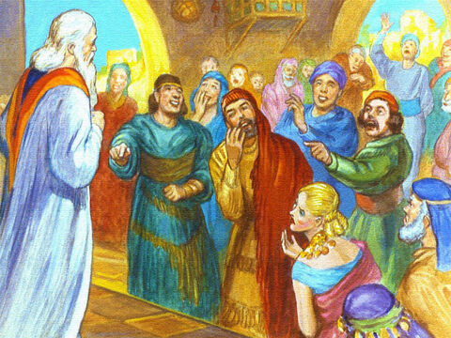
…and were soon among the boldest and most defiant scoffers; for none are so reckless and go to such lengths in sin as do those who have once had light, but have resisted the convicting Spirit of God.
Early Warning: Patriarchs and Prophets pg. 95

Slide 51
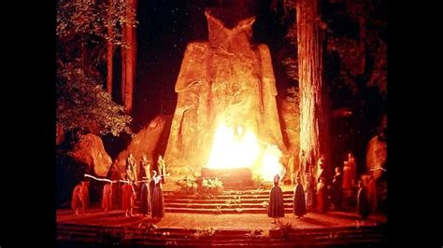
The men of that generation were not all, in the fullest acceptation of the term, idolaters. Many professed to be worshipers of God. They claimed that their idols were representations of the Deity, and that through them the people could obtain a clearer conception of the divine Being.
Early Warning: Patriarchs and Prophets pg. 95

Slide 52
This class were foremost in rejecting the preaching of Noah. As they endeavored to represent God by material objects, their minds were blinded to His majesty and power; they ceased to realize the holiness of His character, or the sacred, unchanging nature of His requirements.
Early Warning: Patriarchs and Prophets pg. 95

Slide 53
As sin became general, it appeared less and less sinful, and they finally declared that the divine law was no longer in force; that it was contrary to the character of God to punish transgression; and they denied that His judgments were to be visited upon the earth.
Early Warning: Patriarchs and Prophets pg. 95

Slide 54
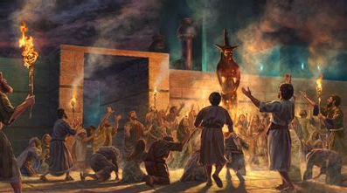
Early Warning: Patriarchs and Prophets pg. 95

Slide 55
Had the men of that generation obeyed the divine law, they would have recognized the voice of God in the warning of His servant; but their minds had become so blinded by rejection of light that they really believed Noah's message to be a delusion.
Early Warning: Patriarchs and Prophets pg. 95

Slide 56
It was not multitudes or majorities that were on the side of right. The world was arrayed against God's justice and His laws, and Noah was regarded as a fanatic. Satan, when tempting Eve to disobey God, said to her, “Ye shall not surely die.” Genesis 3:4. Great men, worldly, honored, and wise men, repeated the same.
Early Warning: Patriarchs and Prophets pg. 96

Slide 57
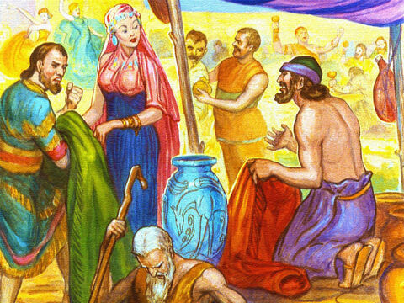
“The threatenings of God,” they said, “are for the purpose of intimidating, and will never be verified. You need not be alarmed. Such an event as the destruction of the world by the God who made it, and the punishment of the beings He has created, will never take place. Be at peace; fear not. Noah is a wild fanatic.”
Early Warning: Patriarchs and Prophets pg. 96

Slide 58
The world made merry at the folly of the deluded old man. Instead of humbling the heart before God, they continued their disobedience and wickedness, the same as though God had not spoken to them through His servant.
Early Warning: Patriarchs and Prophets pg. 96

Slide 59
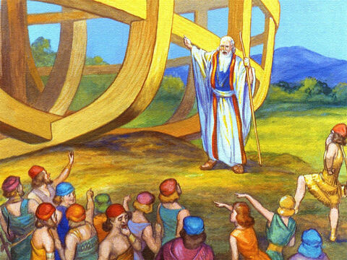
But Noah stood like a rock amid the tempest. Surrounded by popular contempt and ridicule, he distinguished himself by his holy integrity and unwavering faithfulness. A power attended his words, for it was the voice of God to man through His servant.
Early Warning: Patriarchs and Prophets pg. 96

Slide 60
Connection with God made him strong in the strength of infinite power, while for one hundred and twenty years his solemn voice fell upon the ears of that generation in regard to events, which, so far as human wisdom could judge, were impossible.
Early Warning: Patriarchs and Prophets pg. 96

Slide 61
As time passed on, with no apparent change in nature, men whose hearts had at times trembled with fear, began to be reassured. They reasoned, as many reason now, that nature is above the God of nature, and that her laws are so firmly established that God Himself could not change them.
Early Warning: Patriarchs and Prophets pg. 97

Slide 62
Reasoning that if the message of Noah were correct, nature would be turned out of her course, they made that message, in the minds of the world, a delusion—a grand deception. They manifested their contempt for the warning of God by doing just as they had done before the warning was given.
Early Warning: Patriarchs and Prophets pg. 97

Slide 63
They continued their festivities and their gluttonous feasts; they ate and drank, planted and builded, laying their plans in reference to advantages they hoped to gain in the future; and they went to greater lengths in wickedness, and in defiant disregard of God's requirements, to testify that they had no fear of the Infinite One.
Early Warning: Patriarchs and Prophets pg. 97

Slide 64
They asserted that if there were any truth in what Noah had said, the men of renown—the wise, the prudent, the great men—would understand the matter.
Early Warning: Patriarchs and Prophets pg. 97

Slide 65
Late Warnings: Revelation 14:7
⁷ Saying with a loud voice, Fear God, and give glory to him; for the hour of his judgment is come: and worship him that made heaven, and earth, and the sea, and the fountains of waters.

Slide 66
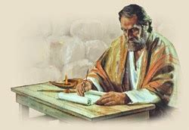
Late Warnings: 2 Peter 3:1-18
3 This second epistle, beloved, I now write unto you; in both which I stir up your pure minds by way of remembrance:

Slide 67

Late Warnings: 2 Peter 3:2-18
² That ye may be mindful of the words which were spoken before by the holy prophets, and of the commandment of us the apostles of the Lord and Saviour:

Slide 68

Late Warnings: 2 Peter 3:3-18
³ Knowing this first, that there shall come in the last days scoffers, walking after their own lusts,

Slide 69
Late Warnings: 2 Peter 3:4-18
⁴ And saying, Where is the promise of his coming? for since the fathers fell asleep, all things continue as they were from the beginning of the creation.

Slide 70

Late Warnings: 2 Peter 3:5-18
⁵ For this they willingly are ignorant of, that by the word of God the heavens were of old, and the earth standing out of the water and in the water:

Slide 71
Late Warnings: 2 Peter 3:6-18
⁶ Whereby the world that then was, being overflowed with water, perished:

Slide 72

Late Warnings: 2 Peter 3:7-18
⁷ But the heavens and the earth, which are now, by the same word are kept in store, reserved unto fire against the day of judgment and perdition of ungodly men.

Slide 73

Late Warnings: 2 Peter 3:8-18
⁸ But, beloved, be not ignorant of this one thing, that one day is with the Lord as a thousand years, and a thousand years as one day.

Slide 74

Late Warnings: 2 Peter 3:9-18
⁹ The Lord is not slack concerning his promise, as some men count slackness; but is longsuffering to us-ward, not willing that any should perish, but that all should come to repentance.

Slide 75

Late Warnings: 2 Peter 3:10-18
¹⁰ But the day of the Lord will come as a thief in the night; in the which the heavens shall pass away with a great noise, and the elements shall melt with fervent heat, the earth also and the works that are therein shall be burned up.

Slide 76

Late Warnings: 2 Peter 3:11-18
¹¹ Seeing then that all these things shall be dissolved, what manner of persons ought ye to be in all holy conversation and godliness,

Slide 77

Late Warnings: 2 Peter 3:12-18
¹² Looking for and hasting unto the coming of the day of God, wherein the heavens being on fire shall be dissolved, and the elements shall melt with fervent heat?

Slide 78

Late Warnings: 2 Peter 3:13-18
¹³ Nevertheless we, according to his promise, look for new heavens and a new earth, wherein dwelleth righteousness.

Slide 79

Late Warnings: 2 Peter 3:14-18
¹⁴ Wherefore, beloved, seeing that ye look for such things, be diligent that ye may be found of him in peace, without spot, and blameless.

Slide 80

Late Warnings: 2 Peter 3:15-18
¹⁵ And account that the longsuffering of our Lord is salvation; even as our beloved brother Paul also according to the wisdom given unto him hath written unto you;

Slide 81

Late Warnings: 2 Peter 3:16-18
¹⁶ As also in all his epistles, speaking in them of these things; in which are some things hard to be understood, which they that are unlearned and unstable wrest, as they do also the other scriptures, unto their own destruction.

Slide 82

Late Warnings: 2 Peter 3:17-18
¹⁷ Ye therefore, beloved, seeing ye know these things before, beware lest ye also, being led away with the error of the wicked, fall from your own stedfastness.

Slide 83

Late Warnings: 2 Peter 3:18
¹⁸ But grow in grace, and in the knowledge of our Lord and Saviour Jesus Christ. To him be glory both now and for ever. Amen.

Slide 84
Fear God: Revelation 14:7
⁷ Saying with a loud voice, Fear God, and give glory to him; for the hour of his judgment is come: and worship him that made heaven, and earth, and the sea, and the fountains of waters.

Slide 85
Fear God: Revelation 14:7
⁷ Saying with a loud voice, Fear God, and give glory to him; for the hour of his judgment is come: and worship him that made heaven, and earth, and the sea, and the fountains of waters.

Slide 86
Fear God: Quarterly/SDA Commentaries
The Greek New Testament word for “fear” in Revelation 14:7 is phobeō. It is used here not in the sense of being afraid of God but in the sense of reverence, awe, and respect. It conveys the thought of absolute loyalty to God and full surrender to His will. It is an attitude of mind that is God-centered rather than self-centered.

Slide 87

Fear God: Genesis 22:6-14
⁶ And Abraham took the wood of the burnt offering, and laid it upon Isaac his son; and he took the fire in his hand, and a knife; and they went both of them together.

Slide 88

Fear God: Genesis 22:7-14
⁷ And Isaac spake unto Abraham his father, and said, My father: and he said, Here am I, my son. And he said, Behold the fire and the wood: but where is the lamb for a burnt offering?

Slide 89

Fear God: Genesis 22:8-14
⁸ And Abraham said, My son, God will provide himself a lamb for a burnt offering: so they went both of them together.

Slide 90

Fear God: Genesis 22:9-14
⁹ And they came to the place which God had told him of; and Abraham built an altar there, and laid the wood in order, and bound Isaac his son, and laid him on the altar upon the wood.

Slide 91

Fear God: Genesis 22:10-14
¹⁰ And Abraham stretched forth his hand, and took the knife to slay his son.

Slide 92

Fear God: Genesis 22:11-14
¹¹ And the angel of the Lord called unto him out of heaven, and said, Abraham, Abraham: and he said, Here am I.

Slide 93

Fear God: Genesis 22:12-14
¹² And he said, Lay not thine hand upon the lad, neither do thou any thing unto him: for now I know that thou fearest God, seeing thou hast not withheld thy son, thine only son from me.

Slide 94
Fear God: Genesis 22:12-14
¹² And he said, Lay not thine hand upon the lad, neither do thou any thing unto him: for now I know that thou fearest God, seeing thou hast not withheld thy son, thine only son from me.

Slide 95

Fear God: Genesis 22:13-14
¹³ And Abraham lifted up his eyes, and looked, and behold behind him a ram caught in a thicket by his horns: and Abraham went and took the ram, and offered him up for a burnt offering in the stead of his son.

Slide 96

Fear God: Genesis 22:14
¹⁴ And Abraham called the name of that place Jehovahjireh: as it is said to this day, In the mount of the Lord it shall be seen.

Slide 97

Fear God: Psalm 89:7
⁷ God is greatly to be feared in the assembly of the saints, and to be had in reverence of all them that are about him.

Slide 98
Fear God: Proverbs 2:3-6
³ Yea, if thou criest after knowledge, and liftest up thy voice for understanding;
⁴ If thou seekest her as silver, and searchest for her as for hid treasures;
⁵ Then shalt thou understand the fear of the Lord, and find the knowledge of God.
⁶ For the Lord giveth wisdom: out of his mouth cometh knowledge and understanding.

Slide 99
Fear God: Ecclesiastes 12:13-14
¹³ Let us hear the conclusion of the whole matter: Fear God, and keep his commandments: for this is the whole duty of man.
¹⁴ For God shall bring every work into judgment, with every secret thing, whether it be good, or whether it be evil.

Slide 100

Fear God: Ephesians 5:20-21
²⁰ Giving thanks always for all things unto God and the Father in the name of our Lord Jesus Christ;
²¹ Submitting yourselves one to another in the fear of God.

Slide 101
Fear God: Deuteronomy 4:10
¹⁰ Specially the day that thou stoodest before the Lord thy God in Horeb, when the Lord said unto me, Gather me the people together, and I will make them hear my words, that they may learn to fear me all the days that they shall live upon the earth, and that they may teach their children.

Slide 102
Fear God: Deuteronomy 8:5-6
⁵ Thou shalt also consider in thine heart, that, as a man chasteneth his son, so the Lord thy God chasteneth thee.
⁶ Therefore thou shalt keep the commandments of the Lord thy God, to walk in his ways, and to fear him.

Slide 103
Fear God: Proverbs 3:5-8
⁵ Trust in the Lord with all thine heart; and lean not unto thine own understanding.
⁶ In all thy ways acknowledge him, and he shall direct thy paths.
⁷ Be not wise in thine own eyes: fear the Lord, and depart from evil.
⁸ It shall be health to thy navel, and marrow to thy bones.

Slide 104
Fear God: Isaiah 11:1-4
11 And there shall come forth a rod out of the stem of Jesse, and a Branch shall grow out of his roots:
² And the spirit of the Lord shall rest upon him, the spirit of wisdom and understanding, the spirit of counsel and might, the spirit of knowledge and of the fear of the Lord;

Slide 105
Fear God: Isaiah 11:1-4
³ And shall make him of quick understanding in the fear of the Lord: and he shall not judge after the sight of his eyes, neither reprove after the hearing of his ears:
⁴ But with righteousness shall he judge the poor, and reprove with equity for the meek of the earth: and he shall smite the earth: with the rod of his mouth, and with the breath of his lips shall he slay the wicked.

Slide 106

Fear God: Philippians 2:1-15
2 If there be therefore any consolation in Christ, if any comfort of love, if any fellowship of the Spirit, if any bowels and mercies,
² Fulfil ye my joy, that ye be likeminded, having the same love, being of one accord, of one mind.

Slide 107

Fear God: Philippians 2:3-15
³ Let nothing be done through strife or vainglory; but in lowliness of mind let each esteem other better than themselves.
⁴ Look not every man on his own things, but every man also on the things of others.

Slide 108

Fear God: Philippians 2:5-15
⁵ Let this mind be in you, which was also in Christ Jesus:
⁶ Who, being in the form of God, thought it not robbery to be equal with God:

Slide 109

Fear God: Philippians 2:7-15
⁷ But made himself of no reputation, and took upon him the form of a servant, and was made in the likeness of men:
⁸ And being found in fashion as a man, he humbled himself, and became obedient unto death, even the death of the cross.

Slide 110

Fear God: Philippians 2:9-15
⁹ Wherefore God also hath highly exalted him, and given him a name which is above every name:
¹⁰ That at the name of Jesus every knee should bow, of things in heaven, and things in earth, and things under the earth;

Slide 111

Fear God: Philippians 2:11-15
¹¹ And that every tongue should confess that Jesus Christ is Lord, to the glory of God the Father.
¹² Wherefore, my beloved, as ye have always obeyed, not as in my presence only, but now much more in my absence, work out your own salvation with fear and trembling.

Slide 112

Fear God: Philippians 2:13-15
¹³ For it is God which worketh in you both to will and to do of his good pleasure.
¹⁴ Do all things without murmurings and disputings:

Slide 113

Fear God: Philippians 2:15
¹⁵ That ye may be blameless and harmless, the sons of God, without rebuke, in the midst of a crooked and perverse nation, among whom ye shine as lights in the world;

Slide 114
Late Warnings: Revelation 14:7
⁷ Saying with a loud voice, Fear God, and give glory to him; for the hour of his judgment is come: and worship him that made heaven, and earth, and the sea, and the fountains of waters.

Slide 115
Late Warnings: Revelation 14:7
⁷ Saying with a loud voice, Fear God, and give glory to him; for the hour of his judgment is come: and worship him that made heaven, and earth, and the sea, and the fountains of waters.

Slide 116

Glory to Him: Joshua 7:19-20
¹⁹ And Joshua said unto Achan, My son, give, I pray thee, glory to the Lord God of Israel, and make confession unto him; and tell me now what thou hast done; hide it not from me.
²⁰ And Achan answered Joshua, and said, Indeed I have sinned against the Lord God of Israel, and thus and thus have I done:

Slide 117
Glory to Him: 1 Samuel 6:4-5
⁴ Then said they, What shall be the trespass offering which we shall return to him? They answered, Five golden emerods, and five golden mice, according to the number of the lords of the Philistines: for one plague was on you all, and on your lords.
⁵ Wherefore ye shall make images of your emerods, and images of your mice that mar the land; and ye shall give glory unto the God of Israel: peradventure he will lighten his hand from off you, and from off your gods, and from off your land.

Slide 118

Glory to Him: Jeremiah 13:15-16
¹⁵ Hear ye, and give ear; be not proud: for the Lord hath spoken.
¹⁶ Give glory to the Lord your God, before he cause darkness, and before your feet stumble upon the dark mountains, and, while ye look for light, he turn it into the shadow of death, and make it gross darkness.

Slide 119

Glory to Him: Malachi 2:1-2
2 And now, O ye priests, this commandment is for you.
² If ye will not hear, and if ye will not lay it to heart, to give glory unto my name, saith the Lord of hosts, I will even send a curse upon you, and I will curse your blessings: yea, I have cursed them already, because ye do not lay it to heart.

Slide 120
Glory to Him: 1 Corinthians 10:31-33
³¹ Whether therefore ye eat, or drink, or whatsoever ye do, do all to the glory of God.
³² Give none offence, neither to the Jews, nor to the Gentiles, nor to the church of God:
³³ Even as I please all men in all things, not seeking mine own profit, but the profit of many, that they may be saved.

Slide 121
Thank You!
Happy Sabbath!

