Slide 1
The Good News of the Judgment
Psalm 51, Daniel 7, Revelation 5
Lesson 5, 2nd Quarter 2023

Slide 2
Memory Text: Revelation 14:7
⁷ Saying with a loud voice, Fear God, and give glory to him; for the hour of his judgment is come: and worship him that made heaven, and earth, and the sea, and the fountains of waters.

Slide 3
Psalm 58:11
¹¹ So that a man shall say, Verily there is a reward for the righteous: verily he is a God that judgeth in the earth.
The JUDGE of all the earth

Slide 4
Genesis 18:25
²⁵ That be far from thee to do after this manner, to slay the righteous with the wicked: and that the righteous should be as the wicked, that be far from thee: Shall not the Judge of all the earth do right?
The JUDGE of all the earth

Slide 5
PSALM 89:14
¹⁴ Justice and judgment are the habitation of thy throne: mercy and truth shall go before thy face.
The JUDGE of all the earth

Slide 6
Romans 14:11-12
¹¹ For it is written, As I live, saith the Lord, every knee shall bow to me, and every tongue shall confess to God.
¹² So then every one of us shall give account of himself to God.
The JUDGE of all the earth

Slide 7
Ecclesiastes 12:14
¹⁴ For God shall bring every work into judgment, with every secret thing, whether it be good, or whether it be evil.
The JUDGE of all the earth

Slide 8
Psalm 94:1-3
94 O Lord God, to whom vengeance belongeth; O God, to whom vengeance belongeth, shew thyself.
² Lift up thyself, thou judge of the earth: render a reward to the proud.
³ Lord, how long shall the wicked, how long shall the wicked triumph?
The JUDGE of all the earth

Slide 9
Psalm 98:1-9
98 O sing unto the Lord a new song; for he hath done marvellous things: his right hand, and his holy arm, hath gotten him the victory.
² The Lord hath made known his salvation: his righteousness hath he openly shewed in the sight of the heathen.
The JUDGE of all the earth

Slide 10
Psalm 98:3-9
³ He hath remembered his mercy and his truth toward the house of Israel: all the ends of the earth have seen the salvation of our God.
⁴ Make a joyful noise unto the Lord, all the earth: make a loud noise, and rejoice, and sing praise.
and the voice of a psalm.
The JUDGE of all the earth

Slide 11
Psalm 98:5-9
⁵ Sing unto the Lord with the harp; with the harp, and the voice of a psalm.
⁶ With trumpets and sound of cornet make a joyful noise before the Lord, the King.
⁷ Let the sea roar, and the fulness thereof; the world, and they that dwell therein.
The JUDGE of all the earth

Slide 12
Psalm 98:8-9
⁸ Let the floods clap their hands: let the hills be joyful together
⁹ Before the Lord; for he cometh to judge the earth: with righteousness shall he judge the world, and the people with equity.
The JUDGE of all the earth

Slide 13
Revelation 14:6-7
⁶ And I saw another angel fly in the midst of heaven, having the everlasting gospel to preach unto them that dwell on the earth, and to every nation, and kindred, and tongue, and people,
⁷ Saying with a loud voice, Fear God, and give glory to him; for the hour of his judgment is come: and worship him that made heaven, and earth, and the sea, and the fountains of waters.

Slide 14
Revelation 14:6-7
⁶ And I saw another angel fly in the midst of heaven, having the everlasting gospel to preach unto them that dwell on the earth, and to every nation, and kindred, and tongue, and people,
⁷ Saying with a loud voice, Fear God, and give glory to him; for the hour of his judgment is come: and worship him that made heaven, and earth, and the sea, and the fountains of waters.

Slide 15
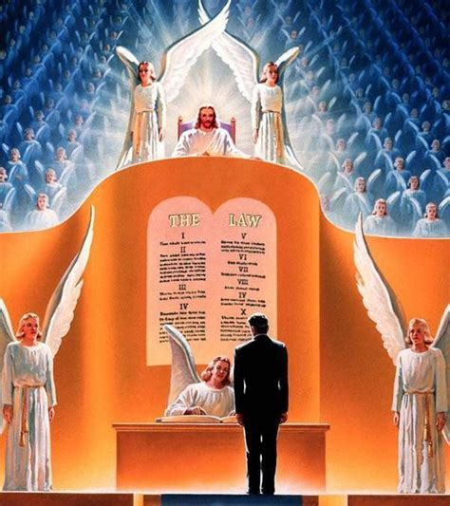
SDA Quarterly, Sunday April 23
The gospel and the judgment, both parts of the first angel’s message, are inseparably intertwined. Were it not for the “everlasting gospel,” we would have no hope in the judgment. In fact, as we will see, the “everlasting gospel” is, indeed, our only hope in the judgment. There is no question that part of the content of the gospel is the announcement of judgment.

Slide 16
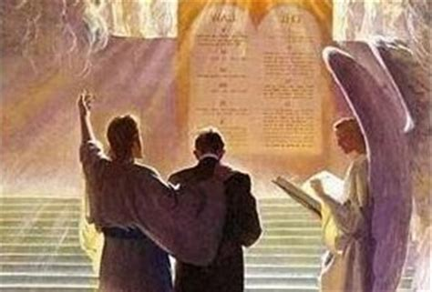
SDA Quarterly, Sunday April 23
During this judgment, the unfallen worlds will see that God has done everything He can to save every human being. This judgment reveals God’s justice and mercy. It says something about His love and law. It speaks of His grace to save and His power to deliver.

Slide 17
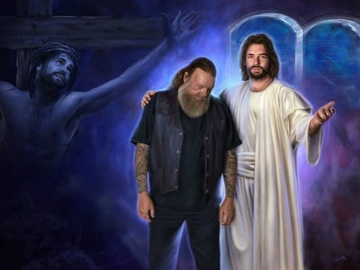
SDA Quarterly, Sunday April 23
The judgment is part of God’s ultimate solution to the sin problem. In the great controversy between good and evil in the universe, God answered Satan’s charges on the cross, but in the judgment, He reveals that He has done everything possible to save us and to lead us to the cross.

Slide 18

Psalm 51:1-19
51 Have mercy upon me, O God, according to thy lovingkindness: according unto the multitude of thy tender mercies blot out my transgressions.
² Wash me throughly from mine iniquity, and cleanse me from my sin.
The Gospel and the Judgment

Slide 19
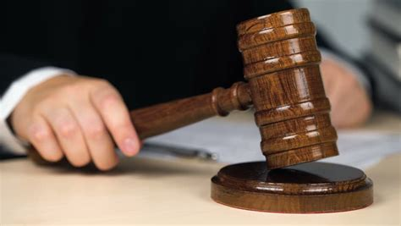
Psalm 51:3-19
³ For I acknowledge my transgressions: and my sin is ever before me.
⁴ Against thee, thee only, have I sinned, and done this evil in thy sight: that thou mightest be justified when thou speakest, and be clear when thou judgest.
The Gospel and the Judgment

Slide 20
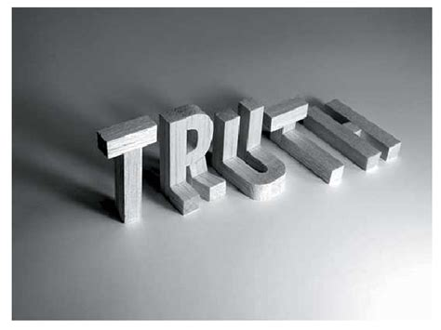
Psalm 51:5-19
⁵ Behold, I was shapen in iniquity; and in sin did my mother conceive me.
⁶ Behold, thou desirest truth in the inward parts: and in the hidden part thou shalt make me to know wisdom.
The Gospel and the Judgment

Slide 21
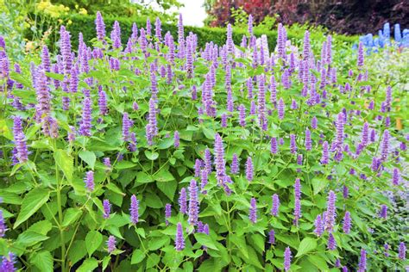
Psalm 51:7-19
⁷ Purge me with hyssop, and I shall be clean: wash me, and I shall be whiter than snow.
⁸ Make me to hear joy and gladness; that the bones which thou hast broken may rejoice.
The Gospel and the Judgment

Slide 22
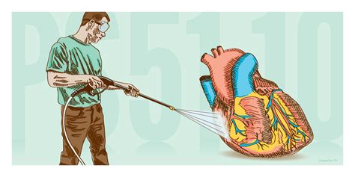
Psalm 51:9-19
⁹ Hide thy face from my sins, and blot out all mine iniquities.
¹⁰ Create in me a clean heart, O God; and renew a right spirit within me.
The Gospel and the Judgment

Slide 23
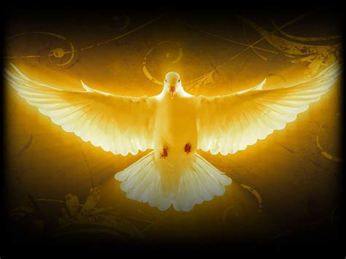
Psalm 51:11-19
¹¹ Cast me not away from thy presence; and take not thy holy spirit from me.
¹² Restore unto me the joy of thy salvation; and uphold me with thy free spirit.
The Gospel and the Judgment

Slide 24

Psalm 51:13-19
¹³ Then will I teach transgressors thy ways; and sinners shall be converted unto thee.
¹⁴ Deliver me from bloodguiltiness, O God, thou God of my salvation: and my tongue shall sing aloud of thy righteousness.
The Gospel and the Judgment

Slide 25

Psalm 51:15-19
¹⁵ O Lord, open thou my lips; and my mouth shall shew forth thy praise.
¹⁶ For thou desirest not sacrifice; else would I give it: thou delightest not in burnt offering.
The Gospel and the Judgment

Slide 26
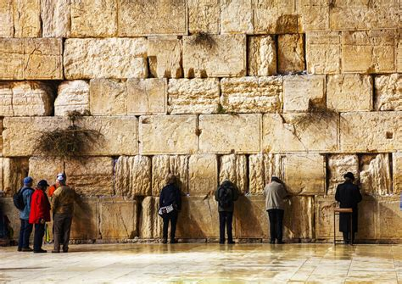
Psalm 51:17-19
¹⁷ The sacrifices of God are a broken spirit: a broken and a contrite heart, O God, thou wilt not despise.
¹⁸ Do good in thy good pleasure unto Zion: build thou the walls of Jerusalem.
The Gospel and the Judgment

Slide 27
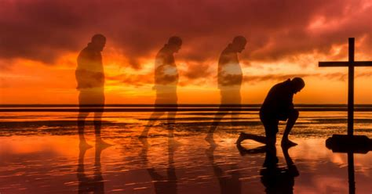
Psalm 51:19
¹⁹ Then shalt thou be pleased with the sacrifices of righteousness, with burnt offering and whole burnt offering: then shall they offer bullocks upon thine altar.
The Gospel and the Judgment

Slide 28
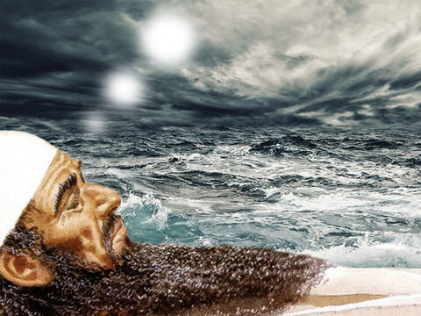
Daniel 7:1-18, 26-27
7 In the first year of Belshazzar king of Babylon Daniel had a dream and visions of his head upon his bed: then he wrote the dream, and told the sum of the matters.

Slide 29
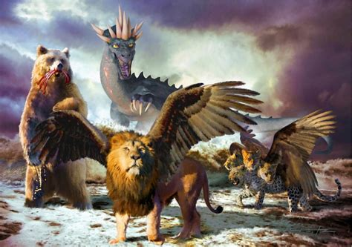
Daniel 7:2-18, 26-27
² Daniel spake and said, I saw in my vision by night, and, behold, the four winds of the heaven strove upon the great sea.
³ And four great beasts came up from the sea, diverse one from another.

Slide 30
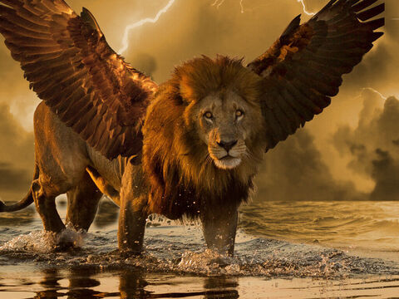
Daniel 7:4-18, 26-27
⁴ The first was like a lion, and had eagle's wings: I beheld till the wings thereof were plucked, and it was lifted up from the earth, and made stand upon the feet as a man, and a man's heart was given to it.

Slide 31
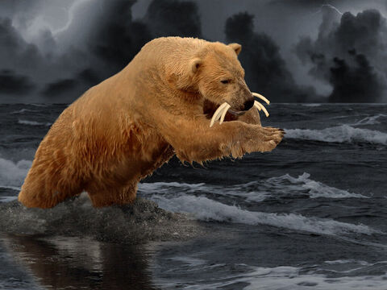
Daniel 7:5-18, 26-27
⁵ And behold another beast, a second, like to a bear, and it raised up itself on one side, and it had three ribs in the mouth of it between the teeth of it: and they said thus unto it, Arise, devour much flesh.

Slide 32
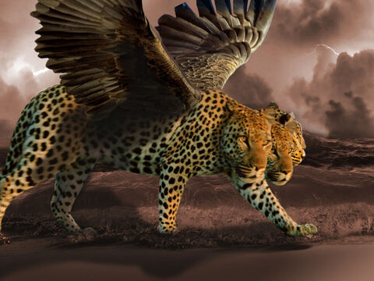
Daniel 7:6-18, 26-27
⁶ After this I beheld, and lo another, like a leopard, which had upon the back of it four wings of a fowl; the beast had also four heads; and dominion was given to it.

Slide 33
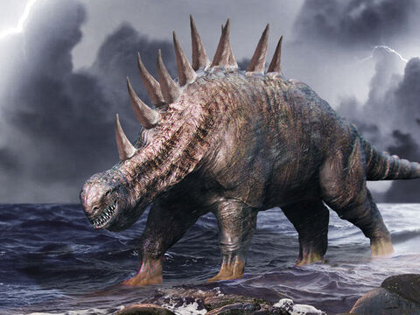
Daniel 7:7-18, 26-27
⁷ After this I saw in the night visions, and behold a fourth beast, dreadful and terrible, and strong exceedingly; and it had great iron teeth: it devoured and brake in pieces, and stamped the residue with the feet of it: and it was diverse from all the beasts that were before it; and it had ten horns.

Slide 34
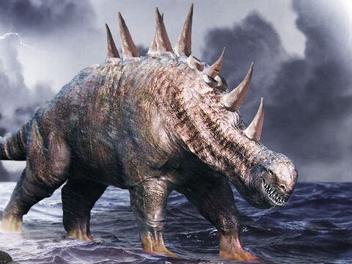
Daniel 7:8-18, 26-27
⁸ I considered the horns, and, behold, there came up among them another little horn, before whom there were three of the first horns plucked up by the roots: and, behold, in this horn were eyes like the eyes of man, and a mouth speaking great things.

Slide 35
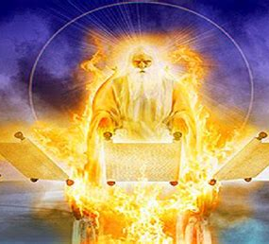
Daniel 7:9-18, 26-27
⁹ I beheld till the thrones were cast down, and the Ancient of days did sit, whose garment was white as snow, and the hair of his head like the pure wool: his throne was like the fiery flame, and his wheels as burning fire.

Slide 36
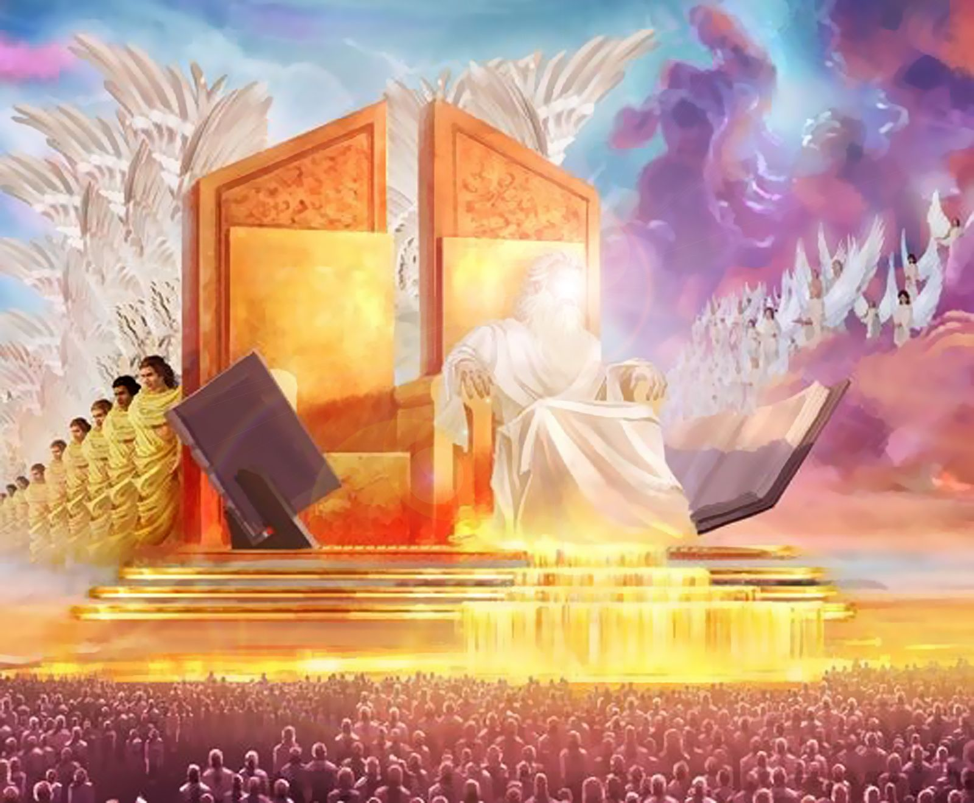
Daniel 7:10-18, 26-27
¹⁰ A fiery stream issued and came forth from before him: thousand thousands ministered unto him, and ten thousand times ten thousand stood before him: the judgment was set, and the books were opened.

Slide 37
The Great Controversy, p. 479
Thus was presented to the prophet's vision the great and solemn day when the characters and the lives of men should pass in review before the Judge of all the earth, and to every man should be rendered “according to his works.” The Ancient of Days is God the Father. Says the psalmist: “Before the mountains were brought forth, or ever Thou hadst formed the earth and the world, even from everlasting to everlasting, Thou art God.” Psalm 90:2. It is He, the source of all being, and the fountain of all law, that is to preside in the judgment. And holy angels as ministers and witnesses, in number “ten thousand times ten thousand, and thousands of thousands,” attend this great tribunal.

Slide 38
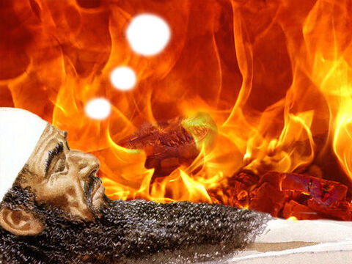
Daniel 7:11-18, 26-27
¹¹ I beheld then because of the voice of the great words which the horn spake: I beheld even till the beast was slain, and his body destroyed, and given to the burning flame.

Slide 39
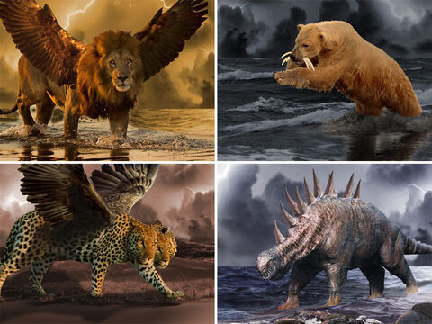
Daniel 7:12-18, 26-27
¹² As concerning the rest of the beasts, they had their dominion taken away: yet their lives were prolonged for a season and time.

Slide 40
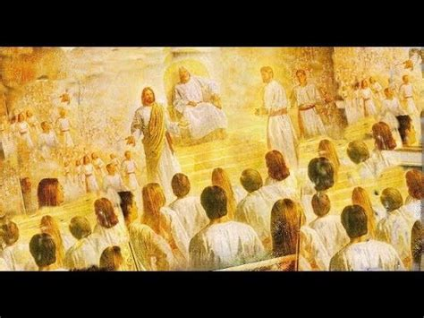
Daniel 7:13-18, 26-27
¹³ I saw in the night visions, and, behold, one like the Son of man came with the clouds of heaven, and came to the Ancient of days, and they brought him near before him.

Slide 41
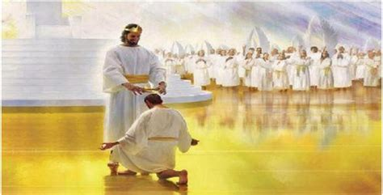
Daniel 7:14-18, 26-27
¹⁴ And there was given him dominion, and glory, and a kingdom, that all people, nations, and languages, should serve him: his dominion is an everlasting dominion, which shall not pass away, and his kingdom that which shall not be destroyed.

Slide 42
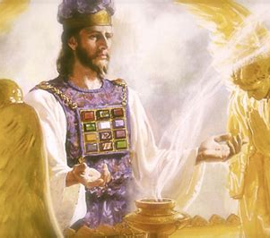
The Great Controversy, p. 479
The coming of Christ here described is not His second coming to the earth. He comes to the Ancient of Days in heaven to receive dominion and glory and a kingdom, which will be given Him at the close of His work as a mediator. It is this coming, and not His second advent to the earth, that was foretold in prophecy to take place at the termination of the 2300 days in 1844.

Slide 43
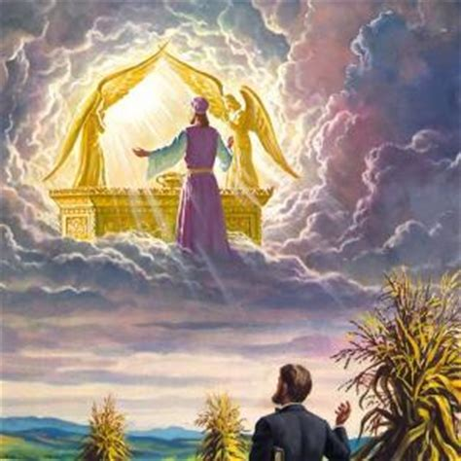
The Great Controversy, p. 479
Attended by heavenly angels, our great High Priest enters the holy of holies and there appears in the presence of God to engage in the last acts of His ministration in behalf of man—to perform the work of investigative judgment and to make an atonement for all who are shown to be entitled to its benefits.

Slide 44
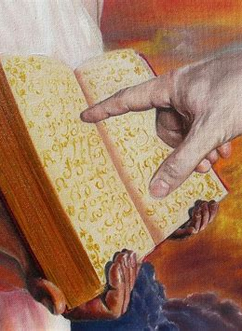
The Great Controversy, p. 480
The books of record in heaven, in which the names and the deeds of men are registered, are to determine the decisions of the judgment. Says the prophet Daniel: “The judgment was set, and the books were opened.” The revelator, describing the same scene, adds: “Another book was opened, which is the book of life: and the dead were judged out of those things which were written in the books, according to their works.” Revelation 20:12.

Slide 45
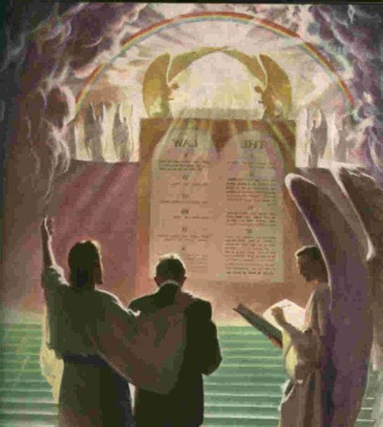
The Great Controversy, p. 483
As the books of record are opened in the judgment, the lives of all who have believed on Jesus come in review before God. Beginning with those who first lived upon the earth, our Advocate presents the cases of each successive generation, and closes with the living.

Slide 46
The Great Controversy, p. 483
Every name is mentioned, every case closely investigated. Names are accepted, names rejected. When any have sins remaining upon the books of record, unrepented of and unforgiven, their names will be blotted out of the book of life, and the record of their good deeds will be erased from the book of God's remembrance.

Slide 47
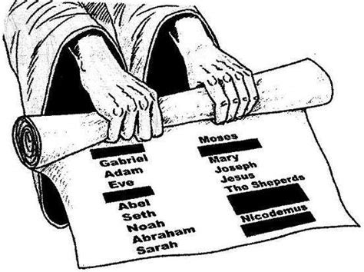
The Great Controversy, p. 483
The Lord declared to Moses: “Whosoever hath sinned against Me, him will I blot out of My book.” Exodus 32:33. And says the prophet Ezekiel: “When the righteous turneth away from his righteousness, and committeth iniquity, ... all his righteousness that he hath done shall not be mentioned.” Ezekiel 18:24.

Slide 48
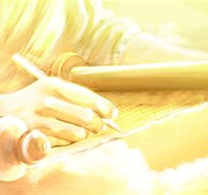
The Great Controversy, p. 483
All who have truly repented of sin, and by faith claimed the blood of Christ as their atoning sacrifice, have had pardon entered against their names in the books of heaven; as they have become partakers of the righteousness of Christ, and their characters are found to be in harmony with the law of God, their sins will be blotted out, and they themselves will be accounted worthy of eternal life.

Slide 49
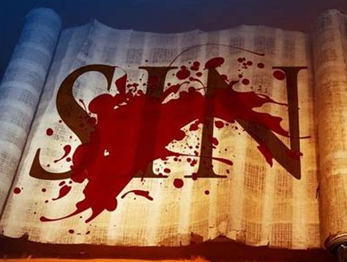
The Great Controversy, p. 483
The Lord declares, by the prophet Isaiah: “I, even I, am He that blotteth out thy transgressions for Mine own sake, and will not remember thy sins.” Isaiah 43:25.

Slide 50
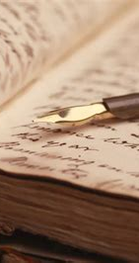
The Great Controversy, p. 483
Said Jesus: “He that overcometh, the same shall be clothed in white raiment; and I will not blot out his name out of the book of life, but I will confess his name before My Father, and before His angels.” “Whosoever therefore shall confess Me before men, him will I confess also before My Father which is in heaven. But whosoever shall deny Me before men, him will I also deny before My Father which is in heaven.” Revelation 3:5; Matthew 10:32, 33.

Slide 51
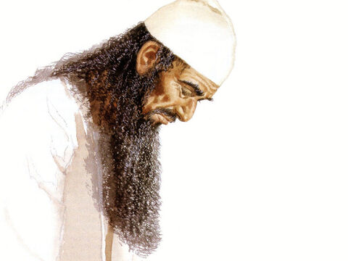
Daniel 7:15-18, 26-27
¹⁵ I Daniel was grieved in my spirit in the midst of my body, and the visions of my head troubled me.

Slide 52
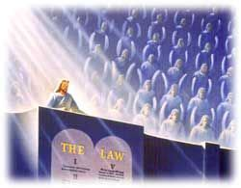
Daniel 7:16-18, 26-27
¹⁶ I came near unto one of them that stood by, and asked him the truth of all this. So he told me, and made me know the interpretation of the things.

Slide 53
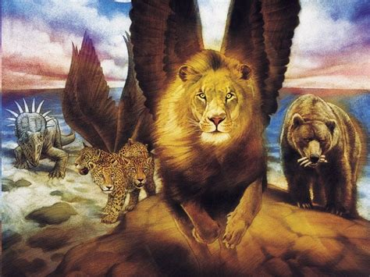
Daniel 7:17-18, 26-27
¹⁷ These great beasts, which are four, are four kings, which shall arise out of the earth.

Slide 54
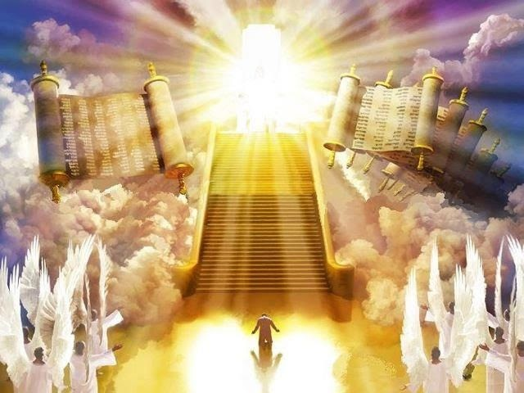
Daniel 7:18, 26-27
¹⁸ But the saints of the most High shall take the kingdom, and possess the kingdom for ever, even for ever and ever.
…

Slide 55
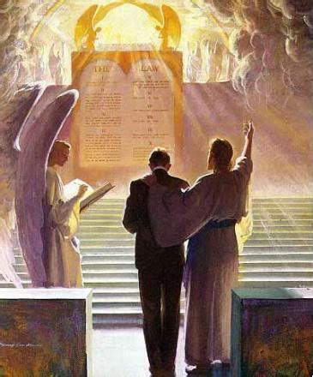
Daniel 7:26-27
…
²⁶ But the judgment shall sit, and they shall take away his dominion, to consume and to destroy it unto the end.

Slide 56
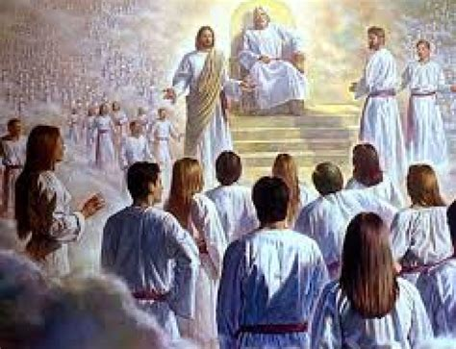
Daniel 7:27
²⁷ And the kingdom and dominion, and the greatness of the kingdom under the whole heaven, shall be given to the people of the saints of the most High, whose kingdom is an everlasting kingdom, and all dominions shall serve and obey him.

Slide 57
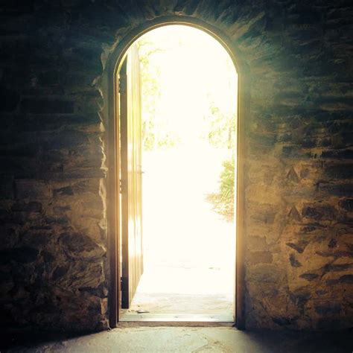
The Throne Room: Revelation 4:1-4
4 After this I looked, and, behold, a door was opened in heaven: and the first voice which I heard was as it were of a trumpet talking with me; which said, Come up hither, and I will shew thee things which must be hereafter.

Slide 58
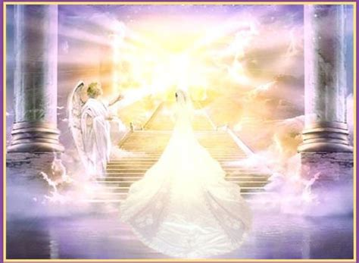
The Throne Room: Revelation 4:2-4
² And immediately I was in the spirit: and, behold, a throne was set in heaven, and one sat on the throne.

Slide 59
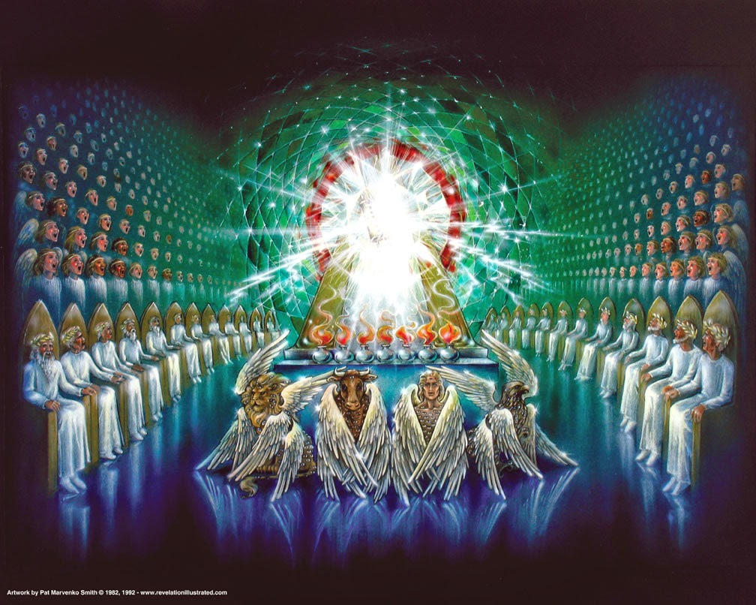
The Throne Room: Revelation 4:3-4
³ And he that sat was to look upon like a jasper and a sardine stone: and there was a rainbow round about the throne, in sight like unto an emerald.

Slide 60
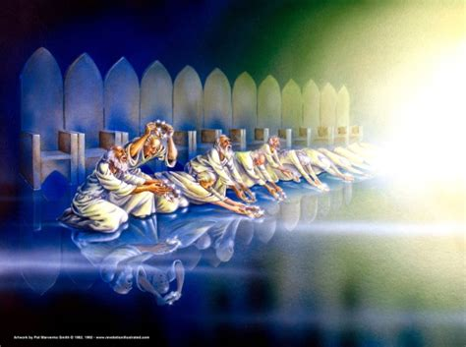
The Throne Room: Revelation 4:4
⁴ And round about the throne were four and twenty seats: and upon the seats I saw four and twenty elders sitting, clothed in white raiment; and they had on their heads crowns of gold.

Slide 61
Testimonies for the Church V. 9, p. 267
The fifth chapter of Revelation needs to be closely studied. It is of great importance to those who shall act a part in the work of God for these last days. There are some who are deceived. They do not realize what is coming on the earth. Those who have permitted their minds to become beclouded in regard to what constitutes sin are fearfully deceived. Unless they make a decided change they will be found wanting when God pronounces judgment upon the children of men. They have transgressed the law and broken the everlasting covenant, and they will receive according to their works.

Slide 62
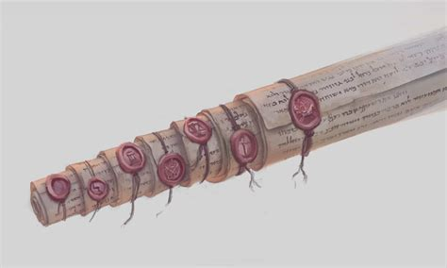
Revelation 5:1-14
5 And I saw in the right hand of him that sat on the throne a book written within and on the backside, sealed with seven seals.

Slide 63
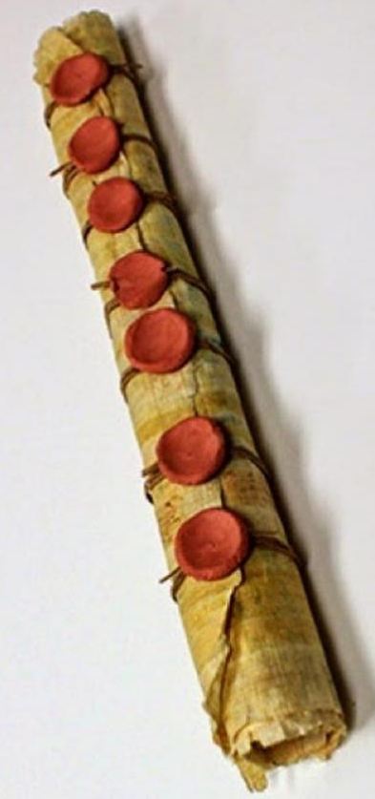
Christ’s Object Lessons p. 294
Shall I crucify your King?” Pilate asked, and from the priests and rulers came the answer, “We have no king but Caesar.” … Thus the Jewish leaders made their choice. Their decision was registered in the book which John saw in the hand of Him that sat upon the throne, the book which no man could open. In all its vindictiveness this decision will appear before them in the day when this book is unsealed by the Lion of the tribe of Judah.

Slide 64
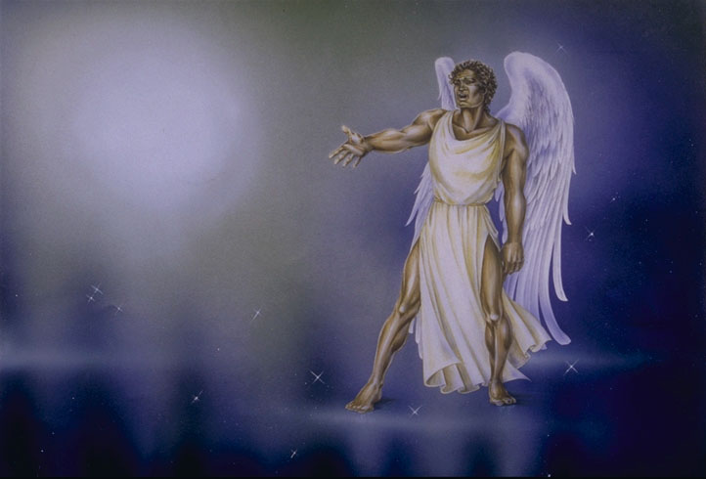
Revelation 5:2-14
² And I saw a strong angel proclaiming with a loud voice, Who is worthy to open the book, and to loose the seals thereof?

Slide 65
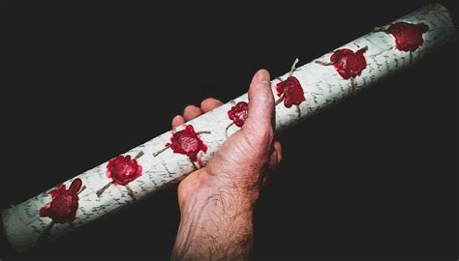
Revelation 5:3-14
³ And no man in heaven, nor in earth, neither under the earth, was able to open the book, neither to look thereon.

Slide 66
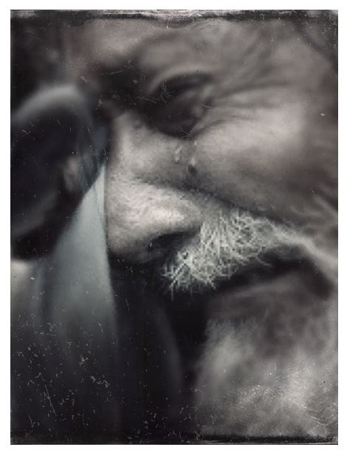
Revelation 5:4-14
⁴ And I wept much, because no man was found worthy to open and to read the book, neither to look thereon.

Slide 67

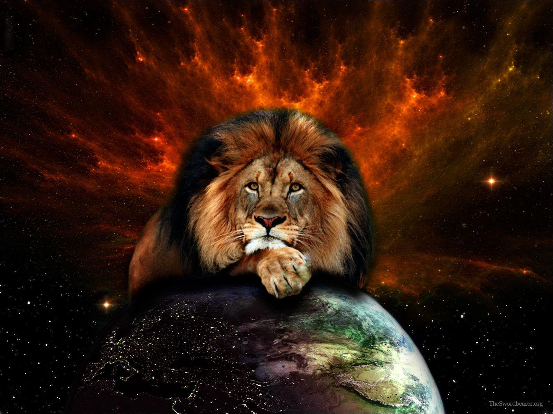
Revelation 5:5-14
Christ has prevailed! This points directly to Christ’s victory in the great controversy with Satan, which is the basis of His right to open the book. Inasmuch as no one else in the entire universe could do this, His victory is unique. An angel could not have taken Christ’s place, for the basic issue in the great controversy is the integrity of the character of God, which is expressed in His law. Neither angel nor man could have accomplished this vindication, for they themselves are subject to the law. Only Christ, who is God, and of whose character the law is an expression, could achieve such a vindication of the divine character. -SDABC V. 7 p. 771
⁵ And one of the elders saith unto me, Weep not: behold, the Lion of the tribe of Judah, the Root of David, hath prevailed to open the book, and to loose the seven seals thereof.

Slide 68
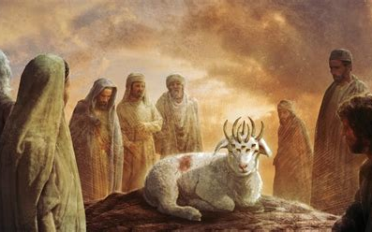
Revelation 5:6-14
Seven is a number signifying perfection. Horns may be understood as symbols of strength and glory. Thus the seven horns of the Lamb would indicate that He is perfect in strength. Eyes are a symbol of perfect wisdom and intelligence. These eyes are identified as the seven Spirits of God, an expression used for the Holy Spirit. In ch. 4:5 a different symbol, “seven lamps,” is used. -SDABC V. 7 p. 772
⁶ And I beheld, and, lo, in the midst of the throne and of the four beasts, and in the midst of the elders, stood a Lamb as it had been slain, having seven horns and seven eyes, which are the seven Spirits of God sent forth into all the earth.

Slide 69
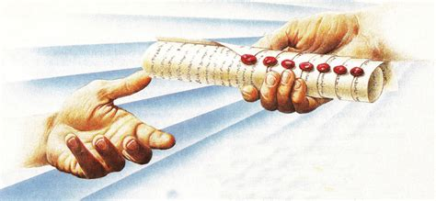
Revelation 5:7-14
⁷ And he came and took the book out of the right hand of him that sat upon the throne.

Slide 70
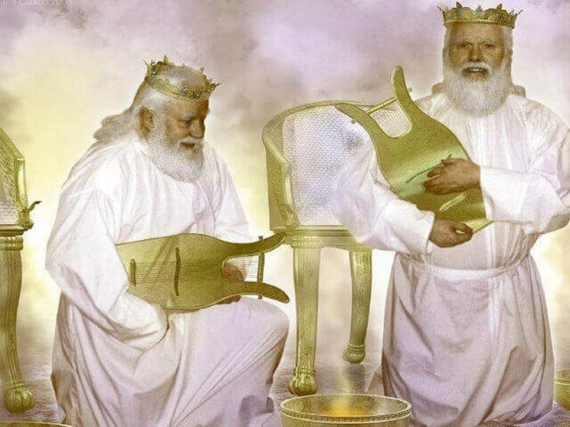
Revelation 5:8-14
⁸ And when he had taken the book, the four beasts and four and twenty elders fell down before the Lamb, having every one of them harps, and golden vials full of odours, which are the prayers of saints.

Slide 71

Revelation 5:9-14
⁹ And they sung a new song, saying, Thou art worthy to take the book, and to open the seals thereof: for thou wast slain, and hast redeemed us to God by thy blood out of every kindred, and tongue, and people, and nation;

Slide 72

Revelation 5:10-14
¹⁰ And hast made us unto our God kings and priests: and we shall reign on the earth.

Slide 73

Revelation 5:11-14
¹¹ And I beheld, and I heard the voice of many angels round about the throne and the beasts and the elders: and the number of them was ten thousand times ten thousand, and thousands of thousands;

Slide 74

Revelation 5:12-14
In response to the testimony of the 4 beasts and the 24 elders, the hosts of heaven join in acclaiming the worthiness of the Lamb. Thus God is vindicated before the angels, who, since the first accusations of Satan in heaven, have not fully understood His action in banishing Satan and saving men.
-SDABC V. 7 p. 773
¹² Saying with a loud voice, Worthy is the Lamb that was slain to receive power, and riches, and wisdom, and strength, and honour, and glory, and blessing.

Slide 75

Revelation 5:13-14
¹³ And every creature which is in heaven, and on the earth, and under the earth, and such as are in the sea, and all that are in them, heard I saying, Blessing, and honour, and glory, and power, be unto him that sitteth upon the throne, and unto the Lamb for ever and ever.
Every creature, that is, every created being. The chorus swells, and in response to the cries of praise from the hosts of heaven, all creation joins in adoration of the Father and the Son. Christ is victor, and the character of God is vindicated before the whole universe.
-SDABC V. 7 p. 773

Slide 76

Revelation 5:14
¹⁴ And the four beasts said, Amen. And the four and twenty elders fell down and worshipped him that liveth for ever and ever.

Slide 77

The Desire of Ages, p. 25
Christ was treated as we deserve, that we might be treated as He deserves. He was condemned for our sins, in which He had no share, that we might be justified by His righteousness, in which we had no share. He suffered the death which was ours, that we might receive the life which was His. “With His stripes we are healed.”

Slide 78

The Great Controversy, p. 489
“He that covereth his sins shall not prosper: but whoso confesseth and forsaketh them shall have mercy.” Proverbs 28:13. If those who hide and excuse their faults could see how Satan exults over them, how he taunts Christ and holy angels with their course, they would make haste to confess their sins and to put them away.

Slide 79

The Great Controversy, p. 489
Through defects in the character, Satan works to gain control of the whole mind, and he knows that if these defects are cherished, he will succeed. Therefore he is constantly seeking to deceive the followers of Christ with his fatal sophistry that it is impossible for them to overcome.

Slide 80

The Great Controversy, p. 489
But Jesus pleads in their behalf His wounded hands, His bruised body; and He declares to all who would follow Him: “My grace is sufficient for thee.” 2 Corinthians 12:9. “Take My yoke upon you, and learn of Me; for I am meek and lowly in heart: and ye shall find rest unto your souls. For My yoke is easy, and My burden is light.” Matthew 11:29, 30. Let none, then, regard their defects as incurable. God will give faith and grace to overcome them.

Slide 81

Testimonies for the Church V.5, p. 472-3
Those who will be true to God and to duty will be menaced, denounced, and proscribed. They will “be betrayed both by parents, and brethren, and kinsfolks, and friends.” Their only hope is in the mercy of God; their only defense will be prayer.

Slide 82

Testimonies for the Church V.5, p. 472-3
As Joshua was pleading before the Angel, so the remnant church, with brokenness of heart and earnest faith, will plead for pardon and deliverance through Jesus their Advocate. They are fully conscious of the sinfulness of their lives, they see their weakness and unworthiness, and as they look upon themselves they are ready to despair.

Slide 83

Testimonies for the Church V.5, p. 473-4
The tempter stands by to accuse them, as he stood by to resist Joshua. He points to their filthy garments, their defective characters. He presents their weakness and folly, their sins of ingratitude, their unlikeness to Christ, which has dishonored their Redeemer. …

Slide 84

Testimonies for the Church V.5, p. 473-4
The people of God have been in many respects very faulty. Satan has an accurate knowledge of the sins which he has tempted them to commit, and he presents these in the most exaggerated light, declaring: ‘Will God banish me and my angels from His presence, and yet reward those who have been guilty of the same sins? Thou canst not do this, O Lord, in justice.

Slide 85
Testimonies for the Church V.5, p. 474
Thy throne will not stand in righteousness and judgment. Justice demands that sentence be pronounced against them.’
But while the followers of Christ have sinned, they have not given themselves to the control of evil. They have put away their sins, and have sought the Lord in humility and contrition, and the divine Advocate pleads in their behalf. He who has been most abused by their ingratitude, who knows their sin, and also their repentance, declares: ‘The Lord rebuke thee, O Satan. I gave My life for these souls. They are graven upon the palms of My hands.’

Slide 86

The Desire of Ages, p. 25
By His life and His death, Christ has achieved even more than recovery from the ruin wrought through sin. It was Satan's purpose to bring about an eternal separation between God and man; but in Christ we become more closely united to God than if we had never fallen.

Slide 87

The Desire of Ages, p. 25
In taking our nature, the Saviour has bound Himself to humanity by a tie that is never to be broken. Through the eternal ages He is linked with us. “God so loved the world, that He gave His only-begotten Son.” John 3:16. He gave Him not only to bear our sins, and to die as our sacrifice; He gave Him to the fallen race.

Slide 88
The Desire of Ages, p. 25
To assure us of His immutable counsel of peace, God gave His only-begotten Son to become one of the human family, forever to retain His human nature. This is the pledge that God will fulfill His word. “Unto us a child is born, unto us a son is given: and the government shall be upon His shoulder.” God has adopted human nature in the person of His Son, and has carried the same into the highest heaven. It is the “Son of man” who shares the throne of the universe. It is the “Son of man” whose name shall be called, “Wonderful, Counselor, The mighty God, The everlasting Father, The Prince of Peace.” Isaiah 9:6.

Slide 89
The Desire of Ages, p. 25
The word “daysman” here is probably a reference to Job 9, where Job is speaking of his relationship to God:
³² For he is not a man, as I am, that I should answer him, and we should come together in judgment.
³³ Neither is there any daysman betwixt us, that might lay his hand upon us both.
In his argument with God, Job feels that there is no one to whom he can look as an arbiter. Daysman, then, might be rendered as “arbiter” or “mediator.” The Desire of Ages tells us that Christ has become the arbiter between fallen humanity and our just God.
The I AM is the Daysman between God and humanity, laying His hand upon both. He who is “holy, harmless, undefiled, separate from sinners,” is not ashamed to call us brethren. Hebrews 7:26; 2:11. In Christ the family of earth and the family of heaven are bound together. Christ glorified is our brother. Heaven is enshrined in humanity, and humanity is enfolded in the bosom of Infinite Love.

Slide 90

The Desire of Ages, p. 25
The I AM is the Daysman between God and humanity, laying His hand upon both. He who is “holy, harmless, undefiled, separate from sinners,” is not ashamed to call us brethren. Hebrews 7:26; 2:11. In Christ the family of earth and the family of heaven are bound together. Christ glorified is our brother. Heaven is enshrined in humanity, and humanity is enfolded in the bosom of Infinite Love.

Slide 91
Thank you!
… and Happy Sabbath!!

