Slide 1
The Hour of His Judgment
Revelation 14:7
Daniel 8&9, Ezra 7, and much, much more
Lesson 6, 2nd Quarter 2023

Slide 2
Memory Text: Romans 13:11-12
¹¹ And that, knowing the time, that now it is high time to awake out of sleep: for now is our salvation nearer than when we believed.
¹² The night is far spent, the day is at hand: let us therefore cast off the works of darkness, and let us put on the armour of light.

Slide 3
Revelation 14:6-7
⁶ And I saw another angel fly in the midst of heaven, having the everlasting gospel to preach unto them that dwell on the earth, and to every nation, and kindred, and tongue, and people,
⁷ Saying with a loud voice, Fear God, and give glory to him; for the hour of his judgment is come: and worship him that made heaven, and earth, and the sea, and the fountains of waters.

Slide 4
The Investigative Judgment: Objectors
After the great disappointment of 1844, a small band of Adventists, unable to deny the presence of God in the Millerite movement, came to the conclusion that, instead of the Second Coming, God had begun what they termed the “Investigative Judgment,” now also known as the Pre-Advent Judgment, as distinct from the Final Judgment.

Slide 5
The Investigative Judgment: Objectors
Throughout the last hundred and seventy years critics from both within and outside the Seventh-day Adventist Church, have questioned the validity of this Investigative Judgment doctrine. And they still raise objections like the following:

Slide 6
The Investigative Judgment: Objectors
The Investigative Judgment is nothing more than a feeble face-saving attempt to address the mistake of 1844.
It is an extra-biblical doctrine invented entirely by Ellen White.
It cheapens the Reformation gospel of salvation by grace through faith.

Slide 7
The Investigative Judgment: Objectors
It robs Adventists of the assurance of salvation and causes them to live in constant fear.
No other denomination has seen any value in this doctrine, and hence all have rejected it.

Slide 8
The Investigative Judgment: Objectors
A good number of Adventist ministers and theologians secretly believe the doctrine to be false but are afraid to admit it.
Supporting evidence is often hard to understand, convoluted, contradictory, very technical, highly debatable, inaccessible, or nonexistent.

Slide 9
The Investigative Judgment: Objectors
There are certainly a number of involved linguistic and contextual arguments regarding Daniel 8:14, a major text about the investigative judgment. With such multitudinous and varied arguments against the doctrine of the investigative judgment, it seems the case is closed! Fortunately, many of these objections are readily addressed.

Slide 10
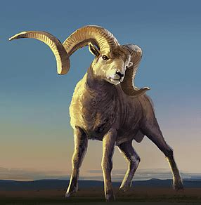
The Investigative Judgment: Daniel 8:3-27
³ Then I lifted up mine eyes, and saw, and, behold, there stood before the river a ram which had two horns: and the two horns were high; but one was higher than the other, and the higher came up last.

Slide 11
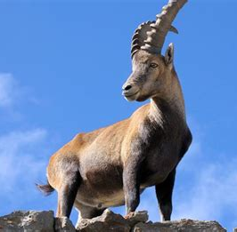
The Investigative Judgment: Daniel 8:4-27
⁴ I saw the ram pushing westward, and northward, and southward; so that no beasts might stand before him, neither was there any that could deliver out of his hand; but he did according to his will, and became great.

Slide 12
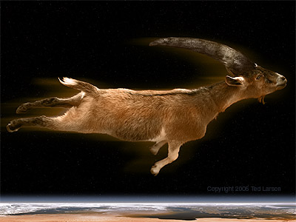
The Investigative Judgment: Daniel 8:5-27
⁵ And as I was considering, behold, an he goat came from the west on the face of the whole earth, and touched not the ground: and the goat had a notable horn between his eyes.

Slide 13
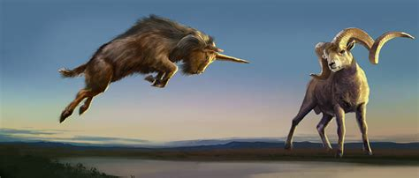
The Investigative Judgment: Daniel 8:6-27
⁶ And he came to the ram that had two horns, which I had seen standing before the river, and ran unto him in the fury of his power.

Slide 14
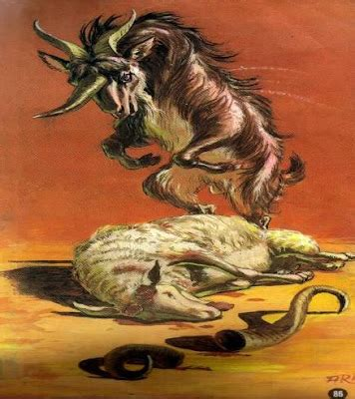
The Investigative Judgment: Daniel 8:7-27
⁷ And I saw him come close unto the ram, and he was moved with choler against him, and smote the ram, and brake his two horns: and there was no power in the ram to stand before him, but he cast him down to the ground, and stamped upon him: and there was none that could deliver the ram out of his hand.

Slide 15
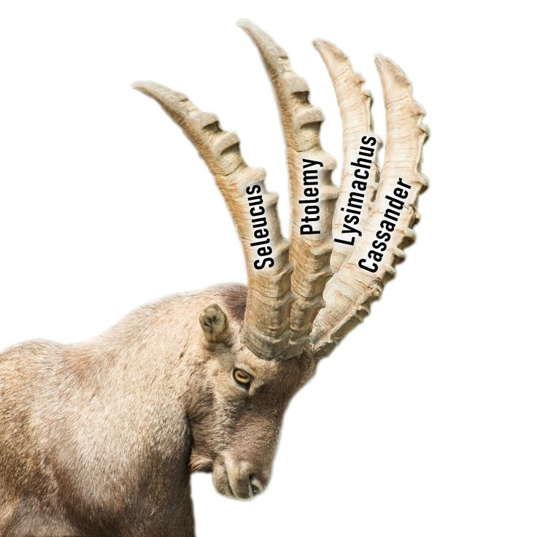
The Investigative Judgment: Daniel 8:8-27
⁸ Therefore the he goat waxed very great: and when he was strong, the great horn was broken; and for it came up four notable ones toward the four winds of heaven.

Slide 16
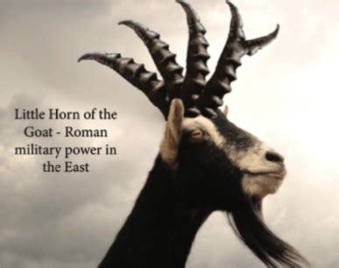
The Investigative Judgment: Daniel 8:9-27
⁹ And out of one of them came forth a little horn, which waxed exceeding great, toward the south, and toward the east, and toward the pleasant land.

Slide 17
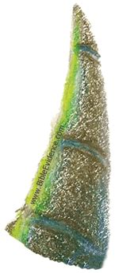
The Investigative Judgment: Daniel 8:10-27
¹⁰ And it waxed great, even to the host of heaven; and it cast down some of the host and of the stars to the ground, and stamped upon them.

Slide 18
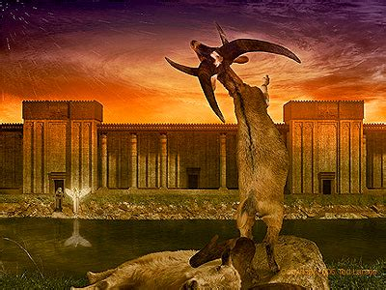
The Investigative Judgment: Daniel 8:11-27
¹¹ Yea, he magnified himself even to the prince of the host, and by him the daily sacrifice was taken away, and the place of the sanctuary was cast down.

Slide 19
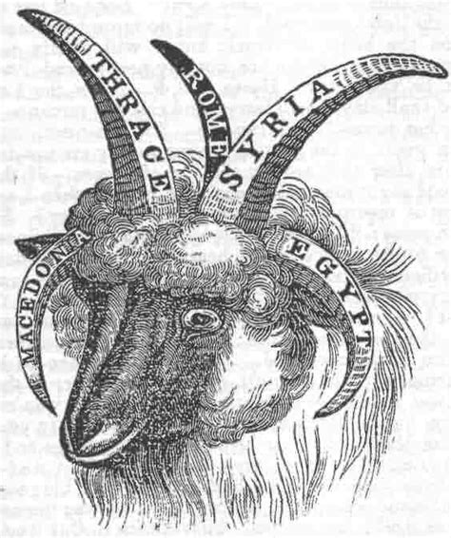
The Investigative Judgment: Daniel 8:12-27
¹² And an host was given him against the daily sacrifice by reason of transgression, and it cast down the truth to the ground; and it practised, and prospered.

Slide 20
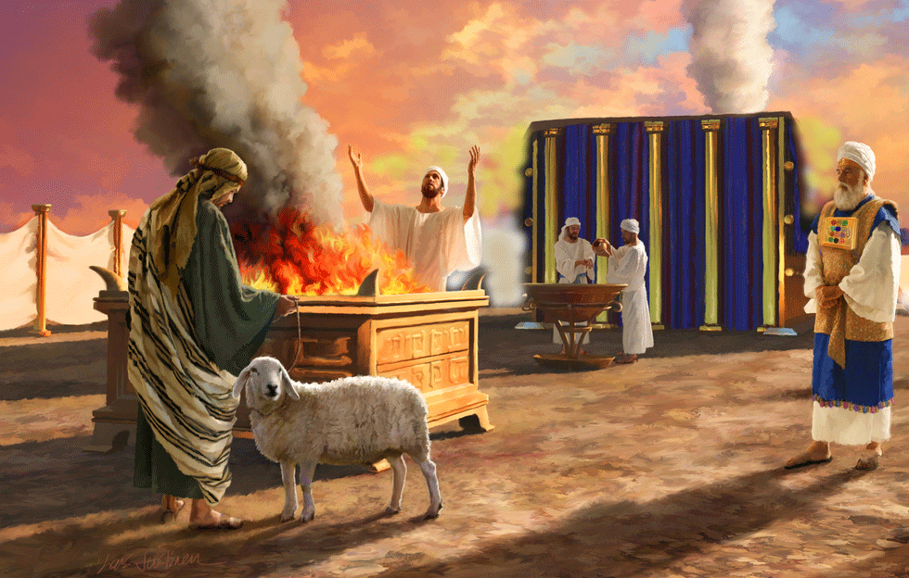
The Investigative Judgment: Daniel 8:13-27
¹³ Then I heard one saint speaking, and another saint said unto that certain saint which spake, How long shall be the vision concerning the daily sacrifice, and the transgression of desolation, to give both the sanctuary and the host to be trodden under foot?

Slide 21

The Investigative Judgment: Daniel 8:14-27
¹⁴ And he said unto me, Unto two thousand and three hundred days; then shall the sanctuary be cleansed.

Slide 22
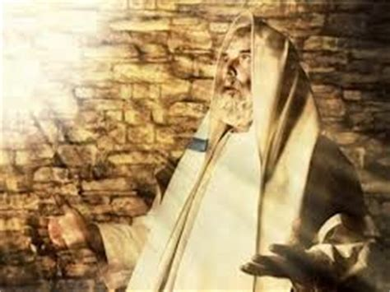
The Investigative Judgment: Daniel 8:15-27
¹⁵ And it came to pass, when I, even I Daniel, had seen the vision, and sought for the meaning, then, behold, there stood before me as the appearance of a man.

Slide 23
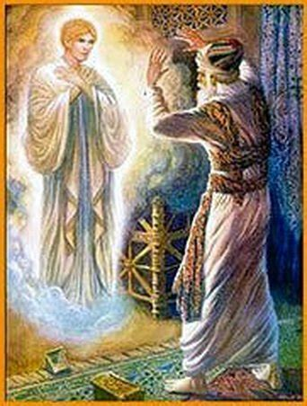
The Investigative Judgment: Daniel 8:16-27
¹⁶ And I heard a man's voice between the banks of Ulai, which called, and said, Gabriel, make this man to understand the vision.

Slide 24
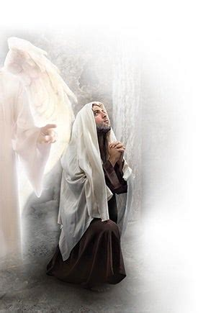
The Investigative Judgment: Daniel 8:17-27
¹⁷ So he came near where I stood: and when he came, I was afraid, and fell upon my face: but he said unto me, Understand, O son of man: for at the time of the end shall be the vision.

Slide 25
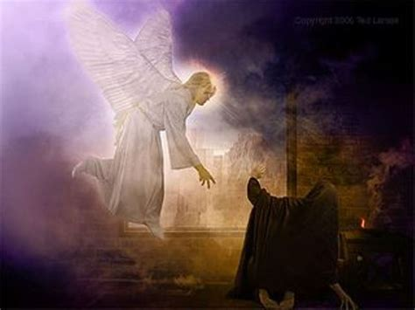
The Investigative Judgment: Daniel 8:18-27
¹⁸ Now as he was speaking with me, I was in a deep sleep on my face toward the ground: but he touched me, and set me upright.

Slide 26
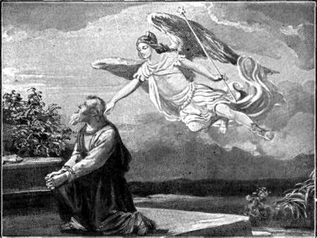
The Investigative Judgment: Daniel 8:19-27
¹⁹ And he said, Behold, I will make thee know what shall be in the last end of the indignation: for at the time appointed the end shall be.

Slide 27
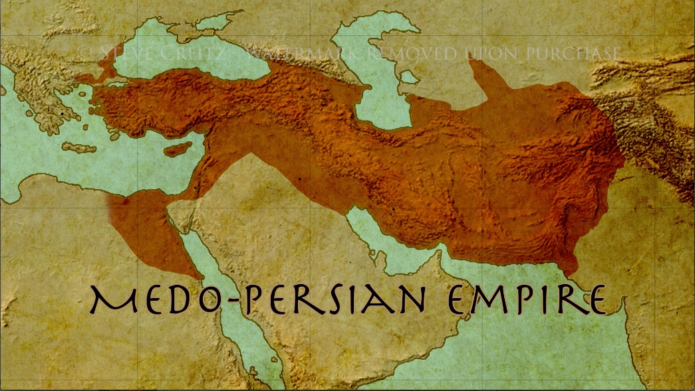
The Investigative Judgment: Daniel 8:20-27
²⁰ The ram which thou sawest having two horns are the kings of Media and Persia.

Slide 28
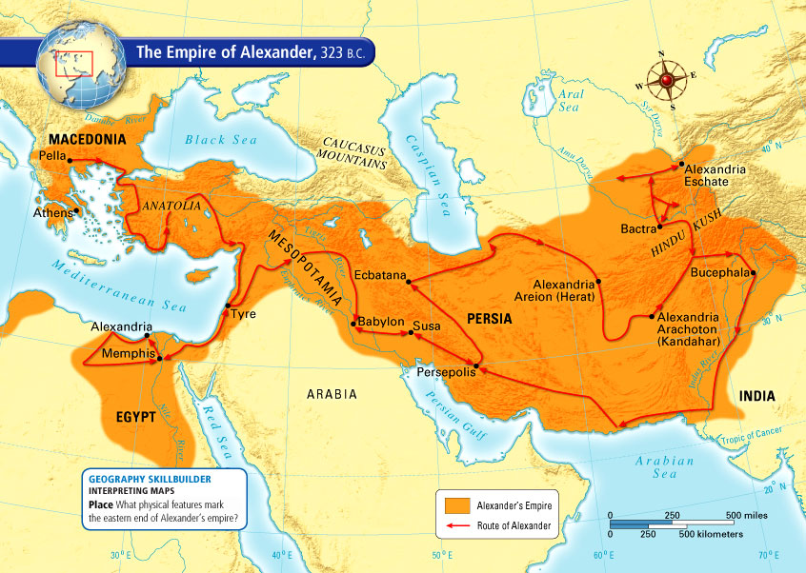
The Investigative Judgment: Daniel 8:21-27
²¹ And the rough goat is the king of Grecia: and the great horn that is between his eyes is the first king.

Slide 29
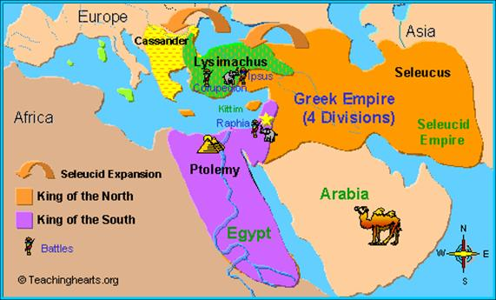
The Investigative Judgment: Daniel 8:22-27
²² Now that being broken, whereas four stood up for it, four kingdoms shall stand up out of the nation, but not in his power.

Slide 30
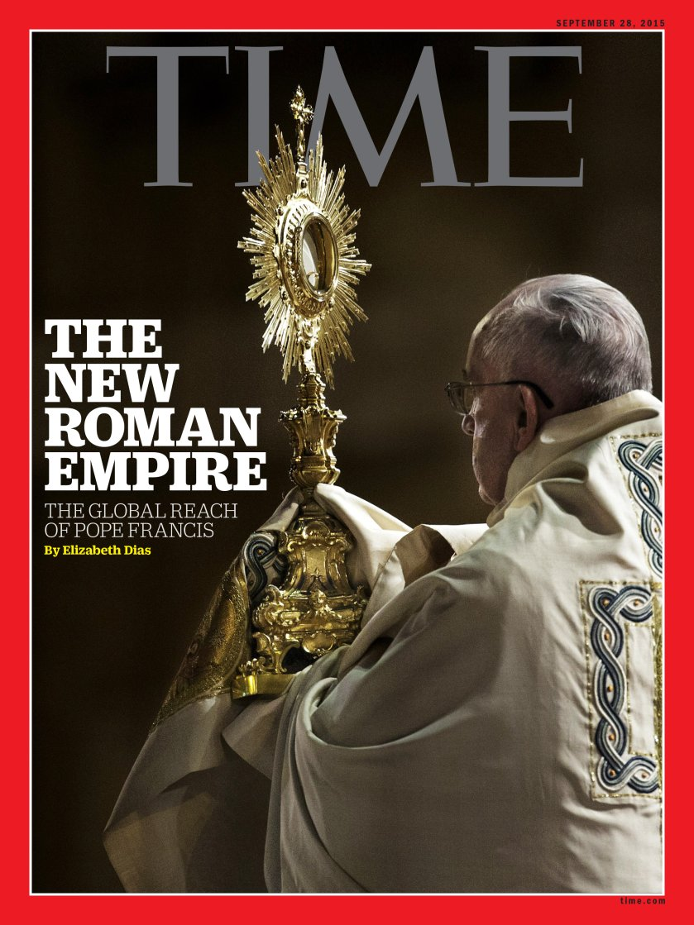
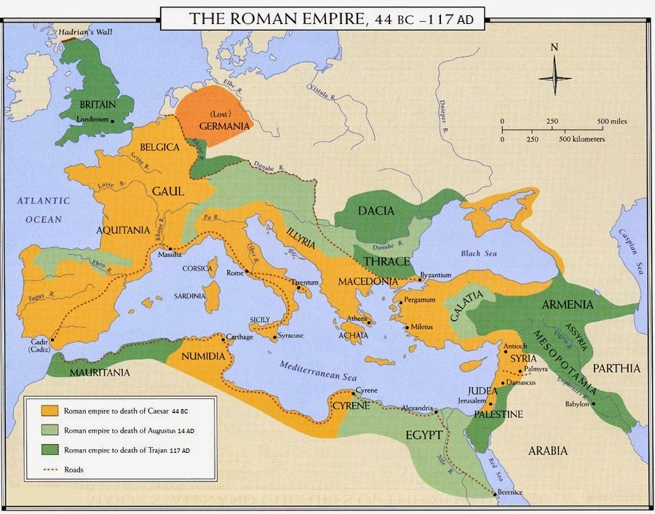
The Investigative Judgment: Daniel 8:23-27
²³ And in the latter time of their kingdom, when the transgressors are come to the full, a king of fierce countenance, and understanding dark sentences, shall stand up.

Slide 31
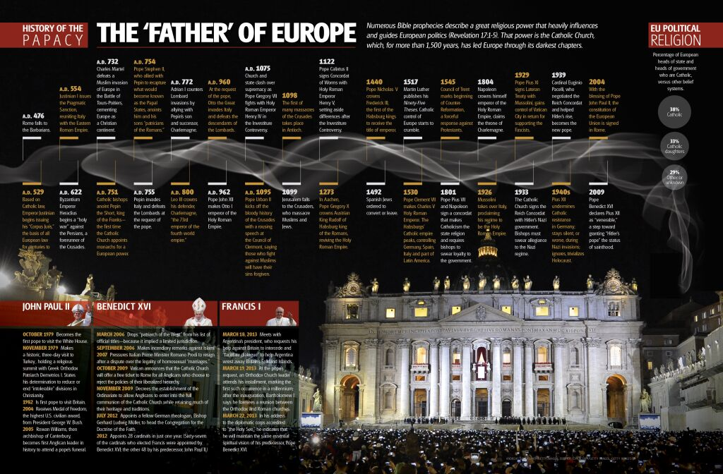
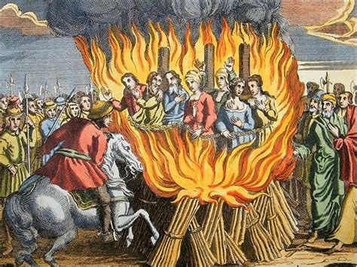
The Investigative Judgment: Daniel 8:24-27
²⁴ And his power shall be mighty, but not by his own power: and he shall destroy wonderfully, and shall prosper, and practise, and shall destroy the mighty and the holy people.

Slide 32
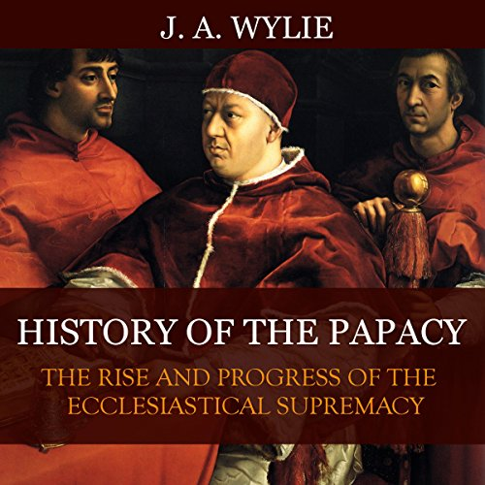
The Investigative Judgment: Daniel 8:25-27
²⁵ And through his policy also he shall cause craft to prosper in his hand; and he shall magnify himself in his heart, and by peace shall destroy many: he shall also stand up against the Prince of princes; but he shall be broken without hand.

Slide 33

The Investigative Judgment: Daniel 8:26-27
²⁶ And the vision of the evening and the morning which was told is true: wherefore shut thou up the vision; for it shall be for many days.

Slide 34
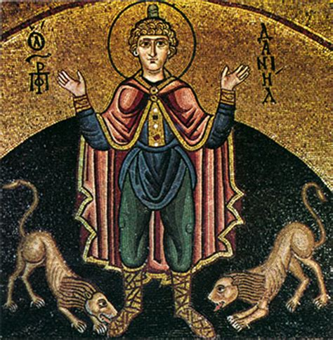
The Investigative Judgment: Daniel 8:27
²⁷ And I Daniel fainted, and was sick certain days; afterward I rose up, and did the king's business; and I was astonished at the vision, but none understood it.

Slide 35
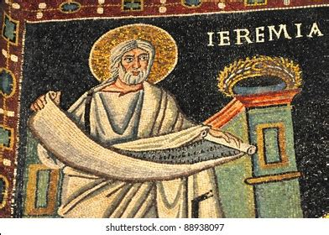
The Investigative Judgment: Daniel 9:2-3
² In the first year of his reign I Daniel understood by books the number of the years, whereof the word of the Lord came to Jeremiah the prophet, that he would accomplish seventy years in the desolations of Jerusalem.

Slide 36
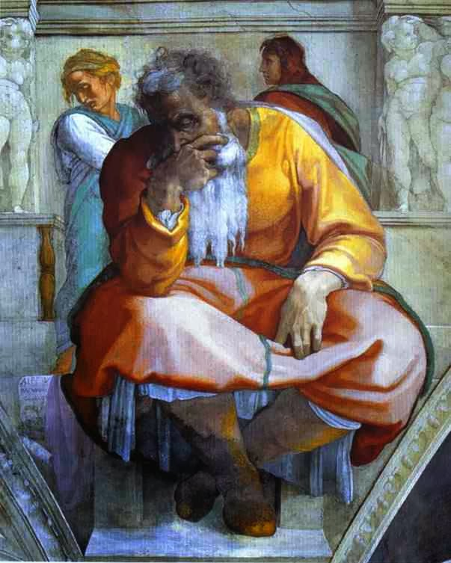
The Investigative Judgment: Daniel 9:3
³ And I set my face unto the Lord God, to seek by prayer and supplications, with fasting, and sackcloth, and ashes:

Slide 37

The Investigative Judgment: SDABC V.4 p.849
Little wonder that Daniel’s attention was focused upon the time prophecy. He was anxious lest the Lord should delay the liberation of His captive people. Although the Lord had promised deliverance to His people at the time appointed, Daniel knew of the conditional nature of many of God’s promises. He may have feared that the impenitence of his people might postpone the fulfillment of the promise. Moreover, the vision of Dan. 8 had predicted further desolation for the sanctuary and the city. His lack of understanding of “the vision of the evening and the morning” (v. 26) must have left him in deep perplexity.

Slide 38
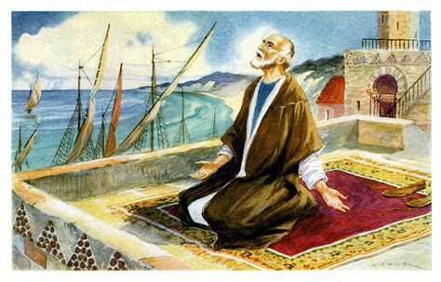
The Investigative Judgment: Daniel 9:20-27
²⁰ And whiles I was speaking, and praying, and confessing my sin and the sin of my people Israel, and presenting my supplication before the Lord my God for the holy mountain of my God;

Slide 39
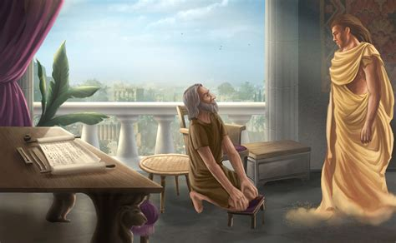
The Investigative Judgment: Daniel 9:21-27
²¹ Yea, whiles I was speaking in prayer, even the man Gabriel, whom I had seen in the vision at the beginning, being caused to fly swiftly, touched me about the time of the evening oblation.

Slide 40
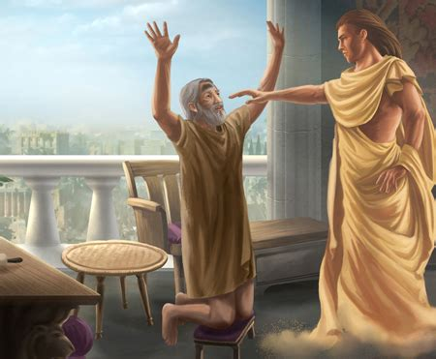
The Investigative Judgment: Daniel 9:22-27
²² And he informed me, and talked with me, and said, O Daniel, I am now come forth to give thee skill and understanding.

Slide 41
The Investigative Judgment: Daniel 9:23-27
²³ At the beginning of thy supplications the commandment came forth, and I am come to shew thee; for thou art greatly beloved: therefore understand the matter, and consider the vision.

Slide 42

The Investigative Judgment: Daniel 9:24-27
²⁴ Seventy weeks are determined upon thy people and upon thy holy city, to finish the transgression, and to make an end of sins, and to make reconciliation for iniquity, and to bring in everlasting righteousness, and to seal up the vision and prophecy, and to anoint the most Holy.

Slide 43
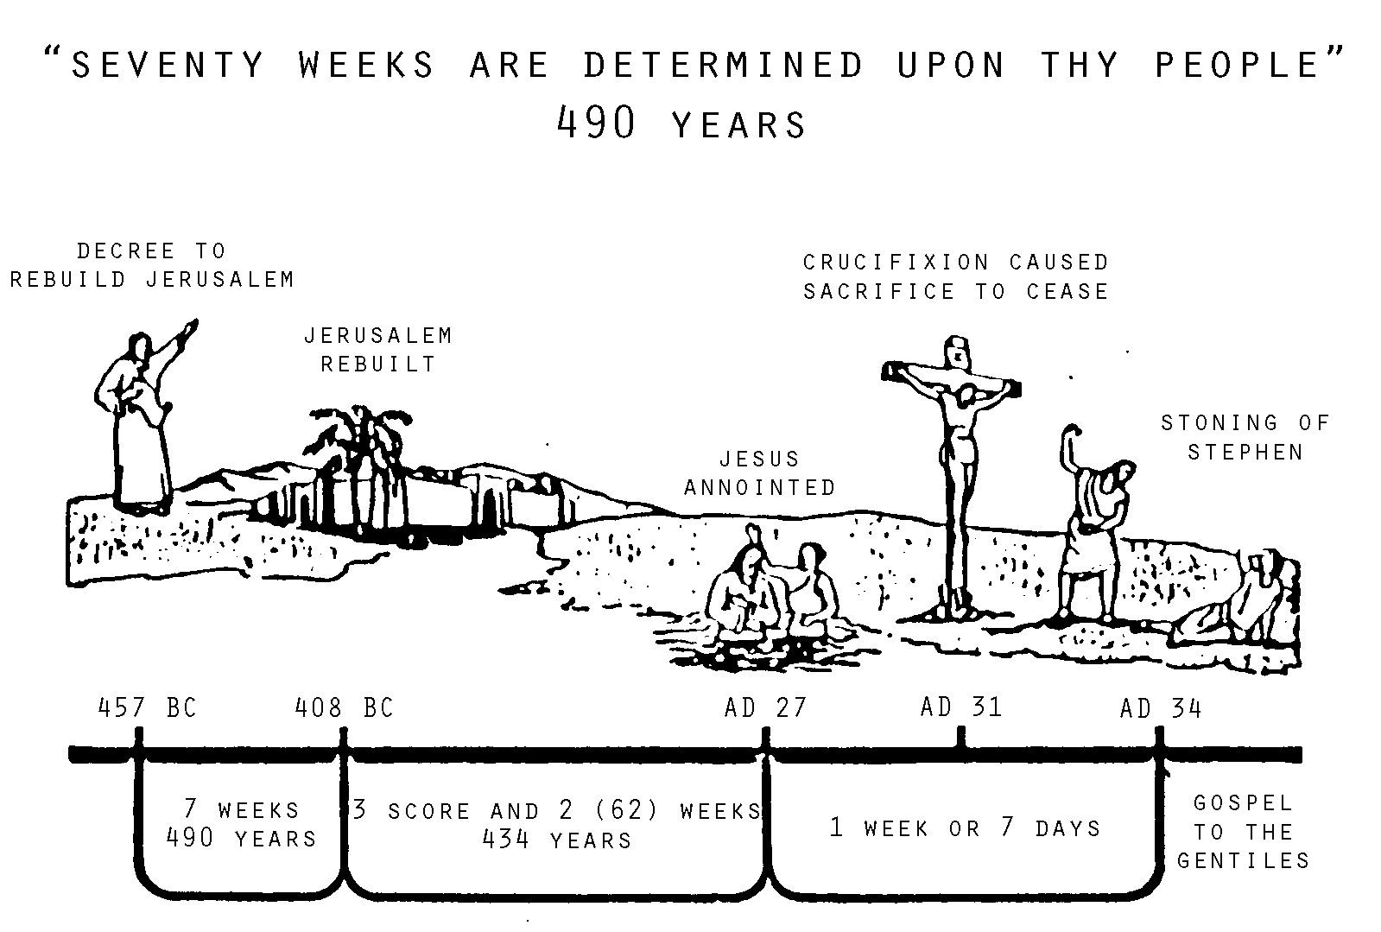
The Investigative Judgment: Daniel 9:25-27
²⁵ Know therefore and understand, that from the going forth of the commandment to restore and to build Jerusalem unto the Messiah the Prince shall be seven weeks, and threescore and two weeks: the street shall be built again, and the wall, even in troublous times.
YEARS

Slide 44
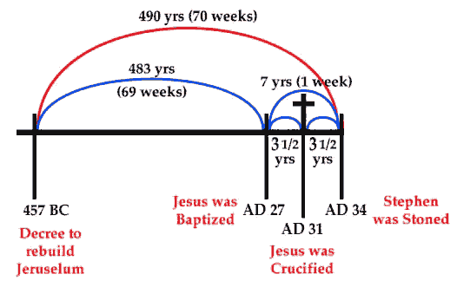
The Investigative Judgment: Daniel 9:26-27
²⁶ And after threescore and two weeks shall Messiah be cut off, but not for himself: and the people of the prince that shall come shall destroy the city and the sanctuary; and the end thereof shall be with a flood, and unto the end of the war desolations are determined.

Slide 45
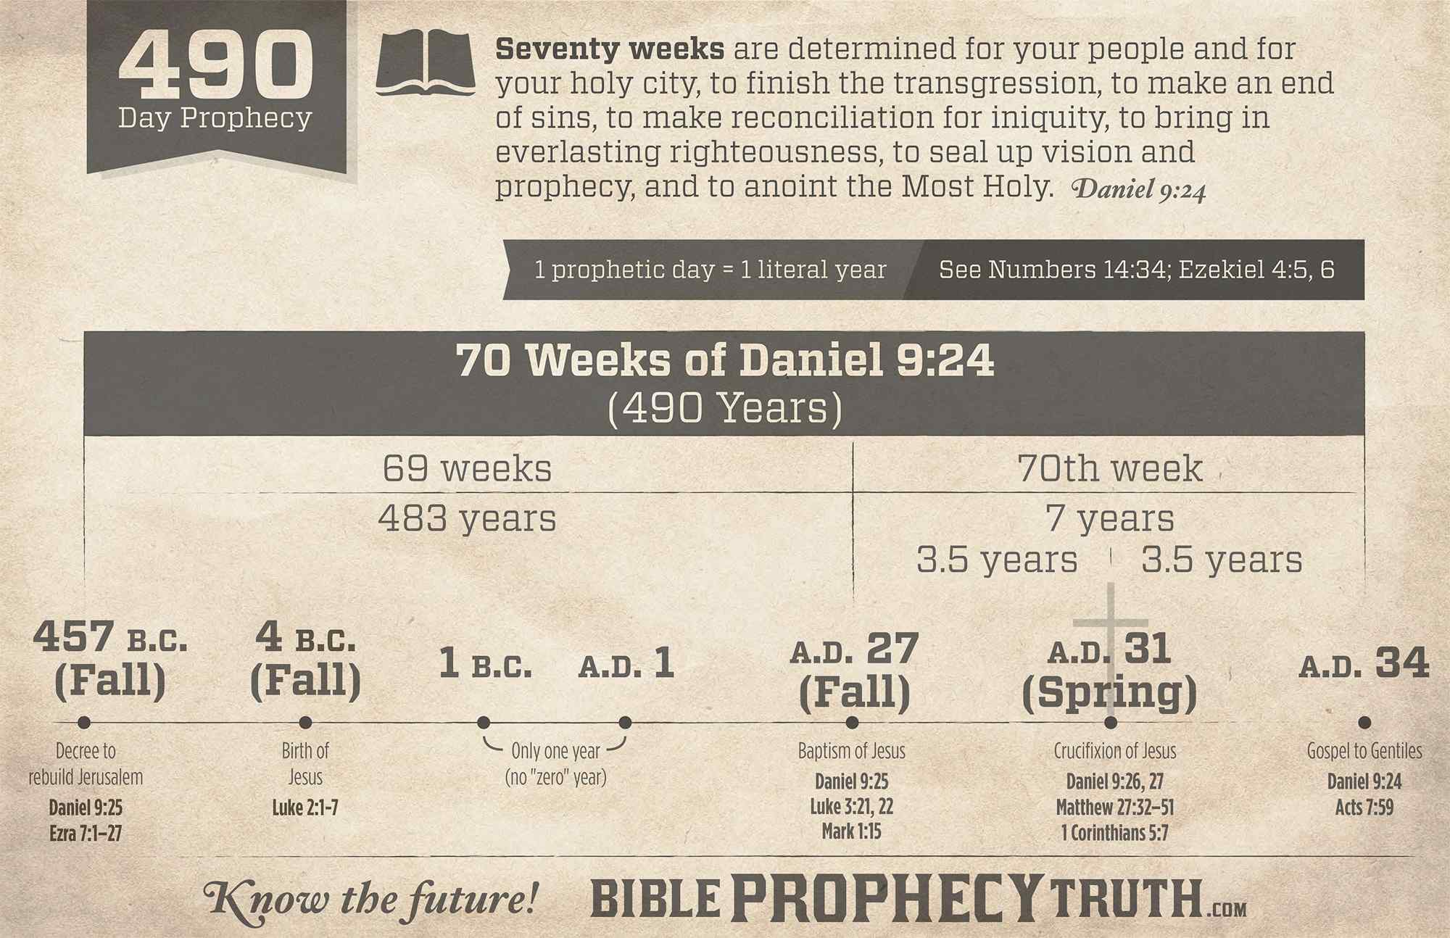
The Investigative Judgment: Daniel 9:27
²⁷ And he shall confirm the covenant with many for one week: and in the midst of the week he shall cause the sacrifice and the oblation to cease, and for the overspreading of abominations he shall make it desolate, even until the consummation, and that determined shall be poured upon the desolate.

Slide 46
Daniel knows that the Jewish nation, still in its Babylonian captivity, is supposed to return to Jerusalem shortly. He reads in Jeremiah 29:10 where the captivity is only supposed to last for 70 years. Then God promises to return His people to their home in Jerusalem.
How Did We Get to 1844 Anyway?

Slide 47
Daniel is confused and concerned about the 2300 day prophecy given to him in Daniel 8:14. Rather than learning about the soon return of the Jews to their ancestral home, Daniel’s been given a vision about a long, long prophetic period, the daily sacrifice being taken away, transgression, and desolation.
How Did We Get to 1844 Anyway?

Slide 48
Daniel is anxious and confused. Most of his vision has been explained to him, but the 2300 day prophecy is “shut up, for it shall be for many days” (Dan. 8:26). But there hasn’t been a word about the end of the 70-year captivity. Naturally, Daniel prays earnestly for guidance.
How Did We Get to 1844 Anyway?

Slide 49
Now, Daniel could work out the 2300-day prophecy as a 2300-year prophecy. The year-for-a-day principle is established for the Jewish people prior to this time (Gen. 29:27; Num. 14:34; Eze. 4:5-6). But he doesn’t have a starting place.
How Did We Get to 1844 Anyway?

Slide 50
The 2300 day prophecy is given in sequence with a discussion about Medo-Persia, Greece, and (what we eventually recognize as) Rome. But where does it start? Daniel doesn’t have a beginning place from which to calculate. He’s praying about these issues in Daniel 9.
How Did We Get to 1844 Anyway?

Slide 51
Daniel 9 shows Gabriel providing an answer to Daniel’s prayers regarding his people. They’re going to return to Jerusalem on schedule, but they have 70 “weeks” or 490 years from that point to get their act together. (Dan. 9:24-27).
How Did We Get to 1844 Anyway?

Slide 52
It’s “from the going forth of the commandment to restore and to build Jeruslaem” (Dan. 9:25). It’s a starting place! The starting place for the 70 week prophecy also provides us with a starting place for the 2300 day prophecy.
How Did We Get to 1844 Anyway?

Slide 53
EZRA 7:12-13
¹² Artaxerxes, king of kings, unto Ezra the priest, a scribe of the law of the God of heaven, perfect peace, and at such a time.
¹³ I make a decree, that all they of the people of Israel, and of his priests and Levites, in my realm, which are minded of their own freewill to go up to Jerusalem, go with thee.
How Did We Get to 1844 Anyway?

Slide 54
EZRA 7:18-21
¹⁸ And whatsoever shall seem good to thee, and to thy brethren, to do with the rest of the silver and the gold, that do after the will of your God.
¹⁹ The vessels also that are given thee for the service of the house of thy God, those deliver thou before the God of Jerusalem.
How Did We Get to 1844 Anyway?

Slide 55
EZRA 7:18-21
²⁰ And whatsoever more shall be needful for the house of thy God, which thou shalt have occasion to bestow, bestow it out of the king's treasure house.
How Did We Get to 1844 Anyway?

Slide 56
EZRA 7:18-21
²¹ And I, even I Artaxerxes the king, do make a decree to all the treasurers which are beyond the river, that whatsoever Ezra the priest, the scribe of the law of the God of heaven, shall require of you, it be done speedily,
How Did We Get to 1844 Anyway?

Slide 57
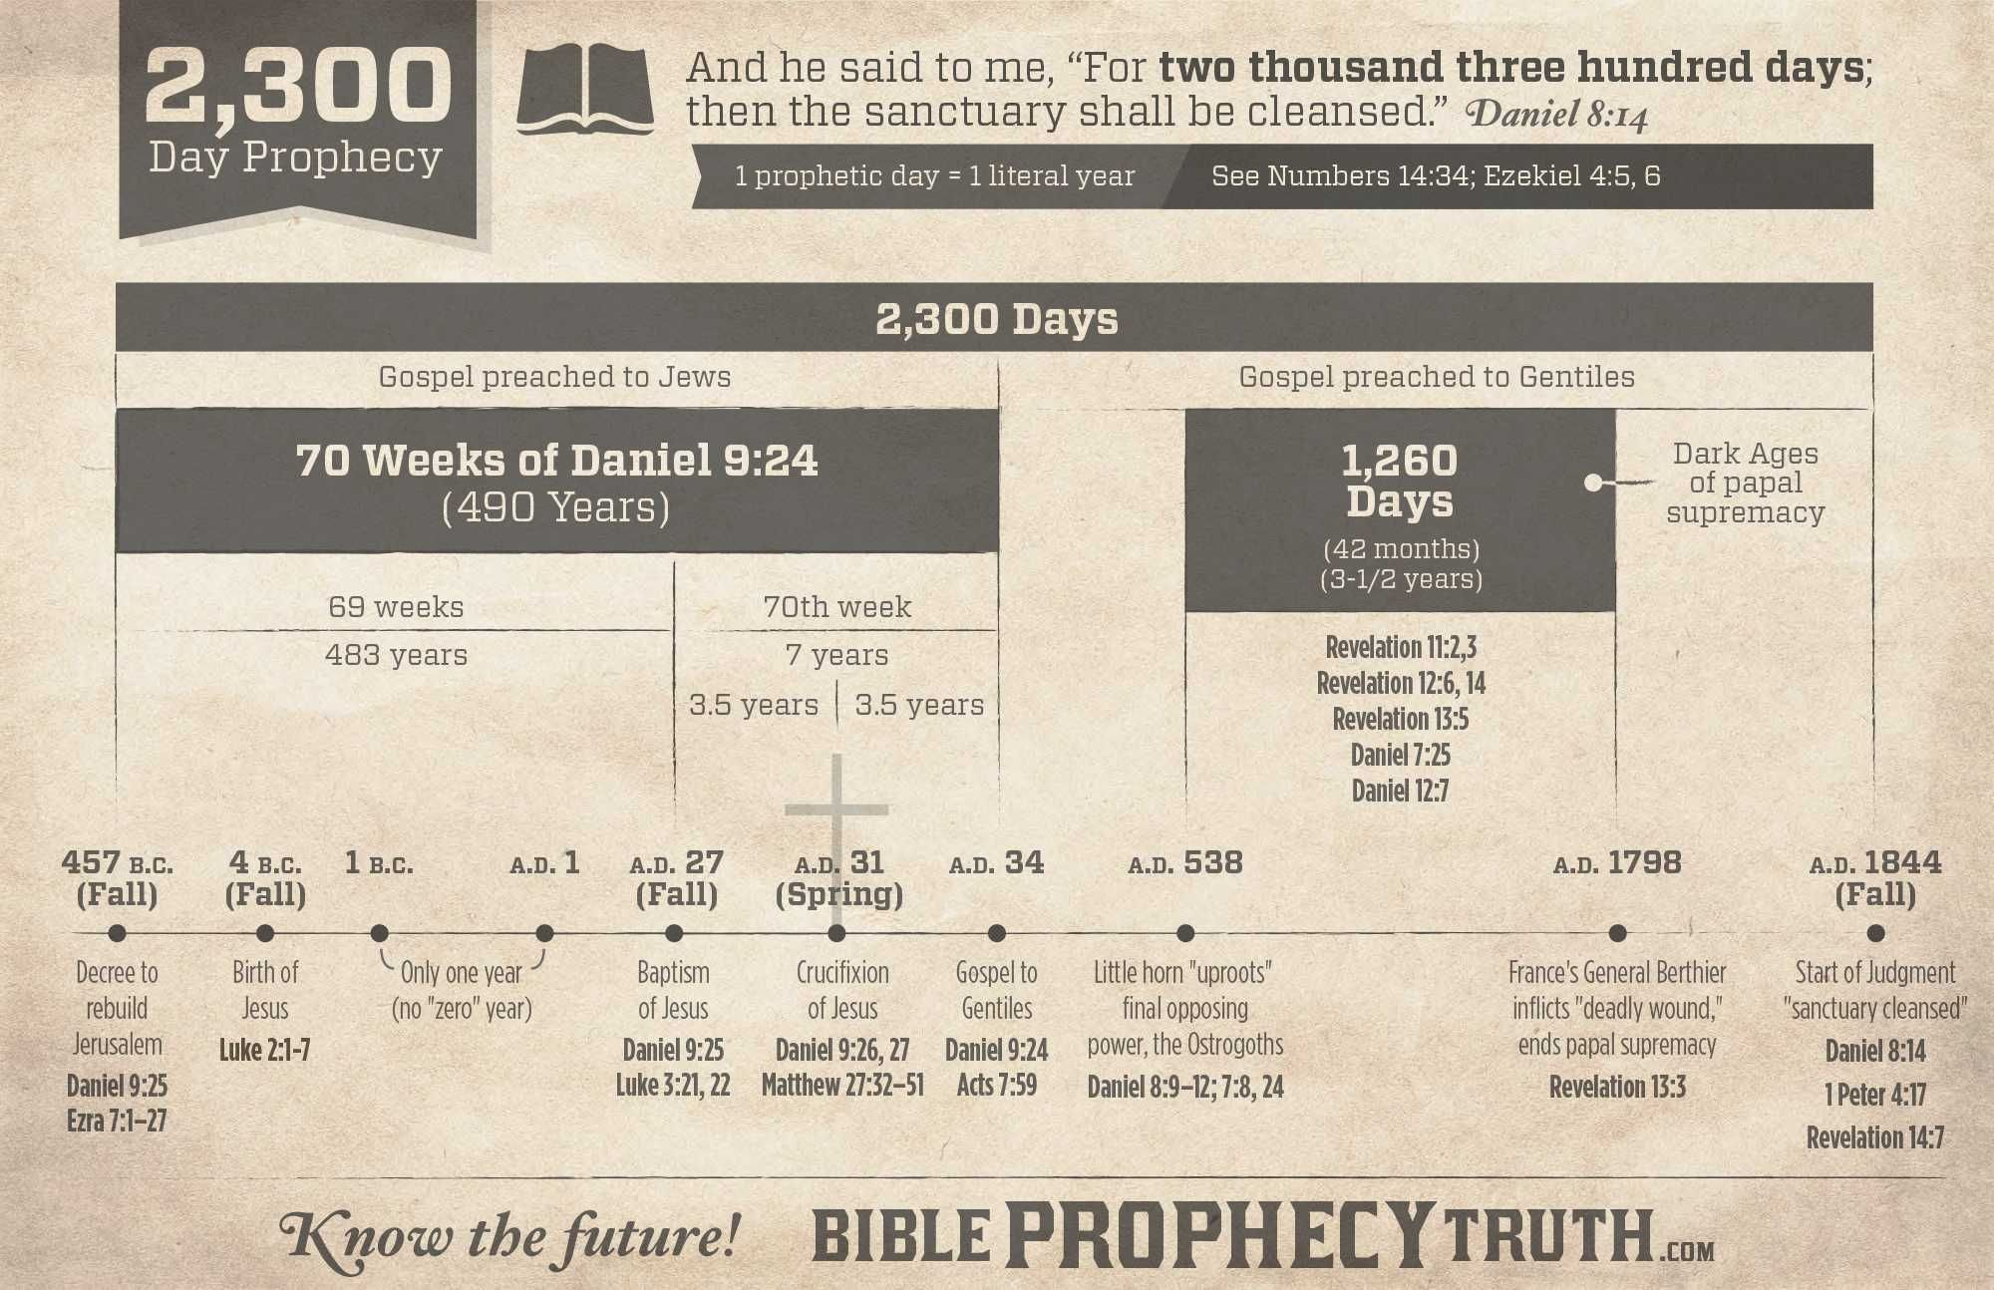
Once we find the decree to restore and to build Jerusalem in 457 BC, we can calculate 2300 “days” as 2300 literal (360-day) years, not counting the year 0, of course, which does not exist. And that’s how we can calculate the end of the 2300 day prophecy to (roughly) October 22, 1844.
How Did We Get to 1844 Anyway?

Slide 58
Of course, Jesus didn’t return in the fall of 1844! So what, exactly, did happen?
¹⁴ And he said unto me, Unto two thousand and three hundred days; then shall the sanctuary be cleansed.
-Daniel 8:14

Slide 59
The Day of Atonement
We know that Jesus is our Archetypal Sacrifice, that His blood is offered freely to cover sins. (²⁰ And, having made peace through the blood of his cross, by him to reconcile all things unto himself; by him, I say, whether they be things in earth, or things in heaven. -Col. 1:20). But curiously, the typical or symbolic sanctuary service was not completed with the sacrificial lamb. There was a second step to the symbolic, typical, purification of sins: The Day of Atonement.

Slide 60
The Day of Atonement
The Day of Atonement or Yom Kippur is the highest holy day of the Jewish calendar. In the Old Testament, the High Priest made an atoning sacrifice for the sins of the people on the Day of Atonement. This act of paying the penalty for sin brought reconciliation (a restored relationship) between the people and God. After the blood sacrifice was offered to the Lord, a goat was released into the wilderness to symbolically carry away the sins of the people. This "scapegoat" was never to return.

Slide 61
The Day of Atonement
The main description of the Day of Atonement is found in Leviticus 16:8-34. Additional regulations pertaining to the feast are outlined in Leviticus 23:26-32 and Numbers 29:7-11.
So if this is the typical Day of Atonement, what does it mean for us? What is the archetypal Day of Atonement?

Slide 62
The Day of Atonement
We read in Levi­ticus 16 that after the high priest had accom­plished what was necessary for his own purification and also that of his house:
a. He was to take two kids of the goats for a sin offering (verse 5).
b. He was to cast lots, one for the Lord; the other for Azazel (verse 8, R.S.V.).

Slide 63
The Day of Atonement
c. He was to "bring the goat upon which the Lord's lot fell, and offer him for a sin offering" (verse 9).
d. He was to take the goat on which the lot for Azazel fell, confess over him the sins of the people of Israel and send him to the wilderness (verses 21, 22).

Slide 64
The Day of Atonement
The “Azazel” goat, or scapegoat, represents an entity that is posed in direct opposition to the Lord.
The scapegoat is not a sin offering (Lev. 16:10). The goat for the "sin offering" represented Christ, who "died for our sins" (1 Cor. 15:3); the other represented Sa­tan, who will perish for his own sins, and also for his part in all the sins he caused the children of God to commit (Rev. 20: 10, 12).

Slide 65
The Day of Atonement
The atonement made with the scapegoat(verse 10) is to be understood as made "upon" or "over" him as in verse 21. He is beyond the benefits of any atonement made in the sacrificial ritual of the sanc­tuary, and this act is totally unrelated to the actual work of redemp­tion.

Slide 66
The Day of Atonement
His mischief shall return upon his own head, and his violent dealing shall come down upon his own pate (Ps. 7:16).
This means, then, that when Satan perishes in the lake of fire he pays the penalty not only for his own rebellion against the Most High but also for his part in all the sins committed, but now forgiven, of the children of God.

Slide 67
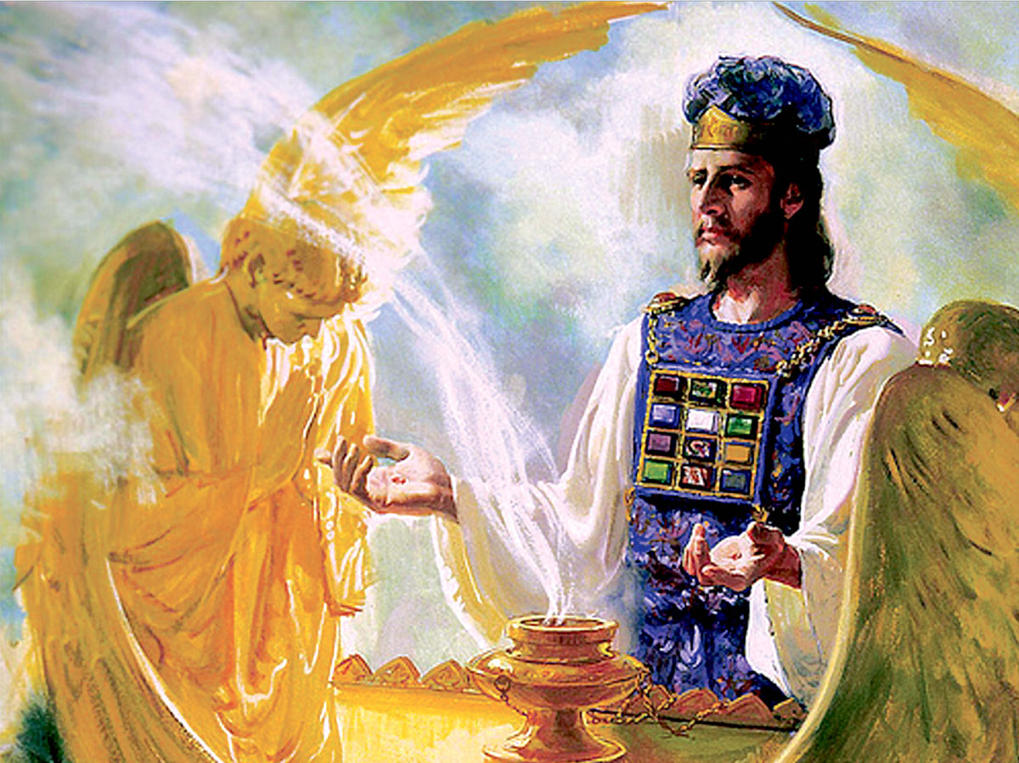
The Sanctuary Cleansed: Hebrews 8:1-2
8 Now of the things which we have spoken this is the sum: We have such an high priest, who is set on the right hand of the throne of the Majesty in the heavens;

Slide 68
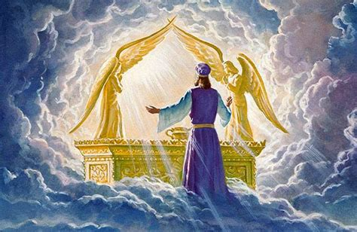
The Sanctuary Cleansed: Hebrews 8:2
² A minister of the sanctuary, and of the true tabernacle, which the Lord pitched, and not man.

Slide 69
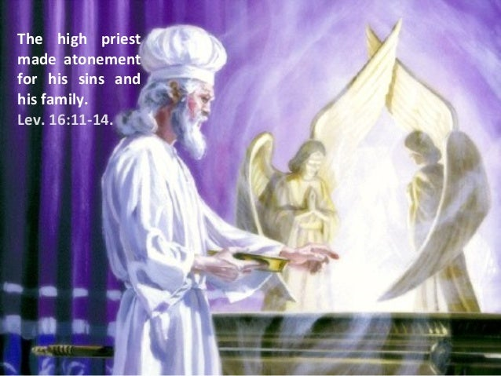
The Sanctuary Cleansed: Hebrews 9:11-12
¹¹ But Christ being come an high priest of good things to come, by a greater and more perfect tabernacle, not made with hands, that is to say, not of this building;

Slide 70
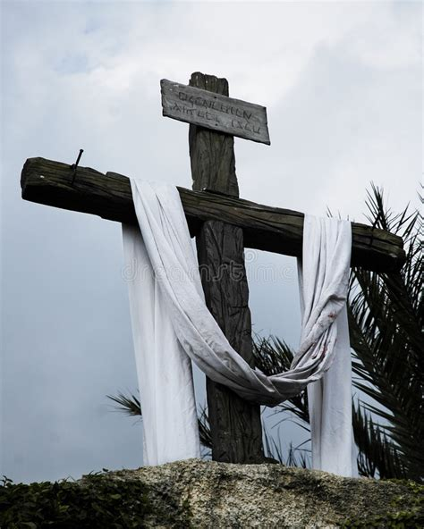
The Sanctuary Cleansed: Hebrews 9:12
¹² Neither by the blood of goats and calves, but by his own blood he entered in once into the holy place, having obtained eternal redemption for us.

Slide 71
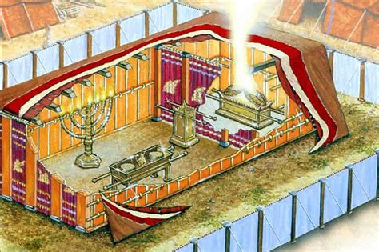
The Sanctuary Cleansed: Hebrews 9:7
⁷ But into the second went the high priest alone once every year, not without blood, which he offered for himself, and for the errors of the people:

Slide 72
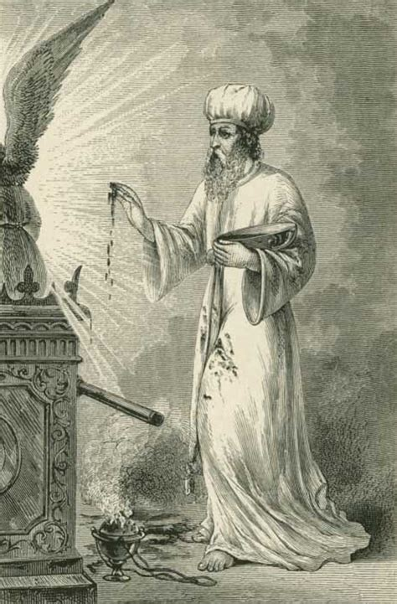
The Sanctuary Cleansed: Hebrews 9:23-26
²³ It was therefore necessary that the patterns of things in the heavens should be purified with these; but the heavenly things themselves with better sacrifices than these.

Slide 73
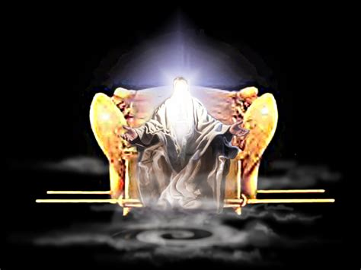
The Sanctuary Cleansed: Hebrews 9:24-26
²⁴ For Christ is not entered into the holy places made with hands, which are the figures of the true; but into heaven itself, now to appear in the presence of God for us:

Slide 74
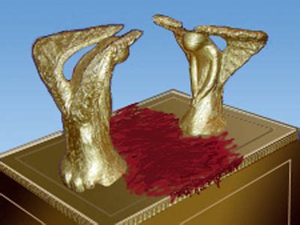
The Sanctuary Cleansed: Hebrews 9:25-26
²⁵ Nor yet that he should offer himself often, as the high priest entereth into the holy place every year with blood of others;

Slide 75
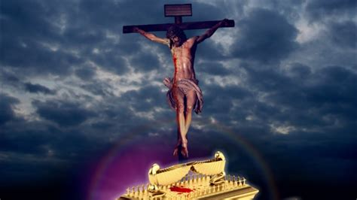
The Sanctuary Cleansed: Hebrews 9:26
²⁶ For then must he often have suffered since the foundation of the world: but now once in the end of the world hath he appeared to put away sin by the sacrifice of himself.

Slide 76
The Sanctuary Cleansed
There’s an element of judgment involved in this archetypal Day of Atonement. It’s a very serious thing. The whole nation of Israel was to cleanse itself and pray for deliverance while this was going on. Because there was a possibility of failure!
The question is this: Do you accept Christ’s sacrifice on your behalf or have you chosen to go your own way with the scapegoat himself?

Slide 77
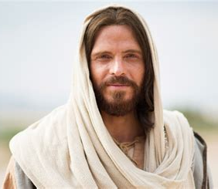
The Sanctuary Cleansed: Hebrews 4:15 -16
¹⁵ For we have not an high priest which cannot be touched with the feeling of our infirmities; but was in all points tempted like as we are, yet without sin.
¹⁶ Let us therefore come boldly unto the throne of grace, that we may obtain mercy, and find grace to help in time of need.

Slide 78

An IJ Summary:
What takes place in the judgment day of God?
There is to be a judgment (Eccl. 12: 13, 14; Heb. 9:27).
There is to be a judgment of all men (Rom. 14:10).
There is to be a judgment of the righteous and the wicked (Eccl. 3:17).
There will be an "investigation" of all cases, for the books of record are to be opened for an investigation, after which the redeemed ones will be "accounted worthy" (Dan. 7:10; Luke 20:35; 21:36; 2 Thess. 1:5).

Slide 79
An IJ Summary:
There will be a pronouncement of the verdict (Rev. 22:11, 12).
There will be an "execution" of the judgment on the wicked (Rev. 20:11-15).
There will be the clearing of all the cases of the righteous (Dan. 12:1; Luke 10: 20; Heb. 12:23).

Slide 80
An IJ Summary:
What takes place at the second Advent?
There will be the resurrection of the righteous dead (1 Cor. 15:50-54).
There will be the translation of the righteous living (1 Thess. 4:16, 17).
The resurrection of the righteous is called the "first" resurrection (Rev. 20:5, last part, and 6). The "rest of the dead"(the wicked) are not raised until the end of the 1000-year period (Rev. 20:5).

Slide 81
An IJ Summary:
What does all this imply? The wicked dead are not raised at the second advent of our Lord, but the righteous dead are raised, and not only so, they are raised to immor­tality and to be forever with their Lord.
This being so, the cases of all, both righteous and wicked, must have been de­termined before the Second Advent. Re­member that what happens at the second appearing of our Lord is done "in the twinkling of an eye" (1 Cor. 15:52). There­fore, the cases of all have been determined before that event. That this is so is seen from the following:

Slide 82
An IJ Summary:
1. There is an "accounting worthy" of the righteous before the Second Advent.— Luke 20:35; 21:36; 2 Thess. 1:5.
Note that the righteous are accounted:
Worthy to obtain that world, Worthy to obtain that resurrection (Luke 20:35)
Worthy to escape all these things, Worthy to stand before the Son of man (Luke 21:36)
Worthy of the kingdom (9 Thess. 1:5) of God

Slide 83
An IJ Summary:
2. Prior to the Second Advent a special preparatory message goes forth to the whole world, which among other things declares that the hour of God's judgment is come. Paul in his day could announce the judgment "to come" (Acts 24:25), but near the time of the Second Advent it can be said with assurance that the hour of the judgment is come (lit., came). That this message is to be heralded to the whole world before Christ returns in glory is, we believe, set forth in the sequence of events as outlined in Revelation 14.

Slide 84
An IJ Summary:
The message of the judgment hour is given in verse 6 and onward; the character of the people who accept it is outlined in verse 12, and the Second Advent for which they are prepared is described in verse 14. Hence it would seem clear that the mes­sage is given to the world during this phase of the judgment to prepare a people to stand in the great day of God.

Slide 85
An IJ Summary:
3. The prophecies of the Word of God foretell an aspect of the judgment before the coming of our Lord Jesus Christ. Daniel 7, 8, and 9 tell the story.

Slide 86
An IJ Summary:
“We have before us a passage of overwhelming grandeur and sublimity; the description of a scene of awful solemnity. , . . The passage exhibits the judgment-seat of God, with myriads of attendant angels, and the infliction of pronounced doom on a large portion of the human race. The judgment is not indeed, like that in Rev. xx., the general judgment. ... As already observed, this is not the general judgment at the termination of Christ's reign on earth, or, as the phrase is commonly un­derstood, the end of the world. It appears rather to be an invisible judgment carried on within the veil and revealed bv its effects and the execution of its sentence. ... It may be sitting now.”
— "Daniel," The Preacher's Homiletic Commentary, pp. 136, 139.

Slide 87
An IJ Summary:
John Calvin also has an interesting comment on this point:
“An account must one day be rendered before the judgment seat of Christ; for the man who seriously considers this must of necessity be touched with fear, and shake off all negligence. He declares, therefore, that he discharges his responsibility faithfully and with pure conscience (2 Tim. 1:3). He is one who walks in the fear of the Lord (Acts 9:31), thinking of the account to be rendered by him.” —Commentary on 2 Corinthians 5:10.
This is all in full harmony with what we have observed above, that "God shall judge the righteous and the wicked" (Eccl. 3: 17).

Slide 88
1: A separation of true believers from mere claimants must take place at the end.
In Defense of the Investigative Judgment:
Matthew 13:47-50
⁴⁷ Again, the kingdom of heaven is like unto a net, that was cast into the sea, and gathered of every kind:
⁴⁸ Which, when it was full, they drew to shore, and sat down, and gathered the good into vessels, but cast the bad away.

Slide 89
1: A separation of true believers from mere claimants must take place at the end.
In Defense of the Investigative Judgment:
Matthew 13:47-50
⁴⁹ So shall it be at the end of the world: the angels shall come forth, and sever the wicked from among the just,
⁵⁰ And shall cast them into the furnace of fire: there shall be wailing and gnashing of teeth.

Slide 90
1: A separation of true believers from mere claimants must take place at the end.
In Defense of the Investigative Judgment:
Matthew 13:30, 40-43
³⁰ Let both grow together until the harvest: and in the time of harvest I will say to the reapers, Gather ye together first the tares, and bind them in bundles to burn them: but gather the wheat into my barn.
⁴⁰ As therefore the tares are gathered and burned in the fire; so shall it be in the end of this world.

Slide 91
1: A separation of true believers from mere claimants must take place at the end.
In Defense of the Investigative Judgment:
Matthew 13:30, 40-43
⁴¹ The Son of man shall send forth his angels, and they shall gather out of his kingdom all things that offend, and them which do iniquity;
⁴² And shall cast them into a furnace of fire: there shall be wailing and gnashing of teeth.
⁴³ Then shall the righteous shine forth as the sun in the kingdom of their Father. Who hath ears to hear, let him hear.

Slide 92
2: God searches hearts THEN He rewards. He always investigates the facts first.
In Defense of the Investigative Judgment:
Genesis 3:9-11
⁹ And the Lord God called unto Adam, and said unto him, Where art thou?
¹⁰ And he said, I heard thy voice in the garden, and I was afraid, because I was naked; and I hid myself.
¹¹ And he said, Who told thee that thou wast naked? Hast thou eaten of the tree, whereof I commanded thee that thou shouldest not eat?

Slide 93
2: God searches hearts THEN He rewards. He always investigates the facts first.
In Defense of the Investigative Judgment:
Genesis 4:9
⁹ And the Lord said unto Cain, Where is Abel thy brother? And he said, I know not: Am I my brother's keeper?

Slide 94
2: God searches hearts THEN He rewards. He always investigates the facts first.
In Defense of the Investigative Judgment:
Genesis 11:4-5
⁴ And they said, Go to, let us build us a city and a tower, whose top may reach unto heaven; and let us make us a name, lest we be scattered abroad upon the face of the whole earth.
⁵ And the Lord came down to see the city and the tower, which the children of men builded.

Slide 95
2: God searches hearts THEN He rewards. He always investigates the facts first.
In Defense of the Investigative Judgment:
Genesis 18:20-21
²⁰ And the Lord said, Because the cry of Sodom and Gomorrah is great, and because their sin is very grievous;
²¹ I will go down now, and see whether they have done altogether according to the cry of it, which is come unto me; and if not, I will know.

Slide 96
2: God searches hearts THEN He rewards. He always investigates the facts first.
In Defense of the Investigative Judgment:
Revelation 2:23
²³ And I will kill her children with death; and all the churches shall know that I am he which searcheth the reins and hearts: and I will give unto every one of you according to your works.

Slide 97
3: Just such an investigation is depicted just prior to the wedding feast.
In Defense of the Investigative Judgment:
Matthew 22:10-14
¹⁰ So those servants went out into the highways, and gathered together all as many as they found, both bad and good: and the wedding was furnished with guests.
¹¹ And when the king came in to see the guests, he saw there a man which had not on a wedding garment:

Slide 98
3: Just such an investigation is depicted just prior to the wedding feast.
In Defense of the Investigative Judgment:
Matthew 22:10-14
¹² And he saith unto him, Friend, how camest thou in hither not having a wedding garment? And he was speechless.
¹³ Then said the king to the servants, Bind him hand and foot, and take him away, and cast him into outer darkness, there shall be weeping and gnashing of teeth.
¹⁴ For many are called, but few are chosen.

Slide 99
3: Just such an investigation is depicted just prior to the wedding feast.
In Defense of the Investigative Judgment:
Luke 12:35-37
³⁵ Let your loins be girded about, and your lights burning;
³⁶ And ye yourselves like unto men that wait for their lord, when he will return from the wedding; that when he cometh and knocketh, they may open unto him immediately.
³⁷ Blessed are those servants, whom the lord when he cometh shall find watching: verily I say unto you, that he shall gird himself, and make them to sit down to meat, and will come forth and serve them.

Slide 100
3: Just such an investigation is depicted just prior to the wedding feast.
In Defense of the Investigative Judgment:
Matthew 25:3-4
³ They that were foolish took their lamps, and took no oil with them:
⁴ But the wise took oil in their vessels with their lamps.

Slide 101
4: The Judgment must occur before Christ receives His kingdom, which happens just prior to His triumphant return.
In Defense of the Investigative Judgment:
Daniel 7:9, 10, 13, 14
⁹ I beheld till the thrones were cast down, and the Ancient of days did sit, whose garment was white as snow, and the hair of his head like the pure wool: his throne was like the fiery flame, and his wheels as burning fire.
¹⁰ A fiery stream issued and came forth from before him: thousand thousands ministered unto him, and ten thousand times ten thousand stood before him: the judgment was set, and the books were opened.

Slide 102
4: The Judgment must occur before Christ receives His kingdom, which happens just prior to His triumphant return.
In Defense of the Investigative Judgment:
Daniel 7:9, 10, 13, 14
¹³ I saw in the night visions, and, behold, one like the Son of man came with the clouds of heaven, and came to the Ancient of days, and they brought him near before him.
¹⁴ And there was given him dominion, and glory, and a kingdom, that all people, nations, and languages, should serve him: his dominion is an everlasting dominion, which shall not pass away, and his kingdom that which shall not be destroyed.

Slide 103
5: The verb tense (aorist) describing the judgement suggests it has already started.
In Defense of the Investigative Judgment:
Revelation 14:6, 7, 9
⁶ And I saw another angel fly in the midst of heaven, having the everlasting gospel to preach unto them that dwell on the earth, and to every nation, and kindred, and tongue, and people,
⁷ Saying with a loud voice, Fear God, and give glory to him; for the hour of his judgment is come: and worship him that made heaven, and earth, and the sea, and the fountains of waters.

Slide 104
6: The books record our choices, and an investigation of these choices must occur before judgment can be rendered.
In Defense of the Investigative Judgment:
John 3:36
³⁶ He that believeth on the Son hath everlasting life: and he that believeth not the Son shall not see life; but the wrath of God abideth on him.

Slide 105
6: The books record our choices, and an investigation of these choices must occur before judgment can be rendered.
In Defense of the Investigative Judgment:
1 John 5:11-12
¹¹ And this is the record, that God hath given to us eternal life, and this life is in his Son.
¹² He that hath the Son hath life; and he that hath not the Son of God hath not life.

Slide 106
6: The books record our choices, and an investigation of these choices must occur before judgment can be rendered.
In Defense of the Investigative Judgment:
Exodus 32:32-33
³² Yet now, if thou wilt forgive their sin--; and if not, blot me, I pray thee, out of thy book which thou hast written.
³³ And the Lord said unto Moses, Whosoever hath sinned against me, him will I blot out of my book.

Slide 107
6: The books record our choices, and an investigation of these choices must occur before judgment can be rendered.
In Defense of the Investigative Judgment:
Psalm 69:28
²⁸ Let them be blotted out of the book of the living, and not be written with the righteous.

Slide 108
6: The books record our choices, and an investigation of these choices must occur before judgment can be rendered.
In Defense of the Investigative Judgment:
Revelation 3:5
⁵ He that overcometh, the same shall be clothed in white raiment; and I will not blot out his name out of the book of life, but I will confess his name before my Father, and before his angels.

Slide 109
6: The books record our choices, and an investigation of these choices must occur before judgment can be rendered.
In Defense of the Investigative Judgment:
Revelation 22:19
¹⁹ And if any man shall take away from the words of the book of this prophecy, God shall take away his part out of the book of life, and out of the holy city, and from the things which are written in this book.

Slide 110
7: The DEAD are judged out of the books
In Defense of the Investigative Judgment:
Revelation 20:12-13
¹² And I saw the dead, small and great, stand before God; and the books were opened: and another book was opened, which is the book of life: and the dead were judged out of those things which were written in the books, according to their works.
¹³ And the sea gave up the dead which were in it; and death and hell delivered up the dead which were in them: and they were judged every man according to their works.

Slide 111
The conclusion of this judgment is FINAL!! Revelation 22:11-12
¹¹ He that is unjust, let him be unjust still: and he which is filthy, let him be filthy still: and he that is righteous, let him be righteous still: and he that is holy, let him be holy still.

Slide 112
The conclusion of this judgment is FINAL!! Revelation 22:11-12
¹² And, behold, I come quickly; and my reward is with me, to give every man according as his work shall be.

Slide 113
A Brief History Of the Investigative Judgement Doctrine
https://atoday.org/the-real-history-of-the-investigative-judgment-doctrine/
When most Seventh-day Adventists think of the investigative judgment, they think of Hiram Edson’s iconic insight in a cornfield after the night of the Great Disappointment. But Edson’s vision of Christ entering the inner sanctuary of the heavenly tabernacle didn’t mention the investigative judgment. Edson, along with O.R.L. Crosier and Dr. Franklin B. Hahn, developed the teaching that Jesus had entered the Most Holy Place, which was then published in an article by Crosier in a Millerite publication called The Day Star.

Slide 114
A Brief History Of the Investigative Judgement Doctrine
https://atoday.org/the-real-history-of-the-investigative-judgment-doctrine/
There is no mention of the investigative judgment in that article or in Edson’s account of the cornfield experience. Edson saw that Jesus had “a work to perform in the Most Holy Place,” but he wasn’t sure what it was.

Slide 115
A Brief History Of the Investigative Judgement Doctrine
https://atoday.org/the-real-history-of-the-investigative-judgment-doctrine/
As early as 1841, Josiah Litch had advanced the notion that judgment could happen before Christ’s second advent. Citing Hebrews 9:27, Acts 10:42, and 2 Timothy 4:1, Litch wrote: “Nor is there a text which presents the judicial scene of judgment after the resurrection. On the contrary, the Scriptures can be harmonized on no other principle than that every man’s doom is fixed before his resurrection.”

Slide 116
A Brief History Of the Investigative Judgement Doctrine
https://atoday.org/the-real-history-of-the-investigative-judgment-doctrine/
The development of these ideas into what came to be called the investigative judgment begins with Elon Everts. Ordained to the gospel ministry during the fall of 1853 in New Haven, Vermont, his name was a familiar one in the Review, with several letters describing his evangelistic labors in Vermont. Everts eventually migrated to Round Grove, Illinois, where he continued his evangelistic work, including time with J.N. Loughborough, and died in February of 1858 at age 51.

Slide 117
A Brief History Of the Investigative Judgement Doctrine
https://atoday.org/the-real-history-of-the-investigative-judgment-doctrine/
James and Ellen White first discussed Christ’s Most Holy Place ministry with Everts during a wagon ride in Illinois in 1856. Everts was quite certain Jesus was in the heavenly sanctuary, but he was unsure about what he had been doing there for more than a decade.

Slide 118
A Brief History Of the Investigative Judgement Doctrine
https://atoday.org/the-real-history-of-the-investigative-judgment-doctrine/
Everts began to flesh out his ideas in a “communication” published in the Jan. 1, 1857, issue of the Advent Review and Sabbath Herald. He worked from 1 Peter 4:5-6: “Who shall give account to him that is ready to judge the quick and the dead. For this cause was the gospel preached also to them that are dead, that they might be judged according to men in the flesh, but live according to God in the spirit.”

Slide 119
A Brief History Of the Investigative Judgement Doctrine
https://atoday.org/the-real-history-of-the-investigative-judgment-doctrine/
Since the Scripture speaks of a judgment of both the living and the dead, Everts reasoned that Jesus had been judging the dead of the ages since 1844, offering this text as evidence that judgment must take place before Christ’s return during the final generation of life on Earth. Here Everts first floated the phrase “investigative judgment” to attempt to explain what Jesus was doing—the first time it appeared in an Adventist publication. He followed this with another article on the investigative judgment, dated June 4, 1854, but not printed in the Review until June 11, 1857.

Slide 120
A Brief History Of the Investigative Judgement Doctrine
https://atoday.org/the-real-history-of-the-investigative-judgment-doctrine/
The first full article addressing the investigative judgment came from James White, who picked up the themes of Everts’ “communication” just a month later, in the January 29, 1857, Review, with an article titled “The Judgment.”
James White’s argument was based on his understanding of the blotting out of sin, the record of sin in heaven, and the “lot” of Daniel 12:13: “For thou shalt rest, and stand in thy lot at the end of the days.”

Slide 121
A Brief History Of the Investigative Judgement Doctrine
https://atoday.org/the-real-history-of-the-investigative-judgment-doctrine/
He listed more than 70 Old Testament passages from The Englishman’s Hebrew Concordance, some of which indicated that “lot” referred to the position of the judged. Daniel in his lot was a reference to his already having been judged. James White followed Everts in the idea that Scripture taught that there would be a judgment of both the living and the dead, based on 1 Peter 4:5-6, and that this judgment had started with the righteous dead in 1844.

Slide 122
A Brief History Of the Investigative Judgement Doctrine
https://atoday.org/the-real-history-of-the-investigative-judgment-doctrine/
A pamphlet printed in Battle Creek in 1872 refers to the investigative judgment as Principle XVIII:
That the time of the cleansing of the sanctuary (see proposition X), synchronizing with the time of the proclamation of the third message, is a time of investigative judgment, first with reference to the dead, and at the close of probation with reference to the living, to determine who of the myriads now sleeping in the dust of the earth are worthy of a part in the first resurrection, and who of its living multitudes are worthy of translation—points which must be determined before the Lord appears.

Slide 123
A Brief History Of the Investigative Judgement Doctrine
https://atoday.org/the-real-history-of-the-investigative-judgment-doctrine/
Uriah Smith wrote at length about the investigative judgment in his 1877 work The Sanctuary and the 2300 Days, which saw in Daniel 7:9-10 the basis for the investigative judgment: “Thus the cleansing of the sanctuary involves the examination of the records of all the deeds of our lives. It is an investigative Judgment. Every individual of every generation from the beginning of the world thus passes in review before the great tribunal above. So Daniel, describing the opening of this scene, calls it a work of judgment, and expressly notices the fact that the books were opened.”

Slide 124
A Brief History Of the Investigative Judgement Doctrine
https://atoday.org/the-real-history-of-the-investigative-judgment-doctrine/
In a sweeping statement, Smith joined several biblical motifs: “We have already seen that the cleansing of the sanctuary, the investigative Judgment of the saints, the blotting out, or remission, of sin, and the finishing of the mystery of God, are all one and the same thing. We now make the additional statement that this is also the atonement.”

Slide 125
A Brief History Of the Investigative Judgement Doctrine
https://atoday.org/the-real-history-of-the-investigative-judgment-doctrine/
The Biblical Institute, an 1878 synopsis of Adventist doctrines by Uriah Smith and James White, also linked the cleansing of the sanctuary with the investigative judgment and the finishing of the mystery of God. On page 84 of the same work, they stated that the investigative judgment takes place as the sanctuary is cleansed.

Slide 126
A Brief History Of the Investigative Judgement Doctrine
https://atoday.org/the-real-history-of-the-investigative-judgment-doctrine/
Prior to his death in 1883, J.N. Andrews wrote The Sanctuary of the Bible. He mentions the investigative judgment twice, saying it is identical with the cleansing of the sanctuary: “The nature of that work we will now briefly indicate. The work of the Judgment is divided into two parts. The first part is the investigative judgment, which takes place in the heavenly sanctuary, God the Father sitting in judgment.

Slide 127
A Brief History Of the Investigative Judgement Doctrine
https://atoday.org/the-real-history-of-the-investigative-judgment-doctrine/
The second part is the execution of the judgment, and is committed wholly to Christ, who comes to our earth to accomplish this work. John 5:22-27; Jude 14, 15. It is while the investigative judgment is in session that the cleansing of the sanctuary takes place. Or, to speak more accurately, the cleansing of the sanctuary is identical with the work of the investigative judgment.”
His posthumously published The Judgment: Its Events and Their Order includes an entire chapter on the investigative judgment.

Slide 128
A Brief History Of the Investigative Judgement Doctrine
https://atoday.org/the-real-history-of-the-investigative-judgment-doctrine/
Because Ellen White’s The Great Controversy is the most widely read source of religious history among Adventists, it may be easy for us to assume that the investigative judgment teaching started with her. Yet we’ve shown that several Adventist scholars had already written upon the topic for 30 years before she took it up. Her first address of the investigative judgment isn’t until 1884, in chapter 23 of The Spirit of Prophecy, Vol. 4.

Slide 129
A Brief History Of the Investigative Judgement Doctrine
https://atoday.org/the-real-history-of-the-investigative-judgment-doctrine/
While her husband had found evidence for an investigative judgment in Daniel 12:13 and the judgment of the living and the dead referred to in 1 Peter 4:5-6, Ellen White mentions neither, relying instead (as did Uriah Smith) on Daniel 7 (which James hadn’t mentioned) and arguing that verses 9 through 10 and 13 through 14 portray the opening of the investigative judgment in heaven.

Slide 130
A Brief History Of the Investigative Judgement Doctrine
https://atoday.org/the-real-history-of-the-investigative-judgment-doctrine/
Ellen White expanded her investigative judgment teaching in the 1888 edition of The Great Controversy, introducing a unique array of passages to support and illustrate it: “The coming of Christ as our high priest to the most holy place, for the cleansing of the sanctuary, brought to view in Daniel 8:14; the coming of the Son of man to the Ancient of days, as presented in Daniel 7:13; and the coming of the Lord to his temple, foretold by Malachi, are descriptions of the same event;

Slide 131
A Brief History Of the Investigative Judgement Doctrine
https://atoday.org/the-real-history-of-the-investigative-judgment-doctrine/
and this is also represented by the coming of the bridegroom to the marriage, described by Christ in the parable of the ten virgins, of Matthew 25.” She also appealed to Matthew 22:11 to support her investigative judgment teaching.
Other early treatments of the investigative judgment include Uriah Smith’s influential Daniel and the Revelation (1897) and S.N. Haskell’s The Story of Daniel the Prophet (1901), The Story of the Seer of Patmos (1905), and The Cross and Its Shadow (1914).

Slide 132
A Brief History Of the Investigative Judgement Doctrine
https://atoday.org/the-real-history-of-the-investigative-judgment-doctrine/
Ellen White’s 1911 edition of The Great Controversy remains the primary source for the investigative judgment teaching, but she was largely silent on the subject of the investigative judgment until 1884, long after it had been studied and written on by Elon Everts, James White, J.N. Andrews, and Uriah Smith, who were the principal proponents of the teaching. While Ellen White later enhanced and gave credibility to the teaching, she did not originate it.

Slide 133
Thank You!
Happy Sabbath!

