Slide 1
Worshiping the Creator
Lesson 7
2nd Quarter, 2023
Revelation 14:7
1 Chronicles 16, Isaiah 40, Job 38-40

Slide 2
MEMORY TEXT: Revelation 4:11
¹¹ Thou art worthy, O Lord, to receive glory and honour and power: for thou hast created all things, and for thy pleasure they are and were created.

Slide 3
KEY VERSE
⁷ Saying with a loud voice, Fear God, and give glory to him; for the hour of his judgment is come: and worship him that made heaven, and earth, and the sea, and the fountains of waters.
Revelation 14:7

Slide 4
KEY VERSE
⁷ Saying with a loud voice, Fear God, and give glory to him; for the hour of his judgment is come: and worship him that made heaven, and earth, and the sea, and the fountains of waters.
Revelation 14:7

Slide 5
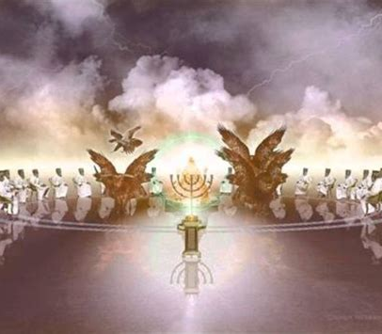
Revelation 5:11-14
¹¹ And I beheld, and I heard the voice of many angels round about the throne and the beasts and the elders: and the number of them was ten thousand times ten thousand, and thousands of thousands;

Slide 6
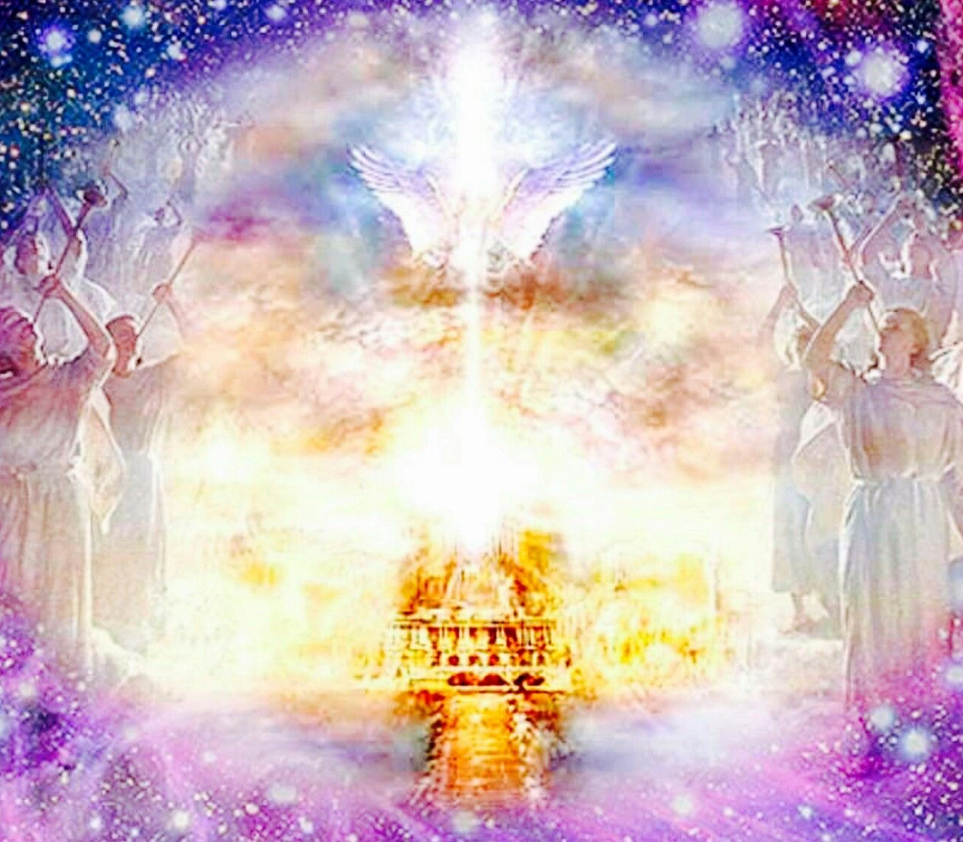
Revelation 5:12-14
¹² Saying with a loud voice, Worthy is the Lamb that was slain to receive power, and riches, and wisdom, and strength, and honour, and glory, and blessing.

Slide 7
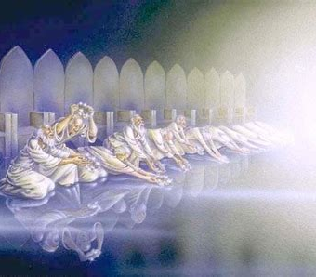
Revelation 5:13-14
¹³ And every creature which is in heaven, and on the earth, and under the earth, and such as are in the sea, and all that are in them, heard I saying, Blessing, and honour, and glory, and power, be unto him that sitteth upon the throne, and unto the Lamb for ever and ever.

Slide 8
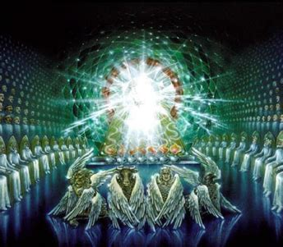
Revelation 5:14
¹⁴ And the four beasts said, Amen. And the four and twenty elders fell down and worshipped him that liveth for ever and ever.

Slide 9
⁸ Give thanks unto the Lord, call upon his name, make known his deeds among the people.
⁹ Sing unto him, sing psalms unto him, talk ye of all his wondrous works.
¹⁰ Glory ye in his holy name: let the heart of them rejoice that seek the Lord.
¹¹ Seek the Lord and his strength, seek his face continually.
David’s Psalm, on the arrival of the Ark in Jerusalem
1 Chronicles 16:8-36
Worship: Talk of all His works

Slide 10
¹² Remember his marvellous works that he hath done, his wonders, and the judgments of his mouth;
¹³ O ye seed of Israel his servant, ye children of Jacob, his chosen ones.
¹⁴ He is the Lord our God; his judgments are in all the earth.
David’s Psalm, on the arrival of the Ark in Jerusalem
1 Chronicles 16:12-36
Worship: Talk of all His works

Slide 11
¹⁵ Be ye mindful always of his covenant; the word which he commanded to a thousand generations;
¹⁶ Even of the covenant which he made with Abraham, and of his oath unto Isaac;
¹⁷ And hath confirmed the same to Jacob for a law, and to Israel for an everlasting covenant,
¹⁸ Saying, Unto thee will I give the land of Canaan, the lot of your inheritance
David’s Psalm, on the arrival of the Ark in Jerusalem
1 Chronicles 16:12-36
Worship: Be mindful of the covenant

Slide 12
¹⁹ When ye were but few, even a few, and strangers in it.
²⁰ And when they went from nation to nation, and from one kingdom to another people;
²¹ He suffered no man to do them wrong: yea, he reproved kings for their sakes,
²² Saying, Touch not mine anointed, and do my prophets no harm.
David’s Psalm, on the arrival of the Ark in Jerusalem
1 Chronicles 16:19-36
Worship: Gratitude for His watch-care

Slide 13
²³ Sing unto the Lord, all the earth; shew forth from day to day his salvation.
²⁴ Declare his glory among the heathen; his marvellous works among all nations.
²⁵ For great is the Lord, and greatly to be praised: he also is to be feared above all gods.
²⁶ For all the gods of the people are idols: but the Lord made the heavens.
David’s Psalm, on the arrival of the Ark in Jerusalem
1 Chronicles 16:23-36
Worship: Declare His works, His act of creation

Slide 14
²⁷ Glory and honour are in his presence; strength and gladness are in his place.
²⁸ Give unto the Lord, ye kindreds of the people, give unto the Lord glory and strength.
²⁹ Give unto the Lord the glory due unto his name: bring an offering, and come before him: worship the Lord in the beauty of holiness.
David’s Psalm, on the arrival of the Ark in Jerusalem
1 Chronicles 16:27-36
Worship: Sacrifice and obey

Slide 15
³⁰ Fear before him, all the earth: the world also shall be stable, that it be not moved.
³¹ Let the heavens be glad, and let the earth rejoice: and let men say among the nations, The Lord reigneth.
³² Let the sea roar, and the fulness thereof: let the fields rejoice, and all that is therein.
David’s Psalm, on the arrival of the Ark in Jerusalem
1 Chronicles 16:30-36
Worship: Obey, give thanks for His promises

Slide 16
³³ Then shall the trees of the wood sing out at the presence of the Lord, because he cometh to judge the earth.
³⁴ O give thanks unto the Lord; for he is good; for his mercy endureth for ever.
David’s Psalm, on the arrival of the Ark in Jerusalem
1 Chronicles 16:33-36
Worship: Give thanks for His judgment AND mercy

Slide 17
³⁵ And say ye, Save us, O God of our salvation, and gather us together, and deliver us from the heathen, that we may give thanks to thy holy name, and glory in thy praise.
³⁶ Blessed be the Lord God of Israel for ever and ever. And all the people said, Amen, and praised the Lord.
David’s Psalm, on the arrival of the Ark in Jerusalem
1 Chronicles 16:35-36
Worship: Give thanks for His salvation

Slide 18
A Creation Discussion:
SDABC V. 1 p. 46-47
Throughout its history the Seventh-day Adventist Church has held that the first 35 verses of the book of Genesis contain a valid, factual account of literal events that occurred during seven consecutive rotations of Planet Earth—the creation week.

Slide 19
A Creation Discussion:
SDABC V. 1 p. 46-47
This interpretation places within creation week the origin of the parent stock for all organisms supported by the planet and also the origin of the physical circumstances on which the continuing life of this parent stock depends.

Slide 20
A Creation Discussion: SDABC V. 1 p. 46-47
The uniqueness and singularity of creative acts such as those described in Genesis 1 place their explanation or verification beyond the range of scientific procedures. Knowledge concerning the nature and time of such events is dependent on the testimony of reliable witnesses—on revelation. If it should be proved that complex biochemicals or physical structures associated with living organisms could develop from simpler states as a consequence of the ordinary properties of matter, such proof would not constitute evidence that these features actually evolved in this manner; it would introduce only the evolutionary process as one possibility in addition to the fiat-creation stipulation set forth in the Bible.
Nature of Evidence Regarding Origins

Slide 21
A Creation Discussion: SDABC V. 1 p. 46-47
The human mind, perhaps any created intelligence, is incapable of understanding the origin of the universe. A godless approach to the problem begins with previously existing inanimate matter that possesses capabilities that naturally result in the development of life and all other features of the contemporary universe. A God-related approach begins with an intelligence capable of designing, constructing, and maintaining all features of the universe. The origin of either the primary matter required by the first model or the intelligence required by the second model is humanly incomprehensible.
Nature of Evidence Regarding Origins

Slide 22
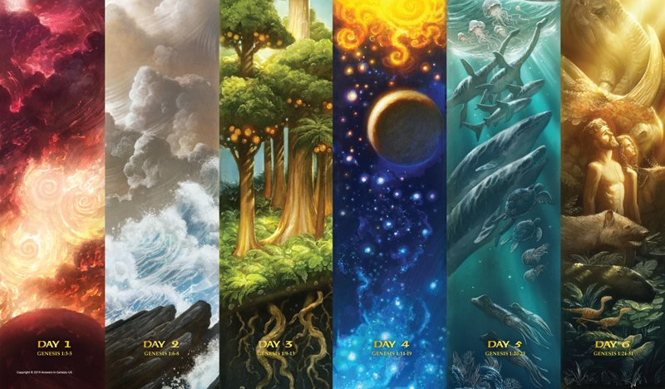
A Creation Discussion: SDABC V. 1 p. 46-47
The Biblical Creation Model:
The physical substance of the universe and the laws of interaction that characterize this substance were brought into existence by the Creator and are the manifestation of His continued purpose.
The Biblical Creation Model

Slide 23
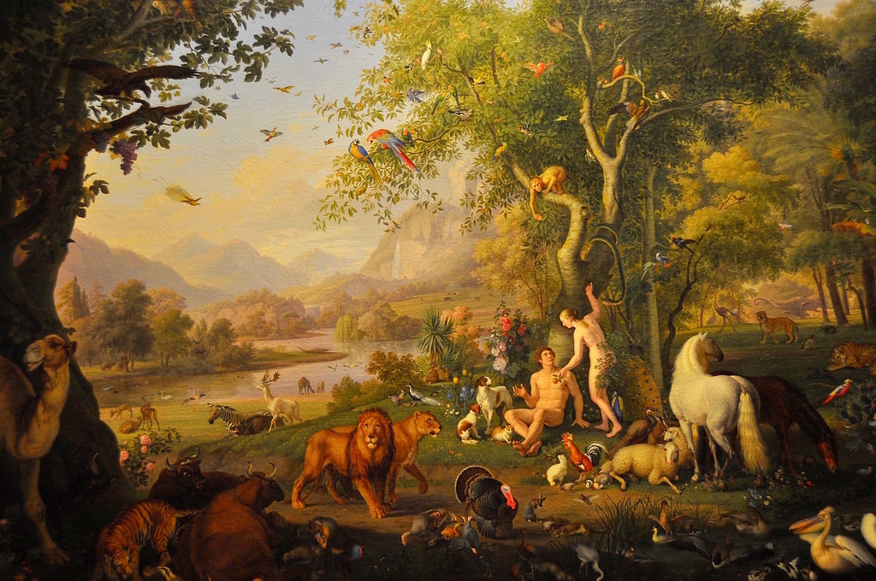
A Creation Discussion: SDABC V. 1 p. 46-47
Within six successive rotations of Planet Earth approximately 6,000 years ago, the Creator organized and/or created the planet to provide an ideal environment for living organisms and placed there the ancestors of all the organisms that have lived on this planet.
The Biblical Creation Model

Slide 24
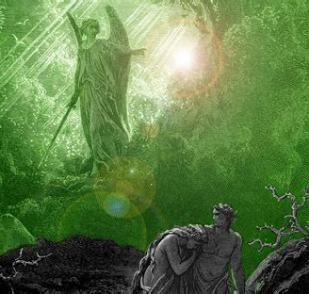
A Creation Discussion: SDABC V. 1 p. 46-47
The initial perfect creation, which reflected the personality of the Creator, whose principal characteristic is love, was subsequently modified as a result of sin, so it became progressively less ideal, with death the fate of all organisms.
The Biblical Creation Model

Slide 25
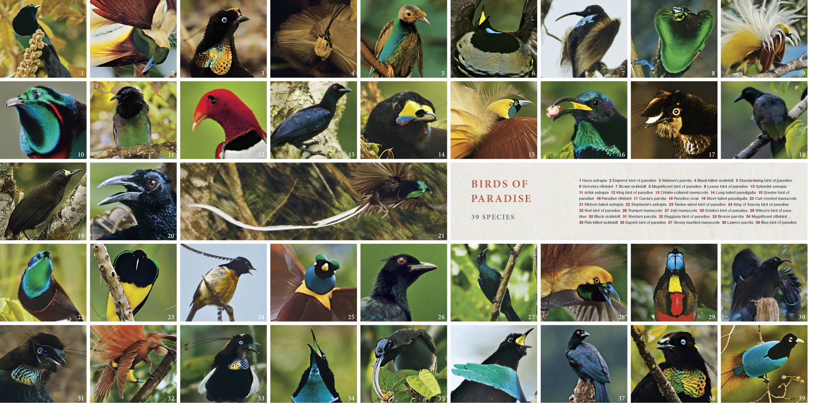
A Creation Discussion: SDABC V. 1 p. 46-47
The originally created organisms were endowed with capability for propagation with modification, which has resulted in a wide range of adaptation and speciation within basic categories.
The Biblical Creation Model

Slide 26
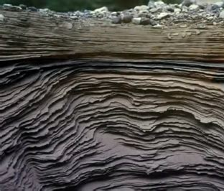
A Creation Discussion: SDABC V. 1 p. 46-47
The surface of the planet was radically transformed in a post-creation event, known as the Flood, that buried remains of the previous world and resulted in a post-Flood world that in many situations provided a drastically different environment for living organisms.
The Biblical Creation Model

Slide 27
A Creation Discussion: SDABC V. 1 p. 46-47
Currently fashionable evolutionary theory postulates that (1) both inorganic and organic matter developed spontaneously through fortuitous random interaction, (2) suitable supporting environments, as well as living forms, developed slowly over several billion years, (3, 4) the present varieties of plants and animals are at the growing edge of a natural development process that generally progresses from simple to complex, from one basic kind of organism to another, and (5) the present environment is the product of normal physical processes operating over hundreds of millions of years.
Contrasting Theories

Slide 28
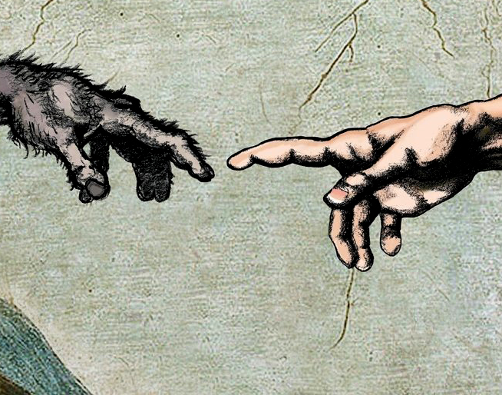
A Creation Discussion: SDABC V. 1 p. 46-47
A large segment of the contemporary Christian world accepts the basic evolutionary scenario by postulating it to be the manner in which God has worked in bringing the universe and the life on earth to its present state. This viewpoint is known as theistic evolution.
Contrasting Theories

Slide 29
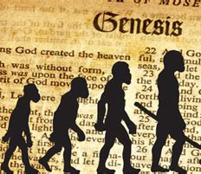
A Creation Discussion: SDABC V. 1 p. 46-47
It avoids tension with the scientific community and supplies the creative power of God to replace the implausibilities in the evolutionary model; but it considers the Biblical specifications concerning creation, the Flood, and the early history of man to be metaphorical rather than factual.
Contrasting Theories

Slide 30
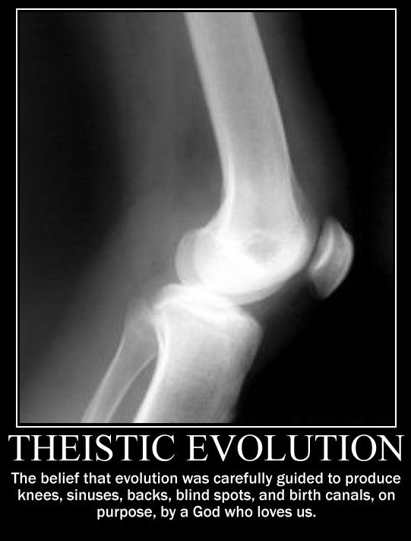
A Creation Discussion: SDABC V. 1 p. 46-47
Theistic evolution is a feature of religion that is humanistic rather than revelational and God-centered. It must be evaluated on the basis of the evidence supporting the claims for inspiration and authority of Scripture made by Jesus and the Bible writers, and on the compatibility of the presumed evolutionary process with the character and capability of God as presented in the Bible.
Contrasting Theories

Slide 31
A Creation Discussion: SDABC V. 1 p. 48
Since 1860 the literature of the Seventh-day Adventist Church has presented more than one viewpoint concerning creation of the elementary matter from which the physical structure of living organisms is formed.
Some scholars and church leaders have taken the position that all elementary matter in our planet came into existence at the beginning of creation week.
Others have understood the testimony of Scripture to suggest, or at least allow, that the substance of earth and solar system is the result, at least in part, of creative activity before creation week.

Slide 32
Assuming pre-existing matter, where did life start? How did things begin to live and die?
The Science of Life

Slide 33
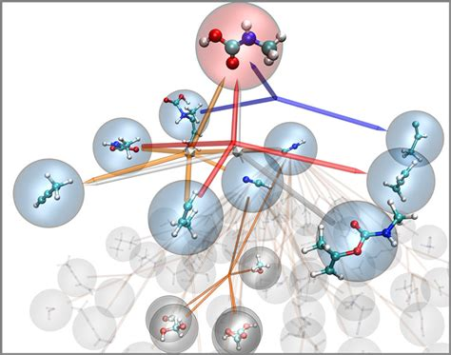
THE SCIENCE OF LIFE: SDABC V. 1 p. 48-49
A common evolutionist model for the origin of life begins with chemical evolution. Chemical evolution requires sequences of spontaneous chemical reactions that convert simple molecules, each containing only a few atoms, into giant compounds of thousands of atoms.
THE TESTIMONY OF BIOCHEMISTRY

Slide 34
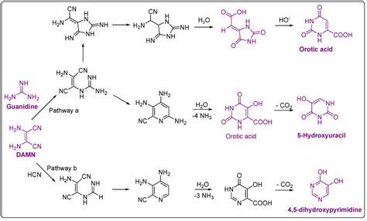
THE SCIENCE OF LIFE: SDABC V. 1 p. 48-49
These compounds are then organized into simple cells according to the following scenario:
(a) the formation of biomonomers such as amino acids and mononucleotides;
THE TESTIMONY OF BIOCHEMISTRY

Slide 35
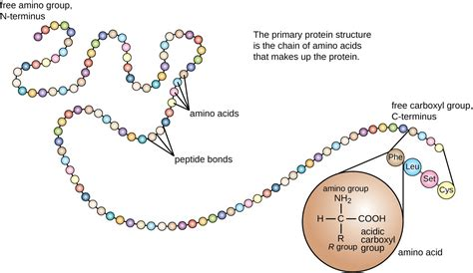
THE SCIENCE OF LIFE: SDABC V. 1 p. 48-49
(b) the condensation of these building-block-type molecules into polymers such as proteins and nucleic acids;
THE TESTIMONY OF BIOCHEMISTRY

Slide 36
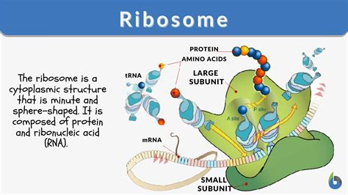
THE SCIENCE OF LIFE: SDABC V. 1 p. 48-49
(c) self-assembly of biopolymers into supramolecular complexes such as ribosomes and membranes;
THE TESTIMONY OF BIOCHEMISTRY

Slide 37
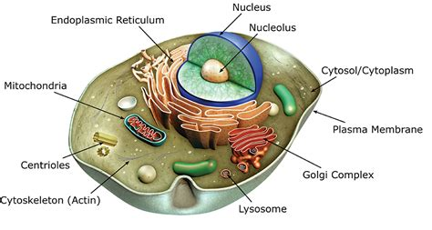
THE SCIENCE OF LIFE: SDABC V. 1 p. 48-49
(d) the organization of these complexes into organelles such as nuclei, endoplasmic reticula, and mitochondria; and
THE TESTIMONY OF BIOCHEMISTRY

Slide 38
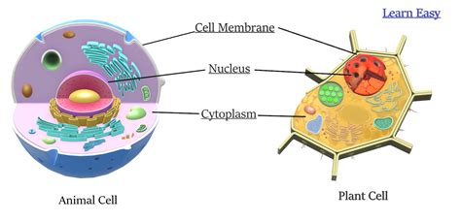
THE SCIENCE OF LIFE: SDABC V. 1 p. 48-49
(e) the formation of a simple cell by the assembly of these organelles
THE TESTIMONY OF BIOCHEMISTRY

Slide 39
STEPS TO LIFE:
It all has to come together…
The formation of BIOMONOMERS (amino acids)
Combination into POLYMERS (proteins)
Assembly into SUPRAMOLECULAR COMPLEXES
Organization into ORGANELLES
Formation of CELLS

Slide 40
The Formation of Biomonomers
(Specifically, Amino Acids)
The Science of Life (a)

Slide 41
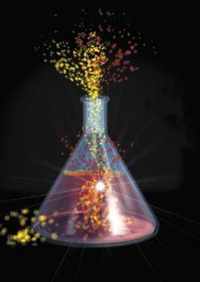
THE SCIENCE OF LIFE: SDABC V. 1 p. 48-49
Extended scientific observations have established that for a reaction to be spontaneous two processes will take place. First, the reacting substances will lose what is called free energy, reaching a lower energy state as products. Second, with rare exception these products will be more disordered than were the reactants.
THE TESTIMONY OF BIOCHEMISTRY

Slide 42
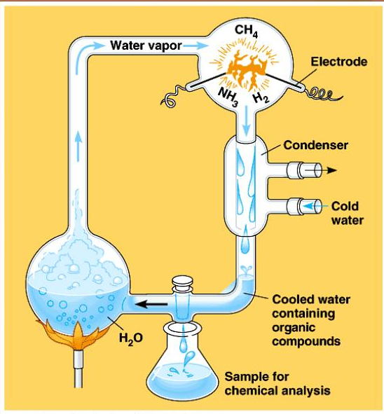
THE SCIENCE OF LIFE: SDABC V. 1 p. 48-49
Reactions that do not meet the above requirements for spontaneity will occur only if forced to do so with the expenditure of energy.
THE TESTIMONY OF BIOCHEMISTRY

Slide 43
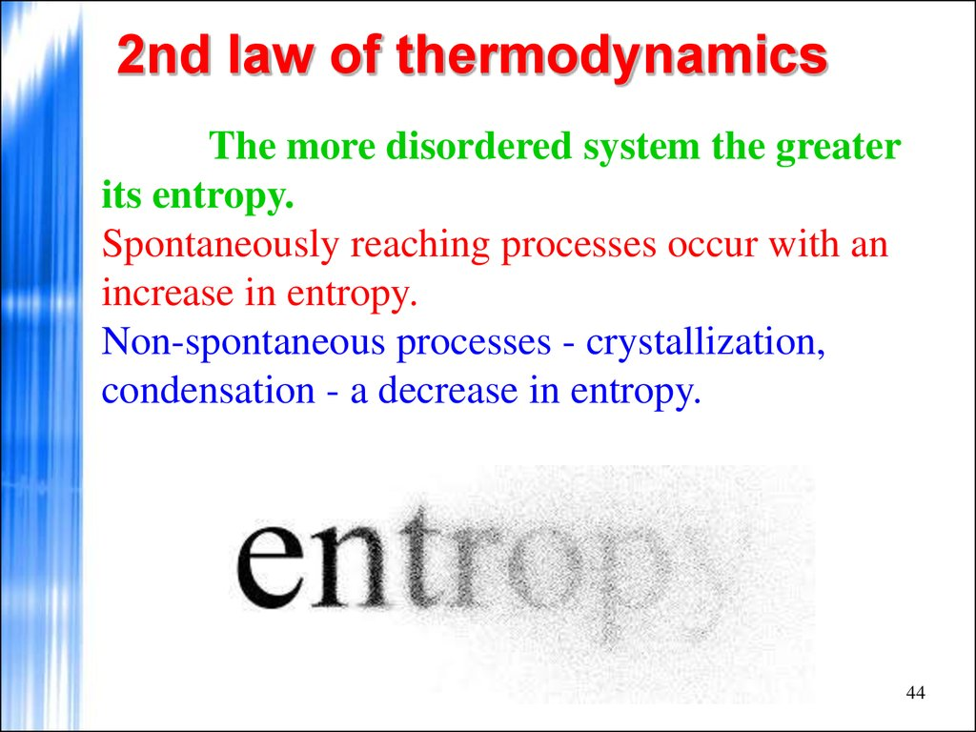
THE SCIENCE OF LIFE: SDABC V. 1 p. 48-49
Processes that occur spontaneously without intelligent direction and energy input always proceed toward lower free energy, lower complexity, lower information content, and a state of higher probability. This principle is often referred to as the second law of thermodynamics.
THE TESTIMONY OF BIOCHEMISTRY

Slide 44
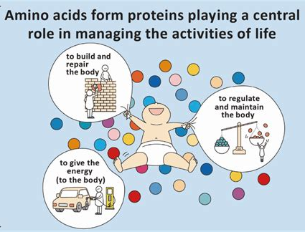
THE SCIENCE OF LIFE: SDABC V. 1 p. 48-50
Amino acids are considered to be fundamental building blocks of organisms. They are made up of carbon, hydrogen, oxygen, nitrogen, and sometimes sulphur in exact proportions and in critically exact spatial arrangement. When chemically bound together in long, chainlike fashion and in appropriate sequence they form proteins.
(a) THE FORMATION OF BIOMONOMERS (Amino Acids)

Slide 45
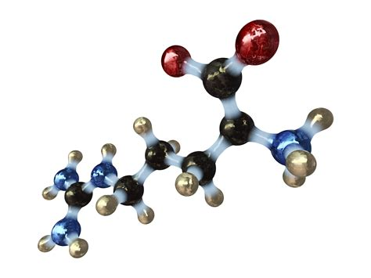
THE SCIENCE OF LIFE: SDABC V. 1 p. 48-50
Amino acids do not now occur in nature by themselves, and there is no evidence that they can be formed spontaneously from their basic constituents under present circumstances on earth. (Minute traces of some of the simpler amino acids have been found in a few meteorites [Cronin and Moore 1976].)
(a) THE FORMATION OF BIOMONOMERS (Amino Acids)

Slide 46
THE SCIENCE OF LIFE: SDABC V. 1 p. 48-50
Proponents of chemical evolution, therefore, are compelled to seek for plausible mechanisms that could yield amino acids under postulated primitive conditions. Up to possibly 18 of the 20 amino acids necessary for organisms may be synthesized by mixing methane (containing carbon and hydrogen), ammonia (containing nitrogen and hydrogen), and water (containing oxygen and hydrogen), in a reducing atmosphere of hydrogen gas, and by highly energizing the mixture in a variety of ways.
(a) THE FORMATION OF BIOMONOMERS (Amino Acids)

Slide 47
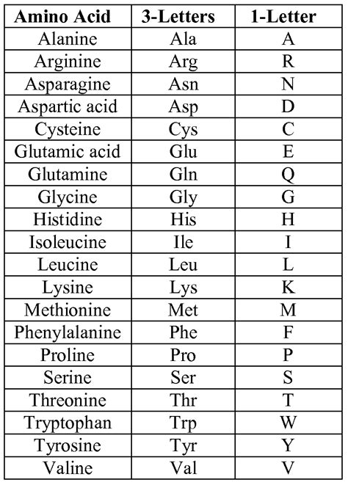
THE SCIENCE OF LIFE: SDABC V. 1 p. 48-50
The amount of amino acids produced in these experiments has been low, usually less than 1 percent, in comparison to the initial quantity of the carbon compounds present. These procedures all require that somewhat elaborate precautions be taken to remove the amino acids from the reacting system as they are formed so as to prevent their subsequent destruction by the energy source (Miller and Urey 1959).
(a) THE FORMATION OF BIOMONOMERS (Amino Acids)

Slide 48
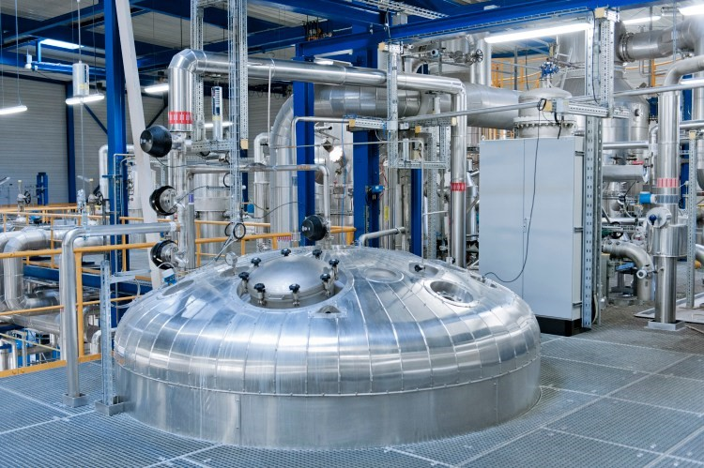
THE SCIENCE OF LIFE: SDABC V. 1 p. 48-50
The highly specialized laboratory conditions necessary for amino-acid synthesis make it difficult to propose a “primitive earth” situation that would provide adequate energy and sufficient preservation of the reaction products.
85 cubic meter fermentation reactor at EW Biotech’s L-alanine Production Facility in Leuna, Germany
(a) THE FORMATION OF BIOMONOMERS (Amino Acids)

Slide 49
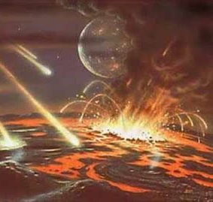
THE SCIENCE OF LIFE: SDABC V. 1 p. 48-50
Volcanic heat, lightning discharge, radioactivity and ultraviolet radiation are possible sources of energy; but there is increasing evidence that earth’s gaseous envelope has always contained an abundance of oxygen, rather than the hydrogen necessary for a reducing atmosphere in which amino acids can be synthesized (Javor and Snow 1974; Walton 1976).
(a) THE FORMATION OF BIOMONOMERS (Amino Acids)

Slide 50
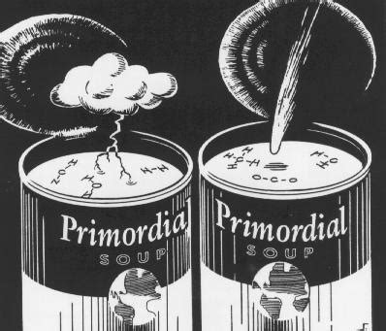
THE SCIENCE OF LIFE: SDABC V. 1 p. 48-50
In the presence of oxygen, amino acids and any other biologically relevant molecules would have been quickly destroyed. Furthermore, an atmosphere without oxygen would not have a protective high altitude layer of ozone to stop ultraviolet radiation, which rapidly destroys organic compounds.
(a) THE FORMATION OF BIOMONOMERS (Amino Acids)

Slide 51
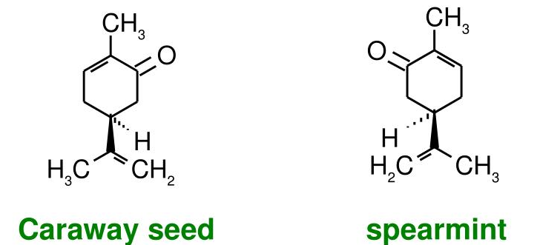
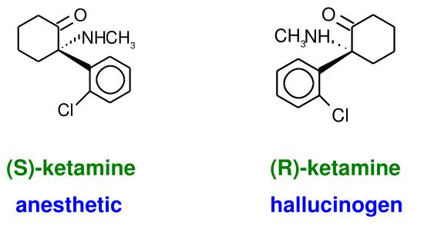
THE SCIENCE OF LIFE: SDABC V. 1 p. 48-50
There are additional difficulties with the scheme for a synthesis of amino acids that would supposedly lead to living cells. An amino acid may occur in four structural forms. This property is known as stereochemistry.
(a) THE FORMATION OF BIOMONOMERS (Amino Acids)

Slide 52
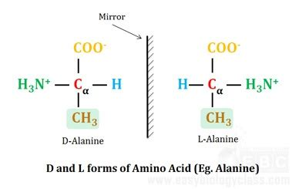
THE SCIENCE OF LIFE: SDABC V. 1 p. 48-50
Two of the forms are like a person’s two hands, right-hand form and left-hand form, very much alike yet different in the same way the image in a mirror is reversed from the object before the mirror.
(a) THE FORMATION OF BIOMONOMERS (Amino Acids)

Slide 53
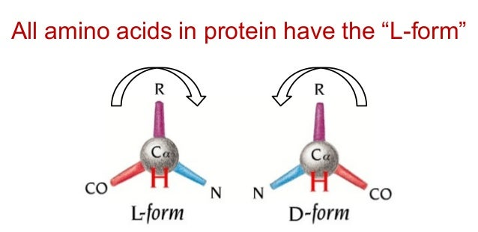
THE SCIENCE OF LIFE: SDABC V. 1 p. 48-50
These two forms are called D and L forms and laboratory syntheses normally yield approximately equal amounts of each. The proteins of living organisms consist almost entirely of the L form of each of the 20 different necessary amino acids.
(a) THE FORMATION OF BIOMONOMERS (Amino Acids)

Slide 54
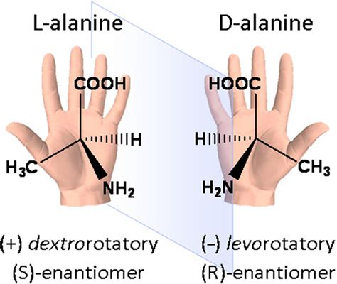
THE SCIENCE OF LIFE: SDABC V. 1 p. 50
If life randomly evolved and half of the “available” amino acids were D forms, why are D forms not equally represented in living organisms?
(a) THE FORMATION OF BIOMONOMERS (Amino Acids)

Slide 55
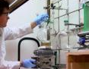
THE SCIENCE OF LIFE: SDABC V. 1 p. 50
In addition to the D and L forms, varieties of amino acids not normally found in proteins are also produced in simulated “primitive earth” experiments, sometimes in great abundance (Lawless and Boynton 1973). The question can be raised: Why are not these varieties also involved in protein formation, at least in some organisms?
(a) THE FORMATION OF BIOMONOMERS (Amino Acids)

Slide 56
THE SCIENCE OF LIFE: SDABC V. 1 p. 50
Similar difficulties exist with schemes for prebiotic syntheses of monosaccharides, fatty acids, and nitrogenous bases that are the building blocks of polysaccharides, lipids, and nucleic acids.
Formation of BIOMONOMERS:
Amino Acids ►►Proteins
Monosaccharides ►► Polysaccharides
Fatty Acids ►►Lipids
Nitrogenous Bases ►►Nucleic Acids
ALL OF THESE COMPOUNDS ARE NECESSARY FOR supramolecular complexes such as ribosomes and membranes, IE, FOR LIFE!
(a) THE FORMATION OF BIOMONOMERS

Slide 57
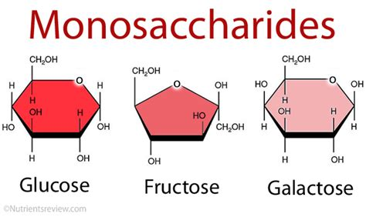
THE SCIENCE OF LIFE: SDABC V. 1 p. 50
None of these can be synthesized under prebiotic conditions in the presence of oxygen. Moreover, monosaccharides would again be produced as equal mixtures of several structural forms, of which only one is actually found in living organisms.
(a) THE FORMATION OF BIOMONOMERS

Slide 58
THE SCIENCE OF LIFE: SDABC V. 1 p. 50
It has been proved conclusively that an intelligent person using rather complex and sophisticated equipment under so-called “primitive earth” conditions, is able to synthesize a few simple compounds; but it does not follow that the reverse must also be true, that is, that simple chemical compounds have the capacity spontaneously to organize into man, given sufficient time.
(a) THE FORMATION OF BIOMONOMERS

Slide 59
STEPS TO LIFE:
It all has to come together…
The formation of BIOMONOMERS (amino acids)
Combination into POLYMERS (proteins)
Assembly into SUPRAMOLECULAR COMPLEXES
Organization into ORGANELLES
Formation of CELLS

Slide 60
Okay, so imagining that through some miraculous chain of circumstances, amino acids and other biomonomers were formed…. Then what?
The Science of Life

Slide 61
THE SCIENCE OF LIFE: SDABC V. 1 p. 50
A model for the spontaneous evolution of life not only must account for the origin of the basic building units such as amino acids and simple sugars, called biomonomers, it must also account for the combining of these building blocks into more complex and highly characteristic molecules called biopolymers. The process of uniting these is called polymerization. For instance, amino acids or mononucleotides are polymerized to form proteins and nucleic acids, respectively.
(b) THE FORMATION OF BIOPOLYMERS (Proteins)

Slide 62
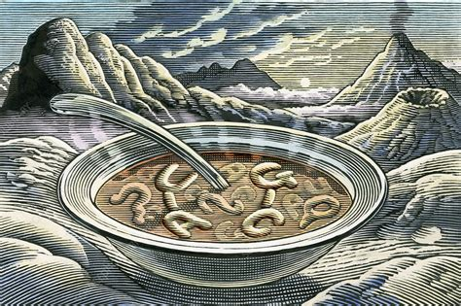
THE SCIENCE OF LIFE: SDABC V. 1 p. 50
First, one needs to consider the polymerization (combination into more complex forms) of the biomonomers (basic units) into large polymers (complex molecules), which involves a dehydration (removal of water) reaction.
(b) THE FORMATION OF BIOPOLYMERS (Proteins)

Slide 63
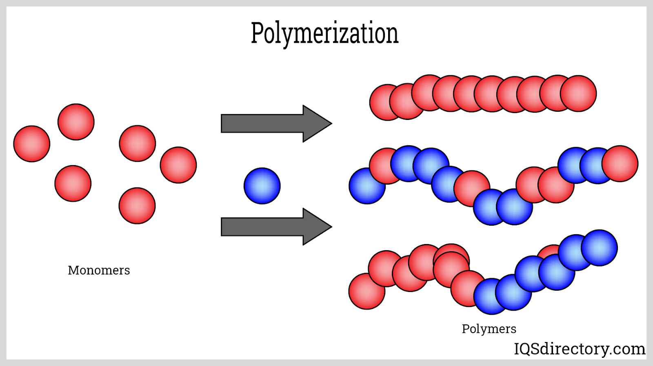
THE SCIENCE OF LIFE: SDABC V. 1 p. 50
Second, the arrangement of the biomonomers has to be highly specific; a proper sequence is critical for their biological activity.
(b) THE FORMATION OF BIOPOLYMERS (Proteins)

Slide 64
THE SCIENCE OF LIFE: SDABC V. 1 p. 50-51
The dehydration reaction requires energy; and several schemes have been suggested to provide this energy. In experiments carried out by Fox and his co-workers (Fox 1965) mixtures of dry amino acids were heated up to 175° C. and protein-like substances called proteinoids were obtained. Proteinoid formation always required high amino-acid concentrations. It cannot be accomplished in the presence of water, for water is a product of the reaction and must be removed in order to carry the polymerization to completion.
(b) THE FORMATION OF BIOPOLYMERS (Proteins)

Slide 65
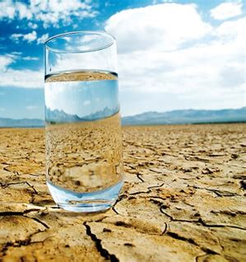
THE SCIENCE OF LIFE: SDABC V. 1 p. 51
In the presence of water the polymers tend to hydrolyze and degrade back to the monomers. It is difficult to imagine how such large amounts of amino acids could be concentrated at certain dry localities (volcanoes, e.g.) on the surface of the primitive earth, postulated to be mostly covered with oceans.
(b) THE FORMATION OF BIOPOLYMERS (Proteins)

Slide 66
THE SCIENCE OF LIFE: SDABC V. 1 p. 51
The experiments performed by Miller and Urey (1959), described above, assumed the formation of the amino acids in an aqueous media. Attempts have been made to couple amino acids in an aqueous environment by using dehydrating molecules such as cyanamides (Steinman, et al., 1964).
(b) THE FORMATION OF BIOPOLYMERS (Proteins)

Slide 67
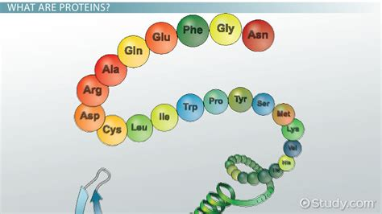
THE SCIENCE OF LIFE: SDABC V. 1 p. 51
While proteins may contain several hundred amino acids in a chain, this method can join only up to four in any appreciable yields. More serious is the problem of the linear sequence of amino acids in proteins.
(b) THE FORMATION OF BIOPOLYMERS (Proteins)

Slide 68
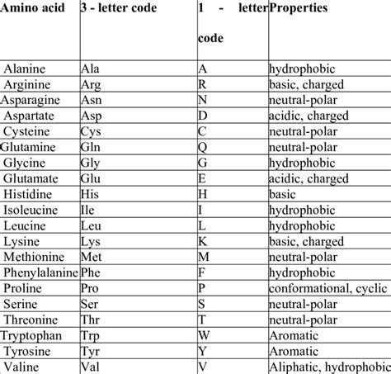
THE SCIENCE OF LIFE: SDABC V. 1 p. 51
Useful proteins are not random polymers of 20 kinds of amino acids. There are many chemical functions that are vital to the life of a cell, and each function requires a specific sequence of amino acids in the protein, which enables that process to be followed in the cell.
(b) THE FORMATION OF BIOPOLYMERS (Proteins)

Slide 69
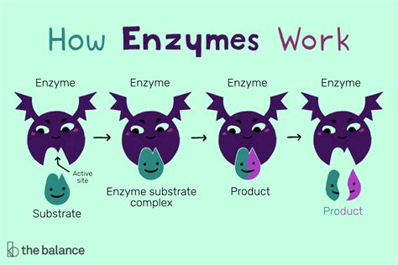
THE SCIENCE OF LIFE: SDABC V. 1 p. 51
A given protein may act as an enzyme, or biological catalyst, required for the many chemical reactions carried out by each living cell, each reaction usually requiring a different and specific enzyme.
(b) THE FORMATION OF BIOPOLYMERS (Proteins)

Slide 70
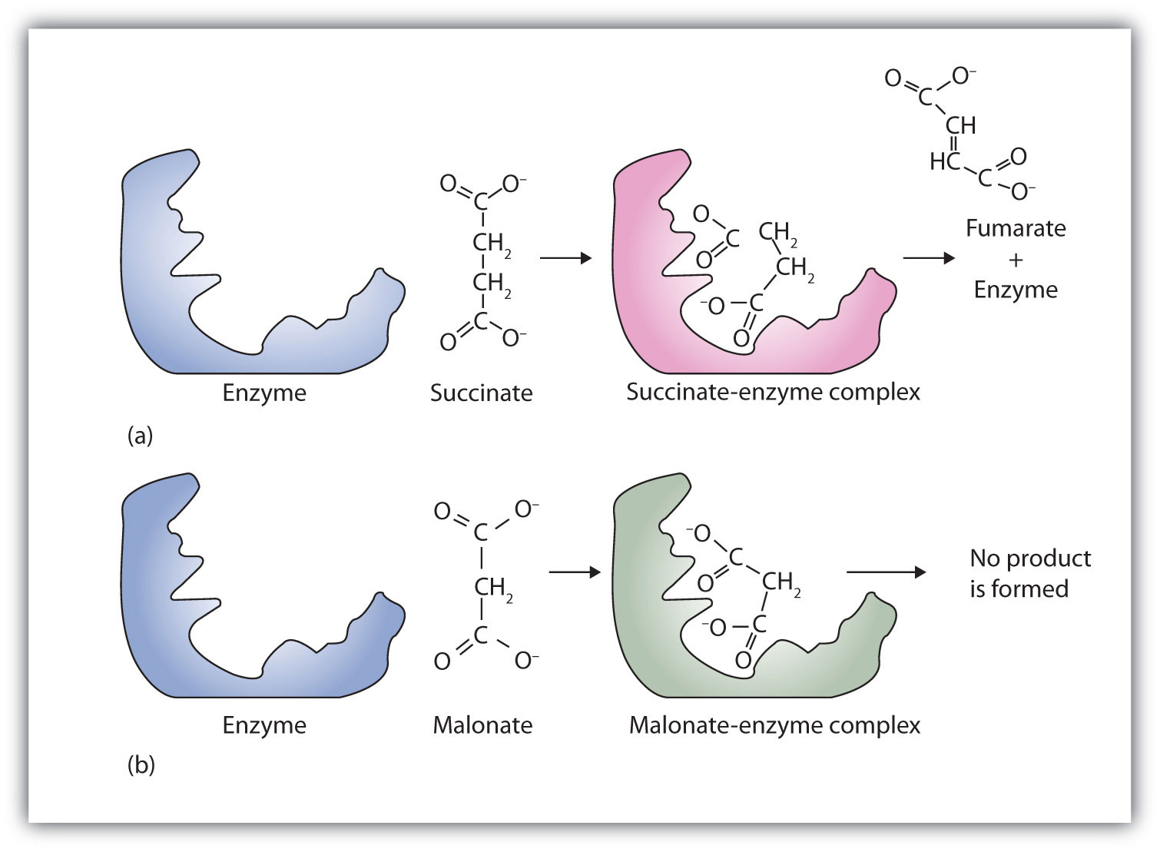
THE SCIENCE OF LIFE: SDABC V. 1 p. 51
(b) THE FORMATION OF BIOPOLYMERS (Proteins)

Slide 71
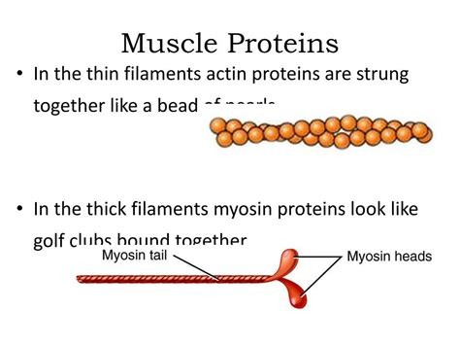
THE SCIENCE OF LIFE: SDABC V. 1 p. 51
It can serve as structural material such as collagen, found in tendons and ligaments. Some proteins are involved in transport, such as hemoglobin, which carries oxygen from the lungs to tire inner tissues of the body.
(b) THE FORMATION OF BIOPOLYMERS (Proteins)

Slide 72
THE SCIENCE OF LIFE: SDABC V. 1 p. 51
A protein may be an antibody that provides a specific protective mechanism against infection. Hormones, the chemical messengers involved in regulating an organism, may also be protein in nature. Some proteins act as storage for the essential amino acids. Others, such as actin, have the ability to contract and are needed for muscular action. All of these diverse functions depend on a highly specific number and order for the 20 kinds of amino acids that form protein structure.
(b) THE FORMATION OF BIOPOLYMERS (Proteins)

Slide 73
Problems with Proteins
The Science of Life (b)

Slide 74
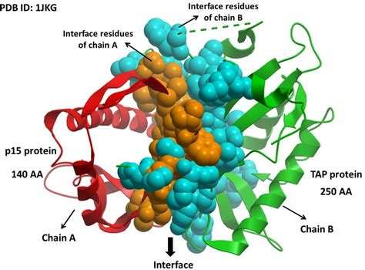
THE SCIENCE OF LIFE: Scientific American, July 1, 2021
Proteins are intricate nanomachines that perform most tasks in living things by constantly interacting with one another. They digest food, fight invaders, repair damage, sense their surroundings, carry signals, exert force, help create thoughts, and replicate.
THE TESTIMONY OF BIOCHEMISTRY

Slide 75
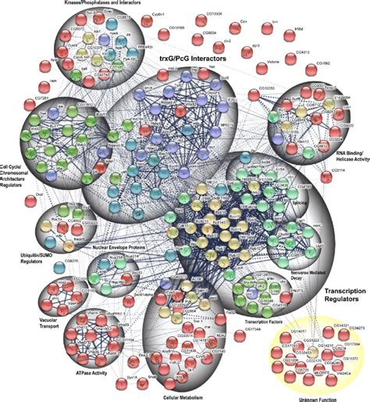
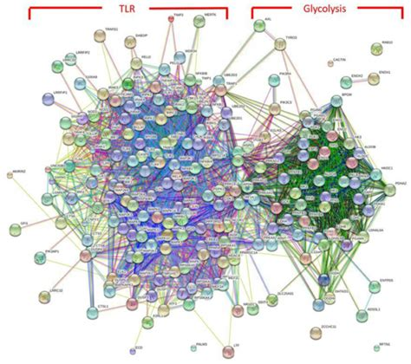
Protein Interaction Maps:

Slide 76
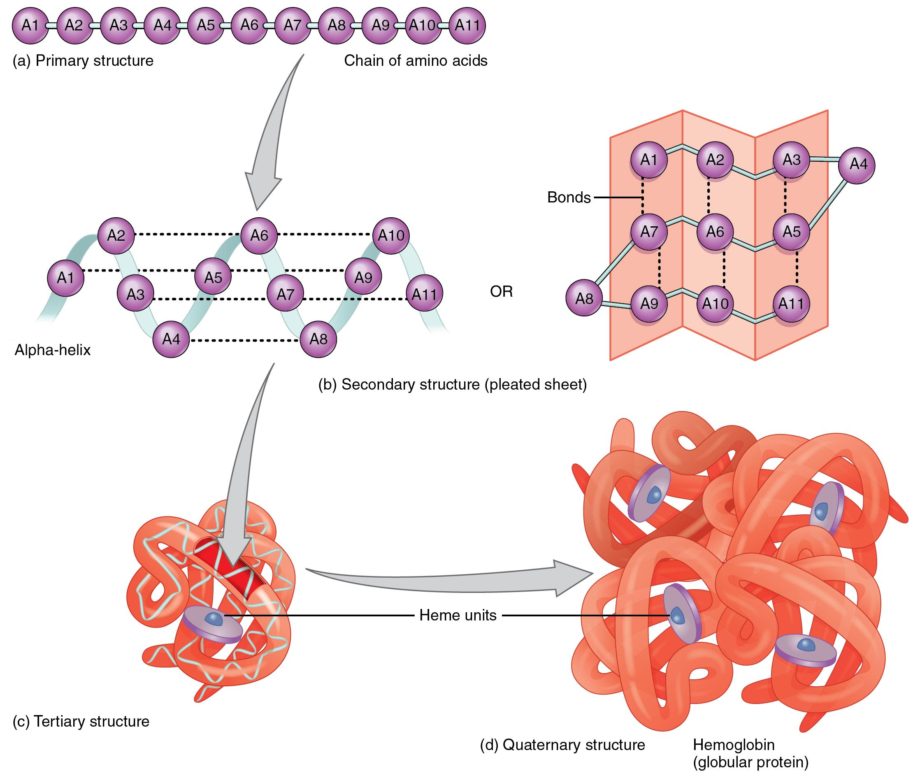
THE SCIENCE OF LIFE: Scientific American, July 1, 2021
They are made of long strings of simpler molecules called amino acids, and they twist and fold into enormously complex 3-D structures.
THE TESTIMONY OF BIOCHEMISTRY

Slide 77
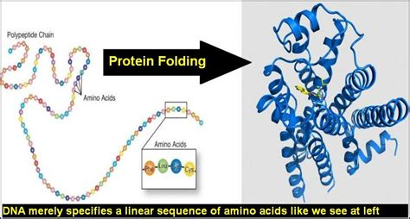
THE SCIENCE OF LIFE: Scientific American, July 1, 2021
Their origamilike shapes are governed by the order and number of the different aminos used to build them, which have distinct attractive and repellent forces.
THE TESTIMONY OF BIOCHEMISTRY

Slide 78
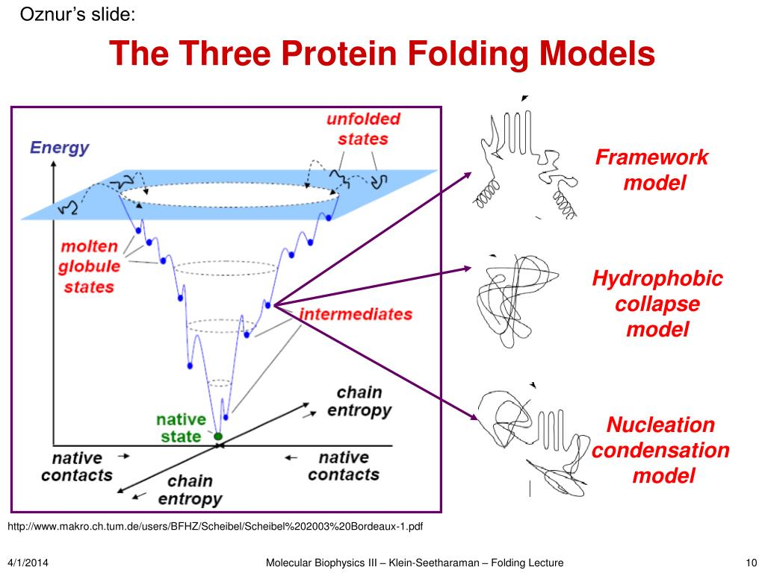
THE SCIENCE OF LIFE: Scientific American, July 1, 2021
The complexity of those interactions is so great and the scale so small (the average cell contains 42 million proteins) that we have never been able to figure out the rules governing how they spontaneously and dependably contort from strings to things. Many experts assumed we never would.
THE TESTIMONY OF BIOCHEMISTRY

Slide 79
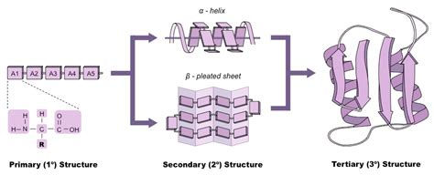
THE SCIENCE OF LIFE: Scientific American, July 1, 2021
But new insights and breakthroughs in artificial intelligence are coaxing, or forcing, proteins to give up their secrets.
THE TESTIMONY OF BIOCHEMISTRY

Slide 80
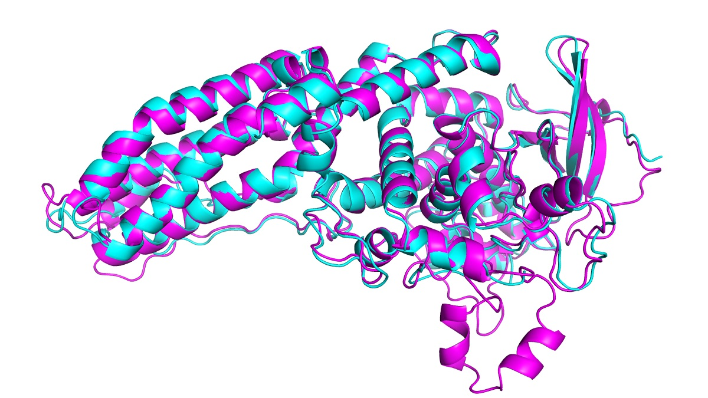
DeepMind’s AlphaFold AI Protein Folding Prediction:
In this year’s CASP (Critical Assessment of Methods of Protein Structure Prediction), AlphaFold predicted the structure of dozens of proteins with a margin of error of just 1.6 angstroms, or 0.16 nanometers. This is a solution to a 50-year-old problem in biochemistry!

Slide 81

THE SCIENCE OF LIFE: SDABC V. 1 p. 52
The proteinoids formed under the conditions of Fox’s experiments, mentioned above, possess random amino-acid sequences.
(b) THE FORMATION OF BIOPOLYMERS (Proteins)

Slide 82

THE SCIENCE OF LIFE: SDABC V. 1 p. 52
While it is possible that one of them will have the sequence of a functional protein, the chances of producing by random events on earth even a few of the proteins of a given cell are extremely low. Logic would dictate that one should look for alternatives.
(b) THE FORMATION OF BIOPOLYMERS (Proteins)

Slide 83

THE SCIENCE OF LIFE: SDABC V. 1 p. 52
In a sequence containing only 20 different amino acids in which each kind occurs only once, 2 x 10¹⁸ (2 followed by 18 zeros) different sequences can be formed.
(b) THE FORMATION OF BIOPOLYMERS (Proteins)

Slide 84

THE SCIENCE OF LIFE: SDABC V. 1 p. 52
It has been calculated that for a protein consisting of 288 amino acid units there are 10³⁰⁰ (1 followed by 300 zeros) possible combinations if only 12 kinds of amino acids are used.
(b) THE FORMATION OF BIOPOLYMERS (Proteins)

Slide 85

THE SCIENCE OF LIFE: SDABC V. 1 p. 52
If only one molecule of each of these combinations existed on earth, then the total mass of these sequences would be 10²⁸⁰ grams; yet the total mass of the earth, inorganic matter and all, is only 10²⁷ grams.
(b) THE FORMATION OF BIOPOLYMERS (Proteins)

Slide 86

THE SCIENCE OF LIFE: SDABC V. 1 p. 52
Another class of large molecular components of living cells is the nucleic acids. Nucleic acids, specifically DNA or deoxyribonucleic acid, contain on a molecular level the information that directs the synthesis of all the proteins vital to the operation of the cell.
(b) THE FORMATION OF BIOPOLYMERS (Proteins)

Slide 87

THE SCIENCE OF LIFE: SDABC V. 1 p. 52
The sequence of the mononucleotides in DNA is nature’s master code, which, when translated by a living cell, controls the sequence of the amino acids found in proteins. Errors in this code or in its translation may lead to the formation of nonfunctional proteins.
(b) THE FORMATION OF BIOPOLYMERS (Proteins)

Slide 88


THE SCIENCE OF LIFE: SDABC V. 1 p. 52
The problem of spontaneous synthesis of nucleic acids is even more formidable than that of proteins, since here it is necessary to have specific bond formation between three main components—purine or pyrimidine bases, pentose sugars, and phosphoric acid.
(b) THE FORMATION OF BIOPOLYMERS (Proteins)

Slide 89

THE SCIENCE OF LIFE: SDABC V. 1 p. 52
These three components properly arranged will form the mononucleotides, which in turn are the building blocks of the nucleic acids. The difficulty of nucleic-acid formation can be illustrated by pointing out that to this date no serious attempts have been made at producing nucleic acids under postulated prebiotic conditions.
(b) THE FORMATION OF BIOPOLYMERS (Proteins)

Slide 90
STEPS TO LIFE:
It all has to come together…
The formation of BIOMONOMERS (amino acids)
Combination into POLYMERS (proteins)
Assembly into SUPRAMOLECULAR COMPLEXES
Organization into ORGANELLES
Formation of CELLS

Slide 91

THE SCIENCE OF LIFE: SDABC V. 1 p. 52
The structure of a living cell is also highly organized. Both at the surface and inside are membranes that allow selective passage of certain compounds and the exclusion of others.
(c/d) Supramolecular Complexes and Organelles

Slide 92

THE SCIENCE OF LIFE: SDABC V. 1 p. 52
Some inner membranes function to bind proteins in the specific three-dimensional arrangement required to carry out many of the reaction sequences involved in the maintenance of life.
(c/d) Supramolecular Complexes and Organelles

Slide 93

THE SCIENCE OF LIFE: SDABC V. 1 p. 52
A good example may be found in the mitochondria—small organelles within the cell sometimes referred to as the powerhouse—where highly specific relationships are required between the enzymes that carry out the transfer of electrons from the substrates of oxygen and simultaneously synthesize energy-rich molecules.
(c/d) Supramolecular Complexes and Organelles

Slide 94

THE SCIENCE OF LIFE: SDABC V. 1 p. 52
Such complex specificity poses further constraints on a model that demands that the organizational level be reached by random processes.
(c/d) Supramolecular Complexes and Organelles

Slide 95

THE SCIENCE OF LIFE: SDABC V. 1 p. 52
In evaluating the possibility of the spontaneous origin of the basic molecules needed for life, one must conclude that a plausible mechanism has not been discovered or postulated.
(c/d) Supramolecular Complexes and Organelles

Slide 96

THE SCIENCE OF LIFE: SDABC V. 1 p. 52
Experiments assuming prebiotic conditions have not yet been able to produce all of the basic building blocks of biological systems. For most of those that have been produced the yields are extremely low, even under optimal conditions.
(c/d) Supramolecular Complexes and Organelles

Slide 97

THE SCIENCE OF LIFE: SDABC V. 1 p. 52
No satisfactory explanation accounts for the unique stereo-chemistry, or structure, of amino acids, sugar, and other molecules found in biological systems.
(c/d) Supramolecular Complexes and Organelles

Slide 98

THE SCIENCE OF LIFE: SDABC V. 1 p. 52-53
No model has been developed that can satisfactorily account for the highly specific sequences of amino acids in proteins and of nucleotides in nucleic acids or for the origin of the DNA genetic code.
(c/d) Supramolecular Complexes and Organelles

Slide 99

THE SCIENCE OF LIFE: SDABC V. 1 p. 53
Even if all of the basic building blocks could be synthesized they would not spontaneously be organized into biologically active subcellular structures. As pointed out by Monod (1971, pp. 95-113), life depends on an extremely high level of organization and specificity.
(c/d) Supramolecular Complexes and Organelles

Slide 100

THE SCIENCE OF LIFE: SDABC V. 1 p. 53
Precise control and regulation mechanisms must be built into the cell for the proper functioning of the organism. Chemical systems do not spontaneously order themselves; rather they tend to randomize.
(c/d) Supramolecular Complexes and Organelles

Slide 101
STEPS TO LIFE:
It all has to come together…
The formation of BIOMONOMERS (amino acids)
Combination into POLYMERS (proteins)
Assembly into SUPRAMOLECULAR COMPLEXES
Organization into ORGANELLES
Formation of CELLS

Slide 102

THE SCIENCE OF LIFE: SDABC V. 1 p. 53
The formidable obstacles to the spontaneous origin of life at the chemical and biochemical level, mentioned above, become even more complex when we consider the possible spontaneous origin of a simple but fully functional cell.
(e) The Formation of Cells

Slide 103

THE SCIENCE OF LIFE: SDABC V. 1 p. 53
This would be the simplest form of independent life that all biologists would accept as unquestionably alive. Despite occasional claims to the contrary, no serious attempts to put together a functional cell from its many known constituents have been made by physiologists, biochemists, or molecular biologists.
(e) The Formation of Cells

Slide 104


THE SCIENCE OF LIFE: SDABC V. 1 p. 53
Some of those who have carefully considered the problem recognize that in the light of present knowledge it is difficult, if not impossible, to conceive of success for such efforts (Pollard 1965). One can say that “the available facts do not provide a basis for postulating that cells arose on this planet” (Green and Goldberger 1967, p. 407)
(e) The Formation of Cells

Slide 105
REALITIES
It all has to come together…
Consider this sequence:
that amino acids, monosaccharides and all the rest spontaneously came into being despite solid science preventing them,

Slide 106
REALITIES
It all has to come together…
Then they magically formed the fantastically complex 3D forms of protein chains, lipids, and other polymers necessary to life… (which is simply statistically impossible),

Slide 107
REALITIES
It all has to come together…
Those polymers then formed the intricate arrangements necessary for functional cell membranes, well behaved protein channels, ribosomes, and other supramolecular complexes,

Slide 108
REALITIES
It all has to come together…
Which combined to form the fabulously precise and interdependent mitochondria, cell nuclei, and other organelles necessary to the production of energy and disposal of waste in a cell,

Slide 109

REALITIES
It all has to come together…
Which then, fortuitously and with marked accuracy, came together and developed the spectacular symbiosis necessary to the formation of a living cell (and the processes needful for cellular reproduction) …

Slide 110
REALITIES
It all has to come together…
And even if all of these events were to occur without causation or design, we would only see the development of a single cell, the “simplest” of all creatures. What about more complex organisms? The almost infinite subtleties of their interrelationships?

Slide 111

THE SCIENCE OF LIFE: SDABC V. 1 p. 53
When we turn to the multicellular organisms, be it plant or animal, we find another universe of complexity and interrelationships between numerous types of highly specialized cells, usually grouped in tissues and organs.
Multicellular Organisms

Slide 112

THE SCIENCE OF LIFE: SDABC V. 1 p. 53
Control of development and growth add another level of complexity, as does the regulation of normal function by endocrine, nervous, and other influences.
Multicellular Organisms

Slide 113

THE SCIENCE OF LIFE: SDABC V. 1 p. 53
Any candid student of physiology must stand convinced of the multitudinous evidences of design found in every multicellular organism studied to date.
Multicellular Organisms

Slide 114

THE SCIENCE OF LIFE: SDABC V. 1 p. 53
When the Christian views the mind and the body that it controls, unfolded in all the intricacy of modem anatomy, physiology, and biochemistry, he must agree with David, who said “I am fearfully and wonderfully made: marvellous are thy works” (Ps. 139:14)
Multicellular Organisms

Slide 115
MEMORY TEXT: Revelation 4:11
¹¹ Thou art worthy, O Lord, to receive glory and honour and power: for thou hast created all things, and for thy pleasure they are and were created.

Slide 116
Job 38:1-40:5
38 Then the Lord answered Job out of the whirlwind, and said,
² Who is this that darkeneth counsel by words without knowledge?
³ Gird up now thy loins like a man; for I will demand of thee, and answer thou me.
⁴ Where wast thou when I laid the foundations of the earth? declare, if thou hast understanding.

Slide 117
A Quick Note About God’s Answer to Job
SDABC V3 p598
God does not vindicate Job at once. His divine purpose is not to settle an argument, but to reveal Himself. Neither does He explain to Job the reason for his suffering. A clear understanding of God is superior in importance to an unfolding of all the reasons for divine providence. God does not explain why the wicked prosper or why the righteous suffer.

Slide 118
A Quick Note About God’s Answer to Job
SDABC V3 p598
He says nothing about the future world, or future compensation for present inequalities. God simply reveals Himself—His goodness, His power, His wisdom—and He intends that this revelation shall answer Job’s problems.God’s reply acquaints Job not merely with facts but with God. This approach was so effective that Job’s response was, “Now mine eye seeth thee” (ch. 42:5).

Slide 119
A Quick Note About God’s Answer to Job
SDABC V3 p598
When Job saw God, his perplexities disappeared. Only God could provide this kind of solution for his problems. There is a profundity about God’s way of answering Job’s questions that challenges the deepest thought.

Slide 120

Job 38:5-40:5
⁵ Who hath laid the measures thereof, if thou knowest? or who hath stretched the line upon it?
⁶ Whereupon are the foundations thereof fastened? or who laid the corner stone thereof;

Slide 121

Job 38:7-40:5
⁷ When the morning stars sang together, and all the sons of God shouted for joy?
⁸ Or who shut up the sea with doors, when it brake forth, as if it had issued out of the womb?

Slide 122

Job 38:9-40:5
⁹ When I made the cloud the garment thereof, and thick darkness a swaddlingband for it,
¹⁰ And brake up for it my decreed place, and set bars and doors,

Slide 123

Job 38:11-40:5
¹¹ And said, Hitherto shalt thou come, but no further: and here shall thy proud waves be stayed?
¹² Hast thou commanded the morning since thy days; and caused the dayspring to know his place;

Slide 124

Job 38:13-40:5
¹³ That it might take hold of the ends of the earth, that the wicked might be shaken out of it?
¹⁴ It is turned as clay to the seal; and they stand as a garment.

Slide 125

Job 38:15-40:5
¹⁵ And from the wicked their light is withholden, and the high arm shall be broken.
¹⁶ Hast thou entered into the springs of the sea? or hast thou walked in the search of the depth?

Slide 126

Job 38:17-40:5
¹⁷ Have the gates of death been opened unto thee? or hast thou seen the doors of the shadow of death?
¹⁸ Hast thou perceived the breadth of the earth? declare if thou knowest it all.

Slide 127

Job 38:19-40:5
¹⁹ Where is the way where light dwelleth? and as for darkness, where is the place thereof,
²⁰ That thou shouldest take it to the bound thereof, and that thou shouldest know the paths to the house thereof?

Slide 128

Job 38:21-40:5
²¹ Knowest thou it, because thou wast then born? or because the number of thy days is great?
²² Hast thou entered into the treasures of the snow? or hast thou seen the treasures of the hail,

Slide 129

Job 38:23-40:5
²³ Which I have reserved against the time of trouble, against the day of battle and war?
²⁴ By what way is the light parted, which scattereth the east wind upon the earth?

Slide 130

Job 38:25-40:5
²⁵ Who hath divided a watercourse for the overflowing of waters, or a way for the lightning of thunder;
²⁶ To cause it to rain on the earth, where no man is; on the wilderness, wherein there is no man;

Slide 131

Job 38:27-40:5
²⁷ To satisfy the desolate and waste ground; and to cause the bud of the tender herb to spring forth?
²⁸ Hath the rain a father? or who hath begotten the drops of dew?

Slide 132

Job 38:29-40:5
²⁹ Out of whose womb came the ice? and the hoary frost of heaven, who hath gendered it?
³⁰ The waters are hid as with a stone, and the face of the deep is frozen.

Slide 133

Job 38:31-40:5
³¹ Canst thou bind the sweet influences of Pleiades, or loose the bands of Orion?
³² Canst thou bring forth Mazzaroth in his season? or canst thou guide Arcturus with his sons?

Slide 134

Job 38:33-40:5
³³ Knowest thou the ordinances of heaven? canst thou set the dominion thereof in the earth?
³⁴ Canst thou lift up thy voice to the clouds, that abundance of waters may cover thee?

Slide 135

Job 38:35-40:5
³⁵ Canst thou send lightnings, that they may go and say unto thee, Here we are?
³⁶ Who hath put wisdom in the inward parts? or who hath given understanding to the heart?

Slide 136

Job 38:37-40:5
³⁷ Who can number the clouds in wisdom? or who can stay the bottles of heaven,
³⁸ When the dust groweth into hardness, and the clods cleave fast together?

Slide 137

Job 38:39-40:5
³⁹ Wilt thou hunt the prey for the lion? or fill the appetite of the young lions,
⁴⁰ When they couch in their dens, and abide in the covert to lie in wait?

Slide 138

Job 38:41-40:5
⁴¹ Who provideth for the raven his food? when his young ones cry unto God, they wander for lack of meat.
39 Knowest thou the time when the wild goats of the rock bring forth? or canst thou mark when the hinds do calve?

Slide 139

Job 39:2-40:5
² Canst thou number the months that they fulfil? or knowest thou the time when they bring forth?
³ They bow themselves, they bring forth their young ones, they cast out their sorrows.

Slide 140

Job 39:4-40:5
⁴ Their young ones are in good liking, they grow up with corn; they go forth, and return not unto them.
⁵ Who hath sent out the wild ass free? or who hath loosed the bands of the wild ass?

Slide 141

Job 39:6-40:5
⁶ Whose house I have made the wilderness, and the barren land his dwellings.
⁷ He scorneth the multitude of the city, neither regardeth he the crying of the driver.

Slide 142

Job 39:8-40:5
⁸ The range of the mountains is his pasture, and he searcheth after every green thing.
⁹ Will the unicorn be willing to serve thee, or abide by thy crib?

Slide 143

Job 39:10-40:5
¹⁰ Canst thou bind the unicorn with his band in the furrow? or will he harrow the valleys after thee?
¹¹ Wilt thou trust him, because his strength is great? or wilt thou leave thy labour to him?

Slide 144

Job 39:12-40:5
¹² Wilt thou believe him, that he will bring home thy seed, and gather it into thy barn?
¹³ Gavest thou the goodly wings unto the peacocks? or wings and feathers unto the ostrich?

Slide 145

Job 39:14-40:5
¹⁴ Which leaveth her eggs in the earth, and warmeth them in dust,
¹⁵ And forgetteth that the foot may crush them, or that the wild beast may break them.

Slide 146

Job 39:16-40:5
¹⁶ She is hardened against her young ones, as though they were not her's: her labour is in vain without fear;
¹⁷ Because God hath deprived her of wisdom, neither hath he imparted to her understanding.

Slide 147

Job 39:18-40:5
¹⁸ What time she lifteth up herself on high, she scorneth the horse and his rider.
¹⁹ Hast thou given the horse strength? hast thou clothed his neck with thunder?

Slide 148

Job 39:20-40:5
²⁰ Canst thou make him afraid as a grasshopper? the glory of his nostrils is terrible.
²¹ He paweth in the valley, and rejoiceth in his strength: he goeth on to meet the armed men.

Slide 149

Job 39:22-40:5
²² He mocketh at fear, and is not affrighted; neither turneth he back from the sword.
²³ The quiver rattleth against him, the glittering spear and the shield.

Slide 150

Job 39:24-40:5
²⁴ He swalloweth the ground with fierceness and rage: neither believeth he that it is the sound of the trumpet.
²⁵ He saith among the trumpets, Ha, ha; and he smelleth the battle afar off, the thunder of the captains, and the shouting.

Slide 151

Job 39:26-40:5
²⁶ Doth the hawk fly by thy wisdom, and stretch her wings toward the south?
²⁷ Doth the eagle mount up at thy command, and make her nest on high?

Slide 152

Job 39:28-40:5
²⁸ She dwelleth and abideth on the rock, upon the crag of the rock, and the strong place.
²⁹ From thence she seeketh the prey, and her eyes behold afar off.
³⁰ Her young ones also suck up blood: and where the slain are, there is she.

Slide 153

Job 40:1-5
40 Moreover the Lord answered Job, and said,
² Shall he that contendeth with the Almighty instruct him? he that reproveth God, let him answer it.
³ Then Job answered the Lord, and said,

Slide 154

Job 40:4-5
⁴ Behold, I am vile; what shall I answer thee? I will lay mine hand upon my mouth.
⁵ Once have I spoken; but I will not answer: yea, twice; but I will proceed no further.

Slide 155
A Quick Note About Job’s Answer to God
SDABC V3 p605
It seems as if God is giving Job an opportunity to make a complete surrender at this point. Job has heard the profound questions of chs. 38 and 39. Now the question comes to him, Can he, the faultfinder, the contender, instruct the God of all nature? The answer that Job will give is obvious, in view of the revelations of the previous two chapters.

Slide 156
A Quick Note About Job’s Answer to God
SDABC V3 p605
Job is pointedly challenged to defend his endeavors to instruct God. Satan predicted that Job would curse God. This he had not done. But he had erred in trying to tell God what to do. Job had expressed himself as anxious to argue his case with God. He seemed to feel that, somehow, God did not quite understand.

Slide 157
A Quick Note About Job’s Answer to God
SDABC V3 p605
Now, after God has given a new revelation of His wisdom, Job is asked whether he still feels himself qualified to be the plaintiff in a case against God. Job had anticipated such an opportunity as this—an opportunity to lay his case directly before God. This is his long-awaited occasion. What would he do with it?

Slide 158
A Quick Note About Job’s Answer to God
SDABC V3 p605
Instead of saying, “I am innocent,” as he had intended to say, he replies, “I am vile.” God’s revelation has changed his entire attitude toward himself and toward God. A similar conviction dawns upon all men who arrive at a proper appreciation of God.

Slide 159
A Quick Note About Job’s Answer to God
SDABC V3 p605
Yet God continues in a similar vein for a further couple of chapters. Apparently Job needs further instruction. From the whirlwind returns the divine voice. If God’s motive had been to abash Job, He would not need to say more. Already Job has admitted his littleness, and has promised to say no more. But God’s primary purpose is not to embarrass Job, but to lead him to a new experience.

Slide 160

Acts 17:24-28
²⁴ God that made the world and all things therein, seeing that he is Lord of heaven and earth, dwelleth not in temples made with hands;
²⁵ Neither is worshipped with men's hands, as though he needed any thing, seeing he giveth to all life, and breath, and all things;

Slide 161

Acts 17:26-28
²⁶ And hath made of one blood all nations of men for to dwell on all the face of the earth, and hath determined the times before appointed, and the bounds of their habitation;

Slide 162

Acts 17:27-28
²⁷ That they should seek the Lord, if haply they might feel after him, and find him, though he be not far from every one of us:
²⁸ For in him we live, and move, and have our being; as certain also of your own poets have said, For we are also his offspring.

Slide 163
Isaiah 40:25-31
²⁵ To whom then will ye liken me, or shall I be equal? saith the Holy One.
²⁶ Lift up your eyes on high, and behold who hath created these things, that bringeth out their host by number: he calleth them all by names by the greatness of his might, for that he is strong in power; not one faileth.

Slide 164
Isaiah 40:27-31
²⁷ Why sayest thou, O Jacob, and speakest, O Israel, My way is hid from the Lord, and my judgment is passed over from my God?
²⁸ Hast thou not known? hast thou not heard, that the everlasting God, the Lord, the Creator of the ends of the earth, fainteth not, neither is weary? there is no searching of his understanding.

Slide 165
Isaiah 40:29-31
²⁹ He giveth power to the faint; and to them that have no might he increaseth strength.
³⁰ Even the youths shall faint and be weary, and the young men shall utterly fall:
³¹ But they that wait upon the Lord shall renew their strength; they shall mount up with wings as eagles; they shall run, and not be weary; and they shall walk, and not faint.

Slide 166
THANK YOU!
&
Happy Sabbath!

