Slide 1
The Sabbath and the End
Revelation 13:11-14:7, 3:14-22
Genesis 17, Romans 4 & 6, Ephesians 1
Lesson 8, 2nd Quarter 2023

Slide 2
Memory Text: Ephesians 3:9
⁹ And to make all men see what is the fellowship of the mystery, which from the beginning of the world hath been hid in God, who created all things by Jesus Christ:

Slide 3
Key Text: Revelation 14:6-7
⁶ And I saw another angel fly in the midst of heaven, having the everlasting gospel to preach unto them that dwell on the earth, and to every nation, and kindred, and tongue, and people,
⁷ Saying with a loud voice, Fear God, and give glory to him; for the hour of his judgment is come: and worship him that made heaven, and earth, and the sea, and the fountains of waters.

Slide 4
Israel's Sign: Genesis 17:9-11
⁹ And God said unto Abraham, Thou shalt keep my covenant therefore, thou, and thy seed after thee in their generations.
¹⁰ This is my covenant, which ye shall keep, between me and you and thy seed after thee; Every man child among you shall be circumcised.
¹¹ And ye shall circumcise the flesh of your foreskin; and it shall be a token of the covenant betwixt me and you.

Slide 5
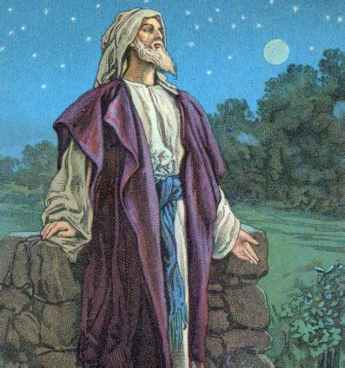
Israel's Sign: Genesis 17:14-23
¹⁴ And the uncircumcised man child whose flesh of his foreskin is not circumcised, that soul shall be cut off from his people; he hath broken my covenant.
¹⁵ And God said unto Abraham, As for Sarai thy wife, thou shalt not call her name Sarai, but Sarah shall her name be.

Slide 6
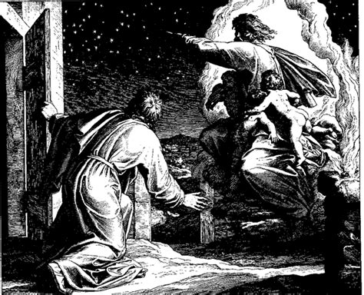
Israel's Sign: Genesis 17:16-23
¹⁶ And I will bless her, and give thee a son also of her: yea, I will bless her, and she shall be a mother of nations; kings of people shall be of her.

Slide 7
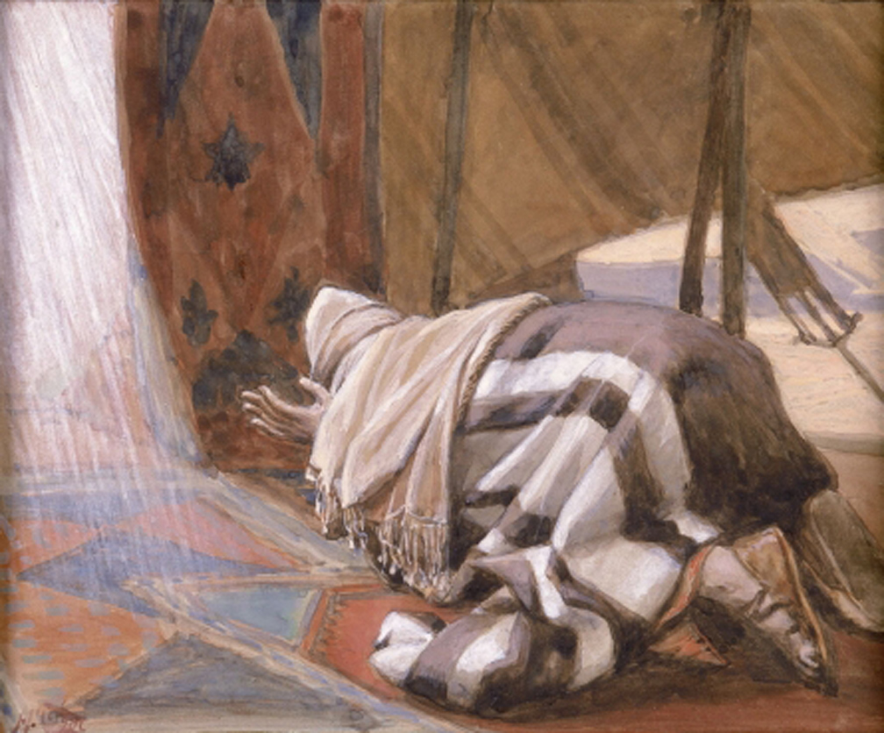
Israel's Sign: Genesis 17:17-23
¹⁷ Then Abraham fell upon his face, and laughed, and said in his heart, Shall a child be born unto him that is an hundred years old? and shall Sarah, that is ninety years old, bear?

Slide 8
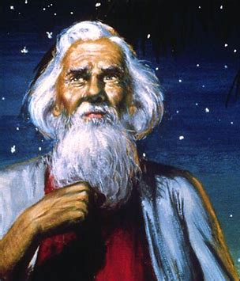
Israel's Sign: Genesis 17:18-23
¹⁸ And Abraham said unto God, O that Ishmael might live before thee!
¹⁹ And God said, Sarah thy wife shall bear thee a son indeed; and thou shalt call his name Isaac: and I will establish my covenant with him for an everlasting covenant, and with his seed after him.

Slide 9
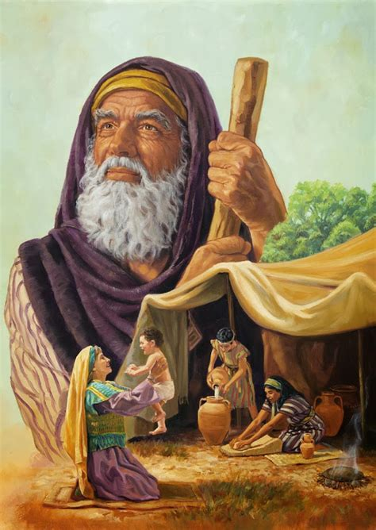
Israel's Sign: Genesis 17:20-23
²⁰ And as for Ishmael, I have heard thee: Behold, I have blessed him, and will make him fruitful, and will multiply him exceedingly; twelve princes shall he beget, and I will make him a great nation.
²¹ But my covenant will I establish with Isaac, which Sarah shall bear unto thee at this set time in the next year.

Slide 10
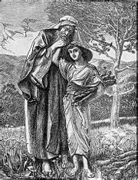
Israel's Sign: Genesis 17:22-23
²² And he left off talking with him, and God went up from Abraham.
²³ And Abraham took Ishmael his son, and all that were born in his house, and all that were bought with his money, every male among the men of Abraham's house; and circumcised the flesh of their foreskin in the selfsame day, as God had said unto him.

Slide 11
Abraham and Sarah have demonstrated that they’re trusting in the flesh. They have conspired to get a son—Ishmael—through their own fleshly machinations rather than trusting in God and God’s timing. And now, what is God asking them to do? The sign of the covenant becomes a cutting off of the flesh.
It’s a little graphic as a sign, but it was meant to be! It’s a bloody, graphic message to a very pragmatic desert people. God is to be trusted, even (or maybe especially) over one’s own flesh.

Slide 12
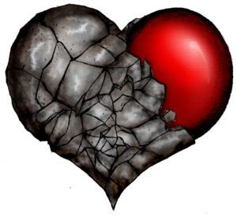
Israel's Sign: Deuteronomy 30:6
⁶ And the Lord thy God will circumcise thine heart, and the heart of thy seed, to love the Lord thy God with all thine heart, and with all thy soul, that thou mayest live.

Slide 13
Notice that it’s a matter of survival. We need to love the Lord with everything we have, so that we might live. The symbolism is everything here! Circumcision becomes the symbol for an Israelite’s absolute love and trust in God.
It’s meant to be a sign of faith for the Jewish people. But we sinful humans find odd ways to misinterpret God’s plainest words. A sign of faith isn’t a replacement for faith itself.

Slide 14
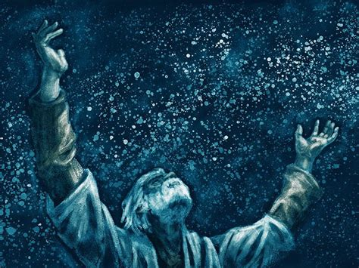
Explaining Israel's Sign: Romans 4:1-17
4 What shall we say then that Abraham our father, as pertaining to the flesh, hath found?
² For if Abraham were justified by works, he hath whereof to glory; but not before God.

Slide 15
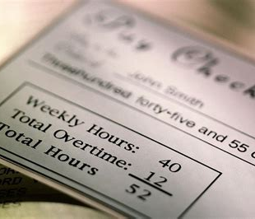
Explaining Israel's Sign: Romans 4:3-17
³ For what saith the scripture? Abraham believed God, and it was counted unto him for righteousness.
⁴ Now to him that worketh is the reward not reckoned of grace, but of debt.

Slide 16

Explaining Israel's Sign: Romans 4:5-17
⁵ But to him that worketh not, but believeth on him that justifieth the ungodly, his faith is counted for righteousness.
⁶ Even as David also describeth the blessedness of the man, unto whom God imputeth righteousness without works,

Slide 17
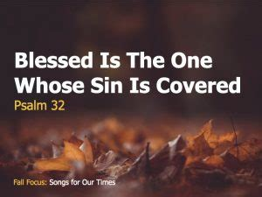
Explaining Israel's Sign: Romans 4:7-17
⁷ Saying, Blessed are they whose iniquities are forgiven, and whose sins are covered.
⁸ Blessed is the man to whom the Lord will not impute sin.

Slide 18
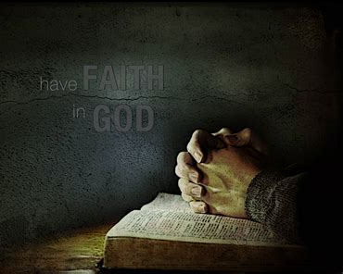
Explaining Israel's Sign: Romans 4:9-17
⁹ Cometh this blessedness then upon the circumcision only, or upon the uncircumcision also? for we say that faith was reckoned to Abraham for righteousness.

Slide 19
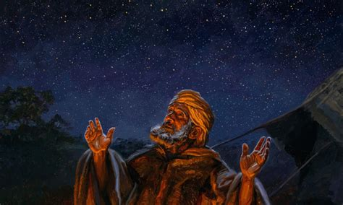
Explaining Israel's Sign: Romans 4:10-17
¹⁰ How was it then reckoned? when he was in circumcision, or in uncircumcision? Not in circumcision, but in uncircumcision.

Slide 20
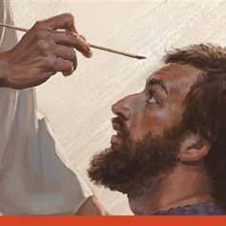
Explaining Israel's Sign: Romans 4:11-17
¹¹ And he received the sign of circumcision, a seal of the righteousness of the faith which he had yet being uncircumcised: that he might be the father of all them that believe, though they be not circumcised; that righteousness might be imputed unto them also:

Slide 21
Explaining Israel's Sign: Romans 4:11-17
¹¹ And he received the sign of circumcision, a seal of the righteousness of the faith which he had yet being uncircumcised: that he might be the father of all them that believe, though they be not circumcised; that righteousness might be imputed unto them also:

Slide 22
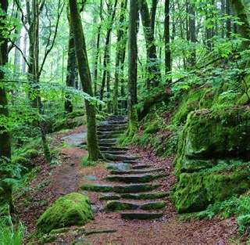
Explaining Israel's Sign: Romans 4:12-17
¹² And the father of circumcision to them who are not of the circumcision only, but who also walk in the steps of that faith of our father Abraham, which he had being yet uncircumcised.

Slide 23
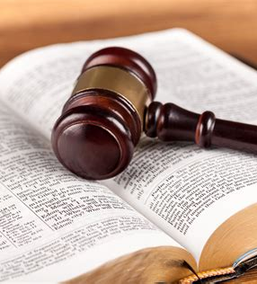
Explaining Israel's Sign: Romans 4:13-17
¹³ For the promise, that he should be the heir of the world, was not to Abraham, or to his seed, through the law, but through the righteousness of faith.
¹⁴ For if they which are of the law be heirs, faith is made void, and the promise made of none effect:

Slide 24
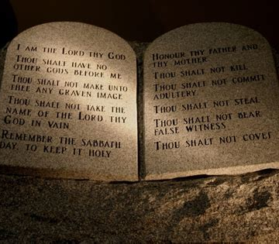
Explaining Israel's Sign: Romans 4:15-17
¹⁵ Because the law worketh wrath: for where no law is, there is no transgression.
¹⁶ Therefore it is of faith, that it might be by grace; to the end the promise might be sure to all the seed; not to that only which is of the law, but to that also which is of the faith of Abraham; who is the father of us all,

Slide 25
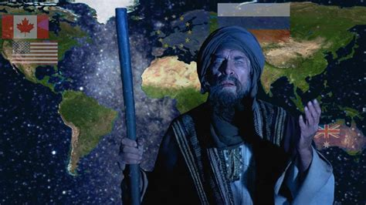
Explaining Israel's Sign: Romans 4:17
¹⁷ (As it is written, I have made thee a father of many nations,) before him whom he believed, even God, who quickeneth the dead, and calleth those things which be not as though they were.

Slide 26
Paul tells us clearly that circumcision was a seal for Abraham, “a seal of the righteousness of the faith which he had” before his circumcision. The seal isn’t Abraham’s faith itself, but a marker, sign, or token that his faith existed. It was evidence that Abraham trusted in God (righteousness by faith) above his own flesh (righteousness by works).
But we know that this sign became misinterpreted over time. The Jewish people came to value the physical symbol so highly that they forgot the meaning of the symbol.

Slide 27
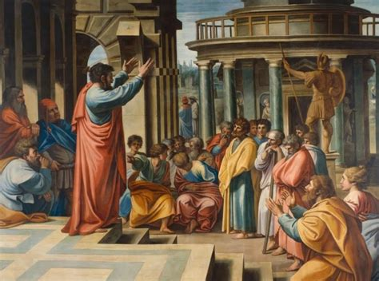
Explaining Israel's Sign: Galatians 5:2-6
² Behold, I Paul say unto you, that if ye be circumcised, Christ shall profit you nothing.
³ For I testify again to every man that is circumcised, that he is a debtor to do the whole law.

Slide 28
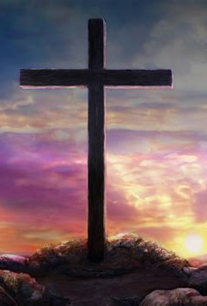
Explaining Israel's Sign: Galatians 5:4-6
⁴ Christ is become of no effect unto you, whosoever of you are justified by the law; ye are fallen from grace.
⁵ For we through the Spirit wait for the hope of righteousness by faith.
⁶ For in Jesus Christ neither circumcision availeth any thing, nor uncircumcision; but faith which worketh by love.

Slide 29
God gives a seal or a sign of righteousness by faith and his people can pervert it into a sign that becomes identified with showing our own righteousness by our works!
We have to be careful to maintain our focus on the things God actually intended for us, rather than the traditions that develop around them. That’s why Paul writes in Romans 2:28-29…
²⁸ For he is not a Jew, which is one outwardly; neither is that circumcision, which is outward in the flesh: ²⁹ But he is a Jew, which is one inwardly; and circumcision is that of the heart, in the spirit, and not in the letter; whose praise is not of men, but of God.

Slide 30
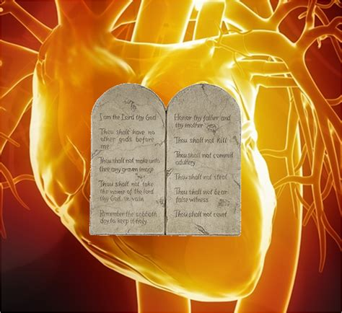
Changing the Sign: 1 Corinthians 7:18-19
¹⁸ Is any man called being circumcised? let him not become uncircumcised. Is any called in uncircumcision? let him not be circumcised.
¹⁹ Circumcision is nothing, and uncircumcision is nothing, but the keeping of the commandments of God.

Slide 31
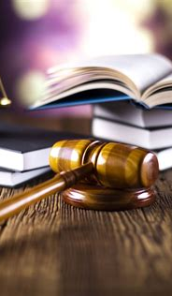
Changing the Sign: Galatians 6:12-16
¹² As many as desire to make a fair shew in the flesh, they constrain you to be circumcised; only lest they should suffer persecution for the cross of Christ.
¹³ For neither they themselves who are circumcised keep the law; but desire to have you circumcised, that they may glory in your flesh.

Slide 32
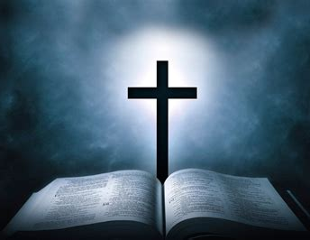
Changing the Sign: Galatians 6:14-16
¹⁴ But God forbid that I should glory, save in the cross of our Lord Jesus Christ, by whom the world is crucified unto me, and I unto the world.
¹⁵ For in Christ Jesus neither circumcision availeth any thing, nor uncircumcision, but a new creature.

Slide 33
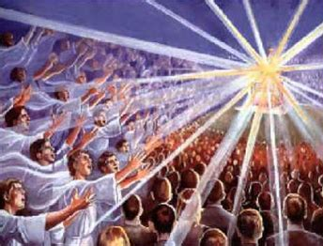
Changing the Sign: Galatians 6:16
¹⁶ And as many as walk according to this rule, peace be on them, and mercy, and upon the Israel of God.

Slide 34
In the New Testament, circumcision is set aside as the sign of the covenant, as a sign of righteousness by faith, and in its place is the sign of baptism. The idea of cutting off a person’s inclinations to make room for God’s plans hadn’t changed though! The symbolism just expanded slightly.
Instead of symbolically cutting the flesh, baptism symbolically cuts off a person’s life—at least, as it is currently being lived. It’s replaced, not with just an altered body, but with an altered way of living.

Slide 35

Spiritual Israel's Sign: Romans 6:1-8
6 What shall we say then? Shall we continue in sin, that grace may abound?
² God forbid. How shall we, that are dead to sin, live any longer therein?

Slide 36
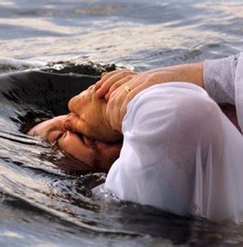
Spiritual Israel's Sign: Romans 6:3-8
³ Know ye not, that so many of us as were baptized into Jesus Christ were baptized into his death?
⁴ Therefore we are buried with him by baptism into death: that like as Christ was raised up from the dead by the glory of the Father, even so we also should walk in newness of life.

Slide 37
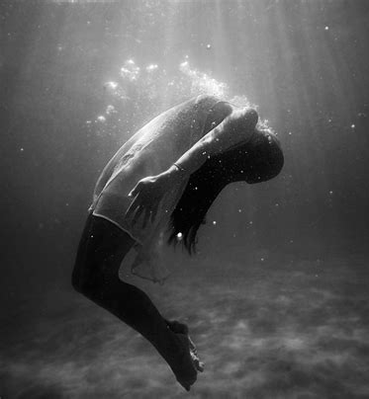
Spiritual Israel's Sign: Romans 6:5-8
⁵ For if we have been planted together in the likeness of his death, we shall be also in the likeness of his resurrection:
⁶ Knowing this, that our old man is crucified with him, that the body of sin might be destroyed, that henceforth we should not serve sin.

Slide 38
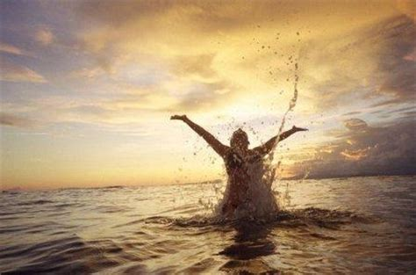
Spiritual Israel's Sign: Romans 6:7-8
⁷ For he that is dead is freed from sin.
⁸ Now if we be dead with Christ, we believe that we shall also live with him:

Slide 39
So baptism represents a complete change in a Christian’s lifestyle, a dying to self and to sin, and a completely new life in Christ. The idea of placing God’s directions FIRST in our lives is unchanged. Abraham and Sarah received the same message with the sign of circumcision.
And baptism is the indicator/sign/symbol/token of the same righteousness-by-faith for us! Baptism isn’t, by itself, a replacement for faith, but just a sign of it.

Slide 40
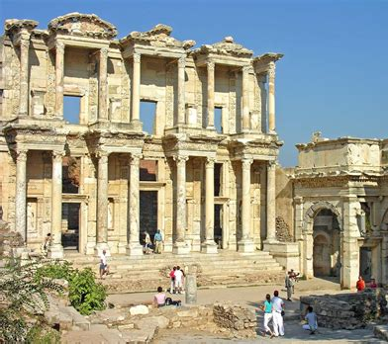
Spiritual Israel's Sign: Ephesians 1:1-14
1 Paul, an apostle of Jesus Christ by the will of God, to the saints which are at Ephesus, and to the faithful in Christ Jesus:
² Grace be to you, and peace, from God our Father, and from the Lord Jesus Christ.

Slide 41
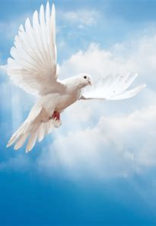
Spiritual Israel's Sign: Ephesians 1:3-14
³ Blessed be the God and Father of our Lord Jesus Christ, who hath blessed us with all spiritual blessings in heavenly places in Christ:
⁴ According as he hath chosen us in him before the foundation of the world, that we should be holy and without blame before him in love:

Slide 42
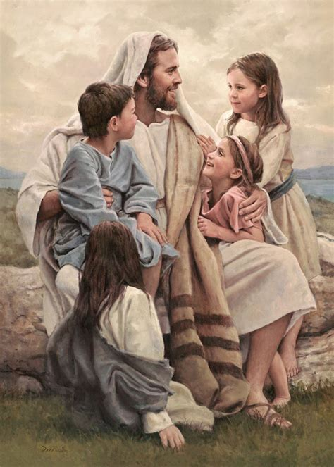
Spiritual Israel's Sign: Ephesians 1:5-14
⁵ Having predestinated us unto the adoption of children by Jesus Christ to himself, according to the good pleasure of his will,
⁶ To the praise of the glory of his grace, wherein he hath made us accepted in the beloved.

Slide 43
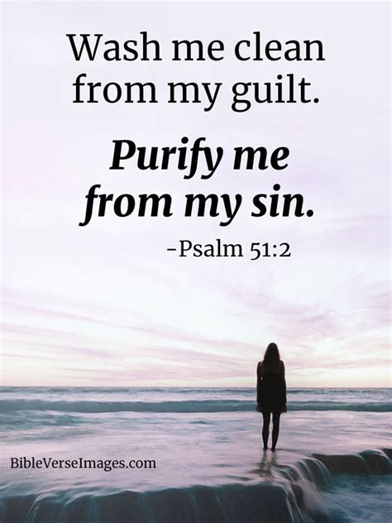
Spiritual Israel's Sign: Ephesians 1:7-14
⁷ In whom we have redemption through his blood, the forgiveness of sins, according to the riches of his grace;
⁸ Wherein he hath abounded toward us in all wisdom and prudence;

Slide 44
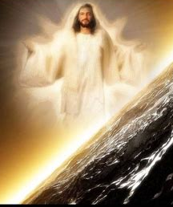
Spiritual Israel's Sign: Ephesians 1:9-14
⁹ Having made known unto us the mystery of his will, according to his good pleasure which he hath purposed in himself:
¹⁰ That in the dispensation of the fulness of times he might gather together in one all things in Christ, both which are in heaven, and which are on earth; even in him:

Slide 45
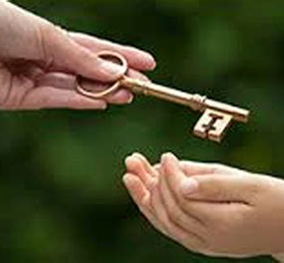
Spiritual Israel's Sign: Ephesians 1:11-14
¹¹ In whom also we have obtained an inheritance, being predestinated according to the purpose of him who worketh all things after the counsel of his own will:
¹² That we should be to the praise of his glory, who first trusted in Christ.

Slide 46
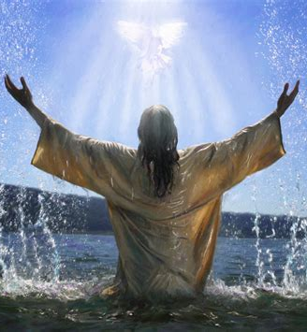
Spiritual Israel's Sign: Ephesians 1:13-14
¹³ In whom ye also trusted, after that ye heard the word of truth, the gospel of your salvation: in whom also after that ye believed, ye were sealed with that holy Spirit of promise,
¹⁴ Which is the earnest of our inheritance until the redemption of the purchased possession, unto the praise of his glory.

Slide 47
Spiritual Israel's Sign: Ephesians 1:13-14
¹³ In whom ye also trusted, after that ye heard the word of truth, the gospel of your salvation: in whom also after that ye believed, ye were sealed with that holy Spirit of promise,
¹⁴ Which is the earnest of our inheritance until the redemption of the purchased possession, unto the praise of his glory.

Slide 48
Paul describes a sealing (baptism) in connection with conversion and reception of the gift of the Holy Spirit. He calls this gift a “deposit” or “down payment” given to all believers as an assurance of the complete redemption and future inheritance they will receive when Jesus comes.
Notice how the seal of baptism always seems to be mentioned in connection with abandoning sin and self. This is the same circumcision of the heart that Deuteronomy mentioned.

Slide 49

Spiritual Israel's Sign: Ephesians 4:30-32
³⁰ And grieve not the holy Spirit of God, whereby ye are sealed unto the day of redemption.
³¹ Let all bitterness, and wrath, and anger, and clamour, and evil speaking, be put away from you, with all malice:
³² And be ye kind one to another, tenderhearted, forgiving one another, even as God for Christ's sake hath forgiven you.

Slide 50
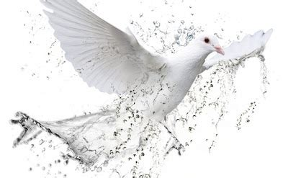
Spiritual Israel's Sign: 2 Timothy 2:19
¹⁹ Nevertheless the foundation of God standeth sure, having this seal, The Lord knoweth them that are his. And, let every one that nameth the name of Christ depart from iniquity.

Slide 51
We're called in Jesus to good works. We're not saved by our works, but we're called to live in harmony with God's loving principles. It's true, the law points to our need for a Savior. The law drives us to Jesus. But once we're there, the law has not ceased. It has another important purpose and that is revealing God's character.
We see God's loving character in His law. We see what it looks like to love God with all our heart, mind, and soul, and to love our neighbor as ourselves. And so it should come as no surprise as we're looking at this topic, God’s seal, from this perspective!

Slide 52
The seal of God is a sign of God’s ownership and protection of His people.
It recognizes that they have chosen HIM above all else.
The book of Revelation pictures another sealing just prior to the second advent. It is contrasted to a mark placed on certain people in that same timeframe.

Slide 53
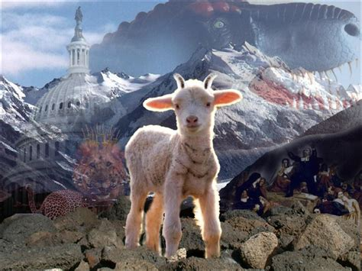
The Seal of God: Revelation 13:11-14:5
¹¹ And I beheld another beast coming up out of the earth; and he had two horns like a lamb, and he spake as a dragon.

Slide 54
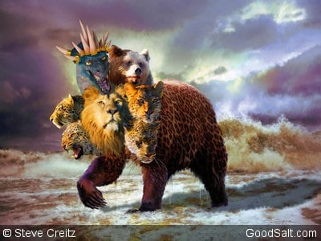
The Seal of God: Revelation 13:12-14:5
¹² And he exerciseth all the power of the first beast before him, and causeth the earth and them which dwell therein to worship the first beast, whose deadly wound was healed.

Slide 55
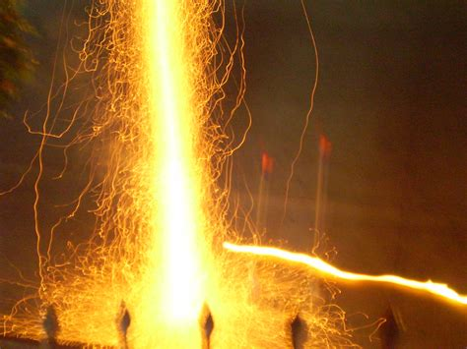
The Seal of God: Revelation 13:13-14:5
¹³ And he doeth great wonders, so that he maketh fire come down from heaven on the earth in the sight of men,

Slide 56
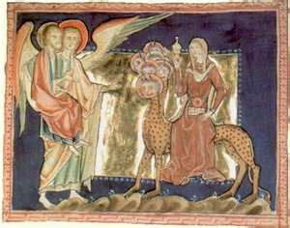
The Seal of God: Revelation 13:14-14:5
¹⁴ And deceiveth them that dwell on the earth by the means of those miracles which he had power to do in the sight of the beast; saying to them that dwell on the earth, that they should make an image to the beast, which had the wound by a sword, and did live.

Slide 57
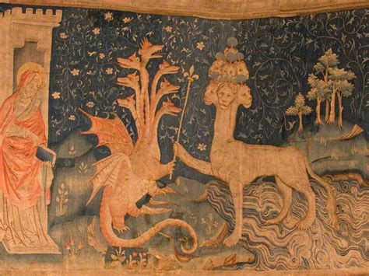
The Seal of God: Revelation 13:15-14:5
¹⁵ And he had power to give life unto the image of the beast, that the image of the beast should both speak, and cause that as many as would not worship the image of the beast should be killed.

Slide 58
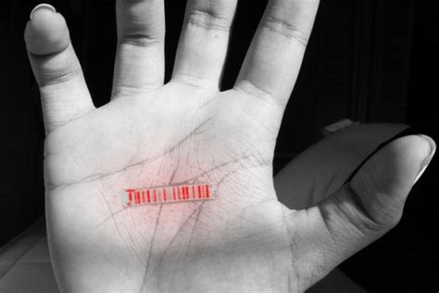
The Seal of God: Revelation 13:16-14:5
¹⁶ And he causeth all, both small and great, rich and poor, free and bond, to receive a mark in their right hand, or in their foreheads:
¹⁷ And that no man might buy or sell, save he that had the mark, or the name of the beast, or the number of his name.

Slide 59
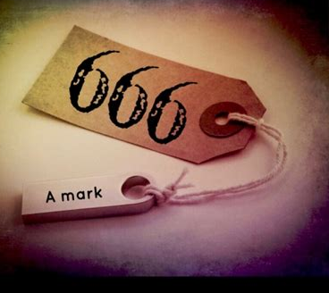
The Seal of God: Revelation 13:18-14:5
¹⁸ Here is wisdom. Let him that hath understanding count the number of the beast: for it is the number of a man; and his number is Six hundred threescore and six.

Slide 60
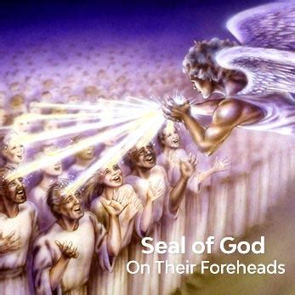
The Seal of God: Revelation 14:1-5
14 And I looked, and, lo, a Lamb stood on the mount Sion, and with him an hundred forty and four thousand, having his Father's name written in their foreheads.

Slide 61
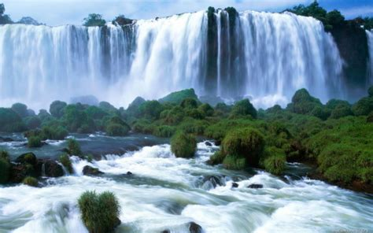
The Seal of God: Revelation 14:2-5
² And I heard a voice from heaven, as the voice of many waters, and as the voice of a great thunder: and I heard the voice of harpers harping with their harps:

Slide 62
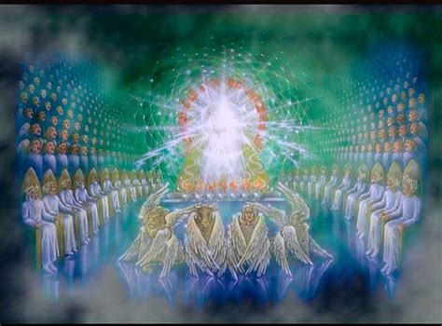
The Seal of God: Revelation 14:3-5
³ And they sung as it were a new song before the throne, and before the four beasts, and the elders: and no man could learn that song but the hundred and forty and four thousand, which were redeemed from the earth.

Slide 63
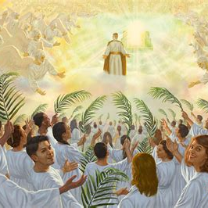
The Seal of God: Revelation 14:4-5
⁴ These are they which were not defiled with women; for they are virgins. These are they which follow the Lamb whithersoever he goeth. These were redeemed from among men, being the firstfruits unto God and to the Lamb.

Slide 64
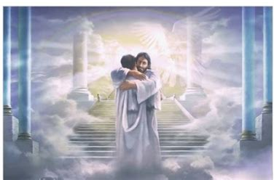
The Seal of God: Revelation 14:5
⁵ And in their mouth was found no guile: for they are without fault before the throne of God.

Slide 65
This final seal is given to the 144,000 At the end of time. They have God’s name (or signature) written in their foreheads.
Through the Holy Spirit’s work in their lives they have come to reflect God’s character.

Slide 66
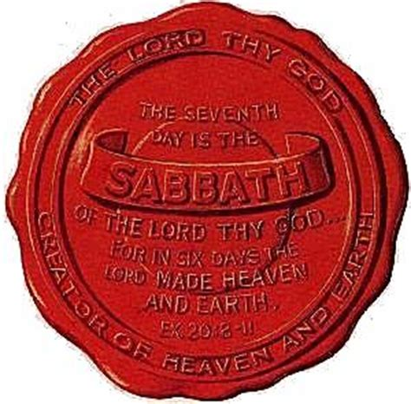
The Seal of God: Exodus 31:12-17
¹² And the Lord spake unto Moses, saying,
¹³ Speak thou also unto the children of Israel, saying, Verily my sabbaths ye shall keep: for it is a sign between me and you throughout your generations; that ye may know that I am the Lord that doth sanctify you.

Slide 67
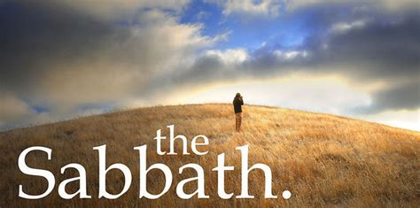
The Seal of God: Exodus 31:14-17
¹⁴ Ye shall keep the sabbath therefore; for it is holy unto you: every one that defileth it shall surely be put to death: for whosoever doeth any work therein, that soul shall be cut off from among his people.

Slide 68
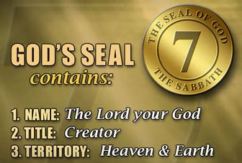
The Seal of God: Exodus 31:15-17
¹⁵ Six days may work be done; but in the seventh is the sabbath of rest, holy to the Lord: whosoever doeth any work in the sabbath day, he shall surely be put to death.

Slide 69
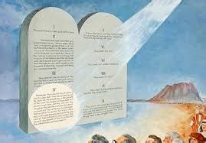
The Seal of God: Exodus 31:16-17
¹⁶ Wherefore the children of Israel shall keep the sabbath, to observe the sabbath throughout their generations, for a perpetual covenant.

Slide 70

The Seal of God: Exodus 31:17
¹⁷ It is a sign between me and the children of Israel for ever: for in six days the Lord made heaven and earth, and on the seventh day he rested, and was refreshed.

Slide 71

The Seal of God: Mark 2:27-28
²⁷ And he said unto them, The sabbath was made for man, and not man for the sabbath:
²⁸ Therefore the Son of man is Lord also of the sabbath.

Slide 72

The Seal of God: Ezekiel 20:11-12
¹¹ And I gave them my statutes, and shewed them my judgments, which if a man do, he shall even live in them.
¹² Moreover also I gave them my sabbaths, to be a sign between me and them, that they might know that I am the Lord that sanctify them.

Slide 73

The Seal of God: Hebrews 4:4-11
⁴ For he spake in a certain place of the seventh day on this wise, And God did rest the seventh day from all his works.
⁵ And in this place again, If they shall enter into my rest.

Slide 74

The Seal of God: Hebrews 4:6-11
⁶ Seeing therefore it remaineth that some must enter therein, and they to whom it was first preached entered not in because of unbelief:
⁷ Again, he limiteth a certain day, saying in David, To day, after so long a time; as it is said, To day if ye will hear his voice, harden not your hearts.

Slide 75

The Seal of God: Hebrews 4:8-11
⁸ For if Jesus had given them rest, then would he not afterward have spoken of another day.
⁹ There remaineth therefore a rest to the people of God.

Slide 76

The Seal of God: Hebrews 4:10-11
¹⁰ For he that is entered into his rest, he also hath ceased from his own works, as God did from his.
¹¹ Let us labour therefore to enter into that rest, lest any man fall after the same example of unbelief.

Slide 77
The symbol, mark, of God’s authority and power is His holy Sabbath day. When we enter God’s rest (receive salvation), we should keep His seventh-day Sabbath holy as a symbol, or mark, of salvation.
True Sabbath keeping signifies that a person has surrendered his life to Jesus Christ and is willing to follow wherever Jesus leads.

Slide 78

An End-Time Appeal: Revelation 3:14-22
¹⁴ And unto the angel of the church of the Laodiceans write; These things saith the Amen, the faithful and true witness, the beginning of the creation of God;
¹⁵ I know thy works, that thou art neither cold nor hot: I would thou wert cold or hot.

Slide 79

An End-Time Appeal: Revelation 3:16-22
¹⁶ So then because thou art lukewarm, and neither cold nor hot, I will spue thee out of my mouth.
¹⁷ Because thou sayest, I am rich, and increased with goods, and have need of nothing; and knowest not that thou art wretched, and miserable, and poor, and blind, and naked:

Slide 80

An End-Time Appeal: Revelation 3:18-22
¹⁸ I counsel thee to buy of me gold tried in the fire, that thou mayest be rich; and white raiment, that thou mayest be clothed, and that the shame of thy nakedness do not appear; and anoint thine eyes with eyesalve, that thou mayest see.

Slide 81

An End-Time Appeal: Revelation 3:19-22
¹⁹ As many as I love, I rebuke and chasten: be zealous therefore, and repent.
²⁰ Behold, I stand at the door, and knock: if any man hear my voice, and open the door, I will come in to him, and will sup with him, and he with me.

Slide 82

An End-Time Appeal: Revelation 3:21-22
²¹ To him that overcometh will I grant to sit with me in my throne, even as I also overcame, and am set down with my Father in his throne.
²² He that hath an ear, let him hear what the Spirit saith unto the churches.

Slide 83
The message to the Church of Laodicea is an appeal to all of us! It pleads with us to make a choice. Any choice, apparently, is better than apathy. And this appeal comes from (among other titles) the “beginning of the Creation of God.”
It’s an appeal from our Creator, just as we’ve seen in Revelation 14!

Slide 84
Key Text: Revelation 14:6-7
⁶ And I saw another angel fly in the midst of heaven, having the everlasting gospel to preach unto them that dwell on the earth, and to every nation, and kindred, and tongue, and people,
⁷ Saying with a loud voice, Fear God, and give glory to him; for the hour of his judgment is come: and worship him that made heaven, and earth, and the sea, and the fountains of waters.

Slide 85
As we come to the book of Revelation, we've been looking at God's end time people. These People trust him fully and have absolute confidence in The Father. And They are representing God's character.
Just like the 10 commandments, which also represent God’s character, these people are sealed by Sabbath-keeping.

Slide 86

A Sabbath Promise: Isaiah 58:1, 13-14
58 Cry aloud, spare not, lift up thy voice like a trumpet, and shew my people their transgression, and the house of Jacob their sins.

Slide 87

A Sabbath Promise: Isaiah 58:1, 13-14
¹³ If thou turn away thy foot from the sabbath, from doing thy pleasure on my holy day; and call the sabbath a delight, the holy of the Lord, honourable; and shalt honour him, not doing thine own ways, nor finding thine own pleasure, nor speaking thine own words:

Slide 88

A Sabbath Promise: Isaiah 58:1, 13-14
¹⁴ Then shalt thou delight thyself in the Lord; and I will cause thee to ride upon the high places of the earth, and feed thee with the heritage of Jacob thy father: for the mouth of the Lord hath spoken it.

Slide 89
“There was and is a commandment to keep holy the Sabbath day, but that Sabbath day was not Sunday. ... It will be said, however, and with some show of triumph, that the Sabbath was transferred from the seventh to the first day of the week. ... Where can the record of such a transaction be found? Not in the New Testament—absolutely not. There is no scriptural evidence of the change of the Sabbath institution from the seventh to the first day of the week.”
Dr. Edward T. Hiscox, author of The Baptist Manual, in a paper read before a New York ministers' conference held Nov. 13, 1893.

Slide 90
“You may read the Bible from Genesis to Revelation, and you will not find a single line authorizing the sanctification of Sunday. The Scriptures enforce the religious observance of Saturday, a day which [Catholics] never sanctify.”
James Cardinal Gibbons, The Faith of Our Fathers, 93rd edition, 1917, p. 58.

Slide 91
“Finally, we have the testimony of Christ on this subject. In Mark 2:27, he says: ‘The Sabbath was made for man, and not man for the Sabbath.’ From this passage it is evident that the Sabbath was made not merely for the Israelites, as Paley and Hengstenberg would have us believe, but for man ... that is, for the race. Hence we conclude that the Sabbath was sanctified from the beginning, and that it was given to Adam, even in Eden, as one of those primeval institutions that God ordained for the happiness of all men.”
Robert Milligan, Scheme of Redemption, (St. Louis, The Bethany Press, 1962), p. 165.

Slide 92
“The Christian Sabbath [Sunday] is not in the Scriptures, and was not by the primitive church called the Sabbath.”
Dwight's Theology, Vol. 4, p. 401.

Slide 93
“Sunday (Dies Solis, of the Roman calendar, ‘day of the sun,’ because dedicated to the sun), the first day of the week, was adopted by the early Christians as a day of worship. ... No regulations for its observance are laid down in the New Testament, nor, indeed, is its observance even enjoined.”
"Sunday," A Religious Encyclopedia, Vol. 3, (New York, Funk and Wagnalls, 1883) p. 2259.

Slide 94
“The observance of the Lord’s day [Sunday] is founded not on any command of God, but on the authority of the church.”
Augsburg Confession of Faith, quoted in Catholic Sabbath Manual, Part 2, Chapter 1, Section 10.

Slide 95
“Take the matter of Sunday. There are indications in the New Testament as to how the church came to keep the first day of the week as its day of worship, but there is no passage telling Christians to keep that day, or to transfer the Jewish Sabbath to that day.”
Harris Franklin Rall, Christian Advocate, July 2, 1942.

Slide 96
“The Sabbath was binding in Eden, and it has been in force ever since. This fourth commandment begins with the word ‘remember,’ showing that the Sabbath already existed when God wrote the law on the tables of stone at Sinai. How can men claim that this one commandment has been done away with when they will admit that the other nine are still binding?”
D. L. Moody, Weighed and Wanting, p. 47.

Slide 97
“Until, therefore, it can be shown that the whole moral law has been repealed, the Sabbath will stand. ... The teaching of Christ confirms the perpetuity of the Sabbath.”
T. C. Blake, D.D., Theology Condensed, pp. 474, 475.

Slide 98
“‘Why do we worship on Sunday? Doesn’t the Bible teach us that Saturday should be the Lord’s Day?’ ... Apparently we will have to seek the answer from some other source than the New Testament”
David A. Womack, "Is Sunday the Lord's Day?" The Pentecostal Evangel, Aug. 9, 1959, No. 2361, p. 3.

Slide 99
“Sunday was a name given by the heathens to the first day of the week, because it was the day on which they worshipped the sun. ... The seventh day was blessed and hallowed by God himself, and ... he requires His creatures to keep it holy to Him. This commandment is of universal and perpetual obligation.”
Eadie's Biblical Cyclopedia, 1890 ed., p. 561.

Slide 100
Thank you!
And HAPPY SABBATH!

