Slide 1
A City Called Confusion
Hosea 2,Ezekiel 16, Ephesians 5, James 4 & Revelation 17
Lesson 9, 2nd Quarter 2023

Slide 2
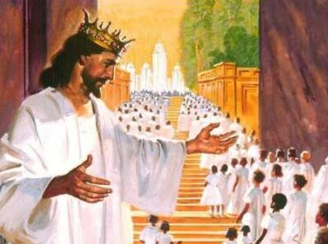
Memory Text
Revelation 17:14
¹⁴ These shall make war with the Lamb, and the Lamb shall overcome them: for he is Lord of lords, and King of kings: and they that are with him are called, and chosen, and faithful.

Slide 3
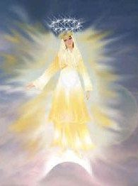
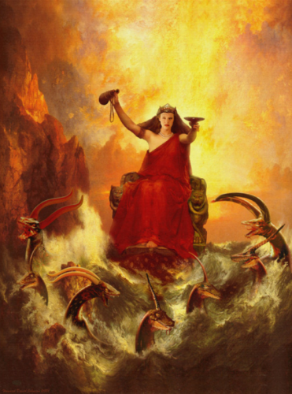
Two Contrasting Systems
² I have likened the daughter of Zion to a comely and delicate woman. Jeremiah 6:2
⁴ Ye adulterers and adulteresses, know ye not that the friendship of the world is enmity with God? James 4:4a

Slide 4

A Comely Woman: Ephesians 5:25-32
²⁵ Husbands, love your wives, even as Christ also loved the church, and gave himself for it;

Slide 5

A Comely Woman: Ephesians 5:26-32
²⁶ That he might sanctify and cleanse it with the washing of water by the word,

Slide 6
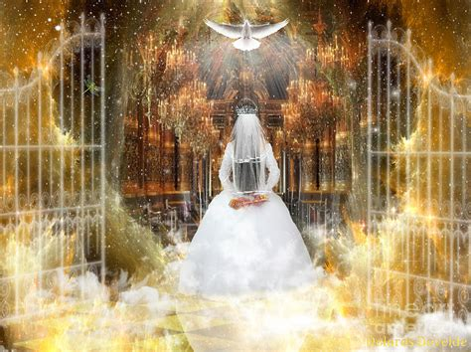
A Comely Woman: Ephesians 5:27-32
²⁷ That he might present it to himself a glorious church, not having spot, or wrinkle, or any such thing; but that it should be holy and without blemish.

Slide 7

A Comely Woman: Ephesians 5:28-32
²⁸ So ought men to love their wives as their own bodies. He that loveth his wife loveth himself.
²⁹ For no man ever yet hated his own flesh; but nourisheth and cherisheth it, even as the Lord the church:

Slide 8
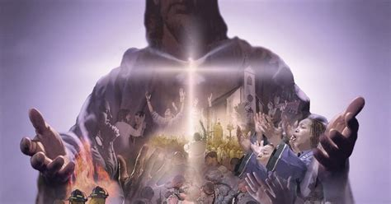
A Comely Woman: Ephesians 5:30-32
³⁰ For we are members of his body, of his flesh, and of his bones.

Slide 9

A Comely Woman: Ephesians 5:31-32
³¹ For this cause shall a man leave his father and mother, and shall be joined unto his wife, and they two shall be one flesh.
³² This is a great mystery: but I speak concerning Christ and the church.

Slide 10
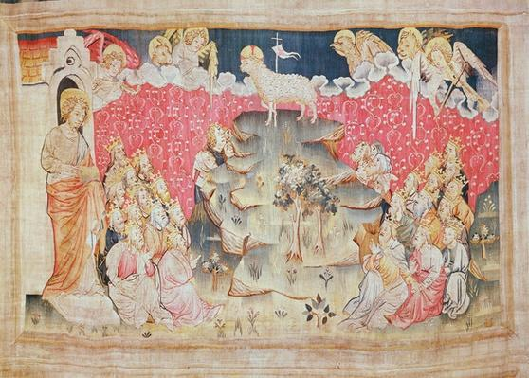
A Comely Woman: Revelation 14:1-5
14 And I looked, and, lo, a Lamb stood on the mount Sion, and with him an hundred forty and four thousand, having his Father's name written in their foreheads.

Slide 11
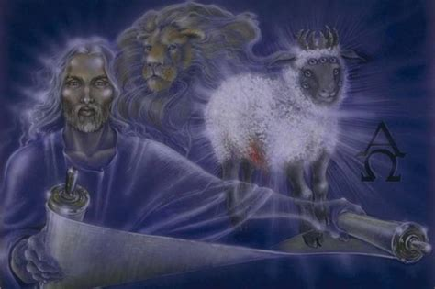
A Comely Woman: Revelation 14:2-5
² And I heard a voice from heaven, as the voice of many waters, and as the voice of a great thunder: and I heard the voice of harpers harping with their harps:

Slide 12
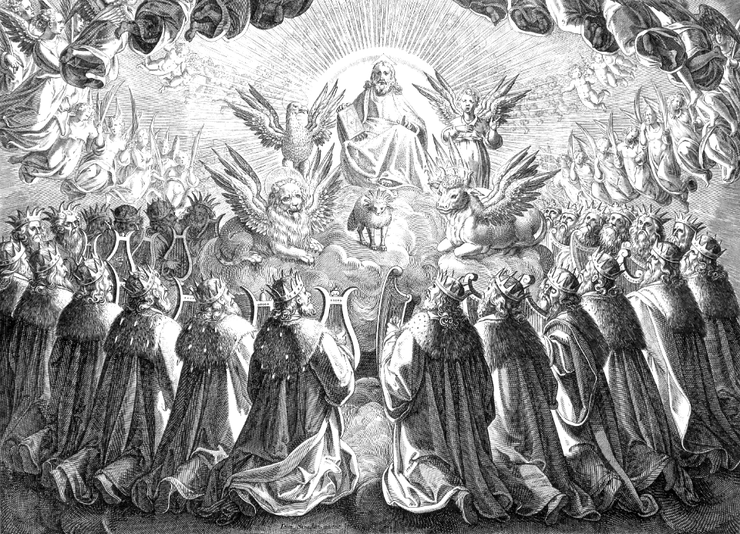
A Comely Woman: Revelation 14:3-5
³ And they sung as it were a new song before the throne, and before the four beasts, and the elders: and no man could learn that song but the hundred and forty and four thousand, which were redeemed from the earth.

Slide 13
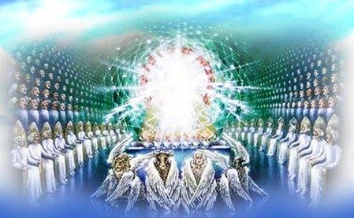
A Comely Woman: Revelation 14:4-5
⁴ These are they which were not defiled with women; for they are virgins. These are they which follow the Lamb whithersoever he goeth. These were redeemed from among men, being the firstfruits unto God and to the Lamb.

Slide 14
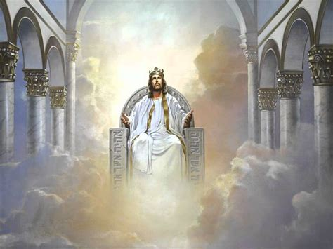
A Comely Woman: Revelation 14:5
⁵ And in their mouth was found no guile: for they are without fault before the throne of God.

Slide 15
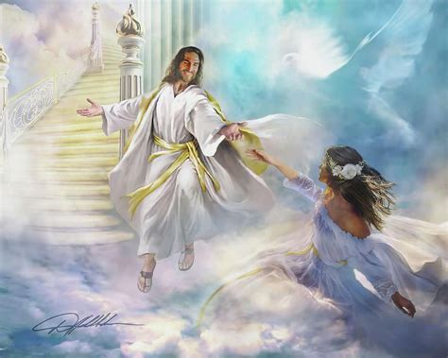
A Comely Woman
The Bible repeatedly describes God’s people as a woman, the Bride of Christ, beautiful, pure, and entirely faithful.
Sadly, reality has generally fallen rather short of this picture!

Slide 16
A Note on Ezekiel: A Prophet Among You, p.157
As spiritual leader of Judah in exile, the Lord chose Ezekiel, a young priest, and called him to be His prophet. It was he who ministered to the people in Babylon during many years of the Captivity. Daniel, who occupied important positions in the royal court, supplemented the work of Ezekiel, but it was this prophet-priest who maintained contact with the people and was their spiritual guide. He held before them the glory of God as it had been revealed to him, and taught them that the Lord could be with them where they were as well as in Jerusalem.

Slide 17
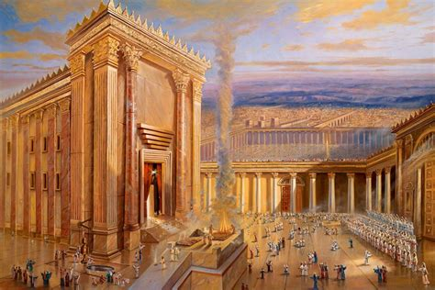
Adoption and Marriage: Ezekiel 16:1-22, 60
16 Again the word of the Lord came unto me, saying,
² Son of man, cause Jerusalem to know her abominations,

Slide 18
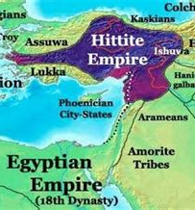
Adoption and Marriage: Ezekiel 16:3-22, 60
³ And say, Thus saith the Lord God unto Jerusalem; Thy birth and thy nativity is of the land of Canaan; thy father was an Amorite, and thy mother an Hittite.

Slide 19
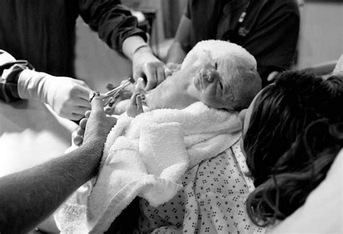
Adoption and Marriage: Ezekiel 16:4-22, 60
⁴ And as for thy nativity, in the day thou wast born thy navel was not cut, neither wast thou washed in water to supple thee; thou wast not salted at all, nor swaddled at all.

Slide 20
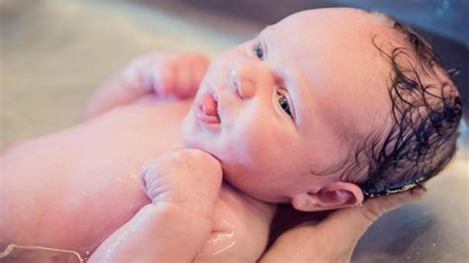
Adoption and Marriage: Ezekiel 16:5-22, 60
⁵ None eye pitied thee, to do any of these unto thee, to have compassion upon thee; but thou wast cast out in the open field, to the lothing of thy person, in the day that thou wast born.

Slide 21
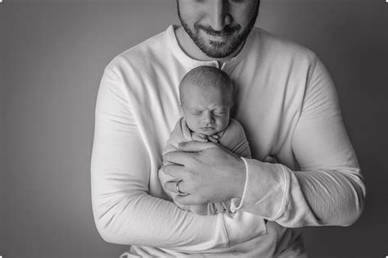
Adoption and Marriage: Ezekiel 16:6-22, 60
⁶ And when I passed by thee, and saw thee polluted in thine own blood, I said unto thee when thou wast in thy blood, Live; yea, I said unto thee when thou wast in thy blood, Live.

Slide 22
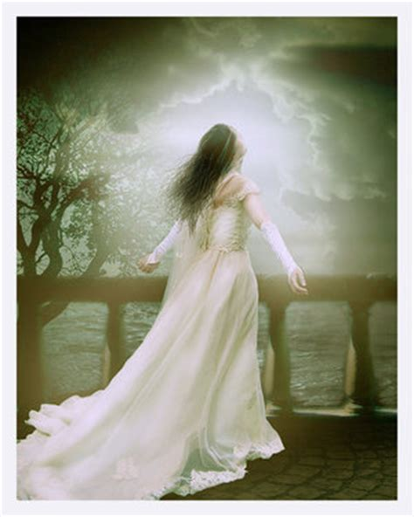
Adoption and Marriage: Ezekiel 16:7-22, 60
⁷ I have caused thee to multiply as the bud of the field, and thou hast increased and waxen great, and thou art come to excellent ornaments: thy breasts are fashioned, and thine hair is grown, whereas thou wast naked and bare.

Slide 23
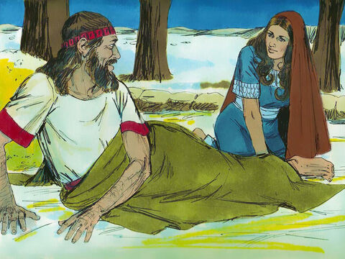
Adoption and Marriage: Ezekiel 16:8-22, 60
⁸ Now when I passed by thee, and looked upon thee, behold, thy time was the time of love; and I spread my skirt over thee, and covered thy nakedness: yea, I sware unto thee, and entered into a covenant with thee, saith the Lord God, and thou becamest mine.

Slide 24
Ezekiel 16: Symbolism
The Guardian and Betrothed (speaking)
Represents Jesus in His relationship with the church
The Bride
Represents God’s people corporately, the church

Slide 25
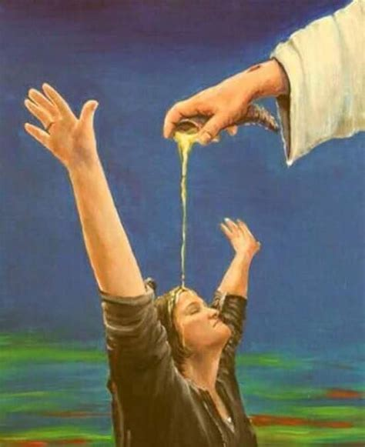
Adoption and Marriage: Ezekiel 16:9-22, 60
⁹ Then washed I thee with water; yea, I throughly washed away thy blood from thee, and I anointed thee with oil.

Slide 26
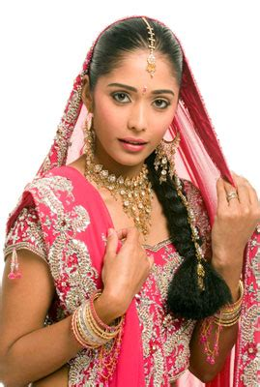
Adoption and Marriage: Ezekiel 16:10-22, 60
¹⁰ I clothed thee also with broidered work, and shod thee with badgers' skin, and I girded thee about with fine linen, and I covered thee with silk.

Slide 27
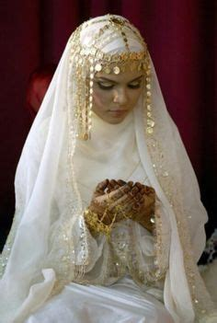
Adoption and Marriage: Ezekiel 16:11-22, 60
¹¹ I decked thee also with ornaments, and I put bracelets upon thy hands, and a chain on thy neck.
¹² And I put a jewel on thy forehead, and earrings in thine ears, and a beautiful crown upon thine head.

Slide 28
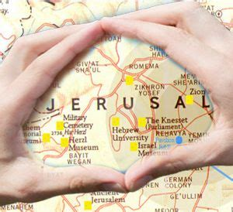
Adoption and Marriage: Ezekiel 16:13-22, 60
¹³ Thus wast thou decked with gold and silver; and thy raiment was of fine linen, and silk, and broidered work; thou didst eat fine flour, and honey, and oil: and thou wast exceeding beautiful, and thou didst prosper into a kingdom.

Slide 29
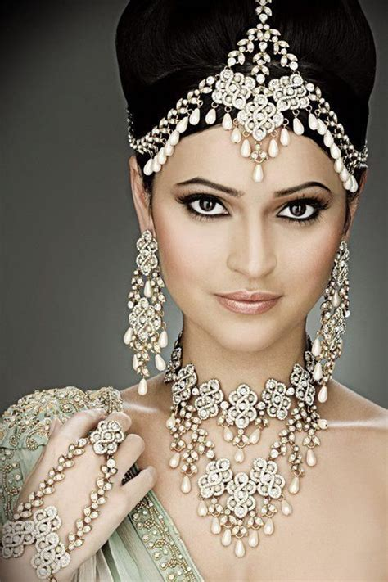
Adoption and Marriage: Ezekiel 16:14-22, 60
¹⁴ And thy renown went forth among the heathen for thy beauty: for it was perfect through my comeliness, which I had put upon thee, saith the Lord God.

Slide 30
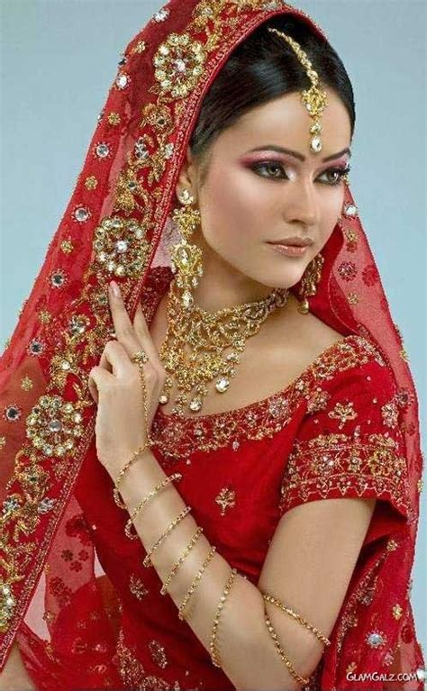
Adoption and Marriage: Ezekiel 16:15-22, 60
¹⁵ But thou didst trust in thine own beauty, and playedst the harlot because of thy renown, and pouredst out thy fornications on every one that passed by; his it was.

Slide 31
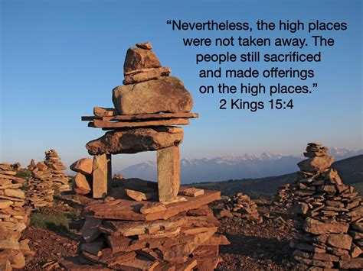
Adoption and Marriage: Ezekiel 16:16-22, 60
¹⁶ And of thy garments thou didst take, and deckedst thy high places with divers colours, and playedst the harlot thereupon: the like things shall not come, neither shall it be so.

Slide 32
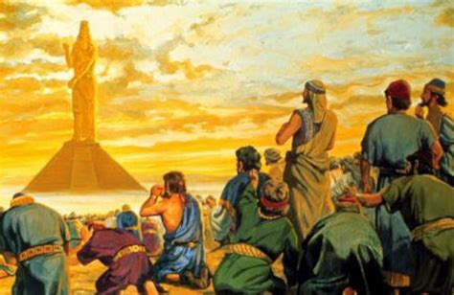
Adoption and Marriage: Ezekiel 16:17-22, 60
¹⁷ Thou hast also taken thy fair jewels of my gold and of my silver, which I had given thee, and madest to thyself images of men, and didst commit whoredom with them,

Slide 33
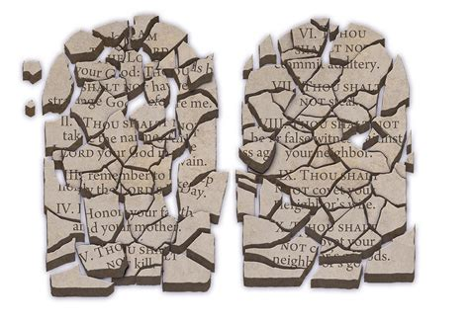
Adoption and Marriage: Ezekiel 16:18-22, 60
¹⁸ And tookest thy broidered garments, and coveredst them: and thou hast set mine oil and mine incense before them.

Slide 34
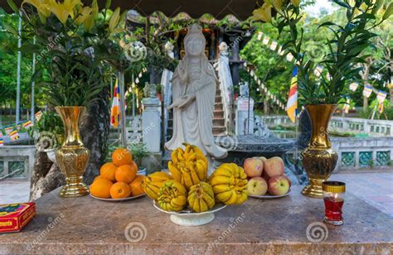
Adoption and Marriage: Ezekiel 16:19-22, 60
¹⁹ My meat also which I gave thee, fine flour, and oil, and honey, wherewith I fed thee, thou hast even set it before them for a sweet savour: and thus it was, saith the Lord God.

Slide 35
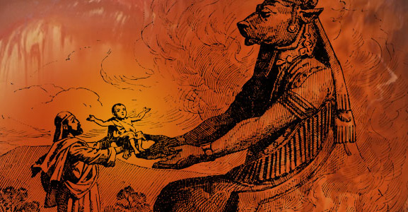
Adoption and Marriage: Ezekiel 16:20-22, 60
²⁰ Moreover thou hast taken thy sons and thy daughters, whom thou hast borne unto me, and these hast thou sacrificed unto them to be devoured. Is this of thy whoredoms a small matter,

Slide 36
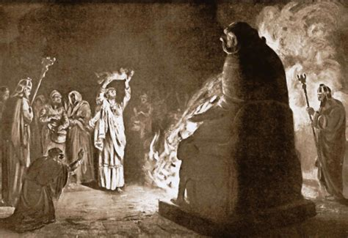
Adoption and Marriage: Ezekiel 16:21-22, 60
²¹ That thou hast slain my children, and delivered them to cause them to pass through the fire for them?

Slide 37
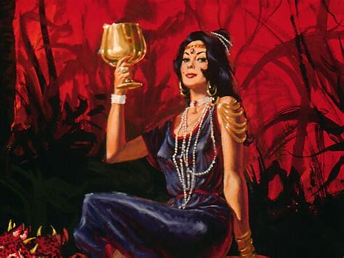
Adoption and Marriage: Ezekiel 16:22, 60-62
²² And in all thine abominations and thy whoredoms thou hast not remembered the days of thy youth, when thou wast naked and bare, and wast polluted in thy blood.

Slide 38
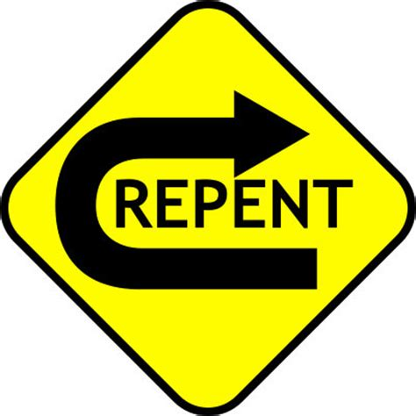
Adoption and Marriage: Ezekiel 16:60-62
⁶⁰ Nevertheless I will remember my covenant with thee in the days of thy youth, and I will establish unto thee an everlasting covenant.

Slide 39

Adoption and Marriage: Ezekiel 16:61-62
⁶¹ Then thou shalt remember thy ways, and be ashamed, when thou shalt receive thy sisters, thine elder and thy younger: and I will give them unto thee for daughters, but not by thy covenant.

Slide 40
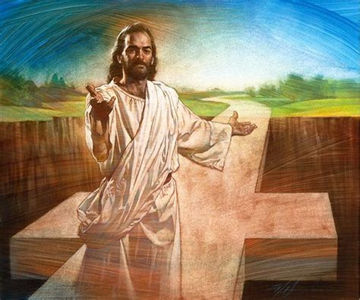
Adoption and Marriage: Ezekiel 16:62
⁶² And I will establish my covenant with thee; and thou shalt know that I am the Lord:

Slide 41
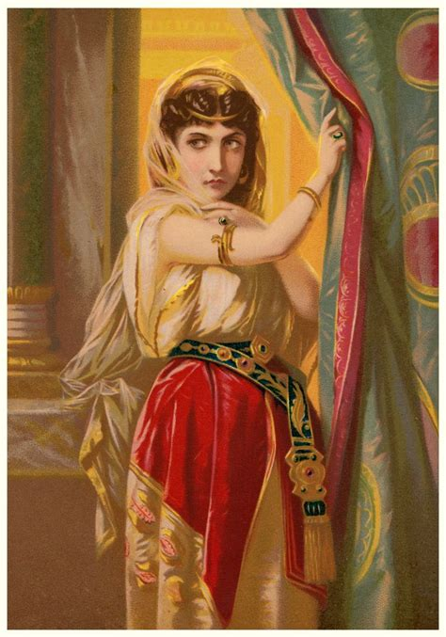
A Troubled Marriage: Hosea 1:2
² The beginning of the word of the Lord by Hosea. And the Lord said to Hosea, Go, take unto thee a wife of whoredoms and children of whoredoms: for the land hath committed great whoredom, departing from the Lord.

Slide 42
A Note on Hosea: A Prophet Among You, p.155
In Hosea’s message, especially, the love of God for His erring people was depicted, and with it was an expression of His eagerness to receive them back. Hosea’s appeal was the last, and because of its nature perhaps the strongest, sent to Israel. ..When it became apparent that the evils that covered the land had gone beyond remedy, the sentence was pronounced:

Slide 43
A Note on Hosea: A Prophet Among You, p.155
“Ephraim is joined to idols: let him alone.” Hosea 4:17. “The days of visitation are come, the days of recompense are come; Israel shall know it.” Hosea 9:7. ..But the final chapter of the book is one of invitation: “O Israel, return unto the Lord thy God.... I will heal their backsliding, I will love them freely: for Mine anger is turned away from him.” Hosea 14:1-4.

Slide 44
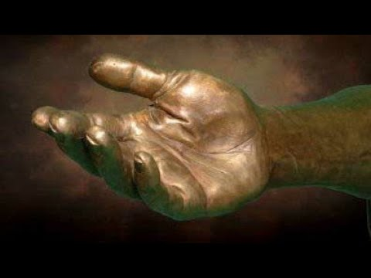
A Troubled Marriage: Hosea 2:1-23
Pleading
Ammi: “My people”
Ruhamah: “Pitied,” or “having received compassion”
2 Say ye unto your brethren, Ammi; and to your sisters, Ruhamah.

Slide 45
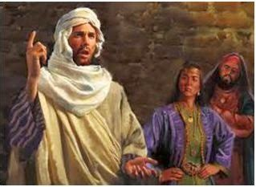
A Troubled Marriage: Hosea 2:2-23
Pleading
² Plead with your mother, plead: for she is not my wife, neither am I her husband: let her therefore put away her whoredoms out of her sight, and her adulteries from between her breasts;

Slide 46
A Troubled Marriage: Symbolism
The Loving Husband (speaking)
Represents Jesus in His relationship with the church
The Children of Whoredoms
Represents God’s people corporately, the church
The Unfaithful Wife
God’s people as individuals, the church members

Slide 47
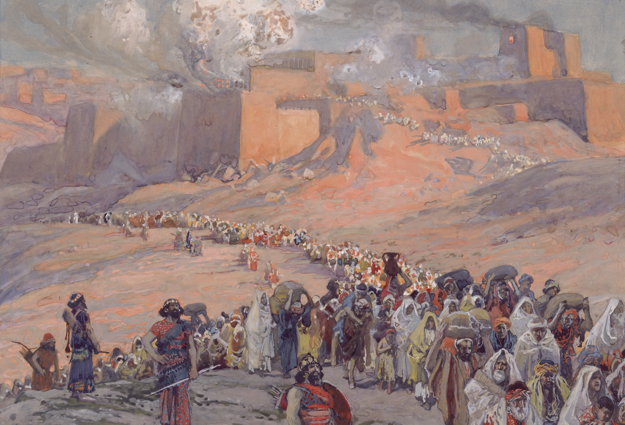
A Troubled Marriage: Hosea 2:3-23
Tough Love
³ Lest I strip her naked, and set her as in the day that she was born, and make her as a wilderness, and set her like a dry land, and slay her with thirst.

Slide 48
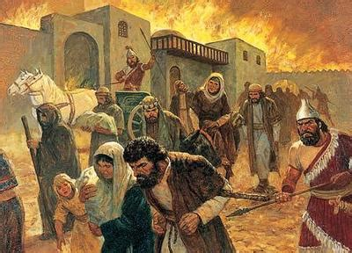
A Troubled Marriage: Hosea 2:4-23
Tough Love
⁴ And I will not have mercy upon her children; for they be the children of whoredoms.

Slide 49
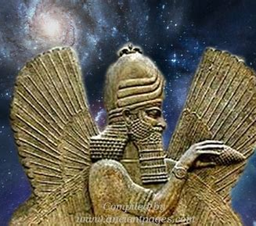
A Troubled Marriage: Hosea 2:5-23
Tough Love
⁵ For their mother hath played the harlot: she that conceived them hath done shamefully: for she said, I will go after my lovers, that give me my bread and my water, my wool and my flax, mine oil and my drink.

Slide 50
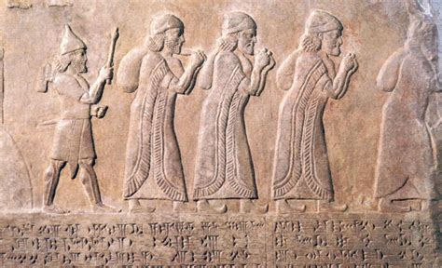
A Troubled Marriage: Hosea 2:6-23
Tough Love
⁶ Therefore, behold, I will hedge up thy way with thorns, and make a wall, that she shall not find her paths.

Slide 51
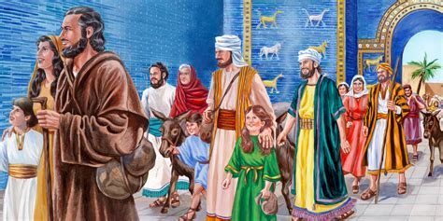
A Troubled Marriage: Hosea 2:7-23
Tough Love
⁷ And she shall follow after her lovers, but she shall not overtake them; and she shall seek them, but shall not find them: then shall she say, I will go and return to my first husband; for then was it better with me than now.

Slide 52
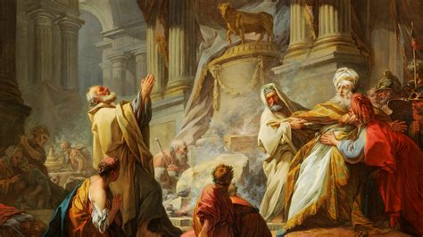
A Troubled Marriage: Hosea 2:8-23
Tough Love
⁸ For she did not know that I gave her corn, and wine, and oil, and multiplied her silver and gold, which they prepared for Baal.

Slide 53
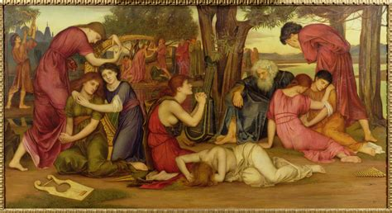
A Troubled Marriage: Hosea 2:9-23
Tough Love
⁹ Therefore will I return, and take away my corn in the time thereof, and my wine in the season thereof, and will recover my wool and my flax given to cover her nakedness.

Slide 54
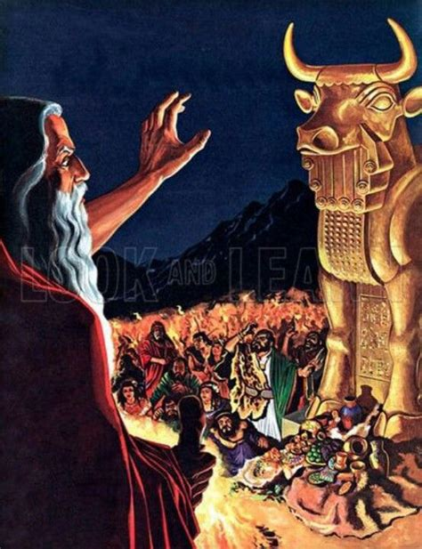
A Troubled Marriage: Hosea 2:10-23
Tough Love
¹⁰ And now will I discover her lewdness in the sight of her lovers, and none shall deliver her out of mine hand.

Slide 55
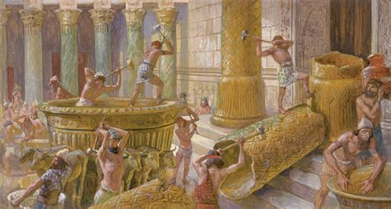
A Troubled Marriage: Hosea 2:11-23
Tough Love
¹¹ I will also cause all her mirth to cease, her feast days, her new moons, and her sabbaths, and all her solemn feasts.

Slide 56
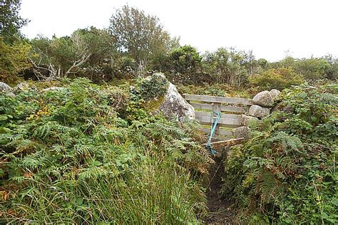
A Troubled Marriage: Hosea 2:12-23
Tough Love
¹² And I will destroy her vines and her fig trees, whereof she hath said, These are my rewards that my lovers have given me: and I will make them a forest, and the beasts of the field shall eat them.

Slide 57
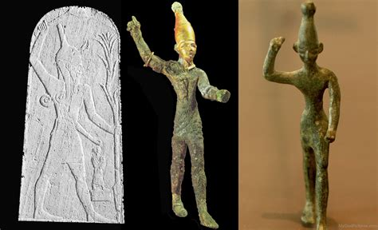
A Troubled Marriage: Hosea 2:13-23
Tough Love
¹³ And I will visit upon her the days of Baalim, wherein she burned incense to them, and she decked herself with her earrings and her jewels, and she went after her lovers, and forgat me, saith the Lord.

Slide 58
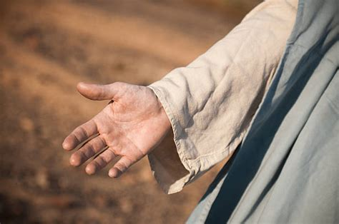
A Troubled Marriage: Hosea 2:14-23
Reconciliation
¹⁴ Therefore, behold, I will allure her, and bring her into the wilderness, and speak comfortably unto her.

Slide 59
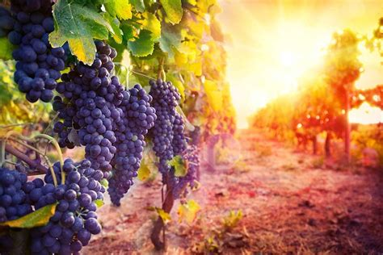
A Troubled Marriage: Hosea 2:15-23
Reconciliation
¹⁵ And I will give her her vineyards from thence, and the valley of Achor for a door of hope: and she shall sing there, as in the days of her youth, and as in the day when she came up out of the land of Egypt.

Slide 60
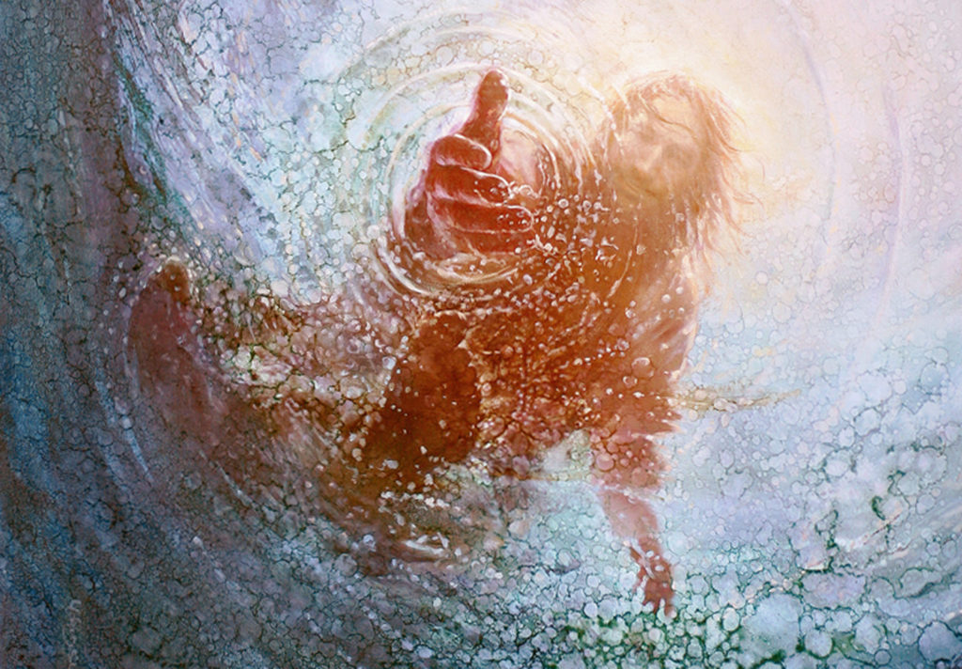
A Troubled Marriage: Hosea 2:16-23
Reconciliation
¹⁶ And it shall be at that day, saith the Lord, that thou shalt call me Ishi; and shalt call me no more Baali.
Both Ishi and Baali mean “my husband” but the connotations are very different.
Ishi: “My beloved husband”, is a tender term of endearment.
Baali: “My master,” or “my owner” describes a stern authority figure of a husband.

Slide 61

A Troubled Marriage: Hosea 2:17-23
Reconciliation
¹⁷ For I will take away the names of Baalim out of her mouth, and they shall no more be remembered by their name.

Slide 62

A Troubled Marriage: Hosea 2:18-23
Reconciliation
¹⁸ And in that day will I make a covenant for them with the beasts of the field and with the fowls of heaven, and with the creeping things of the ground: and I will break the bow and the sword and the battle out of the earth, and will make them to lie down safely.

Slide 63

A Troubled Marriage: Hosea 2:19-23
Reconciliation
¹⁹ And I will betroth thee unto me for ever; yea, I will betroth thee unto me in righteousness, and in judgment, and in lovingkindness, and in mercies.

Slide 64

A Troubled Marriage: Hosea 2:20-23
Reconciliation
²⁰ I will even betroth thee unto me in faithfulness: and thou shalt know the Lord.

Slide 65

A Troubled Marriage: Hosea 2:21-23
Reconciliation
²¹ And it shall come to pass in that day, I will hear, saith the Lord, I will hear the heavens, and they shall hear the earth;
²² And the earth shall hear the corn, and the wine, and the oil; and they shall hear Jezreel.
Jezreel means “scatter” or “sow.” Here it promises the establishment and security of God’s people.

Slide 66

A Troubled Marriage: Hosea 2:23
Reconciliation
²³ And I will sow her unto me in the earth; and I will have mercy upon her that had not obtained mercy; and I will say to them which were not my people, Thou art my people; and they shall say, Thou art my God.

Slide 67

A Little Less Symbolism: James 4:1-10
4 From whence come wars and fightings among you? come they not hence, even of your lusts that war in your members?

Slide 68

A Little Less Symbolism: James 4:2-10
² Ye lust, and have not: ye kill, and desire to have, and cannot obtain: ye fight and war, yet ye have not, because ye ask not.
³ Ye ask, and receive not, because ye ask amiss, that ye may consume it upon your lusts.

Slide 69

A Little Less Symbolism: James 4:4-10
⁴ Ye adulterers and adulteresses, know ye not that the friendship of the world is enmity with God? whosoever therefore will be a friend of the world is the enemy of God.

Slide 70

A Little Less Symbolism: James 4:5-10
⁵ Do ye think that the scripture saith in vain, The spirit that dwelleth in us lusteth to envy?
⁶ But he giveth more grace. Wherefore he saith, God resisteth the proud, but giveth grace unto the humble.

Slide 71

A Little Less Symbolism: James 4:7-10
⁷ Submit yourselves therefore to God. Resist the devil, and he will flee from you.
⁸ Draw nigh to God, and he will draw nigh to you. Cleanse your hands, ye sinners; and purify your hearts, ye double minded.

Slide 72

A Little Less Symbolism: James 4:9-10
⁹ Be afflicted, and mourn, and weep: let your laughter be turned to mourning, and your joy to heaviness.
¹⁰ Humble yourselves in the sight of the Lord, and he shall lift you up.

Slide 73
Jesus Pleads with the Church… But Not Forever
Paul, Ezekiel, Hosea, and James all make a point of mentioning that the unfaithful “woman” or church will eventually be reconciled with Jesus, her divine “husband.”
But it is always the woman’s choice! Jesus says He will “allure” her, but she doesn’t have to choose Him.
Some people are pretty rebellious about reconciling with God. Those who ultimately refuse the gracious pleas of Jesus won’t be classified with the Bride of Christ at the end. They have a different designation.

Slide 74

A Dichotomy Revealed: Revelation 17:1-18:4
17 And there came one of the seven angels which had the seven vials, and talked with me, saying unto me, Come hither; I will shew unto thee the judgment of the great whore that sitteth upon many waters:

Slide 75

A Dichotomy Revealed: Revelation 17:2-18:4
² With whom the kings of the earth have committed fornication, and the inhabitants of the earth have been made drunk with the wine of her fornication.

Slide 76

A Dichotomy Revealed: Revelation 17:3-18:4
³ So he carried me away in the spirit into the wilderness: and I saw a woman sit upon a scarlet coloured beast, full of names of blasphemy, having seven heads and ten horns.

Slide 77

A Dichotomy Revealed: Revelation 17:4-18:4
⁴ And the woman was arrayed in purple and scarlet colour, and decked with gold and precious stones and pearls, having a golden cup in her hand full of abominations and filthiness of her fornication:

Slide 78

A Dichotomy Revealed: Revelation 17:5-18:4
⁵ And upon her forehead was a name written, Mystery, Babylon The Great, The Mother Of Harlots And Abominations Of The Earth.

Slide 79
A Dichotomy Revealed: Mystery, Babylon the Great
Although, in one sense, mystical Babylon may be considered as representative of apostate religious systems throughout history, “Babylon the great” in the book of Revelation designates, in a special sense, the united apostate religions at the close of time. In ch. 17:18 mystical Babylon is called “that great city.”
SDABC V.7 p.

Slide 80
A Dichotomy Revealed: Mystery, Babylon the Great
Here, doubtless, Babylon is referred to as “great” in view of the fact that this chapter deals most particularly with Satan’s great final effort to secure the allegiance of the human race through religion. “Babylon the great” is the name by which Inspiration refers to the great threefold religious union of the papacy, apostate Protestantism, and spiritism.
SDABC V.7 p.

Slide 81
A Dichotomy Revealed: Mystery, Babylon the Great
Here, doubtless, Babylon is referred to as “great” in view of The term “Babylon” refers to the organizations themselves and to their leaders, not so much to the members as such. The latter are referred to as “many waters” (Rev. 17:1, 15) and as the “inhabitants of the earth.”
SDABC V.7 p.

Slide 82

Mystery, Babylon: Quarterly, Tues. May 23, 2023
It all began on the plain of the land of Shinar, a region in the southern part of Mesopotamia, today south Iraq, called Babylonia. It is there that the Tower of Babel was built, a symbol of human self-sufficiency, self-preservation, and independence from God (Gen. 11:1-4).

Slide 83
Mystery, Babylon: Patriarchs and Prophets, p.119
The dwellers on the plain of Shinar disbelieved God's covenant that He would not again bring a flood upon the earth. Many of them denied the existence of God and attributed the Flood to the operation of natural causes. Others believed in a Supreme Being, and that it was He who had destroyed the antediluvian world; and their hearts, like that of Cain, rose up in rebellion against Him. One object before them in the erection of the tower was to secure their own safety in case of another deluge.

Slide 84
Mystery, Babylon: Patriarchs and Prophets, p.119
By carrying the structure to a much greater height than was reached by the waters of the Flood, they thought to place themselves beyond all possibility of danger. And as they would be able to ascend to the region of the clouds, they hoped to ascertain the cause of the Flood. The whole undertaking was designed to exalt still further the pride of its projectors and to turn the minds of future generations away from God and lead them into idolatry.

Slide 85

Mystery, Babylon: Later History
Under Nabopolassar, Babylon escaped Assyrian rule, and the allied Medo-Babylonian armies finally destroyed the Assyrian Empire between 626 BC and 609 BC. Babylon thus became the capital of the Neo-Babylonian (sometimes called the Chaldean) Empire.

Slide 86

Mystery, Babylon: Later History
With the recovery of Babylonian independence, a new era of architectural activity ensued, particularly during the reign of his son Nebuchadnezzar II (604–561 BC).

Slide 87

Mystery, Babylon: Later History
Nebuchadnezzar ordered the complete reconstruction of the imperial grounds, including the Etemenanki ziggurat, and the construction of the Ishtar Gate—the most prominent of eight gates around Babylon.

Slide 88


Mystery, Babylon: Later History
The Ishtar Gate was named for the goddess of love and war. Bulls and dragons, symbols of the god Marduk, decorated the gate.

Slide 89

Mystery, Babylon: Daniel 3:1, 6
3 Nebuchadnezzar the king made an image of gold, whose height was threescore cubits, and the breadth thereof six cubits: he set it up in the plain of Dura, in the province of Babylon….
⁶ And whoso falleth not down and worshippeth shall the same hour be cast into the midst of a burning fiery furnace.

Slide 90

Mystery, Babylon: Babylon the Great (?)
Notice that the thing with Babylon always seems to revolve around some kind of apostate worship! From the original tower (worship of self) to Nebuchadnezzar’s construction projects (also basically worship of self with some incidental idol iconography), Babylon seems to focus on denying worship of God!

Slide 91

A Dichotomy Revealed: Revelation 17:6-18:4
⁶ And I saw the woman drunken with the blood of the saints, and with the blood of the martyrs of Jesus: and when I saw her, I wondered with great admiration.

Slide 92

A Dichotomy Revealed: Revelation 17:7-18:4
⁷ And the angel said unto me, Wherefore didst thou marvel? I will tell thee the mystery of the woman, and of the beast that carrieth her, which hath the seven heads and ten horns.

Slide 93

A Dichotomy Revealed: Revelation 17:8-18:4
⁸ The beast that thou sawest was, and is not; and shall ascend out of the bottomless pit, and go into perdition: and they that dwell on the earth shall wonder, whose names were not written in the book of life from the foundation of the world, when they behold the beast that was, and is not, and yet is.

Slide 94

A Dichotomy Revealed: Revelation 17:9-18:4
⁹ And here is the mind which hath wisdom. The seven heads are seven mountains, on which the woman sitteth.
¹⁰ And there are seven kings: five are fallen, and one is, and the other is not yet come; and when he cometh, he must continue a short space.

Slide 95

A Dichotomy Revealed: Revelation 17:11-18:4
¹¹ And the beast that was, and is not, even he is the eighth, and is of the seven, and goeth into perdition.
¹² And the ten horns which thou sawest are ten kings, which have received no kingdom as yet; but receive power as kings one hour with the beast.

Slide 96

A Dichotomy Revealed: Revelation 17:13-18:4
¹³ These have one mind, and shall give their power and strength unto the beast.
¹⁴ These shall make war with the Lamb, and the Lamb shall overcome them: for he is Lord of lords, and King of kings: and they that are with him are called, and chosen, and faithful.

Slide 97

A Dichotomy Revealed: Revelation 17:15-18:4
¹⁵ And he saith unto me, The waters which thou sawest, where the whore sitteth, are peoples, and multitudes, and nations, and tongues.

Slide 98

A Dichotomy Revealed: Revelation 17:16-18:4
¹⁶ And the ten horns which thou sawest upon the beast, these shall hate the whore, and shall make her desolate and naked, and shall eat her flesh, and burn her with fire.

Slide 99

A Dichotomy Revealed: Revelation 17:17-18:4
¹⁷ For God hath put in their hearts to fulfil his will, and to agree, and give their kingdom unto the beast, until the words of God shall be fulfilled.
¹⁸ And the woman which thou sawest is that great city, which reigneth over the kings of the earth.

Slide 100

A Dichotomy Revealed: Revelation 18:1-4
18 And after these things I saw another angel come down from heaven, having great power; and the earth was lightened with his glory.

Slide 101

A Dichotomy Revealed: Revelation 18:2-4
² And he cried mightily with a strong voice, saying, Babylon the great is fallen, is fallen, and is become the habitation of devils, and the hold of every foul spirit, and a cage of every unclean and hateful bird.

Slide 102

A Dichotomy Revealed: Revelation 18:3-4
³ For all nations have drunk of the wine of the wrath of her fornication, and the kings of the earth have committed fornication with her, and the merchants of the earth are waxed rich through the abundance of her delicacies.

Slide 103

A Dichotomy Revealed: Revelation 18:4
⁴ And I heard another voice from heaven, saying, Come out of her, my people, that ye be not partakers of her sins, and that ye receive not of her plagues.

Slide 104
A Choice of Worship
² I have likened the daughter of Zion to a comely and delicate woman. Jeremiah 6:2
We always have the choice to submit to God’s correction, humble ourselves, and be reconciled to Him as part of His pure, holy people—the “comely and delicate woman” who becomes the Bride of Christ. He tenderly pleads with us in the Bible to return to Him.
⁴ Ye adulterers and adulteresses, know ye not that the friendship of the world is enmity with God? James 4:4a

Slide 105
A Choice of Worship
But there is another choice. Choosing to reject Christ’s continual please to come back to Him makes us part of the apostate system of worship known as Babylon. But as we know, Babylon is fallen!!
² I have likened the daughter of Zion to a comely and delicate woman. Jeremiah 6:2
⁴ Ye adulterers and adulteresses, know ye not that the friendship of the world is enmity with God? James 4:4a

Slide 106
Babylon is said to be “the mother of harlots.” By her daughters must be symbolized churches that cling to her doctrines and traditions, and follow her example of sacrificing the truth and the approval of God, in order to form an unlawful alliance with the world. The message of Revelation 14 announcing the fall of Babylon, must apply to religious bodies that were once pure and have become corrupt.
The Great Controversy, p. 382
A Choice of Worship

Slide 107
Since this message follows the warning of the Judgment, it must be given in the last days, therefore it cannot refer to the Romish Church, for that church has been in a fallen condition for many centuries. Furthermore, in the eighteenth chapter of the Revelation, in a message which is yet future, the people of God are called upon to come out of Babylon. According to this scripture, many of God's people must still be in Babylon.
The Great Controversy, p. 382
A Choice of Worship

Slide 108
And in what religious bodies are the greater part of the followers of Christ now to be found? Without doubt, in the various churches professing the Protestant faith. At the time of their rise, these churches took a noble stand for God and the truth, and his blessing was with them. Even the unbelieving world was constrained to acknowledge the beneficent results that followed an acceptance of the principles of the gospel.
The Great Controversy, p. 382
A Choice of Worship

Slide 109
In the words of the prophet to Israel, “Thy renown went forth among the heathen for thy beauty; for it was perfect through my comeliness, which I had put upon thee, saith the Lord God.” But they fell by the same desire which was the curse and ruin of Israel,—the desire of imitating the practices and courting the friendship of the ungodly. “Thou didst trust in thine own beauty, and playedst the harlot because of thy renown.”
The Great Controversy, p. 382
A Choice of Worship

Slide 110
“It is our individual duty to walk humbly with God. We are not to seek any strange, new message. We are not to think that the chosen ones of God who are trying to walk in the light compose Babylon. The fallen denominational churches are Babylon. Babylon has been fostering poisonous doctrines, the wine of error.…
God’s Remnant Church, p.42
A Choice of Worship

Slide 111
This wine of error is made up of false doctrines, such as the natural immortality of the soul, the eternal torment of the wicked, the denial of the pre-existence of Christ prior to His birth in Bethlehem, and advocating and exalting the first day of the week above God’s holy and sanctified day….
God’s Remnant Church, p.42
A Choice of Worship

Slide 112
These and kindred errors are presented to the world by the various churches, and thus the Scriptures are fulfilled that say, ‘For all nations have drunk of the wine of the wrath of her fornication.’…
God’s Remnant Church, p.42
A Choice of Worship

Slide 113
It is a wrath which is created by false doctrines, and when kings and presidents drink this wine of the wrath of her fornication, they are stirred with anger against those who will not come into harmony with the false and satanic heresies which exalt the false Sabbath, and lead men to trample underfoot God’s memorial.
God’s Remnant Church, p.42
A Choice of Worship

Slide 114
Thank You!
… And Happy Sabbath!!

