Slide 1
Satan’s Final Deceptions
Lesson 10, 2nd Quarter 2023
Ezekiel 20, 2 Thessalonians 2, Revelation 16:13-14; 18:4-5

Slide 2
Memory Text: John 17:17
¹⁷ Sanctify them through thy truth: thy word is truth.

Slide 3
Historical Note: Timeline
Jehoiakim 634-598 BC
18th ruler of Judah, reigned 11 yrs
Fall of Jerusalem in 586 BC
Jehoiachin 616-597 BC
reigned 3 mo 10 days
Jehoiachin’s captivity
Jeremiah 643-570 BC
Ezekiel taken to Babylon in 597 BC
Ezekiel 622-571 BC
Daniel taken to Babylon in 605 BC
Daniel: 622-630 BC
645 635 625 615 605 595 585 575 565 555 545 535 525

Slide 4
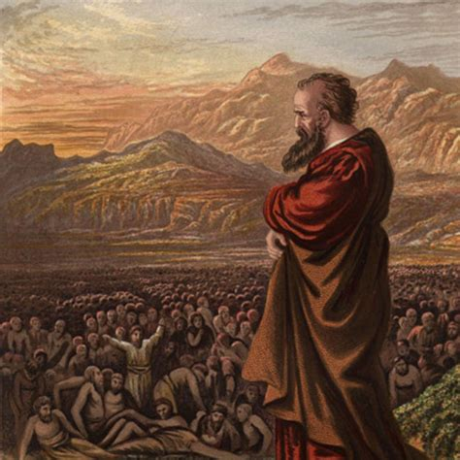
Timely Warnings: Ezekiel 20:1-44
20 And it came to pass in the seventh year, in the fifth month, the tenth day of the month, that certain of the elders of Israel came to enquire of the Lord, and sat before me.
² Then came the word of the Lord unto me, saying,

Slide 5

Timely Warnings: Ezekiel 20:1-44
20 And it came to pass in the seventh year, in the fifth month, the tenth day of the month, that certain of the elders of Israel came to enquire of the Lord, and sat before me.
² Then came the word of the Lord unto me, saying,
That is, of Jehoiachin’s captivity, which would have fallen in approximately 591/590 B.C.

Slide 6
Historical Note: Timeline
Jehoiakim 634-598 BC
18th ruler of Judah, reigned 11 yrs
Fall of Jerusalem in 586 BC
Jehoiachin 616-597 BC
reigned 3 mo 10 days
Jehoiachin’s captivity
Jeremiah 643-570 BC
Ezekiel taken to Babylon in 597 BC
Ezekiel 622-571 BC
Daniel taken to Babylon in 605 BC
Daniel: 622-630 BC
645 635 625 615 605 595 585 575 565 555 545 535 525

Slide 7
Timely Warnings: Ezekiel 20:1-44
The nature of their inquiry is not disclosed. No doubt they wished to know what message the Lord had to give them in this present crisis.
20 And it came to pass in the seventh year, in the fifth month, the tenth day of the month, that certain of the elders of Israel came to enquire of the Lord, and sat before me.
² Then came the word of the Lord unto me, saying,

Slide 8
Timely Warnings: Ezekiel 20:1-44
20 And it came to pass in the seventh year, in the fifth month, the tenth day of the month, that certain of the elders of Israel came to enquire of the Lord, and sat before me.
² Then came the word of the Lord unto me, saying,

Slide 9
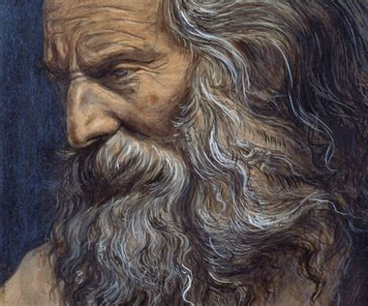
Timely Warnings: Ezekiel 20:3-44
³ Son of man, speak unto the elders of Israel, and say unto them, Thus saith the Lord God; Are ye come to enquire of me? As I live, saith the Lord God, I will not be enquired of by you.

Slide 10
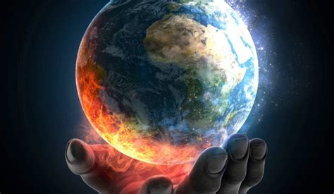
I will not be enquired of by you: SDABC V.4 p. 645
God never withholds light from the honest seeker. But if the inquirer refuses to walk in the light already revealed, it is presumptuous to ask for more. Men frequently seek for more light in the hope of avoiding some unpleasant duty that God is asking them to perform (see 2 Thess. 2:10, 11).

Slide 11
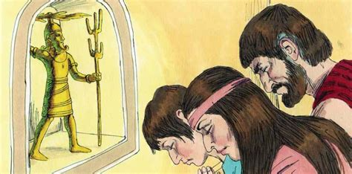
Timely Warnings: Ezekiel 20:4-44
⁴ Wilt thou judge them, son of man, wilt thou judge them? cause them to know the abominations of their fathers:

Slide 12
I will not be enquired of by you:
God firmly declines to “be enquired of” by the sinful people. They have repeatedly refused His directions and He won’t entertain their inquiries anymore. Instead, He directs His prophet Ezekiel to remind the people of their own history. They should be able to locate their answers there! It’s a little bit of an insult. The Jewish people are particularly proud of their forefathers and their detailed knowledge of their history.

Slide 13
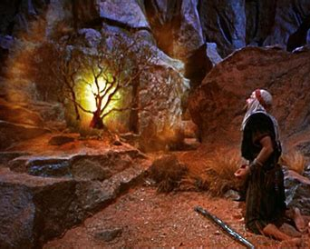
Timely Warnings: Ezekiel 20:5-44
Ezekiel 20:5-9 discusses the Egyptian period of Israel’s history.
⁵ And say unto them, Thus saith the Lord God; In the day when I chose Israel, and lifted up mine hand unto the seed of the house of Jacob, and made myself known unto them in the land of Egypt, when I lifted up mine hand unto them, saying, I am the Lord your God;

Slide 14

Timely Warnings: Ezekiel 20:6-44
Ezekiel 20:5-9 discusses the Egyptian period of Israel’s history.
⁶ In the day that I lifted up mine hand unto them, to bring them forth of the land of Egypt into a land that I had espied for them, flowing with milk and honey, which is the glory of all lands:

Slide 15
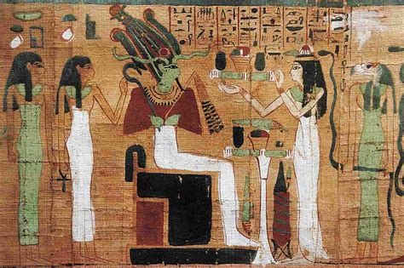
Timely Warnings: Ezekiel 20:7-44
Ezekiel 20:5-9 discusses the Egyptian period of Israel’s history.
⁷ Then said I unto them, Cast ye away every man the abominations of his eyes, and defile not yourselves with the idols of Egypt: I am the Lord your God.

Slide 16
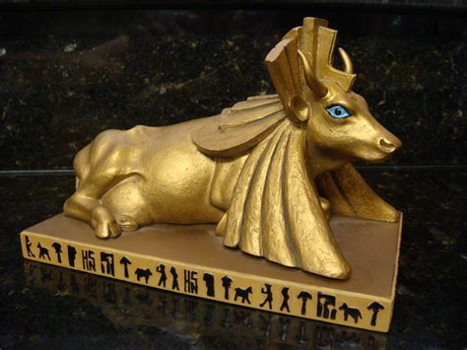
Timely Warnings: Ezekiel 20:8-44
Ezekiel 20:5-9 discusses the Egyptian period of Israel’s history.
⁸ But they rebelled against me, and would not hearken unto me: they did not every man cast away the abominations of their eyes, neither did they forsake the idols of Egypt: then I said, I will pour out my fury upon them, to accomplish my anger against them in the midst of the land of Egypt.

Slide 17
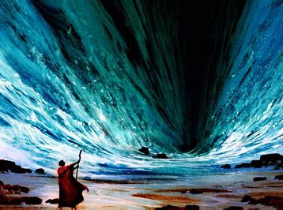
Timely Warnings: Ezekiel 20:9-44
Ezekiel 20:5-9 discusses the Egyptian period of Israel’s history.
⁹ But I wrought for my name's sake, that it should not be polluted before the heathen, among whom they were, in whose sight I made myself known unto them, in bringing them forth out of the land of Egypt.

Slide 18
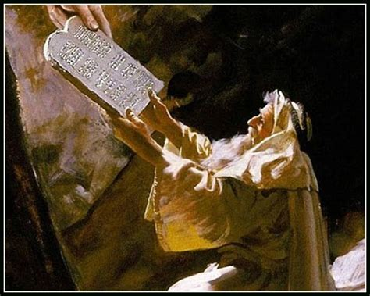
Timely Warnings: Ezekiel 20:10-44
Ezekiel 20:10-26 addresses Israel’s time in the wilderness.
¹⁰ Wherefore I caused them to go forth out of the land of Egypt, and brought them into the wilderness.
¹¹ And I gave them my statutes, and shewed them my judgments, which if a man do, he shall even live in them.

Slide 19
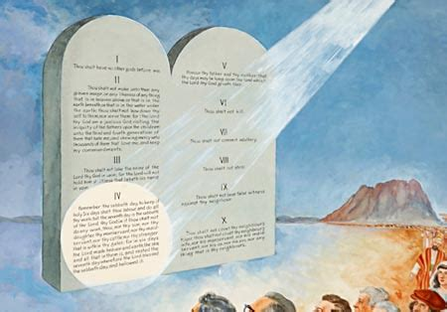
Timely Warnings: Ezekiel 20:12-44
Ezekiel 20:10-26 addresses Israel’s time in the wilderness.
¹² Moreover also I gave them my sabbaths, to be a sign between me and them, that they might know that I am the Lord that sanctify them.

Slide 20
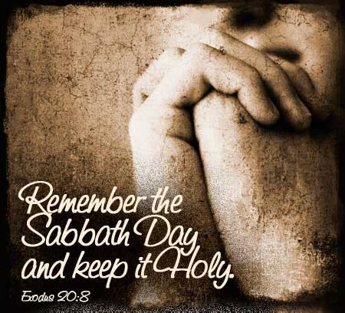
Timely Warnings: Ezekiel 20:13-44
Ezekiel 20:10-26 addresses Israel’s time in the wilderness.
¹³ But the house of Israel rebelled against me in the wilderness: they walked not in my statutes, and they despised my judgments, which if a man do, he shall even live in them; and my sabbaths they greatly polluted: then I said, I would pour out my fury upon them in the wilderness, to consume them.

Slide 21
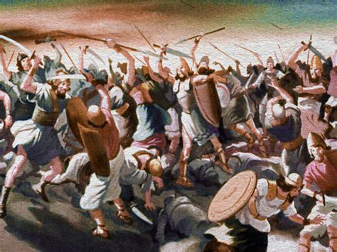
Timely Warnings: Ezekiel 20:14-44
Ezekiel 20:10-26 addresses Israel’s time in the wilderness.
¹⁴ But I wrought for my name's sake, that it should not be polluted before the heathen, in whose sight I brought them out.

Slide 22
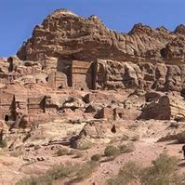
Timely Warnings: Ezekiel 20:15-44
Ezekiel 20:10-26 addresses Israel’s time in the wilderness.
¹⁵ Yet also I lifted up my hand unto them in the wilderness, that I would not bring them into the land which I had given them, flowing with milk and honey, which is the glory of all lands;

Slide 23
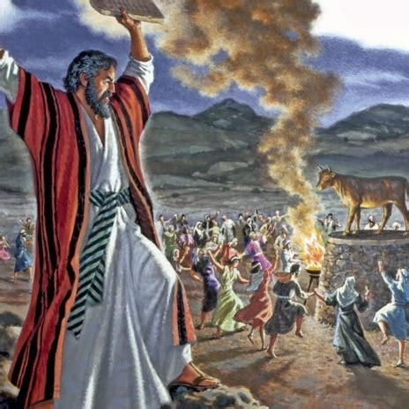
Timely Warnings: Ezekiel 20:16-44
Ezekiel 20:10-26 addresses Israel’s time in the wilderness.
¹⁶ Because they despised my judgments, and walked not in my statutes, but polluted my sabbaths: for their heart went after their idols.

Slide 24
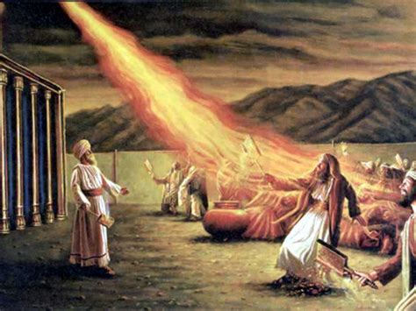
Timely Warnings: Ezekiel 20:17-44
Ezekiel 20:10-26 addresses Israel’s time in the wilderness.
¹⁷ Nevertheless mine eye spared them from destroying them, neither did I make an end of them in the wilderness.

Slide 25
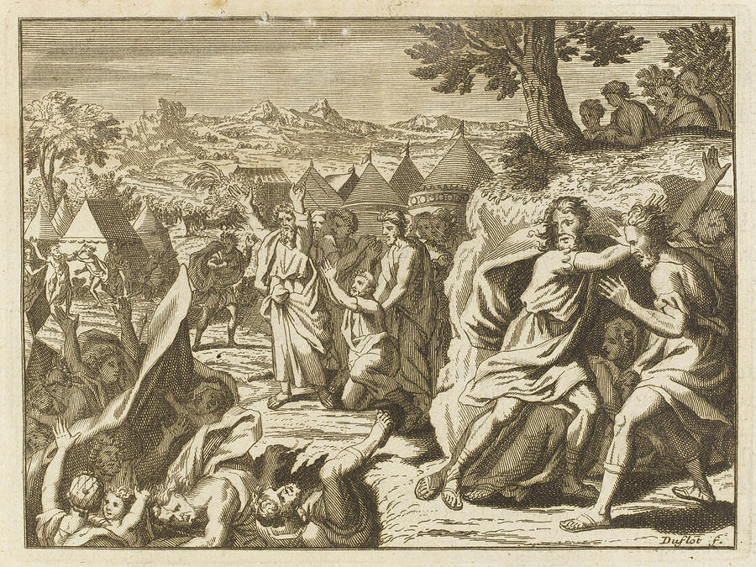
Timely Warnings: Ezekiel 20:18-44
Ezekiel 20:10-26 addresses Israel’s time in the wilderness.
¹⁸ But I said unto their children in the wilderness, Walk ye not in the statutes of your fathers, neither observe their judgments, nor defile yourselves with their idols:

Slide 26
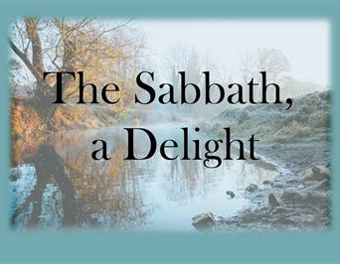
Timely Warnings: Ezekiel 20:19-44
Ezekiel 20:10-26 addresses Israel’s time in the wilderness.
¹⁹ I am the Lord your God; walk in my statutes, and keep my judgments, and do them;
²⁰ And hallow my sabbaths; and they shall be a sign between me and you, that ye may know that I am the Lord your God.

Slide 27
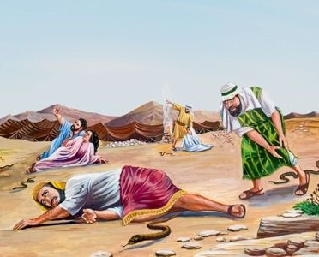
Timely Warnings: Ezekiel 20:21-44
Ezekiel 20:10-26 addresses Israel’s time in the wilderness.
²¹ Notwithstanding the children rebelled against me: they walked not in my statutes, neither kept my judgments to do them, which if a man do, he shall even live in them; they polluted my sabbaths: then I said, I would pour out my fury upon them, to accomplish my anger against them in the wilderness.

Slide 28
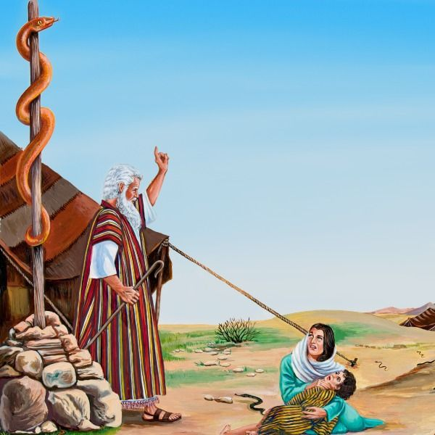
Timely Warnings: Ezekiel 20:22-44
Ezekiel 20:10-26 addresses Israel’s time in the wilderness.
²² Nevertheless I withdrew mine hand, and wrought for my name's sake, that it should not be polluted in the sight of the heathen, in whose sight I brought them forth.

Slide 29
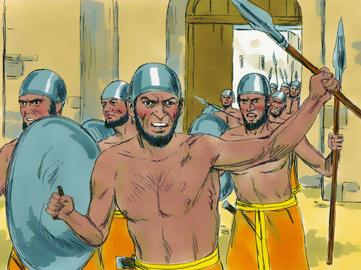
Timely Warnings: Ezekiel 20:23-44
Ezekiel 20:10-26 addresses Israel’s time in the wilderness.
²³ I lifted up mine hand unto them also in the wilderness, that I would scatter them among the heathen, and disperse them through the countries;

Slide 30

Timely Warnings: Ezekiel 20:24-44
Ezekiel 20:10-26 addresses Israel’s time in the wilderness.
²⁴ Because they had not executed my judgments, but had despised my statutes, and had polluted my sabbaths, and their eyes were after their fathers' idols.

Slide 31
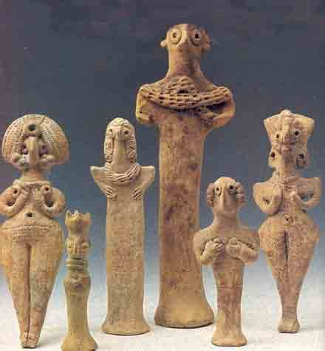
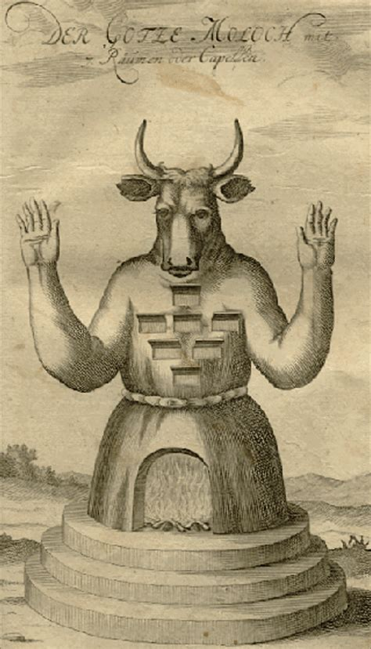
Timely Warnings: Ezekiel 20:25-44
Ezekiel 20:10-26 addresses Israel’s time in the wilderness.
²⁵ Wherefore I gave them also statutes that were not good, and judgments whereby they should not live;

Slide 32
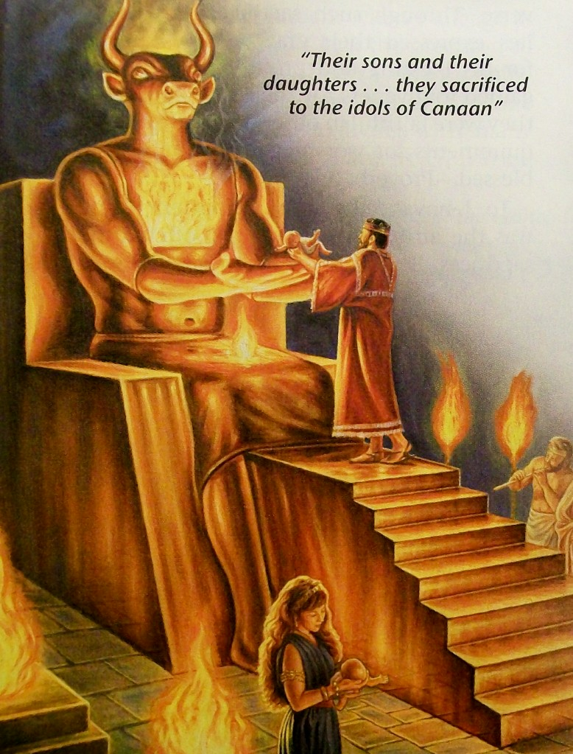
Timely Warnings: Ezekiel 20:26-44
Ezekiel 20:10-26 addresses Israel’s time in the wilderness.
²⁶ And I polluted them in their own gifts, in that they caused to pass through the fire all that openeth the womb, that I might make them desolate, to the end that they might know that I am the Lord.

Slide 33
Statutes that were not good: SDABC V.4 p. 647
These are not the “statutes, ... which if a man do, he shall even live in them” (v. 11). They are not any part of the Mosaic law. This is evident from the reference to the consecration of children to Molech in v. 26. The statutes the people had adopted, which were not good, came from the heathen round about them. But how can it be said that God gave these to them? In Bible figure, many acts are attributed to God, not with the idea that He actually performs them, but from the point of view that in His omnipotence and omniscience He does not prevent them. An understanding of this principle helps to explain many apparently contradictory statements, which, like the one here under consideration, seem to contradict flatly the Bible teaching that God’s character is pure and holy.

Slide 34
Statutes that were not good: SDABC V.4 p. 647
Attempts have been made to apply this text to the multitude of ceremonies and ordinances of the Mosaic law, which, if Israel had been obedient and had loved to keep God’s commandments, would not have been required. But the provisions of the Mosaic code can hardly be designated “statutes that were not good,” for the former were already in existence when Ezekiel made this pronouncement.

Slide 35
Statutes that were not good: Patriarchs and Prophets p. 367
“The ceremonial law was given by Christ. Even after it was no longer to be observed, Paul presented it before the Jews in its true position and value, showing its place in the plan of redemption and its relation to the work of Christ; and the great apostle pronounces this law glorious, worthy of its divine Originator. The solemn service of the sanctuary typified the grand truths that were to be revealed through successive generations.”

Slide 36
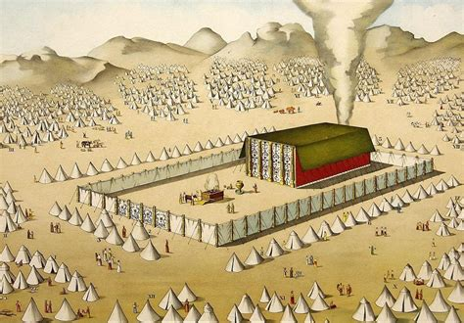
Statutes that were not good: SDABC V.4 p. 647
The clearer light that we now possess should not lead us to despise that which was earlier given in types and symbols!

Slide 37
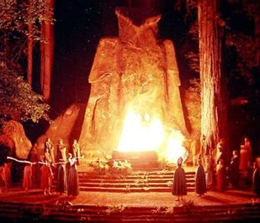
Timely Warnings: Ezekiel 20:27-44
Ezekiel 20:27-32 speaks to Israel’s rebellion after entering Canaan.
²⁷ Therefore, son of man, speak unto the house of Israel, and say unto them, Thus saith the Lord God; Yet in this your fathers have blasphemed me, in that they have committed a trespass against me.

Slide 38
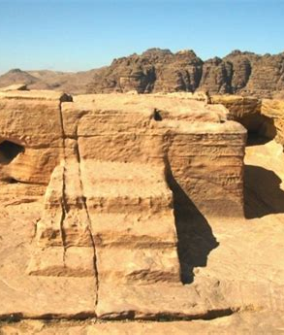
Timely Warnings: Ezekiel 20:28-44
Ezekiel 20:27-32 speaks to Israel’s rebellion after entering Canaan.
²⁸ For when I had brought them into the land, for the which I lifted up mine hand to give it to them, then they saw every high hill, and all the thick trees, and they offered there their sacrifices, and there they presented the provocation of their offering: there also they made their sweet savour, and poured out there their drink offerings.

Slide 39
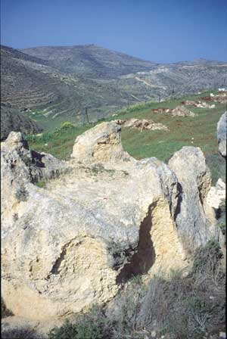
Timely Warnings: Ezekiel 20:29-44
Ezekiel 20:27-32 speaks to Israel’s rebellion after entering Canaan.
²⁹ Then I said unto them, What is the high place whereunto ye go? And the name whereof is called Bamah unto this day.

Slide 40
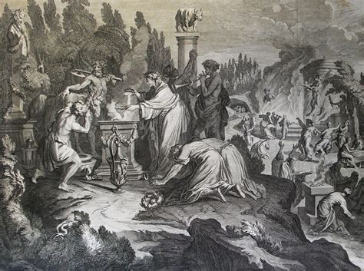
Timely Warnings: Ezekiel 20:30-44
Ezekiel 20:27-32 speaks to Israel’s rebellion after entering Canaan.
³⁰ Wherefore say unto the house of Israel, Thus saith the Lord God; Are ye polluted after the manner of your fathers? and commit ye whoredom after their abominations?

Slide 41
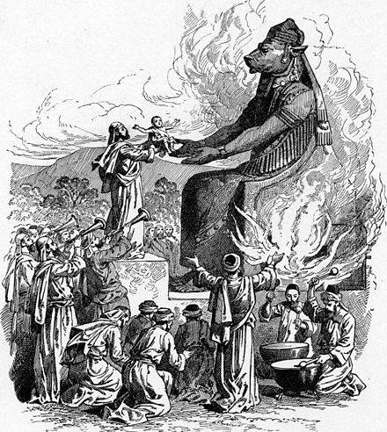
Timely Warnings: Ezekiel 20:31-44
Ezekiel 20:27-32 speaks to Israel’s rebellion after entering Canaan.
³¹ For when ye offer your gifts, when ye make your sons to pass through the fire, ye pollute yourselves with all your idols, even unto this day: and shall I be enquired of by you, O house of Israel? As I live, saith the Lord God, I will not be enquired of by you.

Slide 42
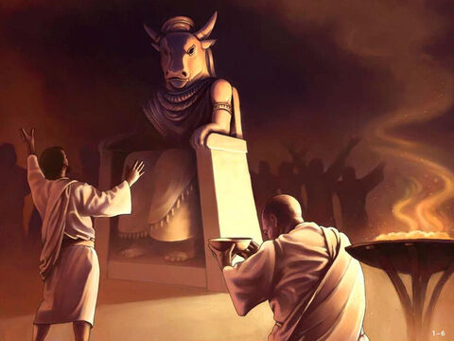
Timely Warnings: Ezekiel 20:32-44
Ezekiel 20:27-32 speaks to Israel’s rebellion after entering Canaan.
³² And that which cometh into your mind shall not be at all, that ye say, We will be as the heathen, as the families of the countries, to serve wood and stone.

Slide 43
We will be as the heathen: SDABC V. 4 p. 647
The prophet here reads the secret aspirations of his inquirers and flatly contradicts their sordid ambitions. Possibly they flattered themselves that if they could be released from their spiritual responsibility as Jehovah’s chosen people they would escape the severe punishments that the prophets had threatened. They may have believed that if they simply accepted the state of the heathen, together with correspondingly smaller responsibilities, Jehovah would leave them alone.

Slide 44
We will be as the heathen: SDABC V. 4 p. 647
But as it was, they felt that they were being continually disturbed with judgments on account of their unwillingness to accomplish their divine mission. The answer comes that this will not be at all, for Israel stands in a very different relationship to God from that of the heathen. Men are dealt with according to the light and privileges they have had.

Slide 45
We will be as the heathen: SDABC V. 4 p. 648
God does not easily withdraw these privileges nor lightly abandon those for whom He has planned a high destiny. What He purposes and executes is for the good of those concerned, as they themselves will ultimately be led to admit. God continues to work with any who submit, and accomplishes His designs, though it be but with a remnant. This is the theme of the prophecy that follows.

Slide 46
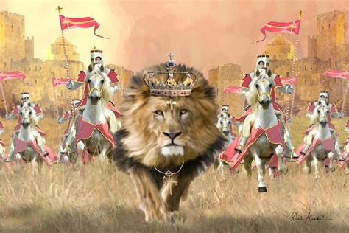
Timely Warnings: Ezekiel 20:33-44
Historically, the plan Ezekiel here mentions was never fulfilled, at least not to any significant degree. These assurances therefore fall to Spiritual Israel!
³³ As I live, saith the Lord God, surely with a mighty hand, and with a stretched out arm, and with fury poured out, will I rule over you:

Slide 47
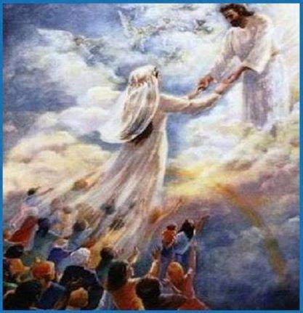
Timely Warnings: Ezekiel 20:34-44
Ezekiel 20:33-44 speaks to an unfulfilled plan with promises for our future.
³⁴ And I will bring you out from the people, and will gather you out of the countries wherein ye are scattered, with a mighty hand, and with a stretched out arm, and with fury poured out.

Slide 48
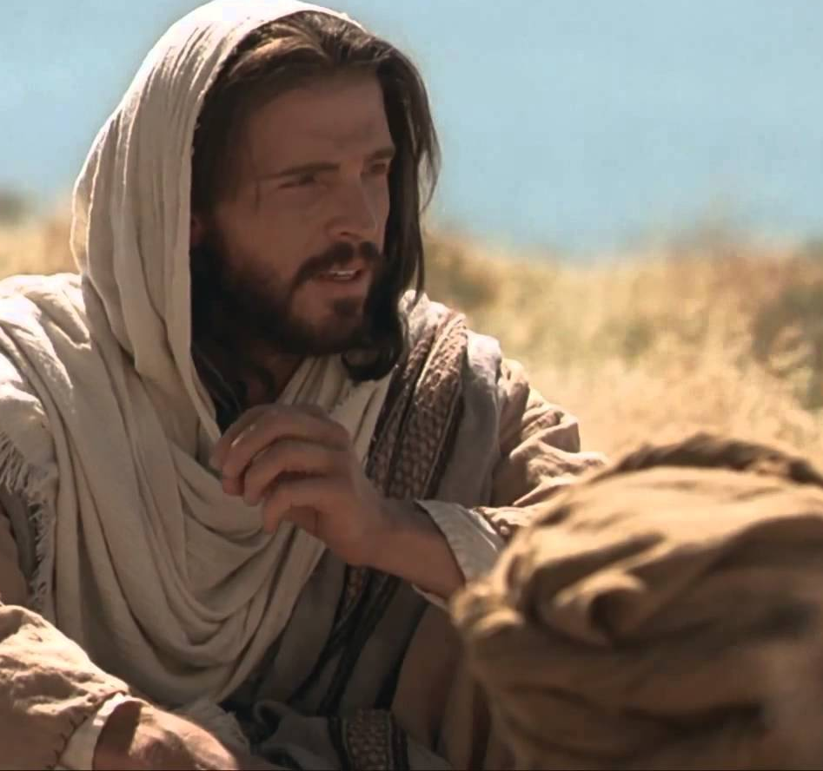
Timely Warnings: Ezekiel 20:35-44
Ezekiel 20:33-44 speaks to an unfulfilled plan with promises for our future.
³⁵ And I will bring you into the wilderness of the people, and there will I plead with you face to face.
³⁶ Like as I pleaded with your fathers in the wilderness of the land of Egypt, so will I plead with you, saith the Lord God.

Slide 49
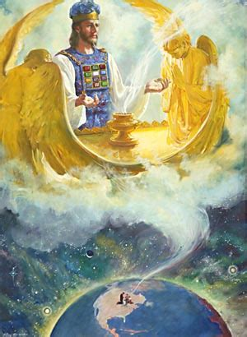
Timely Warnings: Ezekiel 20:37-44
Ezekiel 20:33-44 speaks to an unfulfilled plan with promises for our future.
³⁷ And I will cause you to pass under the rod, and I will bring you into the bond of the covenant:

Slide 50
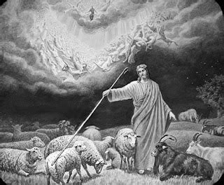
Timely Warnings: Ezekiel 20:38-44
Ezekiel 20:33-44 speaks to an unfulfilled plan with promises for our future.
³⁸ And I will purge out from among you the rebels, and them that transgress against me: I will bring them forth out of the country where they sojourn, and they shall not enter into the land of Israel: and ye shall know that I am the Lord.

Slide 51
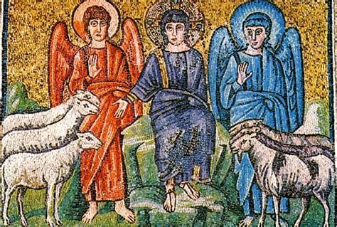
Timely Warnings: Ezekiel 20:39-44
Ezekiel 20:33-44 speaks to an unfulfilled plan with promises for our future.
³⁹ As for you, O house of Israel, thus saith the Lord God; Go ye, serve ye every one his idols, and hereafter also, if ye will not hearken unto me: but pollute ye my holy name no more with your gifts, and with your idols.

Slide 52
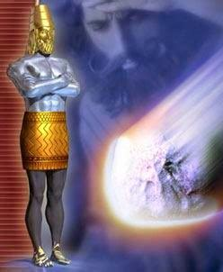
Timely Warnings: Ezekiel 20:40-44
Ezekiel 20:33-44 speaks to an unfulfilled plan with promises for our future.
⁴⁰ For in mine holy mountain, in the mountain of the height of Israel, saith the Lord God, there shall all the house of Israel, all of them in the land, serve me: there will I accept them, and there will I require your offerings, and the firstfruits of your oblations, with all your holy things.

Slide 53
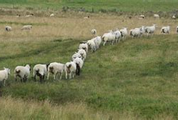
Timely Warnings: Ezekiel 20:41-44
Ezekiel 20:33-44 speaks to an unfulfilled plan with promises for our future.
⁴¹ I will accept you with your sweet savour, when I bring you out from the people, and gather you out of the countries wherein ye have been scattered; and I will be sanctified in you before the heathen.

Slide 54
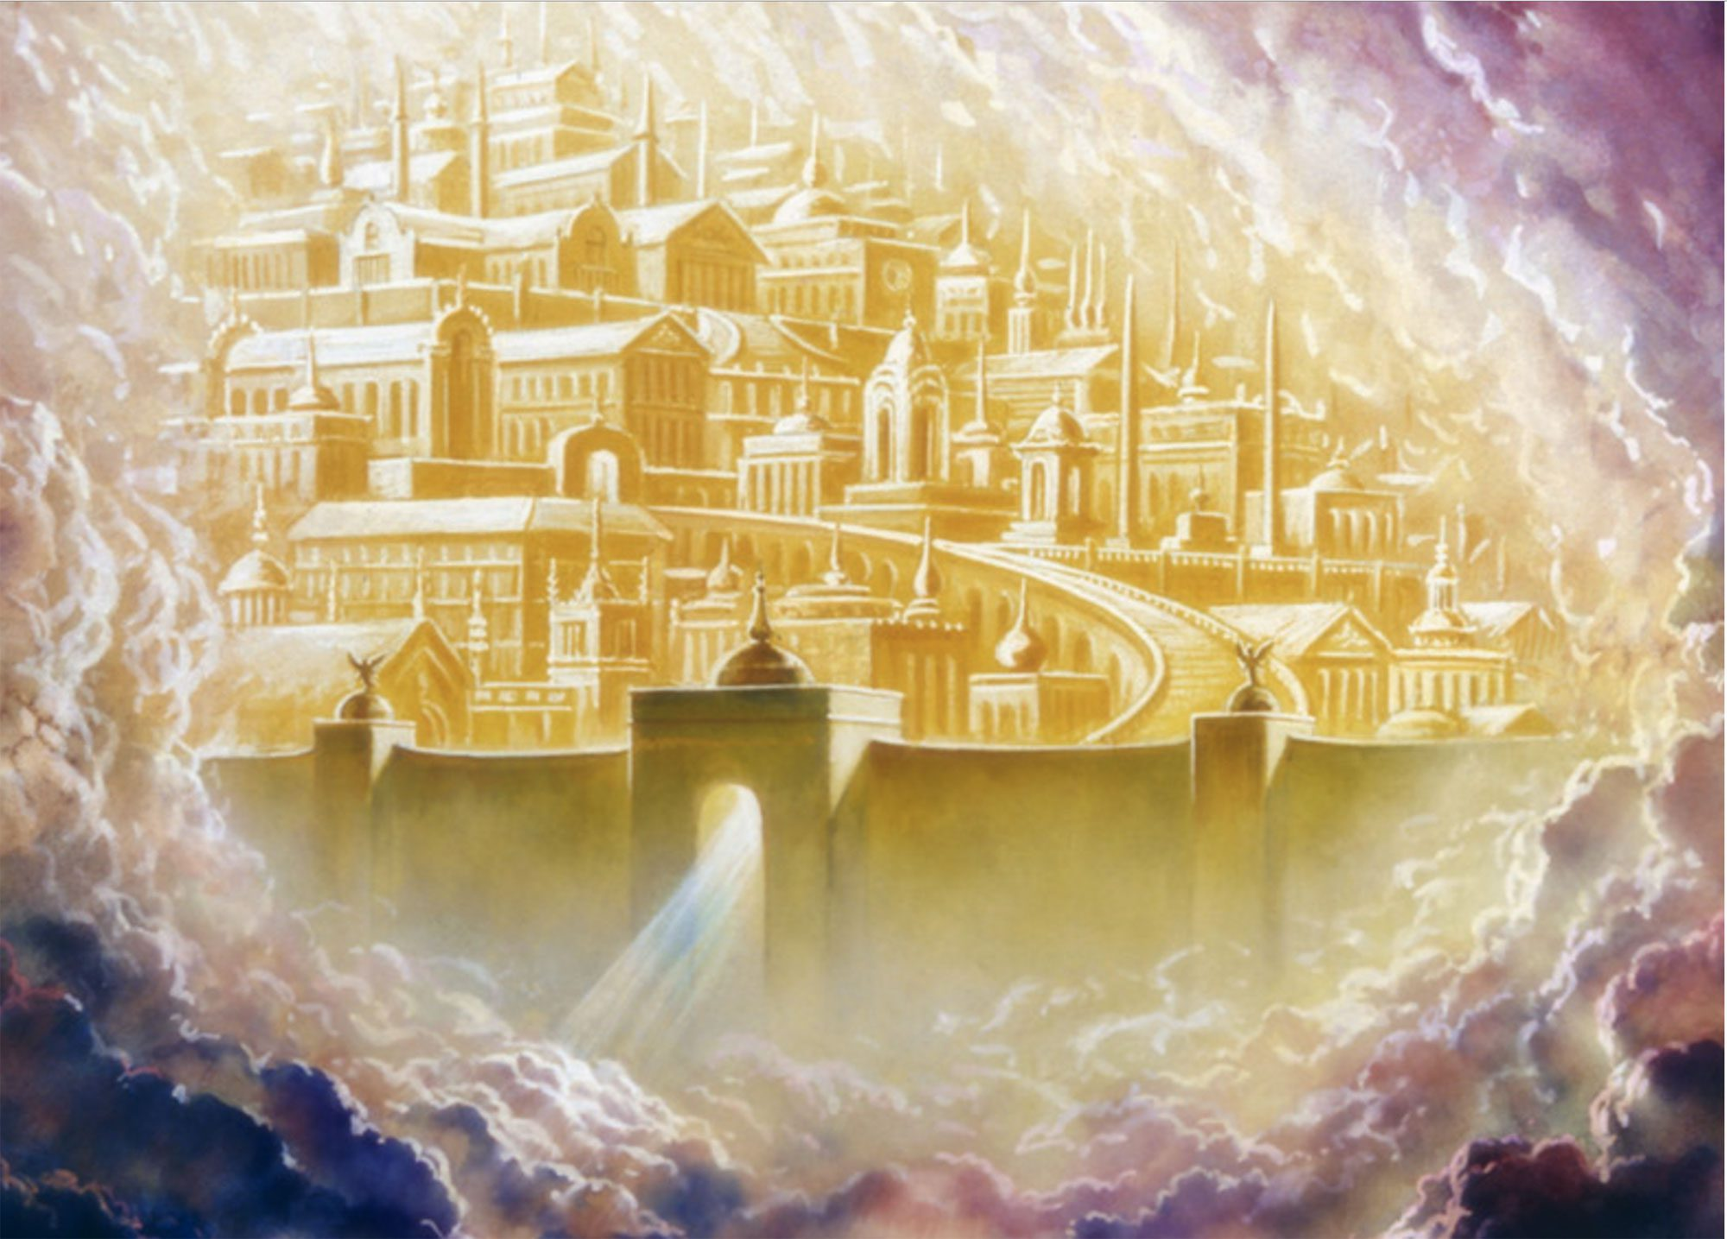
Timely Warnings: Ezekiel 20:42-44
Ezekiel 20:33-44 speaks to an unfulfilled plan with promises for our future.
⁴² And ye shall know that I am the Lord, when I shall bring you into the land of Israel, into the country for the which I lifted up mine hand to give it to your fathers.

Slide 55
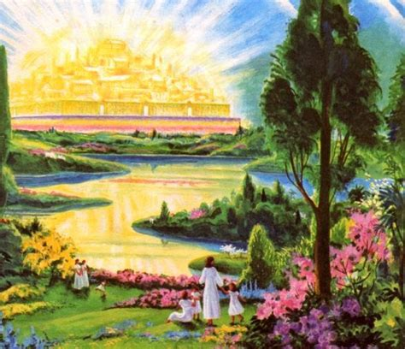
Timely Warnings: Ezekiel 20:43-44
Ezekiel 20:33-44 speaks to an unfulfilled plan with promises for our future.
⁴³ And there shall ye remember your ways, and all your doings, wherein ye have been defiled; and ye shall lothe yourselves in your own sight for all your evils that ye have committed.

Slide 56
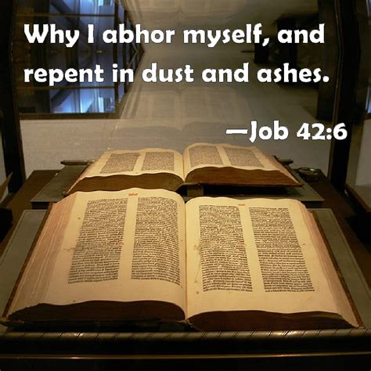
Loathe yourselves: SDABC V. 4 p. 648
This is the mark of the truly penitent. Those who seek to excuse their sins have not taken the first step toward true repentance. Job is an example of one who for a time sought to justify his course. It was only when a revelation of the character of God was portrayed before him that the contrast between his own sinfulness and the purity of his Maker became painfully apparent.

Slide 57
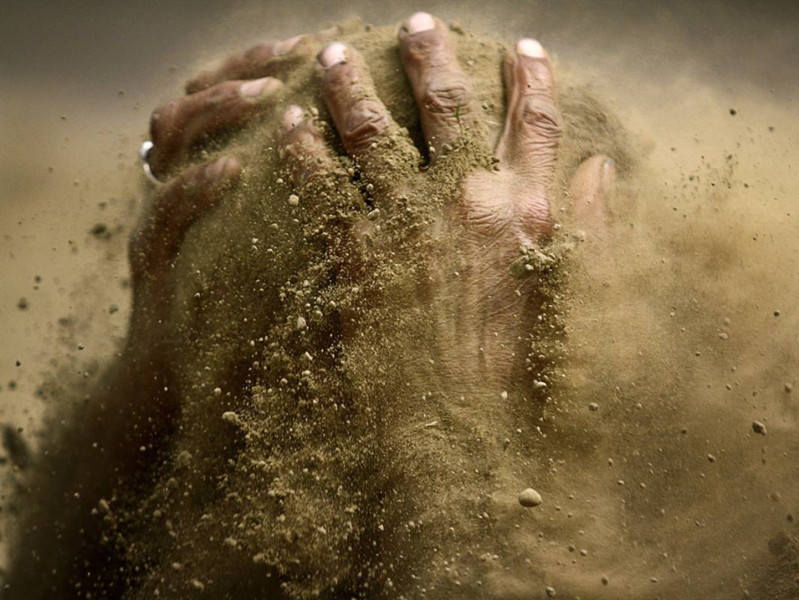
Loathe yourselves: SDABC V. 4 p. 649
Self-loathing over sins is one of the most effective antidotes for a future repetition of those sins. The reason we fall so repeatedly into the same errors is that we do not mourn over our sins.

Slide 58

Timely Warnings: Ezekiel 20:44
Ezekiel 20:33-44 speaks to an unfulfilled plan with promises for our future.
⁴⁴ And ye shall know that I am the Lord when I have wrought with you for my name's sake, not according to your wicked ways, nor according to your corrupt doings, O ye house of Israel, saith the Lord God.

Slide 59
NOT according to your wicked ways: SDABC V. 4 p. 649
Salvation is and will ever be an unmerited gift. Our wicked ways have earned for us only death. There is no amount of “works” that the sinner can accumulate that will finally constitute him worthy of heaven. On the other hand there is no sin so great that it cannot be removed by sincere repentance and reformation. When the righteous man receives his rewards, all the sins that he has committed will not even be mentioned to him.

Slide 60

Timely Warnings: Ezekiel 20
More than two and a half thousand years ago, Ezekiel warned the people to be careful of God’s Sabbaths! Somehow that central issue of worship and obedience continues to be a sticking point today. And we know that worse is coming!

Slide 61
Sacred Sabbath: Prophets and Kings p. 181
“Before entering the Promised Land, the Israelites were admonished by Moses to “keep the Sabbath day to sanctify it.” Deuteronomy 5:12. The Lord designed that by a faithful observance of the Sabbath command, Israel should continually be reminded of their accountability to Him as their Creator and their Redeemer.

Slide 62
Sacred Sabbath: Prophets and Kings p. 181
While they should keep the Sabbath in the proper spirit, idolatry could not exist; but should the claims of this precept of the Decalogue be set aside as no longer binding, the Creator would be forgotten and men would worship other gods. “I gave them My Sabbaths,” God declared, “to be a sign between Me and them, that they might know that I am the Lord that sanctify them.” Yet “they despised My judgments, and walked not in My statutes, but polluted My Sabbaths: for their heart went after their idols.”

Slide 63
Sacred Sabbath: Prophets and Kings p. 181
And in His appeal to them to return to Him, He called their attention anew to the importance of keeping the Sabbath holy. “I am the Lord your God,” He said; “walk in My statutes, and keep My judgments, and do them; and hallow My Sabbaths; and they shall be a sign between Me and you, that ye may know that I am the Lord your God.” Ezekiel 20:12, 16, 19, 20. ”

Slide 64
Sacred Sabbath: Prophets and Kings p. 182
In calling the attention of Judah to the sins that finally brought upon them the Babylonian Captivity, the Lord declared: “Thou hast ... profaned My Sabbaths.” “Therefore have I poured out Mine indignation upon them; I have consumed them with the fire of My wrath: their own way have I recompensed upon their heads.” Ezekiel 22:8, 31.

Slide 65
Sacred Sabbath: Prophets and Kings p. 182
At the restoration of Jerusalem, in the days of Nehemiah, Sabbathbreaking was met with the stern inquiry, “Did not your fathers thus, and did not our God bring all this evil upon us, and upon this city? yet ye bring more wrath upon Israel by profaning the Sabbath.” Nehemiah 13:18.

Slide 66
Sacred Sabbath: Prophets and Kings p. 182
Christ, during His earthly ministry, emphasized the binding claims of the Sabbath; in all His teaching He showed reverence for the institution He Himself had given. In His days the Sabbath had become so perverted that its observance reflected the character of selfish and arbitrary men rather than the character of God. Christ set aside the false teaching by which those who claimed to know God had misrepresented Him. “

Slide 67
Sacred Sabbath: Prophets and Kings p. 182
Christ, during His earthly ministry, emphasized the binding claims of the Sabbath; in all His teaching He showed reverence for the institution He Himself had given. In His days the Sabbath had become so perverted that its observance reflected the character of selfish and arbitrary men rather than the character of God. Christ set aside the false teaching by which those who claimed to know God had misrepresented Him.”

Slide 68
Sacred Sabbath: Great Controversy, p. 640
“The enemies of God's law, from the ministers down to the least among them, have a new conception of truth and duty. Too late they see that the Sabbath of the fourth commandment is the seal of the living God. Too late they see the true nature of their spurious sabbath and the sandy foundation upon which they have been building... Not until the day of final accounts will it be known how great is the responsibility of men in holy office and how terrible are the results of their unfaithfulness… Fearful will be the doom of him to whom God shall say: Depart, thou wicked servant.

Slide 69
Timely Warnings: Ezekiel 20
Also striking in this chapter is God’s disinterest in the enquiries of the elders. We know that God loves to reason with His people when they are diligently seeking Him. So we can conclude that these elders are double-minded, disingenuous, engaging in sophistry rather than actually seeking insight. Of course, God is not mocked. He directs them to study their own history. Not much has changed since Ezekiel’s day! We have much sophistry and double-mindedness going on now. And we may expect an increase in this as time goes forward.

Slide 70
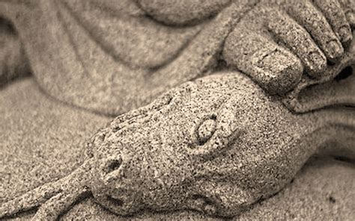
Lies and Confusion: Revelation 12:9
⁹ And the great dragon was cast out, that old serpent, called the Devil, and Satan, which deceiveth the whole world: he was cast out into the earth, and his angels were cast out with him.

Slide 71
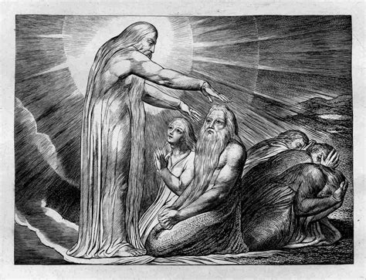
Lies and Confusion: Revelation 13:13-14
¹³ And he doeth great wonders, so that he maketh fire come down from heaven on the earth in the sight of men,

Slide 72
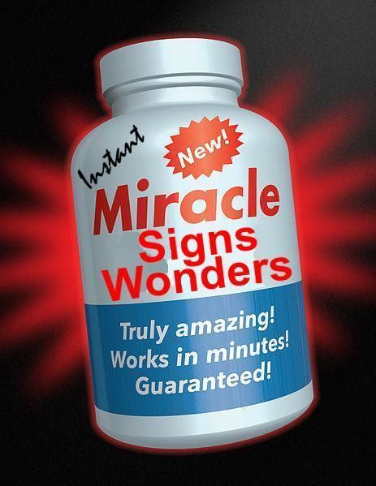
Lies and Confusion: Revelation 13:14
¹⁴ And deceiveth them that dwell on the earth by the means of those miracles which he had power to do in the sight of the beast; saying to them that dwell on the earth, that they should make an image to the beast, which had the wound by a sword, and did live.

Slide 73

Lies and Confusion: Mark 13:21-23
²¹ And then if any man shall say to you, Lo, here is Christ; or, lo, he is there; believe him not:

Slide 74
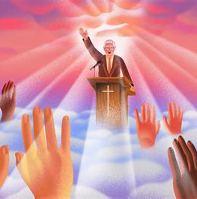
Lies and Confusion: Mark 13:22-23
²² For false Christs and false prophets shall rise, and shall shew signs and wonders, to seduce, if it were possible, even the elect.
²³ But take ye heed: behold, I have foretold you all things.

Slide 75
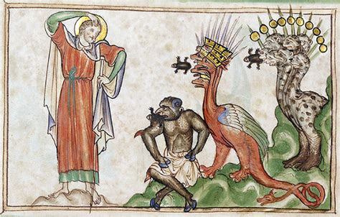
Lies and Confusion: Revelation 16:13-14
¹³ And I saw three unclean spirits like frogs come out of the mouth of the dragon, and out of the mouth of the beast, and out of the mouth of the false prophet.

Slide 76
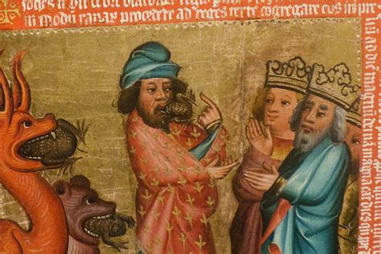
Lies and Confusion: Revelation 16:13-14
¹⁴ For they are the spirits of devils, working miracles, which go forth unto the kings of the earth and of the whole world, to gather them to the battle of that great day of God Almighty.

Slide 77
We will be as the heathen: SDABC V. 7 p.
We identify the “dragon,” “beast,” and false prophet as modern spiritism (GC 561, 562), or paganism, the papacy, and apostate Protestantism. The three unclean spirits apparently either symbolize or represent this evil trio of religious powers, which together constitute latter-day “great Babylon.”

Slide 78
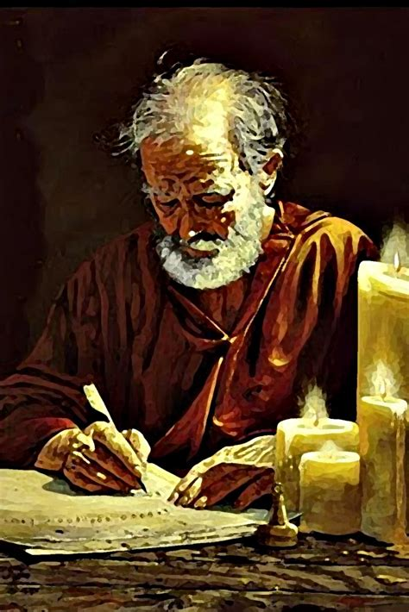
Lies and Confusion: 2 Thessalonians 2:1-12
2 Now we beseech you, brethren, by the coming of our Lord Jesus Christ, and by our gathering together unto him,

Slide 79
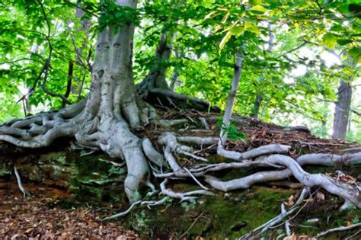
Lies and Confusion: 2 Thessalonians 2:2-12
² That ye be not soon shaken in mind, or be troubled, neither by spirit, nor by word, nor by letter as from us, as that the day of Christ is at hand.

Slide 80

Lies and Confusion: 2 Thessalonians 2:3-12
³ Let no man deceive you by any means: for that day shall not come, except there come a falling away first, and that man of sin be revealed, the son of perdition;

Slide 81

Lies and Confusion: 2 Thessalonians 2:4-12
⁴ Who opposeth and exalteth himself above all that is called God, or that is worshipped; so that he as God sitteth in the temple of God, shewing himself that he is God.

Slide 82

Lies and Confusion: 2 Thessalonians 2:5-12
⁵ Remember ye not, that, when I was yet with you, I told you these things?
⁶ And now ye know what withholdeth that he might be revealed in his time.

Slide 83

Lies and Confusion: 2 Thessalonians 2:7-12
⁷ For the mystery of iniquity doth already work: only he who now letteth will let, until he be taken out of the way.

Slide 84

Lies and Confusion: 2 Thessalonians 2:8-12
⁸ And then shall that Wicked be revealed, whom the Lord shall consume with the spirit of his mouth, and shall destroy with the brightness of his coming:

Slide 85

Lies and Confusion: 2 Thessalonians 2:9-12
⁹ Even him, whose coming is after the working of Satan with all power and signs and lying wonders,

Slide 86

Lies and Confusion: 2 Thessalonians 2:10-12
¹⁰ And with all deceivableness of unrighteousness in them that perish; because they received not the love of the truth, that they might be saved.

Slide 87

Lies and Confusion: 2 Thessalonians 2:11-12
¹¹ And for this cause God shall send them strong delusion, that they should believe a lie:
¹² That they all might be damned who believed not the truth, but had pleasure in unrighteousness.

Slide 88

Lies and Confusion: Matthew 16:1-4
16 The Pharisees also with the Sadducees came, and tempting desired him that he would shew them a sign from heaven.

Slide 89

Lies and Confusion: Matthew 16:2-4
² He answered and said unto them, When it is evening, ye say, It will be fair weather: for the sky is red.

Slide 90

Lies and Confusion: Matthew 16:3-4
³ And in the morning, It will be foul weather to day: for the sky is red and lowering. O ye hypocrites, ye can discern the face of the sky; but can ye not discern the signs of the times?

Slide 91

Lies and Confusion: Matthew 16:4
⁴ A wicked and adulterous generation seeketh after a sign; and there shall no sign be given unto it, but the sign of the prophet Jonas. And he left them, and departed.

Slide 92
The sign of Jonas: The Desire of Ages p. 406
“As Jonah was three days and three nights in the belly of the whale, Christ was to be the same time “in the heart of the earth.” And as the preaching of Jonah was a sign to the Ninevites, so Christ's preaching was a sign to His generation. But what a contrast in the reception of the word! The people of the great heathen city trembled as they heard the warning from God. …

Slide 93
The sign of Jonas: The Desire of Ages p. 406
Kings and nobles humbled themselves; the high and the lowly together cried to the God of heaven, and His mercy was granted unto them. “The men of Nineveh shall rise in judgment with this generation,” Christ had said, “and shall condemn it: because they repented at the preaching of Jonas; and, behold, a greater than Jonas is here.” Matthew 12:40, 41. “

Slide 94

Lies and Confusion: Proverbs 14:12
¹² There is a way which seemeth right unto a man, but the end thereof are the ways of death.

Slide 95

Lies and Confusion: Jeremiah 17:9-10
⁹ The heart is deceitful above all things, and desperately wicked: who can know it?
¹⁰ I the Lord search the heart, I try the reins, even to give every man according to his ways, and according to the fruit of his doings.

Slide 96

Lies and Confusion: Proverbs 28:26
²⁶ He that trusteth in his own heart is a fool: but whoso walketh wisely, he shall be delivered.

Slide 97
So we can’t always trust signs, miracles, wonders. We’ve been warned that Satan can use such devices.
We can’t even trust ourselves! Apparently our minds and hearts will often lead us wrong.
I guess we’re going to have to follow God’s suggestion from Ezekiel 20 and do a little study!

Slide 98
Good Directions: Mark 13:22-23
²² For false Christs and false prophets shall rise, and shall shew signs and wonders, to seduce, if it were possible, even the elect.
²³ But take ye heed: behold, I have foretold you all things.
Study your history!!

Slide 99
Good Directions: 2 Thessalonians 2:5-6
⁵ Remember ye not, that, when I was yet with you, I told you these things?
⁶ And now ye know what withholdeth that he might be revealed in his time.
Study your history!!

Slide 100
Good Directions: Matthew 16:4
⁴ A wicked and adulterous generation seeketh after a sign; and there shall no sign be given unto it, but the sign of the prophet Jonas. And he left them, and departed.
Study your history!!

Slide 101

Good Directions: Proverbs 3:5-7
⁵ Trust in the Lord with all thine heart; and lean not unto thine own understanding.
⁶ In all thy ways acknowledge him, and he shall direct thy paths.
⁷ Be not wise in thine own eyes: fear the Lord, and depart from evil.

Slide 102

Good Directions: Trust in the Lord
We MUST have directions that we can trust! The consequences of trusting the wrong source are dire!
DO NOT BE DECEIVED.

Slide 103

Good Directions: Revelation 18:4-5
⁴ And I heard another voice from heaven, saying, Come out of her, my people, that ye be not partakers of her sins, and that ye receive not of her plagues.

Slide 104

Good Directions: Revelation 18:4-5
⁵ For her sins have reached unto heaven, and God hath remembered her iniquities.

Slide 105
HAPPY SABBATH!!
Thank you &

