Slide 1
The Seal of God and the Mark of the Beast: Part 1
Revelation 6:15-7:17; 18:2-10, Ezekiel 9
Lesson 11, 2nd Quarter 2023

Slide 2
Memory Text: Revelation 7:2-3
² And I saw another angel ascending from the east, having the seal of the living God: and he cried with a loud voice to the four angels, to whom it was given to hurt the earth and the sea,
³ Saying, Hurt not the earth, neither the sea, nor the trees, till we have sealed the servants of our God in their foreheads.

Slide 3
KEY VERSES: The 2nd Angel’s Message
Revelation 14:8
⁸ And there followed another angel, saying, Babylon is fallen, is fallen, that great city, because she made all nations drink of the wine of the wrath of her fornication.

Slide 4
KEY VERSES: The 3rd Angel’s Message
Revelation 14:9-12
⁹ And the third angel followed them, saying with a loud voice, If any man worship the beast and his image, and receive his mark in his forehead, or in his hand,
¹⁰ The same shall drink of the wine of the wrath of God, which is poured out without mixture into the cup of his indignation; and he shall be tormented with fire and brimstone in the presence of the holy angels, and in the presence of the Lamb:

Slide 5
KEY VERSES: The 3rd Angel’s Message
Revelation 14:9-12
¹¹ And the smoke of their torment ascendeth up for ever and ever: and they have no rest day nor night, who worship the beast and his image, and whosoever receiveth the mark of his name.
¹² Here is the patience of the saints: here are they that keep the commandments of God, and the faith of Jesus.

Slide 6
Three Angels’ Messages:
1st Angel: Worship the Creator God of the Gospel!
2nd Angel: False System of Worship Doomed!
3rd Angel: Choose!
Live or Die by Your Choice.

Slide 7
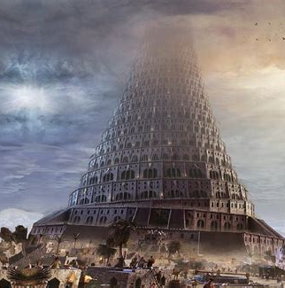
Early Babylon: SDABC V.7 p. 828-9
In Babylonian the name Bab-ilu (Babel, or Babylon) meant “gate of the gods,” but the Hebrews derogatorily associated it with balal, a word in their language meaning “to confuse.”

Slide 8
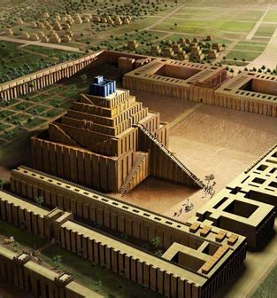
Early Babylon: SDABC V.7 p. 829
The rulers of Babylon doubtless called their city the “gate” of the gods in the sense that they chose to think of it as the place where the gods consorted with men, to order the affairs of earth.

Slide 9
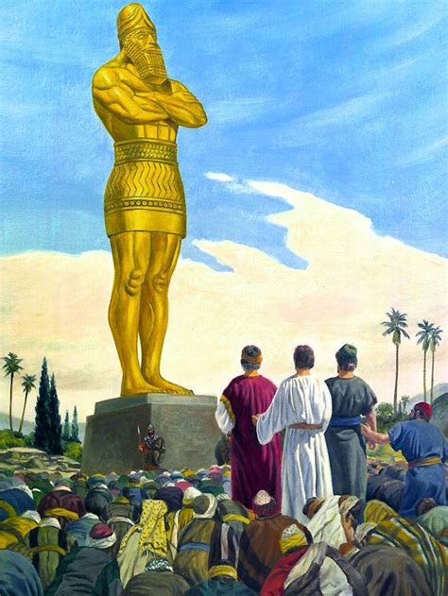
Early Babylon: SDABC V.7 p. 829
The name thus seems to have reflected the claim of the Babylonian kings that they had been commissioned to rule the world by divine mandate.

Slide 10
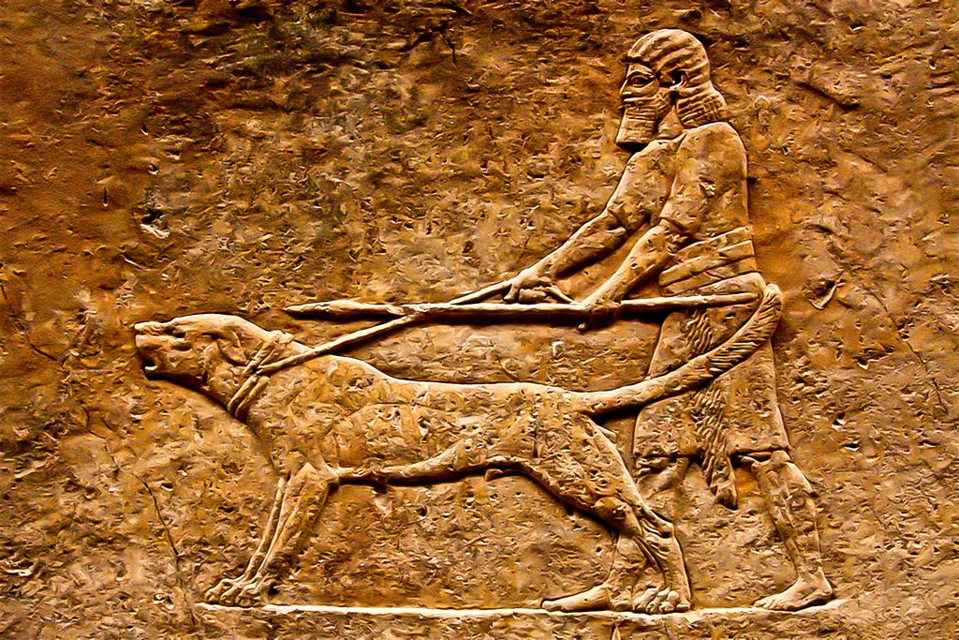
Early Babylon: Genesis 10:8-11
⁸ And Cush begat Nimrod: he began to be a mighty one in the earth.

Slide 11
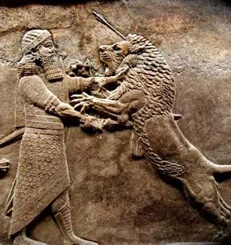
Early Babylon: Genesis 10:8-11
⁹ He was a mighty hunter before the Lord: wherefore it is said, Even as Nimrod the mighty hunter before the Lord.

Slide 12
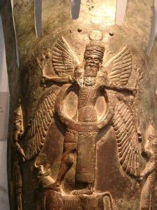
Early Babylon: Genesis 10:8-11
¹⁰ And the beginning of his kingdom was Babel, and Erech, and Accad, and Calneh, in the land of Shinar.

Slide 13
Early Babylon: Genesis 10:8-11
¹¹ Out of that land went forth Asshur, and builded Nineveh, and the city Rehoboth, and Calah,
¹² And Resen between Nineveh and Calah: the same is a great city.

Slide 14
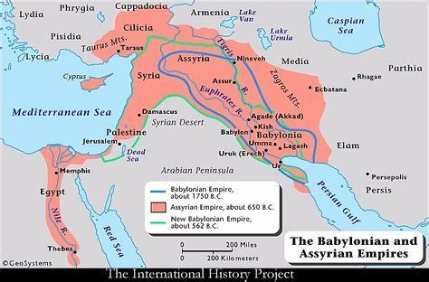

Slide 15
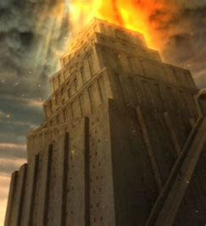
Early Babylon: SDABC V.7 p. 829
Babylon was founded by Nimrod. From the very beginning the city was emblematic of disbelief in the true God and defiance of His will, and its tower a monument to apostasy, a citadel of rebellion against Him.

Slide 16
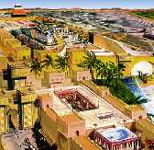
Early Babylon: Isaiah 14:4-6, 12-14
⁴ That thou shalt take up this proverb against the king of Babylon, and say, How hath the oppressor ceased! the golden city ceased!
⁵ The Lord hath broken the staff of the wicked, and the sceptre of the rulers.

Slide 17
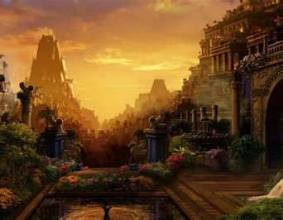
Early Babylon: Isaiah 14:6, 12-14
⁶ He who smote the people in wrath with a continual stroke, he that ruled the nations in anger, is persecuted, and none hindereth.

Slide 18
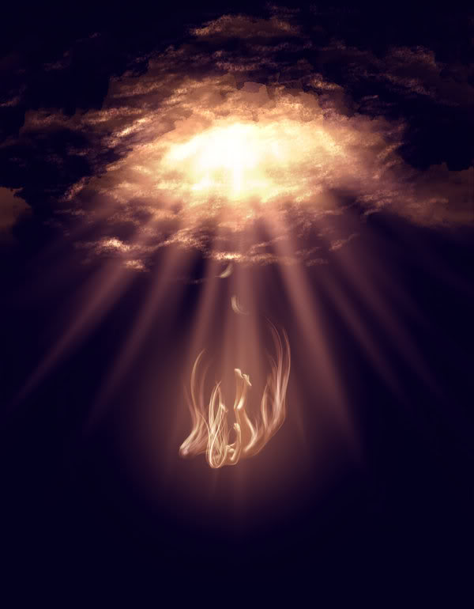
Early Babylon: Isaiah 14:12-14
¹² How art thou fallen from heaven, O Lucifer, son of the morning! how art thou cut down to the ground, which didst weaken the nations!

Slide 19
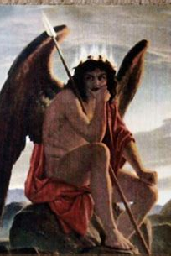
Early Babylon: Isaiah 14:13-14
¹³ For thou hast said in thine heart, I will ascend into heaven, I will exalt my throne above the stars of God: I will sit also upon the mount of the congregation, in the sides of the north:
¹⁴ I will ascend above the heights of the clouds; I will be like the most High.

Slide 20
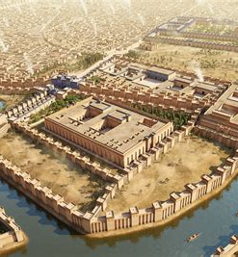
Early Babylon: SDABC V.7 p. 829
The prophet Isaiah identifies Lucifer as the invisible king of Babylon. In fact, it would appear that Satan designed to make Babylon the center and agency of his master plan to secure control of the human race, even as God purposed to work through Jerusalem.

Slide 21
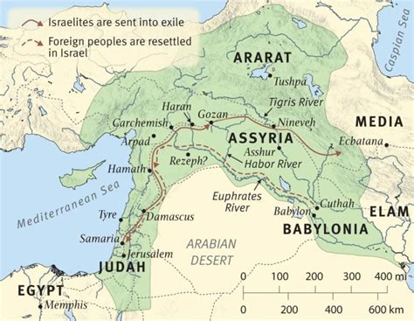
Early Babylon: SDABC V.7 p. 829
Thus, throughout OT times, the two cities typified the forces of evil and good at work in the world.

Slide 22
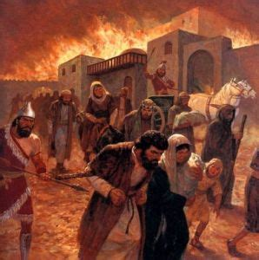
Early Babylon: SDABC V.7 p. 829
The founders of Babylon aspired to set up a government entirely independent of God, and had He not intervened, they would eventually have succeeded in banishing righteousness from the earth.

Slide 23
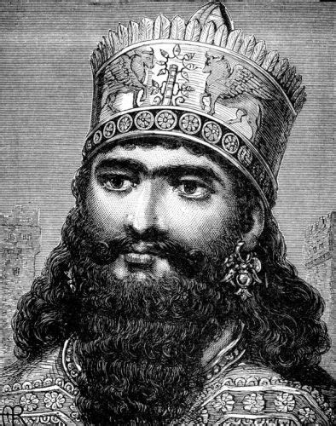
Early Babylon: SDABC V.7 p. 829
When Nebuchadnezzar II rebuilt Babylon it became one of the wonders of the ancient world. His plan to make his kingdom universal and eternal was a success to the extent that, in splendor and power, the new Babylonian Empire surpassed its predecessors.

Slide 24
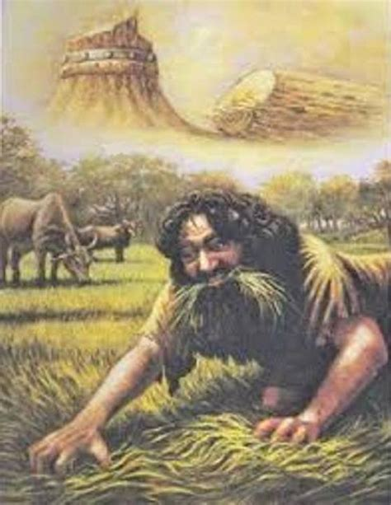
Early Babylon: SDABC V.7 p. 829
However, it also became haughty and cruel. It conquered God’s people and threatened with defeat His purpose for them as a nation. In a dramatic series of events God humbled Nebuchadnezzar and secured the submission of his will.

Slide 25
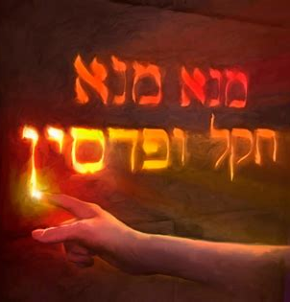
Early Babylon: SDABC V.7 p. 829
But his successors refused to humble themselves before Go, and eventually the kingdom was weighed in the balances of heaven, found wanting, and its mandate revoked by the decree of the divine Watcher.

Slide 26
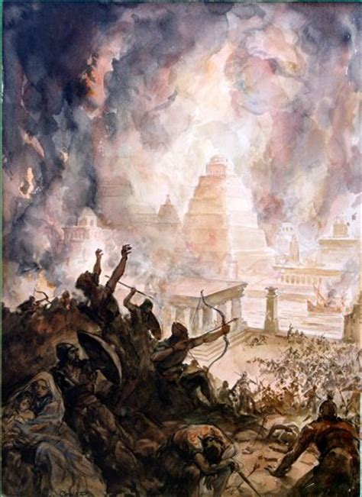
Early Babylon: SDABC V.7 p. 829
Later Babylon became one of the capitals of the Persian Empire, but it was partly destroyed by Xerxes. Over the centuries the city gradually lost more and more of its importance and eventually, toward the close of the 1st century A.D., virtually ceased to exist.

Slide 27
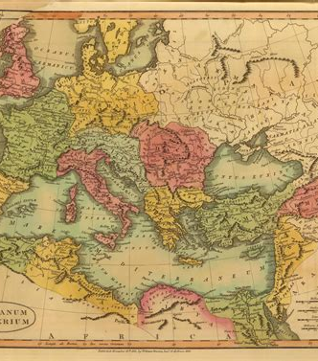
Finding Babylon: SDABC V.7 p. 829
Ever since the fall of ancient Babylon Satan has sought, through one world power after another, to control the world, and would probably long since have succeeded had it not been for repeated instances of divine intervention.

Slide 28
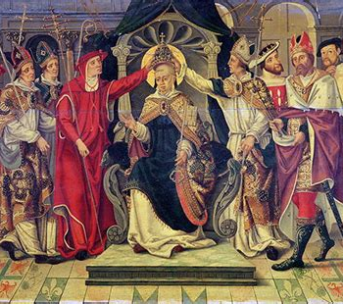
Finding Babylon: SDABC V.7 p. 829
Undoubtedly his most nearly successful attempt to subvert the church has been through the papal apostasy of the Middle Ages.

Slide 29
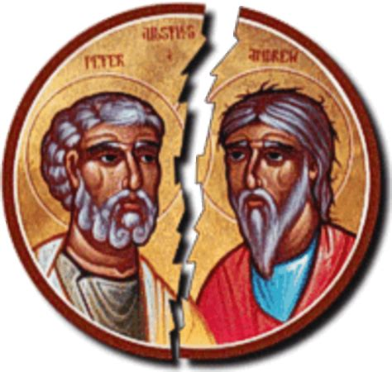
Finding Babylon: SDABC V.7 p. 829
But God intervened to prevent the success of each subsequent threat to the ultimate accomplishment of His purposes, and the nations have never been able to “cleave” together.

Slide 30
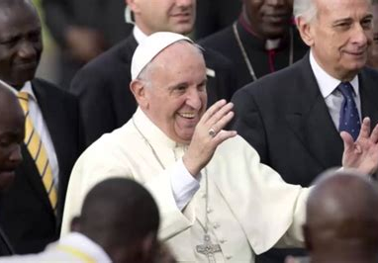
Finding Babylon: SDABC V.7 p. 829
Evil is inherently divisive. However, near the end of time Satan will be permitted to achieve what appears, briefly, to be success.

Slide 31
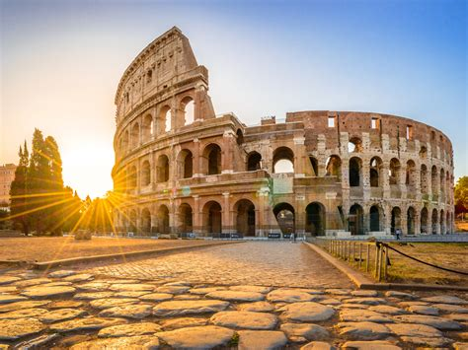
Finding Babylon: SDABC V.7 p. 829
Apparently toward the close of the 1st century A.D. Christians were already referring to the city and empire of Rome by the cryptic title Babylon.

Slide 32
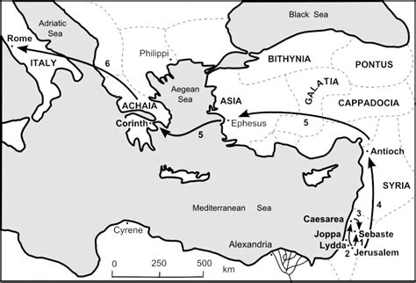
Finding Babylon: 1 Peter 5:13
¹³ The church that is at Babylon, elected together with you, saluteth you; and so doth Marcus my son.

Slide 33
Finding Babylon: SDABC V.7 p. 829
There is no evidence to support the idea that Peter ever labored in literal Babylon. On the other hand, tradition locates his closing labors and violent death at Rome. It is known that early Christians often used the cryptic title “Babylon” when speaking of the Roman capital, to avoid political reprisal. There is general agreement among commentators that Peter here uses the term Babylon for a veiled reference to Rome.

Slide 34
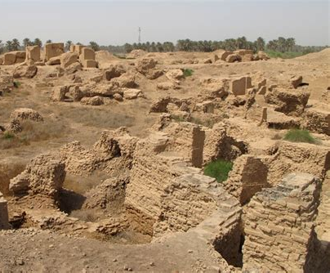
Finding Babylon: SDABC V.7 p. 829
By that time the once magnificent literal city of Babylon lay, almost, if not altogether, in rains, an uninhabited waste, and thus a graphic illustration of the impending fate of mystical Babylon.

Slide 35
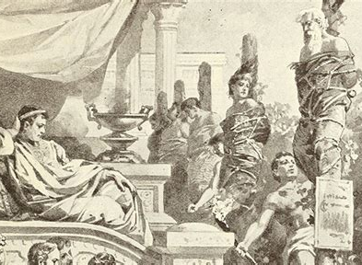
Finding Babylon: SDABC V.7 p. 829-830
The Jews were again in exile under the merciless hand of Rome, even as they had once been exiled by Babylon, and Christians also experienced repeated sporadic persecution at her hand.

Slide 36
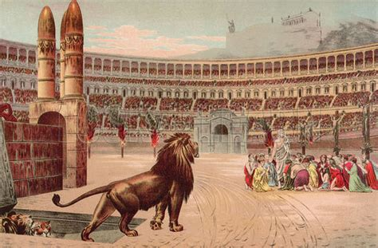
Finding Babylon: SDABC V.7 p. 830
Among Jews and Christians alike, Babylon thus became an appropriate and incriminating term to describe imperial Rome.

Slide 37
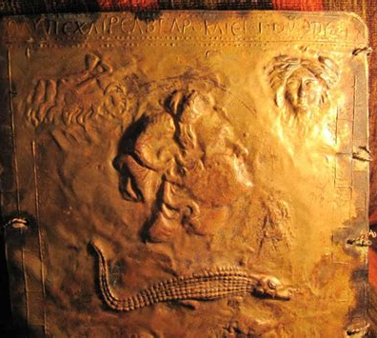
Finding Babylon: SDABC V.7 p. 830
During the early Christian centuries the cryptic designation Babylon for the city and empire of Rome appears commonly in both Jewish and Christian literature.

Slide 38
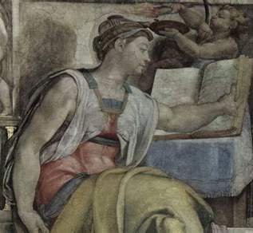
Finding Babylon: SDABC V.7 p. 830
Book V of the Sibylline Oracles, a pseudepigraphical Jewish production dating from about A.D. 125, gives what purports to be a prophecy of the fate of Rome closely parallel to the description of that of mystical Babylon in the Revelation.

Slide 39
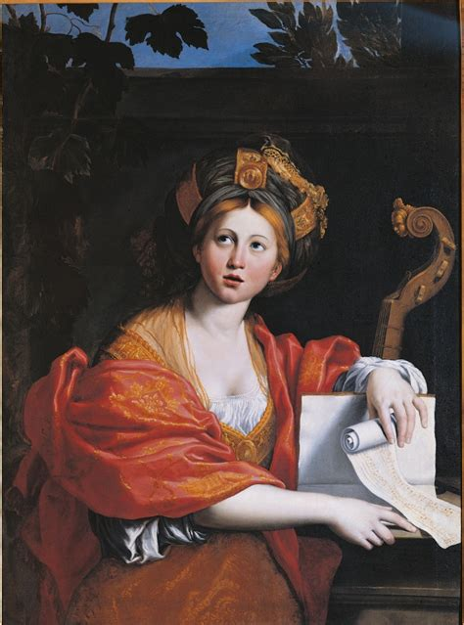
Finding Babylon: SDABC V.7 p. 830
Speaking of Rome as a “wicked city” that loves “magic,” indulges in “adulteries,” and has a “bloodthirsty heart and a godless mind,” and observing that “many faithful saints of the Hebrews have perished” because of her,

Slide 40
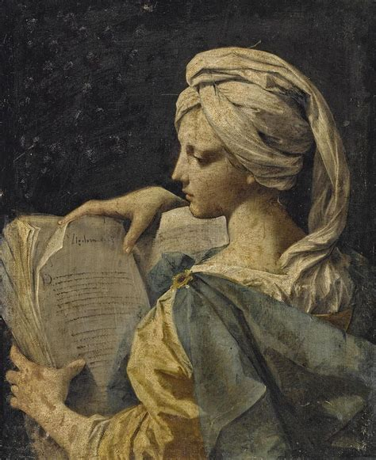
Finding Babylon: SDABC V.7 p. 830
the writer predicts her eventual desolation: “In widowhood shalt thou sit beside thy banks. ... But thou hast said, I am unique, and none shall bring ruin on me. But now God ... shall destroy thee and all of thine.”

Slide 41
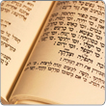
Finding Babylon: SDABC V.7 p. 830
In 2 Baruch, another pseudepigraphical work of the 1st or 2d century A.D., the name Babylon is used of Rome in the same way as in the Revelation.

Slide 42
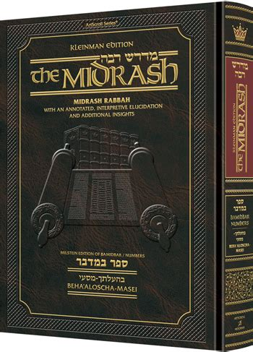
Finding Babylon: SDABC V.7 p. 830
Similarly, the writer of the Jewish Midrash Rabbah, on S. of Sol. 1:6, says, “They called the place Rome Babylon” (Soncino ed., p. 60

Slide 43
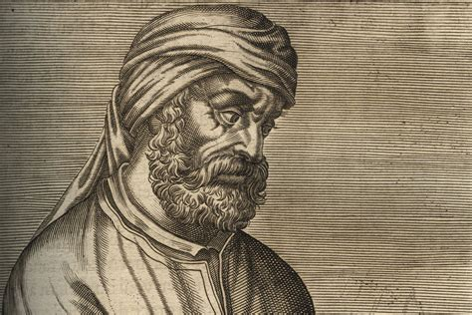
Finding Babylon: SDABC V.7 p. 830
Tertullian, who lived at the close of the second century, specifically declares that the term Babylon in the Apocalypse refers to the capital city of imperial Rome (Against Marcion iii. 13; Answer to the Jews 9; see also Irenaeus Against Heresies v. 26. 1).

Slide 44
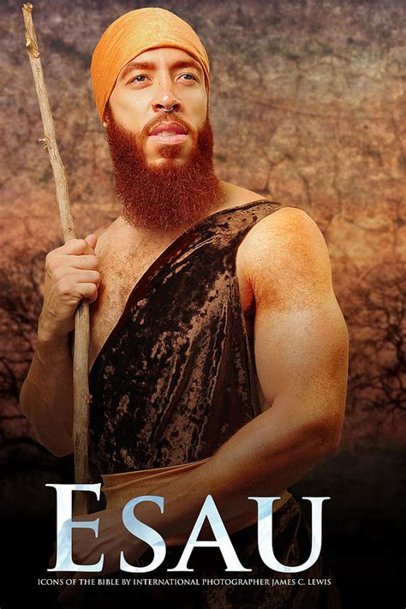
Finding Babylon: SDABC V.7 p. 830
Among the Jews of early Christian times Edom was another cryptic designation for Rome (see Midrash Rabbah, on S. of Sol. 1:6, p. 60; also Talmud Makkoth 12a, Soncino ed., p. 80).

Slide 45
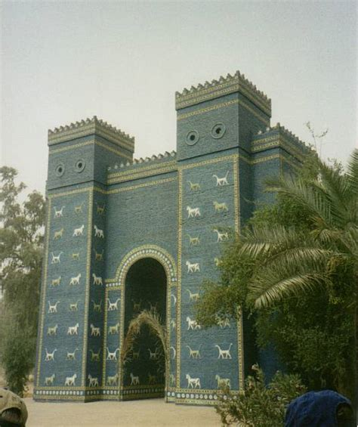
Finding Babylon: SDABC V.7 p. 830
Babylon, both literal and mystical, has thus long been recognized as the traditional enemy of God’s truth and people. As used in the Revelation the name is symbolic of all apostate religious organizations and their leadership, from antiquity down to the close of time.

Slide 46
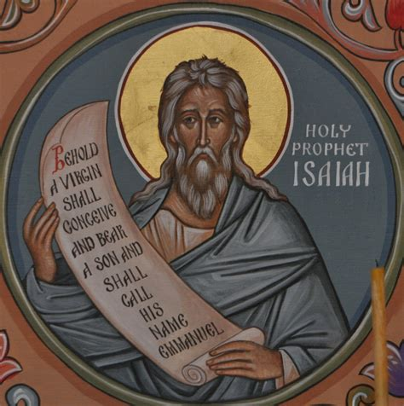
Babylon Fallen: Isaiah 21:9
⁹ And, behold, here cometh a chariot of men, with a couple of horsemen. And he answered and said, Babylon is fallen, is fallen; and all the graven images of her gods he hath broken unto the ground.

Slide 47
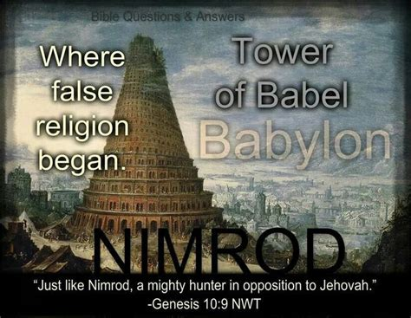
Babylon Fallen: SDABC V.7 p. 830
Babylon is a comprehensive term that John employs to describe all religious bodies and movements that have fallen away from the truth. This fact requires us to view this “fall” as progressive and cumulative.

Slide 48
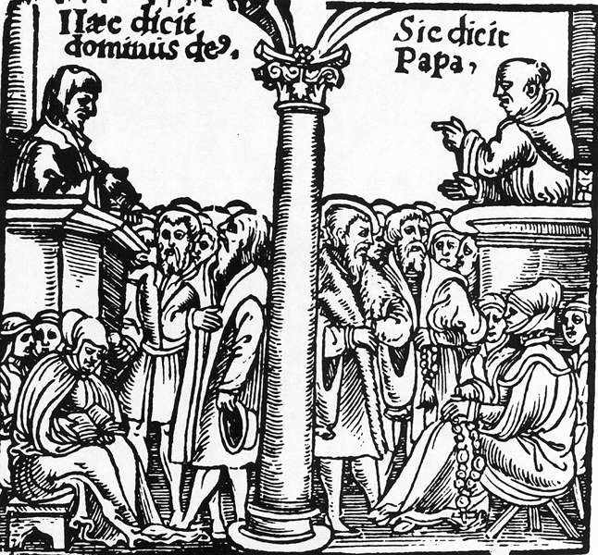
Babylon Fallen: SDABC V.7 p. 830
This prophecy of the fall of Babylon finds its last-day fulfillment in the departure of Protestantism at large from the purity and simplicity of the gospel.

Slide 49
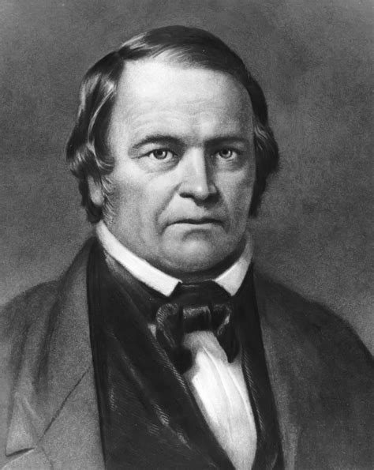
Babylon Fallen: SDABC V.7 p. 830
This message was first preached by the advent movement known as Millerism, in the summer of 1844, and was applied to the churches that rejected the first angel’s message concerning the judgment.

Slide 50
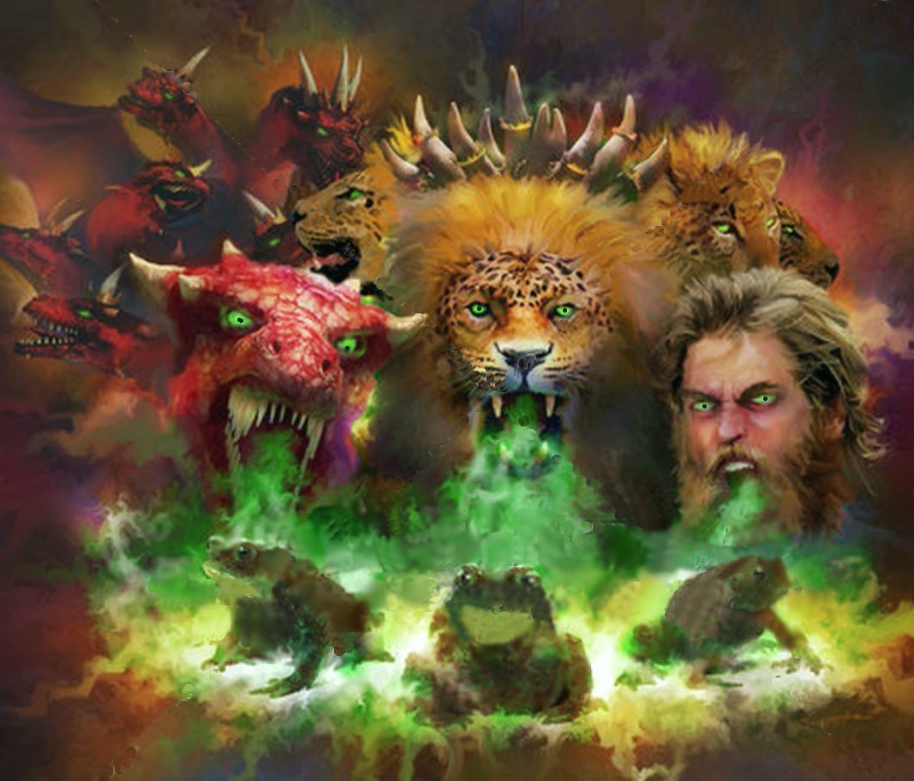
Babylon Fallen: SDABC V.7 p. 830
The message will have increasing relevance as the end draws near, and will meet its complete fulfillment with the union of the various religious elements under the leadership of Satan.

Slide 51
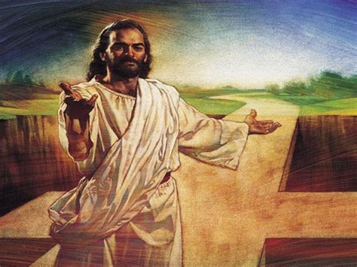
Babylon Fallen: SDABC V.7 p. 830
The message of ch. 18:2-4 announces the complete downfall of Babylon and calls upon God’s people who are scattered throughout the various religious bodies comprising Babylon, to separate from them.

Slide 52
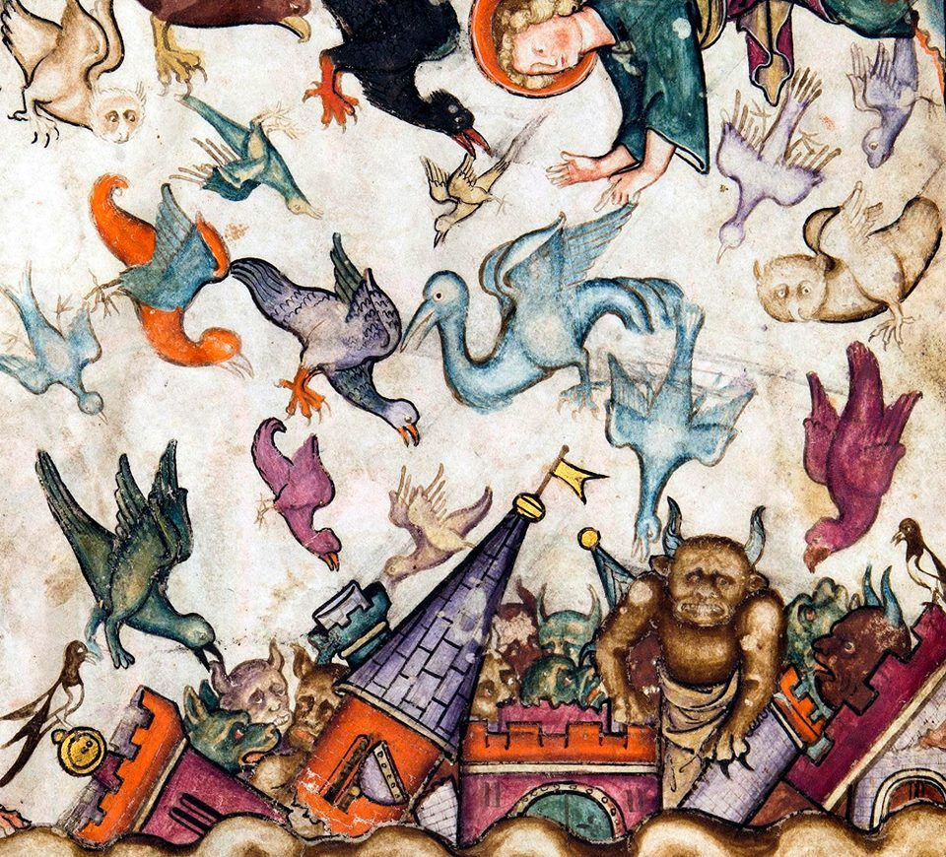
Babylon Fallen: Revelation 18:2-10
² And he cried mightily with a strong voice, saying, Babylon the great is fallen, is fallen, and is become the habitation of devils, and the hold of every foul spirit, and a cage of every unclean and hateful bird.

Slide 53
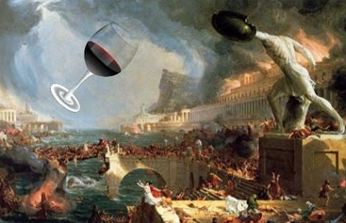
Babylon Fallen: Revelation 18:3-10
³ For all nations have drunk of the wine of the wrath of her fornication, and the kings of the earth have committed fornication with her, and the merchants of the earth are waxed rich through the abundance of her delicacies.

Slide 54
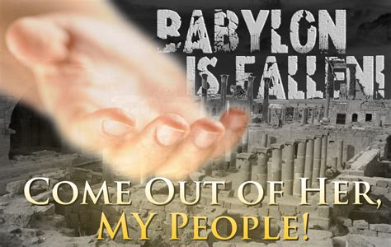
Babylon Fallen: Revelation 18:4-10
⁴ And I heard another voice from heaven, saying, Come out of her, my people, that ye be not partakers of her sins, and that ye receive not of her plagues.

Slide 55
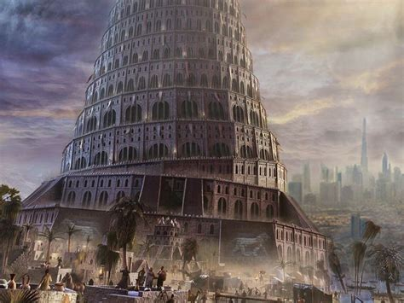
Babylon Fallen: Revelation 18:5-10
⁵ For her sins have reached unto heaven, and God hath remembered her iniquities.

Slide 56
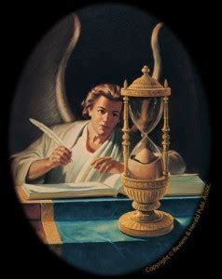
Babylon Fallen: Revelation 18:6-10
⁶ Reward her even as she rewarded you, and double unto her double according to her works: in the cup which she hath filled fill to her double.

Slide 57
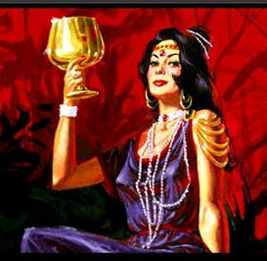
Babylon Fallen: Revelation 18:7-10
⁷ How much she hath glorified herself, and lived deliciously, so much torment and sorrow give her: for she saith in her heart, I sit a queen, and am no widow, and shall see no sorrow.

Slide 58
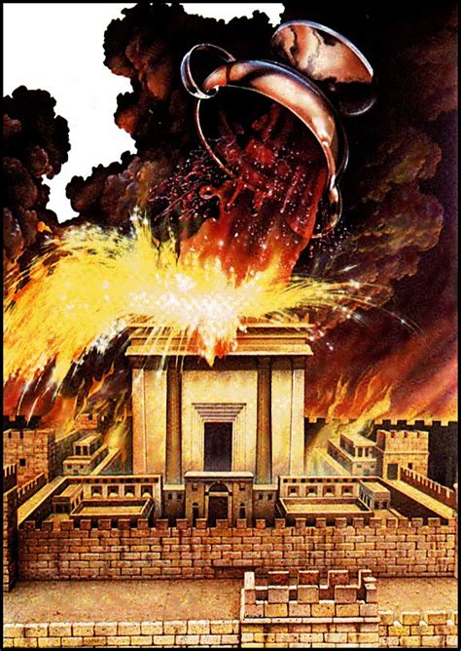
Babylon Fallen: Revelation 18:8-10
⁸ Therefore shall her plagues come in one day, death, and mourning, and famine; and she shall be utterly burned with fire: for strong is the Lord God who judgeth her.

Slide 59

Babylon Fallen: Revelation 18:9-10
⁹ And the kings of the earth, who have committed fornication and lived deliciously with her, shall bewail her, and lament for her, when they shall see the smoke of her burning,

Slide 60

Babylon Fallen: Revelation 18:10
¹⁰ Standing afar off for the fear of her torment, saying, Alas, alas that great city Babylon, that mighty city! for in one hour is thy judgment come.

Slide 61
KEY VERSES: The 2nd Angel’s Message
Revelation 14:8
⁸ And there followed another angel, saying, Babylon is fallen, is fallen, that great city, because she made all nations drink of the wine of the wrath of her fornication.

Slide 62
KEY VERSES: The 3rd Angel’s Message
Revelation 14:9-12
⁹ And the third angel followed them, saying with a loud voice, If any man worship the beast and his image, and receive his mark in his forehead, or in his hand,
¹⁰ The same shall drink of the wine of the wrath of God, which is poured out without mixture into the cup of his indignation; and he shall be tormented with fire and brimstone in the presence of the holy angels, and in the presence of the Lamb:

Slide 63
KEY VERSES: The 3rd Angel’s Message
Revelation 14:9-12
¹¹ And the smoke of their torment ascendeth up for ever and ever: and they have no rest day nor night, who worship the beast and his image, and whosoever receiveth the mark of his name.
¹² Here is the patience of the saints: here are they that keep the commandments of God, and the faith of Jesus.

Slide 64

Babylon Fallen: SDABC V.7 p. 832-3
The special point controverted will be the fourth of the Ten Commandments. There is general agreement among Christians that the other nine are of universal obligation,

Slide 65

Babylon Fallen: SDABC V.7 p. 833
but early in the Christian Era men began to set aside the seventh-day Sabbath and to substitute the observance of the first day of the week as the day of worship.

Slide 66

Babylon Fallen: SDABC V.7 p. 833
Sunday-observing Christians today set forth various reasons as to why they observe the first day of the week instead of the seventh, and as to why they feel free to ignore the original Sabbath.

Slide 67

Babylon Fallen: SDABC V.7 p. 833
Since all those views are unsupported by Scripture, they are unacceptable to all for whom the Bible and the Bible only is the rale of faith. The crisis will come when symbolic Babylon prevails upon the state to enforce Sunday observance by civil law and seeks to punish all dissenters.

Slide 68

Babylon Fallen: SDABC V.7 p. 833
This is the issue described in Rev. 13:12-17. In this dark hour those who cling to the Bible will refuse to give up the observance of the true Sabbath.

Slide 69

Babylon Fallen: SDABC V.7 p. 833
Among the identifying features of the faithful ones that might have been mentioned, the prophecy points out two predominant marks: the keeping of the commandments of God and of the faith of Jesus.

Slide 70

Out of Babylon: Revelation 6:15-7:17
¹⁵ And the kings of the earth, and the great men, and the rich men, and the chief captains, and the mighty men, and every bondman, and every free man, hid themselves in the dens and in the rocks of the mountains;

Slide 71

Out of Babylon: Revelation 6:16-7:17
¹⁶ And said to the mountains and rocks, Fall on us, and hide us from the face of him that sitteth on the throne, and from the wrath of the Lamb:
¹⁷ For the great day of his wrath is come; and who shall be able to stand?

Slide 72

Out of Babylon: Revelation 7:1-17
7 And after these things I saw four angels standing on the four corners of the earth, holding the four winds of the earth, that the wind should not blow on the earth, nor on the sea, nor on any tree.

Slide 73

Four Winds: SDABC V. 7 p. 781
These four winds are plainly destructive forces. Viewed in the light of the great controversy between Christ and Satan, these destructive forces represent the efforts of Satan to spread ruin and destruction everywhere.

Slide 74

Four Winds: SDABC V. 7 p. 781
In symbolic vision John saw four angels; actually, many angels are employed in the task of holding in check the designs of the enemy. These angels belt “the world. ...

Slide 75

Four Winds: SDABC V. 7 p. 781
They are keeping the armies of Satan at bay till the sealing of God’s people shall be accomplished. ... They are given the work of keeping back the raging power of him who has come down like a roaring lion, seeking whom he may devour” (EGW Supplementary Material on ch. 5:11).

Slide 76

Four Winds: SDABC V. 7 p. 781
When the work of sealing is completed, then God will say to the angels, ‘“No longer combat Satan in his efforts to destroy. Let him work out his malignity upon the children of disobedience; for the cup of their iniquity is full”’ (EGWRH Sept. 17, 1901; cf. 6T 408).

Slide 77

Four Winds: The Great Controversy p.614
When the four angels finally let go and cease holding in check the malicious designs of Satan and “the fierce winds of human passion, all the elements of strife will be let loose. The whole world will be involved in min more terrible than that which came upon Jerusalem of old.”

Slide 78

Out of Babylon: Revelation 7:2-17
² And I saw another angel ascending from the east, having the seal of the living God: and he cried with a loud voice to the four angels, to whom it was given to hurt the earth and the sea,

Slide 79

Out of Babylon: Revelation 7:3-17
³ Saying, Hurt not the earth, neither the sea, nor the trees, till we have sealed the servants of our God in their foreheads.

Slide 80


The Seal: SDABC V. 7 p. 782
From remote antiquity seals were used in tire Near East much as signatures are today. Thus they attested the authorship of a document, indicated the ownership of the object upon which the seal was impressed, or secured objects such as chests, boxes, tombs, against being opened or molested.

Slide 81

Out of Babylon: Ezekiel 9:1-6
9 He cried also in mine ears with a loud voice, saying, Cause them that have charge over the city to draw near, even every man with his destroying weapon in his hand.

Slide 82

Out of Babylon: Ezekiel 9:2-6
² And, behold, six men came from the way of the higher gate, which lieth toward the north, and every man a slaughter weapon in his hand; and one man among them was clothed with linen, with a writer's inkhorn by his side: and they went in, and stood beside the brasen altar.

Slide 83

Out of Babylon: Ezekiel 9:3-6
³ And the glory of the God of Israel was gone up from the cherub, whereupon he was, to the threshold of the house. And he called to the man clothed with linen, which had the writer's inkhorn by his side;

Slide 84
Out of Babylon: Ezekiel 9:4-6
⁴ And the Lord said unto him, Go through the midst of the city, through the midst of Jerusalem, and set a mark upon the foreheads of the men that sigh and that cry for all the abominations that be done in the midst thereof.

Slide 85

Out of Babylon: Ezekiel 9:5-6
⁵ And to the others he said in mine hearing, Go ye after him through the city, and smite: let not your eye spare, neither have ye pity:

Slide 86

Out of Babylon: Ezekiel 9:6
⁶ Slay utterly old and young, both maids, and little children, and women: but come not near any man upon whom is the mark; and begin at my sanctuary. Then they began at the ancient men which were before the house.

Slide 87
The Seal: SDABC V. 4 p. 606
The distinguishing mark in Revelation is “the seal of God” and, like the mark in Ezekiel, is based on character qualifications. God places His mark of approval upon all who, through the power of the Holy Spirit, reflect the image of Jesus (see COL 67). This stamp of approbation has been likened to God’s mark of ownership, as though God inscribes upon those who qualify for citizenship in His kingdom His name and address—“God, New Jerusalem” (TM 446).

Slide 88
The Seal: Testimonies V.8 p. 117
“The sign, or seal, of God is revealed in the observance of the seventh-day Sabbath, the Lord's memorial of creation. “The Lord spake unto Moses, saying, Speak thou also unto the children of Israel, saying, Verily My Sabbaths ye shall keep: for it is a sign between Me and you throughout your generations; that ye may know that I am the Lord that doth sanctify you.” Exodus 31:12, 13. Here the Sabbath is clearly designated as a sign between God and His people.”

Slide 89
The Seal: Testimonies V.8 p. 117
“The mark of the beast is the opposite of this—the observance of the first day of the week. This mark distinguishes those who acknowledge the supremacy of the papal authority from those who acknowledge the authority of God. ”

Slide 90

The Seal: SDABC V. 4 p. 606
The outward, visible sign of this completion of the work of grace in the soul will be the observance of the true Sabbath of the Bible. This will be brought about in the following way: The seventh-day Sabbath has always stood as God’s appointed rest day for man.

Slide 91

The Seal: SDABC V. 4 p. 606
Established at creation, it was designed to be of perpetual obligation. The command to observe it was placed in the bosom of the moral law. Neither Christ nor His apostles abrogated the Sabbath.

Slide 92

The Seal: SDABC V. 4 p. 606
The great apostasy following the death of the apostles presumed to set it aside and substitute in its place another day of rest, the first day of the week. But the Word of God predicts a great work of Sabbath reform to precede the second coming of Christ.

Slide 93

The Seal: SDABC V. 4 p. 606
It also predicts that simultaneously Satan, the great apostate leader, will exalt his own counterfeit system of religion, presenting a false sabbath, Sunday, as the day of worship.

Slide 94

The Seal: SDABC V. 4 p. 606
He will be successful to the extent that he will be able to unite the whole world in a great religious reform movement, a prominent feature of which will be the exaltation of Sunday.

Slide 95

The Seal: SDABC V. 4 p. 606
As a result of his efforts in this direction the whole world will be divided into two camps, those who are faithful to God and keep His Sabbath, and those who join the universal counterfeit religious movement and honor the false sabbath.

Slide 96

The Seal: SDABC V. 4 p. 606
The observance of the true Sabbath will thus become the distinguishing mark of the true worshiper of God.

Slide 97

The Seal: SDABC V. 4 p. 606-7
Yet it is not the outward observance of the Sabbath that constitutes the mark. The mark is placed upon those “that sigh and that cry for all the abominations that be done.”

Slide 98

The Seal: SDABC V. 4 p. 606-7
The seal stands for that character qualification that all must have who are accounted worthy of citizenship in the kingdom of glory about to be established. Only those who have purified their souls will cling to the Sabbath in that awful time of trouble preceding the return of Jesus.

Slide 99

The Seal: SDABC V. 4 p. 606-7
Insincere Sabbathkeepers will abandon the ranks of God’s people and unite with Satan against heaven, and join in the battle against the Ruler of the universe. Thus only the genuine and true remain as the sole defenders of God’s holy Sabbath.

Slide 100

The Seal: SDABC V. 4 p. 606-7
These are joined by others of God’s true children who, until now, have been scattered throughout the various communions of Christendom, but who, under the increasing light of the loud cry, embrace the Sabbath and join God’s remnant people.

Slide 101

The Seal: SDABC V. 4 p. 607
The Lord cannot change His standard. To do so would be to change Himself. Rather, He supplies grace for the acquirement of every virtue and the correction of every defect.

Slide 102

The Seal: SDABC V. 4 p. 607
He asks of every Christian that full advantage be taken of these provisions. He demands no less than perfection. Unless this is attained, the soul will be found without the seal of God when probation closes.

Slide 103

Out of Babylon: Revelation 7:4-17
⁴ And I heard the number of them which were sealed: and there were sealed an hundred and forty and four thousand of all the tribes of the children of Israel.

Slide 104

Out of Babylon: Revelation 7:5-17
⁵ Of the tribe of Juda were sealed twelve thousand. Of the tribe of Reuben were sealed twelve thousand. Of the tribe of Gad were sealed twelve thousand.

Slide 105
Out of Babylon: Revelation 7:6-17
⁶ Of the tribe of Aser were sealed twelve thousand. Of the tribe of Nephthalim were sealed twelve thousand. Of the tribe of Manasses were sealed twelve thousand.

Slide 106
Out of Babylon: Revelation 7:7-17
⁷ Of the tribe of Simeon were sealed twelve thousand. Of the tribe of Levi were sealed twelve thousand. Of the tribe of Issachar were sealed twelve thousand.

Slide 107
Out of Babylon: Revelation 7:8-17
⁸ Of the tribe of Zabulon were sealed twelve thousand. Of the tribe of Joseph were sealed twelve thousand. Of the tribe of Benjamin were sealed twelve thousand.

Slide 108

Where is Dan? SDABC V. 7 p. 783
Twelve tribes are listed here, but they are not entirely identical with the enumerations found in the OT. The OT lists commonly begin with Reuben, whereas the present enumeration begins with Judah, perhaps because Christ came of the tribe of Judah.

Slide 109
Where is Dan? SDABC V. 7 p. 783
In the OT, Levi is sometimes not included as a tribe, though, of course, he is listed as a son of Jacob. This was doubtless because Levi received no inheritance among the tribes. Here the tribe of Levi is counted, but not that of Dan.

Slide 110
Where is Dan? SDABC V. 7 p. 783
To reckon Levi and yet retain the number 12 it was necessary to omit one of the tribes, inasmuch as Joseph was reckoned as two tribes, namely Ephraim (probably called “Joseph” in Rev. 7:8) and Manasseh.

Slide 111
Where is Dan? Judges 18:30-31
³⁰ And the children of Dan set up the graven image: and Jonathan, the son of Gershom, the son of Manasseh, he and his sons were priests to the tribe of Dan until the day of the captivity of the land.
³¹ And they set them up Micah's graven image, which he made, all the time that the house of God was in Shiloh.

Slide 112

Where is Dan? SDABC V. 7 p. 783
Perhaps Dan was excluded because of that tribe’s reputation for idolatry!

Slide 113

Out of Babylon: Revelation 7:9-17
⁹ After this I beheld, and, lo, a great multitude, which no man could number, of all nations, and kindreds, and people, and tongues, stood before the throne, and before the Lamb, clothed with white robes, and palms in their hands;

Slide 114

Out of Babylon: Revelation 7:10-17
¹⁰ And cried with a loud voice, saying, Salvation to our God which sitteth upon the throne, and unto the Lamb.

Slide 115

Out of Babylon: Revelation 7:11-17
¹¹ And all the angels stood round about the throne, and about the elders and the four beasts, and fell before the throne on their faces, and worshipped God,

Slide 116

Out of Babylon: Revelation 7:12-17
¹² Saying, Amen: Blessing, and glory, and wisdom, and thanksgiving, and honour, and power, and might, be unto our God for ever and ever. Amen.

Slide 117

Out of Babylon: Revelation 7:13-17
¹³ And one of the elders answered, saying unto me, What are these which are arrayed in white robes? and whence came they?

Slide 118

Out of Babylon: Revelation 7:14-17
¹⁴ And I said unto him, Sir, thou knowest. And he said to me, These are they which came out of great tribulation, and have washed their robes, and made them white in the blood of the Lamb.

Slide 119

Out of Babylon: Revelation 7:15-17
¹⁵ Therefore are they before the throne of God, and serve him day and night in his temple: and he that sitteth on the throne shall dwell among them.

Slide 120

Out of Babylon: Revelation 7:16-17
¹⁶ They shall hunger no more, neither thirst any more; neither shall the sun light on them, nor any heat.

Slide 121

Out of Babylon: Revelation 7:17
¹⁷ For the Lamb which is in the midst of the throne shall feed them, and shall lead them unto living fountains of waters: and God shall wipe away all tears from their eyes.

Slide 122
THANK YOU!!
And Happy Sabbath!

