Slide 1
The Seal of God and the Mark of the Beast,
Part 2
Daniel 7,
Revelation 12, 13 &17
Lesson 12, 2nd Quarter 2023

Slide 2
Memory Text: Revelation 13:10
¹⁰ He that leadeth into captivity shall go into captivity: he that killeth with the sword must be killed with the sword. Here is the patience and the faith of the saints.

Slide 3
Three Angels’ Messages:
1st Angel: Worship the Creator God of the Gospel!
2nd Angel: False System of Worship Doomed!
3rd Angel: Choose!
Live or Die by Your Choice.

Slide 4
KEY VERSES: The 2nd Angel’s Message
Revelation 14:8
⁸ And there followed another angel, saying, Babylon is fallen, is fallen, that great city, because she made all nations drink of the wine of the wrath of her fornication.

Slide 5
KEY VERSES: The 3rd Angel’s Message
Revelation 14:9-12
⁹ And the third angel followed them, saying with a loud voice, If any man worship the beast and his image, and receive his mark in his forehead, or in his hand,
¹⁰ The same shall drink of the wine of the wrath of God, which is poured out without mixture into the cup of his indignation; and he shall be tormented with fire and brimstone in the presence of the holy angels, and in the presence of the Lamb:

Slide 6
KEY VERSES: The 3rd Angel’s Message
Revelation 14:9-12
¹¹ And the smoke of their torment ascendeth up for ever and ever: and they have no rest day nor night, who worship the beast and his image, and whosoever receiveth the mark of his name.
¹² Here is the patience of the saints: here are they that keep the commandments of God, and the faith of Jesus.

Slide 7
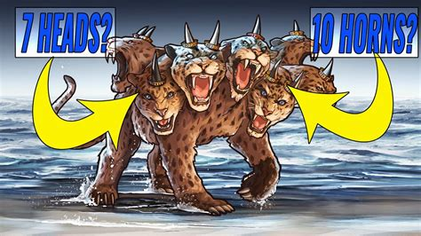
What Beast?
13 And I stood upon the sand of the sea, and saw a beast rise up out of the sea, having seven heads and ten horns, and upon his horns ten crowns, and upon his heads the name of blasphemy.
Revelation 13:1-18

Slide 8
What Beast?
13 And I stood upon the sand of the sea, and saw a beast rise up out of the sea, having seven heads and ten horns, and upon his horns ten crowns, and upon his heads the name of blasphemy.
Revelation 13:1-18

Slide 9
What Beast? Revelation 13:1
Rev. 13:1 And I stood upon the sand of the sea, and saw a beast rise up out of the sea, having seven heads and ten horns, and upon his horns ten crowns, and upon his heads the name of blasphemy.
Beasts: We know from the angel’s words in Daniel 7:17 that beasts represent kings, kingdoms, or political powers:
¹⁷ These great beasts, which are four, are four kings, which shall arise out of the earth.

Slide 10
What Beast? Revelation 13:1
Rev. 13:1 And I stood upon the sand of the sea, and saw a beast rise up out of the sea, having seven heads and ten horns, and upon his horns ten crowns, and upon his heads the name of blasphemy.
Out of the sea: We know from the angel’s words in Revelation 17:15 that the sea can represent a great density of population:
¹⁵ And he saith unto me, The waters which thou sawest, where the whore sitteth, are peoples, and multitudes, and nations, and tongues.

Slide 11
What Beast? Revelation 13:1
But what about all those heads and horns? They’re political powers, kings and so forth, but why so many? What do they represent? What do we need to know about them?
There are some connections we need to notice! The first is that this beast of the sea has some commonalities with other prophetic “beasts” in the Bible.

Slide 12
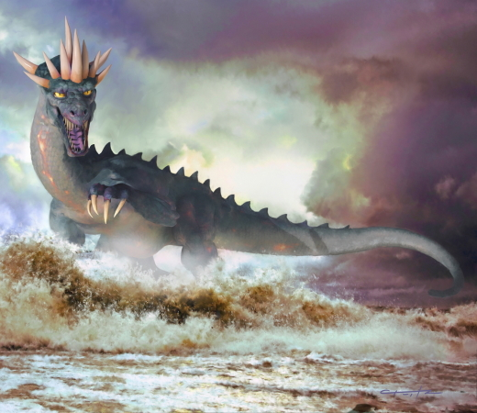
⁷ After this I saw in the night visions, and behold a fourth beast, dreadful and terrible, and strong exceedingly; and it had great iron teeth: it devoured and brake in pieces, and stamped the residue with the feet of it: and it was diverse from all the beasts that were before it; and it had ten horns.
Notice that Daniel 7:7 involves a beast with ten horns also! The “terrible beast.”

Slide 13
What Beast? Revelation 13:1, 12:3
Beast of Revelation 13:
Dragon of Rev. 12, clearly identified as SATAN
13 And I stood upon the sand of the sea, and saw a beast rise up out of the sea, having seven heads and ten horns, and upon his horns ten crowns, and upon his heads the name of blasphemy.
³ And there appeared another wonder in heaven; and behold a great red dragon, having seven heads and ten horns, and seven crowns upon his heads.

Slide 14
What Beast? Revelation 13:1, 17:3
Beast of Revelation 13:
Scarlet beast of Rev. 17 carrying “Mystery: Babylon the Great.”
13 And I stood upon the sand of the sea, and saw a beast rise up out of the sea, having seven heads and ten horns, and upon his horns ten crowns, and upon his heads the name of blasphemy.
³ So he carried me away in the spirit into the wilderness: and I saw a woman sit upon a scarlet coloured beast, full of names of blasphemy, having seven heads and ten horns.

Slide 15
What Beast? Revelation 13:1
Rev. 13:1 And I stood upon the sand of the sea, and saw a beast rise up out of the sea, having seven heads and ten horns, and upon his horns ten crowns, and upon his heads the name of blasphemy.
As per the SDA Commentary: The heads in ch. 17:9, 10 are identified as “seven mountains” and “seven kings.” It seems reasonable to conclude that the seven heads of the dragon represents political powers that have championed the cause of the dragon, and through which the dragon has exercised his persecuting power.

Slide 16
What Beast? Revelation 13:1
Rev. 13:1 And I stood upon the sand of the sea, and saw a beast rise up out of the sea, having seven heads and ten horns, and upon his horns ten crowns, and upon his heads the name of blasphemy.
As per the SDA Commentary: In view of the fact that Inspiration has not indicated whether the seven heads are to be understood as representing seven particular nations and has not specified any point of time from which they are to be reckoned, this commentary considers that evidence is insufficient to warrant a dogmatic identification of them.
This DOES NOT MEAN that they cannot be identified, only that the identification is not yet undeniably clear!

Slide 17
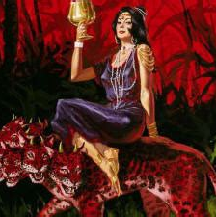
An Excursus into Revelation 17:
Rev. 17:3-18
³ So he carried me away in the spirit into the wilderness: and I saw a woman sit upon a scarlet coloured beast, full of names of blasphemy, having seven heads and ten horns.

Slide 18
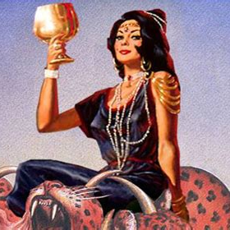
An Excursus into Revelation 17:
Rev. 17:4-18
⁴ And the woman was arrayed in purple and scarlet colour, and decked with gold and precious stones and pearls, having a golden cup in her hand full of abominations and filthiness of her fornication:

Slide 19
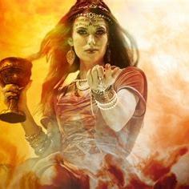
An Excursus into Revelation 17:
Rev. 17:5-18
⁵ And upon her forehead was a name written, Mystery, Babylon The Great, The Mother Of Harlots And Abominations Of The Earth.

Slide 20
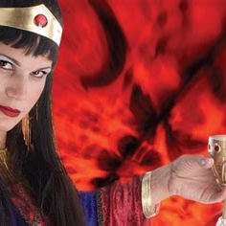
An Excursus into Revelation 17:
Rev. 17:6-18
⁶ And I saw the woman drunken with the blood of the saints, and with the blood of the martyrs of Jesus: and when I saw her, I wondered with great admiration.

Slide 21
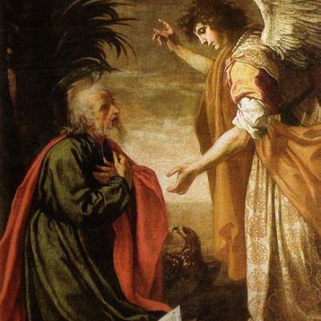
An Excursus into Revelation 17:
Rev. 17:7-18
⁷ And the angel said unto me, Wherefore didst thou marvel? I will tell thee the mystery of the woman, and of the beast that carrieth her, which hath the seven heads and ten horns.

Slide 22
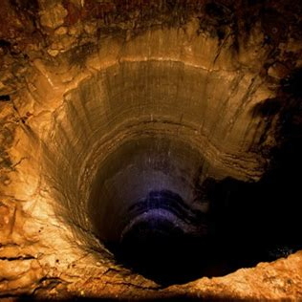
An Excursus into Revelation 17:
Rev. 17:8-18
⁸ The beast that thou sawest was, and is not; and shall ascend out of the bottomless pit, and go into perdition: and they that dwell on the earth shall wonder, whose names were not written in the book of life from the foundation of the world, when they behold the beast that was, and is not, and yet is.

Slide 23
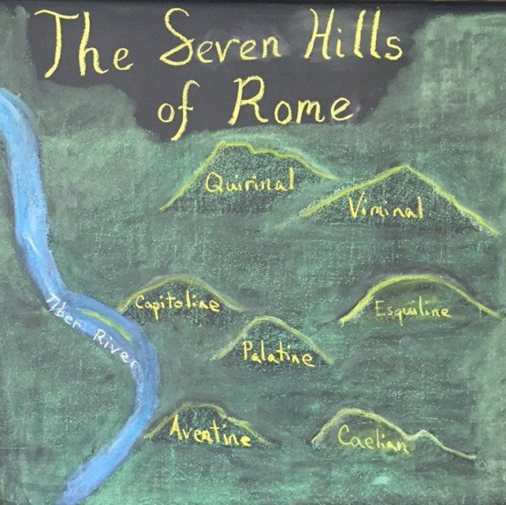
An Excursus into Revelation 17:
Rev. 17:9-18
⁹ And here is the mind which hath wisdom. The seven heads are seven mountains, on which the woman sitteth.

Slide 24
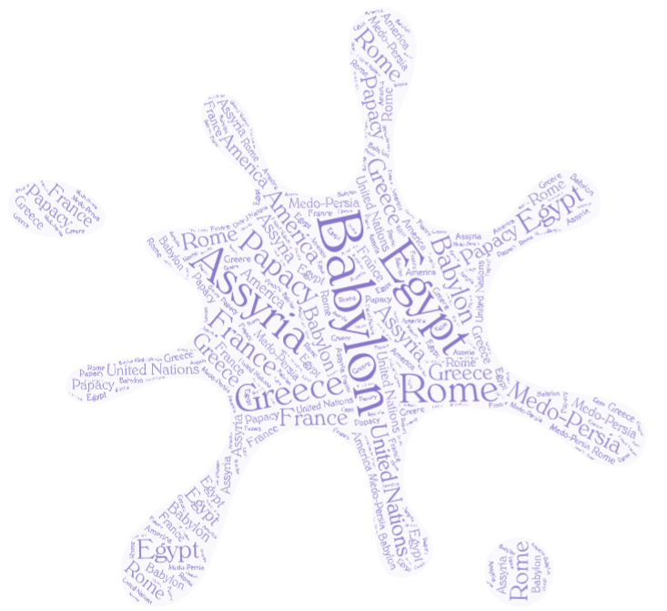
An Excursus into Revelation 17:
Rev. 17:10-18
¹⁰ And there are seven kings: five are fallen, and one is, and the other is not yet come; and when he cometh, he must continue a short space.

Slide 25
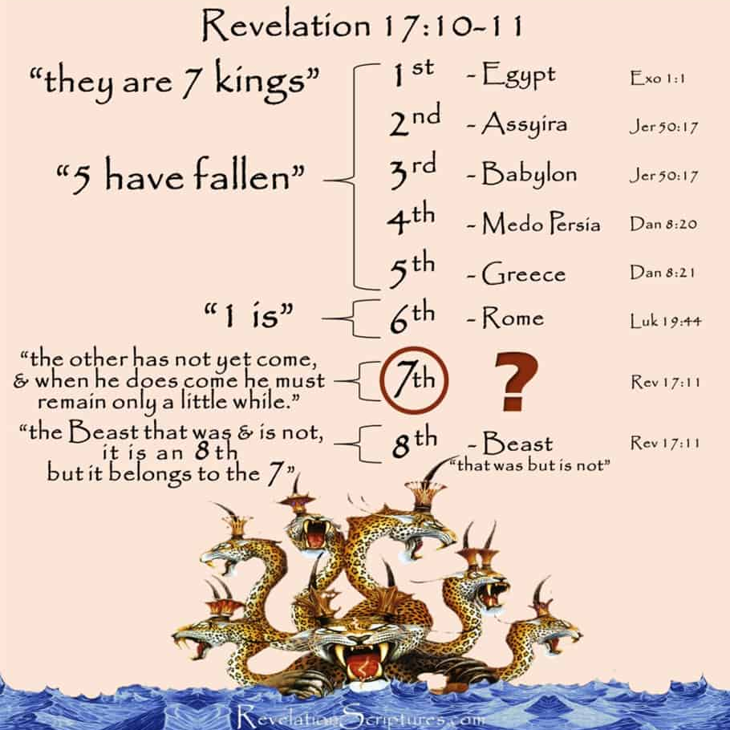
An Excursus into Revelation 17:
Rev. 17:11-18
¹¹ And the beast that was, and is not, even he is the eighth, and is of the seven, and goeth into perdition.

Slide 26
An Excursus into Revelation 17:10
SDABC V.7 p. 855-856 The point of time at which it may be stated that five of the heads have “fallen,” that one “is,” and that the other has “not yet come” is not clearly indicated.
That being the case, we have difficulty saying for certain which of the seven have “fallen,” and which “is!”
It may be noted that if the events foretold in ch. 17 are, in part, identical with those of ch. 13, it follows that the papal head is the one here designated “the other.”

Slide 27
An Excursus into Revelation 17:11
SDABC V.7 p. 856 The eighth, however, is the beast in its revived state, in the “yet is” period following its ascent out of the “bottomless pit.” Some consider the eighth power to be the papacy alone; others suggest that it represents Satan. Those who take the latter view point out that at the time here indicated Satan attempts to impersonate Christ.

Slide 28
An Excursus into Revelation 17:11
SDABC V.7 p. 856 The beast itself—“the eighth”—was, it would seem, the same beast to which the seven heads had been attached. Absence in the Greek of the definite article before the word “eighth” suggests that the beast itself was the real authority back of the seven heads, and that it is therefore more than merely another head, the eighth in a series. It is their summation and climax—the beast itself. In the Greek the word for “eighth” is masculine and hence cannot refer to a head, the word for which is feminine.

Slide 29
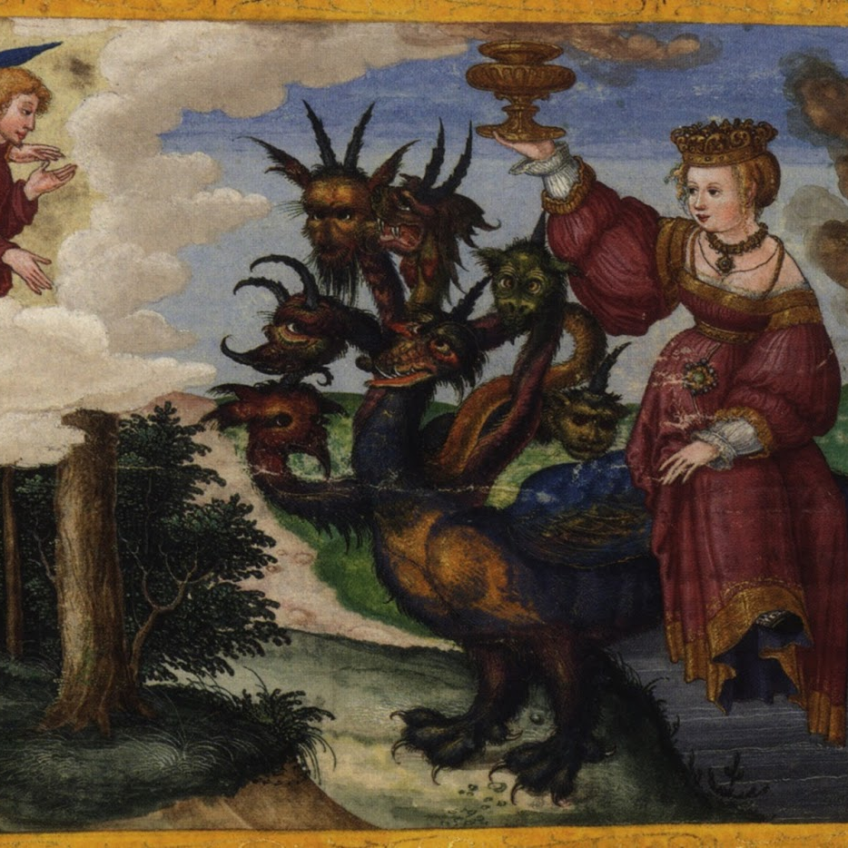
An Excursus into Revelation 17:
Rev. 17:12-18
¹² And the ten horns which thou sawest are ten kings, which have received no kingdom as yet; but receive power as kings one hour with the beast.

Slide 30
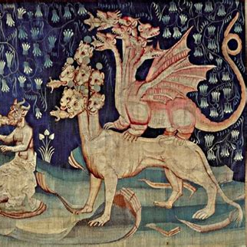
An Excursus into Revelation 17:
Rev. 17:13-18
¹³ These have one mind, and shall give their power and strength unto the beast.

Slide 31
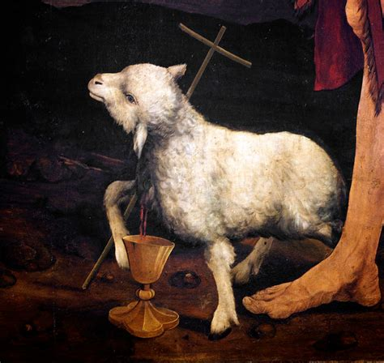
An Excursus into Revelation 17:
Rev. 17:14-18
¹⁴ These shall make war with the Lamb, and the Lamb shall overcome them: for he is Lord of lords, and King of kings: and they that are with him are called, and chosen, and faithful.

Slide 32
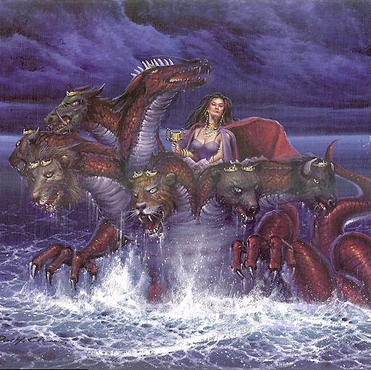
An Excursus into Revelation 17:
Rev. 17:15-18
¹⁵ And he saith unto me, The waters which thou sawest, where the whore sitteth, are peoples, and multitudes, and nations, and tongues.

Slide 33
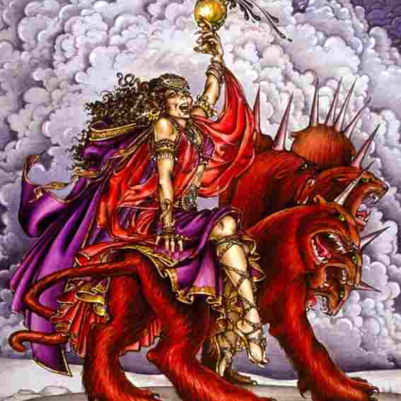
An Excursus into Revelation 17:
Rev. 17:16-18
¹⁶ And the ten horns which thou sawest upon the beast, these shall hate the whore, and shall make her desolate and naked, and shall eat her flesh, and burn her with fire..

Slide 34
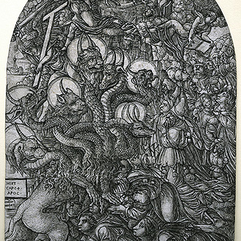
An Excursus into Revelation 17:
Rev. 17:17-18
¹⁷ For God hath put in their hearts to fulfil his will, and to agree, and give their kingdom unto the beast, until the words of God shall be fulfilled.

Slide 35
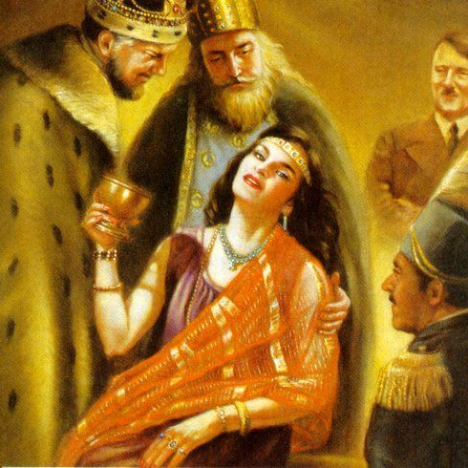
An Excursus into Revelation 17:
Rev. 17:18
¹⁸ And the woman which thou sawest is that great city, which reigneth over the kings of the earth.

Slide 36
Letters and Manuscripts, Vol. 14, Letter to J.H. Kellogg, par. 17-22
We have a message to bear to the churches. Christ declares, “I am Alpha and Omega, the beginning and the end, the first and the last. Blessed are they that do his commandments, that they may have right to the tree of life, and may enter in through the gates into the city. ...

Slide 37
Letters and Manuscripts, Vol. 14, Letter to J.H. Kellogg, par. 18-22
I Jesus have sent mine angel to testify unto you these things in the churches. I am the root and the offspring of David, and the bright and morning star. And the Spirit and the bride say, Come. And let him that heareth say, Come. And let him that is athirst come. And whosoever will, let him take the water of life freely.” (Revelation 22:13, 14, 16, 17).
We are to give to the people the warnings contained in Revelation. But many workers are engaged in a line of work that is disqualifying them to preach the Word (and do the very work God has appointed them to do.)

Slide 38
Letters and Manuscripts, Vol. 14, Letter to J.H. Kellogg, par. 18-22
The truth in regard to the Sabbath of the Lord is to be proclaimed. The seventh day is to be shown to be the seal of the living God. People are to be shown what they may expect from the papal power. The time has come when the Protestant churches are reaching out to grasp the hand of the power that has made void the law of God. More work is to be done in the W.C.T.U. Here is a special field that has scarcely been touched.

Slide 39
Letters and Manuscripts, Vol. 14, Letter to J.H. Kellogg, par. 20-22
In the seventeenth of Revelation is foretold the destruction of all the churches who corrupt themselves by idolatrous devotion to the service of the Papacy, those who have drunk of the wine of the wrath of her fornication. John writes, “And there came one of the seven angels which had the seven vials, and talked with me, saying unto me, Come hither; I will show unto thee the judgment of the great whore that sitteth upon many waters:

Slide 40
Letters and Manuscripts, Vol. 14, Letter to J.H. Kellogg, par. 20-22
with whom the kings of the earth have committed fornication, and the inhabitants of the earth have been made drunk with the wine of her fornication. So he carried me away in the spirit into the wilderness; and I saw a woman sit upon a scarlet colored beast, full of names of blasphemy, having seven heads and ten horns. And the woman was arrayed in purple and scarlet color, and decked with gold and precious stones and pearls, having a golden cup in her hand full of abominations and filthiness of her fornications.”

Slide 41
Letters and Manuscripts, Vol. 14, Letter to J.H. Kellogg, par. 21-22
Thus is represented the papal power, which with all deceivableness of unrighteousness, by outside attraction and gorgeous display, deceives all nations, promising them, as did Satan our first parents, all good to those who receive its mark, and all harm to those who oppose its fallacies. The power which has the deepest inward corruption will make the greatest display, and will clothe itself with the most elaborate signs of power. The Bible plainly declares that this covers a corrupt and deceiving wickedness. “Upon her forehead was a name written, Mystery, Babylon the Great, the mother of harlots and abominations of the earth.”

Slide 42
Letters and Manuscripts, Vol. 14, Letter to J.H. Kellogg, par. 22
What is it that gives its kingdom to this power? Protestantism, a power which while professing to have the temper and spirit of a lamb, and to be allied to heaven, speaks with the voice of a dragon. It is moved by a power from beneath.
Keeping the big picture (and our task) in mind, let’s take a look at the other passage with strong connections to our discussion in Revelation 13, namely Revelation 12.

Slide 43
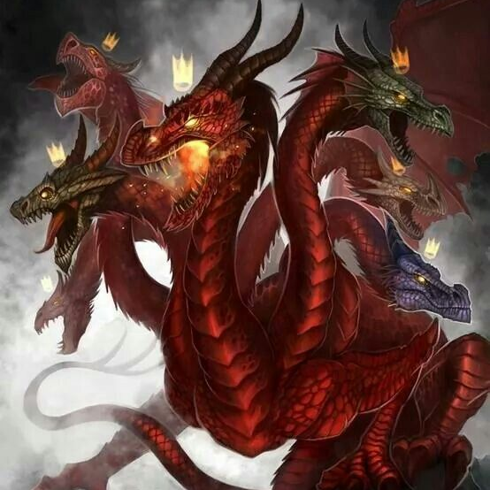
³ And there appeared another wonder in heaven; and behold a great red dragon, having seven heads and ten horns, and seven crowns upon his heads.
An Excursus into Revelation 12:
Rev. 12:3-10

Slide 44
An Excursus into Revelation 12:3
SDABC V.7 p. 807 In v. 9 the power thus represented is identified as “that old serpent, called the Devil, and Satan.” Here the symbol represents Satan as working through pagan Rome, the power ruling the world when Jesus was born. The dragon is described as “red,” probably because of the fact that in all his connection with the church of God he has appeared in the role of persecutor and destroyer. It has been his studied purpose to destroy the children of the Most High.

Slide 45
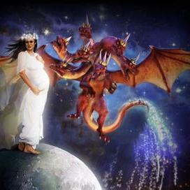
⁴ And his tail drew the third part of the stars of heaven, and did cast them to the earth: and the dragon stood before the woman which was ready to be delivered, for to devour her child as soon as it was born.
An Excursus into Revelation 12:
Rev. 12:4-10

Slide 46
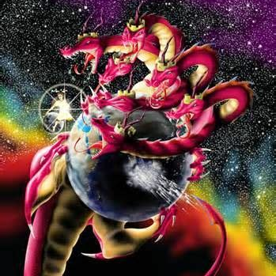
⁵ And she brought forth a man child, who was to rule all nations with a rod of iron: and her child was caught up unto God, and to his throne.
An Excursus into Revelation 12:
Rev. 12:5-10

Slide 47
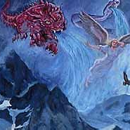
⁶ And the woman fled into the wilderness, where she hath a place prepared of God, that they should feed her there a thousand two hundred and threescore days.
An Excursus into Revelation 12:
Rev. 12:6-10

Slide 48
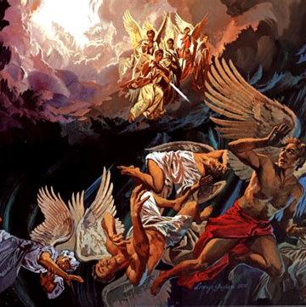
⁷ And there was war in heaven: Michael and his angels fought against the dragon; and the dragon fought and his angels,
⁸ And prevailed not; neither was their place found any more in heaven.
An Excursus into Revelation 12:
Rev. 12:7-10

Slide 49
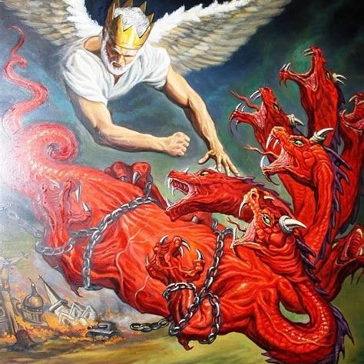
⁹ And the great dragon was cast out, that old serpent, called the Devil, and Satan, which deceiveth the whole world: he was cast out into the earth, and his angels were cast out with him.
An Excursus into Revelation 12:
Rev. 12:9-10

Slide 50
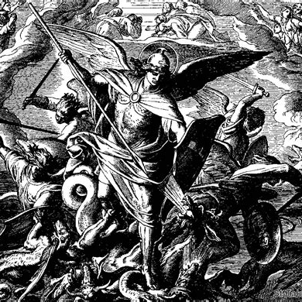
¹⁰ And I heard a loud voice saying in heaven, Now is come salvation, and strength, and the kingdom of our God, and the power of his Christ: for the accuser of our brethren is cast down, which accused them before our God day and night.
An Excursus into Revelation 12:
Rev. 12:10

Slide 51
So, keeping in mind the connections that we have with Daniel 7, Revelation 17, and Revelation 13, with their figures and imagery…
Recall that we were looking into the third angel’s message of Revelation 14 which begins: ⁹ And the third angel followed them, saying with a loud voice, If any man worship the beast and his image, and receive his mark in his forehead, or in his hand…
So we need to work at identifying the “beast and his image,” which is why we’re seeking to understand Revelation 13.
So back to our main question, “what beast?”

Slide 52
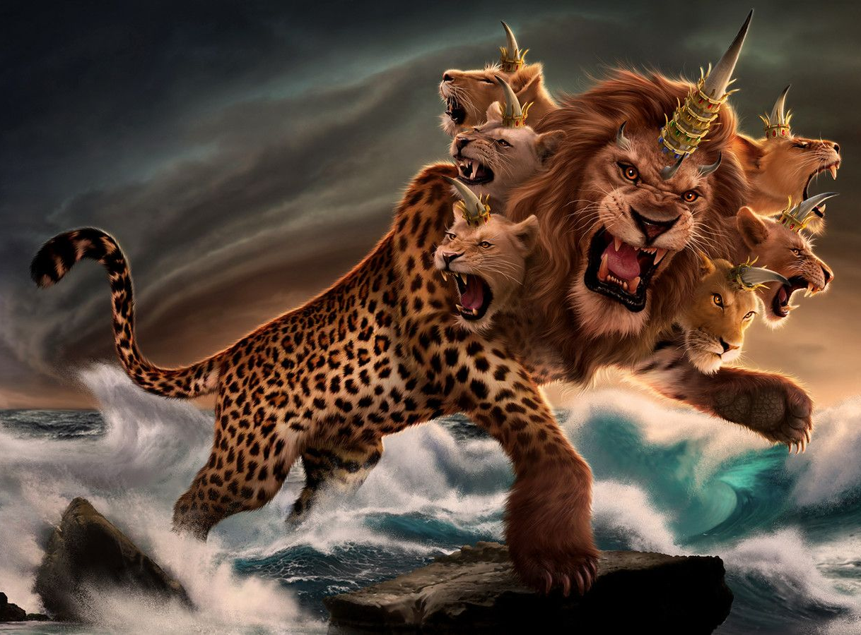
What Beast?
13 And I stood upon the sand of the sea, and saw a beast rise up out of the sea, having seven heads and ten horns, and upon his horns ten crowns, and upon his heads the name of blasphemy.
Revelation 13:1-18

Slide 53
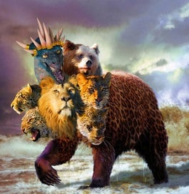
What Beast?
² And the beast which I saw was like unto a leopard, and his feet were as the feet of a bear, and his mouth as the mouth of a lion: and the dragon gave him his power, and his seat, and great authority.
Revelation 13:2-18

Slide 54
What Beast? Revelation 13:1-2
SDABC V.7 p. 817 There is doubtless an allusion here to the symbolism of Dan. 7. Of the beasts seen by Daniel the first was like a lion, the second like a bear, the third like a leopard. The beast seen by John had physical characteristics drawn from all three. This doubtless denotes that the power represented by the beast of Revelation possessed characteristics prominent in the kingdoms of Babylon, Persia, and Greece. Some have noted that John alludes to these powers in the reverse order of their appearance in history, as he looks backward from his day.

Slide 55
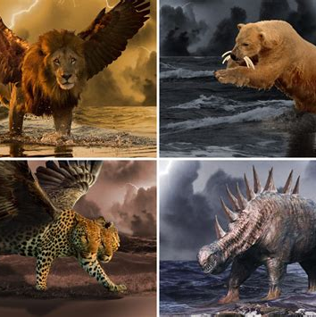
Briefly on Beasts:
Daniel 7:2-8
² Daniel spake and said, I saw in my vision by night, and, behold, the four winds of the heaven strove upon the great sea.
³ And four great beasts came up from the sea, diverse one from another.

Slide 56
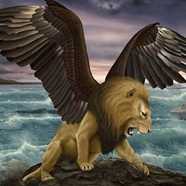
Briefly on Beasts:
Daniel 7:4-8
⁴ The first was like a lion, and had eagle's wings: I beheld till the wings thereof were plucked, and it was lifted up from the earth, and made stand upon the feet as a man, and a man's heart was given to it.

Slide 57
Briefly on Beasts: Daniel 7:4
SDABC V.4 p. 820 The lion as the king of beasts and the eagle as the king of birds fittingly represented the empire of Babylon at the height of its glory. A lion is noted for its strength, whereas the eagle is famous for the power and the range of its flight. Nebuchadnezzar’s power was felt not only in Babylon but from the Mediterranean to the Persian Gulf, and from Asia Minor to Egypt. Thus it is fitting, in order to represent the spread of Babylon’s power, that the lion should be provided with eagle’s wings.

Slide 58
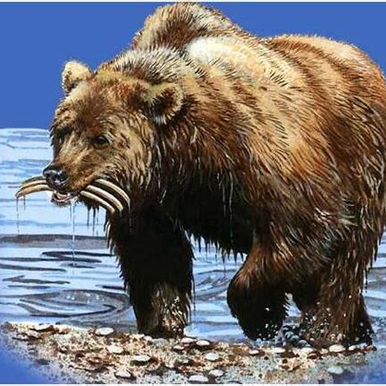
Briefly on Beasts:
Daniel 7:5-8
⁵ And behold another beast, a second, like to a bear, and it raised up itself on one side, and it had three ribs in the mouth of it between the teeth of it: and they said thus unto it, Arise, devour much flesh.

Slide 59
Briefly on Beasts: Daniel 7:5
SDABC V.4 p. 821 The Persian, or Medo-Persian, Empire, corresponding to the silver of the image. The bear is cruel and rapacious, characteristics that are attributed to the Medes in Isa. 13:17, 18. The three ribs are not mentioned in the interpretation (vs. 17-27), but many commentators have considered them a symbol of the three principal powers that were conquered by the Medo-Persian Empire—Lydia, Babylon, and Egypt.

Slide 60
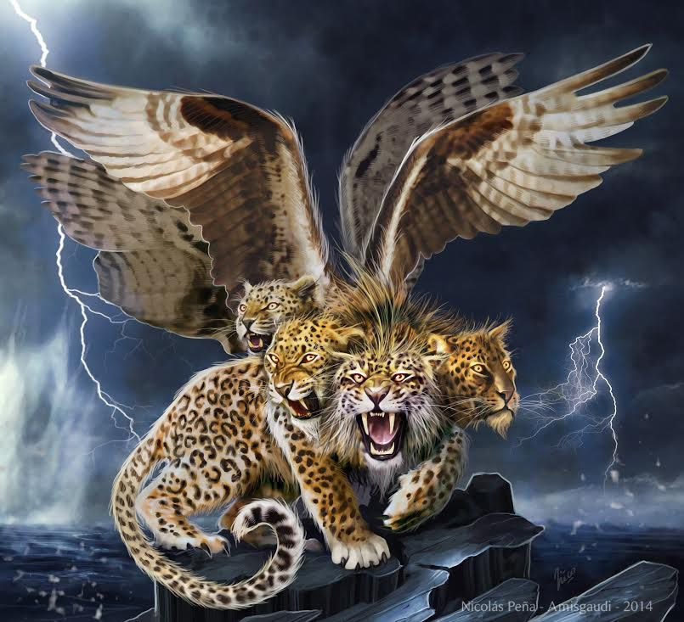
Briefly on Beasts:
Daniel 7:6-8
⁶ After this I beheld, and lo another, like a leopard, which had upon the back of it four wings of a fowl; the beast had also four heads; and dominion was given to it.

Slide 61
Briefly on Beasts: Daniel 7:6
SDABC V.4 p. 821 The leopard is a fierce, carnivorous animal noted for the swiftness and agility of its movements. The power succeeding the Persian Empire is identified in ch. 8:21 as “Grecia.” This “Grecia” must not be confused with the Greece of the classical period, inasmuch as that period preceded the fall of Persia. The “Grecia” of Daniel was the semi-Greek Macedonian Empire of Alexander the Great, which inaugurated what is called the Hellenistic period. Not until Alexander’s day could reference be made to the “first king” of a Greek empire who was “a mighty king” with “great dominion.”

Slide 62
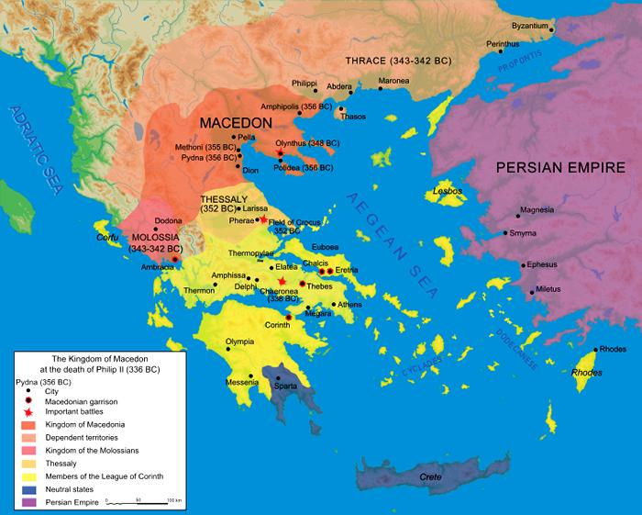
Briefly on Beasts: Daniel 7:6
SDABC V.4 p. 821 In 336 Alexander succeeded to the throne of Macedonia, a semi-Greek state on the northern border of Greece. Alexander’s father, Philip, had already united most of the citystates of Greece under his rule by 338 B.C. Alexander proved his mettle by subduing revolts in Greece and Thrace.

Slide 63
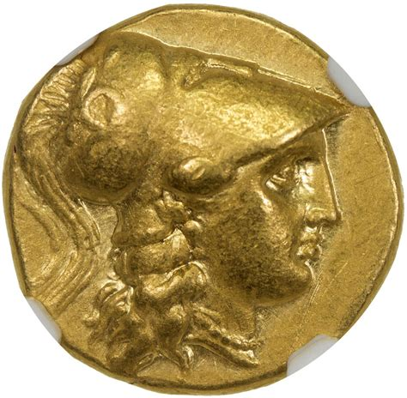
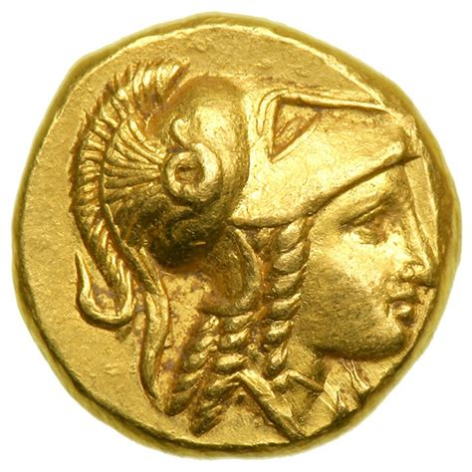
Briefly on Beasts: Daniel 7:6
SDABC V.4 p. 821 After order had been restored in his own kingdom, Alexander set himself the task of conquering the Persian Empire, an ambition he had inherited from his father. Among the factors that spurred the young king on in his plans were personal ambition, the need for economic expansion, the desire to spread Greek culture, and a not unnatural animosity toward the Persians because of their past relations with his countrymen.

Slide 64
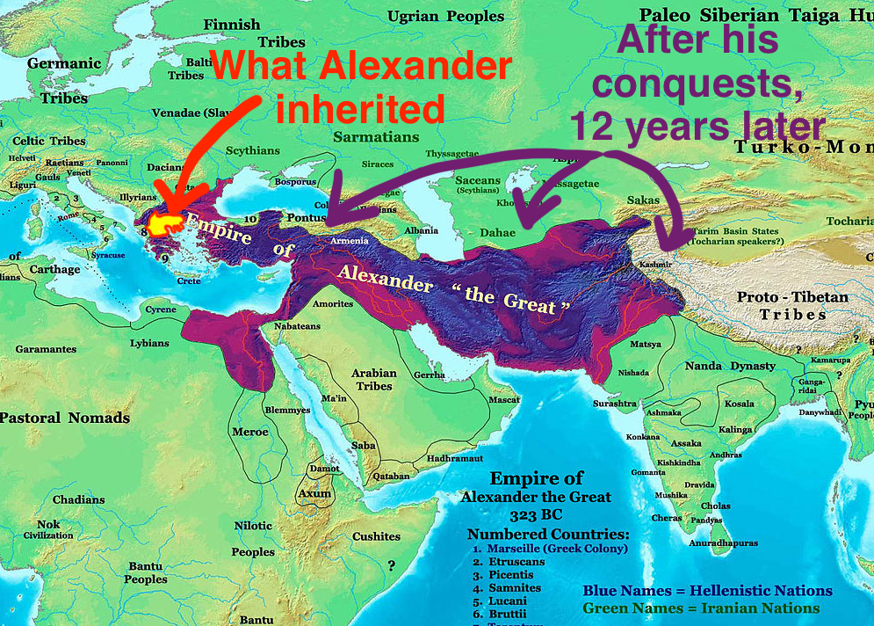
Briefly on Beasts: Daniel 7:6
SDABC V.4 p. 821 In 334 B.C. Alexander crossed the Hellespont and entered Persian territory with only 35,000 men, the meager sum of 70 talents in cash, and but one month’s store of provisions. The campaign was a series of triumphs.

Slide 65
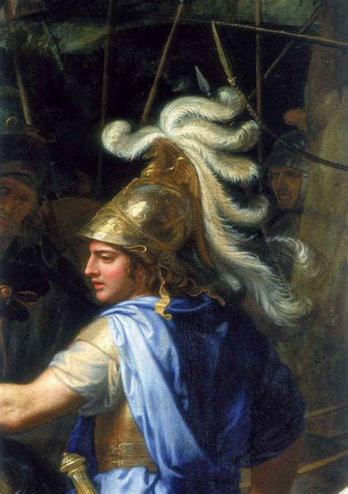
Briefly on Beasts: Daniel 7:6
SDABC V.4 p. 821 The first victory was achieved at Granicus, the next at Issus in the following year, and the next at Tyre in the year after that. Passing through Palestine, Alexander conquered Gaza and then entered Egypt virtually unopposed. Here in 331 B.C. he founded the city of Alexandria.

Slide 66
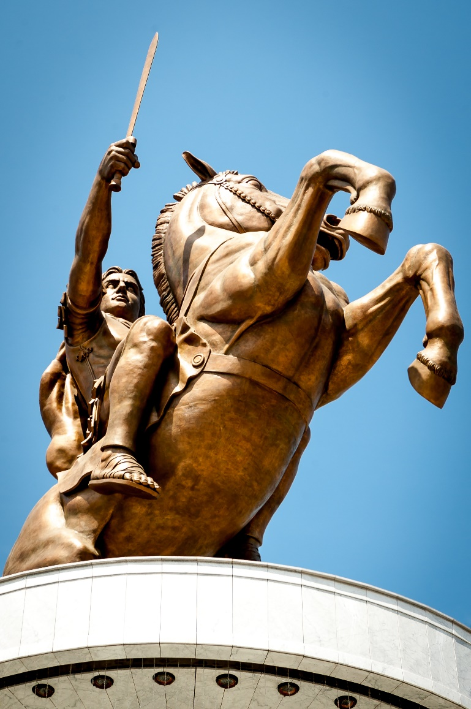
Briefly on Beasts: Daniel 7:6
SDABC V.4 p. 821 He declared himself the successor to the Pharaohs and his troops hailed him as a god. When he set forth again that year he directed his armies toward Mesopotamia, the heart of the Persian Empire. The Persians took their stand near Arbela, east of the junction of the Tigris and Great Zab rivers, but their forces were defeated and routed.

Slide 67
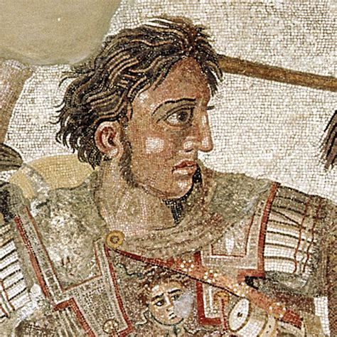
Briefly on Beasts: Daniel 7:6
SDABC V.4 p. 821 The fabulous riches of the world’s greatest empire lay open to the young king, 25 years old. After preliminary organization of his empire Alexander pushed his conquests to the north and to the east. By 329 B.C. he had taken Maracanda, now Samarkand in Turkistan.

Slide 68
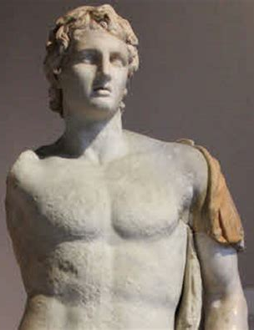
Briefly on Beasts: Daniel 7:6
SDABC V.4 p. 821 Two years later he invaded northwest India. Soon after crossing the Indus River, however, his troops refused to go farther, and he was forced to yield to them. Returning to Persia and Mesopotamia, Alexander was faced with the stupendous work of organizing the administration of his territories.

Slide 69
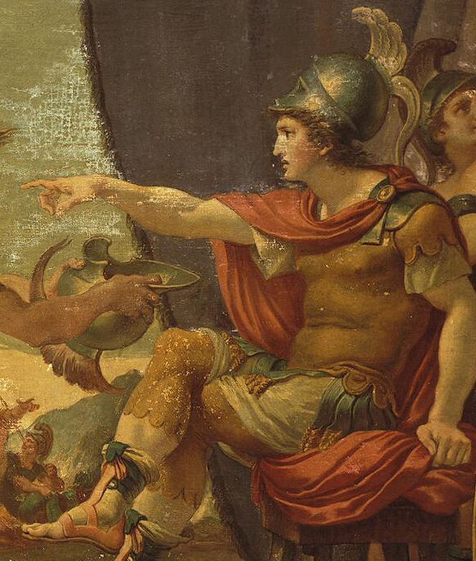
Briefly on Beasts: Daniel 7:6
SDABC V.4 p. 821-822 In 323 B.C. he made his capital in Babylon, a city that still preserved reminders of the glory of Nebuchadnezzar’s day. In the same year, after a round of hard drinking, Alexander fell ill and died of “swamp fever,” which is thought to be the ancient name for, or counterpart of, malaria.

Slide 70
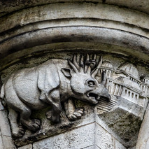
Briefly on Beasts:
Daniel 7:7-8
⁷ After this I saw in the night visions, and behold a fourth beast, dreadful and terrible, and strong exceedingly; and it had great iron teeth: it devoured and brake in pieces, and stamped the residue with the feet of it: and it was diverse from all the beasts that were before it; and it had ten horns.

Slide 71
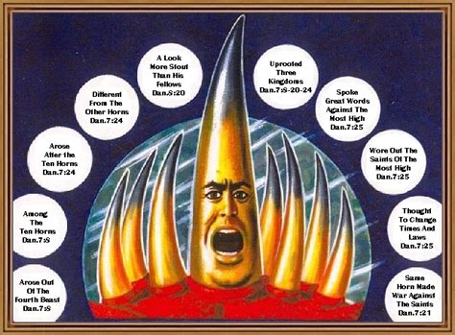
Briefly on Beasts:
Daniel 7:8
⁸ I considered the horns, and, behold, there came up among them another little horn, before whom there were three of the first horns plucked up by the roots: and, behold, in this horn were eyes like the eyes of man, and a mouth speaking great things.

Slide 72
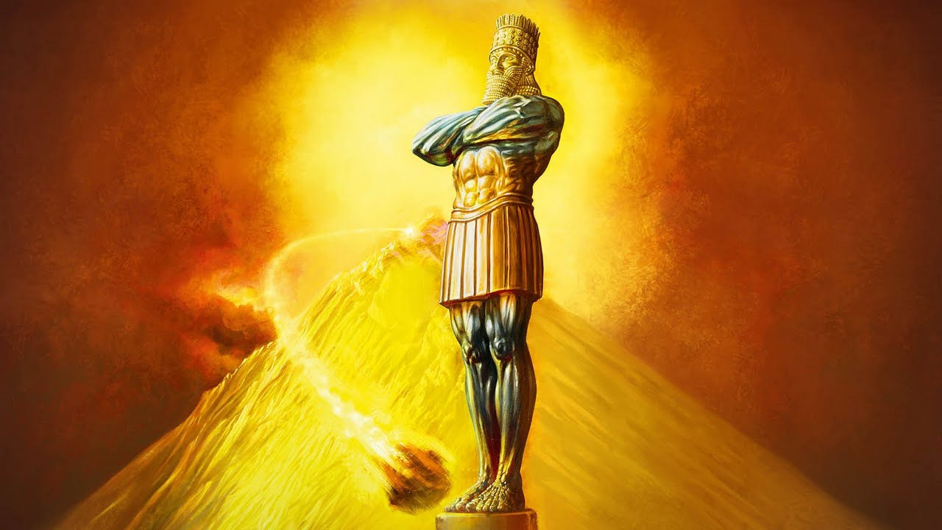
Briefly on Beasts: Daniel 7:7-8
SDABC V.4 p. 823 There was, presumably, no parallel in the natural world by which to designate this hideous creature, for no comparison is made as in the case of the first three beasts. There should be no question, however, but that it represents the same power that is portrayed by the iron legs of the great image. It is clear from history that the world power succeeding the third prophetic empire was Rome.

Slide 73
The Little Horn Power of Daniel 7
Rises from 4th beast
After 10 horn powers
Different from horns
Stouter than fellows
Uprooted 3 horns
Spoke great words
Papacy rises in Rome
After Germanic tribes
Religious vs. secular
Dominated medieval life
Overthrew Heruli, Vandals, Ostrogoths
Vicar of Christ

Slide 74
The Little Horn Power of Daniel 7
Wear out the saints
Thought to change times and laws
War against the saints
Persecutes ‘heretics’
Attempted to change Sabbath observance law
Took military action against those of differing beliefs

Slide 75
The Little Horn Power: SDA Quarterly June 11, 2023
In the fourth century, the Roman Emperor Constantine legalized Christianity throughout the empire. When he moved his capital in A.D. 330 to Byzantium to unite the eastern and western parts of his empire, it left a leadership vacuum in Rome. The pope, then, filled this void. He became not only a powerful religious leader but also a political force to be reckoned with in Europe. In A.D. 538, Justinian, the Roman emperor, officially granted the Roman bishop the role of the defender of the faith.

Slide 76
The Little Horn Power: SDA Quarterly June 11, 2023
The medieval church exercised great influence from A.D. 538 to A.D. 1798, including the terrible persecution mentioned in the introduction to the lesson. Napoleon’s General Berthier took the pope captive in A.D. 1798, in exact fulfillment of the prophecy.
Berthier and his army captured Pope Pius VI and unceremoniously removed him from the papal throne. The blow to the papacy was serious, but, according to Revelation 13:12, the deadly wound would be healed, and the world would hear more from this power — a lot more.

Slide 77
What Beast?
13 And I stood upon the sand of the sea, and saw a beast rise up out of the sea, having seven heads and ten horns, and upon his horns ten crowns, and upon his heads the name of blasphemy.
RECALL!
Revelation 13
Revelation 13:1-18

Slide 78
What Beast?
² And the beast which I saw was like unto a leopard, and his feet were as the feet of a bear, and his mouth as the mouth of a lion: and the dragon gave him his power, and his seat, and great authority.
Revelation 13:2-18

Slide 79
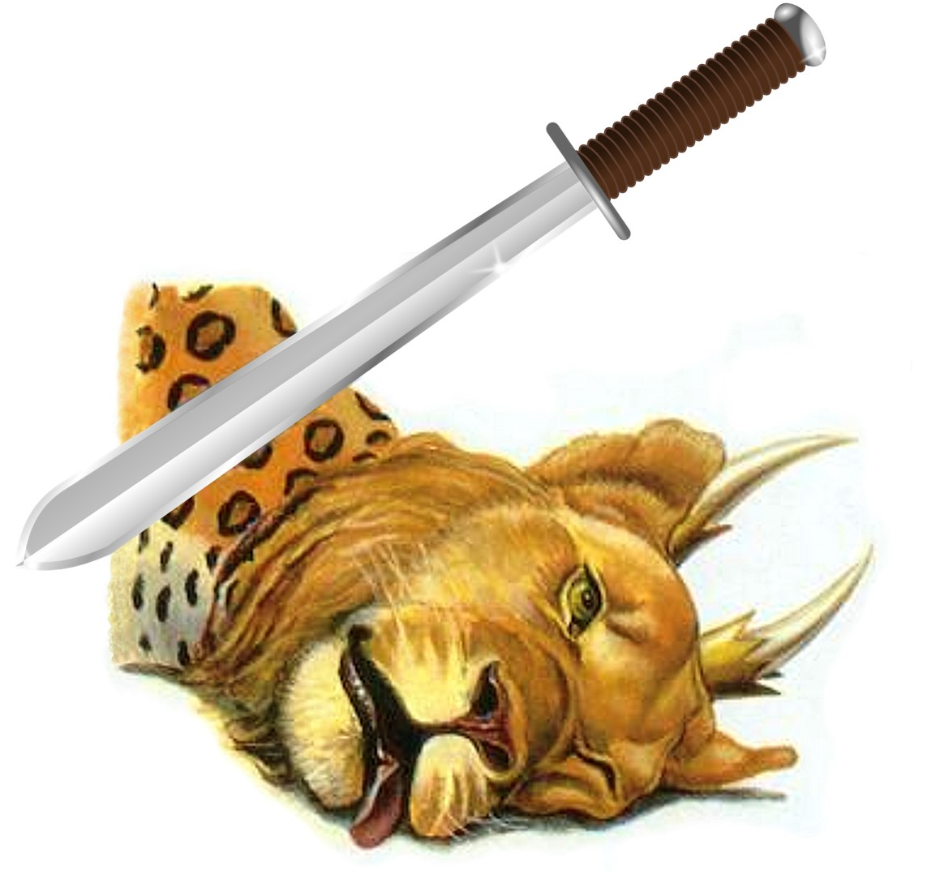
What Beast?
³ And I saw one of his heads as it were wounded to death; and his deadly wound was healed: and all the world wondered after the beast.
Revelation 13:3-18

Slide 80
Wounded to Death: Revelation 13:3
SDABC V.7 p. 817 The word is translated “slain” in ch. 5:6. The phrase may be translated, “beaten to death.” Adventists believe that this prediction met its dramatic fulfillment in 1798 when Berthier, at the head of a French army, entered Rome, declared the political rale of the papacy at an end, and took the pope prisoner to France, where he soon died (see GC 439). However, this incident marked only the climax of a long series of events. The decline of papal power had begun many years before. The launching of the Protestant Reformation was a significant event in the long series.

Slide 81
Deadly Wound Healed: Revelation 13:3
SDABC V.7 p. 817 There was a gradual revival in papal life in the years following the revolution in France. The papacy suffered a new setback when in 1870 the Papal States were taken from it. A significant event occurred in 1929 when the Lateran Treaty restored temporal power to the pope, who was given the rule of Vatican City, a section of the city of Rome about 108.7 acres in extent.

Slide 82
Deadly Wound Healed: Revelation 13:3
SDABC V.7 p. 817 However, the prophet envisioned a much greater restoration. He saw the wound completely healed, as the Greek implies. Following the healing he saw “all that dwell upon the earth,” except a faithful few, worshiping the beast. This is still future. Though the papacy receives homage from certain groups, vast populations show it no deference. But that is to change. The beast of v. 11 “causeth the earth and them which dwell therein to worship the first beast, whose deadly wound was healed” (v. 12).

Slide 83
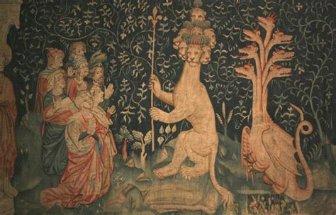
What Beast?
⁴ And they worshipped the dragon which gave power unto the beast: and they worshipped the beast, saying, Who is like unto the beast? who is able to make war with him?
Revelation 13:4-18

Slide 84
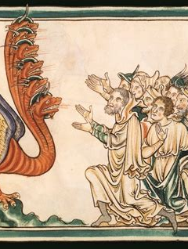
Worshipped the Dragon: Revelation 13:4
SDABC V.7 p. 818 Worshiping the beast is in fact worshiping the dragon, for the beast is but the visible agency of the dragon, carrying out the dragon’s program. Through Roman Catholism, spiritism, and apostate Protestantism, Satan aims to cause the world to worship him. He will be successful except for a noble remnant that refuses to bow to his demands.

Slide 85
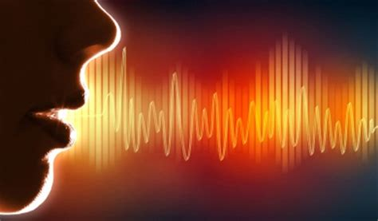
What Beast?
⁵ And there was given unto him a mouth speaking great things and blasphemies; and power was given unto him to continue forty and two months.
Revelation 13:5-18

Slide 86
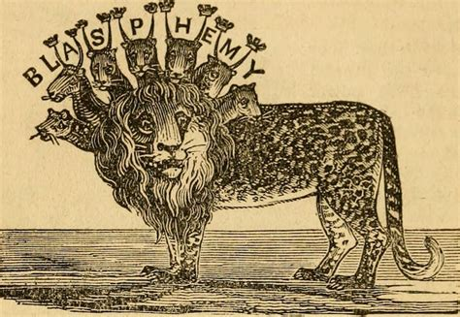
What Beast?
⁶ And he opened his mouth in blasphemy against God, to blaspheme his name, and his tabernacle, and them that dwell in heaven.
Revelation 13:6-18

Slide 87
What Beast? Revelation 13, Daniel 7
Beast of Rev. 13
Blasphemy
42 months
War with saints, overcome
Little Horn
Blasphemy
3 ½ years
War with saints, prevail

Slide 88
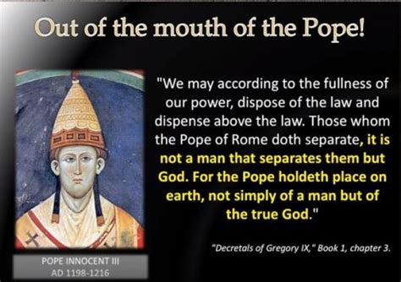

Slide 89
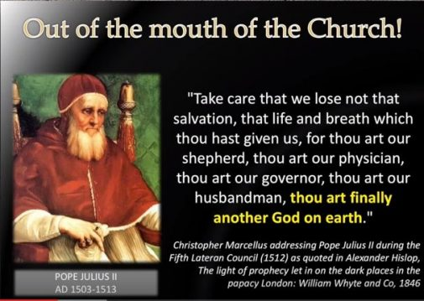

Slide 90


Slide 91


Slide 92


Slide 93


Slide 94

What Beast?
⁷ And it was given unto him to make war with the saints, and to overcome them: and power was given him over all kindreds, and tongues, and nations.
Revelation 13:7-18

Slide 95

What Beast?
⁸ And all that dwell upon the earth shall worship him, whose names are not written in the book of life of the Lamb slain from the foundation of the world.
⁹ If any man have an ear, let him hear.
Revelation 13:8-18

Slide 96

What Beast?
¹⁰ He that leadeth into captivity shall go into captivity: he that killeth with the sword must be killed with the sword. Here is the patience and the faith of the saints.
Revelation 13:10-18

Slide 97

With the Sword: Revelation 13:10
SDABC 7.4 p. 819 The idea may be regarded as similar to that expressed in Jer. 15:2, “Such as are for death, to death…” The KJV reading assures the persecuted children of God that those who pursue them and condemn them to exile and to death will themselves meet a similar fate. Some commentators interpret v. 10 as a warning to Christians not to use force against the antichristian power.

Slide 98

What Beast?
¹¹ And I beheld another beast coming up out of the earth; and he had two horns like a lamb, and he spake as a dragon.
Revelation 13:11-18

Slide 99

What Beast?
¹² And he exerciseth all the power of the first beast before him, and causeth the earth and them which dwell therein to worship the first beast, whose deadly wound was healed.
Revelation 13:12-18

Slide 100

What Beast?
¹³ And he doeth great wonders, so that he maketh fire come down from heaven on the earth in the sight of men,
Revelation 13:13-18

Slide 101

What Beast?
¹⁴ And deceiveth them that dwell on the earth by the means of those miracles which he had power to do in the sight of the beast; saying to them that dwell on the earth, that they should make an image to the beast, which had the wound by a sword, and did live.
Revelation 13:14-18

Slide 102

The Image: Revelation 13:14
SDABC 7.4 p. 820 For the second beast to exercise all the authority of the first beast, it will have to enter the field of religion, and seek to dominate religious worship. For the United States to take this step will mean a complete reversal of its present policy of granting full freedom of religion to its citizens. Such a step is here predicted.

Slide 103

What Beast?
¹⁵ And he had power to give life unto the image of the beast, that the image of the beast should both speak, and cause that as many as would not worship the image of the beast should be killed.
Revelation 13:15-18

Slide 104

What Beast?
¹⁶ And he causeth all, both small and great, rich and poor, free and bond, to receive a mark in their right hand, or in their foreheads:
¹⁷ And that no man might buy or sell, save he that had the mark, or the name of the beast, or the number of his name.
Revelation 13:16-18

Slide 105

What Beast?
¹⁸ Here is wisdom. Let him that hath understanding count the number of the beast: for it is the number of a man; and his number is Six hundred threescore and six.
Revelation 13:18

Slide 106
The Mark of the Beast and the Seal of God
After the warning against the worship of the beast and his image the prophecy declares: “Here are they that keep the commandments of God, and the faith of Jesus.”
The Great Controversy,
p. 445

Slide 107
The Mark of the Beast and the Seal of God
Since those who keep God's commandments are thus placed in contrast with those that worship the beast and his image and receive his mark, it follows that the keeping of God's law, on the one hand, and its violation, on the other, will make the distinction between the worshipers of God and the worshipers of the beast.
The Great Controversy,
p. 445

Slide 108
The Mark of the Beast and the Seal of God
Since those who keep God's commandments are thus placed in contrast with those that worship the beast and his image and receive his mark, it follows that the keeping of God's law, on the one hand, and its violation, on the other, will make the distinction between the worshipers of God and the worshipers of the beast.
The Great Controversy,
p. 446

Slide 109
The Mark of the Beast and the Seal of God
The special characteristic of the beast, and therefore of his image, is the breaking of God's commandments. Says Daniel, of the little horn, the papacy: “He shall think to change times and the law.” Daniel 7:25, R.V. And Paul styled the same power the “man of sin,” who was to exalt himself above God. One prophecy is a complement of the other.
The Great Controversy,
p. 446

Slide 110
The Mark of the Beast and the Seal of God
Only by changing God's law could the papacy exalt itself above God; whoever should understandingly keep the law as thus changed would be giving supreme honor to that power by which the change was made. Such an act of obedience to papal laws would be a mark of allegiance to the pope in the place of God.
The Great Controversy,
p. 446

Slide 111
The Mark of the Beast and the Seal of God
The papacy has attempted to change the law of God. The second commandment, forbidding image worship, has been dropped from the law, and the fourth commandment has been so changed as to authorize the observance of the first instead of the seventh day as the Sabbath.
The Great Controversy,
p. 446

Slide 112
The Mark of the Beast and the Seal of God
But papists urge, as a reason for omitting the second commandment, that it is unnecessary, being included in the first, and that they are giving the law exactly as God designed it to be understood. This cannot be the change foretold by the prophet.
The Great Controversy,
p. 446

Slide 113
The Mark of the Beast and the Seal of God
An intentional, deliberate change is presented: “He shall think to change the times and the law.” The change in the fourth commandment exactly fulfills the prophecy. For this the only authority claimed is that of the church. Here the papal power openly sets itself above God.
The Great Controversy,
p. 446

Slide 114
The Mark of the Beast and the Seal of God
While the worshipers of God will be especially distinguished by their regard for the fourth commandment,—since this is the sign of His creative power and the witness to His claim upon man's reverence and homage,—the worshipers of the beast will be distinguished by their efforts to tear down the Creator's memorial, to exalt the institution of Rome.
The Great Controversy,
p. 446

Slide 115
The Mark of the Beast and the Seal of God
It was in behalf of the Sunday that popery first asserted its arrogant claims; and its first resort to the power of the state was to compel the observance of Sunday as “the Lord's day.” But the Bible points to the seventh day, and not to the first, as the Lord's day.
The Great Controversy,
p. 446

Slide 116
The Mark of the Beast and the Seal of God
Said Christ: “The Son of man is Lord also of the Sabbath.” The fourth commandment declares: “The seventh day is the Sabbath of the Lord.” And by the prophet Isaiah the Lord designates it: “My holy day.” Mark 2:28; Isaiah 58:13.
The Great Controversy,
p. 446

Slide 117
The Mark of the Beast and the Seal of God
Said Christ: “The Son of man is Lord also of the Sabbath.” The fourth commandment declares: “The seventh day is the Sabbath of the Lord.” And by the prophet Isaiah the Lord designates it: “My holy day.” Mark 2:28; Isaiah 58:13.
The Great Controversy,
p. 446

Slide 118
The Mark of the Beast and the Seal of God
But Christians of past generations observed the Sunday, supposing that in so doing they were keeping the Bible Sabbath; and there are now true Christians in every church, not excepting the Roman Catholic communion, who honestly believe that Sunday is the Sabbath of divine appointment.
The Great Controversy,
p. 449

Slide 119
The Mark of the Beast and the Seal of God
God accepts their sincerity of purpose and their integrity before Him. But when Sunday observance shall be enforced by law, and the world shall be enlightened concerning the obligation of the true Sabbath, then whoever shall transgress the command of God, to obey a precept which has no higher authority than that of Rome, will thereby honor popery above God.
The Great Controversy,
p. 449

Slide 120
The Mark of the Beast and the Seal of God
He is paying homage to Rome and to the power which enforces the institution ordained by Rome. He is worshiping the beast and his image. As men then reject the institution which God has declared to be the sign of His authority, and honor in its stead that which Rome has chosen as the token of her supremacy, they will thereby accept the sign of allegiance to Rome—“the mark of the beast.”
The Great Controversy,
p. 449

Slide 121
The Mark of the Beast and the Seal of God
And it is not until the issue is thus plainly set before the people, and they are brought to choose between the commandments of God and the commandments of men, that those who continue in transgression will receive “the mark of the beast.”
The Great Controversy,
p. 449

Slide 122
The Mark of the Beast and the Seal of God
The most fearful threatening ever addressed to mortals is contained in the third angel's message. That must be a terrible sin which calls down the wrath of God unmingled with mercy. Men are not to be left in darkness concerning this important matter;
The Great Controversy,
p. 449

Slide 123
The Mark of the Beast and the Seal of God
the warning against this sin is to be given to the world before the visitation of God's judgments, that all may know why they are to be inflicted, and have opportunity to escape them. Prophecy declares that the first angel would make his announcement to “every nation, and kindred, and tongue, and people.”
The Great Controversy,
p. 449

Slide 124
The Mark of the Beast and the Seal of God
The warning of the third angel, which forms a part of the same threefold message, is to be no less widespread. It is represented in the prophecy as being proclaimed with a loud voice, by an angel flying in the midst of heaven; and it will command the attention of the world.
The Great Controversy,
p. 449

Slide 125
The Mark of the Beast and the Seal of God
In the issue of the contest all Christendom will be divided into two great classes—those who keep the commandments of God and the faith of Jesus, and those who worship the beast and his image and receive his mark.
The Great Controversy,
p. 450

Slide 126
The Mark of the Beast and the Seal of God
Although church and state will unite their power to compel “all, both small and great, rich and poor, free and bond” (Revelation 13:16), to receive “the mark of the beast,” yet the people of God will not receive it.
The Great Controversy,
p. 450

Slide 127
The Mark of the Beast and the Seal of God
The prophet of Patmos beholds “them that had gotten the victory over the beast, and over his image, and over his mark, and over the number of his name, stand on the sea of glass, having the harps of God” and singing the song of Moses and the Lamb. Revelation 15:2, 3.
The Great Controversy,
p. 450

Slide 128
Thank you!
And Happy Sabbath!

