Slide 1
Ablaze With God’s Glory
Lesson 13, 2nd Quarter 2023
John 7 & 8, 1 Thessalonians 5,
2 Thessalonians 2, Revelation 4, 5, & 21

Slide 2
Memory Text: Revelation 18:1
18 And after these things I saw another angel come down from heaven, having great power; and the earth was lightened with his glory.

Slide 3
KEY VERSES: The 1st Angel’s Message
Revelation 14:6-7
⁶ And I saw another angel fly in the midst of heaven, having the everlasting gospel to preach unto them that dwell on the earth, and to every nation, and kindred, and tongue, and people,

Slide 4
KEY VERSES: The 1st Angel’s Message
Revelation 14:6-7
⁷ Saying with a loud voice, Fear God, and give glory to him; for the hour of his judgment is come: and worship him that made heaven, and earth, and the sea, and the fountains of waters.

Slide 5
KEY VERSES: The 2nd Angel’s Message
Revelation 14:8
⁸ And there followed another angel, saying, Babylon is fallen, is fallen, that great city, because she made all nations drink of the wine of the wrath of her fornication.

Slide 6
KEY VERSES: The 3rd Angel’s Message
Revelation 14:9-12
⁹ And the third angel followed them, saying with a loud voice, If any man worship the beast and his image, and receive his mark in his forehead, or in his hand,

Slide 7
KEY VERSES: The 3rd Angel’s Message
Revelation 14:9-12
¹⁰ The same shall drink of the wine of the wrath of God, which is poured out without mixture into the cup of his indignation; and he shall be tormented with fire and brimstone in the presence of the holy angels, and in the presence of the Lamb:

Slide 8
KEY VERSES: The 3rd Angel’s Message
Revelation 14:9-12
¹¹ And the smoke of their torment ascendeth up for ever and ever: and they have no rest day nor night, who worship the beast and his image, and whosoever receiveth the mark of his name.
¹² Here is the patience of the saints: here are they that keep the commandments of God, and the faith of Jesus.

Slide 9
Three Angels’ Messages:
1st Angel: Worship the Creator God of the Gospel!
2nd Angel: False System of Worship Doomed!
3rd Angel: Choose!
Live or Die by Your Choice.

Slide 10
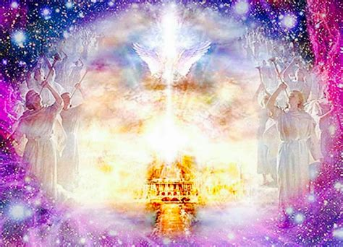
End of the Story: Revelation 4:2-11
² And immediately I was in the spirit: and, behold, a throne was set in heaven, and one sat on the throne.

Slide 11
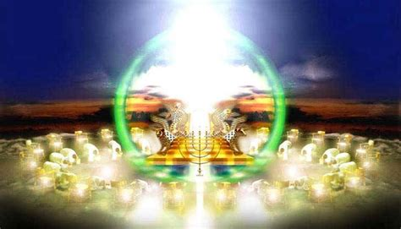
End of the Story: Revelation 4:3-11
³ And he that sat was to look upon like a jasper and a sardine stone: and there was a rainbow round about the throne, in sight like unto an emerald.

Slide 12
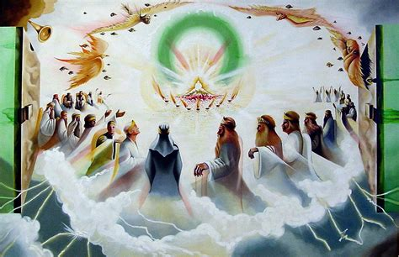
End of the Story: Revelation 4:4-11
⁴ And round about the throne were four and twenty seats: and upon the seats I saw four and twenty elders sitting, clothed in white raiment; and they had on their heads crowns of gold.

Slide 13
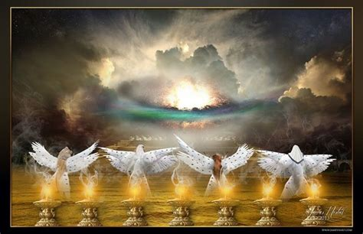
End of the Story: Revelation 4:5-11
⁵ And out of the throne proceeded lightnings and thunderings and voices: and there were seven lamps of fire burning before the throne, which are the seven Spirits of God.

Slide 14
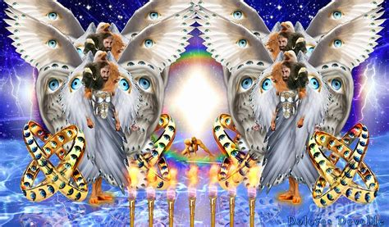
End of the Story: Revelation 4:6-11
⁶ And before the throne there was a sea of glass like unto crystal: and in the midst of the throne, and round about the throne, were four beasts full of eyes before and behind.

Slide 15
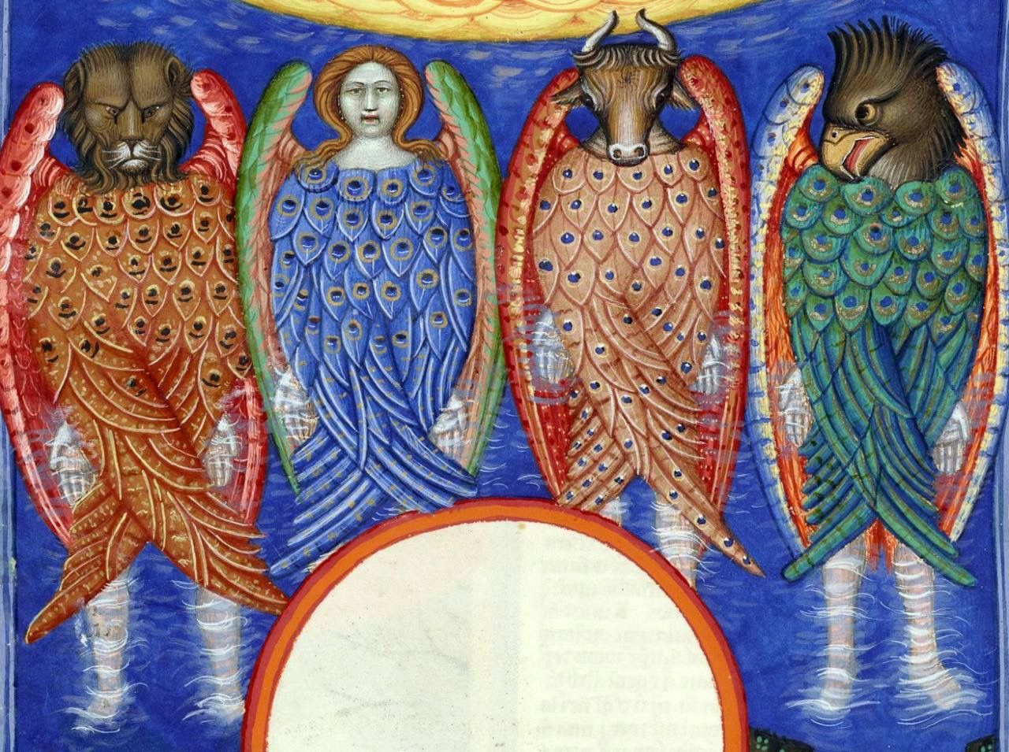
End of the Story: Revelation 4:7-11
⁷ And the first beast was like a lion, and the second beast like a calf, and the third beast had a face as a man, and the fourth beast was like a flying eagle.

Slide 16
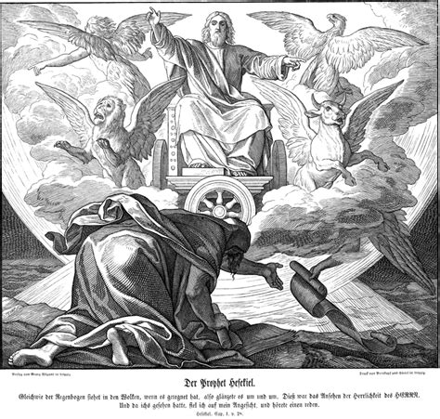
End of the Story: Revelation 4:8-11
⁸ And the four beasts had each of them six wings about him; and they were full of eyes within: and they rest not day and night, saying, Holy, holy, holy, Lord God Almighty, which was, and is, and is to come.

Slide 17
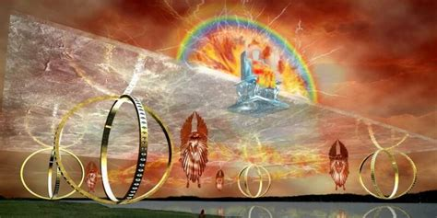
End of the Story: Revelation 4:9-11
⁹ And when those beasts give glory and honour and thanks to him that sat on the throne, who liveth for ever and ever,

Slide 18
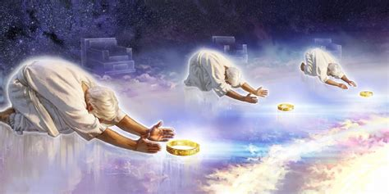
End of the Story: Revelation 4:10-11
¹⁰ The four and twenty elders fall down before him that sat on the throne, and worship him that liveth for ever and ever, and cast their crowns before the throne, saying,

Slide 19
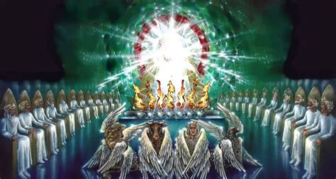
End of the Story: Revelation 4:11
¹¹ Thou art worthy, O Lord, to receive glory and honour and power: for thou hast created all things, and for thy pleasure they are and were created.

Slide 20
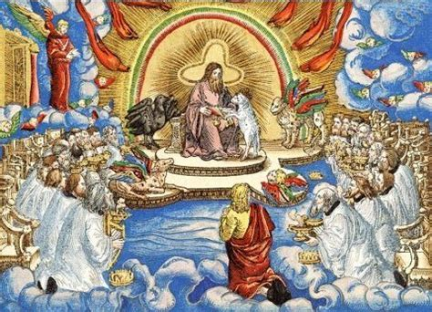
End of the Story: Revelation 5:8-14
⁸ And when he had taken the book, the four beasts and four and twenty elders fell down before the Lamb, having every one of them harps, and golden vials full of odours, which are the prayers of saints.

Slide 21
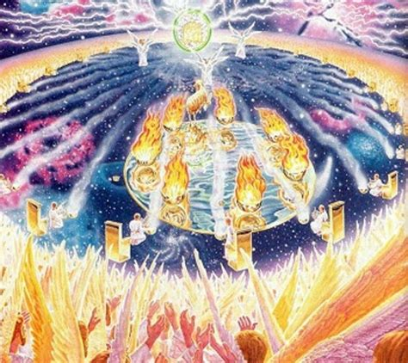
End of the Story: Revelation 5:9-14
⁹ And they sung a new song, saying, Thou art worthy to take the book, and to open the seals thereof: for thou wast slain, and hast redeemed us to God by thy blood out of every kindred, and tongue, and people, and nation;

Slide 22
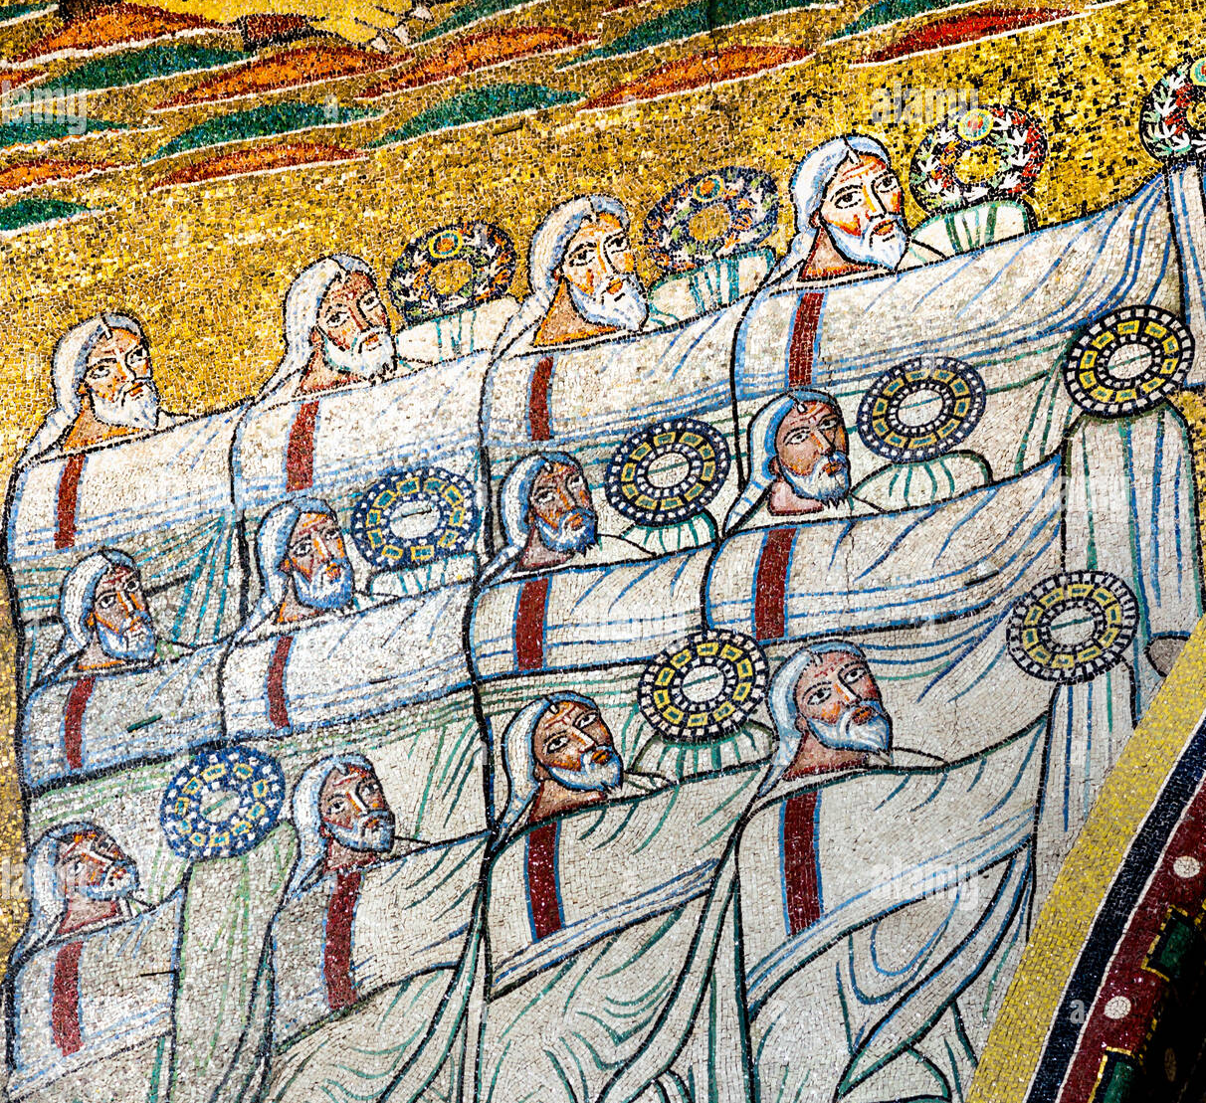
End of the Story: Revelation 5:10-14
¹⁰ And hast made us unto our God kings and priests: and we shall reign on the earth.

Slide 23
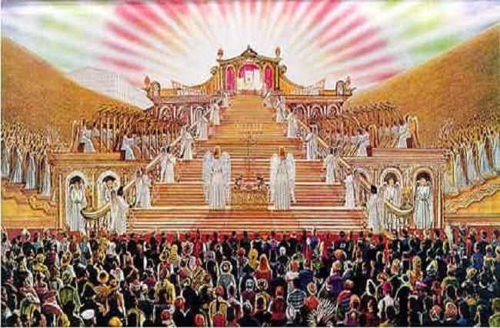
End of the Story: Revelation 5:11-14
¹¹ And I beheld, and I heard the voice of many angels round about the throne and the beasts and the elders: and the number of them was ten thousand times ten thousand, and thousands of thousands;

Slide 24
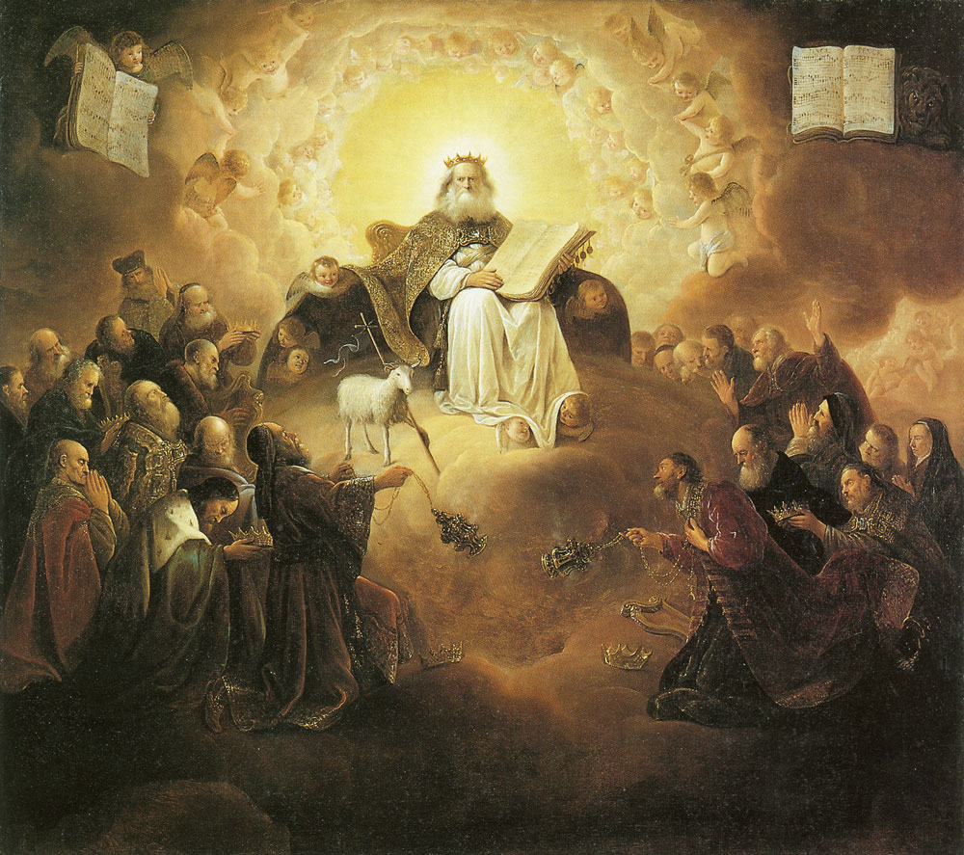
End of the Story: Revelation 5:12-14
¹² Saying with a loud voice, Worthy is the Lamb that was slain to receive power, and riches, and wisdom, and strength, and honour, and glory, and blessing.

Slide 25
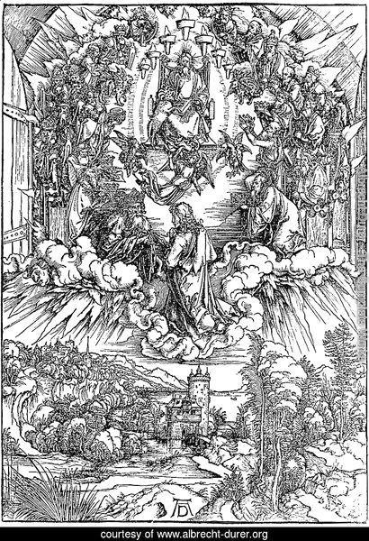
End of the Story: Revelation 5:13-14
¹³ And every creature which is in heaven, and on the earth, and under the earth, and such as are in the sea, and all that are in them, heard I saying, Blessing, and honour, and glory, and power, be unto him that sitteth upon the throne, and unto the Lamb for ever and ever.

Slide 26
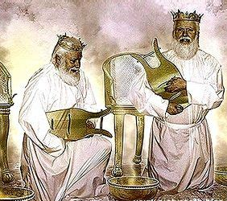
End of the Story: Revelation 5:14
¹⁴ And the four beasts said, Amen. And the four and twenty elders fell down and worshipped him that liveth for ever and ever.

Slide 27
THE END:
GOD WINS!!
All created beings worship Him, and sin is eradicated forever!
Unfortunately, before that, there’s a certain amount of evil, grief, and confusion…

Slide 28
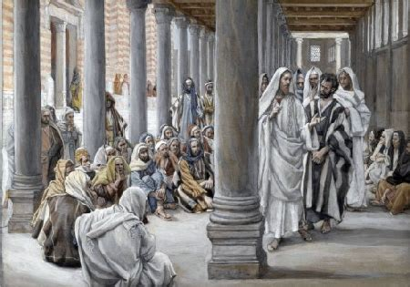
Certainty and Conflict: John 7:14-18
¹⁴ Now about the midst of the feast Jesus went up into the temple, and taught.

Slide 29
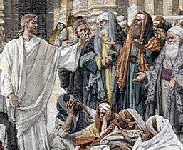
Certainty and Conflict: John 7:15-18
¹⁵ And the Jews marvelled, saying, How knoweth this man letters, having never learned?

Slide 30
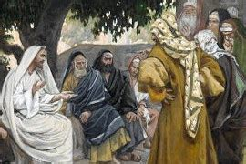
Certainty and Conflict: John 7:16-18
¹⁶ Jesus answered them, and said, My doctrine is not mine, but his that sent me.

Slide 31
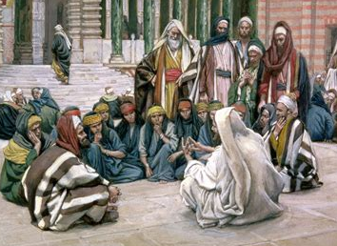
Certainty and Conflict: John 7:17-18
¹⁷ If any man will do his will, he shall know of the doctrine, whether it be of God, or whether I speak of myself.

Slide 32
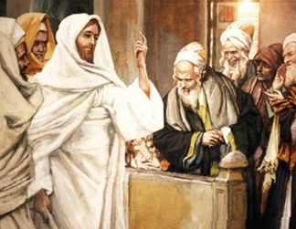
Certainty and Conflict: John 7:18
¹⁸ He that speaketh of himself seeketh his own glory: but he that seeketh his glory that sent him, the same is true, and no unrighteousness is in him.

Slide 33
Certainty and Conflict: SDABC V.5 p. 978
The clause may be translated, “if any man’s will is to do his will”. He who sincerely desires to do the will of God will be enlightened by God and enabled to evaluate correctly the claims of others. A prerequisite to receiving light is that the seeker for truth must be willing to follow in the light that may be revealed.

Slide 34
Certainty and Conflict: SDABC V.5 p. 978
The difficulty of finding out “what is truth” in religion is a common subject of complaint among men. They point to the many differences that prevail among Christians on matters of doctrine, and profess to be unable to decide who is right. In thousands of cases this professed inability to discover truth becomes an excuse for living without any religion at all.

Slide 35
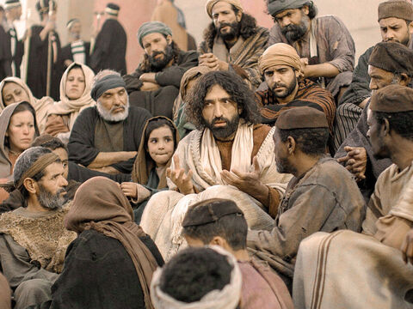
Knowing Truth: John 8:31-47
³¹ Then said Jesus to those Jews which believed on him, If ye continue in my word, then are ye my disciples indeed;

Slide 36
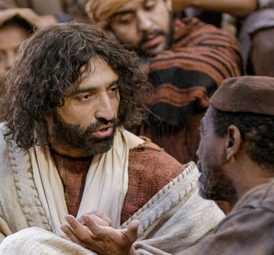
Knowing Truth : John 8:32-47
³² And ye shall know the truth, and the truth shall make you free.
³³ They answered him, We be Abraham's seed, and were never in bondage to any man: how sayest thou, Ye shall be made free?

Slide 37
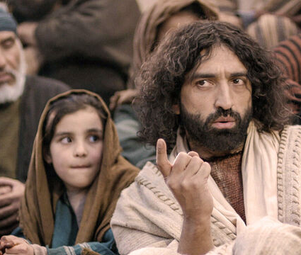
Knowing Truth : John 8:34-47
³⁴ Jesus answered them, Verily, verily, I say unto you, Whosoever committeth sin is the servant of sin.
³⁵ And the servant abideth not in the house for ever: but the Son abideth ever.

Slide 38
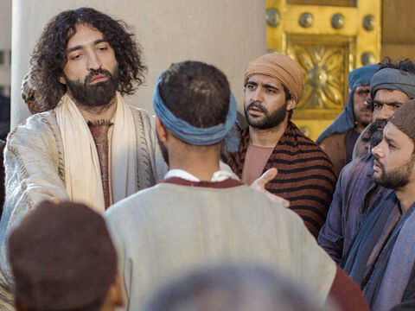
Knowing Truth: John 8:36-47
³⁶ If the Son therefore shall make you free, ye shall be free indeed.
³⁷ I know that ye are Abraham's seed; but ye seek to kill me, because my word hath no place in you.

Slide 39
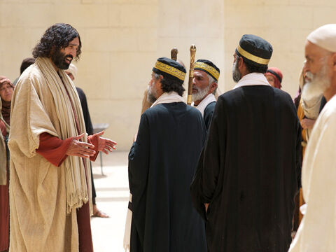
Knowing Truth: John 8:38-47
³⁸ I speak that which I have seen with my Father: and ye do that which ye have seen with your father.

Slide 40
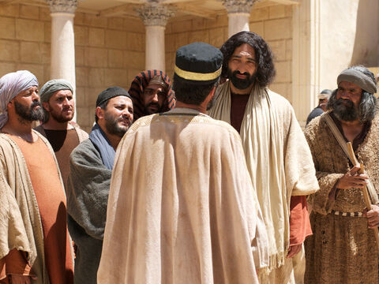
Knowing Truth: John 8:39-47
³⁹ They answered and said unto him, Abraham is our father. Jesus saith unto them, If ye were Abraham's children, ye would do the works of Abraham.

Slide 41
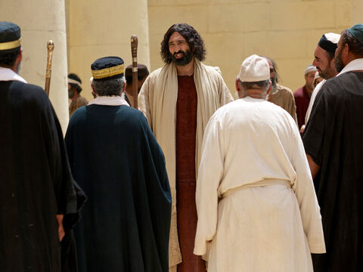
Knowing Truth: John 8:40-47
⁴⁰ But now ye seek to kill me, a man that hath told you the truth, which I have heard of God: this did not Abraham.

Slide 42
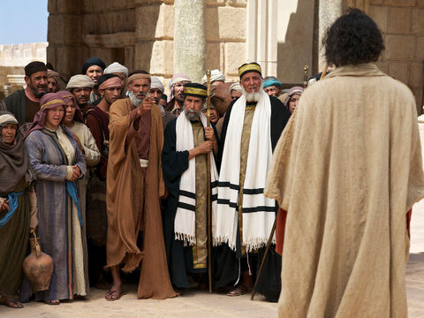
Knowing Truth: John 8:41-47
⁴¹ Ye do the deeds of your father. Then said they to him, We be not born of fornication; we have one Father, even God.

Slide 43
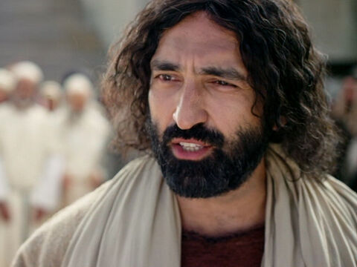
Knowing Truth: John 8:42-47
⁴² Jesus said unto them, If God were your Father, ye would love me: for I proceeded forth and came from God; neither came I of myself, but he sent me.

Slide 44
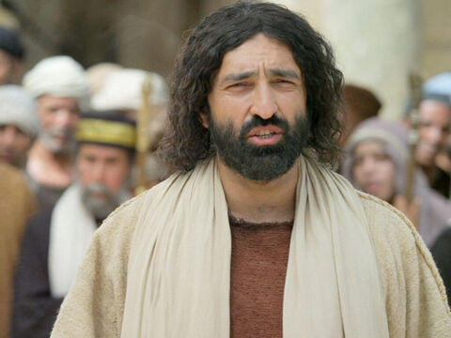
Knowing Truth: John 8:43-47
⁴³ Why do ye not understand my speech? even because ye cannot hear my word.

Slide 45
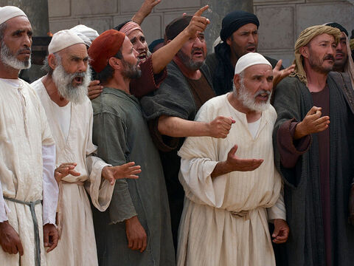
Knowing Truth: John 8:44-47
⁴⁴ Ye are of your father the devil, and the lusts of your father ye will do. He was a murderer from the beginning, and abode not in the truth, because there is no truth in him. When he speaketh a lie, he speaketh of his own: for he is a liar, and the father of it.

Slide 46
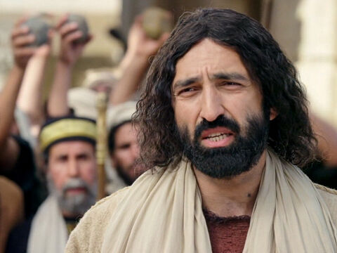
Knowing Truth: John 8:45-47
⁴⁵ And because I tell you the truth, ye believe me not.
⁴⁶ Which of you convinceth me of sin? And if I say the truth, why do ye not believe me?

Slide 47
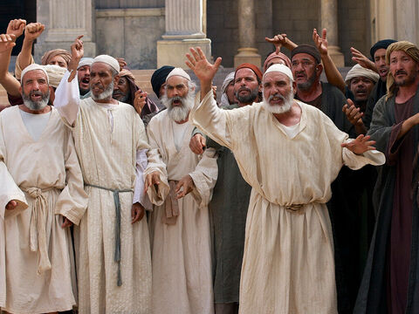
Knowing Truth: John 8:47
⁴⁷ He that is of God heareth God's words: ye therefore hear them not, because ye are not of God.

Slide 48
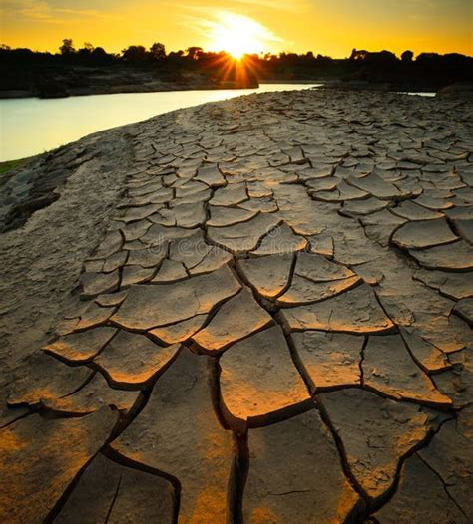
Truth and Lies: Ezekiel 22:23-29
²³ And the word of the Lord came unto me, saying,
²⁴ Son of man, say unto her, Thou art the land that is not cleansed, nor rained upon in the day of indignation.

Slide 49
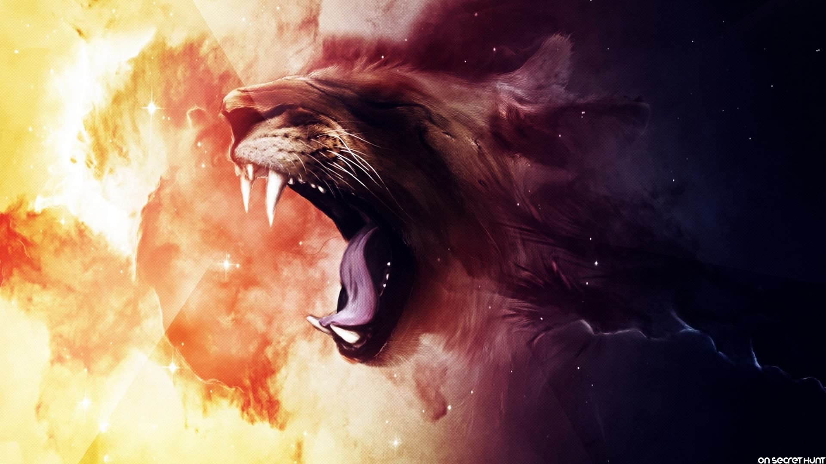
Truth and Lies: Ezekiel 22:25-29
²⁵ There is a conspiracy of her prophets in the midst thereof, like a roaring lion ravening the prey; they have devoured souls; they have taken the treasure and precious things; they have made her many widows in the midst thereof.

Slide 50
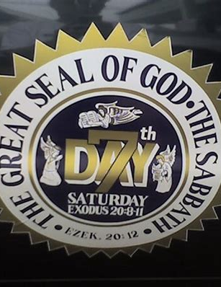
Truth and Lies: Ezekiel 22:26-29
²⁶ Her priests have violated my law, and have profaned mine holy things: they have put no difference between the holy and profane, neither have they shewed difference between the unclean and the clean, and have hid their eyes from my sabbaths, and I am profaned among them.

Slide 51
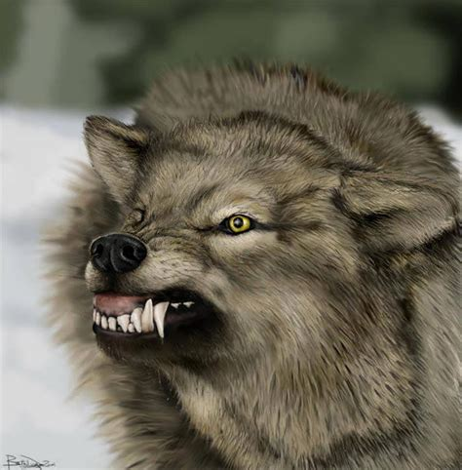
Truth and Lies: Ezekiel 22:27-29
²⁷ Her princes in the midst thereof are like wolves ravening the prey, to shed blood, and to destroy souls, to get dishonest gain.

Slide 52
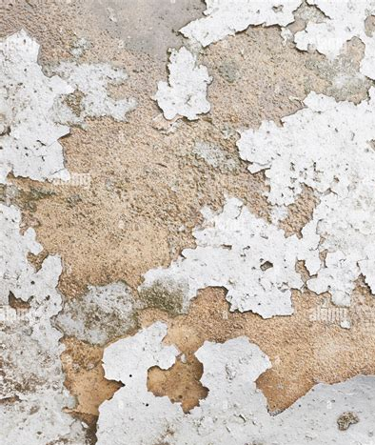
Truth and Lies: Ezekiel 22:28-29
²⁸ And her prophets have daubed them with untempered morter, seeing vanity, and divining lies unto them, saying, Thus saith the Lord God, when the Lord hath not spoken.

Slide 53
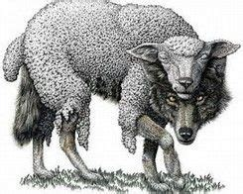
Truth and Lies: Ezekiel 22:29
²⁹ The people of the land have used oppression, and exercised robbery, and have vexed the poor and needy: yea, they have oppressed the stranger wrongfully.

Slide 54
Truth and Lies: SDABC V.4 p. 619
The illustration is as follows: Someone built up a flimsy partition wall. The false prophets whitewashed it, improving its appearance, but adding nothing to its strength. The rulers and people devised various schemes, and the self-appointed prophets gave them weight by their influence and persuasion. We note a striking parallel in the religious world today. Many false doctrines, which have no support in the Word of God, have been introduced into the Christian faith.

Slide 55
Truth and Lies: SDABC V.4 p. 656
There are voices in the religious world to support almost any kind of belief!
Several important rules will help men today to distinguish between that which is untempered mortar and that which is genuine. These rules should be used to test any alleged claim to scriptural support. They serve equally as a system of guidance to direct one in original Bible research, lest unwarranted conclusions be drawn.

Slide 56
Truth and Lies: SDABC V.4 p. 656
1. The Bible should always be studied in the setting of prayer. Only the Holy Spirit can help us to see the importance of those things easy to be understood, and keep us from wresting those truths difficult of comprehension (see GC 599, 600). Furthermore, spiritual things are spiritually discerned (see 1 Cor. 2:14), so that a man without the Spirit of God cannot understand divine things. Prayer, properly exercised, will place a man in a condition to receive heavenly truth.

Slide 57
Truth and Lies: SDABC V.4 p. 656
2. There must be willingness to follow revealed light (John 7:17). God’s truths are not thrown about promiscuously for men to trample under their feet. God reserves an understanding of His messages for those who are willing to walk in the light that illuminates their minds. A stubborn refusal to walk in this light locks the door to further understanding of divine truth.

Slide 58
Truth and Lies: SDABC V.4 p. 656
3. The Bible must be interpreted according to the analogy of the rest of Scripture. The Bible, correctly understood, does not contradict itself. If a conclusion drawn from a Scripture passage is contradicted in another portion of the Book, that conclusion must be labeled as false. Often a verse or passage, taken by itself, can be shown to have several possible interpretations. In such an event that exposition which is in complete harmony with the whole Bible must be adopted.

Slide 59
Truth and Lies: SDABC V.4 p. 656
4. The Bible must be interpreted in the light of its context. The student ought to note carefully the setting of the passage under consideration to find out what the writer was talking about. The student must limit his application to the bounds set by the author…

Slide 60
Truth and Lies: SDABC V.4 p. 656
4. … For example, when Paul said, “All things are lawful unto me” (1 Cor. 6:12), his words, taken by themselves, could be interpreted to mean that Paul was here declaring himself to be a libertine. But the context shows that he is speaking about the propriety of eating meats sacrificed to idols. One has no right to apply the “all things” to anything further than that which was in the mind of Paul when he made this statement.

Slide 61
Truth and Lies: SDABC V.4 p. 656
5. The Bible must be permitted to be its own interpreter. Often the Holy Spirit does not immediately interpret the symbol it employs, but the same Spirit would be expected elsewhere to explain the shadowy language, if men are to grasp its meaning. This is found to be the case. One might add that when such further elucidation is absent, any attempt by men to interpret these symbols can at best be only conjecture.

Slide 62
Truth and Lies: SDABC V.4 p. 656
5. The Bible must be permitted to be its own interpreter. Often the Holy Spirit does not immediately interpret the symbol it employs, but the same Spirit would be expected elsewhere to explain the shadowy language, if men are to grasp its meaning. This is found to be the case. One might add that when such further elucidation is absent, any attempt by men to interpret these symbols can at best be only conjecture.

Slide 63
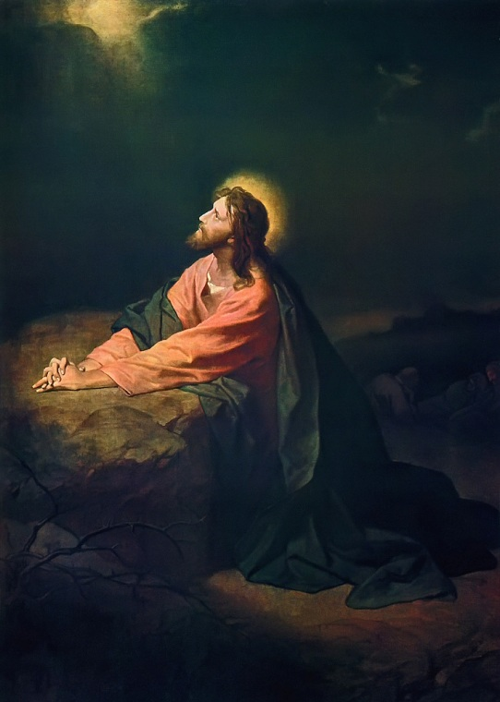
Sanctified by Truth: John 17:1, 13-21
17 These words spake Jesus, and lifted up his eyes to heaven, and said, Father, the hour is come; glorify thy Son, that thy Son also may glorify thee:

Slide 64
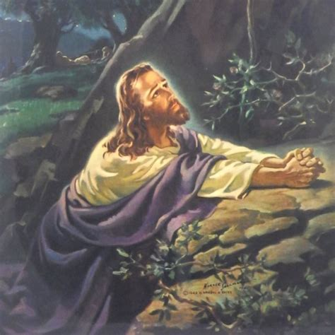
Sanctified by Truth: John 17:13-21
¹³ And now come I to thee; and these things I speak in the world, that they might have my joy fulfilled in themselves.

Slide 65
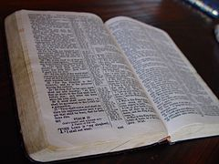
Sanctified by Truth: John 17:14-21
¹⁴ I have given them thy word; and the world hath hated them, because they are not of the world, even as I am not of the world.

Slide 66
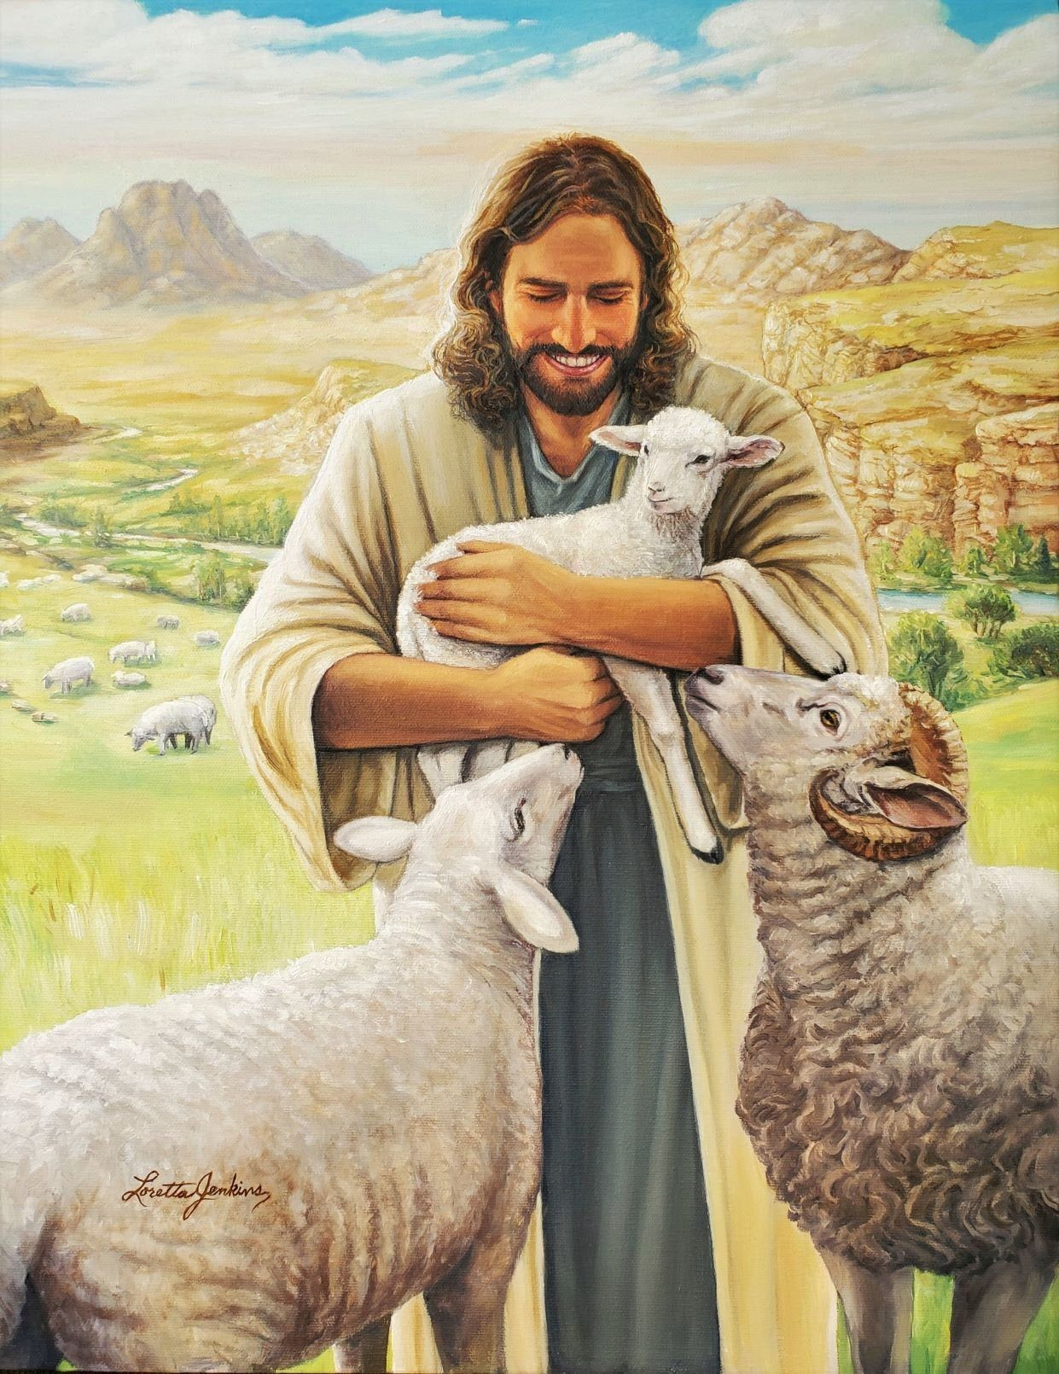
Sanctified by Truth: John 17:15-21
¹⁵ I pray not that thou shouldest take them out of the world, but that thou shouldest keep them from the evil.

Slide 67
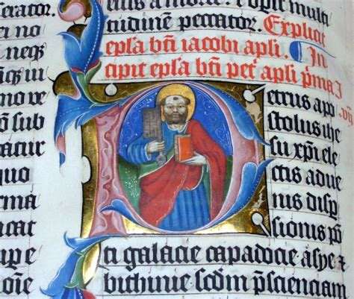
Sanctified by Truth: John 17:16-21
¹⁶ They are not of the world, even as I am not of the world.
¹⁷ Sanctify them through thy truth: thy word is truth.

Slide 68
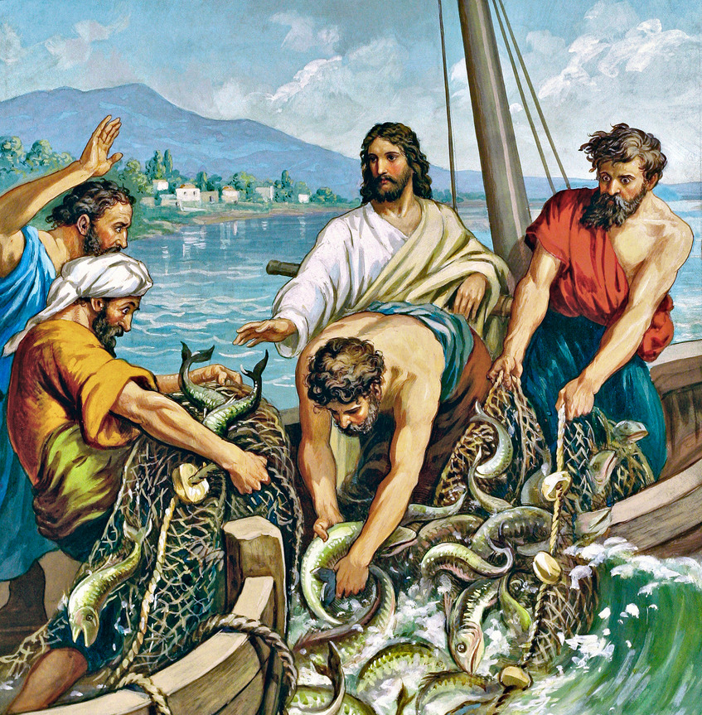
Sanctified by Truth: John 17:18-21
¹⁸ As thou hast sent me into the world, even so have I also sent them into the world.

Slide 69
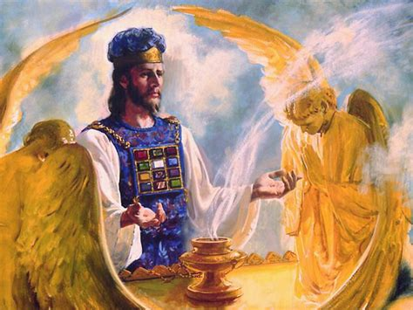
Sanctified by Truth: John 17:19-21
¹⁹ And for their sakes I sanctify myself, that they also might be sanctified through the truth.

Slide 70
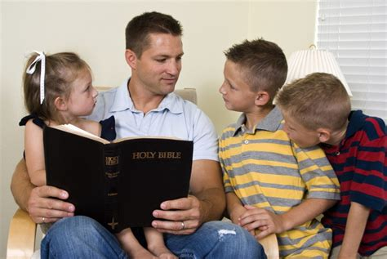
Sanctified by Truth: John 17:20-21
²⁰ Neither pray I for these alone, but for them also which shall believe on me through their word;

Slide 71
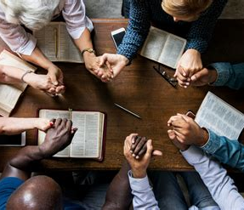
Sanctified by Truth: John 17:21
²¹ That they all may be one; as thou, Father, art in me, and I in thee, that they also may be one in us: that the world may believe that thou hast sent me.

Slide 72

A Final Plea: Revelation 18:1-5
18 And after these things I saw another angel come down from heaven, having great power; and the earth was lightened with his glory.

Slide 73

A Final Plea: Revelation 18:2-5
² And he cried mightily with a strong voice, saying, Babylon the great is fallen, is fallen, and is become the habitation of devils, and the hold of every foul spirit, and a cage of every unclean and hateful bird.

Slide 74

A Final Plea: Revelation 18:3-5
³ For all nations have drunk of the wine of the wrath of her fornication, and the kings of the earth have committed fornication with her, and the merchants of the earth are waxed rich through the abundance of her delicacies.

Slide 75

A Final Plea: Revelation 18:4-5
⁴ And I heard another voice from heaven, saying, Come out of her, my people, that ye be not partakers of her sins, and that ye receive not of her plagues.

Slide 76

A Final Plea: Revelation 18:5
⁵ For her sins have reached unto heaven, and God hath remembered her iniquities.

Slide 77
PAUL gives a practicum:
(A course that is designed to give students supervised practical application of previously studied theory.)

Slide 78

Hold to Truth: 2 Thessalonians 2:1-17
2 Now we beseech you, brethren, by the coming of our Lord Jesus Christ, and by our gathering together unto him,

Slide 79

Hold to Truth: 2 Thessalonians 2:2-17
² That ye be not soon shaken in mind, or be troubled, neither by spirit, nor by word, nor by letter as from us, as that the day of Christ is at hand.

Slide 80

Hold to Truth: 2 Thessalonians 2:3-17
³ Let no man deceive you by any means: for that day shall not come, except there come a falling away first, and that man of sin be revealed, the son of perdition;

Slide 81

Hold to Truth: 2 Thessalonians 2:4-17
⁴ Who opposeth and exalteth himself above all that is called God, or that is worshipped; so that he as God sitteth in the temple of God, shewing himself that he is God.

Slide 82

Hold to Truth: 2 Thessalonians 2:5-17
⁵ Remember ye not, that, when I was yet with you, I told you these things?
⁶ And now ye know what withholdeth that he might be revealed in his time.

Slide 83

Hold to Truth: 2 Thessalonians 2:7-17
⁷ For the mystery of iniquity doth already work: only he who now letteth will let, until he be taken out of the way.

Slide 84

Hold to Truth: 2 Thessalonians 2:8-17
⁸ And then shall that Wicked be revealed, whom the Lord shall consume with the spirit of his mouth, and shall destroy with the brightness of his coming:

Slide 85

Hold to Truth: 2 Thessalonians 2:9-17
⁹ Even him, whose coming is after the working of Satan with all power and signs and lying wonders,

Slide 86

Hold to Truth: 2 Thessalonians 2:10-17
¹⁰ And with all deceivableness of unrighteousness in them that perish; because they received not the love of the truth, that they might be saved.

Slide 87

Hold to Truth: 2 Thessalonians 2:11-17
¹¹ And for this cause God shall send them strong delusion, that they should believe a lie:
¹² That they all might be damned who believed not the truth, but had pleasure in unrighteousness.

Slide 88

Hold to Truth: 2 Thessalonians 2:13-17
¹¹ And for this cause God shall send them strong delusion, that they should believe a lie:
¹² That they all might be damned who believed not the truth, but had pleasure in unrighteousness.

Slide 89

Hold to Truth: 2 Thessalonians 2:13-17
¹³ But we are bound to give thanks alway to God for you, brethren beloved of the Lord, because God hath from the beginning chosen you to salvation through sanctification of the Spirit and belief of the truth:

Slide 90

Hold to Truth: 2 Thessalonians 2:14-17
¹⁴ Whereunto he called you by our gospel, to the obtaining of the glory of our Lord Jesus Christ.

Slide 91
Hold to Truth: 2 Thessalonians 2:15-17
“Traditions” from the Greek paradoseis. The word means things delivered, handed over, or transmitted by way of teaching or doctrine. The prominent idea of the word is one of authority above that of the teacher; therefore, here it refers to inspired messages received by Paul and his companions and faithfully passed on to the Thessalonians.
¹⁵ Therefore, brethren, stand fast, and hold the traditions which ye have been taught, whether by word, or our epistle.

Slide 92

Hold to Truth: 2 Thessalonians 2:16-17
¹⁶ Now our Lord Jesus Christ himself, and God, even our Father, which hath loved us, and hath given us everlasting consolation and good hope through grace,

Slide 93

Hold to Truth: 2 Thessalonians 2:17
¹⁷ Comfort your hearts, and stablish you in every good word and work.

Slide 94

Live in Truth: 1 Thessalonians 5:1-28
5 But of the times and the seasons, brethren, ye have no need that I write unto you.
² For yourselves know perfectly that the day of the Lord so cometh as a thief in the night.

Slide 95

Live in Truth: 1 Thessalonians 5:3-28
³ For when they shall say, Peace and safety; then sudden destruction cometh upon them, as travail upon a woman with child; and they shall not escape.

Slide 96

Live in Truth: 1 Thessalonians 5:4-28
⁴ But ye, brethren, are not in darkness, that that day should overtake you as a thief.
⁵ Ye are all the children of light, and the children of the day: we are not of the night, nor of darkness.

Slide 97

Live in Truth: 1 Thessalonians 5:6-28
⁶ Therefore let us not sleep, as do others; but let us watch and be sober.
⁷ For they that sleep sleep in the night; and they that be drunken are drunken in the night.

Slide 98

Live in Truth: 1 Thessalonians 5:8-28
⁸ But let us, who are of the day, be sober, putting on the breastplate of faith and love; and for an helmet, the hope of salvation.

Slide 99

Live in Truth: 1 Thessalonians 5:9-28
⁹ For God hath not appointed us to wrath, but to obtain salvation by our Lord Jesus Christ,

Slide 100

Live in Truth: 1 Thessalonians 5:10-28
¹⁰ Who died for us, that, whether we wake or sleep, we should live together with him.
¹¹ Wherefore comfort yourselves together, and edify one another, even as also ye do.

Slide 101

Live in Truth: 1 Thessalonians 5:12-28
¹² And we beseech you, brethren, to know them which labour among you, and are over you in the Lord, and admonish you;

Slide 102

Live in Truth: 1 Thessalonians 5:13-28
¹³ And to esteem them very highly in love for their work's sake. And be at peace among yourselves.

Slide 103

Live in Truth: 1 Thessalonians 5:14-28
¹⁴ Now we exhort you, brethren, warn them that are unruly, comfort the feebleminded, support the weak, be patient toward all men.

Slide 104

Live in Truth: 1 Thessalonians 5:15-28
¹⁵ See that none render evil for evil unto any man; but ever follow that which is good, both among yourselves, and to all men.

Slide 105

Live in Truth: 1 Thessalonians 5:16-28
¹⁶ Rejoice evermore.
¹⁷ Pray without ceasing.
¹⁸ In every thing give thanks: for this is the will of God in Christ Jesus concerning you.

Slide 106

Live in Truth: 1 Thessalonians 5:19-28
¹⁹ Quench not the Spirit.
²⁰ Despise not prophesyings.
²¹ Prove all things; hold fast that which is good.
²² Abstain from all appearance of evil.

Slide 107

Live in Truth: 1 Thessalonians 5:23-28
²³ And the very God of peace sanctify you wholly; and I pray God your whole spirit and soul and body be preserved blameless unto the coming of our Lord Jesus Christ.

Slide 108

Live in Truth: 1 Thessalonians 5:24-28
²⁴ Faithful is he that calleth you, who also will do it.
²⁵ Brethren, pray for us.
²⁶ Greet all the brethren with an holy kiss.

Slide 109

Live in Truth: 1 Thessalonians 5:27-28
²⁷ I charge you by the Lord that this epistle be read unto all the holy brethren.
²⁸ The grace of our Lord Jesus Christ be with you. Amen.

Slide 110
The Final Message: Testimonies v.6, p.19
The Lord God of heaven will not send upon the world His judgments for disobedience and transgression until He has sent His watchmen to give the warning. He will not close up the period of probation until the message shall be more distinctly proclaimed.

Slide 111
The Final Message: Testimonies v.6, p.19
The law of God is to be magnified; its claims must be presented in their true, sacred character, that the people may be brought to decide for or against the truth. Yet the work will be cut short in righteousness. The message of Christ's righteousness is to sound from one end of the earth to the other to prepare the way of the Lord. This is the glory of God, which closes the work of the third angel.

Slide 112
The Final Message: Testimonies v.6, p.19
There is no work in our world so great, so sacred, and so glorious, no work that God honors so much, as this gospel work. The message presented at this time is the last message of mercy for a fallen world. Those who have the privilege of hearing this message, and who persist in refusing to heed the warning, cast away their last hope of salvation. There will be no second probation.

Slide 113
The Final Message: Testimonies v.6, p.19
The word of truth, “It is written,” is the gospel we are to preach. No flaming sword is placed before this tree of life. All who will may partake of it. There is no power that can prohibit any soul from taking of its fruit. All may eat, and live forever.

Slide 114

Back to the End: Revelation 21:1-5, 23-27
21 And I saw a new heaven and a new earth: for the first heaven and the first earth were passed away; and there was no more sea.

Slide 115

Back to the End: Revelation 21:2-5, 23-27
² And I John saw the holy city, new Jerusalem, coming down from God out of heaven, prepared as a bride adorned for her husband.

Slide 116

Back to the End: Revelation 21:3-5, 23-27
³ And I heard a great voice out of heaven saying, Behold, the tabernacle of God is with men, and he will dwell with them, and they shall be his people, and God himself shall be with them, and be their God.

Slide 117

Back to the End: Revelation 21:4-5, 23-27
⁴ And God shall wipe away all tears from their eyes; and there shall be no more death, neither sorrow, nor crying, neither shall there be any more pain: for the former things are passed away.

Slide 118

Back to the End: Revelation 21:5, 23-27
⁵ And he that sat upon the throne said, Behold, I make all things new. And he said unto me, Write: for these words are true and faithful.

Slide 119

Back to the End: Revelation 21:23-27
²³ And the city had no need of the sun, neither of the moon, to shine in it: for the glory of God did lighten it, and the Lamb is the light thereof.

Slide 120

Back to the End: Revelation 21:24-27
²⁴ And the nations of them which are saved shall walk in the light of it: and the kings of the earth do bring their glory and honour into it.

Slide 121

Back to the End: Revelation 21:25-27
²⁵ And the gates of it shall not be shut at all by day: for there shall be no night there.
²⁶ And they shall bring the glory and honour of the nations into it.

Slide 122

Back to the End: Revelation 21:27
²⁷ And there shall in no wise enter into it any thing that defileth, neither whatsoever worketh abomination, or maketh a lie: but they which are written in the Lamb's book of life.

Slide 123
Thank you!
And Happy Sabbath!

