Slide 1


Slide 2

Living the Light

Slide 3
The Third Angel’s Message
Lesson 1: The Time of the Message
July 7, 1888
Lesson 1, 3rd Quarter 1888

Slide 4

The
Method
The Questions:
What must be shown
The Scripture:
What God testifies
Historical Sources:
What confirms the record
The Conclusion:
What follows from the evidence

Slide 5

1. What four kingdoms are represented in Daniel 2:31-40 and Daniel 7:1-7?
Answer:
Babylon (Dan. 2:37-38);
Medo-Persia (Dan. 5:28);
Grecia (Dan. 8:20-21);
and Rome (Luke 2:1).

Slide 6
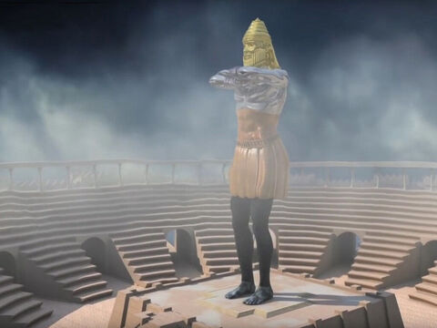
Daniel
2:31-40
³¹ Thou, O king, sawest, and behold a great image. This great image, whose brightness was excellent, stood before thee; and the form thereof was terrible.

Slide 7
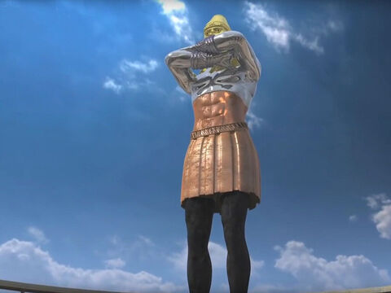
Daniel
2:31-40
³² This image's head was of fine gold, his breast and his arms of silver, his belly and his thighs of brass,
³³ His legs of iron, his feet part of iron and part of clay.

Slide 8
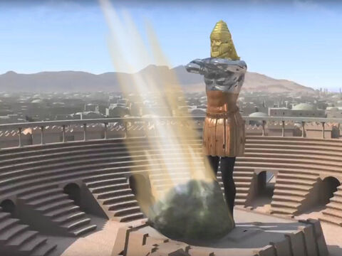
Daniel
2:31-40
³⁴ Thou sawest till that a stone was cut out without hands, which smote the image upon his feet that were of iron and clay, and brake them to pieces.

Slide 9

Daniel
2:31-40
³⁵ Then was the iron, the clay, the brass, the silver, and the gold, broken to pieces together, and became like the chaff of the summer threshingfloors; and the wind carried them away, that no place was found for them: and the stone that smote the image became a great mountain, and filled the whole earth.

Slide 10
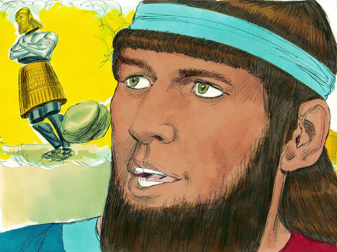
Daniel
2:31-40
³⁶ This is the dream; and we will tell the interpretation thereof before the king.
³⁷ Thou, O king, art a king of kings: for the God of heaven hath given thee a kingdom, power, and strength, and glory.

Slide 11
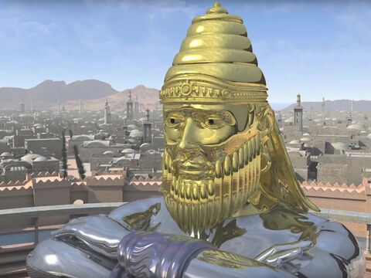
Daniel
2:31-40
³⁸ And wheresoever the children of men dwell, the beasts of the field and the fowls of the heaven hath he given into thine hand, and hath made thee ruler over them all. Thou art this head of gold.

Slide 12
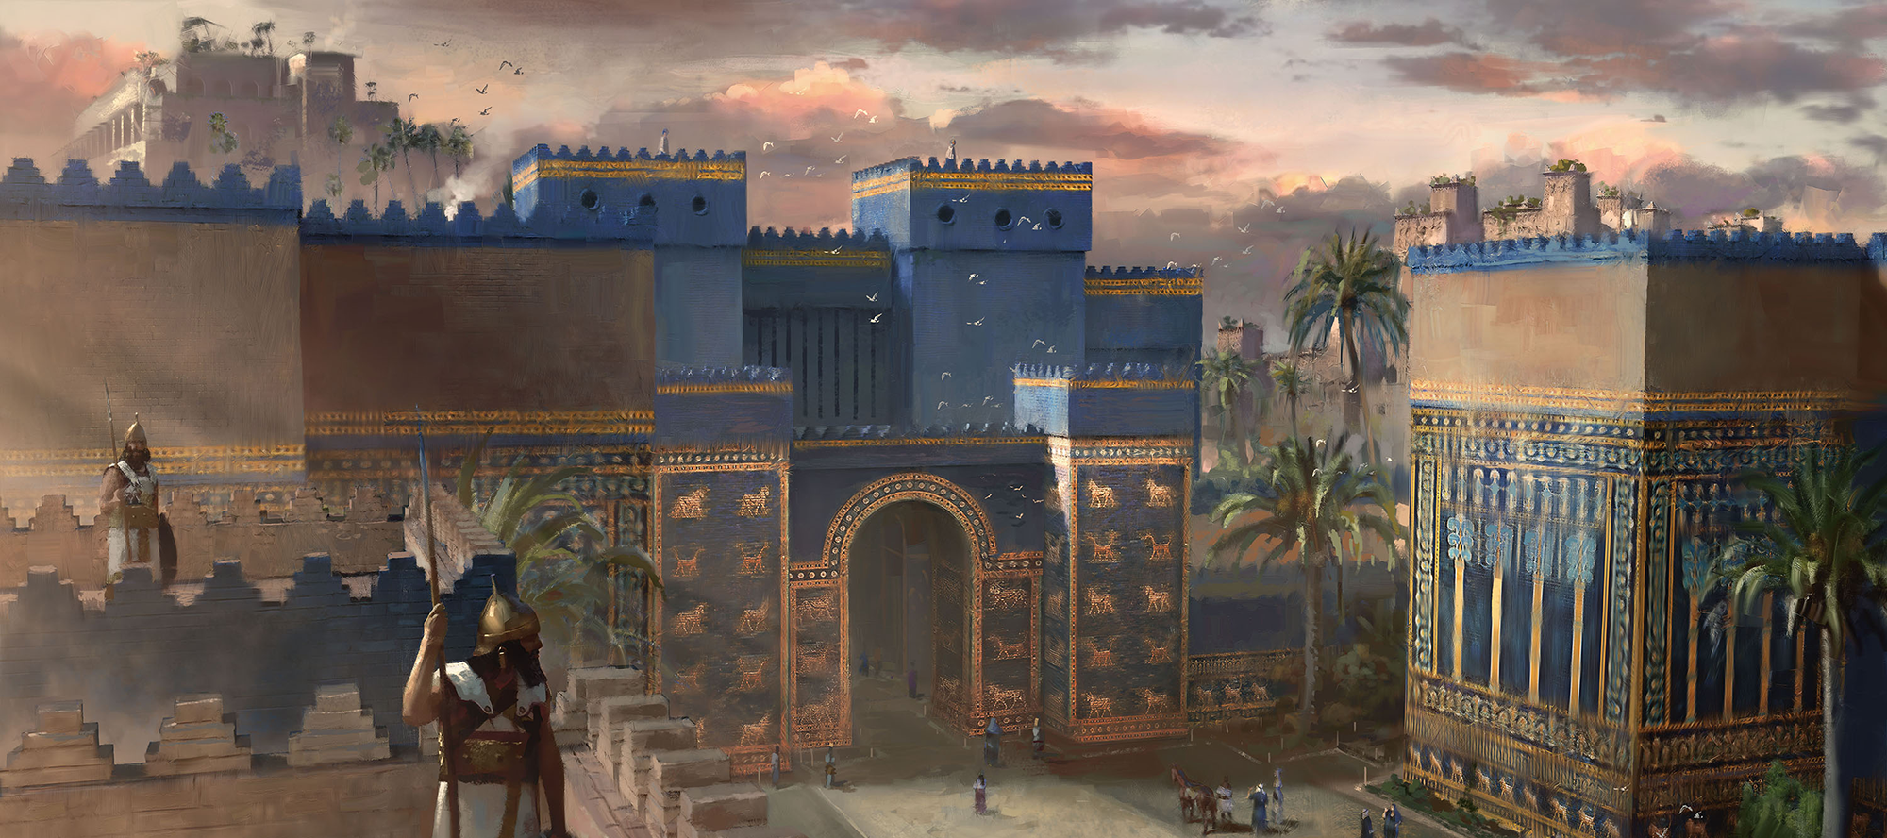
NEO-Babylon: The Babylon of Daniel’s DAy
The collapse of the Assyrian Empire created a power vacuum in Mesopotamia, which was filled by the rise of the Neo-Babylonian Empire under Nabopolassar and his son Nebuchadnezzar II.

Slide 13
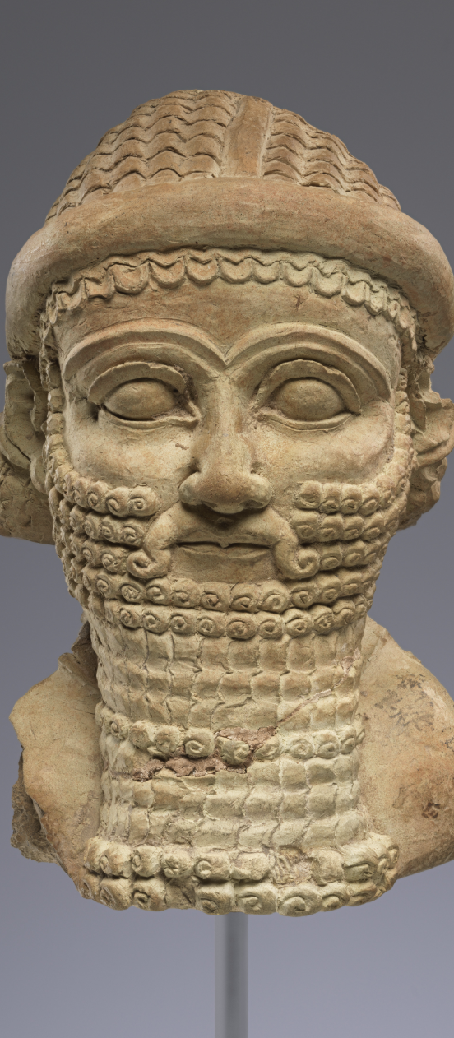
NEO-Babylon: The Babylon of Daniel’s DAy
Assyria had dominated the Near East for centuries
Then Nineveh fell (612 BC) and Assyria ceased to exist as an imperial power
Babylon had existed for millennia
Under Nabopolassar, it:
  Threw off Assyrian control
  Led the coalition that destroyed Nineveh
Under Nebuchadnezzar II, it:
Became the dominant Near Eastern empire
Inherited Assyria’s territory, influence, and enemies

Slide 14
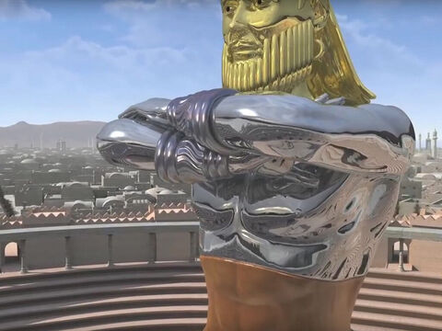
Daniel
2:31-40
³⁹ And after thee shall arise another kingdom inferior to thee, and another third kingdom of brass, which shall bear rule over all the earth.

Slide 15
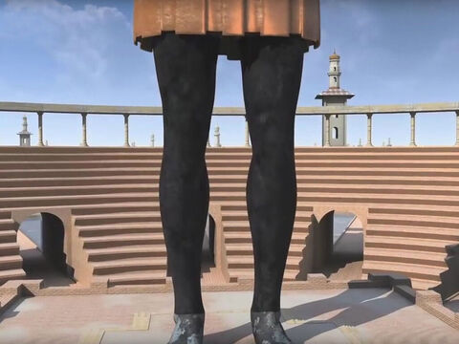
Daniel
2:31-40
⁴⁰ And the fourth kingdom shall be strong as iron: forasmuch as iron breaketh in pieces and subdueth all things: and as iron that breaketh all these, shall it break in pieces and bruise.

Slide 16
… about 50 years pass…
Daniel 2
Occurs in the second year of King Nebuchadnezzar II
Historically dated to about 603/602 BC
Daniel is still a young captive early in his service
Daniel 7
Occurs in the first year of King Belshazzar
Historically dated to about 553 BC
Daniel is now an elder statesman and prophet

Slide 17
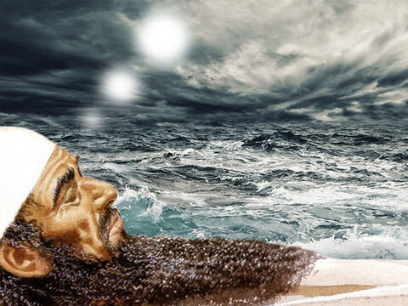
Daniel
7:1-7
7 In the first year of Belshazzar king of Babylon Daniel had a dream and visions of his head upon his bed: then he wrote the dream, and told the sum of the matters.

Slide 18
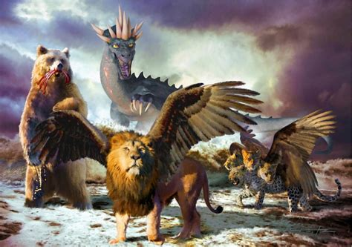
Daniel
7:1-7
² Daniel spake and said, I saw in my vision by night, and, behold, the four winds of the heaven strove upon the great sea.
³ And four great beasts came up from the sea, diverse one from another.

Slide 19
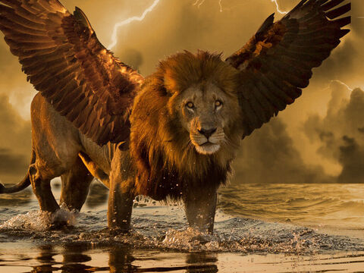
Daniel
7:1-7
⁴ The first was like a lion, and had eagle's wings: I beheld till the wings thereof were plucked, and it was lifted up from the earth, and made stand upon the feet as a man, and a man's heart was given to it.

Slide 20

Daniel
7:1-7
⁵ And behold another beast, a second, like to a bear, and it raised up itself on one side, and it had three ribs in the mouth of it between the teeth of it: and they said thus unto it, Arise, devour much flesh.

Slide 21

Daniel
7:1-7
⁶ After this I beheld, and lo another, like a leopard, which had upon the back of it four wings of a fowl; the beast had also four heads; and dominion was given to it.

Slide 22
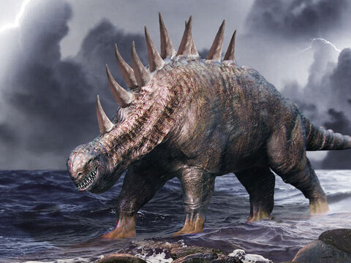
Daniel
7:1-7
⁷ After this I saw in the night visions, and behold a fourth beast, dreadful and terrible, and strong exceedingly; and it had great iron teeth: it devoured and brake in pieces, and stamped the residue with the feet of it: and it was diverse from all the beasts that were before it; and it had ten horns.

Slide 23
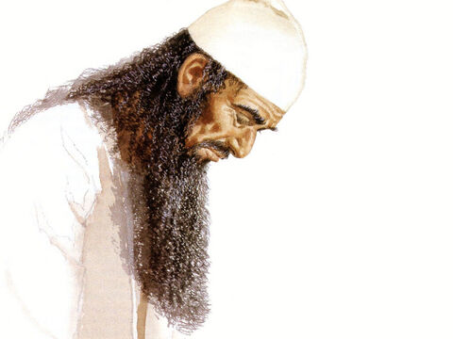
Daniel
7:15-19
¹⁵ I Daniel was grieved in my spirit in the midst of my body, and the visions of my head troubled me.

Slide 24
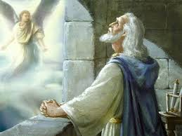
Daniel
7:15-19
¹⁶ I came near unto one of them that stood by, and asked him the truth of all this. So he told me, and made me know the interpretation of the things.

Slide 25
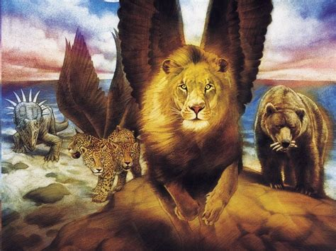
Daniel
7:15-19
¹⁷ These great beasts, which are four, are four kings, which shall arise out of the earth.

Slide 26
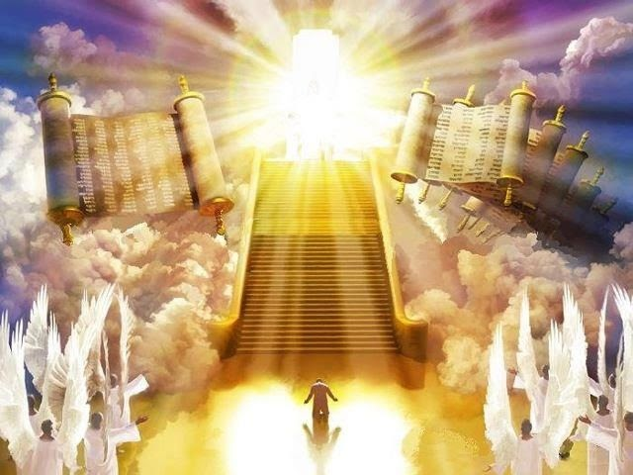
Daniel
7:15-19
¹⁸ But the saints of the most High shall take the kingdom, and possess the kingdom for ever, even for ever and ever.

Slide 27
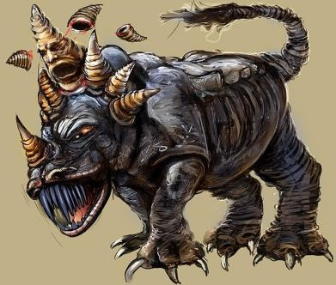
Daniel
7:15-19
¹⁹ Then I would know the truth of the fourth beast, which was diverse from all the others, exceeding dreadful, whose teeth were of iron, and his nails of brass; which devoured, brake in pieces, and stamped the residue with his feet;
…

Slide 28
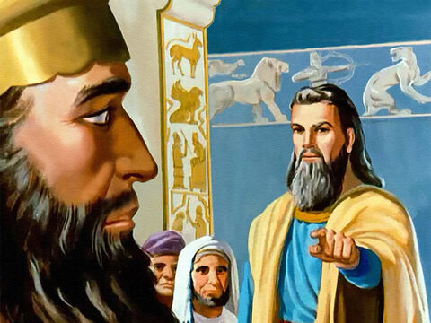
Daniel
5:18, 26-28
¹⁸ O thou king, the most high God gave Nebuchadnezzar thy father a kingdom, and majesty, and glory, and honour:
…

Slide 29

Daniel
5:18, 26-28
²⁶ This is the interpretation of the thing: Mene; God hath numbered thy kingdom, and finished it.
²⁷ Tekel; Thou art weighed in the balances, and art found wanting.

Slide 30
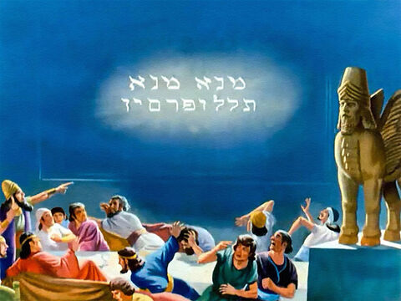
Daniel
5:18, 26-28
²⁸ Peres; Thy kingdom is divided, and given to the Medes and Persians.

Slide 31
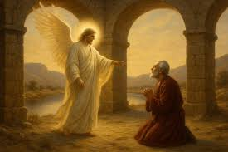
Daniel
8:19-21
¹⁹ And he said, Behold, I will make thee know what shall be in the last end of the indignation: for at the time appointed the end shall be.

Slide 32
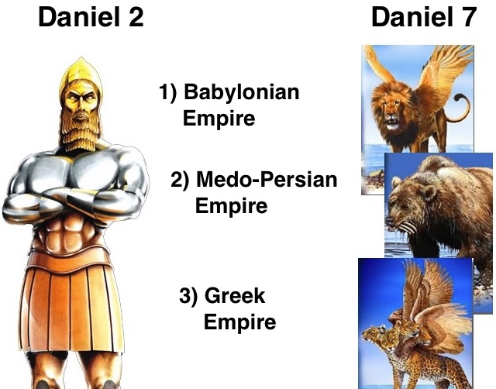
Daniel
8:19-21
²⁰ The ram which thou sawest having two horns are the kings of Media and Persia.
²¹ And the rough goat is the king of Grecia: and the great horn that is between his eyes is the first king.

Slide 33
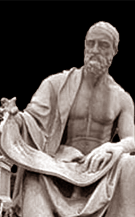
What happens after Greece?
168 BC – Battle of Pydna
Rome defeats Macedon, ending Greek political independence.
146 BC – Destruction of Corinth
Greece is formally absorbed into Roman control.
Drawing from Polybius, Histories, Book 1 (esp. the opening purpose statement):
Within a remarkably short time, Rome rose from a regional power to dominion over nearly the entire known world. Greek states, once dominant, were brought under Roman authority—not gradually, but decisively—by Roman discipline, military organization, and political stability.

Slide 34
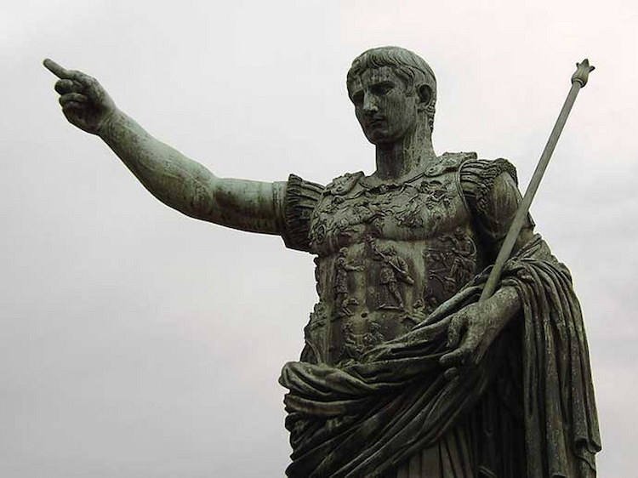
Luke 2:1
And it came to pass in those days, that there went out a decree from Caesar Augustus that all the world should be taxed.

Slide 35

1. What four kingdoms are represented in Daniel 2:31-40 and Daniel 7:1-7?
Answer:
Babylon (Dan. 2:37-38);
Medo-Persia (Dan. 5:28);
Grecia (Dan. 8:20-21);
and Rome (Luke 2:1).

Slide 36
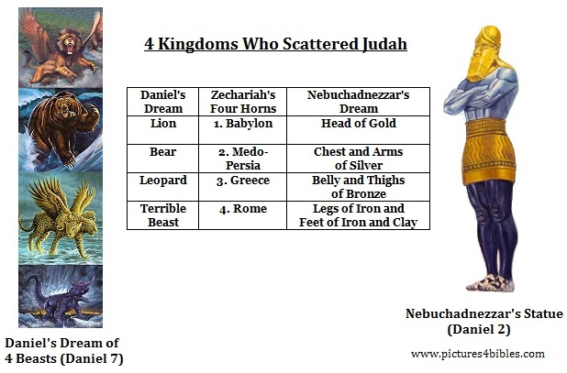

Slide 37
2. What is represented by the ten horns upon the fourth beast?
Daniel 7:7, 24

Slide 38
Daniel
7:7, 24
⁷ After this I saw in the night visions, and behold a fourth beast, dreadful and terrible, and strong exceedingly; and it had great iron teeth: it devoured and brake in pieces, and stamped the residue with the feet of it: and it was diverse from all the beasts that were before it; and it had ten horns.

Slide 39
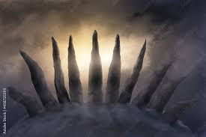
Daniel
7:7, 24
²⁴ And the ten horns out of this kingdom are ten kings that shall arise: and another shall rise after them; and he shall be diverse from the first, and he shall subdue three kings.

Slide 40
Notes about the Ten Horns/Kingdoms
They arise from the 4th beast, ROME
They are contemporaneous with one another
They are part of Rome’s decline, not a new empire

Slide 41
3. To what date did the kingdom of Babylon continue?
Answer:
B.C. 538

Slide 42
3. To what date did the kingdom of Babylon continue?
Babylon Ends: 538 BC
Babylon falls to Cyrus the Great
The city is taken without prolonged siege
Babylon ceases to exist as an independent imperial power
Fall of Babylon, 539 BC
First full year of Persian administration: 538 BC
This is standard in:
Persian chronicles
Classical historians (e.g., Herodotus)
Modern Near Eastern history
Why 538 is used: it marks the effective transfer of rule, not the moment of capture.

Slide 43
4. To what date did Medo-Persia continue?
Answer:
B.C. 331

Slide 44
4. To what date did Medo-Persia continue?
Medo-Persia Ends: 331 BC
Defeat by Alexander the Great
Decisive battle: Battle of Gaugamela
First full year of Persian administration: 538 BC
After this:
Persian imperial authority collapses
Alexander becomes ruler of the Near Eastern world
This date is:
Universally cited in classical history
Used in secular textbooks without controversy

Slide 45
5. To what date did Grecia continue?
Answer:
B.C. 168

Slide 46
5. To what date did Grecia continue?
Greece Ends: 168 BC
Greek rule fragments after Alexander
Final political independence ends with Rome’s victory over Macedon
Key event: Battle of Pydna
After Pydna:
Greek kingdoms lose sovereignty
Rome becomes the dominant Mediterranean power
This is why historians mark 168 BC as the end of Greek world rule—even though Greek culture continues.

Slide 47
6. To what date did Rome continue?
Answer:
A.D. 476

Slide 48
6. To what date did Rome continue?
(Western) Rome Ends: AD 476
In AD 476:
Romulus Augustulus was deposed
By Odoacer, a Germanic ruler
The imperial insignia were sent to Constantinople
No Western Roman emperor was ever appointed again
What ended was:
The Western Roman imperial office
The legal fiction of a unified Roman West
Centralized Roman political authority in Europe

Slide 49
6. To what date did Rome continue?
(Western) Rome Ends: AD 476
Note: Daniel’s prophecy follows the Roman Empire as it functioned in the West, where imperial authority ended and Rome fractured into multiple kingdoms, fulfilling the prophetic description of division. The Eastern Empire, by contrast, continued as a single, unified imperial state and therefore does not follow the prophetic sequence being described.

Slide 50
7. When Rome fell, what stood in its place?
Daniel 7:24, first part

Slide 51
Daniel
7:24
²⁴ And the ten horns out of this kingdom are ten kings that shall arise: and another shall rise after them; and he shall be diverse from the first, and he shall subdue three kings.

Slide 52
8. What was to arise after them and yet among them?
Daniel 7:8, first part and
Daniel 7:24, last part

Slide 53

Daniel
7:8
⁸ I considered the horns, and, behold, there came up among them another little horn, before whom there were three of the first horns plucked up by the roots: and, behold, in this horn were eyes like the eyes of man, and a mouth speaking great things.

Slide 54

Daniel
7:24
²⁴ And the ten horns out of this kingdom are ten kings that shall arise: and another shall rise after them; and he shall be diverse from the first, and he shall subdue three kings.

Slide 55
9. What was the nature of this power as compared with the ten?
Daniel 7:20, last clause

Slide 56
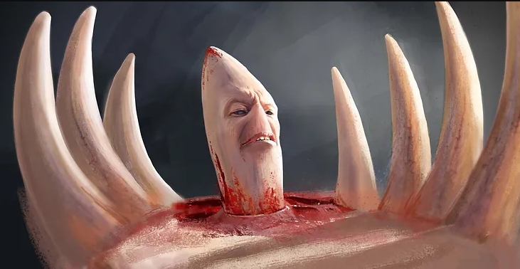
Daniel
7:20
²⁰ And of the ten horns that were in his head, and of the other which came up, and before whom three fell; even of that horn that had eyes, and a mouth that spake very great things, whose look was more stout than his fellows.

Slide 57
10. What else was peculiar about the horn?
Daniel 7:8 and
Daniel 7:20, last clause of each

Slide 58
Daniel
7:8
⁸ I considered the horns, and, behold, there came up among them another little horn, before whom there were three of the first horns plucked up by the roots: and, behold, in this horn were eyes like the eyes of man, and a mouth speaking great things.

Slide 59
Daniel
7:20
²⁰ And of the ten horns that were in his head, and of the other which came up, and before whom three fell; even of that horn that had eyes, and a mouth that spake very great things, whose look was more stout than his fellows.

Slide 60
11. What did he both speak and do?
Daniel 7:25

Slide 61
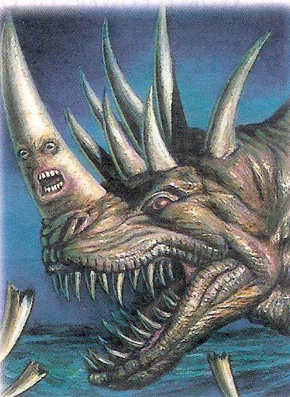
Daniel
7:25
²⁵ And he shall speak great words against the most High, and shall wear out the saints of the most High, and think to change times and laws: and they shall be given into his hand until a time and times and the dividing of time.

Slide 62
12. What power of all the earth has done to the greatest extent what is here said?
Answer:
The Papacy

Slide 63
Identifying the little Horn Power
According to Daniel 7, the power must be:
1. Arising among the ten kingdoms
(Daniel 7:8, 24)
→ Must arise in Western Rome, after its division
2. Different from the other kingdoms
(Daniel 7:24)
→ Not merely political; a different kind of authority
3. Greater in influence than its fellows
(Daniel 7:20)
→ Exercising authority beyond ordinary kings

Slide 64
Identifying the little Horn Power
According to Daniel 7, the power must be:
4. Possessing eyes and a mouth
(Daniel 7:8, 20)
→ Intelligence, deliberation, official speech
5. Speaking great words against God (Daniel 7:25)
6. Persecuting the saints (Daniel 7:25)
7. Claiming authority over “times and laws” (Daniel 7:25)
8. Exercising this authority for a defined prophetic period
(Daniel 7:25)

Slide 65
Identifying the little Horn Power
No single political kingdom fits this profile.
No pagan empire fits this profile.
No secular institution fits this profile.

Slide 66
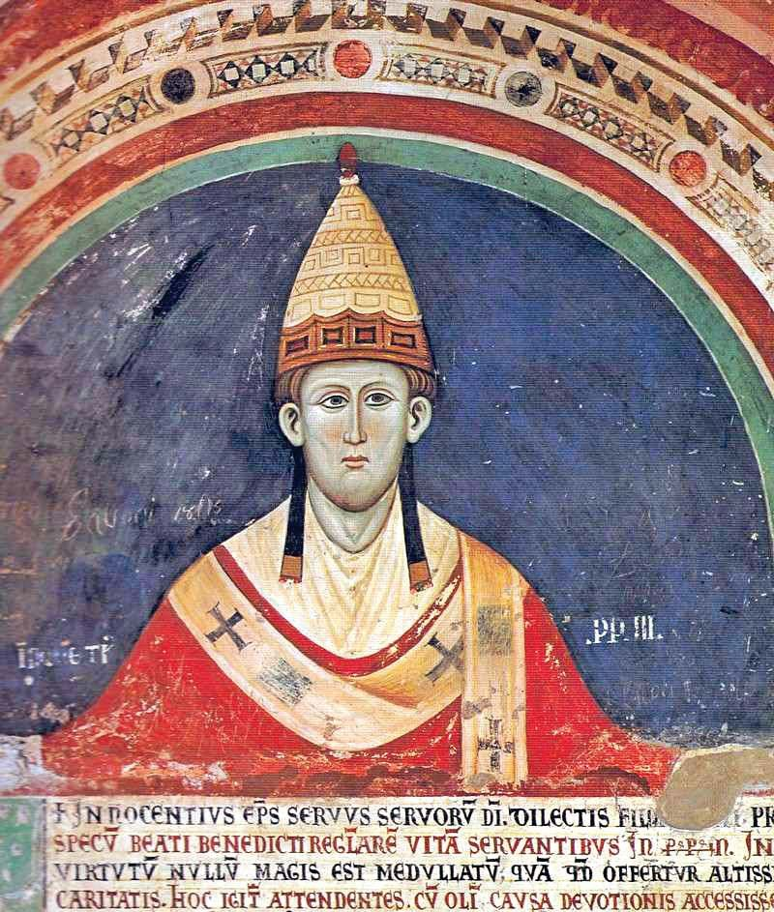
Identifying the little Horn Power
1. Arises in Western Rome
After AD 476, the Papacy:
Remains in Rome
Expands influence precisely as imperial authority collapses
Gains civil authority among the divided kingdoms
This is uncontested history.

Slide 67
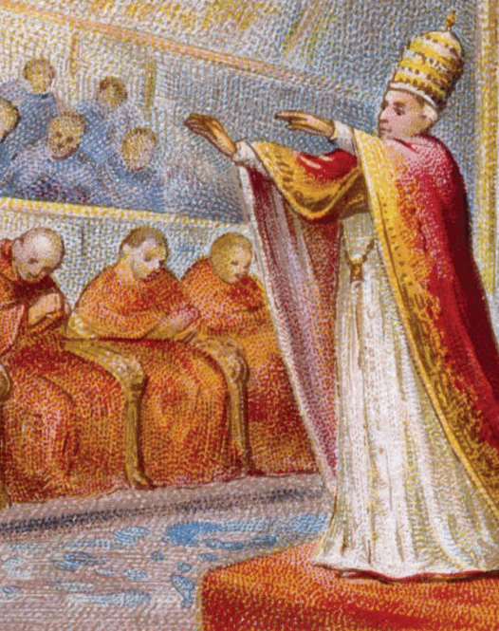
Identifying the little Horn Power
2. Different in Nature
Unlike the ten kingdoms:
The Papacy is ecclesiastical
It combines religious and civil authority
It rules by doctrine, decree, and law
This satisfies Daniel’s requirement of being “diverse.”

Slide 68
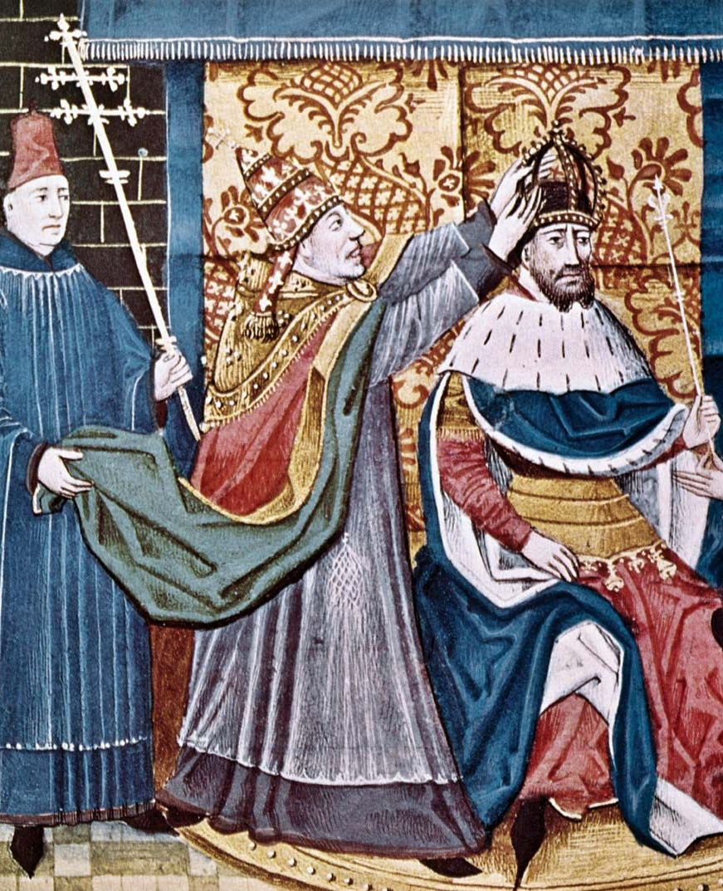
Identifying the little Horn Power
3. Greater Than Its Fellows
By the early medieval period:
Kings are crowned or rebuked by popes
Emperors seek papal legitimacy
The Bishop of Rome speaks over rulers, not merely beside them
That is “more stout than his fellows.”

Slide 69
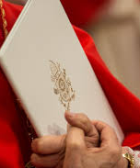
Identifying the little Horn Power
4. Eyes and a Mouth
The Papacy:
Issues formal decrees
Speaks authoritatively through councils, bulls, and dogma
Claims the right to define doctrine for Christendom
This is not brute force — it is institutional intelligence and speech.

Slide 70
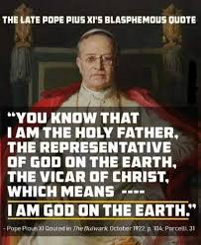
Identifying the little Horn Power
5. Speaking Against God
Historically documented claims include:
Authority to forgive sins
Authority to define doctrine above Scripture
Titles and prerogatives belonging to God alone
These are not caricatures — they are claims made in official ecclesiastical sources.

Slide 71
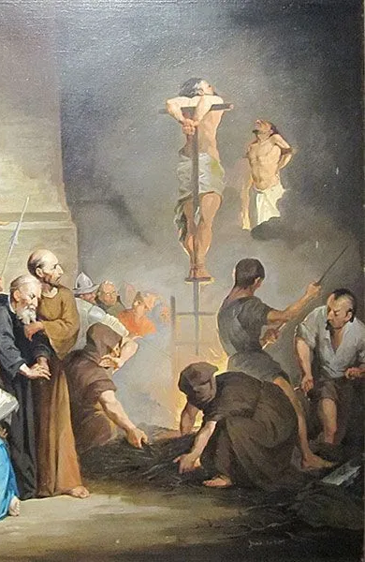
Identifying the little Horn Power
6. Persecution of the Saints
Across centuries:
• Dissenters punished for adhering to plain Bible teachings
• Scripture restricted, with access and interpretation controlled
• Conscience constrained by law, enforcing obedience to church authority
These actions are widely acknowledged in the historical record, as characteristic of the authority exercised by the Papacy.

Slide 72
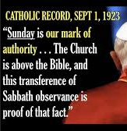
Identifying the little Horn Power
7. Changing Times and Laws
Historically:
God’s law altered in catechetical teaching
Sacred times redefined
Authority claimed to modify divine commands
This point is particularly strong — and unique.

Slide 73
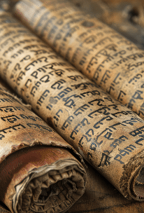
Identifying the little Horn Power
8. Exercising Authority for a Defined Prophetic Period
Across centuries:
Authority rises at a recognizable point
Continues as a unified power for many generations
Ends with a clear historical loss of dominance
This pattern uniquely fits the time-limited authority described in Daniel 7.

Slide 74
Identifying the little Horn Power
The Papacy uniquely fulfills Daniel’s description of a power arising among divided Rome, distinct from political kingdoms, exercising religious authority, persecuting dissent, and claiming power over divine law. The Papacy is not identified here because of hostility, but because no other historical power fulfills every part of Daniel’s description.

Slide 75
13. Upon the rise of this horn, what was done with three of the ten?
Daniel 7:8, 20

Slide 76
Daniel
7:8
⁸ I considered the horns, and, behold, there came up among them another little horn, before whom there were three of the first horns plucked up by the roots: and, behold, in this horn were eyes like the eyes of man, and a mouth speaking great things.

Slide 77
Daniel
7:20
²⁰ And of the ten horns that were in his head, and of the other which came up, and before whom three fell; even of that horn that had eyes, and a mouth that spake very great things, whose look was more stout than his fellows.

Slide 78
14. What three of the ten kingdoms fell?
Answer: The Heruli, the Vandals, and the Ostrogoths.
(See Uriah Smith’s Thoughts on Daniel and the Revelation for comments on Daniel 7:24. Those wishing to study the historical background may consult Edward Gibbon’s The History of the Decline and Fall of the Roman Empire, chapter 39, paragraphs 6–8, and chapter 41, paragraphs 7–12 and 21–28.)

Slide 79

Three Uprooted Horns
For a kingdom to be one of the three from ten uprooted, it must:
Exist in the West, among the divided Roman territories
Persist long enough to come into conflict with rising papal authority
Be fundamentally incompatible with that authority (religiously and politically)

Slide 80
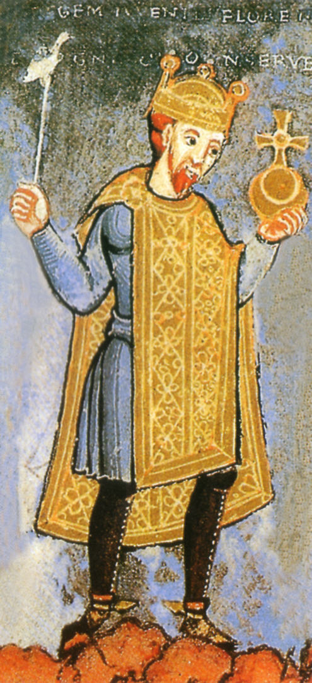
Three Uprooted Horns
The Bishop of Rome was emerging as:
a religious authority
supported by imperial legacy
Certain kingdoms:
rejected Roman ecclesiastical authority
adhered to non-Catholic forms of Christianity
These kingdoms could not simply be absorbed or negotiated with!

Slide 81
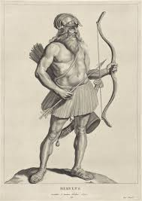
Three Uprooted Horns
Historically, three kingdoms among the Western Roman divisions were eliminated during the rise of papal authority:
the Heruli, the Vandals, and the Ostrogoths.

Slide 82
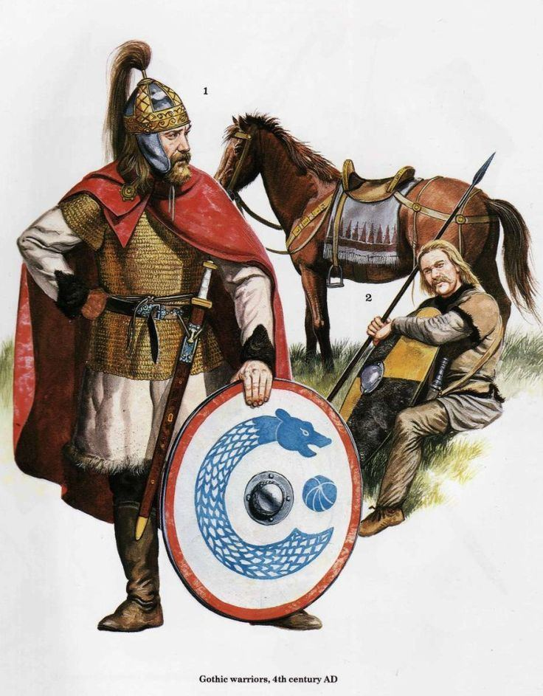
Three Uprooted Horns
Across these three kingdoms:
• They ruled within former Western Roman territory
• They held power after 476, during Rome’s fragmentation
• They opposed the authority of the Bishop of Rome
• They adhered to forms of Christianity rejected by Rome
• Their removal directly strengthened papal influence

Slide 83
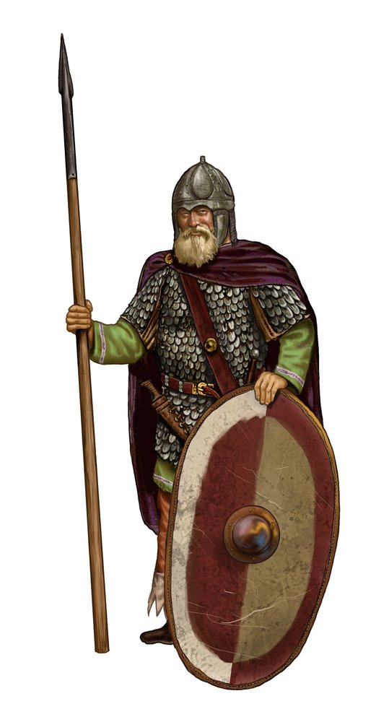
From Gibbon:
After the fall of the Western Roman Empire, political authority in Italy passed through successive barbarian kingdoms.
These kingdoms restricted the independence and authority of the Bishop of Rome.
(The Heruli were political rivals in Italy, the Vandals openly opposed Roman Catholic authority—they were Arian Christians—and the Ostrogoths held superior civil and military power in Italy.)

Slide 84
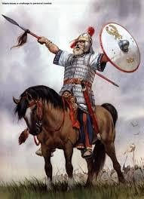
From Gibbon:
As each ruling power was removed, papal authority faced fewer political restraints.
With the elimination of the final ruling power in Italy, the Bishop of Rome emerged without a competing sovereign in the West.
History identifies which kingdoms fell; prophecy foretold that three would be uprooted.

Slide 85
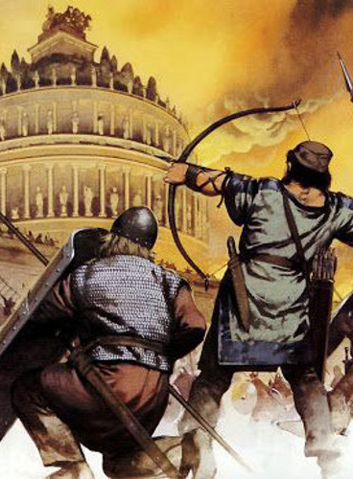
From Gibbon:
Taken together, Gibbon shows that:
The Heruli were removed from Italy, ending the first post-imperial rule and beginning the removal of political obstacles to papal authority
The Vandals were removed, eliminating external Arian opposition and restoring Catholic dominance in North Africa

Slide 86
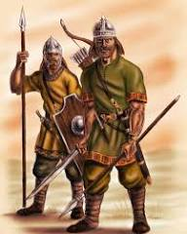
From Gibbon:
The Ostrogoths were destroyed, removing the final political restraint on papal authority in Italy
These removals occurred in sequence, not at random
Each removal strengthened the position of the Roman bishop
History thus identifies which powers fell and why their fall mattered to papal authority.

Slide 87
15. At what dates did these fall?
Answer: Heruli, A.D. 493; Vandals, A.D. 534; Ostrogoths, A.D. 538.

Slide 88
15. At what dates did these fall?
Note: The dates associated with the fall of these kingdoms are standard historical markers recognized in secular histories of the late Roman Empire, including but not limited to Gibbon.
• Heruli removed from Italy (493)
• Vandals defeated in North Africa (534)
• Ostrogoths eliminated from Italy (538)

Slide 89
16. What then is the date of the establishment of the Papacy?
See Note.

Slide 90
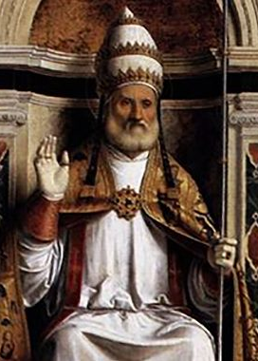
16. What then is the date of the establishment of the Papacy?
As the little horn power, the Papacy, was to be established by the fall of three of the ten kingdoms, and as the last of these fell in A.D. 538, it is clear that A.D. 538 is the date from which the establishment of the Papacy must be reckoned.

Slide 91
17. How long was the Papacy to have power over the saints, the times, and the laws?
Daniel 7:25

Slide 92
Daniel
7:25
²⁵ And he shall speak great words against the most High, and shall wear out the saints of the most High, and think to change times and laws: and they shall be given into his hand until a time and times and the dividing of time.

Slide 93
18. Literally, what length of time is this?
Revelation 12:14; Revelation 12:6; Ezekiel 4:4–6

Slide 94

Revelation 12:14
¹⁴ And to the woman were given two wings of a great eagle, that she might fly into the wilderness, into her place, where she is nourished for a time, and times, and half a time, from the face of the serpent.

Slide 95
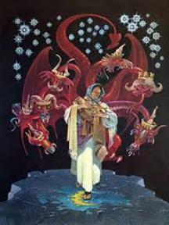
Revelation 12:6
⁶ And the woman fled into the wilderness, where she hath a place prepared of God, that they should feed her there a thousand two hundred and threescore days.

Slide 96
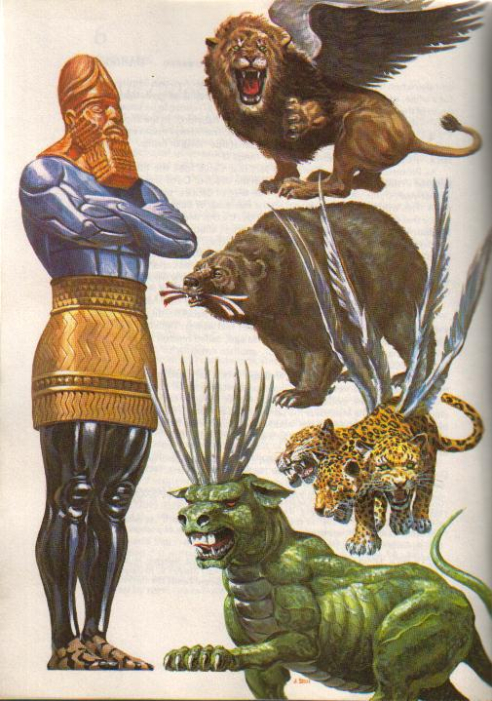
How Apocalyptic Prophecy Must Be Read
• The Bible gives symbols for powers (beasts, horns, crowns)
• These symbols represent real historical entities
Question:
Should symbolic prophecy be read symbolically—or literally?

Slide 97

The Inductive Test of Prophetic Time
Daniel 7 describes:
• A power rising from divided Rome
• Dominating long-term history
Prophetic period given:
“a time, times, and half a time”
Test the readings:
• Literal days → fail to match history
• Symbolic years → align with known fulfillment
When a literal reading fails, and a symbolic reading explains the facts, the prophecy interprets itself.

Slide 98
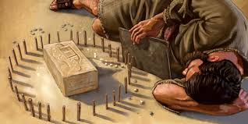
Ezekiel
4:4-6
⁴ Lie thou also upon thy left side, and lay the iniquity of the house of Israel upon it: according to the number of the days that thou shalt lie upon it thou shalt bear their iniquity.

Slide 99
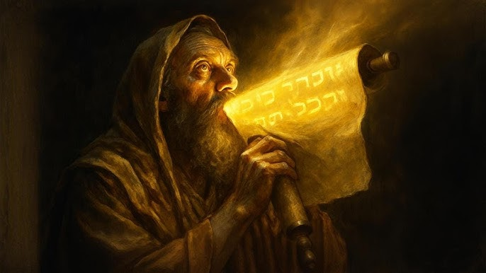
Ezekiel
4:4-6
⁵ For I have laid upon thee the years of their iniquity, according to the number of the days, three hundred and ninety days: so shalt thou bear the iniquity of the house of Israel.

Slide 100
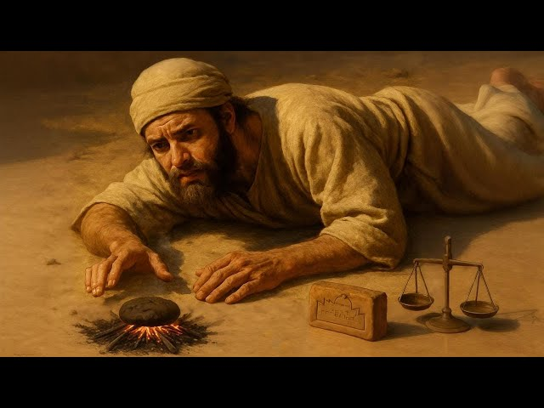
Ezekiel
4:4-6
⁶ And when thou hast accomplished them, lie again on thy right side, and thou shalt bear the iniquity of the house of Judah forty days: I have appointed thee each day for a year.

Slide 101

Numbers
14:34
³⁴ After the number of the days in which ye searched the land, even forty days, each day for a year, shall ye bear your iniquities, even forty years, and ye shall know my breach of promise.

Slide 102
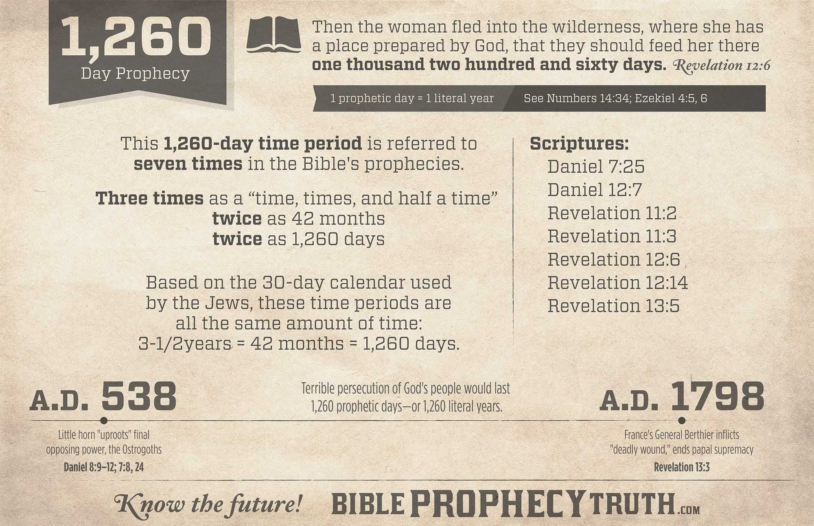

Slide 103
19. Beginning in A.D. 538, when should it end?
Answer: A.D. 1798.

Slide 104
20. What historical event marks the end of the 1,260 years of Papal supremacy?
Answer: In A.D. 1798, the French army under General Berthier abolished the Papacy in Rome, proclaimed a republic there, and carried Pope Pius VI captive from place to place until he died at Valence, France, August 28, 1799.

Slide 105
Thank you!
… and Happy Sabbath!!

Slide 106


