Slide 1


Slide 2

Living the Light

Slide 3
The Third Angel’s Message
Lesson 2: The Time of the Message - CONTINUED
July 14, 1888
Lesson 2, 3rd Quarter 1888

Slide 4

1. To what event, and date, were we brought in the previous lesson?
It’s kind of a trick question. We didn’t get quite all the way through the last lesson in class! Hopefully you were able to cover it during your own private research on Lesson 1. So, to review…

Slide 5
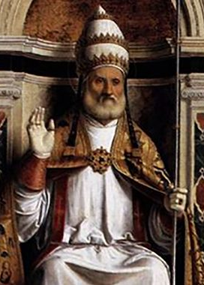
What then is the date of the establishment of the Papacy?
As the little horn power, the Papacy, was to be established by the fall of three of the ten kingdoms, and as the last of these fell in A.D. 538, it is clear that A.D. 538 is the date from which the establishment of the Papacy must be reckoned.

Slide 6
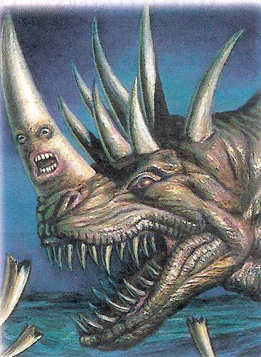
Daniel
7:25
²⁵ And he shall speak great words against the most High, and shall wear out the saints of the most High, and think to change times and laws: and they shall be given into his hand until a time and times and the dividing of time.

Slide 7
18. Literally, what length of time is this?
Revelation 12:14; Revelation 12:6; Ezekiel 4:4–6

Slide 8
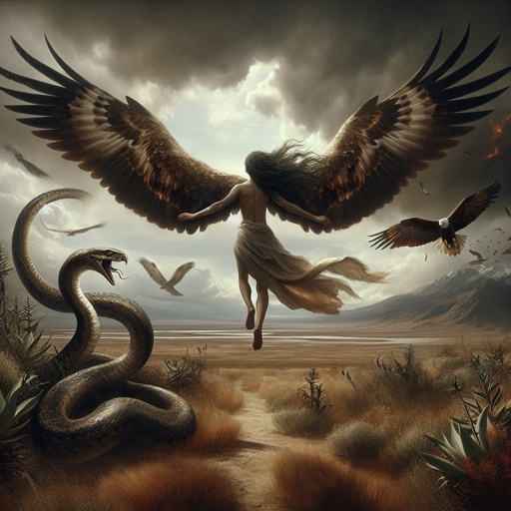
Revelation 12:14
¹⁴ And to the woman were given two wings of a great eagle, that she might fly into the wilderness, into her place, where she is nourished for a time, and times, and half a time, from the face of the serpent.

Slide 9
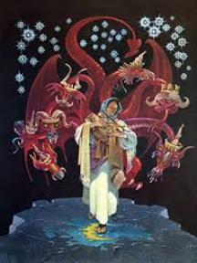
Revelation 12:6
⁶ And the woman fled into the wilderness, where she hath a place prepared of God, that they should feed her there a thousand two hundred and threescore days.

Slide 10
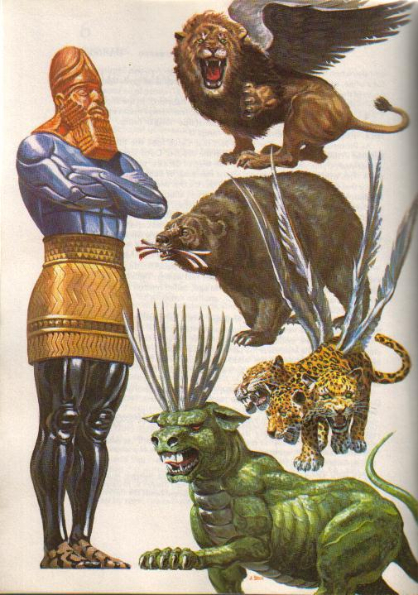
How Apocalyptic Prophecy Must Be Read
• The Bible gives symbols for powers (beasts, horns, crowns)
• These symbols represent real historical entities
Question:
Should symbolic prophecy be read symbolically—or literally?

Slide 11
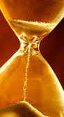
The Inductive Test of Prophetic Time
Daniel 7 describes:
• A power rising from divided Rome
• Dominating long-term history
Prophetic period given:
“a time, times, and half a time”
Test the readings:
• Literal days → fail to match history
• Symbolic years → align with known fulfillment
When a literal reading fails, and a symbolic reading explains the facts, the prophecy interprets itself.

Slide 12
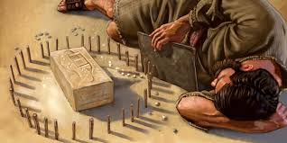
Ezekiel
4:4-6
⁴ Lie thou also upon thy left side, and lay the iniquity of the house of Israel upon it: according to the number of the days that thou shalt lie upon it thou shalt bear their iniquity.

Slide 13
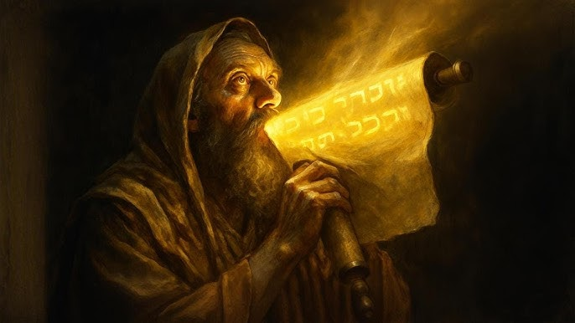
Ezekiel
4:4-6
⁵ For I have laid upon thee the years of their iniquity, according to the number of the days, three hundred and ninety days: so shalt thou bear the iniquity of the house of Israel.

Slide 14
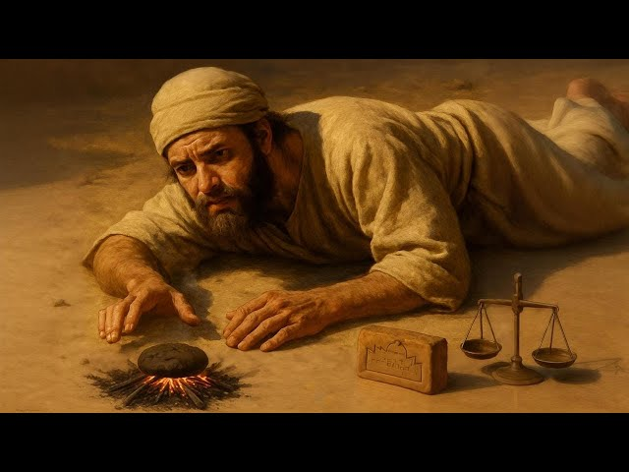
Ezekiel
4:4-6
⁶ And when thou hast accomplished them, lie again on thy right side, and thou shalt bear the iniquity of the house of Judah forty days: I have appointed thee each day for a year.

Slide 15

Numbers
14:34
³⁴ After the number of the days in which ye searched the land, even forty days, each day for a year, shall ye bear your iniquities, even forty years, and ye shall know my breach of promise.

Slide 16
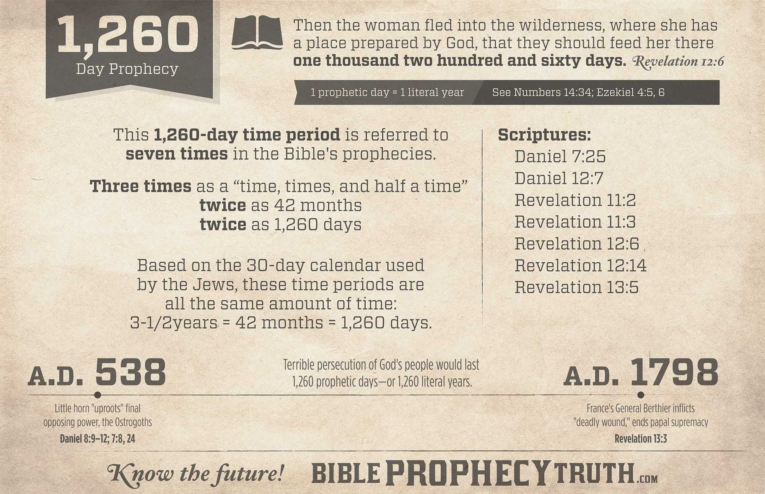

Slide 17
Beginning in A.D. 538, when should the Papacy end?
Answer: A.D. 1798.

Slide 18
What historical event marks the end of the 1,260 years of Papal supremacy?
Answer: In A.D. 1798, the French army under General Berthier abolished the Papacy in Rome, proclaimed a republic there, and carried Pope Pius VI captive from place to place until he died at Valence, France, August 28, 1799.

Slide 19
2. In this dealing with the Papacy, what additional prophecies were fulfilled?
Revelation 13:3, first part; and Revelation 13:10

Slide 20
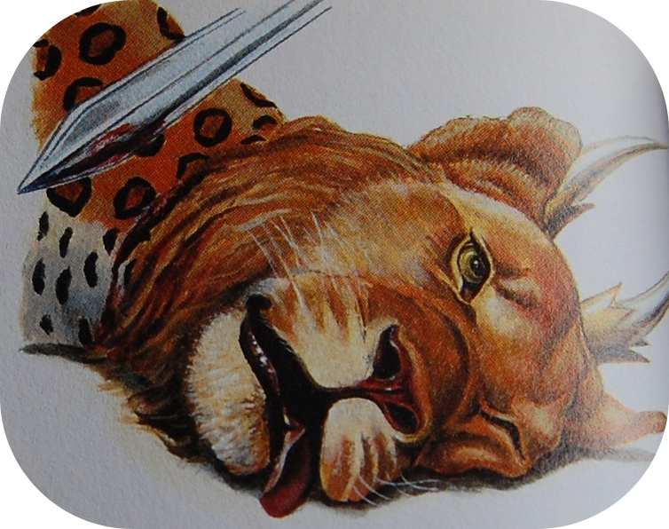
REVELATION
13:3
³ And I saw one of his heads as it were wounded to death; and his deadly wound was healed: and all the world wondered after the beast.

Slide 21
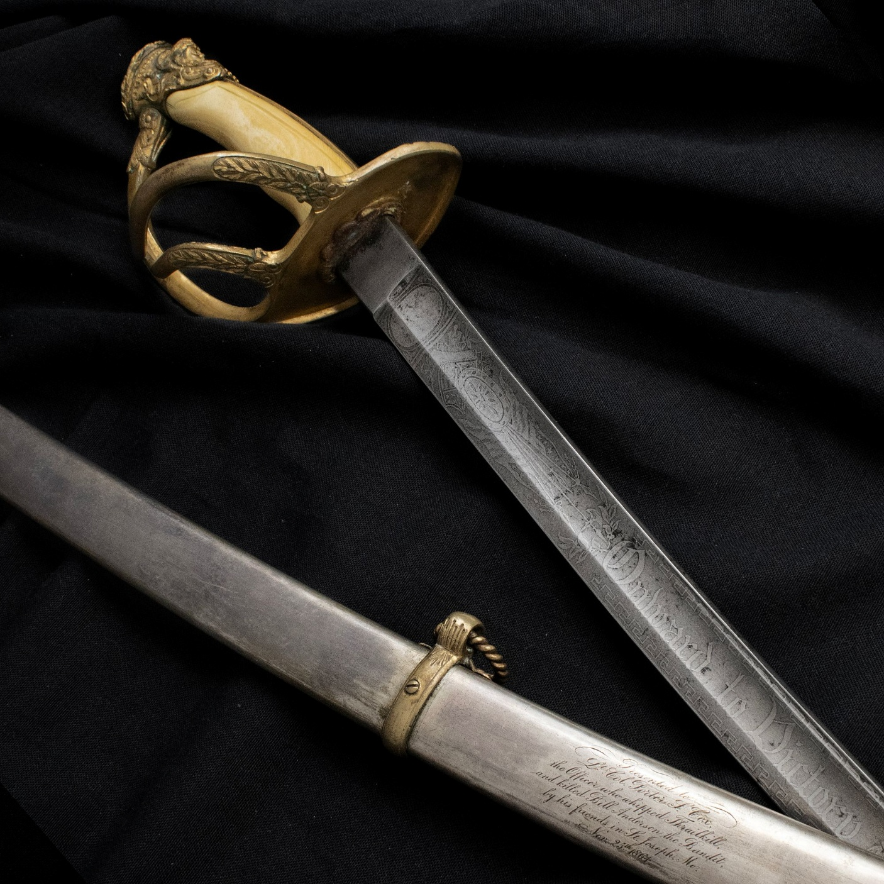
REVELATION
13:10
¹⁰ He that leadeth into captivity shall go into captivity: he that killeth with the sword must be killed with the sword. Here is the patience and the faith of the saints.

Slide 22
3. How may we know that this prophecy relates to the same power as that in the previous lesson?
Compare Daniel 7:4–8 with Revelation 13:1–2;
and Daniel 7:8, 25 with Revelation 13:5–7.

Slide 23
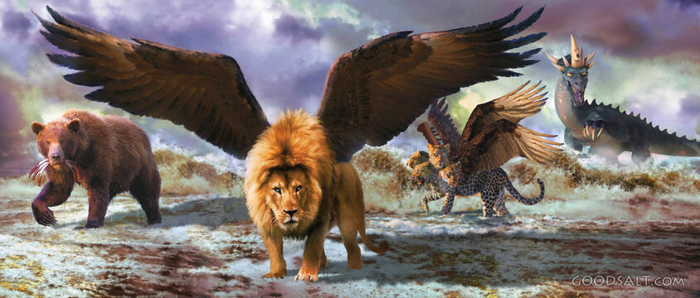
Daniel
7:4-8
⁴ The first was like a lion, and had eagle's wings: I beheld till the wings thereof were plucked, and it was lifted up from the earth, and made stand upon the feet as a man, and a man's heart was given to it.

Slide 24
Daniel
7:4-8
⁵ And behold another beast, a second, like to a bear, and it raised up itself on one side, and it had three ribs in the mouth of it between the teeth of it: and they said thus unto it, Arise, devour much flesh.

Slide 25
Daniel
7:4-8
⁶ After this I beheld, and lo another, like a leopard, which had upon the back of it four wings of a fowl; the beast had also four heads; and dominion was given to it.

Slide 26
Daniel
7:4-8
⁷ After this I saw in the night visions, and behold a fourth beast, dreadful and terrible, and strong exceedingly; and it had great iron teeth: it devoured and brake in pieces, and stamped the residue with the feet of it: and it was diverse from all the beasts that were before it; and it had ten horns.

Slide 27
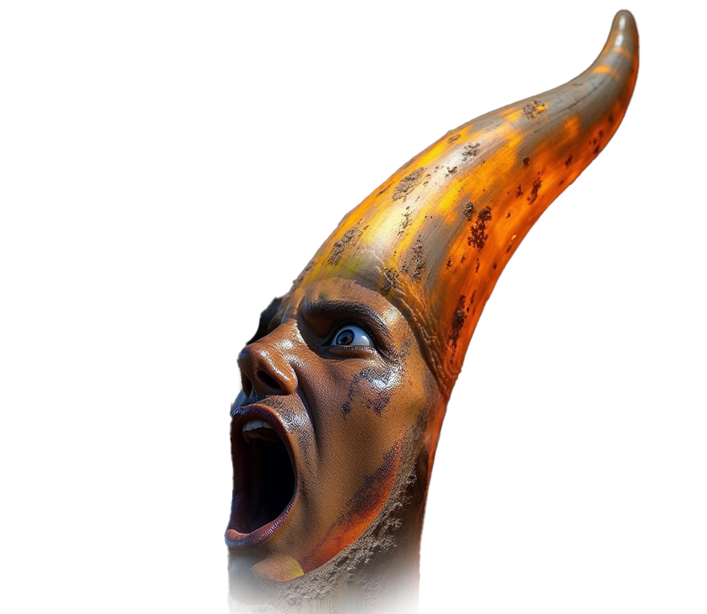
Daniel
7:4-8
⁸ I considered the horns, and, behold, there came up among them another little horn, before whom there were three of the first horns plucked up by the roots: and, behold, in this horn were eyes like the eyes of man, and a mouth speaking great things.

Slide 28
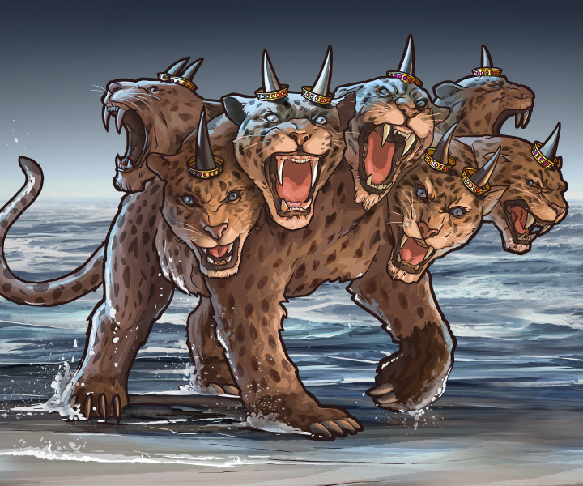
Revelation
13:1-2
13 And I stood upon the sand of the sea, and saw a beast rise up out of the sea, having seven heads and ten horns, and upon his horns ten crowns, and upon his heads the name of blasphemy.

Slide 29
Revelation
13:1-2
² And the beast which I saw was like unto a leopard, and his feet were as the feet of a bear, and his mouth as the mouth of a lion: and the dragon gave him his power, and his seat, and great authority.

Slide 30
Commonalities? Differences?
What do you notice?

Slide 31
Commonalities? Differences?
What do you notice?
Lion
Bear
Leopard
Ten horns
Speaking great words
Blasphemy
4 beasts
One beast

Slide 32
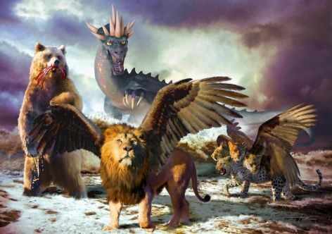
Daniel
7:2-3
² Daniel spake and said, I saw in my vision by night, and, behold, the four winds of the heaven strove upon the great sea.
³ And four great beasts came up from the sea, diverse one from another.

Slide 33
Revelation
13:1-2
13 And I stood upon the sand of the sea, and saw a beast rise up out of the sea, having seven heads and ten horns, and upon his horns ten crowns, and upon his heads the name of blasphemy.

Slide 34
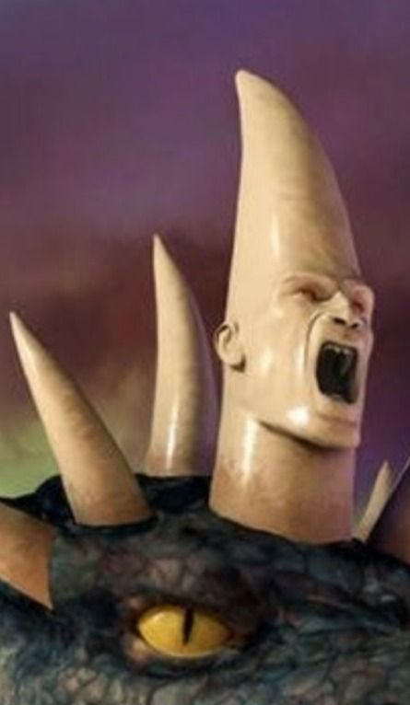
Daniel
7:8, 25
⁸ I considered the horns, and, behold, there came up among them another little horn, before whom there were three of the first horns plucked up by the roots: and, behold, in this horn were eyes like the eyes of man, and a mouth speaking great things.

Slide 35
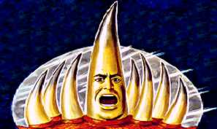
Daniel
7:8, 25
²⁵ And he shall speak great words against the most High, and shall wear out the saints of the most High, and think to change times and laws: and they shall be given into his hand until a time and times and the dividing of time.

Slide 36
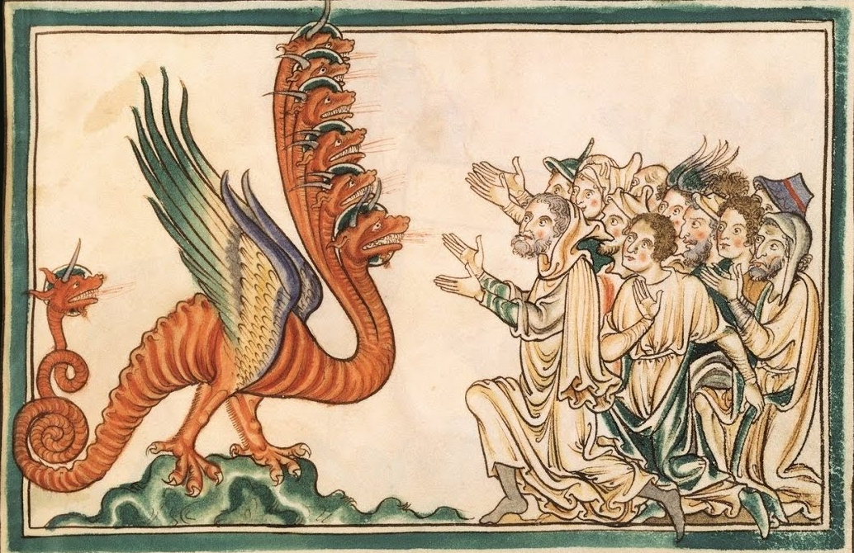
Revelation
13:5-7
⁵ And there was given unto him a mouth speaking great things and blasphemies; and power was given unto him to continue forty and two months.

Slide 37
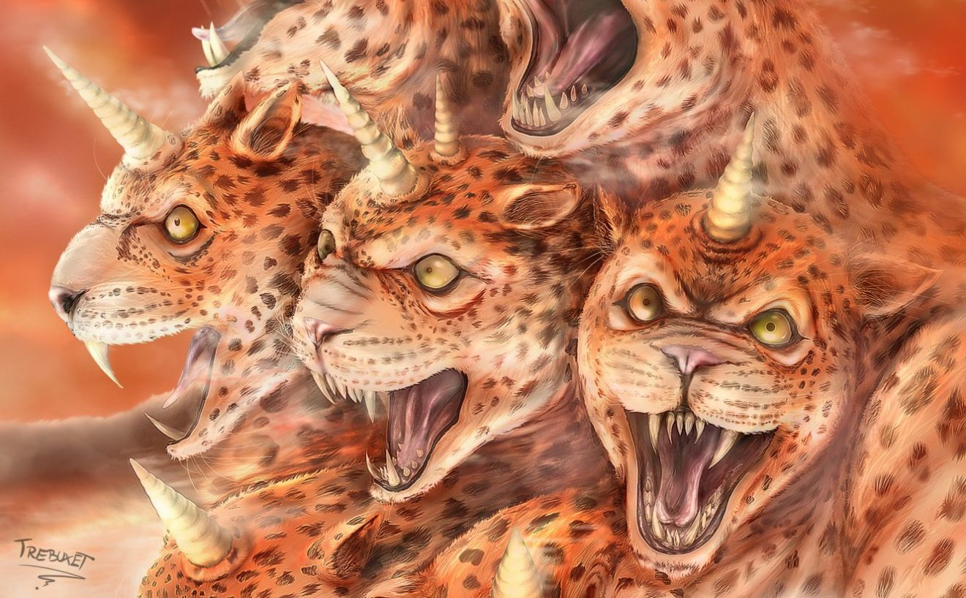
Revelation
13:5-7
⁶ And he opened his mouth in blasphemy against God, to blaspheme his name, and his tabernacle, and them that dwell in heaven.

Slide 38
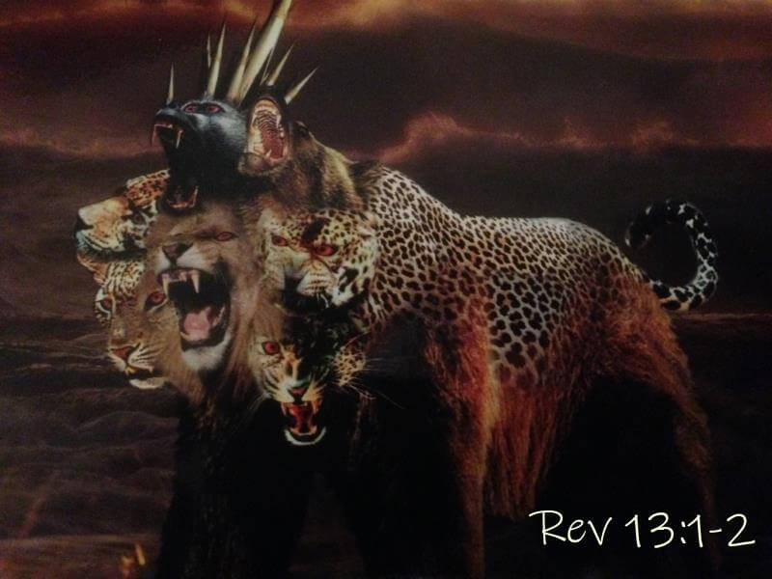
Revelation
13:5-7
⁷ And it was given unto him to make war with the saints, and to overcome them: and power was given him over all kindreds, and tongues, and nations.

Slide 40
We know that this prophecy in Revelation 13 relates to the same power as that in the previous lesson (Daniel 7) because these powers share…
• The same composite structure
• The same geographic origin
• The same blasphemous claims
• The same persecution of saints
• The same prophetic time period

Slide 41
4. Was this captivity and deadly wound to put a total end to the Papacy?
Revelation 13:3

Slide 42
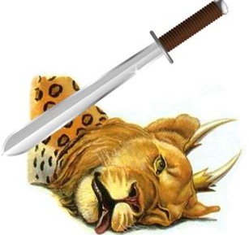
Revelation
13:3
³ And I saw one of his heads as it were wounded to death; and his deadly wound was healed: and all the world wondered after the beast.

Slide 43
REVELATION
13:10
¹⁰ He that leadeth into captivity shall go into captivity: he that killeth with the sword must be killed with the sword. Here is the patience and the faith of the saints.

Slide 44
5. When was it that this captivity occurred?
Answer: A.D. 1798

Slide 45
6. At that time, what else did the prophet see?
Revelation 13:11

Slide 46
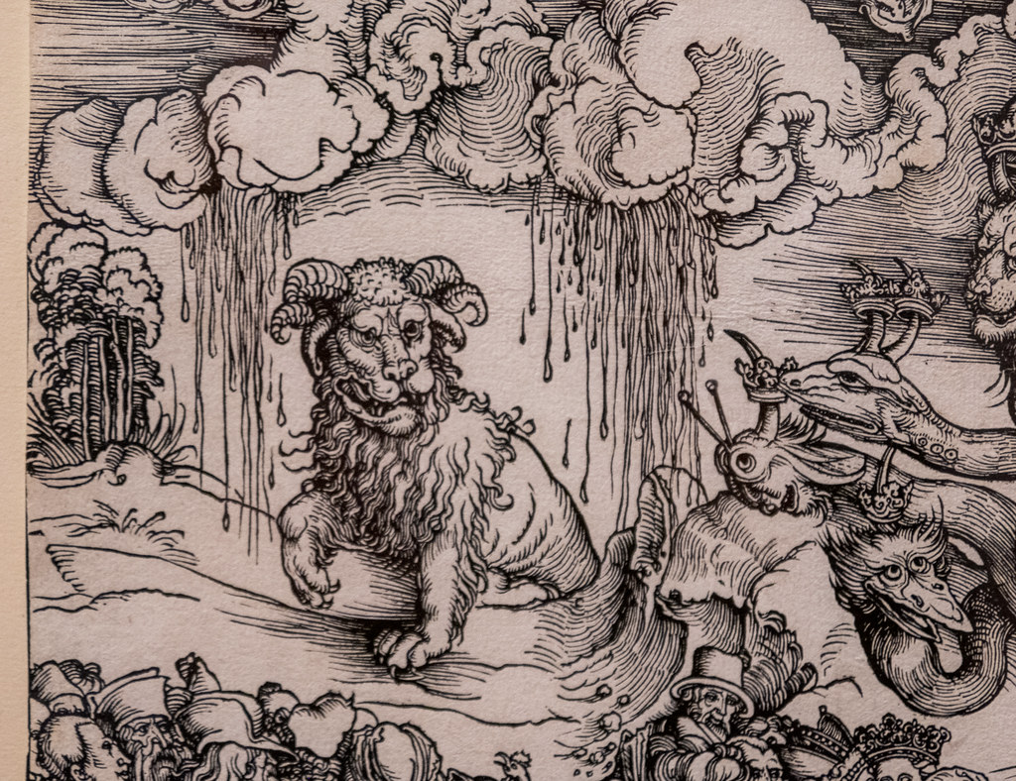
Revelation
13:11
¹¹ And I beheld another beast coming up out of the earth; and he had two horns like a lamb, and he spake as a dragon.

Slide 47
7. Is it for us to know what this means?
Deuteronomy 29:29

Slide 48
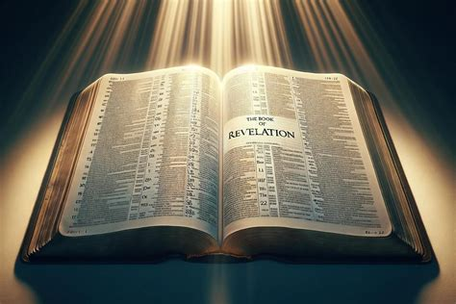
Deuteronomy
29:29
²⁹ The secret things belong unto the Lord our God: but those things which are revealed belong unto us and to our children for ever, that we may do all the words of this law.

Slide 49
8. Is this a revelation?
Revelation, 1:1, 3

Slide 50
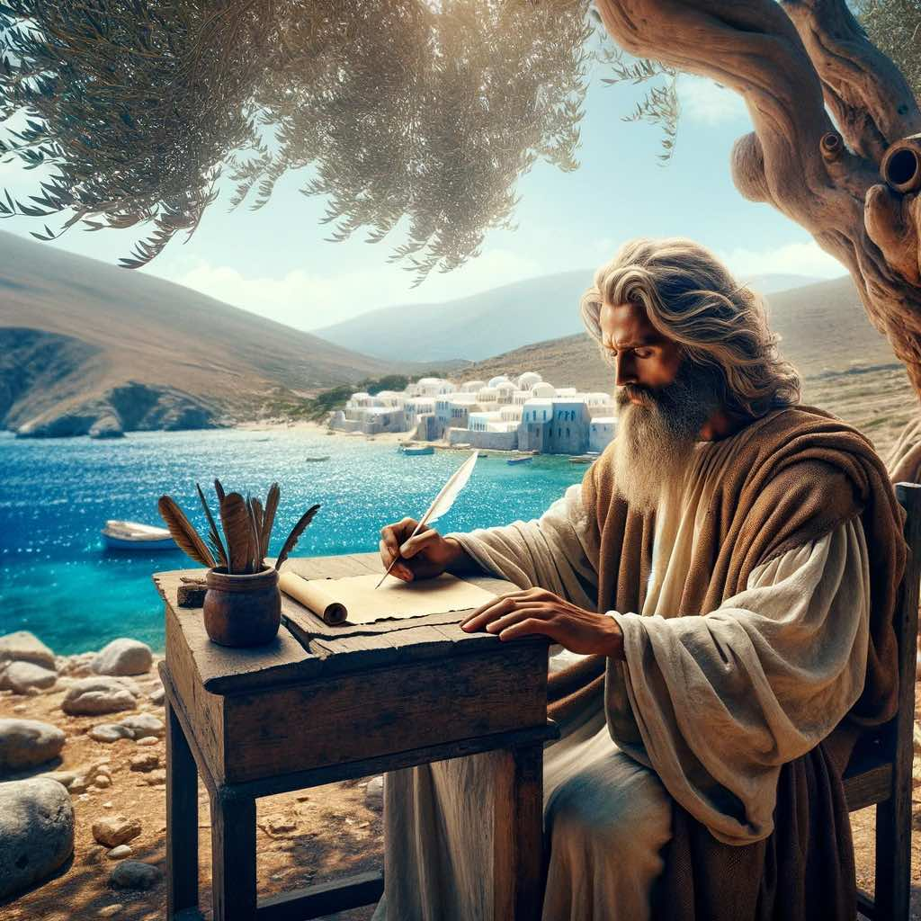
Revelation
1:1, 3
The Revelation of Jesus Christ, which God gave unto him, to shew unto his servants things which must shortly come to pass; and he sent and signified it by his angel unto his servant John:

Slide 51
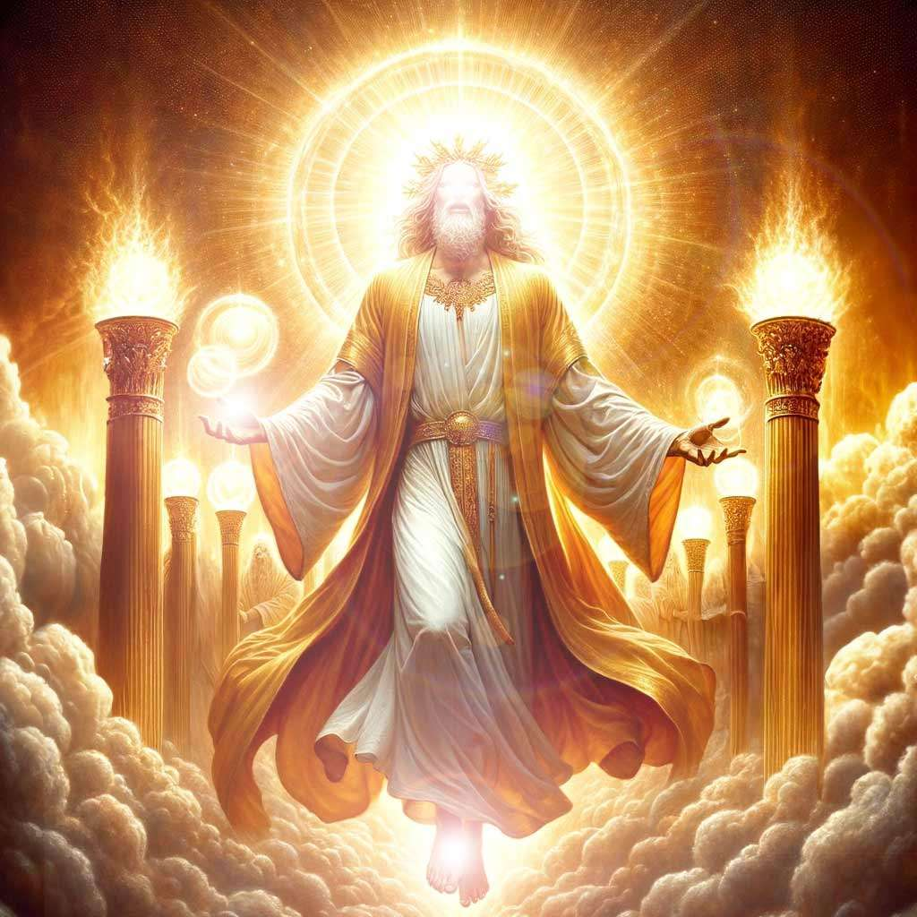
Revelation
1:1, 3
³ Blessed is he that readeth, and they that hear the words of this prophecy, and keep those things which are written therein: for the time is at hand.

Slide 52
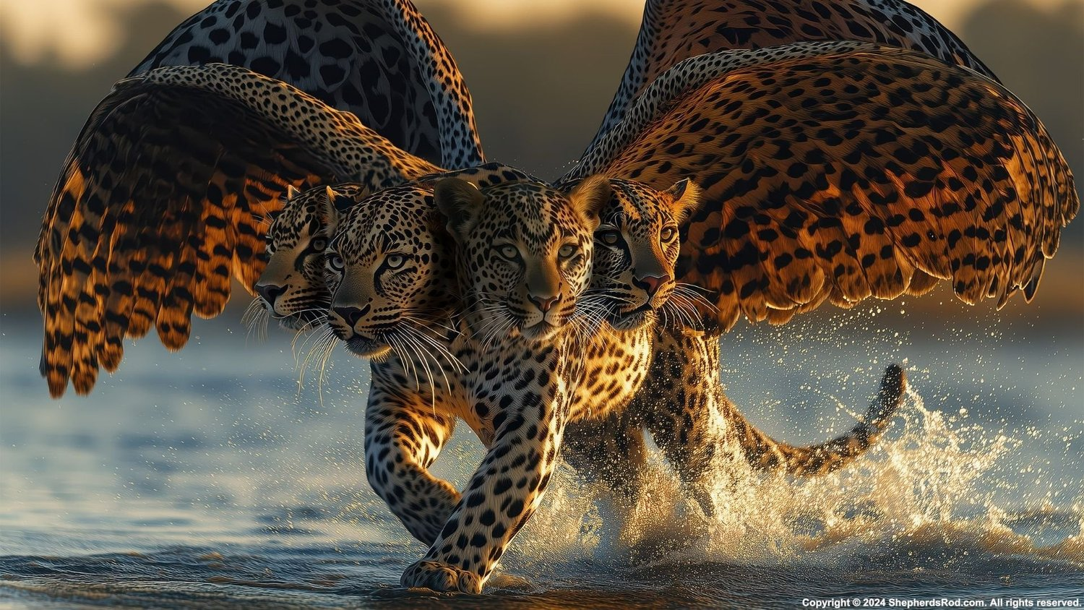
9. What part of the world was represented by the symbol of the leopard?
Answer: Grecia

Slide 53
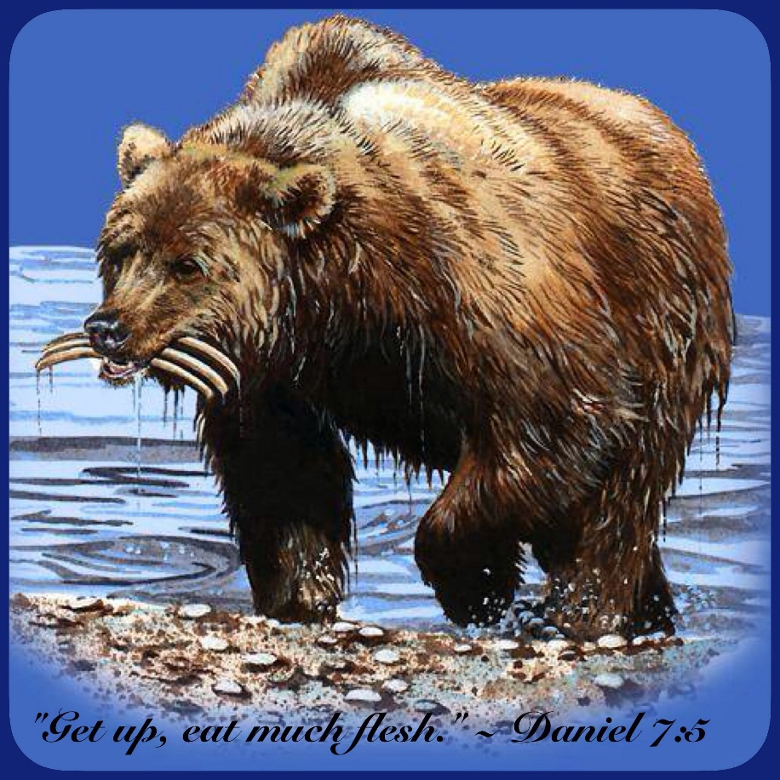
9. What part of the world was represented by the symbol of the Bear?
Answer: Media and Persia

Slide 54
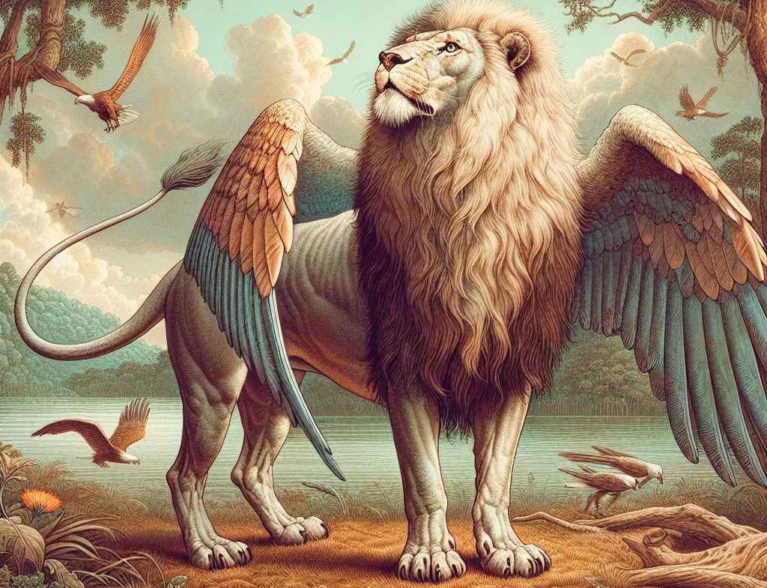
9. What part of the world was represented by the symbol of the lion?
Answer: Babylonia

Slide 55
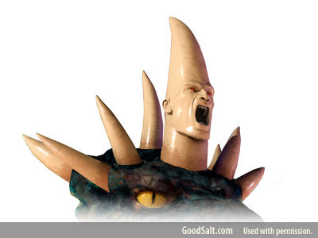
9. What part the beast and the ten horns?
Answer: Western Europe and North Africa

Slide 56
10. Then, as the characteristics of all these are found in the first beast of Revelation 13, what parts of the world are covered by the description of this first beast?
Answer: The principal parts of Europe, Asia, and Africa.

Slide 57
11. From where was this other beast seen coming up?
Answer: “Out of the earth.”
Revelation 13:11

Slide 58
13. What is meant by “sea,” when used as a symbol?
Revelation 17:15

Slide 59
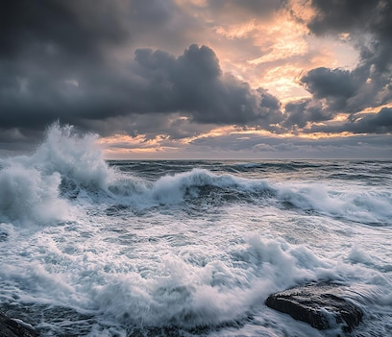
REVELATION
17:15
And he saith unto me, The waters which thou sawest, where the whore sitteth, are peoples, and multitudes, and nations, and tongues.

Slide 60
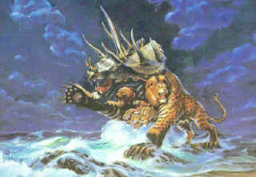
14. What then is represented by a power coming up out of the sea?
As a symbolic sea represents peoples, multitudes, nations, and tongues (Revelation 17:15), it is evident how the great world empires came up from the sea.

Slide 61
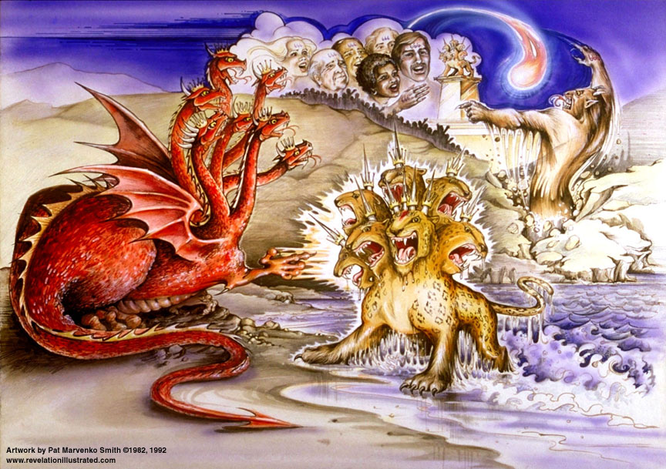
14. What then is represented by a power coming up out of the sea?
It is equally plain that a power symbolized as coming up out of the earth would arise from a condition of things opposite to that represented by the sea—that is, from a place where, prior to its rise, there had not been peoples, multitudes, nations, and tongues.

Slide 62
16. In A.D. 1798, how much of Europe, Asia, and Africa was occupied by peoples, multitudes, and established and organized nations?
Answer: All the known parts of them.

Slide 63
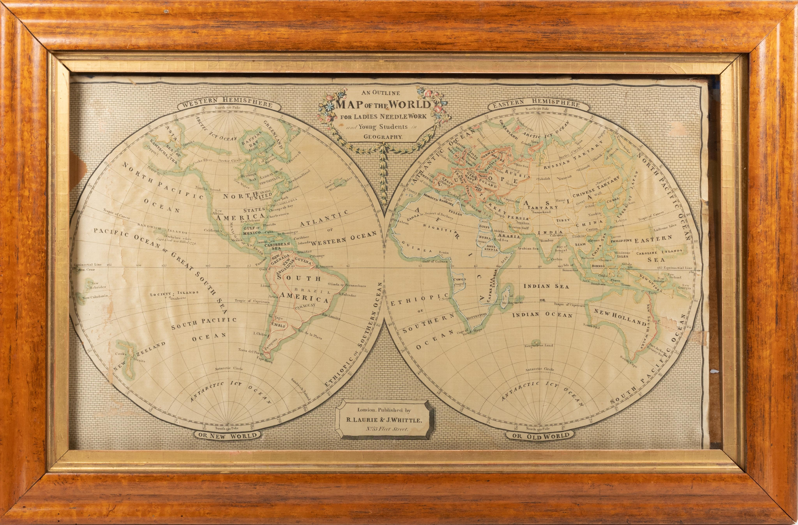

Slide 65
17. How long had it been so?
Answer: For ages.

Slide 66
18. Therefore, as the symbols directly connected with the first beast embrace the principal parts of Europe, Asia, and Africa; and as all the rest of the known parts of the Eastern Continent had for ages been occupied by established nations; and as the other beast was to arise where this had not been so; where must this “other beast” arise?
Answer: In the Western Continent.

Slide 67
19. Did the dominion of the first beast, or any of the ten kingdoms, extend to any part of the Western Continent in A.D. 1798?
Answer: It did. Spain, France, Portugal, and Britain then owned all except the possessions of what had been the thirteen British colonies, which then formed the United States of America.

Slide 68
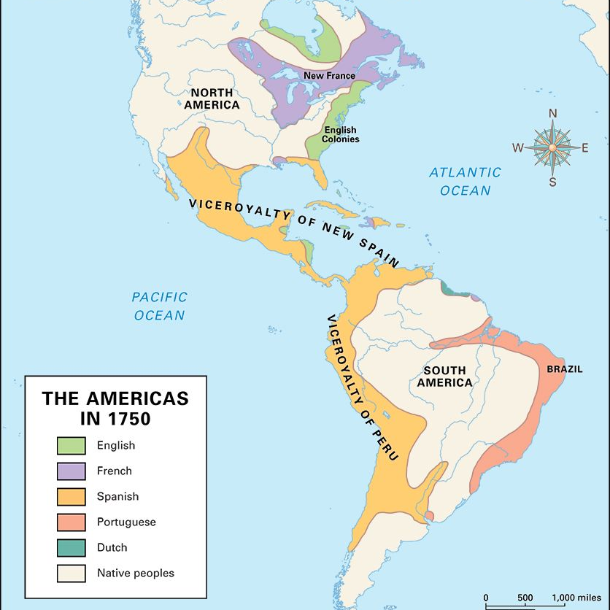
... and then 1776 happens...

Slide 69
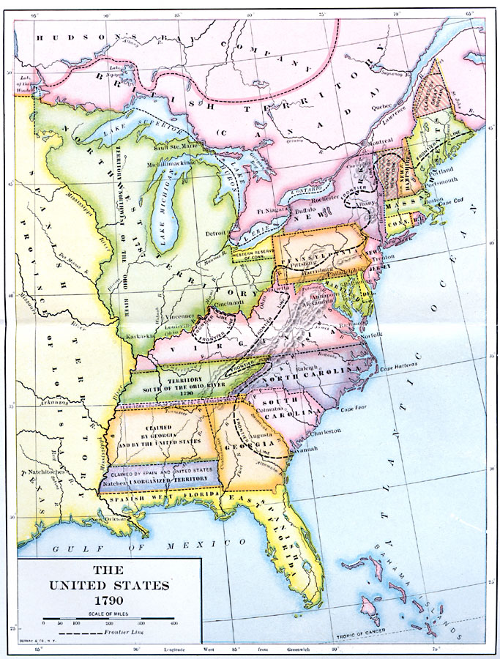

Slide 70
20. What position then did the Government of the United States occupy in A.D. 1798?
Answer: It was the only independent nation then on the earth that had arisen where there had not formerly been, for ages, peoples, multitudes, and established nations.

Slide 71
21. What then is the inevitable conclusion?
Answer: That the United States Government is the power signified in the prophecy of Revelation 13:11–17.

Slide 72
22. What is to be said to the people of this Government?
Revelation 13:14, last part

Slide 73
REVELATION
13:14
¹⁴ And deceiveth them that dwell on the earth by the means of those miracles which he had power to do in the sight of the beast; saying to them that dwell on the earth, that they should make an image to the beast, which had the wound by a sword, and did live.

Slide 74
23. When they shall have made an image to the beast, what will he do?
Revelation 13:11, 15

Slide 75
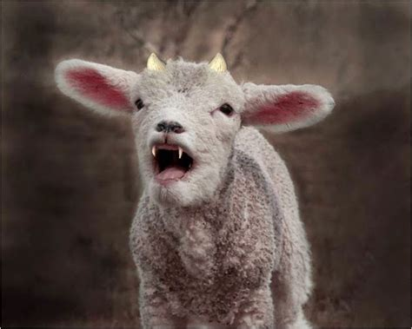
REVELATION
13:11
¹¹ And I beheld another beast coming up out of the earth; and he had two horns like a lamb, and he spake as a dragon.

Slide 76
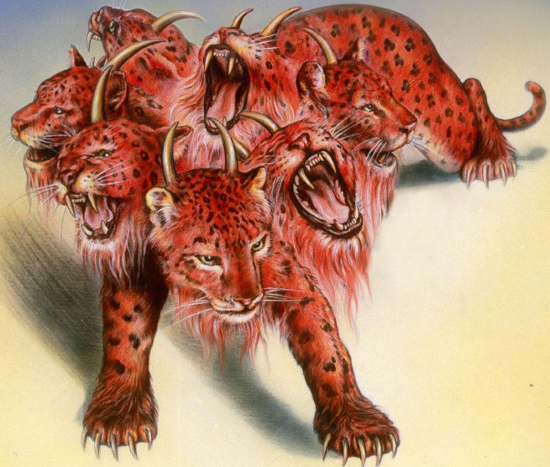
REVELATION
13:15
¹⁵ And he had power to give life unto the image of the beast, that the image of the beast should both speak, and cause that as many as would not worship the image of the beast should be killed.

Slide 77
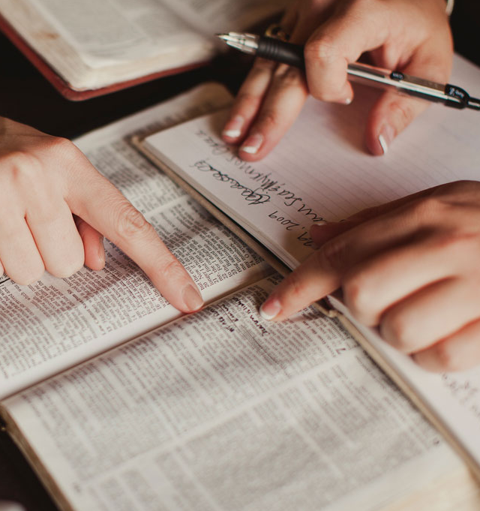
Principles for Prophecy
1. Prophecy Interprets Itself
We don’t need to guess what the beasts mean, for instance — Daniel told us!
Daniel 7 explains what beasts represent
Revelation 13 uses the same symbols
Careful study reveals more truth than first impressions suggest. Keep studying God’s Word!

Slide 78
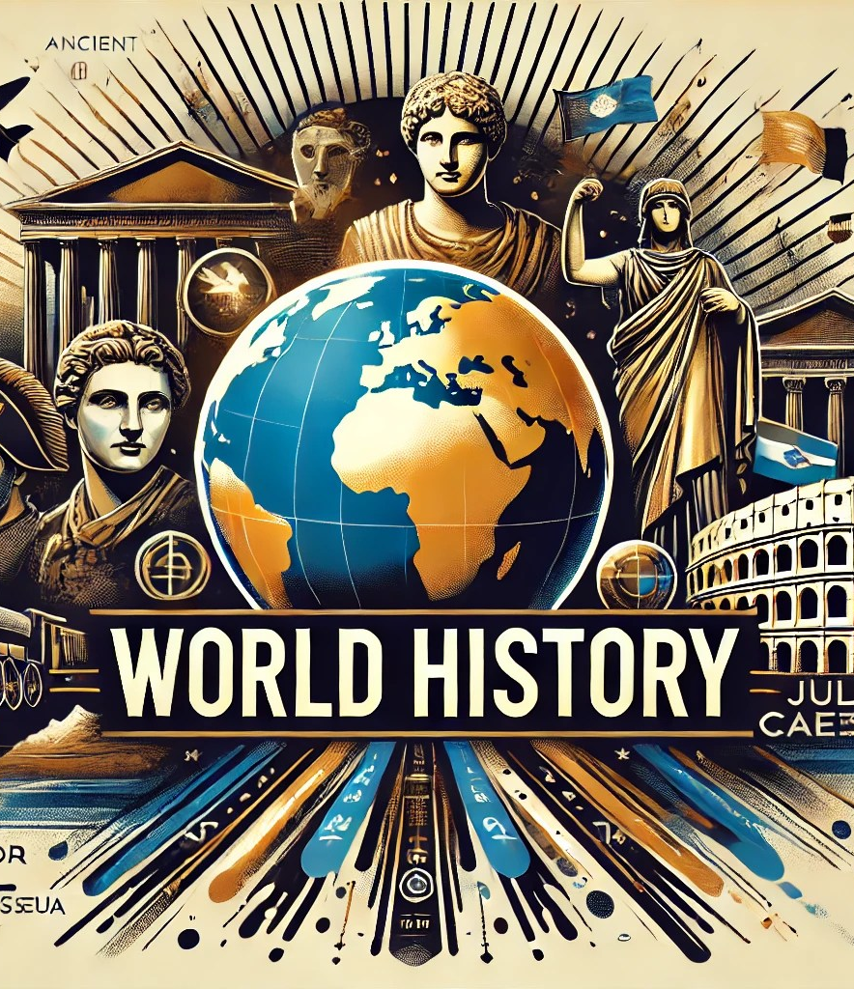
Principles for Prophecy
2. Symbols are Identified by Evidence
We don’t have to guess what the symbols mean — God supplies the clues in Scripture and history! We ask careful questions:
What does it do?
When and where does it arise?
Is this symbol explained?
What other symbols does it resemble?
Only after the evidence lines up does the identification make sense.

Slide 79
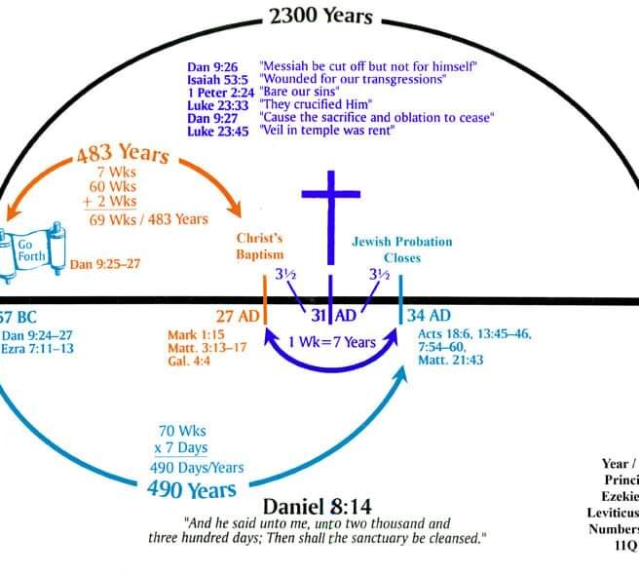
Principles for Prophecy
3. God Reveals Truth Progressively—and Clearly!
When John saw another beast rising in Revelation 13, no one knew its name.
John saw it and history later showed where and how
Understanding comes as prophecy meets history — not before, and not by guesswork.
God reveals what His people need, when they need it.
GOOD NEWS!! We’re at the end of history!

Slide 80
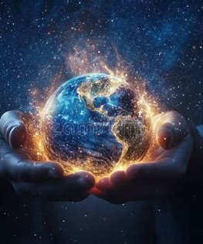
Principles for Prophecy
4. Prophecy is Given for Clarity—NOT Fear
Jesus assured His disciples that He wanted them to know what was coming. Prophecy teaches us to:
Recognize God’s work in history
Avoid deception
Remain steady as events unfold
Prophecy affirms our faith by reminding us about God’s complete control of world events.

Slide 81
Thank you!
… and Happy Sabbath!!

Slide 82


