Slide 1


Slide 2

Living the Light

Slide 3
The Third Angel’s Message
Lesson 3: The Time of the Message - CONTINUED
July 21, 1888
Lesson 3, 3rd Quarter 1888

Slide 4
This is one continuous study:
Lesson 1 — The Time of the Message
Lesson 2 — The Time of the Message — Continued
Lesson 3 — The Time of the Message — Continued
Lesson 4 — The Time of the Message — Continued
Lesson 5 — The Time of the Message — Concluded

Slide 5
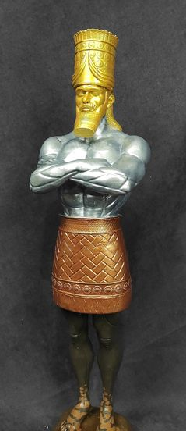
Lessons 1 and 2
Establish God’s method in prophecy
Show the big picture of world history
Identify the major powers of history and their progression
Emphasize clarity, not fear

Slide 6
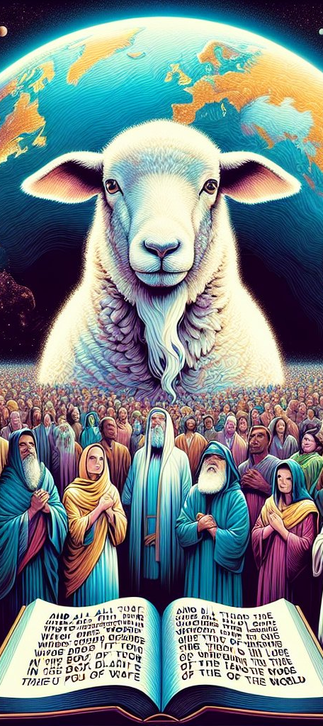
Where Lesson 2 Left Us:
(Revelation 13)
The first beast’s long period of dominion ended (A.D. 1798)
Its power was broken and diminished, not destroyed
A second power, representing the United States, was seen arising at that same time
That second power can give ‘life’ and persecuting authority to the image of the first beast

Slide 7

1. What warning does God give against the worship of the beast and his image?
Revelation 14:9-11

Slide 8
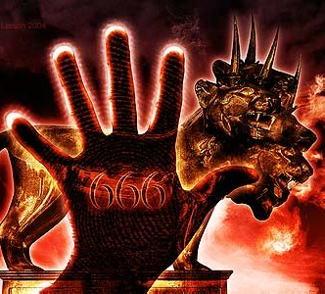
Revelation
14:9-11
⁹ And the third angel followed them, saying with a loud voice, If any man worship the beast and his image, and receive his mark in his forehead, or in his hand,

Slide 9
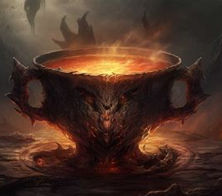
Revelation
14:9-11
¹⁰ The same shall drink of the wine of the wrath of God, which is poured out without mixture into the cup of his indignation; and he shall be tormented with fire and brimstone in the presence of the holy angels, and in the presence of the Lamb:

Slide 10
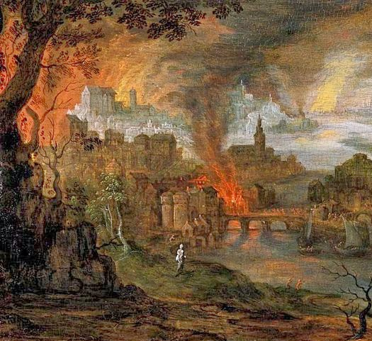
Revelation
14:9-11
¹¹ And the smoke of their torment ascendeth up for ever and ever: and they have no rest day nor night, who worship the beast and his image, and whosoever receiveth the mark of his name.

Slide 11
2. This text says, “The third angel followed them.” Followed whom?
Revelation 14:6, 8

Slide 12
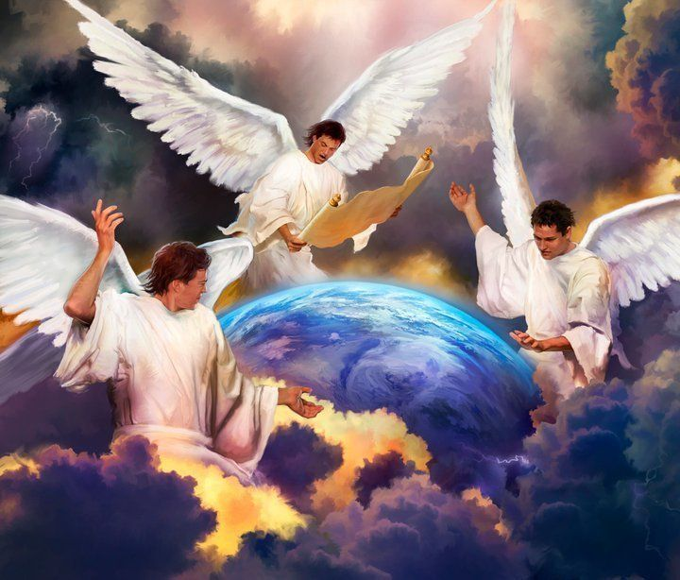
Revelation
14:6, 8
⁶ And I saw another angel fly in the midst of heaven, having the everlasting gospel to preach unto them that dwell on the earth, and to every nation, and kindred, and tongue, and people,

Slide 13
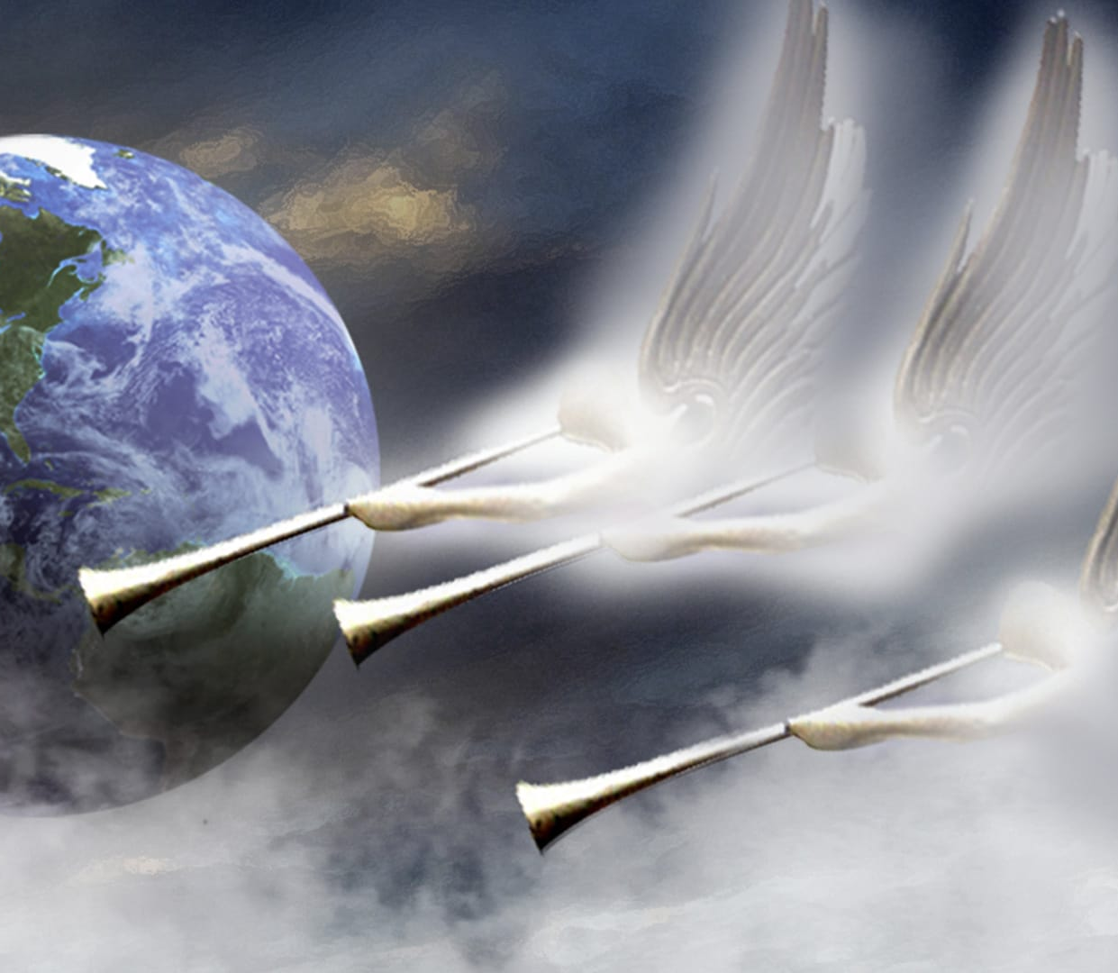
Revelation
14:6, 8
⁸ And there followed another angel, saying, Babylon is fallen, is fallen, that great city, because she made all nations drink of the wine of the wrath of her fornication.

Slide 14
3. The sixth verse says, “I saw another angel fly in the midst of heaven.” To what does this seem to direct us?
Answer: To another angel that had been seen previously.

Slide 15
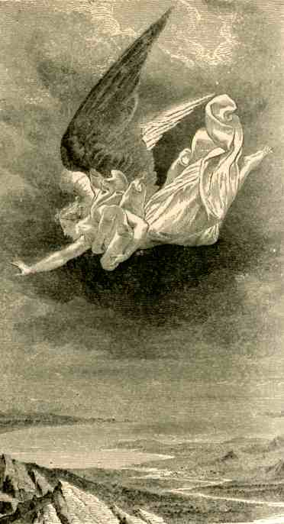
Step 1 — Revelation 14:6 Does NOT Say “The First Angel”
It says:
“I saw another angel fly in the midst of heaven…”
Grammatically and narratively, “another” implies:
Not the first of its kind
A continuation or parallel of something already seen

Slide 16
4. Where is the record of John’s seeing another angel flying thus?
Revelation 8:13

Slide 17
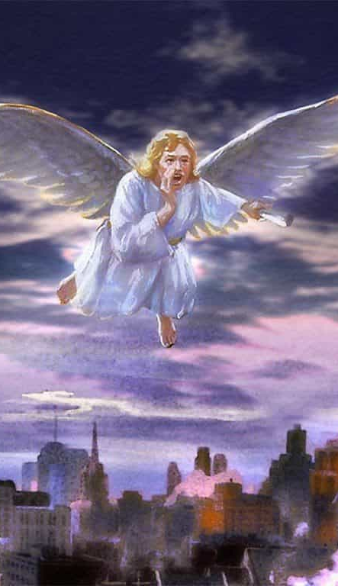
Step 2 — A Particular Description
The angels in Revelation 14 are described in unique language:
Flying
In the midst of heaven
Proclaiming a universal message
Announcing events that affect the whole earth
This combination of features appears together only once earlier in Revelation.

Slide 18
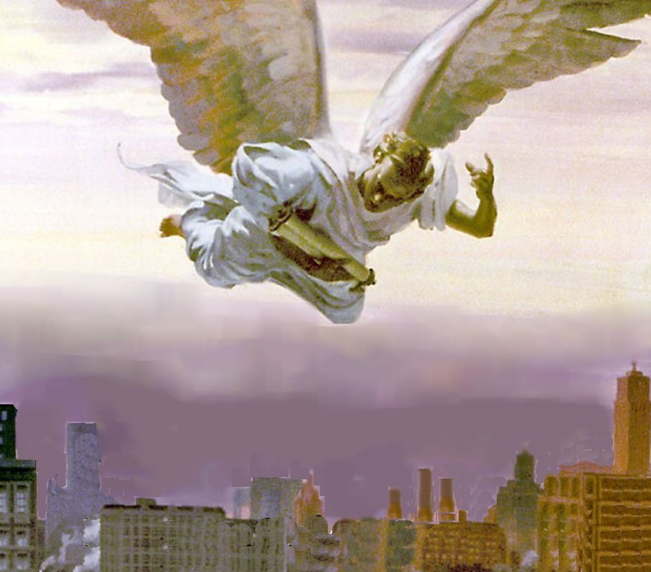
Revelation
8:13
¹³ And I beheld, and heard an angel flying through the midst of heaven, saying with a loud voice, Woe, woe, woe, to the inhabiters of the earth by reason of the other voices of the trumpet of the three angels, which are yet to sound!

Slide 19
Step 3 — The Messages Match in Scope and Function (Structural Parallelism)
Revelation 8:13:
Announces three woes
Warns before judgments fall
Speaks globally
Introduces trumpet sequence
Revelation 14:
Announces three angels
Warns before final worship crisis
Speaks to every nation, kindred, tongue, and people
Introduces final gospel warning

Slide 20
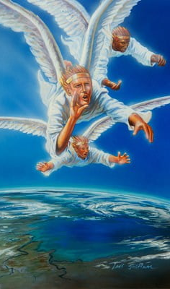
Step 4 — Implications
When Revelation 14 introduces ‘another angel flying in the midst of heaven,’ it intentionally echoes Revelation 8:13—linking the final warning to the close of the trumpet judgments, which unfold through identifiable events in history.

Slide 21
5. What is the burden of this angel’s cry?

Slide 22
Revelation
8:13
¹³ And I beheld, and heard an angel flying through the midst of heaven, saying with a loud voice, Woe, woe, woe, to the inhabiters of the earth by reason of the other voices of the trumpet of the three angels, which are yet to sound!

Slide 23
5. What is the burden of this angel’s cry?
Answer: A solemn warning that three great woes were about to fall upon the inhabitants of the earth by reason of the remaining trumpet judgments.
Note that the cry announces impending judgment, not yet its completion — a warning given before the final events unfold.

Slide 24
6. How many woes?
Answer: Three woes

Slide 25
7. By reason of what?
Answer: By reason of the voices of the remaining three trumpets!
The woes arise not arbitrarily, but because specific trumpet judgments were yet to sound.

Slide 26
8. Then with what are these three woes connected?
Answer: With the sounding of the last three trumpets, that is, trumpets five, six, and seven.
Each woe corresponds directly to a specific trumpet judgment.

Slide 27
9. To what does the fifth trumpet—the first woe—refer?
Answer: To the rise and spread of Mohammedanism.
“With surprising unanimity, commentators have agreed in regard to this as referring to the empire of the Saracens, or to the rise and progress of the religion and empire of Mohammed.” — Albert Barnes.

Slide 28

A Clear Change in Setting:
In Revelation 8 (the first four trumpets):
Judgments fall on:
  Land
  Sea
  Rivers
  Sun/Moon/Stars
These are broad, environmental, empire-wide judgments. No specific region is singled out. The scope is general.
Then Revelation 9 opens very differently…

Slide 29
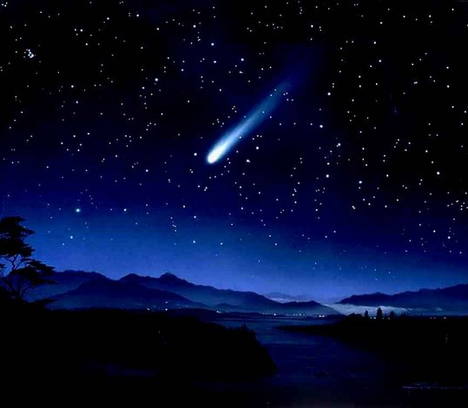
Revelation
9:1-3
9 And the fifth angel sounded, and I saw a star fall from heaven unto the earth: and to him was given the key of the bottomless pit.

Slide 30
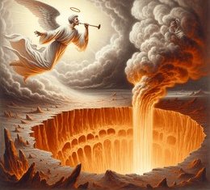
Revelation
9:1-3
² And he opened the bottomless pit; and there arose a smoke out of the pit, as the smoke of a great furnace; and the sun and the air were darkened by reason of the smoke of the pit.

Slide 31

Revelation
9:1-3
³ And there came out of the smoke locusts upon the earth: and unto them was given power, as the scorpions of the earth have power.

Slide 32
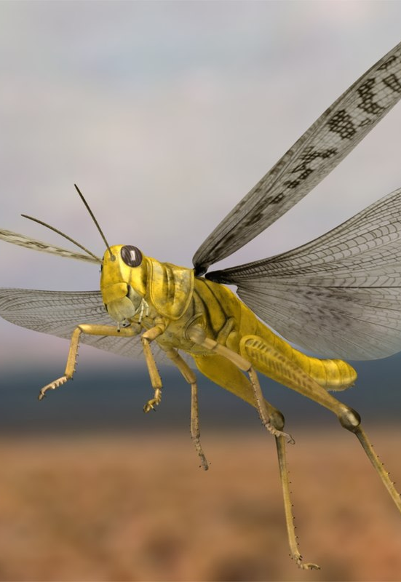
Geographical Clues:
Revelation 9 introduces imagery that is not Roman and not Western, especially locusts and scorpions.
These are desert-region symbols, not Mediterranean or European ones.
In Scripture, locust imagery consistently points to:
arid regions
eastern lands
sudden, overwhelming incursions
(cf. Joel 1–2)

Slide 33

Focus Shifts from Systems to People:
Revelation 9:4 says:
“That they should not hurt the grass of the earth… but only those men which have not the seal of God.”
Earlier trumpets affect structures and systems, but the fifth trumpet affects people directly.
It describes prolonged torment, not collapse. This fits a frontier conflict zone, not a centralized Western empire.

Slide 34
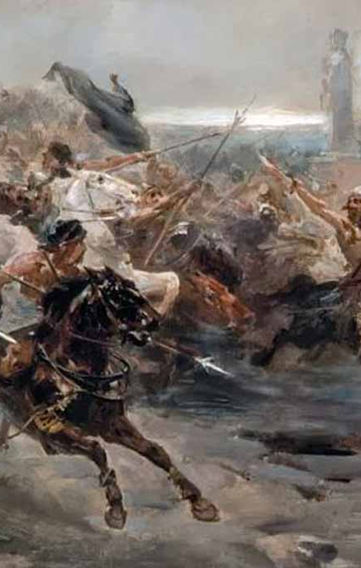
The Political Center of Gravity Has Shifted
By the fifth trumpet:
The prophecy no longer treats the empire as a single whole!
This is a critical shift.
The prophetic perspective focuses on a specific sphere of influence.
The action is now regional, not imperially wide.

Slide 35
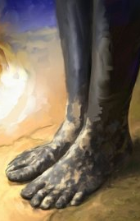
The Political Center of Gravity Has Shifted
As you probably recall:
A similar change happens with
the image in Daniel 2 (clay and iron), and
the beasts in Daniel (shift to focus on the horns).
This suits the time period as the Roman empire begins crumbles in the west, and there is no longer an empire uniting the known world.

Slide 36
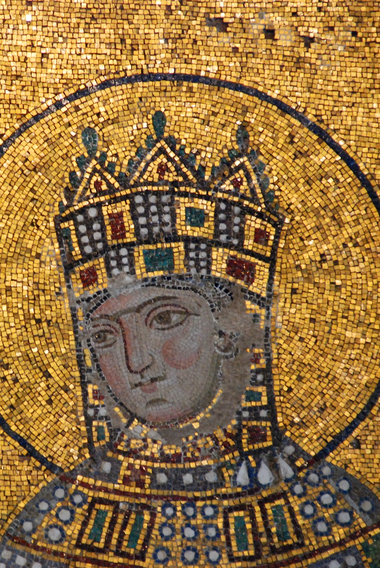
So what was happening in the east as Rome was collapsing in the west?
Historically, this period is marked by the rise of Islamic powers — first Arab, then Turkish — whose sustained pressure on the Eastern Roman Empire completed its disengagement from the West.

Slide 37
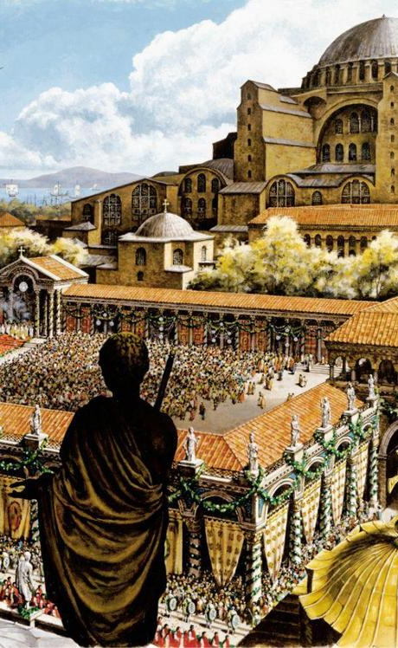
So what was happening in the east as Rome was collapsing in the west?
By the 7th century, Islamic forces had rapidly taken the wealthiest and most strategic provinces (namely Syria, Palestine, Egypt) out of Byzantine control. Yet the Byzantine Empire continued on until the fall of Constantinople in May 1453.

Slide 38
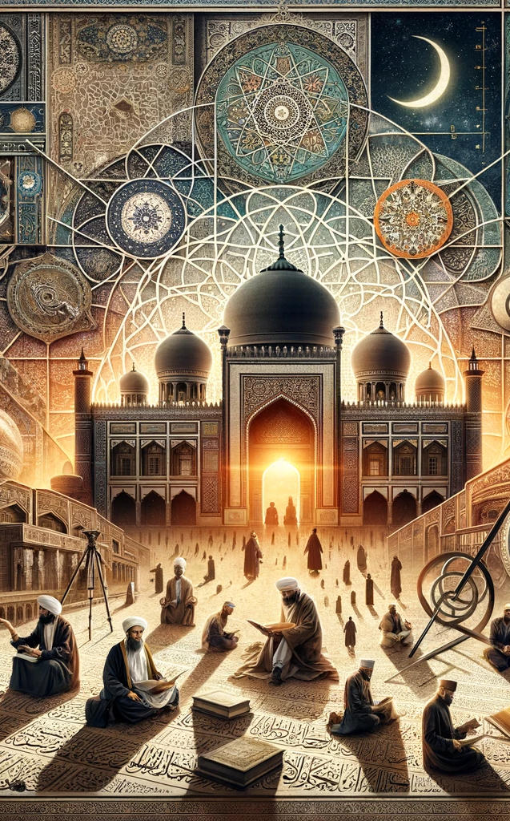
If the fifth trumpet describes a real historical power, Revelation should tell us something about its character and conduct — not just its location or timing.
So we must turn to Scripture to determine what limits were placed on this power.

Slide 39
10. What did the prophet say should be commanded them?
Revelation 9:4

Slide 40
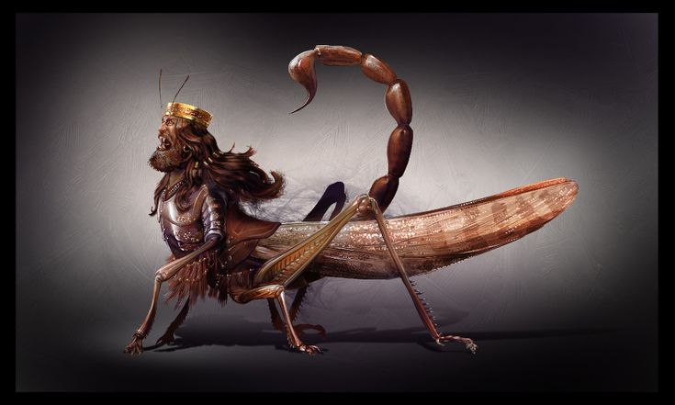
Revelation
9:4
⁴ And it was commanded them that they should not hurt the grass of the earth, neither any green thing, neither any tree; but only those men which have not the seal of God in their foreheads.

Slide 41
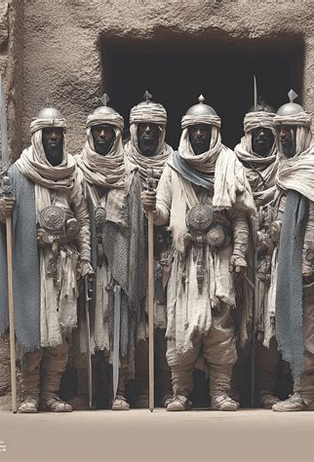
This power is…
NOT permitted indiscriminate destruction!
The judgment is directed toward people, not land or infrastructure
This is highly unusual for ancient warfare
Revelation describes a force acting under moral restraint, not unchecked devastation.

Slide 42
11. What was [Historically] commanded of the Islamic forces?
See Edward Gibbon’s The History of the Decline and Fall of the Roman Empire, chapter 51, paragraph 10, and Note.

Slide 43
Edward Gibbon, The History of the Decline and Fall of the Roman Empire, chapter 51, par. 10):
Remember that you are always in the presence of God; on the verge of death, in the assurance of judgment, and the hope of Paradise. Avoid injustice and oppression; consult with your brethren, and study to preserve the love and confidence of your troops. When you fight the battles of the Lord, acquit yourselves like men, without turning your backs; but let not your victory be stained with the blood of women or children.

Slide 44
Edward Gibbon, The History of the Decline and Fall of the Roman Empire, chapter 51, par. 10):
Destroy no palm trees, nor burn any fields of corn. Cut down no fruit trees, nor do any mischief to cattle, only such as you will eat. When you make any covenant or article, stand to it, and be as good as your word. As you go on, you will find some religious persons who live retired in monasteries and propose to themselves to serve God that way;

Slide 45
Edward Gibbon, The History of the Decline and Fall of the Roman Empire, chapter 51, par. 10):
let them alone, and neither kill them nor destroy their monasteries. And you will find another sort of people who belong to the synagogue of Satan, who have shaven crowns; be sure you cleave their skulls, and give them no quarter till they either turn Mohammedans or pay tribute.

Slide 46
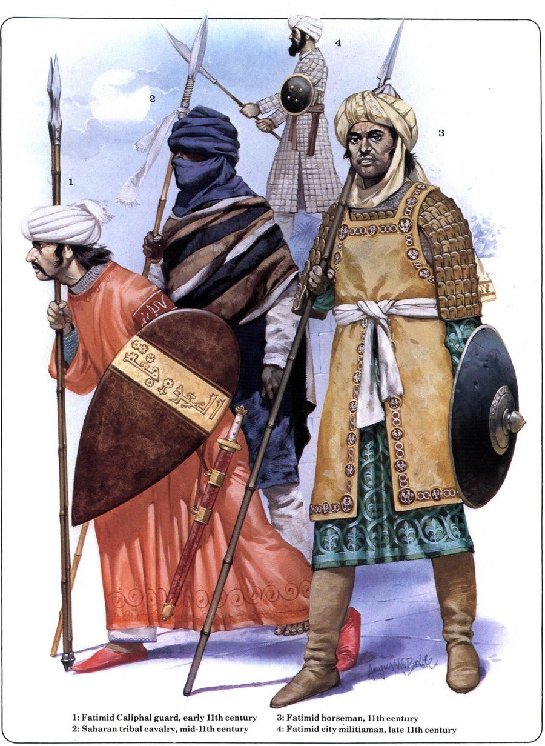
These Commands:
  are religious, not merely political
  were issued explicitly to Islamic armies
  match Revelation 9:4 with striking precision
This is not general symbolism — it is documented historical policy
Revelation’s restraint language is not abstract; it corresponds to known, recorded religious commands.

Slide 47
12. For what specific length of time were they to torment men?
Revelation 9:5, 10

Slide 48

Revelation
9:5,10
⁵ And to them it was given that they should not kill them, but that they should be tormented five months: and their torment was as the torment of a scorpion, when he striketh a man.

Slide 49
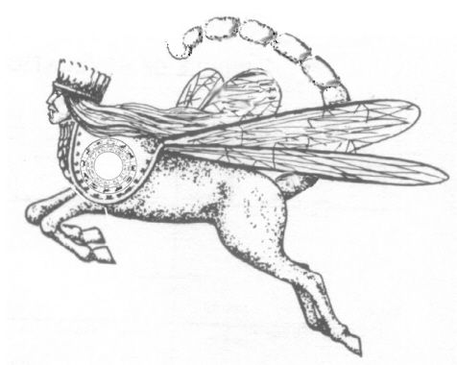
Revelation
9:5,10
¹⁰ And they had tails like unto scorpions, and there were stings in their tails: and their power was to hurt men five months.

Slide 50
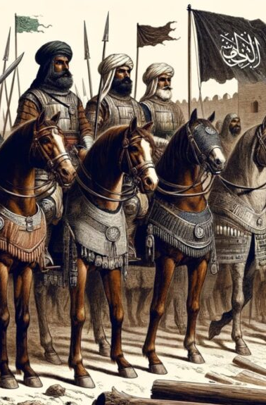
The Prophecy gives:
  a defined beginning
  a defined duration
  and a defined limit
The power is neither annihilating—scorpion stings aren’t typically fatal—nor eternal.
When setting, symbolism, moral restraints, religious character, and limited duration are all considered together, the fifth trumpet — the first woe — corresponds uniquely to the rise and early expansion of Islam.

Slide 51
13. When did this period begin?
Answer: It was on July 27, A.D. 1299, that Othman first invaded the territory of Nicomedia.
(See Gibbon, chapter 64, paragraph 13.)

Slide 52
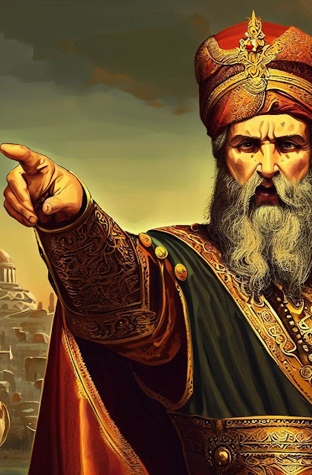
July 27, 1299
(This date is drawn from secular historical records, notably Edward Gibbon.)
The prophetic period is dated from A.D. 1299 because this marks the point at which Ottoman power began sustained, independent pressure against Byzantine territory in the region of Nicomedia. It initiated a period of prolonged pressure, not immediate conquest. This fits Revelation’s language of torment, not destruction.

Slide 53
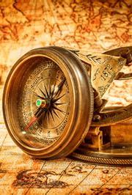
July 27, 1299
A Note on Dates and Prophetic Time
Medieval chronology is rarely precise to a single year.
Early Ottoman history is reconstructed from limited, later sources, and modern historians place key early events within a narrow range (c. 1299–1302).
Prophecy does not date a battle, but the beginning of a condition.
The fifth trumpet marks the onset of sustained, independent pressure on Byzantine territory.

Slide 54

July 27, 1299
The end date confirms the framework.
Counting forward reaches A.D. 1449, when Byzantine political independence was clearly lost.
The period is anchored by convergence, not calendar exactness.
Prophecy traces authority and duration, not isolated events.

Slide 55
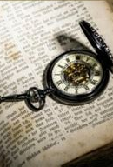
5 Months
(This calculation is done using the Day-Year Principle that we discussed in Lesson 2)
Since in the Hebrew calendar a month had 30 days, we can readily calculate that 5 months would be 150 days. The Day-Year Principle tells us that one prophetic day is the same as a literal year, so 150 prophetic days would be 150 literal years.

Slide 56
14. Then at what time did the first woe end?
Answer: July 27, A.D. 1449.

Slide 57
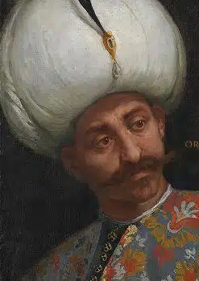
In 1449…
the Byzantine emperor Constantine XI could not assume the throne without the permission of the Ottoman sultan.
This signaled that Byzantine sovereignty had been effectively lost. The empire still existed — but no longer as an independent power.
The torment period ended when political independence was broken.

Slide 58
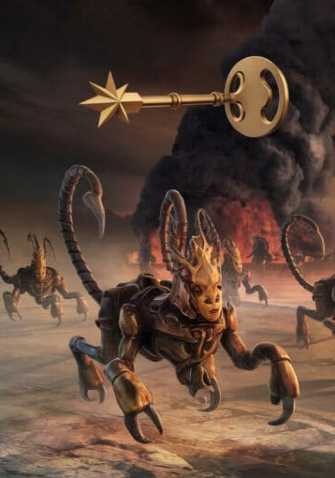
This is not a late or isolated interpretation:
Heinrich Bullinger (16th c.) identified the Turks with the trumpet powers
Martin Luther understood the 5th and 6th trumpets as referring to Islam
William Miller connected the time periods chronologically
Josiah Litch refined the dates to 1299–1449 and 1449–1840

Slide 59
15. What followed?
Revelation 9:13

Slide 60
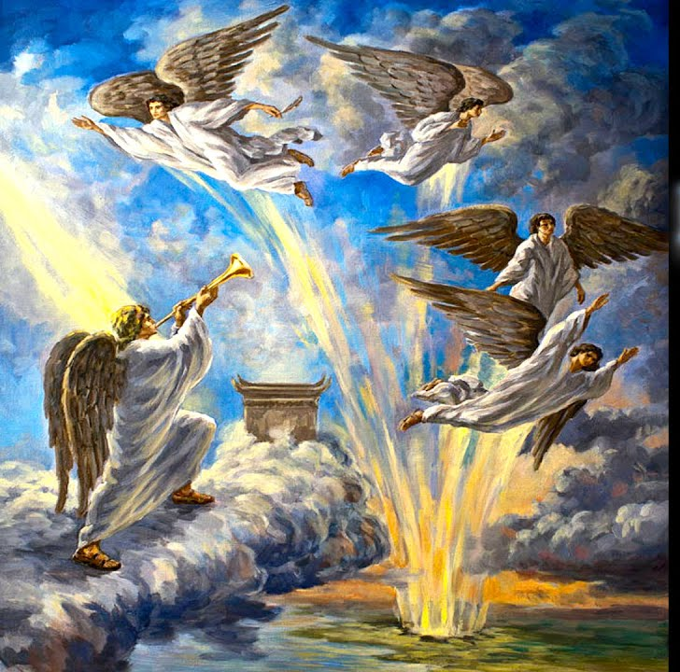
Revelation
9:13
¹³ And the sixth angel sounded, and I heard a voice from the four horns of the golden altar which is before God,

Slide 61
16. How long was the sixth trumpet—the second woe—to continue?
Revelation 9:15

Slide 62
Revelation
9:15
¹⁵ And the four angels were loosed, which were prepared for an hour, and a day, and a month, and a year, for to slay the third part of men.

Slide 63
17. Literally, what length of time is this?
Answer: 391 years and 15 days.

Slide 64

an hour, and a day, and a month, and a year
 | Prophetic Days | Literal Years | Literal Time
Hour | 1/24 days | 1/24 years | 15 days
Day | 1 day | 1 year | 1 year
Month | 30 days | 30 years | 30 years
Year | 360 days | 360 years | 360 years
= 391 years, 15 days

Slide 65
18. When did it end?
Answer: August 11, A.D. 1840.

Slide 66
19. What historical event marks the ending of this time at that date?
Answer: On that day the four great powers of Europe—England, Austria, Prussia, and Russia—assumed control of all the foreign affairs of the government of Turkey, and have held it ever since.
(See Uriah Smith Thoughts on the Revelation in commenting on Revelation 9:18–19.)

Slide 67
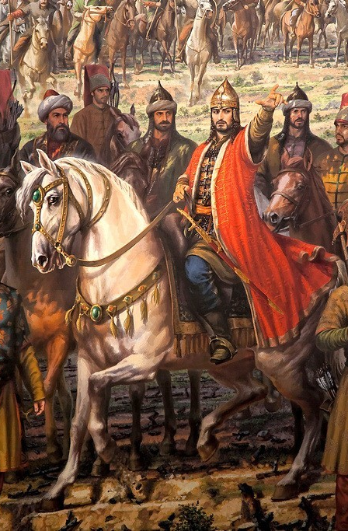
As a Matter of Interest:
World War I (1914–1918) destroyed what remained of Ottoman sovereignty
In 1922, the Ottoman sultanate was abolished
In 1923, the modern Republic of Turkey was established
  The Ottoman Empire ceased to exist
  European control shifted from supervision to dissolution
The prophecy’s concern was already long past

Slide 68
Thank you!
… and Happy Sabbath!!

Slide 69


