Slide 1


Slide 2

Living the Light

Slide 3
The Third Angel’s Message
Lesson 4: The Time of the Message - CONTINUED
July 28, 1888
Lesson 3, 3rd Quarter 1888

Slide 4
This is one continuous study:
Lesson 1 — The Time of the Message
Lesson 2 — The Time of the Message — Continued
Lesson 3 — The Time of the Message — Continued
Lesson 4 — The Time of the Message — Continued
Lesson 5 — The Time of the Message — Concluded

Slide 5
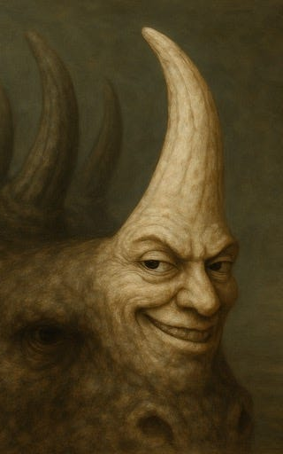
Lessons 1 and 2
The identity of the little horn → the Papacy
The 1,260 years → A.D. 538 to 1798
The deadly wound → 1798
The rise of a new power in the same period → Revelation 13:11
That power arises outside the crowded nations of Europe, Asia, Africa → the United States

Slide 6
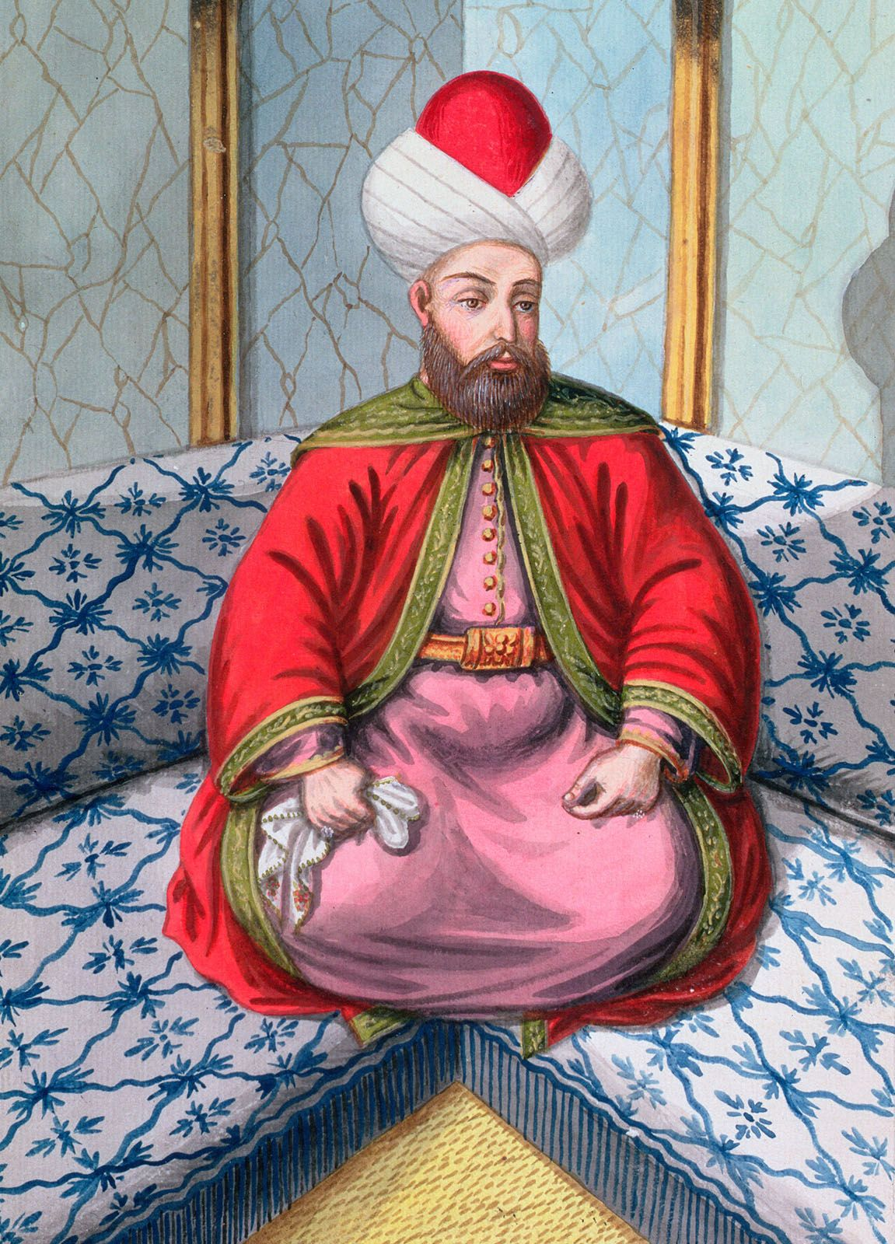
Lesson 3 Shifts Gears
Introduced the three woes connected with the trumpets
Identified:
  First woe → rise of Islam (1299–1449)
  Second woe → Ottoman supremacy (1449–1840)
Landed on a very specific historical date: August 11, 1840

Slide 7

1. To what date were we brought in the first two lessons?

Slide 8
1. To what date were we brought in the first two lessons?
A.D. 1798

Slide 9
2. To what date were we brought in our last lesson?

Slide 10
2. To what date were we brought in our last lesson?
August 11, 1840

Slide 11
3. What prophetic Period then closed?
Answer: The second woe, the sounding of the sixth trumpet.

Slide 12
4. After that, what was to come quickly?
Revelation 11:14

Slide 13
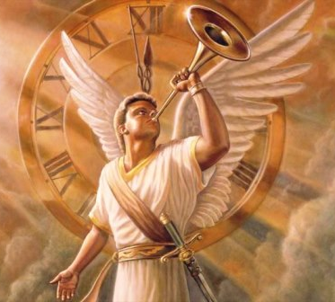
Revelation
11:14
¹⁴ The second woe is past; and, behold, the third woe cometh quickly.

Slide 14
5. How many woes were there to be?
Revelation 8:13

Slide 15
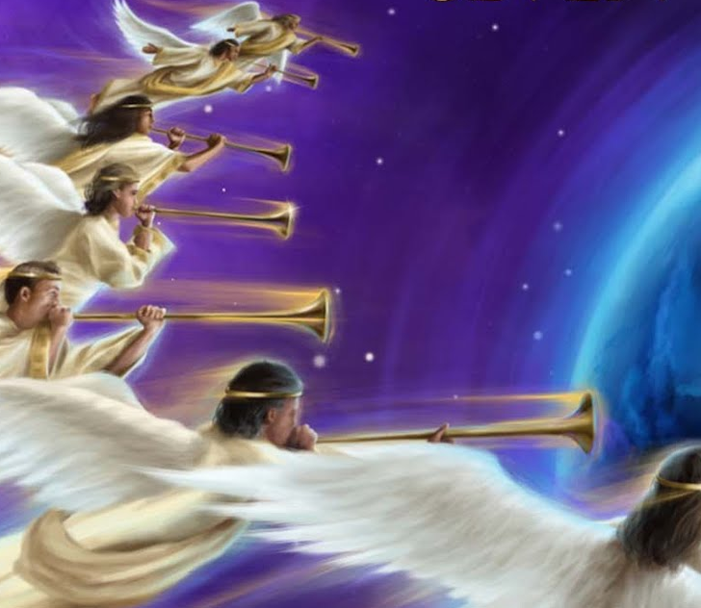
Revelation
8:13
¹³ And I beheld, and heard an angel flying through the midst of heaven, saying with a loud voice, Woe, woe, woe, to the inhabiters of the earth by reason of the other voices of the trumpet of the three angels, which are yet to sound!

Slide 16
6. With what are these three woes connected?

Slide 17
6. With what are these three woes connected?
They are connected with the trumpets, specifically:
The 5th trumpet → first woe
The 6th trumpet → second woe
The 7th trumpet → third woe

Slide 18
7. Then with what is the third woe connected?

Slide 19
7. Then with what is the third woe connected?
Answer: With the seventh trumpet

Slide 20
8. Then when the third woe does begin, what begins at the same time with it?
Answer: The sounding of the seventh trumpet.

Slide 21
9. When the seventh angel sounded, what were heard?
Revelation 11:15

Slide 22
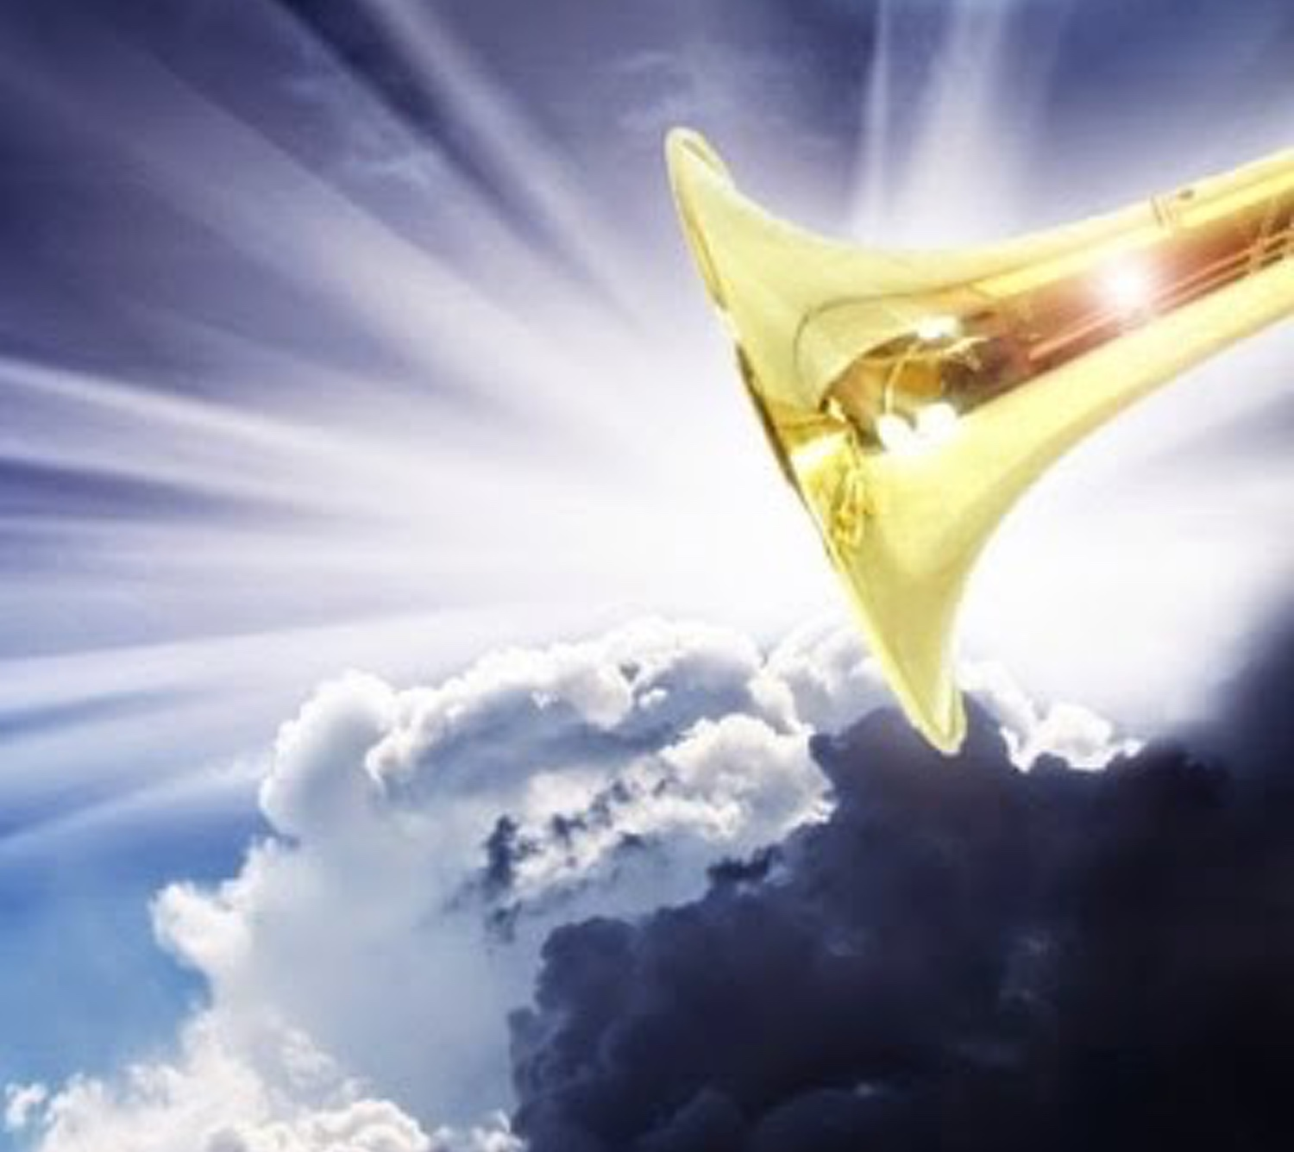
Revelation
11:15
¹⁵ And the seventh angel sounded; and there were great voices in heaven, saying, The kingdoms of this world are become the kingdoms of our Lord, and of his Christ; and he shall reign for ever and ever.

Slide 23
10. What other notable events are mentioned in connection with the seventh trumpet?
Revelation 11:18, 19

Slide 24

Revelation
11:18
¹⁸ And the nations were angry, and thy wrath is come, and the time of the dead, that they should be judged, and that thou shouldest give reward unto thy servants the prophets, and to the saints, and them that fear thy name, small and great; and shouldest destroy them which destroy the earth.

Slide 25
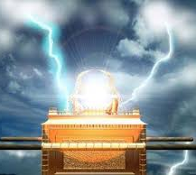
Revelation
11:19
¹⁹ And the temple of God was opened in heaven, and there was seen in his temple the ark of his testament: and there were lightnings, and voices, and thunderings, and an earthquake, and great hail.

Slide 26
11. What is meant by the wrath of God?
Revelation 15:1

Slide 27
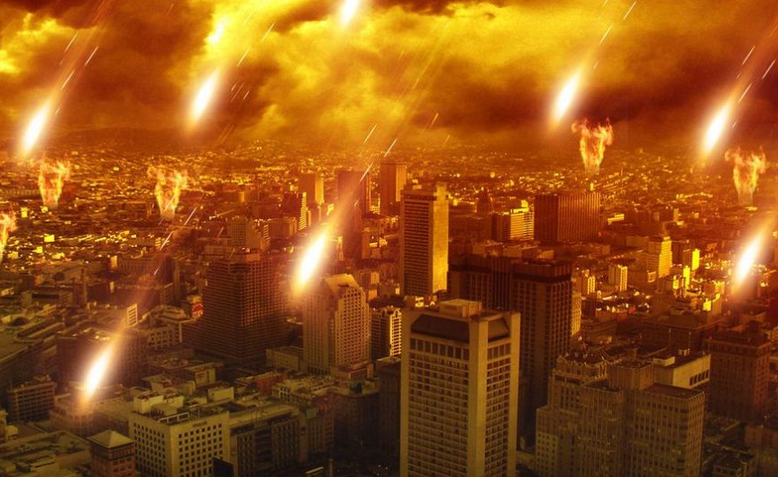
Revelation
15:1
15 And I saw another sign in heaven, great and marvellous, seven angels having the seven last plagues; for in them is filled up the wrath of God.

Slide 28
12. When this time of the dead comes, that they should be judged, what is also said to the living?
Revelation 14:6, 7

Slide 29
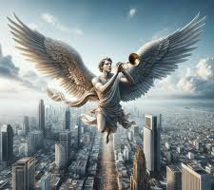
Revelation
14:6, 7
⁶ And I saw another angel fly in the midst of heaven, having the everlasting gospel to preach unto them that dwell on the earth, and to every nation, and kindred, and tongue, and people,

Slide 30
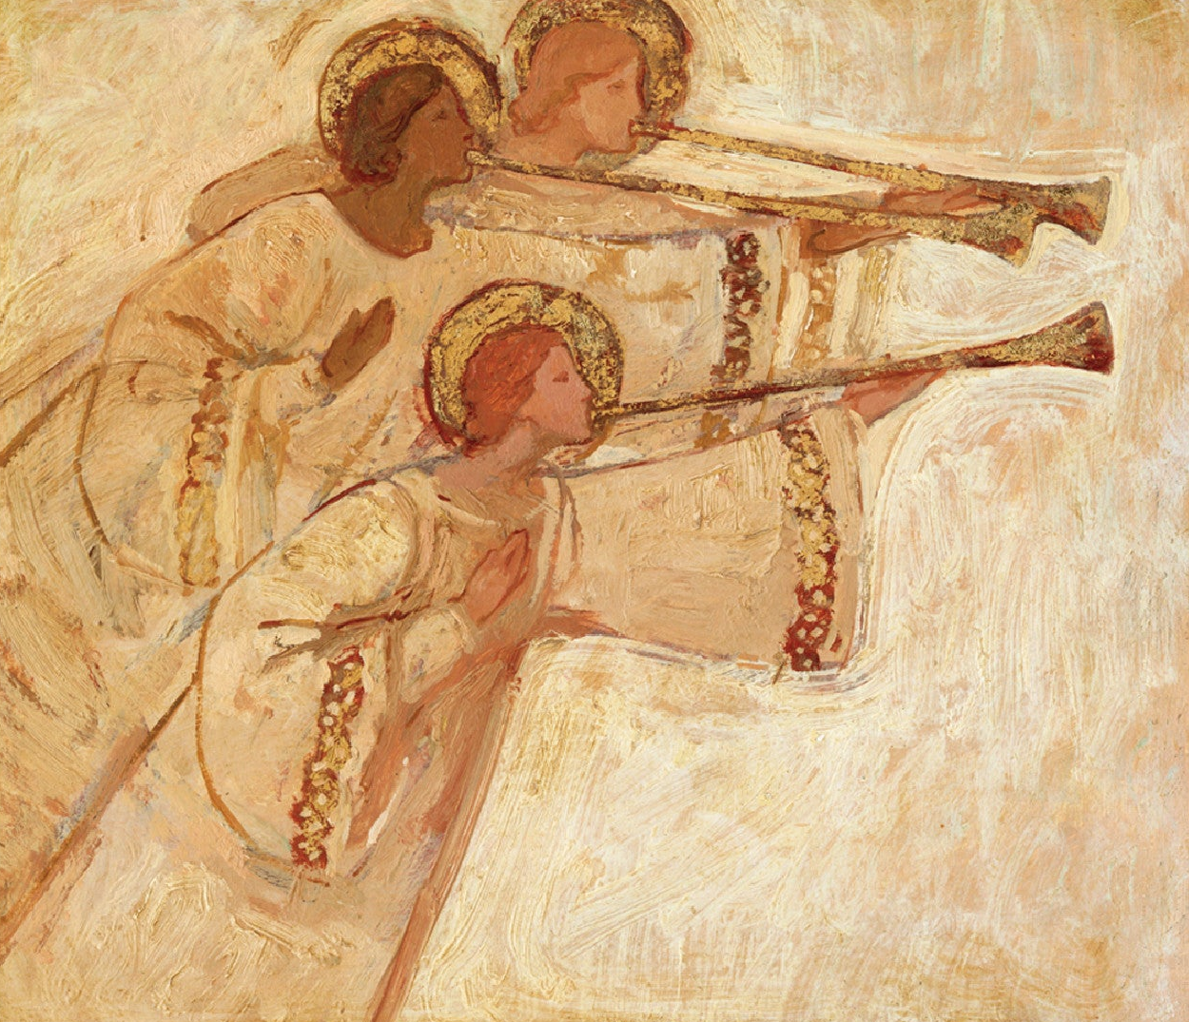
Revelation
14:6, 7
⁷ Saying with a loud voice, Fear God, and give glory to him; for the hour of his judgment is come: and worship him that made heaven, and earth, and the sea, and the fountains of waters.

Slide 31
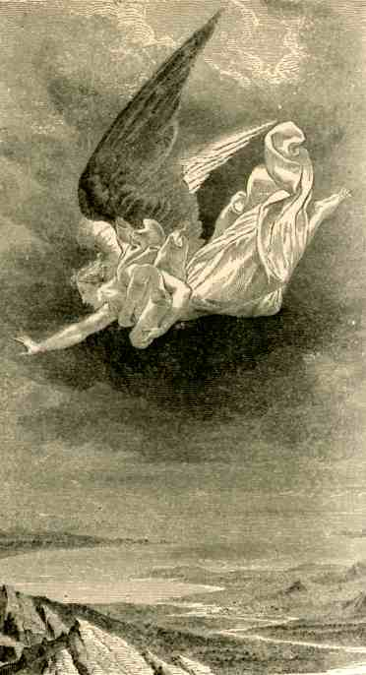
The Link— Revelation 14:6 Does NOT Say “The First Angel”
It says:
“I saw another angel fly in the midst of heaven…”
Grammatically and narratively, “another” implies:
Not the first of its kind
A continuation or parallel of something already seen

Slide 32
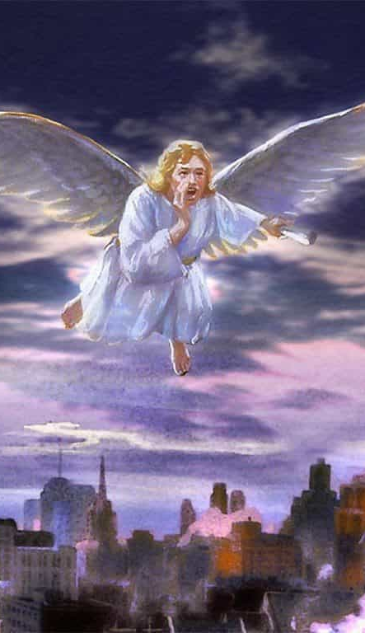
The Link — A Particular Description
The angels in Revelation 14 are described in unique language:
Flying
In the midst of heaven
Proclaiming a universal message
Announcing events that affect the whole earth
This combination of features appears together only once earlier in Revelation.

Slide 33
The Link — The Messages Match in Scope and Function (Structural Parallelism)
Revelation 8:13:
Announces three woes
Warns before judgments fall
Speaks globally
Introduces trumpet sequence
Revelation 14:
Announces three angels
Warns before final worship crisis
Speaks to every nation, kindred, tongue, and people
Introduces final gospel warning

Slide 34
Two Levels at once:
Heaven Acts – Earth Hears
Heavenly Action
Earthly Explanation
“Now is the judgment of this world: now shall the prince of this world be cast out.”
— John 12:31
“And I, if I be lifted up from the earth, will draw all men unto Me.”
— John 12:32

Slide 35
Two Levels at once:
Heaven Acts – Earth Hears
Heavenly Action
Earthly Explanation
“Then came there a voice from heaven, saying, I have both glorified it, and will glorify it again.”
— John 12:28
“The people therefore, that stood by, and heard it, said that it thundered: others said, An angel spake to Him.”
— John 12:29

Slide 36
Two Levels at once:
Heaven Acts – Earth Hears
Heavenly Action
Earthly Explanation
“And I saw the dead, small and great, stand before God; and the books were opened…”
— Revelation 20:12
“Behold, I come quickly; and My reward is with Me, to give every man according as his work shall be.”
— Revelation 22:12

Slide 37
Two Levels at once:
Heaven Acts – Earth Hears
Heavenly Action
Earthly Explanation
“The second woe is past; and, behold, the third woe cometh quickly.
And the seventh angel sounded…”
— Revelation 11:14–15
“I saw another angel fly in the midst of heaven, having the everlasting gospel to preach unto them that dwell on the earth…”
— Revelation 14:6–7

Slide 38
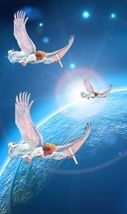
God Doesn’t Act without Warning
So when we see that first angel proclaiming the gospel in Revelation 14, it makes sense to ask: what has just begun in heaven that God is now explaining on earth? And it naturally connects with the massive, climactic events in heaven that we see described during the seventh trumpet.

Slide 39
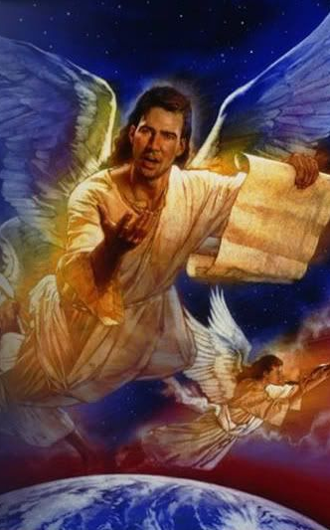
God Doesn’t Act without Warning
The seventh trumpet announces a decisive phase in heaven
The first angel announces what that phase means to the world
These are not identical events, but parallel voices
Judgment begins in heaven — explanation and appeal are given on earth.

Slide 40
13. When is it that reward is given to saints and prophets, and them that fear the name of the Lord?
Revelation 22:12;
Matthew 16:27

Slide 41
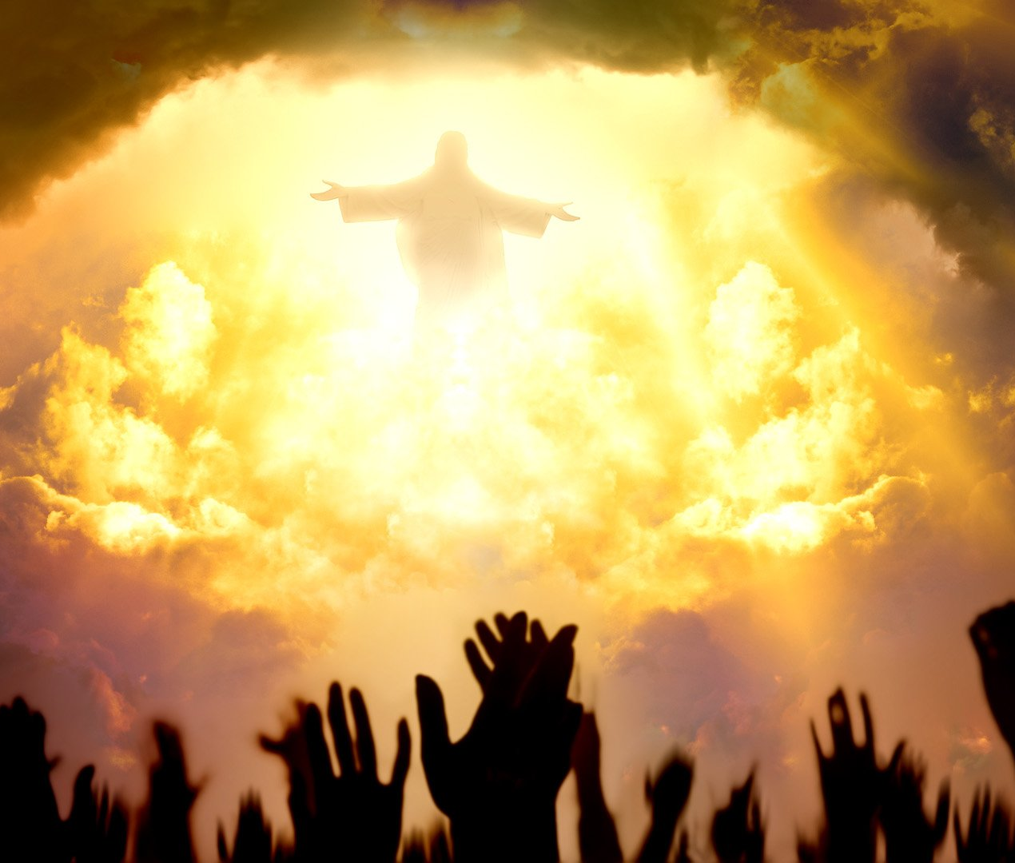
Revelation
22:12
¹² And, behold, I come quickly; and my reward is with me, to give every man according as his work shall be.

Slide 42
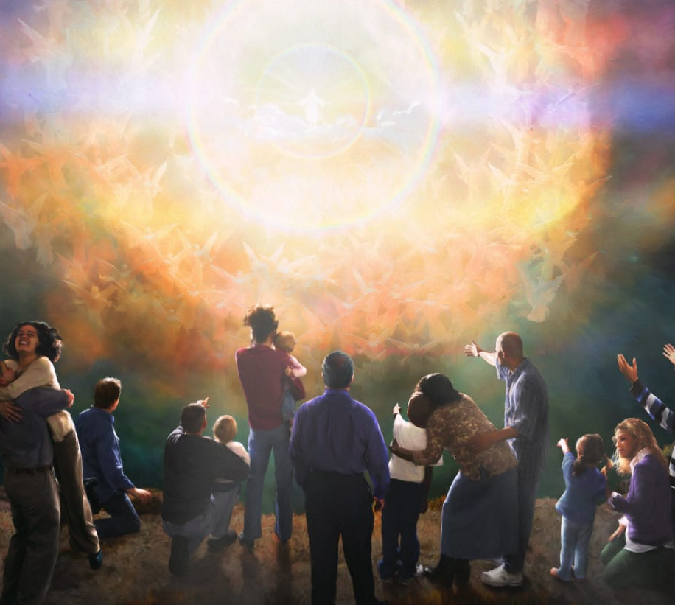
Matthew
16:27
²⁷ For the Son of man shall come in the glory of his Father with his angels; and then he shall reward every man according to his works.

Slide 43
14. When is it that there come these lightnings, and voices, and thunderings, and the earthquake, and great hail?
Revelation 16:17-18, 20-21

Slide 44

Revelation
16:17-18, 20-21
¹⁷ And the seventh angel poured out his vial into the air; and there came a great voice out of the temple of heaven, from the throne, saying, It is done.

Slide 45
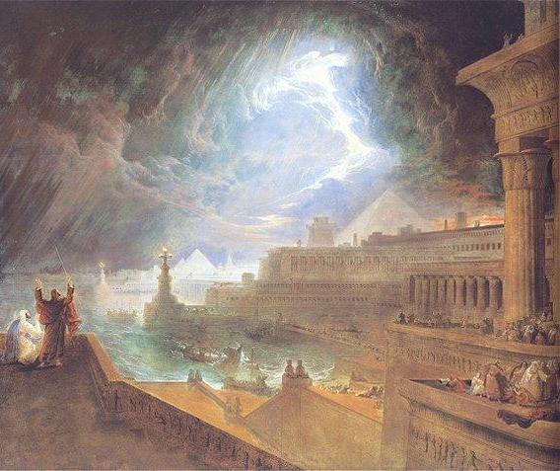
Revelation
16:17-18, 20-21
¹⁸ And there were voices, and thunders, and lightnings; and there was a great earthquake, such as was not since men were upon the earth, so mighty an earthquake, and so great.

Slide 46
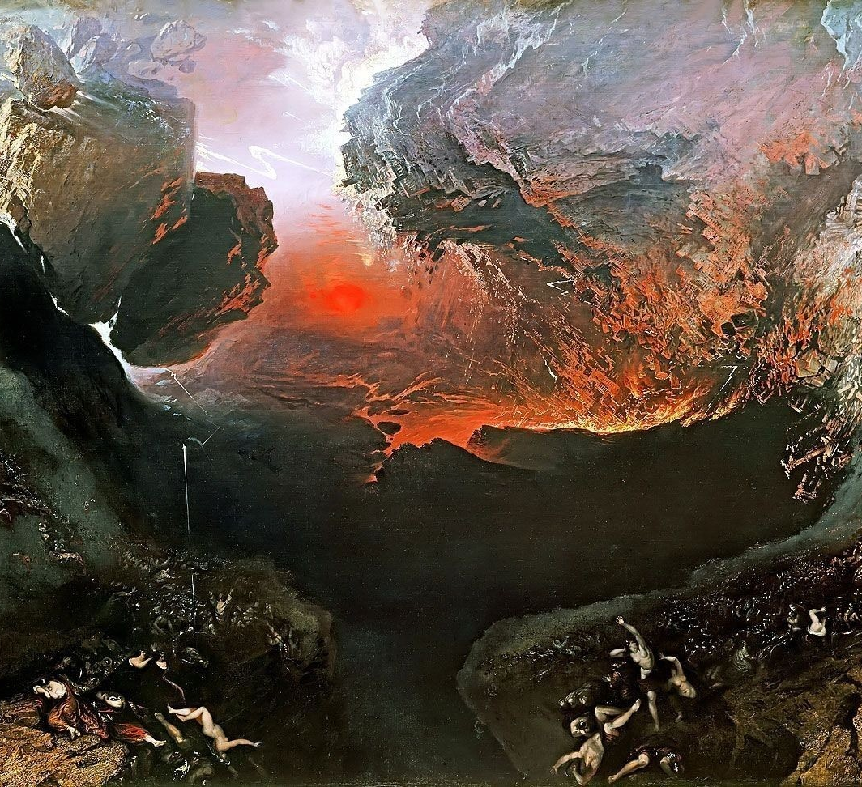
Revelation
16:17-18, 20-21
²⁰ And every island fled away, and the mountains were not found.

Slide 47
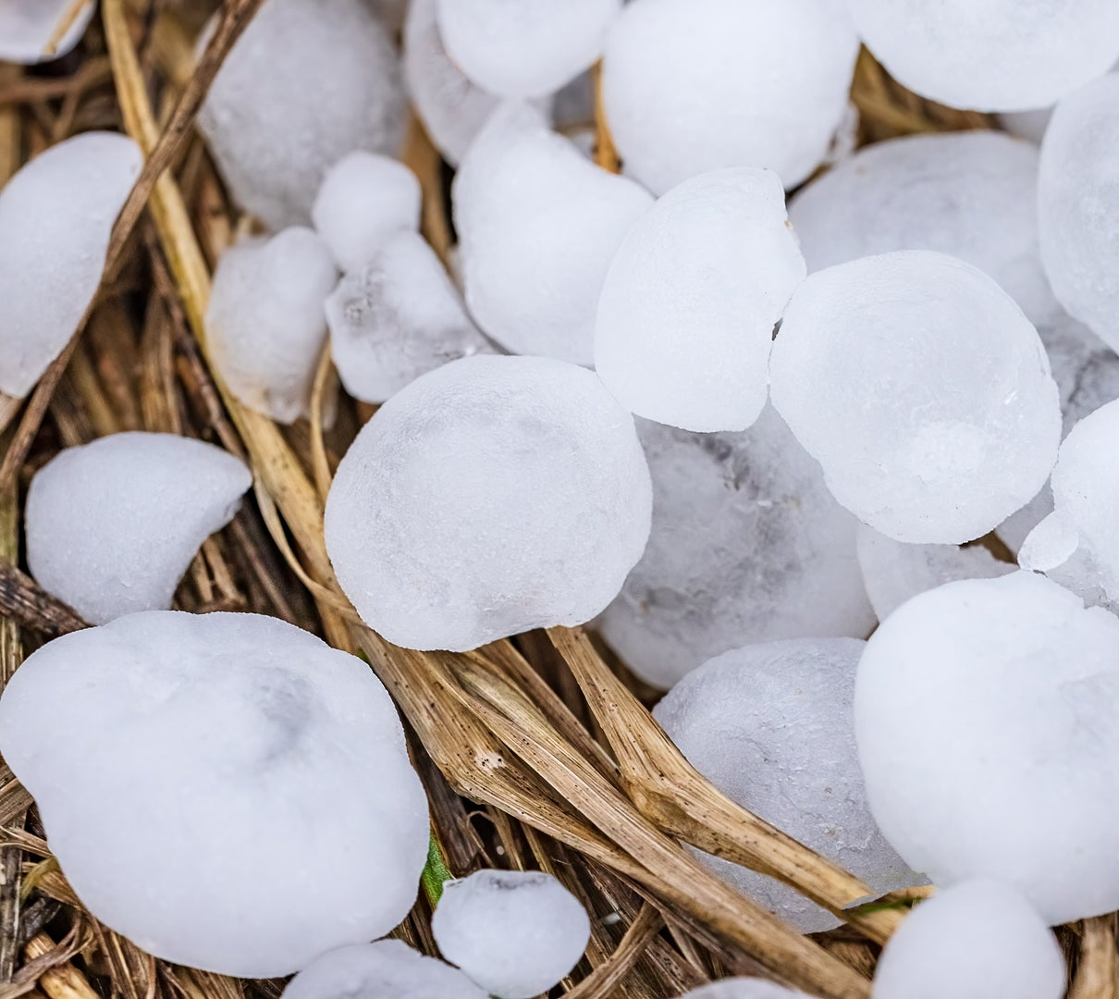
Revelation
16:17-18, 20-21
²¹ And there fell upon men a great hail out of heaven, every stone about the weight of a talent: and men blasphemed God because of the plague of the hail; for the plague thereof was exceeding great.

Slide 48
15. In what length of time, comparatively, was this woe—the seventh trumpet—to come, after the second woe was past?
Revelation 11:14

Slide 49
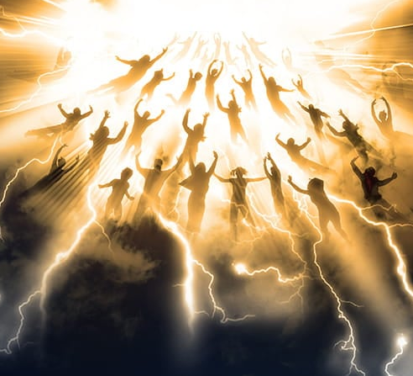
Revelation
11:14
¹⁴ The second woe is past; and, behold, the third woe cometh quickly.

Slide 50
16. When did the second woe end?
Answer: August 11, A.D. 1840.

Slide 51
17. Yet what was to come before the seventh trumpet?
Revelation 10:1, 2, 5, 7

Slide 52
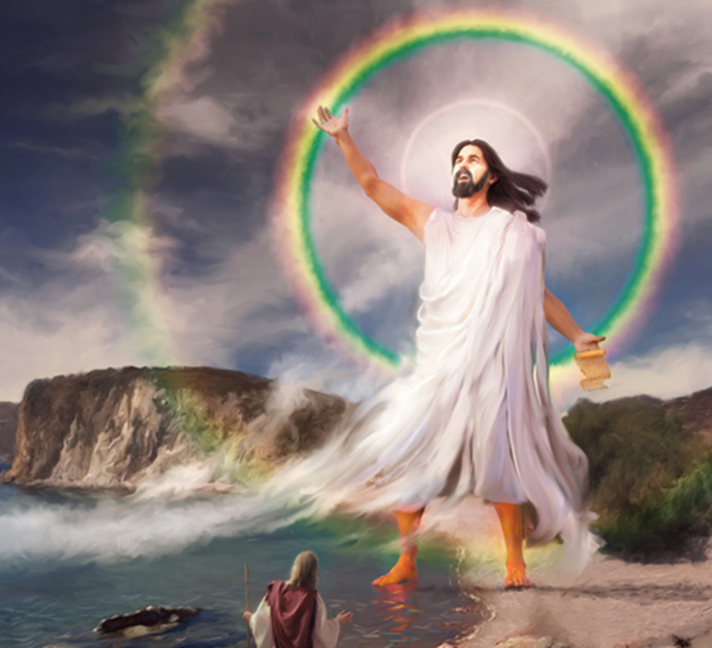
Revelation
10:1, 2, 5,7
10 And I saw another mighty angel come down from heaven, clothed with a cloud: and a rainbow was upon his head, and his face was as it were the sun, and his feet as pillars of fire:

Slide 53
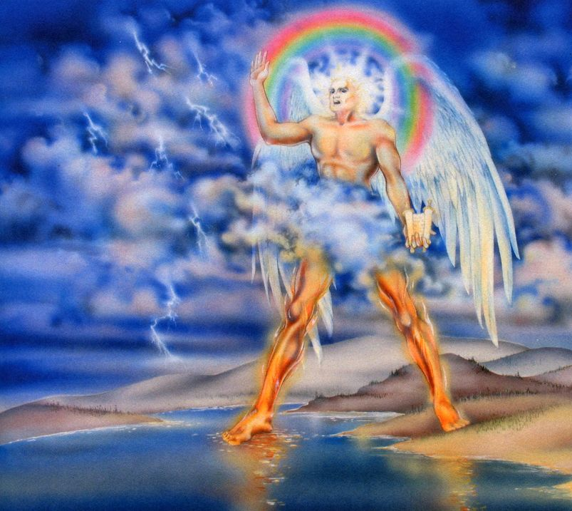
Revelation
10:1, 2, 5,7
² And he had in his hand a little book open: and he set his right foot upon the sea, and his left foot on the earth,

Slide 54
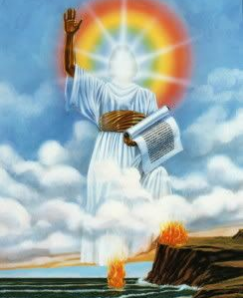
Revelation
10:1, 2, 5,7
⁵ And the angel which I saw stand upon the sea and upon the earth lifted up his hand to heaven,

Slide 55
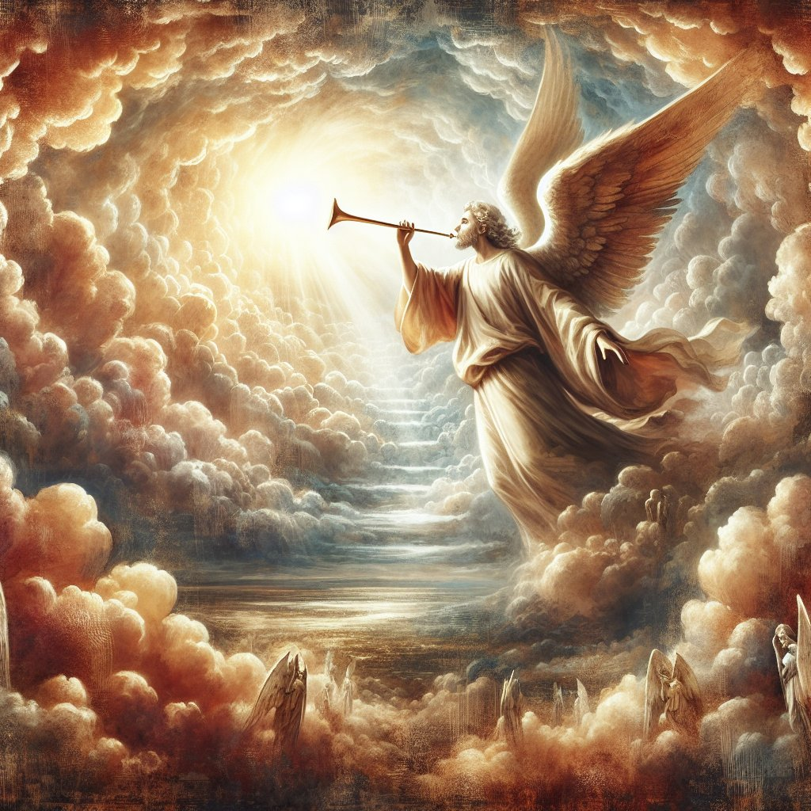
Revelation
10:1, 2, 5,7
⁷ But in the days of the voice of the seventh angel, when he shall begin to sound, the mystery of God should be finished, as he hath declared to his servants the prophets.

Slide 56
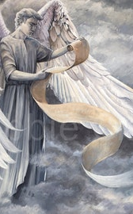
Before the final woe
Revelation moves forward in sequences (seals, trumpets, woes)
Before a final climactic step, John often pauses the action
This pause is intentional, not a digression
During the pause, God:
  explains what is happening
  reassures His people
  prepares them for what comes next

Slide 57

Before the final woe
Seals
  6th seal → pause (Revelation 7)
  God seals and reassures His people
  7th seal → action resumes (Revelation 8:1)
Trumpets / Woes
  2nd woe (6th trumpet) ends → pause (Revelation 10–11)
  God explains what will happen “when the seventh angel begins to sound”3rd woe
  (7th trumpet) follows

Slide 58
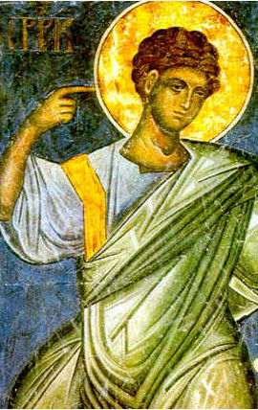
Before the final woe
God does not rush His people into the end without explanation.
He pauses.
He speaks.
He reassures.
He recommissions.
He clarifies what time it is.
Revelation 10 isn’t interrupting the seventh trumpet — it’s explaining how it begins.

Slide 59
“In the days of the voice of the seventh angel, when he shall begin to sound…”
— Revelation 10:7
The seventh trumpet is described as a period that begins, not a single instant

Slide 60
“the seventh angel sounded…The kingdoms of this world are become the kingdoms of our Lord…
— Revelation 11:15
During this time, major end-time realities are introduced:
God’s kingdom (Rev. 11:15)
Judgment (Rev. 11:18)
Completion of God’s mystery (Rev. 10:7)

Slide 61
17. Yet what was to come before the seventh trumpet?
Answer: A special message from heaven.
Revelation 10:1-11:14 describes an interlude of explanation and proclamation — a message declaring what will happen as the seventh trumpet begins.

Slide 62
18. What is it especially that this angel says shall be done in the time of the seventh trumpet angel?

Slide 63
18. What is it especially that this angel says shall be done in the time of the seventh trumpet angel?
Answer: The mystery of God shall be finished.
As the seventh trumpet begins to sound, God’s “mystery” reaches its completion. (There’s a natural follow up question here! Not to worry, it’s coming!)

Slide 64
19. What time in his sounding is this to be done?

Slide 65
19. What time in his sounding is this to be done?
Answer: “In the days [the years] . . . when he shall begin to sound.”
Whatever the “mystery of God” might be, it’s concluding, reaching completion, in the years when the seventh trumpet begins to sound.

Slide 66
20. What is the mystery of God?
Ephesians 3:3, 5–9; Galatians 1:12; Ephesians 6:18, 19; Romans 16:25, 26

Slide 67

Ephesians
3:2-9
² If ye have heard of the dispensation of the grace of God which is given me to you-ward:

Slide 68

Ephesians
3:2-9
³ How that by revelation he made known unto me the mystery; (as I wrote afore in few words,
⁴ Whereby, when ye read, ye may understand my knowledge in the mystery of Christ)

Slide 69
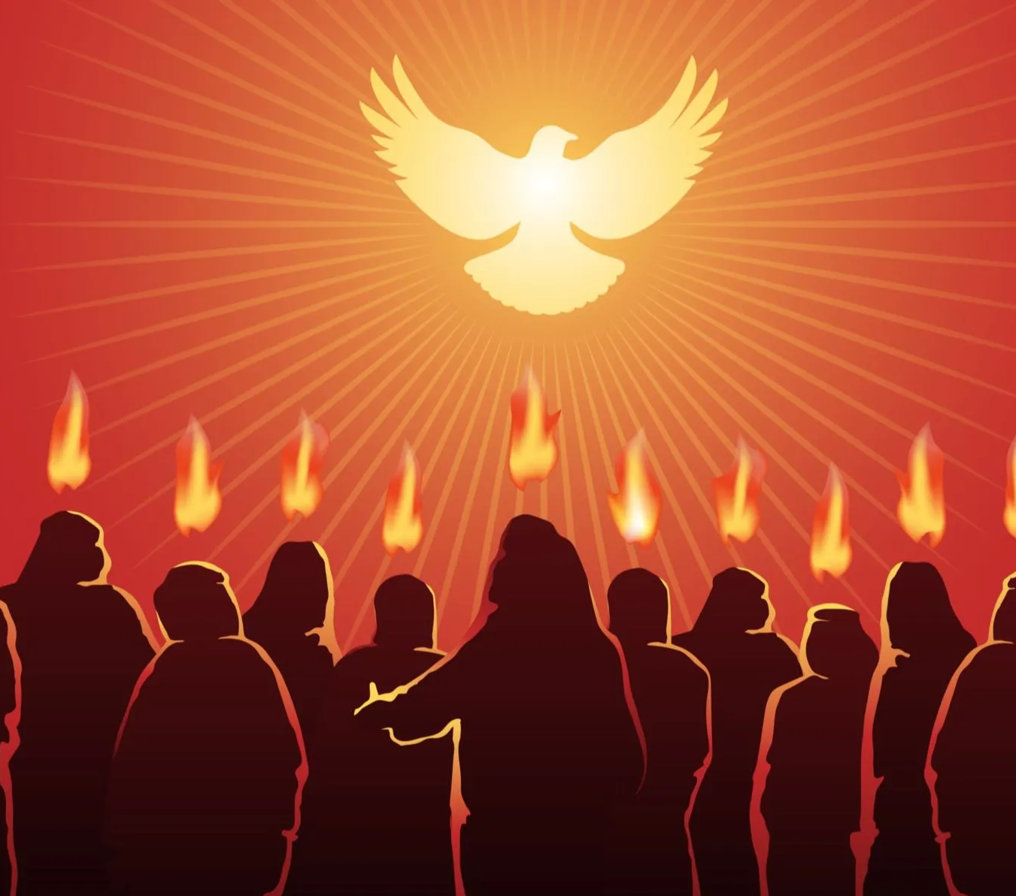
Ephesians
3:2-9
⁵ Which in other ages was not made known unto the sons of men, as it is now revealed unto his holy apostles and prophets by the Spirit;

Slide 70
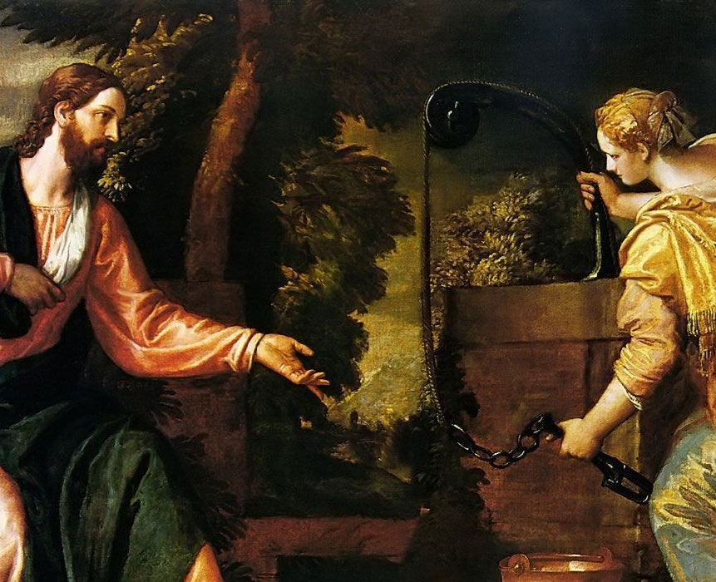
Ephesians
3:2-9
⁶ That the Gentiles should be fellowheirs, and of the same body, and partakers of his promise in Christ by the gospel:

Slide 71
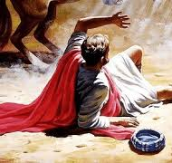
Ephesians
3:2-9
⁷ Whereof I was made a minister, according to the gift of the grace of God given unto me by the effectual working of his power.

Slide 72
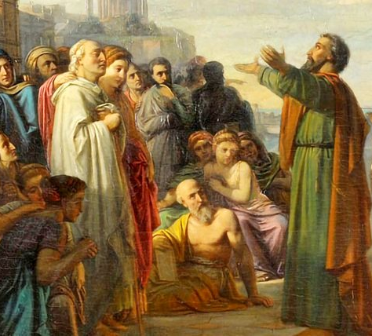
Ephesians
3:2-9
⁸ Unto me, who am less than the least of all saints, is this grace given, that I should preach among the Gentiles the unsearchable riches of Christ;

Slide 73
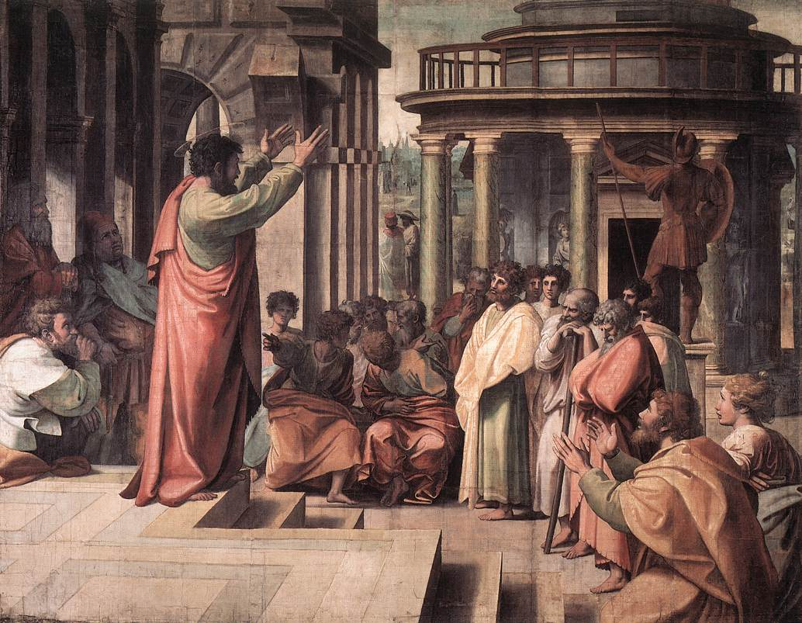
Ephesians
3:2-9
⁹ And to make all men see what is the fellowship of the mystery, which from the beginning of the world hath been hid in God, who created all things by Jesus Christ:

Slide 74
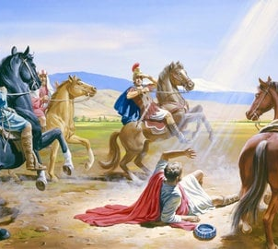
Galatians
1:11-12
¹¹ But I certify you, brethren, that the gospel which was preached of me is not after man.
¹² For I neither received it of man, neither was I taught it, but by the revelation of Jesus Christ.

Slide 75
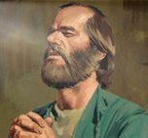
Ephesians
6:18-19
¹⁸ Praying always with all prayer and supplication in the Spirit, and watching thereunto with all perseverance and supplication for all saints;

Slide 76
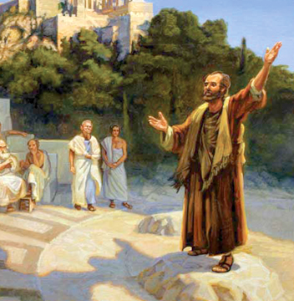
Ephesians
6:18-19
¹⁹ And for me, that utterance may be given unto me, that I may open my mouth boldly, to make known the mystery of the gospel,

Slide 77
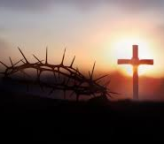
Romans
16:25, 26
²⁵ Now to him that is of power to stablish you according to my gospel, and the preaching of Jesus Christ, according to the revelation of the mystery, which was kept secret since the world began,

Slide 78
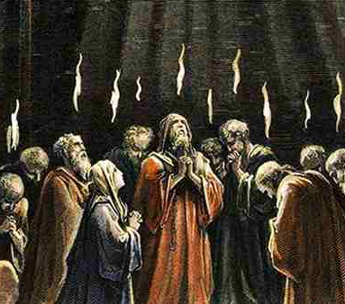
Romans
16:25, 26
²⁶ But now is made manifest, and by the scriptures of the prophets, according to the commandment of the everlasting God, made known to all nations for the obedience of faith:

Slide 79
21. What is the Gospel?
Romans 1:16

Slide 80

1 Corinthians
15:1-4
15 Moreover, brethren, I declare unto you the gospel which I preached unto you, which also ye have received, and wherein ye stand;

Slide 81
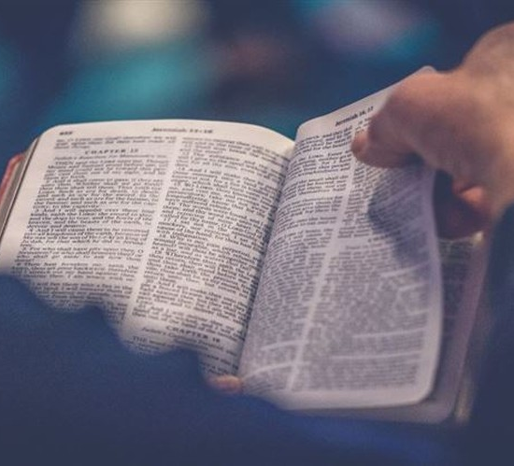
1 Corinthians
15:1-4
² By which also ye are saved, if ye keep in memory what I preached unto you, unless ye have believed in vain.

Slide 82
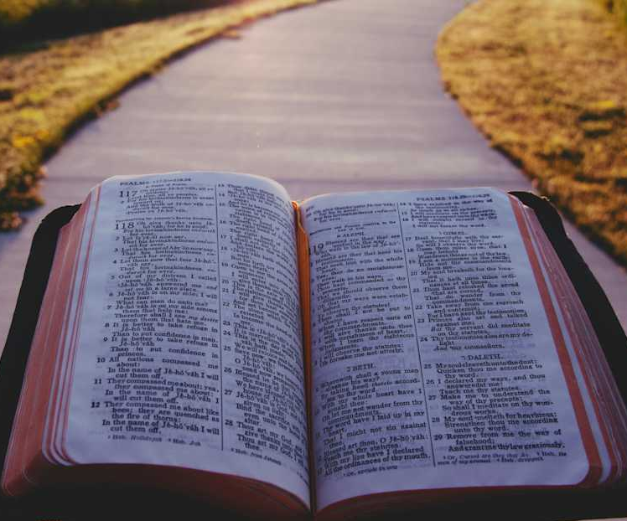
1 Corinthians
15:1-4
³ For I delivered unto you first of all that which I also received, how that Christ died for our sins according to the scriptures;

Slide 83
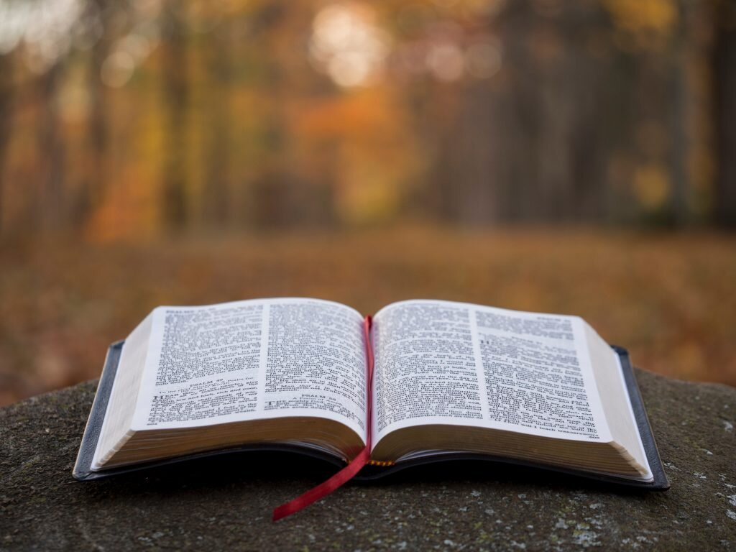
1 Corinthians
15:1-4
⁴ And that he was buried, and that he rose again the third day according to the scriptures:

Slide 84
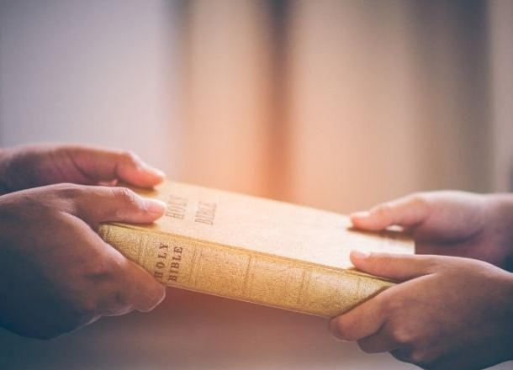
Romans
1:16
¹⁶ For I am not ashamed of the gospel of Christ: for it is the power of God unto salvation to every one that believeth; to the Jew first, and also to the Greek.

Slide 85
22. Then in effect what is said by the angel in Revelation 10:7?
Answer: That in the days of the voice of the seventh angel, when he shall begin to sound, the power of God for the salvation of sinners will cease to be exercised.

Slide 86
23. As all these things are to follow in quick succession when the seventh angel sounds, is it not, therefore, of immense importance to the world to know when the seventh trumpet angel begins to sound?

Slide 87
Thank you!
… and Happy Sabbath!!

Slide 88


