Slide 1


Slide 2

Living the Light

Slide 3
The Third Angel’s Message
Lesson 5: The Time of the Message - Concluded
August 4, 1888
Lesson 5, 3rd Quarter 1888

Slide 4
This is one continuous study:
Lesson 1 — The Time of the Message
Lesson 2 — The Time of the Message — Continued
Lesson 3 — The Time of the Message — Continued
Lesson 4 — The Time of the Message — Continued
Lesson 5 — The Time of the Message — Concluded

Slide 5

Lessons 1 and 2
The identity of the little horn → the Papacy
The 1,260 years → A.D. 538 to 1798
The deadly wound → 1798
The rise of a new power in the same period → Revelation 13:11
That power arises outside the crowded nations of Europe, Asia, Africa → the United States

Slide 6
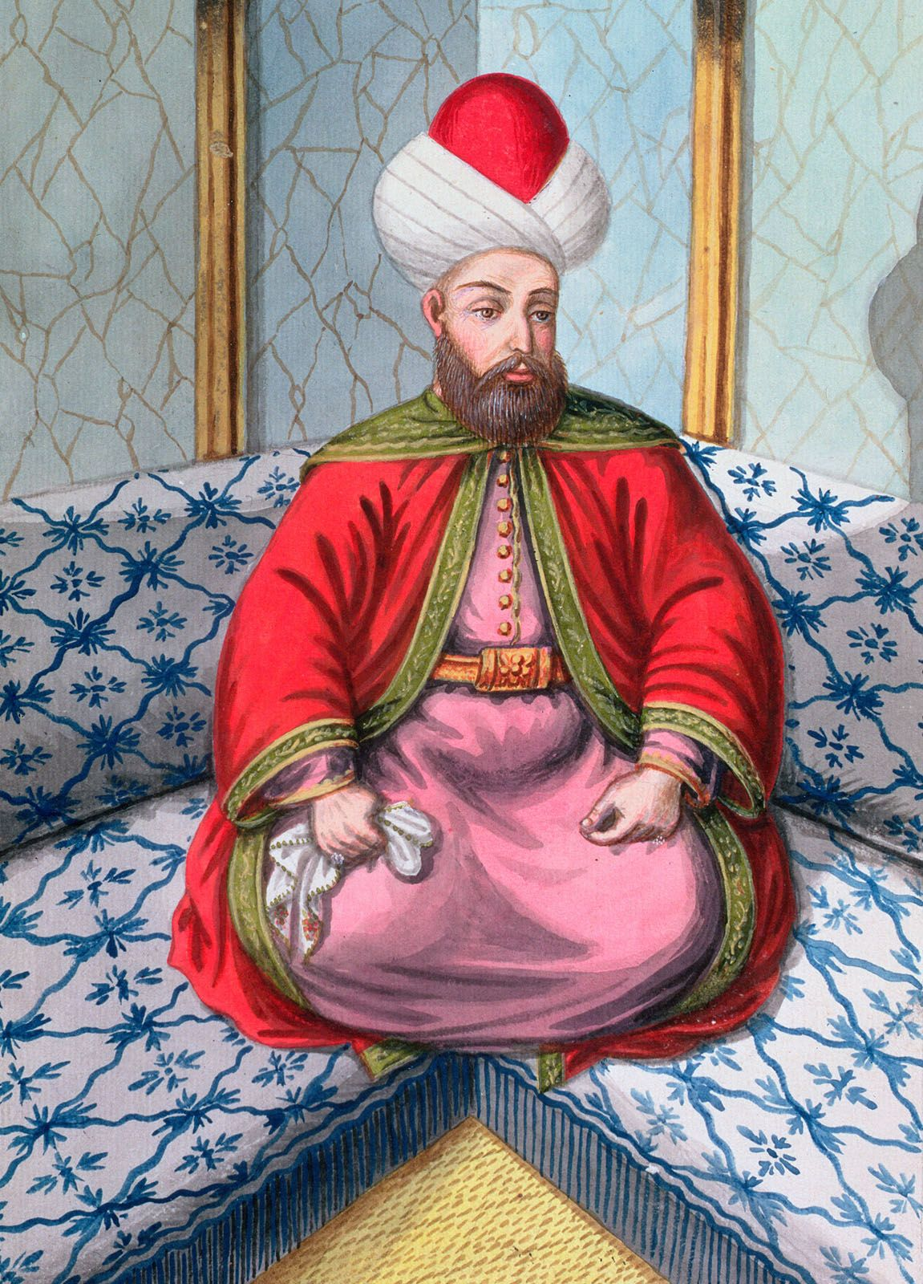
Lesson 3 Shifts Gears
Introduced the three woes connected with the trumpets
Identified:
  First woe → rise of Islam (1299–1449)
  Second woe → Ottoman supremacy (1449–1840)
Landed on a very specific historical date: August 11, 1840

Slide 7
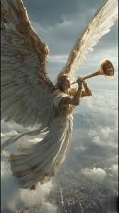
Lesson 4 Sets the Stage
Third woe = Seventh trumpet
Seventh trumpet is a lengthy period that includes:
  Judgment / reward,
  God’s wrath,
  Closing of God’s work of salvation (the ‘Mystery of God.’)
  The First Angel of Revelation 14 follows the 3rd woe/7th trumpet

Slide 8
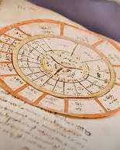
Prophetic Time to Prophetic Meaning
Lessons 1–4 established where we are in prophetic time:
  The great prophetic periods have closed
  The seventh trumpet / third woe has begun
  Judgment is announced
  God’s final work is underway

Slide 9
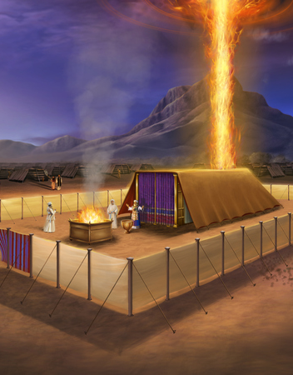
Prophetic Time to Prophetic Meaning
  But prophecy does not stop with announcements! When Revelation speaks of judgment/reward/the closing of God’s saving work, it is pointing us to a specific divine process
  Scripture does not leave that process undefined! God has already given a model, a pattern, and a language for it

Slide 10
Thy way, O God, is in the sanctuary: who is so great a God as our God?
Psalm 77:13

Slide 11

1. What was the purpose of the sanctuary and the service of the Levitical priesthood?

Slide 12
1. What was the purpose of the sanctuary and the service of the Levitical priesthood?
Answer: It was a figure of the sanctuary and service of the priesthood of Christ.
Hebrews 9:9, 22, 23, 11, 12, 24

Slide 13
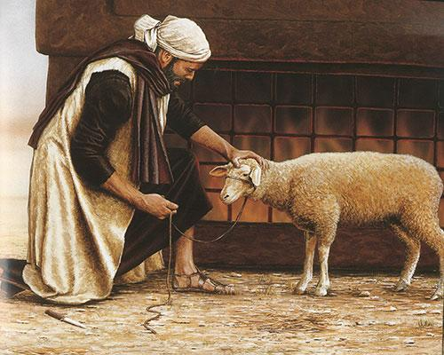
Hebrews
9:9, 22-23
⁹ Which was a figure for the time then present, in which were offered both gifts and sacrifices, that could not make him that did the service perfect, as pertaining to the conscience;

Slide 14
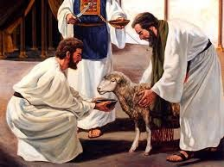
Hebrews
9:9, 22-23
²² And almost all things are by the law purged with blood; and without shedding of blood is no remission.

Slide 15
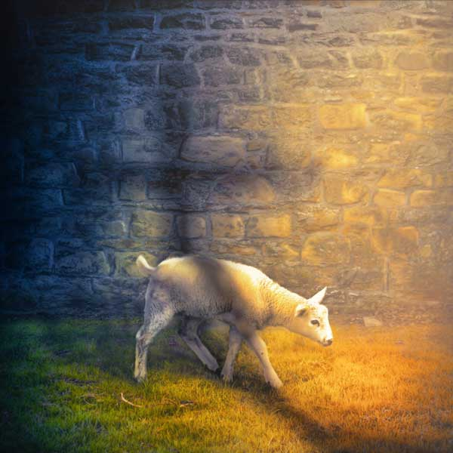
Hebrews
9:9, 22-23
²³ It was therefore necessary that the patterns of things in the heavens should be purified with these; but the heavenly things themselves with better sacrifices than these.

Slide 16
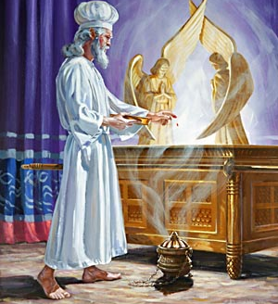
Hebrews
9:11-12, 24
¹¹ But Christ being come an high priest of good things to come, by a greater and more perfect tabernacle, not made with hands, that is to say, not of this building;

Slide 17
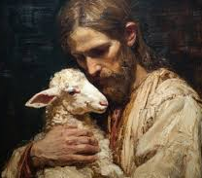
Hebrews
9:11-12, 24
¹² Neither by the blood of goats and calves, but by his own blood he entered in once into the holy place, having obtained eternal redemption for us.

Slide 18
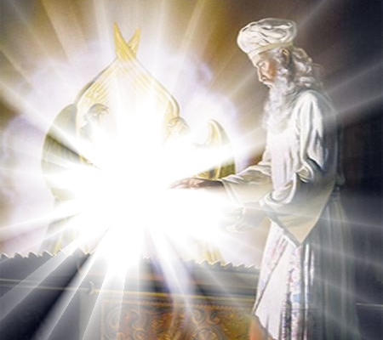
Hebrews
9:11-12, 24
²⁴ For Christ is not entered into the holy places made with hands, which are the figures of the true; but into heaven itself, now to appear in the presence of God for us:

Slide 19
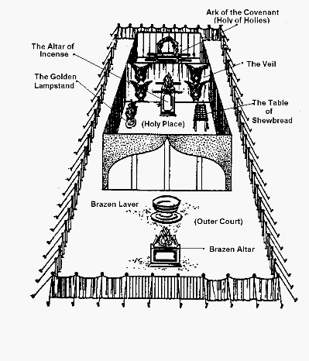
The Sanctuary Services
The sanctuary service was not an end in itself
It was a figure — a teaching model of Christ’s work
“Which was a figure for the time then present.” — Hebrews 9:9

Slide 20
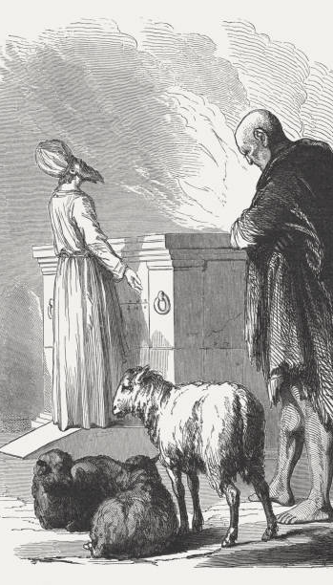
Two Phases of Ministry
1. Daily Service
Sacrifices offered continually
Sin was confessed and transferred
Forgiveness was granted
“Almost all things are by the law purged with blood.” — Hebrews 9:22
God’s mercy was always available
Salvation was real and present

Slide 21
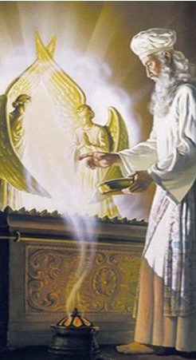
Two Phases of Ministry
2. The Day of Atonement
Occurred once each year
The sanctuary itself was cleansed
Final separation between those who accepted, those who refused atonement
“For on that day shall the priest make an atonement for you, to cleanse you.” — Leviticus 16:30
A work of judgment and of mercy
A decisive settling of cases

Slide 22
2. In the figure, how often was the service completed?
Leviticus 16:34; Hebrews 9:7

Slide 23
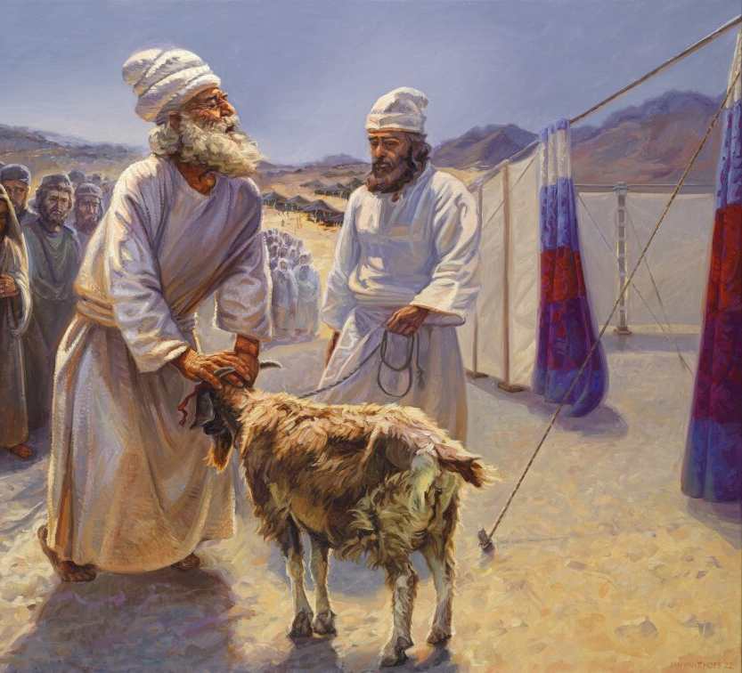
Leviticus
16:34
³⁴ And this shall be an everlasting statute unto you, to make an atonement for the children of Israel for all their sins once a year. And he did as the Lord commanded Moses.

Slide 24
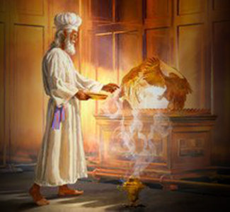
Hebrews
9:7
⁷ But into the second went the high priest alone once every year, not without blood, which he offered for himself, and for the errors of the people:

Slide 25
3. In the reality, how often will it be completed?
Hebrews 9:12, 24–26;
Hebrews 10:3, 10

Slide 26
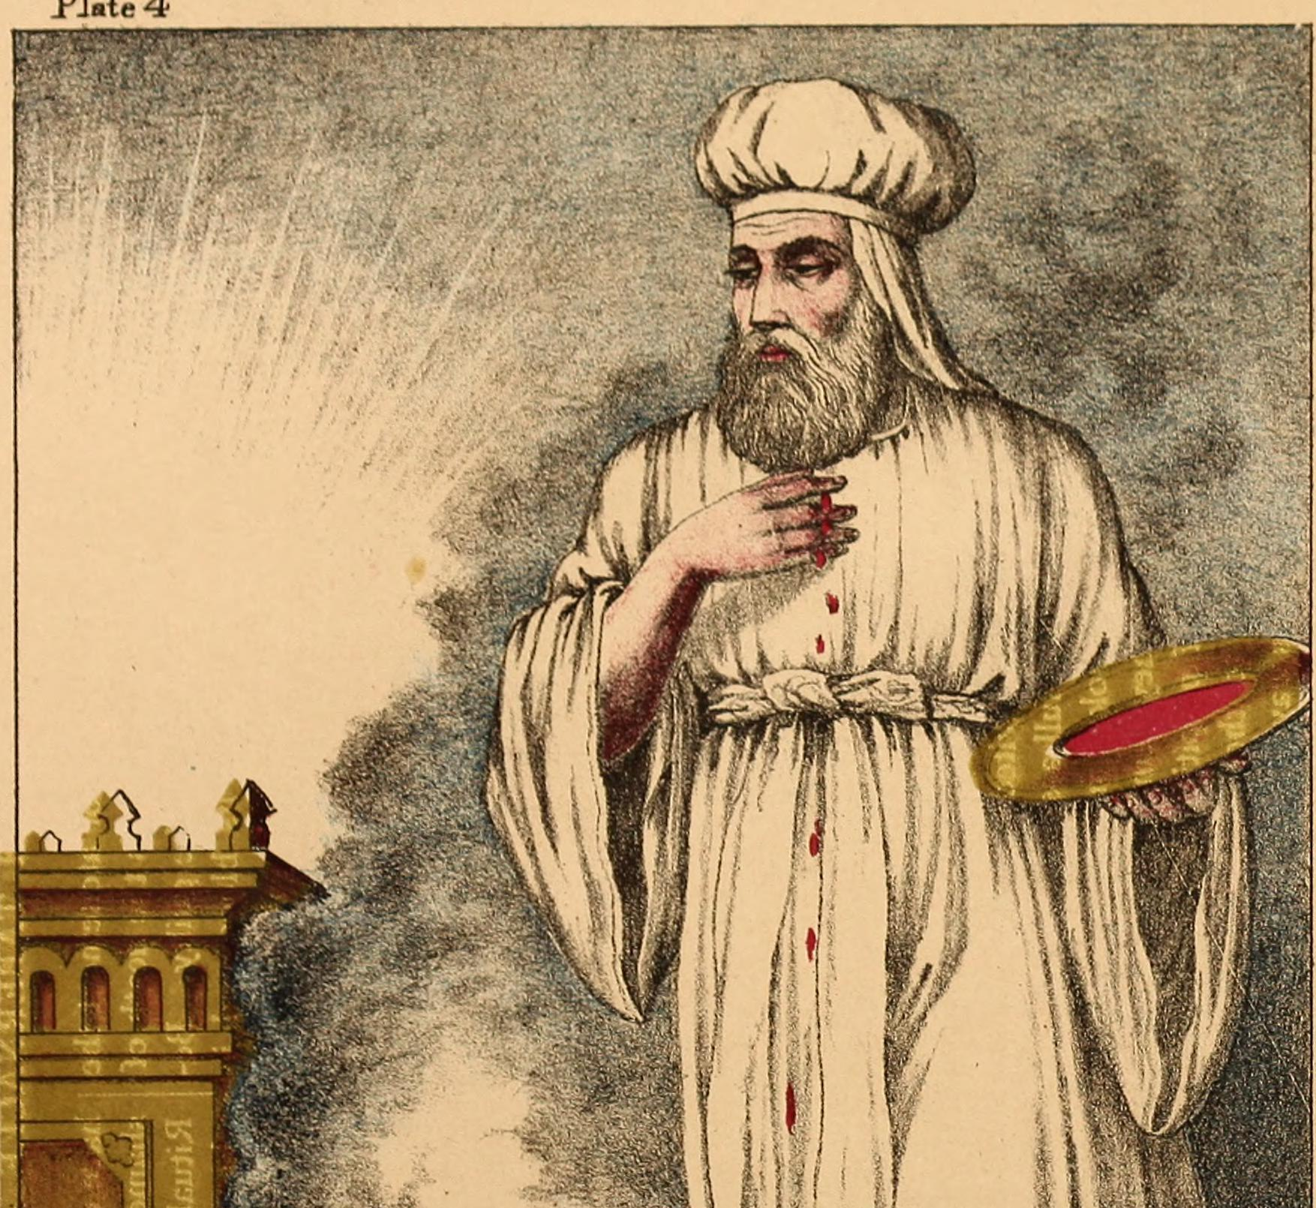
Hebrews
9:12, 24-26
¹² Neither by the blood of goats and calves, but by his own blood he entered in once into the holy place, having obtained eternal redemption for us.

Slide 27
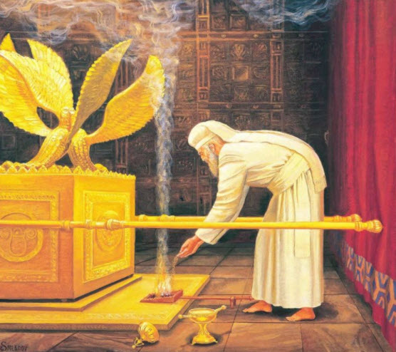
Hebrews
9:12, 24-26
²⁴ For Christ is not entered into the holy places made with hands, which are the figures of the true; but into heaven itself, now to appear in the presence of God for us:

Slide 28
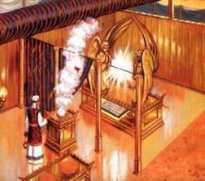
Hebrews
9:12, 24-26
²⁵ Nor yet that he should offer himself often, as the high priest entereth into the holy place every year with blood of others;

Slide 29
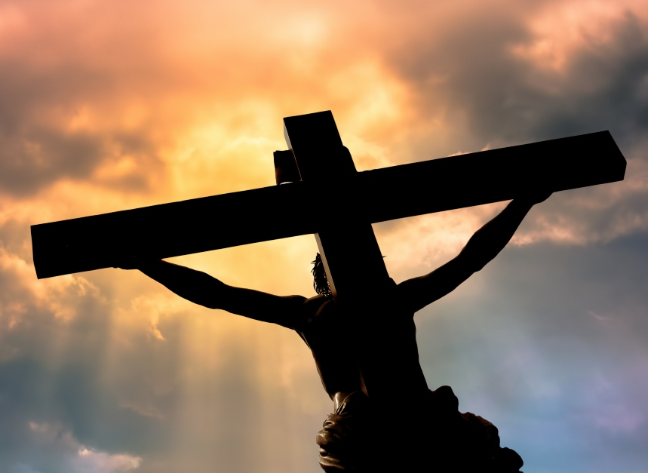
Hebrews
9:12, 24-26
²⁶ For then must he often have suffered since the foundation of the world: but now once in the end of the world hath he appeared to put away sin by the sacrifice of himself.

Slide 30
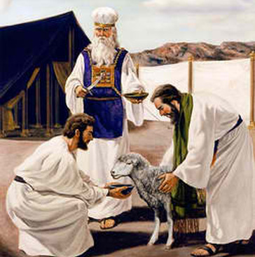
Hebrews
10:3, 10
³ But in those sacrifices there is a remembrance again made of sins every year.

Slide 31
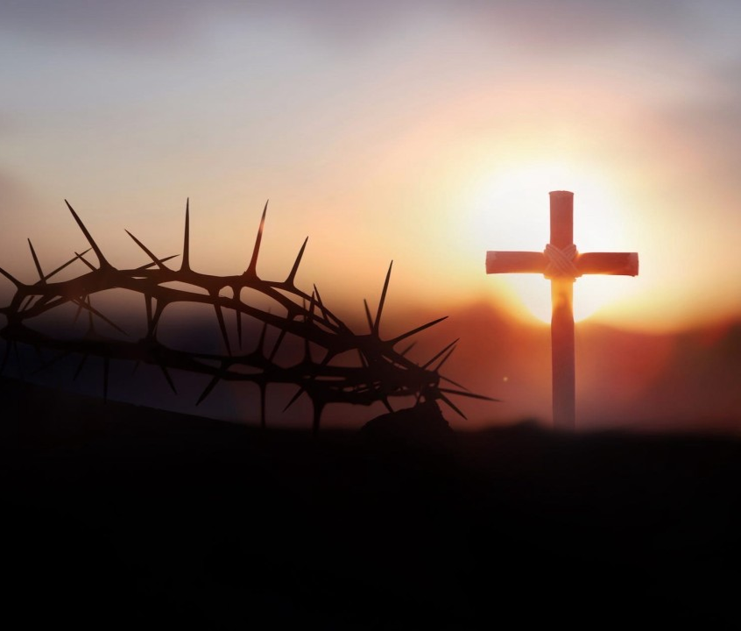
Hebrews
10:3, 10
¹⁰ By the which will we are sanctified through the offering of the body of Jesus Christ once for all.

Slide 32
4. What was that day’s service called which was performed on the last day of the annual service of the earthly sanctuary?
Answer: The atonement, cleansing of the sanctuary, and “reconciling” the sanctuary.
Leviticus 16:19, 20, 33

Slide 33
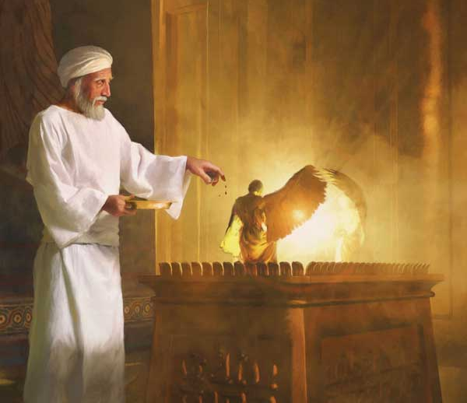
Leviticus
16:19, 20, 33
¹⁹ And he shall sprinkle of the blood upon it with his finger seven times, and cleanse it, and hallow it from the uncleanness of the children of Israel.

Slide 34
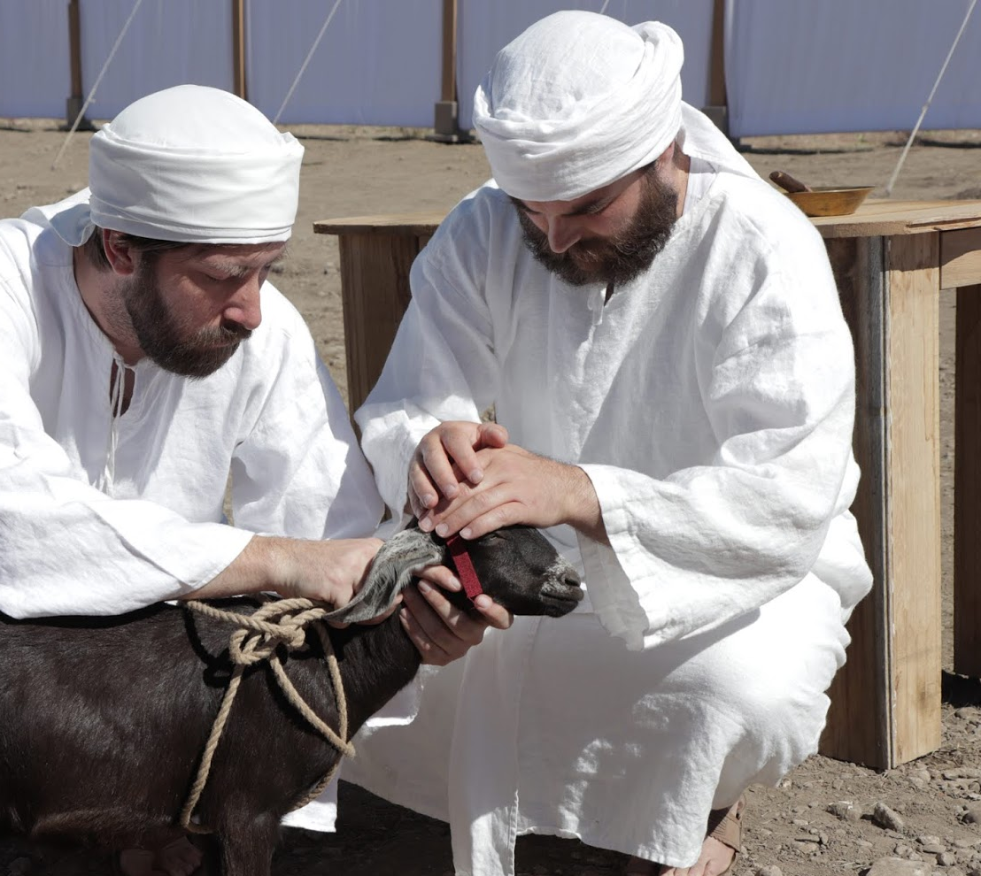
Leviticus
16:19, 20, 33
²⁰ And when he hath made an end of reconciling the holy place, and the tabernacle of the congregation, and the altar, he shall bring the live goat:

Slide 35
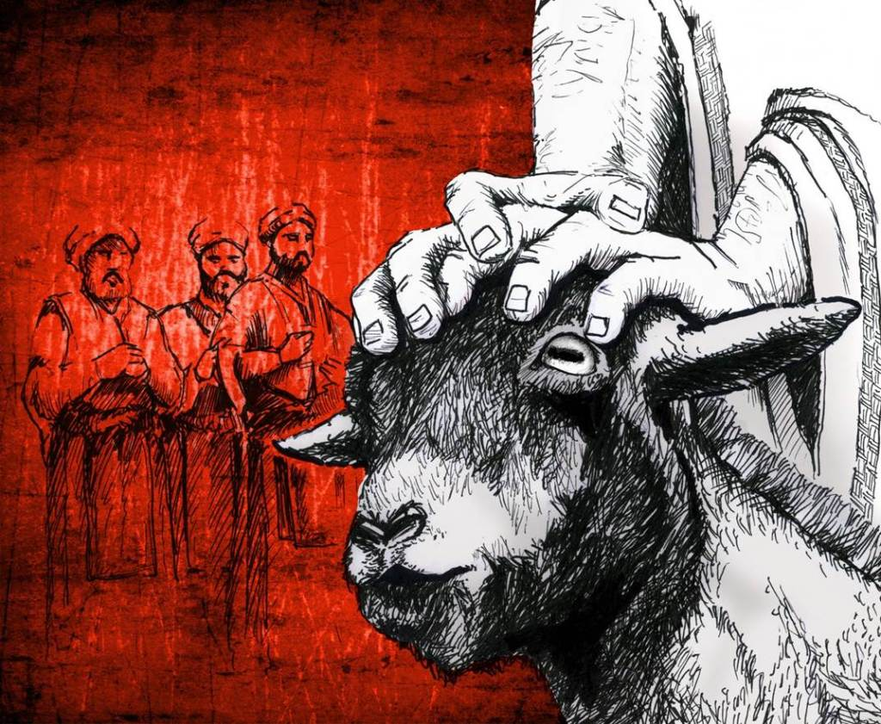
Leviticus
16:19, 20, 33
³³ And he shall make an atonement for the holy sanctuary, and he shall make an atonement for the tabernacle of the congregation, and for the altar, and he shall make an atonement for the priests, and for all the people of the congregation.

Slide 36
5. What made it necessary to cleanse, or reconcile, this sanctuary?
Leviticus 16:16, 30, 34

Slide 37
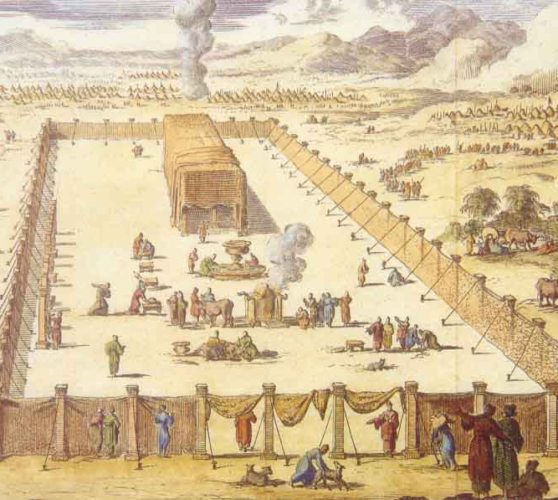
Leviticus
16:16, 30, 34
¹⁶ And he shall make an atonement for the holy place, because of the uncleanness of the children of Israel, and because of their transgressions in all their sins: and so shall he do for the tabernacle of the congregation, that remaineth among them in the midst of their uncleanness.

Slide 38
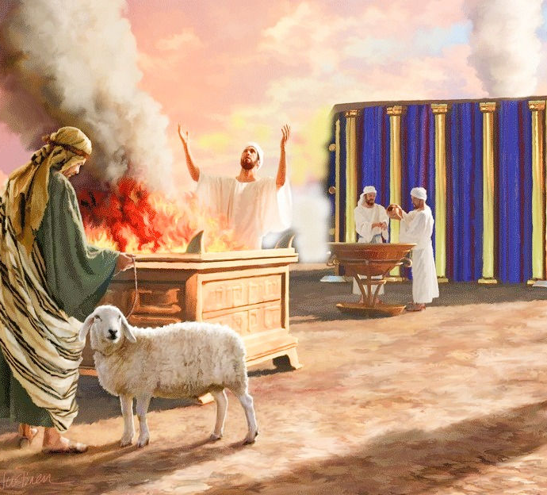
Leviticus
16:16, 30, 34
³⁰ For on that day shall the priest make an atonement for you, to cleanse you, that ye may be clean from all your sins before the Lord.

Slide 39
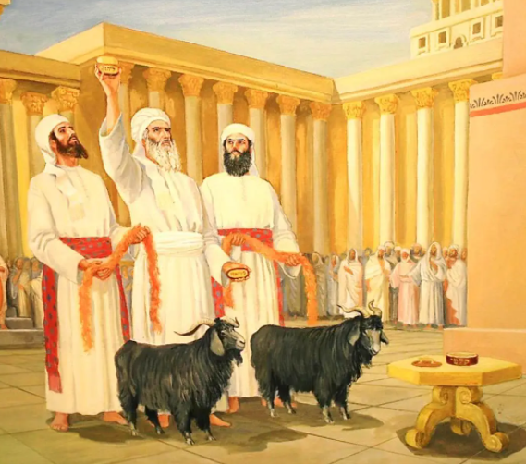
Leviticus
16:16, 30, 34
³⁴ And this shall be an everlasting statute unto you, to make an atonement for the children of Israel for all their sins once a year. And he did as the Lord commanded Moses.

Slide 40
6. Is the heavenly sanctuary to be purified, cleansed, or reconciled?
Hebrews 9:23;
Colossians 1:20

Slide 41
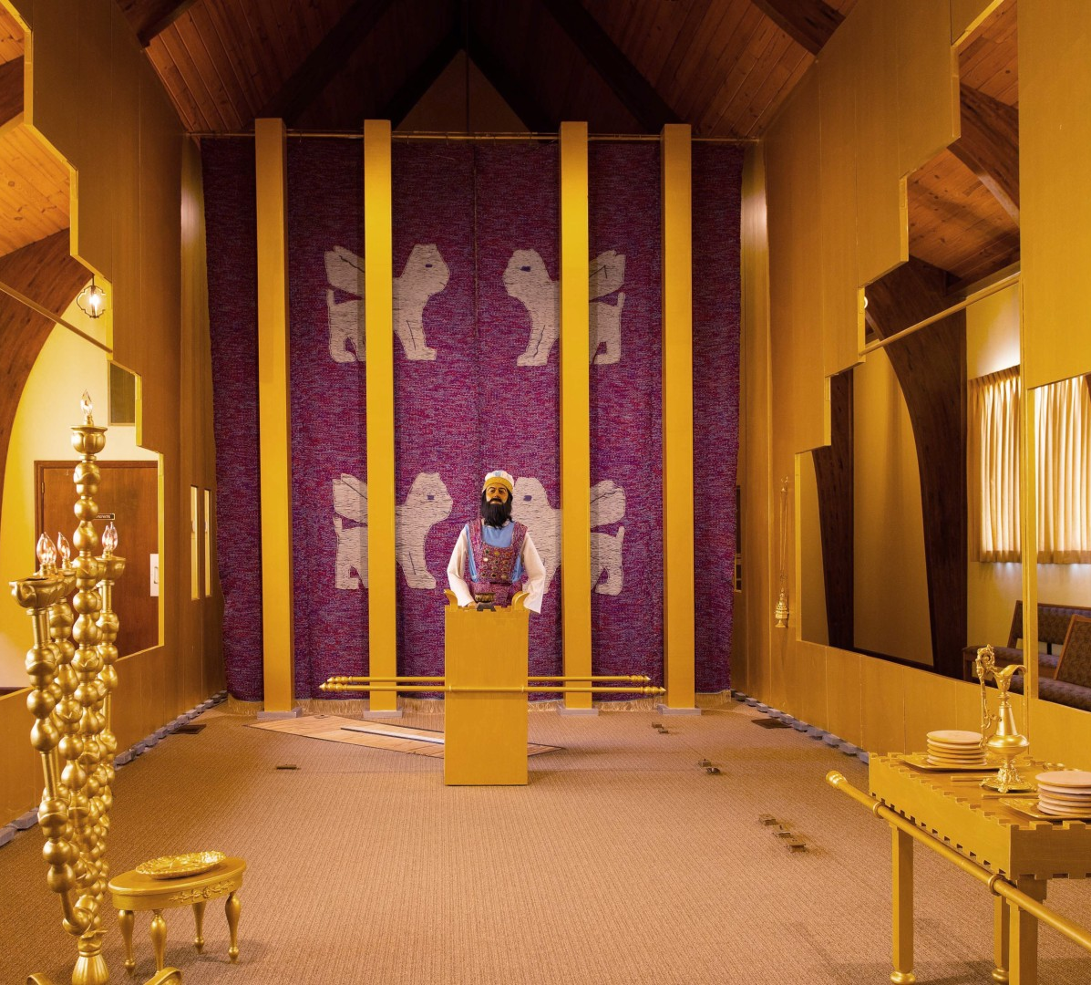
Hebrews
9:23
²³ It was therefore necessary that the patterns of things in the heavens should be purified with these; but the heavenly things themselves with better sacrifices than these.

Slide 42
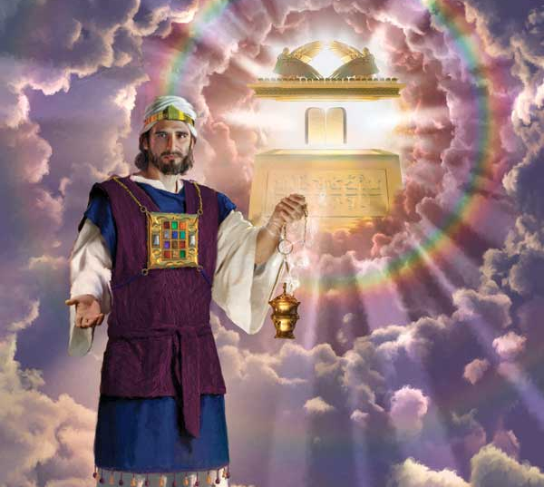
Colossians 1:20
²⁰ And, having made peace through the blood of his cross, by him to reconcile all things unto himself; by him, I say, whether they be things in earth, or things in heaven.

Slide 43
7. What says the prophecy on this?
Daniel 8:14

Slide 44
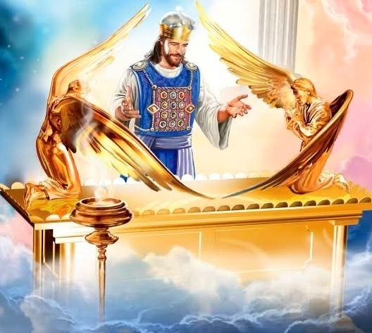
Daniel
8:14
¹⁴ And he said unto me, Unto two thousand and three hundred days; then shall the sanctuary be cleansed.

Slide 45
8. When did this period of time begin?
Answer: B.C. 456 1/2.
Daniel 9:25;
Ezra 7:7–26

Slide 46
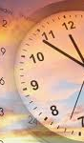
As we read through Daniel 8 and 9…
We learn of the 2300 day prophecy and we know that at the end of it, the sanctuary is cleansed (Daniel 8:14),
But Daniel does not understand it, and we don’t know when it starts.
Then Gabriel, the angel, comes to explain,
Gabriel tells Daniel that “the vision of the evening and the morning which was told is true: wherefore shut thou up the vision; for it shall be for many days.” (Daniel 8:26)

Slide 47

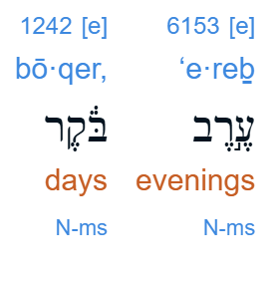
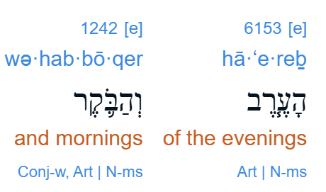
Evening-Mornings
Daniel 8:14 does not use the normal Hebrew word for a calendar day (yôm).
Instead, it uses the paired expression:
“evening–morning”
(ʿereb bōqer)
This is the same phrasing as the “vision of the evening and the morning” that we see in Daniel 8:26.

Slide 48
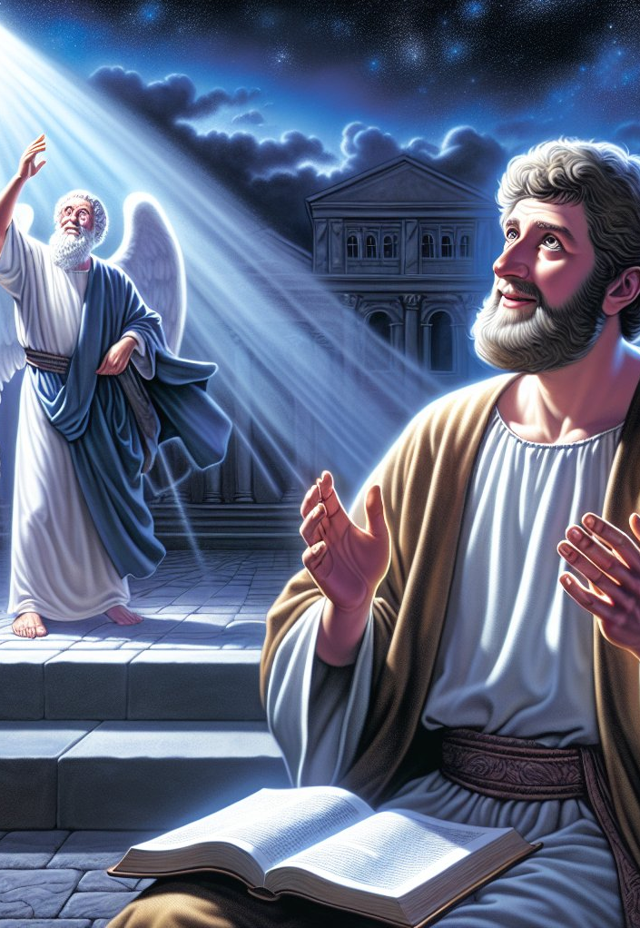
As we read through Daniel 8 and 9…
Just as Gabriel begins to talk about the 2300 “evenings-mornings,”
Daniel faints, and “was sick certain days” but he still doesn’t understand the vision (Daniel 8:27).
After his recovery, Daniel is thinking about the future, how the time is coming for the Jewish people to return to Jerusalem (Daniel 9:2).

Slide 49
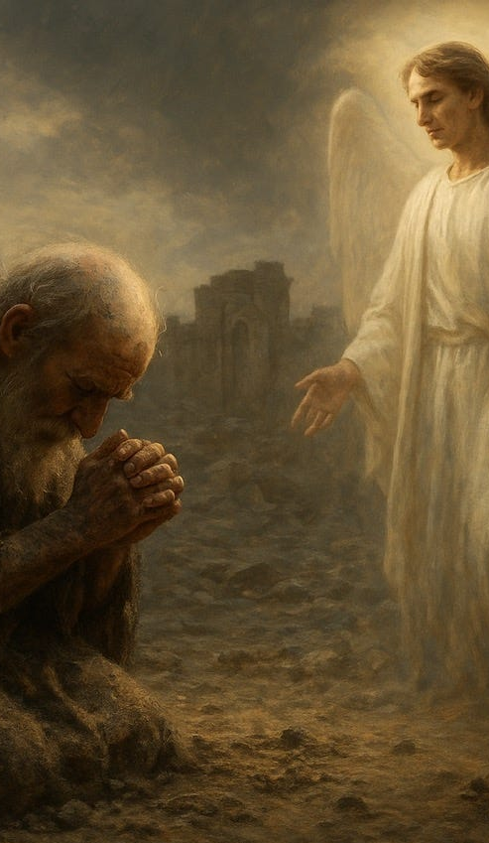
As we read through Daniel 8 and 9…
As Daniel is praying, repenting, no doubt anxious about the unexplained and lengthy prophecy (Daniel 9:2-20),
Gabriel returns and continues, right where he left off, to provide “skill and understanding” (Daniel 9:22).
Gabriel directs Daniel’s attention to “understand the matter and consider the vision” (Daniel 9:23).

Slide 50
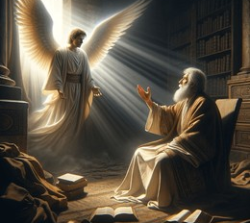
Daniel
9:24-25
²⁴ Seventy weeks are determined upon thy people and upon thy holy city, to finish the transgression, and to make an end of sins, and to make reconciliation for iniquity, and to bring in everlasting righteousness, and to seal up the vision and prophecy, and to anoint the most Holy.

Slide 51
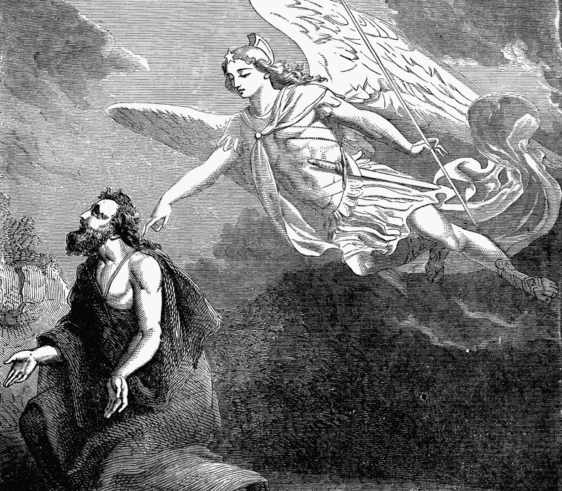
Daniel
9:24-25
²⁵ Know therefore and understand, that from the going forth of the commandment to restore and to build Jerusalem unto the Messiah the Prince shall be seven weeks, and threescore and two weeks: the street shall be built again, and the wall, even in troublous times.

Slide 52

“Determined”
Daniel 9:24: “Seventy weeks are determined upon thy people…”
The Hebrew verb translated “determined” is חָתַךְ (ḥāṯak)
This verb is used only once in the Old Testament, which means we have to rely on:
  Its root meaning in Hebrew
  Cognate usage in related Semitic languages
  The immediate literary context

Slide 53

“Determined”
Daniel 9:24: “Seventy weeks are determined upon thy people…”
We find our selves relying on the root word: ח־ת־ך
Fortunately, the core meaning of this root is consistent. In the verb form, then, we have the meanings:
➡️ to cut
➡️ to divide
➡️ to sever from a larger whole
The imagery is derivative, not standalone.

Slide 54

“Determined”
In modern English, determined sounds like:
a divine decision
a decree without reference to size or source
But in Hebrew thought, verbs are concrete:
ḥāṯak is spatial and relational
it assumes partitioning

Slide 55

“Determined”
English usage has drifted over time
The verb comes from Latin determinare, which literally means:
to set bounds
to mark off
to limit
In Early Modern English (the era of the KJV), determine commonly meant:
to fix the boundary of something
to settle by defining limits

Slide 56

Daniel
9:24-25
²⁴ Seventy weeks are determined upon thy people and upon thy holy city, to finish the transgression, and to make an end of sins, and to make reconciliation for iniquity, and to bring in everlasting righteousness, and to seal up the vision and prophecy, and to anoint the most Holy.

Slide 57
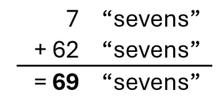
Daniel
9:24-25
²⁵ Know therefore and understand, that from the going forth of the commandment to restore and to build Jerusalem unto the Messiah the Prince shall be seven weeks, and threescore and two weeks: the street shall be built again, and the wall, even in troublous times.

Slide 58
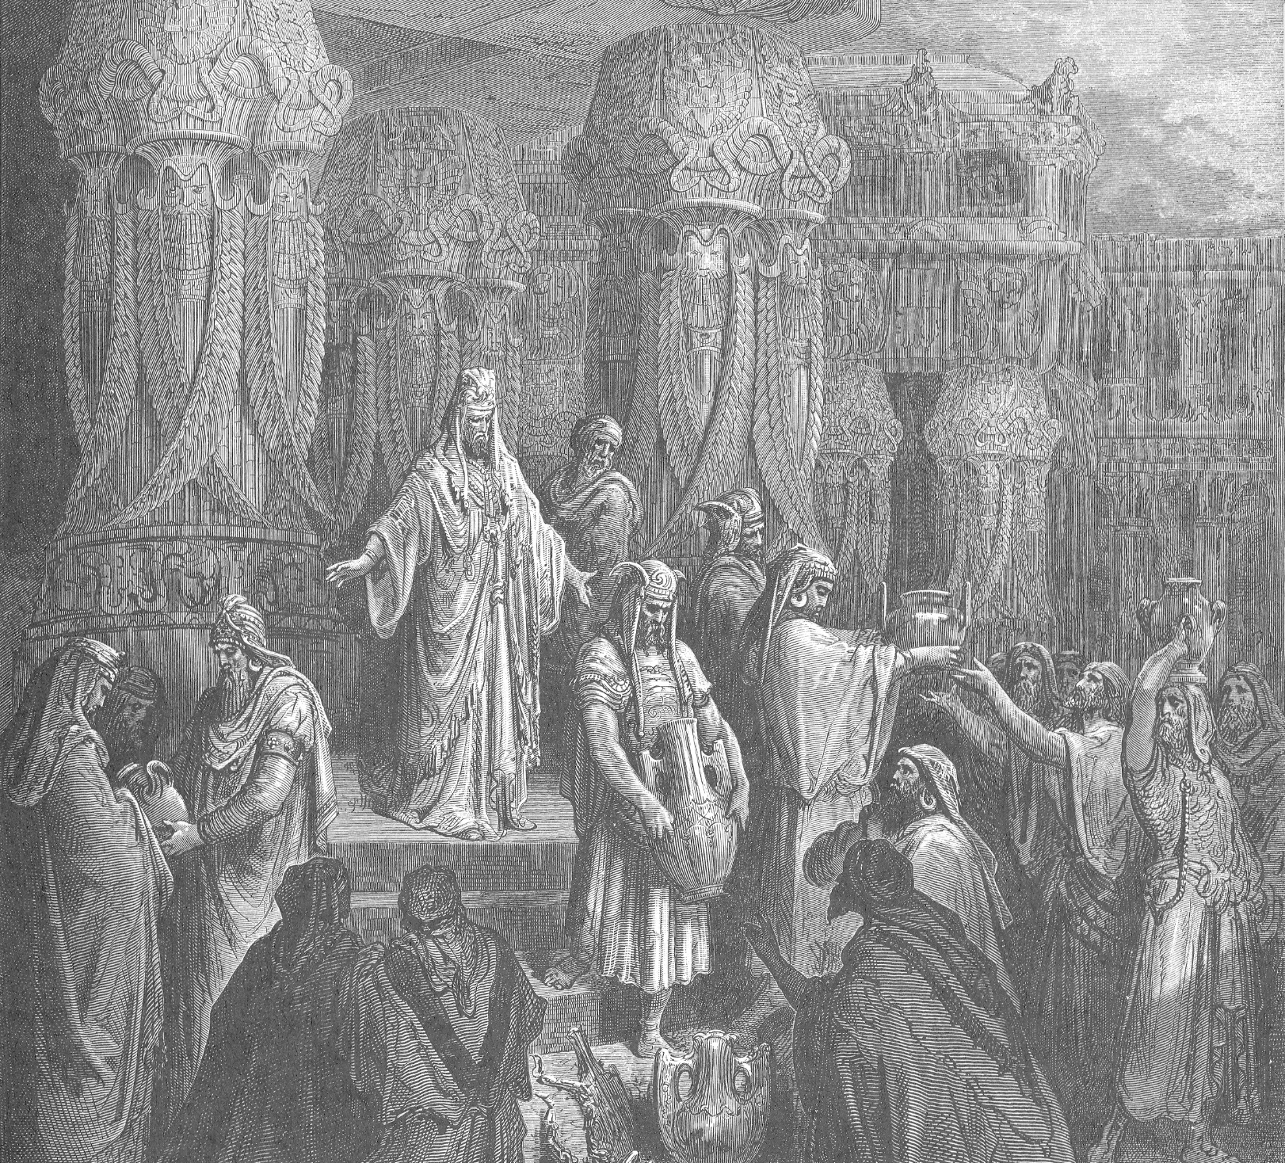
Ezra
7:7-26
⁷ And there went up some of the children of Israel, and of the priests, and the Levites, and the singers, and the porters, and the Nethinims, unto Jerusalem, in the seventh year of Artaxerxes the king.

Slide 59
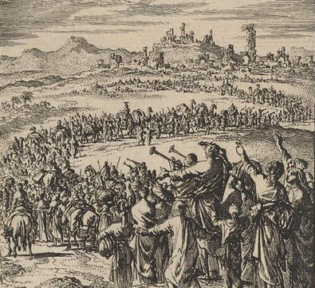
Ezra
7:7-26
⁸ And he came to Jerusalem in the fifth month, which was in the seventh year of the king.
⁹ For upon the first day of the first month began he to go up from Babylon, and on the first day of the fifth month came he to Jerusalem, according to the good hand of his God upon him.

Slide 60
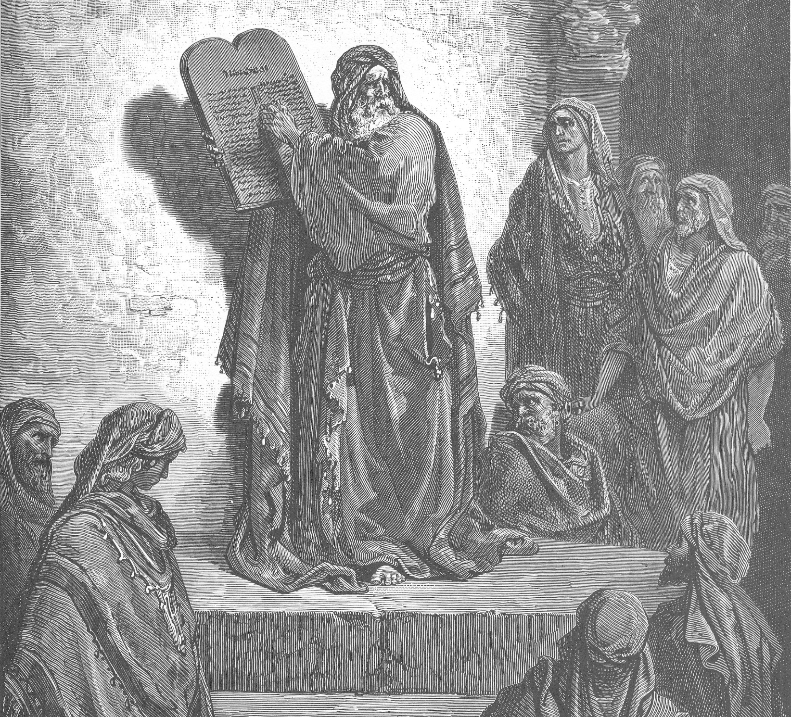
Ezra
7:7-26
¹⁰ For Ezra had prepared his heart to seek the law of the Lord, and to do it, and to teach in Israel statutes and judgments.

Slide 61
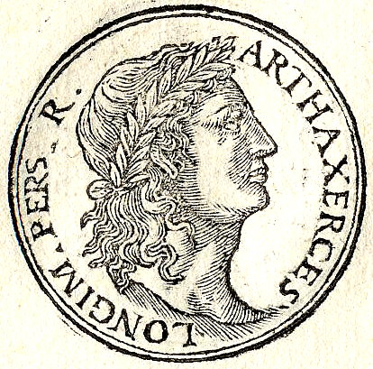
Ezra
7:7-26
¹¹ Now this is the copy of the letter that the king Artaxerxes gave unto Ezra the priest, the scribe, even a scribe of the words of the commandments of the Lord, and of his statutes to Israel.

Slide 62
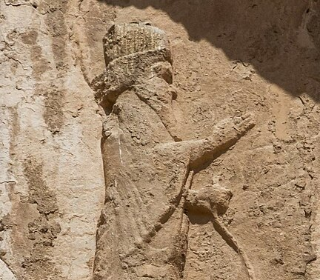
Ezra
7:7-26
¹² Artaxerxes, king of kings, unto Ezra the priest, a scribe of the law of the God of heaven, perfect peace, and at such a time.

Slide 63
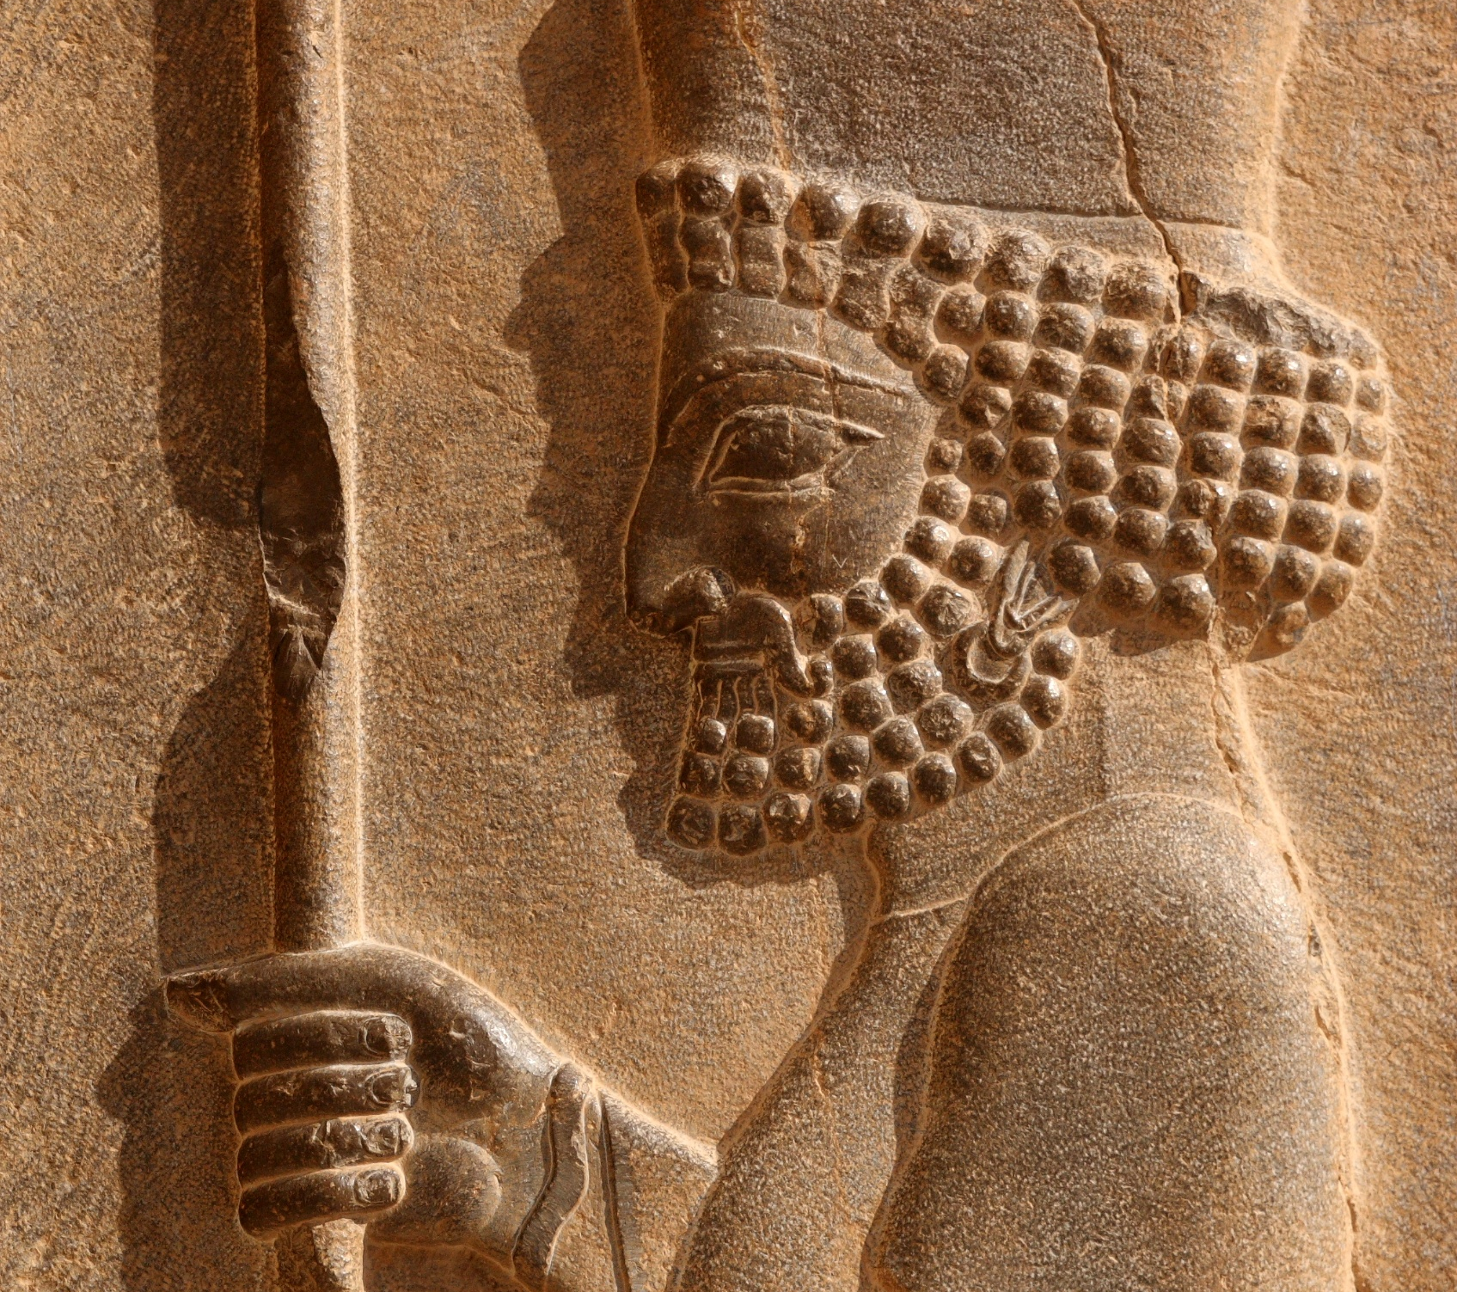
Ezra
7:7-26
¹³ I make a decree, that all they of the people of Israel, and of his priests and Levites, in my realm, which are minded of their own freewill to go up to Jerusalem, go with thee.

Slide 64
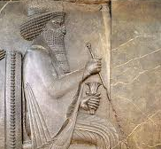
Ezra
7:7-26
¹⁴ Forasmuch as thou art sent of the king, and of his seven counsellors, to enquire concerning Judah and Jerusalem, according to the law of thy God which is in thine hand;

Slide 65
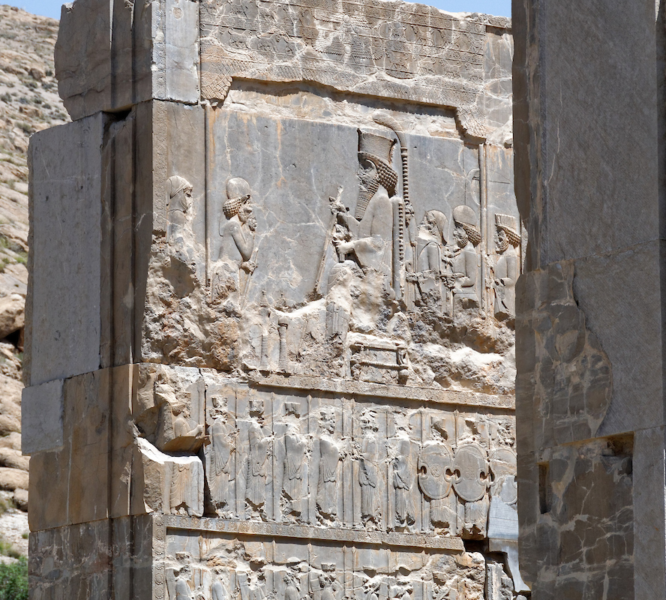
Ezra
7:7-26
¹⁵ And to carry the silver and gold, which the king and his counsellors have freely offered unto the God of Israel, whose habitation is in Jerusalem,

Slide 66
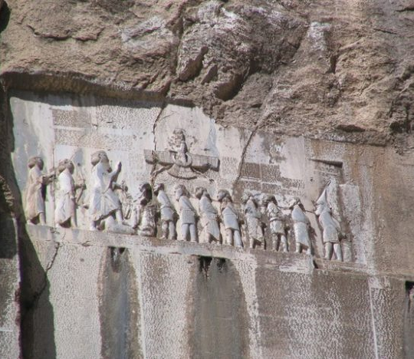
Ezra
7:7-26
¹⁶ And all the silver and gold that thou canst find in all the province of Babylon, with the freewill offering of the people, and of the priests, offering willingly for the house of their God which is in Jerusalem:

Slide 67
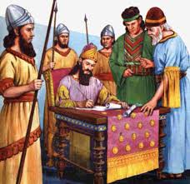
Ezra
7:7-26
¹⁷ That thou mayest buy speedily with this money bullocks, rams, lambs, with their meat offerings and their drink offerings, and offer them upon the altar of the house of your God which is in Jerusalem.

Slide 68
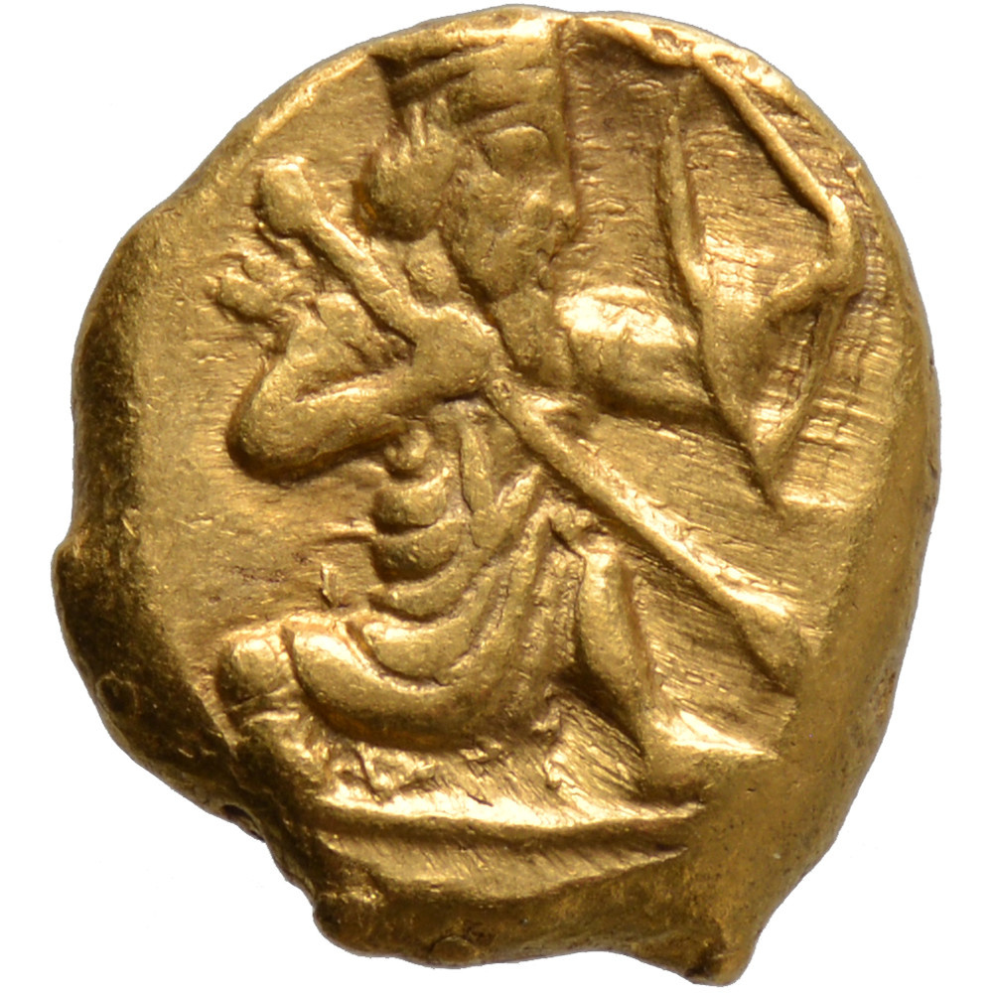
Ezra
7:7-26
¹⁸ And whatsoever shall seem good to thee, and to thy brethren, to do with the rest of the silver and the gold, that do after the will of your God.

Slide 69
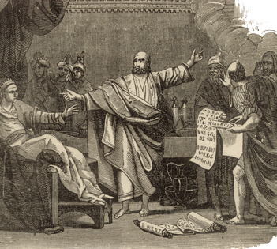
Ezra
7:7-26
¹⁹ The vessels also that are given thee for the service of the house of thy God, those deliver thou before the God of Jerusalem.

Slide 70

Ezra
7:7-26
²⁰ And whatsoever more shall be needful for the house of thy God, which thou shalt have occasion to bestow, bestow it out of the king's treasure house.

Slide 71

Ezra
7:7-26
²¹ And I, even I Artaxerxes the king, do make a decree to all the treasurers which are beyond the river, that whatsoever Ezra the priest, the scribe of the law of the God of heaven, shall require of you, it be done speedily,

Slide 72

Ezra
7:7-26
²² Unto an hundred talents of silver, and to an hundred measures of wheat, and to an hundred baths of wine, and to an hundred baths of oil, and salt without prescribing how much.

Slide 73

Ezra
7:7-26
²³ Whatsoever is commanded by the God of heaven, let it be diligently done for the house of the God of heaven: for why should there be wrath against the realm of the king and his sons?

Slide 74

Ezra
7:7-26
²⁴ Also we certify you, that touching any of the priests and Levites, singers, porters, Nethinims, or ministers of this house of God, it shall not be lawful to impose toll, tribute, or custom, upon them.

Slide 75

Ezra
7:7-26
²⁵ And thou, Ezra, after the wisdom of thy God, that is in thine hand, set magistrates and judges, which may judge all the people that are beyond the river, all such as know the laws of thy God; and teach ye them that know them not.

Slide 76

Ezra
7:7-26
²⁶ And whosoever will not do the law of thy God, and the law of the king, let judgment be executed speedily upon him, whether it be unto death, or to banishment, or to confiscation of goods, or to imprisonment.

Slide 77

The 2300 Days Begins…
Ezra is using the Jewish religious calendar:
1st month = Nisan
Nisan always begins with the new moon closest to the spring equinox
That places it in March–April by our modern calendar
Ezra 7:9 confirms this framework:
1st day of the 1st month → departure
1st day of the 5th month → arrival
(a four-month journey, which fits spring–summer travel)

Slide 78

The 2300 Days Begins…
Artaxerxes I Longimanus:
Began reigning in 465 B.C.
His 7th regnal year = 457 B.C.
________________________________________________________________________________________________________________________________________________________________________
1st day of Nisan
7th year of Artaxerxes I
= Spring 457 B.C.
≈ late March / early April

Slide 79

The 2300 Days Begins…
… what about B.C. 456 ½??
Many 19th-century chronologists did two things:
They assumed:
  A prophetic year of 360 days
  Counted years continuously, not by calendar-year labels

Slide 80

The 2300 Days Begins…
They expressed dates as fractional years when a period began within a year rather than at its start
Spring 457 B.C. is roughly halfway through the civil year
That gets expressed as 456½ B.C.
It’s not a different event—just a different way of naming the same moment.

Slide 81
9. When did it end?
Answer: A.D. 1844.
(For 2300 – 456 ½ = 1843½ = 1844.)

Slide 82

The 2300 Days Ends…
So the count works like this:
From 457 B.C. to A.D. 1
= 456 years
Remaining years: 2,300 − 456
= 1,844
Counting 1,844 years forward from A.D. 1 brings us to
A.D. 1844

Slide 83

The 2300 Days Ends…
Spring-to-spring brings you to spring 1844
But Daniel 8:14 says:
¹⁴ And he said unto me, Unto two thousand and three hundred days; then shall the sanctuary be cleansed.

Slide 84

The 2300 Days Ends…
So you don’t stop when the 2,300th year begins—
you count the 2300 years (which brings us to spring 1844) and then consider the cleansing of the sanctuary.
The sanctuary itself tells us when the work occurs

Slide 85

The 2300 Days Ends…
In the Hebrew system:
The cleansing of the sanctuary occurred on the Day of Atonement
That day always falls in the seventh month (Tishri)
That is autumn, not spring (Leviticus 16; Leviticus 23:27)
So the prophecy itself points us to the season, not merely the year

Slide 86
10. Then when did the cleansing of the heavenly sanctuary begin?
Answer:
Autumn A.D. 1844

Slide 87
11. In the figure, what was done with those who had not their sins taken away by the work of atonement?
Answer: They were cut off without mercy; their probation was ended.
Leviticus 23:29, 30

Slide 88

Leviticus
23:29, 30
²⁹ For whatsoever soul it be that shall not be afflicted in that same day, he shall be cut off from among his people.

Slide 89

Leviticus
23:29, 30
³⁰ And whatsoever soul it be that doeth any work in that same day, the same soul will I destroy from among his people.

Slide 90
12. As this sanctuary service was all in behalf of sinners, and as all who would not partake of it were cut off without remedy, what, in effect, was that work of atonement?
Answer: A work of judgment.

Slide 91
13. When the seventh trumpet angel should begin to sound, what, among other things, was then to come?
Answer: The time of the dead, that they should be judged.
Revelation 11:18

Slide 92

Revelation
11:18
¹⁸ And the nations were angry, and thy wrath is come, and the time of the dead, that they should be judged, and that thou shouldest give reward unto thy servants the prophets, and to the saints, and them that fear thy name, small and great; and shouldest destroy them which destroy the earth.

Slide 93
14. What says the angel of Revelation 14:6, 7?

Slide 94

Revelation
14:6, 7
⁶ And I saw another angel fly in the midst of heaven, having the everlasting gospel to preach unto them that dwell on the earth, and to every nation, and kindred, and tongue, and people,

Slide 95

Revelation
14:6, 7
⁷ Saying with a loud voice, Fear God, and give glory to him; for the hour of his judgment is come: and worship him that made heaven, and earth, and the sea, and the fountains of waters.

Slide 96

Memory Joggers:
The 7th trumpet is a period, not a moment
During that period:
  God’s kingdom is announced
  Judgment is declared
  Reward is still future (Rev 11:18)
The Three Angels’ Messages arise within that same timeframe
  Especially the First Angel:
  “The hour of His judgment is come”

Slide 97
Memory Joggers:
In Revelation 10–11, during the seventh trumpet, we are told: “The mystery of God should be finished” (Rev 10:7)
mystery = the gospel (Eph 3; Rom 16)
Yet:
  Christ has not returned
  Reward has not yet been given (Rev 11:18)
  Mercy is still being proclaimed (Rev 14)
So the seventh trumpet marks the closing phase of salvation — not its execution

Slide 98
Memory Joggers:
Scripture already has a category for “the closing of salvation” in the Sanctuary service
The daily service = ongoing forgiveness
The Day of Atonement = closing work
  sins dealt with finally
  cases settled
  no new confessions afterward
This is not destruction. This is resolution.
So “The mystery of God is finished,” has meaning if we consider the original pattern. “Yes — that is what the Day of Atonement is.”

Slide 99

To sum it up:
God’s work of salvation—the mystery of God, the gospel—is coming to an end in the seventh trumpet. The cleansing of the sanctuary is the natural conclusion of that work.
The three angels’ messages of Revelation 14 are the announcement of that conclusion.

Slide 100
15. What then is the date of the message of Revelation 14:6, 7?
Answer: A.D. 1844.

Slide 101
16. Was there such a message given at that time?

Slide 102

The 1844 Message
During the Second Great Awakening (late 1700s–mid 1800s), a widespread religious revival took place in Europe and North America
Within this revival, the Advent movement emerged in the 1830s–1840s

Slide 103

The 1844 Message
Preachers across denominations proclaimed:
  the fulfillment of prophetic time
  the nearness of Christ’s return
  the solemn reality of coming judgment
This message was global in scope and closely corresponds to the announcement of
“the hour of His judgment is come” (Revelation 14:6–7)

Slide 104
17. What was the result of the rejection of that message?
Revelation 14:8

Slide 105

Revelation
14:8
⁸ And there followed another angel, saying, Babylon is fallen, is fallen, that great city, because she made all nations drink of the wine of the wrath of her fornication.

Slide 106

A Rejected Message
Widespread rejection of the first angel’s message led to spiritual separation
Revelation describes this condition as “Babylon is fallen”
This fall represents:
  rejection of advancing light
  spiritual confusion
  resistance to God’s closing work
As a result, a second message was required to call God’s people out of that condition

Slide 107
18. What was the result of the “falling away” after the first preaching of the gospel?
2 Thessalonians 2:3, 4

Slide 108

A Rejected Message
The Advent message was largely rejected by established churches of the time
As a result:
  the movement was separated from many existing denominations
  widespread spiritual disappointment followed in 1844
  sincere believers were driven back to Scripture for deeper study while others fell away altogether
This rejection did not end God’s work, but led to clearer understanding of prophecy and the sanctuary

Slide 109

2 Thessalonians
2:3,4
³ Let no man deceive you by any means: for that day shall not come, except there come a falling away first, and that man of sin be revealed, the son of perdition;

Slide 110

2 Thessalonians
2:3,4
⁴ Who opposeth and exalteth himself above all that is called God, or that is worshipped; so that he as God sitteth in the temple of God, shewing himself that he is God.

Slide 111

We Are Here
Since 1844, we live in the time of:
  the seventh trumpet
  the Three Angels’ Messages
  the closing work of Christ’s mediation
The gospel is still being proclaimed
Judgment is announced, but reward has not yet been given
Revelation shows that religious power once corrupted will seek renewed authority
The next phase of prophecy describes how that power reappears in a new form… which we’ve already pre-viewed in Revelation 13!

Slide 112
Thank you!
… and Happy Sabbath!!

Slide 113


