Slide 1


Slide 2

Living the Light

Slide 3
The Third Angel’s Message
Lesson 6: The Development of the Beast
August 11, 1888
Lesson 6, 3rd Quarter 1888

Slide 4
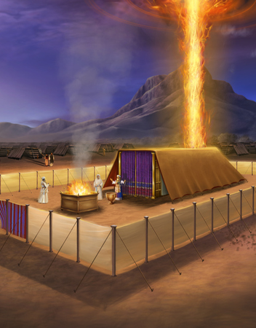
The Beast Forming
  This lesson isn’t about a beast that already existed. It’s about how beasts are formed. The beast from the sea is our case study — not so we can argue about the past, but so we can recognize the patterns Scripture warns us about before they repeat.

Slide 5
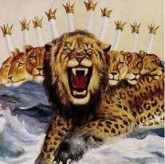
REVELATION
13:1-13
13 And I stood upon the sand of the sea, and saw a beast rise up out of the sea, having seven heads and ten horns, and upon his horns ten crowns, and upon his heads the name of blasphemy.

Slide 6
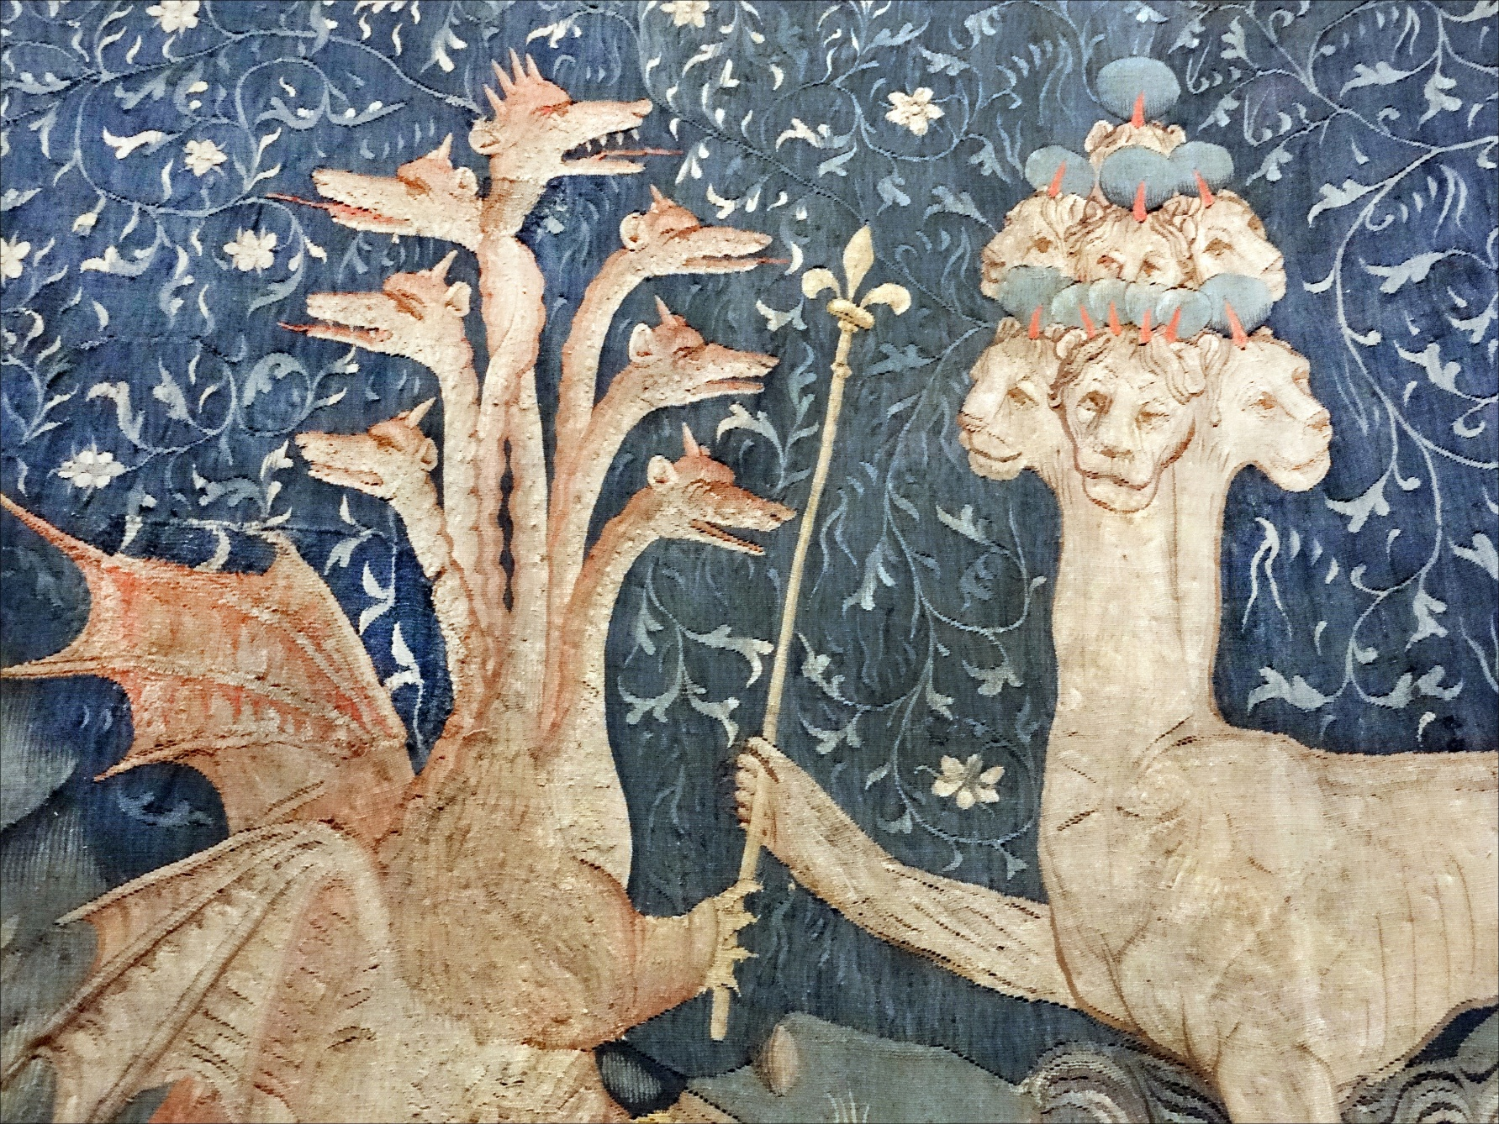
REVELATION
13:1-13
² And the beast which I saw was like unto a leopard, and his feet were as the feet of a bear, and his mouth as the mouth of a lion: and the dragon gave him his power, and his seat, and great authority.

Slide 7
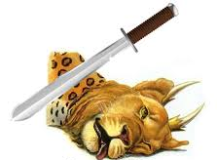
REVELATION
13:1-13
³ And I saw one of his heads as it were wounded to death; and his deadly wound was healed: and all the world wondered after the beast.

Slide 8
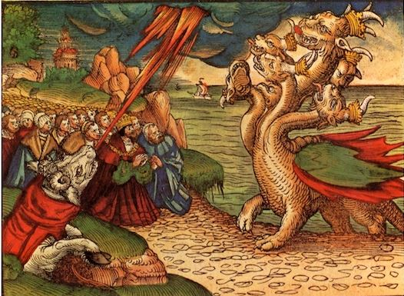
REVELATION
13:1-13
⁴ And they worshipped the dragon which gave power unto the beast: and they worshipped the beast, saying, Who is like unto the beast? who is able to make war with him?

Slide 9

REVELATION
13:1-13
⁵ And there was given unto him a mouth speaking great things and blasphemies; and power was given unto him to continue forty and two months.

Slide 10
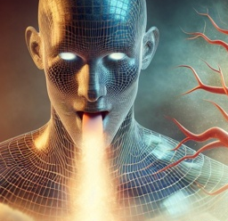
REVELATION
13:1-13
⁶ And he opened his mouth in blasphemy against God, to blaspheme his name, and his tabernacle, and them that dwell in heaven.

Slide 11
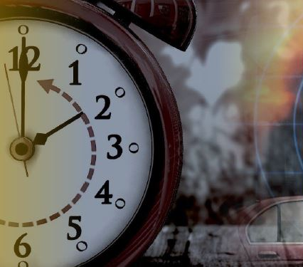
REVELATION
13:1-13
⁷ And it was given unto him to make war with the saints, and to overcome them: and power was given him over all kindreds, and tongues, and nations.

Slide 12
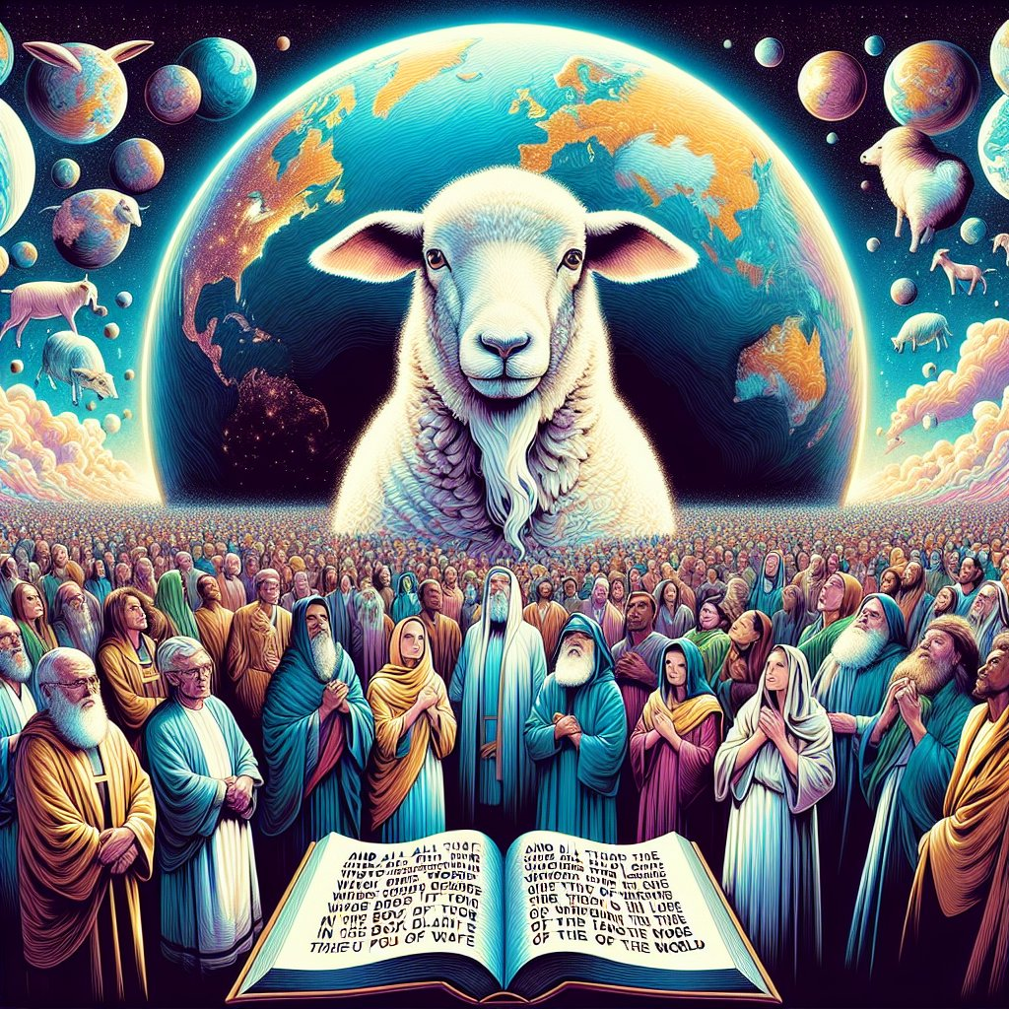
REVELATION
13:1-13
⁸ And all that dwell upon the earth shall worship him, whose names are not written in the book of life of the Lamb slain from the foundation of the world.

Slide 13
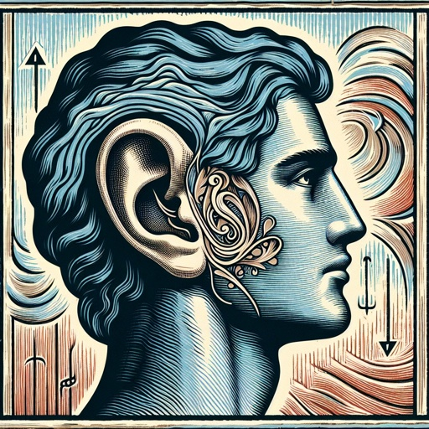
REVELATION
13:1-13
⁹ If any man have an ear, let him hear.

Slide 14
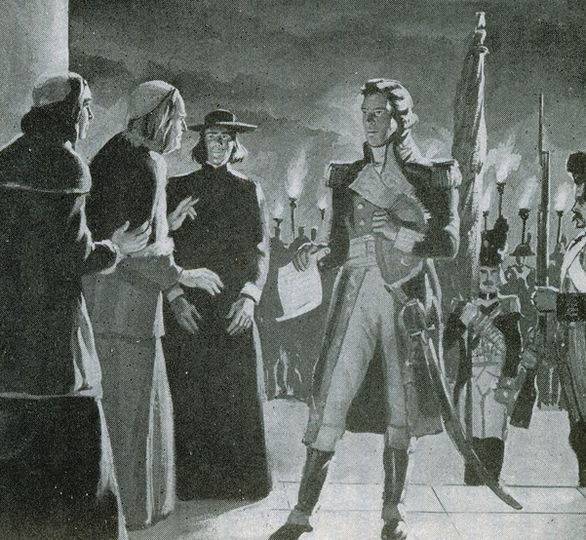
REVELATION
13:1-13
¹⁰ He that leadeth into captivity shall go into captivity: he that killeth with the sword must be killed with the sword. Here is the patience and the faith of the saints.

Slide 15
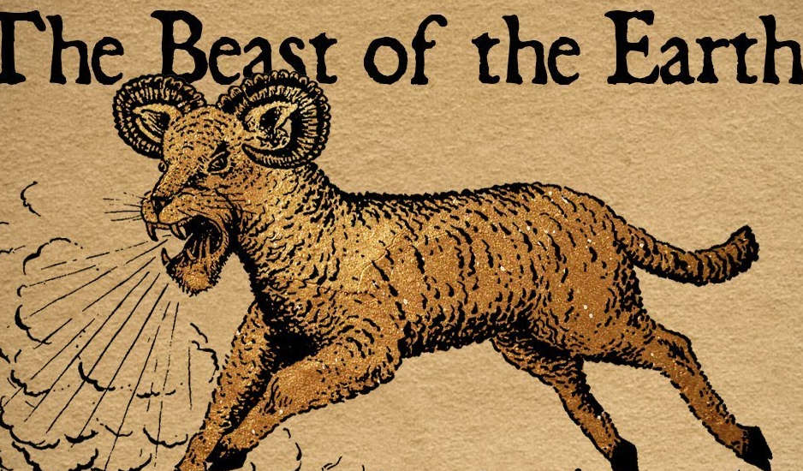
REVELATION
13:1-13
¹¹ And I beheld another beast coming up out of the earth; and he had two horns like a lamb, and he spake as a dragon.

Slide 16
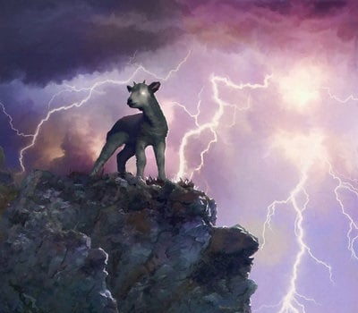
REVELATION
13:1-13
¹² And he exerciseth all the power of the first beast before him, and causeth the earth and them which dwell therein to worship the first beast, whose deadly wound was healed.

Slide 17
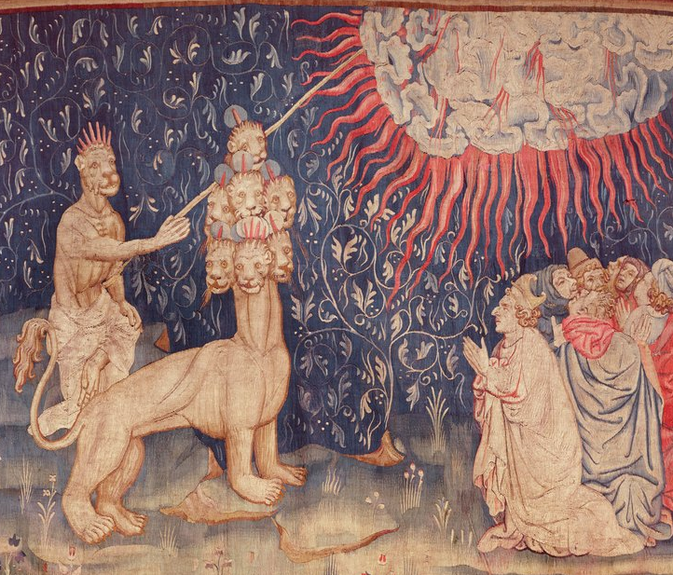
REVELATION
13:1-13
¹³ And he doeth great wonders, so that he maketh fire come down from heaven on the earth in the sight of men,

Slide 18

1. What power is represented by the first beast of Revelation 13?
Answer: The Papacy.

Slide 19
STEP 1
Accommodation

Slide 20
2. From what was it developed?
Answer: “A falling away.”
2 Thessalonians 2:3

Slide 21
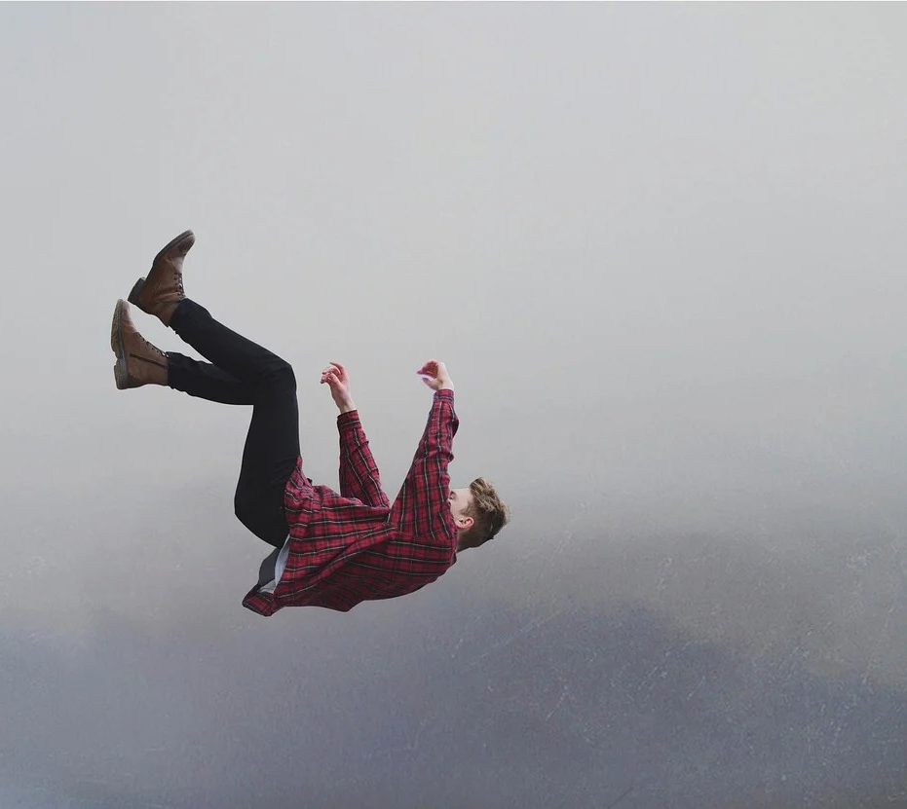
2 Thessalonians
2:3
³ Let no man deceive you by any means: for that day shall not come, except there come a falling away first, and that man of sin be revealed, the son of perdition;

Slide 22
3. In what was shown the first definite evidence of falling away from the truth of God?
Answer: The adoption of heathen rites and customs.

Slide 23
The First What??
FIRST here does not mean:
moral failure (that existed from the start)
false teachers (already present in the NT)
heresy debates (already raging in the 2nd century)
persecution responses (already underway)
Those were contested problems, not accepted developments. The lesson is talking about the first broadly accepted, institutionally defended change.

Slide 24
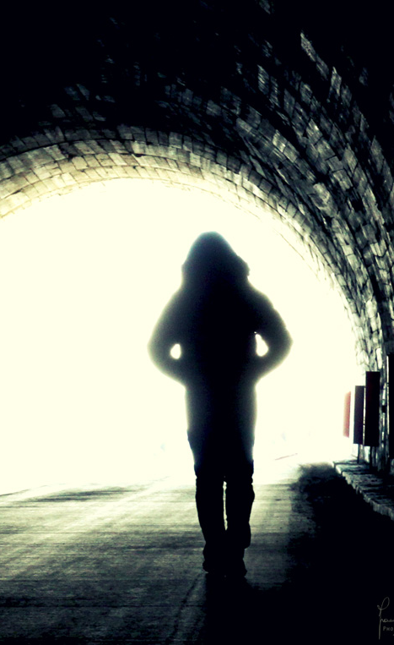
The First What??
  We are not dealing with “the first wrong thing that ever happened in Christianity.” We’re talking about the first systemic, visible, documented shift away from apostolic simplicity that we can trace across the church as a whole.

Slide 25
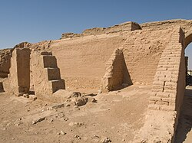
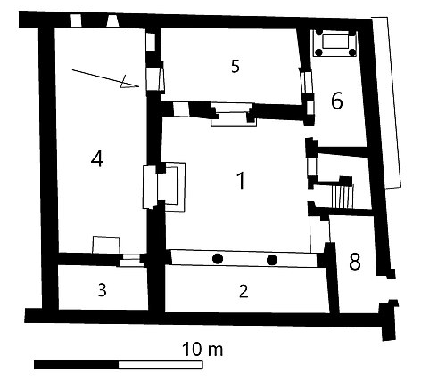
The Dura-Eropos Church: The earliest identified Christian House Church (233-256 AD)

Slide 26
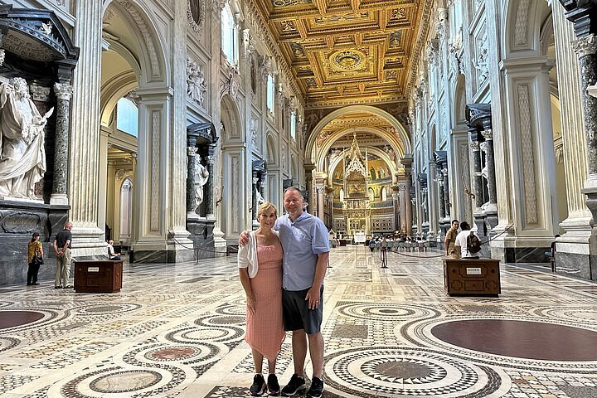
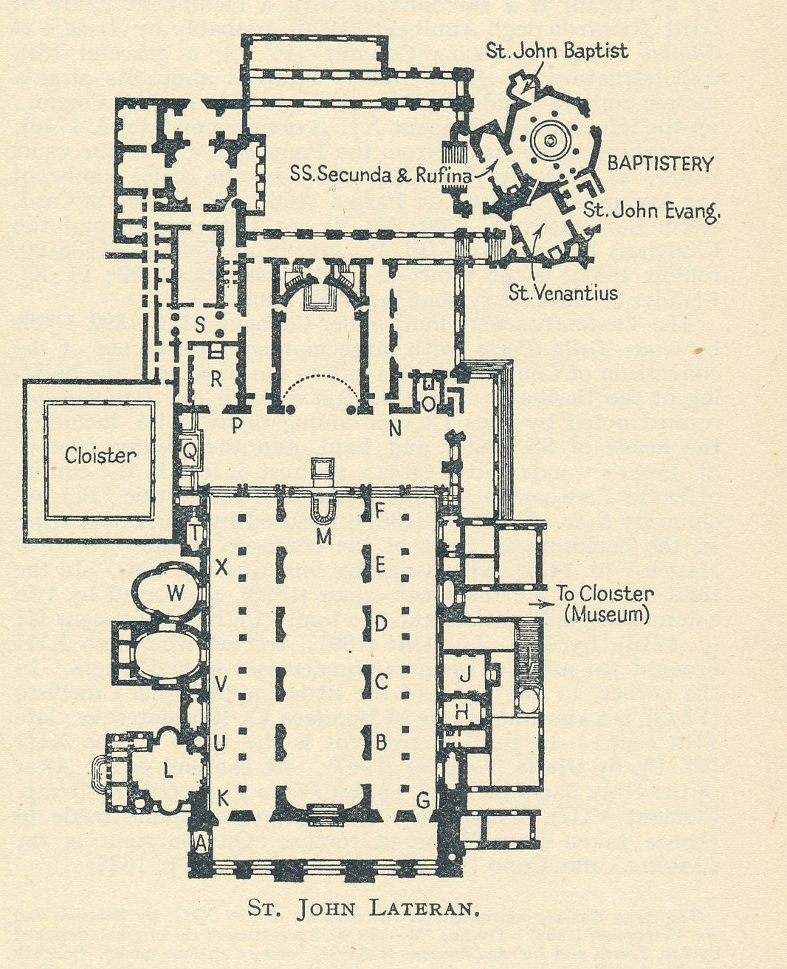
Archbasilica of Saint John Lateran (Founded 324 AD)

Slide 27
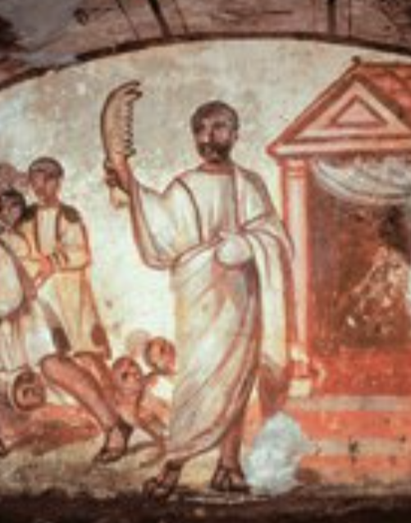
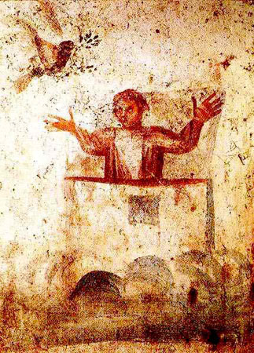
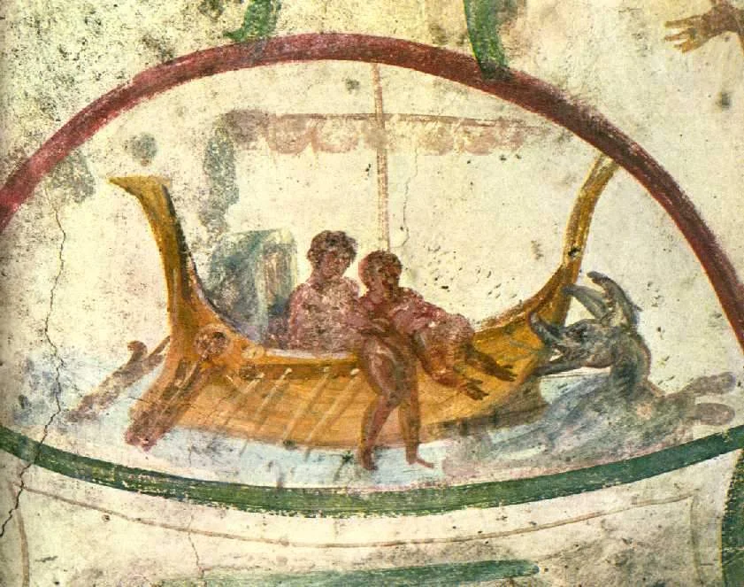
Early Christian Art: Bible Stories

Slide 28
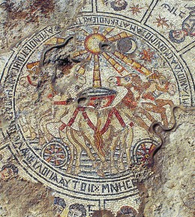
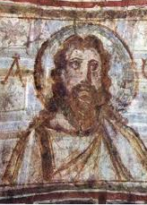
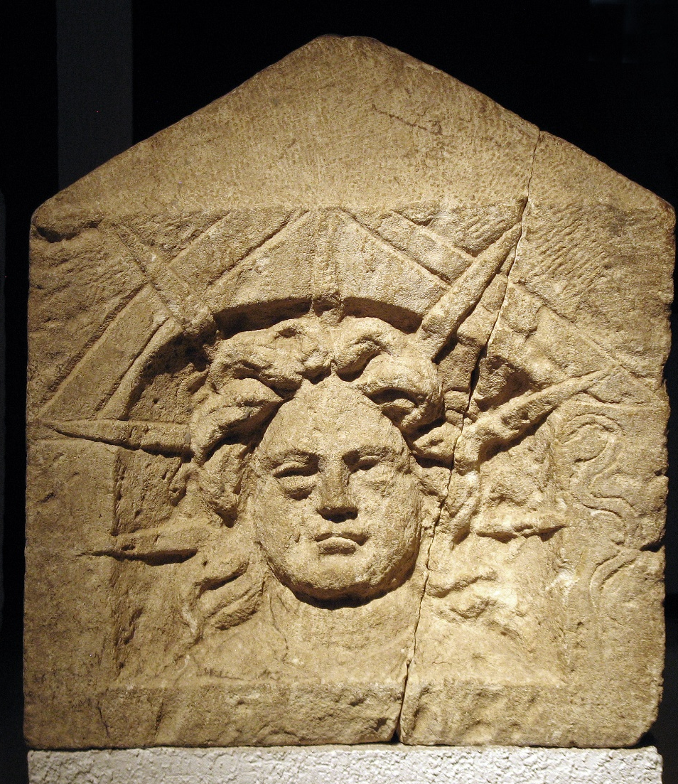
Later Christian Art: Solar Focus

Slide 29
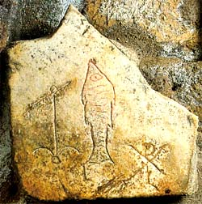
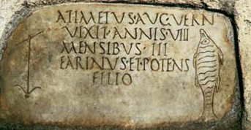
Early Christian Symbols: Anchor, Ichthys, Chi-Rho

Slide 30
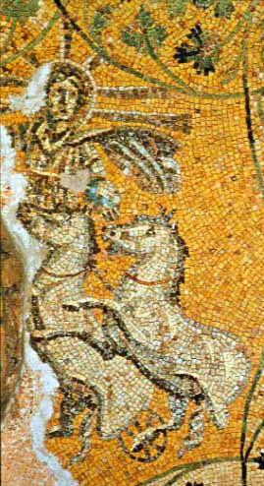
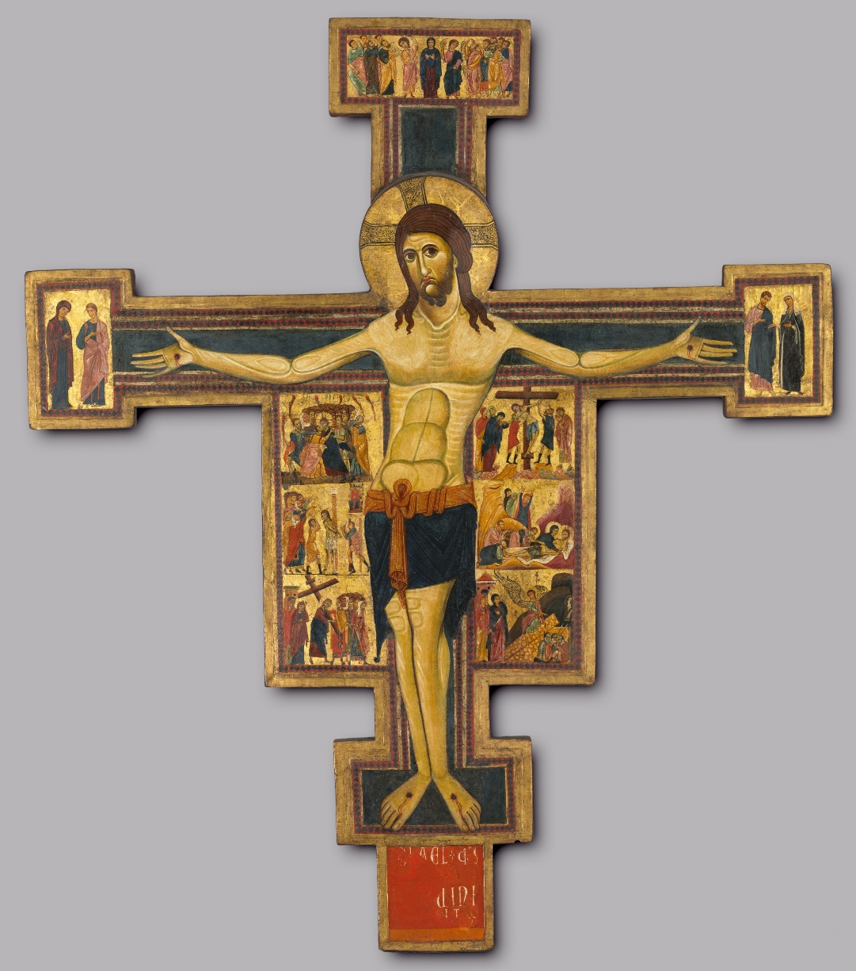
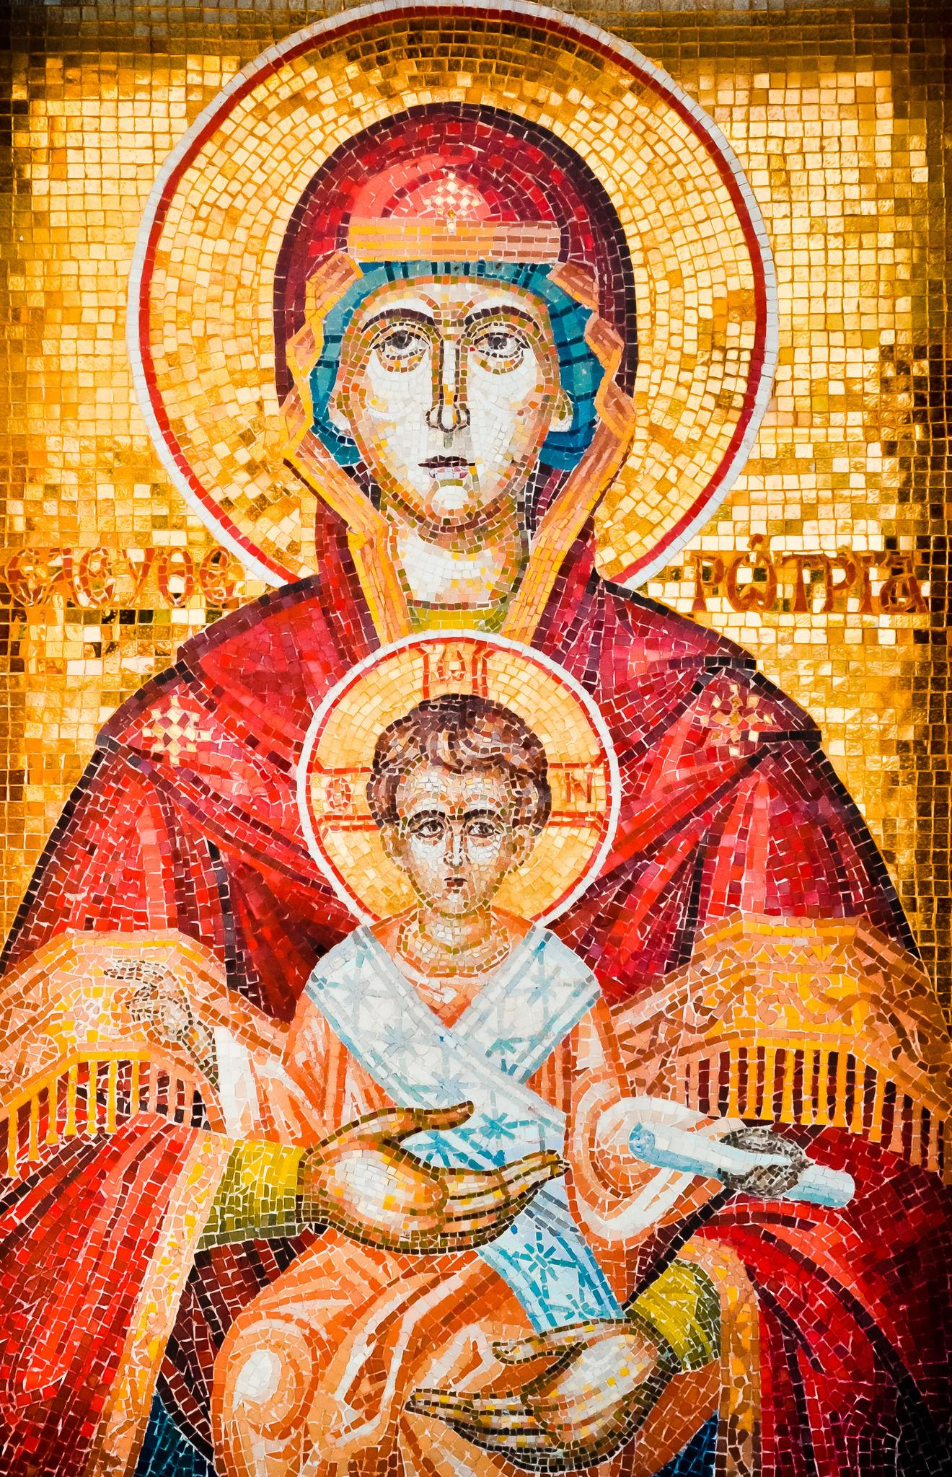
Later Christian symbols:

Slide 31
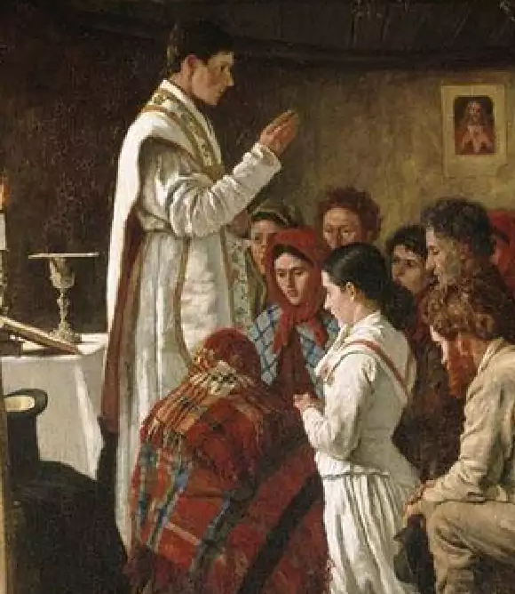
Mosheim,
Church History
The bishops augmented the number of religious rites in the Christian worship, by way of accommodation to the infirmities and prejudices, both of Jews and heathens, in order to facilitate their conversion to Christianity.

Slide 32
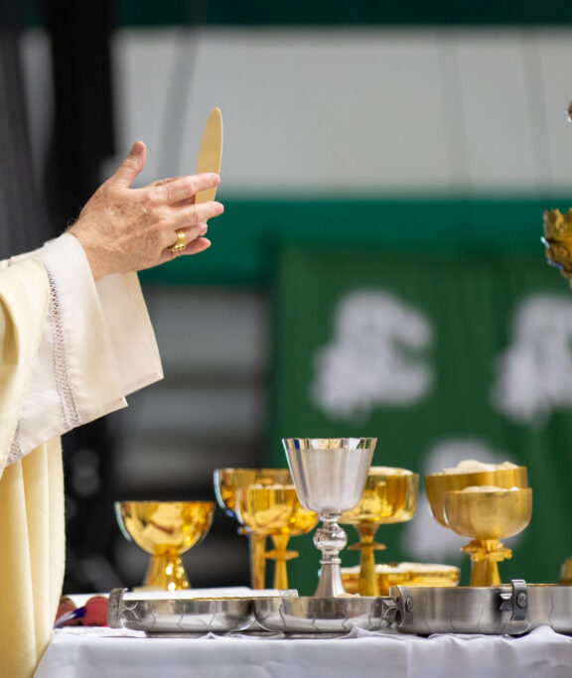
Mosheim,
Church History
For this purpose, they gave the name of mysteries to the institutions of the gospel, and decorated particularly the holy sacrament with that solemn title.

Slide 33
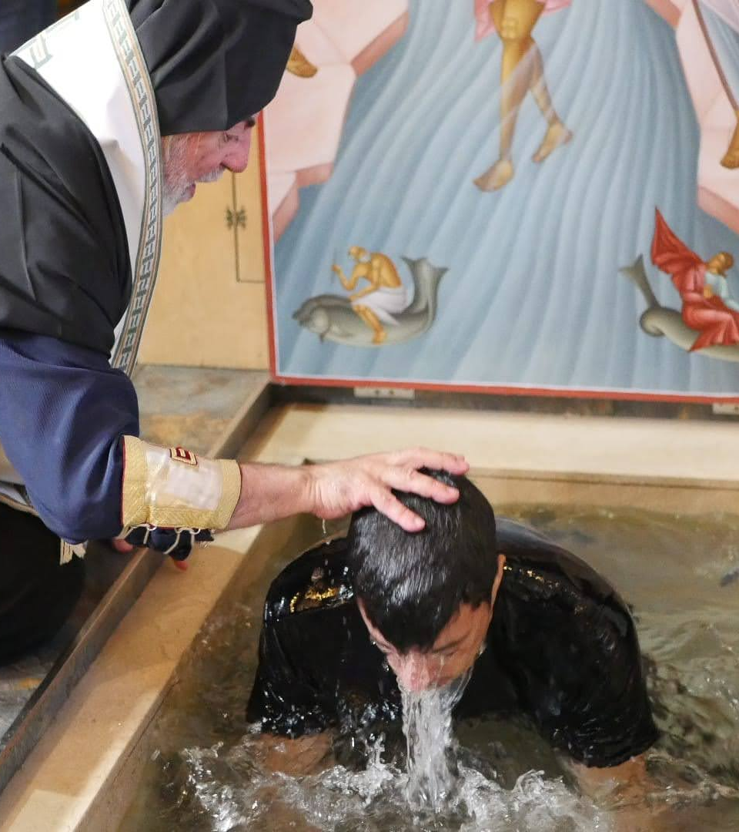
Mosheim,
Church History
They used in that sacred institution, as also in that of baptism, several of the terms employed in the heathen mysteries, and proceeded so far, at length, as even to adopt some of the ceremonies of which those renowned mysteries consisted.

Slide 34
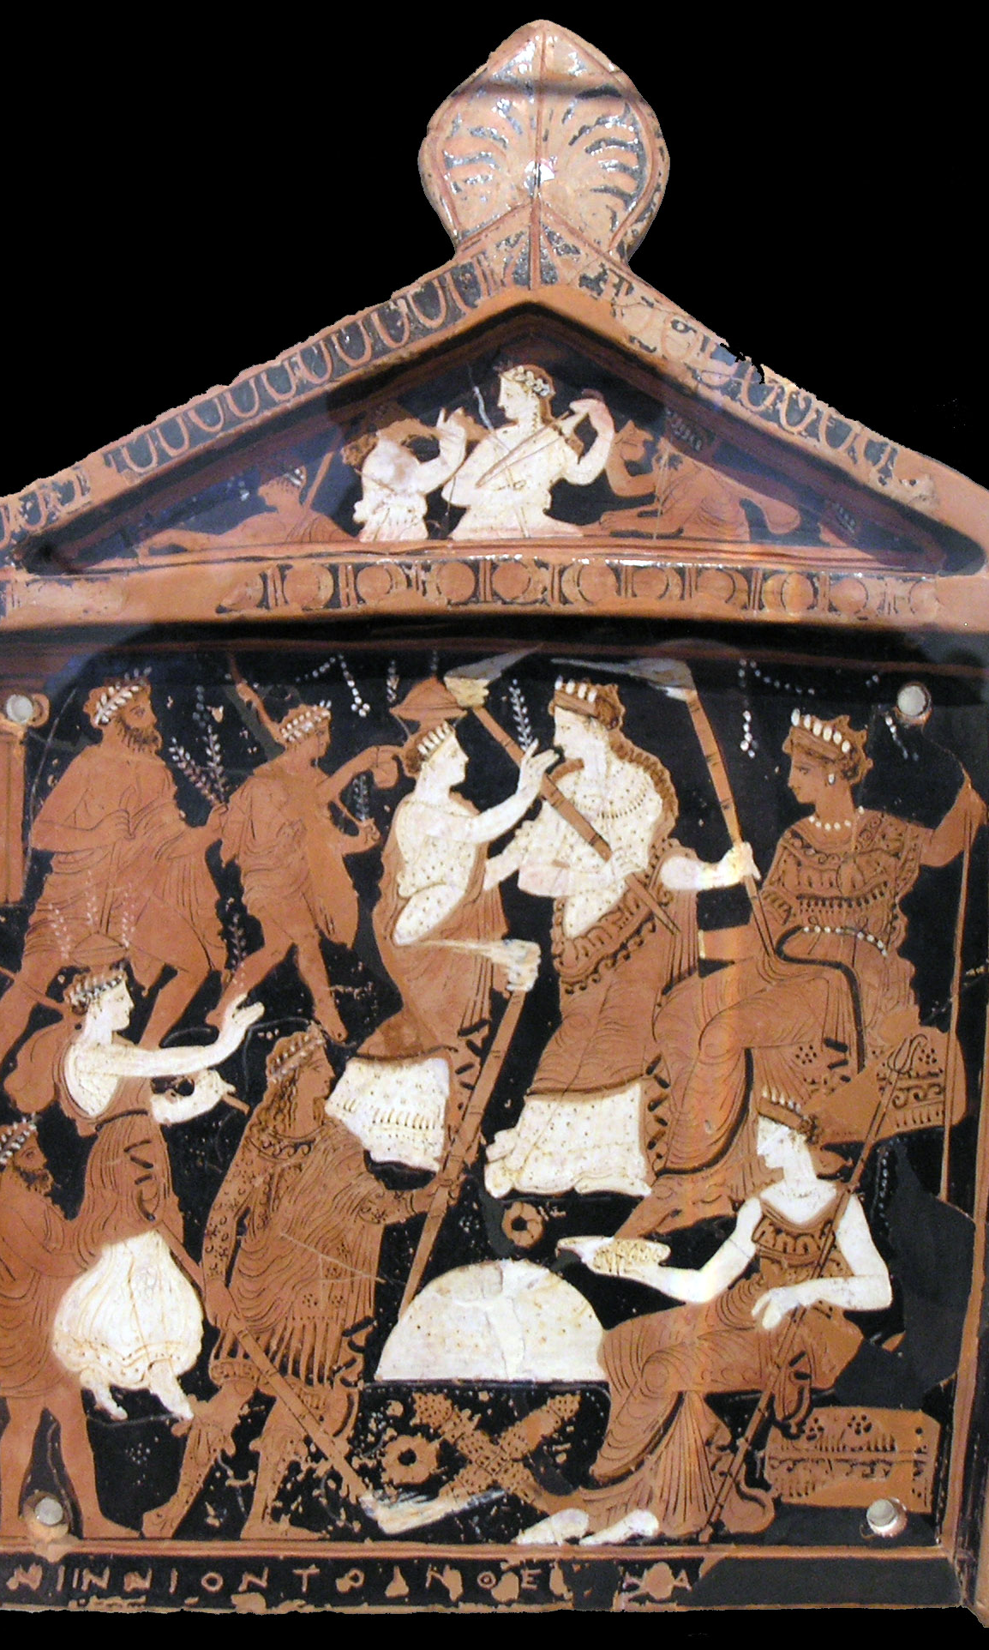
Heathen Mysteries
This refers to the Greco-Roman mystery religions, especially:
Eleusinian Mysteries (Demeter / Persephone)
Isis–Osiris Mysteries (Egyptian, widely Romanized)
Mithraic Mysteries (popular among soldiers)
Dionysian / Orphic Mysteries

Slide 35
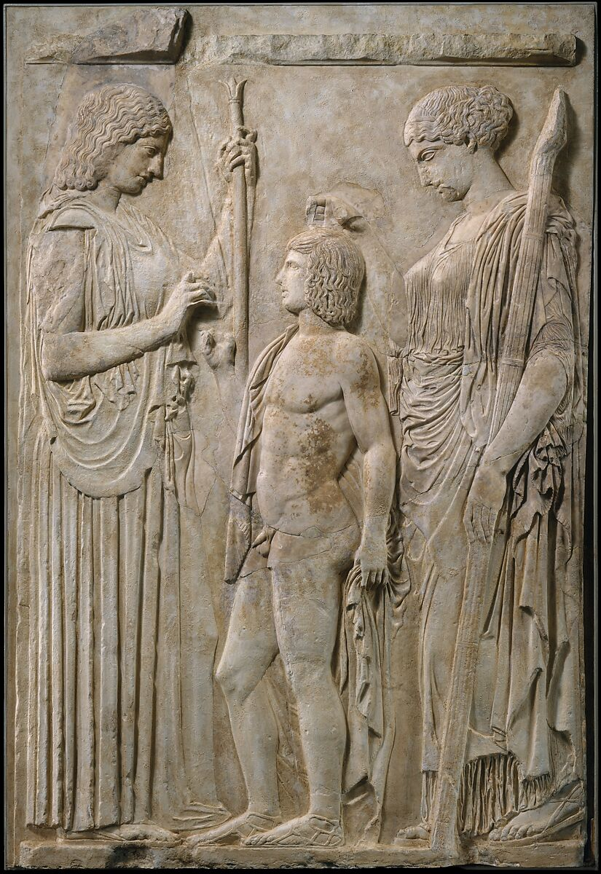
Heathen Mysteries
These were not public civic cults like Jupiter worship. They were initiatory religions, centered on secret rites, staged symbolic acts, purification rituals, sacred meals, promises of salvation or immortality, and, crucially, a distinction between initiates and outsiders.

Slide 36
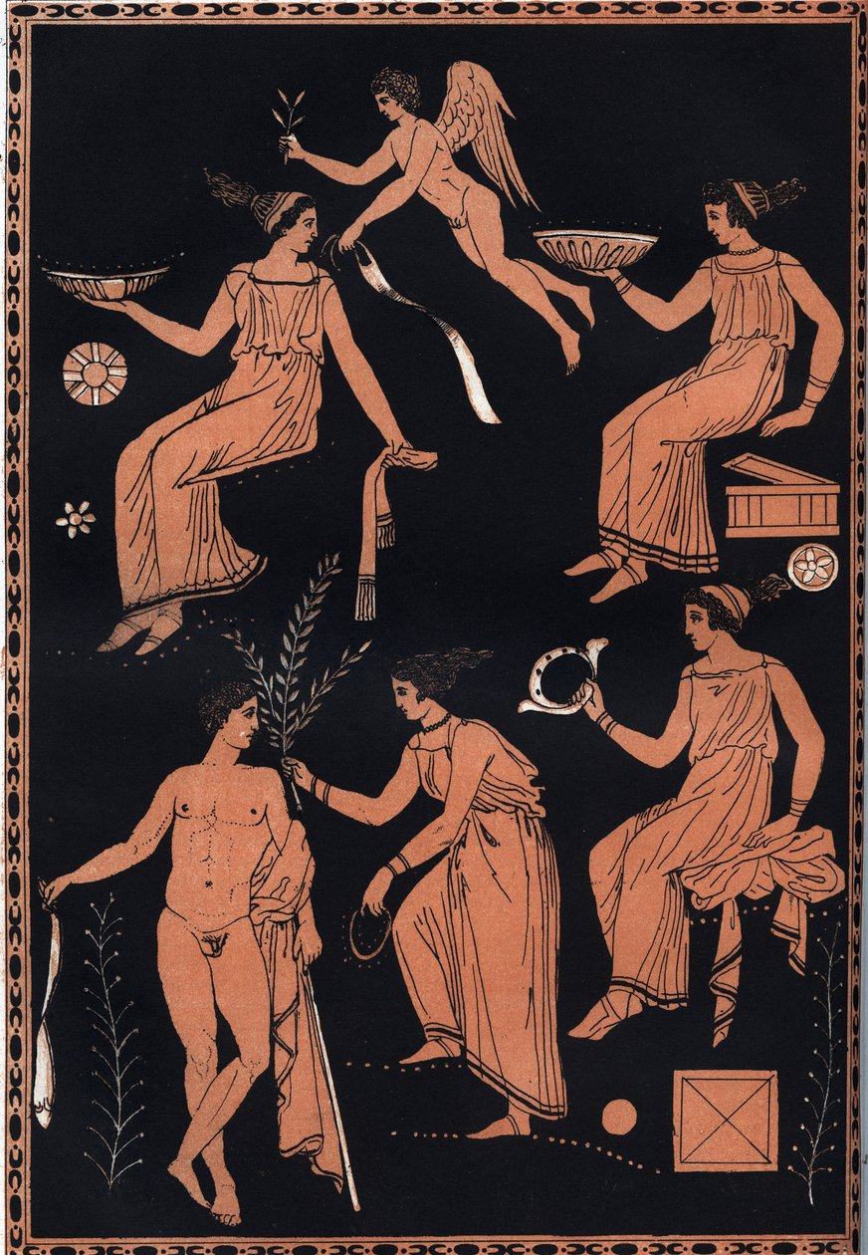
Heathen Mysteries
They imported:
ritual silence and secrecy around rites
solemn preparatory fasts
symbolic gestures
language of initiation grades dramatic ritualization
None of these are apostolic. They are structural imports, not doctrinal ones — at first.

Slide 37
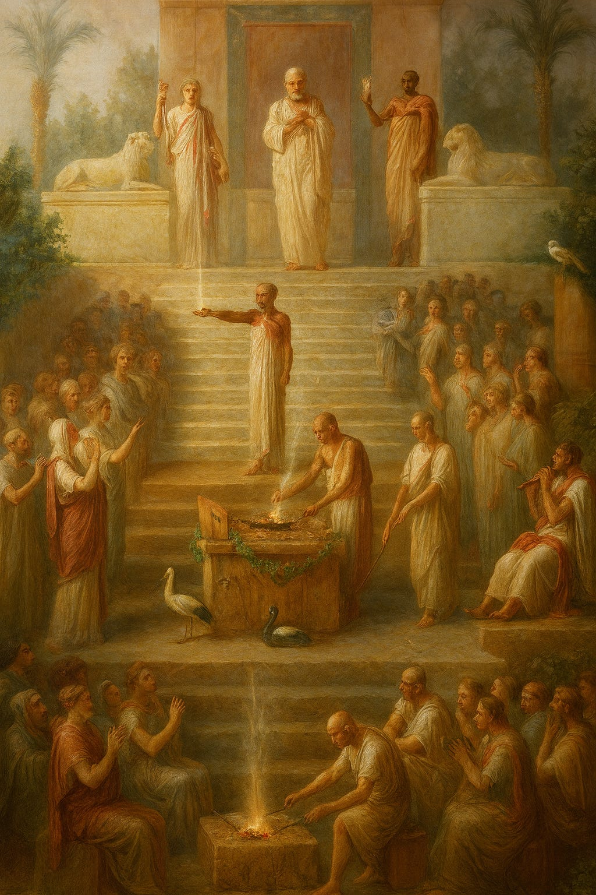
Heathen Mysteries
NONE of this was done maliciously. They wanted:
to make Christianity intelligible to pagans
to give converts familiar conceptual hooks
to increase reverence and seriousness
In other words: accommodation.

Slide 38
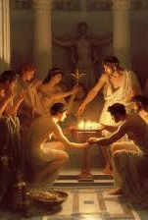
Why this matters:
Once rites themselves are thought to have power:
authority naturally shifts to those who administer the rites
which leads to hierarchy
which invites coercion
which eventually invites state power
So Mosheim identifying the first change. Which is exactly why this qualifies as the FIRST evidence of falling away.

Slide 39
5. What worship was the most widely prevalent among all ancient nations?
Answer: Sun worship.

Slide 40
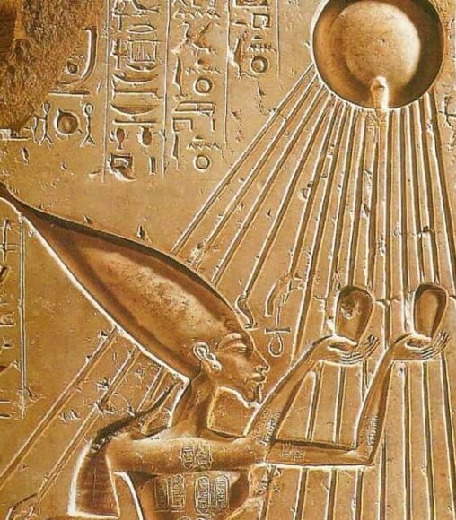
Talbot W. Chambers,
Old Testament Student, Jan. 1886
The oldest, the most widespread, and the most enduring of all the forms of idolatry known to man, viz., the worship of the sun.

Slide 41
6. When this worship was not directed to an image, how was it performed?

Slide 42
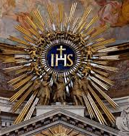
Mosheim, Church History
Before the coming of Christ, all the Eastern nations performed divine worship with their faces turned to that part of the heavens where the sun displays his rising beams. This custom was founded upon a general opinion that God, whose essence they looked upon to be light,

Slide 43
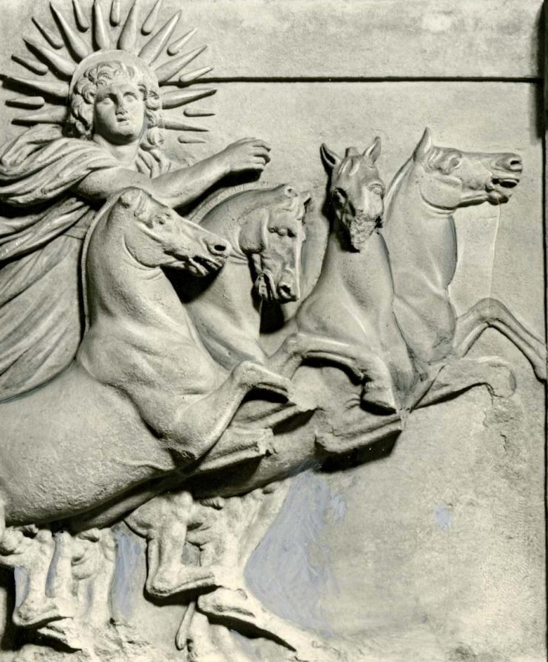
Mosheim, Church History
and whom they considered as being circumscribed within certain limits, dwelt in that part of the firmament, from which he sends forth the sun, the bright image of his benignity and glory.

Slide 44
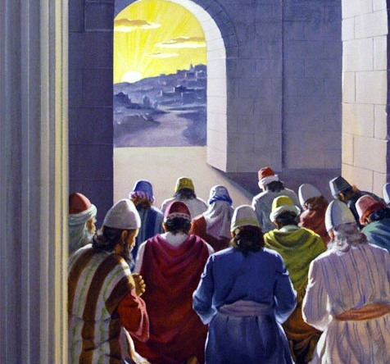
Ezekiel 8:16
¹⁶ And he brought me into the inner court of the Lord's house, and, behold, at the door of the temple of the Lord, between the porch and the altar, were about five and twenty men, with their backs toward the temple of the Lord, and their faces toward the east; and they worshipped the sun toward the east.

Slide 45
7. Was this custom adopted by some who called themselves Christians?

Slide 46
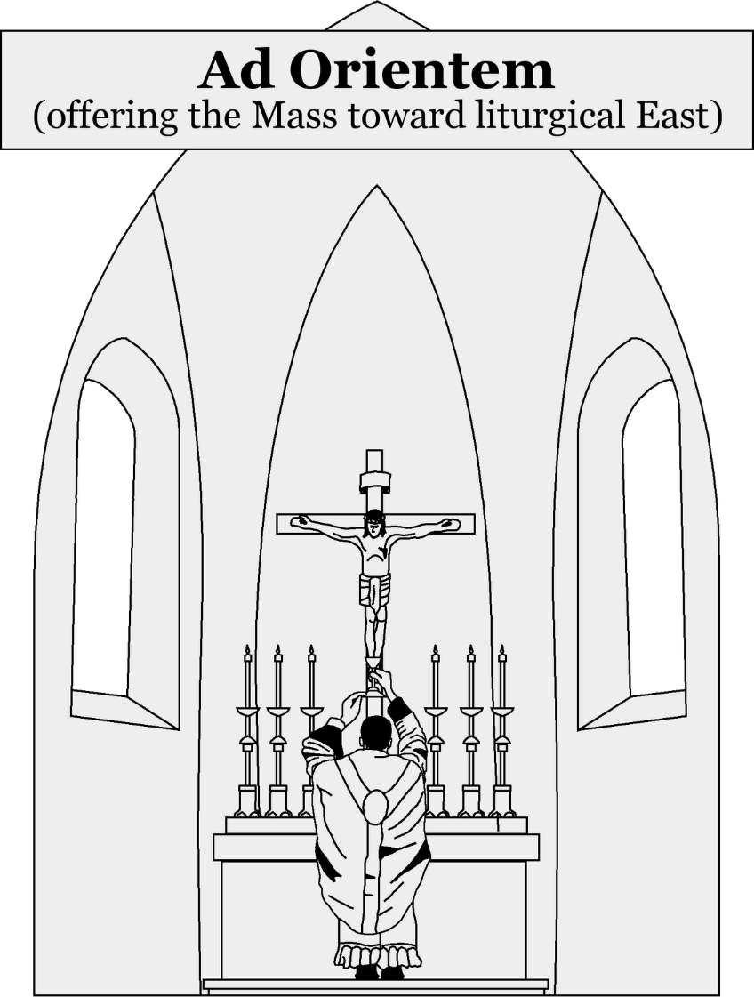
Mosheim, Church History
The Christian converts, indeed, rejected this gross error [of supposing that God dwelt in that part of the firmament]; but they retained the ancient and universal custom of worshiping toward the east, which sprang from it. Nor is that custom abolished even in our times, but still prevails in a great number of Christian churches.

Slide 47
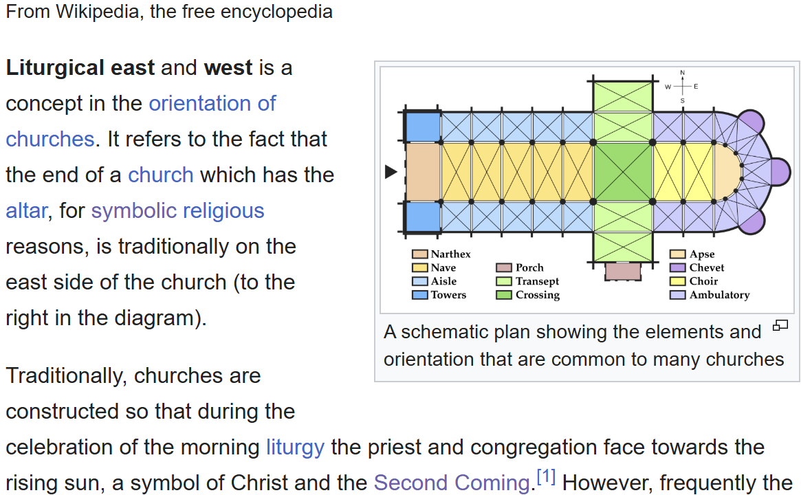

Slide 48
STEP 2
Social Expediency

Slide 49
8. What day was especially devoted to the sun?
Answer: Sunday

Slide 50
9. Was that day adopted by these Christians also?

Slide 51

North British Review, as quoted in History of the Sabbath
That very day was the Sunday of their heathen neighbors and respective countrymen; and patriotism gladly united with expediency in making it at once their Lord’s day and their Sabbath.

Slide 52
STEP 3
Authority

Slide 53
10. Upon what is the Papacy built?
Answer: Self-exaltation

Slide 54
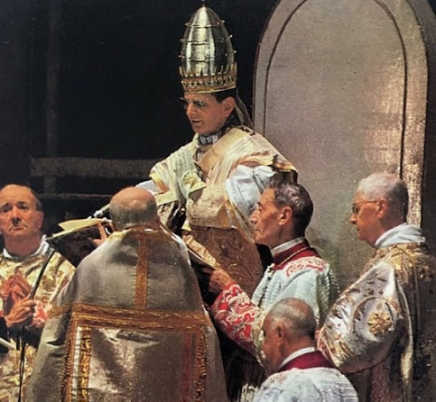
2 Thessalonians 2:4
⁴ Who opposeth and exalteth himself above all that is called God, or that is worshipped; so that he as God sitteth in the temple of God, shewing himself that he is God.

Slide 55
11. In behalf of what was manifested the first arrogant claims of the Papacy?
Answer: In behalf of Sunday.

Slide 56
12. By whom?
Answer: By Victor, who was bishop of Rome, A.D. 193–202.

Slide 57
13. What did he command?

Slide 58
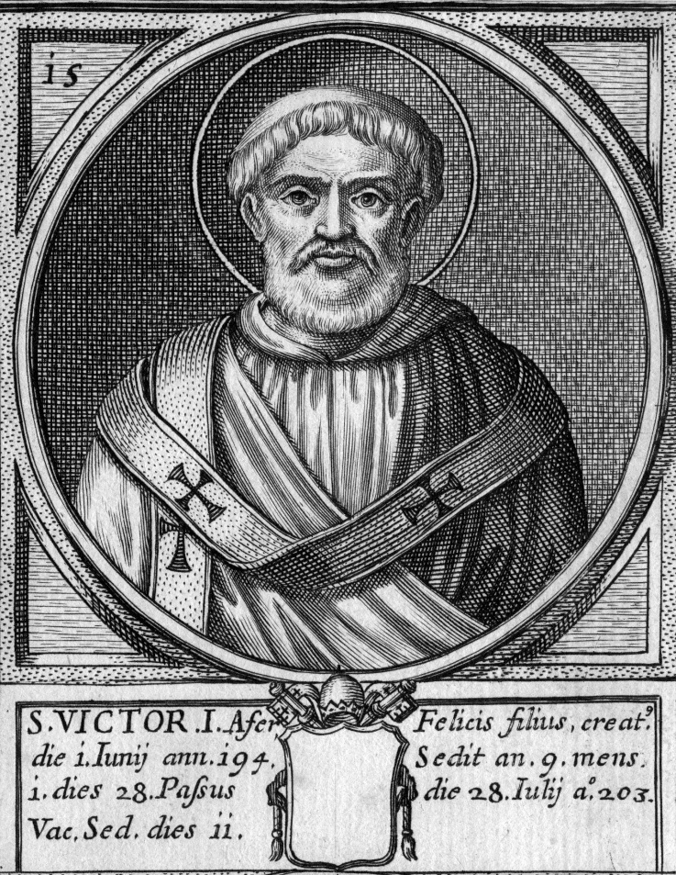
Mosheim, Church History
He wrote an imperious letter to the Asiatic prelates, commanding them to imitate the example of the Western Christians with respect to the time of celebrating the festival of Easter [that is, commanding them to celebrate it on Sunday]. The Asiatics answered this lordly requisition …

Slide 59
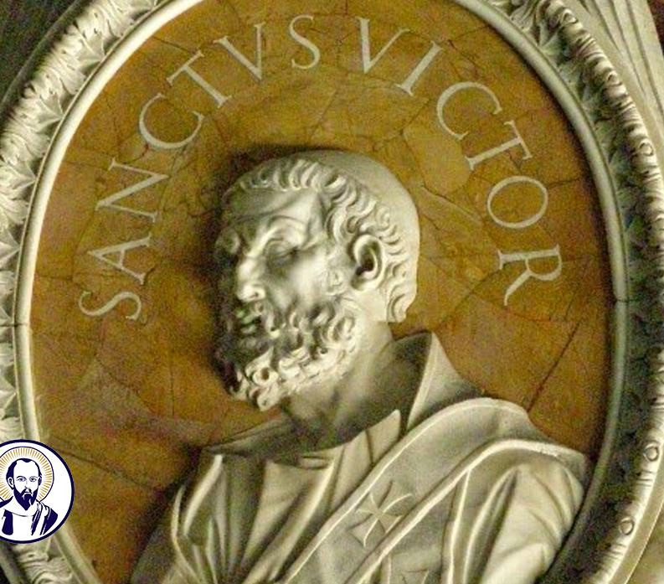
Mosheim, Church History
… with great spirit and resolution, that they would by no means depart in this manner from the custom handed down to them by their ancestors. Upon this the thunder of excommunication began to roar. Victor, exasperated by this resolute answer of the Asiatic bishops, broke communion with them, pronounced them unworthy of the name of his brethren, and excluded them from all fellowship with the church of Rome.

Slide 60
14. How early in the second century had this question been made an important one?

Slide 61
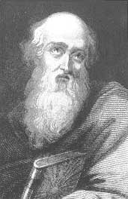
Mosheim, Church History
About the middle of this century, during the reign of Antoninus Pius [about A.D. 160], the venerable Polycarp went to Rome to confer with Anicetus, bishop of that see, upon this matter.

Slide 62
STEP 4
Union

Slide 63
15. What is the characteristic of the Papacy as a world power?
Answer: The union of Church and State — the religious power dominating the civil power and using it to further its own ends.

Slide 64
16. When was the union of Church and State formed, out of which grew the Papacy?
Answer: In the reign of Constantine, A.D. 313–337.

Slide 65
17. What was the condition and work of most of the bishops at this time?

Slide 66
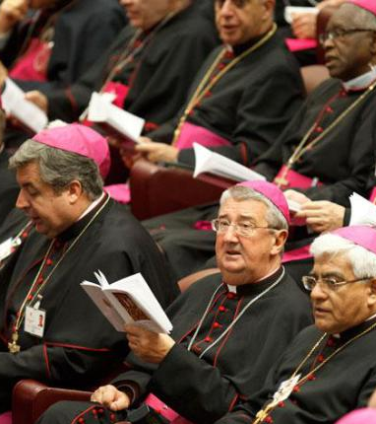
Neander, Church History, volume 2, page 16, Torrey’s edition.
Worldly-minded bishops, instead of caring for the salvation of their flocks, were often but too much inclined to travel about, and entangle themselves in worldly concerns.

Slide 67
18. What had these bishops determined to do?

Slide 68
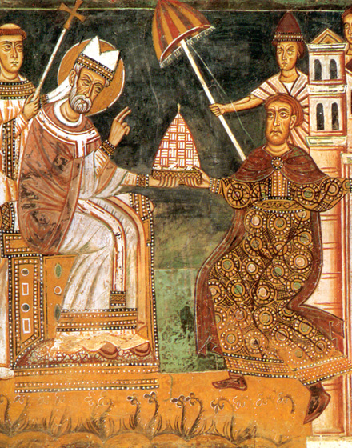
Neander, Church History, volume 2, page 132
This theocratical theory was already the prevailing one in the time of Constantine; and … the bishops voluntarily made themselves dependent on him by their disputes, and by their determination to make use of the power of the State for the furtherance of their aims.

Slide 69
19. What is the “theocratical theory”?
Answer: The theory of government of a State by the immediate power or administration of God.

Slide 70
20. What then is the effect of a man-made theocracy?
Answer: To put man in the place of God.

Slide 71
21. Was this the outcome of the theocratical theory of the bishops of the fourth century?
2 Thessalonians 2:3, 4

Slide 72
2 Thessalonians
2:3
³ Let no man deceive you by any means: for that day shall not come, except there come a falling away first, and that man of sin be revealed, the son of perdition;

Slide 73
2 Thessalonians 2:4
⁴ Who opposeth and exalteth himself above all that is called God, or that is worshipped; so that he as God sitteth in the temple of God, shewing himself that he is God.

Slide 74
Thank you!
… and Happy Sabbath!!

Slide 75


