Slide 1


Slide 2

Living the Light

Slide 3
The Third Angel’s Message
Lesson 7: The Development of the Beast - Concluded
August 18, 1888
Lesson 7, 3rd Quarter 1888

Slide 4
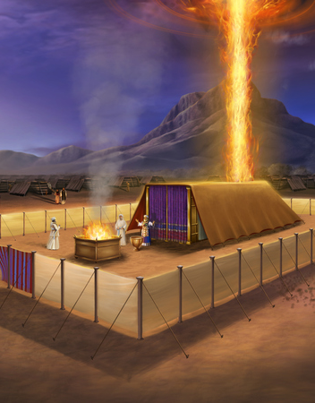
The Beast Forming
  This lesson isn’t about a beast that already existed. It’s about how beasts are formed. The beast from the sea is our case study — not so we can argue about the past, but so we can recognize the patterns Scripture warns us about before they repeat.

Slide 5
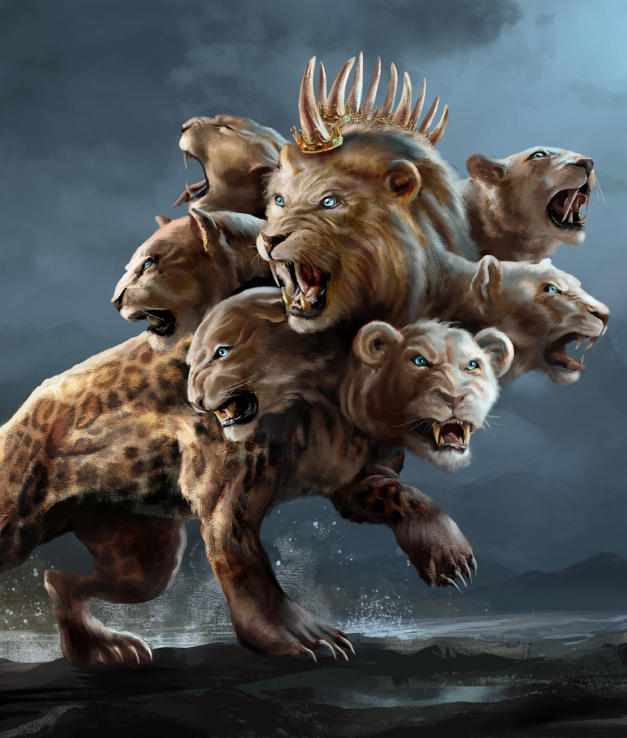
SUMMARY:
Lesson 5
Steps in the Development of the Beast:
STEP 1: Accommodation
STEP 2: Social Expediency
STEP 3: Authority
STEP 4: Union

Slide 6

2 Thessalonians
2:3
³ Let no man deceive you by any means: for that day shall not come, except there come a falling away first, and that man of sin be revealed, the son of perdition;

Slide 7
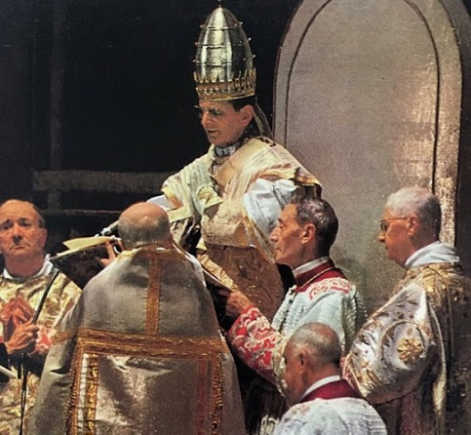
2 Thessalonians 2:4
⁴ Who opposeth and exalteth himself above all that is called God, or that is worshipped; so that he as God sitteth in the temple of God, shewing himself that he is God.

Slide 8
STEP 5
Patronage

Slide 9

1. What did we find in the preceding lesson was the determination of the bishops of the fourth century?

Slide 10
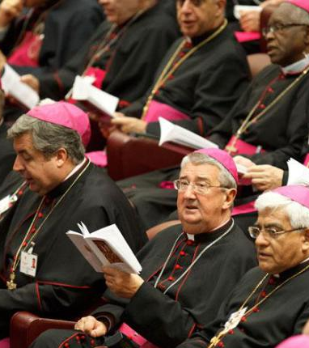
Neander, Church History, volume 2, page 16, Torrey’s edition.
Worldly-minded bishops, instead of caring for the salvation of their flocks, were often but too much inclined to travel about, and entangle themselves in worldly concerns.

Slide 11
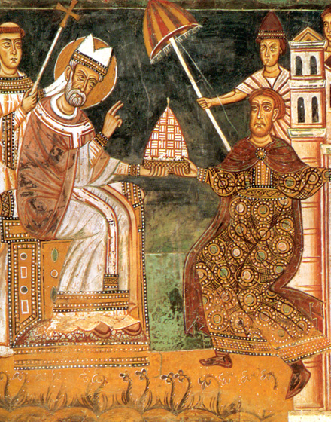
Neander, Church History, volume 2, page 132
This theocratical theory was already the prevailing one in the time of Constantine; and … the bishops voluntarily made themselves dependent on him by their disputes, and by their determination to make use of the power of the State for the furtherance of their aims.

Slide 12
1. What did we find in the preceding lesson was the determination of the bishops of the fourth century?
Answer: To make use of the power of the State for the furtherance of their own aims.

Slide 13
2. What was one of the principal aims of the Western bishops, especially the bishop of Rome?

Slide 14
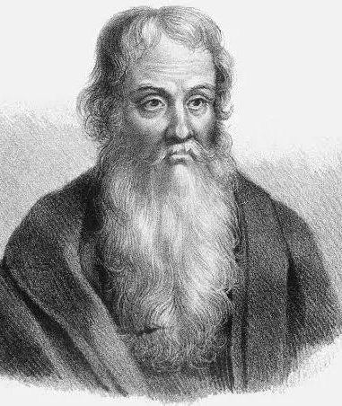
Eusebius of Caesarea
c. A.D. 260–339
Bishop of Caesarea in Palestine
Lived during the reign of Constantine
Often called “the Father of Church History”
Author of Ecclesiastical History, our main source for many events of the 2nd and 3rd centuries

Slide 15
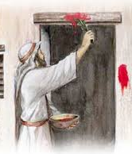
Eusebius, Ecclesiastical History, Book 5, 23.1
“A question of no small importance arose….For the parishes of all Asia, as from an older tradition, held that the fourteenth day of the moon, on which day the Jews were commanded to sacrifice the lamb, should be observed as the feast of the Saviour's passover…”

Slide 16
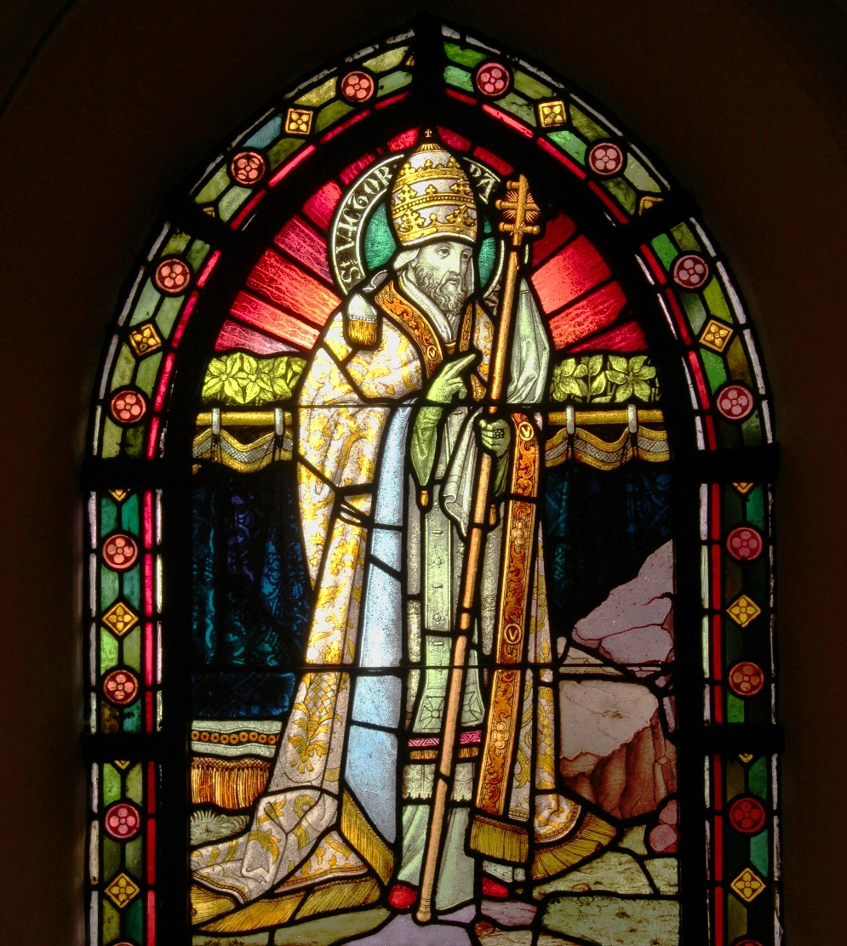
Eusebius, Ecclesiastical History, Book 5, 23.2
“But it was not the custom of the churches in the rest of the world…. Synods and assemblies of bishops were held on this account, and all, with one consent, through mutual correspondence drew up an ecclesiastical decree, that the mystery of the resurrection of the Lord should be celebrated on no other but the Lord's day…”

Slide 17
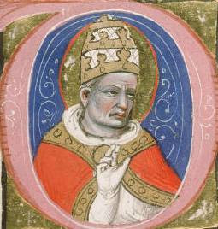
Eusebius, Ecclesiastical History, Book 5, 23.2
“There is still extant a writing of those who were then assembled in Palestine, over whom Theophilus, bishop of Cæsarea, and Narcissus, bishop of Jerusalem, presided. And there is also another writing extant of those who were assembled at Rome to consider the same question, which bears the name of Bishop Victor…”

Slide 18
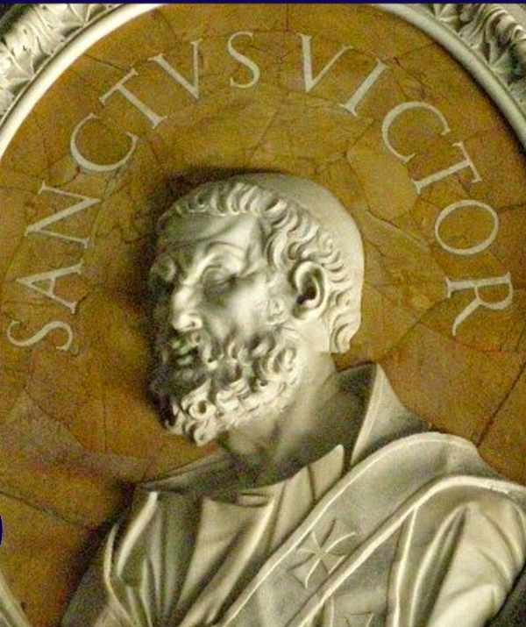
Eusebius, Ecclesiastical History, Book 5, 24.9
“Thereupon Victor, who presided over the church at Rome, immediately attempted to cut off from the common unity the parishes of all Asia, with the churches that agreed with them, as heterodox; and he wrote letters and declared all the brethren there wholly excommunicate.”

Slide 19
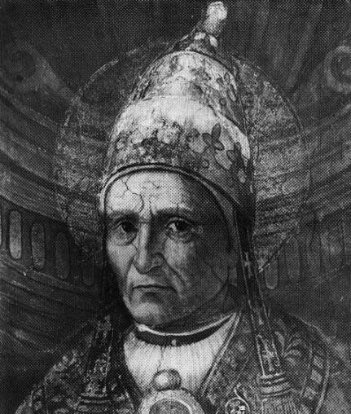
Eusebius, Ecclesiastical History, Book 5, 24.10
“But this did not please all the bishops. And they besought him to consider the things of peace, and of neighborly unity and love. Words of theirs are extant, sharply rebuking Victor.”

Slide 20
2. What was one of the principal aims of the Western bishops, especially the bishop of Rome?
Answer: The exaltation of Sunday.

Slide 21
3. What did they secure from Constantine?

Slide 22
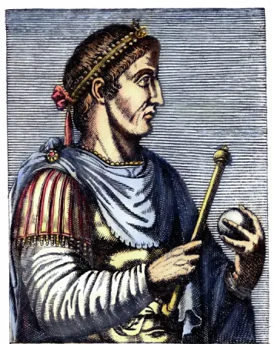
Eusebius of Caesarea, Life of Constantine, Book IV, Ch. 16
On Constantine…
In this manner he [Constantine] represented himself, even through the medium of painting, as habitually engaged in prayer to God. At the same time he forbade, by an express enactment, the setting up of any resemblance of himself in any idol temple, that not even the mere lineaments of his person might receive contamination from the error of forbidden superstition.

Slide 23
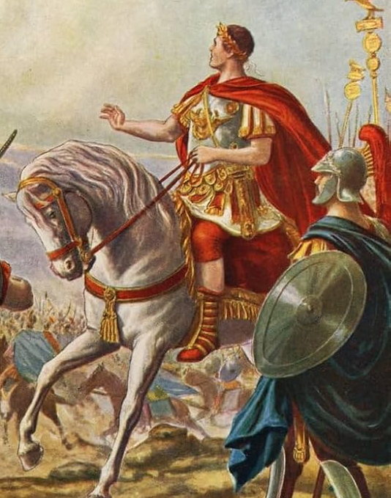
Eusebius of Caesarea, Life of Constantine, Book IV, Ch. 17
On Constantine…
Still nobler proofs of his [Constantine’s] piety might be discerned by those who marked how he modeled as it were his very palace into a church of God, and himself afforded a pattern of zeal to those assembled therein: how he took the sacred scriptures into his hands, and devoted himself to the study of those divinely inspired oracles; after which he would offer up regular prayers with all the members of his imperial court.

Slide 24
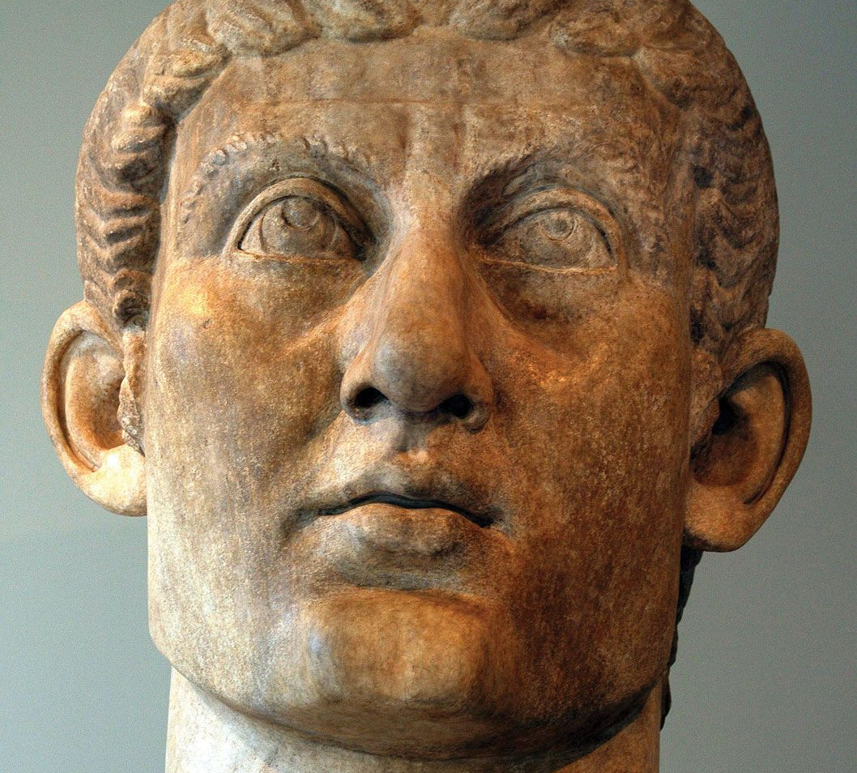
It’s worth noting that Constantine…
Retained the title Pontifex Maximus (chief pagan priest)
Delayed baptism until near death
Used solar imagery in imperial symbolism
Convened councils and enforced decisions

Slide 25
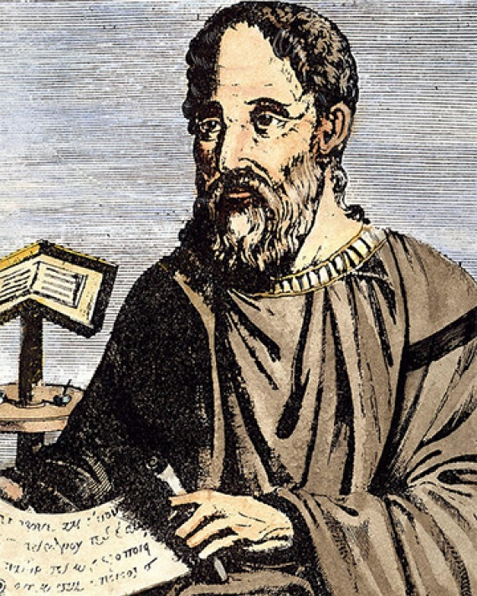
Meanwhile, Eusebius…
Lived under Constantine
Benefited from Constantine’s patronage
Saw Constantine as God’s chosen instrument
Was writing a court history, and not a neutral biography

Slide 26
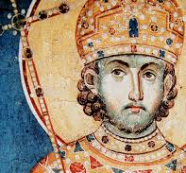
Constantine and His Faith
If you were a fourth-century Christian who had endured persecution under Diocletian… how would Constantine feel to you?
Once political power appears devout, resistance becomes morally complicated.

Slide 27
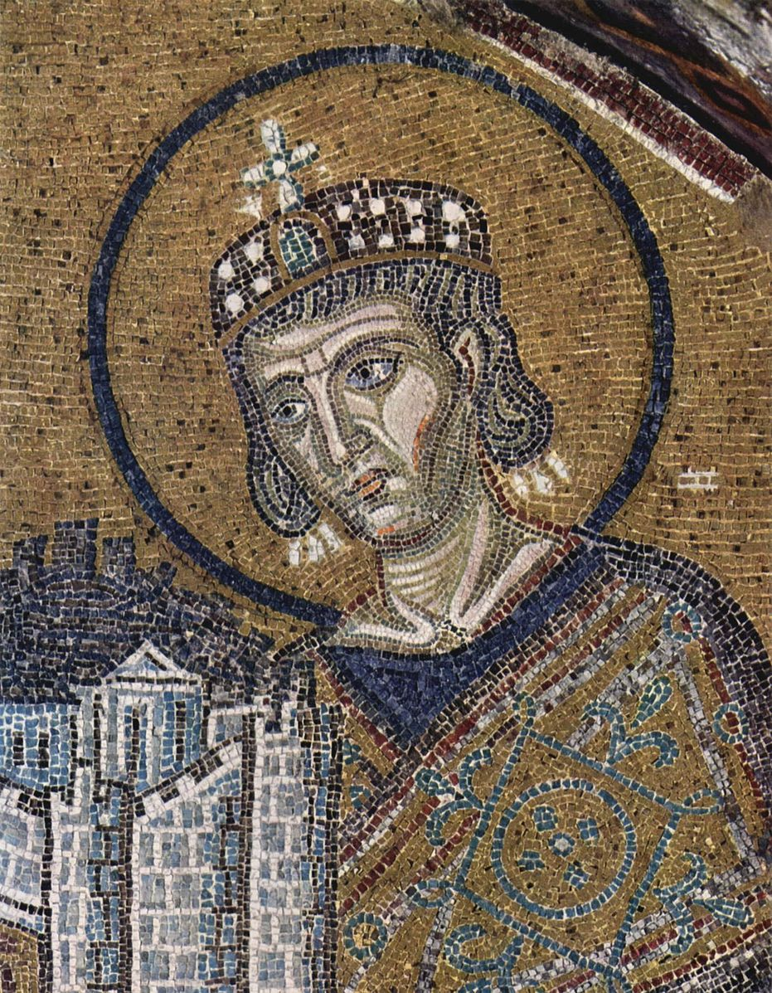
Eusebius of Caesarea, Life of Constantine, Book IV, Ch. 18
On Constantine…
He [Constantine] ordained, too, that one day should be regarded as a special occasion for prayer: I mean that which is truly the first and chief of all, the day of our Lord and Saviour. The entire care of his household was entrusted to deacons and other ministers consecrated to the service of God, and distinguished by gravity of life and every other virtue…

Slide 28
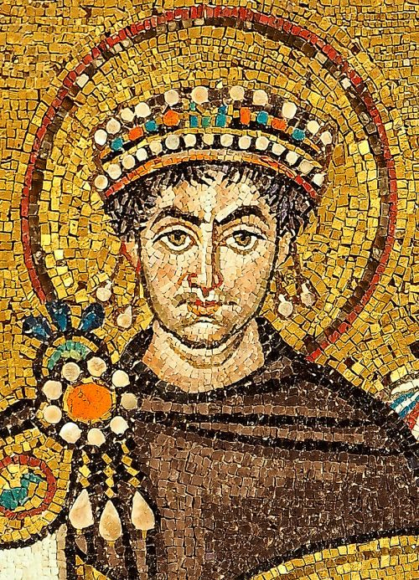
Eusebius of Caesarea, Life of Constantine, Book IV, Ch. 18
On Constantine…
while his trusty body guard, strong in affection and fidelity to his person, found in their emperor an instructor in the practice of piety, and like him held the Lord's salutary day in honor and performed on that day the devotions which he loved. The same observance was recommended by this blessed prince to all classes of his subjects: his earnest desire being gradually to lead all mankind to the worship of God.

Slide 29
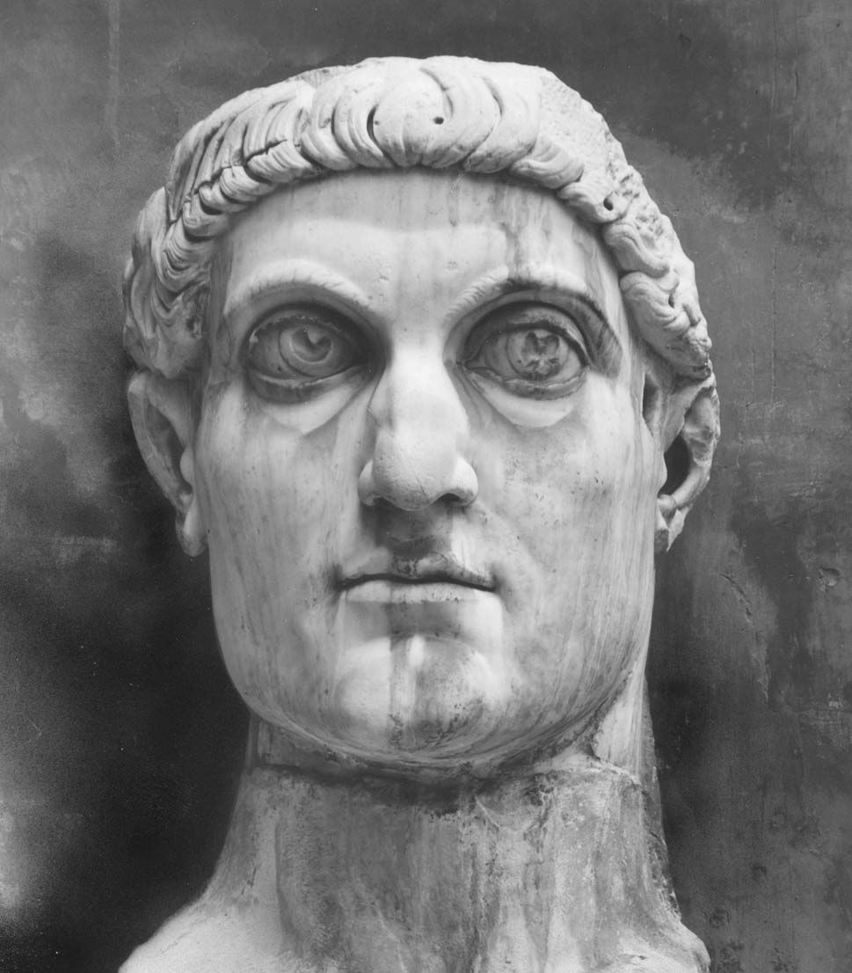
Eusebius of Caesarea, Life of Constantine, Book IV, Ch. 18
On Constantine…
Accordingly he enjoined on all the subjects of the Roman empire to observe the Lord's day, as a day of rest, and also to honor the day which precedes the Sabbath; in memory, I suppose, of what the Saviour of mankind is recorded to have achieved on that day.

Slide 30
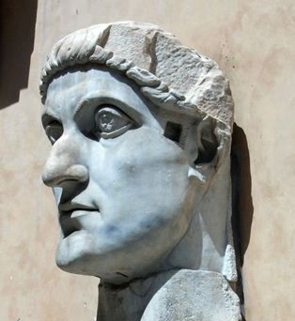
Eusebius of Caesarea, Life of Constantine, Book IV, Ch. 18
On Constantine…
And since his desire was to teach his whole army zealously to honor the Saviour's day (which derives its name from light, and from the sun), he freely granted to those among them who were partakers of the divine faith, leisure for attendance on the services of the Church of God, in order that they might be able, without impediment, to perform their religious worship.

Slide 31
3. What did they secure from Constantine?
Answer: An edict, in A.D. 321, in favor of Sunday—the first Sunday law that ever was.

Slide 32
4. What was this law?

Slide 33
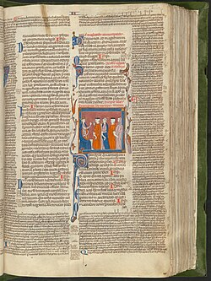
Laws of Festivals
Codex Justinianus
(Code of Justinian)
Justinian’s 6th-century legal compilation preserved earlier Roman imperial laws, including Constantine’s decrees.

Slide 34
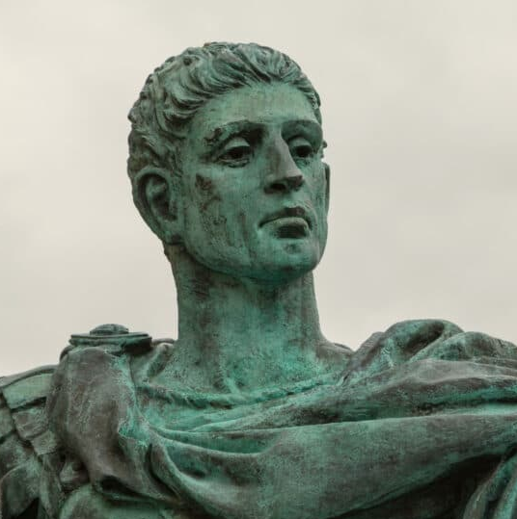
Codex Justinianus, Book 3, Title 12, Law 3
Constantine’s
Edict of 321 AD
“Let all the judges and town people, and the occupation of all trades, rest on the venerable day of the sun; but let those who are situated in the country freely and at full liberty attend to the business of agriculture;”

Slide 35
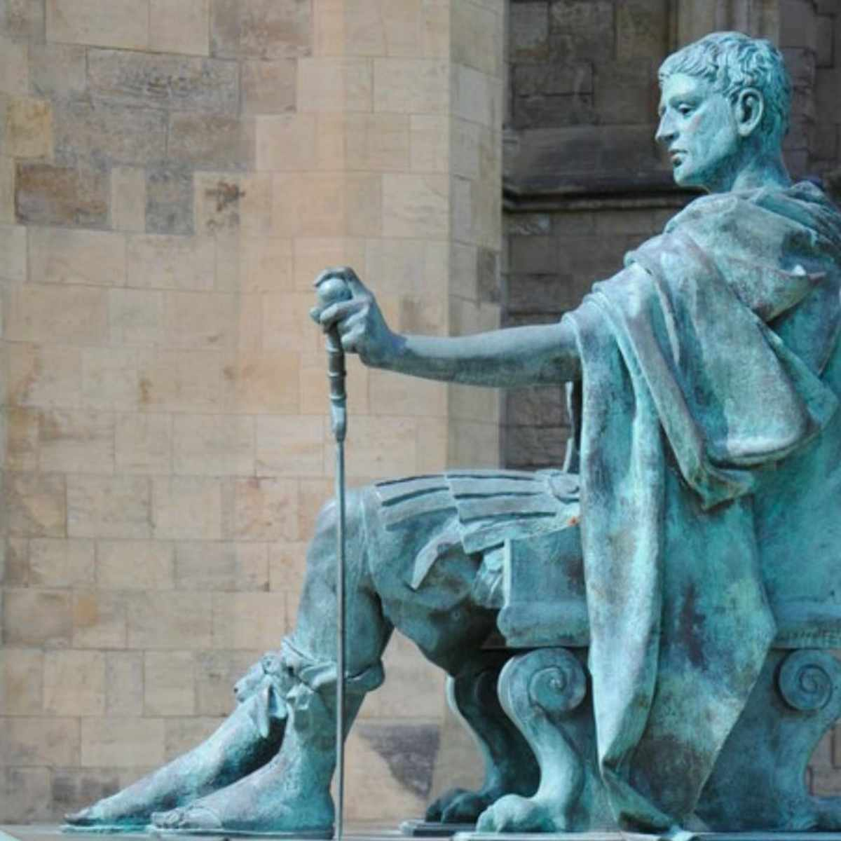
Codex Justinianus, Book 3, Title 12, Law 3
Constantine’s
Edict of 321 AD
“because it often happens that no other day is so fit for sowing corn and planting vines; lest, the critical moment being let slip, men should lose the commodities granted by Heaven.”

Slide 36
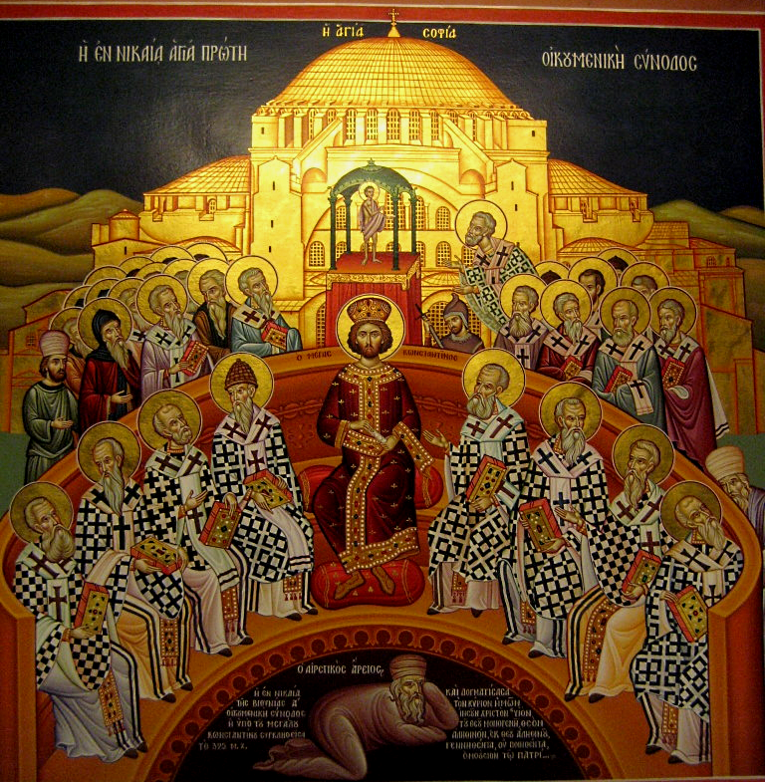
Keep in Mind that…
For three hundred years, Christianity had no access to or protection from government power.
Under Diocletian, Christians were burned, imprisoned, executed.

Slide 37
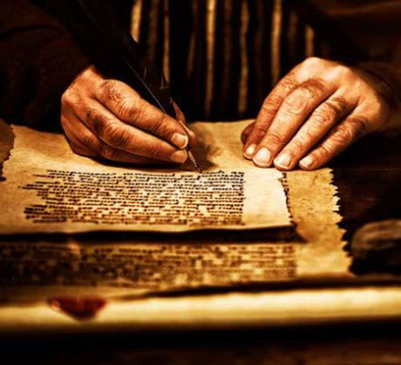
But there were always disagreements…
When Christians disagreed, they debated. They wrote letters. They persuaded. Sometimes they split.
Occasionally they called meetings to make decisions, just as the apostles did.
What changes when the most powerful man in the world calls the meeting?

Slide 38
5. Who convened the Council of Nice?
Answer: Constantine, A.D. 325.

Slide 39
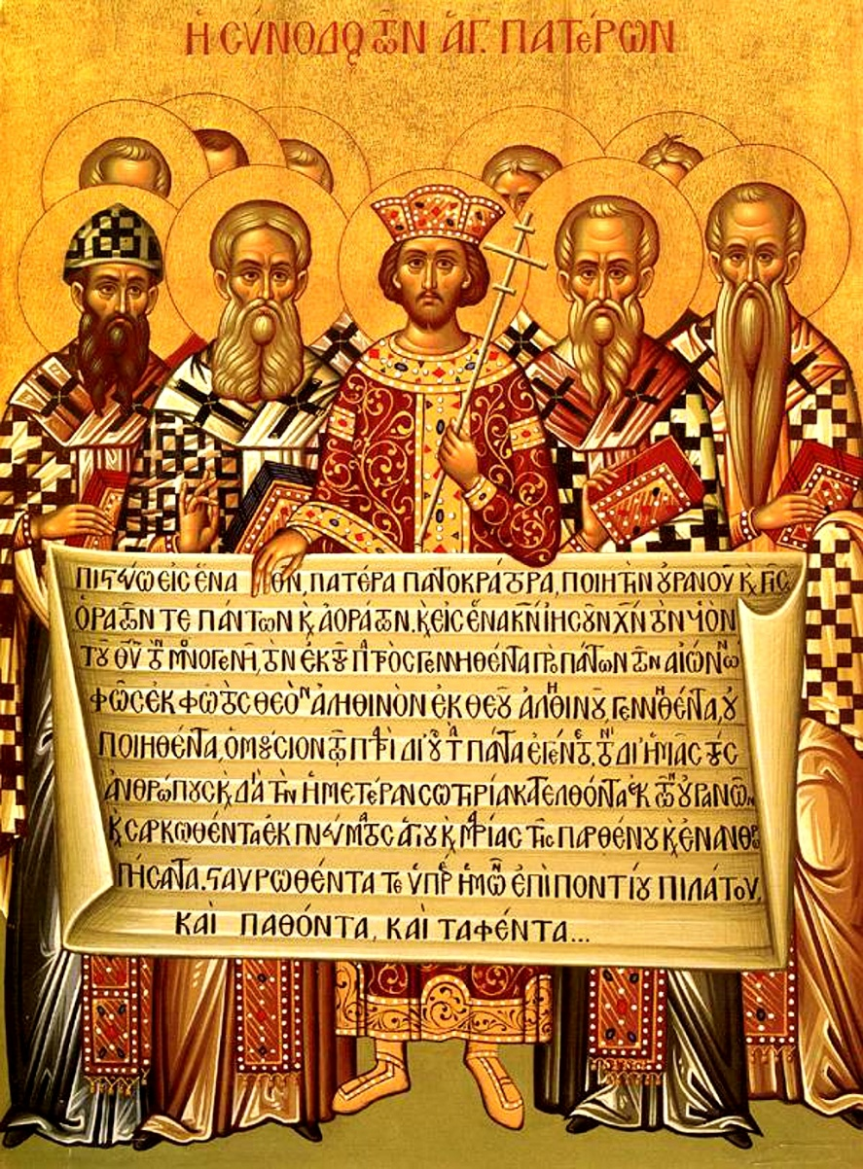
Who calls the Meeting?
The emperor himself calls a council in defense of Christianity. Pays for bishops to travel—supports them publicly.
From their perspective this must have felt like answered prayer!
For the first time in Christian history, a theological disagreement was settled in a meeting convened and backed by the highest level of civil authority.

Slide 40
6. What was one of the two principal decisions rendered by that council?

Slide 41
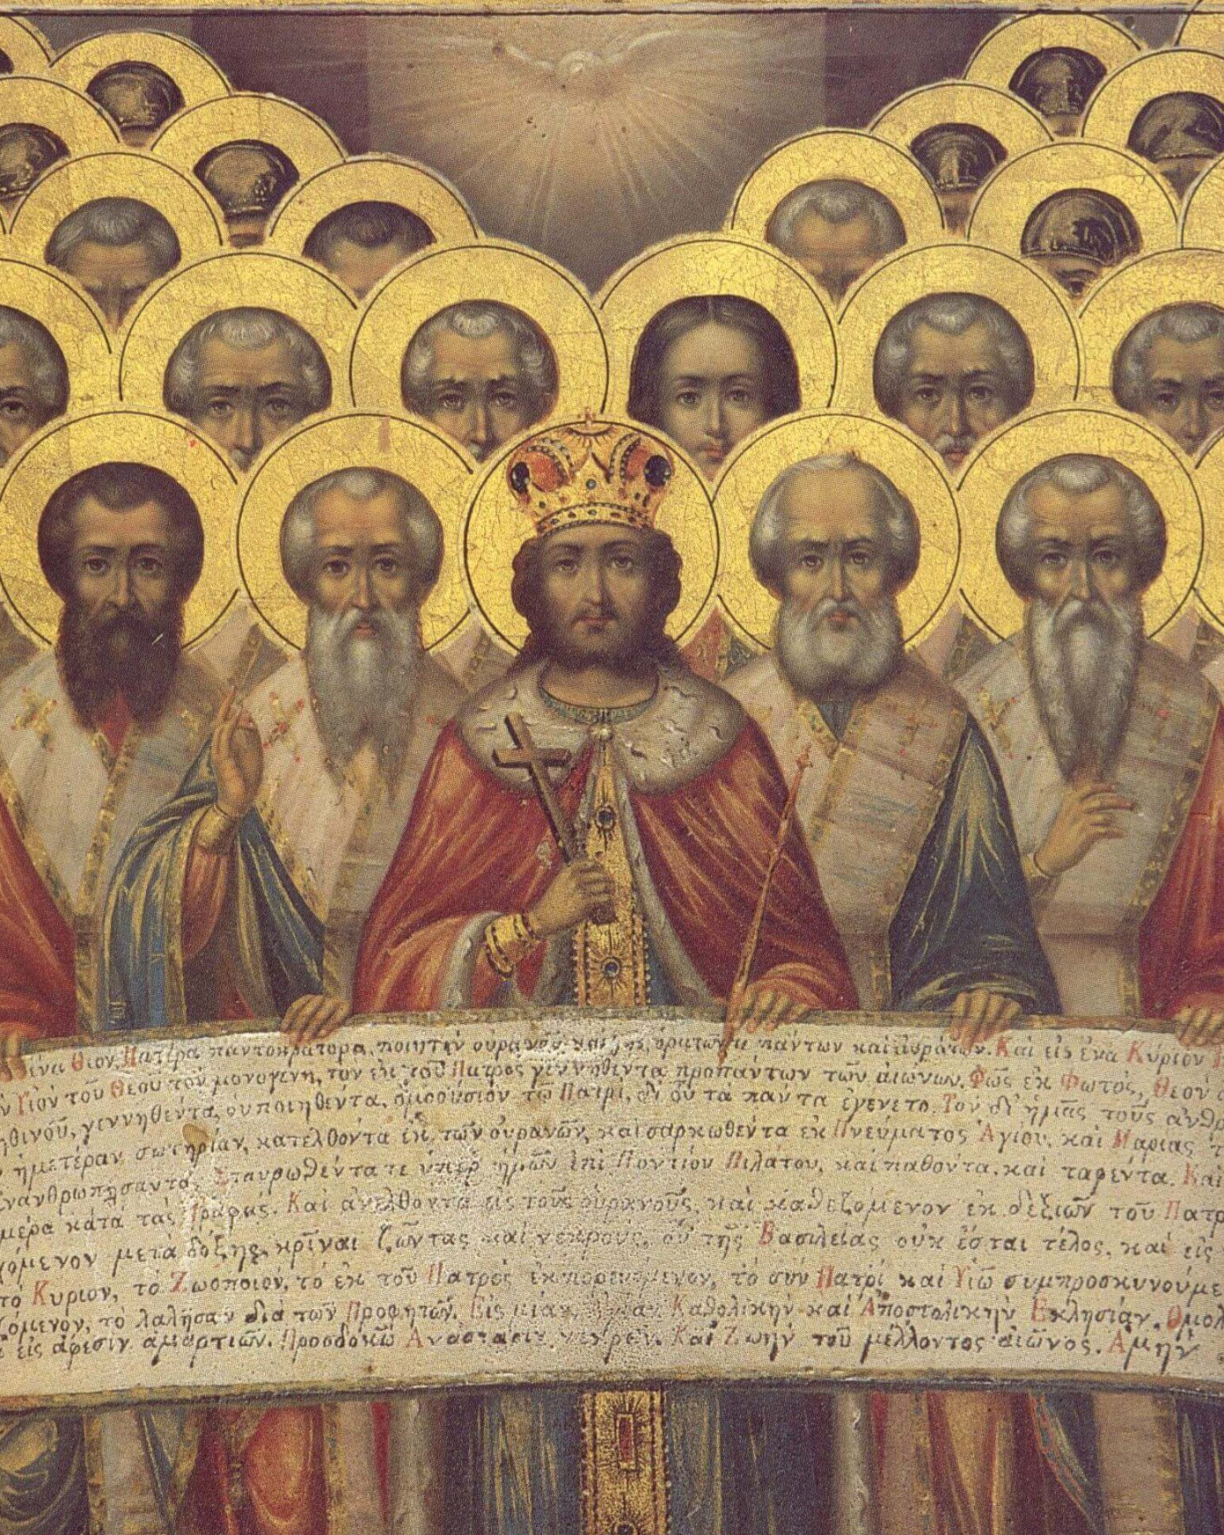
Major Outcomes of the Council:
A doctrinal dispute (Arianism) formally condemned.
A creed drafted and published.
The date of Easter fixed uniformly (Sunday).
Decrees issued under imperial authority.
What do these decisions have in common?

Slide 42
6. What was one of the two principal decisions rendered by that council?
Answer: That Easter should always and everywhere be celebrated on Sunday.

Slide 43
7. Under what authority were its decrees published?

Slide 44
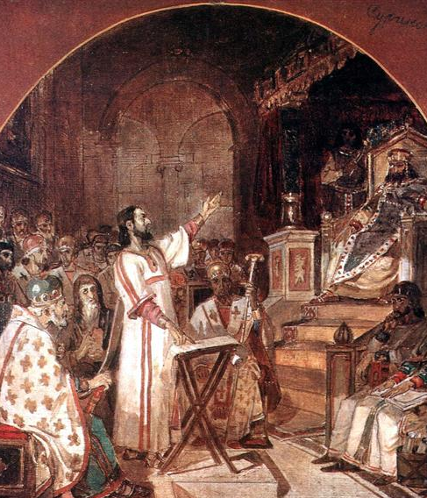
Neander, Church History, volume 2, page 133
“The decrees of these synods were published under the imperial authority, and thus obtained a political importance.”

Slide 45
8. Who was bishop of Rome during twenty-one years and eleven months of Constantine’s reign?
Answer: Sylvester, January 31, 314, to December 31, 335.

Slide 46
9. What did he do by his “apostolic authority” shortly after the Council of Nice?
Answer: He decreed that Sunday should be called the Lord’s day.
—History of the Sabbath, page 350.

Slide 47
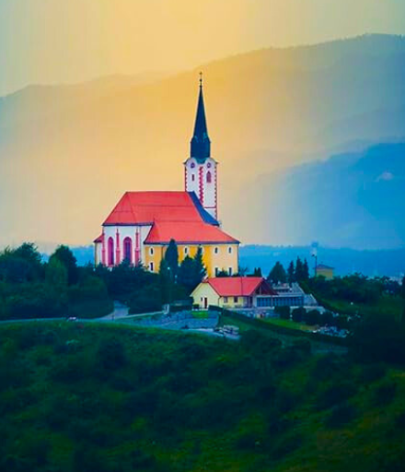
The Lord’s Day:
The term ‘Lord’s Day’ appears in Scripture (Revelation 1:10).
The question is: Which day did the Lord claim as His?
If the Lord has already claimed a day in Scripture, what happens when a different day receives that title under institutional authority?

Slide 48

The Seventh Day is The Sabbath of the LORD:
Exodus 16:23
Exodus 20:10
Exodus 31:13
Exodus 31:15
Exodus 31:17
Exodus 35:2
Leviticus 23:3
Exodus 35:2
Leviticus 23:3
Leviticus 23:38
Deuteronomy 5:14
Isaiah 58:13
Ezekiel 20:12
Ezekiel 20:20

Slide 49

Matthew
12:8
⁸ For the Son of man is Lord even of the sabbath day.

Slide 50

Isaiah 58:13
¹³ If thou turn away thy foot from the sabbath, from doing thy pleasure on my holy day; and call the sabbath a delight, the holy of the Lord, honourable; and shalt honour him, not doing thine own ways, nor finding thine own pleasure, nor speaking thine own words:

Slide 51

We have evidence that:
Even into the 4th century, Socrates and Sozomen note widespread Sabbath worship in the East.
Socrates of Constantinople writes that almost all churches celebrated the sacred mysteries on Sabbath except Rome and Alexandria.

Slide 52
10. What was commanded by the Council of Laodicea, A.D. 363 or 364?
Answer: That if Christians should rest on the Sabbath, “let them be accursed from Christ;” and that they should rest on Sunday.

Slide 53
11. Did Constantine’s Sunday law apply to all classes?

Slide 54
Codex Justinianus, Book 3, Title 12, Law 3
Constantine’s
Edict of 321 AD
“Let all the judges and town people, and the occupation of all trades, rest on the venerable day of the sun; but let those who are situated in the country freely and at full liberty attend to the business of agriculture;”

Slide 55
Codex Justinianus, Book 3, Title 12, Law 3
Constantine’s
Edict of 321 AD
“because it often happens that no other day is so fit for sowing corn and planting vines; lest, the critical moment being let slip, men should lose the commodities granted by Heaven.”

Slide 56
STEP 6
Enforcement

Slide 57
12. Were other laws demanded by the bishops, which should be more general?

Slide 58
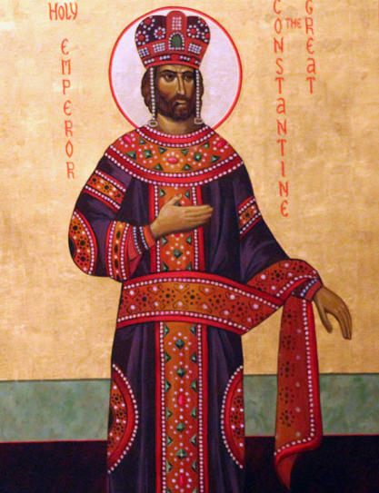
Neander, Church History, Volume 2, pg. 300
“By a law of the year 386, those older changes effected by the Emperor Constantine were more rigorously enforced, and, in general, civil transactions of every kind on Sunday were strictly forbidden. Whoever transgressed was to be considered, in fact, as guilty of sacrilege.”

Slide 59
13. What petition was made to the emperor by a church convention in A.D. 401?

Slide 60
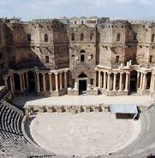
Neander, Church History, Volume 2, pg. 297
That the public shows might be transferred from the Christian Sunday and from feast days, to some other days of the week.

Slide 61
14. What was the object of all these State laws?

Slide 62
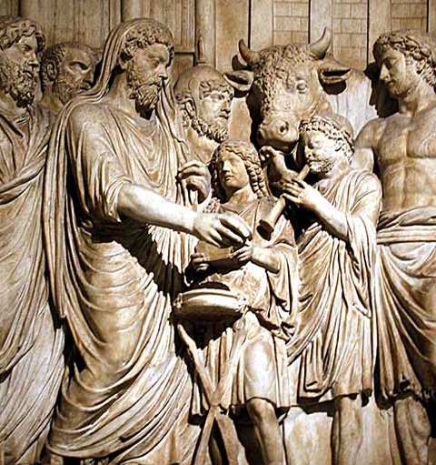
Neander, Church History, Volume 2, pgs. 297, 301
“That the day might be devoted with less interruption to the purposes of devotion.”
“That the devotion of the faithful might be free from all disturbance.”

Slide 63
15. What was it that so much hindered the devotion of the “faithful” of those times?

Slide 64
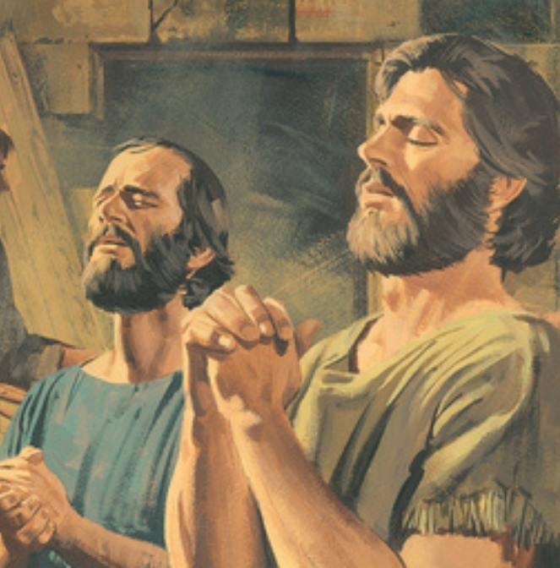
Neander, Church History, Volume 2, pg. 300
Owing to the prevailing passion at that time, especially in the large cities, to run after the various public shows, it so happened that when these spectacles fell on the same days which had been consecrated by the church to some religious festival, they proved a great hindrance to the devotion of Christians, though chiefly, it must be allowed, to those whose Christianity was the least an affair of the life and of the heart.

Slide 65
16. How was their “devotion” disturbed?

Slide 66

Neander, Church History, Volume 2
Church teachers … were, in truth, often forced to complain, that in such competitions the theater was vastly more frequented than the church.

Slide 67
17. What does Neander say of all this?

Slide 68
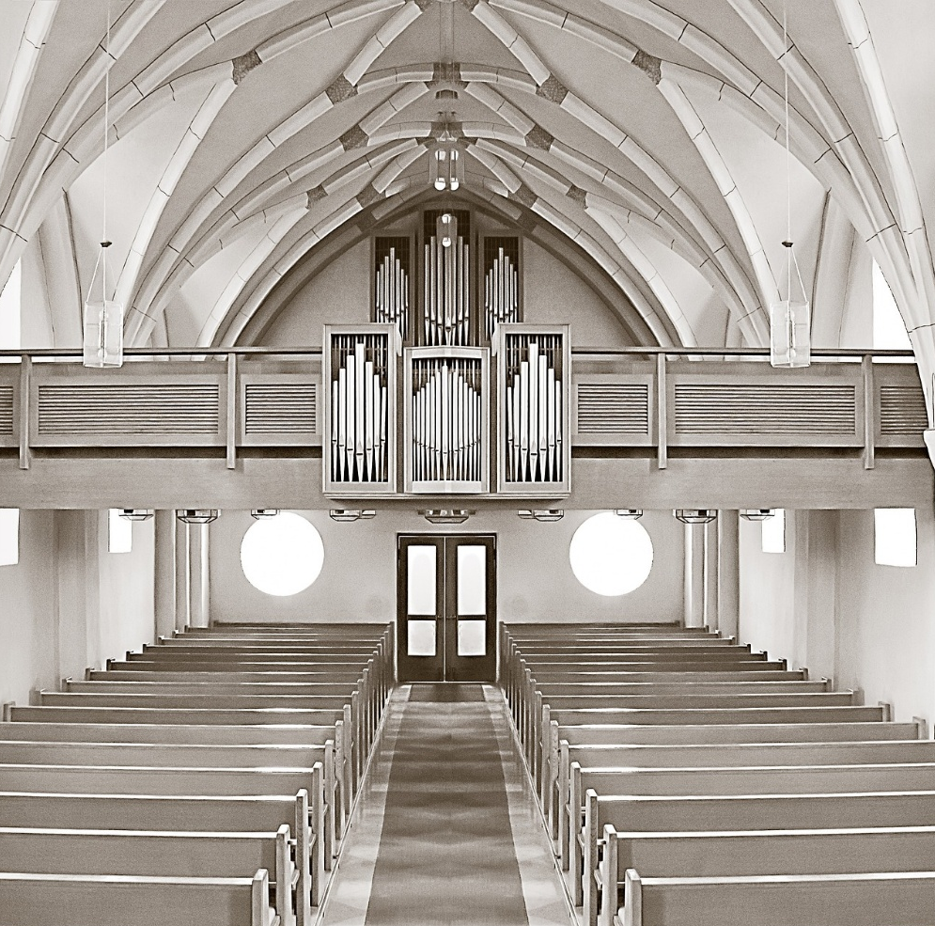
Neander, Church History, Volume 2, Pg. 301
In this way, the church received help from the State for the furtherance of her ends.… But had it not been for that confusion of spiritual and secular interests, had it not been for the vast number of mere outward conversions thus brought about, she would have needed no such help.

Slide 69
18. When the church had received the help of the State to this extent, did she stop there?
Answer: No; she demanded that the civil power should be exerted to compel men to serve God as the church should dictate.

Slide 70
STEP 7
Moralization

Slide 71
19. Which of the fathers of the church was father to this theory?
Answer: Augustine, who lived from A.D. 354 to 430.

Slide 72
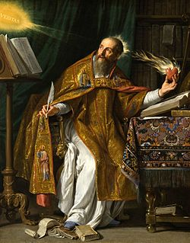
Augustine of Hippo
Bishop of Hippo (North Africa)
Major influence on Catholic and Protestant theology
Influenced Luther, Calvin, and much of Western Christianity
Lived during imperial Christianity’s consolidation

Slide 73
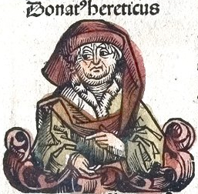
The Donatists
The Donatists were a North African Christian group who:
Rejected bishops who had lapsed during persecution
Claimed the church must be pure
Refused communion with state-backed bishops
This was not paganism. It was intra-Christian conflict.

Slide 74
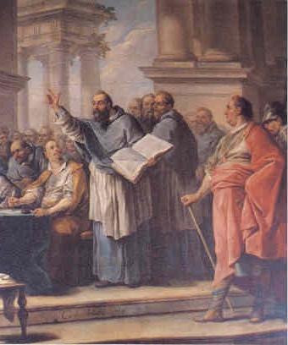
The Donatists
Augustine initially opposed coercion. Later, observing that imperial penalties reduced Donatist resistance, he concluded that compulsion could be spiritually beneficial

Slide 75
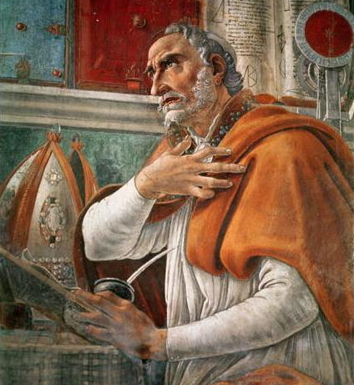
Augustine and the Theology of Coercion
He argues:
Fear can lead someone to truth.
Discipline can save a soul.
The state may be used to correct heretics.
Augustine reframes coercion as love.

Slide 76
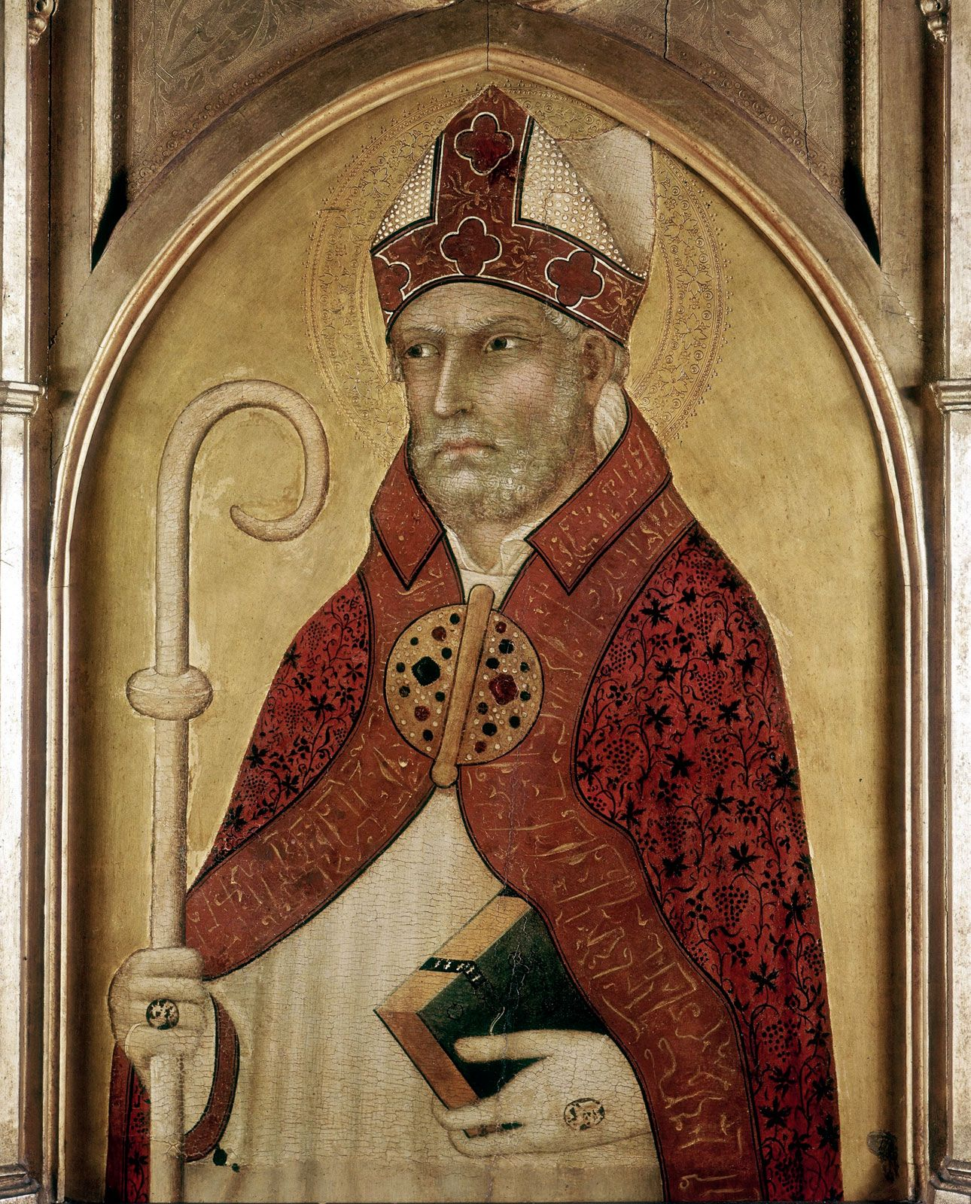
Augustine and the Theology of Coercion
Augustine did not advocate mass slaughter.
He preferred:
Fines
Exile
Legal penalties
He thought these measures would encourage repentance. He believed unity was spiritually necessary. He feared fragmentation of the church. He saw coercion as corrective, not cruel.

Slide 77
20. What did he teach?

Slide 78
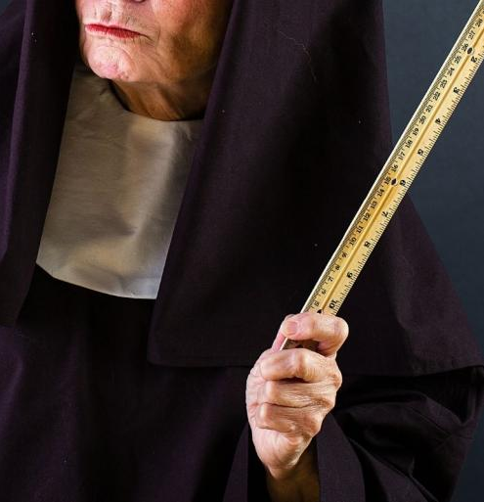
Schaff, Church History, Section 27; Epistle 185, sections 21, 24
It is indeed better that men should be brought to serve God by instruction than by fear of punishment or by pain. But because the former means are better, the latter must not therefore be neglected.… Many must often be brought back to their Lord, like wicked servants, by the rod of temporal suffering, before they attain to the highest grade of religious development.

Slide 79
21. What does Neander say of all this?

Slide 80
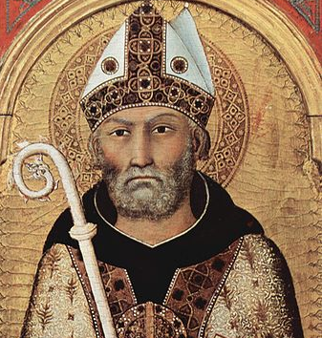
Neander, Church History, Volume 2, Pg. 217
It was by Augustine, then, that a theory was proposed and founded, which … contained the germ of that whole system of spiritual despotism, of intolerance and persecution, which ended in the tribunals of the Inquisition.

Slide 81
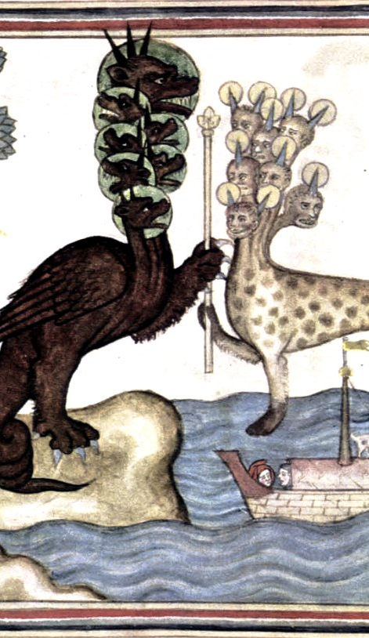
Thus was formed the union of Church and State out of which grew the Papacy. Thus was developed “the beast,” which made war with the saints of God, and wore out the saints of the Most High.

Slide 82
SUMMARY:
Lessons 6 and 7
Steps in the Development of the Beast:
STEP 1: Accommodation
STEP 2: Social Expediency
STEP 3: Authority
STEP 4: Union
STEP 5: Patronage
STEP 6: Enforcement
STEP 7: Moralization

Slide 83
Thank you!
… and Happy Sabbath!!

Slide 84


