Slide 1


Slide 2

Living the Light

Slide 3
The Third Angel’s Message
Lesson 8: The Making of the Image of the Beast
August 25, 1888
Lesson 8, 3rd Quarter 1888

Slide 4
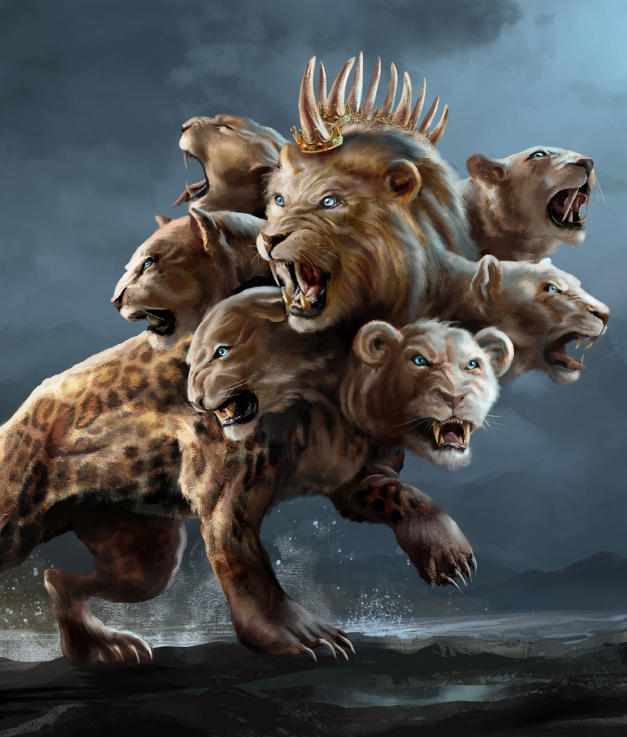
SUMMARY:
Lessons 6 and 7
Steps in the Development of the Beast:
STEP 1: Accommodation
STEP 2: Social Expediency
STEP 3: Authority
STEP 4: Union
STEP 5: Patronage
STEP 6: Enforcement
STEP 7: Moralization

Slide 5
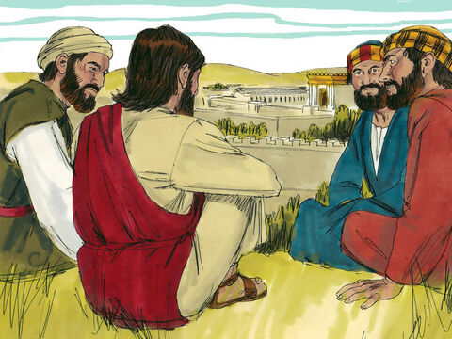
Matthew
24:4-8
⁴ And Jesus answered and said unto them, Take heed that no man deceive you.

Slide 6

Matthew
24:4-8
⁵ For many shall come in my name, saying, I am Christ; and shall deceive many.

Slide 7
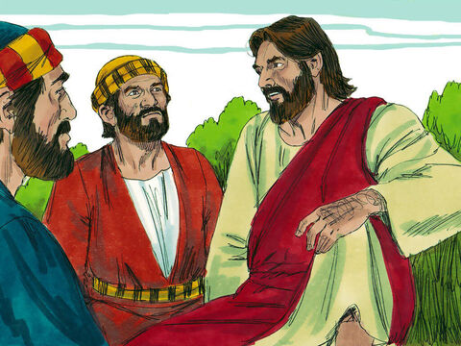
Matthew
24:4-8
⁶ And ye shall hear of wars and rumours of wars: see that ye be not troubled: for all these things must come to pass, but the end is not yet.

Slide 8
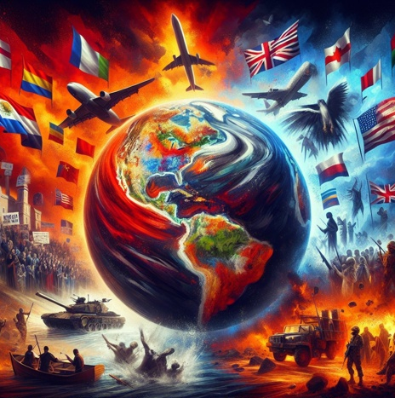
Matthew
24:4-8
⁷ For nation shall rise against nation, and kingdom against kingdom: and there shall be famines, and pestilences, and earthquakes, in divers places.

Slide 9
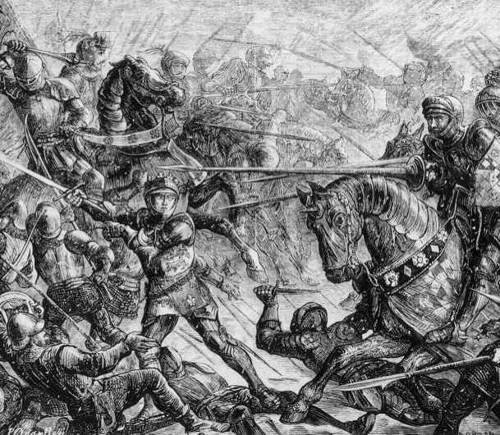
Matthew
24:4-8
⁸ All these are the beginning of sorrows.

Slide 10
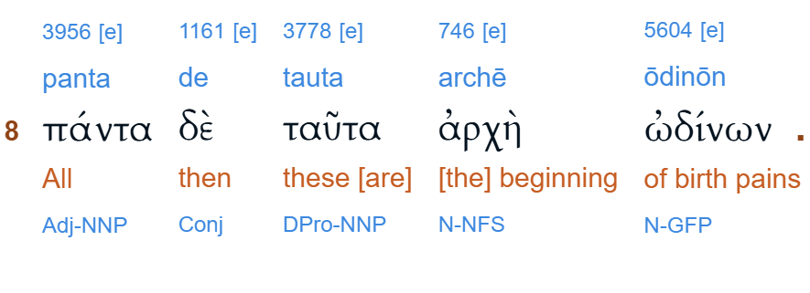

Slide 11
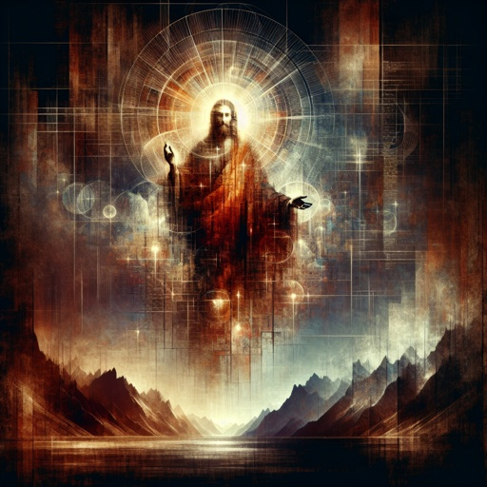
Romans
8:22
²² For we know that the whole creation groaneth and travaileth in pain together until now.

Slide 12
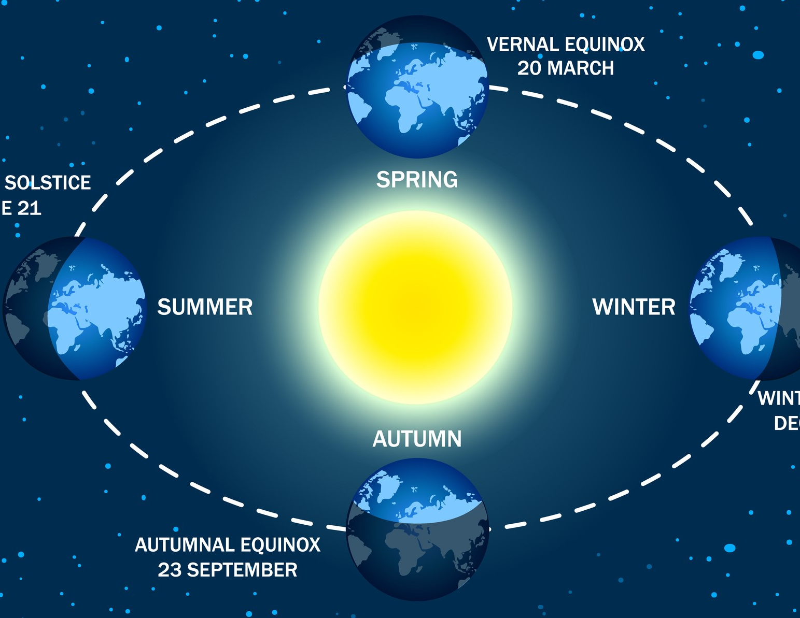
1 Thessalonians
5:1-6
5 But of the times and the seasons, brethren, ye have no need that I write unto you.

Slide 13

1 Thessalonians
5:1-6
² For yourselves know perfectly that the day of the Lord so cometh as a thief in the night.

Slide 14

1 Thessalonians
5:1-6
³ For when they shall say, Peace and safety; then sudden destruction cometh upon them, as travail upon a woman with child; and they shall not escape.

Slide 15
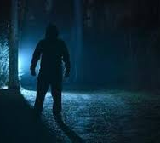
1 Thessalonians
5:1-6
⁴ But ye, brethren, are not in darkness, that that day should overtake you as a thief.

Slide 16
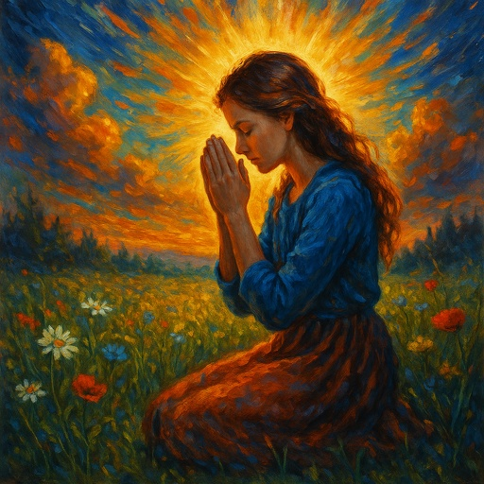
1 Thessalonians
5:1-6
⁵ Ye are all the children of light, and the children of the day: we are not of the night, nor of darkness.

Slide 17
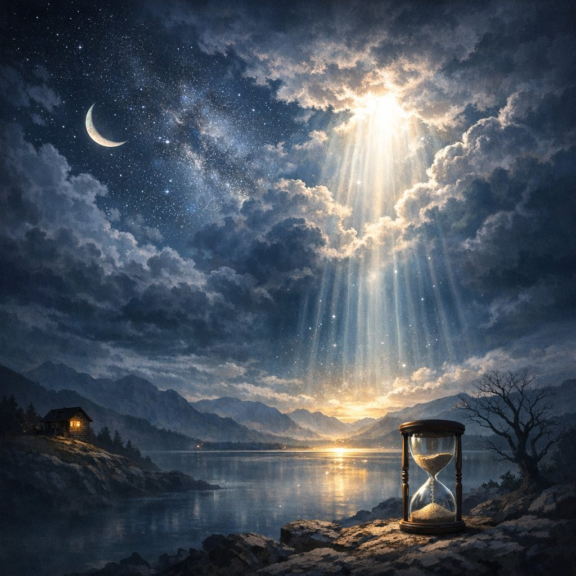
1 Thessalonians
5:1-6
⁶ Therefore let us not sleep, as do others; but let us watch and be sober.

Slide 18
SUMMARY:
Lessons 6 and 7
Steps in the Development of the Beast:
STEP 1: Accommodation
STEP 2: Social Expediency
STEP 3: Authority
STEP 4: Union
STEP 5: Patronage
STEP 6: Enforcement
STEP 7: Moralization

Slide 19

1. What Government have we proved to be represented by the second beast of Revelation 13?

Slide 20
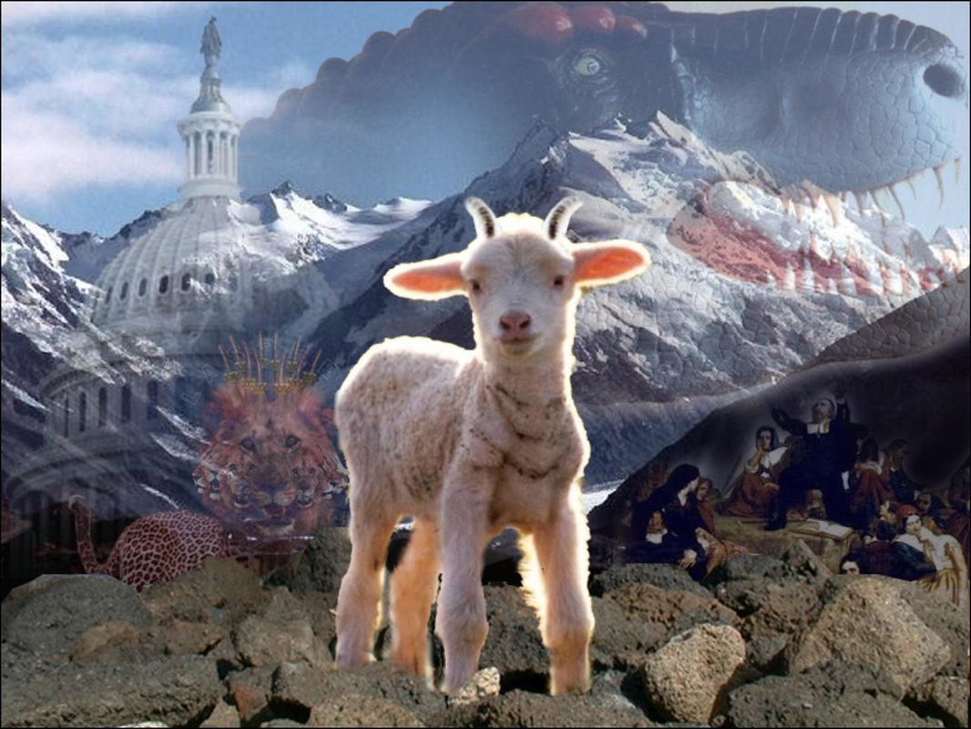
Revelation
13:11
¹¹ And I beheld another beast coming up out of the earth; and he had two horns like a lamb, and he spake as a dragon.

Slide 21
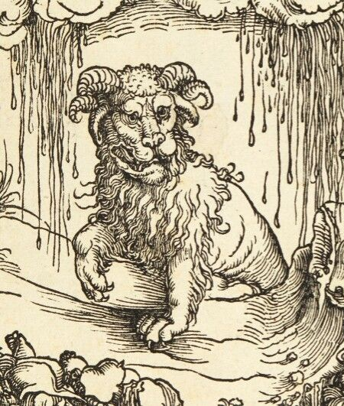
Rising from the Earth
Earlier beasts rise from the “sea” (crowded nations — Daniel 7:2–3).
“Earth” suggests:
Sparse population
New territory
Not arising from old European power struggles
Implies a New World setting.

Slide 22
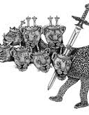
When the First Beast is wounded
The Papacy’s temporal power is broken in 1798.
What power rises to prominence in that same window?
The United States.
Not medieval.
Not ancient.
Modern.

Slide 23
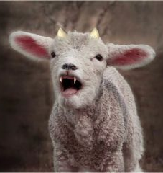
Two Horns like a Lamb
Two lamblike principles historically understood as:
A government without a king: Civil liberty (Republicanism)
A church without a pope: Religious liberty (Protestantism)
Not perfect — but foundational.

Slide 24
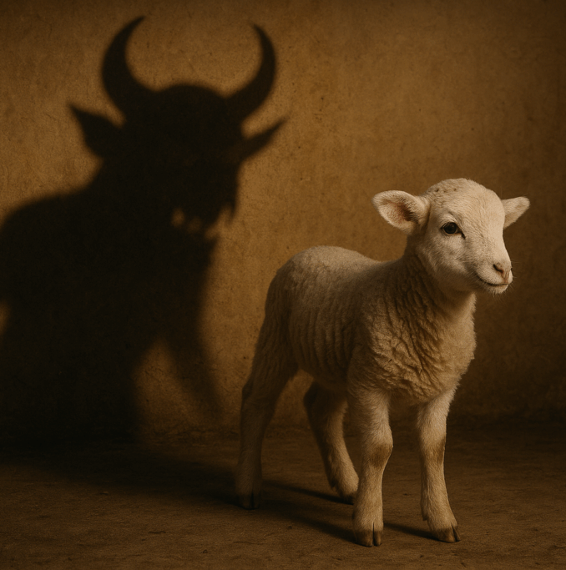
Speaks as a Dragon
The dragon in Revelation represents coercive authority opposed to God.
So this power begins gently…
But later exercises enforcing authority.

Slide 25
2. What power is to be exercised by this beast?
Revelation 13:12, first clause

Slide 26
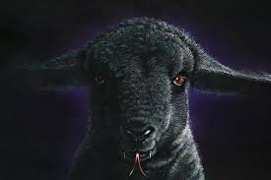
Revelation
13:12
¹² And he exerciseth all the power of the first beast before him, and causeth the earth and them which dwell therein to worship the first beast, whose deadly wound was healed.

Slide 27
3. For what purpose does he use this power?
Revelation 13:12, last part

Slide 28
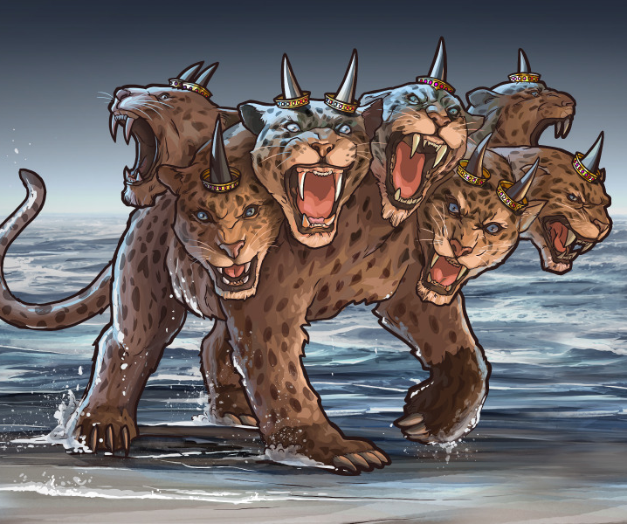
Revelation
13:12
¹² And he exerciseth all the power of the first beast before him, and causeth the earth and them which dwell therein to worship the first beast, whose deadly wound was healed.

Slide 29
4. What is said by him to them that dwell on the earth?
Revelation 14:9, last part

Slide 30
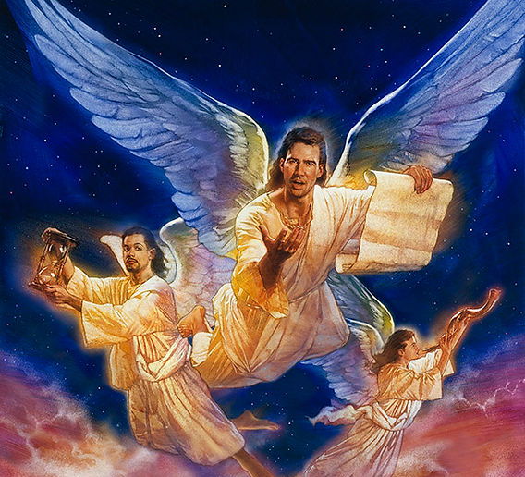
Revelation
14:9
⁹ And the third angel followed them, saying with a loud voice, If any man worship the beast and his image, and receive his mark in his forehead, or in his hand,

Slide 31
5. What power is represented by the first beast?
Answer: The Papacy.

Slide 32
6. What have we found to be the great characteristic of the Papacy?
Answer: The union of Church and State—the Church using the power of the State for the furtherance of its own aims.

Slide 33
7. For what then are we to look in this nation?
Answer: For the religious power to exalt itself, to take the place where it shall dominate the civil, and employ the power of the State for the furtherance of its own ends.

Slide 34
SUMMARY:
Lessons 6 and 7
Steps in the Development of the Beast:
STEP 1: Accommodation
STEP 2: Social Expediency
STEP 3: Authority
STEP 4: Union
STEP 5: Patronage
STEP 6: Enforcement
STEP 7: Moralization

Slide 35
SUMMARY:
Lessons 6 and 7
Steps in the Development of the Beast:
STEP 1: Accommodation
STEP 2: Social Expediency
STEP 3: Authority
STEP 4: Union
STEP 5: Patronage
STEP 6: Enforcement
STEP 7: Moralization

Slide 36
8. Is there any effort even now* being made in this direction?
Answer: Yes, a large and influential organization is working to this very end.
*“Now” in this question (and below) refers to the “now” of 1888.

Slide 37
SUMMARY:
Lessons 6 and 7
Steps in the Development of the Beast:
STEP 1: Accommodation
STEP 2: Social Expediency
STEP 3: Authority
STEP 4: Union
STEP 5: Patronage
STEP 6: Enforcement
STEP 7: Moralization

Slide 38
9. What is this organization called?
Answer: The National Reform Association.

Slide 39
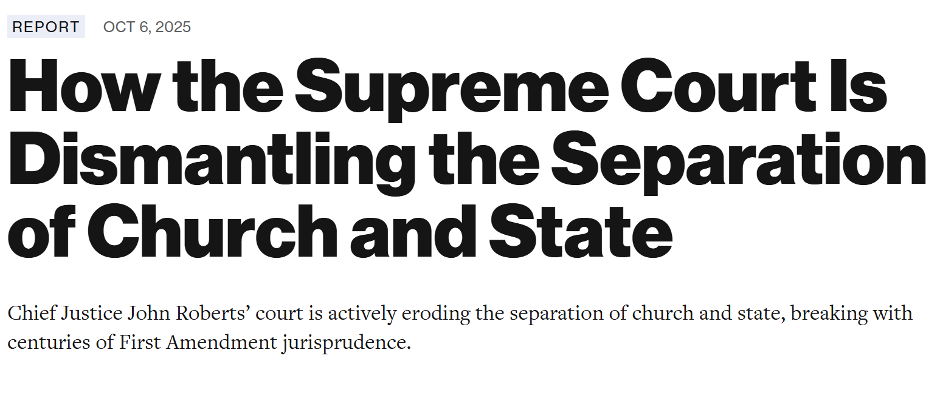

Slide 40
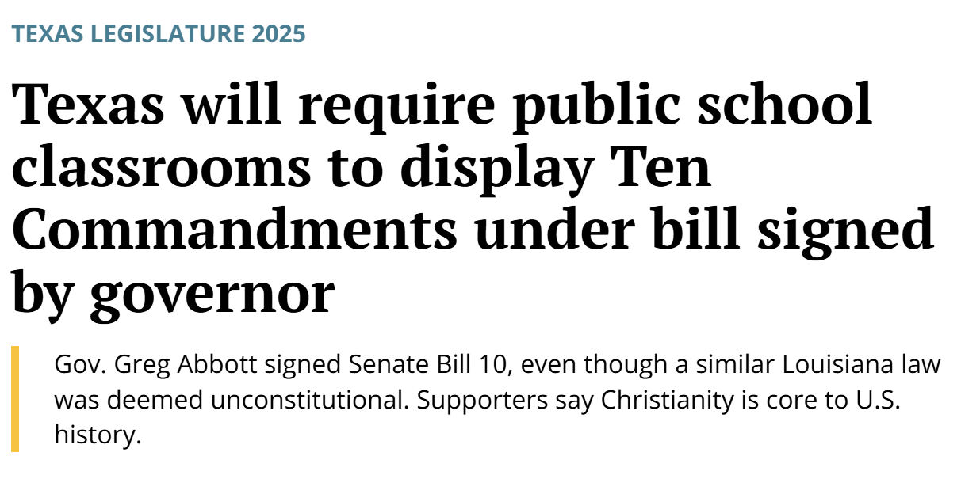

Slide 41
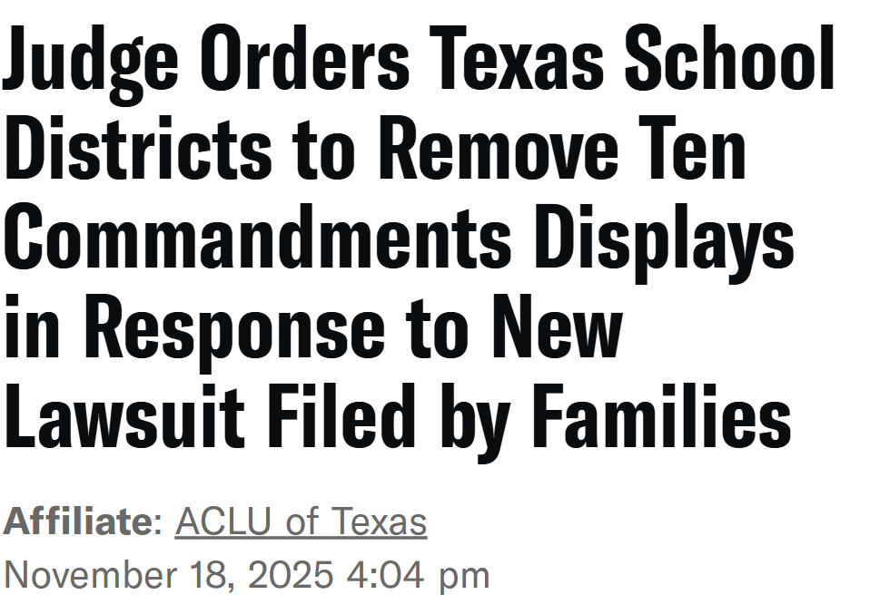

Slide 42
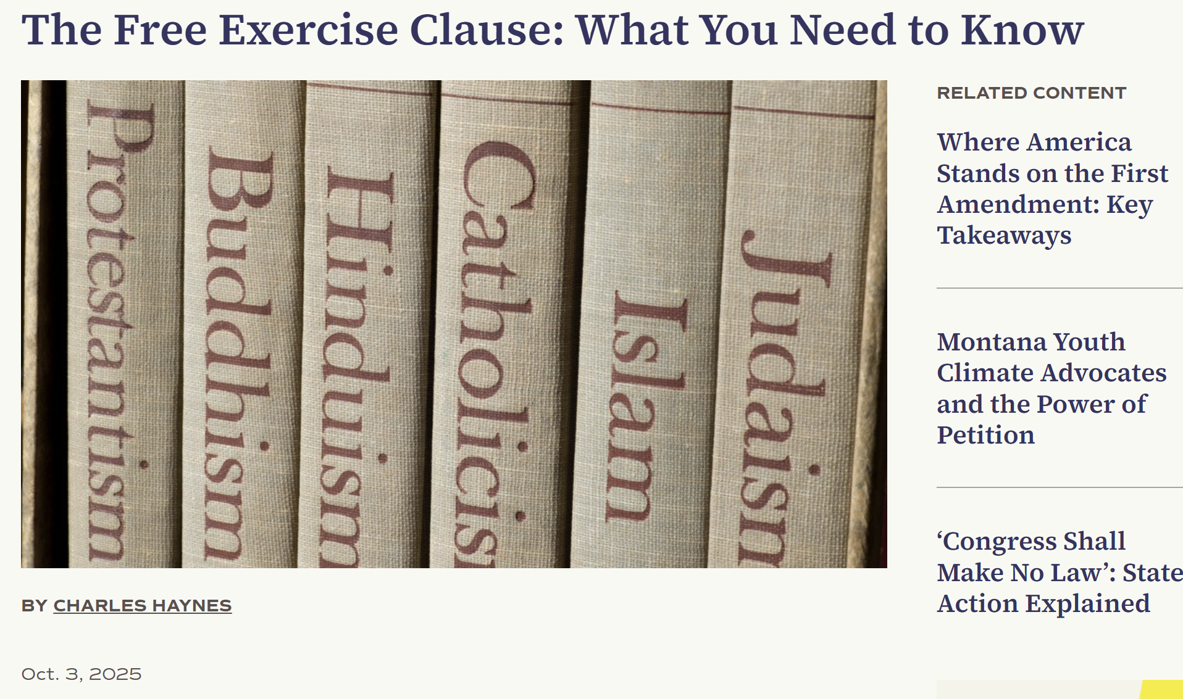

Slide 43
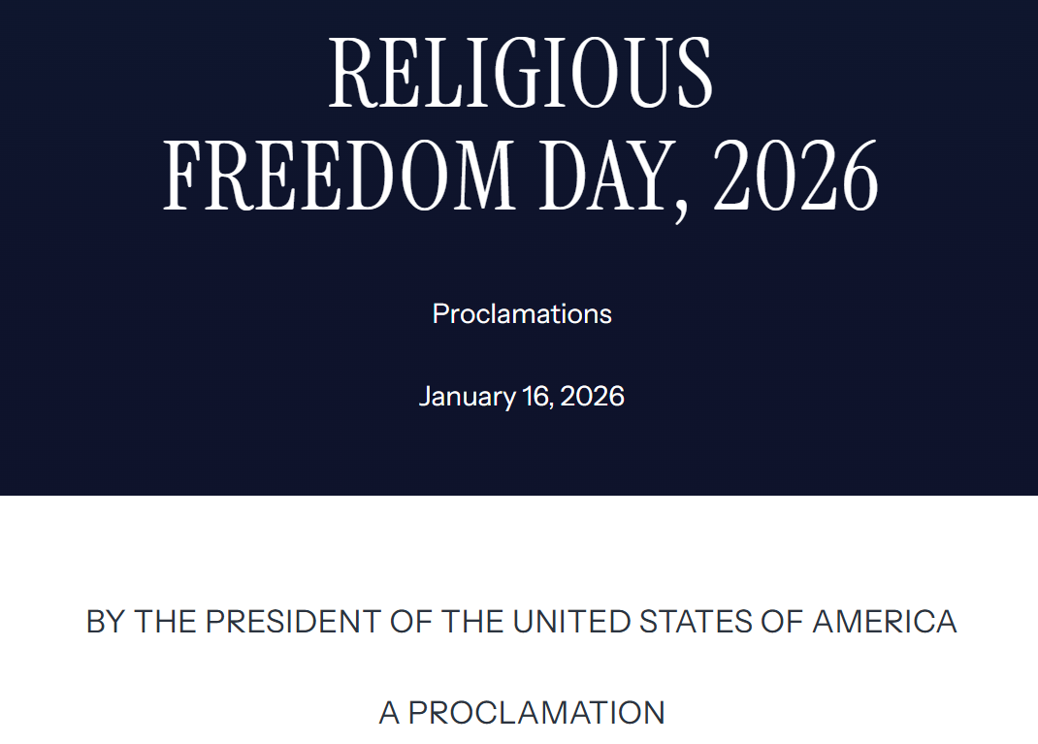

Slide 44
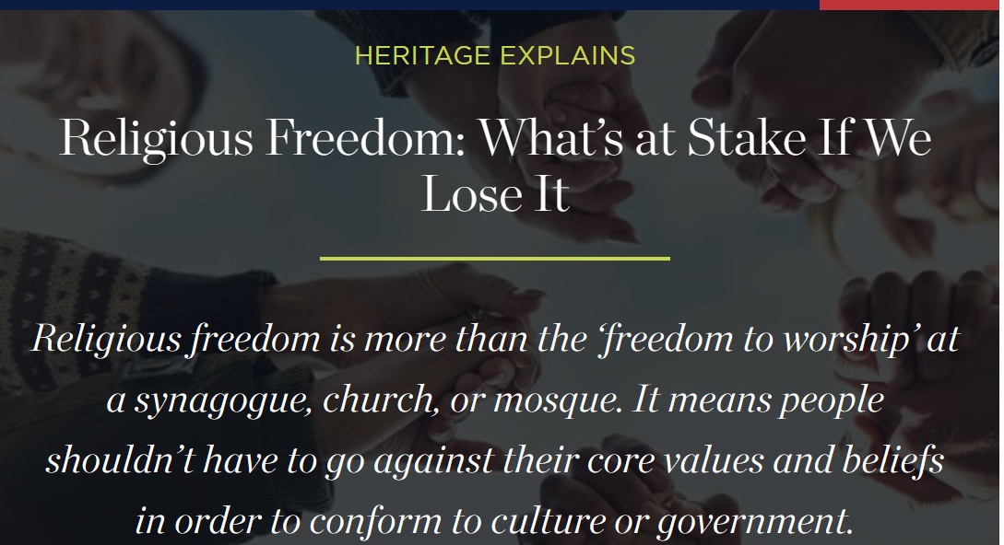

Slide 45
10. What, according to their own words, is the object of the association?

Slide 46
Answer: “To secure such an amendment to the Constitution of the United States as shall suitably express our national acknowledgment of Almighty God as the source of all authority in civil government; of the Lord Jesus Christ as the Ruler of nations; and of his revealed will as of supreme authority; and thus indicate that this is a Christian nation, and place all the Christian laws, institutions, and usages of the Government on an undeniable legal basis in the fundamental law of the land.”

Slide 47
11. Of what does the organization consist in itself?
Answer: Of a president, the names of about one hundred and twenty vice-presidents, a recording secretary, a corresponding secretary, a treasurer, seven district secretaries (at present), and the Reformed Presbyterian Church as a body.

Slide 48
12. Who are some of the prominent men actively engaged in favor of it?
Answer: Joseph Cook, Herrick Johnson, D.D.; Julius H. Seelye, president of Amherst College; Bishop Huntington, of New York; Hon. William Strong, ex-justice of the United States Supreme Court; and many others.

Slide 49
13. Of what other important bodies has it gained the support?
Answer: The principal churches, the National Woman’s Christian Temperance Union, and the Prohibition party in many States.

Slide 50
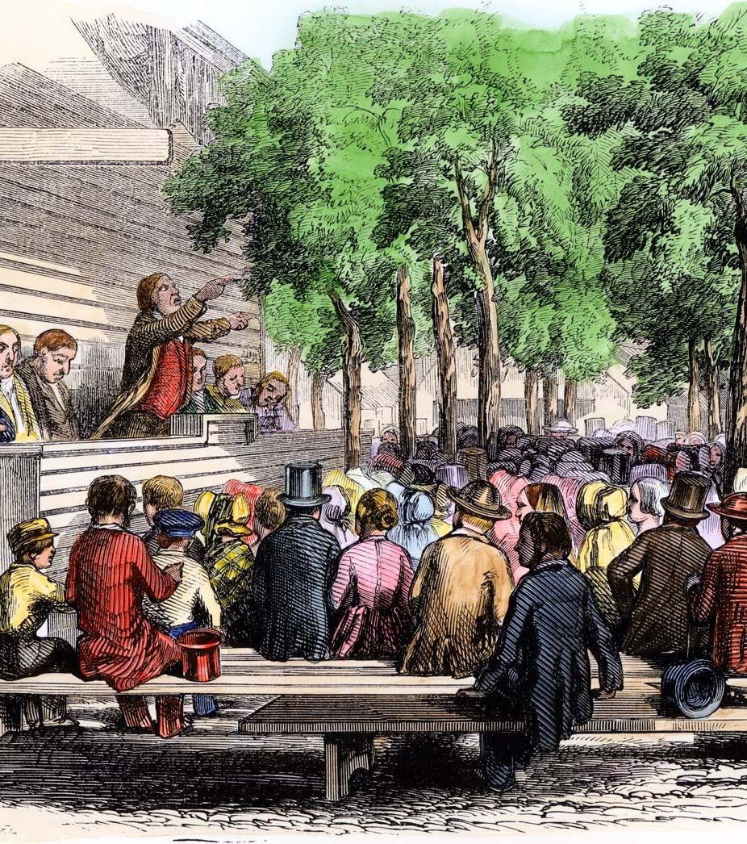
Seeing a Pattern
Foundations (1800-1860)
Second Great Awakening
• Massive Protestant revivalism
• Emphasis on moral reform of society
• Growth of reform movements: temperance, abolition, Sabbath reform
• “Adventist” and Millerite Movements

Slide 51
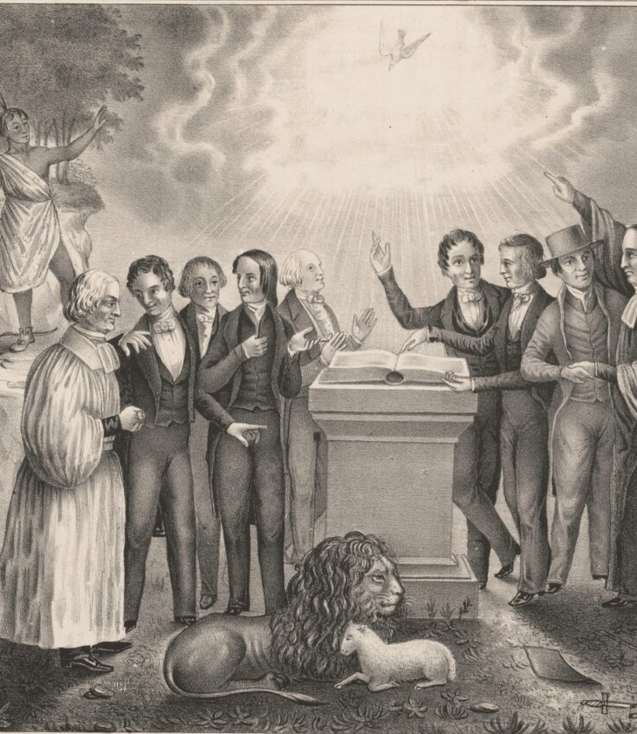
Seeing a Pattern
Foundations (1800-1860)
Postmillennial optimism
• Many Protestants believed America had a divine mission
• The nation seen as an instrument for advancing Christian civilization

Slide 52
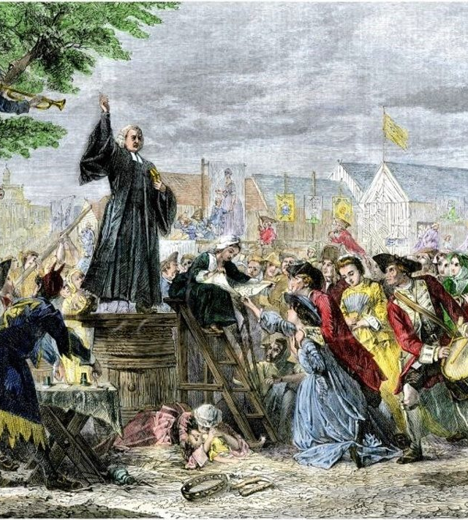
Seeing a Pattern
Foundations (1800-1860)
Strong Protestant cultural dominance
• Sunday laws already present in many states
• Public schools often Protestant in tone
• Bible reading widely practiced in civic settings

Slide 53
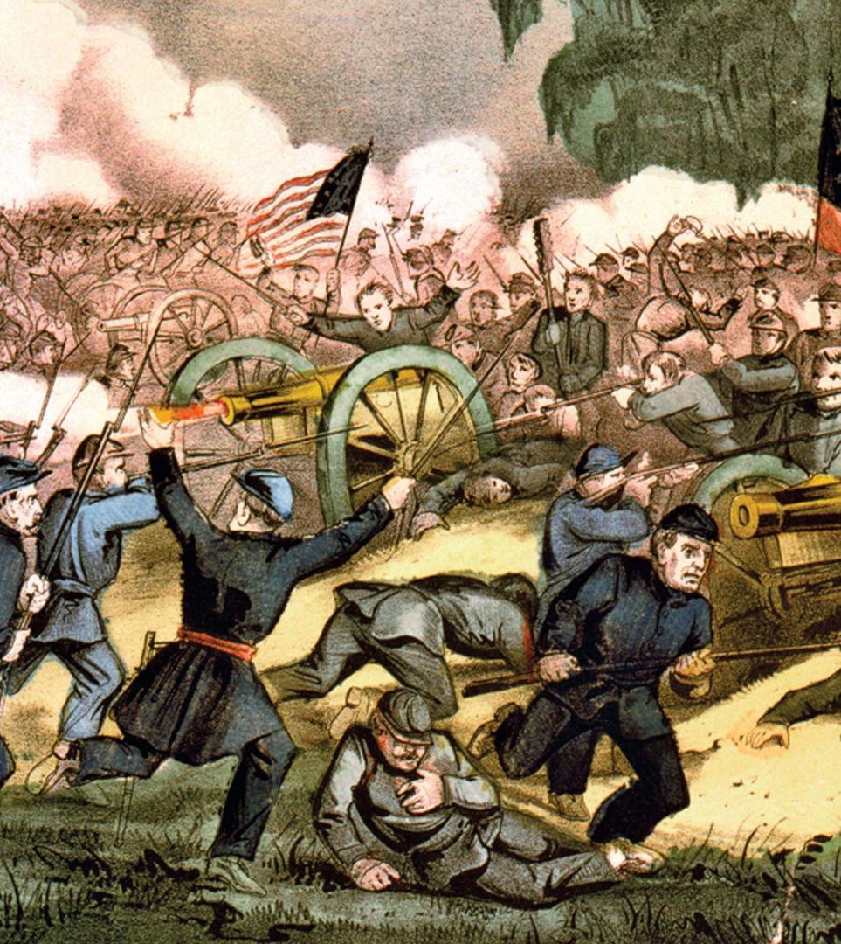
Seeing a Pattern
CIVIL WAR (1861-1865)
Massive National Trauma
Preachers across denominations interpreted the war as:
• Divine judgment
• National chastisement
• Evidence that God was displeased

Slide 54
Seeing a Pattern:
Lincoln’s 2nd Inaugural Address (1865)
‘Woe unto the world because of offences! for it must needs be that offences come; but woe to that man by whom the offence cometh!’ If we shall suppose that American Slavery is one of those offences which, in the providence of God, must needs come, but which, having continued through His appointed time, He now wills to remove, and that He gives to both North and South, this terrible war, as the woe due to those by whom the offence came, shall we discern therein any departure from those divine attributes which the believers in a Living God always ascribe to Him?

Slide 55
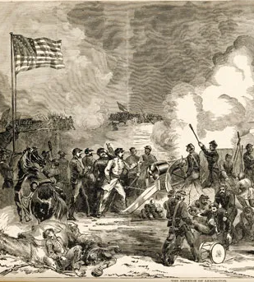
Seeing a Pattern
CIVIL WAR (1861-1865)
Widespread sermons framed the war as punishment for:
• Slavery
• National moral decline
• Failure to explicitly acknowledge Christ in the Constitution

Slide 56
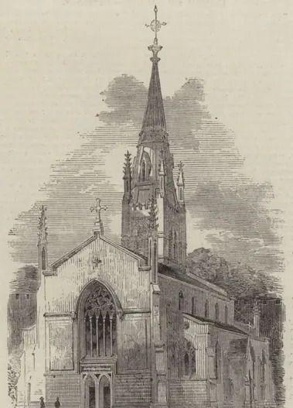
Seeing a Pattern
RELIGIOUS REFLECTION
Many Protestant leaders asked, “Why did God permit this?”
One widely circulated answer:
The Constitution contains no explicit recognition of God or Christ.

Slide 57
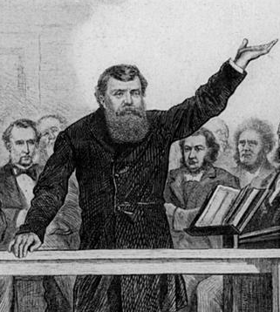
Seeing a Pattern
RELIGIOUS REFLECTION
Concern grew that:
• Secularism was increasing
• Catholic immigration was expanding
• Moral unity required constitutional grounding

Slide 58
Seeing a Pattern:
Horace Bushnell, “Reverses Needed” (1861)
Following the Battle of Bull Run, Reverend Horace Bushnell preached a sermon, “Reverses Needed,” in which he blamed the founding fathers for establishing a government without moral or religious ideas, based upon “godless theorizing.” He suggested that “it might not be amiss, at some fit time,” to add a recognition of God’s authority in the preamble of the Constitution. By doing this we would succeed in “cutting off… the false theories under which we have been so fatally demoralized.”

Slide 59
Seeing a Pattern:
D. M’Allister, “Testimonies to the religious defect of the constitution“ (1874)
“From this atheistic error in our prime conceptions of government [the separation of church and state] has arisen the atheistic habit of separating politics from religion.”

Slide 60
Seeing a Pattern:
Testimony against the US Constitution and the Moral Evils thereof (1839)
All the subjects of Jehovah's moral government, in their relations to each other, are bound to act according to the will of God… Hence all legitimate civil rule is from God, as Creator, and in its constitution and administration must be conformed to the will of its Author. To maintain that it was instituted of God, and then left entirely to the will of the creature, is no better than the doctrine of Epicurus… All such notions are essentially atheistical, offering the highest indignity to the Lawgiver, and doing violence to the natural conscience.

Slide 61
Seeing a Pattern:
Reverend Thomas Robbins, Sermon (1839)
The great evil of our country, in my view, has been that we have attempted to strike out a new path to national prosperity regardless of all the dictates of experience, and the testimony of the Word of God…God is not formally recognized, owned or worshipped. I speak not of individuals, for we doubt not that the Lord Jesus has his church in our land, which has enjoyed the rich blessings of His Holy Spirit. But in our collective national capacity we do not worship the God of heaven, we do not acknowledge his Son, we do not receive His Holy Word.

Slide 62
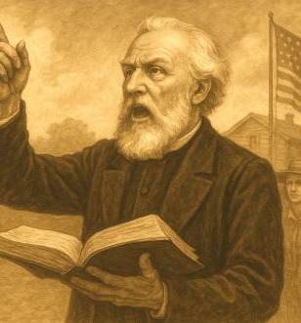
Seeing a Pattern
🧠 The Underlying Logic
The Civil War = divine judgment
Judgment came because the nation failed to acknowledge Christ
To prevent future judgment:
  The nation must formally recognize Christ
  Christian principles must be legally grounded
This is Step 2 (Social Expediency) moving into Step 3 (Authority).

Slide 63
14. What was the prevailing theory of church leaders in the time of Constantine?
Answer: “The theocratical theory”

Slide 64
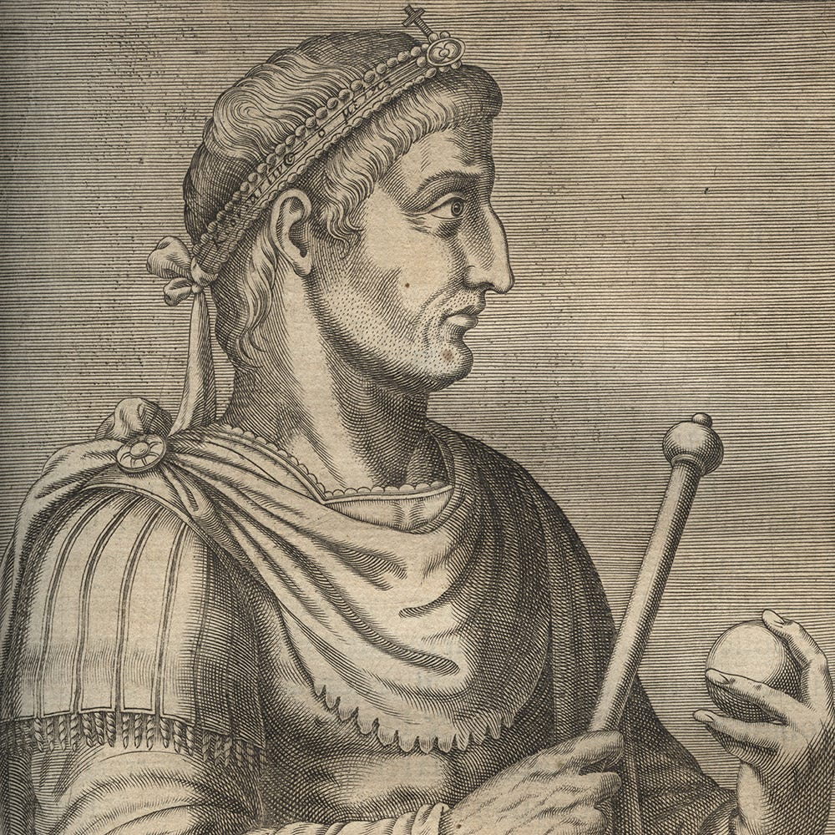
Theocratic Theory
By Constantine’s time, many church leaders believed:
The Roman Empire could become an instrument of God
The emperor could act as God’s servant
Civil law could advance Christian truth
The State could suppress heresy for the good of souls

Slide 65
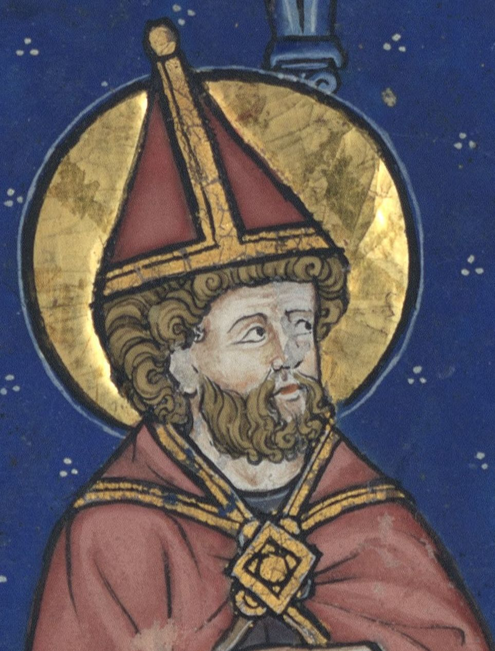
Theocratic Theory
The reasoning went something like this:
God rules all nations.
Therefore Christian rulers should govern explicitly for Christ.
Therefore the State should defend orthodoxy.
Therefore coercion in religious matters can be justified.
That is the theocratical theory.

Slide 66
15. What is the theory of the National Reformers?
Answer: “Every government by equitable laws, is a government of God; a republic thus governed is of him, and is truly and really a theocracy as the commonwealth of Israel.” —Cincinnati National Reform Convention, page 28.

Slide 67
15. What is the theory of the National Reformers?
Answer: “A true theocracy is yet to come, [and] the enthronement of Christ in law and law-makers, hence I pray devotedly as a Christian patriot, for the ballot in the hands of women.” —Monthly Reading, W.C.T.U.

Slide 68
16. What had the church leaders determined to do in the days of Constantine?
Answer: “To make use of the power of the State for the furtherance of their own aims.”

Slide 69
17. What have the same in our day [1888] determined to do?
Answer: The same thing

Slide 70
18. What came of that in the fourth century?
Answer: The Papacy

Slide 71
19. What will come of this in the nineteenth century?
Answer: The image of the Papacy

Slide 72
SUMMARY:
Lessons 6 and 7
Steps in the Development of the Beast:
STEP 1: Accommodation
STEP 2: Social Expediency
STEP 3: Authority
STEP 4: Union
STEP 5: Patronage
STEP 6: Enforcement
STEP 7: Moralization

Slide 73
20. Of what other bodies is the National Reform Association diligently working to secure the support?
Answer: The workingmen and the Catholic Church.

Slide 74
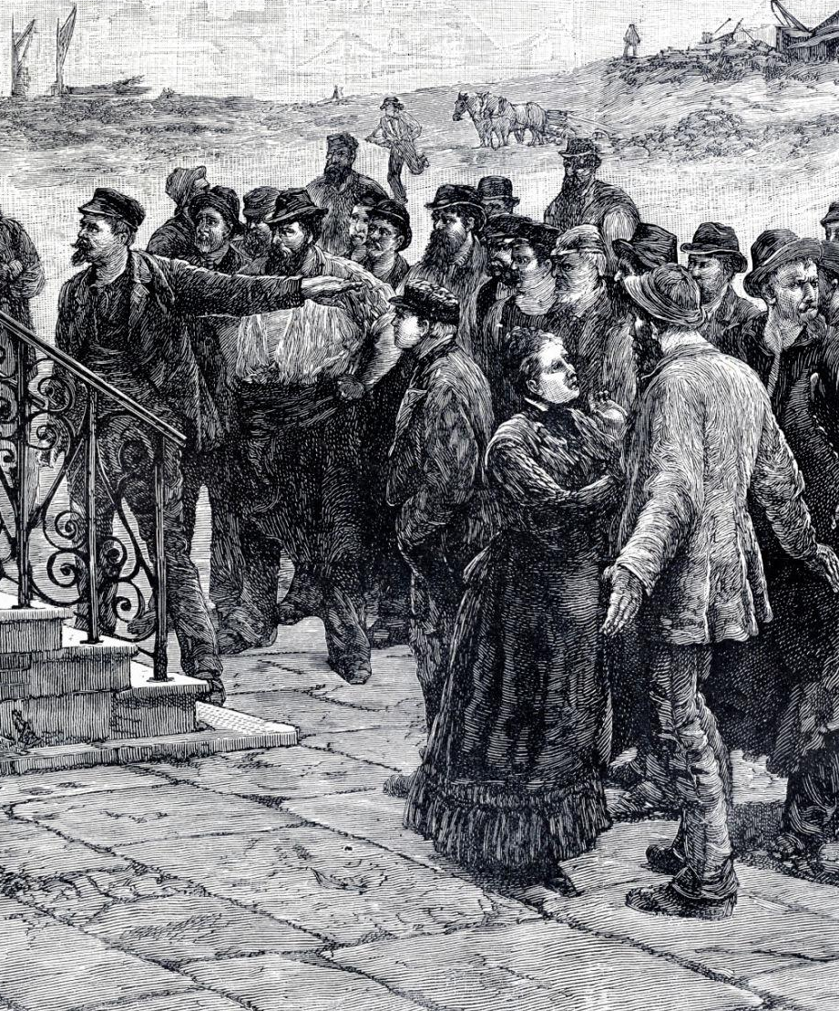
The Workingmen
The term “workingmen” in the 1880s context does not simply mean “ordinary laborers” in a generic sense.
It refers primarily to the organized labor movement emerging in post–Civil War America.

Slide 75
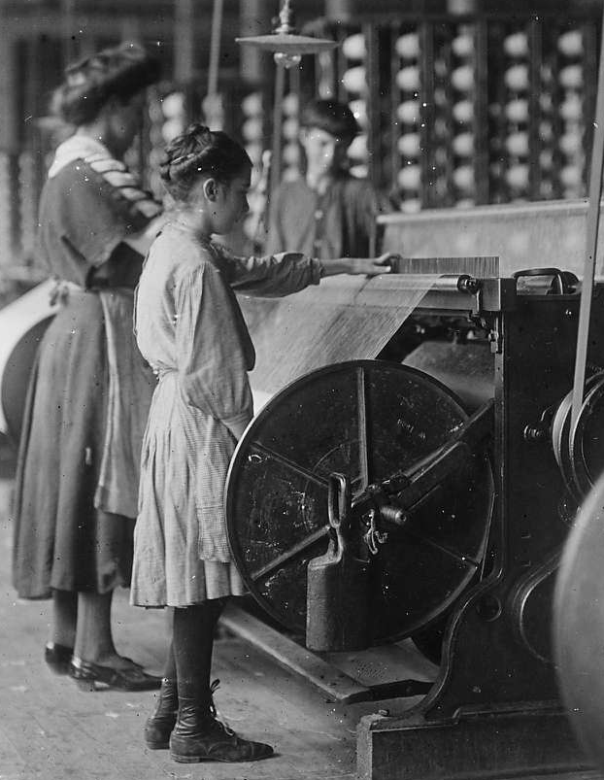
The Workingmen
After the Civil War:
Rapid industrialization
Railroad expansion
Harsh factory conditions
Long hours, low wages
Child labor common
This produced growing labor organization.

Slide 76
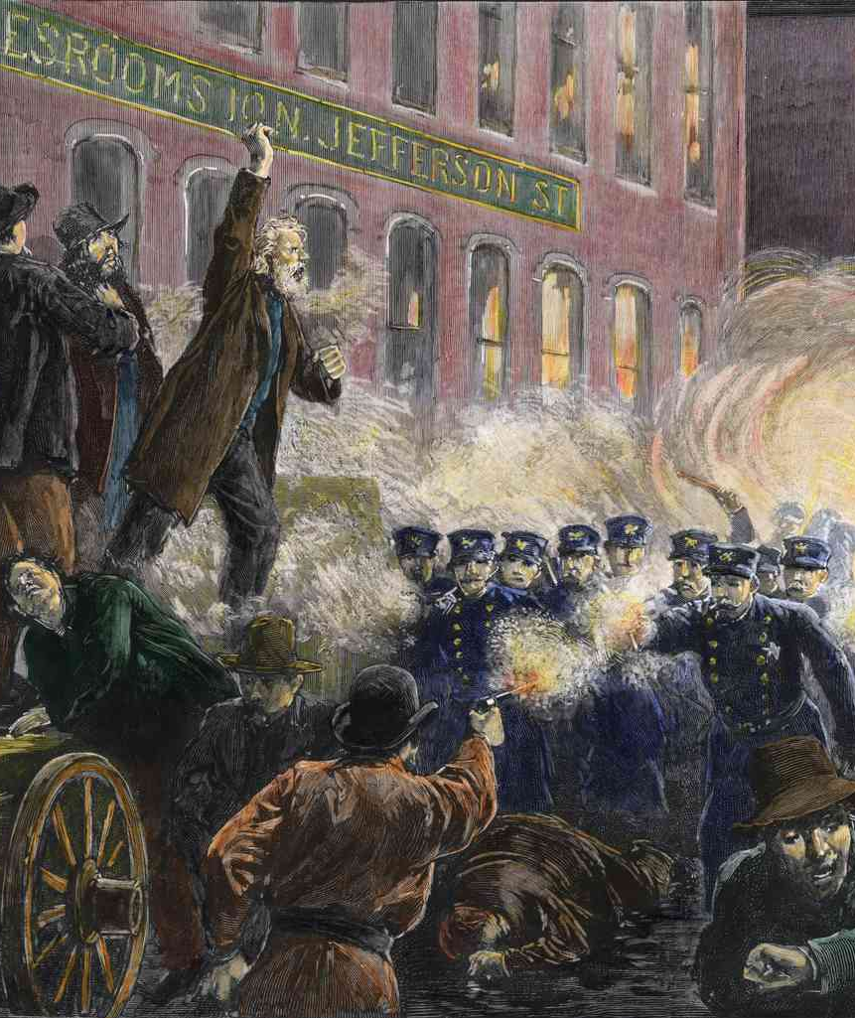
The Workingmen
Major examples:
Knights of Labor (founded 1869)
Early craft unions
Later the American Federation of Labor (founded 1886)
By the 1880s, “workingmen” often meant organized labor.

Slide 77
21. What does this association say of the Catholic Church?

Slide 78
Christian Statesman, December 11, 1884.
“We cordially, gladly, recognize the fact that in the South American republics, and in France and other European countries, the Roman Catholics are the recognized advocates of national Christianity, and stand opposed to all the proposals of secularism. Whenever they are willing to co-operate in resisting the progress of political atheism, we will gladly join hands with them. In a World’s Conference for the promotion of National Christianity—which ought to be held at no distant day—many countries could be represented only by Roman Catholics.”

Slide 79
22. What are all Catholics commanded by the Pope to do?

Slide 80
Encyclical of Pope Leo XIII, 1885.
“All Catholics should do all in their power to cause the constitutions of States and legislation to be modeled on the principles of the true church; and all Catholic writers and journalists should never lose sight, for an instant, from the view of the above prescription.”

Slide 81
23. Then is not the National Reform Association aiming to form a government modeled after the principles of the Papacy?

Slide 82
24. Then, if professed Protestants under the leadership of the National Reform Association succeed in this, what will there be erected in this government?
Answer: An image of the Papacy

Slide 83
SUMMARY:
Lessons 6 and 7
Steps in the Development of the Beast:
STEP 1: Accommodation
STEP 2: Social Expediency
STEP 3: Authority
STEP 4: Union
STEP 5: Patronage
STEP 6: Enforcement
STEP 7: Moralization

Slide 84
Thank you!
… and Happy Sabbath!!

Slide 85


