Slide 1


Slide 2

Living the Light

Slide 3


Slide 4
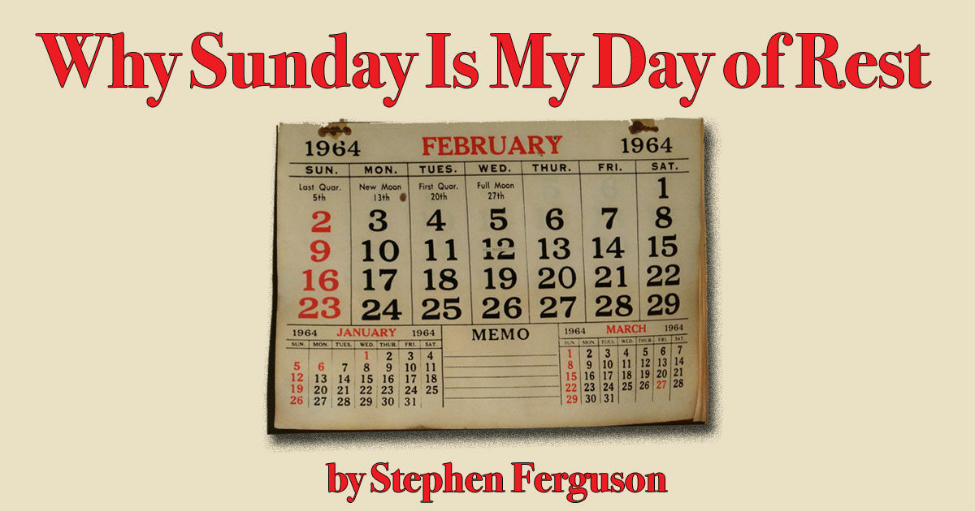

Slide 5
Why Sunday is My Day of Rest
– Adventist today
by Stephen Ferguson | 10 May 2024
Thank goodness for Sunday. As a Seventh-day Adventist, Sunday is my day of rest.
We all know the fourth commandment of the Decalogue by heart, because as Adventists it is our special thing:
Remember the sabbath day, to keep it orderly.
Six days shalt thou labour, and do all thy ordinary paid work.

Slide 6
Why Sunday is My Day of Rest
– Adventist today
But the seventh day is the sabbath of the Lord thy God: on it, ye shall organize a Sabbath-school class, a worship item, a song service, a drama, a potluck lunch, a communion service, a Pathfinder club camp, a nomination committee meeting, or a sermon.
Ye shall spend the Friday-night evening researching, cooking. or rehearsing. 11pm or midnight shall be your allotted time for sleep.

Slide 7
Why Sunday is My Day of Rest
– Adventist today
Everyone in your entire family shall participate in this holy work: thy son, thy daughter, thy manservant and thy maidservant, even thy cattle or the stranger who happens to reside within your gate. If ye are a pastor’s spouse or pastor’s child, thou shall be guilt-tripped into this Lord’s work threefold.

Slide 8
Why Sunday is My Day of Rest
– Adventist today
For in six days the Lord made heaven and earth, the sea, and all that in them is, and rested the seventh day: wherefore the Lord blessed the sabbath day, and hallowed it. Therefore, as the Lord sits back and relaxes, work yourself ragged in church-related activities.
That’s Exodus 20:8-11—with some modern reapplication, just as the apostle Paul used to do. (see Eph. 6:2-3 cf. Ex. 20:12.)

Slide 9
Why Sunday is My Day of Rest
– Adventist today
Thank God for Sunday. I say that genuinely, not in vain. It is the one day most Adventists—at least we supposedly “good Adventists”—get a break.
Last week was especially brutal. I worked till midnight almost every night in my day job as a government lawyer, to ensure certain officers didn’t face dramatic legal penalties in an upcoming court case. I think I did about 20 extra hours of overtime, and while I am grateful for the money, I would honestly have rather had the time off.

Slide 10
Why Sunday is My Day of Rest
– Adventist today
Did I have to work so hard? Not strictly – no. I guess if I didn’t care about people facing potential ruin, I could have taken it easy. Otherwise, yes, I did.
This week also required me to assume the role of sole parent for two elementary-school children, ages 7 and 5, while my wife was traveling on business. After an exhausting week, when Friday evening finally came round, I faced the opening of Sabbath with dread. I realized that tomorrow I had to help run a Primary Sabbath School class in the morning, followed by an Adventurer’s class in the afternoon. I also had to try and find someone to take an adult Sabbath School class, which usually has a dearth of volunteers.

Slide 11
Why Sunday is My Day of Rest
– Adventist today
Did I need to help with these church-related activities? Not strictly – no. If I didn’t care about leaving the children’s ministry leader in the lurch, or about my own children who participate in these activities, or about our church’s Adsafe requirement that two adults be present in these children’s classes. Otherwise, yes, I did.
The only thing that saved me that terrible week, both mentally and physically, was Sunday—that most glorious day!

Slide 12
Why Sunday is My Day of Rest
– Adventist today
Bring on a Sunday law!
I admit Sunday isn’t always perfect. Sometimes I awake on this special eighth day only to have my dreams of a quiet time shattered by my lovely wife, who hands me a list. As I usually have such a busy work week, and spend Sabbath doing church stuff, that often leaves only Sunday for chores.
Nonetheless, all things being equal, Sunday is my best chance for getting some rest.

Slide 13
Why Sunday is My Day of Rest
– Adventist today
It is for this reason I have no fear of an impending Sunday law. In fact, I welcome it. I can only dream of a guaranteed day of complete rest. I long for a time when mowing the lawn, cleaning the pool, putting out laundry, or washing the car on a Sunday will be illegal.

Slide 14
Why Sunday is My Day of Rest
– Adventist today
Work friends who know about my religious beliefs can’t help but be amazed that I sacrifice half my weekend like this. To them, the Adventist Sabbath seems less like a taste of heaven than some level in Dante’s hell. I confess I am probably not doing a great job at selling the Sabbath ideal in my Christian witnessing…

Slide 15

Hebrews 4:10
For he that is entered into his rest, he also hath ceased from his own works, as God did from his.

Slide 16

Isaiah 58:13-14
¹³ If thou turn away thy foot from the sabbath, from doing thy pleasure on my holy day; and call the sabbath a delight, the holy of the Lord, honourable; and shalt honour him, not doing thine own ways, nor finding thine own pleasure, nor speaking thine own words:
¹⁴ Then shalt thou delight thyself in the Lord; and I will cause thee to ride upon the high places of the earth, and feed thee with the heritage of Jacob thy father: for the mouth of the Lord hath spoken it.

Slide 17

2 Corinthians 9:6-8
⁶ But this I say, He which soweth sparingly shall reap also sparingly; and he which soweth bountifully shall reap also bountifully.
⁷ Every man according as he purposeth in his heart, so let him give; not grudgingly, or of necessity: for God loveth a cheerful giver.
⁸ And God is able to make all grace abound toward you; that ye, always having all sufficiency in all things, may abound to every good work:

Slide 18

1 John 5:1-3
5 Whosoever believeth that Jesus is the Christ is born of God: and every one that loveth him that begat loveth him also that is begotten of him.
² By this we know that we love the children of God, when we love God, and keep his commandments.
³ For this is the love of God, that we keep his commandments: and his commandments are not grievous.

Slide 19
Living the Light

Slide 20
The Third Angel’s Message
Lesson 9: The Making of the Image of the Beast - Concluded
September 1, 1888
Lesson 9, 3rd Quarter 1888

Slide 21

1. If the influence of the Protestant churches, the Prohibition party, the W.C.T.U., the Workingmen, and the Catholic Church were heartily united in favor of one measure, could not that measure be carried, whatever it might be?

Slide 22
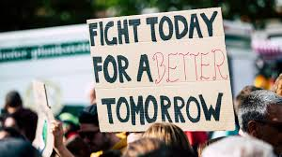


1. If the major religious bodies, organized labor, reform movements, and politically active moral leaders were united behind one measure, any measure, could it pass?

Slide 23




1. If the influence of major evangelical churches, a small but highly motivated political movement, several large labor unions, a powerful political Action Committee, and the Catholic Church were united behind one measure — could it pass? No matter what it Might be?

Slide 24
2. Is there now [1888] any question upon which all these are united in sentiment, and upon which they are fast uniting in action?
Answer: There is.

Slide 25
3. What is it?
Answer: The enforcement of Sunday-keeping by the State.

Slide 26
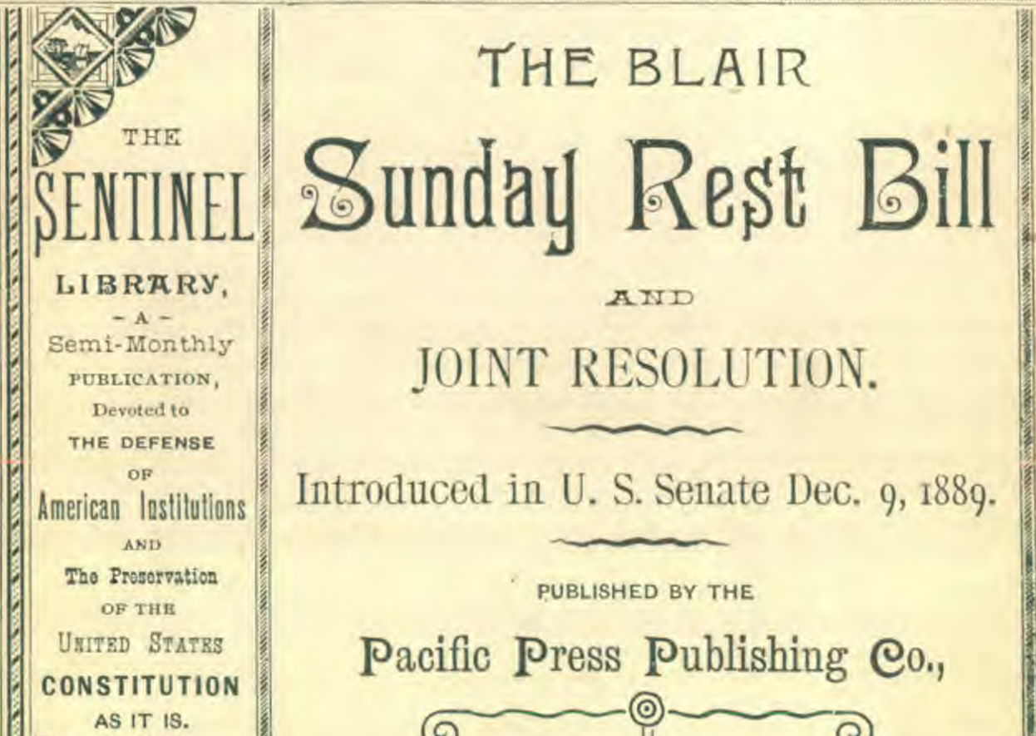

Slide 27

January 8, 2026
“The decline in family formation is a serious cultural and collective action problem, for which prudent and focused government action is a crucial part of the solution…As zoning laws allow a community to determine where one can operate certain businesses, “blue laws” reflect the local judgments as to when one can operate certain businesses. In the case of McGowan v. Maryland (1961), the Supreme Court held by an eight-to-one vote that Sunday-closings laws that include the purpose of providing a uniform day of rest are constitutional and can accommodate the fact that the majority of people who take a day of rest for religious reasons do so on Sundays.”

Slide 28

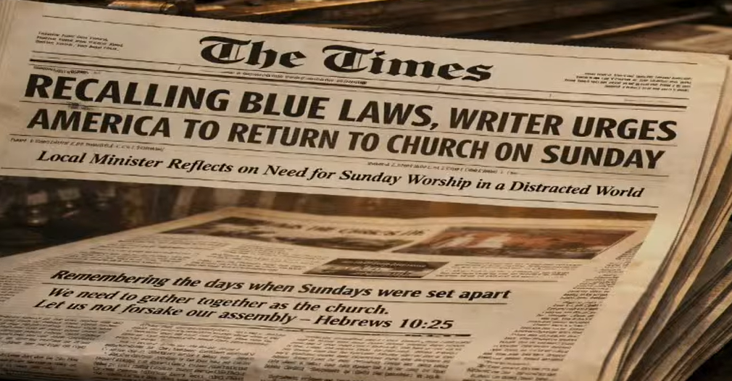

Slide 29
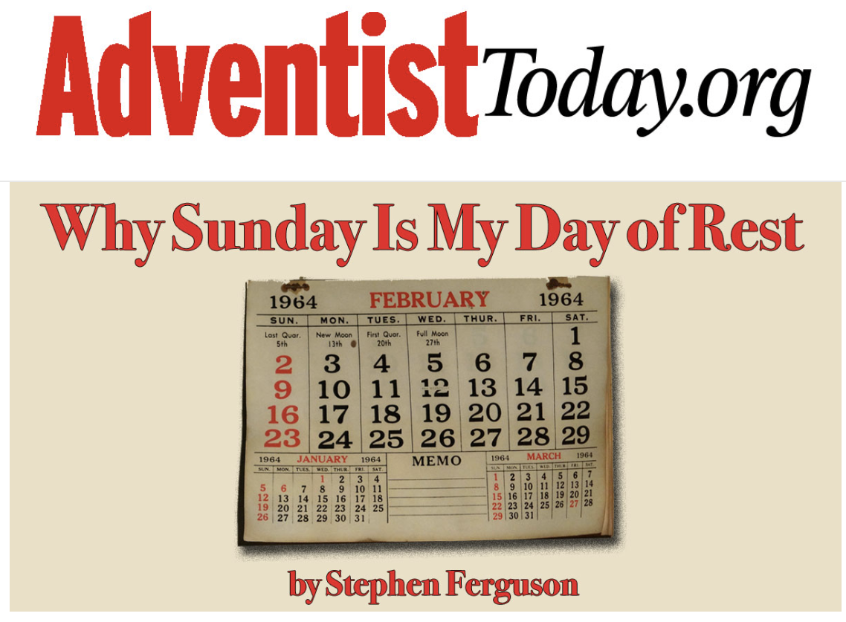

Slide 30
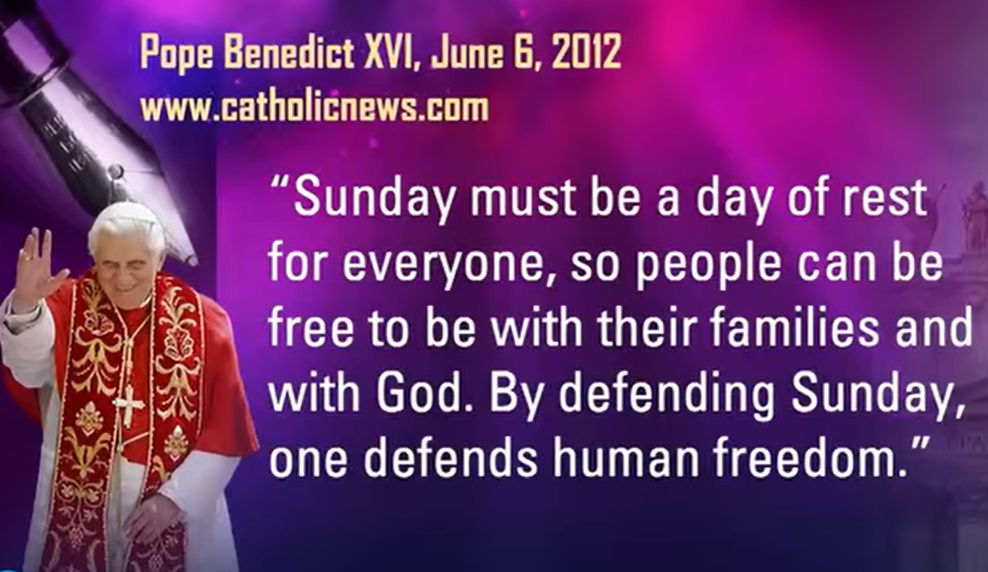

Slide 31
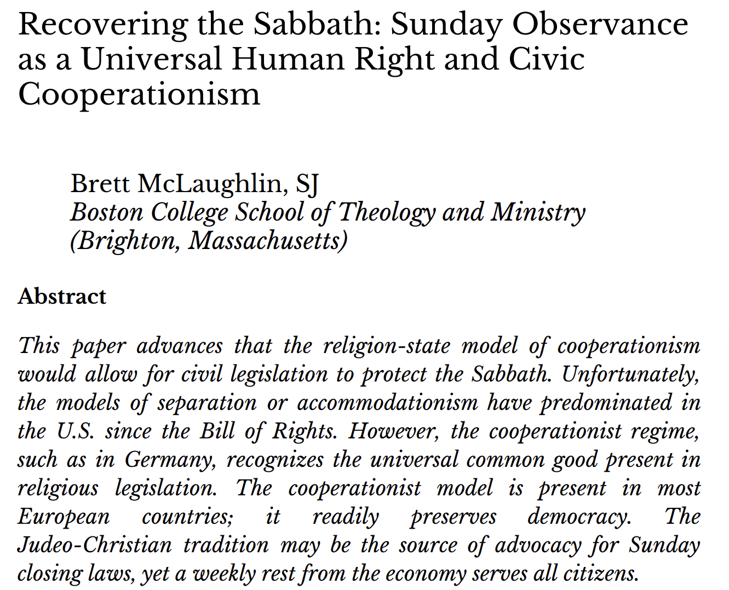

Slide 32
4. Who are the sole leaders in this movement?
Answer: The leaders in the churches.

Slide 33
The Leaders In the Movement
In the 1880s, Sunday law agitation was largely initiated and organized by clergy and religious reform movements.
Why were they doing that?
They believed national morality required legal protection.
They believed civil law could reinforce devotion.
They feared social decline.

Slide 34
5. To what extent are they working it?
Answer: They are “working” and lobbying almost every State Legislature in the Union, and the National Legislature also.

Slide 35
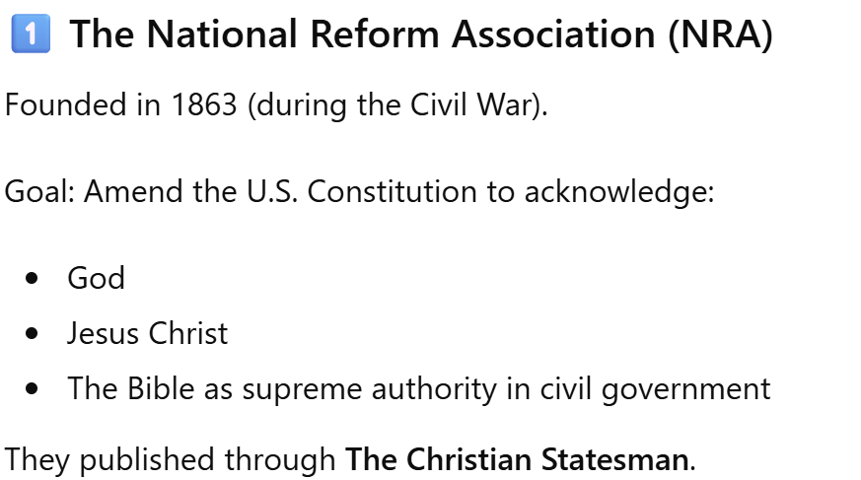

Slide 36
Christian Statesman, December 11, 1884.
“We cordially, gladly, recognize the fact that in the South American republics, and in France and other European countries, the Roman Catholics are the recognized advocates of national Christianity, and stand opposed to all the proposals of secularism. Whenever they are willing to co-operate in resisting the progress of political atheism, we will gladly join hands with them. In a World’s Conference for the promotion of National Christianity—which ought to be held at no distant day—many countries could be represented only by Roman Catholics.”

Slide 37
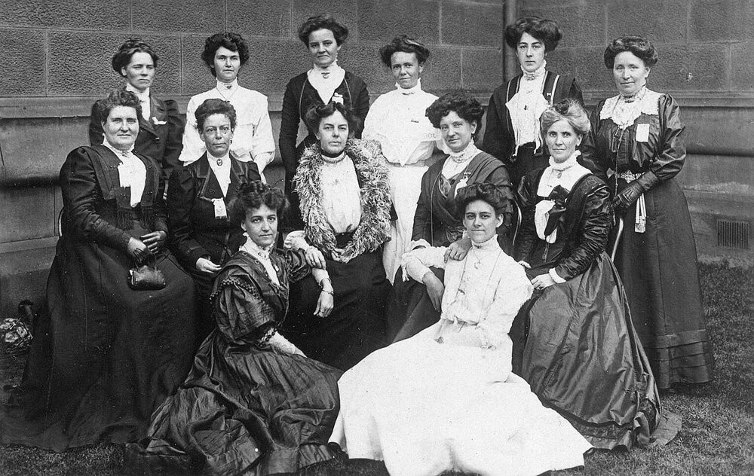

Slide 38
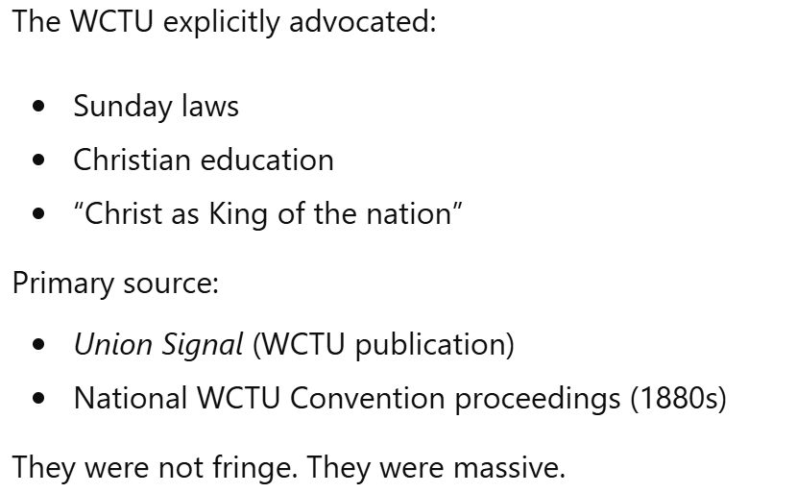

Slide 39

A Theocracy: W.C.T.U
“A true theocracy is yet to come, [and] the enthronement of Christ in law and law-makers, hence I pray devotedly as a Christian patriot, for the ballot in the hands of women.” —Monthly Reading, W.C.T.U.

Slide 40

A Theocracy: NRA
“Every government by equitable laws, is a government of God; a republic thus governed is of him, and is truly and really a theocracy as the commonwealth of Israel.” —Cincinnati National Reform Convention, page 28.

Slide 41
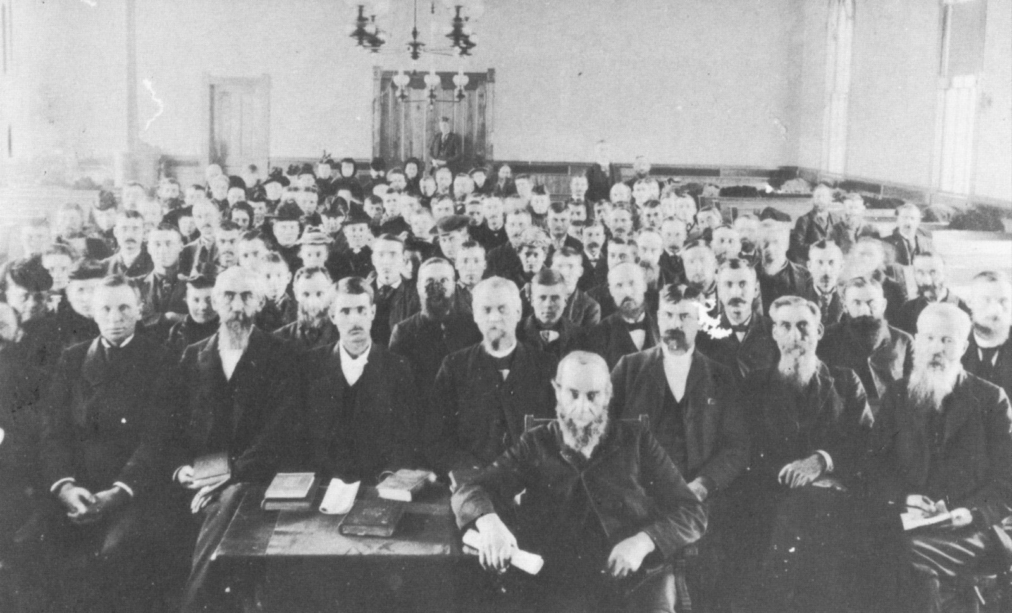
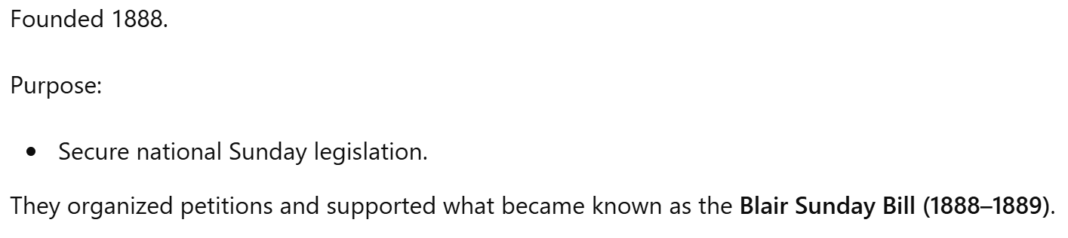

Slide 42
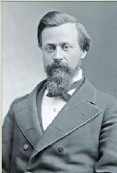

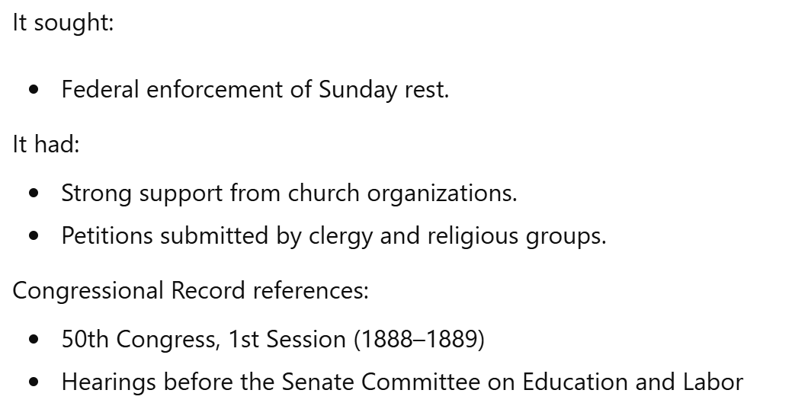

Slide 43


Slide 44
6. What do they ask the State to do?
Answer: To stop all Sunday trains, abolish all Sunday papers, and stop all manner of work on Sunday.

Slide 45
7. For what?
Answer: So that their “devotion may not be hindered.”

Slide 46
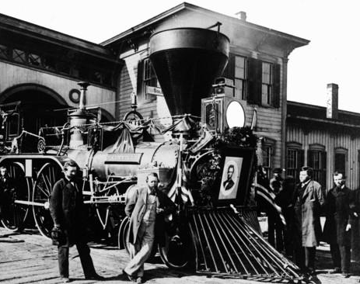
8. What is there about the Sunday train that hinders the devotion of the church-members?
Answer:
“They get a great many passengers, and so break up a great many congregations.”
—Elgin Convention, Illinois, Sunday-law Convention, November, 1887.

Slide 47
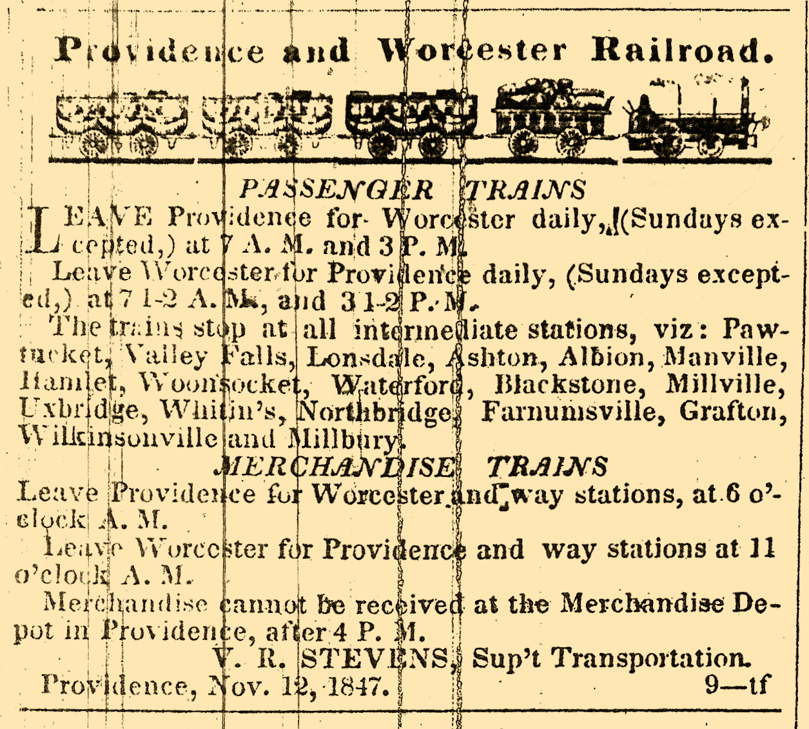

Slide 48
9. What is there about the Sunday newspaper that hinders their devotion?
Answer:
“The laboring classes are apt to rise late on Sunday morning, read the Sunday papers, and allow the hour of worship to go by unheeded.”
—Elgin Convention.

Slide 49
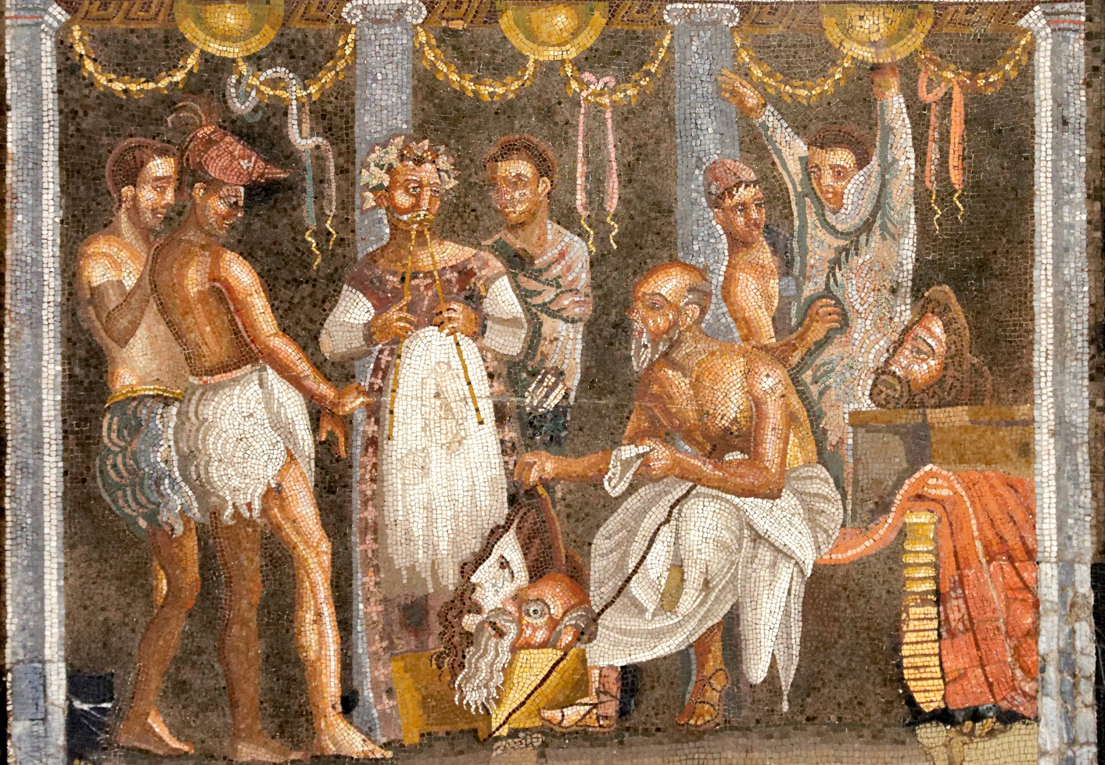
10. What was it that hindered the devotion of the church-members in the fourth century?
Answer: Sunday games and theaters.

Slide 50
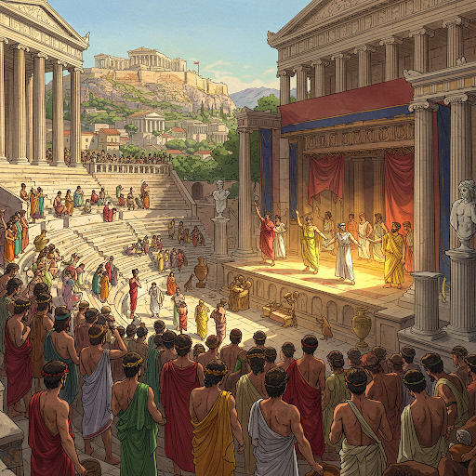
11. How? (In the 4th Century)
Answer: “They got a great many spectators, “and so broke up a great many congregations;” the church-members would go to the games and theaters, and would “let the hour of worship go by unheeded,” and so their devotion was “greatly hindered.”

Slide 51
12. Who were they whose devotion was especially disturbed? (4th Century)
Answer: Those “whose Christianity was the least an affair of the life and of the heart.”

Slide 52
Neander, Church History V. 2, P. 300
“Owing to the prevailing passion at that time, especially in the large cities, to run after the various public shows, it so happened that when these spectacles fell on the same days which had been consecrated by the church to some religious festival, they proved a great hindrance to the devotion of Christians, though chiefly, it must be allowed, to those whose Christianity was the least an affair of the life and of the heart.”

Slide 53
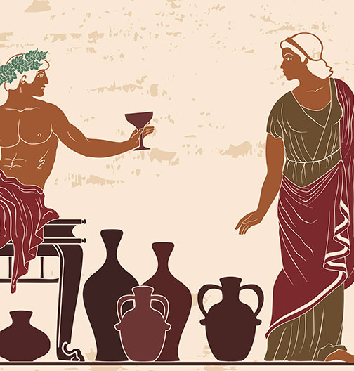
13. What then did they do?
Answer: As they had not enough conscience, nor love of right, to do what they considered to be right, they demanded that the State should take away from them all opportunity to do that which they deemed to be wrong.

Slide 54
14. How is the matter worked now?
“The decline in family formation is a serious cultural and collective action problem, for which prudent and focused government action is a crucial part of the solution…”
Answer: The same way precisely.

Slide 55
15. Was the Papacy content with State laws stopping games and closing theatres?
Answer: No, all manner of work must be stopped.

Slide 56

16. Will the image of the Papacy be content with laws stopping Sunday trains and abolishing Sunday newspapers?

Slide 57
Dr. McAllister, editor, Christian Statesman.
“Let a man be what he may—Jew, seventh-day observer of some other denomination, or those who do not believe in the Christian Sabbath— let the law apply to everyone, that there shall be no public desecration of the first day of the week, the Christian Sabbath, the day of rest for the nation. They may hold any other day of the week as sacred, and observe it; but that day which is the one day in seven for the nation at large, let that not be publicly desecrated by anyone, by officer in the Government, or by private citizen, high or low, rich or poor."

Slide 58
17. Why do they want to compel all people to keep Sunday?
Answer: Because “he who does not keep the Sabbath [Sunday] does not worship God.”
—Elgin Convention.

Slide 59
18. Then what is the purpose of all their Sunday laws?
Answer: To compel all men to worship.

Slide 60
January 8, 2026
“A uniform day of rest that limits commercial activity can provide temporal boundaries that help communities to set aside time for religious observance, family gatherings, outdoor activities, and rest. A stable base of research shows that these practices correlate with better mental health, stronger social bonds, and more stable family structures.”

Slide 61
19. What is it, in reality, that they will compel men, by this means, to worship?
Revelation 13:12

Slide 62

Revelation
13:2
² And the beast which I saw was like unto a leopard, and his feet were as the feet of a bear, and his mouth as the mouth of a lion: and the dragon gave him his power, and his seat, and great authority.

Slide 63
20. What grew out of the Sunday-law movement in the fourth century?
Answer: The beast.

Slide 64
20. What grew out of the Sunday-law movement in the fourth century?
Answer: The beast.

Slide 65
the Sunday-law movement in the fourth century
We are not talking about:
Random Christians liking Sunday.
Private worship patterns.
We are talking about:
A.D. 321 — Constantine’s Sunday edict
Later imperial reinforcement
Church councils aligning doctrine with imperial authority
Gradual coercive power over dissenters

Slide 66
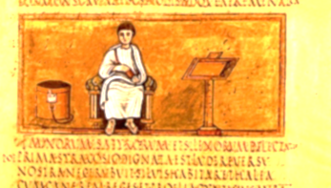
the Sunday-law movement in the fourth century
In 321, Emperor Constantine issued a civil decree:
“On the venerable day of the Sun let the magistrates and people residing in cities rest…”
It was a civil law
It used solar language
It applied broadly (with agricultural exceptions)
This was the first empire-wide civil Sunday law.

Slide 67
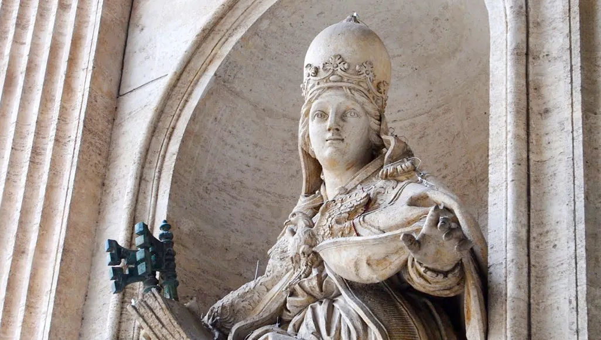
the Sunday-law movement in the fourth century
What happened next? The pattern continued:
325 – Council of Nicaea (imperially convened)
364 – Council of Laodicea discourages Sabbath observance
386 – Stronger Sunday enforcement laws
Increasing penalties for dissent
Gradually:
Church authority + Civil power = Enforcement.

Slide 68
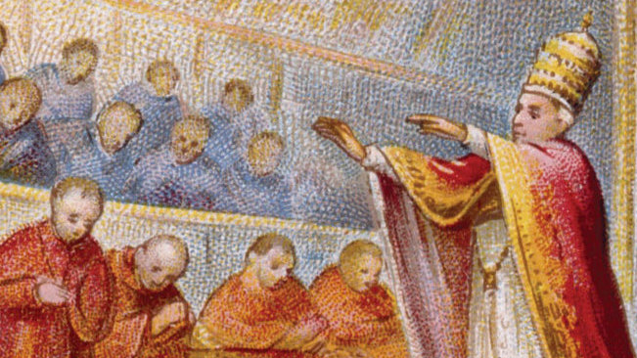
the Sunday-law movement in the fourth century
Recall that the first beast of Revelation 13 represents:
The medieval papal system
A religio-political power
Exercising civil authority in religious matters
Persecuting dissenters
That system did not suddenly appear in A.D. 321.
It developed over centuries.

Slide 69
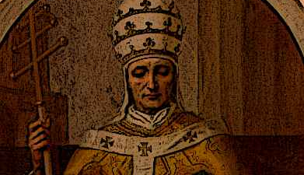
the Sunday-law movement in the fourth century
The Sunday law was one early manifestation of the church-state union that eventually matured into the medieval papal system (the beast).
In other words:
The beast grows out of the union of church and state.
The Sunday law in 321 is evidence of that union taking shape.

Slide 70
21. What will just as surely grow out of this Sunday-law movement in our day?
Answer: The image of the beast.

Slide 71
22. What did the beast do?
Answer: He made war with the saints.
Revelation 13:7; Daniel 7:21, 25

Slide 72
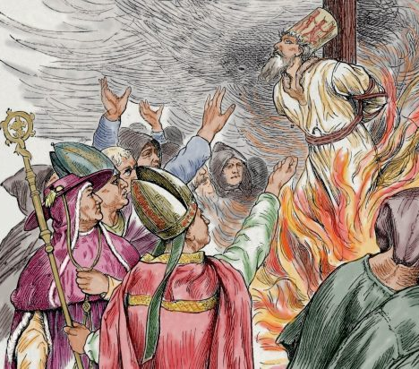
Revelation
13:7
⁷ And it was given unto him to make war with the saints, and to overcome them: and power was given him over all kindreds, and tongues, and nations.

Slide 73
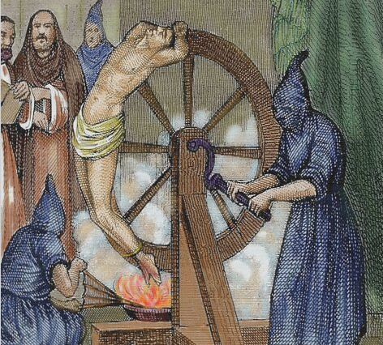
Daniel
7:21, 25
²¹ I beheld, and the same horn made war with the saints, and prevailed against them;

Slide 74

Daniel
7:21, 25
²⁵ And he shall speak great words against the most High, and shall wear out the saints of the most High, and think to change times and laws: and they shall be given into his hand until a time and times and the dividing of time.

Slide 75
23. What will the image of the beast do?
Revelation 13:16, 17

Slide 76
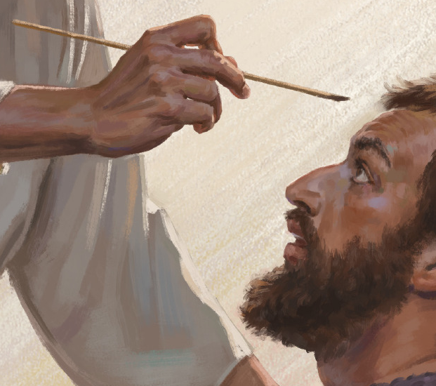
Revelation
13:16, 17
¹⁶ And he causeth all, both small and great, rich and poor, free and bond, to receive a mark in their right hand, or in their foreheads:

Slide 77

Revelation
13:16, 17
¹⁷ And that no man might buy or sell, save he that had the mark, or the name of the beast, or the number of his name.

Slide 78
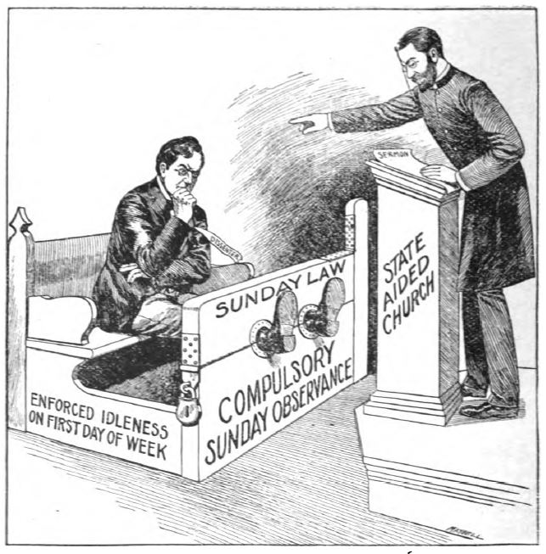
The Image of the Beast
Elgin Sunday-law Convention
“Resolved, That we give our patronage to such business men, manufacturers, and laborers as observe the Sabbath [Sunday].”

Slide 79
24. What further will the image of the beast endeavor to do?
Revelation 13:15

Slide 80
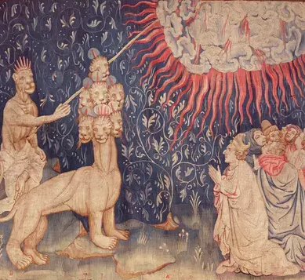
Revelation
13:15
¹⁵ And he had power to give life unto the image of the beast, that the image of the beast should both speak, and cause that as many as would not worship the image of the beast should be killed.

Slide 81
25. Is it in the minds of these National Reformers to do this?

Slide 82
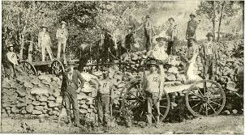
25. Is it in the minds of these National Reformers to do this?
At the Lakeside National Reform Convention, 1887, a certain person said of the enforcement of Sunday laws:
“There is a law in the State of Arkansas enforcing Sunday observance upon the people, and the result has been that many good persons have been imprisoned, but have lost their property and even their lives.”
And Dr. McAllister replied:
“It is better that a few should suffer than that the whole nation should lose its Sabbath.”

Slide 83
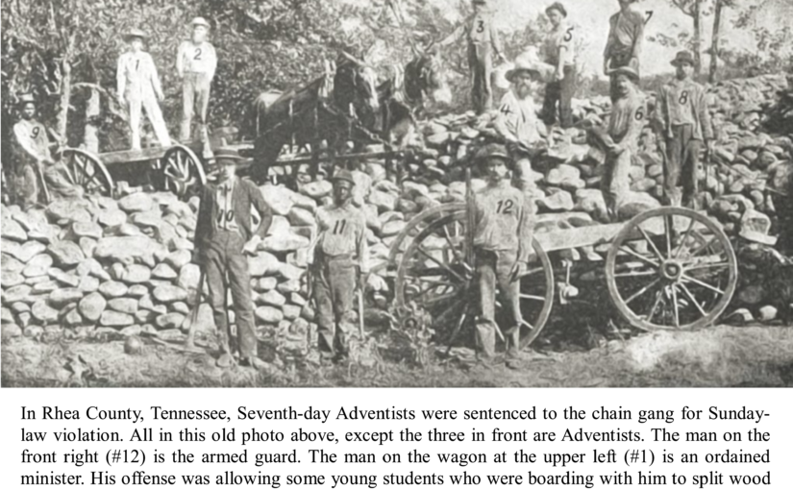
Summer 1895

Slide 84
26. Under what plea did the chief priests and Pharisees justify themselves in killing the Saviour?

Slide 85
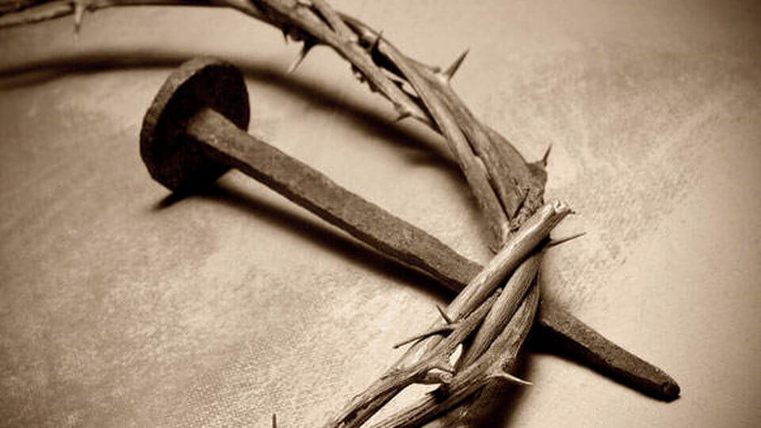
26. Under what plea did the chief priests and Pharisees justify themselves in killing the Saviour?
Answer: “It is expedient for us, that one man should die for the people, and that the whole nation perish not.” “Then from that day forth they took counsel together for to put him to death.” John 11:50

Slide 86
27. Will these in our day accomplish their purpose upon those who refuse to worship the beast and his image?
Revelation 15:2

Slide 87
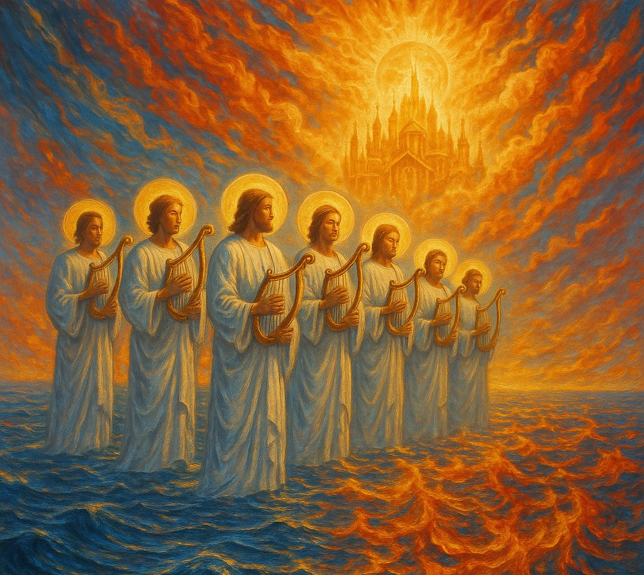
Revelation
15:2
² And I saw as it were a sea of glass mingled with fire: and them that had gotten the victory over the beast, and over his image, and over his mark, and over the number of his name, stand on the sea of glass, having the harps of God.

Slide 88
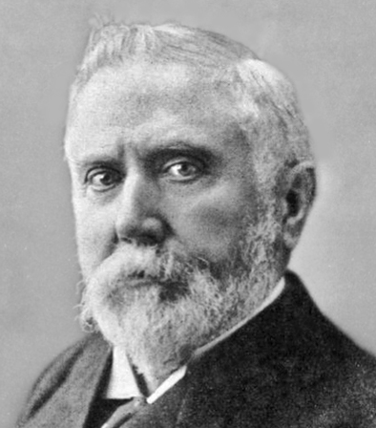
McConnell of the NRA
1887
In the Christian Nation, December 1, 1887, Rev. W. T. McConnell, representative National Reformer, published an “open letter” to the American Sentinel, in which he said:
“You look for trouble in this land in the future, if these principles are applied. I think it will come to you if you maintain your present position. “

Slide 89
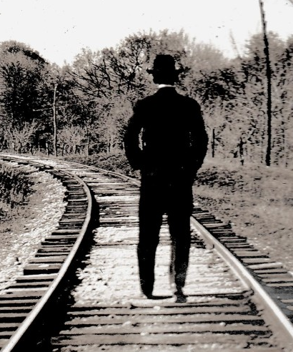
McConnell of the NRA
1887
“The foolhardy fellow who persists in standing on a railroad track may well anticipate trouble when he hears the rumble of the coming train. If he hears the whistle and sees the flaming head-light, he may change his position and avoid the danger; but if he won’t be influenced by these, his most gloomy forebodings of trouble will be realized when the express strikes him.”

Slide 90
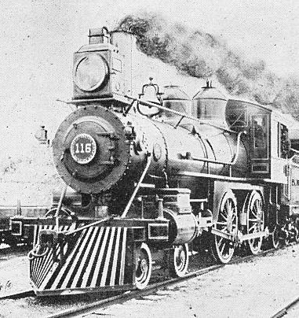
McConnell of the NRA
1887
“So you, neighbor, if, through prejudice or the enmity of unregenerate hearts, you have determined to oppose the progress of this nation in fulfilling its vocation as an instrument in the divine work of regeneration in human society, may rightly expect trouble. It will be sure to come to you.”

Slide 91
January 8, 2026
“By restoring a common rhythm of rest and reflection, community rest laws could help to reverse the trend toward “spiritual homelessness” and foster the social habits necessary for communities to cohere and flourish…
Where new, planned communities or transitioning communities form, they should consider adding rest days as part of their master plans for balanced and thriving community life.”

Slide 92
Thank you!
… and Happy Sabbath!!

Slide 93


