Slide 1


Slide 2

Living the Light

Slide 3
The Third Angel’s Message
Lesson 10: THE PURPOSE OF THE SABBATH IN THE MESSAGE
September 8, 1888
Lesson 10, 3rd Quarter 1888

Slide 4

1. What warning does the Lord send to the world against the worship of the beast and his image?
Revelation 14:9–11

Slide 5
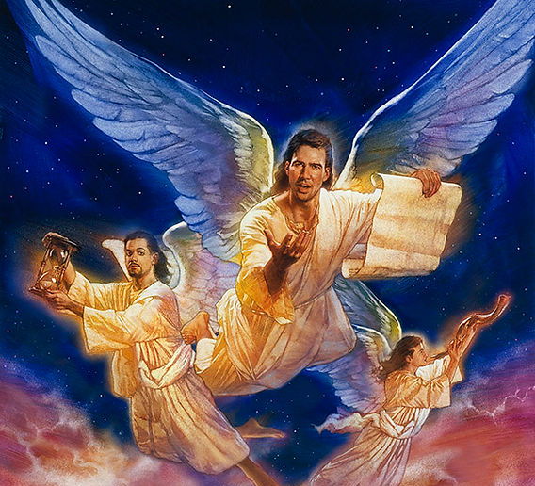
Revelation
14:9-11
⁹ And the third angel followed them, saying with a loud voice, If any man worship the beast and his image, and receive his mark in his forehead, or in his hand,

Slide 6
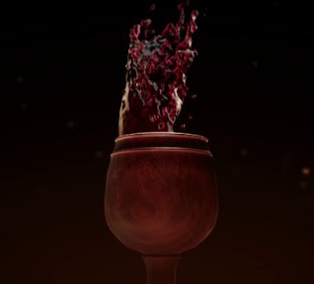
Revelation
14:9-11
¹⁰ The same shall drink of the wine of the wrath of God, which is poured out without mixture into the cup of his indignation; and he shall be tormented with fire and brimstone in the presence of the holy angels, and in the presence of the Lamb:

Slide 7
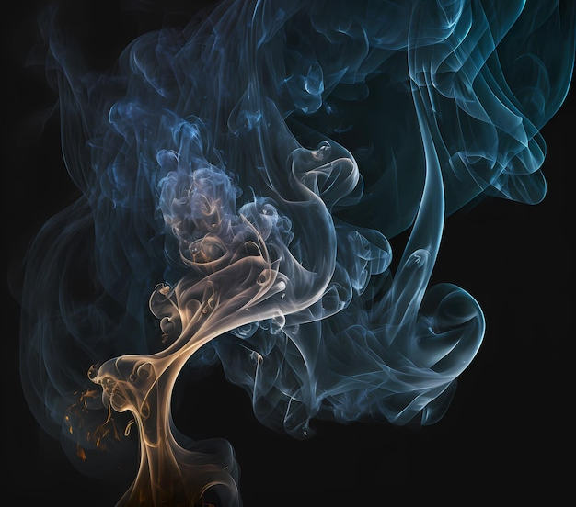
Revelation
14:9-11
¹¹ And the smoke of their torment ascendeth up for ever and ever: and they have no rest day nor night, who worship the beast and his image, and whosoever receiveth the mark of his name.

Slide 8
2. How widely was the first message of this chapter announced?
Revelation 14:6

Slide 9

Revelation
14:6
⁶ And I saw another angel fly in the midst of heaven, having the everlasting gospel to preach unto them that dwell on the earth, and to every nation, and kindred, and tongue, and people,

Slide 10
3. What is said of the second [angel]?
Answer: It followed.
Revelation 14:8

Slide 11
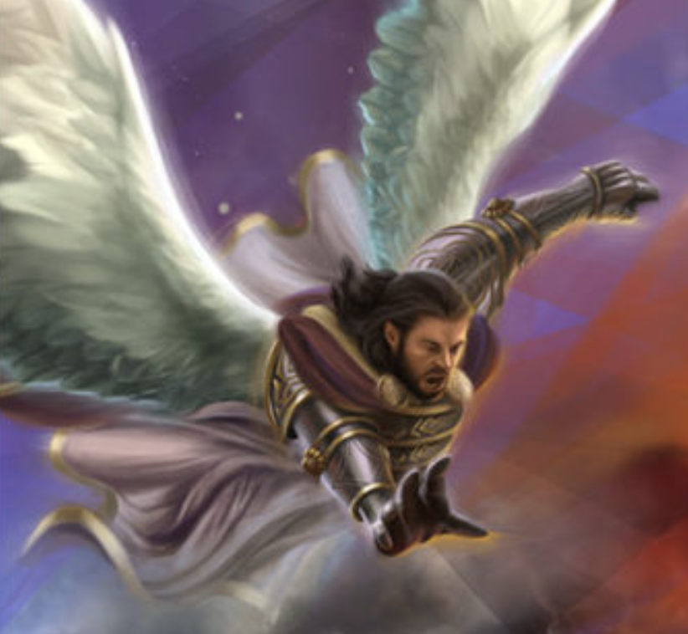
Revelation
14:8
⁸ And there followed another angel, saying, Babylon is fallen, is fallen, that great city, because she made all nations drink of the wine of the wrath of her fornication.

Slide 12
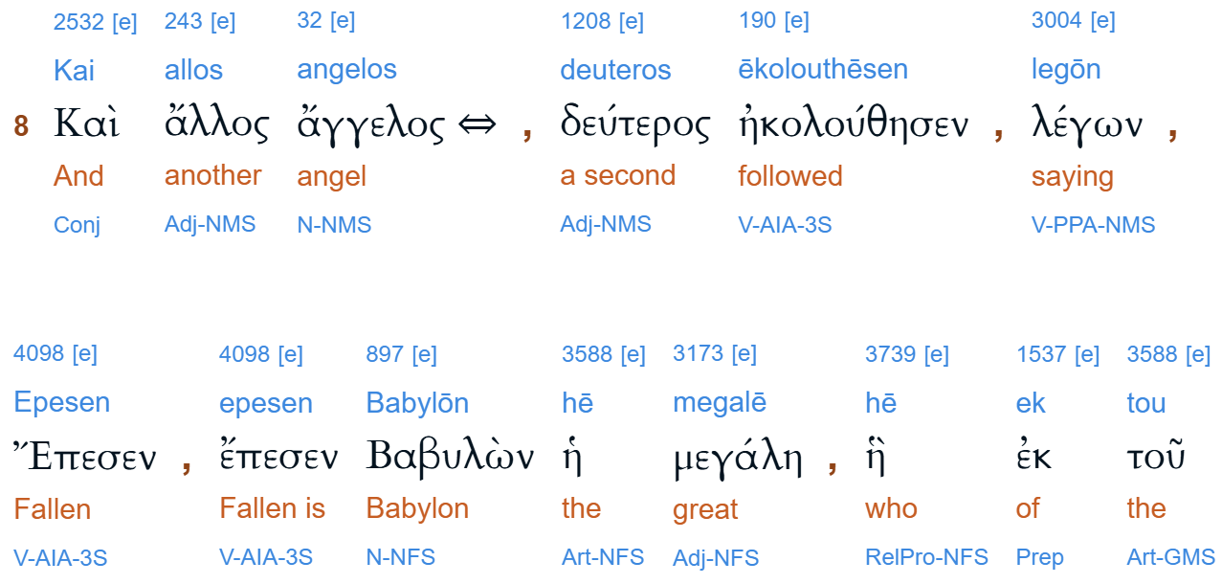

Slide 13
4. And what is said of the third [angel]?
Answer: The third angel followed them.
Revelation 14:9

Slide 14
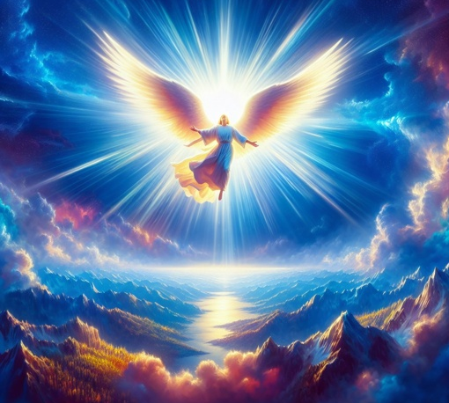
Revelation
14:9
⁹ And the third angel followed them, saying with a loud voice, If any man worship the beast and his image, and receive his mark in his forehead, or in his hand,

Slide 15
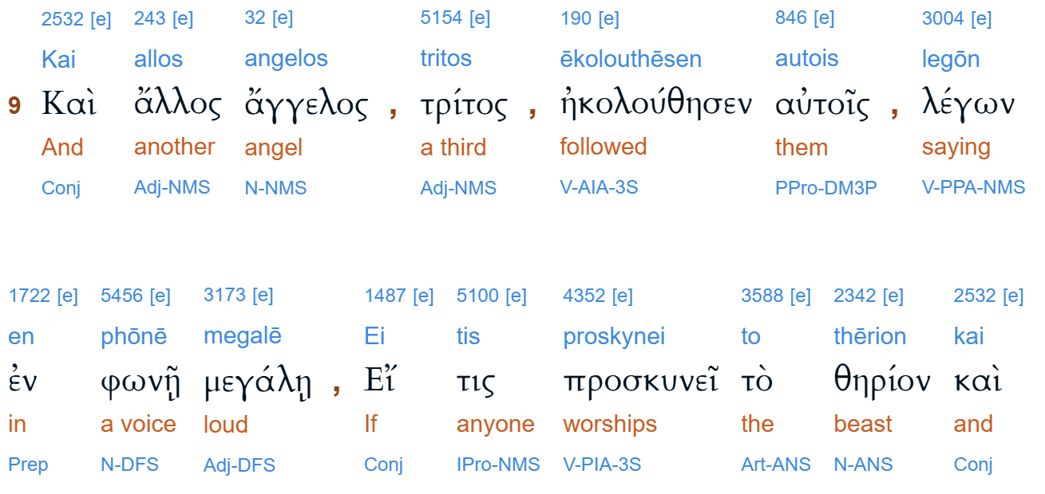

Slide 16
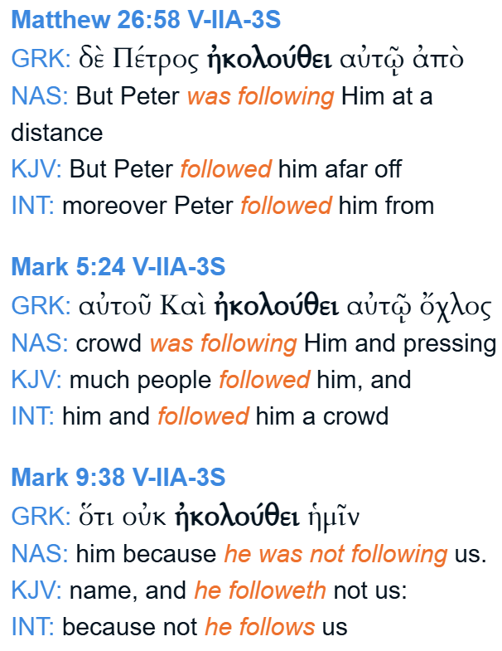
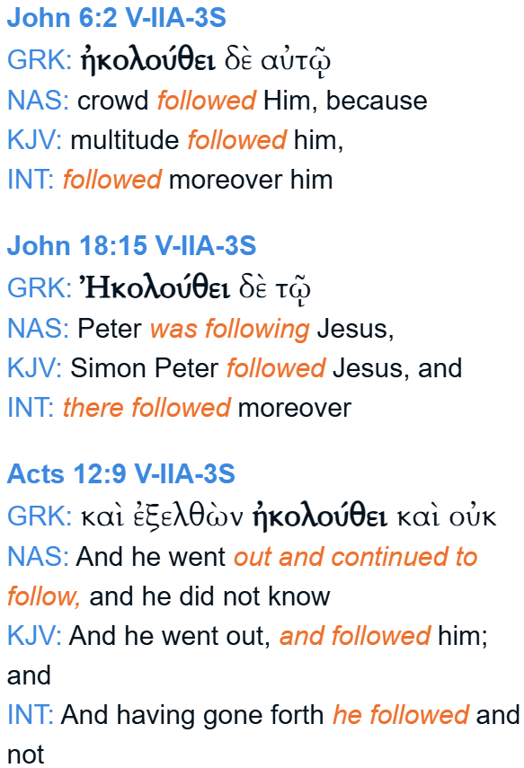

Slide 17
5. If, then, the first one went to every nation and kindred and tongue and people, and the third one follows, what must be the extent to which the Third Angel’s Message will go?

Slide 18
6. What does the first angel have to preach?
Revelation 14:6

Slide 19
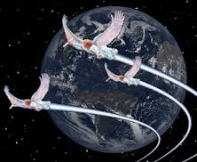
Revelation
14:6
⁶ And I saw another angel fly in the midst of heaven, having the everlasting gospel to preach unto them that dwell on the earth, and to every nation, and kindred, and tongue, and people,

Slide 20
7. What does this angel proclaim?
Answer: “The hour of God’s judgment is come.”
Revelation 14:7

Slide 21
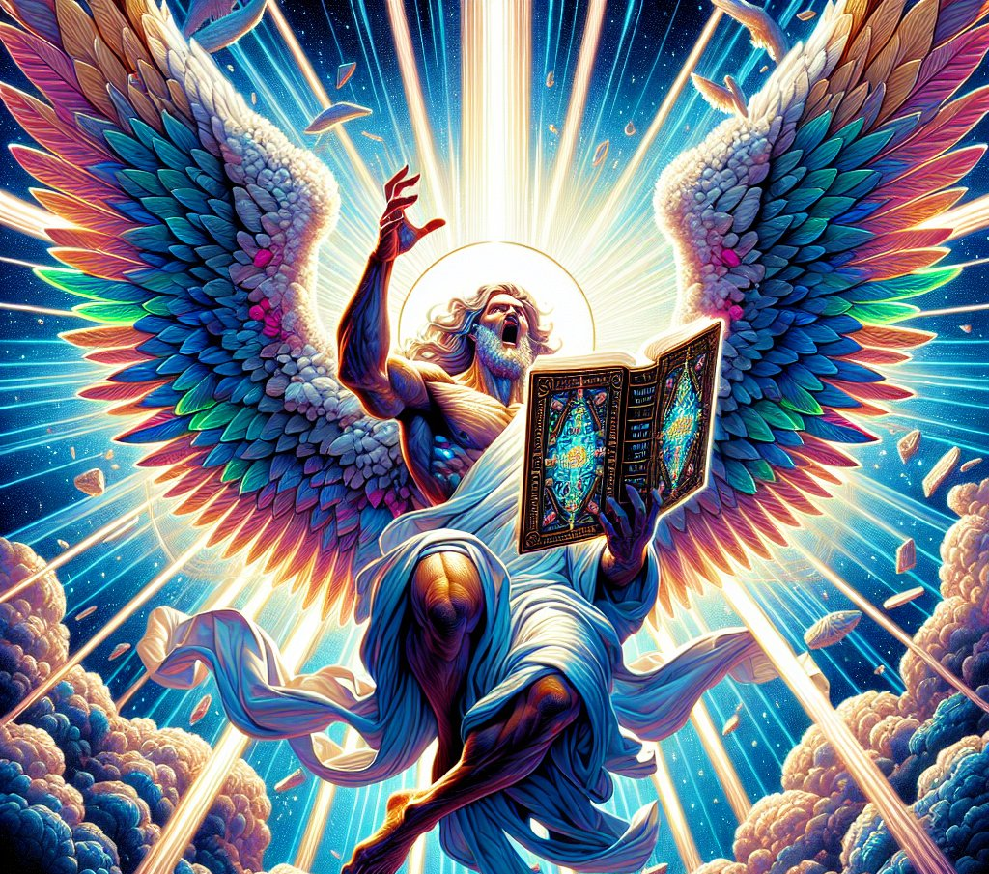
Revelation
14:7
⁷ Saying with a loud voice, Fear God, and give glory to him; for the hour of his judgment is come: and worship him that made heaven, and earth, and the sea, and the fountains of waters.

Slide 22
8. What does he call upon all people to do?
Answer: “Worship Him that made heaven, and earth, and the sea, and the fountains of waters.”

Slide 23
9. What results from the rejection of this message?
Revelation 14:8

Slide 24
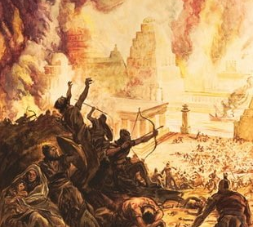
Revelation
14:8
⁸ And there followed another angel, saying, Babylon is fallen, is fallen, that great city, because she made all nations drink of the wine of the wrath of her fornication.

Slide 25
10. What came of the first falling away from the everlasting gospel?
Answer: “That man of sin;” “the mystery of iniquity;” “the beast.”
2 Thessalonians 2:2–8;
Daniel 7:11;
Revelation 19:19, 20.

Slide 26
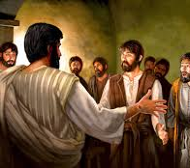
2 Thessalonians 2:1-8
2 Now we beseech you, brethren, by the coming of our Lord Jesus Christ, and by our gathering together unto him,

Slide 27
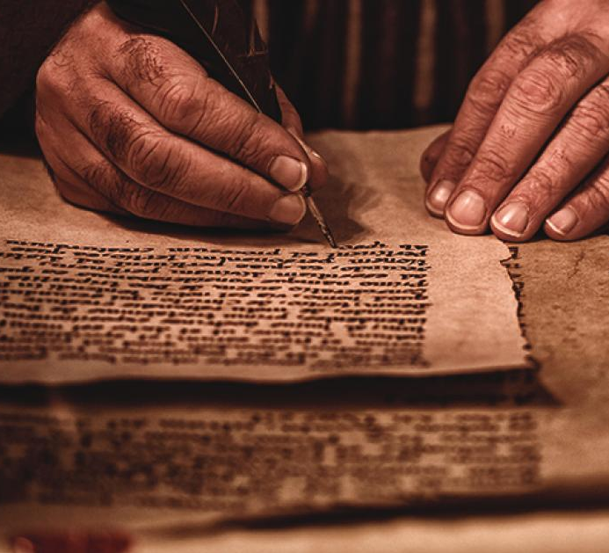
2 Thessalonians 2:1-8
² That ye be not soon shaken in mind, or be troubled, neither by spirit, nor by word, nor by letter as from us, as that the day of Christ is at hand.

Slide 28

2 Thessalonians 2:1-8
³ Let no man deceive you by any means: for that day shall not come, except there come a falling away first, and that man of sin be revealed, the son of perdition;

Slide 29
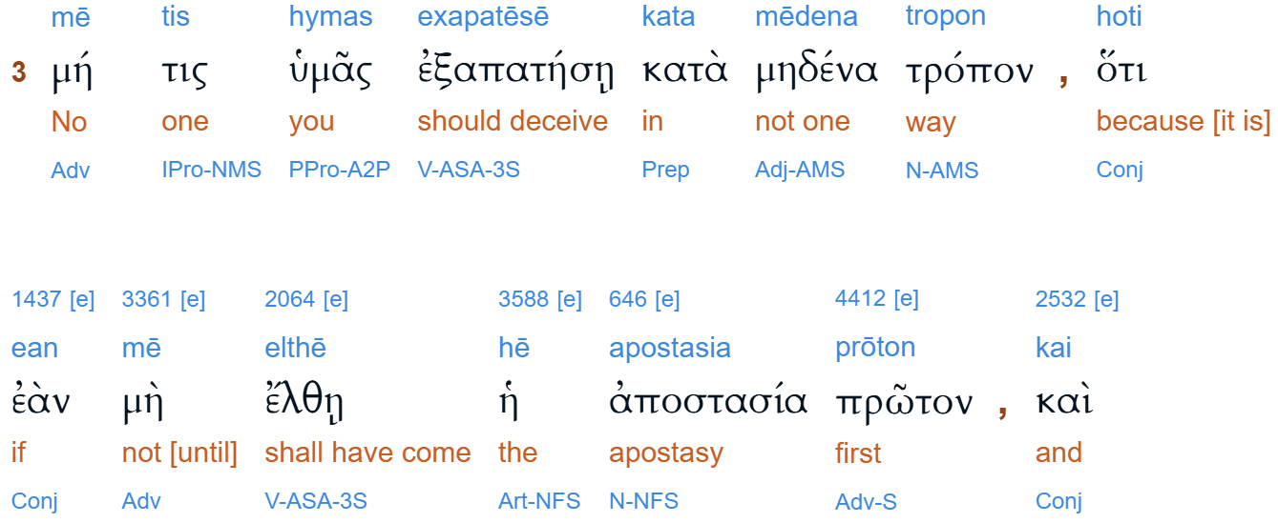
the “falling away”

Slide 30
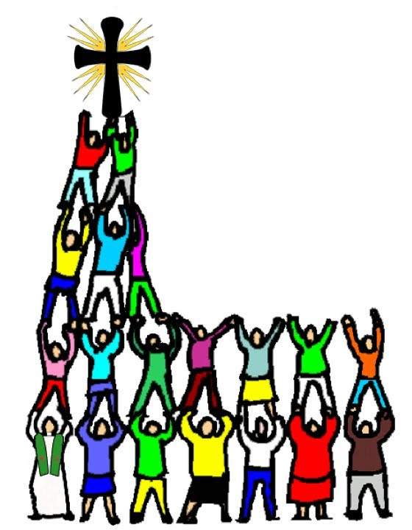
Acts 20:28-31
²⁸ Take heed therefore unto yourselves, and to all the flock, over the which the Holy Ghost hath made you overseers, to feed the church of God, which he hath purchased with his own blood.

Slide 31
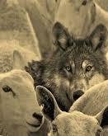
Acts 20:28-31
²⁹ For I know this, that after my departing shall grievous wolves enter in among you, not sparing the flock.
³⁰ Also of your own selves shall men arise, speaking perverse things, to draw away disciples after them.

Slide 32
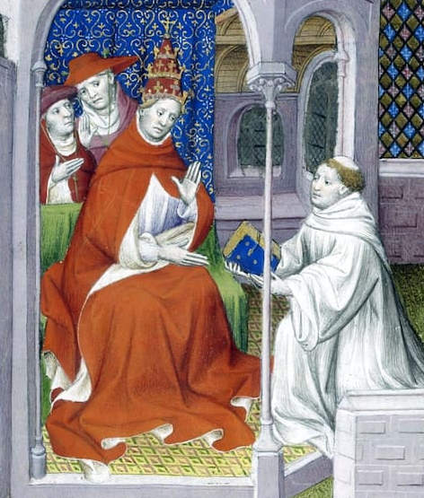
1 Timothy 4:1-3
4 Now the Spirit speaketh expressly, that in the latter times some shall depart from the faith, giving heed to seducing spirits, and doctrines of devils;
² Speaking lies in hypocrisy; having their conscience seared with a hot iron;

Slide 33
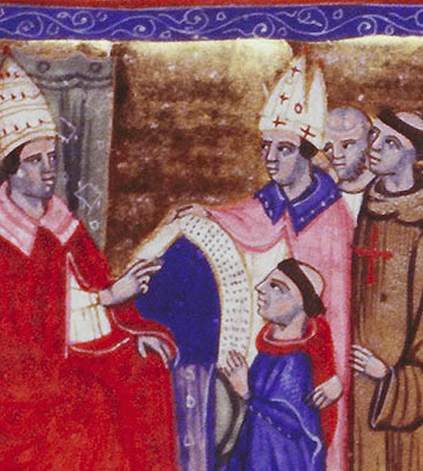
1 Timothy 4:1-3
³ Forbidding to marry, and commanding to abstain from meats, which God hath created to be received with thanksgiving of them which believe and know the truth.

Slide 34
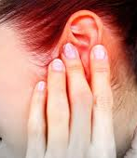
2 Timothy 4:3-4
³ For the time will come when they will not endure sound doctrine; but after their own lusts shall they heap to themselves teachers, having itching ears;
⁴ And they shall turn away their ears from the truth, and shall be turned unto fables.

Slide 35

2 Thessalonians 2:1-8
⁴ Who opposeth and exalteth himself above all that is called God, or that is worshipped; so that he as God sitteth in the temple of God, shewing himself that he is God.

Slide 36
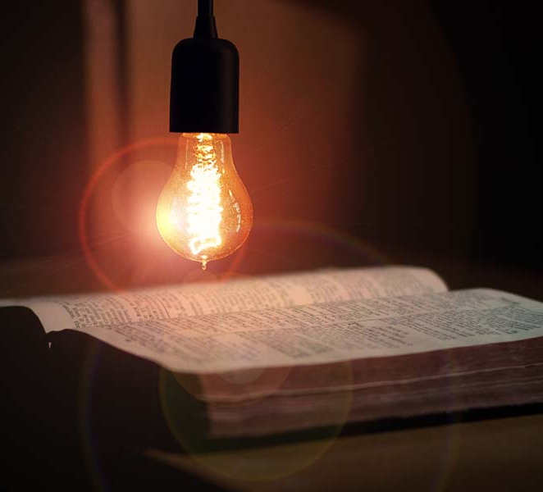
2 Thessalonians 2:1-8
⁵ Remember ye not, that, when I was yet with you, I told you these things?
⁶ And now ye know what withholdeth that he might be revealed in his time.

Slide 37
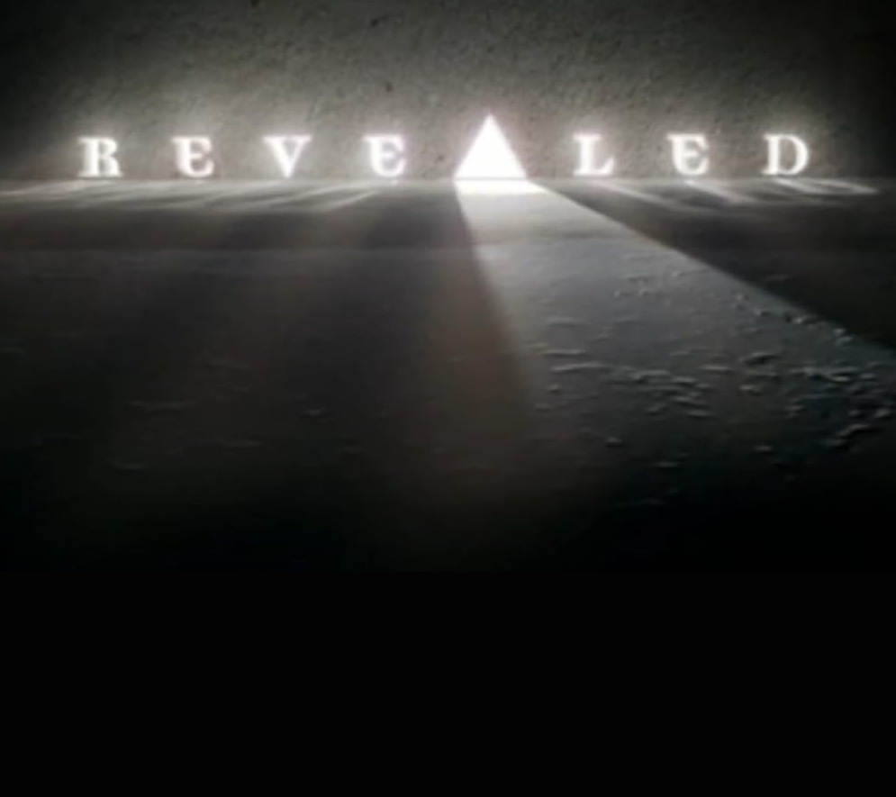
2 Thessalonians 2:1-8
⁷ For the mystery of iniquity doth already work: only he who now letteth will let, until he be taken out of the way.

Slide 38
2 Thessalonians 2:1-8
⁷ For the mystery of iniquity doth already work: only he who now letteth will let, until he be taken out of the way.
Gr. katecho (see on v. 6). In Old English “let” meant “to restrain.”

Slide 39
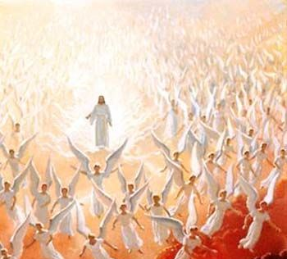
2 Thessalonians 2:1-8
⁸ And then shall that Wicked be revealed, whom the Lord shall consume with the spirit of his mouth, and shall destroy with the brightness of his coming:

Slide 40
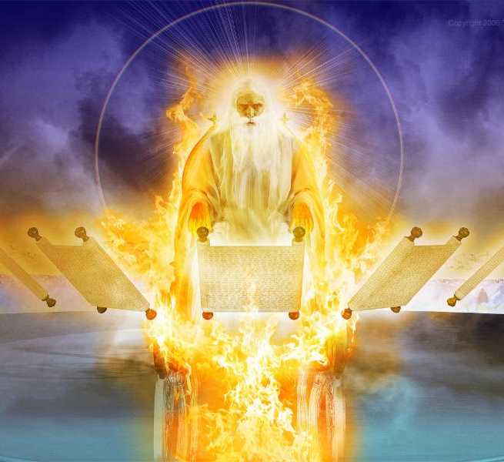
Daniel
7:9-11
⁹ I beheld till the thrones were cast down, and the Ancient of days did sit, whose garment was white as snow, and the hair of his head like the pure wool: his throne was like the fiery flame, and his wheels as burning fire.

Slide 41
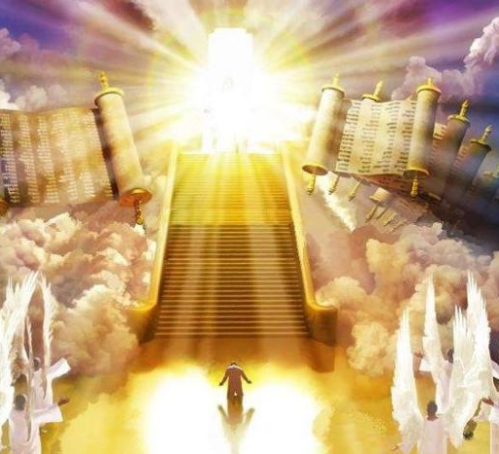
Daniel
7:9-11
¹⁰ A fiery stream issued and came forth from before him: thousand thousands ministered unto him, and ten thousand times ten thousand stood before him: the judgment was set, and the books were opened.

Slide 42
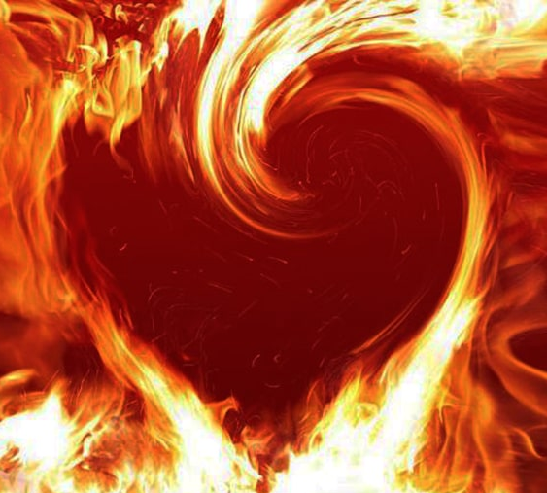
Daniel
7:9-11
¹¹ I beheld then because of the voice of the great words which the horn spake: I beheld even till the beast was slain, and his body destroyed, and given to the burning flame.

Slide 43
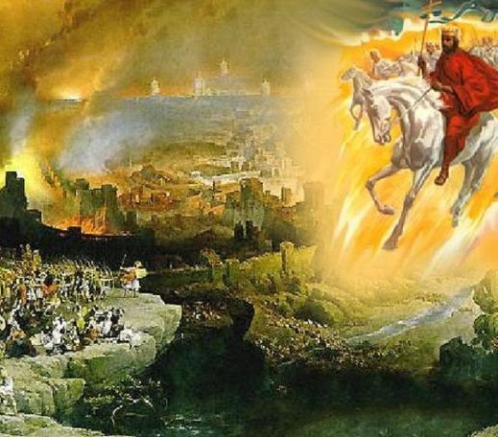
Revelation
19:19-20
¹⁹ And I saw the beast, and the kings of the earth, and their armies, gathered together to make war against him that sat on the horse, and against his army.

Slide 44
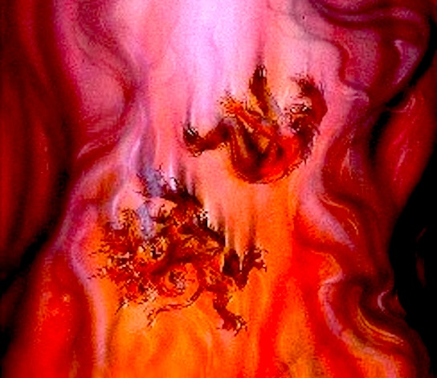
Revelation
19:19-20
²⁰ And the beast was taken, and with him the false prophet that wrought miracles before him, with which he deceived them that had received the mark of the beast, and them that worshipped his image. These both were cast alive into a lake of fire burning with brimstone.

Slide 45
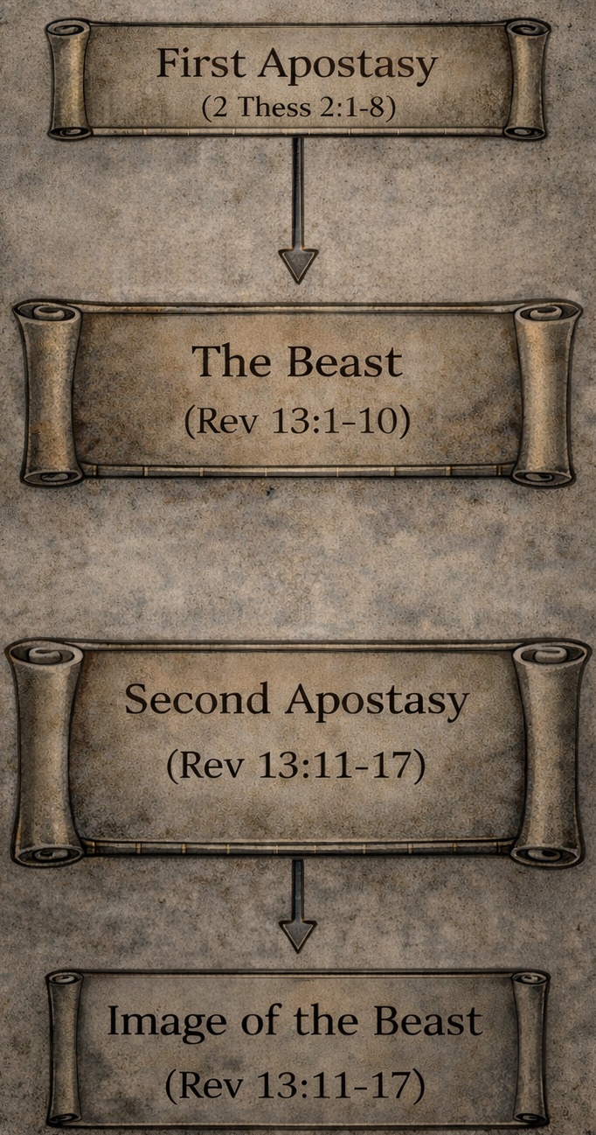
11. What comes of this second falling away from the everlasting gospel?
Answer: “The image of the beast,” and the enforced worship of the beast.

Slide 46
12. When men refuse to worship Him that made heaven and earth and the sea and the fountains of waters, what are they led to do?
Answer: To worship the beast and his image.
Revelation 13:12, 13.

Slide 47
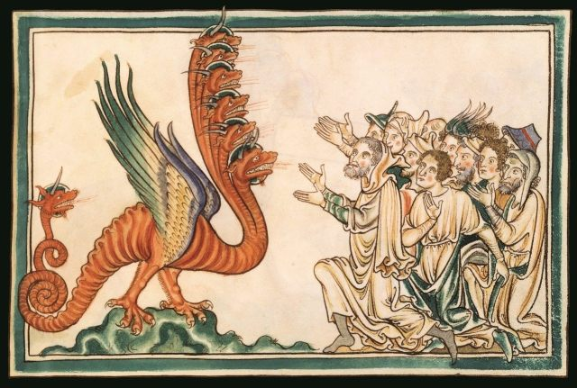
Revelation
13:12-13
¹² And he exerciseth all the power of the first beast before him, and causeth the earth and them which dwell therein to worship the first beast, whose deadly wound was healed.

Slide 48
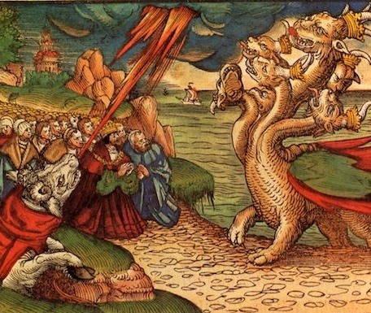
Revelation
13:12-13
¹³ And he doeth great wonders, so that he maketh fire come down from heaven on the earth in the sight of men,

Slide 49
13. What then do the three messages of Revelation 14:6–12 form?
Answer: One threefold message rather than three distinct messages.
(See Note.)

Slide 50
14. When the first in order tells men that the hour of God’s judgment is come, what does the third tell them to do, to be prepared for the judgment?
Revelation 14:12

Slide 51
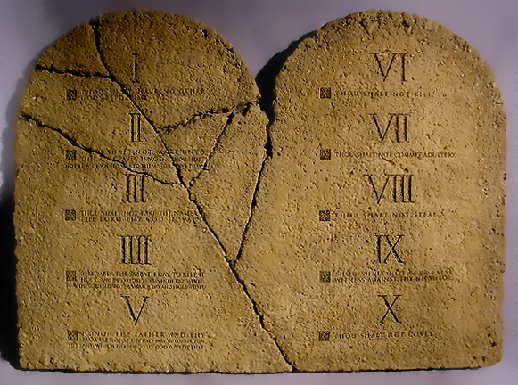
Revelation
14:12
¹² Here is the patience of the saints: here are they that keep the commandments of God, and the faith of Jesus.

Slide 52
15. What is to be the rule in the judgment?
Romans 2:12, 16

Slide 53
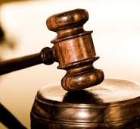
Romans
2:12, 13, 16
¹² For as many as have sinned without law shall also perish without law: and as many as have sinned in the law shall be judged by the law;

Slide 54
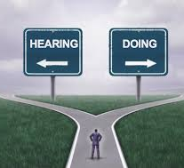
Romans
2:12, 13, 16
¹³ (For not the hearers of the law are just before God, but the doers of the law shall be justified.

Slide 55
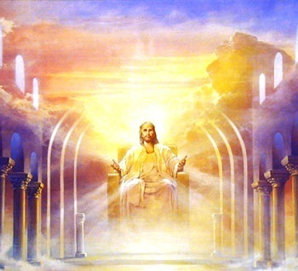
Romans
2:12, 13, 16
¹⁶ In the day when God shall judge the secrets of men by Jesus Christ according to my gospel.

Slide 56
16. When the first angel calls upon all men to worship Him that made heaven and earth, etc., what does the third tell them to do, that their worship may be acceptable to Him, and that they may avoid the worship of the beast and his image?
Revelation 14:12

Slide 57
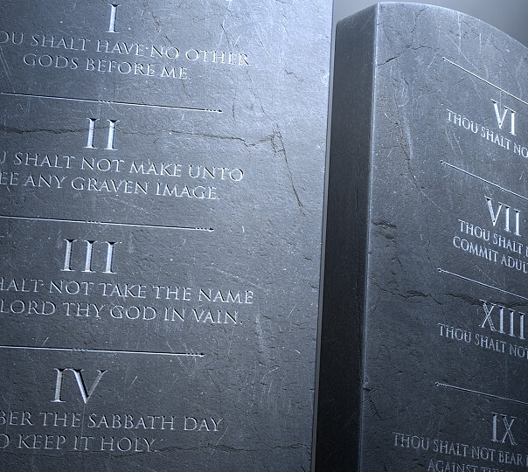
Revelation
14:12
¹² Here is the patience of the saints: here are they that keep the commandments of God, and the faith of Jesus.

Slide 58
17. Is a man’s worship acceptable to God if he does not keep the commandments of God?
Proverbs 28:9

Slide 59
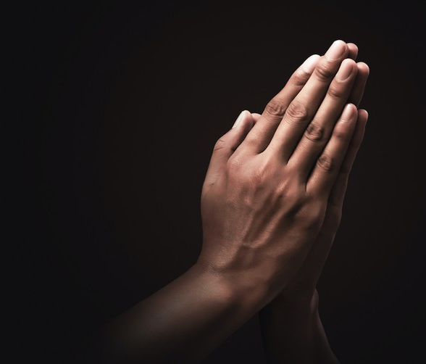
Proverbs 28:9
⁹ He that turneth away his ear from hearing the law, even his prayer shall be abomination.

Slide 60
18. Is it possible to keep the commandments of God without faith in Jesus?
Romans 14:23, last part.

Slide 61
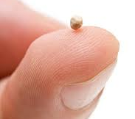
Romans 14:23
²³ And he that doubteth is damned if he eat, because he eateth not of faith: for whatsoever is not of faith is sin.

Slide 62
19. Is there any part of the commandments of God that points specially to Him that made heaven and earth?
Exodus 20:8-11

Slide 63

Exodus 20:8-11
⁸ Remember the sabbath day, to keep it holy.
⁹ Six days shalt thou labour, and do all thy work:

Slide 64

Exodus 20:8-11
¹⁰ But the seventh day is the sabbath of the Lord thy God: in it thou shalt not do any work, thou, nor thy son, nor thy daughter, thy manservant, nor thy maidservant, nor thy cattle, nor thy stranger that is within thy gates:

Slide 65
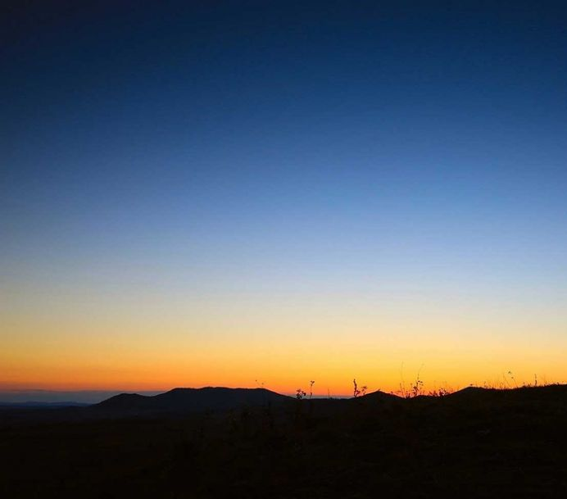
Exodus 20:8-11
¹¹ For in six days the Lord made heaven and earth, the sea, and all that in them is, and rested the seventh day: wherefore the Lord blessed the sabbath day, and hallowed it.

Slide 66
Exodus 20:11
Revelation 14:7
¹¹ For in six days the Lord made heaven and earth, the sea, and all that in them is, and rested the seventh day: wherefore the Lord blessed the sabbath day, and hallowed it.
⁷ Saying with a loud voice, Fear God, and give glory to him; for the hour of his judgment is come: and worship him that made heaven, and earth, and the sea, and the fountains of waters.

Slide 67
Ezekiel 20:12
Moreover also I gave them my sabbaths, to be a sign between me and them, that they might know that I am the LORD that sanctify them.

Slide 68
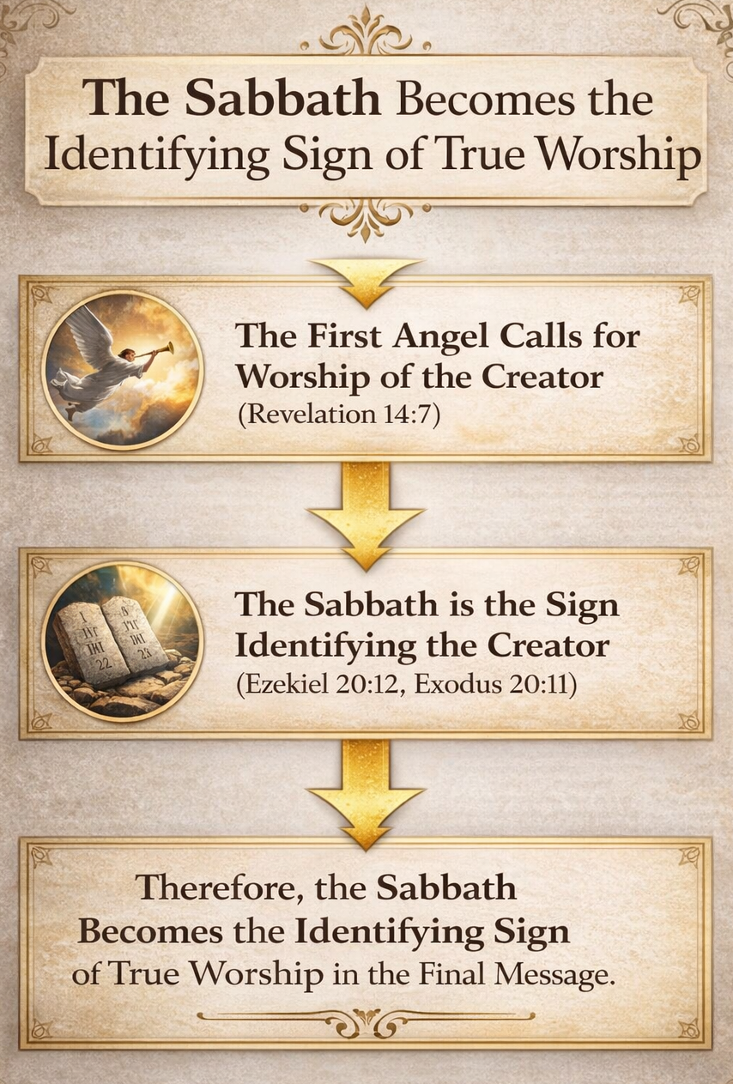

Slide 69
20. Therefore, in the time of the preaching of the Third Angel’s Message, what will be done?
Answer: Every nation, and kindred, and tongue, and people will be called upon particularly to keep the fourth commandment.

Slide 70
21. What day is the Sabbath of the Lord?
Exodus 20:10.

Slide 71

Exodus 20:10
¹⁰ But the seventh day is the sabbath of the Lord thy God: in it thou shalt not do any work, thou, nor thy son, nor thy daughter, thy manservant, nor thy maidservant, nor thy cattle, nor thy stranger that is within thy gates:

Slide 72
22. Of What is a sign?
Answer: “A sign… that ye may know that I am the Lord your God.”
Ezekiel 20:20.

Slide 73
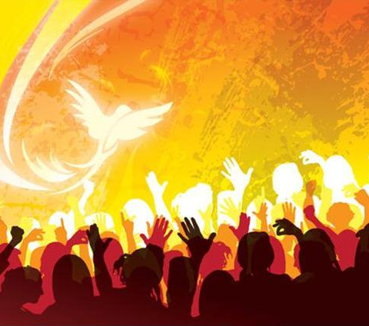
Ezekiel 20:20
²⁰ And hallow my sabbaths; and they shall be a sign between me and you, that ye may know that I am the Lord your God.

Slide 74
23. Why is it such a sign?
Answer: “For in six days the Lord made heaven and earth, the sea, and all that in them is, and rested the seventh day.”
Exodus 31:17.

Slide 75
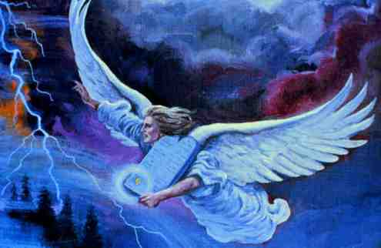
Exodus 31:17
¹⁷ It is a sign between me and the children of Israel for ever: for in six days the Lord made heaven and earth, and on the seventh day he rested, and was refreshed.

Slide 76
24. Then of what is the keeping of the seventh day a sign?
Answer: It is a sign that those who do so worship the true God—“Him that made heaven, and earth, and the sea, and the fountains of waters.”

Slide 77
25. What is the one great question under the Third Angel’s Message?
Answer: Whether men will worship Him that made heaven and earth, or worship the beast and his image.

Slide 78
26. What is the keeping of the seventh day—the Sabbath of the Lord?
Answer: It is the God-given sign that those who do so are worshipers of Him that made heaven and earth.

Slide 79
27. Therefore what is the inevitable conclusion?
Answer: That the keeping of the Sabbath of the Lord—the seventh day—is the one point above every other that distinguishes the worshipers of Him that made heaven and earth from the worshipers of the beast and his image.

Slide 81
Thank you!
… and Happy Sabbath!!

Slide 82


