Slide 1


Slide 2

Living the Light

Slide 3
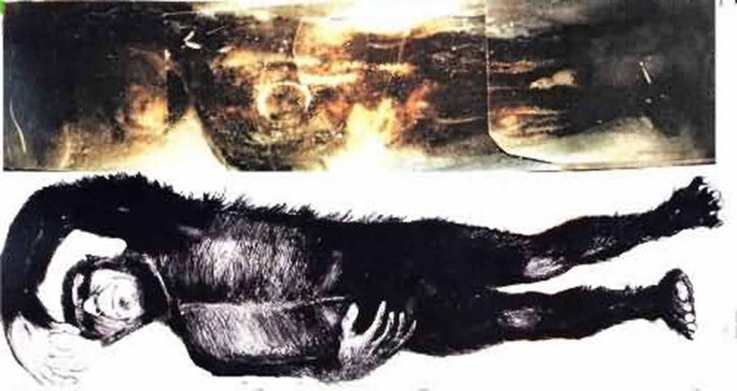

Slide 4
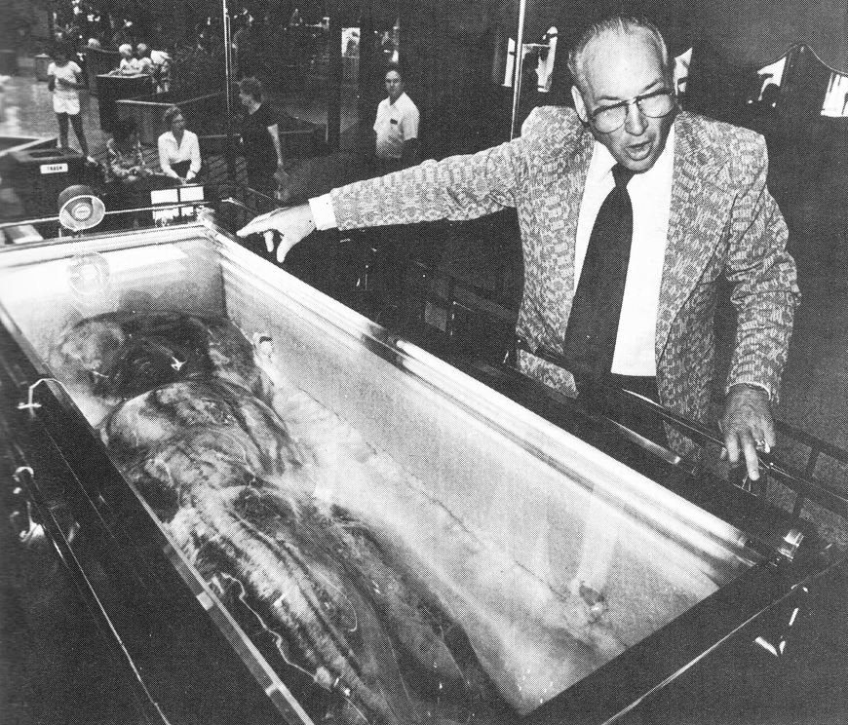

Slide 5
The Third Angel’s Message
Lesson 11: THE Mark of the Beast
September 15, 1888
Lesson 10, 3rd Quarter 1888

Slide 6
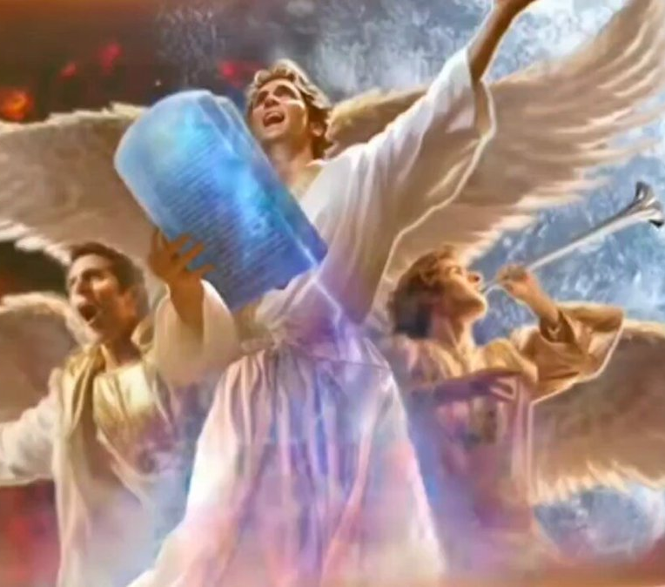
Revelation
14:9-12
⁹ And the third angel followed them, saying with a loud voice, If any man worship the beast and his image, and receive his mark in his forehead, or in his hand,

Slide 7
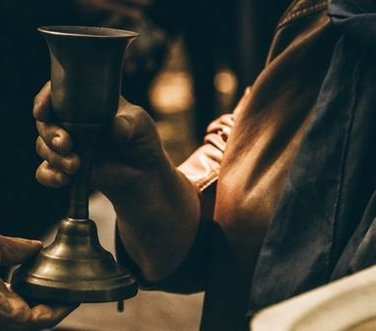
Revelation
14:9-12
¹⁰ The same shall drink of the wine of the wrath of God, which is poured out without mixture into the cup of his indignation; and he shall be tormented with fire and brimstone in the presence of the holy angels, and in the presence of the Lamb:

Slide 8
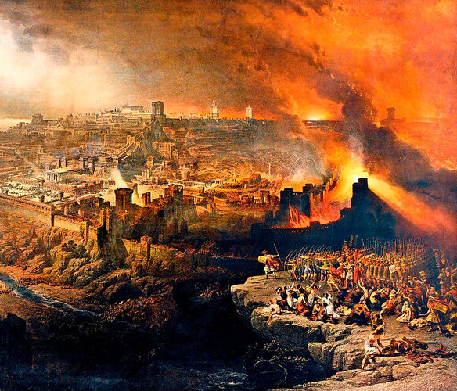
Revelation
14:9-12
¹¹ And the smoke of their torment ascendeth up for ever and ever: and they have no rest day nor night, who worship the beast and his image, and whosoever receiveth the mark of his name.

Slide 9
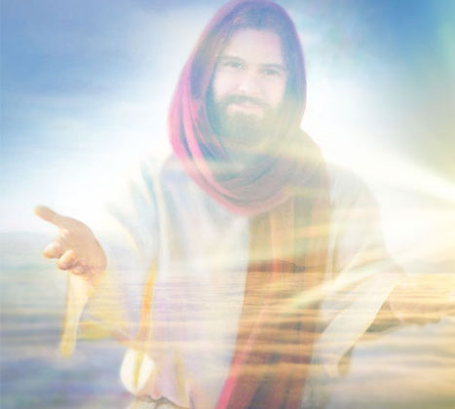
Revelation
14:9-12
¹² Here is the patience of the saints: here are they that keep the commandments of God, and the faith of Jesus.

Slide 10
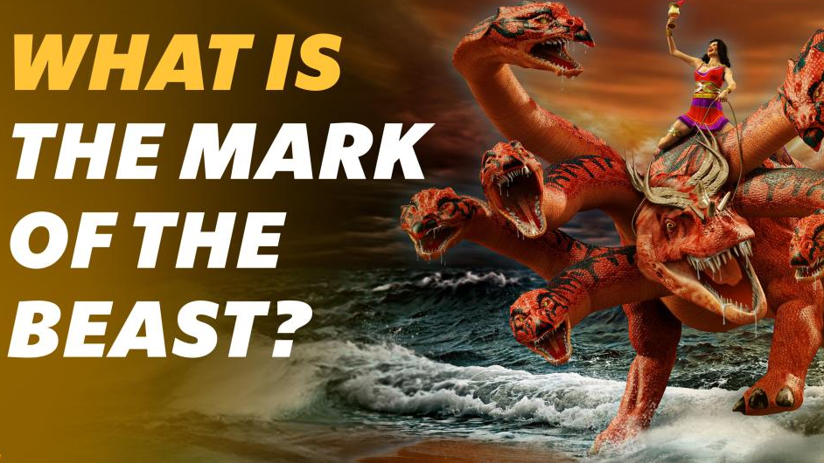

Slide 11


Slide 12


Slide 13
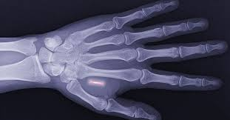

Slide 14


Slide 15

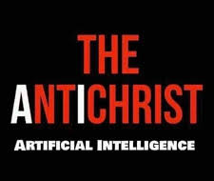

Slide 16
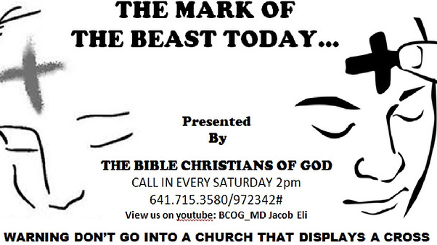

Slide 17
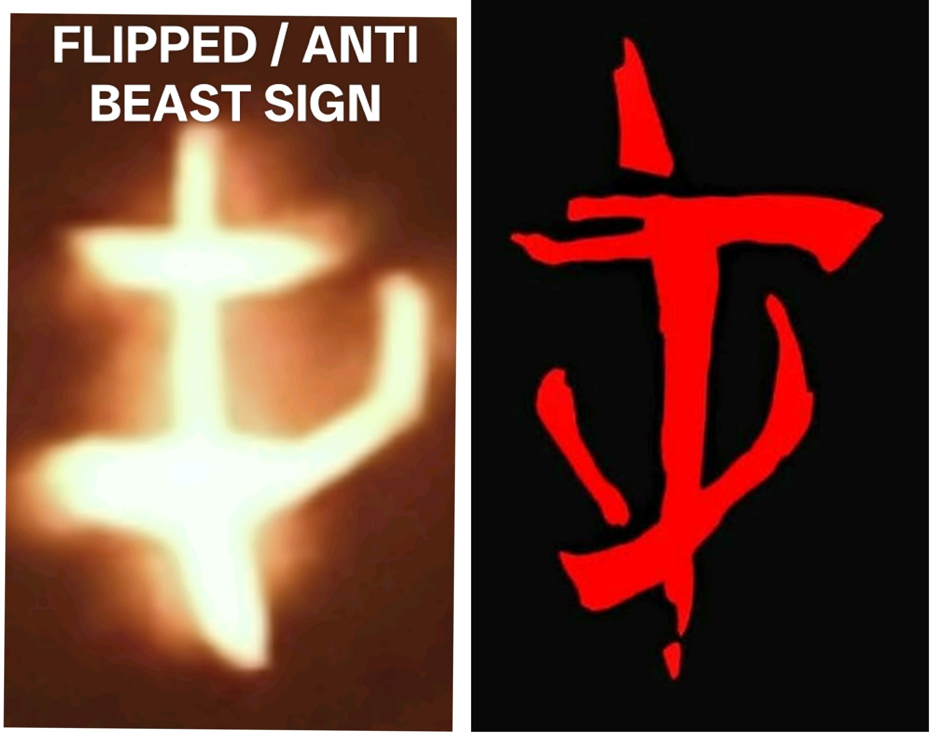

Slide 18
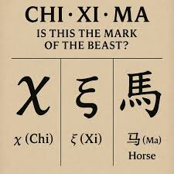

Slide 19
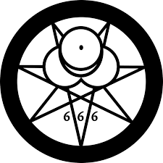
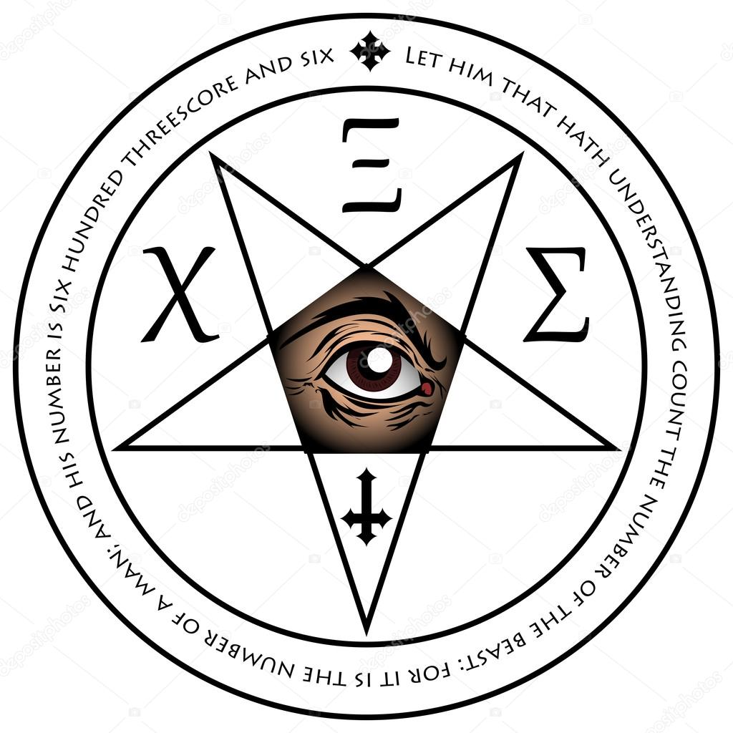

Slide 20
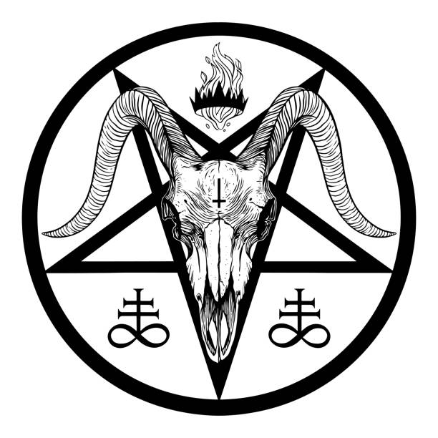

Slide 21


Slide 22


Slide 23
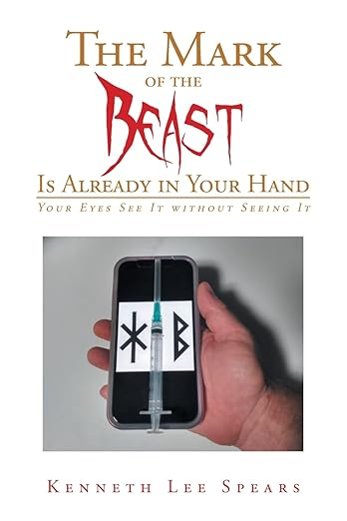
“Just before the coronavirus became a pandemic, the Lord came to me… He began showing and giving me all the knowledge that he wanted to reveal to the world. The Lord told me to prophesy on his behalf…He showed me its relationship to the virus, the vaccine, and also the cell phones that are in people's right hands. It was given to me, every word … Realize I was the first one that revealed this.”

Slide 24
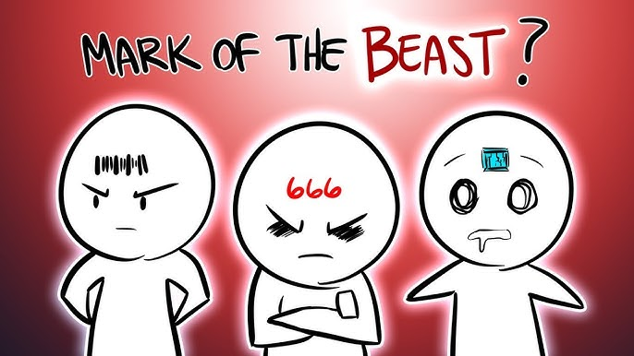

Slide 25
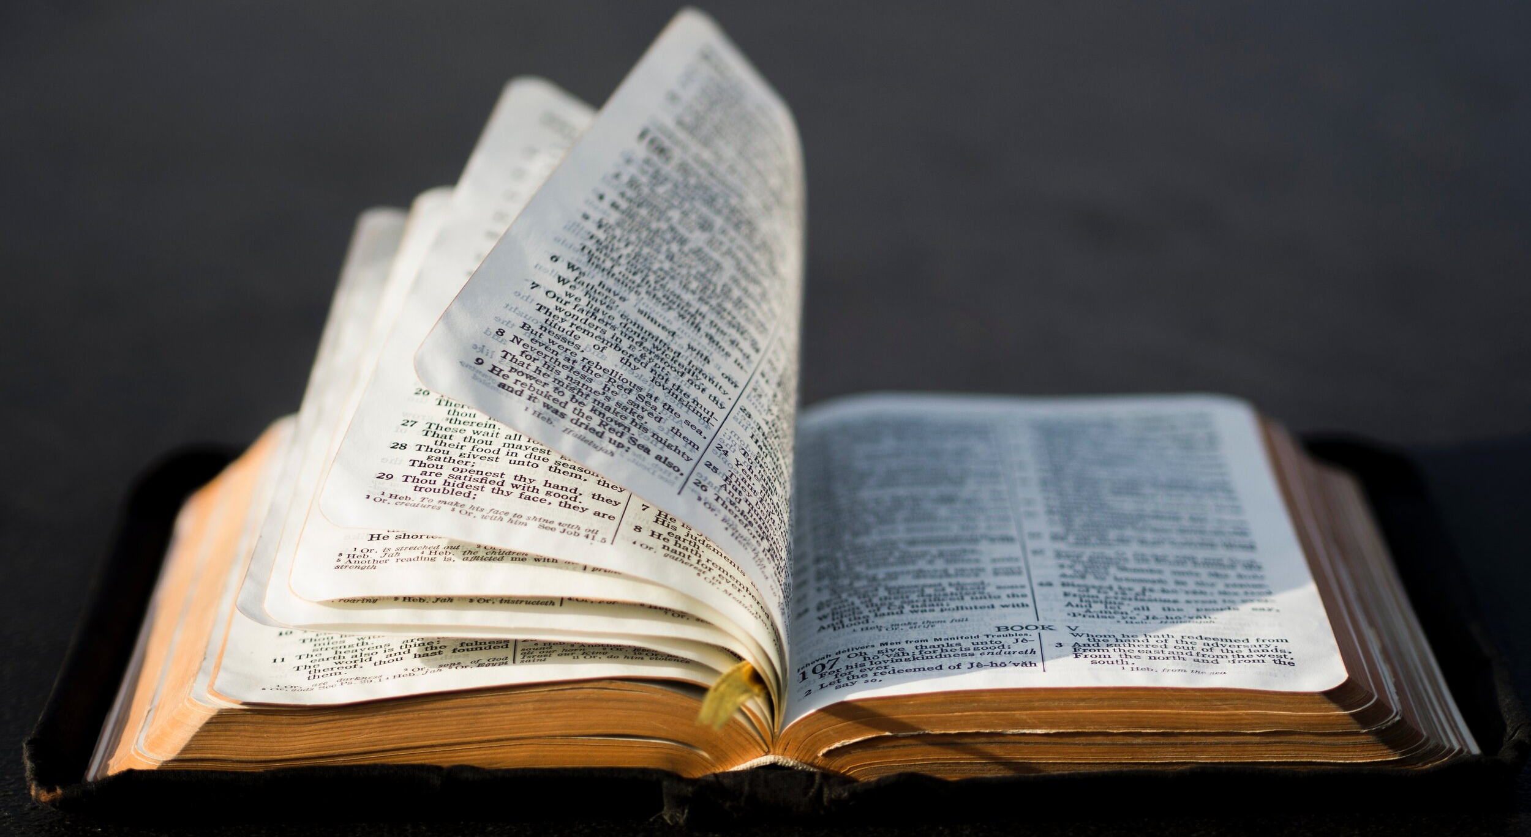

Slide 26

1. Who will be required to worship the beast and his image, and to receive his mark?
Revelation 13:11-12, 15-17

Slide 27
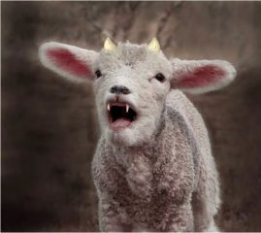
Revelation
13:11-12, 15-17
¹¹ And I beheld another beast coming up out of the earth; and he had two horns like a lamb, and he spake as a dragon.

Slide 28
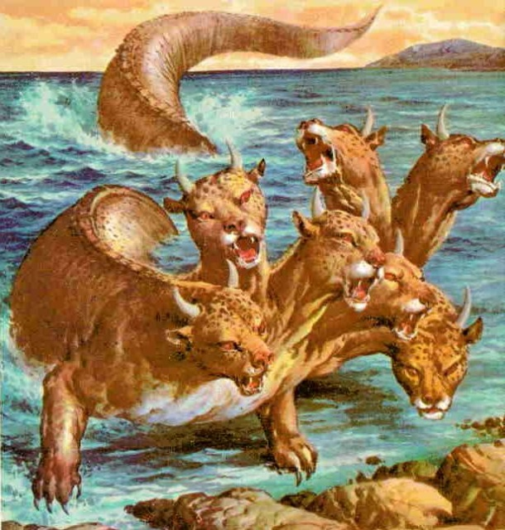
Revelation
13:11-12, 15-17
¹² And he exerciseth all the power of the first beast before him, and causeth the earth and them which dwell therein to worship the first beast, whose deadly wound was healed.

Slide 29
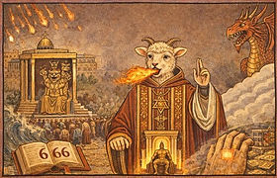
Revelation
13:11-12, 15-17
¹⁵ And he had power to give life unto the image of the beast, that the image of the beast should both speak, and cause that as many as would not worship the image of the beast should be killed.

Slide 30

Revelation
13:11-12, 15-17
¹⁶ And he causeth all, both small and great, rich and poor, free and bond, to receive a mark in their right hand, or in their foreheads:

Slide 31
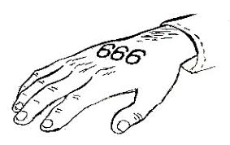
Revelation
13:11-12, 15-17
¹⁷ And that no man might buy or sell, save he that had the mark, or the name of the beast, or the number of his name.

Slide 32
2. In opposition to this what does the Third Angel’s Message say?
Revelation 14:9, 10

Slide 33
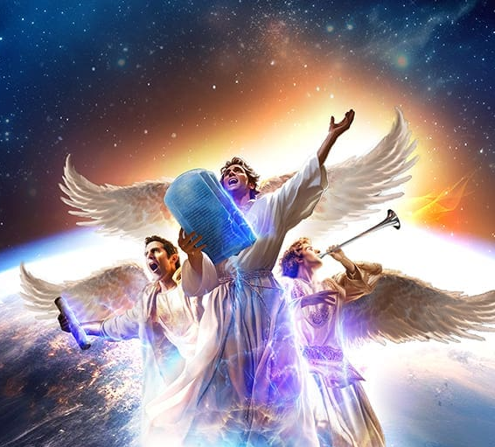
Revelation
14:9-10
⁹ And the third angel followed them, saying with a loud voice, If any man worship the beast and his image, and receive his mark in his forehead, or in his hand,

Slide 34
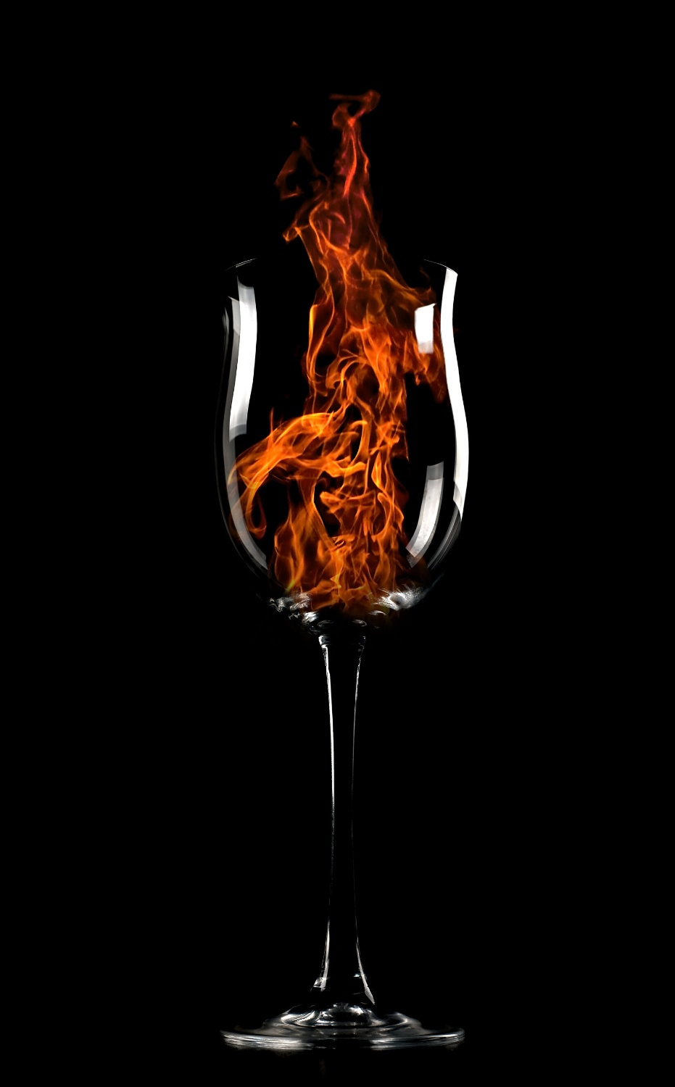
Revelation
14:9-10
¹⁰ The same shall drink of the wine of the wrath of God, which is poured out without mixture into the cup of his indignation; and he shall be tormented with fire and brimstone in the presence of the holy angels, and in the presence of the Lamb:

Slide 35
3. What are those led to do, who heed the voice of this message?
Revelation 14:12

Slide 36
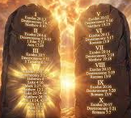
Revelation
14:12
¹² Here is the patience of the saints: here are they that keep the commandments of God, and the faith of Jesus.

Slide 37
4. What does this show?
Answer: That the powers spoken of in Revelation 13:12–17 will put forth all their strength to compel men to do something that is contrary to the commandments of God.

Slide 38
5. What have we found was the principal object of the Papacy, in the fourth century? and what is the purpose of the Protestantism of to-day?
Answer: To use the power of the State to compel all people to keep Sunday as the Lord’s day, or Christian Sabbath.

Slide 39
Recalling Lessons 6-9
1. The Papacy developed through union of church and state.
Church leaders sought to use civil power to enforce religious practice.
2. The main religious issue they pushed the state to enforce was Sunday.
Constantine’s Sunday law (A.D. 321)
Later church councils and laws strengthened it.

Slide 40
Recalling Lessons 6-9
3. There have been similar movements in “modern” Protestantism:
The National Reform Movement of 1888 and 1889 is a compelling example, but not the only one!
4. A key object of Papal policy (as well as policy of what will become the Image of the Beast) is:
Using civil power to compel religious observance—especially Sunday.

Slide 41
6. Of what day is Christ the Lord?
Mark 2:28.

Slide 42
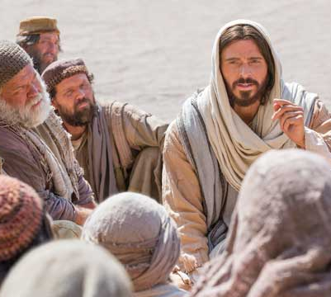
MARK
2:28
²⁸ Therefore the Son of man is Lord also of the sabbath.

Slide 43
7. What day is the Sabbath?
Exodus 20:10

Slide 44
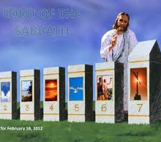
Exodus
20:10
¹⁰ But the seventh day is the sabbath of the Lord thy God: in it thou shalt not do any work, thou, nor thy son, nor thy daughter, thy manservant, nor thy maidservant, nor thy cattle, nor thy stranger that is within thy gates:

Slide 45
8. Then what day is the Lord’s day?

Slide 46
9. What does the Lord call the seventh day?
Exodus 20:10;
Isaiah 58:13.

Slide 47
Exodus
20:10
¹⁰ But the seventh day is the sabbath of the Lord thy God: in it thou shalt not do any work, thou, nor thy son, nor thy daughter, thy manservant, nor thy maidservant, nor thy cattle, nor thy stranger that is within thy gates:

Slide 48
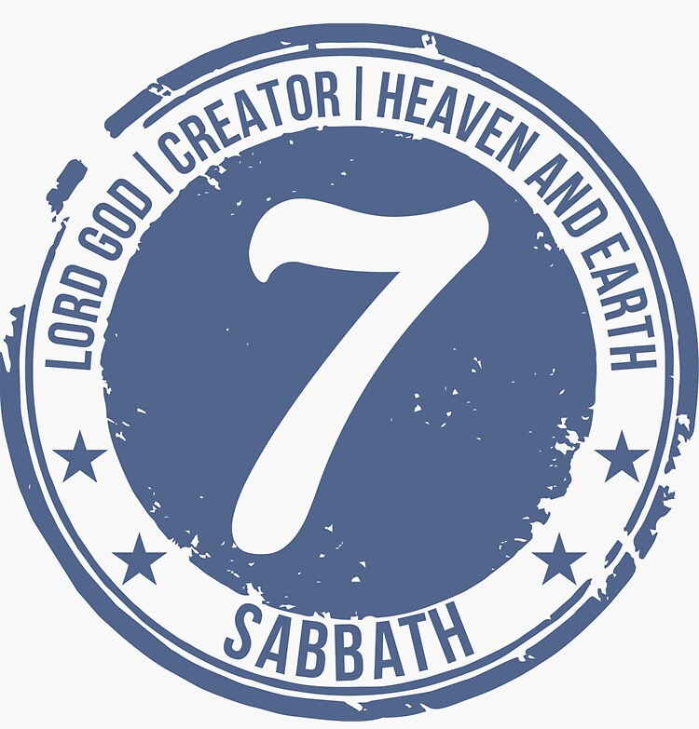
Isaiah
58:13
¹³ If thou turn away thy foot from the sabbath, from doing thy pleasure on my holy day; and call the sabbath a delight, the holy of the Lord, honourable; and shalt honour him, not doing thine own ways, nor finding thine own pleasure, nor speaking thine own words:

Slide 49
10. Is there any commandment of God for keeping Sunday?
Answer: None whatever.

Slide 50
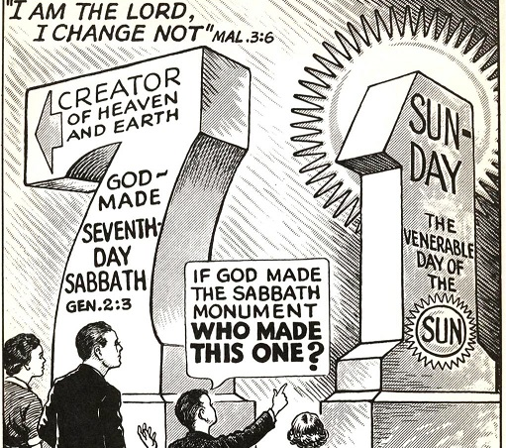

Slide 51
11. What testimonies can you give on this point from eminent first-day authorities?

Slide 52
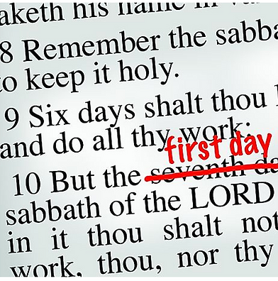
American Tract Society
“The $500 prize-essay of the American Tract Society acknowledges the ‘complete silence of the New Testament so far as any explicit command for the Sabbath [Sunday, the first day of the week] or definite rules for its observance are concerned.’”—Abiding Sabbath, p. 184.

Slide 53

American Sunday-school Union
“Up to the time of Christ’s death, no change had been made in the day.” And, “so far as the record shows, they [the apostles] did not, however, give any explicit command enjoining the abandonment of the seventh-day Sabbath, and its observance on the first day of the week.”—Lord’s Day, pp. 186–188.

Slide 54
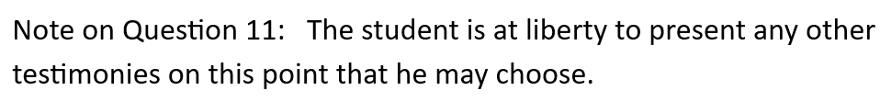

Slide 55
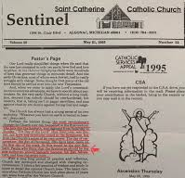
Sentinel, Pastor’s Page, St. Catherine Catholic Church, Algonac, MI, May 21, 1995
“Perhaps the boldest thing, the most revolutionary change the Church ever did, happened in the first century. The holy day, the Sabbath, was changed from Saturday to Sunday. "The Day of the Lord“ was chosen, not from any directions noted in the Scriptures, but from the Church's sense of its own power. The day of resurrection, the day of Pentecost, fifty days later, came on the first day of the week. So this would be the new Sabbath. People who think that the Scriptures should be the sole authority, should logically become 7th Day Adventists, and keep Saturday holy.”

Slide 56
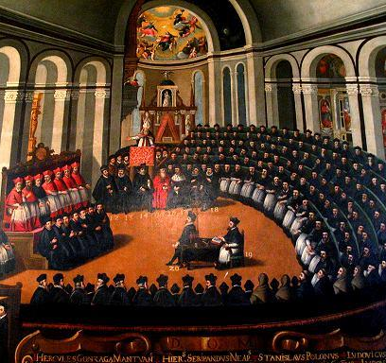
Adrien Nampon, Catholic Doctrine as defined by the Council of Trent
“Tradition, not Scripture, is the rock on which the church of Jesus Christ is built.”

Slide 57
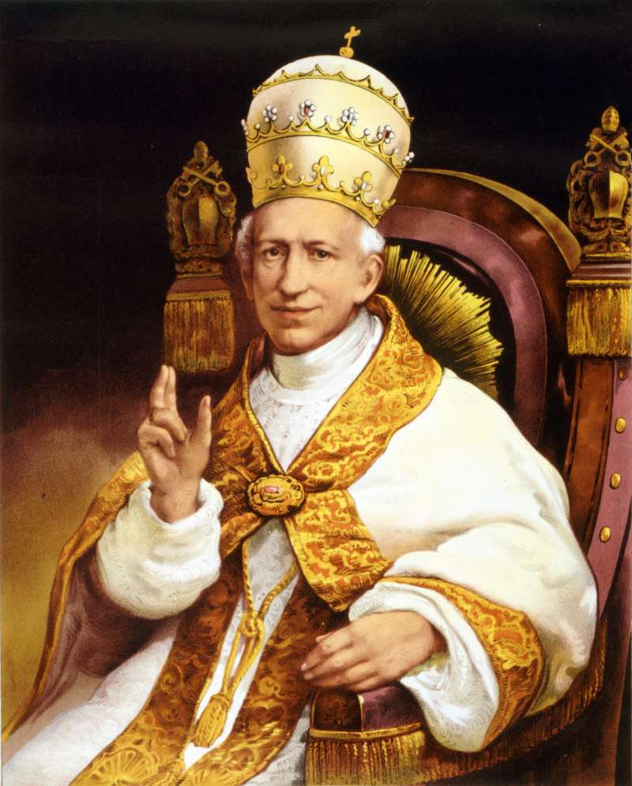
Catholic Press, Aug. 25, 1900
“Sunday is a Catholic institution, and... can be defended only on Catholic principles.... From beginning to end of Scripture there is not a single passage that warrants the transfer of weekly public worship from the last day of the week to the first.”

Slide 58
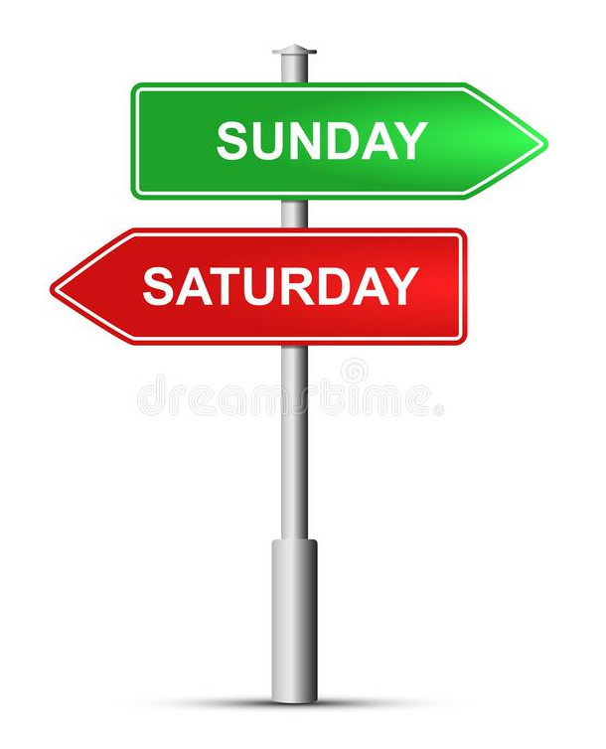
Canon Cafferata, The Catechism Explained
“The Sabbath was Saturday, not Sunday. The Church altered the observance of the Sabbath to the observance of Sunday. Protestants must be rather puzzled by the keeping of Sunday when God distinctly said, 'Keep holy the Sabbath Day.' The word Sunday does not come anywhere in the Bible, so, without knowing it they are obeying the authority of the Catholic Church.”

Slide 59
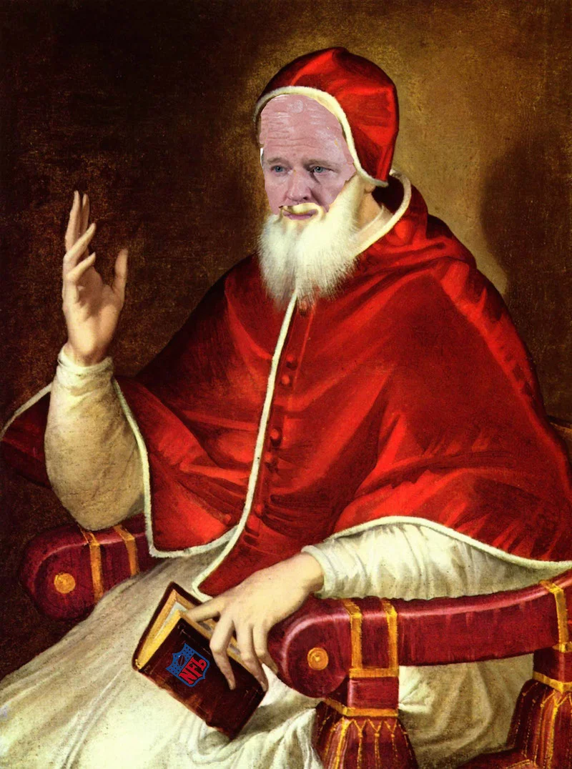
Vincent J. Kelly, Forbidden Sunday and Feast-Day Occupation, 1943
“Some theologians have held that God likewise directly determined the Sunday as the day of worship in the NEW LAW, that he himself has explicitly substituted Sunday for the Sabbath. But this theory is entirely abandoned. It is now commonly held that God simply gave His church the power to set aside whatever day or days she would deem suitable as holy days. The church chose Sunday, the first day of the week, and in the course of time added other days as holy days.”

Slide 60
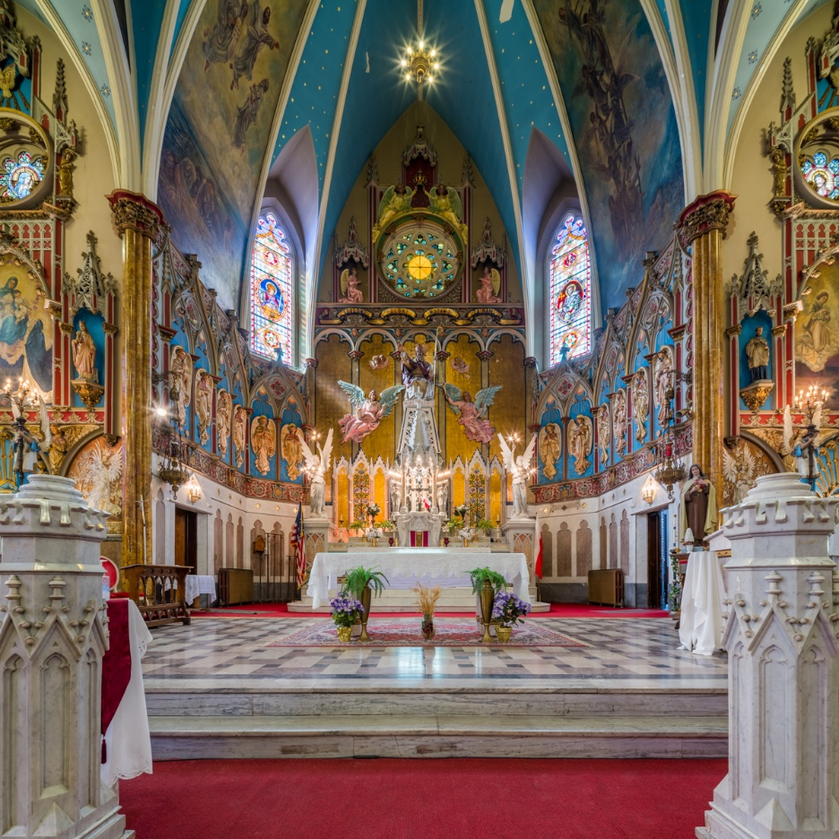
Albert Smith, Chancellor of the Archdiocese of Baltimore, Feb. 10, 1920
“If Protestants would follow the Bible, they would worship God on the Sabbath Day. In keeping the Sunday they are following a law of the Catholic Church.”

Slide 61
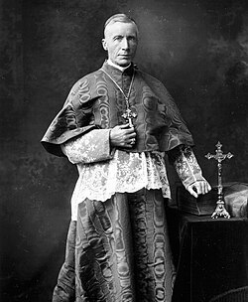
The Faith of our Fathers, Archbishop of Baltimore, 1876
“... you may read the Bible from Genesis to Revelation, and you will not find a single line authorizing the sanctification of Sunday. The Scriptures enforce the religious observance of Saturday, a day which we never sanctify.”

Slide 62
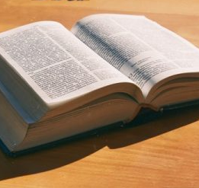
The Catholic Virginian, ‘To tell you the truth,’ Oct. 3, 1947
“All of us believe many things in regard to religion that we do not find in the Bible. For example, nowhere in the Bible do we find that Christ or the Apostles ordered that the Sabbath be changed from Saturday to Sunday. We have the commandment of God given to Moses to keep holy the Sabbath Day, that is the 7th day of the week, Saturday. Today most Christians keep Sunday because it has been revealed to us by the Church outside the Bible.”

Slide 63
12. What was the single link that in the fourth century united Church and State, which developed the beast?
Answer: The Sunday institution

Slide 64
13. What is the single point in a similar movement in our day [1888] which develops only an image to the beast?
Answer: The Sunday institution

Slide 65

Recalling Lessons 6-10
Fourth century:
Church + State enforcing Sunday → the beast
1888:
National Reform Association pushing Sunday laws
→ showed how the image could begin to develop
Last days:
Church + State enforcing Sunday → image of the beast

Slide 66
14. What does the Papacy set forth as the sign of its authority to command men under penalty of sin for disobedience?

Slide 67
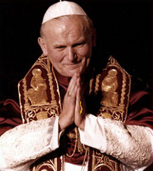
Catechism of the Catholic Christian Instructed
Answer:
“The very act of changing Sabbath into Sunday, which Protestants allow of… because by keeping Sunday strictly they acknowledge the church’s power to ordain feasts, and to command them under sin.”—Catechism of the Catholic Christian Instructed.

Slide 68
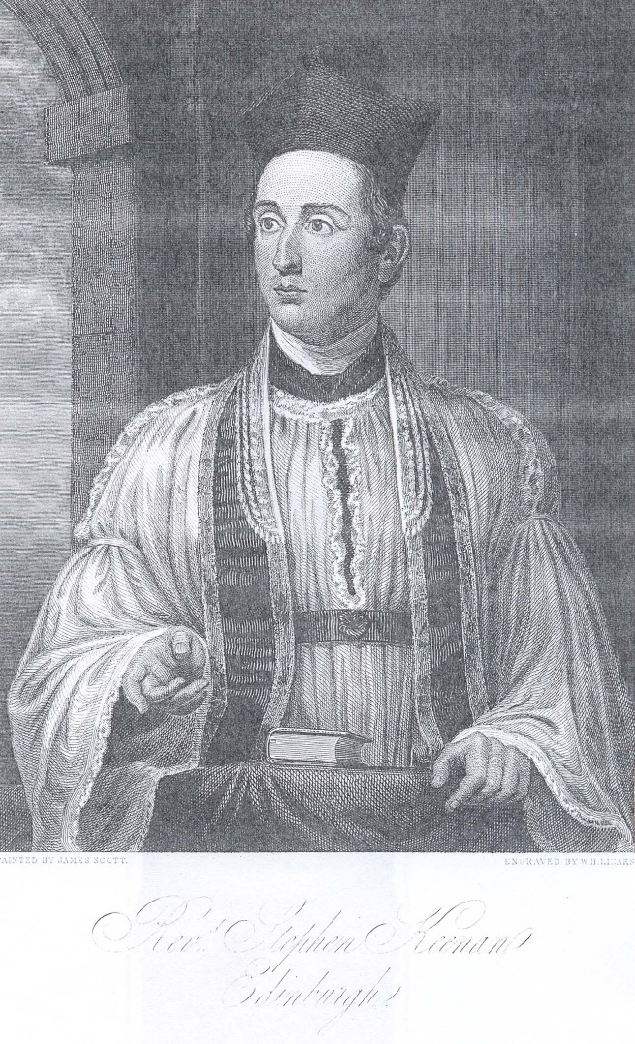
Catholic Questions and Answers
Rev. Stephen Keenan, A Doctrinal Catechism, New York, 1857
Q. Have you any other proofs that they (Protestants) are not guided by the Scripture?
A. Yes; so many, that we cannot admit more than a mere specimen into this small work. They reject much that is clearly contained in Scripture, and profess more that is nowhere discoverable in that Divine Book.

Slide 69
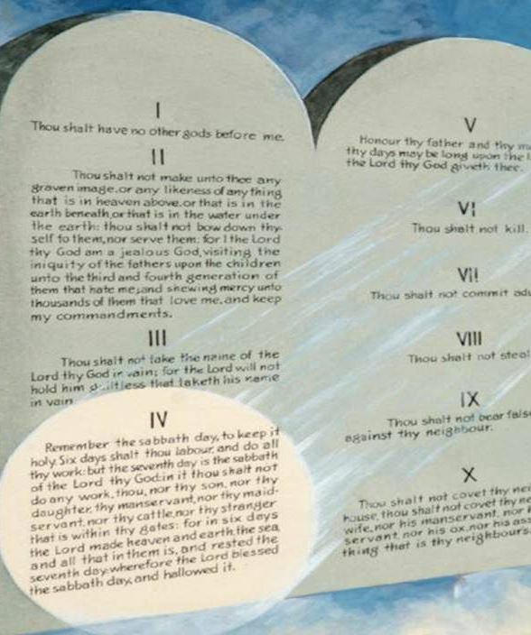
Catholic Questions and Answers
Rev. Stephen Keenan, A Doctrinal Catechism, New York, 1857
Q. Give some examples of both?
A. They should, if the Scripture were their only rule, wash the feet of one another, according to the command of Christ, in the 13th chap. of St. John; —they should keep, not the Sunday, but the Saturday, according to the commandment, "Remember thou keep holy the SABBATH-day;" for this commandment has not, in Scripture, been changed or abrogated;...

Slide 70

Catholic Questions and Answers
Rev. Stephen Keenan, Controversial Catechism, New York, 1896
Q. Must not a sensible Protestant doubt seriously, when he finds that even the Bible is not followed as a rule by his co-religionists?

Slide 71
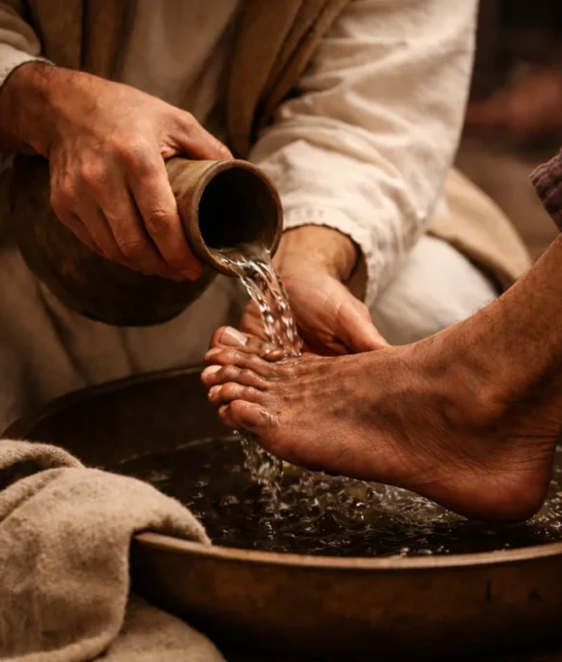
Catholic Questions and Answers
Rev. Stephen Keenan, Controversial Catechism, New York, 1896
A. Surely, when he sees them baptize infants, abrogate the Jewish Sabbath, and observe Sunday for which [pg. 7] there is no Scriptural authority; when he finds them neglect to wash one another's feet, which is expressly commanded, and eat blood and things strangled, which are expressly prohibited in Scripture. He must doubt, if he think at all. ...

Slide 72
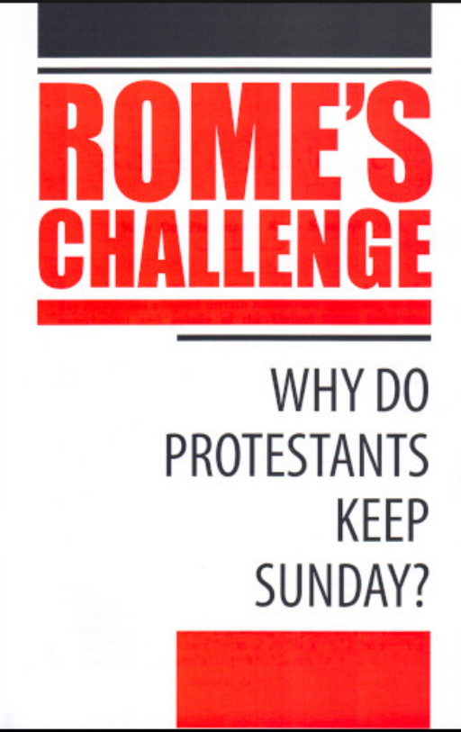
Catholic Questions and Answers
Rev. Stephen Keenan, Controversial Catechism, New York, 1896
Q. Should not the Protestant doubt when he finds that he himself holds tradition as a guide?
A. Yes, if he would but reflect that he has nothing but Catholic Tradition for keeping the Sunday holy; ...

Slide 73
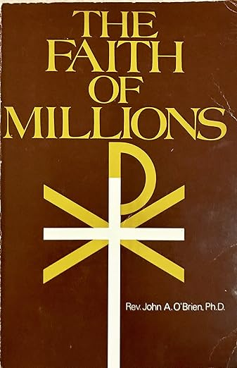
Catholic Questions and Answers
The Faith of Millions: The Credentials of the Catholic Religion
John Anthony O’Brien, Jan. 1, 1974
But since Saturday, not Sunday, is specified in the Bible, isn't it curious that non-Catholics who profess to take their religion directly from the Bible and not the Church, observe Sunday instead of Saturday? Yes, of course, it is inconsistent; but this change was made about fifteen centuries before Protestantism was born, and by that time the custom was universally observed.

Slide 74
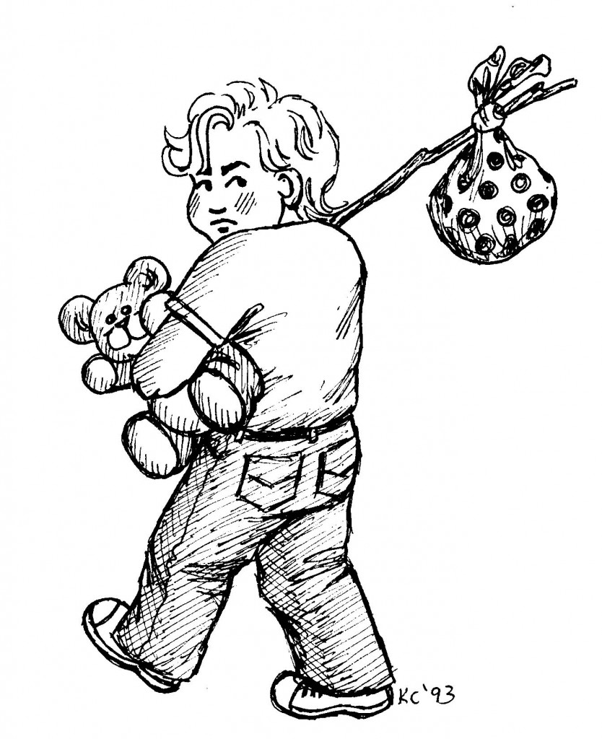
Catholic Questions and Answers
The Faith of Millions: The Credentials of the Catholic Religion
John Anthony O’Brien, Jan. 1, 1974
They have continued the custom, even though it rests upon the authority of the Catholic Church and not upon an explicit text in the Bible. That observance remains as a reminder of the Mother Church from which the non-Catholic sects broke away - like a boy running away from home but still carrying in his pocket a picture of his mother or a lock of her hair.

Slide 75
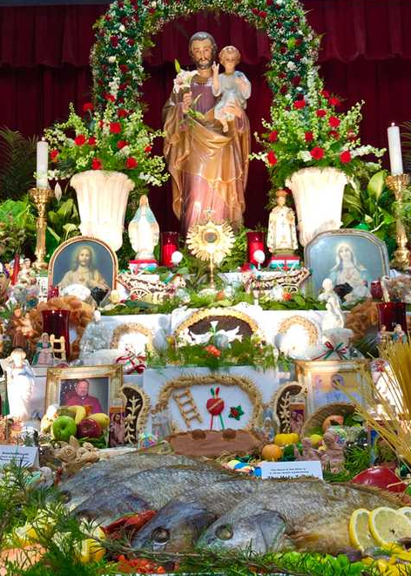
Catholic Questions and Answers
Henry Tuberville, An Abridgment of the Christian Doctrine, 1833
Q. How prove you that the Church hath power to command feasts and holydays?
A. By the very act of changing the Sabbath into Sunday, which Protestants allow of; and therefore they fondly contradict themselves, by keeping Sunday strictly, and breaking most other feasts commanded by the same Church.

Slide 76
15. Then what is the mark of the beast?

Slide 77
16. To whom do those pay homage who keep Sunday?
Answer:
“The keeping of Sunday is an homage they pay, in spite of themselves, to the Catholic Church.”—Plain Talk about Protestantism.

Slide 78
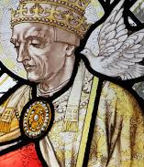
Our Sunday Visitor, Feb. 5, 1950
“Protestants ... accept Sunday rather than Saturday as the day for public worship after the Catholic Church made the change... But the Protestant mind does not seem to realize that ... in observing Sunday, they are accepting the authority of the spokesman for the Church, the pope.”

Slide 79
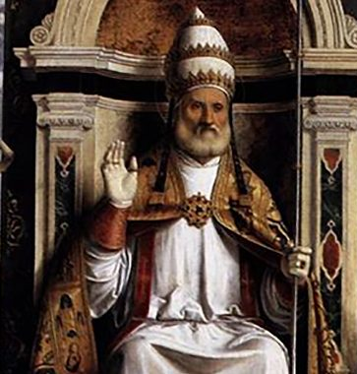
Catholic Record, Sept. 1, 1923
“Deny the authority of the Church and you have no adequate or reasonable explanation or justification for the substitution of Sunday for Saturday in the Third - Protestant Fourth - Commandment of God... The Church is above the Bible, and this transference of Sabbath observance is proof of that fact.”

Slide 80
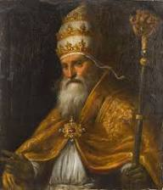
John Cardinal Gibbons, The Catholic Mirror, Dec. 23 1893
“Reason and sense demand the acceptance of one or the other of these alternatives: either Protestantism and the keeping holy of Saturday, or Catholicity and the keeping holy of Sunday. Compromise is impossible.”

Slide 81

Priest Brady, Elizabeth, NJ News, March 18, 1903
“It is well to remind the Presbyterians, Baptists, Methodists, and all other Christians, that the Bible does not support them anywhere in their observance of Sunday. Sunday is an institution of the Roman Catholic Church, and those who observe the day observe a commandment of the Catholic Church.”

Slide 82

The Catholic Universe Bulletin, Aug. 14, 1942, p. 4
“The [Roman Catholic] Church changed the observance of the Sabbath to Sunday by right of the divine, infallible authority given to her by her founder, Jesus Christ. The Protestant claiming the Bible to be the only guide of faith, has no warrant for observing Sunday. In this matter the Seventh-day Adventist is the only consistent Protestant.”

Slide 83
17. Then when Protestant churches attempt to compel people by law to keep Sunday, what is that only to do?
Answer: It is only to compel men to worship the Papacy—to worship the beast.

Slide 84
18. But, as in the very act of doing this these churches make an image to the beast, what then will be the enforced observance of Sunday in this nation?
Answer: It will be the worship of the beast and his image.

Slide 85
19. But may not Sunday-keeping be enforced as a civil duty?
Answer: Never. Because Sunday is wholly a religious institution; and the civil power has no right to enforce religious duties.

Slide 86
20. What does Christ command on this subject?
Matthew 22:21.

Slide 87

Matthew
22:21
²¹ They say unto him, Caesar's. Then saith he unto them, Render therefore unto Caesar the things which are Caesar's; and unto God the things that are God's.

Slide 88
21. By what power was Sunday-keeping instituted?
Answer: The church.

Slide 89
22. Why were the ancient Sunday laws enacted?
Answer: The church demanded it, and it was done to satisfy and help the church.

Slide 90
23. Why are Sunday laws now enacted?
Answer: For the same reasons precisely.

Slide 91
24. Is the church Caesar?
Answer: No.

Slide 92
25. Is the church God?

Slide 93

James
4:12
¹² There is one lawgiver, who is able to save and to destroy: who art thou that judgest another?

Slide 94

Acts
5:29
²⁹ Then Peter and the other apostles answered and said, We ought to obey God rather than men.

Slide 95
26.Then what follows?
Answer: That as Sunday-keeping belongs neither to Caesar nor to God, there is no power in existence that can, of right, command it.

Slide 96
Thank you!
… and Happy Sabbath!!

Slide 97


