Slide 1


Slide 2

Living the Light

Slide 3
The Third Angel’s Message
Lesson 12: THE Last Message of Mercy
September 22, 1888
Lesson 12, 3rd Quarter 1888

Slide 4
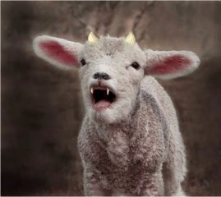
Revelation
13:11-12
¹¹ And I beheld another beast coming up out of the earth; and he had two horns like a lamb, and he spake as a dragon.

Slide 5
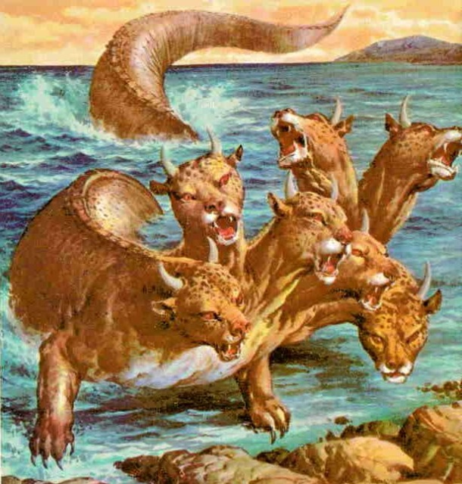
Revelation
13:11-12
¹² And he exerciseth all the power of the first beast before him, and causeth the earth and them which dwell therein to worship the first beast, whose deadly wound was healed.

Slide 6

1. How great will be the pressure to compel all to keep Sunday in this nation?
Revelation 13:15-17

Slide 7
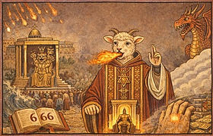
Revelation
13:15-17
¹⁵ And he had power to give life unto the image of the beast, that the image of the beast should both speak, and cause that as many as would not worship the image of the beast should be killed.

Slide 8
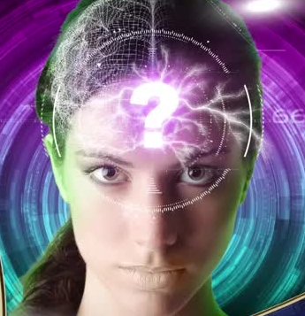
Revelation
13:15-17
¹⁶ And he causeth all, both small and great, rich and poor, free and bond, to receive a mark in their right hand, or in their foreheads:

Slide 9
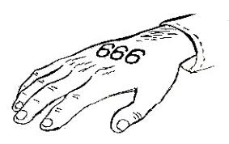
Revelation
13:15-17
¹⁷ And that no man might buy or sell, save he that had the mark, or the name of the beast, or the number of his name.

Slide 10
2. But what says the word of God against it?
Revelation 14:9, 10

Slide 11
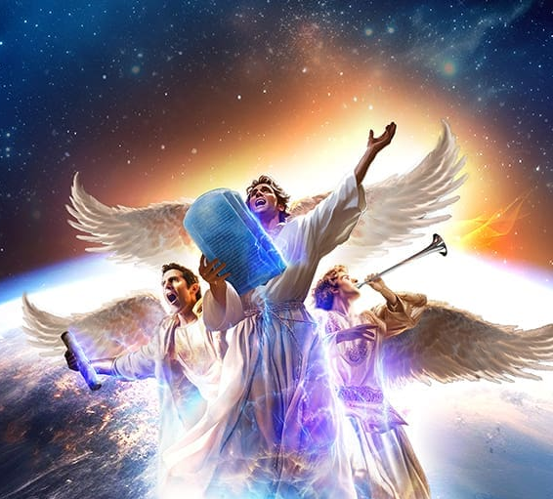
Revelation
14:9-10
⁹ And the third angel followed them, saying with a loud voice, If any man worship the beast and his image, and receive his mark in his forehead, or in his hand,

Slide 12
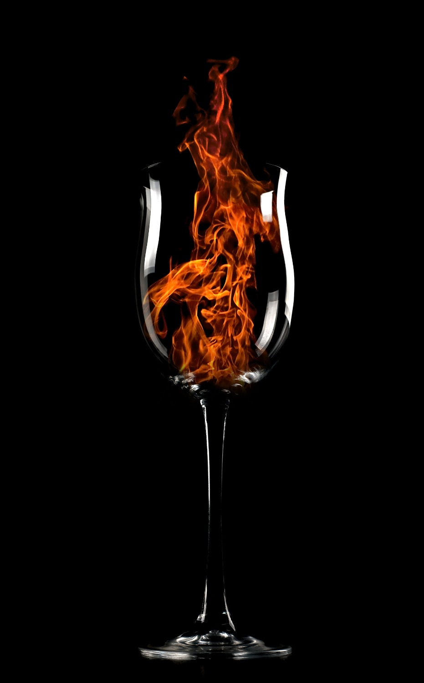
Revelation
14:9-10
¹⁰ The same shall drink of the wine of the wrath of God, which is poured out without mixture into the cup of his indignation; and he shall be tormented with fire and brimstone in the presence of the holy angels, and in the presence of the Lamb:

Slide 13
3. In what form is it said this wine will be poured out?
Answer: “Without mixture.”

Slide 14
4. Is there a cup now in the hand of the Lord from which he pours out?
Psalm 75:8

Slide 15

Psalm
75:8
⁸ For in the hand of the Lord there is a cup, and the wine is red; it is full of mixture; and he poureth out of the same: but the dregs thereof, all the wicked of the earth shall wring them out, and drink them.

Slide 16
5. What is said of this cup?
Answer: “It is full of mixture.”

Slide 17
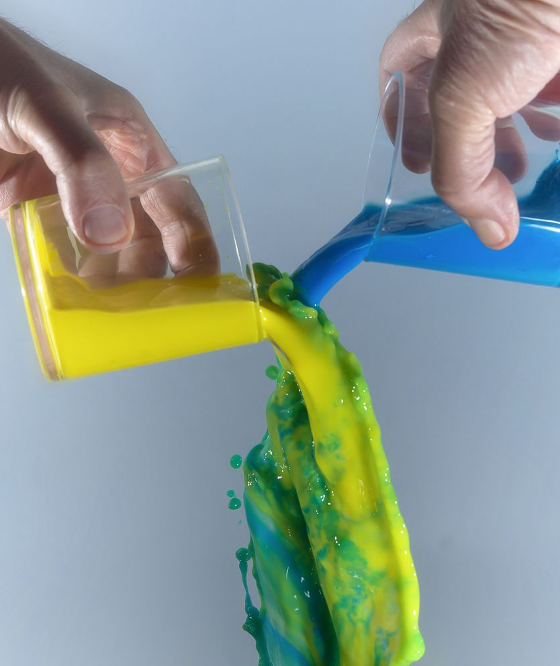
The Mixture
Revelation 14:10: “without mixture”
Psalm 75:8: “full of mixture”
What does “mixture” suggest?
What is the difference between with mixture and without mixture?

Slide 18
6. While it is thus full of mixture, what is it to those who accept God’s mercy?
Psalm 116:13

Slide 19
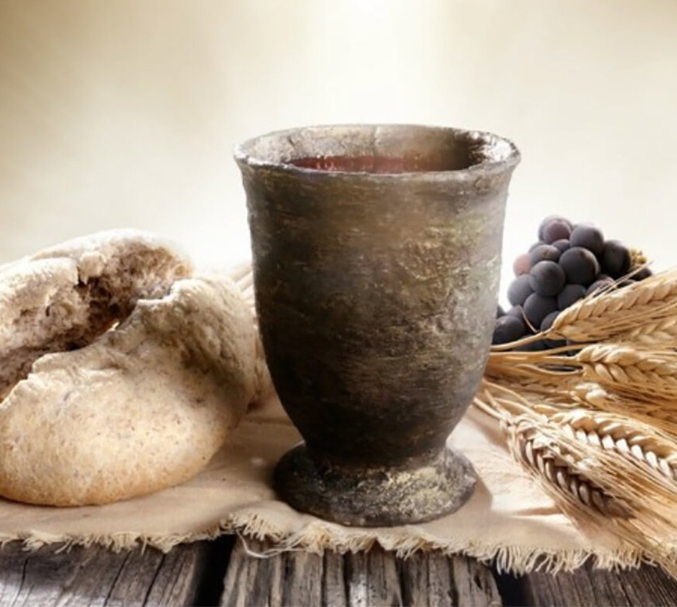
Psalm
116:13
¹³ I will take the cup of salvation, and call upon the name of the Lord.

Slide 20
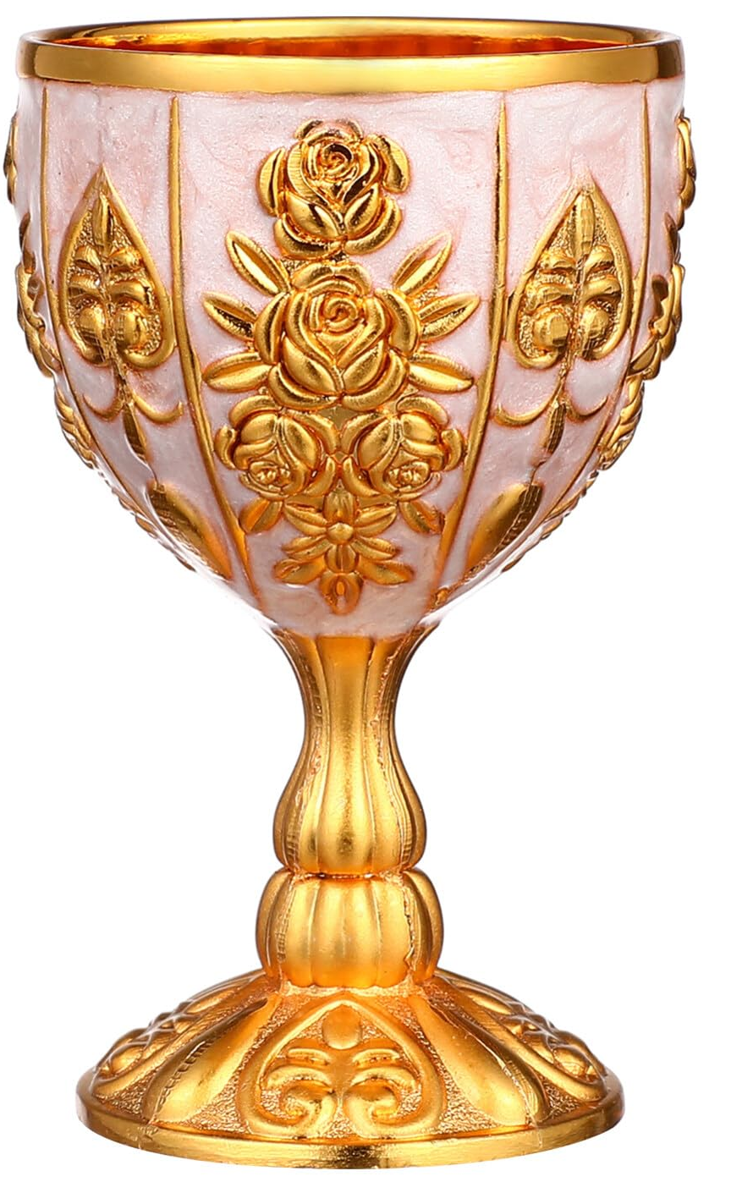
The Cup
We’ve seen a “cup” filled in different ways in several verses now.
What is the cup, then?

Slide 21
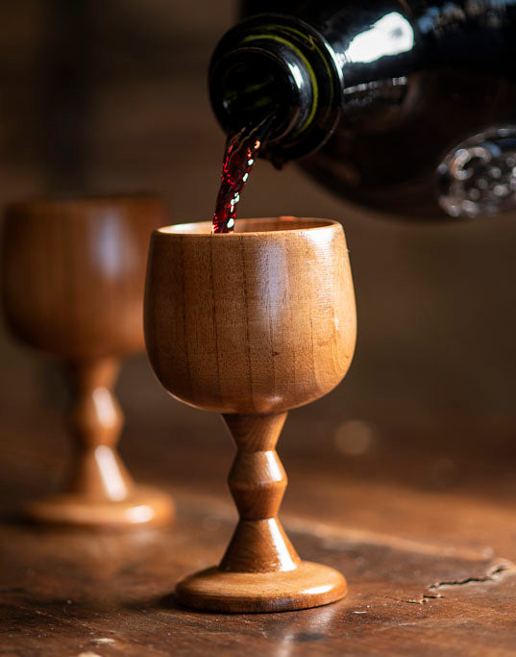
The Cup
In Psalm 116:13 the cup is salvation.
In Psalm 75:8 the cup is wrath, but “full of” mixture.
In Revelation 14:10 the cup becomes wrath without mixture.
What changed?

Slide 22
7. After salvation has been poured out of this cup, what time is referred to when the wine is “poured out without mixture”?
Answer: The time when there will be no salvation for sinners.

Slide 23
8. If men will not drink of the cup of salvation, of what will they be compelled to drink?
Jeremiah 25:15, 28; Psalm 75:8, last part

Slide 24
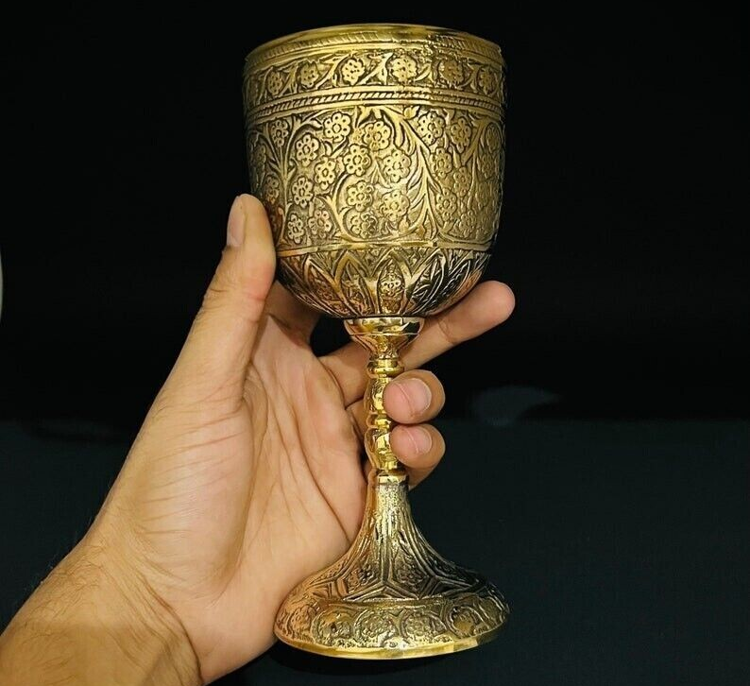
Jeremiah
25:15, 28
¹⁵ For thus saith the Lord God of Israel unto me; Take the wine cup of this fury at my hand, and cause all the nations, to whom I send thee, to drink it.

Slide 25
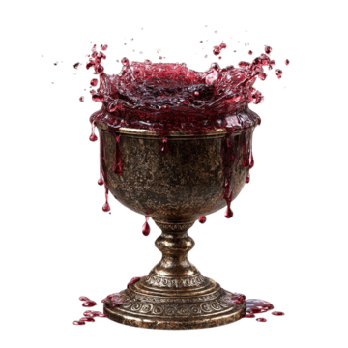
Jeremiah
25:15, 28
²⁸ And it shall be, if they refuse to take the cup at thine hand to drink, then shalt thou say unto them, Thus saith the Lord of hosts; Ye shall certainly drink.

Slide 26
Psalm
75:8
⁸ For in the hand of the Lord there is a cup, and the wine is red; it is full of mixture; and he poureth out of the same: but the dregs thereof, all the wicked of the earth shall wring them out, and drink them.

Slide 27
9. What is this wine of the wrath of God?
Revelation 15:1, 7

Slide 28
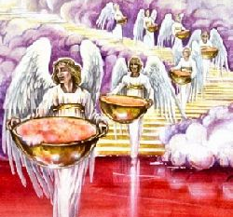
Revelation
15:1, 7
15 And I saw another sign in heaven, great and marvellous, seven angels having the seven last plagues; for in them is filled up the wrath of God.

Slide 29
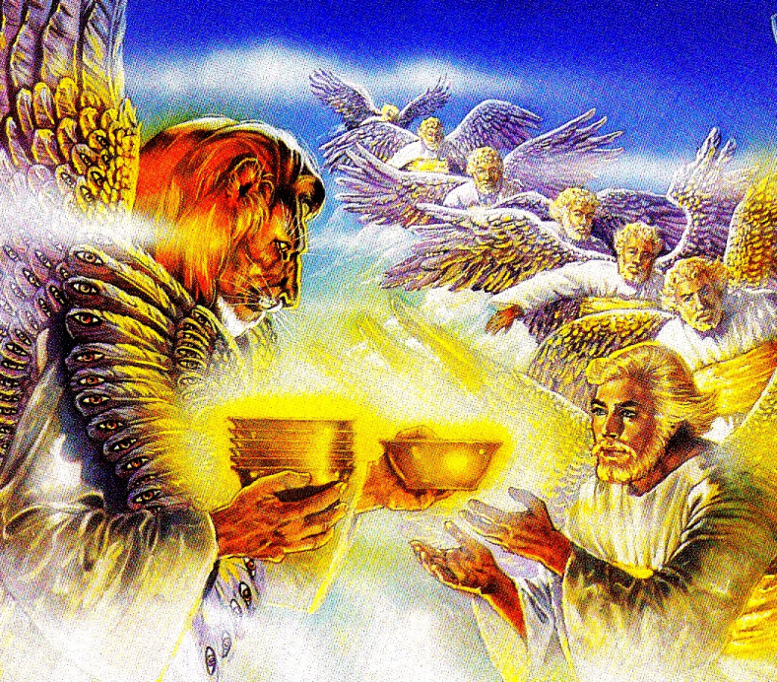
Revelation
15:1, 7
⁷ And one of the four beasts gave unto the seven angels seven golden vials full of the wrath of God, who liveth for ever and ever.

Slide 30
10. What are these seven plagues called?
Answer: The seven last plagues.

Slide 31
11. Will there be any service in the heavenly temple while these plagues are being poured out?
Revelation 15:8

Slide 32
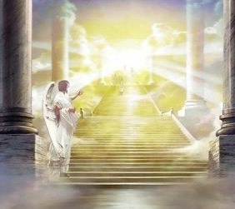
Revelation
15:8
⁸ And the temple was filled with smoke from the glory of God, and from his power; and no man was able to enter into the temple, till the seven plagues of the seven angels were fulfilled.

Slide 33
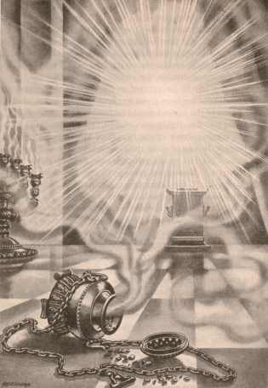
The Temple
The temple is filled with the glory of God, to the point that no one can enter it.
What is the point of entering the temple?
What has been happening, which is no longer happening?

Slide 34
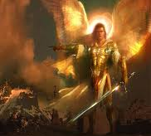
Daniel
12:1-3
12 And at that time shall Michael stand up, the great prince which standeth for the children of thy people: and there shall be a time of trouble, such as never was since there was a nation even to that same time: and at that time thy people shall be delivered, every one that shall be found written in the book.

Slide 35
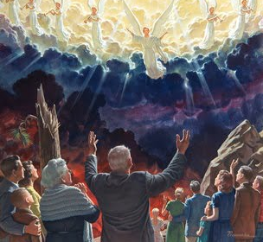
Daniel
12:1-3
² And many of them that sleep in the dust of the earth shall awake, some to everlasting life, and some to shame and everlasting contempt.

Slide 36
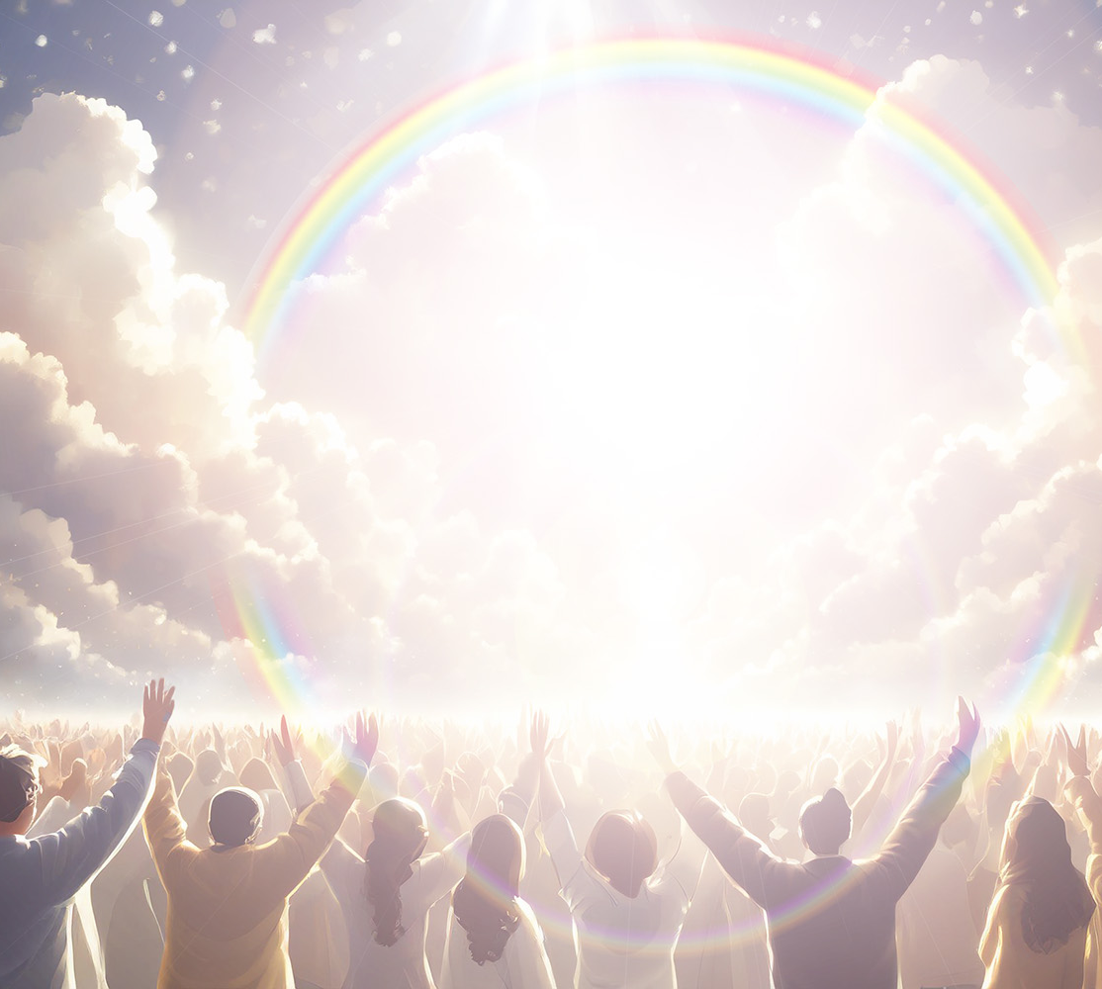
Daniel
12:1-3
³ And they that be wise shall shine as the brightness of the firmament; and they that turn many to righteousness as the stars for ever and ever.

Slide 37
12. What does this show?
Answer: That then there will be no intercessor, and no salvation for sinners.

Slide 38
13. Who will suffer these plagues?
Revelation 14:9, 10

Slide 39
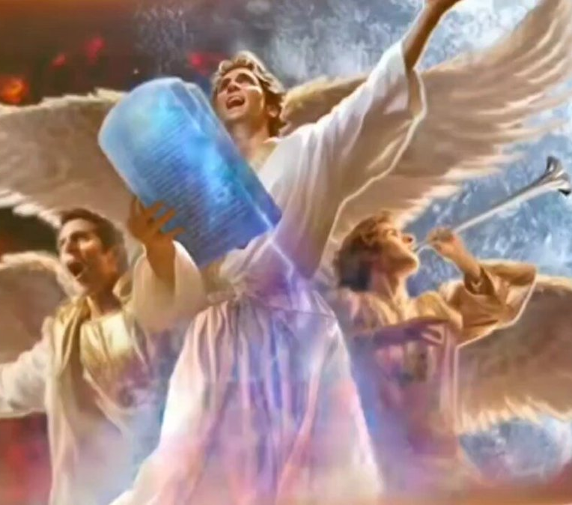
Revelation
14:9-10
⁹ And the third angel followed them, saying with a loud voice, If any man worship the beast and his image, and receive his mark in his forehead, or in his hand,

Slide 40
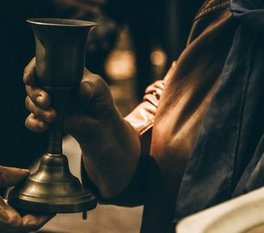
Revelation
14:9-10
¹⁰ The same shall drink of the wine of the wrath of God, which is poured out without mixture into the cup of his indignation; and he shall be tormented with fire and brimstone in the presence of the holy angels, and in the presence of the Lamb:

Slide 41
14. How extensive will be the worship of the beast?
Revelation 13:8

Slide 42

Revelation
13:8
⁸ And all that dwell upon the earth shall worship him, whose names are not written in the book of life of the Lamb slain from the foundation of the world.

Slide 43
15. What does God do to try to save men from this awful doom?
Answer: He sends them the Third Angel’s Message.

Slide 44
16. Then what does this show the Third Angel’s Message to be?
Answer: The last message of mercy to the world.

Slide 45
17. What follows close upon it?
Revelation 14:14

Slide 46
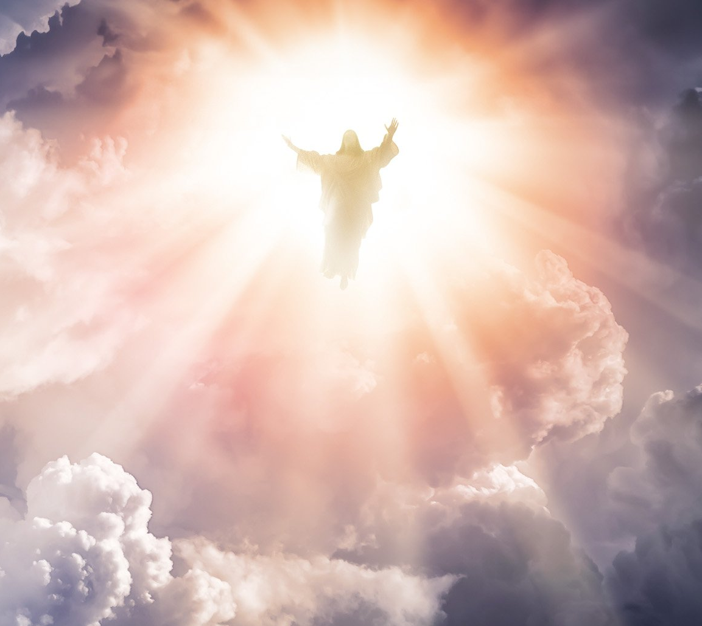
Revelation
14:14
¹⁴ And I looked, and behold a white cloud, and upon the cloud one sat like unto the Son of man, having on his head a golden crown, and in his hand a sharp sickle.

Slide 47
18. What is said to him, and what is done by him, who sits upon the cloud?
  Revelation 14:15, 16

Slide 48
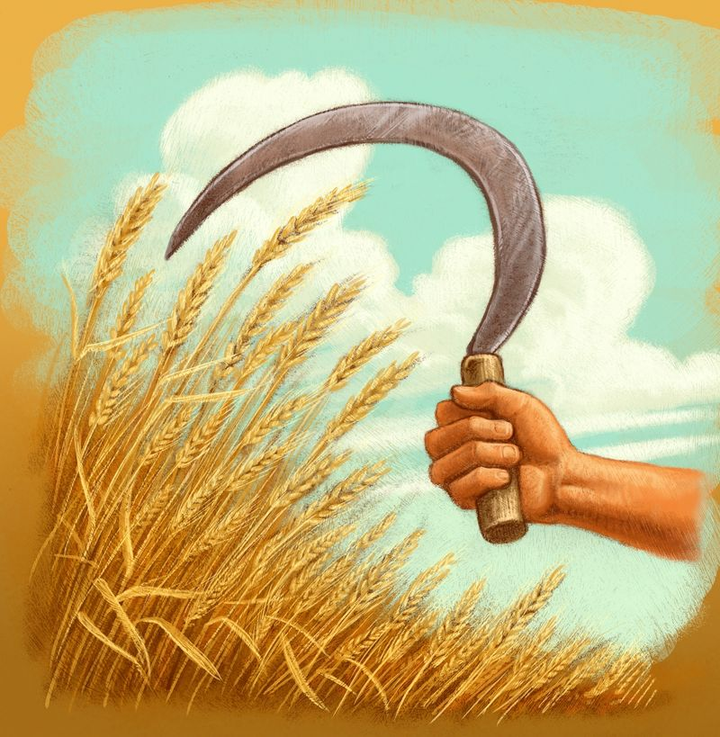
Revelation
14:15-16
¹⁵ And another angel came out of the temple, crying with a loud voice to him that sat on the cloud, Thrust in thy sickle, and reap: for the time is come for thee to reap; for the harvest of the earth is ripe.

Slide 49
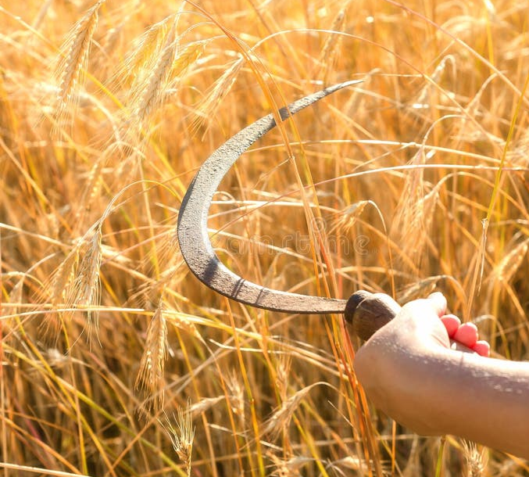
Revelation
14:15-16
¹⁶ And he that sat on the cloud thrust in his sickle on the earth; and the earth was reaped.

Slide 50
19. What is the harvest?
Matthew 13:39

Slide 51
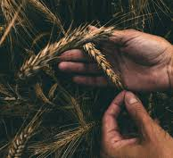
Matthew
13:39
³⁹ The enemy that sowed them is the devil; the harvest is the end of the world; and the reapers are the angels.

Slide 52
20. Then what follows close upon the Third Angel’s Message?

Slide 53
21. Then what again does this show the message to be?
Answer: The last message of mercy to the world.

Slide 54
22. Then is not this message the most important thing in the world?

Slide 55
Thank you!
… and Happy Sabbath!!

Slide 56


