Slide 1


Slide 2

Living the Light

Slide 3
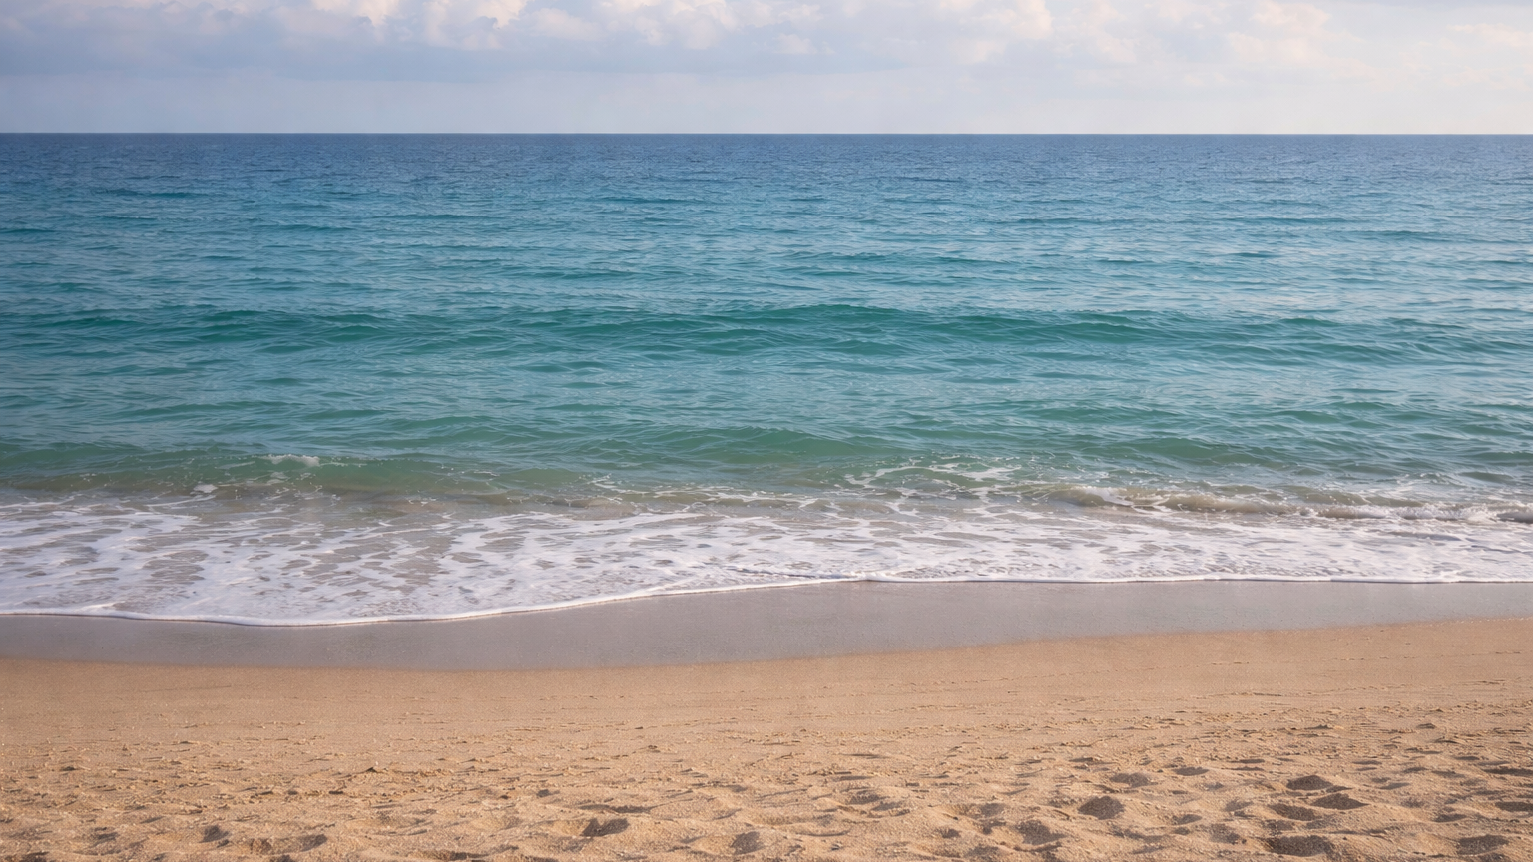

Slide 4
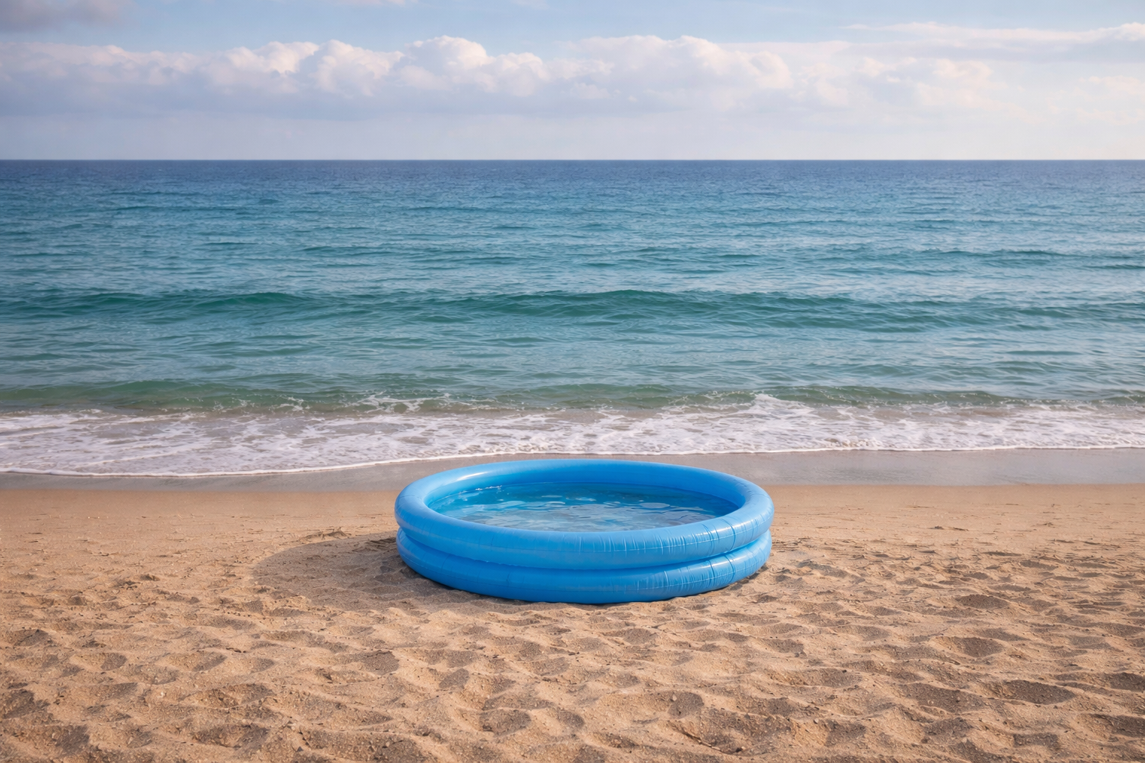

Slide 5
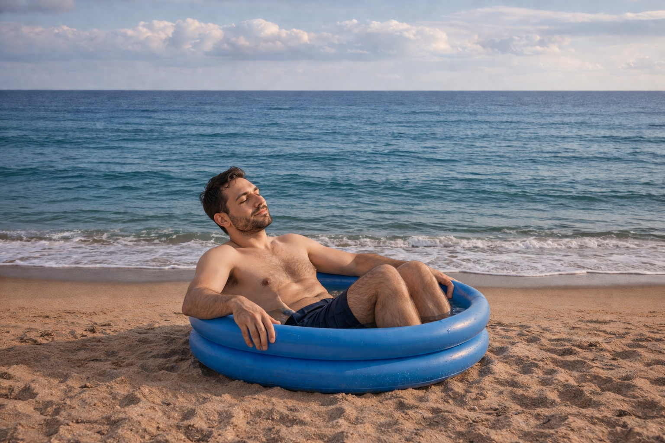

Slide 6
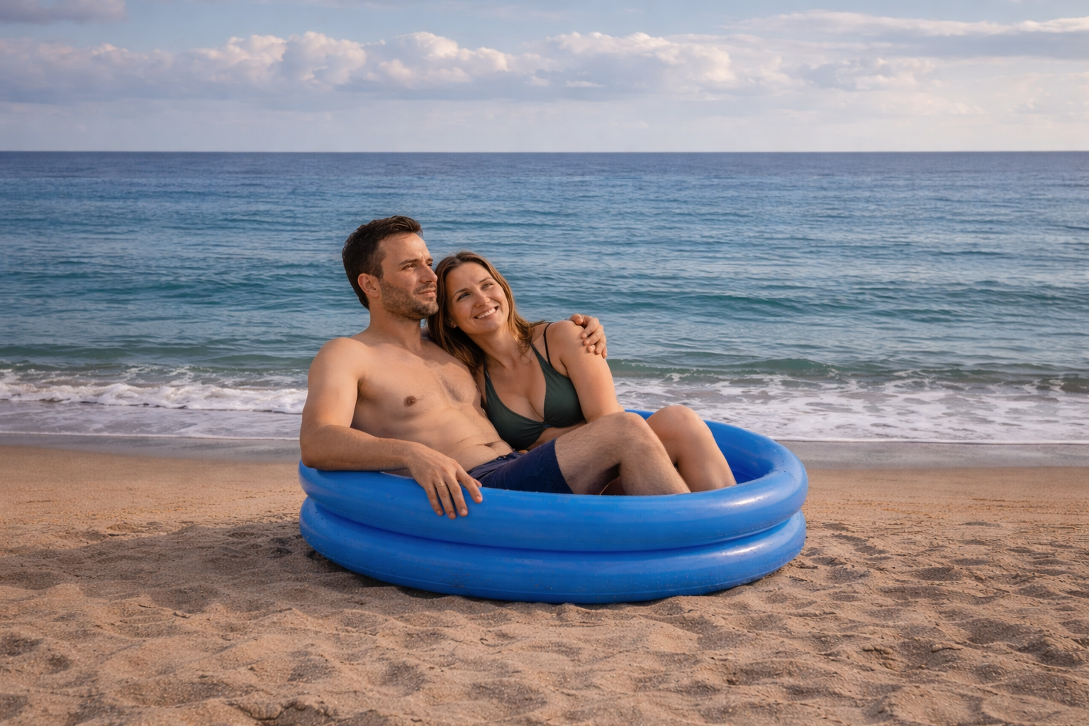

Slide 7
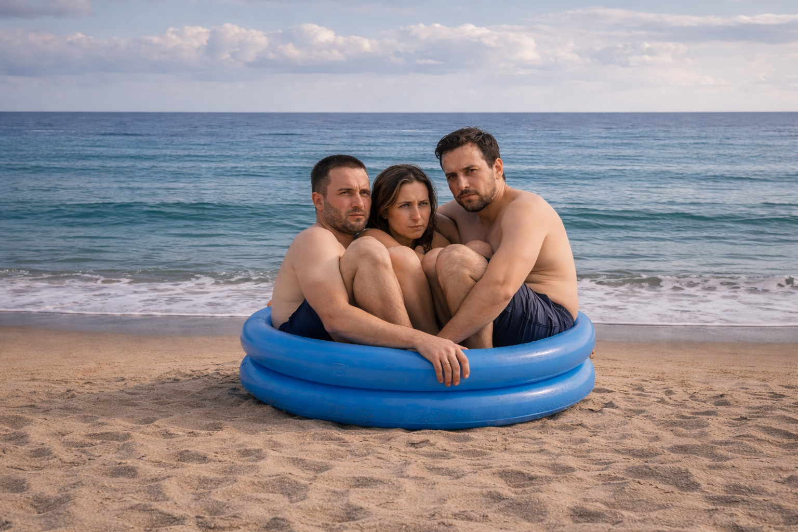

Slide 8
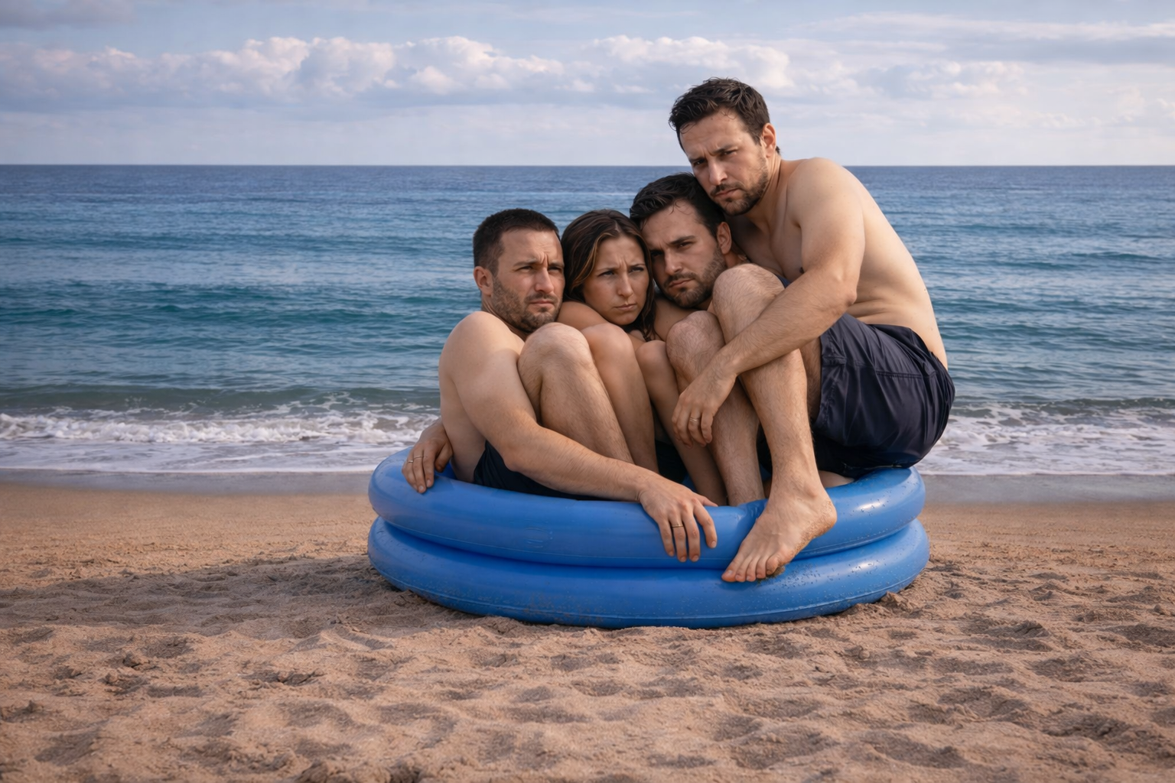

Slide 9
Living the Light

Slide 10
The Third Angel’s Message
Lesson 13: THE Seven Last Plagues
September 29, 1888
Lesson 13, 3rd Quarter 1888

Slide 11
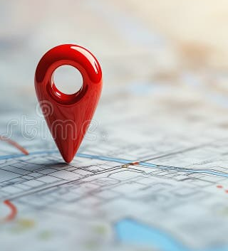
Where are we in Prophecy?
We’ve been talking about that Third Angel’s Message…
The Bible lays out a clear sequence.

Slide 12

Where are we in Prophecy?
1. The Final Message Goes to the World
God sends the Third Angel’s Message to every nation, warning against the worship of the beast.
Revelation 14:9–12
This is the last call to repentance
👉 This is still a time of mercy

Slide 13

Where are we in Prophecy?
2. Probation Closes
When that message has done its work:
  No more decisions are being made
  Every person has chosen their side
Revelation 15:8 — no one can enter the temple
👉This means: no intercessor remains

Slide 14
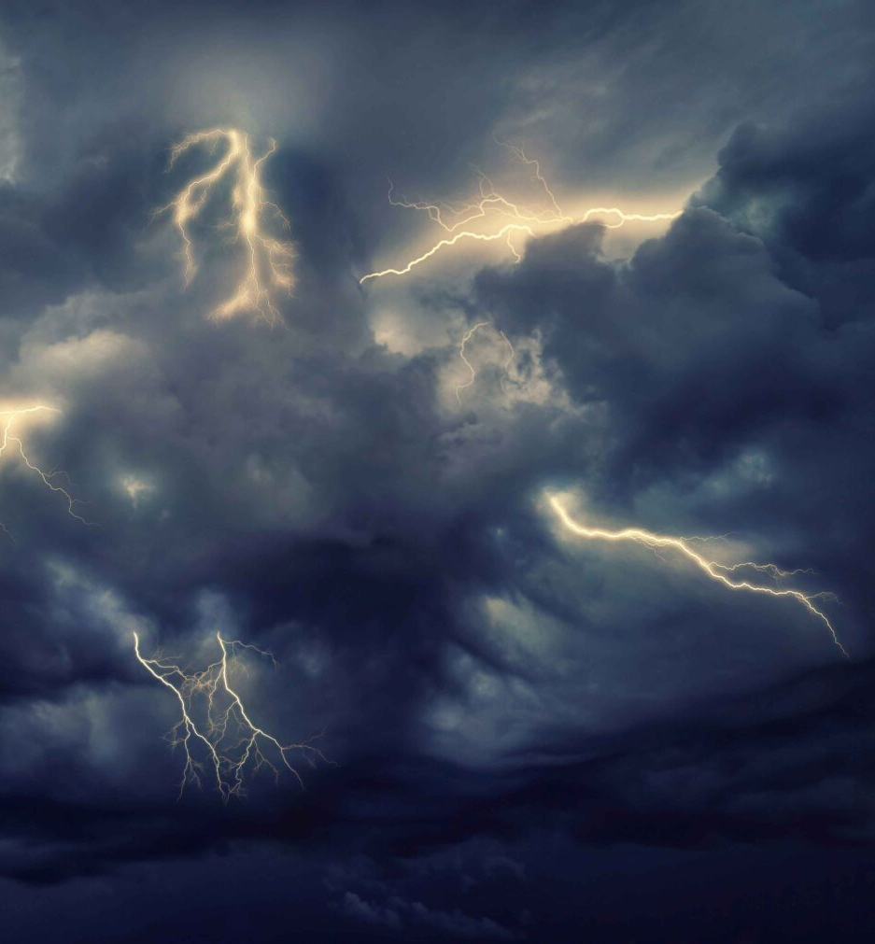
Where are we in Prophecy?
3. The Wrath of God Falls “Without Mixture”
After mercy ends, judgment begins:
  Revelation 15:1 — “the wrath of God” is filled up
  Revelation 14:10 — poured out “without mixture”
👉 No more mercy—only justice

Slide 15
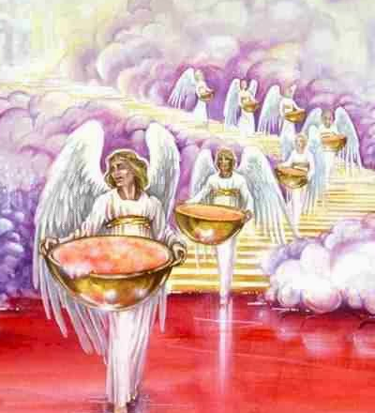
Where are we in Prophecy?
4. The Seven Last Plagues Begin
Now Revelation 16 opens:
  Revelation 16:1 — “Go your ways, and pour out…”
These plagues are:
  Not warnings
  Not calls to repentance
But the execution of final judgment

Slide 16
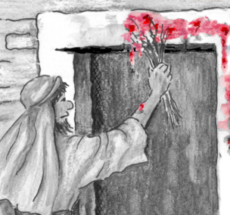
Where are we in Prophecy?
5. God’s People Are Safe
Even in this time:
Psalm 91:9–10 — “no plague shall come nigh thy dwelling”
They are not spared from the world, but protected in it

Slide 17

1. When the Third Angel’s Message shall have done its work, what voice will then be heard from the heavenly temple?
Revelation 16:1

Slide 18
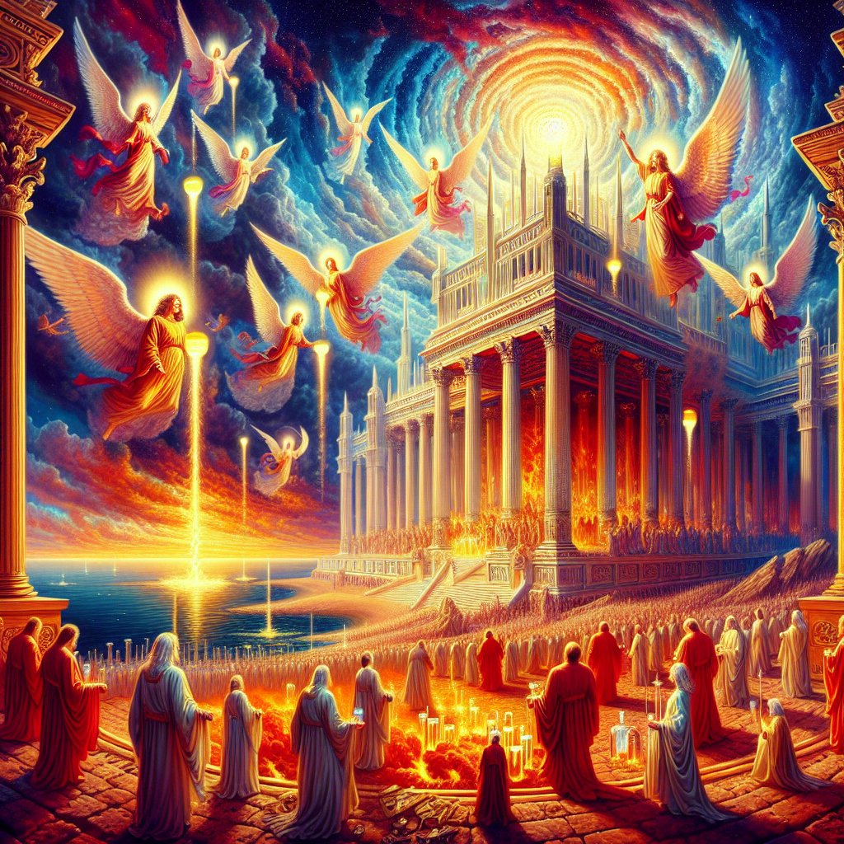
Revelation
16:1
16 And I heard a great voice out of the temple saying to the seven angels, Go your ways, and pour out the vials of the wrath of God upon the earth.

Slide 19
2. In addition to all these plagues, what awful famine will be upon men?
Amos 8:11, 12

Slide 20
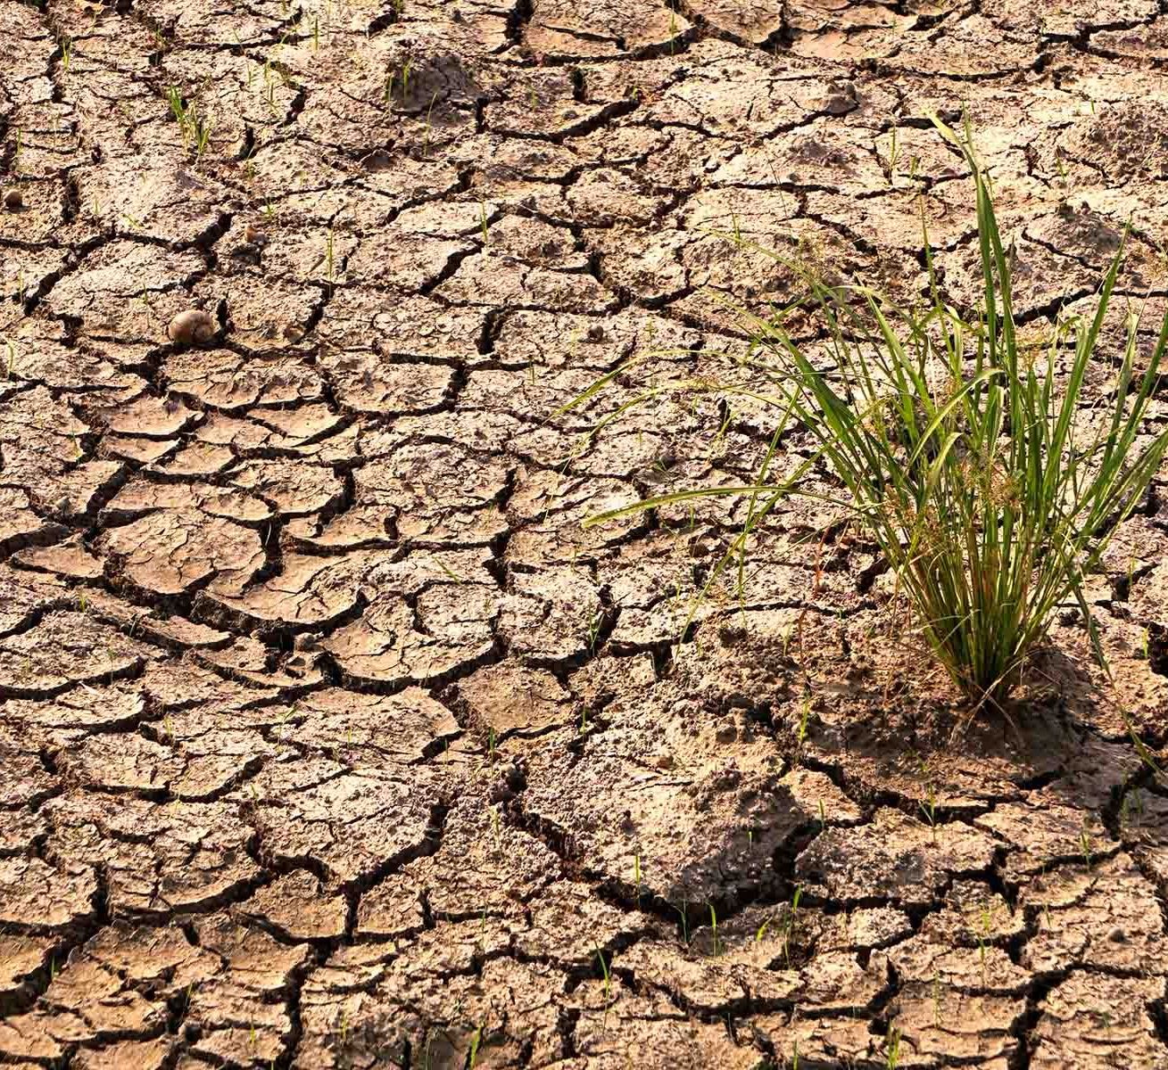
Amos
8:11-12
¹¹ Behold, the days come, saith the Lord God, that I will send a famine in the land, not a famine of bread, nor a thirst for water, but of hearing the words of the Lord:

Slide 21
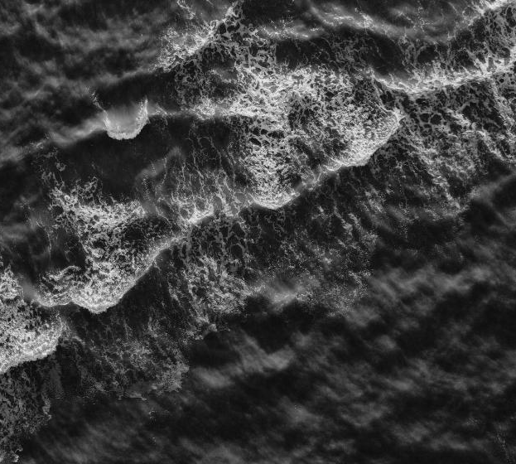
Amos
8:11-12
¹² And they shall wander from sea to sea, and from the north even to the east, they shall run to and fro to seek the word of the Lord, and shall not find it.

Slide 22
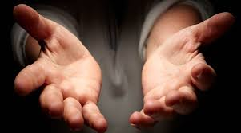
Proverbs
1:24-28
²⁴ Because I have called, and ye refused; I have stretched out my hand, and no man regarded;
²⁵ But ye have set at nought all my counsel, and would none of my reproof:

Slide 23
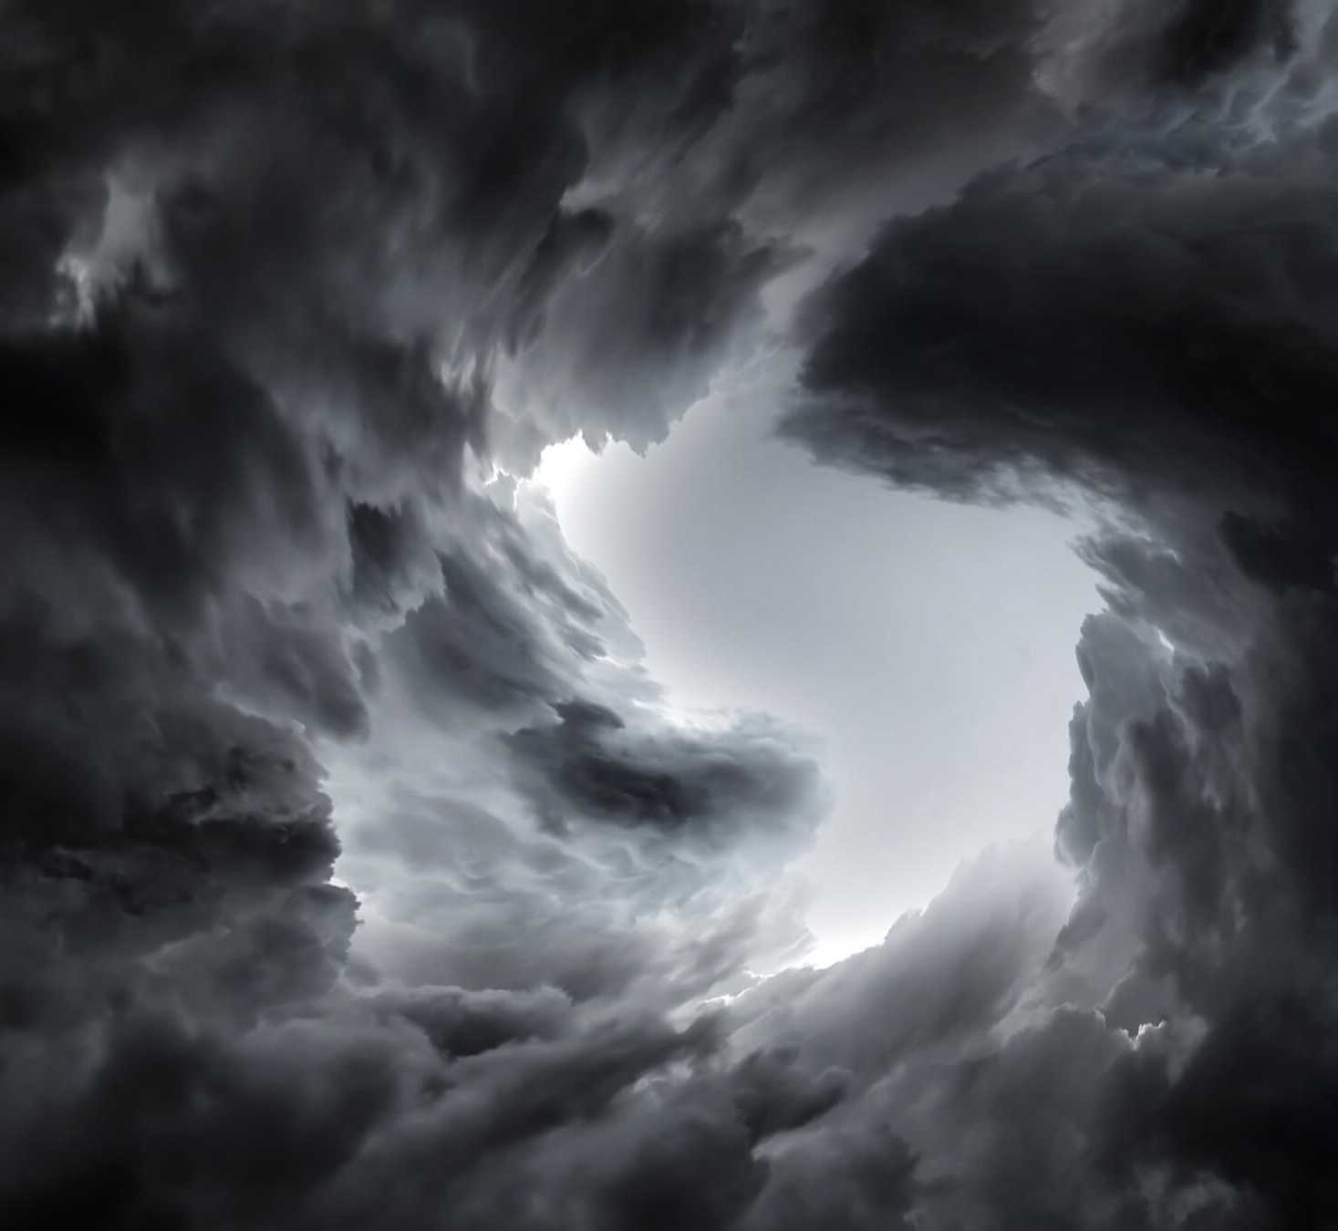
Proverbs
1:24-28
²⁶ I also will laugh at your calamity; I will mock when your fear cometh;
²⁷ When your fear cometh as desolation, and your destruction cometh as a whirlwind; when distress and anguish cometh upon you.

Slide 24

Proverbs
1:24-28
²⁸ Then shall they call upon me, but I will not answer; they shall seek me early, but they shall not find me:

Slide 25
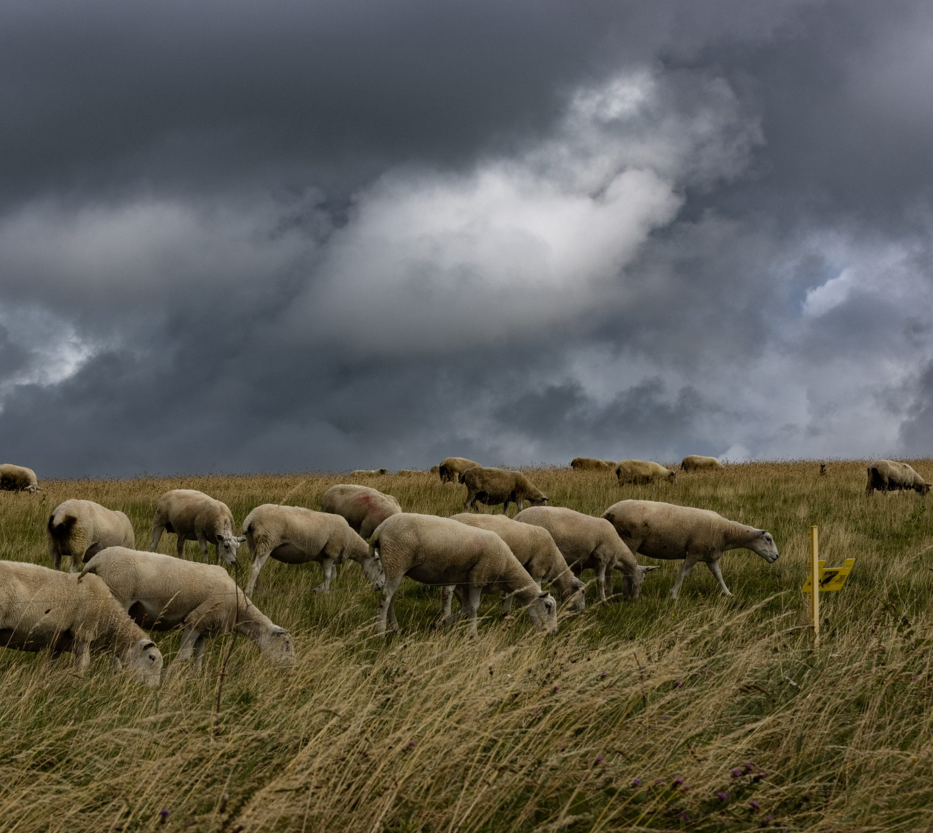
Hosea
5:6
⁶ They shall go with their flocks and with their herds to seek the Lord; but they shall not find him; he hath withdrawn himself from them.

Slide 26
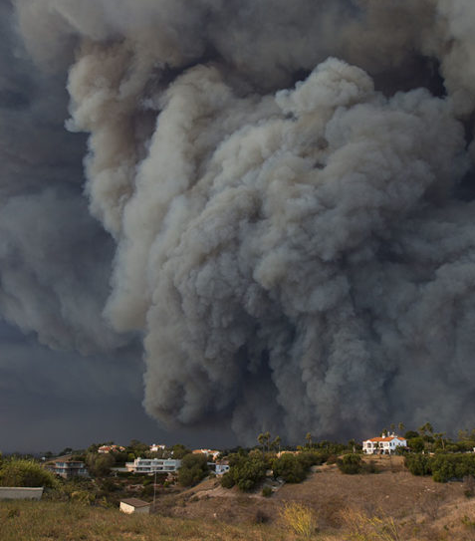
Seeing the Pattern
Scripture Shows God’s Word Is Withdrawn When Probation Closes
Throughout the Bible, when people persistently reject truth:
  God stops sending light
  👉 rejected truth → withdrawn presence

Slide 27
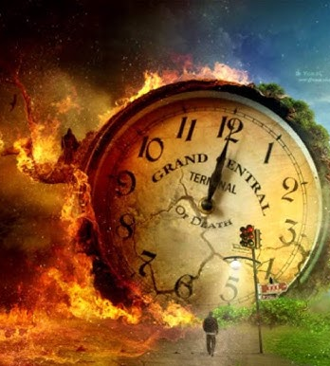
Seeing the Pattern
Right before the seven plagues:
Revelation 15:8 — “no man was able to enter into the temple”
Meaning:
👉 No intercession
👉 No access
👉 No more mediation

Slide 28
3. What will be the first plague? and upon whom will it fall?
Revelation 16:2

Slide 29
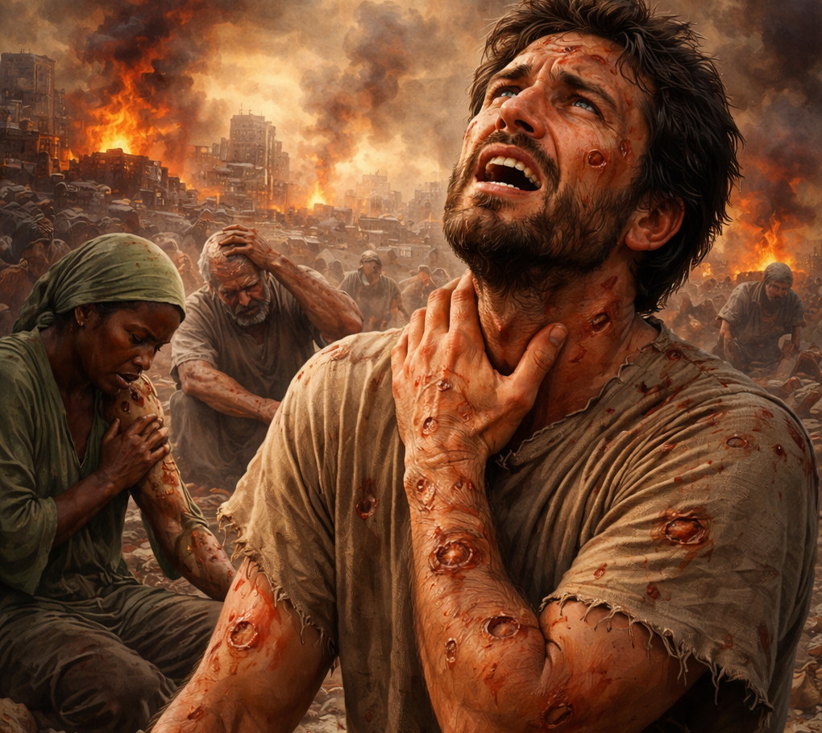
Revelation
16:2
² And the first went, and poured out his vial upon the earth; and there fell a noisome and grievous sore upon the men which had the mark of the beast, and upon them which worshipped his image.

Slide 30
4. What will be the second plague?
Revelation 16:3

Slide 31
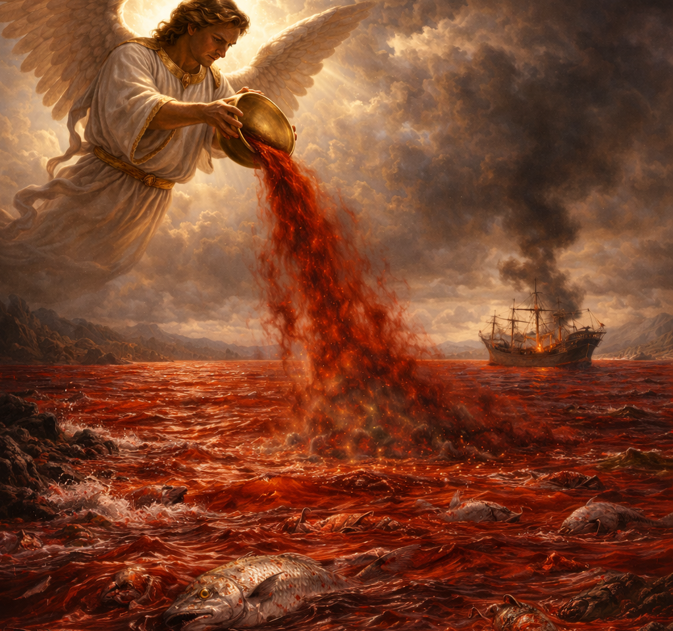
Revelation
16:3
³ And the second angel poured out his vial upon the sea; and it became as the blood of a dead man: and every living soul died in the sea.

Slide 32
5. What will be the third plague?
Revelation 16:4

Slide 33
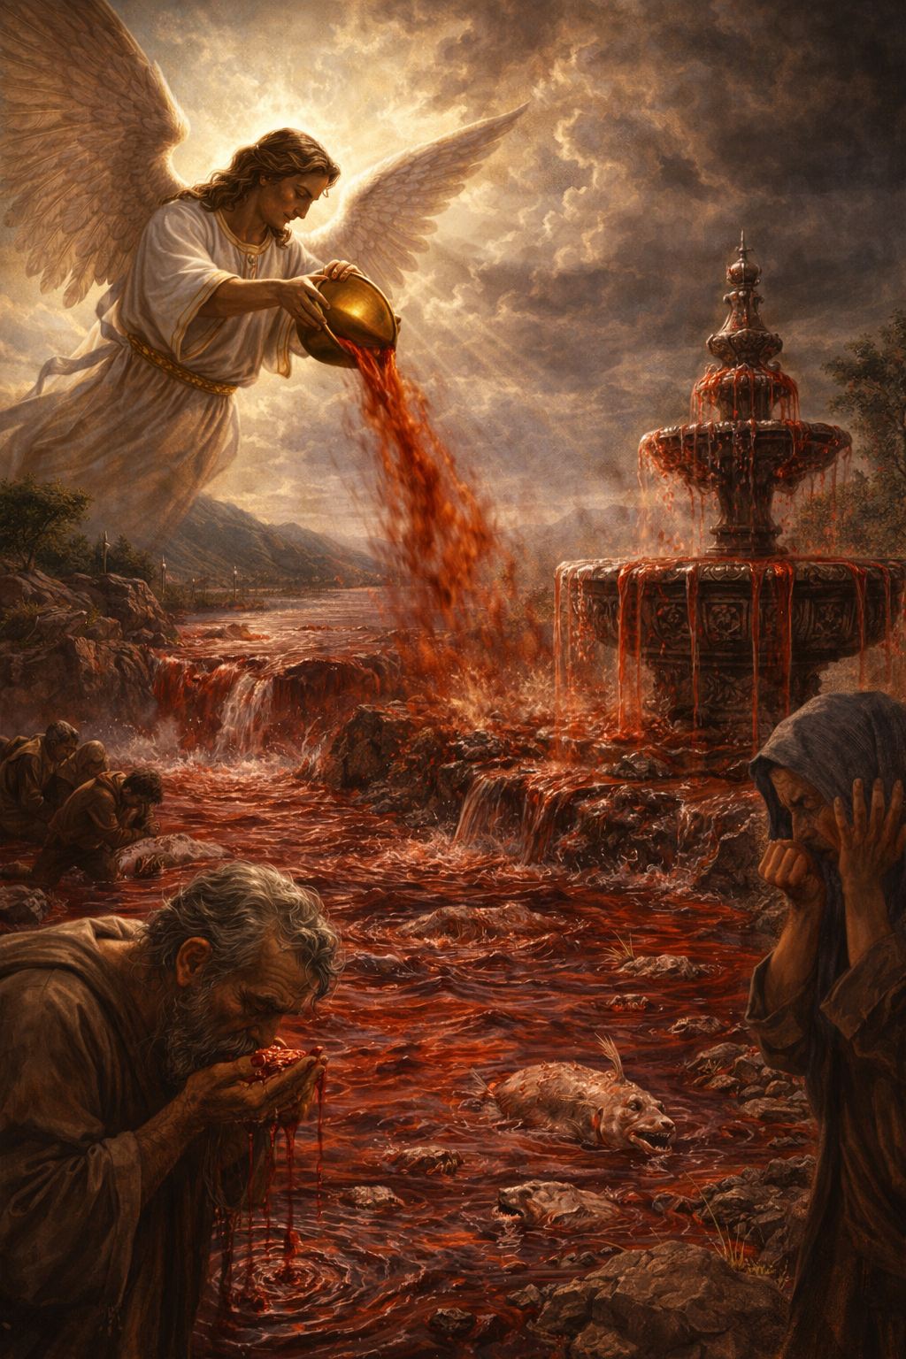
Revelation
16:4
⁴ And the third angel poured out his vial upon the rivers and fountains of waters; and they became blood.

Slide 34
6. Why will the rivers and fountains of water be turned to blood?
Revelation 16:6

Slide 35
Revelation
16:6
⁶ For they have shed the blood of saints and prophets, and thou hast given them blood to drink; for they are worthy.

Slide 36
7. What will be the fourth plague?
Revelation 16:8-9

Slide 37
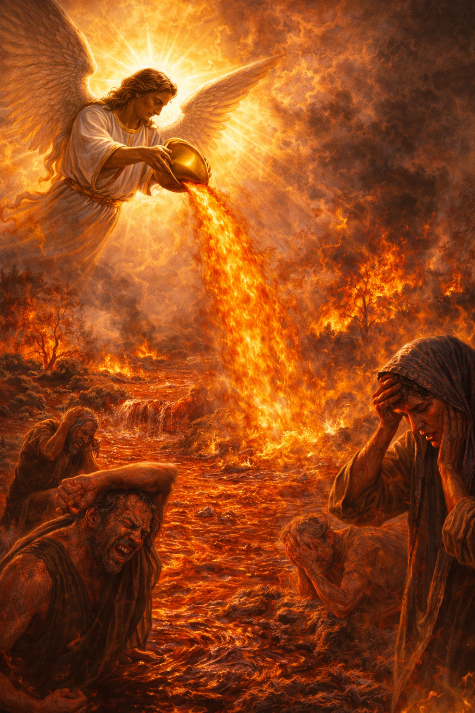
Revelation
16:8-9
⁸ And the fourth angel poured out his vial upon the sun; and power was given unto him to scorch men with fire.

Slide 38
Revelation
16:8-9
⁹ And men were scorched with great heat, and blasphemed the name of God, which hath power over these plagues: and they repented not to give him glory.

Slide 39
8. What will be the further effect of this?
Joel 1:18–20

Slide 40
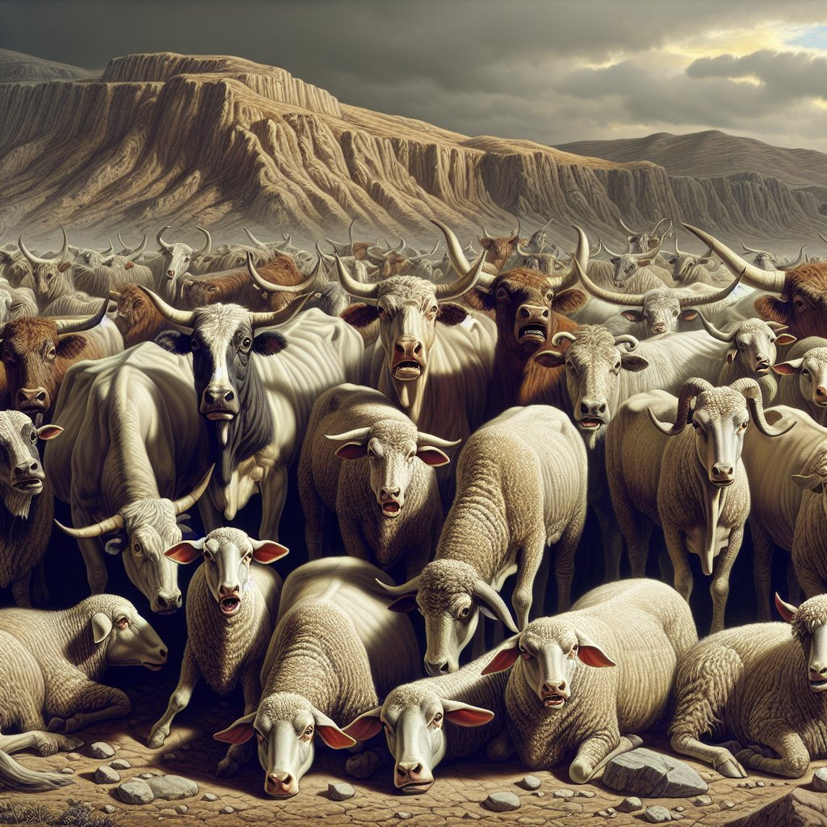
Joel
1:18-20
¹⁸ How do the beasts groan! the herds of cattle are perplexed, because they have no pasture; yea, the flocks of sheep are made desolate.

Slide 41
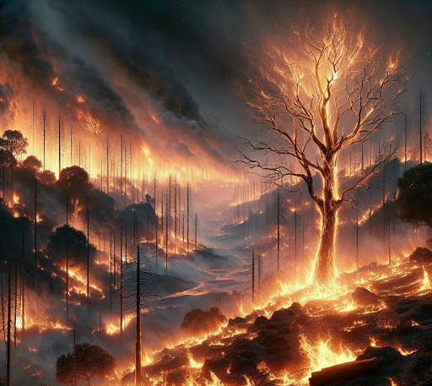
Joel
1:18-20
¹⁹ O Lord, to thee will I cry: for the fire hath devoured the pastures of the wilderness, and the flame hath burned all the trees of the field.

Slide 42
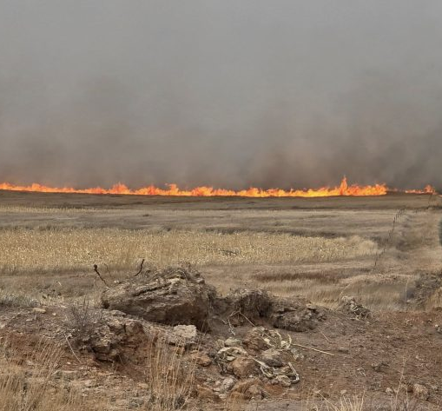
Joel
1:18-20
²⁰ The beasts of the field cry also unto thee: for the rivers of waters are dried up, and the fire hath devoured the pastures of the wilderness.

Slide 43
9. What will be the fifth plague?
Revelation 16:10

Slide 44
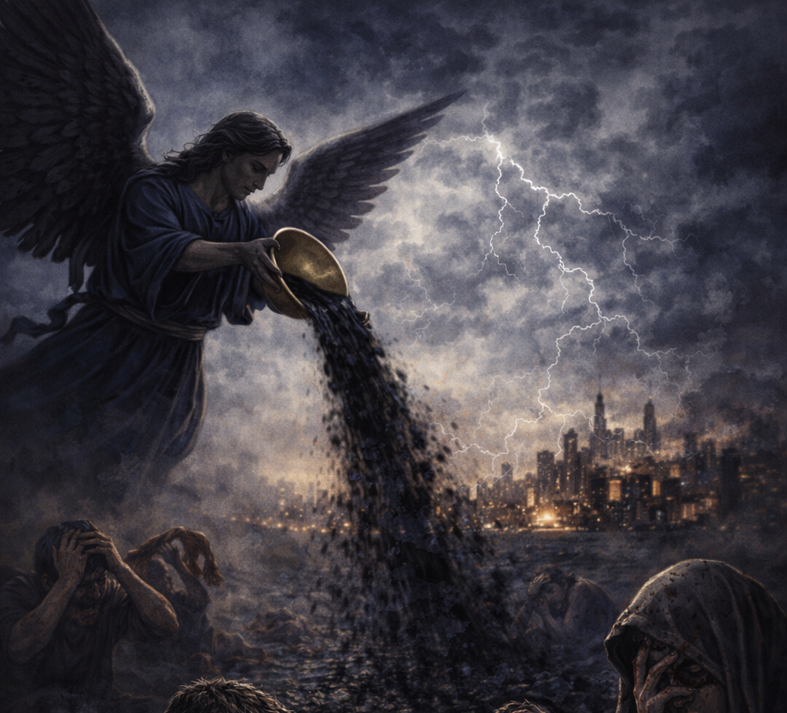
Revelation 16:10
¹⁰ And the fifth angel poured out his vial upon the seat of the beast; and his kingdom was full of darkness; and they gnawed their tongues for pain,

Slide 45
10. Will those who love the truth of God be afraid in this time of darkness and dread?
Psalm 91:5–8

Slide 46
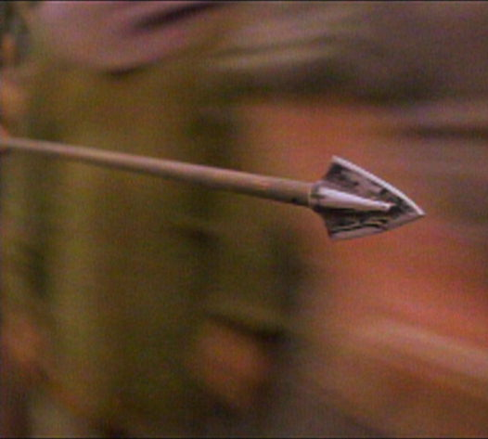
Psalm
91:5-8
⁵ Thou shalt not be afraid for the terror by night; nor for the arrow that flieth by day;

Slide 47

Psalm
91:5-8
⁶ Nor for the pestilence that walketh in darkness; nor for the destruction that wasteth at noonday.

Slide 48
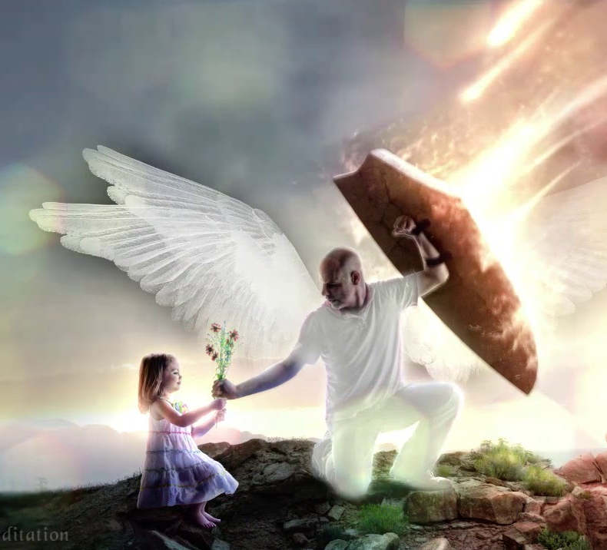
Psalm
91:5-8
⁷ A thousand shall fall at thy side, and ten thousand at thy right hand; but it shall not come nigh thee.

Slide 49
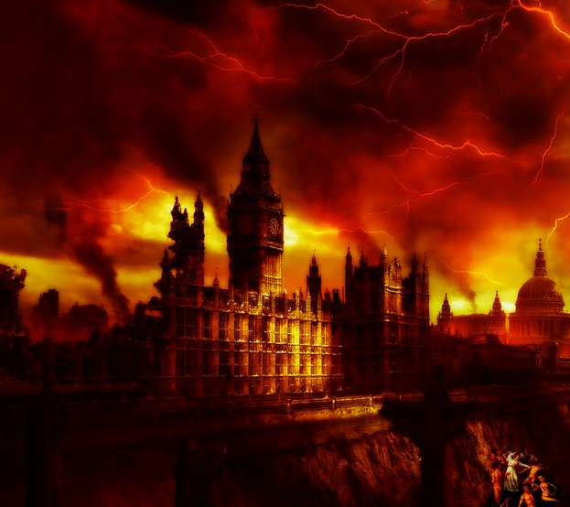
Psalm
91:5-8
⁸ Only with thine eyes shalt thou behold and see the reward of the wicked.

Slide 50
11. What will be the sixth plague?
Revelation 16:12

Slide 51
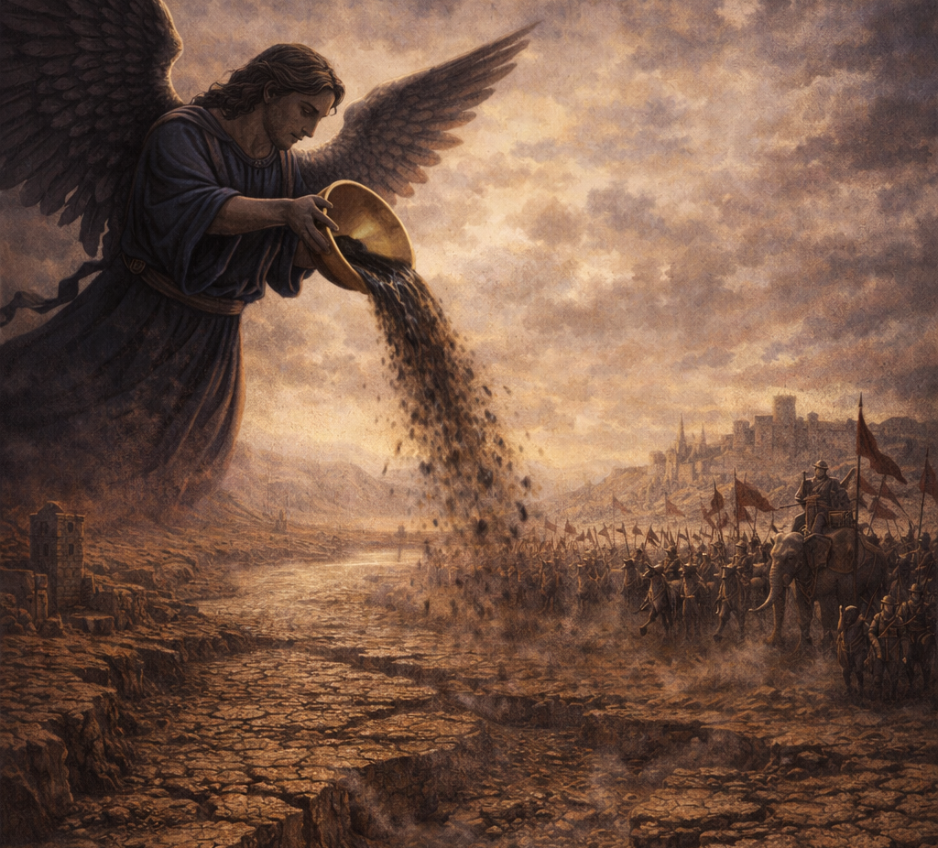
Revelation
16:12
¹² And the sixth angel poured out his vial upon the great river Euphrates; and the water thereof was dried up, that the way of the kings of the east might be prepared.

Slide 52
12. Does this refer to the literal river Euphrates, or to the nation that dwells in the country of the Euphrates?
Answer: The nation. See note.

Slide 53
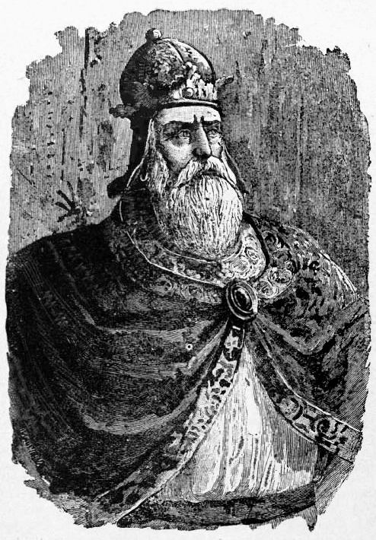
Gibbon, chapter 33, part 21
“It is not possible that it should refer to the literal river, because never in all history have the waters of the literal river Euphrates been a hindrance to any kings either of the East or of the West. A thousand years before Christ, the kings of Assyria crossed it regularly every spring—at the very time when the waters were the highest—in their campaigns. In the year 269 A.D., Tiridates, king of Armenia, swam it with his armor on.”

Slide 54
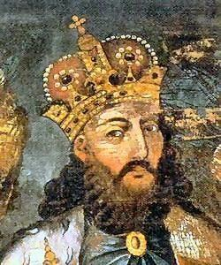
The Waters of the River
The view that the reference is not to the literal river, but to the Euphrates nation, is strengthened by the fact that Isaiah, in speaking of the king of Assyria and his armies, plainly calls them, “The waters of the river.” “Now therefore, behold, the Lord bringeth up upon them [the people of Judah] the waters of the river, strong and many, even the king of Assyria, and all his glory; and he shall come up over all his channels, and go over all his banks.”—Isaiah 8:7.

Slide 55
13. What then does the drying up of the river mean?
Answer: Evidently the wiping out of the Turkish power,—the nation that now [in 1888] rules the Euphrates country.

Slide 56
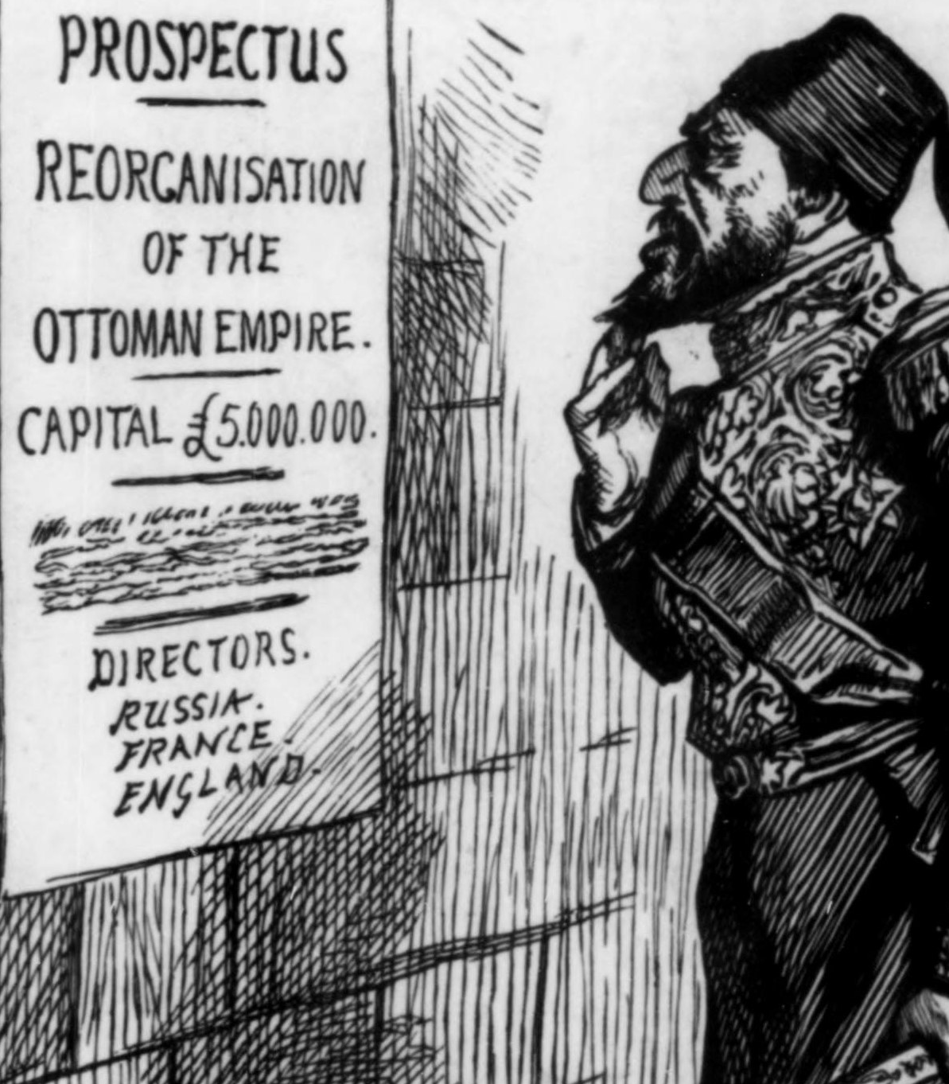
The Euphrates River
In 1888, the Ottoman Empire ruled the Euphrates region. It was already called:
👉 “the sick man of Europe”
It was losing territory steadily to European powers
👉 Many at the time thought:
the drying up is already beginning

Slide 57
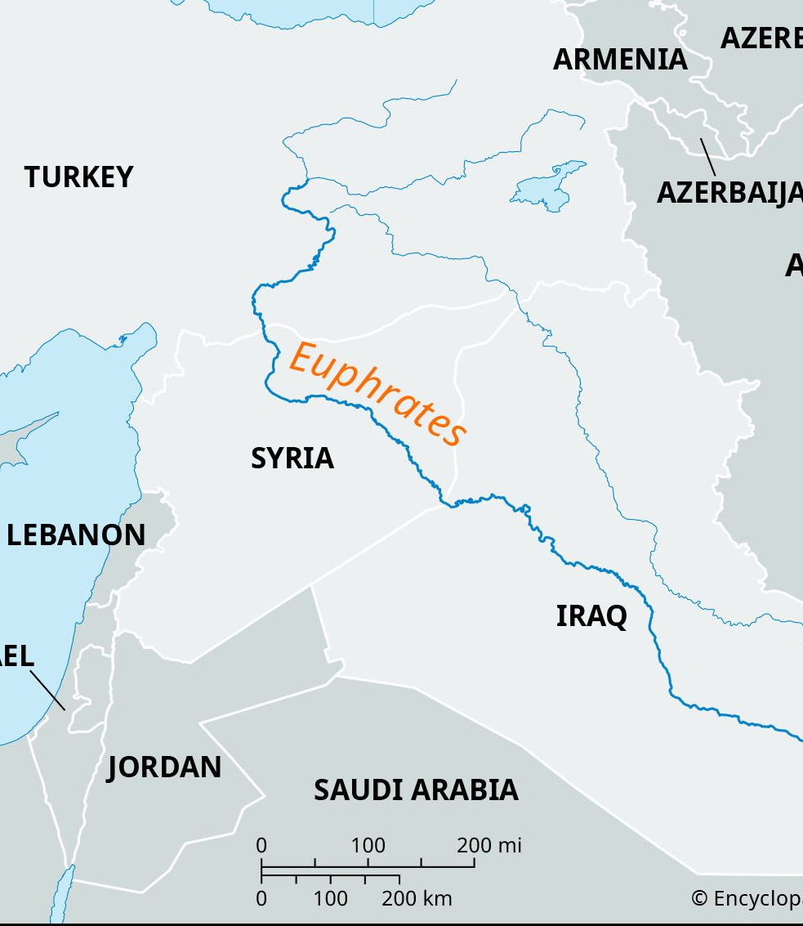
The Euphrates River
Instead of disappearing completely:
  The Ottoman system ended
  But a new national state remained
👉 This complicated the interpretation:
  Was the prophecy fulfilled?
  Or only partially?

Slide 58
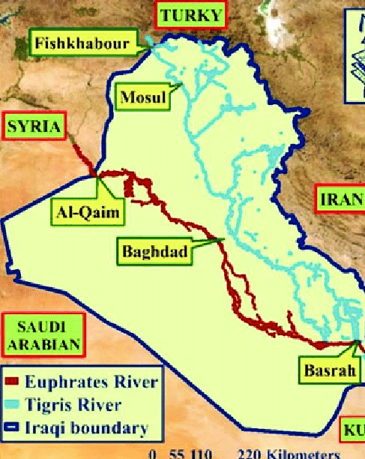
The Euphrates River
The Euphrates region today (Turkey, Syria, Iraq) remains:
  politically unstable
  strategically significant
Alliances shift frequently
👉 Has the Euphrates “dried up” already? How can we be sure?

Slide 59
14. What did the prophet see at this same time?
Revelation 16:13

Slide 60
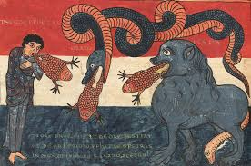
Revelation
16:13
¹³ And I saw three unclean spirits like frogs come out of the mouth of the dragon, and out of the mouth of the beast, and out of the mouth of the false prophet.

Slide 61
15. What are these spirits?
Revelation 16:14, first part

Slide 62
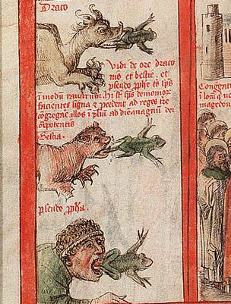
Revelation
16:14
¹⁴ For they are the spirits of devils, working miracles, which go forth unto the kings of the earth and of the whole world, to gather them to the battle of that great day of God Almighty.

Slide 63
16. What do they go forth to do?
Revelation 16:14, last part; Revelation 19:11, 15, 19

Slide 64
Revelation
16:14
¹⁴ For they are the spirits of devils, working miracles, which go forth unto the kings of the earth and of the whole world, to gather them to the battle of that great day of God Almighty.

Slide 65
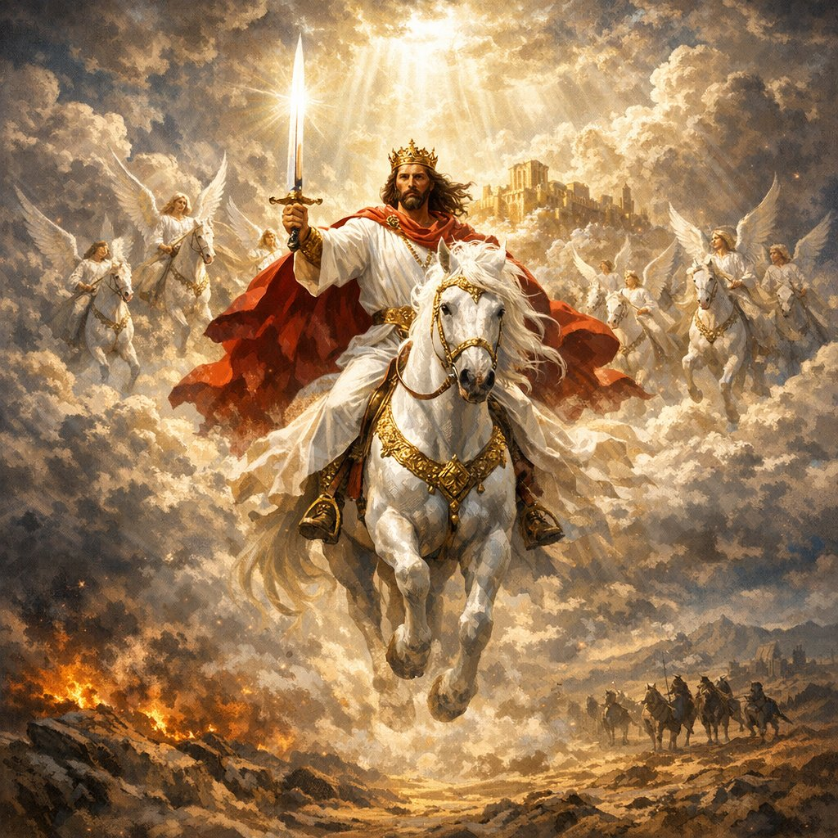
Revelation
19:11, 15, 19
¹¹ And I saw heaven opened, and behold a white horse; and he that sat upon him was called Faithful and True, and in righteousness he doth judge and make war.

Slide 66
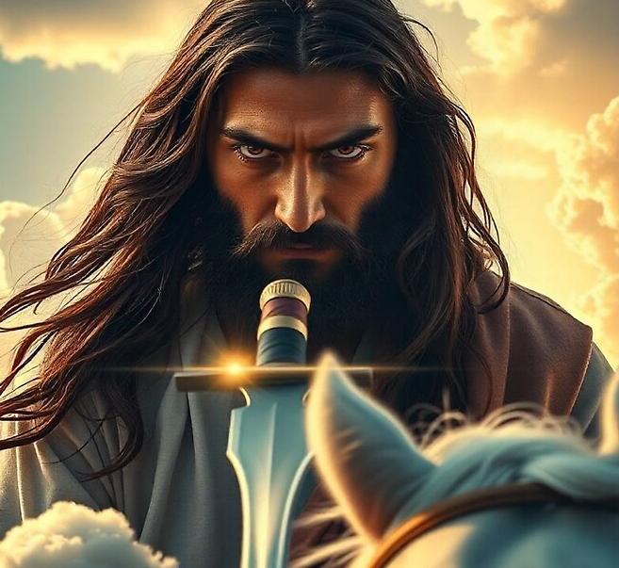
Revelation
19:11, 15, 19
¹⁵ And out of his mouth goeth a sharp sword, that with it he should smite the nations: and he shall rule them with a rod of iron: and he treadeth the winepress of the fierceness and wrath of Almighty God.

Slide 67
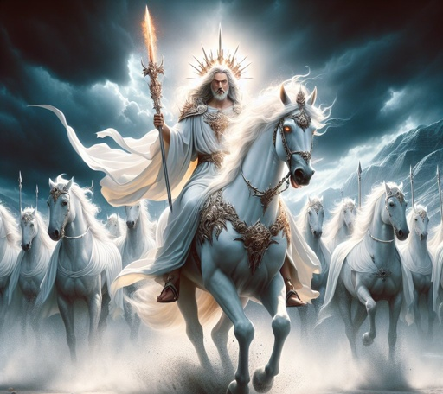
Revelation
19:11, 15, 19
¹⁹ And I saw the beast, and the kings of the earth, and their armies, gathered together to make war against him that sat on the horse, and against his army.

Slide 68
17. When the seventh angel pours out his vial what is heard?
Revelation 16:17

Slide 69
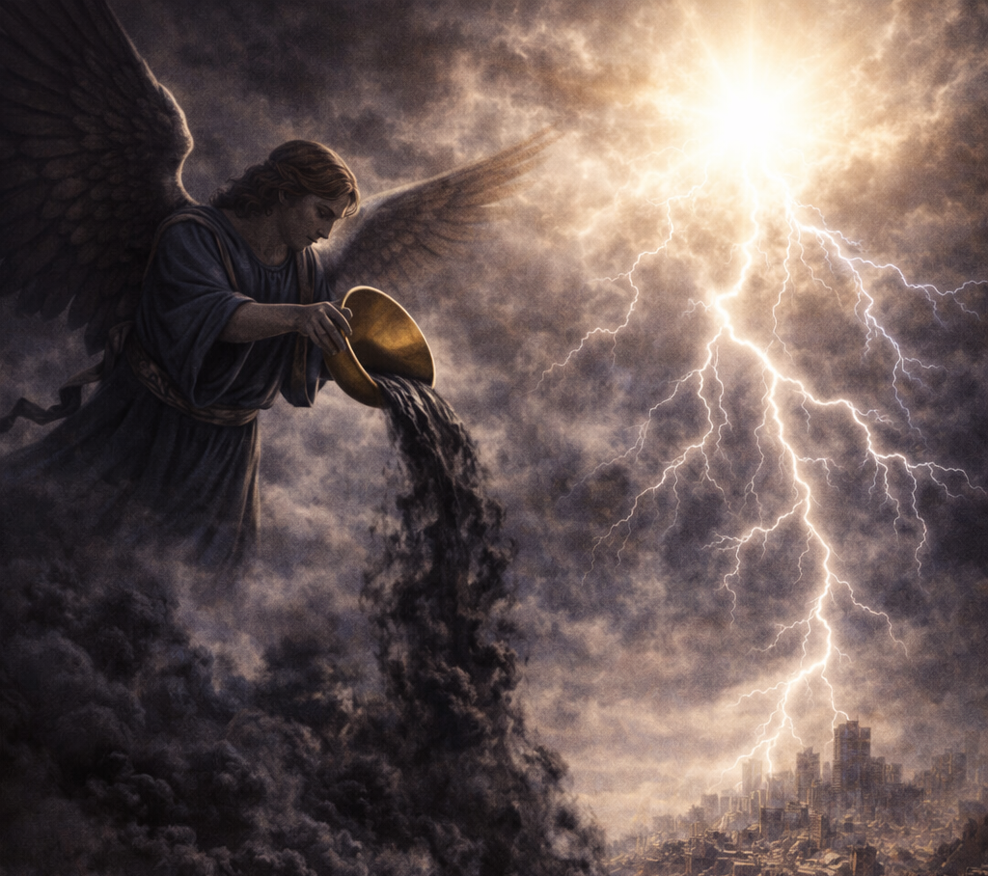
Revelation
16:17
¹⁷ And the seventh angel poured out his vial into the air; and there came a great voice out of the temple of heaven, from the throne, saying, It is done.

Slide 70
18. What is this voice?
Jeremiah 25:30

Slide 71
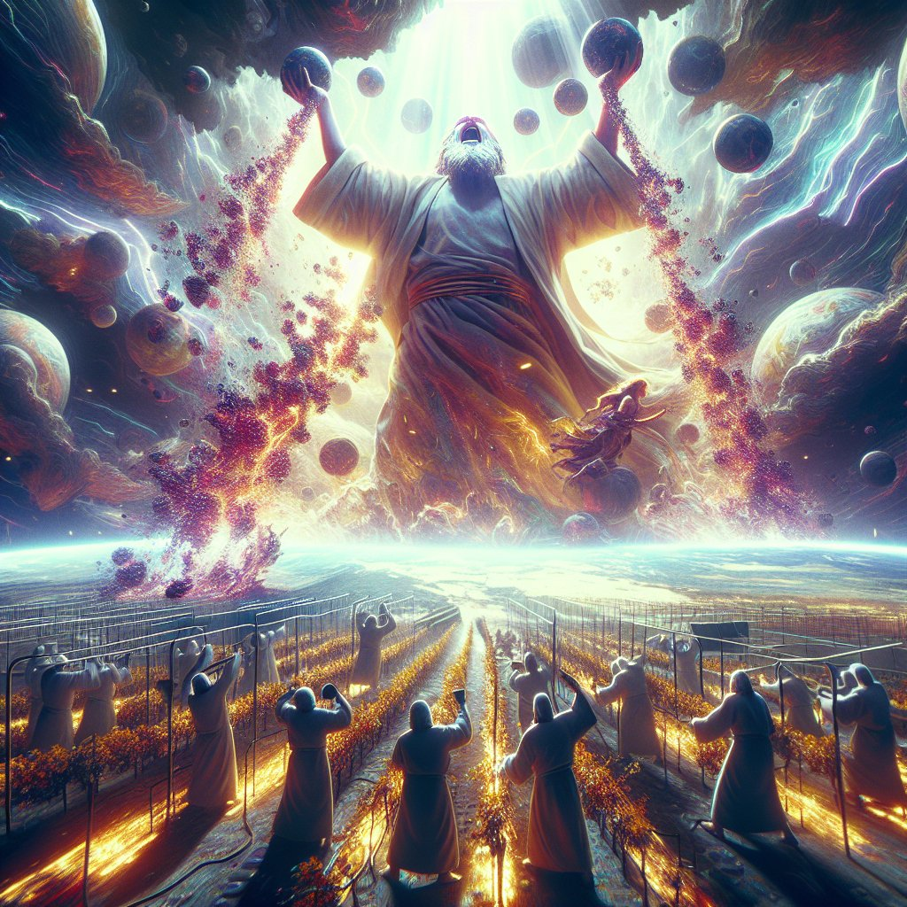
Jeremiah
25:30
³⁰ Therefore prophesy thou against them all these words, and say unto them, The Lord shall roar from on high, and utter his voice from his holy habitation; he shall mightily roar upon his habitation; he shall give a shout, as they that tread the grapes, against all the inhabitants of the earth.

Slide 72
19. What will then happen to heaven and earth?
Haggai 2:21, 22; Hebrews 12:26; Revelation 16:18, 20

Slide 73
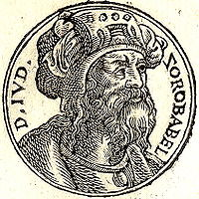
Haggai
2:20-22
²⁰ And again the word of the Lord came unto Haggai in the four and twentieth day of the month, saying,
²¹ Speak to Zerubbabel, governor of Judah, saying, I will shake the heavens and the earth;

Slide 74
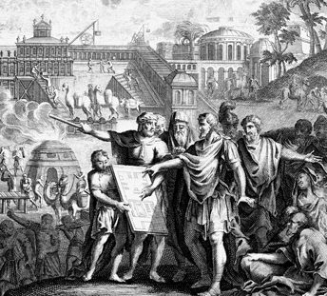
Haggai
2:20-22
²² And I will overthrow the throne of kingdoms, and I will destroy the strength of the kingdoms of the heathen; and I will overthrow the chariots, and those that ride in them; and the horses and their riders shall come down, every one by the sword of his brother.

Slide 75
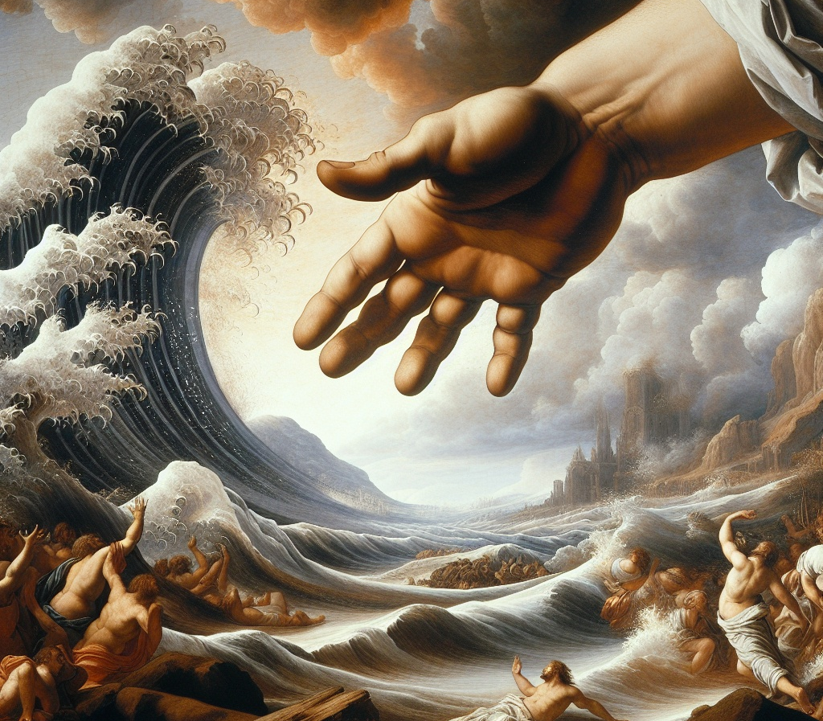
Hebrews
12:26
²⁶ Whose voice then shook the earth: but now he hath promised, saying, Yet once more I shake not the earth only, but also heaven.

Slide 76
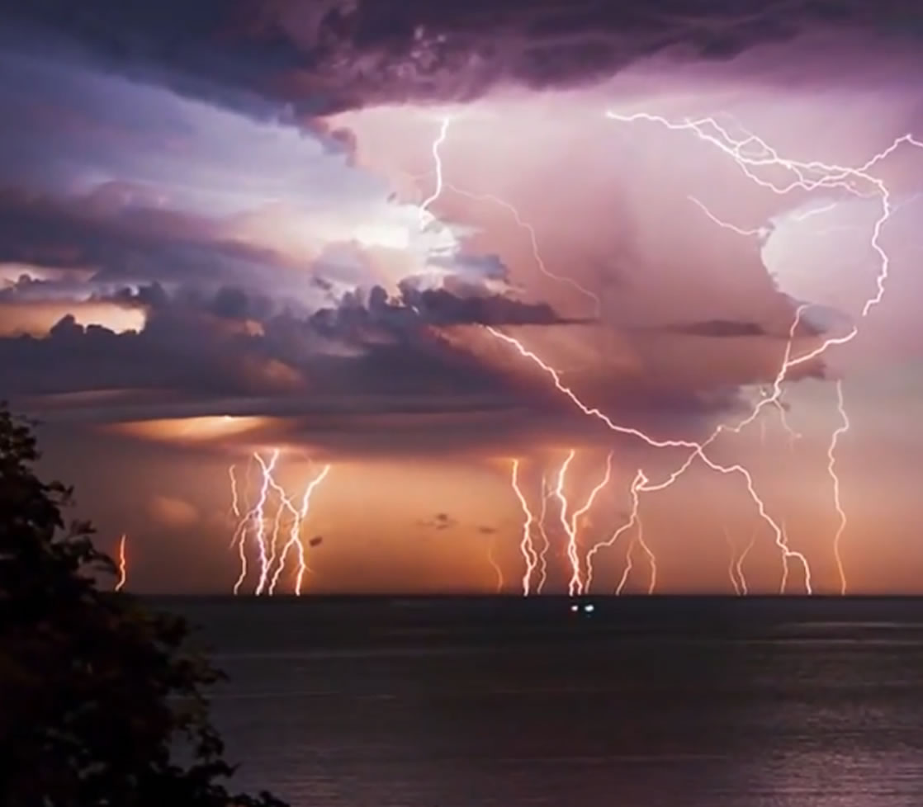
Revelation 16:18, 20
¹⁸ And there were voices, and thunders, and lightnings; and there was a great earthquake, such as was not since men were upon the earth, so mighty an earthquake, and so great.

Slide 77
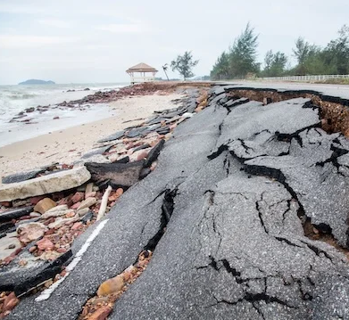
Revelation 16:18, 20
²⁰ And every island fled away, and the mountains were not found.

Slide 78
20. What then falls upon men?
Revelation 16:21

Slide 79
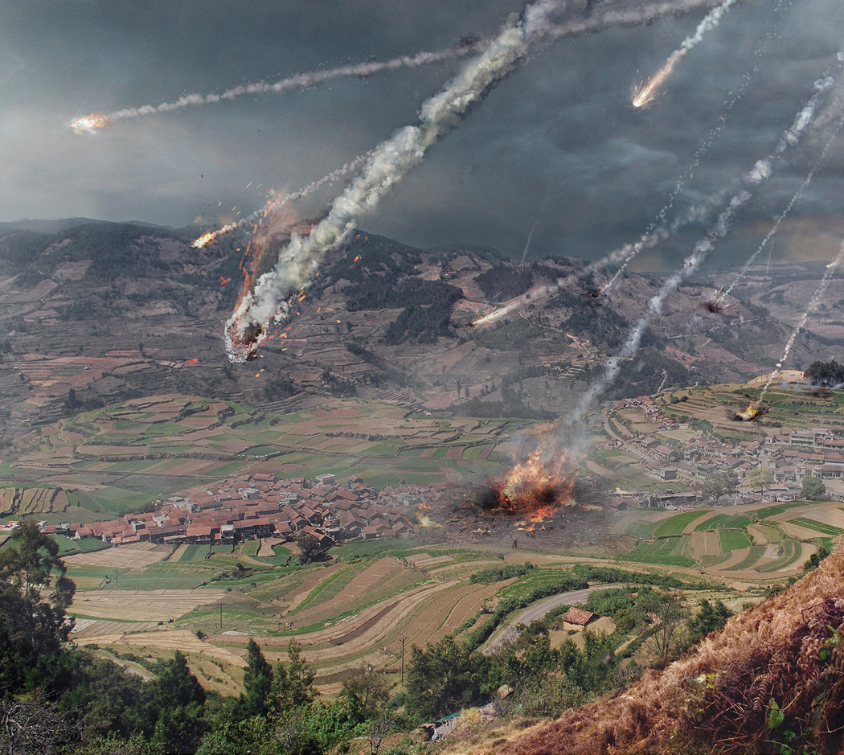
Revelation 16:21
²¹ And there fell upon men a great hail out of heaven, every stone about the weight of a talent: and men blasphemed God because of the plague of the hail; for the plague thereof was exceeding great.

Slide 80
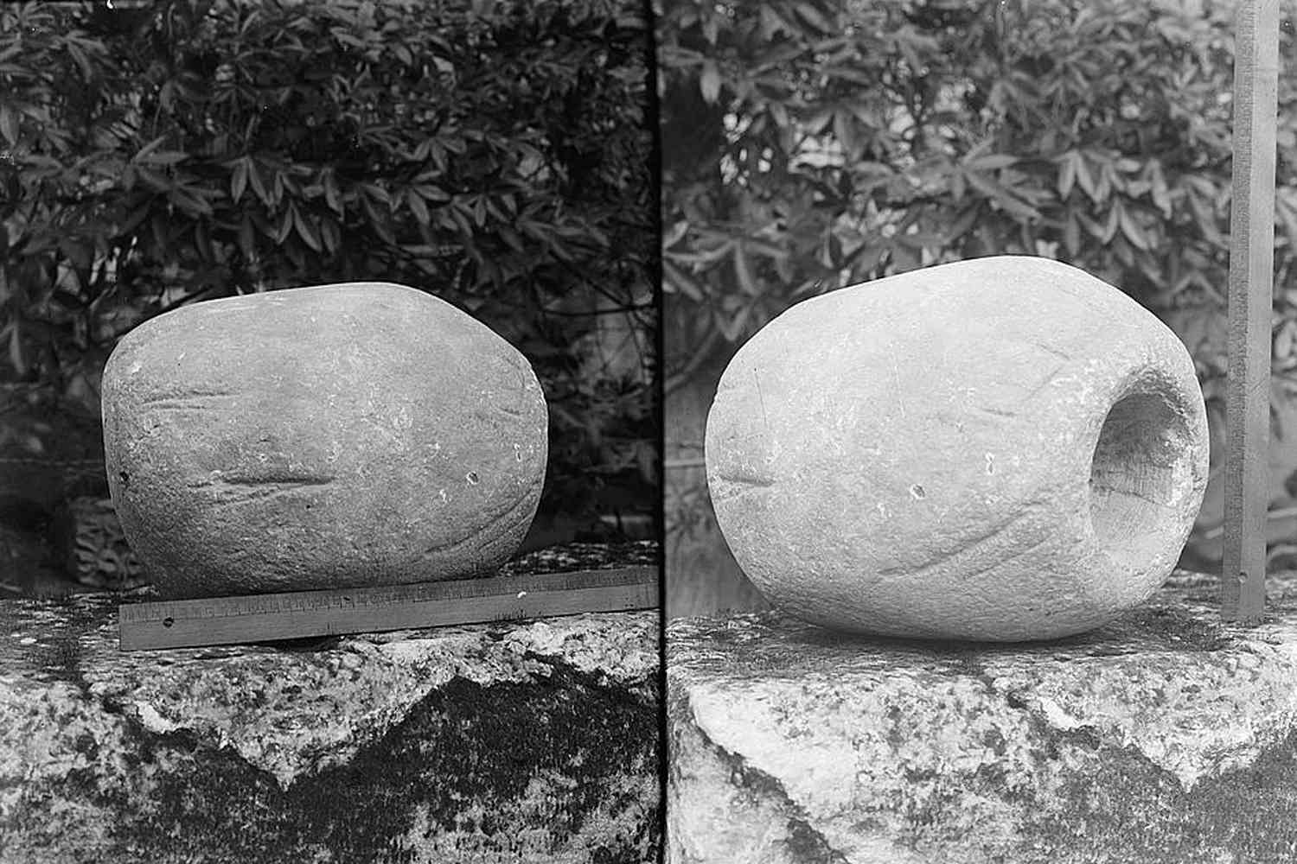
The Weight of a Talent
About 60-80 lbs

Slide 81
21. What will the people of God do in this fearful time?
Joel 3:16; Isaiah 25:9

Slide 82
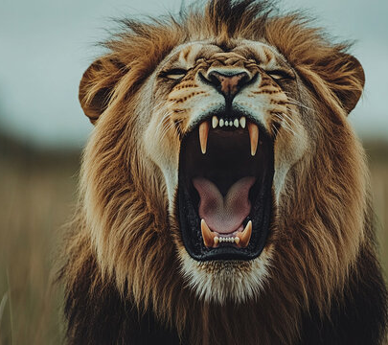
Joel
3:16
¹⁶ The Lord also shall roar out of Zion, and utter his voice from Jerusalem; and the heavens and the earth shall shake: but the Lord will be the hope of his people, and the strength of the children of Israel.

Slide 83

Isaiah
25:9
⁹ And it shall be said in that day, Lo, this is our God; we have waited for him, and he will save us: this is the Lord; we have waited for him, we will be glad and rejoice in his salvation.

Slide 84
22. Will any of these plagues afflict them?
Psalm 91:9, 10

Slide 85

Psalm
91:9-10
⁹ Because thou hast made the Lord, which is my refuge, even the most High, thy habitation;

Slide 86

Psalm
91:9-10
¹⁰ There shall no evil befall thee, neither shall any plague come nigh thy dwelling.

Slide 87
23. What will assure to all this perfect safety?
Answer: The love of the truth of the Third Angel’s Message.
Psalm 91:4;
Zephaniah 2:3

Slide 88

Psalm
91:4
⁴ He shall cover thee with his feathers, and under his wings shalt thou trust: his truth shall be thy shield and buckler.

Slide 89

Zephaniah
2:3
³ Seek ye the Lord, all ye meek of the earth, which have wrought his judgment; seek righteousness, seek meekness: it may be ye shall be hid in the day of the Lord's anger.

Slide 90
24. Then is not that message the most precious boon this world can know?

Slide 91
Thank you!
… and Happy Sabbath!!

Slide 92


