Slide 1


Slide 2

Living the Light

Slide 3
The Third Angel’s Message
Lesson 14: THE Wrath of the Dragon
October 6, 1888
Lesson 14, 3rd Quarter 1888

Slide 4

1. Just after what notable working will the Saviour come?
2 Thessalonians 2:9, 10

Slide 5
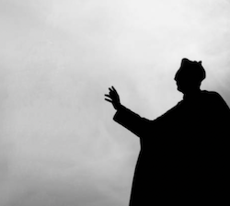
2 Thessalonians
2:9-10
⁹ Even him, whose coming is after the working of Satan with all power and signs and lying wonders,

Slide 6
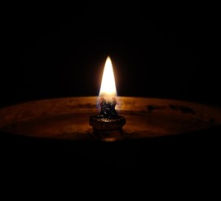
2 Thessalonians
2:9-10
¹⁰ And with all deceivableness of unrighteousness in them that perish; because they received not the love of the truth, that they might be saved.

Slide 7
2. How great will be these signs and wonders?
Matthew 24:24

Slide 8

Matthew
24:24
²⁴ For there shall arise false Christs, and false prophets, and shall shew great signs and wonders; insomuch that, if it were possible, they shall deceive the very elect.

Slide 9
3. Why is it they deceive them that perish?
2 Thessalonians 2:10, last part

Slide 10

2 Thessalonians
2:9-10
¹⁰ And with all deceivableness of unrighteousness in them that perish; because they received not the love of the truth, that they might be saved.

Slide 11
4. What special manifestation of the truth have we found that there will be just before the coming of the Lord?
Revelation 14:9–14

Slide 12
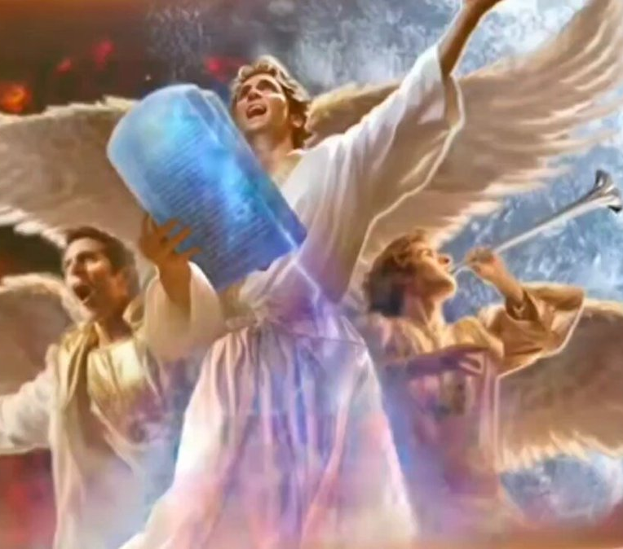
Revelation
14:9-14
⁹ And the third angel followed them, saying with a loud voice, If any man worship the beast and his image, and receive his mark in his forehead, or in his hand,

Slide 13
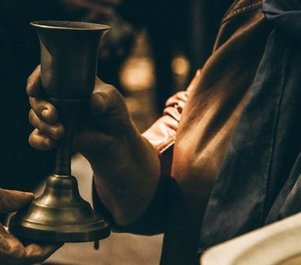
Revelation
14:9-14
¹⁰ The same shall drink of the wine of the wrath of God, which is poured out without mixture into the cup of his indignation; and he shall be tormented with fire and brimstone in the presence of the holy angels, and in the presence of the Lamb:

Slide 14
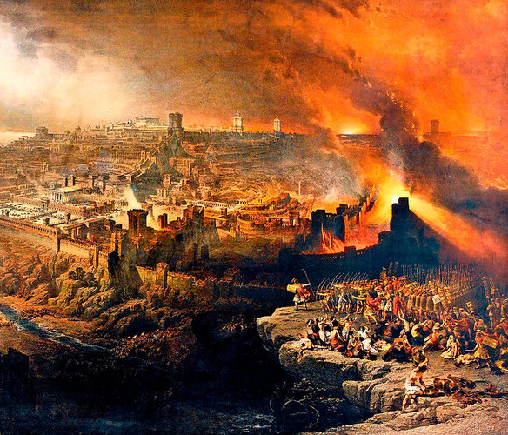
Revelation
14:9-14
¹¹ And the smoke of their torment ascendeth up for ever and ever: and they have no rest day nor night, who worship the beast and his image, and whosoever receiveth the mark of his name.

Slide 15
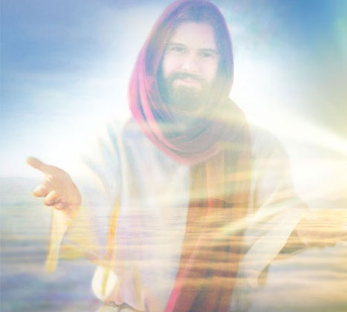
Revelation
14:9-14
¹² Here is the patience of the saints: here are they that keep the commandments of God, and the faith of Jesus.

Slide 16
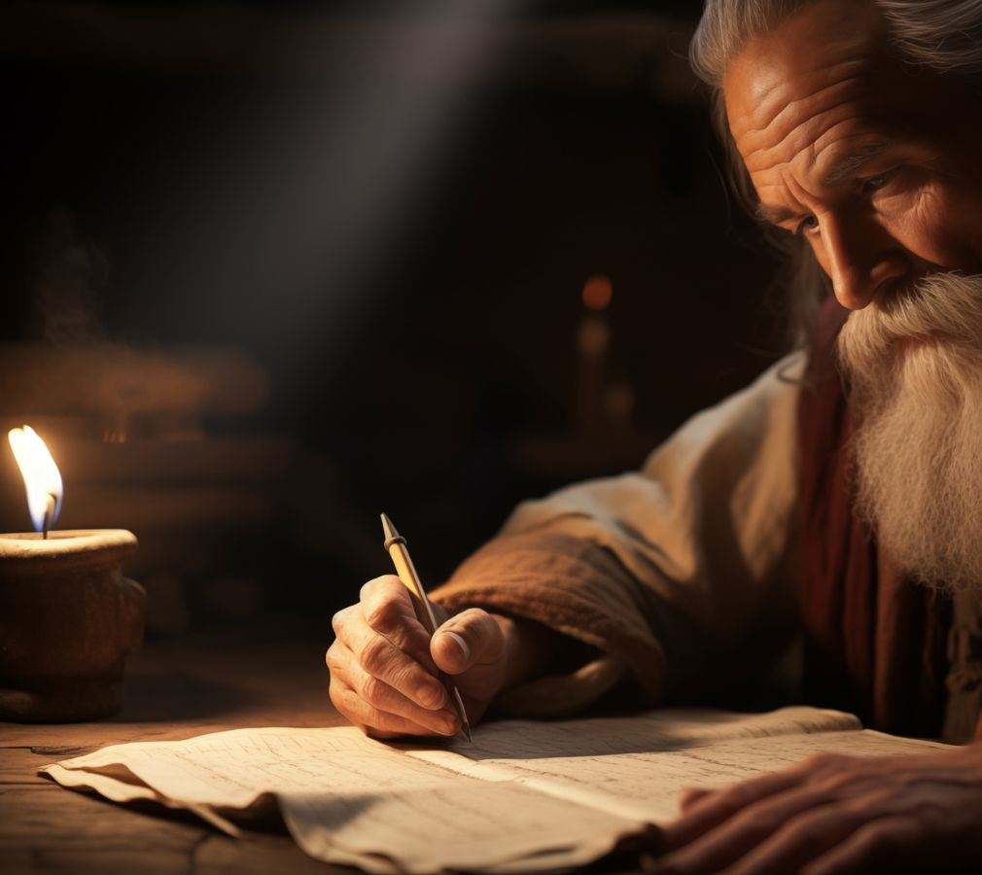
Revelation
14:9-14
¹³ And I heard a voice from heaven saying unto me, Write, Blessed are the dead which die in the Lord from henceforth: Yea, saith the Spirit, that they may rest from their labours; and their works do follow them.

Slide 17
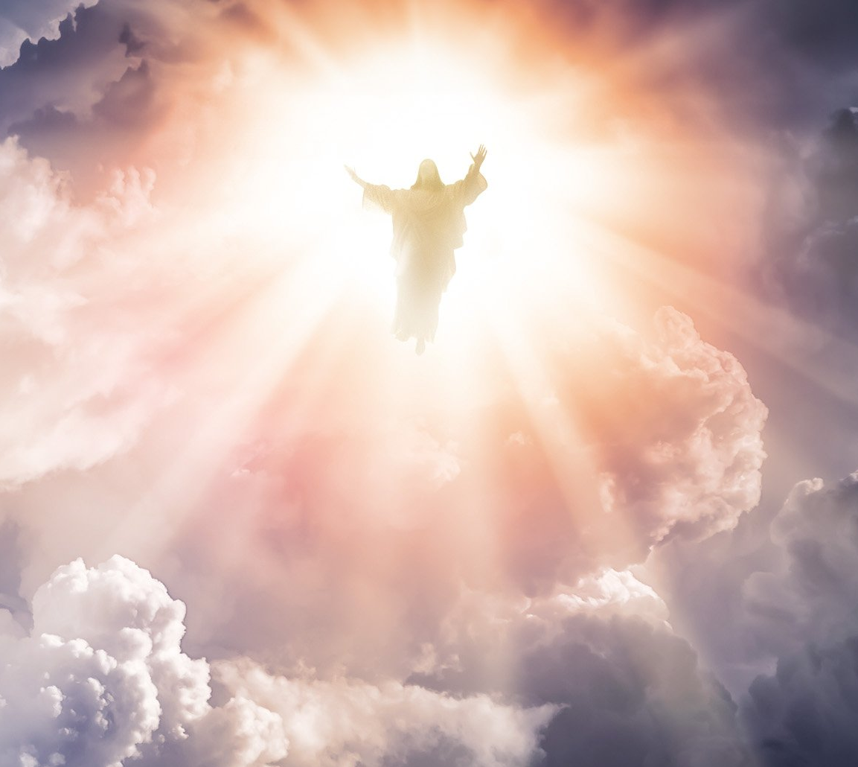
Revelation
14:9-14
¹⁴ And I looked, and behold a white cloud, and upon the cloud one sat like unto the Son of man, having on his head a golden crown, and in his hand a sharp sickle.

Slide 18
5. Are the commandments of God and the faith of Jesus the truth?
Psalm 119:151;
John 14:6

Slide 19
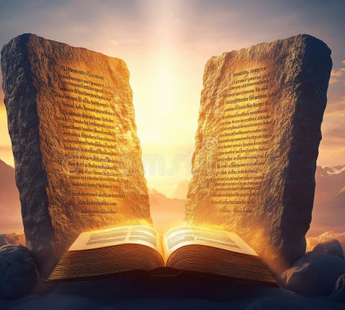
Psalm
119:151
¹⁵¹ Thou art near, O Lord; and all thy commandments are truth.

Slide 20

John
14:6
⁶ Jesus saith unto him, I am the way, the truth, and the life: no man cometh unto the Father, but by me.

Slide 21
6. Are the commandments of God and the faith of Jesus righteousness?
Psalm 119:172; Galatians 5:5, 6

Slide 22

Psalm
119:172
¹⁷² My tongue shall speak of thy word:
for all thy commandments are righteousness.

Slide 23

Galatians
5:5-6
⁵ For we through the Spirit wait for the hope of righteousness by faith.

Slide 24

Galatians
5:5-6
⁶ For in Jesus Christ neither circumcision availeth any thing, nor uncircumcision; but faith which worketh by love.

Slide 25
7. What is the object of Satan’s deceiving, lying miracles and wonders?
Revelation 13:14

Slide 26
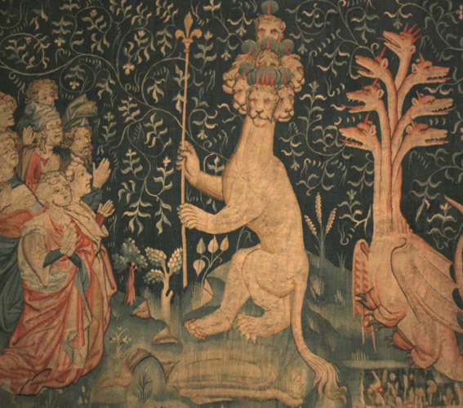
Revelation
13:14
¹⁴ And deceiveth them that dwell on the earth by the means of those miracles which he had power to do in the sight of the beast; saying to them that dwell on the earth, that they should make an image to the beast, which had the wound by a sword, and did live.

Slide 27
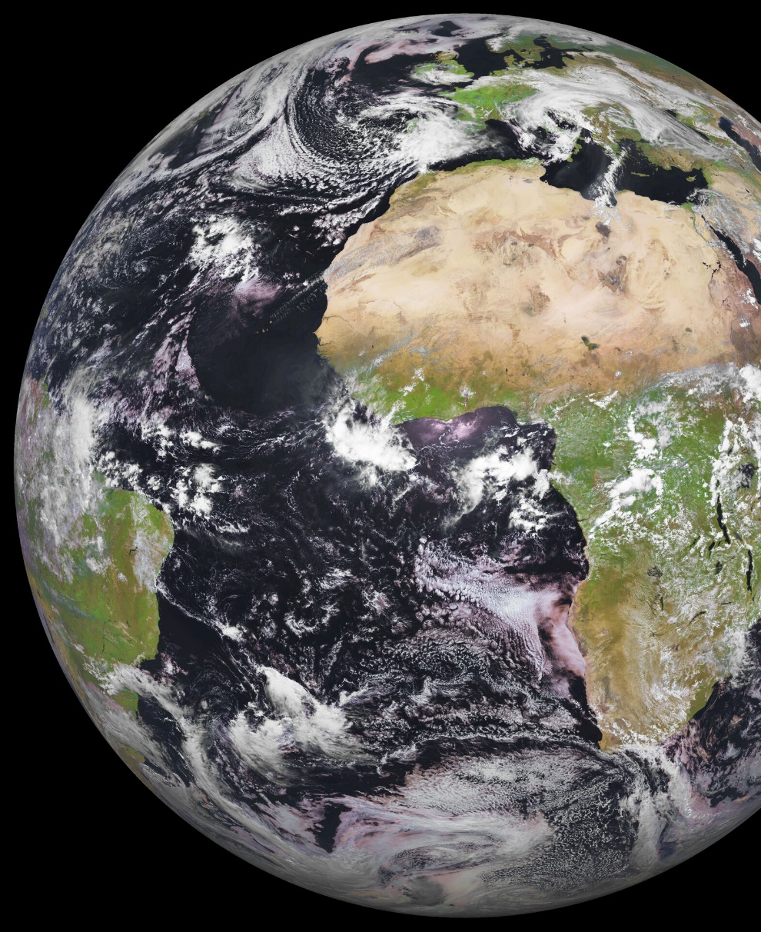
The Point
1. A Final Global Deception Is Coming
Before Christ returns, Satan will work through powerful signs and miracles to deceive the world (2 Thess. 2; Matt. 24).
➡️ The key issue is not intelligence—but whether people love the truth.

Slide 28
8. What is the object of the Third Angel’s Message?
Answer: To save men from the worship of the beast and his image.

Slide 29
9. Then with what will be Satan’s last conflict before the coming of the Lord?
Answer: With the Third Angel’s Message and with those who receive the love of it.

Slide 30
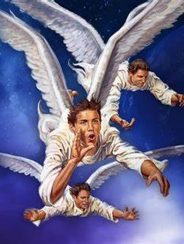
The Point
2. God Sends a Final Message to Counter the Deception
At the same time as this deception, God raises up the Third Angel’s Message.
➡️ Its purpose is to:
Warn against false worship
Call people back to truth, obedience, and faith in Jesus

Slide 31
10. What does this message lead men to do?
Revelation 14:12

Slide 32
Revelation
14:9-14
¹² Here is the patience of the saints: here are they that keep the commandments of God, and the faith of Jesus.

Slide 33
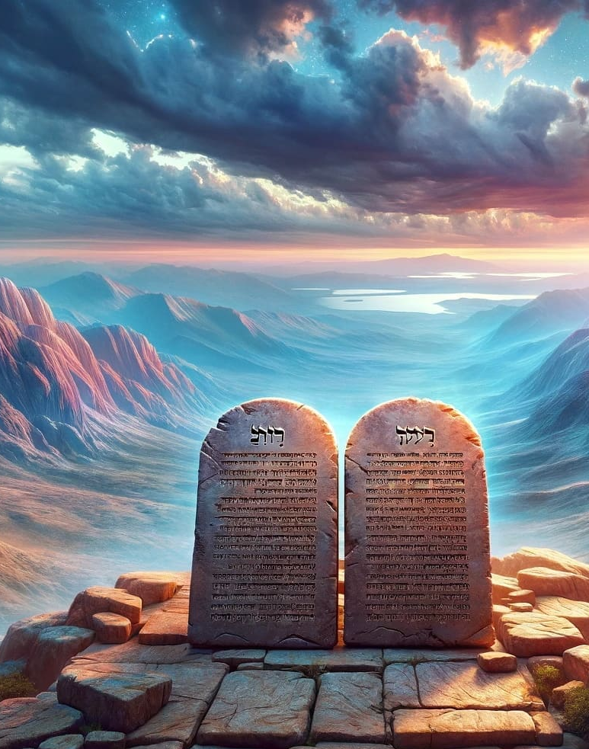
The Point
3. The Conflict Centers on Worship
This message produces a people who:
Keep the commandments of God
Have the faith of Jesus (Rev. 14:12)
➡️ So the final issue becomes:
True worship vs. false worship

Slide 34
11. In what manner does the second beast of Revelation 13 speak?
Revelation 13:11

Slide 35
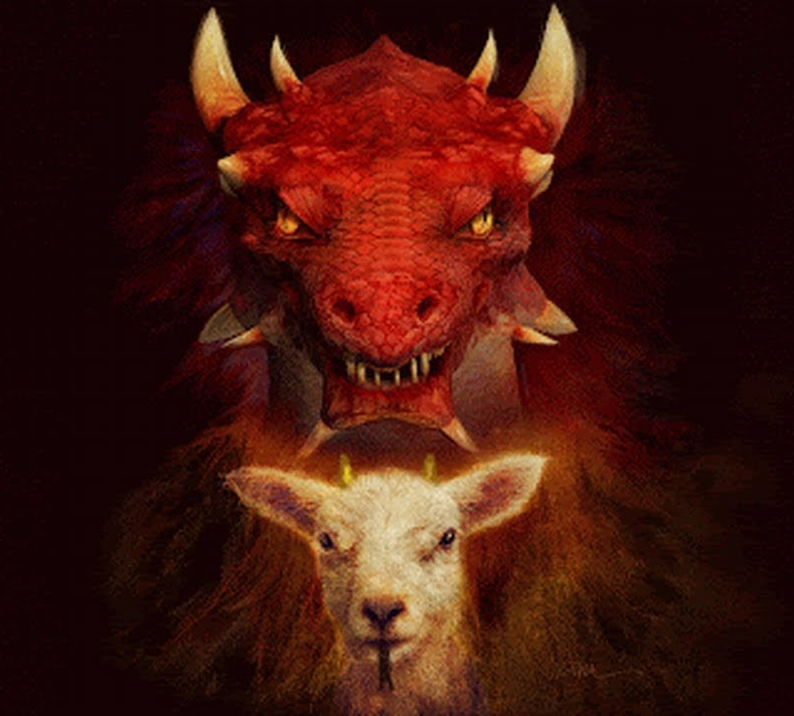
Revelation
13:11
¹¹ And I beheld another beast coming up out of the earth; and he had two horns like a lamb, and he spake as a dragon.

Slide 36
12. What power, and seat, and authority, has the first beast?
Revelation 13:2

Slide 37
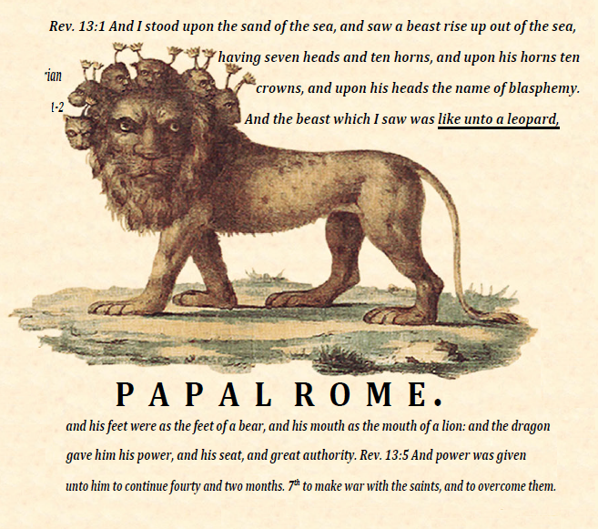
Revelation
13:2
² And the beast which I saw was like unto a leopard, and his feet were as the feet of a bear, and his mouth as the mouth of a lion: and the dragon gave him his power, and his seat, and great authority.

Slide 38
13. What is the great dragon above all?
Revelation 12:9

Slide 39
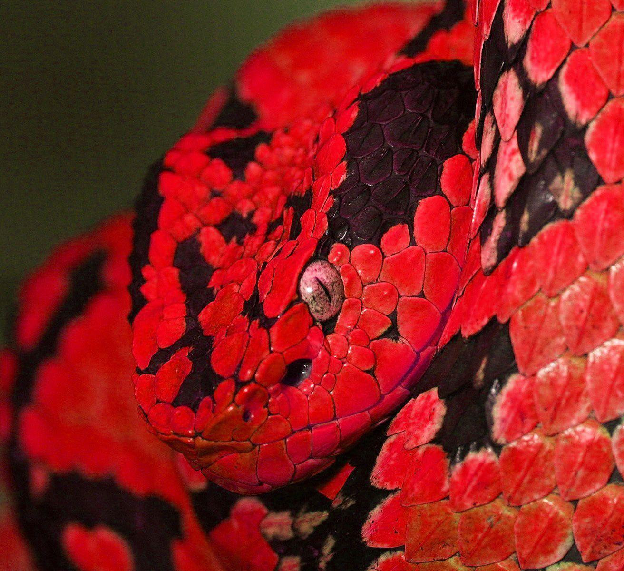
Revelation
12:9
⁹ And the great dragon was cast out, that old serpent, called the Devil, and Satan, which deceiveth the whole world: he was cast out into the earth, and his angels were cast out with him.

Slide 40
14. What then is the source of the dragon spirit?
That is, what is the source of the power behind these oppositional powers: the leopard-like beast, the lamb-like beast, the image of the beast, etc?

Slide 41
15. Through what power did he manifest his wrath when the Saviour was on the earth?
Answer: Pagan Rome.
Revelation 12:4, 5; Matthew 2:1, 2, 8, 16; John 18:31; 19:12, 15, 16

Slide 42
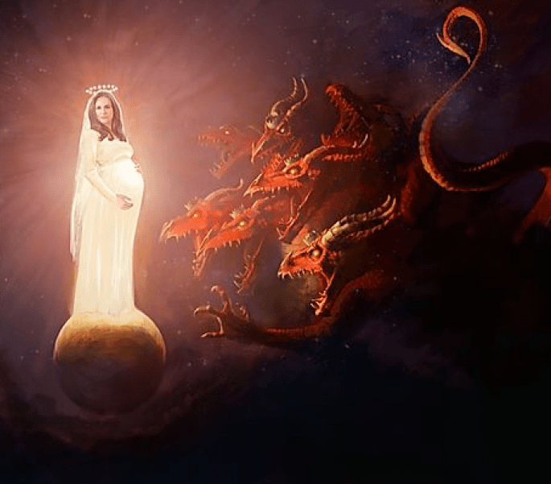
Revelation
12:4-5
⁴ And his tail drew the third part of the stars of heaven, and did cast them to the earth: and the dragon stood before the woman which was ready to be delivered, for to devour her child as soon as it was born.

Slide 43
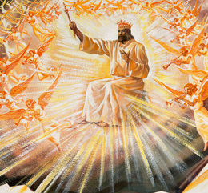
Revelation
12:4-5
⁵ And she brought forth a man child, who was to rule all nations with a rod of iron: and her child was caught up unto God, and to his throne.

Slide 44
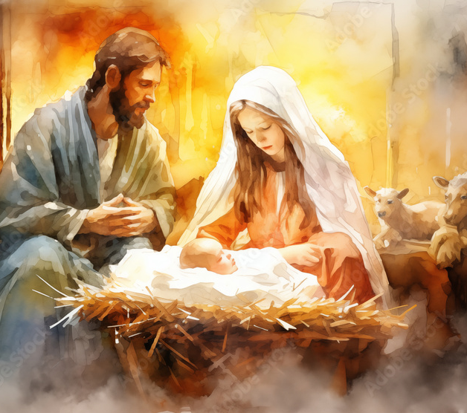
Matthew
2:1-2, 8, 16
2 Now when Jesus was born in Bethlehem of Judaea in the days of Herod the king, behold, there came wise men from the east to Jerusalem,

Slide 45
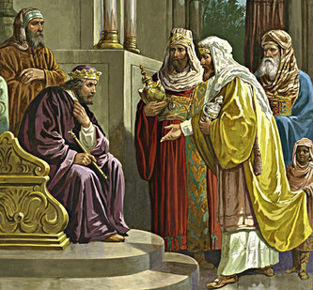
Matthew
2:1-2, 8, 16
² Saying, Where is he that is born King of the Jews? for we have seen his star in the east, and are come to worship him.

Slide 46
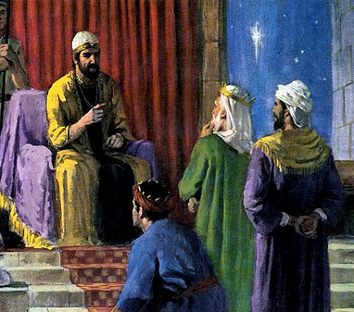
Matthew
2:1-2, 8, 16
⁸ And he sent them to Bethlehem, and said, Go and search diligently for the young child; and when ye have found him, bring me word again, that I may come and worship him also.

Slide 47
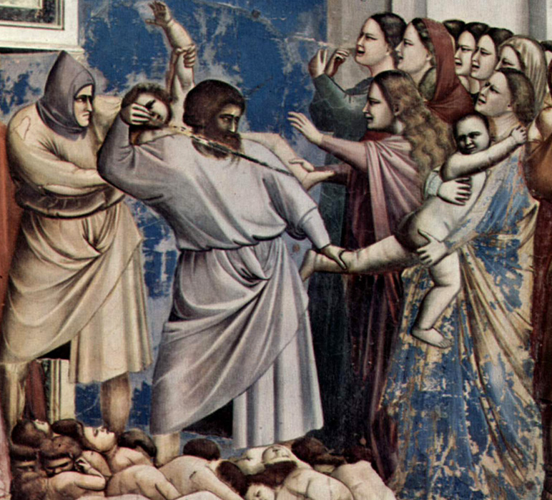
Matthew
2:1-2, 8, 16
¹⁶ Then Herod, when he saw that he was mocked of the wise men, was exceeding wroth, and sent forth, and slew all the children that were in Bethlehem, and in all the coasts thereof, from two years old and under, according to the time which he had diligently inquired of the wise men.

Slide 48
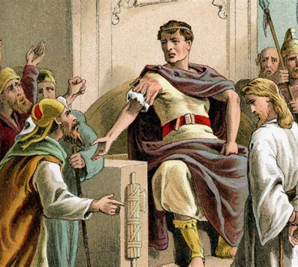
John
18:31
³¹ Then said Pilate unto them, Take ye him, and judge him according to your law. The Jews therefore said unto him, It is not lawful for us to put any man to death:

Slide 49
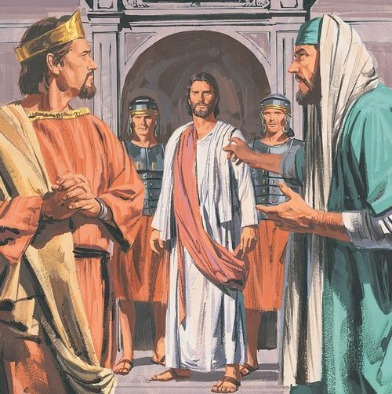
John
19:12, 15, 16
¹² And from thenceforth Pilate sought to release him: but the Jews cried out, saying, If thou let this man go, thou art not Caesar's friend: whosoever maketh himself a king speaketh against Caesar.

Slide 50
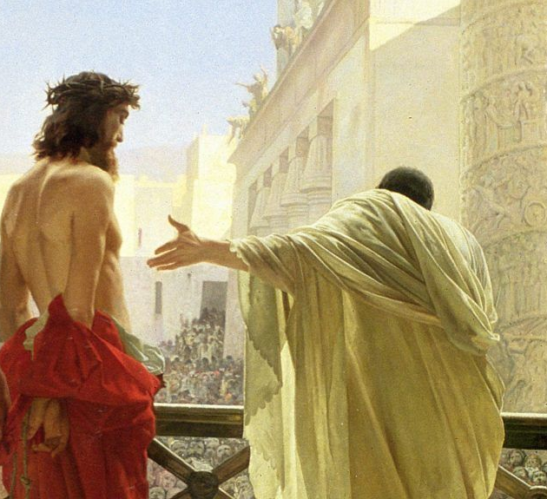
John
19:12, 15, 16
¹⁵ But they cried out, Away with him, away with him, crucify him. Pilate saith unto them, Shall I crucify your King? The chief priests answered, We have no king but Caesar.

Slide 51
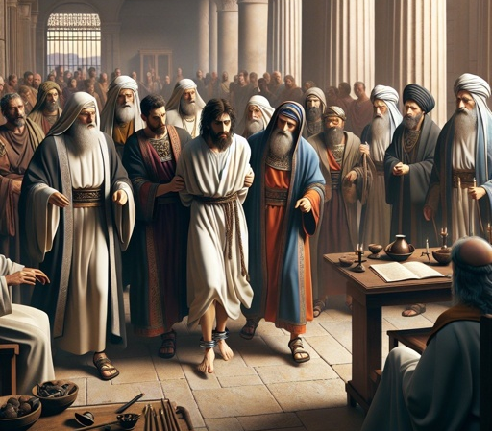
John
19:12, 15, 16
¹⁶ Then delivered he him therefore unto them to be crucified. And they took Jesus, and led him away.

Slide 52
16. Through what power did he manifest his wrath in the Dark Ages?
Answer: The beast.
Revelation 13:2, 5– 7; 12:14–16; Daniel 11:33, 34; Matthew 24:21, 22

Slide 53
Revelation
13:2, 5-7
² And the beast which I saw was like unto a leopard, and his feet were as the feet of a bear, and his mouth as the mouth of a lion: and the dragon gave him his power, and his seat, and great authority.

Slide 54
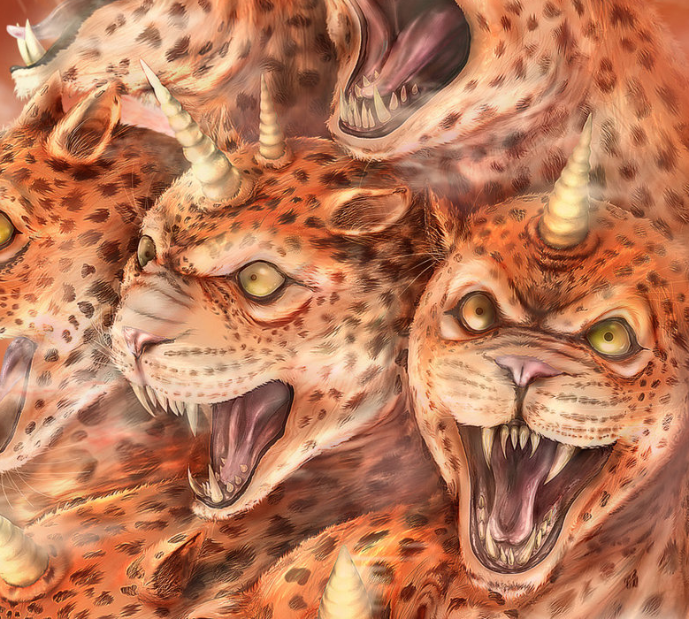
Revelation
13:2, 5-7
⁵ And there was given unto him a mouth speaking great things and blasphemies; and power was given unto him to continue forty and two months.

Slide 55
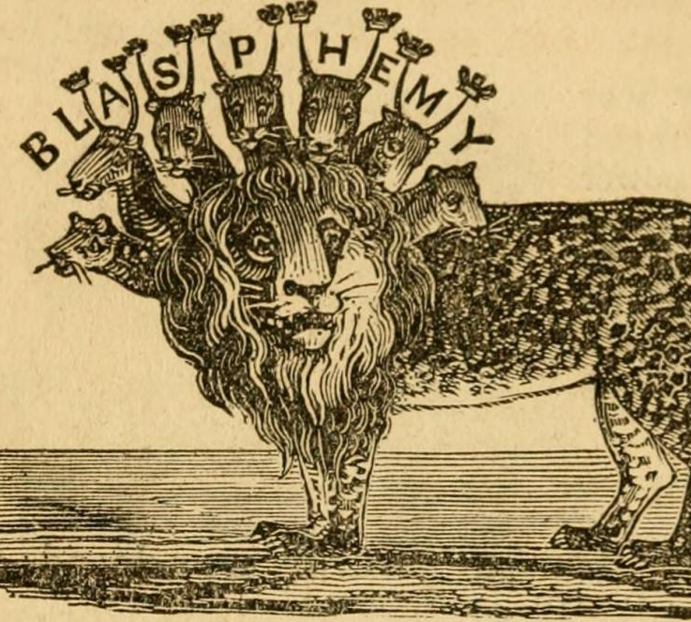
Revelation
13:2, 5-7
⁶ And he opened his mouth in blasphemy against God, to blaspheme his name, and his tabernacle, and them that dwell in heaven.

Slide 56
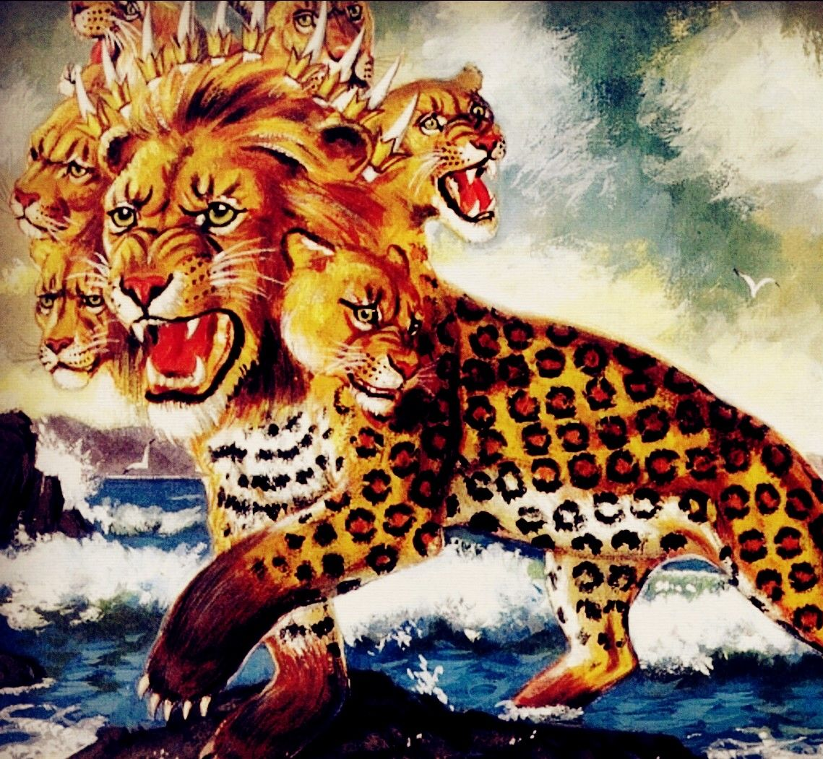
Revelation
13:2, 5-7
⁷ And it was given unto him to make war with the saints, and to overcome them: and power was given him over all kindreds, and tongues, and nations.

Slide 57
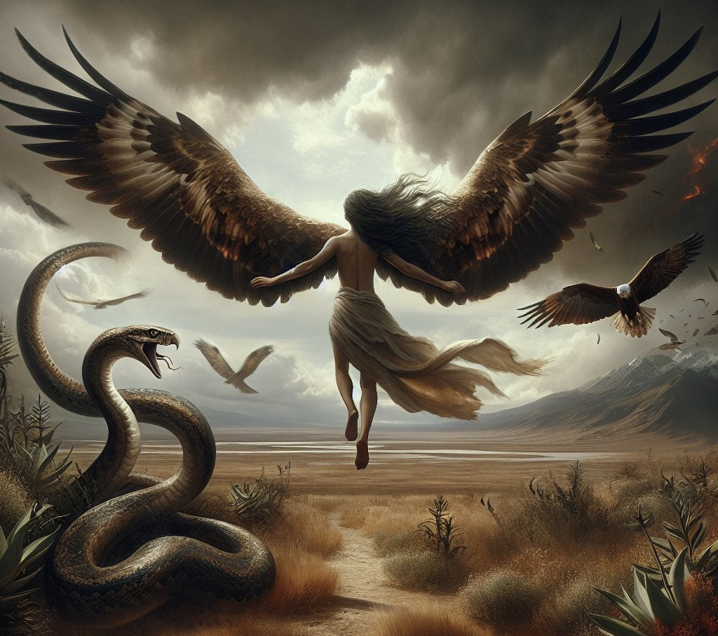
Revelation
12:14-16
¹⁴ And to the woman were given two wings of a great eagle, that she might fly into the wilderness, into her place, where she is nourished for a time, and times, and half a time, from the face of the serpent.

Slide 58
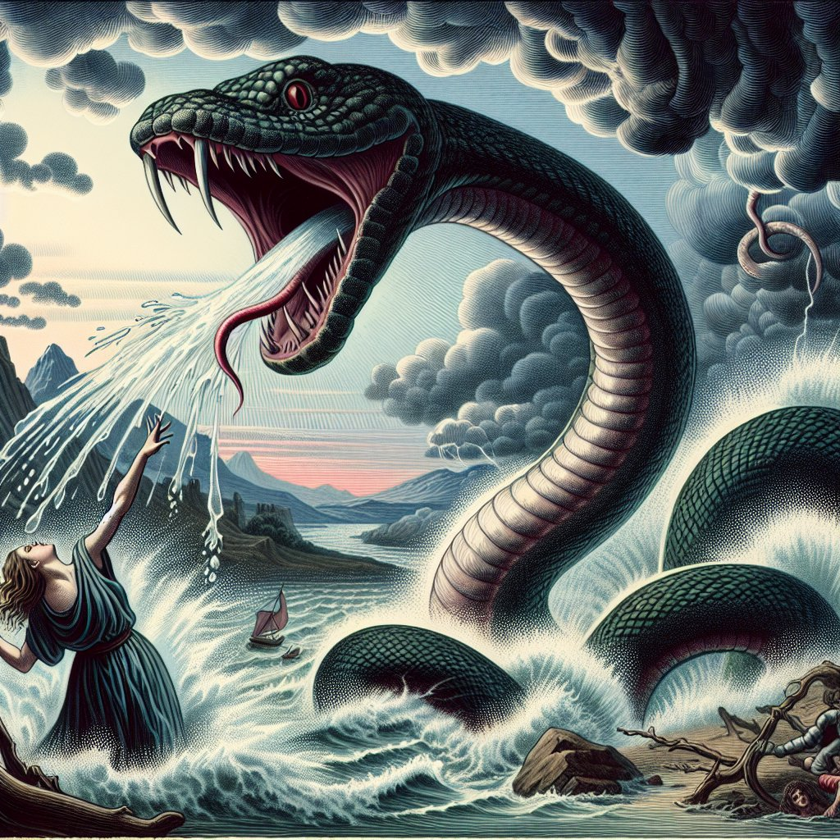
Revelation
12:14-16
¹⁵ And the serpent cast out of his mouth water as a flood after the woman, that he might cause her to be carried away of the flood.

Slide 59
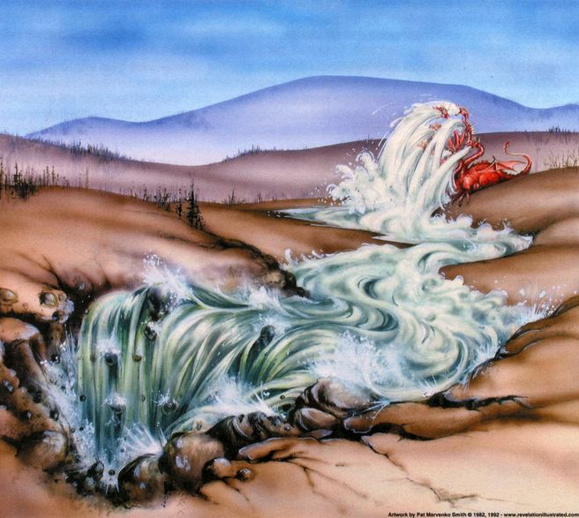
Revelation
12:14-16
¹⁶ And the earth helped the woman, and the earth opened her mouth, and swallowed up the flood which the dragon cast out of his mouth.

Slide 60
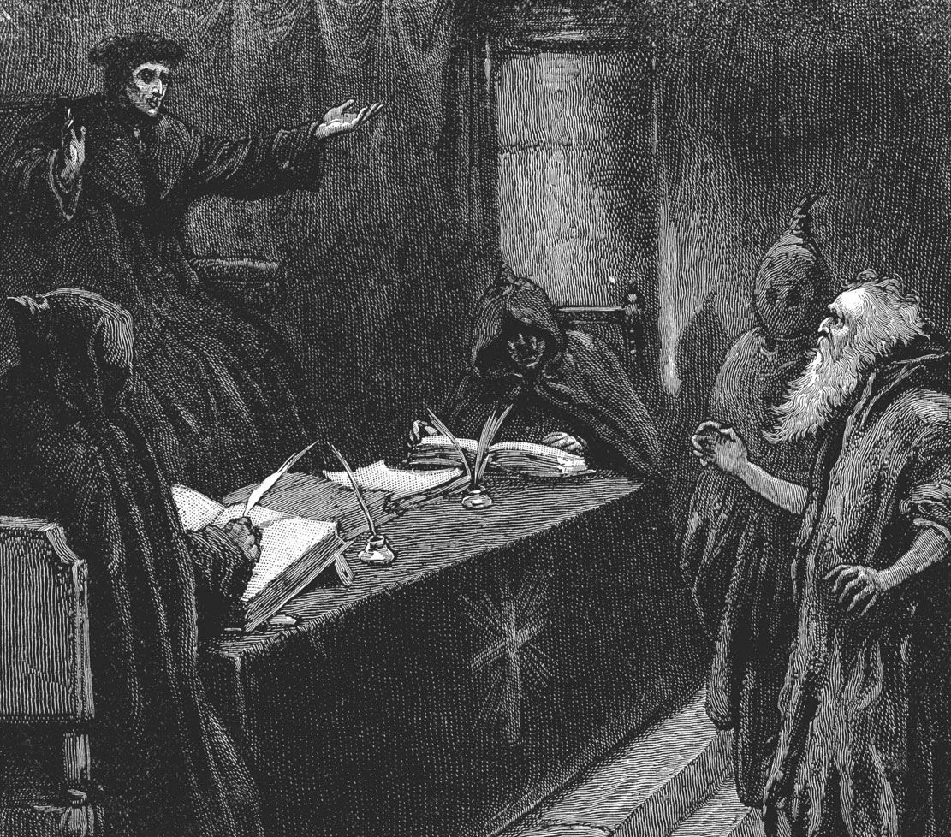
Daniel
11:33-34
³³ And they that understand among the people shall instruct many: yet they shall fall by the sword, and by flame, by captivity, and by spoil, many days.

Slide 61
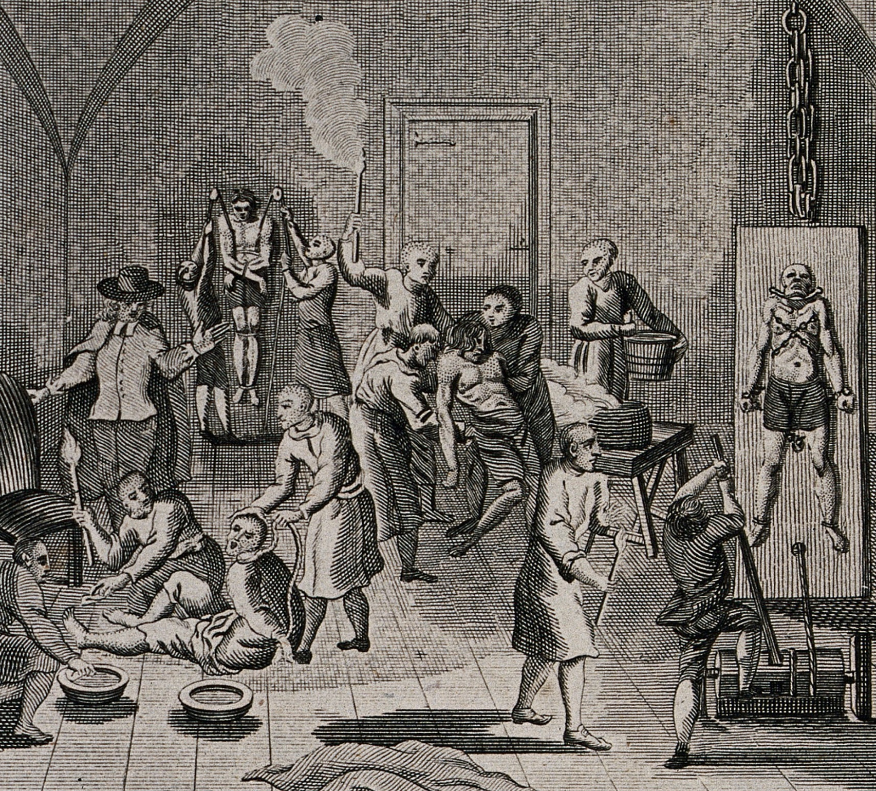
Daniel
11:33-34
³⁴ Now when they shall fall, they shall be holpen with a little help: but many shall cleave to them with flatteries.

Slide 62
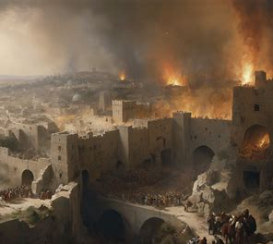
Matthew
24:21-22
²¹ For then shall be great tribulation, such as was not since the beginning of the world to this time, no, nor ever shall be.

Slide 63
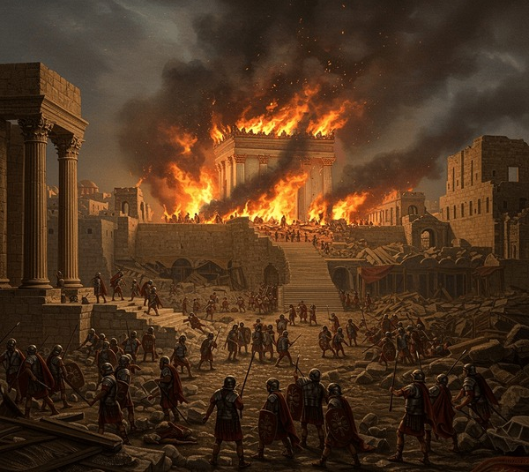
Matthew
24:21-22
²² And except those days should be shortened, there should no flesh be saved: but for the elect's sake those days shall be shortened.

Slide 64
17. Through what power will his wrath be poured out against the last of the church?
Answer: The image of the beast, in association with the beast.
Revelation 13:12, 14

Slide 65
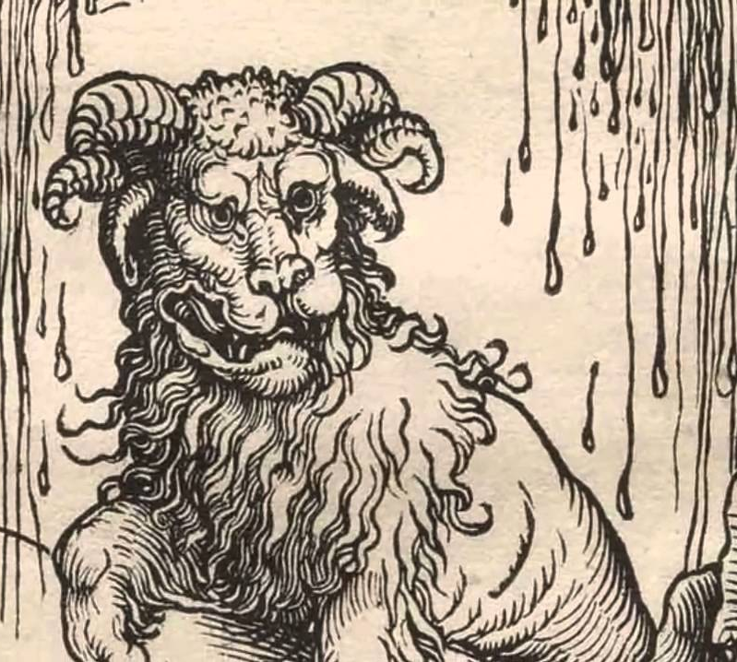
Revelation
13:12, 14
¹² And he exerciseth all the power of the first beast before him, and causeth the earth and them which dwell therein to worship the first beast, whose deadly wound was healed.

Slide 66
Revelation
13:12, 14
¹⁴ And deceiveth them that dwell on the earth by the means of those miracles which he had power to do in the sight of the beast; saying to them that dwell on the earth, that they should make an image to the beast, which had the wound by a sword, and did live.

Slide 67
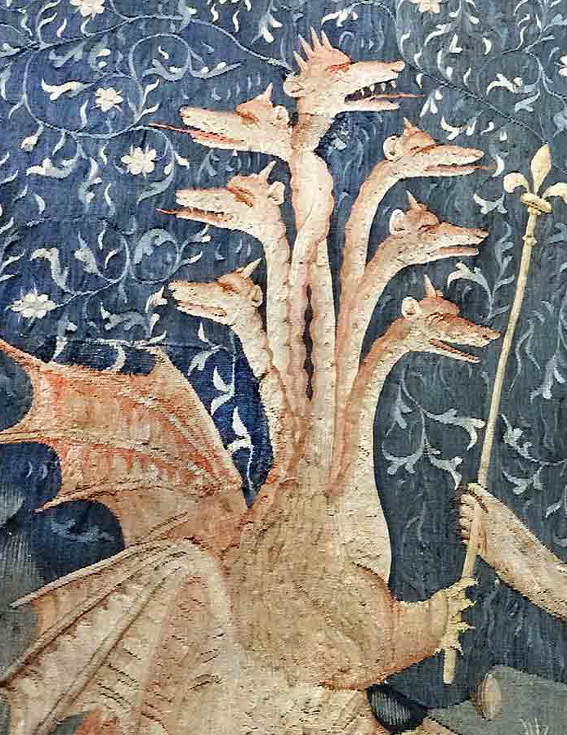
The Point
4. Satan Works Through Earthly Powers
The lesson traces a pattern:
Dragon (Satan) → gives power
Works through:
  Pagan Rome (against Christ)
  Papal Rome (against the saints)
  Final powers (against the remnant)
➡️ Same source, different instruments

Slide 68
18. What will specially excite his wrath against the poor remnant in this last effort?
Revelation 12:17

Slide 69
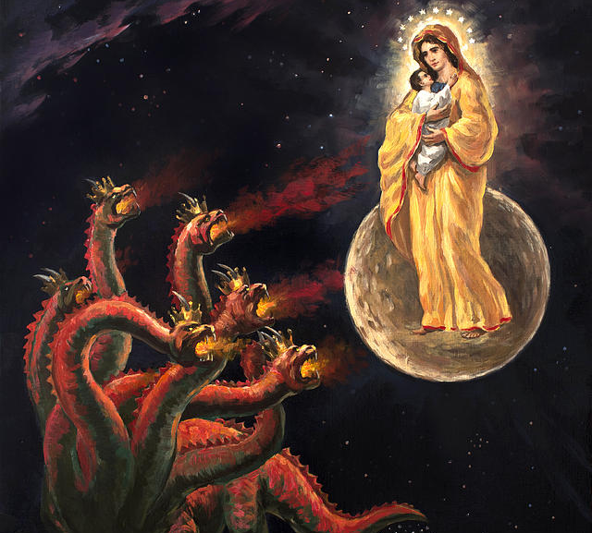
Revelation
12:17
¹⁷ And the dragon was wroth with the woman, and went to make war with the remnant of her seed, which keep the commandments of God, and have the testimony of Jesus Christ.

Slide 70

The Point
5. The Remnant Becomes the Target
At the end, Satan is especially angry with those who:
Keep God’s commandments
Hold to the testimony of Jesus (Rev. 12:17)
➡️ Because they resist his deception

Slide 71
19. What will the Third Angel’s Message do just at this time?
Answer: It will go to every nation, and kindred, and tongue, and people, calling them to keep the commandments of God and the faith of Jesus.

Slide 72
20. What is it then that will cause the devil to be so particularly wrathful, and to put forth all his power?
Answer: The Third Angel’s Message

Slide 73
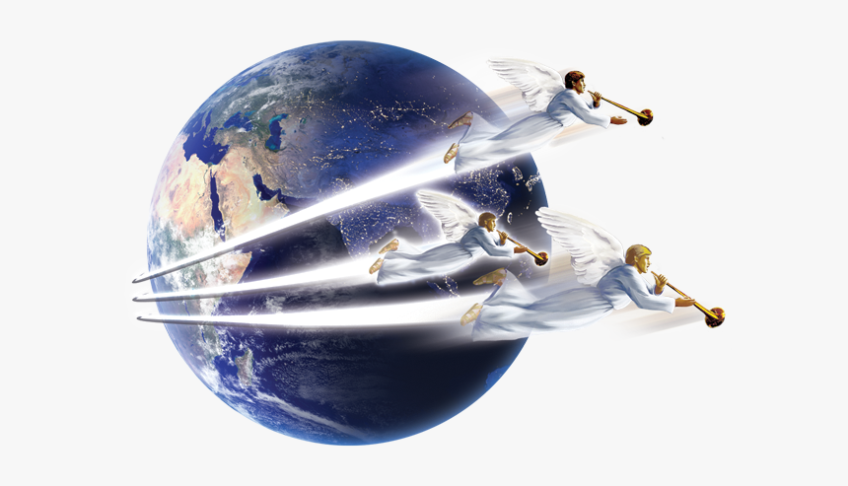
The Point
6. Why the Wrath Intensifies
The Third Angel’s Message:
Exposes Satan’s deceptions
Calls people out of false worship
Undermines his authority
➡️ This is what provokes his final wrath

Slide 74
21. Which side will get the victory?
Revelation 15:2

Slide 75
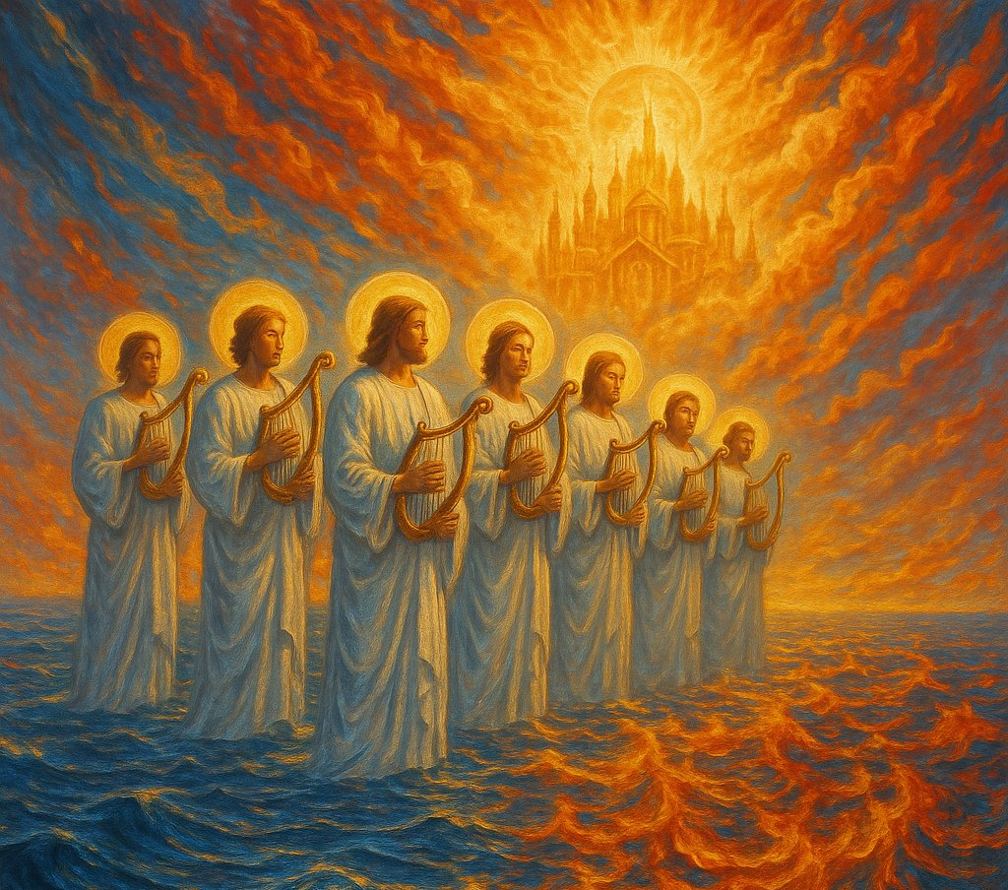
Revelation
15:2
² And I saw as it were a sea of glass mingled with fire: and them that had gotten the victory over the beast, and over his image, and over his mark, and over the number of his name, stand on the sea of glass, having the harps of God.

Slide 76
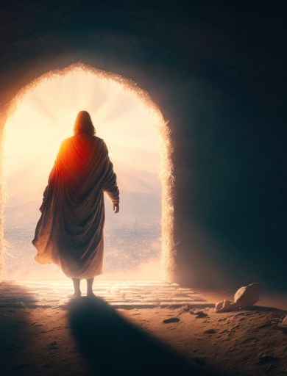
The Point
7. But God’s People Win
Despite the conflict:
📖 Revelation 15:2
➡️ God’s people gain victory over:
The beast
His image
His mark

Slide 77
Thank you!
… and Happy Sabbath!!

Slide 78


