Slide 1


Slide 2

Living the Light

Slide 3
The Third Angel’s Message
Lesson 15: THE Working of Satan
October 13, 1888
Lesson 15, 3rd Quarter 1888

Slide 4

Isaiah
8:17
¹⁷ And I will wait upon the Lord, that hideth his face from the house of Jacob, and I will look for him.

Slide 5

1. What will be said to the people just before the Lord comes?
Isaiah 8:19, with verse 17

Slide 6
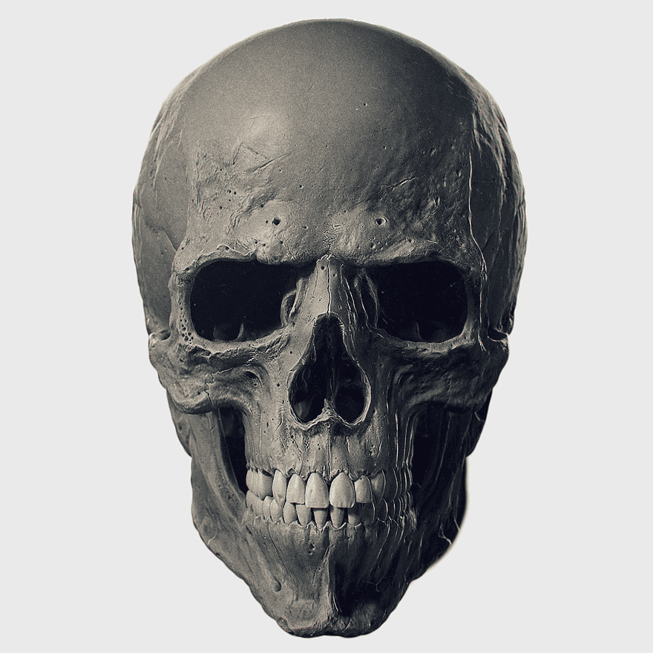
Isaiah
8:19, 17
¹⁹ And when they shall say unto you, Seek unto them that have familiar spirits, and unto wizards that peep, and that mutter: should not a people seek unto their God? for the living to the dead?

Slide 7

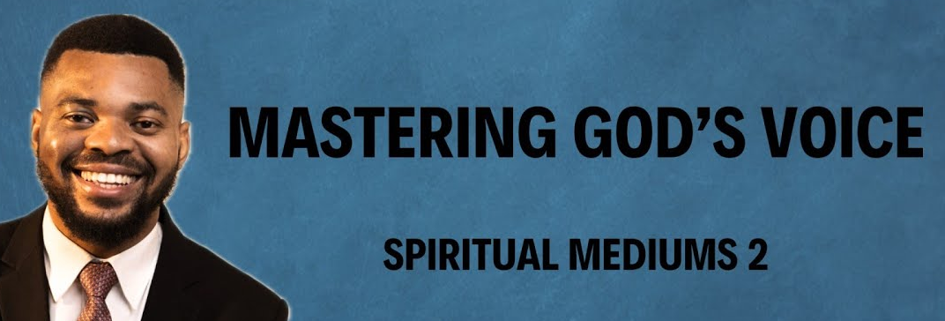
Where do people go for answers when God seems silent?
Spiritualism is not only a religion but a way of life. It is using your intuition or your sixth sense. It is finding the God or Great Spirit within. Finding your God. We are all different. Different upbringings, cultures and beliefs. Finding our God will bring love into our hearts and peace within.

Slide 8

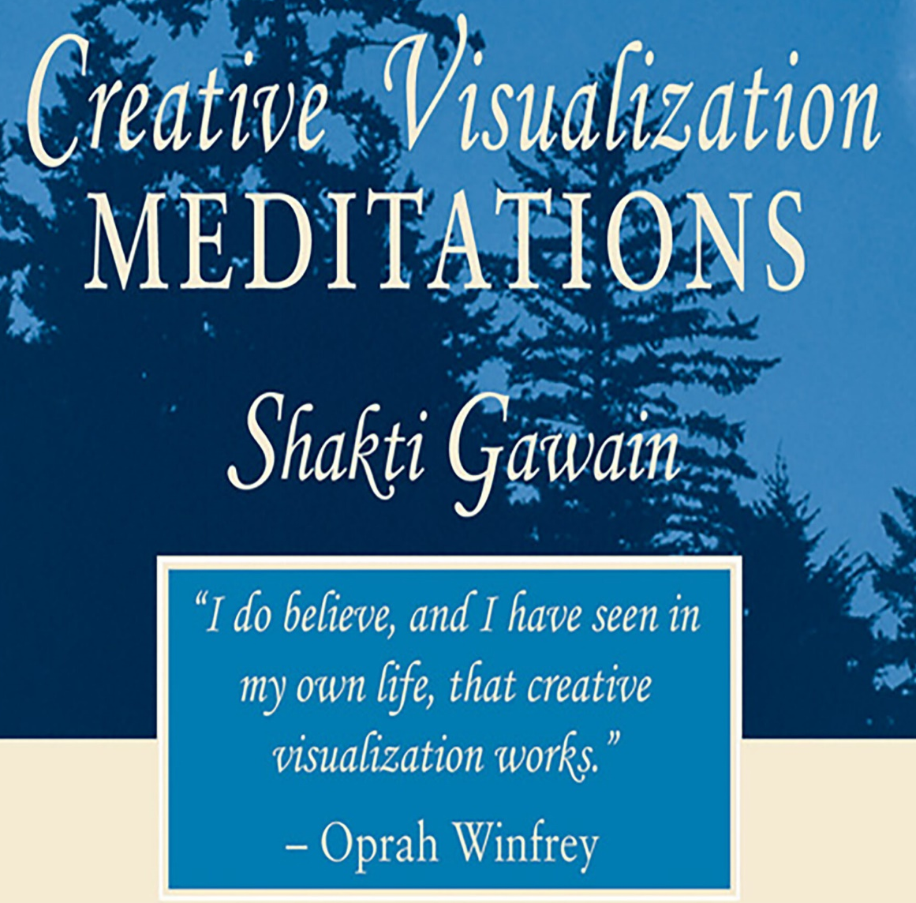
Where do people go for answers when God seems silent?

Slide 9

Isaiah
8:17
¹⁷ And I will wait upon the Lord, that hideth his face from the house of Jacob, and I will look for him.

Slide 10
2. What is the object of their seeking unto them that have familiar spirits?
Answer: To obtain communication with the dead.
Isaiah 8:19, last part.

Slide 11

Isaiah
8:19
¹⁹ And when they shall say unto you, Seek unto them that have familiar spirits, and unto wizards that peep, and that mutter: should not a people seek unto their God? for the living to the dead?

Slide 12
3. What is that doctrine called?
Answer: Spiritualism.

Slide 13
4. Do the dead know anything?
Ecclesiastes 9:5, 6

Slide 14

Ecclesiastes 9:5, 6
⁵ For the living know that they shall die: but the dead know not any thing, neither have they any more a reward; for the memory of them is forgotten.

Slide 15

Ecclesiastes 9:5, 6
⁶ Also their love, and their hatred, and their envy, is now perished; neither have they any more a portion for ever in any thing that is done under the sun.

Slide 16
5. What are the familiar spirits which these persons have, and with which men are invited to communicate?
Revelation 16:14.

Slide 17
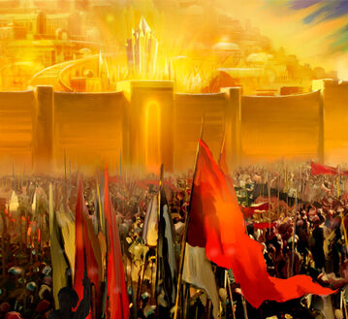
Revelation 16:14
¹⁴ For they are the spirits of devils, working miracles, which go forth unto the kings of the earth and of the whole world, to gather them to the battle of that great day of God Almighty.

Slide 18
6. What have we found to be one great object of these miracles and lying wonders?
Revelation 13:14.

Slide 19
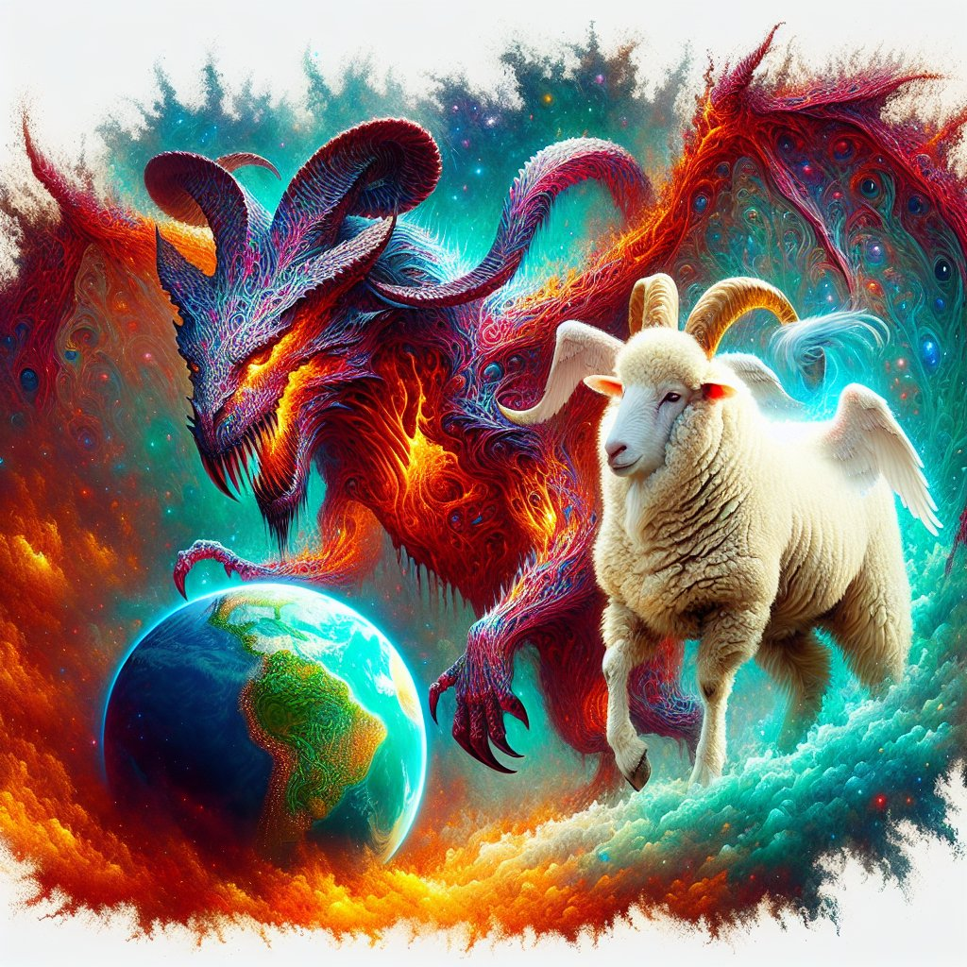
Revelation 13:14
¹⁴ And deceiveth them that dwell on the earth by the means of those miracles which he had power to do in the sight of the beast; saying to them that dwell on the earth, that they should make an image to the beast, which had the wound by a sword, and did live.

Slide 20
7. What does this prove?
Answer: That Spiritualism will act a most important part in making the image to the beast, and enforcing the worship of the beast and his image.

Slide 21
8. When the National Reformers secure their National Constitutional acknowledgment, what do they expect?

Slide 22
8. When the National Reformers secure their National Constitutional acknowledgment, what do they expect?

Slide 23

New York National Reform Convention, 1873
“Let us acknowledge God as our Father and Sovereign, and Source of all good, and his blessing will be upon us. Crime and corruption will come to an end, and the benign reign of Jesus, our rightful Lord, will be established.”

Slide 24

New York National Reform Convention, 1873
“Either like them [the Jews] we will reject him and perish, or becoming a kingdom of our Lord and his Christ, we shall fill the earth and endure forever.”

Slide 25

New York National Reform Convention, 1873
“And when we reach the summit … the train will move out into the most glorious light of millennial days, and the cry will be raised, ‘The kingdoms of this world have become the kingdoms of our Lord and his Christ.’’”

Slide 26
9. When they shall have set up what they call his kingdom, what then do they expect?
Answer:
“When we finish our testimony, then Christ will come and finish his work.”
— Secretary J. M. Foster, Reformed Presbyterian and Covenanter, December, 1887, p. 403.

Slide 27
10. By whom will there be great signs and wonders wrought to deceive?
Matthew 24:24.

Slide 28
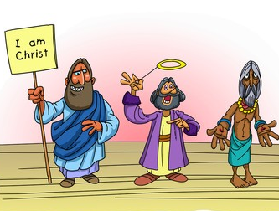
Matthew 24:24
²⁴ For there shall arise false Christs, and false prophets, and shall shew great signs and wonders; insomuch that, if it were possible, they shall deceive the very elect.

Slide 29
11. Who will finally manifest, and work with, all power?
2 Thessalonians 2:8.

Slide 30
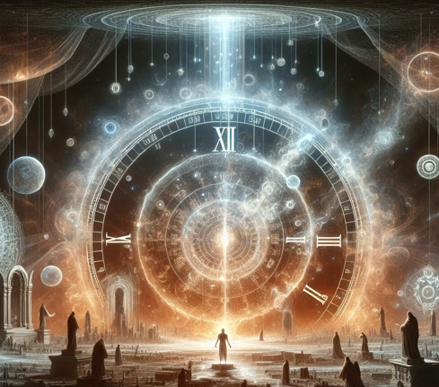
2 Thessalonians 2:8
⁸ And then shall that Wicked be revealed, whom the Lord shall consume with the spirit of his mouth, and shall destroy with the brightness of his coming:

Slide 31
12. As these great wonders are to be wrought by false christs, and as Satan is to work the greatest of them, then in what form will Satan present himself in this?
Answer: In the form of a false christ.

Slide 32
13. When the National Reform kingdom shall have been formed, and Satan, by this great wonder-working power, shall be transformed into an angel of light, and thus shall come personating Christ, then what will be the universal shout?
Answer: “Christ has come;” “The kingdoms of this world have become the kingdoms of our Lord and his Christ.”

Slide 33
14. Then who will be the king of the National Reform Government?

Slide 34
15. Is Spiritualism expecting such a new messiah?
Answer: Spiritualism promises a new messiah, and announces his coming “to this very generation.”

Slide 35
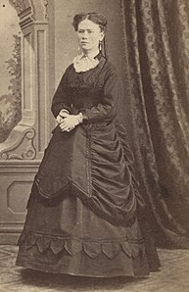
The World’s Advance Thought was thought to be the messenger of the new spiritual dispensation.
Issued from about 1886-1905, this influential publication was largely the work of Lucy Mallory, a "suffragist, vegetarian, and devotee of metaphysical experiences.” Leo Tolstoy was so influenced by Mallory's magazine that he called her the "greatest woman in America.”

Slide 36

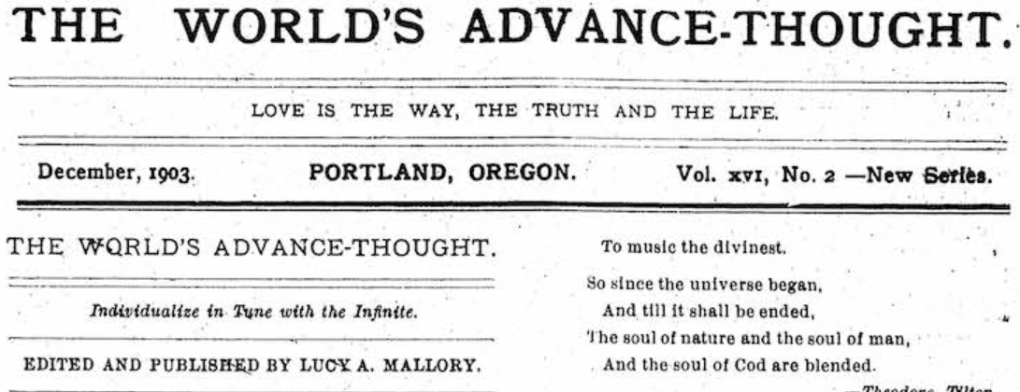

Slide 37
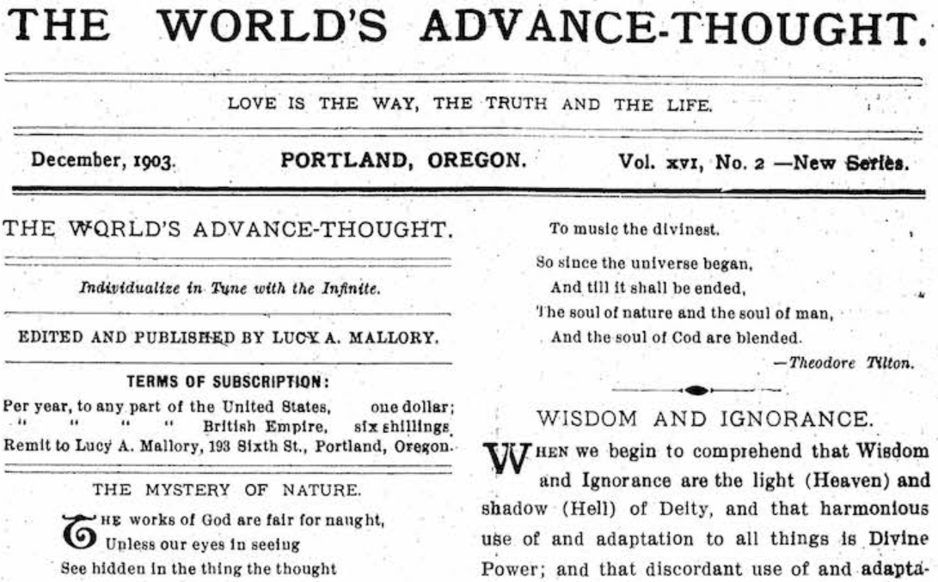

Slide 39
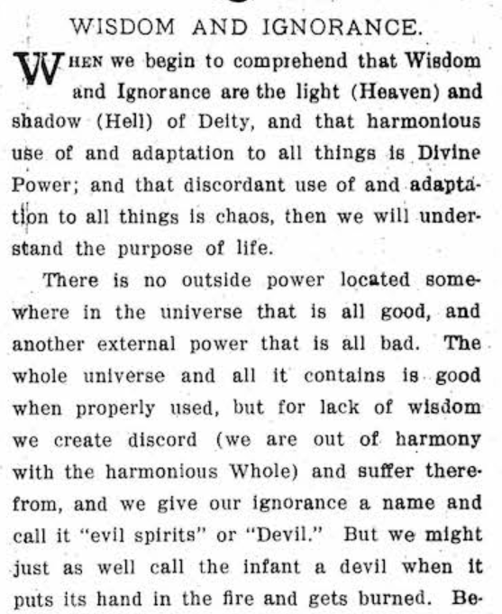


Slide 40

In its issue of April 5, 1886, The World’s Advance-Thought says:
“Another sun of righteousness is called for on earth, and the messenger cannot be far off whose life mission it shall be to practically illustrate the new truths that will be vouchsafed…

Slide 41
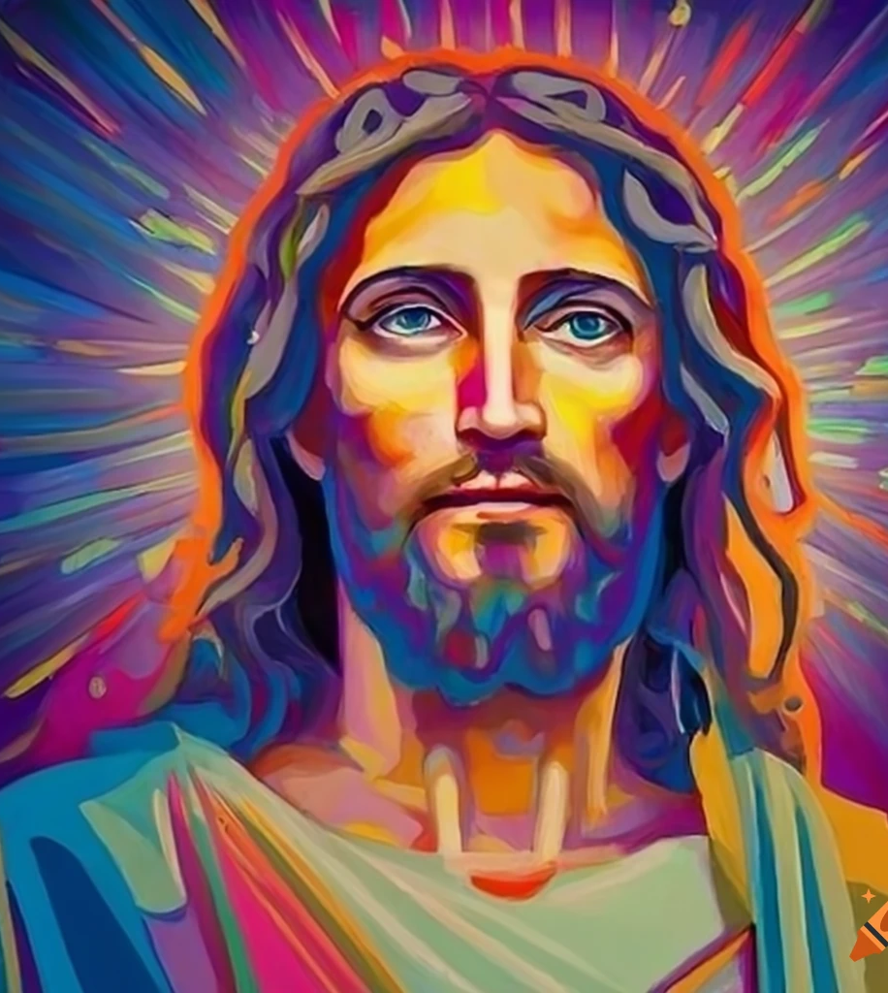
He will not be a mere racial messiah, nor a half-world messiah, as was the great Nazarene;
but something combining the sudden locomotion and lightning communication,

Slide 42

…and the harmonizing influences of commercial intercourse, have made a whole-world messiah possible, and such the next one shall be.

Slide 43
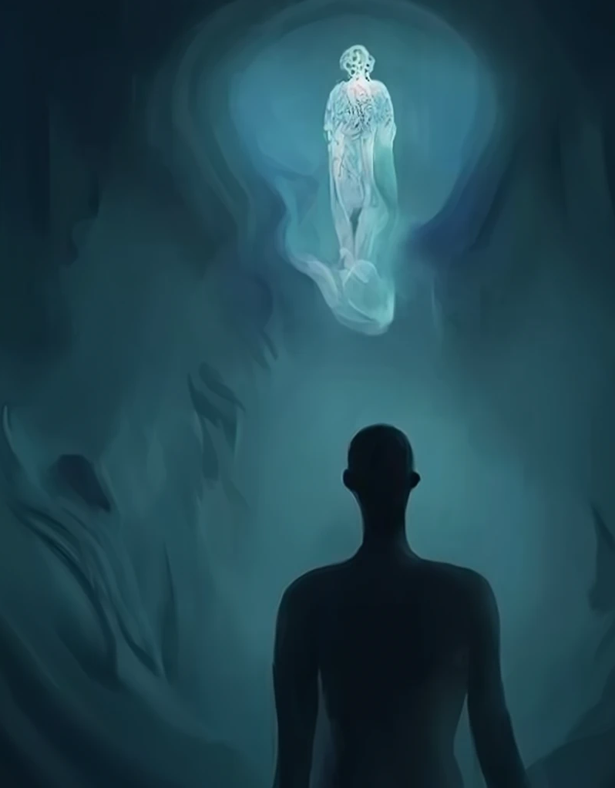
Though themselves ignorant of the fact, as a body, the great and multiplying army of mediums are his avant-couriers…
The unanimity of the immortals’ answers may thrill the world with the promise of a new messiah.”

Slide 44
16. What says infidelity?
That is, ‘what says the unbeliever, the unfaithful person?’ It’s asking how the opponents of truth respond to the topics under discussion.

Slide 45

P. Shu-maker, Flat Creek, La., in a letter to the editor of the American Sentinel (SDA), Sept. 17, 1887.
“Now I think I can safely say that if the National Reform movement succeeds, and God will sign and seal his edicts, so that there can be no doubts about their authority,

Slide 46
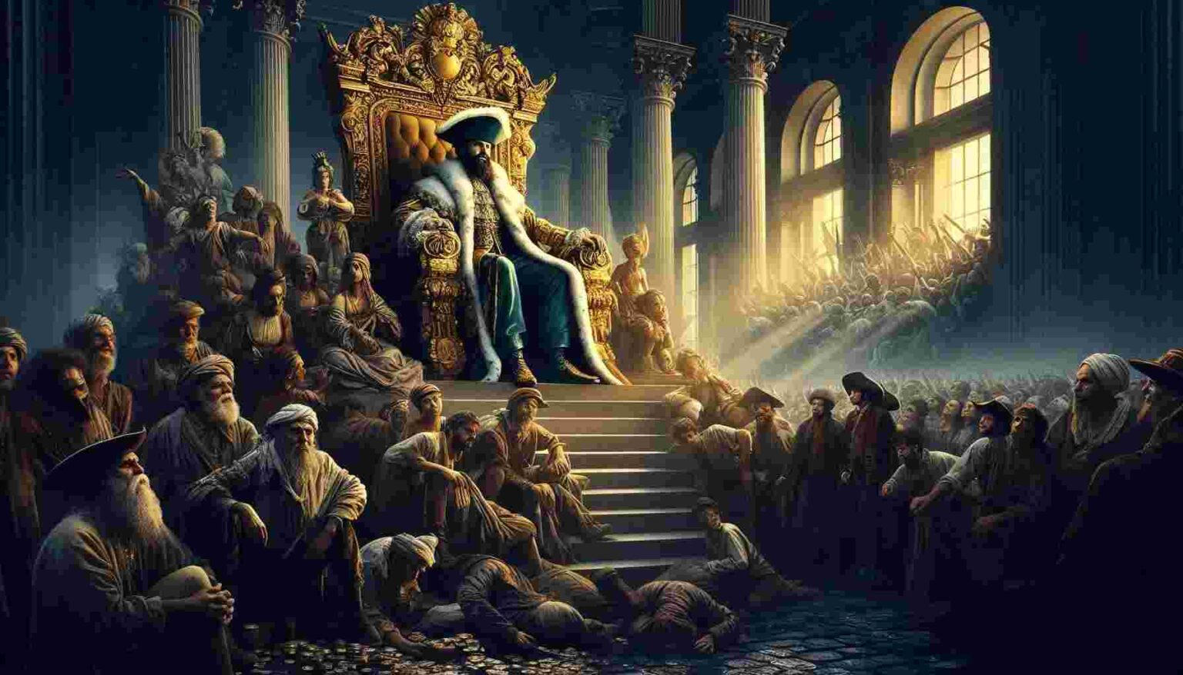
…the disbelievers will cheerfully obey them, and if Jesus will come and sit visibly on the throne, where we can see and talk to him, there will be no unbelievers, and all will obey.”

Slide 47
17. What says the National W. C. T. U.?
That is, the Women’s Christian Temperance Union, a powerful political group at the time. Prohibition hadn’t started yet, after all.

Slide 48
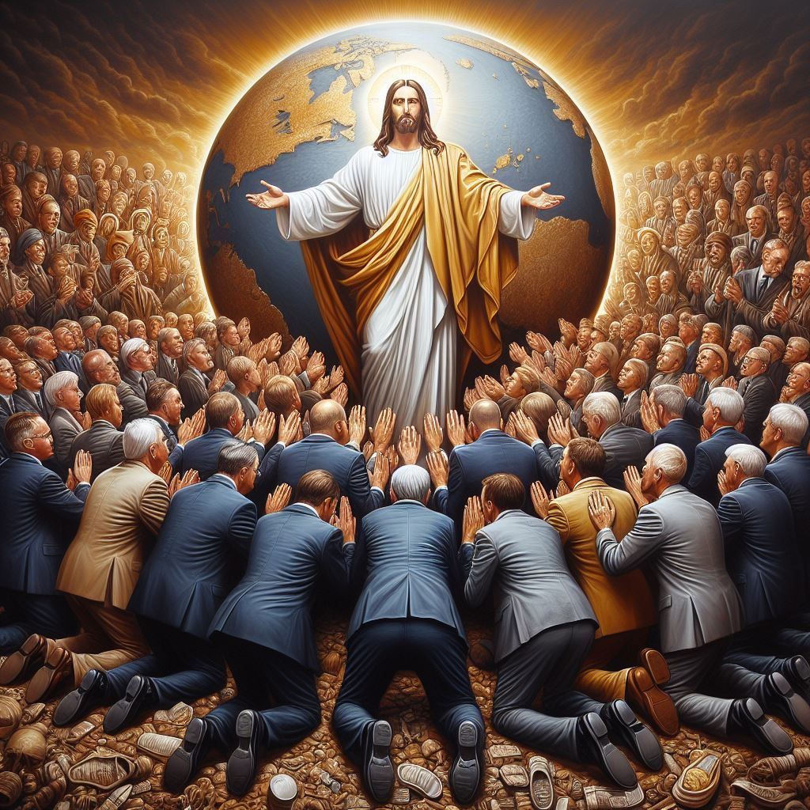
Union Signal (official WCTU publication) December 1, 1887, p. 2.
“The Woman’s Christian Temperance Union, local, State, national and world-wide, has one vital, organic thought, one all-absorbing purpose, one undying enthusiasm, and it is that Christ shall be this world’s king…

Slide 49
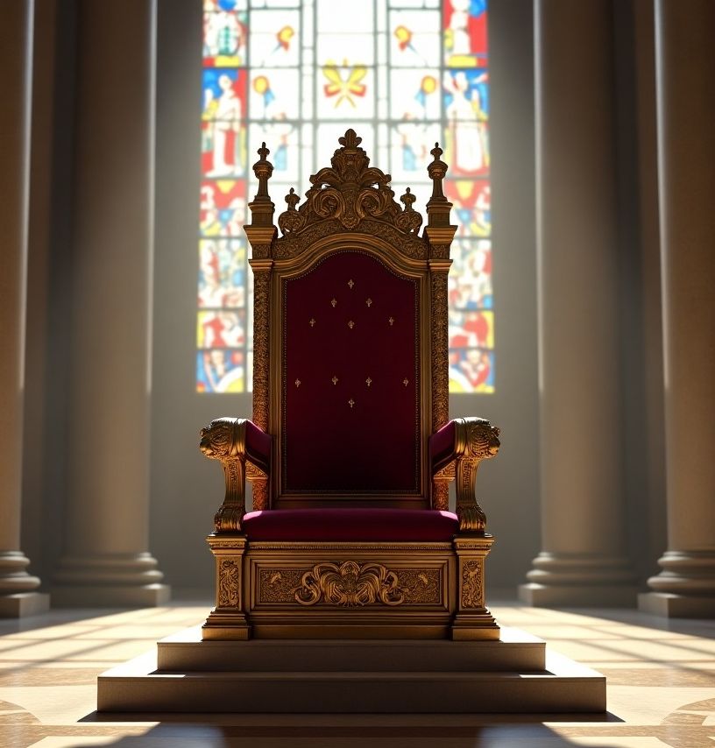
Yes, verily, this world’s king in its realm of cause and effect; king of its courts, its camps, its commerce; king of its colleges and cloisters; king of its customs and its constitutions.”

Slide 50
18. Taking all these with the other different bodies that now favor the National Reform movement, and how general will be the acceptance of the king of the National Reform government?

Slide 51
19. What have we found given to save men from this terrible deception?

Slide 52

What saves a person… any Person.. From deception?

Slide 53
What saves a person… any Person.. From deception?
How about the love of the truth?
(2 Thessalonians 2:10)

Slide 54
20. Then who alone will refuse to acknowledge the National Reform king?
Answer: Those who receive the love of the truth of the Third Angel’s Message.

Slide 55
Thank you!
… and Happy Sabbath!!

Slide 56


Slide 57
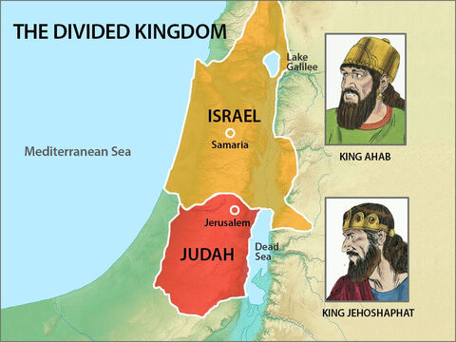

Slide 58
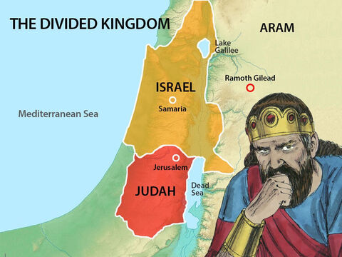

Slide 59
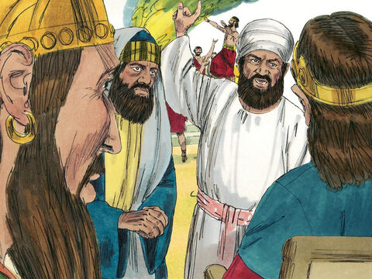

Slide 60
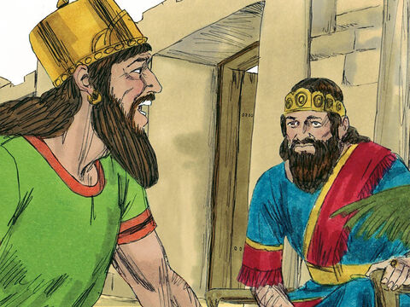

Slide 61
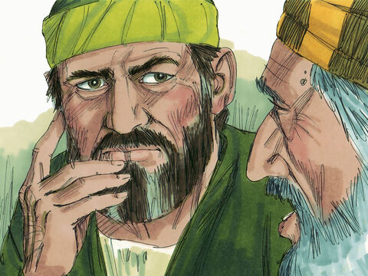

Slide 62
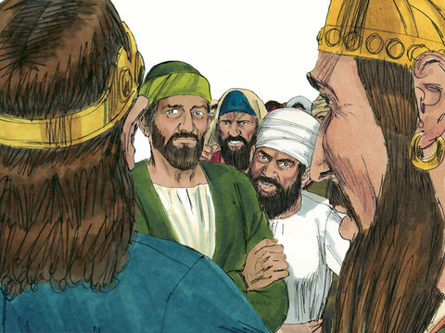

Slide 63
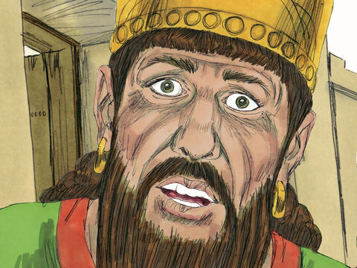

Slide 64
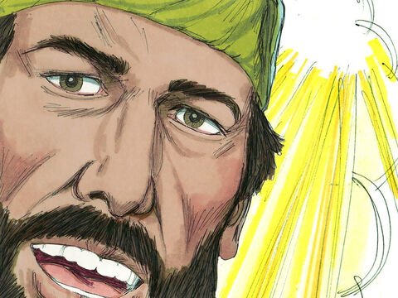

Slide 65
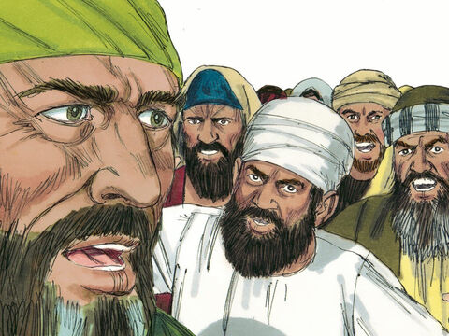

Slide 66
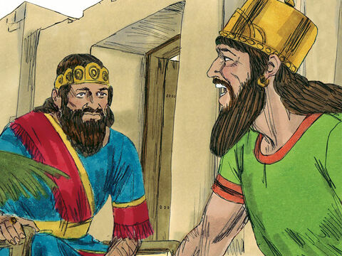

Slide 67
