Slide 1


Slide 2

Living the Light

Slide 3
The Third Angel’s Message
Lesson 16: THE FINAL CONTEST AND THE VICTORY
October 20, 1888
Lesson 16, 3rd Quarter 1888

Slide 4
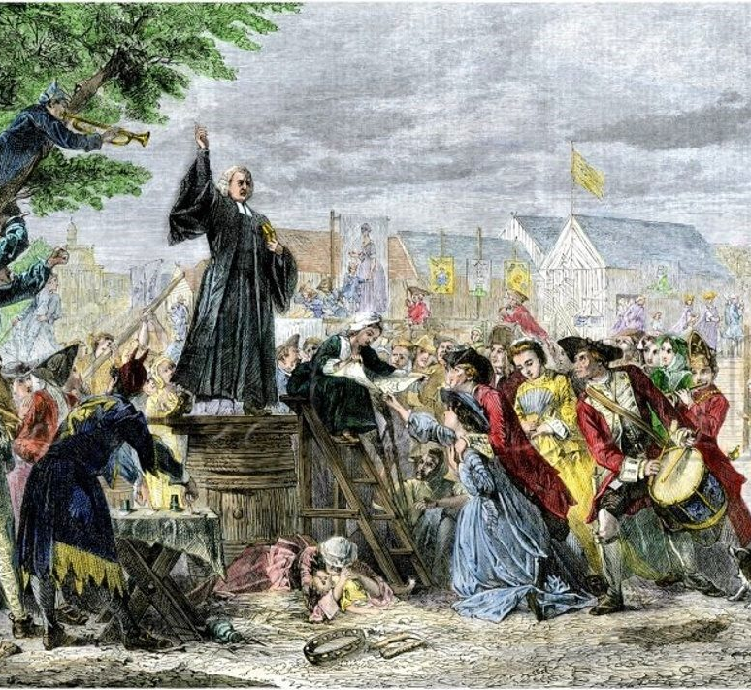
The National Reform Movement
The National Reform Movement wanted to change the U.S. Constitution to officially recognize God and make the nation explicitly Christian.

Slide 5
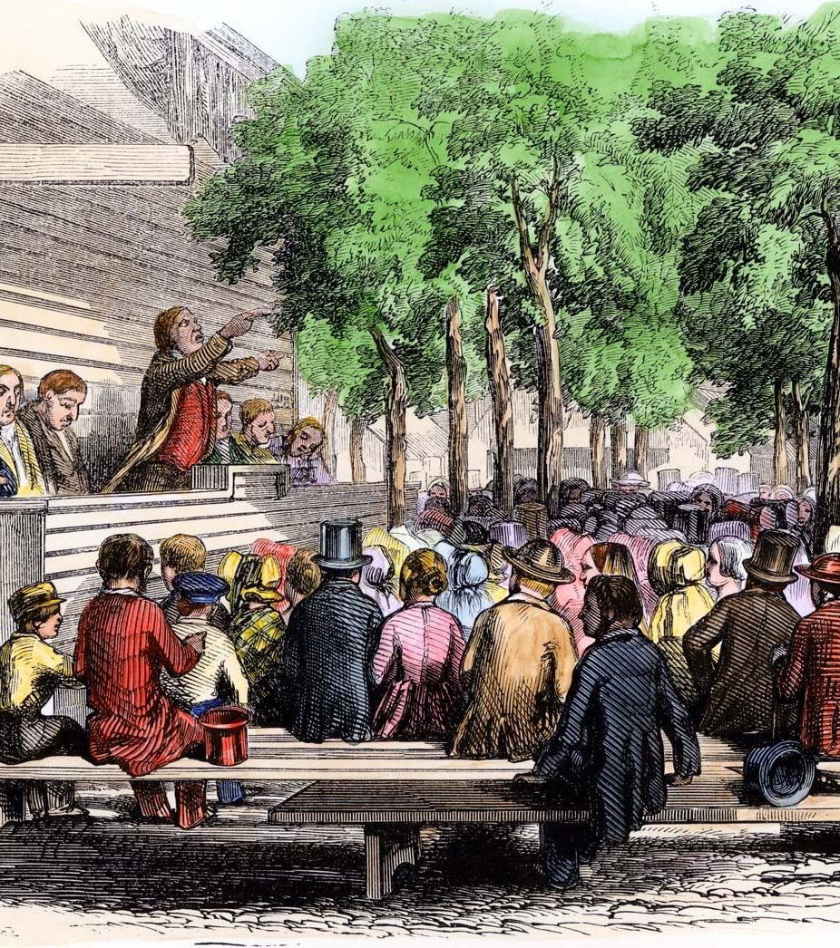
The National Reform Movement
They wanted to “secure such an amendment to the Constitution of the United States as shall suitably express our national acknowledgment of Almighty God as the source of all authority in civil government; of the Lord Jesus Christ as the Ruler of nations; and of his revealed will as of supreme authority; and thus indicate that this is a Christian nation, and place all the Christian laws, institutions, and usages of the Government on an undeniable legal basis in the fundamental law of the land.”

Slide 6
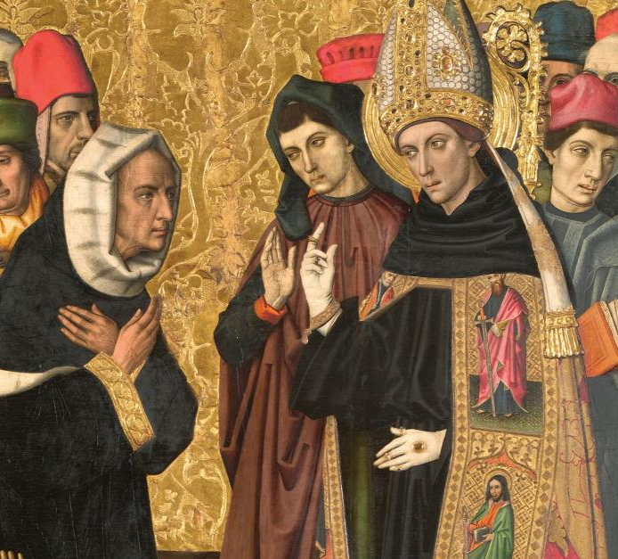
The National Reform Movement
“Every government by equitable laws, is a government of God; a republic thus governed is of him, and is truly and really a theocracy as the commonwealth of Israel.”
—Cincinnati National Reform Convention, page 28.

Slide 7
Christian Statesman, December 11, 1884.
“We cordially, gladly, recognize the fact that in the South American republics, and in France and other European countries, the Roman Catholics are the recognized advocates of national Christianity, and stand opposed to all the proposals of secularism. Whenever they are willing to co-operate in resisting the progress of political atheism, we will gladly join hands with them. In a World’s Conference for the promotion of National Christianity—which ought to be held at no distant day—many countries could be represented only by Roman Catholics.”

Slide 8

P. Shu-maker, Flat Creek, La., in a letter to the editor of the American Sentinel (SDA), Sept. 17, 1887.
“Now I think I can safely say that if the National Reform movement succeeds, and God will sign and seal his edicts, so that there can be no doubts about their authority,

Slide 9
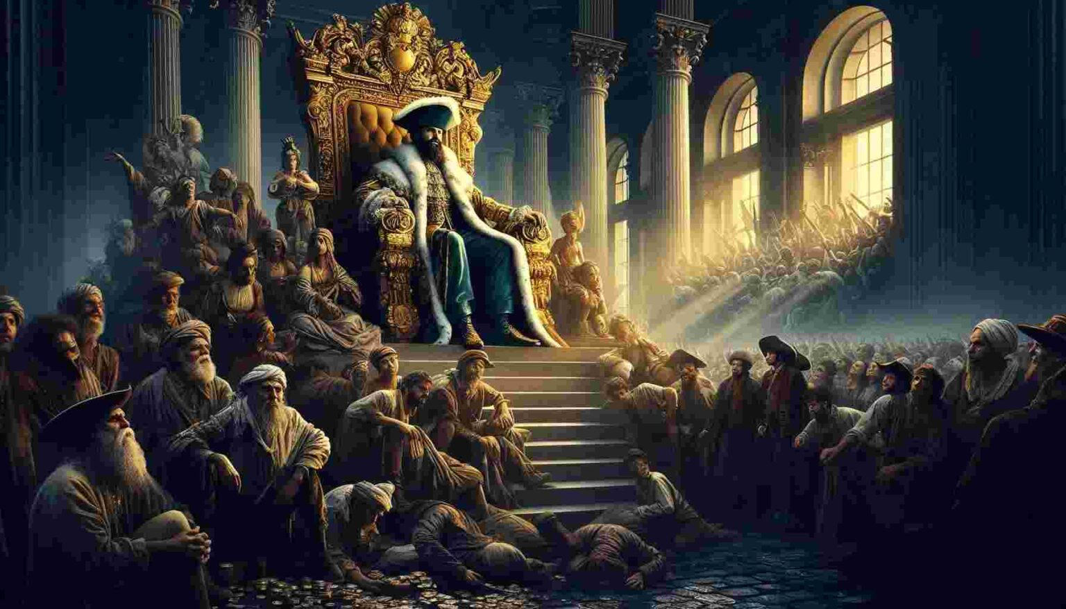
…the disbelievers will cheerfully obey them, and if Jesus will come and sit visibly on the throne, where we can see and talk to him, there will be no unbelievers, and all will obey.”

Slide 10
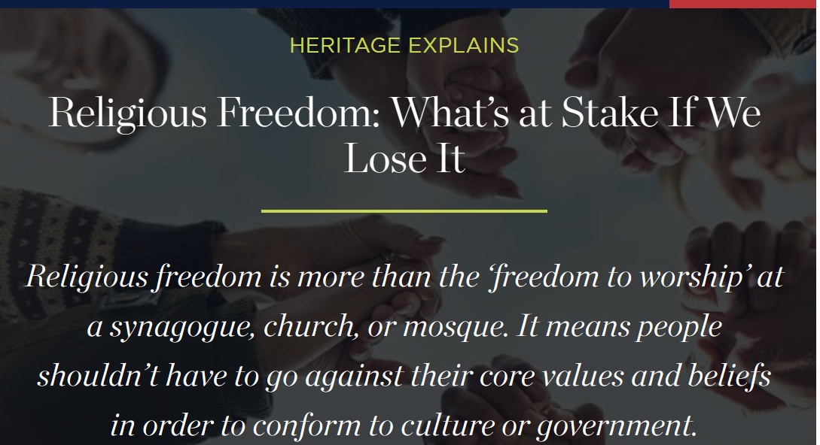

Slide 11
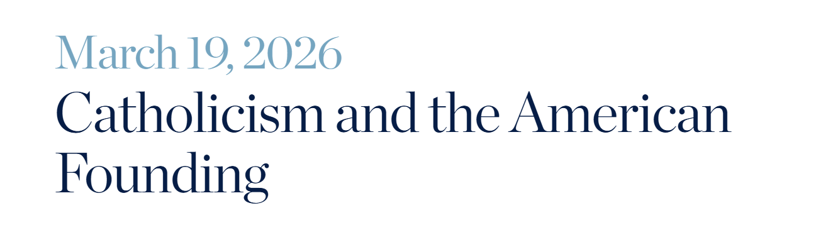
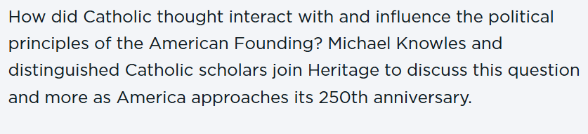

Slide 12
1. Who will be the National Reform king?

Slide 13
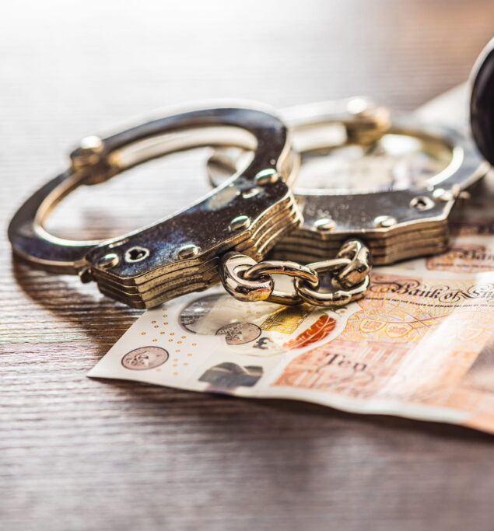
New York National Reform Convention, 1873
“Let us acknowledge God as our Father and Sovereign, and Source of all good, and his blessing will be upon us. Crime and corruption will come to an end, and the benign reign of Jesus, our rightful Lord, will be established.”

Slide 14
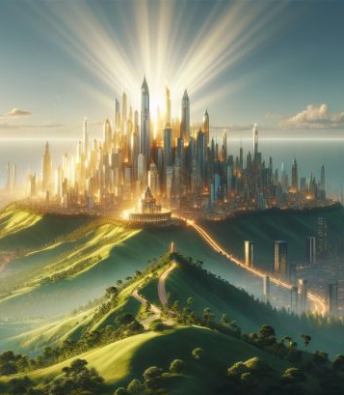
New York National Reform Convention, 1873
“Either like them [the Jews] we will reject him and perish, or becoming a kingdom of our Lord and his Christ, we shall fill the earth and endure forever.”

Slide 15

New York National Reform Convention, 1873
“And when we reach the summit … the train will move out into the most glorious light of millennial days, and the cry will be raised, ‘The kingdoms of this world have become the kingdoms of our Lord and his Christ.’’”

Slide 16

2. Who alone will refuse to acknowledge him as Christ?

Slide 17
3. What do the National Reformers say will be done with all such?

Slide 18
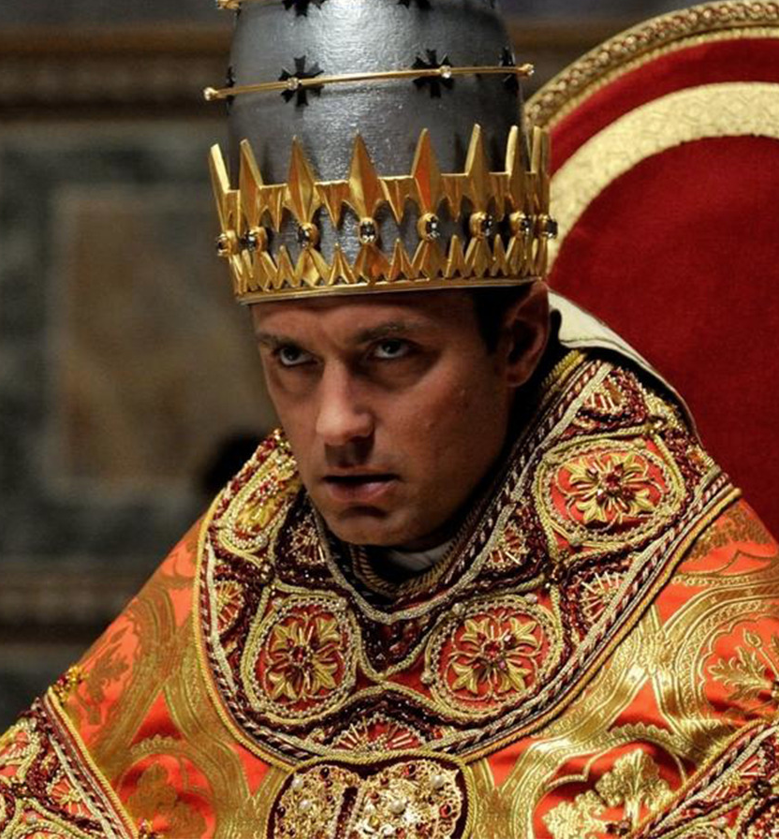
The National Reform Movement
Answer: “The day is coming when all professed Christians who deny the kingship of Christ over the nations, together with their infidel confederates, will, at Christ’s command, be slain before his face, because they will not have him to reign over them.”
—Secretary M. A. Gault, in Christian Statesman, January 14, 1886.

Slide 19
4. What did the prophecy say they would do?
Revelation 13:15
Note: The lesson implies that the National Reform Movement is developing into the image of the beast. So by “they” in this question the lesson is here referring to a movement that supports using civil power for religious purposes… the image of the beast.

Slide 20
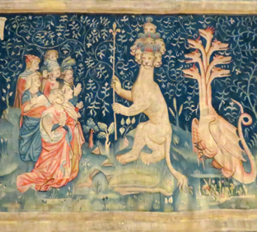
Revelation 13:15
¹⁵ And he had power to give life unto the image of the beast, that the image of the beast should both speak, and cause that as many as would not worship the image of the beast should be killed.

Slide 21
5. What then will those be doing?
Revelation 14:12
Note: We’re referring here to those who would not worship the image of the beast, from the previous verse.

Slide 22
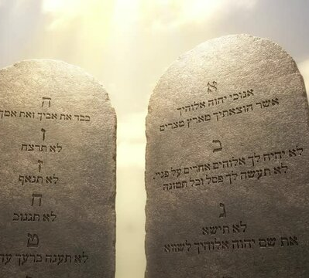
Revelation 14:12
¹² Here is the patience of the saints: here are they that keep the commandments of God, and the faith of Jesus.

Slide 23
6. What then will be the work of the great false christ?
Mark 13:22

Slide 24
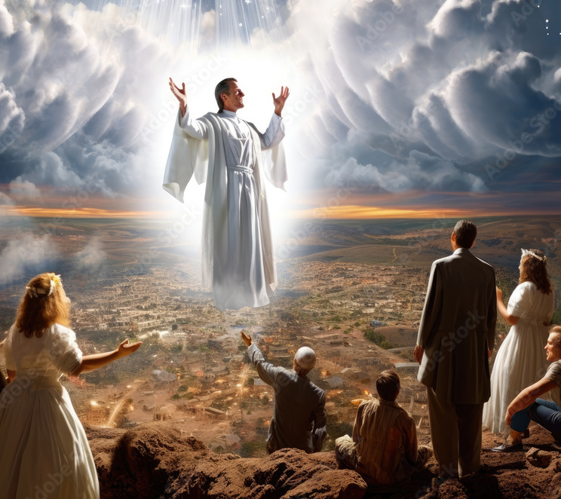
Mark 13:22
²² For false Christs and false prophets shall rise, and shall shew signs and wonders, to seduce, if it were possible, even the elect.

Slide 25
7. What have we found to be the one part of the commandments of God, above all others, that distinguishes those who obey the Third Angel’s Message?
Answer: The keeping of the Sabbath of the Lord.

Slide 26
8. What will be done by the great false christ to seduce them from this?
  Answer: “In his assumed character as Christ, he claims to have changed the Sabbath to Sunday, and commands all to hallow the day which he has blessed.”
  —Great Controversy, Vol. 4, p. 442.

Slide 27
9. What crowning wonder will be wrought to confirm this?
Revelation 13:13

Slide 28
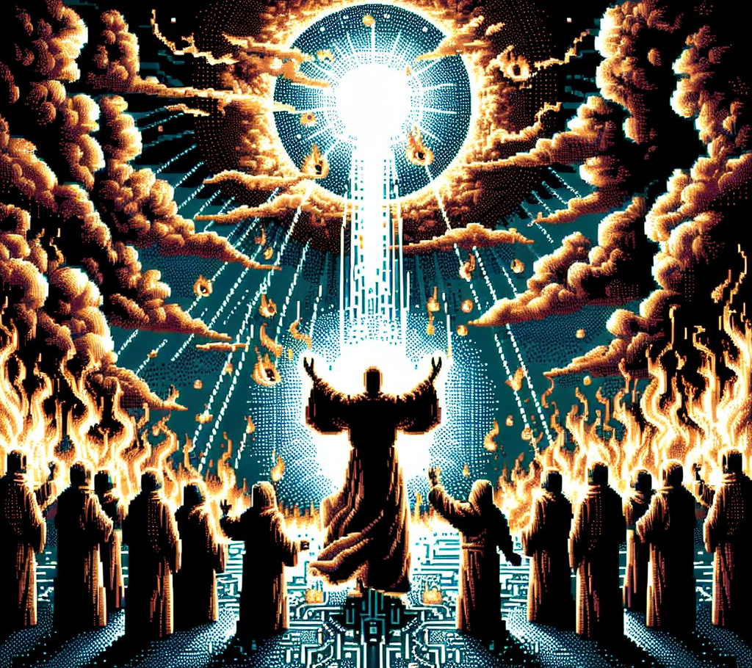
Mark 13:22
¹³ And he doeth great wonders, so that he maketh fire come down from heaven on the earth in the sight of men,

Slide 29
10. What answer may be made by all?
Answer: The seventh day is the Sabbath, even though heaven itself comes down. Matthew 24:35; Luke 16:17.

Slide 30

Matthew 24:35
³⁵ Heaven and earth shall pass away, but my words shall not pass away.

Slide 31
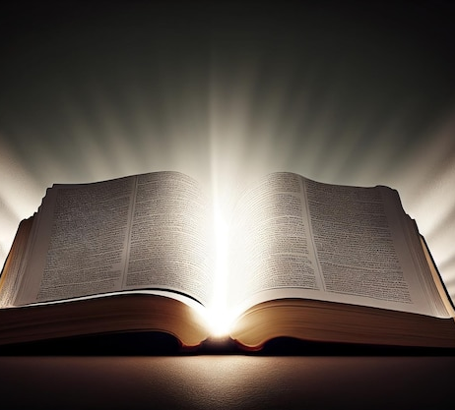
Luke
16:17
¹⁷ And it is easier for heaven and earth to pass, than one tittle of the law to fail.

Slide 32
11. When they yet refuse to receive the mark of the beast and worship his image, what then will be done?
Answer: “A decree will finally be issued denouncing them as deserving of the severest punishment, and giving the people liberty, after a certain time, to put them to death.”
—Great Controversy, Vol. 4, p. 445.

Slide 33
12. Are any put to death when the time expires?
Answer: No. See Note.

Slide 34
13. Where are they next seen?
Revelation 15:2

Slide 35
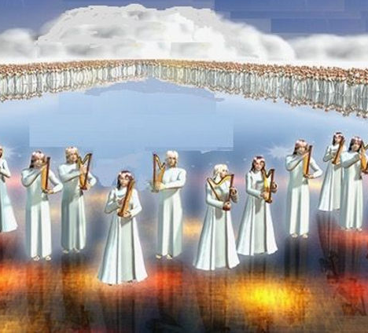
Revelation
15:2
² And I saw as it were a sea of glass mingled with fire: and them that had gotten the victory over the beast, and over his image, and over his mark, and over the number of his name, stand on the sea of glass, having the harps of God.

Slide 36
14. What song do they sing?
Revelation 15:3

Slide 37
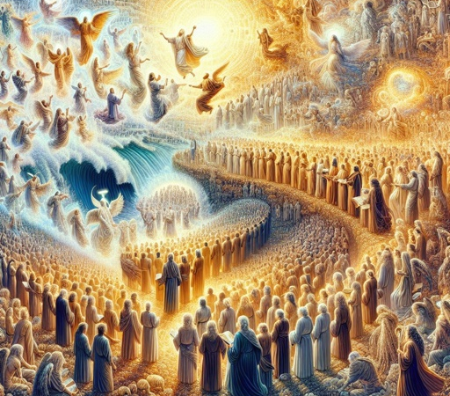
Revelation
15:3
³ And they sing the song of Moses the servant of God, and the song of the Lamb, saying, Great and marvellous are thy works, Lord God Almighty; just and true are thy ways, thou King of saints.

Slide 38
15. Can anybody else learn that song?
Revelation 14:3

Slide 39
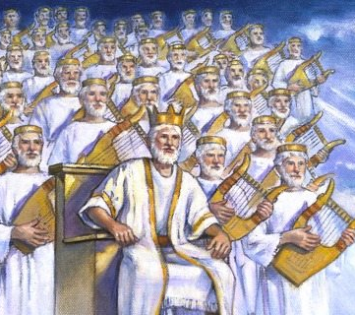
Revelation
14:3
³ And they sung as it were a new song before the throne, and before the four beasts, and the elders: and no man could learn that song but the hundred and forty and four thousand, which were redeemed from the earth.

Slide 40
16. What was the song of Moses?
Answer: The song of victory that they sang when God gave deliverance from Pharaoh’s oppression.

Slide 41
17. What then will be the song of these?
Answer: The song of their deliverance.

Slide 42
18. Deliverance from what?
Answer: From Satan’s oppression through the power of the beast and his image.

Slide 43
19. What was one main cause of Pharaoh’s oppressing Israel?
Answer: The keeping of the Sabbath. Exodus 5:5.

Slide 44
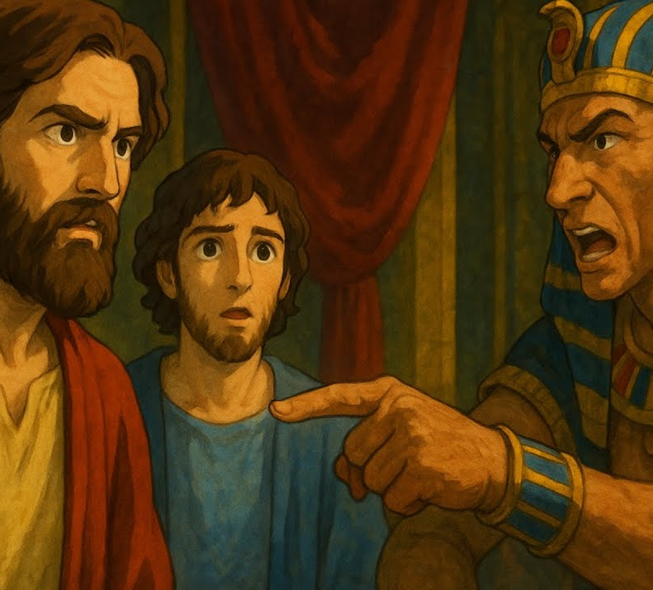
Exodus 5:5
⁵ And Pharaoh said, Behold, the people of the land now are many, and ye make them rest from their burdens.

Slide 45
20. What will be the cause of the wrath of Satan and the tyranny of the beast and his image, upon those who obey the Third Angel’s Message?
Answer: The keeping of the Sabbath.

Slide 46
21. Then why is it that only these will be able to sing the song of Moses?
Answer: Because only these, of all the world, will have been delivered from such bitter oppression.

Slide 47
22. What will these have received that they might be saved?
Answer: “The love of the truth.”

Slide 48
23. What will be their shield in the time of the seven last plagues?
Psalm 91:4

Slide 49
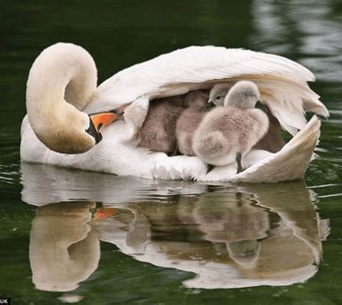
Psalm 91:4
⁴ He shall cover thee with his feathers, and under his wings shalt thou trust: his truth shall be thy shield and buckler.

Slide 50
24. When they approach the glittering gates of the glorious city of God, what will be said?
Isaiah 26:2

Slide 51
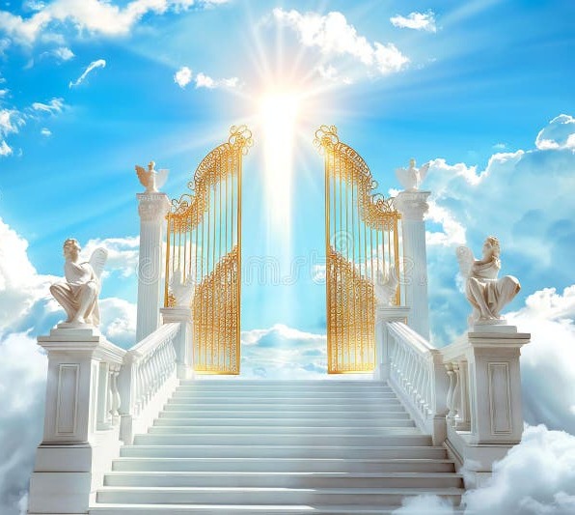
Isaiah 26:2
² Open ye the gates, that the righteous nation which keepeth the truth may enter in.

Slide 52
25. What else is a part of their song?
Revelation 15:3, last part

Slide 53
Revelation
15:3
³ And they sing the song of Moses the servant of God, and the song of the Lamb, saying, Great and marvellous are thy works, Lord God Almighty; just and true are thy ways, thou King of saints.

Slide 54
26. As none others can learn this song, what would this show?
Answer: That these are counted worthy to receive such views of the works and the justice of God, as none others can.

Slide 55
27. How do they obtain these views?
Revelation 14:4, last part

Slide 56
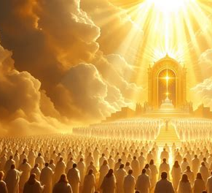
Revelation
14:4
⁴ These are they which were not defiled with women; for they are virgins. These are they which follow the Lamb whithersoever he goeth. These were redeemed from among men, being the firstfruits unto God and to the Lamb.

Slide 57
28. Where and with whom shall they dwell?
Revelation 7:15–17

Slide 58
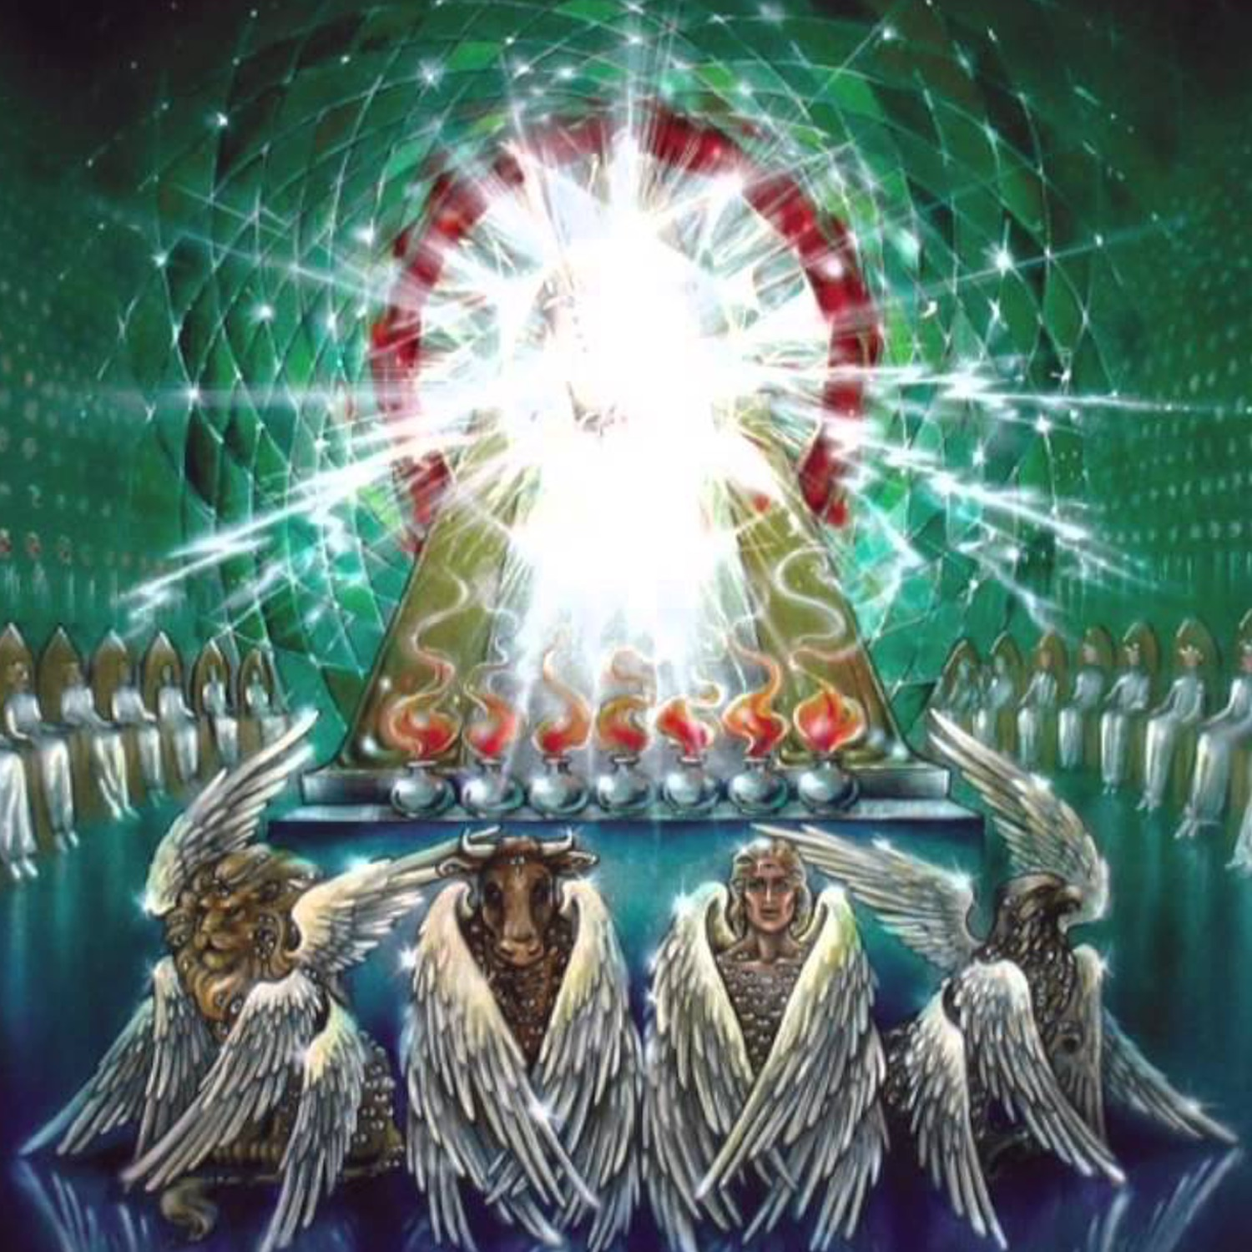
Revelation
7:15-17
¹⁵ Therefore are they before the throne of God, and serve him day and night in his temple: and he that sitteth on the throne shall dwell among them.

Slide 59
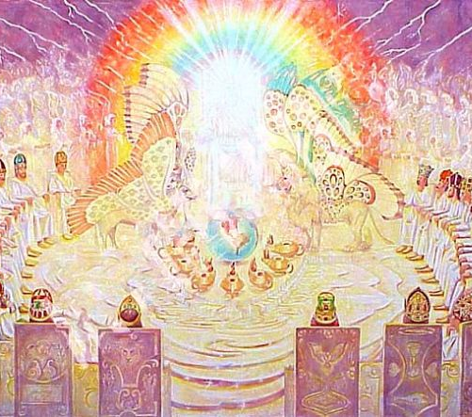
Revelation
7:15-17
¹⁶ They shall hunger no more, neither thirst any more; neither shall the sun light on them, nor any heat.

Slide 60
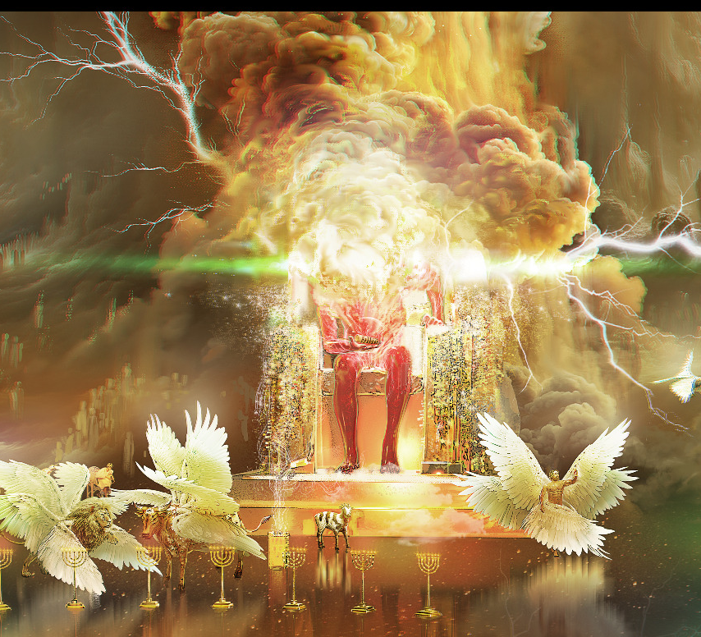
Revelation
7:15-17
¹⁷ For the Lamb which is in the midst of the throne shall feed them, and shall lead them unto living fountains of waters: and God shall wipe away all tears from their eyes.

Slide 61
Thank you!
… and Happy Sabbath!!

Slide 62


