Slide 1
Christ the Shepherd
The 23rd Psalm
3rd Quarter, 2022

Slide 2
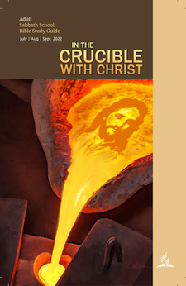
3rd Quarter 2022
Crucible: a ceramic or metal container in which metals or other substances may be melted or subjected to very high temperatures. While crucibles were historically usually made from clay, they can be made from any material that withstands temperatures high enough to melt or otherwise alter its contents.

Slide 3

3rd Quarter 2022
A crucible for aluminum, gold, or silver. It is used to heat the metal and pour it into a mold. You might also use a crucible to burn off impurities from the metal.

Slide 4
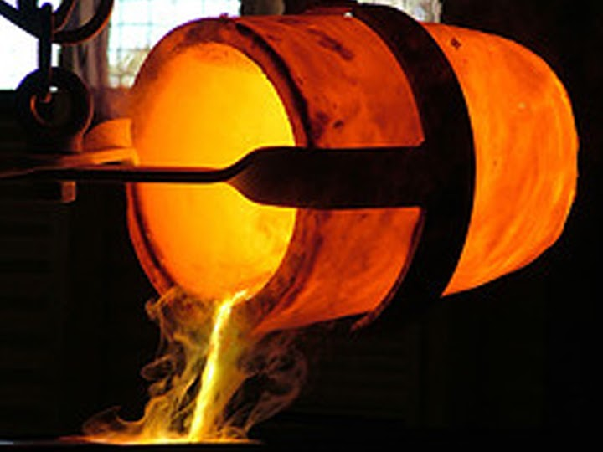
3rd Quarter 2022
In this case, a “crucible” (in which metal is melted down and rendered more usable) is employed as a metaphor for the process by which God reforms human character. This particular lesson is titled, “The Shepherd’s Crucible.”

Slide 5
Genesis 48:15
¹⁵ And he blessed Joseph, and said, God, before whom my fathers Abraham and Isaac did walk, the God which fed me all my life long unto this day,
Earliest Biblical appearance of the figure of the Shepherd
Literally, “The Shepherd of me.”

Slide 6
Isaiah 40:10-11
¹⁰ Behold, the Lord God will come with strong hand, and his arm shall rule for him: behold, his reward is with him, and his work before him.
¹¹ He shall feed his flock like a shepherd: he shall gather the lambs with his arm, and carry them in his bosom, and shall gently lead those that are with young.

Slide 7
Jeremiah 23:3-4
³ And I will gather the remnant of my flock out of all countries whither I have driven them, and will bring them again to their folds; and they shall be fruitful and increase.
⁴ And I will set up shepherds over them which shall feed them: and they shall fear no more, nor be dismayed, neither shall they be lacking, saith the Lord.

Slide 8
Ezekiel 34:12-15
¹² As a shepherd seeketh out his flock in the day that he is among his sheep that are scattered; so will I seek out my sheep, and will deliver them out of all places where they have been scattered in the cloudy and dark day.
¹³ And I will bring them out from the people, and gather them from the countries, and will bring them to their own land, and feed them upon the mountains of Israel by the rivers, and in all the inhabited places of the country.
¹⁴ I will feed them in a good pasture, and upon the high mountains of Israel shall their fold be: there shall they lie in a good fold, and in a fat pasture shall they feed upon the mountains of Israel.
¹⁵ I will feed my flock, and I will cause them to lie down, saith the Lord God.

Slide 9
John 10:14-16
¹⁴ I am the good shepherd, and know my sheep, and am known of mine.
¹⁵ As the Father knoweth me, even so know I the Father: and I lay down my life for the sheep.
¹⁶ And other sheep I have, which are not of this fold: them also I must bring, and they shall hear my voice; and there shall be one fold, and one shepherd.

Slide 10
1 Peter 2:21, 25
²¹ For even hereunto were ye called: because Christ also suffered for us, leaving us an example, that ye should follow his steps: …
²⁵ For ye were as sheep going astray; but are now returned unto the Shepherd and Bishop of your souls.

Slide 11
And best known of all…
The 23rd Psalm!
Which some of you can probably recite. Do you remember how it starts?

Slide 12
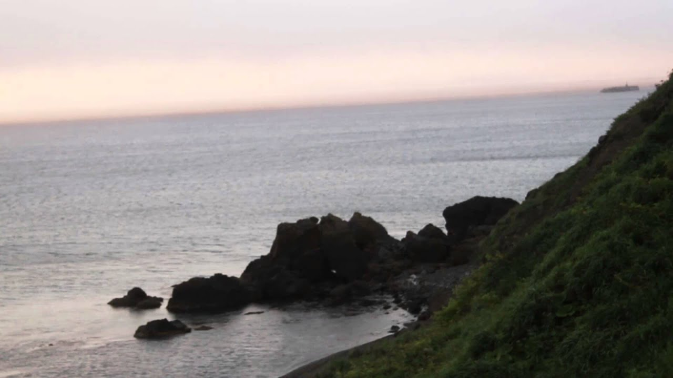
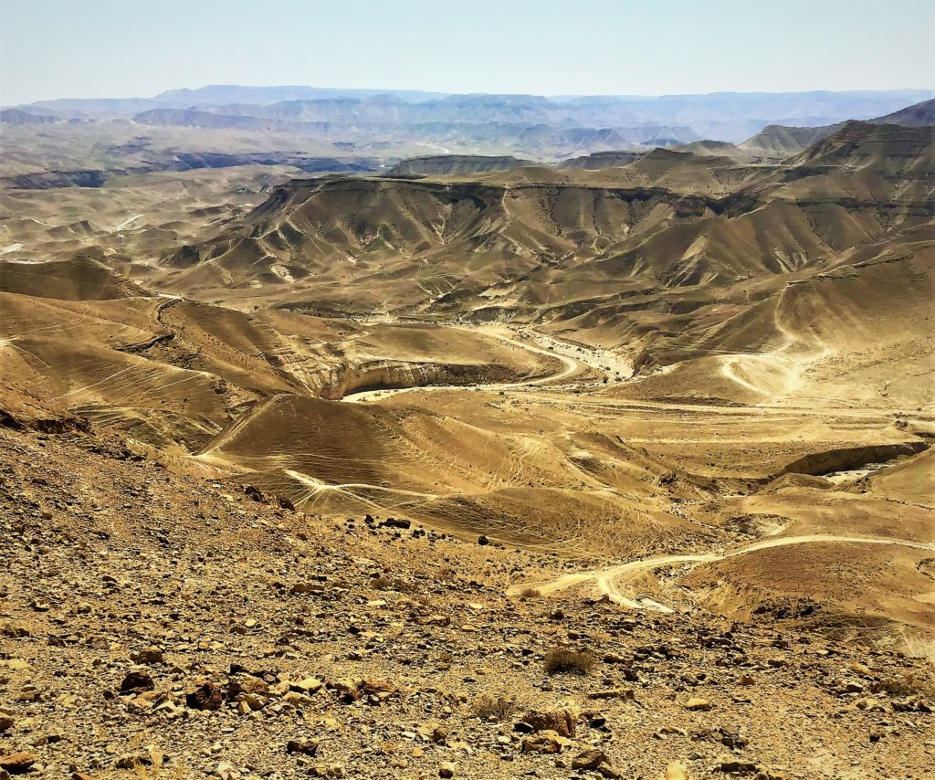
The Lord is my shepherd…
What does it mean for the Lord to be our shepherd?
This is the Judean wilderness. There is harsh terrain, flash flooding, and sparse vegetation.

Slide 13
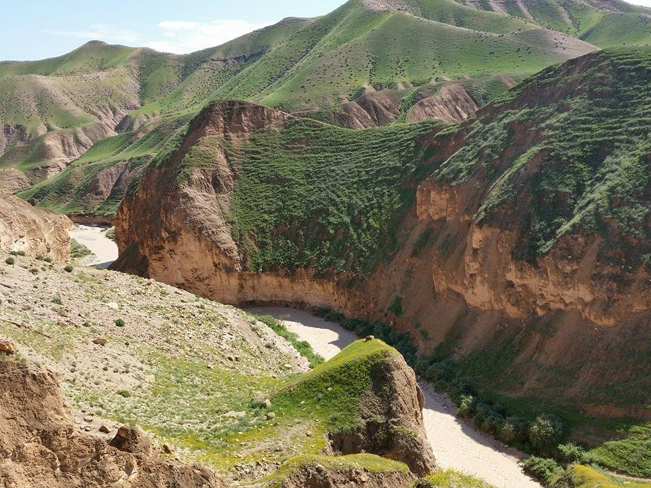
The Lord is my shepherd…
Here is the Judean wilderness after the winter storms.

Slide 14
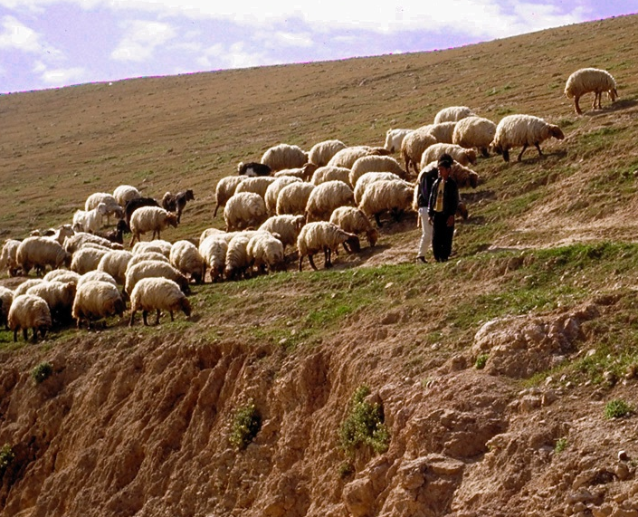
The Lord is my shepherd…
To understand and appreciate the beauty and meaning of the imagery, one must know the hazardous nature of the Judean wilderness, and the intimate life of the Shepherd and his sheep, especially the devotion that springs up between them during the many hours of solitude that they spend together.

Slide 15
… I shall not want.
What does it mean to “want”?
I’m pretty sure, even though the Lord is our shepherd, that we’ll still want… lunch. Or we’ll still want other things. Is this the kind of “want” that David is speaking of?
NOPE! This type of “want” references poverty. To “want” here is to be destitute, to be in desperate need. God, as our shepherd, provides for our needs and protects us from want.

Slide 16
… I shall not want.
Notice how this does not say, “The Lord is my shepherd… I think it’ll be okay.”
“I shall not want” is a statement of absolute trust in God! David knew that God would provide for him.
Can you think of any other verses that assure us that we shall not suffer want? Assuming, of course, that the Lord is our shepherd!

Slide 17
… I shall not want.
Philippians 4:19
¹⁹ But my God shall supply all your need according to his riches in glory by Christ Jesus.

Slide 18
… I shall not want.
2 Corinthians 9:8
⁸ And God is able to make all grace abound toward you; that ye, always having all sufficiency in all things, may abound to every good work:

Slide 19
… I shall not want.
Psalm 34:8-10
⁸ O taste and see that the Lord is good: blessed is the man that trusteth in him.
⁹ O fear the Lord, ye his saints: for there is no want to them that fear him.
¹⁰ The young lions do lack, and suffer hunger: but they that seek the Lord shall not want any good thing.

Slide 20
… I shall not want.
James 1:17
¹⁷ Every good gift and every perfect gift is from above, and cometh down from the Father of lights, with whom is no variableness, neither shadow of turning.

Slide 21
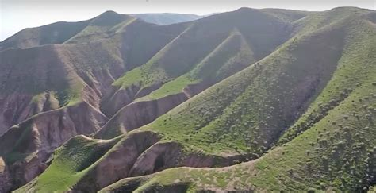
He maketh me to lie down in green pastures…

Slide 22
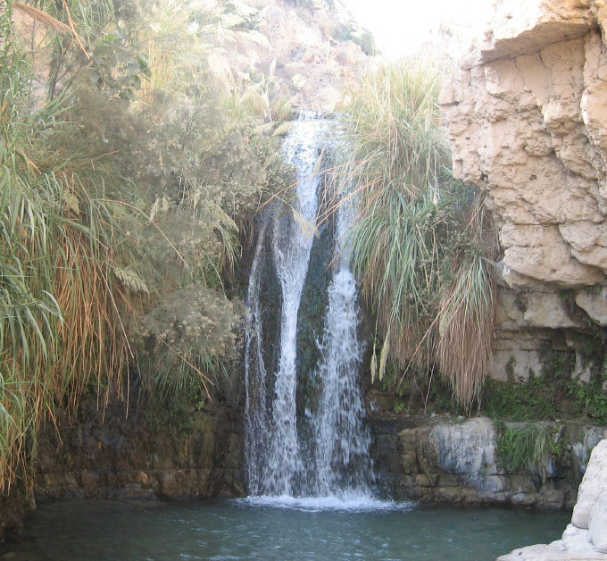
…He leadeth me beside the still waters.
“Still waters” may be literally translated, “waters of resting places,” that is, resting places with water, as by a river, brook, well, or lake.
The symbol of resting places and waters flow throughout the Bible in a great many places.

Slide 23
…He leadeth me beside the still waters.
In David's song His grace is pictured also as the cool, “still waters,” amid green pastures, beside which the heavenly Shepherd leads His flock. Again, “Thou shalt make them,” he says, “drink of the river of Thy pleasures. For with Thee is the fountain of life.” Psalm 19:14; 62:7; Psalm 61:2; 71:3; 73:26; 94:22; 23:2; 36:8, 9. And the wise man declares, “The wellspring of wisdom [is] as a flowing brook.” Proverbs 18:4. To Jeremiah, Christ is “the fountain of living waters;” to Zechariah, “a fountain opened ... for sin and for uncleanness.” Jeremiah 2:13; Zechariah 13:1. Isaiah…records the precious promise, bringing vividly to mind the living stream that flowed for Israel:

Slide 24
…He leadeth me beside the still waters.
“When the poor and needy seek water, and there is none, and their tongue faileth for thirst, I the Lord will hear them, I the God of Israel will not forsake them.” “I will pour water upon him that is thirsty, and floods upon the dry ground;” “in the wilderness shall waters break out, and streams in the desert.” The invitation is given, “Ho, every one that thirsteth, come ye to the waters.” Isaiah 41:17; 44:3; Isaiah 35:6; 55:1. And in the closing pages of the Sacred Word this invitation is echoed. The river of the water of life, “clear as crystal,” proceeds from the throne of God and the Lamb; and the gracious call is ringing down through the ages, “Whosoever will, let him take the water of life freely.” Revelation 22:17.
Patriarchs and Prophets p. 413

Slide 25
He restoreth my soul.
There’s a surprising amount of meaning packed into this brief phrase!
The word translated “restoreth” is the Hebrew word shub. It’s translated as “converting” in Psalm 19:7, where God’s Law is described as “converting” the soul. The same word is translated as “relieve” in a number of verses in Lamentations (1:11, 16, 19).

Slide 26
He restoreth my soul.
The word translated “soul” is the Hebrew word nephesh. It comes from the root naphash, a verb appearing only 3 times in the Old Testament (Ex. 23:12; 31:17; 2 Sam 16:14), each time meaning “to revive oneself” or “to refresh oneself.” It seems to go back to the basic meaning of breathing. Genesis 2:7 says that when God gave life to the body He had formed, the man literally “became a soul of life.”

Slide 27
He restoreth my soul.
The “soul” had not previously existed, but came into existence with the creation of Adam. A new “soul” comes into existence every time a child is born. Each “soul” is separate and distinct, separate from all similar units. This uniqueness of individuality seems to be the idea emphasized in the Hebrew term nephesh.

Slide 28
He restoreth my soul.
Nephesh is applied to animals as well as men. The clause, “let the waters bring forth abundantly the moving creature that hath life” is literally, “let the waters swarm swarms of souls of life [individuals of life].” Beasts and fowl are called “living creatures,” literally, “individuals of life.” As such, animals as well as people are “souls,” or “living individuals.”

Slide 29
He restoreth my soul.
From the basic idea of nephesh being an individual or person springs the idiomatic use of nephesh for the personal pronoun. Expressions like “my soul” are idiomatic for “I” or “me”; “thy soul” for “you”; and “their soul” for “they” or “them”.
Since each new nephesh represents a new unit of life, the word is often used synonymously with “life.” In 119 instances the KJV translates the word this way.

Slide 30
He restoreth my soul.
So when God “restoreth” (shub) “my soul” (nephesh), this carries the same idea as if we were to say that God converts my life.
This is also the connection with the crucible!
God doesn’t just restore our lives to some condition we have previously experienced. He perfects, changes, and converts our lives so that we can be our perfect selves under His plan and His guidance. That is sanctification, the promise inherent in “He restoreth my soul!”

Slide 31
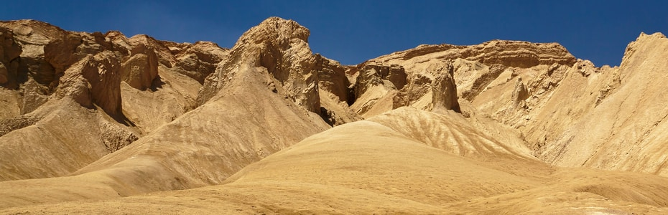
He leadeth me in the paths of righteousness for His name's sake.

Slide 32
He leadeth me in the paths of righteousness for His name's sake.
The rough terrain of Judea offers any number of opportunities to take the wrong path. It’s easy to waste time and suffer serious issues when traversing the highlands, cut with deep wadis (narrow canyons). Taking the wrong path can cost great amounts of time, which can be life-threatening in such arid regions. If we permit, God always leads us in the right way, although it may not seem easy at the time. God’s guidance is a revelation to men of His character. Due to His goodness, He provides directions to the safe path for those who will listen.

Slide 33
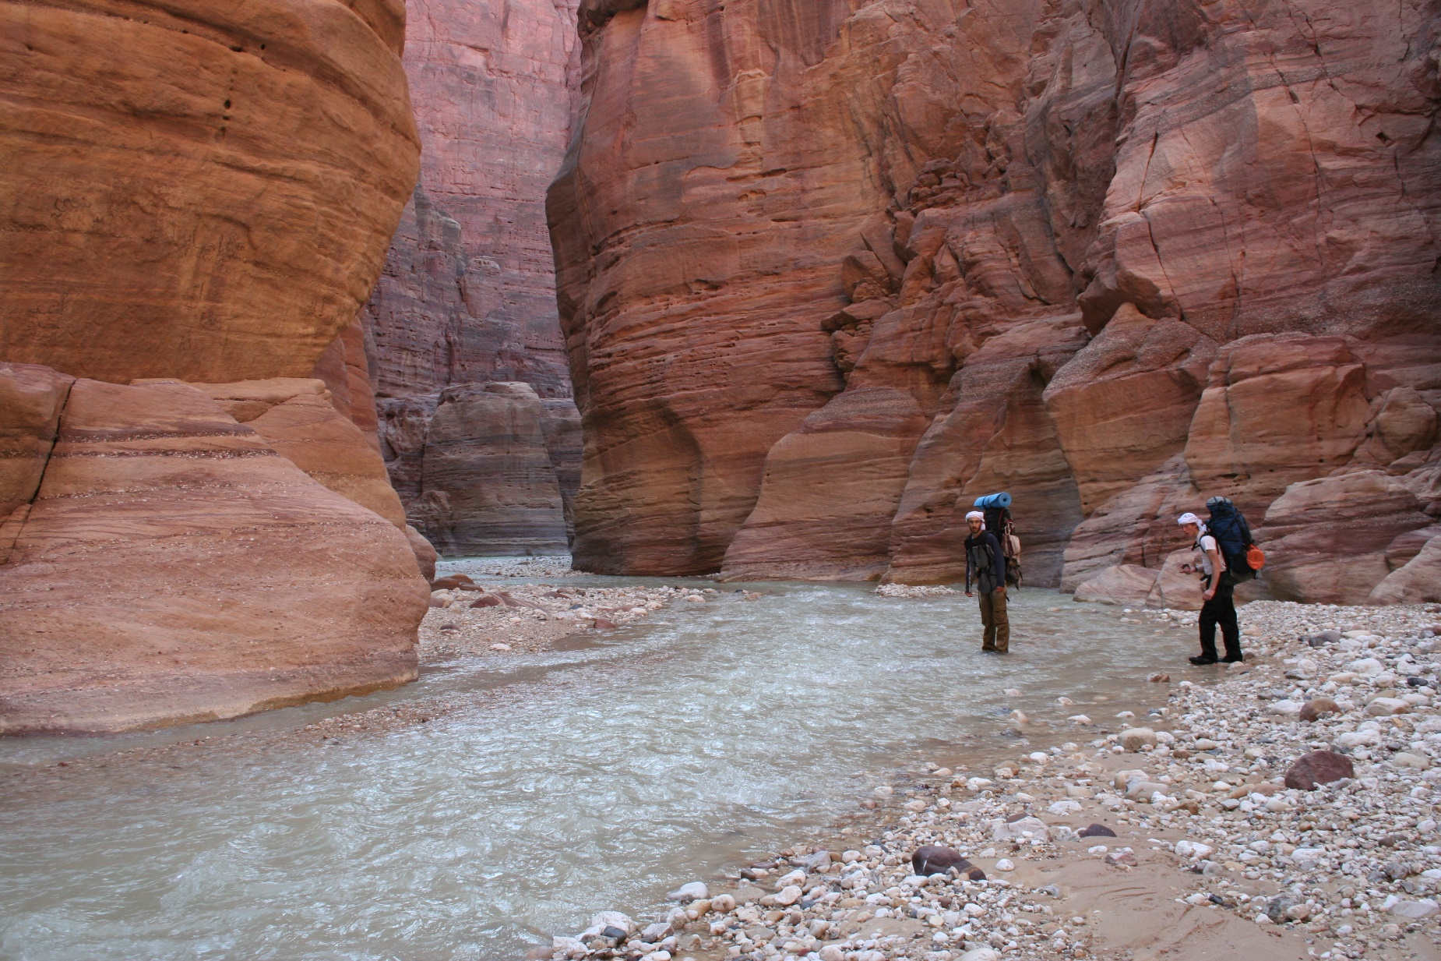
Yea, though I walk through the valley of the shadow of death…

Slide 34
Yea, though I walk through the valley of the shadow of death…
We’ve already mentioned some of the challenges of traveling in the Judean wilderness. One of these difficulties is the fact that the wilderness is split by any number of deep, cliff-sided valleys known as “wadis.” Travel through a deep, overshadowed wadi can be extremely dangerous.
First, it’s all but impossible to climb out of a deep wadi. So if you find yourself in the wrong one, the only choice is a time-consuming retracing of your own steps. If you aren’t carrying sufficient extra water, this is a death sentence.

Slide 35
Yea, though I walk through the valley of the shadow of death…
The twists, turns, and blind corners of a narrow wadi are also perfect for ambush. Large predators such as lions were well known to use this technique in ancient times. Enemy forces and bandits were known to use a similar strategy. A narrow wadi offers extremely limited visibility and even more limited maneuverability. (It’s an extremely long fatal funnel, for those of you who’ve read about combat situations!)

Slide 36
Yea, though I walk through the valley of the shadow of death…
Finally, there is the threat of flash floods. Wadis are eroded by the wash of flood waters downhill. In the desert climate of Judea, rain falls in short but voluminous bursts, and the water washes down all the wadis in the region. It’s possible for flood waters to roar down wadis for many miles, far from place where the rain actually fell. Being caught in a wadi when the flood comes is almost certainly fatal.

Slide 37
…I will fear no evil: for thou art with me;
This is enough! The Christian needs nothing more than the consciousness of God’s presence for security.

Slide 38
Thy rod and thy staff they comfort me.
The rod and the staff are tokens of the Shepherd’s presence, and show the Shepherd to be ready to intervene at any moment. The Shepherd provides rest, refreshment, nourishment, restoration, fellowship, guidance, deliverance from fear, comfort, security, victory over enemies. What more can the Christian ask? Nevertheless, the psalmist proceeds to emphasize these evidences of Jehovah’s goodness and adds to them by employing a different figure, that of the gracious Host.

Slide 39
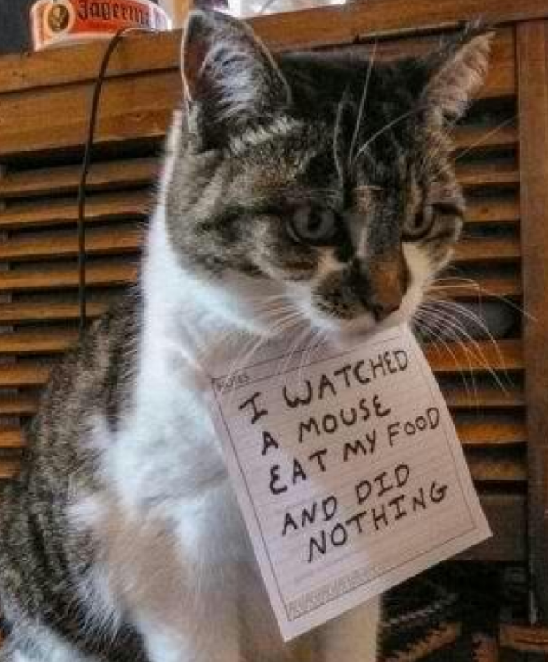
Thou preparest a table before me in the presence of mine enemies:
Nothing to Fear if You’re a Guest of the King!
David now represents himself as a guest in God’s banquet hall. Jehovah is even more than a shepherd—He is a king, lavishing upon His guests the bounties of His table. Since God is the host, the plots of the enemies to injure must come to nothing. God’s children can sit, laugh, and eat in security, even as their enemies gather around them.

Slide 40
… Thou anointest my head with oil; my cup runneth over.
Ephesians 3:14-21
¹⁴ For this cause I bow my knees unto the Father of our Lord Jesus Christ,
¹⁵ Of whom the whole family in heaven and earth is named,
¹⁶ That he would grant you, according to the riches of his glory, to be strengthened with might by his Spirit in the inner man;

Slide 41
… Thou anointest my head with oil; my cup runneth over.
Ephesians 3:14-21
¹⁷ That Christ may dwell in your hearts by faith; that ye, being rooted and grounded in love,
¹⁸ May be able to comprehend with all saints what is the breadth, and length, and depth, and height;
¹⁹ And to know the love of Christ, which passeth knowledge, that ye might be filled with all the fulness of God.

Slide 42
… Thou anointest my head with oil; my cup runneth over.
Ephesians 3:14-21
²⁰ Now unto him that is able to do exceeding abundantly above all that we ask or think, according to the power that worketh in us,
²¹ Unto him be glory in the church by Christ Jesus throughout all ages, world without end. Amen

Slide 43
… Thou anointest my head with oil; my cup runneth over.
Now that is a blessing of plenty!!
God anoints His children as honored guests at His feasting. David says that his “cup” is over-running. We know that God gives unstintingly of His mercies, pressed down and running over. Sometimes He does not choose to give us worldly prosperity, but of His goodness He gives in vast abundance!

Slide 44
Surely goodness and mercy shall follow me all the days of my life:
David thought so!
Are goodness and mercy following you? Where has God shown you mercy and goodness this week?
Material and spiritual blessings are personified as following David all through life. His language shows complete trust in God’s guidance through life’s present vicissitudes, and gladly anticipates that guidance in the future.
I’m still breathing!
Home, friends, family, pets
Bible Study insights
Air Conditioning!
Fulfilling work to do
Church family

Slide 45
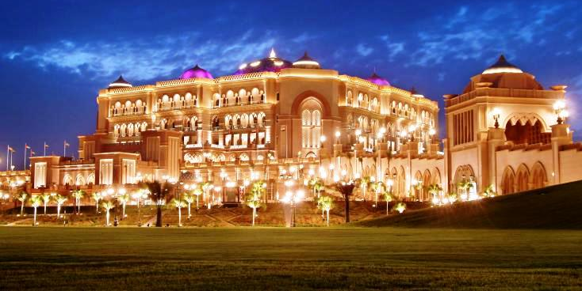
…and I will dwell in the house of the Lord for ever.
The psalmist’s continuance as a guest in God’s house is assured. Ours is too, if we will consent to follow our Shepherd!
In my Father's house are many mansions: if it were not so, I would have told you. I go to prepare a place for you. And if I go and prepare a place for you, I will come again, and receive you unto myself; that where I am, there ye may be also. --John 14:2-3

