Slide 1
The “Crucibles that Come”
1 Peter 3-5
Lesson 2, 3rd Quarter, 2022

Slide 2
Memory Text: 1 Peter 4:12-13
¹² Beloved, think it not strange concerning the fiery trial which is to try you, as though some strange thing happened unto you:
¹³ But rejoice, inasmuch as ye are partakers of Christ's sufferings; that, when his glory shall be revealed, ye may be glad also with exceeding joy.

Slide 3
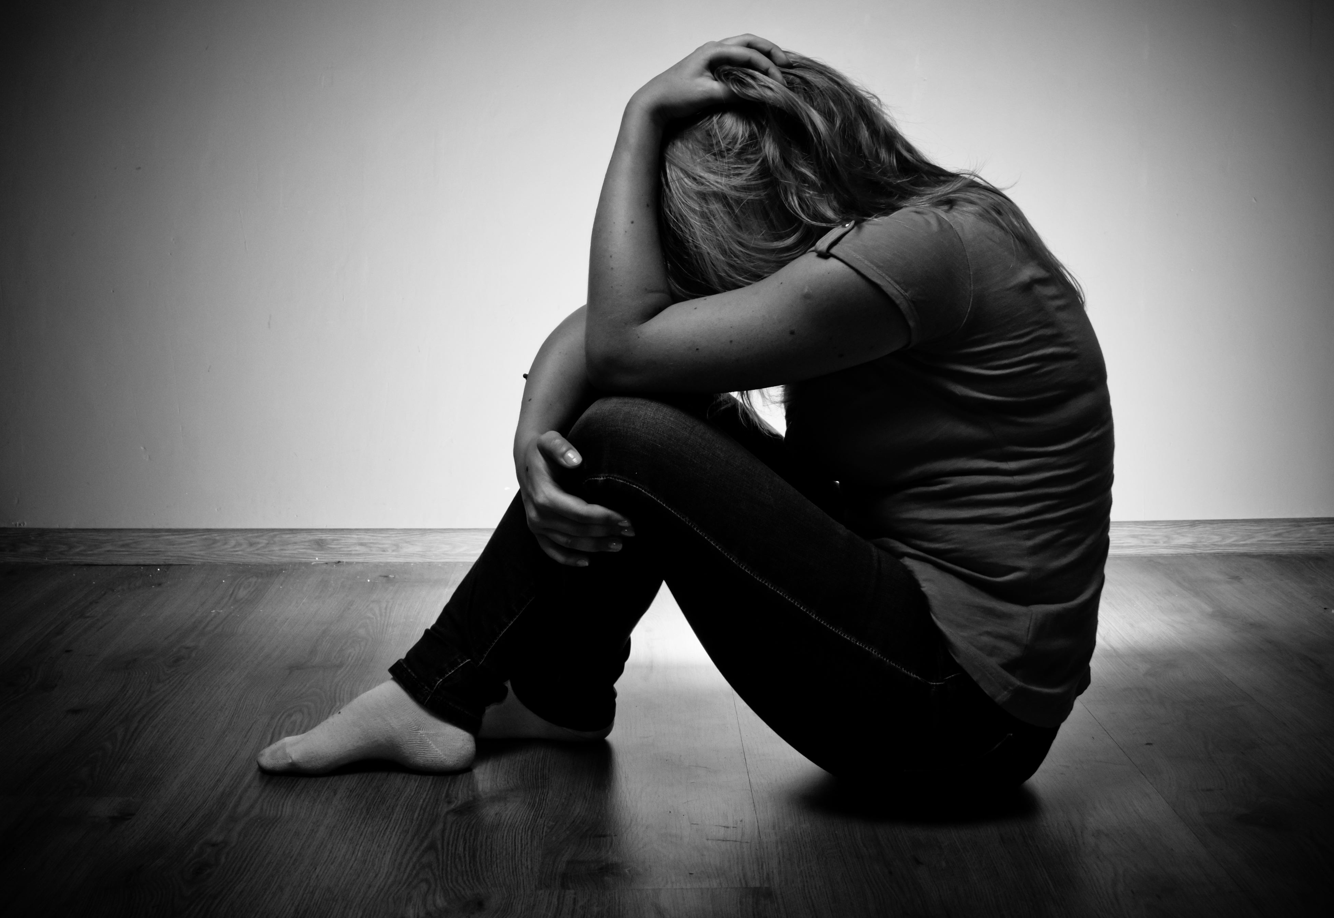
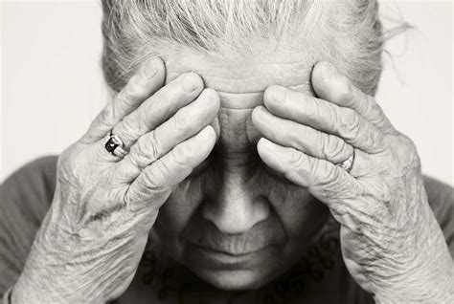
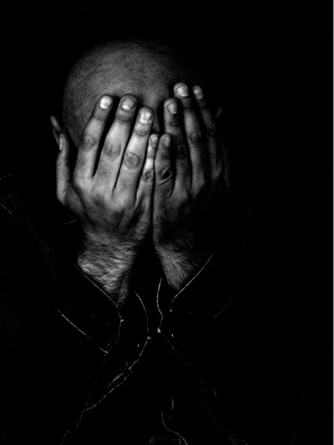
Understanding Human Suffering

Slide 4
From the quarterly (Sunday, July 3)
To begin, let’s go back to 1 Peter 4:12. The Greek word for “surprised” in 1 Peter 4:12 (NIV) means to be “alien” or “foreign.” Peter is urging his readers not to fall into the trap of believing that fiery ordeals and trials are alien to Christian experience. Rather, they are to be considered normal — they can and should be expected.

Slide 5
Memory Text: 1 Peter 4:12-13
¹² Beloved, think it not strange concerning the fiery trial which is to try you, as though some strange thing happened unto you:
¹³ But rejoice, inasmuch as ye are partakers of Christ's sufferings; that, when his glory shall be revealed, ye may be glad also with exceeding joy.

Slide 6
Understanding Christian Suffering
Why shouldn’t suffering be “strange,” “surprising,” or “foreign” to us? Why should we consider suffering as normal and to be expected? Should we simply expect to suffer because we are followers of Christ? That’s not much of an advertisement for Christianity! Yet a number of church groups seem to advocate this position. Others appear to be in some kind of denial—attempting to explain away human suffering.

Slide 7
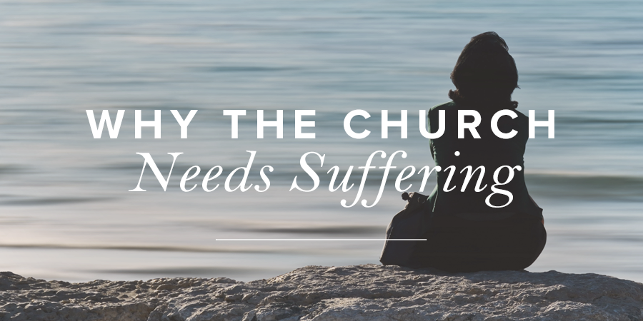
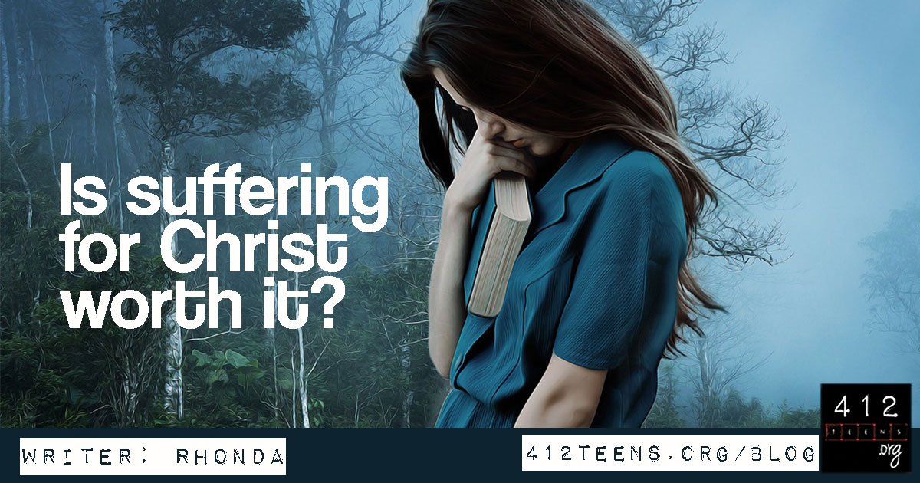
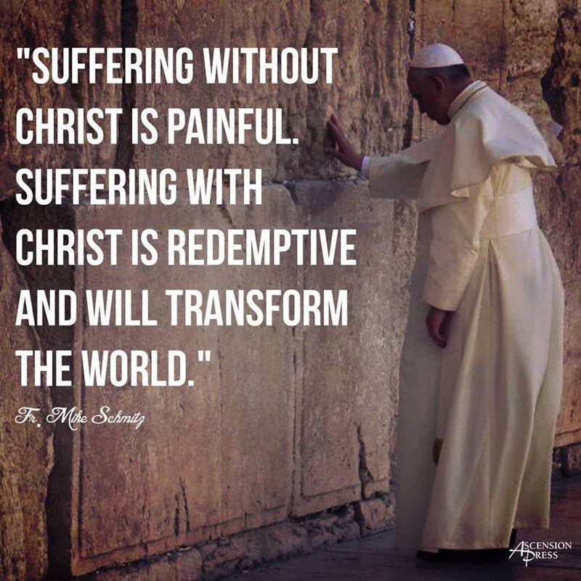
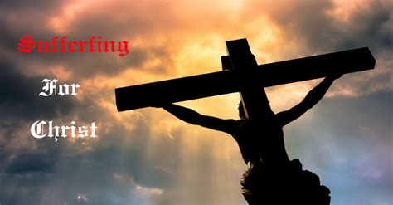
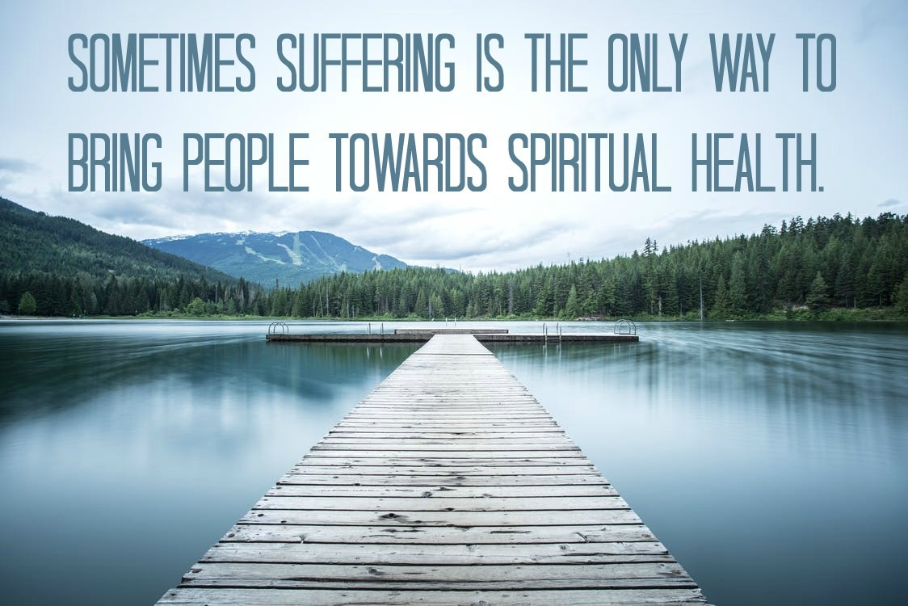
Understanding Christian Suffering

Slide 8
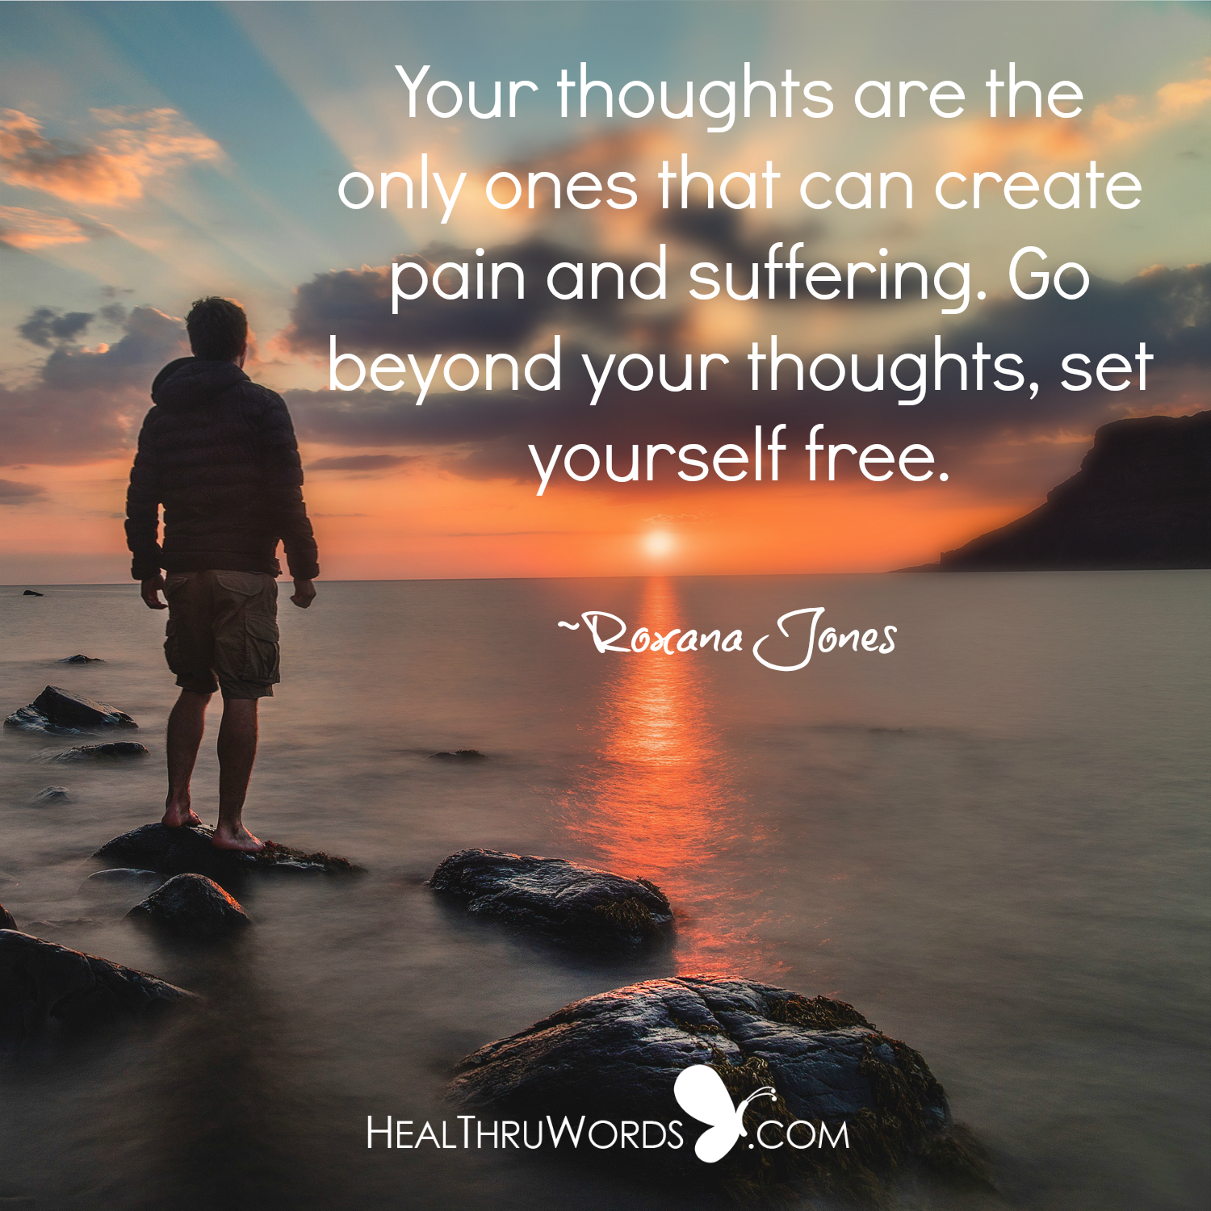
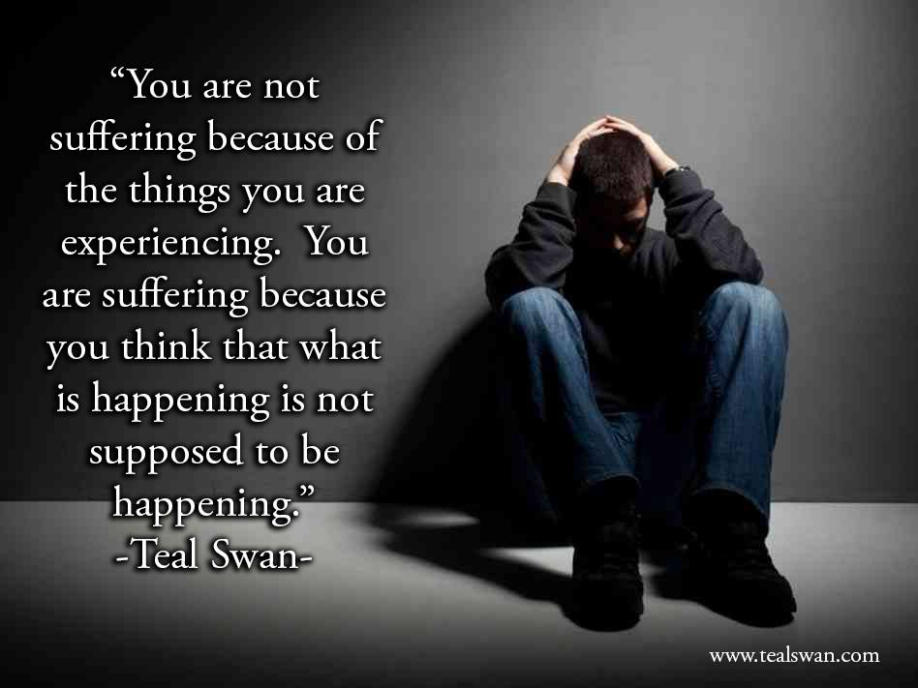
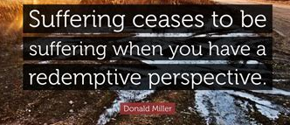

Understanding Suffering

Slide 9
Summary
The first group believes that Christians experience MORE suffering than other people, but it is necessary or worthwhile to suffer.
The second group believes that Christians experience LESS suffering than other people because their experiences are somehow redefined as not suffering.
Do you agree? Does the Bible agree? Consider again our memory text in 1 Peter 4:12-13.

Slide 10
Memory Text: 1 Peter 4:12-13
¹² Beloved, think it not strange concerning the fiery trial which is to try you, as though some strange thing happened unto you:
¹³ But rejoice, inasmuch as ye are partakers of Christ's sufferings; that, when his glory shall be revealed, ye may be glad also with exceeding joy.
Perhaps we need some more context! Turn back to 1 Peter 3:10-17.

Slide 11
1 Peter 3:10-12
¹⁰ For he that will love life, and see good days, let him refrain his tongue from evil, and his lips that they speak no guile:
¹¹ Let him eschew evil, and do good; let him seek peace, and ensue it.
¹² For the eyes of the Lord are over the righteous, and his ears are open unto their prayers: but the face of the Lord is against them that do evil.

Slide 12
1 Peter 3:13-15
¹³ And who is he that will harm you, if ye be followers of that which is good?
¹⁴ But and if ye suffer for righteousness' sake, happy are ye: and be not afraid of their terror, neither be troubled;
¹⁵ But sanctify the Lord God in your hearts: and be ready always to give an answer to every man that asketh you a reason of the hope that is in you with meekness and fear:

Slide 13
1 Peter 3:16-17
¹⁶ Having a good conscience; that, whereas they speak evil of you, as of evildoers, they may be ashamed that falsely accuse your good conversation in Christ.
¹⁷ For it is better, if the will of God be so, that ye suffer for well doing, than for evil doing.

Slide 14
“For it is better, if the will of God be so, that ye suffer for well doing, than for evil doing.”
Notice what 1 Peter 3:17 is saying!
EVERYBODY SUFFERS. IT’S THE HUMAN CONDITION. Christians. Dictators. Good people. Bad people. Saints. Sinners. We all have suffering in our lives.
We can’t choose whether or how much we suffer. But we can choose WHY!

Slide 15
Understanding Christian Suffering
Suffering is a constant! But we do have an important choice to make. We can choose to suffer the consequences of REJECTING Christ or we can choose to suffer the consequences of IMITATING Christ. Suffering is probably going to come one way or the other, but we can choose to have meaning in our suffering!

Slide 16
Quantity and Quality
You’ll notice that many groups who address Christian suffering are concerned with quantity. That is, they will argue that Christians suffer MORE than other people (but it’s worth it) or LESS than other people (because it isn’t really suffering). But we can see here in 1st Peter that everybody suffers. It’s not a matter of QUANTITY.
But there is an important QUALITIATIVE difference between those who suffer for distinct reasons!
Go back to 1 Peter 3:10-12.

Slide 17
1 Peter 3:10-12
¹⁰ For he that will love life, and see good days, let him refrain his tongue from evil, and his lips that they speak no guile:
¹¹ Let him eschew evil, and do good; let him seek peace, and ensue it.
¹² For the eyes of the Lord are over the righteous, and his ears are open unto their prayers: but the face of the Lord is against them that do evil.

Slide 18
Christian Suffering
It’s curious that here in the same passage that tells us that suffering is universal, we see that those who are suffering persecution (suffering because they are imitating Christ) are also able to “love life, and see good days.”
It seems that an imitator of Christ can “love life” even while suffering!

Slide 19
John 16:32-33
³² Behold, the hour cometh, yea, is now come, that ye shall be scattered, every man to his own, and shall leave me alone: and yet I am not alone, because the Father is with me.
³³ These things I have spoken unto you, that in me ye might have peace. In the world ye shall have tribulation: but be of good cheer; I have overcome the world.

Slide 20
2 Timothy 3:12-13
¹² Yea, and all that will live godly in Christ Jesus shall suffer persecution.
¹³ But evil men and seducers shall wax worse and worse, deceiving, and being deceived.

Slide 21
Psalm 34:19
¹⁹ Many are the afflictions of the righteous: but the Lord delivereth him out of them all.

Slide 22
Psalm 38:4-6
⁴ For mine iniquities are gone over mine head: as an heavy burden they are too heavy for me.
⁵ My wounds stink and are corrupt because of my foolishness.
⁶ I am troubled; I am bowed down greatly; I go mourning all the day long.

Slide 23
Ecclesiastes 2:26
²⁶ For God giveth to a man that is good in his sight wisdom, and knowledge, and joy: but to the sinner he giveth travail, to gather and to heap up, that he may give to him that is good before God. This also is vanity and vexation of spirit.

Slide 24
Isaiah 43:1-2
43 But now thus saith the Lord that created thee, O Jacob, and he that formed thee, O Israel, Fear not: for I have redeemed thee, I have called thee by thy name; thou art mine.
² When thou passest through the waters, I will be with thee; and through the rivers, they shall not overflow thee: when thou walkest through the fire, thou shalt not be burned; neither shall the flame kindle upon thee.

Slide 25
2 Corinthians 4:14-18
¹⁴ Knowing that he which raised up the Lord Jesus shall raise up us also by Jesus, and shall present us with you.
¹⁵ For all things are for your sakes, that the abundant grace might through the thanksgiving of many redound to the glory of God.
¹⁶ For which cause we faint not; but though our outward man perish, yet the inward man is renewed day by day.

Slide 26
2 Corinthians 4:14-18
¹⁷ For our light affliction, which is but for a moment, worketh for us a far more exceeding and eternal weight of glory;
¹⁸ While we look not at the things which are seen, but at the things which are not seen: for the things which are seen are temporal; but the things which are not seen are eternal.

Slide 27
The reason for suffering makes all the difference! That’s because a person who suffers for “well-doing” can experience that suffering while also receiving joy, peace, security, and contentment from God.
This does not mean that such a person is not experiencing true suffering! But even as sufferers, they are not focused on themselves. So the suffering is combined with joy and peace.
So we can put our memory text in context! Turn back to 1 Peter 4:12-14

Slide 28
1 Peter 4:12-14
¹² Beloved, think it not strange concerning the fiery trial which is to try you, as though some strange thing happened unto you:
¹³ But rejoice, inasmuch as ye are partakers of Christ's sufferings; that, when his glory shall be revealed, ye may be glad also with exceeding joy.
¹⁴ If ye be reproached for the name of Christ, happy are ye; for the spirit of glory and of God resteth upon you: on their part he is evil spoken of, but on your part he is glorified.

Slide 29
But in addition to suffering for “well doing” we can also suffer for “evil doing.” We bring suffering on ourselves by our rejection of Christ and His guidelines for living. This type of suffering is shameful, difficult to live with, and has the potential to end very badly.
It’s also strictly forbidden to the Christian. Continue in 1 Peter 4:15-19

Slide 30
1 Peter 4:15-16
¹⁵ But let none of you suffer as a murderer, or as a thief, or as an evildoer, or as a busybody in other men's matters.
¹⁶ Yet if any man suffer as a Christian, let him not be ashamed; but let him glorify God on this behalf.

Slide 31
1 Peter 4:17-19
¹⁷ For the time is come that judgment must begin at the house of God: and if it first begin at us, what shall the end be of them that obey not the gospel of God?
¹⁸ And if the righteous scarcely be saved, where shall the ungodly and the sinner appear?
¹⁹ Wherefore let them that suffer according to the will of God commit the keeping of their souls to him in well doing, as unto a faithful Creator.

Slide 32
¹⁹ Wherefore let them that suffer according to the will of God commit the keeping of their souls to him in well doing, as unto a faithful Creator.
Notice that 1 Peter 4:19 tells us that those who suffer as Christians may trust securely in their Creator. They commit the keeping of their lives to Him. This security allows them to “love life, and see good days,” despite their suffering, as we saw in 1 Peter 3:10.
It’s funny how FAITH IS ALWAYS THE ANSWER! Turn to the next chapter, in 1 Peter 5:6-11.

Slide 33
1 Peter 5:6-8
⁶ Humble yourselves therefore under the mighty hand of God, that he may exalt you in due time:
⁷ Casting all your care upon him; for he careth for you.
⁸ Be sober, be vigilant; because your adversary the devil, as a roaring lion, walketh about, seeking whom he may devour:

Slide 34
Satan tempts us to betray Christ. He wants us to wallow in suffering from evil doing—the kind which saps hope and joy and comes from our own wickedness. And whenever we focus on ourselves we fall under his evil influence. But by humbling ourselves “under the mighty hand of God” and “casting all your care upon Him” we can escape Satan’s traps.
We daren’t risk focusing on ourselves. That way lies our adversary the devil!

Slide 35
1 Peter 5:9-11
⁹ Whom resist stedfast in the faith, knowing that the same afflictions are accomplished in your brethren that are in the world.
¹⁰ But the God of all grace, who hath called us unto his eternal glory by Christ Jesus, after that ye have suffered a while, make you perfect, stablish, strengthen, settle you.
¹¹ To him be glory and dominion for ever and ever. Amen.

Slide 36
So we are to resist Satan’s traps, remaining steadfast in faith. We must not be discouraged by suffering, knowing that suffering is universal. But our suffering for well doing has a time limit, making it simply something to be accepted while Christ perfects our characters.
Faith matters. Curiously, suffering does not! Check out the explanation in Romans 5:1-5

Slide 37
Romans 5:1-3
5 Therefore being justified by faith, we have peace with God through our Lord Jesus Christ:
² By whom also we have access by faith into this grace wherein we stand, and rejoice in hope of the glory of God.
³ And not only so, but we glory in tribulations also: knowing that tribulation worketh patience;

Slide 38
Romans 5:4-5
⁴ And patience, experience; and experience, hope:
⁵ And hope maketh not ashamed; because the love of God is shed abroad in our hearts by the Holy Ghost which is given unto us.

Slide 39
That’s justification leading to faith, suffering, sanctification, and hope! Our hope is in Christ and in His sanctification of our character. Obey Him. Nothing else matters!
We must make the choice to put Him first, other people next, and ourselves, well, never. Then our suffering isn’t important—even to ourselves!

Slide 40
Case Studies: Cain Genesis 4:10-14
Cain was angry, basically with God. But he took it out on his brother Abel. He murdered Abel. Then God addressed Cain in Genesis 4:
¹⁰ And he said, What hast thou done? the voice of thy brother's blood crieth unto me from the ground.
¹¹ And now art thou cursed from the earth, which hath opened her mouth to receive thy brother's blood from thy hand;

Slide 41
Case Studies: Cain Genesis 4:10-14
¹² When thou tillest the ground, it shall not henceforth yield unto thee her strength; a fugitive and a vagabond shalt thou be in the earth.
¹³ And Cain said unto the Lord, My punishment is greater than I can bear.
¹⁴ Behold, thou hast driven me out this day from the face of the earth; and from thy face shall I be hid; and I shall be a fugitive and a vagabond in the earth; and it shall come to pass, that every one that findeth me shall slay me.

Slide 42
Case Studies: Cain Genesis 4:10-14
Cain suffered because he did something terrible. This is suffering for
EVIL-DOING

Slide 43
Case Studies: Noah Genesis 6 and 7
God called Noah to preach against the sinfulness of the world, and to warn men of a coming catastrophe. For 120 years, even as he labored to build a structure which no human had before seen, Noah served as God’s messenger to the disbelieving crowds. And for this they mocked him.
‘Great men, worldly, honored, and wise men, repeated the same. “The threatenings of God,” they said, “are for the purpose of intimidating, and will never be verified. You need not be alarmed. Such an event as the destruction of the world by the God who made it, and the punishment of the beings He has created, will never take place. Be at peace; fear not. Noah is a wild fanatic.”’

Slide 44
Case Studies: Noah Genesis 6 and 7
“The world made merry at the folly of the deluded old man. Instead of humbling the heart before God, they continued their disobedience and wickedness, the same as though God had not spoken to them through His servant.”
“But Noah stood like a rock amid the tempest. Surrounded by popular contempt and ridicule, he distinguished himself by his holy integrity and unwavering faithfulness. A power attended his words, for it was the voice of God to man through His servant. Connection with God made him strong in the strength of infinite power, while for one hundred and twenty years his solemn voice fell upon the ears of that generation in regard to events, which, so far as human wisdom could judge, were impossible.”
--Patriarchs and Prophets, pg. 96

Slide 45
Case Studies: Noah Genesis 6 and 7
Noah suffered contempt and ridicule even as he followed God’s instructions. This is suffering for
WELL-DOING

Slide 46
Case Studies: Joseph and Potiphar’s Wife Genesis 39:7-20
Potiphar’s wife was after Joseph. He was an attractive young man and she was lecherous. Joseph tried to reason with her.
⁷ And it came to pass after these things, that his master's wife cast her eyes upon Joseph; and she said, Lie with me.
⁸ But he refused, and said unto his master's wife, Behold, my master wotteth not what is with me in the house, and he hath committed all that he hath to my hand;
⁹ There is none greater in this house than I; neither hath he kept back any thing from me but thee, because thou art his wife: how then can I do this great wickedness, and sin against God?

Slide 47
Case Studies: Joseph and Potiphar’s Wife Genesis 39:7-20
When he continued to refuse her, Potiphar’s wife accused Joseph of attempting to rape her.
¹⁹ And it came to pass, when his master heard the words of his wife, which she spake unto him, saying, After this manner did thy servant to me; that his wrath was kindled.
²⁰ And Joseph's master took him, and put him into the prison, a place where the king's prisoners were bound: and he was there in the prison.

Slide 48
Case Studies: Joseph and Potiphar’s Wife Genesis 39:7-20
Joseph refused to do something he knew was very wrong. But he was thrown in prison anyway! This is suffering for
WELL-DOING

Slide 49
Of course we know that God watched over Joseph and blessed him, even in prison. And God watched over Noah and his family, preserving them in the ark as those that scorned his message were judged. God does permit suffering to come to those who are doing the right thing, but He tempers that suffering with His mercy. Those who suffer for evil-doing have no such assurance.
Suffering comes to everyone. It’s not optional! But we can choose WHY we suffer. And suffering for well-doing comes with the assurance of God’s merciful care.

Slide 50
Thank you and
HAPPY SABBATH!

