Slide 1
Faith-ercise: Faith in Use
Exodus 14, 15, and 17
Lesson 3, 3rd Quarter, 2022

Slide 2
The caged bird (The ministry of Healing, pg. 472)
In the full light of day, and in hearing of the music of other voices, the caged bird will not sing the song that his master seeks to teach him. He learns a snatch of this, a trill of that, but never a separate and entire melody. But the master covers the cage, and places it where the bird will listen to the one song he is to sing. In the dark, he tries and tries again to sing that song until it is learned, and he breaks forth in perfect melody. Then the bird is brought forth, and ever after he can sing that song in the light. Thus God deals with His children. He has a song to teach us, and when we have learned it amid the shadows of affliction we can sing it ever afterward.

Slide 3
The caged bird (The ministry of Healing, pg. 472)
Many are dissatisfied with their lifework. It may be that their surroundings are uncongenial; their time is occupied with commonplace work, when they think themselves capable of higher responsibilities; often their efforts seem to them to be unappreciated or fruitless; their future is uncertain.
Let us remember that while the work we have to do may not be our choice, it is to be accepted as God's choice for us. Whether pleasing or unpleasing, we are to do the duty that lies nearest. “Whatsoever thy hand findeth to do, do it with thy might; for there is no work, nor device, nor knowledge, nor wisdom, in the grave, whither thou goest.” Ecclesiastes 9:10.

Slide 4
The caged bird (The ministry of Healing, pg. 473)
If the Lord desires us to bear a message to Nineveh, it will not be as pleasing to Him for us to go to Joppa or to Capernaum. He has reasons for sending us to the place toward which our feet have been directed. At that very place there may be someone in need of the help we can give. He who sent Philip to the Ethiopian councilor, Peter to the Roman centurion, and the little Israelitish maiden to the help of Naaman, the Syrian captain, sends men and women and youth today as His representatives to those in need of divine help and guidance.

Slide 5
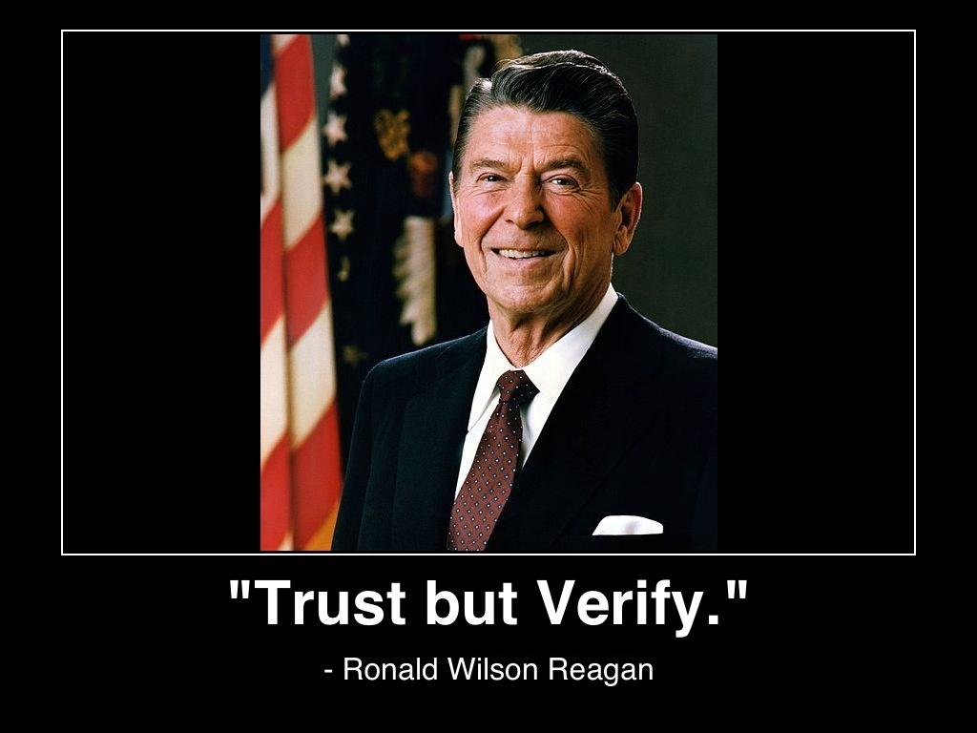
The caged bird (The ministry of Healing, pg. 472)
This discussion seems to be about TRUST. We’re meant to trust God’s leading. And sometimes He leads us into surprising or uncomfortable places. But we are supposed to accept His leading anyway because He knows what is best for us.
NOT FAITH!

Slide 6
What is Faith? (Hebrews 11:1)
Now faith is the substance of things hoped for, the evidence of things not seen.`

Slide 7
What is faith? Hebrews 11:3
³ Through faith we understand that the worlds were framed by the word of God, so that things which are seen were not made of things which do appear.
Faith enables us to trust in God’s word and accept the truth of matters which are outside of our personal experience.

Slide 8
What is faith? Hebrews 11:4
⁴ By faith Abel offered unto God a more excellent sacrifice than Cain, by which he obtained witness that he was righteous, God testifying of his gifts: and by it he being dead yet speaketh.
Abel’s faith enabled him to trust in God’s directions and thus fulfill his obligations. Contrasted is Cain’s lack of faith in God’s directions and his corresponding inability to meet his obligations.

Slide 9
What is faith? Hebrews 11:5
⁵ By faith Enoch was translated that he should not see death; and was not found, because God had translated him: for before his translation he had this testimony, that he pleased God.
Enoch trusted God so much that he was able to walk in step with Him. Every part of his life was in such harmony with God’s will that he was taken to live directly in God’s presence.

Slide 10
What is faith? Hebrews 11:7
⁷ By faith Noah, being warned of God of things not seen as yet, moved with fear, prepared an ark to the saving of his house; by the which he condemned the world, and became heir of the righteousness which is by faith.
Noah trusted that something extremely unusual was going to happen because God told him that it would. Noah had no basis of experience for flooding or even rain, but he still acted on God’s orders. By following God’s directions, Noah saved his whole family.

Slide 11
What is faith? Hebrews 11:8
⁸ By faith Abraham, when he was called to go out into a place which he should after receive for an inheritance, obeyed; and he went out, not knowing whither he went.
Abraham also acted on God’s surprising directions. Notice that both Abraham and Noah were called to act in unanticipated ways, but they trusted God enough to obey His orders.

Slide 12
What is faith? Hebrews 11:6
⁶ But without faith it is impossible to please him: for he that cometh to God must believe that he is, and that he is a rewarder of them that diligently seek him.
Faith is required! And it’s an action—not a state of mind. Faith involves actively doing things according to God’s directions rather than our own wisdom.

Slide 13
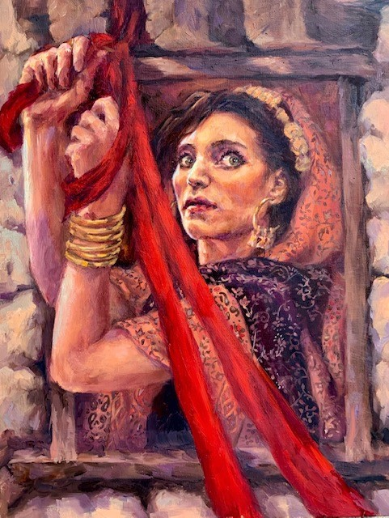
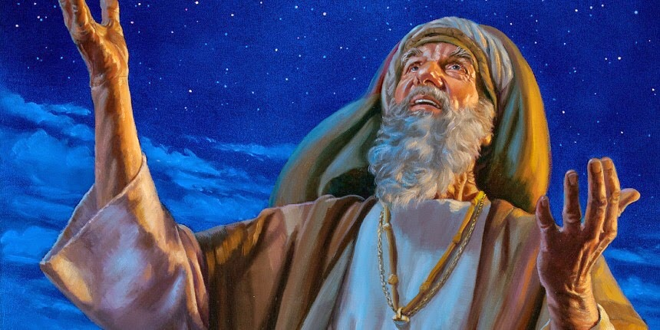
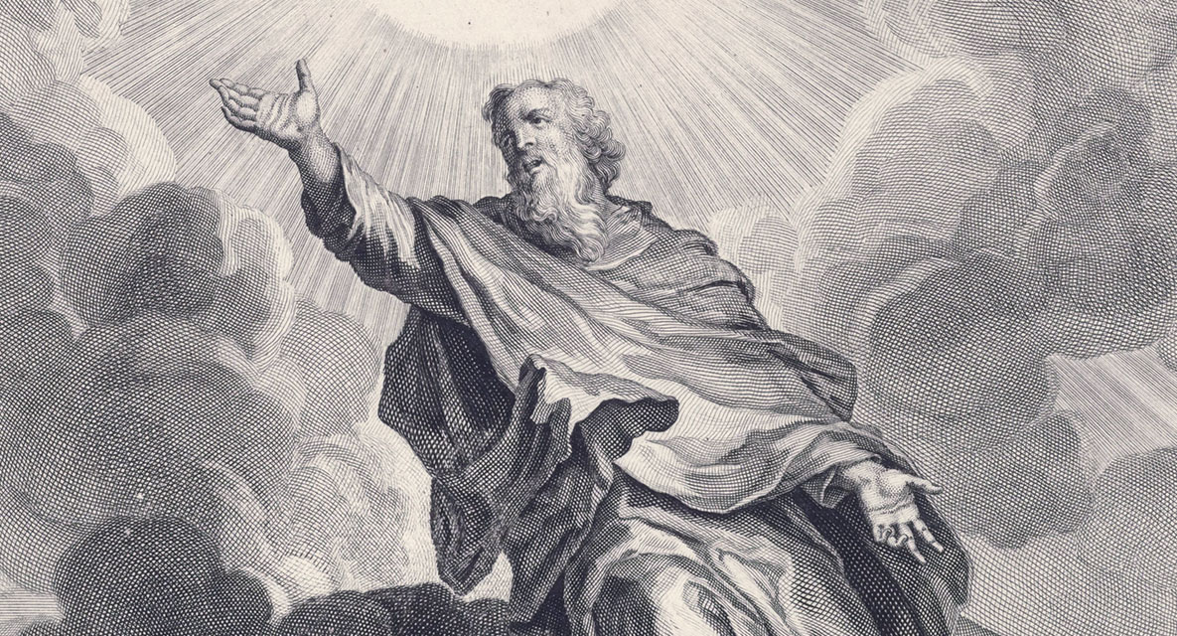
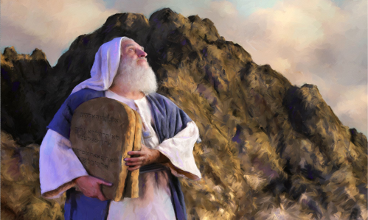
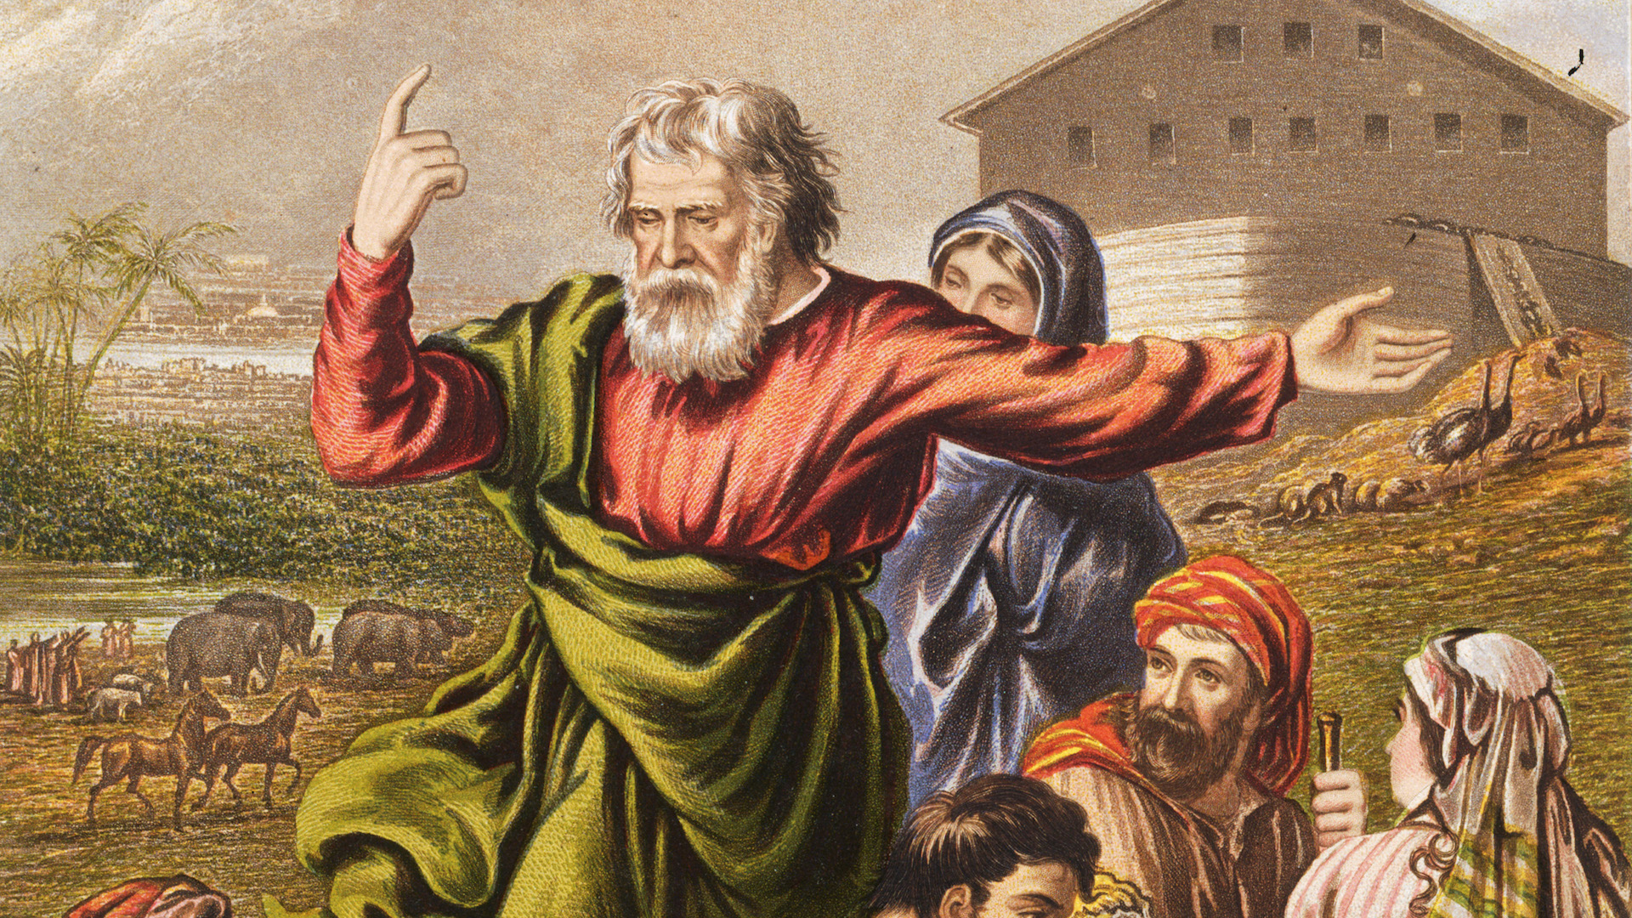
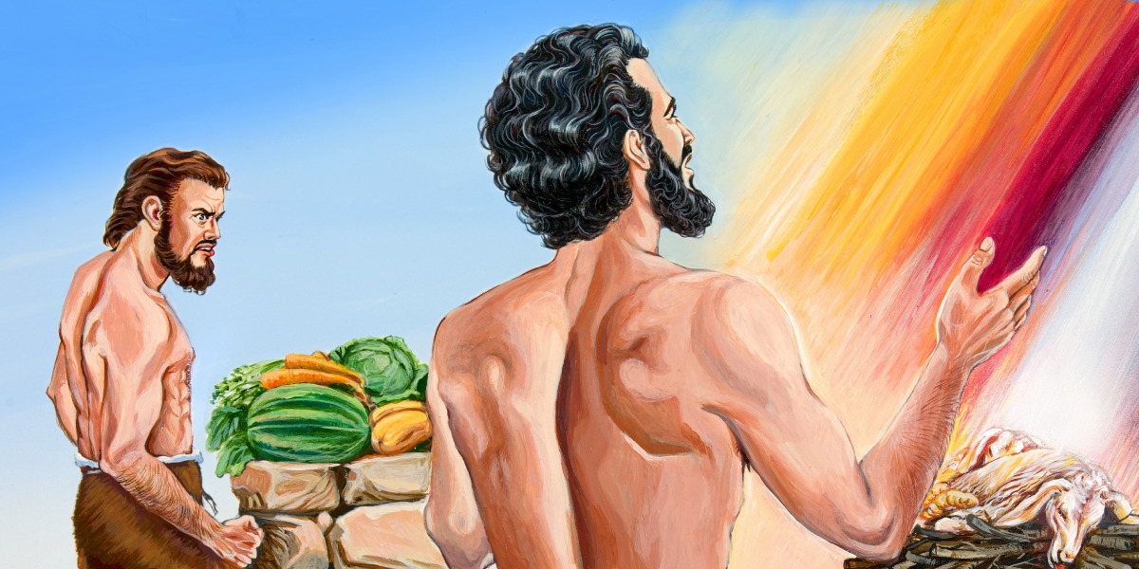
Hebrews 11 describes a number of heroes of faith! There are more yet unmentioned: Sarai, Moses, Rahab, Joseph, Isaac, and others. But these are examples of a FULLY FORMED FAITH. How can we BUILD one?

Slide 14
Building faith—1 Peter 2:1-3
2 Wherefore laying aside all malice, and all guile, and hypocrisies, and envies, and all evil speakings,
² As newborn babes, desire the sincere milk of the word, that ye may grow thereby:
³ If so be ye have tasted that the Lord is gracious.

Slide 15
Building faith—2 Peter 3:17-18
¹⁷ Ye therefore, beloved, seeing ye know these things before, beware lest ye also, being led away with the error of the wicked, fall from your own stedfastness.
¹⁸ But grow in grace, and in the knowledge of our Lord and Saviour Jesus Christ. To him be glory both now and for ever. Amen.

Slide 16
Building faith—Philippians 2:12-13
¹² Wherefore, my beloved, as ye have always obeyed, not as in my presence only, but now much more in my absence, work out your own salvation with fear and trembling.
¹³ For it is God which worketh in you both to will and to do of his good pleasure.

Slide 17
Building faith—Galatians 2:20
²⁰ I am crucified with Christ: nevertheless I live; yet not I, but Christ liveth in me: and the life which I now live in the flesh I live by the faith of the Son of God, who loved me, and gave himself for me.

Slide 18
Building faith—James 2:14-17
¹⁴ What doth it profit, my brethren, though a man say he hath faith, and have not works? can faith save him?
¹⁵ If a brother or sister be naked, and destitute of daily food,
¹⁶ And one of you say unto them, Depart in peace, be ye warmed and filled; notwithstanding ye give them not those things which are needful to the body; what doth it profit?
¹⁷ Even so faith, if it hath not works, is dead, being alone.

Slide 19
Building faith—James 2:18-22
¹⁸ Yea, a man may say, Thou hast faith, and I have works: shew me thy faith without thy works, and I will shew thee my faith by my works.
¹⁹ Thou believest that there is one God; thou doest well: the devils also believe, and tremble.
²⁰ But wilt thou know, O vain man, that faith without works is dead?
²¹ Was not Abraham our father justified by works, when he had offered Isaac his son upon the altar?
²² Seest thou how faith wrought with his works, and by works was faith made perfect?

Slide 20
Building faith—James 2:23-26
²³ And the scripture was fulfilled which saith, Abraham believed God, and it was imputed unto him for righteousness: and he was called the Friend of God.
²⁴ Ye see then how that by works a man is justified, and not by faith only.
²⁵ Likewise also was not Rahab the harlot justified by works, when she had received the messengers, and had sent them out another way?
²⁶ For as the body without the spirit is dead, so faith without works is dead also.

Slide 21
Building Faith
Faith is a direct result of action taken as a response to God’s communications. And He wants to communicate with us… and for us to communicate with Him, appealing for His presence and assistance in perfect assurance (faith) that He will fulfill His word for us.
Faith, then, is built by actions which are obedient to God’s directions! Notice that the Bible characters mentioned here in James (Abraham, Rahab) are also spoken of in the faith chapter of Hebrews 11! Their works made their faith alive and worthy.
God has given us the book of Exodus as a wonderful historical example of building up His people’s faith, basically from scratch!

Slide 22
Real World Faith—Exodus 14:1-4
14 And the Lord spake unto Moses, saying,
² Speak unto the children of Israel, that they turn and encamp before Pihahiroth, between Migdol and the sea, over against Baalzephon: before it shall ye encamp by the sea.
³ For Pharaoh will say of the children of Israel, They are entangled in the land, the wilderness hath shut them in.
⁴ And I will harden Pharaoh's heart, that he shall follow after them; and I will be honoured upon Pharaoh, and upon all his host; that the Egyptians may know that I am the Lord. And they did so.

Slide 23
Real World Faith—Exodus 14:1-4
Notice that God gives an explanation of His otherwise strange directions!
The Israelites are to essentially corner themselves, but NOT so that they’ll have hardship. This incident will bring honor to God, letting people get to know Him. This builds the faith of the Israelites, but also of the Egyptians and everyone else who hears the tale.
³ For Pharaoh will say of the children of Israel, They are entangled in the land, the wilderness hath shut them in.
⁴ And I will harden Pharaoh's heart, that he shall follow after them; and I will be honoured upon Pharaoh, and upon all his host; that the Egyptians may know that I am the Lord. And they did so.

Slide 24
Real World Faith—Exodus 14:5-8
⁵ And it was told the king of Egypt that the people fled: and the heart of Pharaoh and of his servants was turned against the people, and they said, Why have we done this, that we have let Israel go from serving us?
⁶ And he made ready his chariot, and took his people with him:
⁷ And he took six hundred chosen chariots, and all the chariots of Egypt, and captains over every one of them.
⁸ And the Lord hardened the heart of Pharaoh king of Egypt, and he pursued after the children of Israel: and the children of Israel went out with an high hand.
That is, triumphantly

Slide 25
Real World Faith—Exodus 14:9-11
⁹ But the Egyptians pursued after them, all the horses and chariots of Pharaoh, and his horsemen, and his army, and overtook them encamping by the sea, beside Pihahiroth, before Baalzephon.
¹⁰ And when Pharaoh drew nigh, the children of Israel lifted up their eyes, and, behold, the Egyptians marched after them; and they were sore afraid: and the children of Israel cried out unto the Lord.
¹¹ And they said unto Moses, Because there were no graves in Egypt, hast thou taken us away to die in the wilderness? wherefore hast thou dealt thus with us, to carry us forth out of Egypt?
NOT FAITH

Slide 26
Real World Faith—Exodus 14:12-14
¹² Is not this the word that we did tell thee in Egypt, saying, Let us alone, that we may serve the Egyptians? For it had been better for us to serve the Egyptians, than that we should die in the wilderness.
¹³ And Moses said unto the people, Fear ye not, stand still, and see the salvation of the Lord, which he will shew to you to day: for the Egyptians whom ye have seen to day, ye shall see them again no more for ever.
¹⁴ The Lord shall fight for you, and ye shall hold your peace.
FAITH

Slide 27
Real World Faith—Exodus 14:10, 13-14
¹⁰ And when Pharaoh drew nigh, the children of Israel lifted up their eyes, and, behold, the Egyptians marched after them; and they were sore afraid: and the children of Israel cried out unto the Lord.
…
¹³ And Moses said unto the people, Fear ye not, stand still, and see the salvation of the Lord, which he will shew to you to day: for the Egyptians whom ye have seen to day, ye shall see them again no more for ever.
¹⁴ The Lord shall fight for you, and ye shall hold your peace.
Has God put His people into a position of suffering, a “crucible?” Who is suffering here?
Moses, a man of faith, tells the people to (essentially) shut it, hold still, and be amazed because something awesome is coming. He doesn’t seem to be suffering. He has faith.
The people are afraid. They’re certainly suffering uncertainty and doubt. But it’s unnecessary. There’s no need to be fearful, and they wouldn’t be afraid if they had faith.

Slide 28
Real World Faith—Exodus 14:15-18
¹⁵ And the Lord said unto Moses, Wherefore criest thou unto me? speak unto the children of Israel, that they go forward:
¹⁶ But lift thou up thy rod, and stretch out thine hand over the sea, and divide it: and the children of Israel shall go on dry ground through the midst of the sea.
¹⁷ And I, behold, I will harden the hearts of the Egyptians, and they shall follow them: and I will get me honour upon Pharaoh, and upon all his host, upon his chariots, and upon his horsemen.
¹⁸ And the Egyptians shall know that I am the Lord, when I have gotten me honour upon Pharaoh, upon his chariots, and upon his horsemen.

Slide 29
Real World Faith—Exodus 14:19-21
¹⁹ And the angel of God, which went before the camp of Israel, removed and went behind them; and the pillar of the cloud went from before their face, and stood behind them:
²⁰ And it came between the camp of the Egyptians and the camp of Israel; and it was a cloud and darkness to them, but it gave light by night to these: so that the one came not near the other all the night.
²¹ And Moses stretched out his hand over the sea; and the Lord caused the sea to go back by a strong east wind all that night, and made the sea dry land, and the waters were divided.

Slide 30
Real World Faith—Exodus 14:22-225
²² And the children of Israel went into the midst of the sea upon the dry ground: and the waters were a wall unto them on their right hand, and on their left.
²³ And the Egyptians pursued, and went in after them to the midst of the sea, even all Pharaoh's horses, his chariots, and his horsemen.
²⁴ And it came to pass, that in the morning watch the Lord looked unto the host of the Egyptians through the pillar of fire and of the cloud, and troubled the host of the Egyptians,
²⁵ And took off their chariot wheels, that they drave them heavily: so that the Egyptians said, Let us flee from the face of Israel; for the Lord fighteth for them against the Egyptians.

Slide 31
Real World Faith—Exodus 14:22-25
²² And the children of Israel went into the midst of the sea upon the dry ground: and the waters were a wall unto them on their right hand, and on their left.
²³ And the Egyptians pursued, and went in after them to the midst of the sea, even all Pharaoh's horses, his chariots, and his horsemen.
²⁴ And it came to pass, that in the morning watch the Lord looked unto the host of the Egyptians through the pillar of fire and of the cloud, and troubled the host of the Egyptians,
²⁵ And took off their chariot wheels, that they drave them heavily: so that the Egyptians said, Let us flee from the face of Israel; for the Lord fighteth for them against the Egyptians.
FAITH

Slide 32
Real World Faith—Exodus 14:26-28
²⁶ And the Lord said unto Moses, Stretch out thine hand over the sea, that the waters may come again upon the Egyptians, upon their chariots, and upon their horsemen.
²⁷ And Moses stretched forth his hand over the sea, and the sea returned to his strength when the morning appeared; and the Egyptians fled against it; and the Lord overthrew the Egyptians in the midst of the sea.
²⁸ And the waters returned, and covered the chariots, and the horsemen, and all the host of Pharaoh that came into the sea after them; there remained not so much as one of them.

Slide 33
Real World Faith—Exodus 14:29-31
²⁹ But the children of Israel walked upon dry land in the midst of the sea; and the waters were a wall unto them on their right hand, and on their left.
³⁰ Thus the Lord saved Israel that day out of the hand of the Egyptians; and Israel saw the Egyptians dead upon the sea shore.
³¹ And Israel saw that great work which the Lord did upon the Egyptians: and the people feared the Lord, and believed the Lord, and his servant Moses.
FAITH

Slide 34
Real World Faith—Exodus 14:25, 29, 31
²⁵ And took off their chariot wheels, that they drave them heavily: so that the Egyptians said, Let us flee from the face of Israel; for the Lord fighteth for them against the Egyptians.
…
²⁹ But the children of Israel walked upon dry land in the midst of the sea; and the waters were a wall unto them on their right hand, and on their left…
³¹ And Israel saw that great work which the Lord did upon the Egyptians: and the people feared the Lord, and believed the Lord, and his servant Moses.
Here we see the end result of God’s bizarre directions, as given at the beginning of the chapter. The Egyptians become convinced of God’s presence and power. The Israelites begin to fear the Lord and believe in Him. Their faith has been built up!
Notice that FAITH has not come about here because of SUFFERING. Many people believe that suffering can build faith, but that’s not the whole story. Suffering generally offers an opportunity for OBEDIENCE (or disobedience naturally) and OBEDIENCE builds FAITH!

Slide 35
Real World Faith—Exodus 15:22-24
²² So Moses brought Israel from the Red sea, and they went out into the wilderness of Shur; and they went three days in the wilderness, and found no water.
²³ And when they came to Marah, they could not drink of the waters of Marah, for they were bitter: therefore the name of it was called Marah.
²⁴ And the people murmured against Moses, saying, What shall we drink?
NOT FAITH

Slide 36
Real World Faith—Exodus 15:23, 24
²³ And when they came to Marah, they could not drink of the waters of Marah, for they were bitter: therefore the name of it was called Marah.
²⁴ And the people murmured against Moses, saying, What shall we drink?
After the miraculous results of the Red Sea crossing, you’d think the Israelites would have built up a little faith. But no! When presented with a frightening situation (undrinkable water), God intended that His people learn to communicate with Him and trust in Him. Instead, they accused Moses (and God) of trying to kill them.

Slide 37
Real World Faith—Exodus 15:25-26
²⁵ And he cried unto the Lord; and the Lord shewed him a tree, which when he had cast into the waters, the waters were made sweet: there he made for them a statute and an ordinance, and there he proved them,
²⁶ And said, If thou wilt diligently hearken to the voice of the Lord thy God, and wilt do that which is right in his sight, and wilt give ear to his commandments, and keep all his statutes, I will put none of these diseases upon thee, which I have brought upon the Egyptians: for I am the Lord that healeth thee.

Slide 38
Real World Faith—Exodus 15:26
²⁶ And said, If thou wilt diligently hearken to the voice of the Lord thy God, and wilt do that which is right in his sight, and wilt give ear to his commandments, and keep all his statutes, I will put none of these diseases upon thee, which I have brought upon the Egyptians: for I am the Lord that healeth thee.
Here God attempts to teach His people about the connection between obedience and faith!
The Israelites are suffering fear and thirst because of the bitter waters. But once again there is no need!
The Israelites will not suffer any Egyptian plagues (neither thirst nor fear) if they will obey God.

Slide 39
Real World Faith—Exodus 17:1-4
17 And all the congregation of the children of Israel journeyed from the wilderness of Sin, after their journeys, according to the commandment of the Lord, and pitched in Rephidim: and there was no water for the people to drink.
² Wherefore the people did chide with Moses, and said, Give us water that we may drink. And Moses said unto them, Why chide ye with me? wherefore do ye tempt the Lord?
³ And the people thirsted there for water; and the people murmured against Moses, and said, Wherefore is this that thou hast brought us up out of Egypt, to kill us and our children and our cattle with thirst?
⁴ And Moses cried unto the Lord, saying, What shall I do unto this people? they be almost ready to stone me.
NOT FAITH

Slide 40
Real World Faith—Exodus 17:2-3
² Wherefore the people did chide with Moses, and said, Give us water that we may drink. And Moses said unto them, Why chide ye with me? wherefore do ye tempt the Lord?
³ And the people thirsted there for water; and the people murmured against Moses, and said, Wherefore is this that thou hast brought us up out of Egypt, to kill us and our children and our cattle with thirst?
Once again God gives His people an opportunity to express their trust in Him and avoid the plagues of fear and thirst.
And once again the people approach the situation with accusations and doubt rather than faith. This “murmuring” is more than fear and inexperience, as previously. The people are murderous. And they’re “tempting” the Lord, that is, they are defiantly disobedient. They’ve brought their thirst upon themselves.

Slide 41
Real World Faith—Exodus 17:5-7
⁵ And the Lord said unto Moses, Go on before the people, and take with thee of the elders of Israel; and thy rod, wherewith thou smotest the river, take in thine hand, and go.
⁶ Behold, I will stand before thee there upon the rock in Horeb; and thou shalt smite the rock, and there shall come water out of it, that the people may drink. And Moses did so in the sight of the elders of Israel.
⁷ And he called the name of the place Massah, and Meribah, because of the chiding of the children of Israel, and because they tempted the Lord, saying, Is the Lord among us, or not?

Slide 42
Real World Faith—Exodus 17:7
⁷ And he called the name of the place Massah, and Meribah, because of the chiding of the children of Israel, and because they tempted the Lord, saying, Is the Lord among us, or not?
Moses called the place “temptation” and “murmuring.”
The people’s question in verse 7 is not a very genuine inquiry. For one thing, they could see Him in the pillar of cloud by day and fire by night. For another, God’s miraculous intervention provided both daily food and daily water. This isn’t a true question but an expression of defiance and faithlessness.

Slide 43
Personal Faith—Philippians 1:6
⁶ Being confident of this very thing, that he which hath begun a good work in you will perform it until the day of Jesus Christ:

Slide 44
Personal Faith—Hebrews 12:1-2
12 Wherefore seeing we also are compassed about with so great a cloud of witnesses, let us lay aside every weight, and the sin which doth so easily beset us, and let us run with patience the race that is set before us,
² Looking unto Jesus the author and finisher of our faith; who for the joy that was set before him endured the cross, despising the shame, and is set down at the right hand of the throne of God.

Slide 45
Keep building your faith through obedience!
Happy Sabbath!

