Slide 1
Redemption for Gomer
Hosea Chapters 1, 2, and 3
Lesson 5, 3rd Quarter, 2022

Slide 2
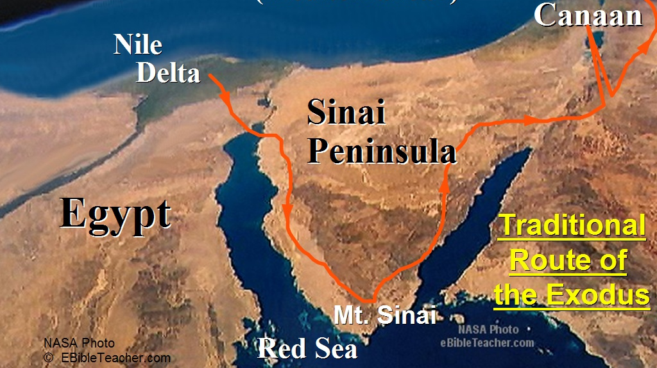
A Little History: The Exodus from Egypt

Slide 3
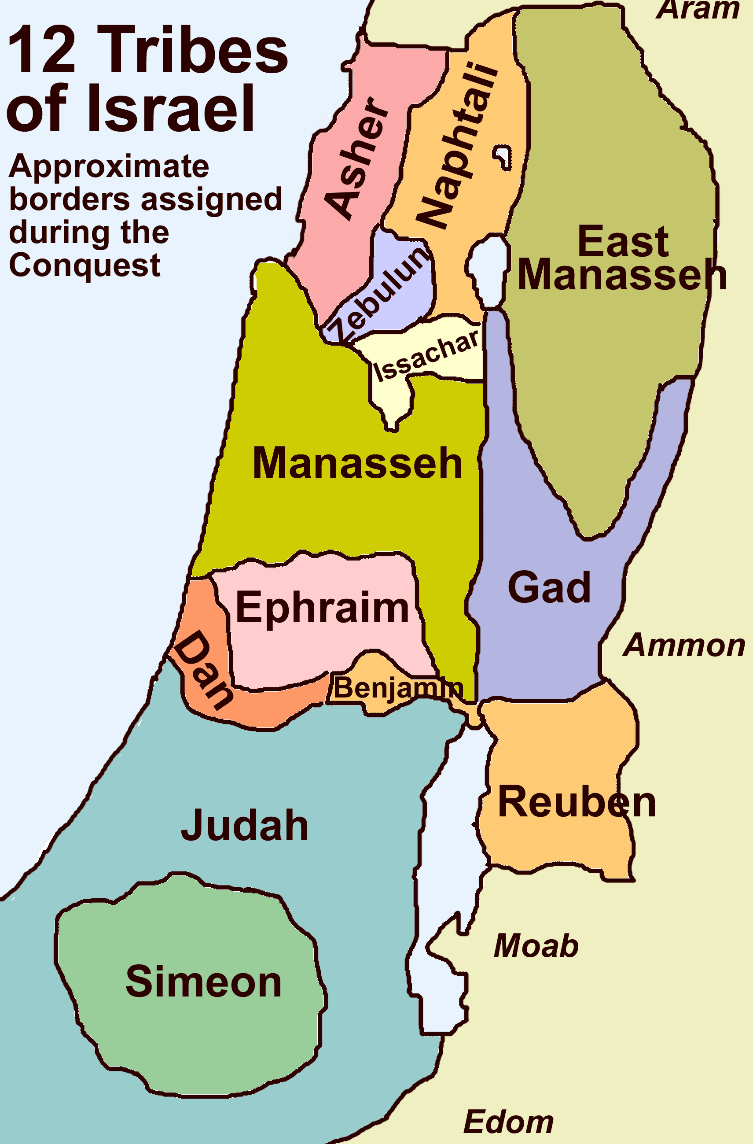
A Little History:
The Plan for Canaan

Slide 4
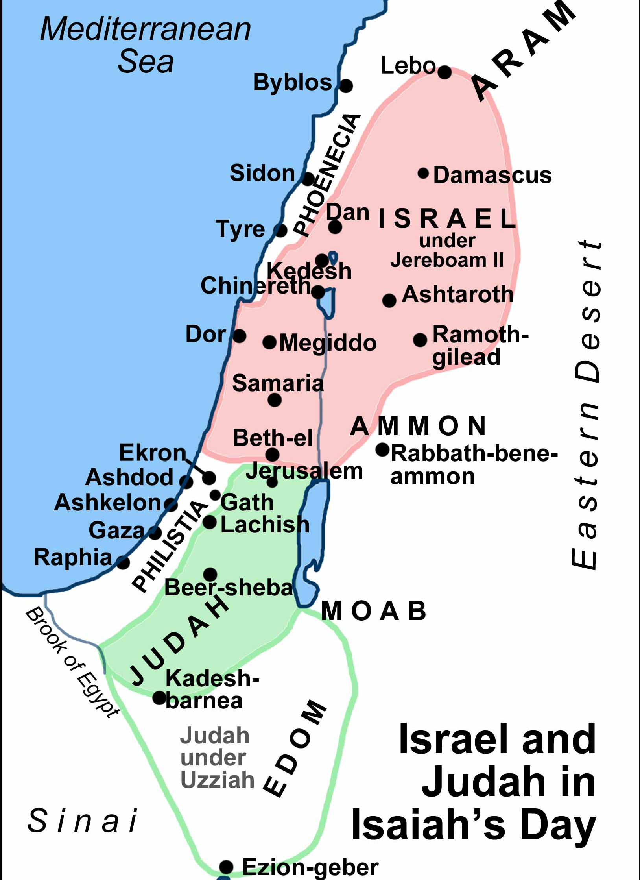
A Little History: the Two Kingdoms

Slide 5
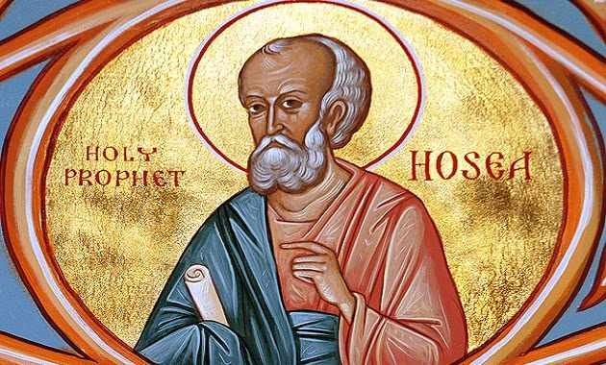
A little History: The Prophet Hosea
Hosea was citizen of the northern kingdom of Israel, whose ruler, Jeroboam II, is called by the prophet “our king.” A comparison between some of his prophecies and those of Amos indicates that Hosea was a younger contemporary of Amos. Having begun his ministry in the time of Uzziah, king of Judah, and Jeroboam II, king of Israel, Hosea continued until the time of Hezekiah, king of Judah. However, all his messages were addressed to the northern nation.

Slide 6
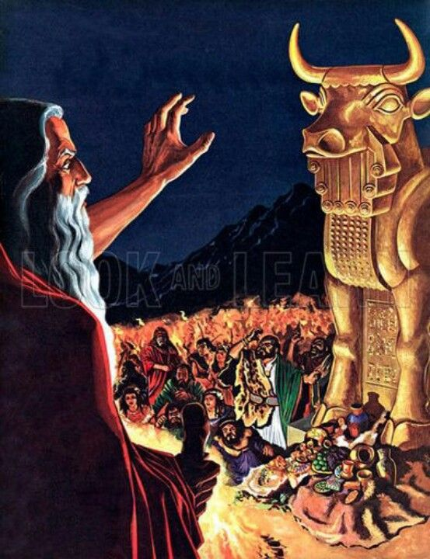
A little History: The Prophet Hosea
Hosea lived in the darkest period of the history of the kingdom of Israel. Political anarchy and misrule were the order of the day. Kings took the throne after murdering their predecessors, and in turn were themselves assassinated. Hosea repeatedly refers to the idolatrous calf worship set up by Jeroboam I as a prime cause of Israel’s wickedness. This idolatry probably gave entrance to cruder and more inhuman worship offered to Baal and Ashtoreth, the shocking abomination of child sacrifice and other unspeakable degradations. The priests, wholly devoted to idolatry, joined in and added to the corruption that covered the land.

Slide 7
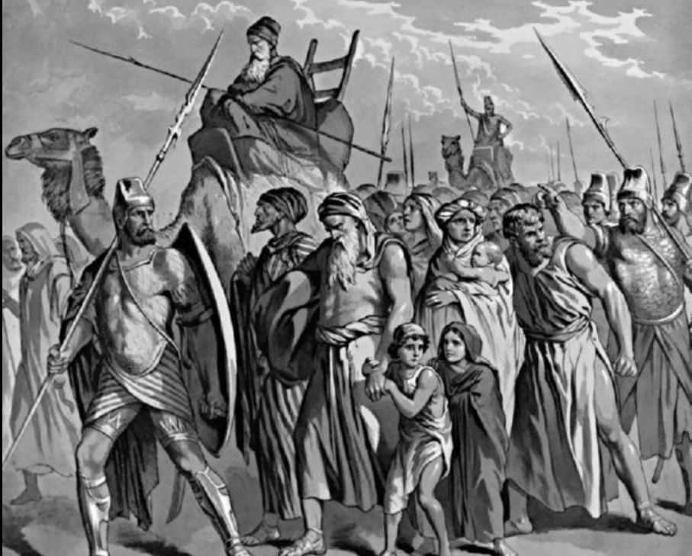
A little History: The Prophet Hosea
Against this flood of iniquity in Israel, Hosea was called by God to rebuke idolatry and wickedness, and to appeal to the invincible love of God for His erring children. But the appeals of Hosea went unheard by an apostate people. The wicked nation held to its rebellious course of action, and was carried into the cruel captivity of Assyrian bondage. Hosea bore God’s last message to the northern kingdom prior to its fall in roughly 722 BC.
2 Kings 17:5-18 gives an explanation of these events.

Slide 8
2 Kings 17:5-8
⁵ Then the king of Assyria came up throughout all the land, and went up to Samaria, and besieged it three years.
⁶ In the ninth year of Hoshea the king of Assyria took Samaria, and carried Israel away into Assyria, and placed them in Halah and in Habor by the river of Gozan, and in the cities of the Medes.
⁷ For so it was, that the children of Israel had sinned against the Lord their God, which had brought them up out of the land of Egypt, from under the hand of Pharaoh king of Egypt, and had feared other gods,
⁸ And walked in the statutes of the heathen, whom the Lord cast out from before the children of Israel, and of the kings of Israel, which they had made.

Slide 9
2 Kings 17:9-12
⁹ And the children of Israel did secretly those things that were not right against the Lord their God, and they built them high places in all their cities, from the tower of the watchmen to the fenced city.
¹⁰ And they set them up images and groves in every high hill, and under every green tree:
¹¹ And there they burnt incense in all the high places, as did the heathen whom the Lord carried away before them; and wrought wicked things to provoke the Lord to anger:
¹² For they served idols, whereof the Lord had said unto them, Ye shall not do this thing.

Slide 10
2 Kings 17:12-15
¹³ Yet the Lord testified against Israel, and against Judah, by all the prophets, and by all the seers, saying, Turn ye from your evil ways, and keep my commandments and my statutes, according to all the law which I commanded your fathers, and which I sent to you by my servants the prophets.
¹⁴ Notwithstanding they would not hear, but hardened their necks, like to the neck of their fathers, that did not believe in the Lord their God.
¹⁵ And they rejected his statutes, and his covenant that he made with their fathers, and his testimonies which he testified against them; and they followed vanity, and became vain, and went after the heathen that were round about them, concerning whom the Lord had charged them, that they should not do like them.

Slide 11
2 Kings 17:16-18
¹⁶ And they left all the commandments of the Lord their God, and made them molten images, even two calves, and made a grove, and worshipped all the host of heaven, and served Baal.
¹⁷ And they caused their sons and their daughters to pass through the fire, and used divination and enchantments, and sold themselves to do evil in the sight of the Lord, to provoke him to anger.
¹⁸ Therefore the Lord was very angry with Israel, and removed them out of his sight: there was none left but the tribe of Judah only.

Slide 12
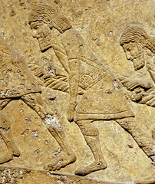
A final warning
Hosea is the prophet charged with speaking to God’s people just before this dreadful calamity. He doesn’t excuse their evil behavior at all. Instead, Hosea paints in the darkest hues the dreadful retributions that will fall upon Israel if they persist in their rebellious ways. These warnings are not threats, but statements of fact, showing that punishment inevitably follows sin.

Slide 13
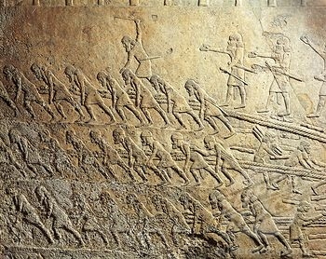
Assyrian Slave Labor.

Slide 14
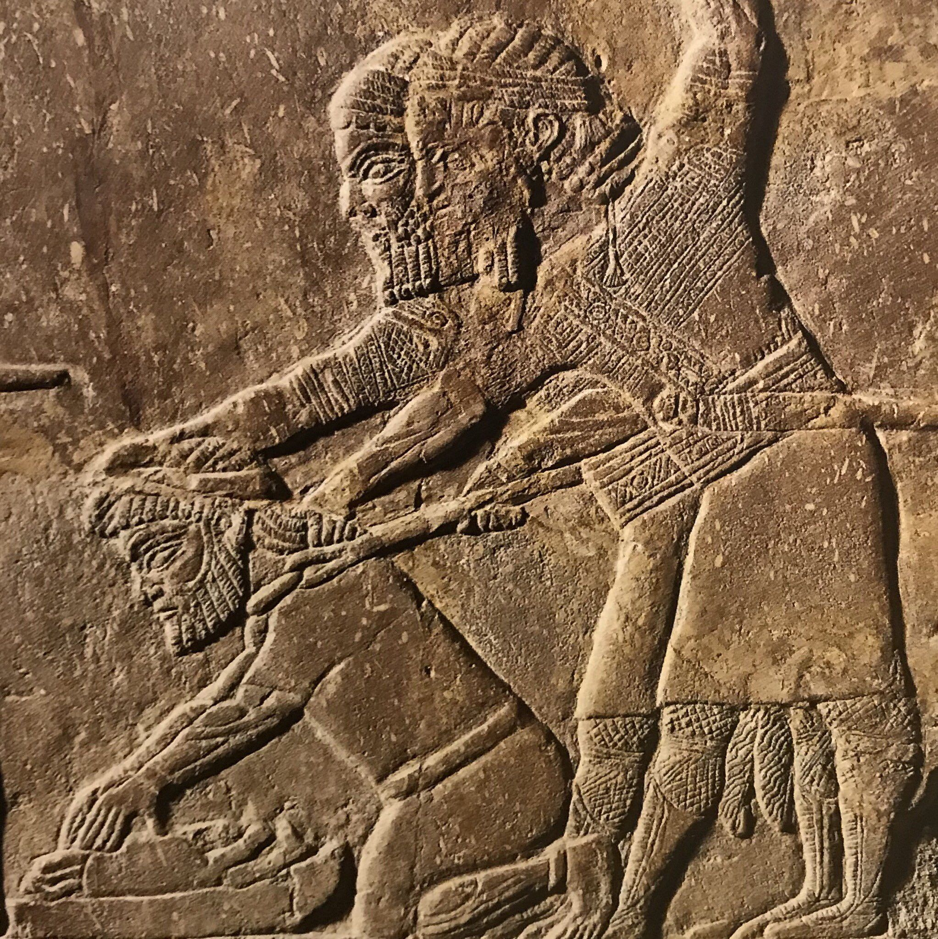
Two Assyrian soldiers forcing Babylonian captive to grind bones of his family.

Slide 15
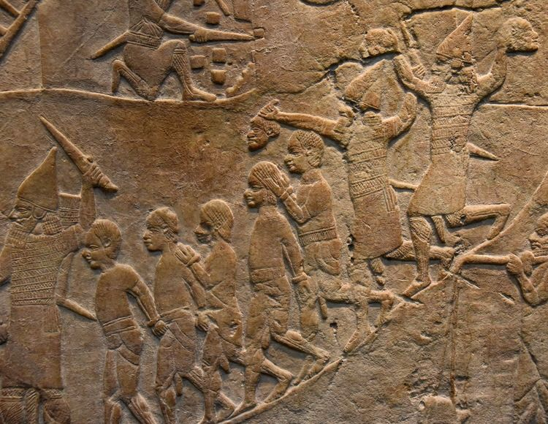
Assyrian soldiers carrying decapitated heads.

Slide 16
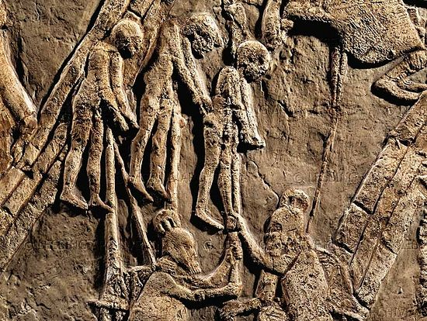
Hebrews captured by Assyrian soldiers in a relief from King Sennacherib's palace in Niniveh.

Slide 17
How could God allow this to happen?
God loves His children! How could He allow such terrible suffering to happen to anybody, much less the nation of Israel?
God’s messages to Israel through Hosea are filled with love. Through all his writing, Hosea depicts the yearning love of God for His wayward people. The book is filled with appeals to repentance and messages of hope for those who will turn again to their loving Father. Yet the choice of those who insist on following their wicked, rebellious ways cannot be disregarded. Ultimately, their choice is honored, and disaster falls on the northern kingdom.
But God still loves His people. He reached out to His rebellious children in a very personal and unusual way in Hosea’s time.
Turn to Hosea 1:2-11

Slide 18
Hosea 1:2-3
² The beginning of the word of the Lord by Hosea. And the Lord said to Hosea, Go, take unto thee a wife of whoredoms and children of whoredoms: for the land hath committed great whoredom, departing from the Lord.
³ So he went and took Gomer the daughter of Diblaim; which conceived, and bare him a son.

Slide 19
Hosea 1:4-5
⁴ And the Lord said unto him, Call his name Jezreel; for yet a little while, and I will avenge the blood of Jezreel upon the house of Jehu, and will cause to cease the kingdom of the house of Israel.
⁵ And it shall come to pass at that day, that I will break the bow of Israel, in the valley of Jezreel.
NOTE: Jezreel means “God will sow” or “God will scatter.” Since seed is planted by scattering, this name is a play on words that may mean either that God will establish or God will destroy.

Slide 20
Hosea 1:6-7
⁶ And she conceived again, and bare a daughter. And God said unto him, Call her name Loruhamah: for I will no more have mercy upon the house of Israel; but I will utterly take them away.
⁷ But I will have mercy upon the house of Judah, and will save them by the Lord their God, and will not save them by bow, nor by sword, nor by battle, by horses, nor by horsemen.
NOTE: Lo-ruhamah means “not pitied,” or “not having received compassion.” Paul apparently interprets this phrase as “not beloved” in Romans 9:25. Peter identifies a people that “had not obtained mercy” in reference to the same general passage in 1 Peter 2:10.

Slide 21
Hosea 1:8-9
⁸ Now when she had weaned Loruhamah, she conceived, and bare a son.
⁹ Then said God, Call his name Loammi: for ye are not my people, and I will not be your God.
NOTE: Lo-ammi means literally, “not my people.”

Slide 22
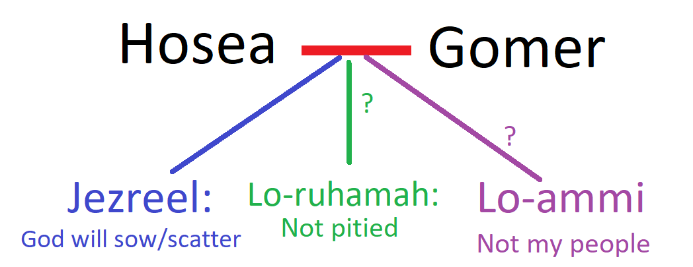
Hosea’s Family Tree

Slide 23
Hosea 1:10-11
¹⁰ Yet the number of the children of Israel shall be as the sand of the sea, which cannot be measured nor numbered; and it shall come to pass, that in the place where it was said unto them, Ye are not my people, there it shall be said unto them, Ye are the sons of the living God.
¹¹ Then shall the children of Judah and the children of Israel be gathered together, and appoint themselves one head, and they shall come up out of the land: for great shall be the day of Jezreel.
NOTE: God is not mocked. If we disobey Him we cannot expect to escape the penalty for our transgressions. Hosea’s children, representing the apostate children of Israel, declare by their names the increasingly severe punishments for this apostasy. However, divine mercy is pictured here as strongly as divine judgement. God is a God of justice and love.

Slide 24
Hosea’s Family Dysfunction
We are told in Hosea 1:2 that God directed Hosea to marry a “wife of whoredoms,” and he married Gomer.
We see that Gomer’s unfaithfulness is thoroughly established in the third chapter of the book of Hosea.
See Hosea 3:1

Slide 25
Hosea 3:1
3 Then said the Lord unto me, Go yet, love a woman beloved of her friend, yet an adulteress, according to the love of the Lord toward the children of Israel, who look to other gods, and love flagons of wine.
NOTE: God establishes some particular symbols with this verse. When He says “go yet,” He’s saying, “again.” That is, Gomer has already left Hosea to be with other men, but God is telling Hosea to go and get her, and take her again as wife.

Slide 26
Symbols from Hosea 3:1
Hosea represents God (in this scenario)
Gomer (Hosea’s wife) represents God’s people
Adultery represents Idolatry (anything valued above God)

Slide 27
Hosea’s Family Dysfunction
Hosea is believed to have used the actual experience of his unfaithful wife as a representation of unfaithful Israel, particularly in the evocative verses of Hosea chapter 2.
Since Israel had committed spiritual adultery with idols, she had naturally ceased to be the spouse of God. She was no longer united to Him by faith and love, and so God disowned her.
Hosea chapter 2 depicts God’s deep sorrow because of Israel’s unfaithfulness.

Slide 28
Recall our Symbols from Hosea 3:1
Hosea represents God (in this scenario)
Gomer (Hosea’s wife) represents God’s people
Adultery represents Idolatry (anything valued above God)
Keeping this symbolism in mind, turn to Hosea 2:1-7

Slide 29
Hosea 2:1-2
2 Say ye unto your brethren, Ammi; and to your sisters, Ruhamah.
² Plead with your mother, plead: for she is not my wife, neither am I her husband: let her therefore put away her whoredoms out of her sight, and her adulteries from between her breasts;
NOTE: Ammi means “my people” and Ruhamah means “pitied,” or “having received compassion.”

Slide 30
Hosea 2:3-4
³ Lest I strip her naked, and set her as in the day that she was born, and make her as a wilderness, and set her like a dry land, and slay her with thirst.
⁴ And I will not have mercy upon her children; for they be the children of whoredoms.
NOTE: Israel would be reduced to the condition she was in when God first chose her as His people, a downtrodden nation of slaves. These children “of whoredoms” lead to some doubt that the younger two of Hosea’s children were actually his children at all.

Slide 31
Hosea 2:5-6
⁵ For their mother hath played the harlot: she that conceived them hath done shamefully: for she said, I will go after my lovers, that give me my bread and my water, my wool and my flax, mine oil and my drink.
⁶ Therefore, behold, I will hedge up thy way with thorns, and make a wall, that she shall not find her paths.
NOTE: The loving husband in this passage puts obstacles in his unfaithful wife’s path, making a wall, making it difficult for her to achieve her wicked goals.

Slide 32
Hosea 2:7
⁷ And she shall follow after her lovers, but she shall not overtake them; and she shall seek them, but shall not find them: then shall she say, I will go and return to my first husband; for then was it better with me than now.
NOTE: Frustrated by the obstacles that have been placed in her way, the unfaithful wife considers returning to her “first husband” because “it was better with me than now.” This is the benefit of such obstacles!

Slide 33
Suffering with purpose
The loving husband places obstacles in his wife’s path, preventing her from achieving her wicked purposes. In frustration, she considers returning to Him.
God allows our evil choices to create problems and suffering. Hopefully these challenges inspire us, His people, to consider returning to Him when we have wandered from the true path.
Much of the next section highlights the suffering of the unfaithful wife as a result of her poor choices.

Slide 34
Hosea 2:8-12
⁸ For she did not know that I gave her corn, and wine, and oil, and multiplied her silver and gold, which they prepared for Baal.
⁹ Therefore will I return, and take away my corn in the time thereof, and my wine in the season thereof, and will recover my wool and my flax given to cover her nakedness.
¹⁰ And now will I discover her lewdness in the sight of her lovers, and none shall deliver her out of mine hand.
¹¹ I will also cause all her mirth to cease, her feast days, her new moons, and her sabbaths, and all her solemn feasts.
¹² And I will destroy her vines and her fig trees, whereof she hath said, These are my rewards that my lovers have given me: and I will make them a forest, and the beasts of the field shall eat them.

Slide 35
Hosea 2:13-15
¹³ And I will visit upon her the days of Baalim, wherein she burned incense to them, and she decked herself with her earrings and her jewels, and she went after her lovers, and forgat me, saith the Lord.
¹⁴ Therefore, behold, I will allure her, and bring her into the wilderness, and speak comfortably unto her.
¹⁵ And I will give her her vineyards from thence, and the valley of Achor for a door of hope: and she shall sing there, as in the days of her youth, and as in the day when she came up out of the land of Egypt.
NOTE: There is a shift in verse 14. The loving husband now attempts to “allure” his errant wife. This abrupt transition heightens the picture of the persistent, unfailing love of God toward His people in spite of their waywardness. Note that we may forget God, but He cannot forget us.

Slide 36
Redeeming Love
God loves His people so much that He is willing to “allure” us, even though we “forgat” Him! That is truly divine grace and mercy.
Hosea himself did something stunningly selfless, apparently as a model of God’s unfailing love for His disappointing people.
Turn for a moment to Hosea 3:2-3.

Slide 37
Hosea 3:2-3
² So I bought her to me for fifteen pieces of silver, and for an homer of barley, and an half homer of barley:
³ And I said unto her, Thou shalt abide for me many days; thou shalt not play the harlot, and thou shalt not be for another man: so will I also be for thee.
NOTE: Gomer had evidently fallen into some kind of debt or slavery after leaving Hosea. Modeling Christ’s love for His wicked people, Hosea not only reclaims Gomer as His wife but actually buys her out of slavery so that he may do so. This after she betrayed him! This human model of selfless forgiveness is designed to help us understand the infinite, merciful love of God.
Return to Hosea 2:16-23

Slide 38
Hosea 2:16-17
¹⁶ And it shall be at that day, saith the Lord, that thou shalt call me Ishi; and shalt call me no more Baali.
¹⁷ For I will take away the names of Baalim out of her mouth, and they shall no more be remembered by their name.
NOTE: Both Ishi and Baali can mean “my husband,” but Ishi is a term of tender affection. Some interpret Baali as meaning “my husband” but also “my Lord,” or “my Master,” a more formal title denoting stern authority and rule. Others suggest that the name Baali was to be discontinued because of its idolatrous associations, as we see in verse 17.

Slide 39
Hosea 2:18-21
¹⁸ And in that day will I make a covenant for them with the beasts of the field and with the fowls of heaven, and with the creeping things of the ground: and I will break the bow and the sword and the battle out of the earth, and will make them to lie down safely.
¹⁹ And I will betroth thee unto me for ever; yea, I will betroth thee unto me in righteousness, and in judgment, and in lovingkindness, and in mercies.
²⁰ I will even betroth thee unto me in faithfulness: and thou shalt know the Lord.
²¹ And it shall come to pass in that day, I will hear, saith the Lord, I will hear the heavens, and they shall hear the earth;
NOTE: God is willing to be reunited with his unfaithful people, and restore them to their former honorable state.

Slide 40
Compare Hosea 3:4-5!

Slide 41
Hosea 3:4-5
⁴ For the children of Israel shall abide many days without a king, and without a prince, and without a sacrifice, and without an image, and without an ephod, and without teraphim:
⁵ Afterward shall the children of Israel return, and seek the Lord their God, and David their king; and shall fear the Lord and his goodness in the latter days.
NOTE: The ten tribes that formed the northern kingdom, Israel, had rebelled and broken away from the house of David. To them was made no promise of a return to their former status of national independence. In the restoration of Judah individual members of the tribes might share, and doubtless many did. Cut those who returned were all under one king. The final fulfillment of this prediction occurs for Spiritual Israel “at the close of earth’s history, when Christ shall appear.” (PK 298).
Return to Hosea 2:22-23

Slide 42
Hosea 2:22-23
²² And the earth shall hear the corn, and the wine, and the oil; and they shall hear Jezreel.
²³ And I will sow her unto me in the earth; and I will have mercy upon her that had not obtained mercy; and I will say to them which were not my people, Thou art my people; and they shall say, Thou art my God.
NOTE: Here the metaphorical meaning of the names of Gomer’s children is reversed, and picturesquely used to represent the restored marital relationship. Here God says He will sow, not scatter, have mercy on those previously without mercy, and claim as His people those who had not been His people. Amen!

Slide 43
Happy Sabbath!
Thank you!!

