Slide 1
Pressing on to Perfection
John 16, Colossians 1, Philippians 3
Lesson 6, 3rd Quarter, 2022

Slide 2
God’s Part—John 16:1-15
16 These things have I spoken unto you, that ye should not be offended.
² They shall put you out of the synagogues: yea, the time cometh, that whosoever killeth you will think that he doeth God service.
³ And these things will they do unto you, because they have not known the Father, nor me.
Discouraged, weakened in faith

Slide 3
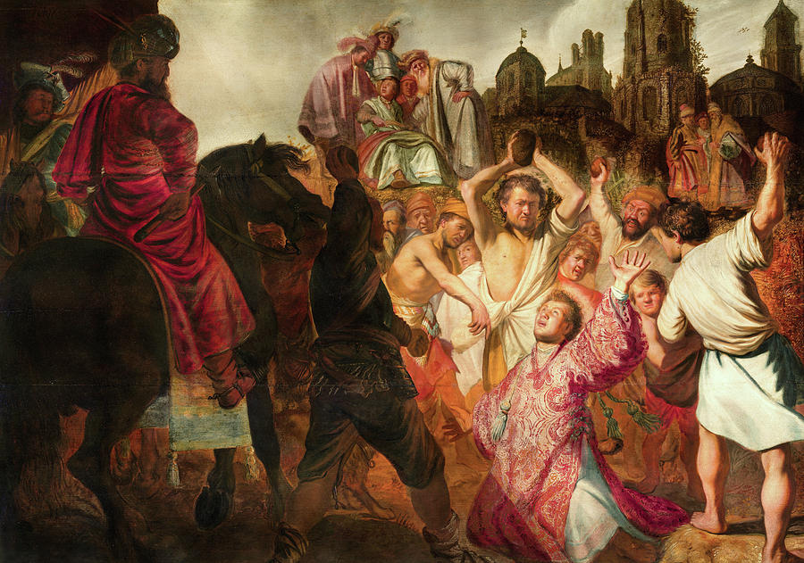
The Stoning of Stephen (AD 34)

Slide 4
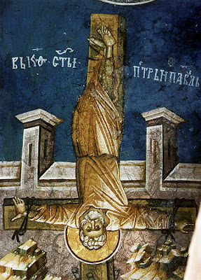
By tradition, the apostle Peter was crucified on an inverted cross in about AD 67.

Slide 5
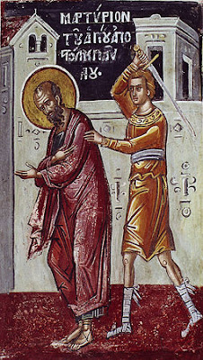
By tradition, Paul was beheaded in Rome.

Slide 6
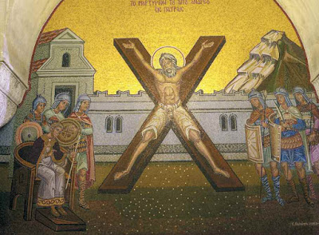
By tradition, the apostle Andrew was crucified on an X-shaped cross in Patras, Greece.

Slide 7
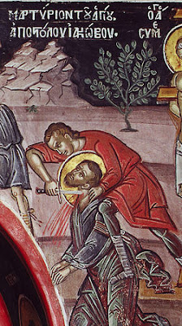
James the son of Zebedee is the only disciple whose martyrdom is recorded in the Bible (Acts 12:2). Herod had him killed by the sword, and he was likely beheaded.

Slide 8
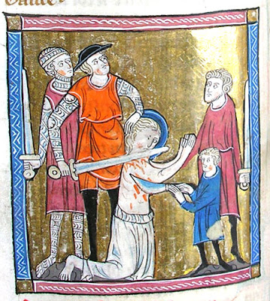
By tradition, the apostle Bartholomew was crucified, skinned alive, and beheaded in Armenia.

Slide 9
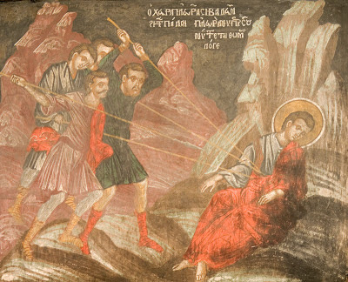
By tradition, the apostle Thomas was martyred when he was stabbed with five spears.

Slide 10
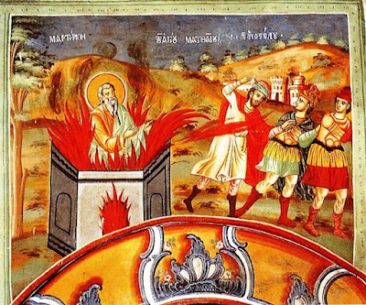
By tradition, the apostle Matthew is supposed to have been burned alive in Ethiopia.

Slide 11
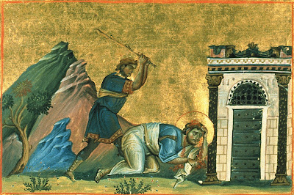
By tradition, the apostle James the son of Alphaeus, is depicted as either having been crucified or possibly beaten to death with rods or whips.

Slide 12
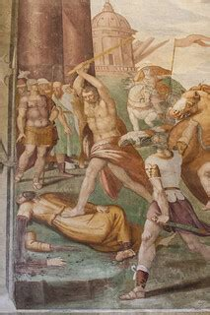
Traditions surrounding the death of the apostle Thaddeus (also known as Jude) are contradictory. He may have been crucified, shot with arrows, or killed with an axe.

Slide 13
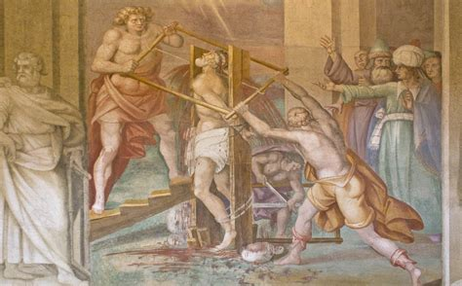
Traditions around the death of the apostle Simon also generally include crucifixion.

Slide 14
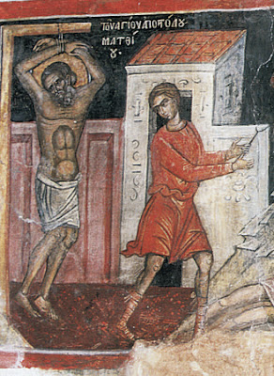
By tradition, Matthias was killed by stoning in Palestine.

Slide 15
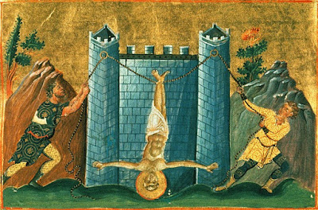
Traditionally speaking, the apostle Philip is thought to have been crucified upside down on the wall of a pagan temple in Hierapolis, though there is an alternate tradition suggesting that he died a natural death.

Slide 16
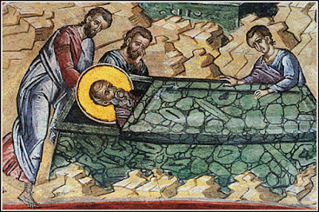
The apostle John was NOT MARTYRED!! He died a natural death, possibly the only apostle to do so.

Slide 17
God’s Part—John 16:1-3
16 These things have I spoken unto you, that ye should not be offended.
² They shall put you out of the synagogues: yea, the time cometh, that whosoever killeth you will think that he doeth God service.
³ And these things will they do unto you, because they have not known the Father, nor me.
Discouraged, weakened in faith

Slide 18
God’s Part—John 16:4
⁴ But these things have I told you, that when the time shall come, ye may remember that I told you of them. And these things I said not unto you at the beginning, because I was with you.
Jesus did not give these warnings previously, because He was there in person to encourage the disciples. While he was present, most of the persecution was directed at Him anyway.

Slide 19
God’s Part—John 16:5-6
⁵ But now I go my way to him that sent me; and none of you asketh me, Whither goest thou?
⁶ But because I have said these things unto you, sorrow hath filled your heart.
The disciples should have rejoiced at the prospect of glory to which their Master was returning. Instead, the thought of their own separation from Him filled their hearts with anxiety and fear. They thought of themselves rather than their Master.

Slide 20
God’s Part—John 16:7
Profitable. Jesus had to go through the crucifixion, resurrection, and ascension before the Holy Spirit could be sent. In His human body, Jesus couldn’t be everywhere at the same time, as the Holy Spirit can.
⁷ Nevertheless I tell you the truth; It is expedient for you that I go away: for if I go not away, the Comforter will not come unto you; but if I depart, I will send him unto you.

Slide 21
God’s Part—John 16:8
Convict or, better, convince! The Holy spirit is an effectual persuader of reluctant humanity.
⁸ And when he is come, he will reprove the world of sin, and of righteousness, and of judgment:

Slide 22
God’s Part—John 16:9
⁹ Of sin, because they believe not on me;
The day of Pentecost delivered a striking example of this aspect of the Holy Spirit’s work. Those who heard Peter’s address were “pricked in their heart” (Acts 2:37). One of the first evidences of the Holy Spirit is the deep conviction that one is a sinner.
God has provided only one means of salvation: faith in Jesus. The Holy Spirit needs to act to convince fallen humanity of its sinfulness, because we lack that faith in Christ.

Slide 23
God’s Part—John 16:10
¹⁰ Of righteousness, because I go to my Father, and ye see me no more;
Not only does the Spirit expose sin; He also convicts of positive righteousness He urges men to accept the righteousness of Christ, both the imputed and the imparted. (More on this in a minute!)
While on earth, Jesus had pointed the way to the perfect righteousness required of those who enter the Kingdom of Heaven. After His departure this would be the special work of the Holy Spirit.

Slide 24
Imputed Righteousness
The righteousness of Christ credited to the believers — that is, treated as if it were theirs through faith. Imputed Righteousness is synonymous with Justification by Faith.
(Romans 10:6, 9-10)
⁶ But the righteousness which is of faith speaketh on this wise, Say not in thine heart, Who shall ascend into heaven? (that is, to bring Christ down from above:)…
⁹ That if thou shalt confess with thy mouth the Lord Jesus, and shalt believe in thine heart that God hath raised him from the dead, thou shalt be saved.
¹⁰ For with the heart man believeth unto righteousness; and with the mouth confession is made unto salvation.

Slide 25
Imparted Righteousness
Imparted righteousness is the gracious gift of God given at the justification which enables the believer to strive for holiness and victory over sin. This is synonymous with sanctification.
Galatians 2:20- I am crucified with Christ: nevertheless I live; yet not I, but Christ liveth in me: and the life which I now live in the flesh I live by the faith of the Son of God, who loved me, and gave himself for me.
Phillipians 2:13- For it is God which worketh in you both to will and to do of his good pleasure.

Slide 26
God’s Part—John 16:10
¹⁰ Of righteousness, because I go to my Father, and ye see me no more;
Not only does the Spirit expose sin; He also convicts of positive righteousness He urges men to accept the righteousness of Christ, both the imputed and the imparted. (More on this in a minute!)
While on earth, Jesus had pointed the way to the perfect righteousness required of those who enter the Kingdom of Heaven. After His departure this would be the special work of the Holy Spirit.

Slide 27
God’s Part—John 16:11
¹¹ Of judgment, because the prince of this world is judged.
Jesus also warned men of the judgment to come. None can escape it. Though fear of judgment is not to be the prime motive of doing right, it is a powerful agency in awakening sin-darkened minds.
The vindication of the divine character at the cross assured that Satan (who claims to be prince of this earth) would be brought to trial and condemned. And as this is true of the arch-rebel himself, it is surely true for all who follow him.

Slide 28
Roles of the Holy Spirit:
And when he is come, he will reprove the world of sin, and of righteousness, and of judgment:
Thus the Spirit convicts men of their sin,
Points them to the salvation and righteousness that is in Jesus, and
Warns them of the consequences of continuing in their sins and of neglecting the salvation freely offered.

Slide 29
God’s Part—John 16:12
The human mind is capable of acquiring new information at a limited rate! Jesus had taught the disciples much, but there were many things yet to be revealed. The wisdom of God is infinite and cannot be exhausted. A lifetime of diligent study enables one to gain just a limited concept of the infinite treasures of God’s understanding. But there can also be other problems!
¹² I have yet many things to say unto you, but ye cannot bear them now.

Slide 30

Our Part: A Bad Example
1 Corinthians 3:1-3
3 And I, brethren, could not speak unto you as unto spiritual, but as unto carnal, even as unto babes in Christ.
² I have fed you with milk, and not with meat: for hitherto ye were not able to bear it, neither yet now are ye able.
³ For ye are yet carnal: for whereas there is among you envying, and strife, and divisions, are ye not carnal, and walk as men?

Slide 31
Our Part: A Bad Example
1 Corinthians 3:1-3
² I have fed you with milk, and not with meat: for hitherto ye were not able to bear it, neither yet now are ye able.
³ For ye are yet carnal…
Sometimes a spiritual lethargy prevents a person from acquiring further divine truth.
This is the case with the Corinthians, whom Paul here designates as “carnal,” requiring to be fed with milk because they were not able to endure a substantial spiritual diet.

Slide 32
God’s Part—John 16:13
¹³ Howbeit when he, the Spirit of truth, is come, he will guide you into all truth: for he shall not speak of himself; but whatsoever he shall hear, that shall he speak: and he will shew you things to come.
Yet hope for growth remains! God has provided the Holy Spirit to “guide” us “into all truth.” Christians are urged to leave the first “principles of the doctrine of Christ” and “go on unto perfection” (Heb. 6:1, 5:11-14).

Slide 33
God’s Part—John 16:14-5
¹⁴ He shall glorify me: for he shall receive of mine, and shall shew it unto you.
¹⁵ All things that the Father hath are mine: therefore said I, that he shall take of mine, and shall shew it unto you.
By a revelation of the majesty and glory of the risen Christ and an unveiling of the mysteries of the plan of salvation, the Holy Spirit glorifies Christ. We see here a description of the interconnectedness of the three persons of the Godhead. Christ’s glory comes from His Father, while the Holy Spirit displays it for the saving of humanity. Notice that all of this effort is on the part of the Godhead! But we have our part to play too.

Slide 34
Our Part: A Better Example
Colossians 1:23
²³ If ye continue in the faith grounded and settled, and be not moved away from the hope of the gospel, which ye have heard, and which was preached to every creature which is under heaven; whereof I Paul am made a minister;
The Colossians had heard the word of life. They had accepted the faith and had been reconciled (justified, having received imputed righteousness) by the blood of Christ. They were “saints and faithful brethren” (v. 2). But all their efforts would prove pointless if they should fail to “continue.” Paul stresses their need of abiding and remaining in their confidence in the gospel.

Slide 35
Our Part: A Better Example
Colossians 1:24-25
Paul rejoices in bearing persecution for Christ’s sake if through this experience the faith of Christians might be increased. He is pleased that God’s cause is advancing, and willing to suffer in order to see it advance.
²⁴ Who now rejoice in my sufferings for you, and fill up that which is behind of the afflictions of Christ in my flesh for his body's sake, which is the church:
²⁵ Whereof I am made a minister, according to the dispensation of God which is given to me for you, to fulfil the word of God;

Slide 36
Our Part: A Better Example
Colossians 1:26-28
This is Christian leadership!
²⁶ Even the mystery which hath been hid from ages and from generations, but now is made manifest to his saints:
²⁷ To whom God would make known what is the riches of the glory of this mystery among the Gentiles; which is Christ in you, the hope of glory:
²⁸ Whom we preach, warning every man, and teaching every man in all wisdom; that we may present every man perfect in Christ Jesus:

Slide 37
Our Part: A Better Example
Colossians 1:28
²⁸ Whom we preach, warning every man, and teaching every man in all wisdom; that we may present every man perfect in Christ Jesus:
What a tremendous goal! Every person is to be warned, without exception of any kind. Every class of society is to be reached with the gospel of salvation. And besides warning, Paul also offers instruction to everyone “in all wisdom.” The ultimate goal of all this effort? Presenting “every man perfect in Christ Jesus.”

Slide 38
Our Part: A Better Example
Colossians 1:29
²⁹ Whereunto I also labour, striving according to his working, which worketh in me mightily.
The “striving” here is that of an athlete putting forth the utmost effort to achieve victory. But Paul isn’t struggling with the power of everything that he himself has. Paul is striving “according to His working,” that is, using the operative power of Christ. Paul struggles, laboring, with utmost effort, but not with his own strength. No, instead, with Christ’s strength, which “worketh in me mightily. Notice the effort is Paul’s, but the strength is Christ’s!

Slide 39
Our Part: A Better Example
Colossians 1:28-29
²⁸ Whom we preach, warning every man, and teaching every man in all wisdom; that we may present every man perfect in Christ Jesus:
²⁹ Whereunto I also labour, striving according to his working, which worketh in me mightily.
So we have…
Paul’s effort
Christ’s strength
For the purpose of presenting “every man perfect in Christ Jesus.”

Slide 40
Our Part: Perfection & Advancement
Philippians 3:8-9
⁸ Yea doubtless, and I count all things but loss for the excellency of the knowledge of Christ Jesus my Lord: for whom I have suffered the loss of all things, and do count them but dung, that I may win Christ,
⁹ And be found in him, not having mine own righteousness, which is of the law, but that which is through the faith of Christ, the righteousness which is of God by faith:
Winning Christ is the most, the only important thing! We must be found in Him, not though our own law-keeping, which is never enough, but through “the faith of Christ.” That’s justification!

Slide 41
Our Part: Perfection & Advancement
Philippians 3:10-11
¹⁰ That I may know him, and the power of his resurrection, and the fellowship of his sufferings, being made conformable unto his death;
¹¹ If by any means I might attain unto the resurrection of the dead.
Gain, as an objective. Achieve.
Paul was not merely wanting to be acquainted with the power that effected Christ’s resurrection; he longed for that power to operate in him also. For this wish to be fulfilled, Paul would have to live a life like Christ’s. Hence he is expressing the desire to have the same sin-conquering power in his life as did Christ.

Slide 42
Our Part: Perfection & Advancement
Philippians 3:12
¹² Not as though I had already attained, either were already perfect: but I follow after, if that I may apprehend that for which also I am apprehended of Christ Jesus.
Lay hold of, obtain.
Paul had been justified by his faith in Christ. He said so in verse 9! But here he states that he is imperfect and has not yet achieved the purpose for which Christ called him. Paul was determined to fulfill that design. It is the Christian’s duty to press on always in the Christian life, because that is the purpose for which Christ called him.

Slide 43
Our Part: Perfection & Advancement
Philippians 3:13-14
¹³ Brethren, I count not myself to have apprehended: but this one thing I do, forgetting those things which are behind, and reaching forth unto those things which are before,
¹⁴ I press toward the mark for the prize of the high calling of God in Christ Jesus.
Paul has described his past experience; he now refers to his present condition and disclaims having reached that stage of perfection that God intended him to attain and which he himself desires. He is still in the process of working out his own salvation, always pressing forward to “the prize of the high calling of God in Christ Jesus.”

Slide 44
Our Part: Perfection & Advancement
Philippians 3:15
¹⁵ Let us therefore, as many as be perfect, be thus minded: and if in any thing ye be otherwise minded, God shall reveal even this unto you.
The word “perfect” here is used in terms of completion, and may accurately be translated as “mature.” Paul calls on all those who have achieved a level of maturity in their Christian thought to take the same attitude toward Christian growth that he himself does. He admonishes them to continue to put themselves to the stretch for the purpose of gaining the prize. This is consistent with the gospel message in general! Immature Christians are obviously urged to learn and grow, but more mature Christians are called to the same!

Slide 45
Our Part: Perfection & Advancement
Philippians 3:16
¹⁶ Nevertheless, whereto we have already attained, let us walk by the same rule, let us mind the same thing.
Paul is saying in effect: Discover what has contributed to Christian development in the past and follow the same plan in the future. The method of Christian attainment does not change. Unfortunately there are many who, with rapid strides, begin the Christian way, then grow weary and do not continue with the same grace that started them on their way. They become dependent on past experience instead of enjoying new victories and making fresh progress. Satisfaction with past attainments leads to carelessness. Yesterday’s conquests will not suffice for today. Christians must continually advance!

