Slide 1
Faith, Hope, and Certainty
Romans 8
Lesson 8, 3rd Quarter, 2022

Slide 2
Romans 8:5-8
⁵ For they that are after the flesh do mind the things of the flesh; but they that are after the Spirit the things of the Spirit.
⁶ For to be carnally minded is death; but to be spiritually minded is life and peace.
⁷ Because the carnal mind is enmity against God: for it is not subject to the law of God, neither indeed can be.
⁸ So then they that are in the flesh cannot please God.

Slide 3

OVERVIEW
Romans 8:5-8—Carnal/Flesh=Death, Spiritual=Life. They do not coexist. You must be either in the Spirit or the Flesh.

Slide 4
Romans 8:9-10
⁹ But ye are not in the flesh, but in the Spirit, if so be that the Spirit of God dwell in you. Now if any man have not the Spirit of Christ, he is none of his.
¹⁰ And if Christ be in you, the body is dead because of sin; but the Spirit is life because of righteousness.
The old life in the flesh ceases only as new life in the Spirit begins! The ruling power of the flesh can be expelled from the life only when the Spirit is invited to come and exercise full control. When the Spirit really dwells within, the life after the flesh has ended.
This is an invitation to self-examination. Absence of the Spirit, and the fruit of the Spirit, is evidence that we are yet living in the flesh. SDABC V6 pg. 564

Slide 5
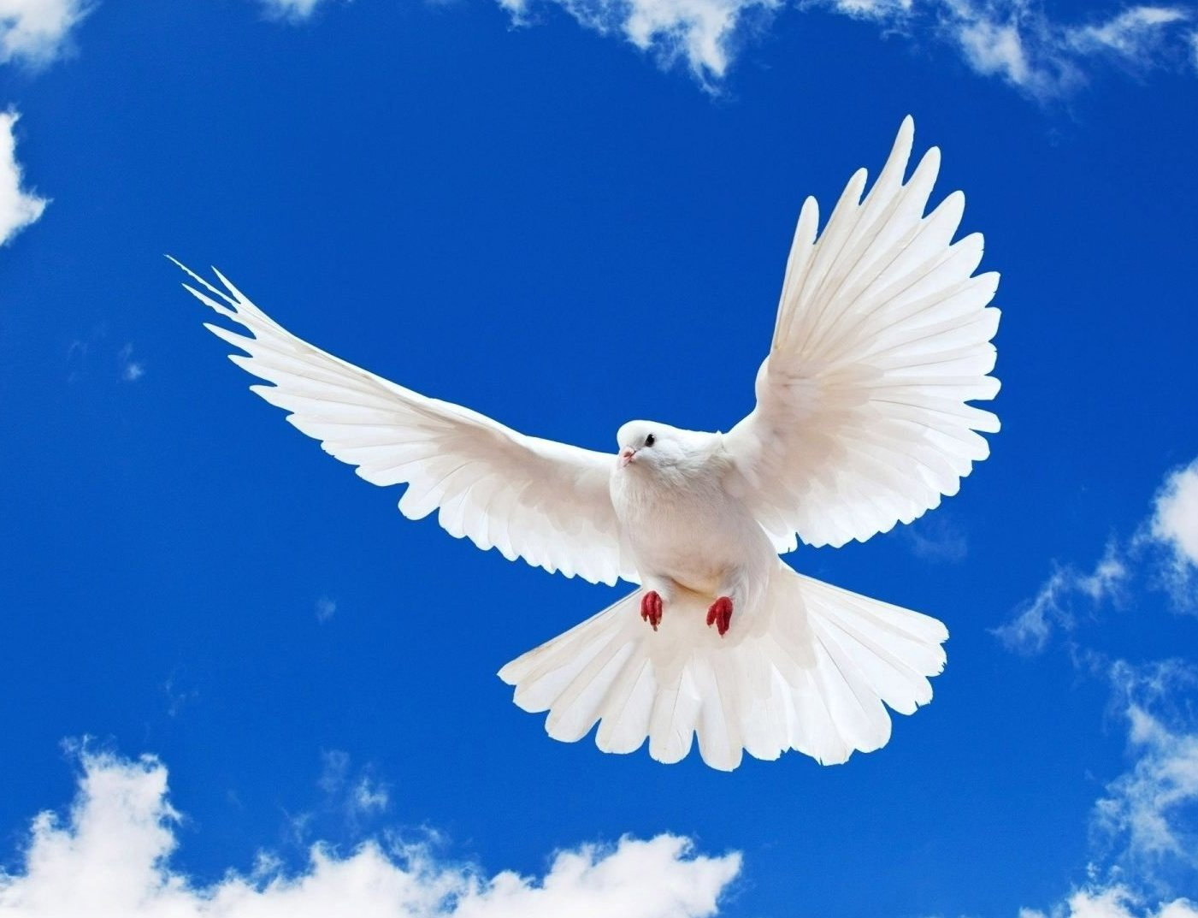
Galatians 5:22-23
²² But the fruit of the Spirit is love, joy, peace, longsuffering, gentleness, goodness, faith,
²³ Meekness, temperance: against such there is no law.

Slide 6
Romans 8:11-13
¹¹ But if the Spirit of him that raised up Jesus from the dead dwell in you, he that raised up Christ from the dead shall also quicken your mortal bodies by his Spirit that dwelleth in you.
¹² Therefore, brethren, we are debtors, not to the flesh, to live after the flesh.
¹³ For if ye live after the flesh, ye shall die: but if ye through the Spirit do mortify the deeds of the body, ye shall live.
Quicken = enliven, make alive
Either our sins must die or we must. If they are allowed to live, we shall die. If they are put to death, we shall be saved.
The gospel frees us from the condemnation of the law and from the destroying error of attempting to keep the law by our own efforts, but it does not free us from obedience to the will of God. No man can be saved in his sins.
SDABC V6 pg. 565-6

Slide 7
OVERVIEW
Romans 8:5-8—Carnal/Flesh=Death, Spiritual=Life. They do not coexist. You must be either in the Spirit or the Flesh.
Romans 8:9-13, Galatians 5:22-23—Choose! Living in the Spirit means demonstrating the Fruit of the Spirit in your life.

Slide 8
Ephesians 2:1-3
2 And you hath he quickened, who were dead in trespasses and sins;
² Wherein in time past ye walked according to the course of this world, according to the prince of the power of the air, the spirit that now worketh in the children of disobedience:
³ Among whom also we all had our conversation in times past in the lusts of our flesh, fulfilling the desires of the flesh and of the mind; and were by nature the children of wrath, even as others.
Man is suffering from more than social maladjustment or annoying complexes—he is in a state of spiritual death. Natural man is in subjection to Satan, prince of this world. His children, the children of disobedience, are essentially antagonistic to God and in a state of rebellion. SDABC V6 pgs. 1006-7

Slide 9
Ephesians 2:4-6
⁴ But God, who is rich in mercy, for his great love wherewith he loved us,
⁵ Even when we were dead in sins, hath quickened us together with Christ, (by grace ye are saved;)
⁶ And hath raised us up together, and made us sit together in heavenly places in Christ Jesus:
As Christ was quickened from the grave, so man is quickened from spiritual death. We are crucified with Him, we die with Him, we rise with Him, we live with Him, we reign with Him, we are joint heirs with Him, we suffer with Him, and we share His glory. Salvation is achieved not by instruction or persuasion, but by the believer’s having access, through faith, to the energizing life that flows from Christ. SDABC V6 pg. 1007

Slide 10
Romans 8:14-15
¹⁴ For as many as are led by the Spirit of God, they are the sons of God.
¹⁵ For ye have not received the spirit of bondage again to fear; but ye have received the Spirit of adoption, whereby we cry, Abba, Father.
The leading of the Spirit does not mean a momentary impulse but a steady, habitual influence. It is not those whose hearts are occasionally touched by the Spirit or those who now and then yield to his power, who are the sons of God. God recognizes as His sons only those who are continually led by His Spirit. We have been adopted, having no natural claim on God. His act of adopting us is one of pure sovereign love. SDABC V6 pg. 566-7

Slide 11
OVERVIEW
Romans 8:5-8—Carnal/Flesh=Death, Spiritual=Life. They do not coexist. You must be either in the Spirit or the Flesh.
Romans 8:9-13, Galatians 5:22-23—Choose! Living in the Spirit means demonstrating the Fruit of the Spirit in your life.
Ephesians 2:1-6, Romans 8:14-15—God will bring you to life if you so choose, even though you were dead in sin. He will adopt you.

Slide 12
Romans 8:16-18
¹⁶ The Spirit itself beareth witness with our spirit, that we are the children of God:
¹⁷ And if children, then heirs; heirs of God, and joint-heirs with Christ; if so be that we suffer with him, that we may be also glorified together.
¹⁸ For I reckon that the sufferings of this present time are not worthy to be compared with the glory which shall be revealed in us.

Slide 13
Romans 8:16-18
To suffer with Christ may also mean to struggle with the powers of temptation as He did, so that as He was made “perfect through sufferings” (Heb. 2:9, 10, 18), we may be also. The plan of salvation does not offer believers a life free from suffering and trial this side of the kingdom. On the contrary, it calls upon them to follow Christ in the same path of self-denial and reproach. As Jesus was constantly opposed by Satan and persecuted by the world, so will be all those who are being transformed into His likeness. Their increasing unlikeness to the world will provoke ever greater hostility. But it is through such trial and persecution that the character of Christ is reproduced and revealed in His people. SDABC V6 pg. 568-9

Slide 14
Thoughts from the Mount of Blessing, pg. 10
Our sorrows do not spring out of the ground. God “doth not afflict willingly nor grieve the children of men.” Lamentations 3:33. When He permits trials and afflictions, it is “for our profit, that we might be partakers of His holiness.” Hebrews 12:10. If received in faith, the trial that seems so bitter and hard to bear will prove a blessing. The cruel blow that blights the joys of earth will be the means of turning our eyes to heaven. How many there are who would never have known Jesus had not sorrow led them to seek comfort in Him!

Slide 15
Thoughts from the Mount of Blessing, pg. 10
The trials of life are God's workmen, to remove the impurities and roughness from our character. Their hewing, squaring, and chiseling, their burnishing and polishing, is a painful process; it is hard to be pressed down to the grinding wheel. But the stone is brought forth prepared to fill its place in the heavenly temple. Upon no useless material does the Master bestow such careful, thorough work. Only His precious stones are polished after the similitude of a palace.
The Lord will work for all who put their trust in Him. Precious victories will be gained by the faithful. Precious lessons will be learned. Precious experiences will be realized.

Slide 16
OVERVIEW
Romans 8:5-8—Carnal/Flesh=Death, Spiritual=Life. They do not coexist. You must be either in the Spirit or the Flesh.
Romans 8:9-13, Galatians 5:22-23—Choose! Living in the Spirit means demonstrating the Fruit of the Spirit in your life.
Ephesians 2:1-6, Romans 8:14-15—God will bring you to life if you so choose, even though you were dead in sin. He will adopt you.
Romans 8:16-18—An adopted son has some (purposeful) troubles!

Slide 17
Examples from Isaiah 40: Historical Context
At this point in history, Isaiah 40, the northern kingdom of Israel had already fallen. Danger from Assyria, the chief enemy of Judah in the first 39 chapters of Isaiah, was now, for the most part at least, in the past. Through the prophet Isaiah God now prepares His people for an even greater calamity—the Babylonian captivity a century later.
In the new section beginning with chapter 40 God finds Israel discouraged because of the seeming failure of His purpose for them as a nation.

Slide 18
Isaiah 40:27-28
²⁷ Why sayest thou, O Jacob, and speakest, O Israel, My way is hid from the Lord, and my judgment is passed over from my God?
²⁸ Hast thou not known? hast thou not heard, that the everlasting God, the Lord, the Creator of the ends of the earth, fainteth not, neither is weary? there is no searching of his understanding.
Many in Judah felt that God had forgotten them and that He was not treating them justly. But there were many things that they failed to understand. Seated on His throne in the heavens, God sees all, knows all, and takes everything into consideration. He weighs carefully every factor, the past as well as the present, the future as well as the past. Whatever He does is wise, right, just and good. Who is man to feel that he is being neglected or treated unjustly by God? SDABC V4 pg. 248

Slide 19
Isaiah 40:29-31
²⁹ He giveth power to the faint; and to them that have no might he increaseth strength.
³⁰ Even the youths shall faint and be weary, and the young men shall utterly fall:
³¹ But they that wait upon the Lord shall renew their strength; they shall mount up with wings as eagles; they shall run, and not be weary; and they shall walk, and not faint.
The Christian life is a constant process of receiving from God and giving to God. Strength is expended in service for the Master, but there are always new supplies of grace and vitality available from Him who knows not weariness.
SDABC V4 pg. 248

Slide 20
The Desire of Ages, pg. 827
Instead of man's speculations, let the word of God be preached. Let Christians put away their dissensions, and give themselves to God for the saving of the lost. Let them in faith ask for the blessing, and it will come. The outpouring of the Spirit in apostolic days was the “former rain,” and glorious was the result. But the “latter rain” will be more abundant. Joel 2:23.
All who consecrate soul, body, and spirit to God will be constantly receiving a new endowment of physical and mental power. The inexhaustible supplies of heaven are at their command. Christ gives them the breath of His own spirit, the life of His own life. The Holy Spirit puts forth its highest energies to work in heart and mind. The grace of God enlarges and multiplies their faculties, and every perfection of the divine nature comes to their assistance in the work of saving souls. Through co-operation with Christ they are complete in Him, and in their human weakness they are enabled to do the deeds of Omnipotence.

Slide 21
Isaiah 41:10-14
¹⁰ Fear thou not; for I am with thee: be not dismayed; for I am thy God: I will strengthen thee; yea, I will help thee; yea, I will uphold thee with the right hand of my righteousness.
¹¹ Behold, all they that were incensed against thee shall be ashamed and confounded: they shall be as nothing; and they that strive with thee shall perish.
¹² Thou shalt seek them, and shalt not find them, even them that contended with thee: they that war against thee shall be as nothing, and as a thing of nought.
¹³ For I the Lord thy God will hold thy right hand, saying unto thee, Fear not; I will help thee.
¹⁴ Fear not, thou worm Jacob, and ye men of Israel; I will help thee, saith the Lord, and thy redeemer, the Holy One of Israel.

Slide 22
Isaiah 41:10-14
There was much of which the professed people of God could be afraid in the days of Isaiah. The northern kingdom, Israel, had been wiped out of existence by Assyrian military might, and it appeared that Judah could not long endure. The people were greatly in need of a message of comfort and hope, and Isaiah sought to inspire them with courage and cheer. Yet God reminds the people of Israel that they have no value or strength of themselves. Without God they are a weak, helpless, and insignificant people, to be despised and trampled underfoot. With God the weakest child of His is more than a match for all the powers of darkness. Everyone who strives against God or against His people will ultimately perish, whereas the meek and faithful will inherit the earth. SDABC V4 pg. 252

Slide 23
OVERVIEW
Romans 8:5-8—Carnal/Flesh=Death, Spiritual=Life. They do not coexist. You must be either in the Spirit or the Flesh.
Romans 8:9-13, Galatians 5:22-23—Choose! Living in the Spirit means demonstrating the Fruit of the Spirit in your life.
Ephesians 2:1-6, Romans 8:14-15—God will bring you to life if you so choose, even though you were dead in sin. He will adopt you.
Romans 8:16-18—An adopted son has some (purposeful) troubles!
Isaiah 40:27-31, 41:10-14—God provides strength to overcome trials.

Slide 24
Romans 8:24-25
²⁴ For we are saved by hope: but hope that is seen is not hope: for what a man seeth, why doth he yet hope for?
²⁵ But if we hope for that we see not, then do we with patience wait for it.
It is hope that sets salvation vividly before the believer and so leads him to strive, by faith, to obtain it.
Note that this is not passive hope or waiting! We must wait “with patience,” a word suggesting perseverance amid obstacles. We cannot as yet see ultimate salvation, but we do hope for it. Therefore, we are willing patiently to endure the sufferings that lie on the road to it. SDABC V6 pg. 572

Slide 25
Romans 8:26-28
²⁶ Likewise the Spirit also helpeth our infirmities: for we know not what we should pray for as we ought: but the Spirit itself maketh intercession for us with groanings which cannot be uttered.
²⁷ And he that searcheth the hearts knoweth what is the mind of the Spirit, because he maketh intercession for the saints according to the will of God.
²⁸ And we know that all things work together for good to them that love God, to them who are the called according to his purpose.

Slide 26
Romans 8:26-28
God knows the desires the Holy Spirit inspires in our hearts. He does not need to have these deep emotions expressed in words. He does not need the eloquence of language to induce Him to hear. He understands the anxious longings of the heart and is ready to aid and to bless.
We can be certain that, according to the eternal purpose of God, all things contribute the welfare of those who love Him.
Even the troubles and suffering of this life, far from hindering our salvation, may help it forward. At every step the Christian may be in the hands of God and be carrying out the divine purpose.
SDABC V6 pg. 573

Slide 27
The Ministry of Healing pgs. 486-488
We are prone to look to our fellow men for sympathy and uplifting, instead of looking to Jesus. In His mercy and faithfulness God often permits those in whom we place confidence to fail us, in order that we may learn the folly of trusting in man and making flesh our arm. Let us trust fully, humbly, unselfishly in God. He knows the sorrows that we feel to the depths of our being, but which we cannot express. When all things seem dark and unexplainable, remember the words of Christ, “What I do thou knowest not now; but thou shalt know hereafter.” John 13:7.
Study the history of Joseph and of Daniel. The Lord did not prevent the plottings of men who sought to do them harm; but He caused all these devices to work for good to His servants who amidst trial and conflict preserved their faith and loyalty.

Slide 28
The Ministry of Healing pgs. 486-488
So long as we are in the world, we shall meet with adverse influences. There will be provocations to test the temper; and it is by meeting these in a right spirit that the Christian graces are developed. If Christ dwells in us, we shall be patient, kind, and forbearing, cheerful amid frets and irritations. Day by day and year by year we shall conquer self, and grow into a noble heroism. This is our allotted task; but it cannot be accomplished without help from Jesus, resolute decision, unwavering purpose, continual watchfulness, and unceasing prayer. Each one has a personal battle to fight. Not even God can make our characters noble or our lives useful, unless we become co-workers with Him. Those who decline the struggle lose the strength and joy of victory.

Slide 29
The Ministry of Healing pgs. 486-488
We need not keep our own record of trials and difficulties, griefs, and sorrows. All these things are written in the books, and heaven will take care of them. While we are counting up the disagreeable things, many things that are pleasant to reflect upon are passing from memory, such as the merciful kindness of God surrounding us every moment and the love over which angels marvel, that God gave His Son to die for us. If as workers for Christ you feel that you have had greater cares and trials than have fallen to the lot of others, remember that for you there is a peace unknown to those who shun these burdens. There is comfort and joy in the service of Christ. Let the world see that life with Him is no failure.

Slide 30
The Ministry of Healing pgs. 486-488
If you do not feel lighthearted and joyous, do not talk of your feelings. Cast no shadow upon the lives of others. A cold, sunless religion never draws souls to Christ. It drives them away from Him into the nets that Satan has spread for the feet of the straying. Instead of thinking of your discouragements, think of the power you can claim in Christ's name. Let your imagination take hold upon things unseen. Let your thoughts be directed to the evidences of the great love of God for you. Faith can endure trial, resist temptation, bear up under disappointment. Jesus lives as our advocate. All is ours that His mediation secures.

Slide 31
OVERVIEW
Romans 8:5-8—Carnal/Flesh=Death, Spiritual=Life. They do not coexist. You must be either in the Spirit or the Flesh.
Romans 8:9-13, Galatians 5:22-23—Choose! Living in the Spirit means demonstrating the Fruit of the Spirit in your life.
Ephesians 2:1-6, Romans 8:14-15—God will bring you to life if you so choose, even though you were dead in sin. He will adopt you.
Romans 8:16-18—An adopted son has some (purposeful) troubles!
Isaiah 40:27-31, 41:10-14—God provides strength to overcome trials.
Romans 8:24-28—We look forward in hope to our salvation and the end of all trials. But we’re never alone in them.

Slide 32
Romans 8:31-32
³¹ What shall we then say to these things? If God be for us, who can be against us?
³² He that spared not his own Son, but delivered him up for us all, how shall he not with him also freely give us all things?
Paul has already shown that God is on our side—or rather, that we are on His side. God regards us as His sons and has sent His Spirit to help us, for it is His purpose to save us. It is encouraging to recognize that, since God has purposed and is actively engaged in accomplishing salvation for believers, all our enemies are also His enemies. If God would not spare even His own Son, what is there that He would withhold? SDABC V6 pg. 577

Slide 33
Romans 8:32
The Christian could ask for no greater ground for confidence and patient endurance than is given in this verse. When God gave His son, He also gave Himself, and thereby revealed to the universe how far He was willing to go to save repentant sinners. Surely, then, no matter what trials may come, we should never doubt that God is ever working for us and that He will give us all that is necessary for our present and future good.
SDABC V6 pg. 577

Slide 34
Romans 8:33-34
³³ Who shall lay any thing to the charge of God's elect? It is God that justifieth.
³⁴ Who is he that condemneth? It is Christ that died, yea rather, that is risen again, who is even at the right hand of God, who also maketh intercession for us.
God’s elect need fear no accuser. It is God Himself, the Judge of all, who pronounces them upright according to His plan of justification. Christ, who died for His people, is at God’s right hand pleading for them. Who, then, can accuse God’s chosen people? Who can condemn them? Satan presents our sins to God as evidence that we deserve only destruction. But God answers the charges brought against His chosen people. Christ has paid for their sins with His own life. SDABC V6 pg. 578

Slide 35
Romans 8:35-37
³⁵ Who shall separate us from the love of Christ? shall tribulation, or distress, or persecution, or famine, or nakedness, or peril, or sword?
³⁶ As it is written, For thy sake we are killed all the day long; we are accounted as sheep for the slaughter.
³⁷ Nay, in all these things we are more than conquerors through him that loved us.
There is no affliction so heavy, no temptation so strong, that it cannot be overcome through Christ. For the One who loved us enough to give Himself for us is even now living in us to continue the work of our salvation. Therefore, we can do all things through Him who strengthens us (Phil. 4:13).
SDABC V6 pg. 579

Slide 36
Romans 8:38-39
³⁸ For I am persuaded, that neither death, nor life, nor angels, nor principalities, nor powers, nor things present, nor things to come,
³⁹ Nor height, nor depth, nor any other creature, shall be able to separate us from the love of God, which is in Christ Jesus our Lord.
Paul now expresses his own personal conviction that no power in heaven or earth can separate us from divine love. He doesn’t mean to imply that it is impossible for a believer to fall away and be lost by their own choice. Paul means that nothing can pluck us out of Christ’s arms against our will.
SDABC V6 pg. 579

Slide 37
Steps to Christ pgs. 85-86
If we will but listen, God's created works will teach us precious lessons of obedience and trust. From the stars that in their trackless courses through space follow from age to age their appointed path, down to the minutest atom, the things of nature obey the Creator's will.
And God cares for everything and sustains everything that He has created. He who upholds the unnumbered worlds throughout immensity, at the same time cares for the wants of the little brown sparrow that sings its humble song without fear.

Slide 38
Steps to Christ pgs. 85-86
When men go forth to their daily toil, as when they engage in prayer; when they lie down at night, and when they rise in the morning; when the rich man feasts in his palace, or when the poor man gathers his children about the scanty board, each is tenderly watched by the heavenly Father. No tears are shed that God does not notice. There is no smile that He does not mark.
If we would but fully believe this, all undue anxieties would be dismissed. Our lives would not be so filled with disappointment as now; for everything, whether great or small, would be left in the hands of God, who is not perplexed by the multiplicity of cares, or overwhelmed by their weight. We should then enjoy a rest of soul to which many have long been strangers.

Slide 39
OVERVIEW
Romans 8:5-8—Carnal/Flesh=Death, Spiritual=Life. They do not coexist. You must be either in the Spirit or the Flesh.
Romans 8:9-13, Galatians 5:22-23—Choose! Living in the Spirit means demonstrating the Fruit of the Spirit in your life.
Ephesians 2:1-6, Romans 8:14-15—God will bring you to life if you so choose, even though you were dead in sin. He will adopt you.
Romans 8:16-18—An adopted son has some (purposeful) troubles!
Isaiah 40:27-31, 41:10-14—God provides strength to overcome trials.
Romans 8:24-28—We look forward in hope to our salvation and the end of all trials. But we’re never alone in them.
Romans 8:31-39—Victory is completely assured for those who faithfully cling to Christ. Don’t worry in the meantime!

Slide 40
1 Peter 5:6-7
⁶ Humble yourselves therefore under the mighty hand of God, that he may exalt you in due time:
⁷ Casting all your care upon him; for he careth for you.

Slide 41
Thank you,
Happy Sabbath!

