Slide 1
Blessed are the Meek
Ezekiel 24, Numbers 12, 1 Peter 2
Lesson 10, 3rd Quarter, 2022

Slide 2
Meekness in the Bible
Blessed are the meek: for they shall inherit the earth. -Matthew 5:5
The meek will he guide in judgment: and the meek will he teach his way. -Psalm 25:9
The Lord lifteth up the meek: he casteth the wicked down to the ground. -Psalm 147:6
The meek also shall increase their joy in the Lord, and the poor among men shall rejoice in the Holy One of Israel. -Isaiah 29:19
Seek ye the Lord, all ye meek of the earth, which have wrought his judgment; seek righteousness, seek meekness: it may be ye shall be hid in the day of the Lord's anger. -Zephaniah 2:3

Slide 3
Meekness vs. Humility
MEEK:
enduring injury with patience and without resentment : MILD
deficient in spirit and courage : SUBMISSIVE
not violent or strong : MODERATE
HUMBLE:
not proud or haughty : MODEST
reflecting a spirit of deference or submission
ranking low in a hierarchy or scale; not costly or luxurious : LOWLY, UNPRETENTIOUS

Slide 4
Meekness
Despite
Emotion:
Ezekiel
Ezekiel 24

Slide 5
¹⁵ Also the word of the Lord came unto me, saying,
¹⁶ Son of man, behold, I take away from thee the desire of thine eyes with a stroke: yet neither shalt thou mourn nor weep, neither shall thy tears run down.
¹⁷ Forbear to cry, make no mourning for the dead, bind the tire of thine head upon thee, and put on thy shoes upon thy feet, and cover not thy lips, and eat not the bread of men.
The word translated “tire” is sometimes rendered as “turban” or “headdress” and refers to the common headwear of the day. Those in mourning would commonly tear their clothing, remove their headwear, and pour dust or ashes over their heads.
Meekness despite Emotion:
Ezekiel 24:15-27

Slide 6
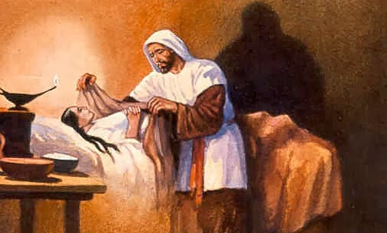

Slide 7
¹⁸ So I spake unto the people in the morning: and at even my wife died; and I did in the morning as I was commanded.
¹⁹ And the people said unto me, Wilt thou not tell us what these things are to us, that thou doest so?
²⁰ Then I answered them, The word of the Lord came unto me, saying,
²¹ Speak unto the house of Israel, Thus saith the Lord God; Behold, I will profane my sanctuary, the excellency of your strength, the desire of your eyes, and that which your soul pitieth; and your sons and your daughters whom ye have left shall fall by the sword.
Meekness despite Emotion:
Ezekiel 24:15-27

Slide 8
²² And ye shall do as I have done: ye shall not cover your lips, nor eat the bread of men.
²³ And your tires shall be upon your heads, and your shoes upon your feet: ye shall not mourn nor weep; but ye shall pine away for your iniquities, and mourn one toward another.
²⁴ Thus Ezekiel is unto you a sign: according to all that he hath done shall ye do: and when this cometh, ye shall know that I am the Lord God.
Meekness despite Emotion:
Ezekiel 24:15-27

Slide 9
²⁵ Also, thou son of man, shall it not be in the day when I take from them their strength, the joy of their glory, the desire of their eyes, and that whereupon they set their minds, their sons and their daughters,
²⁶ That he that escapeth in that day shall come unto thee, to cause thee to hear it with thine ears?
²⁷ In that day shall thy mouth be opened to him which is escaped, and thou shalt speak, and be no more dumb: and thou shalt be a sign unto them; and they shall know that I am the Lord.
Meekness despite Emotion:
Ezekiel 24:15-27

Slide 10
The Source of Suffering
Ezekiel is informed that his wife, whom he deeply loves, is about to die. We need not infer from the language used here that her death was the result of a direct stroke by God. His wife may have been ill for some time, and God may have warned him of her approaching death. By figure God is frequently said to do that which He permits or does not prevent. It is Satan who is the author of sin, suffering, and death. However, God delights to take that which the enemy brings upon us to annoy, and make it serve some good end. Here the loss of the desire of Ezekiel’s eyes was used to impress vividly upon the minds of the people the divine message.
--SDABC V4 pg. 662

Slide 11
The Source of Suffering
Ezekiel’s experience forcibly impresses the lesson that to engage in the service of God does not mean immunity from suffering and calamity. At time it seems that God’s messengers are more fiercely assailed than others not actively engaged in Christian labor. Many a disaster has struck those who have dedicated their lives to some far-flung mission field. Sudden death or sore disease has sometimes fallen upon such dedicated ones. These calamities ought not to be considered as strokes of divine judgment. They are the result of Satan’s work. The enemy must be allowed a degree of access to souls so that in the end he will not be able to declare that he was not given a fair opportunity. This principle is demonstrated in the history of Job.
--SDABC V4 pg. 662

Slide 12
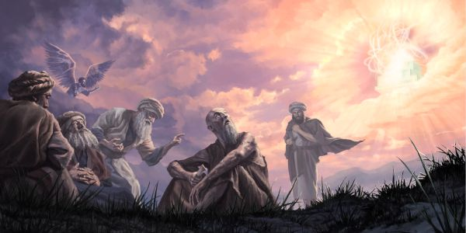

Slide 13
The Source of Suffering: Desire of Ages pg. 471
It was generally believed by the Jews that sin is punished in this life. Every affliction was regarded as the penalty of some wrongdoing, either of the sufferer himself or of his parents. It is true that all suffering results from the transgression of God's law, but this truth had become perverted. Satan, the author of sin and all its results, had led men to look upon disease and death as proceeding from God,—as punishment arbitrarily inflicted on account of sin. Hence one upon whom some great affliction or calamity had fallen had the additional burden of being regarded as a great sinner.
Thus the way was prepared for the Jews to reject Jesus. He who “hath borne our griefs, and carried our sorrows” was looked upon by the Jews as “stricken, smitten of God, and afflicted;” and they hid their faces from Him. Isaiah 53:4, 3.
God had given a lesson designed to prevent this. The history of Job had shown that suffering is inflicted by Satan, and is overruled by God for purposes of mercy. But Israel did not understand the lesson. The same error for which God had reproved the friends of Job was repeated by the Jews in their rejection of Christ.

Slide 14
Meekness Despite Emotion: Ezekiel
Ezekiel’s wife is about to die, but he isn’t allowed to mourn her passing. Mourning in Ezekiel’s time was a loud, public affair. People would scream, weep, tear their clothing, pour ashes and dust on their heads, and walk around barefoot to display their distress and grief. Ezekiel loved his wife very much, but he is told not to display his grief at her death. And Ezekiel follows these difficult directions without complaint. That is meekness (and obedience) in the face of enormous emotional stress. Notice that meekness here is an extension of trust. Ezekiel trusts God’s directions. He trusts God’s will in permitting the loss of his wife. He trusts that God will make it right in the end. With this trust there is no reason for anger, resentment, or visible displays of grief. Thus Ezekiel is able to meekly follow God’s directions without chaffing against them.

Slide 15

MEEKNESS:
Enduring injury with patience and without resentment
=
Trusting God in all circumstances

Slide 16
Meekness
Despite
Betrayal:
Moses
Numbers 12

Slide 17
12 And Miriam and Aaron spake against Moses because of the Ethiopian woman whom he had married: for he had married an Ethiopian woman.
² And they said, Hath the Lord indeed spoken only by Moses? hath he not spoken also by us? And the Lord heard it.
³ (Now the man Moses was very meek, above all the men which were upon the face of the earth.)
⁴ And the Lord spake suddenly unto Moses, and unto Aaron, and unto Miriam, Come out ye three unto the tabernacle of the congregation. And they three came out.
Meekness despite Betrayal:
Numbers 12:1-15

Slide 18
⁵ And the Lord came down in the pillar of the cloud, and stood in the door of the tabernacle, and called Aaron and Miriam: and they both came forth.
⁶ And he said, Hear now my words: If there be a prophet among you, I the Lord will make myself known unto him in a vision, and will speak unto him in a dream.
⁷ My servant Moses is not so, who is faithful in all mine house.
⁸ With him will I speak mouth to mouth, even apparently, and not in dark speeches; and the similitude of the Lord shall he behold: wherefore then were ye not afraid to speak against my servant Moses?
Meekness despite Betrayal:
Numbers 12:1-15

Slide 19
⁹ And the anger of the Lord was kindled against them; and he departed.
¹⁰ And the cloud departed from off the tabernacle; and, behold, Miriam became leprous, white as snow: and Aaron looked upon Miriam, and, behold, she was leprous.
¹¹ And Aaron said unto Moses, Alas, my lord, I beseech thee, lay not the sin upon us, wherein we have done foolishly, and wherein we have sinned.
¹² Let her not be as one dead, of whom the flesh is half consumed when he cometh out of his mother's womb.
Meekness despite Betrayal:
Numbers 12:1-15

Slide 20
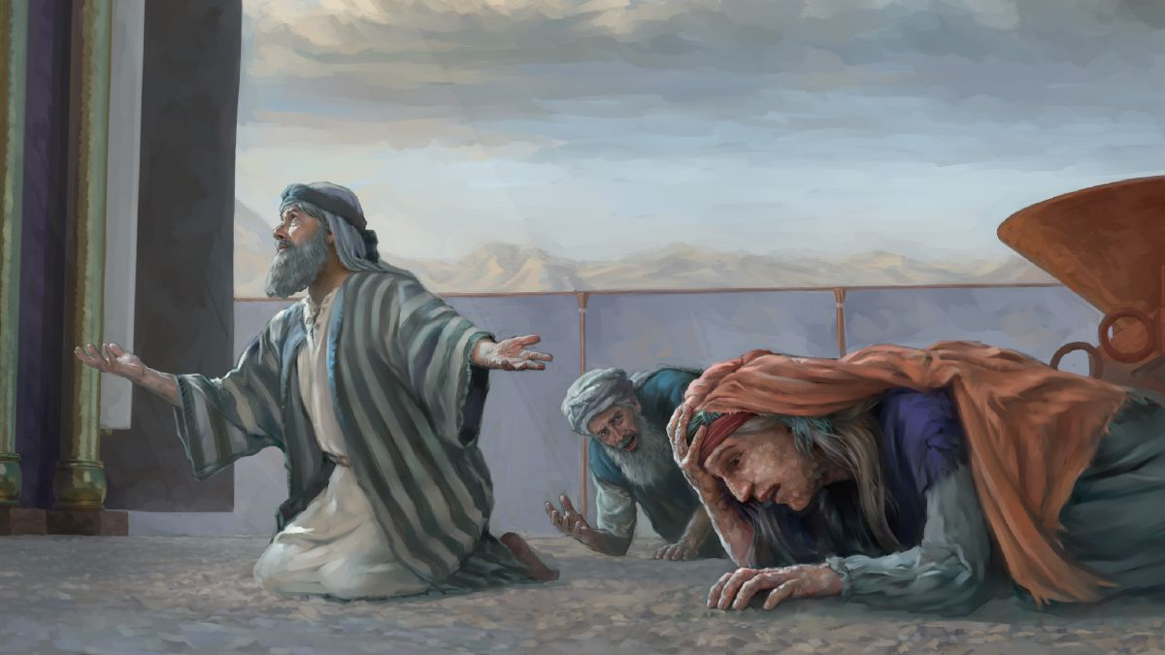

Slide 21
¹³ And Moses cried unto the Lord, saying, Heal her now, O God, I beseech thee.
¹⁴ And the Lord said unto Moses, If her father had but spit in her face, should she not be ashamed seven days? let her be shut out from the camp seven days, and after that let her be received in again.
¹⁵ And Miriam was shut out from the camp seven days: and the people journeyed not till Miriam was brought in again.
Meekness despite Betrayal:
Numbers 12:1-15

Slide 22
Meekness Despite Betrayal: Moses
The word translated “meek” in verse 3 is from a root meaning “humble,” “submissive,” “lowly.” The same word is rendered variously as “poor” (Job 24:4), “humble” (Ps. 9:12), and “lowly” (Prov. 3:34, 16:19). The trait of character here described as meekness is essential to leadership in the cause of God.
Moses was not naturally meek (Ex. 2:11-14); that trait came to him as the result of 40 years spent in the hard school of the wilderness of Midian. Only a meek man knows how to be submissive to God and to his subordinates and at the same time be a courageous and dynamic leader. There is no place in the work of the Lord for a leader who conceives it to be his privilege to domineer over his fellow workers and dictate to them. --SDABC V1 pg. 861

Slide 23
Patriarchs and Prophets pg. 382
In the appointment of the seventy elders Miriam and Aaron had not been consulted, and their jealousy was excited against Moses. At the time of Jethro's visit, while the Israelites were on the way to Sinai, the ready acceptance by Moses of the counsel of his father-in-law had aroused in Aaron and Miriam a fear that his influence with the great leader exceeded theirs. In the organization of the council of elders they felt that their position and authority had been ignored. Miriam and Aaron had never known the weight of care and responsibility which had rested upon Moses; yet because they had been chosen to aid him they regarded themselves as sharing equally with him the burden of leadership, and they regarded the appointment of further assistants as uncalled for.

Slide 24
Patriarchs and Prophets pg. 383
Moses felt the importance of the great work committed to him as no other man had ever felt it. He realized his own weakness, and he made God his counselor. Aaron esteemed himself more highly, and trusted less in God. He had failed when entrusted with responsibility, giving evidence of the weakness of his character by his base compliance in the matter of the idolatrous worship at Sinai. But Miriam and Aaron, blinded by jealousy and ambition, lost sight of this. Aaron had been highly honored by God in the appointment of his family to the sacred office of the priesthood; yet even this now added to the desire for self-exaltation. “And they said, Hath the Lord indeed spoken only by Moses? hath He not spoken also by us?” Regarding themselves as equally favored by God, they felt that they were entitled to the same position and authority.

Slide 25
Patriarchs and Prophets pg. 384
When Zipporah rejoined her husband in the wilderness, she saw that his burdens were wearing away his strength, and she made known her fears to Jethro, who suggested measures for his relief. Here was the chief reason for Miriam's antipathy to Zipporah. Smarting under the supposed neglect shown to herself and Aaron, she regarded the wife of Moses as the cause, concluding that her influence had prevented him from taking them into his counsels as formerly. Had Aaron stood up firmly for the right, he might have checked the evil; but instead of showing Miriam the sinfulness of her conduct, he sympathized with her, listened to her words of complaint, and thus came to share her jealousy.

Slide 26
Patriarchs and Prophets pg. 384
Their accusations were borne by Moses in uncomplaining silence. It was the experience gained during the years of toil and waiting in Midian—the spirit of humility and long-suffering there developed—that prepared Moses to meet with patience the unbelief and murmuring of the people and the pride and envy of those who should have been his unswerving helpers.
Moses “was very meek, above all the men which were upon the face of the earth,” and this is why he was granted divine wisdom and guidance above all others. Says the Scripture, “The meek will He guide in judgment: and the meek will He teach His way.” Psalm 25:9. The meek are guided by the Lord, because they are teachable, willing to be instructed.

Slide 27
Patriarchs and Prophets pg. 384
They have a sincere desire to know and to do the will of God. The Saviour's promise is, “If any man will do His will, he shall know of the doctrine.” John 7:17. And He declares by the apostle James, “If any of you lack wisdom, let him ask of God, that giveth to all men liberally, and upbraideth not; and it shall be given him.” James 1:5.
But His promise is only to those who are willing to follow the Lord wholly. God does not force the will of any; hence He cannot lead those who are too proud to be taught, who are bent upon having their own way. Of the double-minded man—he who seeks to follow his own will, while professing to do the will of God—it is written, “Let not that man think that he shall receive anything of the Lord.” James 1:7.

Slide 28
Meekness Despite Betrayal: Moses
Moses’ own siblings turned against him in their arrogance, desiring to establish their own importance. Miriam particularly wanted to be seen as a leader every bit as favored by God as her brother Moses.
Moses had struggled with Pharaoh and the Egyptians. He had struggled with the Israelites and their (repeated) insolence and wickedness. And now he was confronted with rebellion by his own siblings. But he doesn’t express frustration at any point in this narrative. Instead, Moses is described as very meek. His only action is to cry out to the Lord… to heal his sister.

Slide 29
6 Brethren, if a man be overtaken in a fault, ye which are spiritual, restore such an one in the spirit of meekness; considering thyself, lest thou also be tempted.
² Bear ye one another's burdens, and so fulfil the law of Christ.
³ For if a man think himself to be something, when he is nothing, he deceiveth himself.
Meekness despite Betrayal:
Galatians 6:1-3

Slide 30
Meekness Despite Betrayal: Moses
Moses gives us an example of exactly what Paul was speaking of in Galatians 6:1. He prays for the restoration of Miriam in a spirit of meekness, not seeking to defend himself in anyway. Notice that this also reflects Moses’ trust in God. He doesn’t need to defend himself at all because he can see that God Himself will be his defense. And this is true for all of God’s people!

Slide 31
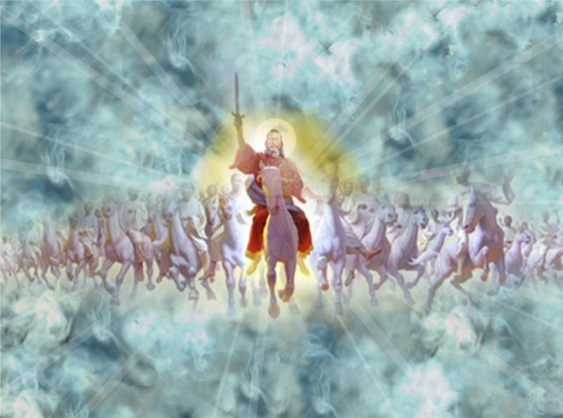
Meekness Through TRUST in GOD
Job 31, Matthew 5, Romans 12

Slide 32
²⁸ This also were an iniquity to be punished by the judge: for I should have denied the God that is above.
²⁹ If I rejoice at the destruction of him that hated me, or lifted up myself when evil found him:
³⁰ Neither have I suffered my mouth to sin by wishing a curse to his soul.
Meekness Through Trust in God:
Job 31:28-30

Slide 33
³⁸ Ye have heard that it hath been said, An eye for an eye, and a tooth for a tooth:
³⁹ But I say unto you, That ye resist not evil: but whosoever shall smite thee on thy right cheek, turn to him the other also.
⁴⁰ And if any man will sue thee at the law, and take away thy coat, let him have thy cloak also.
⁴¹ And whosoever shall compel thee to go a mile, go with him twain.
Meekness Through Trust in God:
Matthew 5:38-48

Slide 34
⁴² Give to him that asketh thee, and from him that would borrow of thee turn not thou away.
⁴³ Ye have heard that it hath been said, Thou shalt love thy neighbour, and hate thine enemy.
⁴⁴ But I say unto you, Love your enemies, bless them that curse you, do good to them that hate you, and pray for them which despitefully use you, and persecute you;
Meekness Through Trust in God:
Matthew 5:38-48

Slide 35
⁴⁵ That ye may be the children of your Father which is in heaven: for he maketh his sun to rise on the evil and on the good, and sendeth rain on the just and on the unjust.
⁴⁶ For if ye love them which love you, what reward have ye? do not even the publicans the same?
⁴⁷ And if ye salute your brethren only, what do ye more than others? do not even the publicans so?
⁴⁸ Be ye therefore perfect, even as your Father which is in heaven is perfect.
Meekness Through Trust in God:
Matthew 5:38-48

Slide 36
¹⁷ Recompense to no man evil for evil. Provide things honest in the sight of all men.
¹⁸ If it be possible, as much as lieth in you, live peaceably with all men.
¹⁹ Dearly beloved, avenge not yourselves, but rather give place unto wrath: for it is written, Vengeance is mine; I will repay, saith the Lord.
²⁰ Therefore if thine enemy hunger, feed him; if he thirst, give him drink: for in so doing thou shalt heap coals of fire on his head.
²¹ Be not overcome of evil, but overcome evil with good.
Meekness Through Trust in God:
Romans 12:17-21

Slide 37
Meekness in
Unfairness:
Slavery
1 Peter 2

Slide 38
⁵ Servants, be obedient to them that are your masters according to the flesh, with fear and trembling, in singleness of your heart, as unto Christ;
⁶ Not with eyeservice, as menpleasers; but as the servants of Christ, doing the will of God from the heart;
⁷ With good will doing service, as to the Lord, and not to men:
⁸ Knowing that whatsoever good thing any man doeth, the same shall he receive of the Lord, whether he be bond or free.
Meekness IN unfairness:
Ephesians 6:5-8

Slide 39
Meekness in Unfairness: Slavery
The one aim should be to please Christ in the discharge of duty to the slave master… A slave might be tempted to rationalize that since his servitude was unjust, it was only proper that he should gain his rights by subterfuge if necessary. To do right BECAUSE IT IS RIGHT is a high Christian principle.
By following Paul’s instructions on their relations with their masters, the large number of Christian slaves within the empire would have a powerful influence on the upper class, who were the slave owners. Thus, in their own way, the vast number of slaves would form a missionary body whose power would be felt throughout society. Inevitably, with slave and master truly brethren, a social and religious revolution would be underway.
--SDABC V6 pg. 1041-2

Slide 40
Meekness in Unfairness: Slavery
The servant who takes a sincere interest in the welfare of his master and his business has already escaped the weight of his burden and is approaching the status of a freeman.
The conviction that one is led by God is a most powerful incentive to the contented life, as is the knowledge that one’s efforts are accepted by God. The martyr faced the stake in this confidence, and the slave bore patiently his grievous wrongs because of it. However, the martyr’s courage and the slave’s patience do not make right the wrongs of the persecutor and the master. They must answer to God for their wrongs.
--SDABC V6 pg. 1042

Slide 41
¹⁸ Servants, be subject to your masters with all fear; not only to the good and gentle, but also to the froward.
¹⁹ For this is thankworthy, if a man for conscience toward God endure grief, suffering wrongfully.
²⁰ For what glory is it, if, when ye be buffeted for your faults, ye shall take it patiently? but if, when ye do well, and suffer for it, ye take it patiently, this is acceptable with God.
Meekness IN unfairness:
1 Peter 2:18-20

Slide 42
Meekness in Unfairness: Slavery
It may not be hard to serve a good and reasonable master, but much Christian fortitude is required to serve faithfully a crooked and perverse one. Nevertheless, a “froward” master is no excuse for discourtesy or disobedience. The Christian slave daily confronted perplexing situations. Often he was required to carry out the preparations for his master’s idol worship, or to serve harmful food and drink, or to witness demoralizing entertainment. Nevertheless, the Christian slave was to carry out his duties faithfully. For the Christian slave to remain faithful to an overbearing and “crooked” master requires much of the grace of God. Looking with favor upon the devotion of the believing slave, God bestows upon him the resources of heaven to make his burden easier to bear. --SDABC V7 pg. 565

Slide 43
JESUS,
Our
Ultimate
Example
²⁸ Come unto me, all ye that labour and are heavy laden, and I will give you rest.
²⁹ Take my yoke upon you, and learn of me; for I am meek and lowly in heart: and ye shall find rest unto your souls.
³⁰ For my yoke is easy, and my burden is light.
MEEKNESS IN UNFAIRNESS:
Matthew 11:28-30

Slide 44
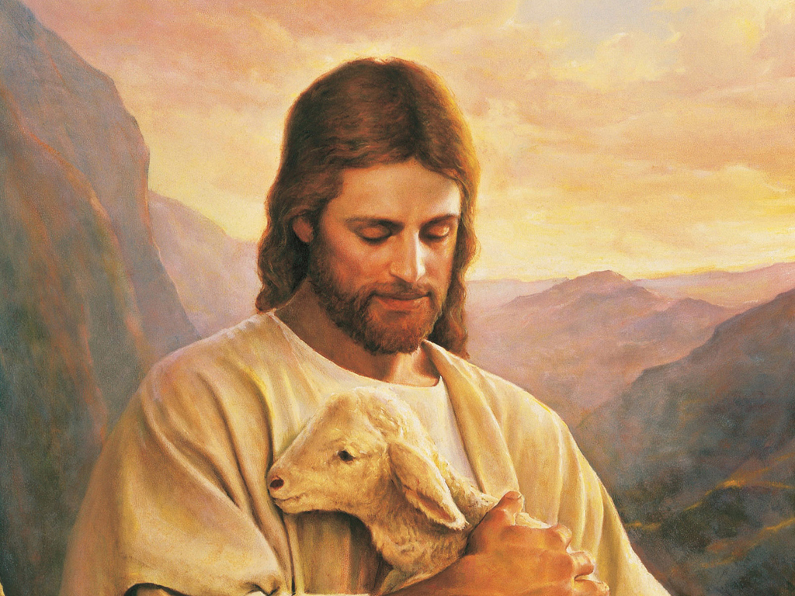
JESUS,
Our
Ultimate
Example
MEEKNESS IN UNFAIRNESS:
1 Peter 2

Slide 45
²¹ For even hereunto were ye called: because Christ also suffered for us, leaving us an example, that ye should follow his steps:
²² Who did no sin, neither was guile found in his mouth:
²³ Who, when he was reviled, reviled not again; when he suffered, he threatened not; but committed himself to him that judgeth righteously:
Meekness IN unfairness:
1 Peter 2:21-25

Slide 46
²⁴ Who his own self bare our sins in his own body on the tree, that we, being dead to sins, should live unto righteousness: by whose stripes ye were healed.
²⁵ For ye were as sheep going astray; but are now returned unto the Shepherd and Bishop of your souls.
Meekness IN unfairness:
1 Peter 2:21-25

Slide 47
MEEKNESS:
Enduring injury with patience and without resentment
=
Trusting God in all circumstances
=
Banishment of SELF

Slide 48
The Ministry of Healing, pg. 485
We cannot afford to let our spirits chafe over any real or supposed wrong done to ourselves. Self is the enemy we most need to fear. No form of vice has a more baleful effect upon the character than has human passion not under the control of the Holy Spirit. No other victory we can gain will be so precious as the victory gained over self.
We should not allow our feelings to be easily wounded. We are to live, not to guard our feelings or our reputation, but to save souls. As we become interested in the salvation of souls we cease to mind the little differences that so often arise in our association with one another.

Slide 49
The Ministry of Healing, pg. 486
Whatever others may think of us or do to us, it need not disturb our oneness with Christ, the fellowship of the Spirit. “What glory is it, if, when ye be buffeted for your faults, ye shall take it patiently? but if, when ye do well, and suffer for it, ye take it patiently, this is acceptable with God.” 1 Peter 2:20.
Under a storm of stinging, faultfinding words, keep the mind stayed upon the word of God. Let mind and heart be stored with God's promises. If you are ill-treated or wrongfully accused, instead of returning an angry answer, repeat to yourself the precious promises:

Slide 50
The Ministry of Healing, pg. 486
“Be not overcome of evil, but overcome evil with good.” Romans 12:21.
“Commit thy way unto the Lord; trust also in Him; and He shall bring it to pass. And He shall bring forth thy righteousness as the light, and thy judgment as the noonday.” Psalm 37:5, 6.
“There is nothing covered, that shall not be revealed; neither hid, that shall not be known.” Luke 12:2.
“Thou hast caused men to ride over our heads; we went through fire and through water: but Thou broughtest us out into a wealthy place.” Psalm 66:12.

Slide 51
The Desire of Ages, pg. 301
“Blessed are the meek.” The difficulties we have to encounter may be very much lessened by that meekness which hides itself in Christ. If we possess the humility of our Master, we shall rise above the slights, the rebuffs, the annoyances, to which we are daily exposed, and they will cease to cast a gloom over the spirit.
The highest evidence of nobility in a Christian is self-control. He who under abuse or cruelty fails to maintain a calm and trustful spirit robs God of His right to reveal in him His own perfection of character. Lowliness of heart is the strength that gives victory to the followers of Christ; it is the token of their connection with the courts above.

Slide 52
The Upward Look, pg. 177
Now is our time of peril. Our only safety is in walking in the footsteps of Christ, and wearing His yoke. Troublous times are before us. In many instances, friends will become alienated. Without cause, men will become our enemies. The motives of the people of God will be misinterpreted, not only by the world, but by their own brethren. The Lord's servants will be put in hard places. A mountain will be made out of a molehill to justify men in pursuing a selfish, unrighteous course.

Slide 53
The Upward Look, pg. 177
The work that men have done faithfully will be disparaged and underrated, because apparent prosperity did not attend their efforts. By misrepresentation, these men will be clothed in the dark vestments of dishonesty, because circumstances beyond their control made their work perplexing. They will be pointed to as men that cannot be trusted. And this will be done by the members of the church. God's servants must arm themselves with the mind of Christ. They must not expect to escape insult and misjudgment. They will be called enthusiasts and fanatics. But let them not become discouraged. God's hand is on the wheel of His providence, guiding His work to the glory of His name.

Slide 54
¹⁰ Finally, my brethren, be strong in the Lord, and in the power of his might.
¹¹ Put on the whole armour of God, that ye may be able to stand against the wiles of the devil.
¹² For we wrestle not against flesh and blood, but against principalities, against powers, against the rulers of the darkness of this world, against spiritual wickedness in high places.
Our Ultimate Example:
Ephesians 6:10-12

Slide 55
Thank you!
Happy Sabbath!

