Slide 1
Patience and Trust
1 Samuel 26, Psalm 37
Lesson 11, 3rd Quarter, 2022

Slide 2
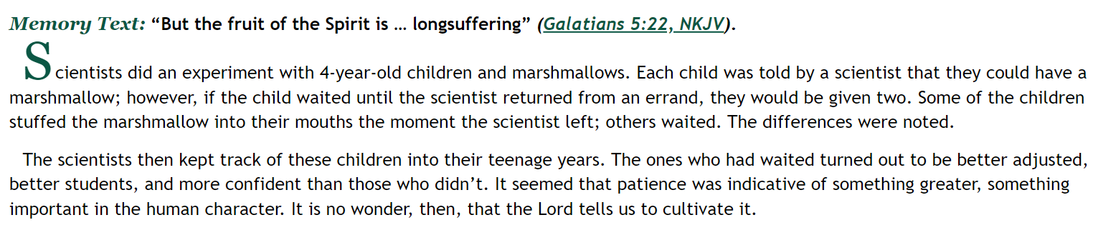
SDA Quarterly
Lesson 11, Sabbath Afternoon
The Marshmallow TEST

Slide 3
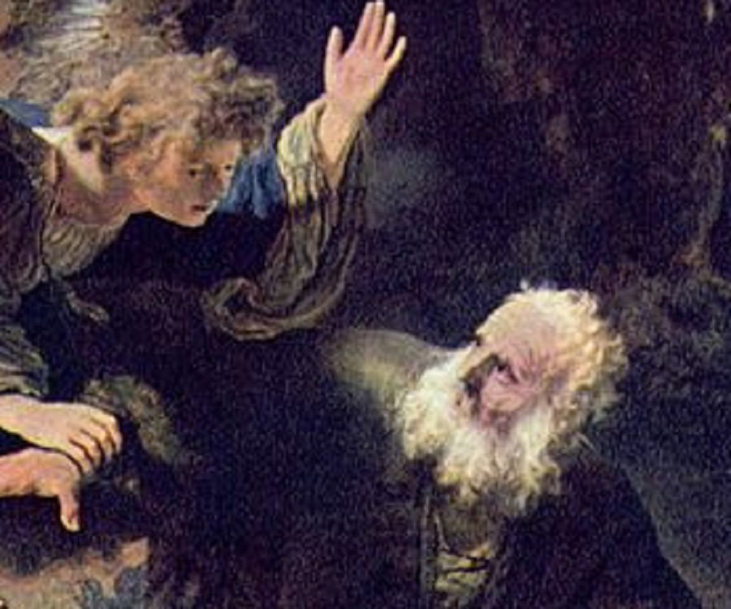
Abraham: Sometimes a Patient Man

Slide 4
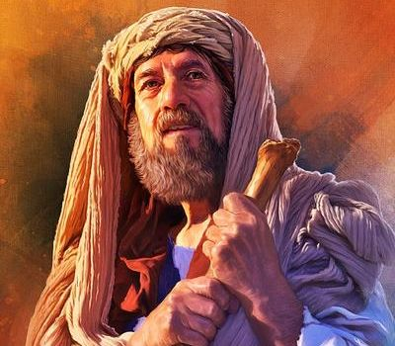
(Abraham) The Plan: Genesis 12:1-4
12 Now the Lord had said unto Abram, Get thee out of thy country, and from thy kindred, and from thy father's house, unto a land that I will shew thee:
² And I will make of thee a great nation, and I will bless thee, and make thy name great; and thou shalt be a blessing:
³ And I will bless them that bless thee, and curse him that curseth thee: and in thee shall all families of the earth be blessed.

Slide 5
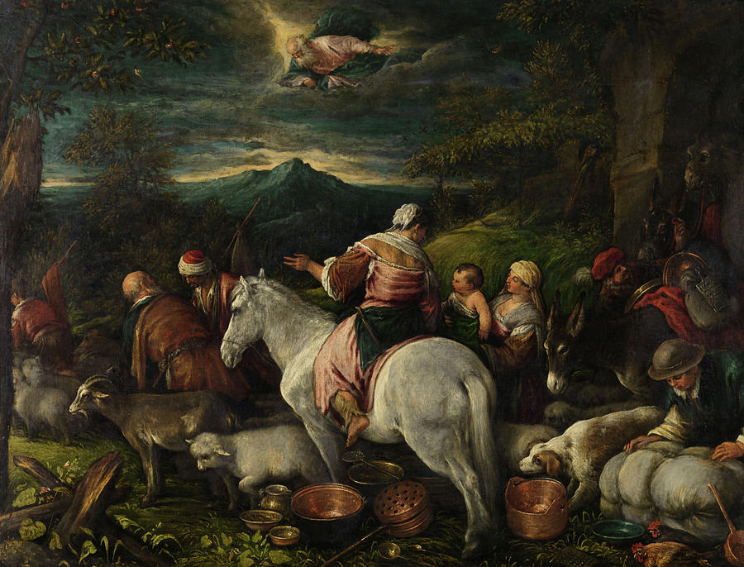
(Abraham) The Plan: Genesis 12:1-4
³ And I will bless them that bless thee, and curse him that curseth thee: and in thee shall all families of the earth be blessed.
⁴ So Abram departed, as the Lord had spoken unto him; and Lot went with him: and Abram was seventy and five years old when he departed out of Haran.

Slide 6
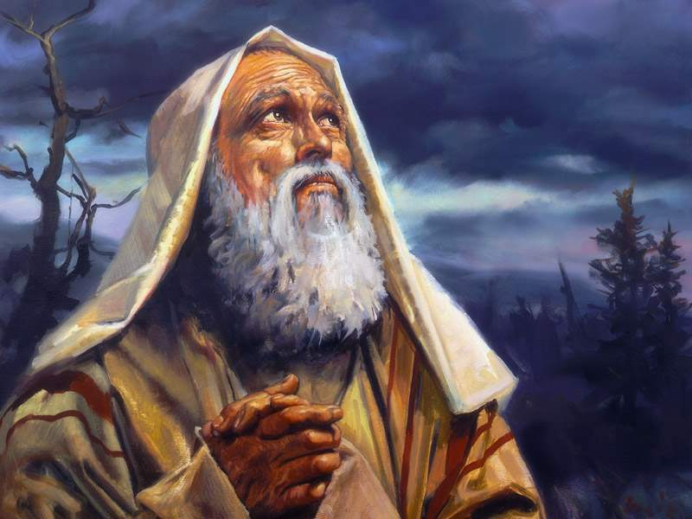
(Abraham) The Plan: Genesis 13:14-16
¹⁴ And the Lord said unto Abram, after that Lot was separated from him, Lift up now thine eyes, and look from the place where thou art northward, and southward, and eastward, and westward:
¹⁵ For all the land which thou seest, to thee will I give it, and to thy seed for ever.
¹⁶ And I will make thy seed as the dust of the earth: so that if a man can number the dust of the earth, then shall thy seed also be numbered.

Slide 7
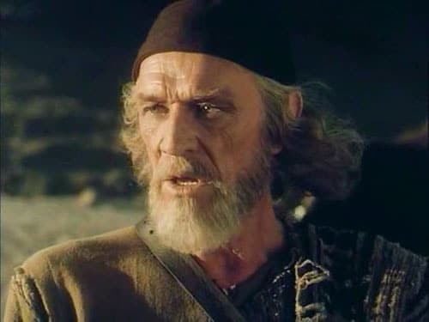
(Abraham) Impatience: Genesis 15:1-6
15 After these things the word of the Lord came unto Abram in a vision, saying, Fear not, Abram: I am thy shield, and thy exceeding great reward.
² And Abram said, Lord God, what wilt thou give me, seeing I go childless, and the steward of my house is this Eliezer of Damascus?
³ And Abram said, Behold, to me thou hast given no seed: and, lo, one born in my house is mine heir.

Slide 8
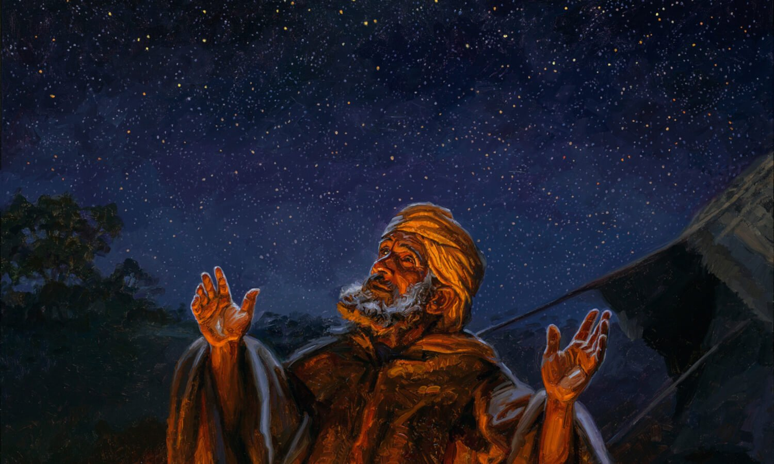
(Abraham) The Plan: Genesis 15:4-6
⁴ And, behold, the word of the Lord came unto him, saying, This shall not be thine heir; but he that shall come forth out of thine own bowels shall be thine heir.
⁵ And he brought him forth abroad, and said, Look now toward heaven, and tell the stars, if thou be able to number them: and he said unto him, So shall thy seed be.
⁶ And he believed in the Lord; and he counted it to him for righteousness.

Slide 9
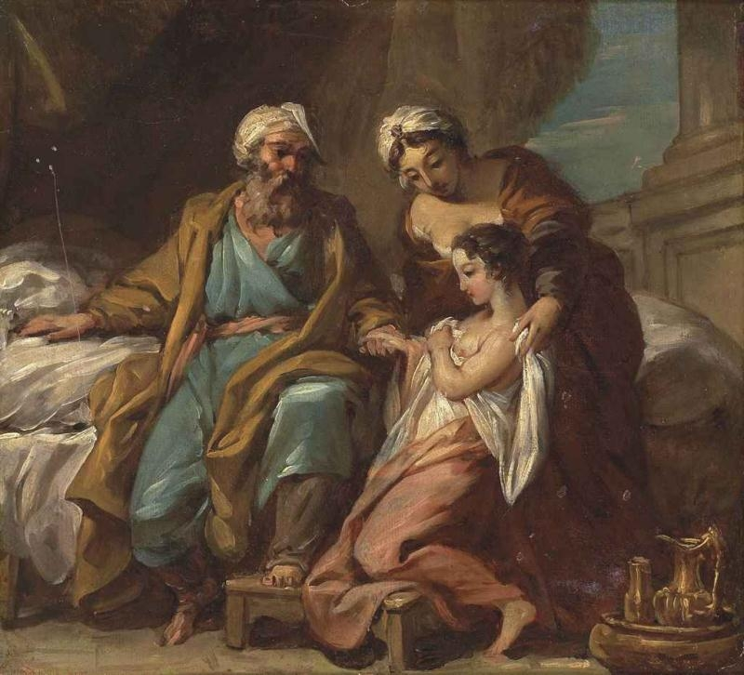
(Abraham) Impatience: Genesis 16:1-4
16 Now Sarai Abram's wife bare him no children: and she had an handmaid, an Egyptian, whose name was Hagar.
² And Sarai said unto Abram, Behold now, the Lord hath restrained me from bearing: I pray thee, go in unto my maid; it may be that I may obtain children by her. And Abram hearkened to the voice of Sarai.

Slide 10
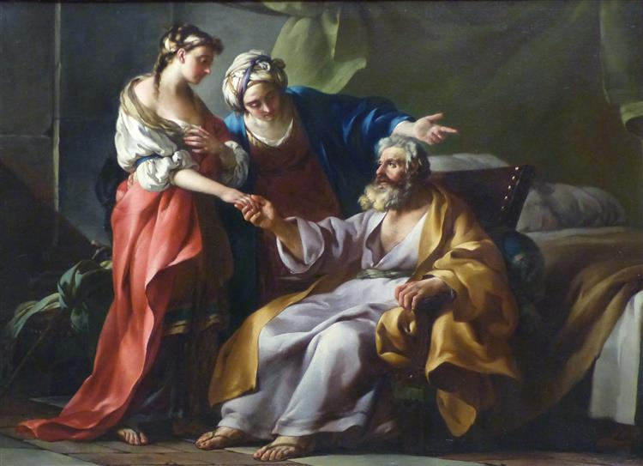
(Abraham) Impatience: Genesis 16:3-4
³ And Sarai Abram's wife took Hagar her maid the Egyptian, after Abram had dwelt ten years in the land of Canaan, and gave her to her husband Abram to be his wife.
⁴ And he went in unto Hagar, and she conceived: and when she saw that she had conceived, her mistress was despised in her eyes.

Slide 11
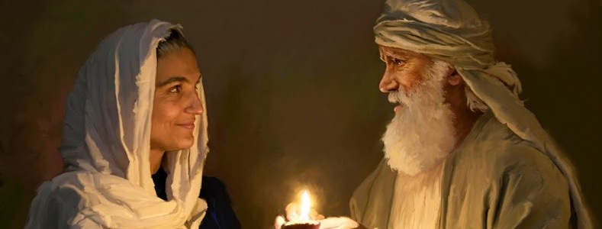
(Abraham) God’s Timing: Genesis 17:15-21
¹⁵ And God said unto Abraham, As for Sarai thy wife, thou shalt not call her name Sarai, but Sarah shall her name be.
¹⁶ And I will bless her, and give thee a son also of her: yea, I will bless her, and she shall be a mother of nations; kings of people shall be of her.

Slide 12
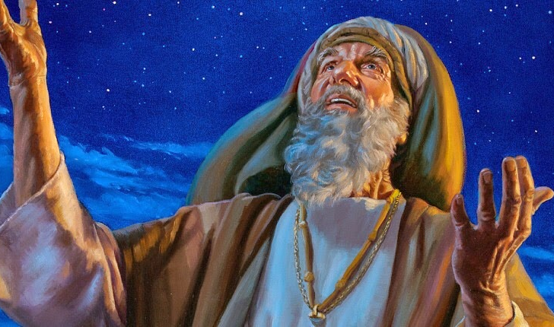
(Abraham) GOD’s Timing: Genesis 17:17-21
¹⁷ Then Abraham fell upon his face, and laughed, and said in his heart, Shall a child be born unto him that is an hundred years old? and shall Sarah, that is ninety years old, bear?
¹⁸ And Abraham said unto God, O that Ishmael might live before thee!
¹⁹ And God said, Sarah thy wife shall bear thee a son indeed; and thou shalt call his name Isaac: and I will establish my covenant with him for an everlasting covenant, and with his seed after him.

Slide 13
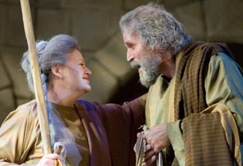
(Abraham) GOD’s Timing: Genesis 17:20-21
²⁰ And as for Ishmael, I have heard thee: Behold, I have blessed him, and will make him fruitful, and will multiply him exceedingly; twelve princes shall he beget, and I will make him a great nation.
²¹ But my covenant will I establish with Isaac, which Sarah shall bear unto thee at this set time in the next year.

Slide 14
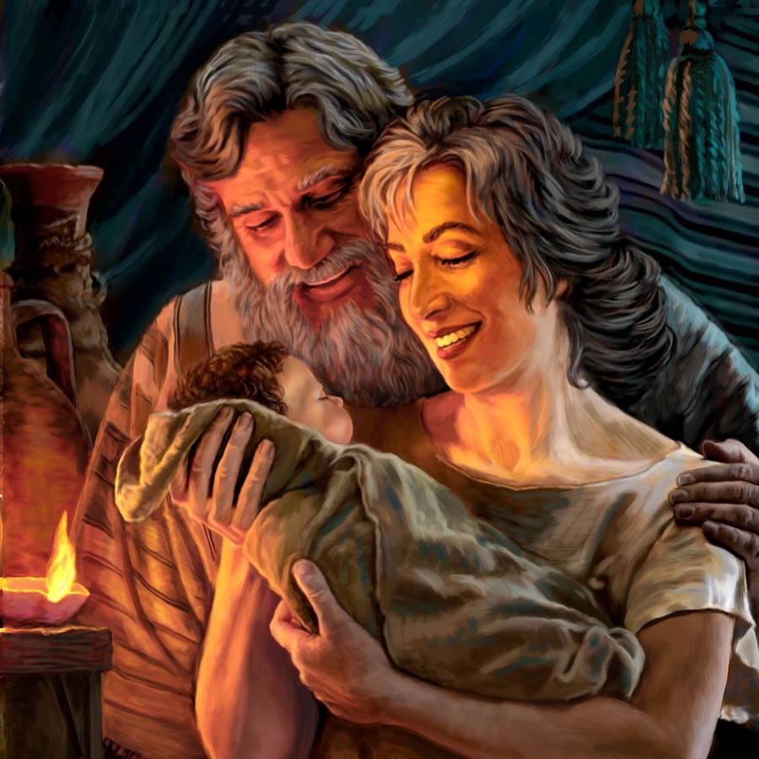
(Abraham) GOD’s Timing: Genesis 21:1-3, 5
21 And the Lord visited Sarah as he had said, and the Lord did unto Sarah as he had spoken.
² For Sarah conceived, and bare Abraham a son in his old age, at the set time of which God had spoken to him.
³ And Abraham called the name of his son that was born unto him, whom Sarah bare to him, Isaac. …
⁵ And Abraham was an hundred years old, when his son Isaac was born unto him.

Slide 15
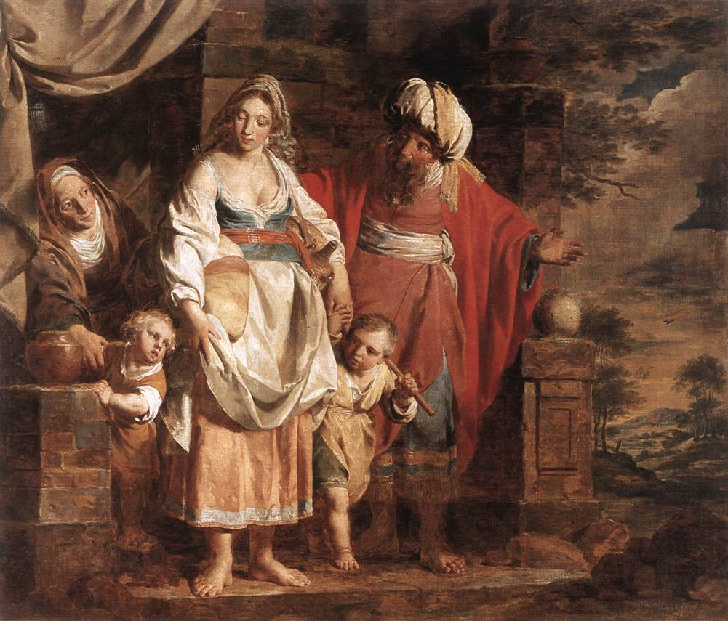
(Abraham) Consequences: Genesis 21:9-11
⁹ And Sarah saw the son of Hagar the Egyptian, which she had born unto Abraham, mocking.
¹⁰ Wherefore she said unto Abraham, Cast out this bondwoman and her son: for the son of this bondwoman shall not be heir with my son, even with Isaac.
¹¹ And the thing was very grievous in Abraham's sight because of his son.

Slide 16
Abraham: Sometimes a Patient Man
Abraham waited ten years for a son… then he and Sarai thought they’d waited long enough. They didn’t trust that God would work it out. They decided to take immediate action, and so Hagar and Ishmael came along. But fifteen years after that, the son of promise, Isaac, was born. Just as God had told Abraham 25 years earlier! Eventually, Abraham came to trust God so much that he was willing to sacrifice his beloved son Isaac at God’s command. Abraham eventually learned patience… and trust!

Slide 17

Joseph: Patience Despite Hardship

Slide 18
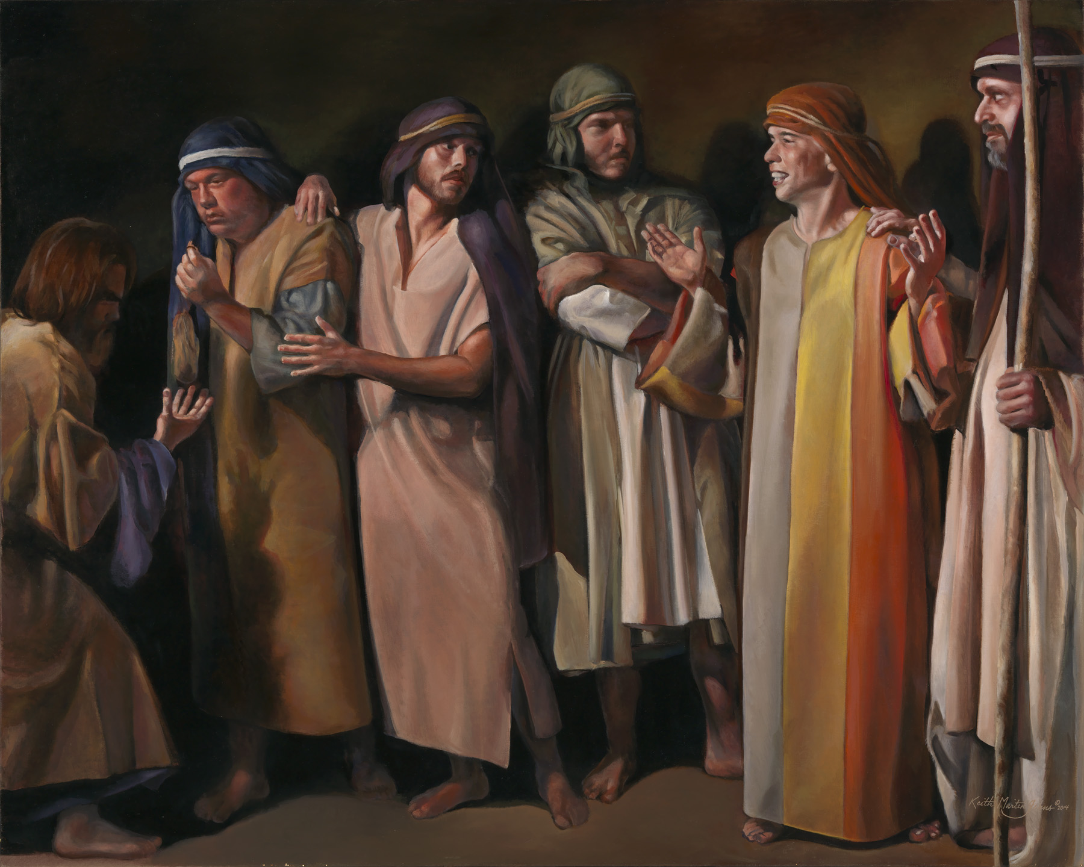
(Joseph) Man’s Timing: Genesis 37:3-11
³ Now Israel loved Joseph more than all his children, because he was the son of his old age: and he made him a coat of many colours.
⁴ And when his brethren saw that their father loved him more than all his brethren, they hated him, and could not speak peaceably unto him.

Slide 19
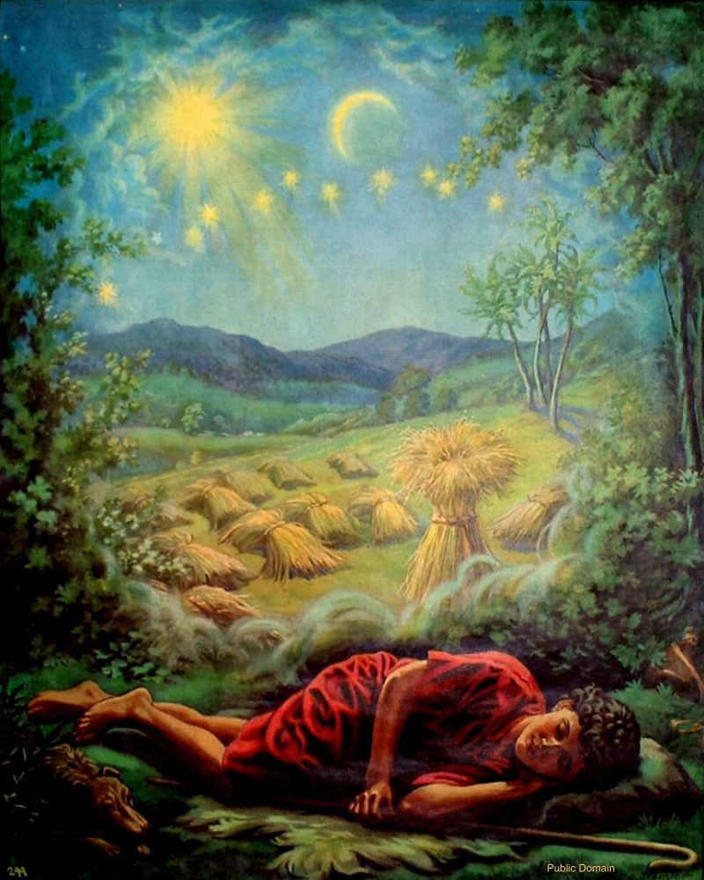
(Joseph) Man’s Timing: Genesis 37:5-11
⁵ And Joseph dreamed a dream, and he told it his brethren: and they hated him yet the more.
⁶ And he said unto them, Hear, I pray you, this dream which I have dreamed:
⁷ For, behold, we were binding sheaves in the field, and, lo, my sheaf arose, and also stood upright; and, behold, your sheaves stood round about, and made obeisance to my sheaf.

Slide 20
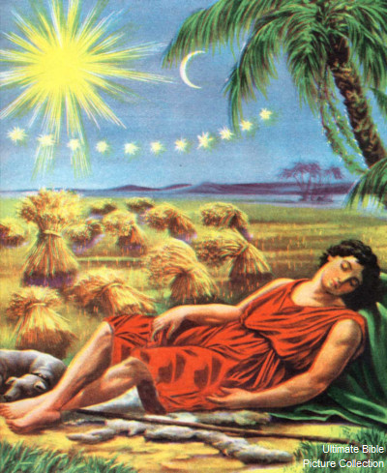
(Joseph) Man’s Timing: Genesis 37:8-11
⁸ And his brethren said to him, Shalt thou indeed reign over us? or shalt thou indeed have dominion over us? And they hated him yet the more for his dreams, and for his words.
⁹ And he dreamed yet another dream, and told it his brethren, and said, Behold, I have dreamed a dream more; and, behold, the sun and the moon and the eleven stars made obeisance to me.

Slide 21
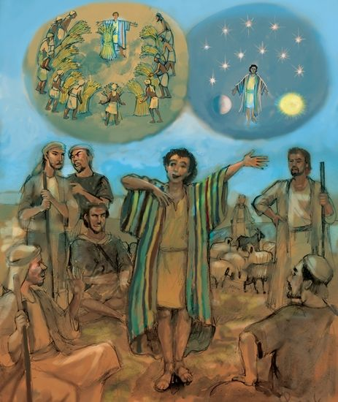
(Joseph) Man’s Timing: Genesis 37:10-11
¹⁰ And he told it to his father, and to his brethren: and his father rebuked him, and said unto him, What is this dream that thou hast dreamed? Shall I and thy mother and thy brethren indeed come to bow down ourselves to thee to the earth?
¹¹ And his brethren envied him; but his father observed the saying.

Slide 22
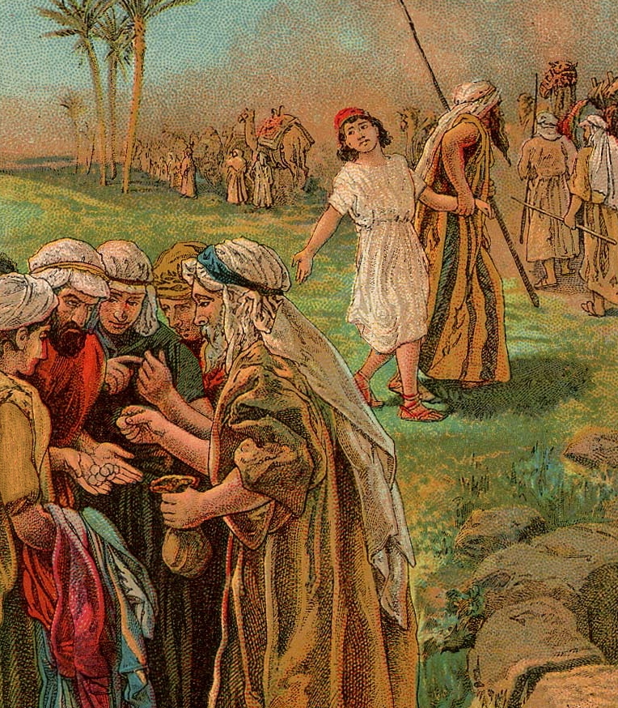
(Joseph) God’s Timing: Genesis 37:26-28
²⁶ And Judah said unto his brethren, What profit is it if we slay our brother, and conceal his blood?
²⁷ Come, and let us sell him to the Ishmeelites, and let not our hand be upon him; for he is our brother and our flesh. And his brethren were content.
²⁸ Then there passed by Midianites merchantmen; and they drew and lifted up Joseph out of the pit, and sold Joseph to the Ishmeelites for twenty pieces of silver: and they brought Joseph into Egypt.

Slide 23
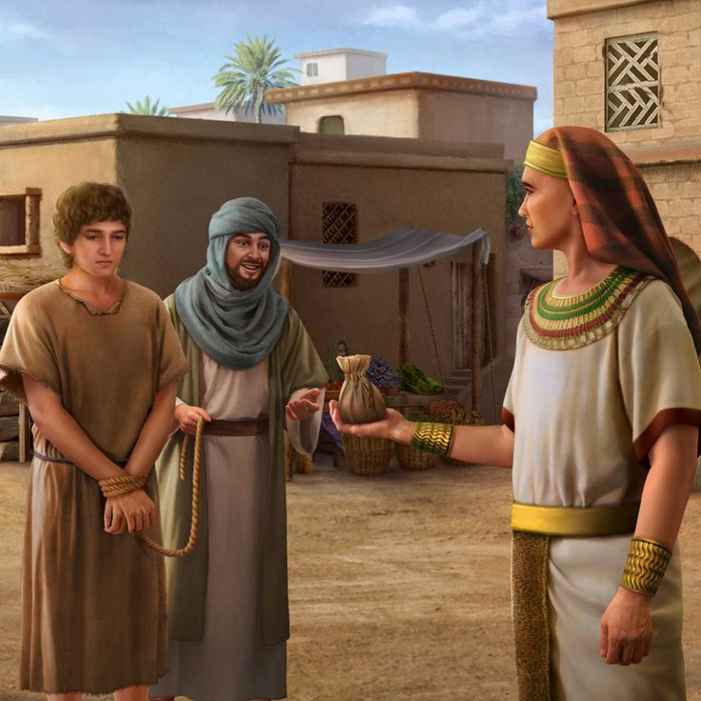
(Joseph) God’s Timing: Genesis 39:1-23
39 And Joseph was brought down to Egypt; and Potiphar, an officer of Pharaoh, captain of the guard, an Egyptian, bought him of the hands of the Ishmeelites, which had brought him down thither.
² And the Lord was with Joseph, and he was a prosperous man; and he was in the house of his master the Egyptian.
³ And his master saw that the Lord was with him, and that the Lord made all that he did to prosper in his hand.

Slide 24
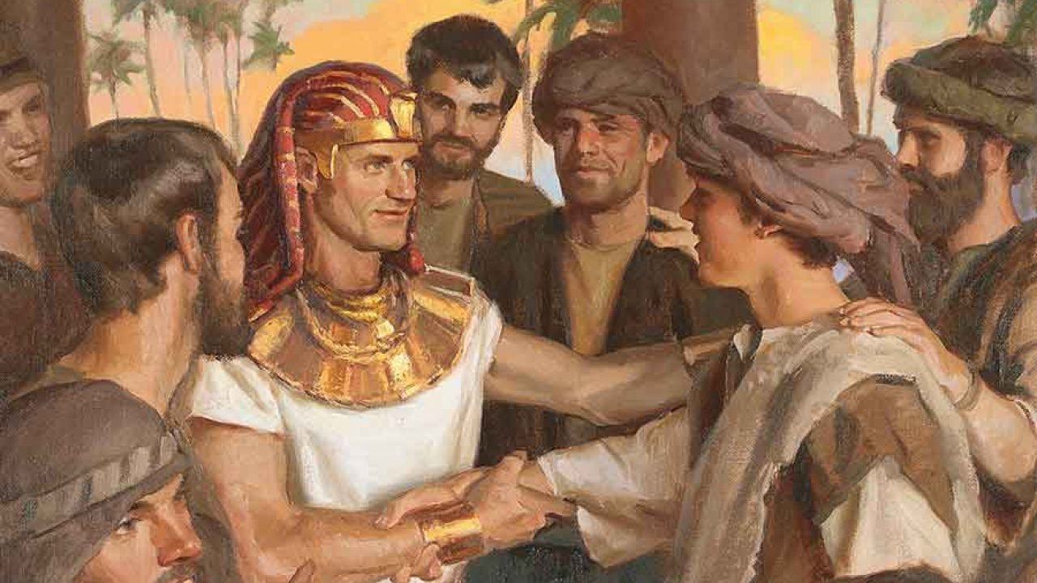
(Joseph) God’s Timing: Genesis 39:4-23
⁴ And Joseph found grace in his sight, and he served him: and he made him overseer over his house, and all that he had he put into his hand.
⁵ And it came to pass from the time that he had made him overseer in his house, and over all that he had, that the Lord blessed the Egyptian's house for Joseph's sake; and the blessing of the Lord was upon all that he had in the house, and in the field.

Slide 25
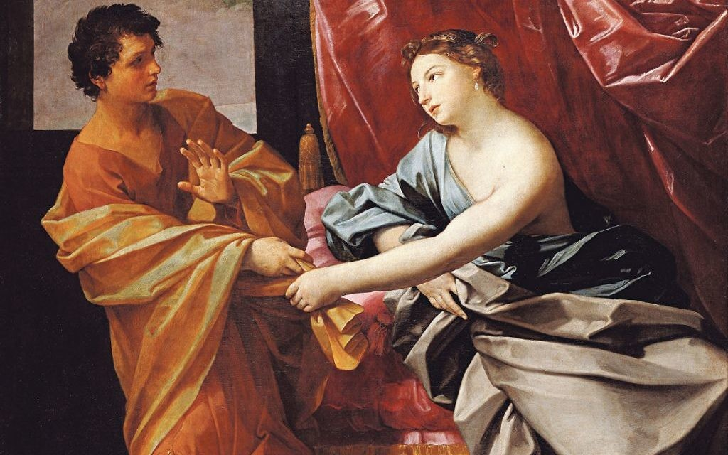
(Joseph) God’s Timing: Genesis 39:6-23
⁶ And he left all that he had in Joseph's hand; and he knew not ought he had, save the bread which he did eat. And Joseph was a goodly person, and well favoured.
⁷ And it came to pass after these things, that his master's wife cast her eyes upon Joseph; and she said, Lie with me.
⁸ But he refused, and said unto his master's wife, Behold, my master wotteth not what is with me in the house, and he hath committed all that he hath to my hand;

Slide 26
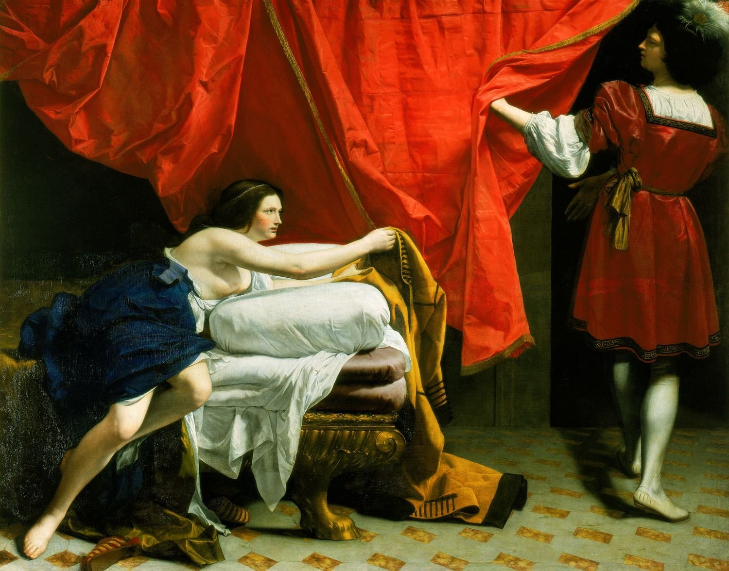
(Joseph) God’s Timing: Genesis 39:9-23
⁹ There is none greater in this house than I; neither hath he kept back any thing from me but thee, because thou art his wife: how then can I do this great wickedness, and sin against God?
¹⁰ And it came to pass, as she spake to Joseph day by day, that he hearkened not unto her, to lie by her, or to be with her.

Slide 27
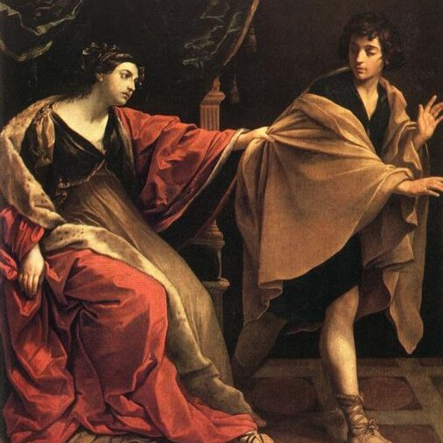
(Joseph) God’s Timing: Genesis 39:11-23
¹¹ And it came to pass about this time, that Joseph went into the house to do his business; and there was none of the men of the house there within.
¹² And she caught him by his garment, saying, Lie with me: and he left his garment in her hand, and fled, and got him out.
¹³ And it came to pass, when she saw that he had left his garment in her hand, and was fled forth,

Slide 28
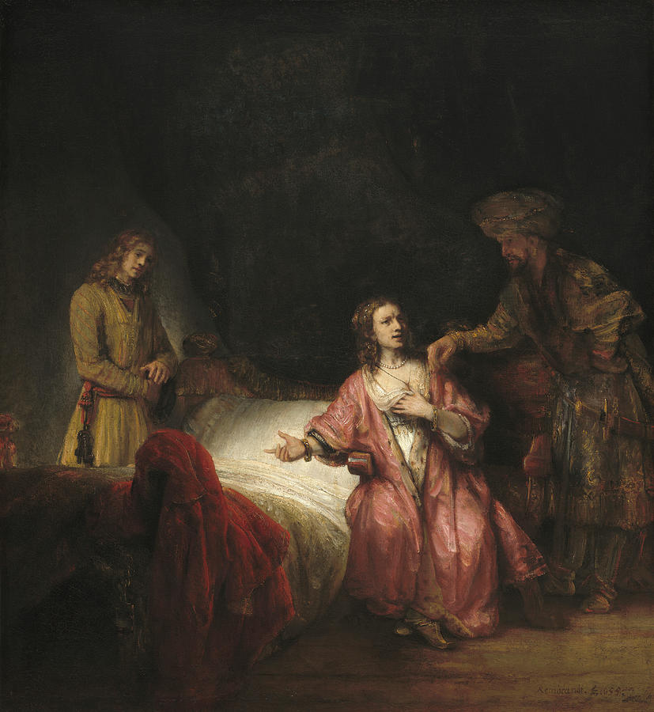
(Joseph) God’s Timing: Genesis 39:14-23
¹⁴ That she called unto the men of her house, and spake unto them, saying, See, he hath brought in an Hebrew unto us to mock us; he came in unto me to lie with me, and I cried with a loud voice:
¹⁵ And it came to pass, when he heard that I lifted up my voice and cried, that he left his garment with me, and fled, and got him out.
¹⁶ And she laid up his garment by her, until his lord came home.

Slide 29
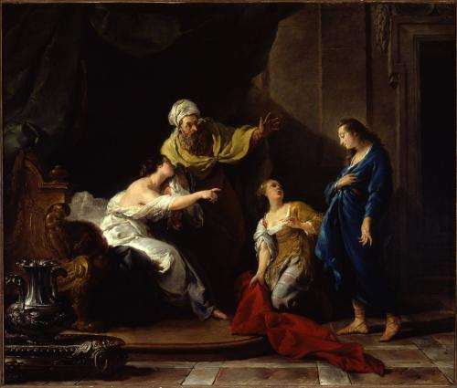
(Joseph) God’s Timing: Genesis 39:17-23
¹⁷ And she spake unto him according to these words, saying, The Hebrew servant, which thou hast brought unto us, came in unto me to mock me:
¹⁸ And it came to pass, as I lifted up my voice and cried, that he left his garment with me, and fled out.

Slide 30
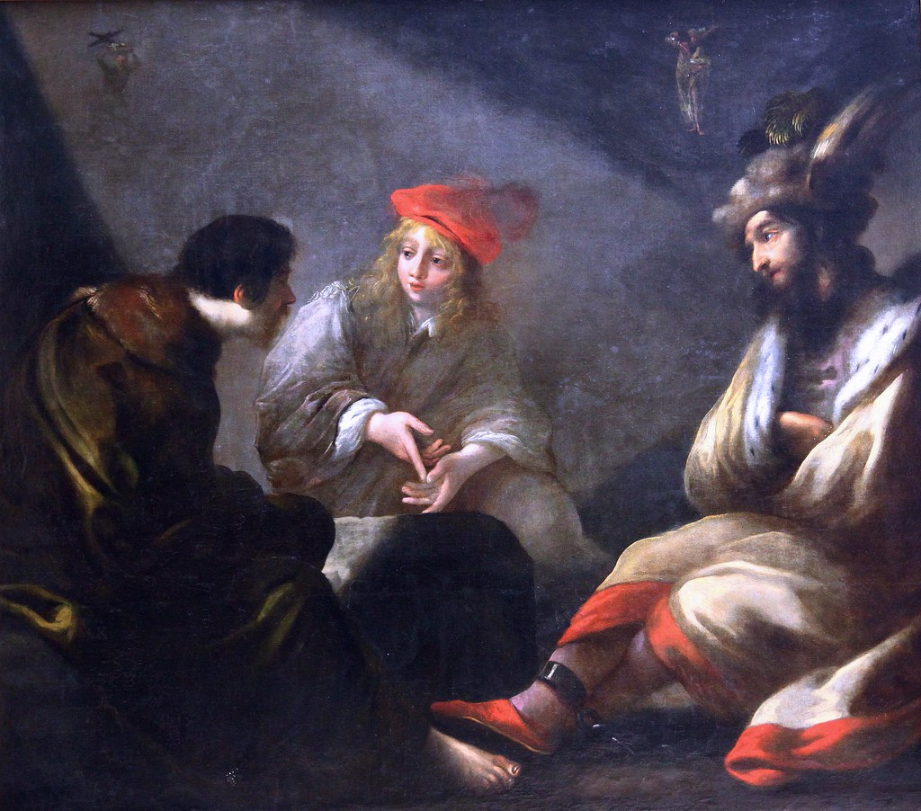
(Joseph) God’s Timing: Genesis 39:19-23
¹⁹ And it came to pass, when his master heard the words of his wife, which she spake unto him, saying, After this manner did thy servant to me; that his wrath was kindled.
²⁰ And Joseph's master took him, and put him into the prison, a place where the king's prisoners were bound: and he was there in the prison.

Slide 31
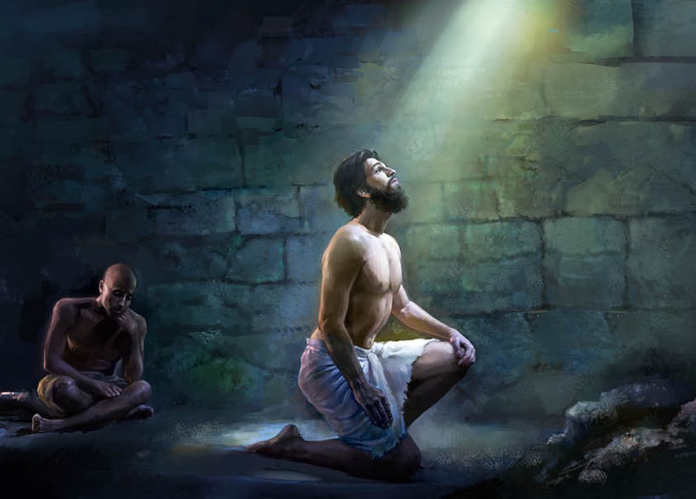
(Joseph) God’s Timing: Genesis 39:21-23
²¹ But the Lord was with Joseph, and shewed him mercy, and gave him favour in the sight of the keeper of the prison.
²² And the keeper of the prison committed to Joseph's hand all the prisoners that were in the prison; and whatsoever they did there, he was the doer of it.
²³ The keeper of the prison looked not to any thing that was under his hand; because the Lord was with him, and that which he did, the Lord made it to prosper.

Slide 32
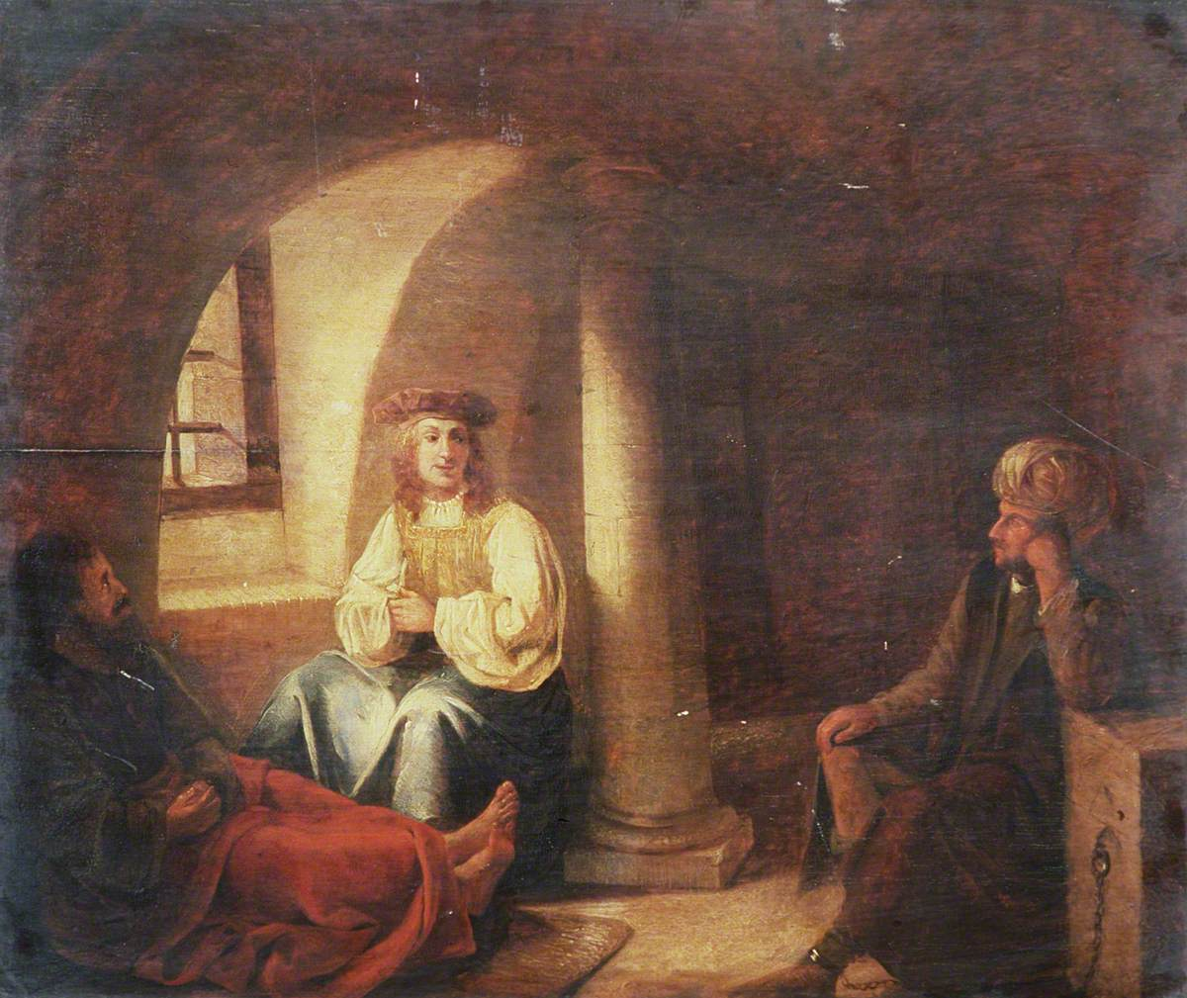
(Joseph) God’s Timing: Genesis 40:1-3
40 And it came to pass after these things, that the butler of the king of Egypt and his baker had offended their lord the king of Egypt.
² And Pharaoh was wroth against two of his officers, against the chief of the butlers, and against the chief of the bakers.
³ And he put them in ward in the house of the captain of the guard, into the prison, the place where Joseph was bound.

Slide 33
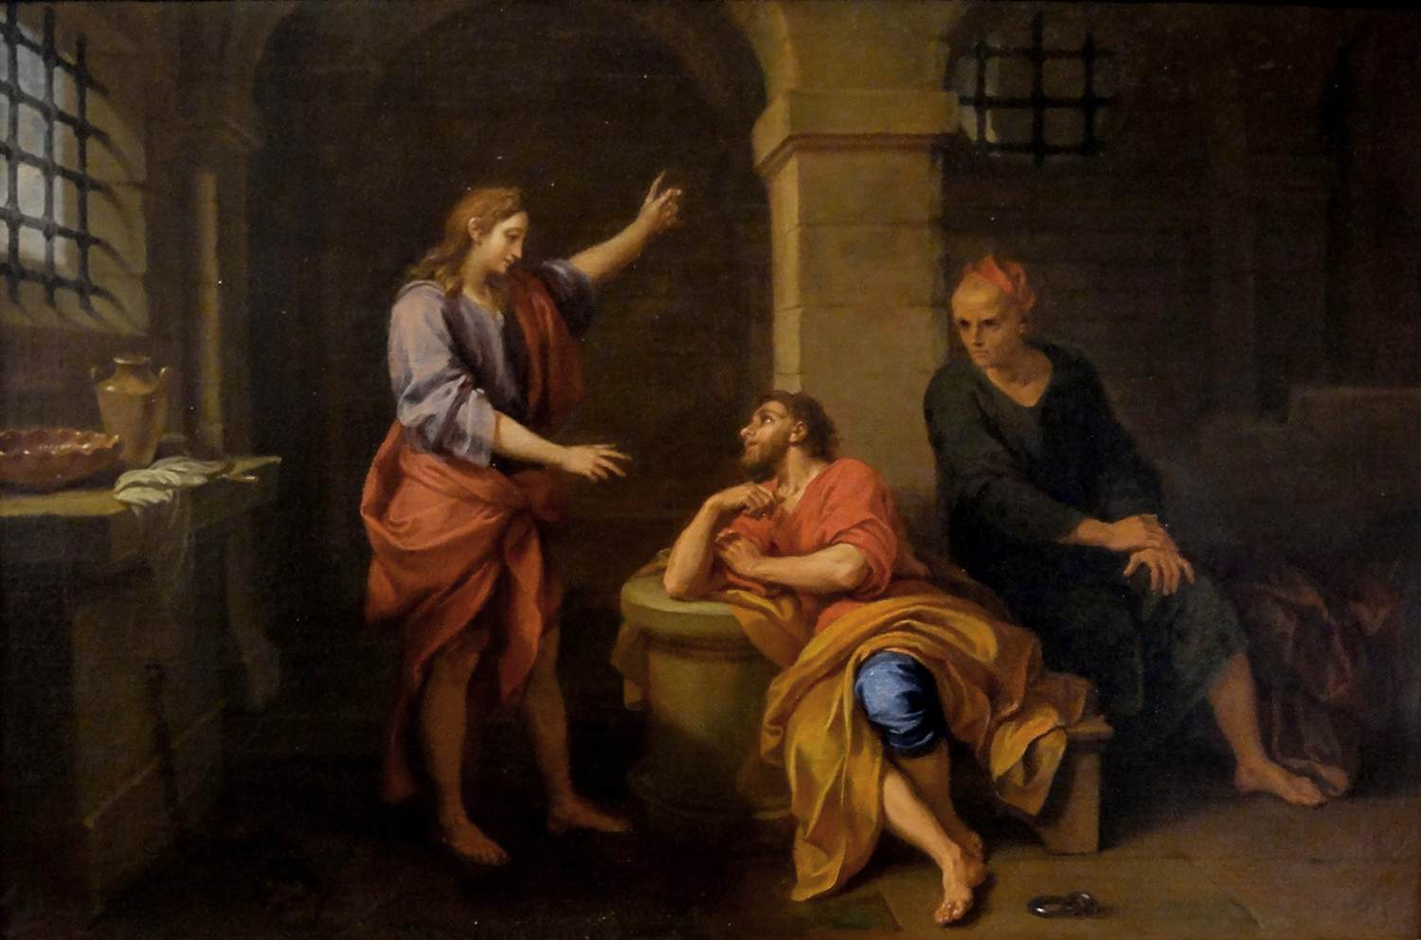
(Joseph) God’s Timing: Genesis 40:5-6
⁵ And they dreamed a dream both of them, each man his dream in one night, each man according to the interpretation of his dream, the butler and the baker of the king of Egypt, which were bound in the prison.
⁶ And Joseph came in unto them in the morning, and looked upon them, and, behold, they were sad.

Slide 34
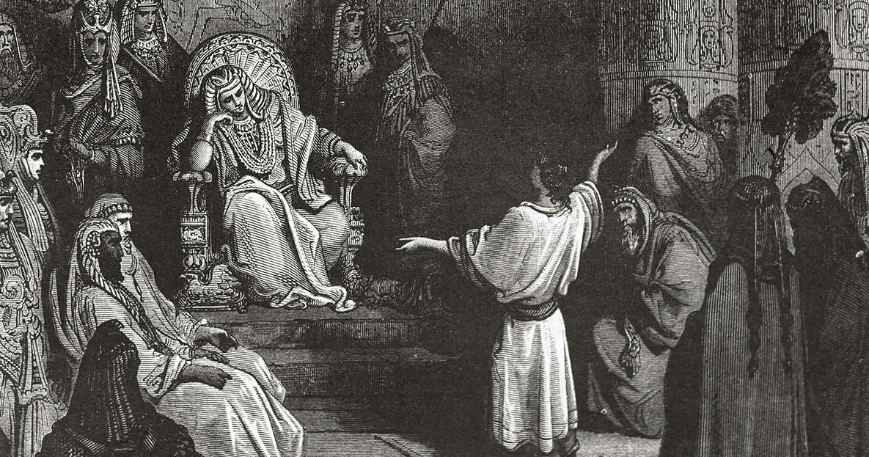
(Joseph) God’s Timing: Genesis 40:20-23
²⁰ And it came to pass the third day, which was Pharaoh's birthday, that he made a feast unto all his servants: and he lifted up the head of the chief butler and of the chief baker among his servants.
²¹ And he restored the chief butler unto his butlership again; and he gave the cup into Pharaoh's hand:
²² But he hanged the chief baker: as Joseph had interpreted to them.
²³ Yet did not the chief butler remember Joseph, but forgat him.

Slide 35
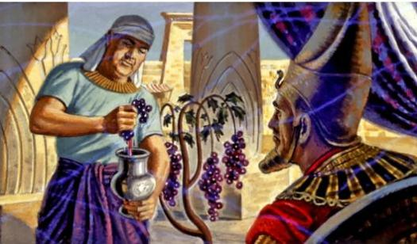
(Joseph) God’s Timing: Genesis 41:1, 8-10
41 And it came to pass at the end of two full years, that Pharaoh dreamed: and, behold, he stood by the river. …
⁸ And it came to pass in the morning that his spirit was troubled; and he sent and called for all the magicians of Egypt, and all the wise men thereof: and Pharaoh told them his dream; but there was none that could interpret them unto Pharaoh.
⁹ Then spake the chief butler unto Pharaoh, saying, I do remember my faults this day:
¹⁰ Pharaoh was wroth with his servants, and put me in ward in the captain of the guard's house, both me and the chief baker:

Slide 36
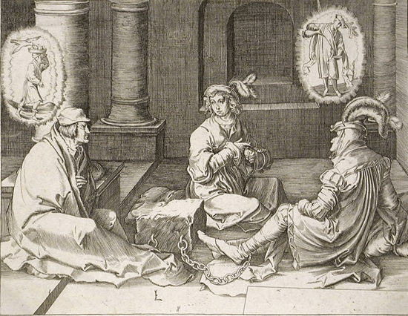
(Joseph) God’s Timing: Genesis 41:11-16
¹¹ And we dreamed a dream in one night, I and he; we dreamed each man according to the interpretation of his dream.
¹² And there was there with us a young man, an Hebrew, servant to the captain of the guard; and we told him, and he interpreted to us our dreams; to each man according to his dream he did interpret.
¹³ And it came to pass, as he interpreted to us, so it was; me he restored unto mine office, and him he hanged.

Slide 37
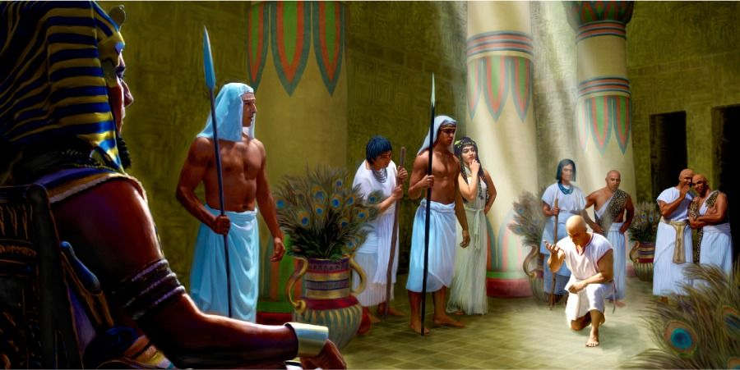
(Joseph) God’s Timing: Genesis 41:14-16
¹⁴ Then Pharaoh sent and called Joseph, and they brought him hastily out of the dungeon: and he shaved himself, and changed his raiment, and came in unto Pharaoh.
¹⁵ And Pharaoh said unto Joseph, I have dreamed a dream, and there is none that can interpret it: and I have heard say of thee, that thou canst understand a dream to interpret it.
¹⁶ And Joseph answered Pharaoh, saying, It is not in me: God shall give Pharaoh an answer of peace.

Slide 38
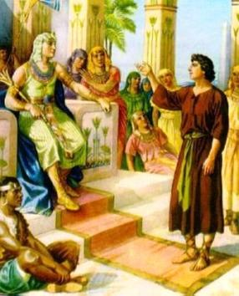
(Joseph) God’s Timing: Genesis 41:33-35
³³ Now therefore let Pharaoh look out a man discreet and wise, and set him over the land of Egypt.
³⁴ Let Pharaoh do this, and let him appoint officers over the land, and take up the fifth part of the land of Egypt in the seven plenteous years.
³⁵ And let them gather all the food of those good years that come, and lay up corn under the hand of Pharaoh, and let them keep food in the cities.

Slide 39
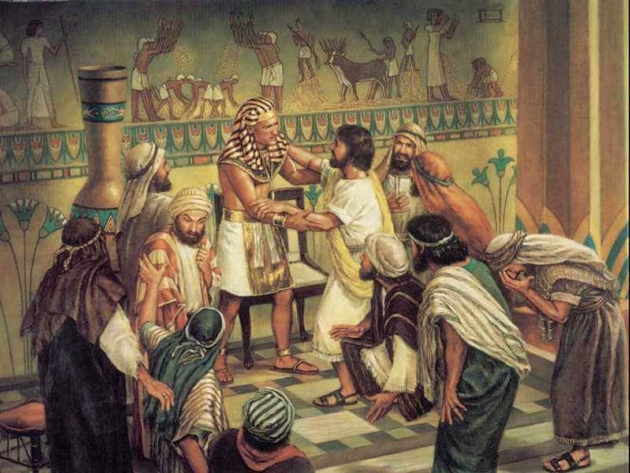
(Joseph) God’s Timing: Genesis 41:39-43
³⁹ And Pharaoh said unto Joseph, Forasmuch as God hath shewed thee all this, there is none so discreet and wise as thou art:
⁴⁰ Thou shalt be over my house, and according unto thy word shall all my people be ruled: only in the throne will I be greater than thou.
⁴¹ And Pharaoh said unto Joseph, See, I have set thee over all the land of Egypt.

Slide 40
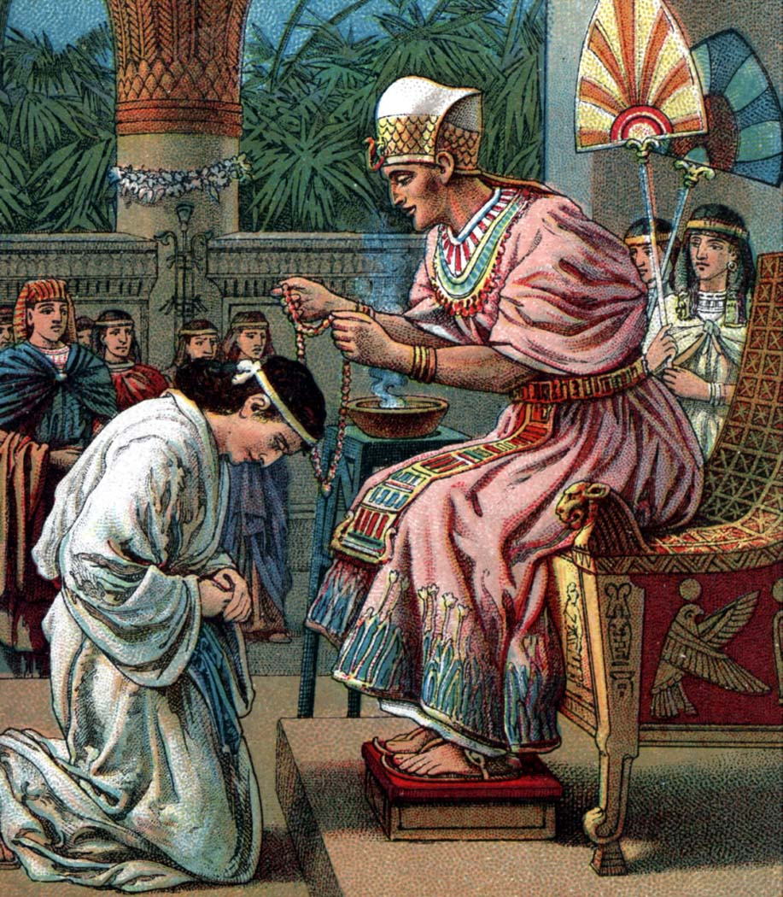
(Joseph) God’s Timing: Genesis 41:42-43
⁴² And Pharaoh took off his ring from his hand, and put it upon Joseph's hand, and arrayed him in vestures of fine linen, and put a gold chain about his neck;
⁴³ And he made him to ride in the second chariot which he had; and they cried before him, Bow the knee: and he made him ruler over all the land of Egypt.

Slide 41
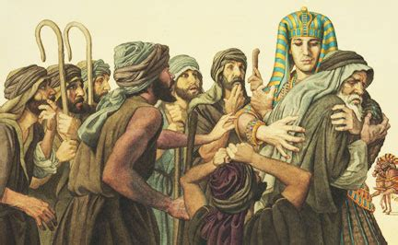
(Joseph) God’s Timing: Genesis 45:4-9
⁴ And Joseph said unto his brethren, Come near to me, I pray you. And they came near. And he said, I am Joseph your brother, whom ye sold into Egypt.
⁵ Now therefore be not grieved, nor angry with yourselves, that ye sold me hither: for God did send me before you to preserve life.
⁶ For these two years hath the famine been in the land: and yet there are five years, in the which there shall neither be earing nor harvest.

Slide 42
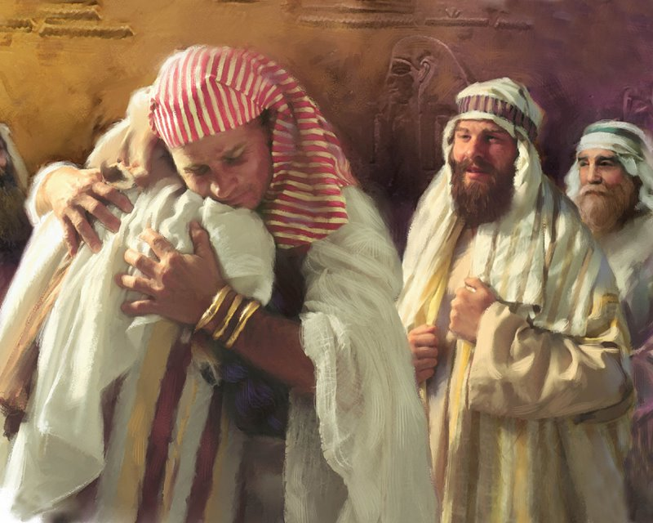
(Joseph) God’s Timing: Genesis 45:7-9
⁷ And God sent me before you to preserve you a posterity in the earth, and to save your lives by a great deliverance.
⁸ So now it was not you that sent me hither, but God: and he hath made me a father to Pharaoh, and lord of all his house, and a ruler throughout all the land of Egypt.
⁹ Haste ye, and go up to my father, and say unto him, Thus saith thy son Joseph, God hath made me lord of all Egypt: come down unto me, tarry not:

Slide 43
Joseph: Patience Despite Hardship
Joseph started out convinced of his glorious position within the family. But he went through some really rough lessons about relying on God. He had to endure enslavement, and later imprisonment, while patiently trusting that God would make his dreams come true. That’s a lot of years of patience, especially from a young man! But Joseph trusted in God despite truly terrible circumstances. And eventually, his dreams came true, just as God had shown him.

Slide 44
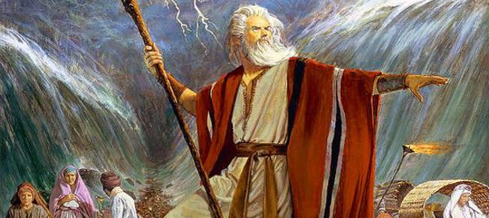
MOSES: A Powerhouse of Patience

Slide 45
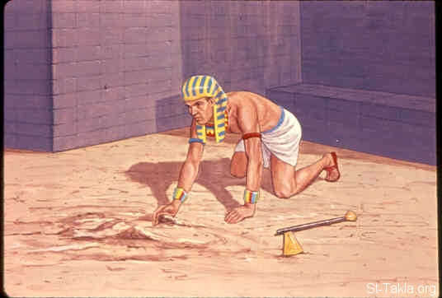
(Moses) Man’s Timing: Exodus 2:11-15
¹¹ And it came to pass in those days, when Moses was grown, that he went out unto his brethren, and looked on their burdens: and he spied an Egyptian smiting an Hebrew, one of his brethren.
¹² And he looked this way and that way, and when he saw that there was no man, he slew the Egyptian, and hid him in the sand.

Slide 46
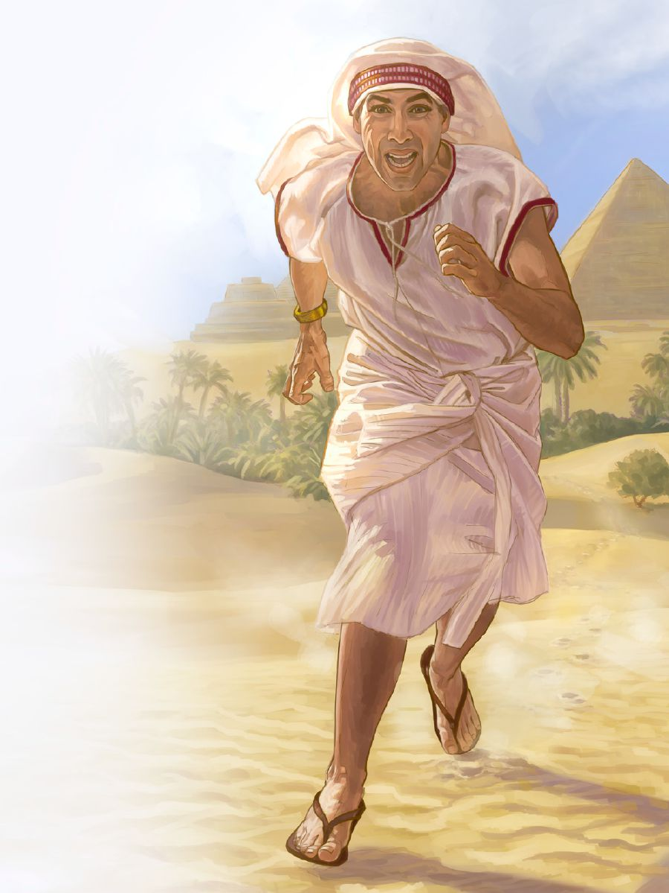
(Moses) Man’s Timing: Exodus 2:13-15
¹³ And when he went out the second day, behold, two men of the Hebrews strove together: and he said to him that did the wrong, Wherefore smitest thou thy fellow?
¹⁴ And he said, Who made thee a prince and a judge over us? intendest thou to kill me, as thou killedst the Egyptian? And Moses feared, and said, Surely this thing is known.
¹⁵ Now when Pharaoh heard this thing, he sought to slay Moses. But Moses fled from the face of Pharaoh, and dwelt in the land of Midian: and he sat down by a well.

Slide 47
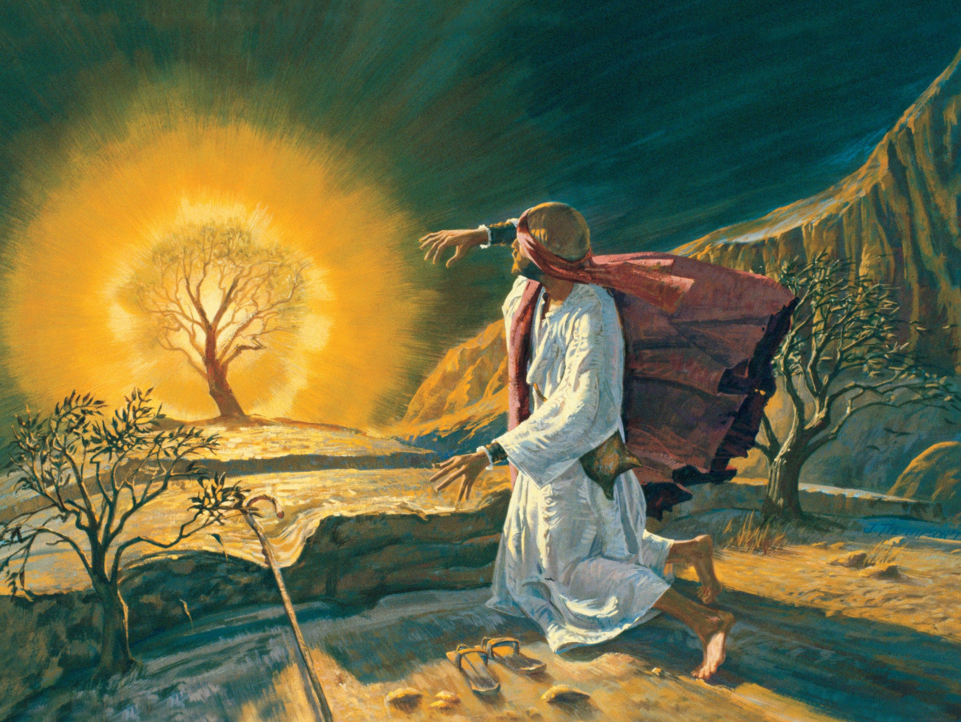
(Moses) God’s Timing: Exodus 3:1-7
3 Now Moses kept the flock of Jethro his father in law, the priest of Midian: and he led the flock to the backside of the desert, and came to the mountain of God, even to Horeb.
² And the angel of the Lord appeared unto him in a flame of fire out of the midst of a bush: and he looked, and, behold, the bush burned with fire, and the bush was not consumed.

Slide 48
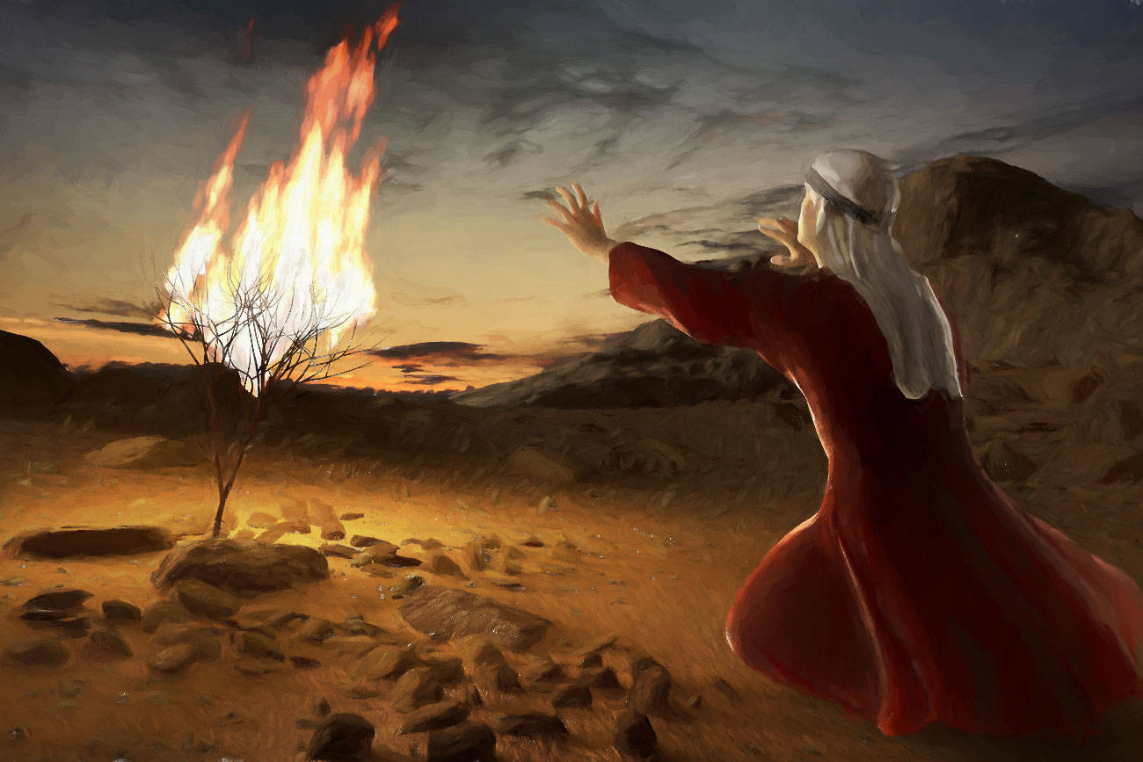
(Moses) God’s Timing: Exodus 3:3-7
³ And Moses said, I will now turn aside, and see this great sight, why the bush is not burnt.
⁴ And when the Lord saw that he turned aside to see, God called unto him out of the midst of the bush, and said, Moses, Moses. And he said, Here am I.
⁵ And he said, Draw not nigh hither: put off thy shoes from off thy feet, for the place whereon thou standest is holy ground.

Slide 49
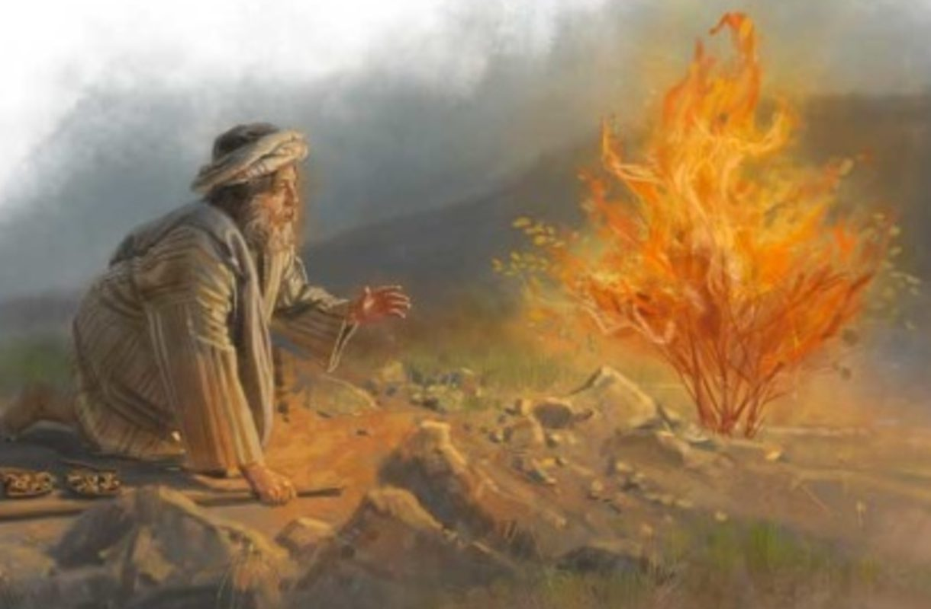
(Moses) God’s Timing: Exodus 3:6-7
⁶ Moreover he said, I am the God of thy father, the God of Abraham, the God of Isaac, and the God of Jacob. And Moses hid his face; for he was afraid to look upon God.
⁷ And the Lord said, I have surely seen the affliction of my people which are in Egypt, and have heard their cry by reason of their taskmasters; for I know their sorrows;

Slide 50
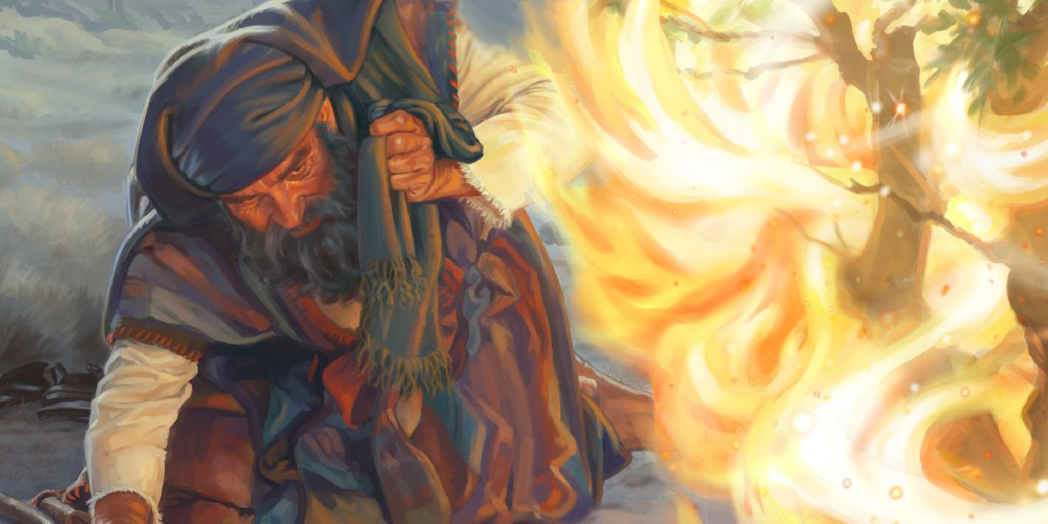
(Moses) God’s Timing: Exodus 3:10-11
¹⁰ Come now therefore, and I will send thee unto Pharaoh, that thou mayest bring forth my people the children of Israel out of Egypt.
¹¹ And Moses said unto God, Who am I, that I should go unto Pharaoh, and that I should bring forth the children of Israel out of Egypt?

Slide 51
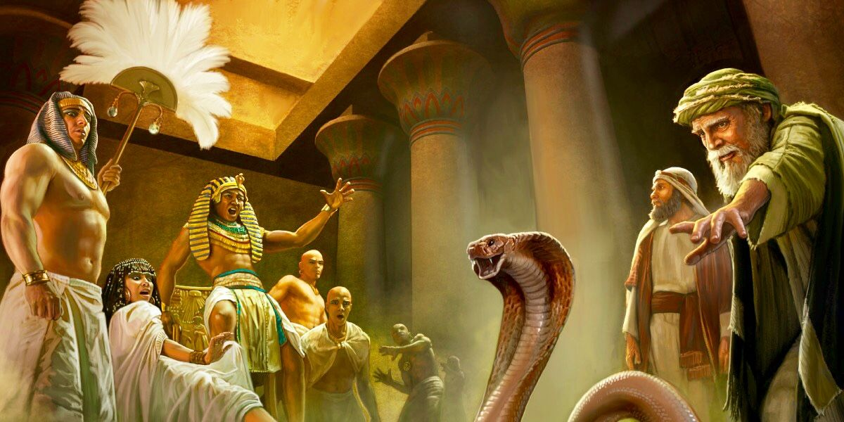
(Moses) God’s Timing: Exodus 5:1-3
5 And afterward Moses and Aaron went in, and told Pharaoh, Thus saith the Lord God of Israel, Let my people go, that they may hold a feast unto me in the wilderness.

Slide 52
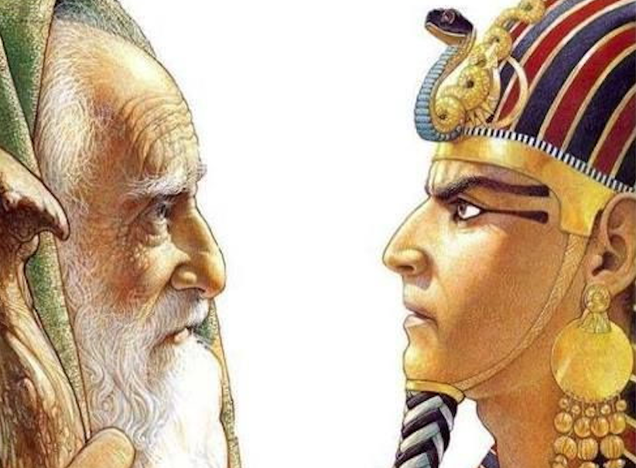
(Moses) God’s Timing: Exodus 5:2-3
² And Pharaoh said, Who is the Lord, that I should obey his voice to let Israel go? I know not the Lord, neither will I let Israel go.
³ And they said, The God of the Hebrews hath met with us: let us go, we pray thee, three days' journey into the desert, and sacrifice unto the Lord our God; lest he fall upon us with pestilence, or with the sword.

Slide 53
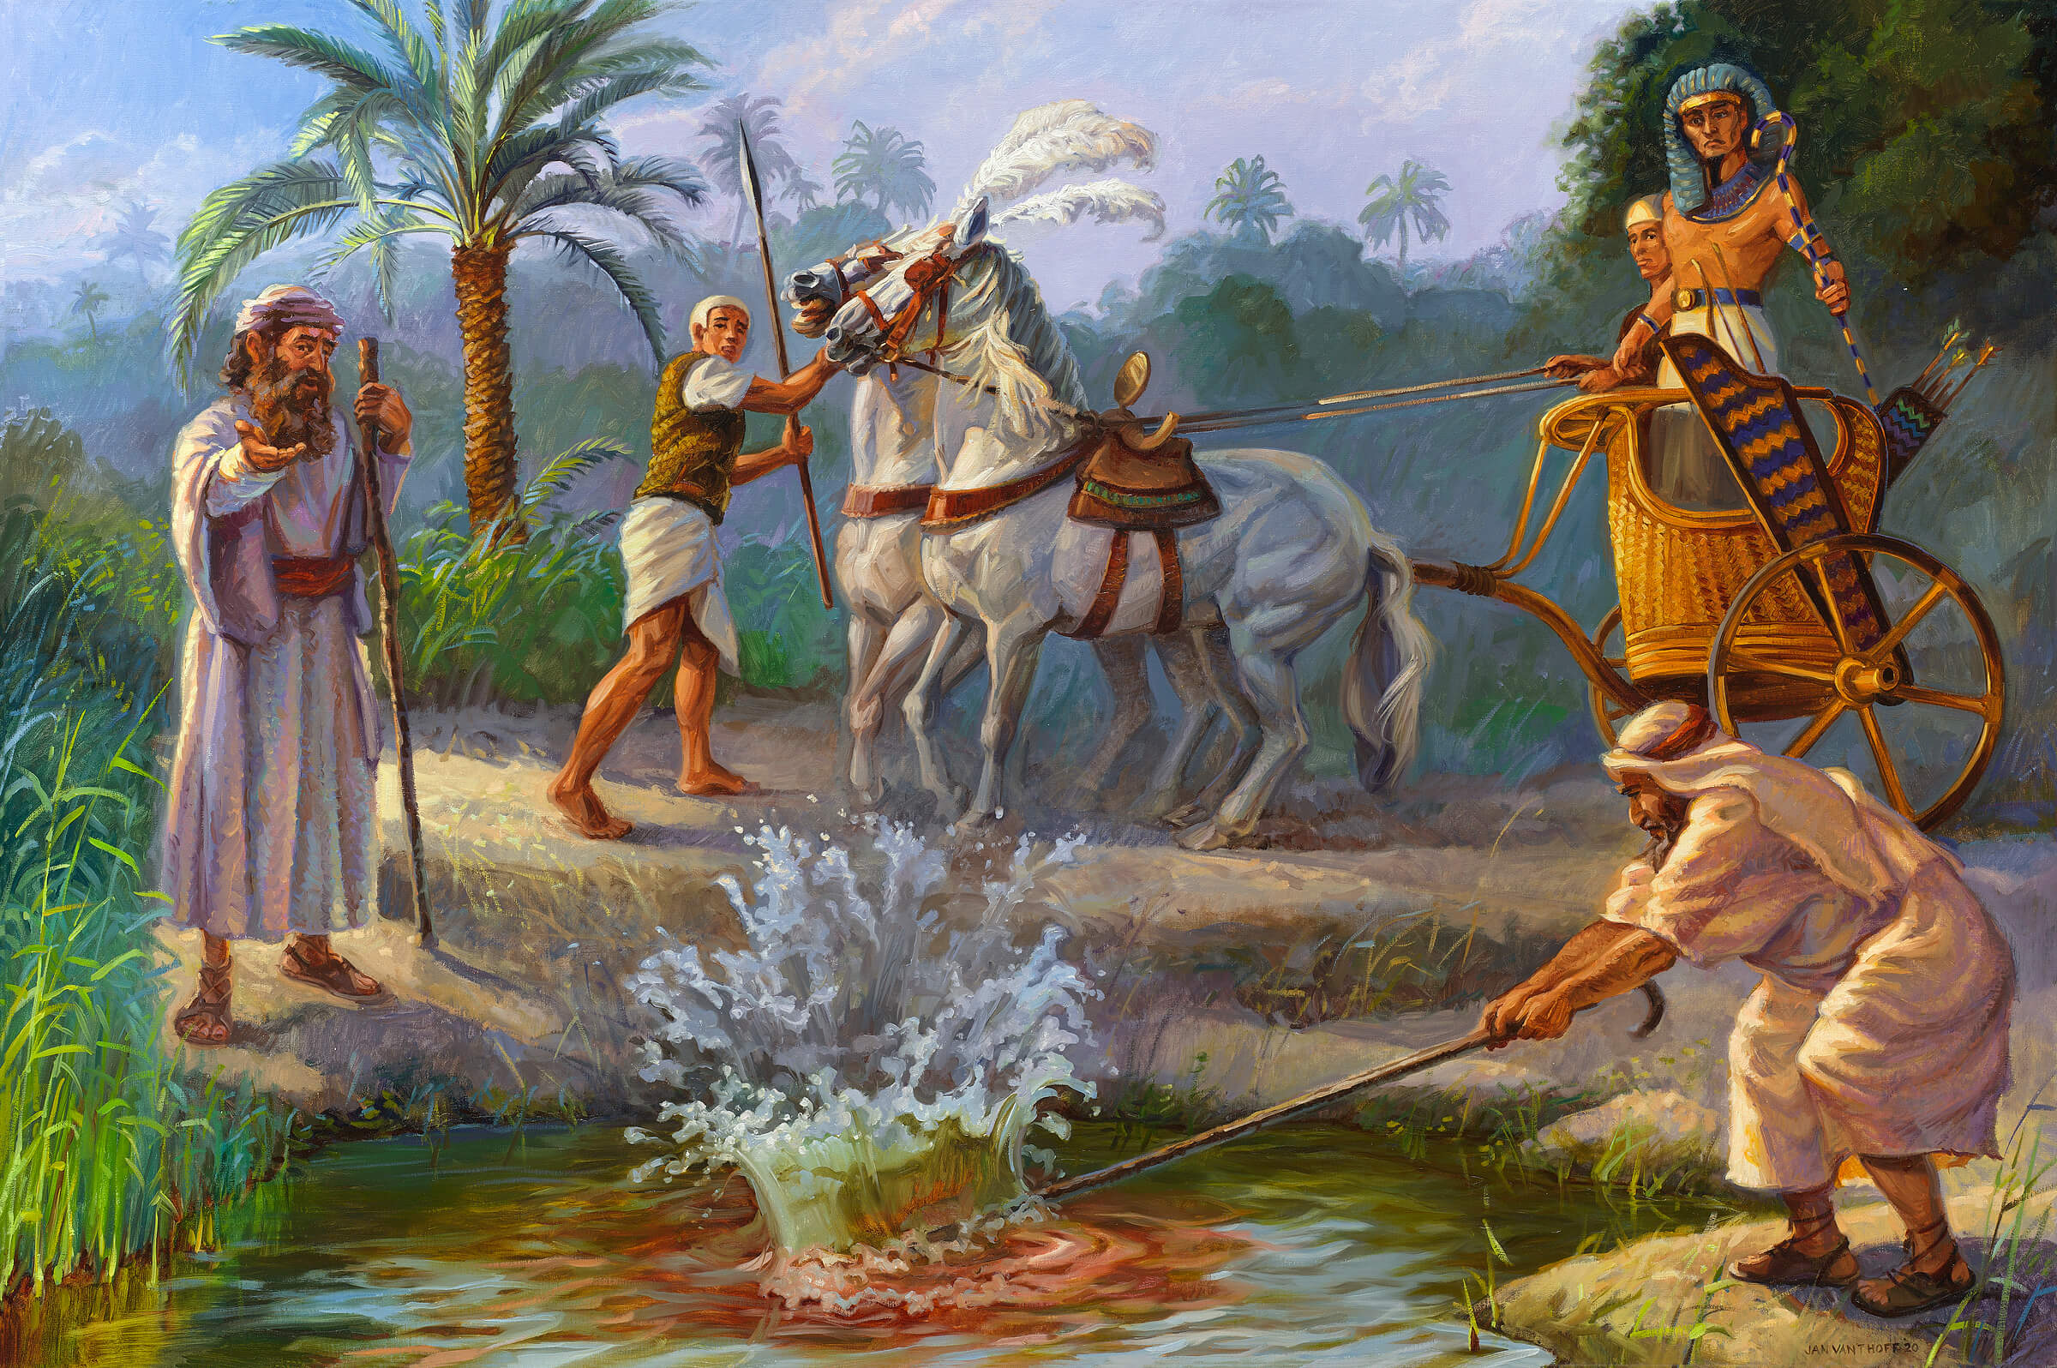
1: Nile River Turns to Blood

Slide 54
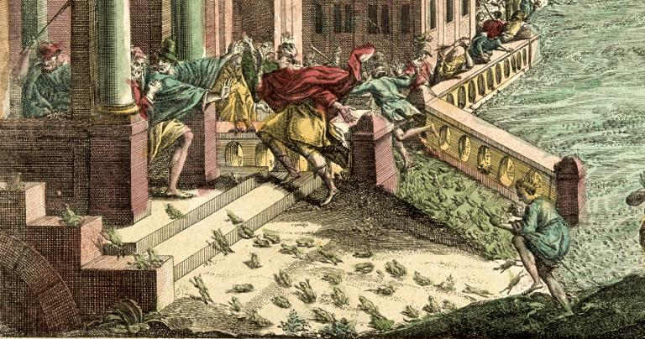
2: Plague of Frogs

Slide 55

3: Plague of Lice

Slide 56

4: Plague of Flies

Slide 57

5: The Murrain

Slide 58

6: The Plague of Boils

Slide 59

7: The Plague of Hail

Slide 60

8: The Plague of Locusts

Slide 61

9: The Plague of Darkness

Slide 62

10: The Death of the Firstborn

Slide 63

(Moses) God’s Timing: Exodus 12:30-36
³⁰ And Pharaoh rose up in the night, he, and all his servants, and all the Egyptians; and there was a great cry in Egypt; for there was not a house where there was not one dead.
³¹ And he called for Moses and Aaron by night, and said, Rise up, and get you forth from among my people, both ye and the children of Israel; and go, serve the Lord, as ye have said.
³² Also take your flocks and your herds, as ye have said, and be gone; and bless me also.

Slide 64

(Moses) God’s Timing: Exodus 12:33-36
³³ And the Egyptians were urgent upon the people, that they might send them out of the land in haste; for they said, We be all dead men.
³⁴ And the people took their dough before it was leavened, their kneadingtroughs being bound up in their clothes upon their shoulders.
³⁵ And the children of Israel did according to the word of Moses; and they borrowed of the Egyptians jewels of silver, and jewels of gold, and raiment:
³⁶ And the Lord gave the people favour in the sight of the Egyptians, so that they lent unto them such things as they required. And they spoiled the Egyptians.

Slide 65
MOSES: A Powerhouse of Patience
Moses knew that he was intended to lead his people out of Egypt. But when he decided to begin this mighty mission, it all went terribly wrong. He murdered a man and had to flee Egypt. Moses had to wait—and be prepared—before he could fulfill his task. He had to learn patience and obedience, rather than pride. God spent 40 years instructing him in these skills, and Moses became a powerhouse in the skill of waiting on God!

Slide 66

Job: Patience in Painful Times

Slide 67

(Job) Man’s Timing: Job 33:8-13
⁸ Surely thou hast spoken in mine hearing, and I have heard the voice of thy words, saying,
⁹ I am clean without transgression, I am innocent; neither is there iniquity in me.
¹⁰ Behold, he findeth occasions against me, he counteth me for his enemy,
ELIHU speaks:

Slide 68

(Job) Man’s Timing: Job 33:11-13
ELIHU continues:
¹¹ He putteth my feet in the stocks, he marketh all my paths.
¹² Behold, in this thou art not just: I will answer thee, that God is greater than man.
¹³ Why dost thou strive against him? for he giveth not account of any of his matters.

Slide 69

(Job) Man’s Timing: Job 36:1-10
ELIHU goes on…
36 Elihu also proceeded, and said,
² Suffer me a little, and I will shew thee that I have yet to speak on God's behalf.
³ I will fetch my knowledge from afar, and will ascribe righteousness to my Maker.
⁴ For truly my words shall not be false: he that is perfect in knowledge is with thee.
⁵ Behold, God is mighty, and despiseth not any: he is mighty in strength and wisdom.

Slide 70

(Job) Man’s Timing: Job 36:6-10
⁶ He preserveth not the life of the wicked: but giveth right to the poor.
⁷ He withdraweth not his eyes from the righteous: but with kings are they on the throne; yea, he doth establish them for ever, and they are exalted.
⁸ And if they be bound in fetters, and be holden in cords of affliction;
⁹ Then he sheweth them their work, and their transgressions that they have exceeded.
¹⁰ He openeth also their ear to discipline, and commandeth that they return from iniquity.
… and on.

Slide 71

(Job) God’s Timing: Job 38:1-3
38 Then the Lord answered Job out of the whirlwind, and said,
² Who is this that darkeneth counsel by words without knowledge?
³ Gird up now thy loins like a man; for I will demand of thee, and answer thou me.

Slide 72

(Job) God’s Timing: Job 40:1-5
40 Moreover the Lord answered Job, and said,
² Shall he that contendeth with the Almighty instruct him? he that reproveth God, let him answer it.
³ Then Job answered the Lord, and said,
⁴ Behold, I am vile; what shall I answer thee? I will lay mine hand upon my mouth.
⁵ Once have I spoken; but I will not answer: yea, twice; but I will proceed no further.

Slide 73

(Job) God’s Timing: Job 42:1-7
42 Then Job answered the Lord, and said,
² I know that thou canst do every thing, and that no thought can be withholden from thee.
³ Who is he that hideth counsel without knowledge? therefore have I uttered that I understood not; things too wonderful for me, which I knew not.

Slide 74

(Job) God’s Timing: Job 42:4-7
⁴ Hear, I beseech thee, and I will speak: I will demand of thee, and declare thou unto me.
⁵ I have heard of thee by the hearing of the ear: but now mine eye seeth thee.
⁶ Wherefore I abhor myself, and repent in dust and ashes.

Slide 75

(Job) God’s Timing: Job 42:7
⁷ And it was so, that after the Lord had spoken these words unto Job, the Lord said to Eliphaz the Temanite, My wrath is kindled against thee, and against thy two friends: for ye have not spoken of me the thing that is right, as my servant Job hath

Slide 76

(Job) God’s Timing: Job 42:10-12
¹⁰ And the Lord turned the captivity of Job, when he prayed for his friends: also the Lord gave Job twice as much as he had before.
¹¹ Then came there unto him all his brethren, and all his sisters, and all they that had been of his acquaintance before, and did eat bread with him in his house: and they bemoaned him, and comforted him over all the evil that the Lord had brought upon him: every man also gave him a piece of money, and every one an earring of gold.
¹² So the Lord blessed the latter end of Job more than his beginning: for he had fourteen thousand sheep, and six thousand camels, and a thousand yoke of oxen, and a thousand she asses.

Slide 77
Job: Patience in Painful Times
Job is possibly the Bible’s most patient example. Insofar as we know, Job never had the opportunity that we have to understand his suffering. He was simply required to patiently endure everything that happened to him in the knowledge that God was in control. That’s magnificent patience, but even more spectacular trust.

Slide 78

David: Patience Through Persecution

Slide 79

(David) God’s Timing: 1 Samuel 16:1-3
16 And the Lord said unto Samuel, How long wilt thou mourn for Saul, seeing I have rejected him from reigning over Israel? fill thine horn with oil, and go, I will send thee to Jesse the Bethlehemite: for I have provided me a king among his sons.
² And Samuel said, How can I go? if Saul hear it, he will kill me. And the Lord said, Take an heifer with thee, and say, I am come to sacrifice to the Lord.
³ And call Jesse to the sacrifice, and I will shew thee what thou shalt do: and thou shalt anoint unto me him whom I name unto thee.

Slide 80

(David) God’s Timing: 1 Samuel 16:11-13
¹¹ And Samuel said unto Jesse, Are here all thy children? And he said, There remaineth yet the youngest, and, behold, he keepeth the sheep. And Samuel said unto Jesse, Send and fetch him: for we will not sit down till he come hither.
¹² And he sent, and brought him in. Now he was ruddy, and withal of a beautiful countenance, and goodly to look to. And the Lord said, Arise, anoint him: for this is he.
¹³ Then Samuel took the horn of oil, and anointed him in the midst of his brethren: and the Spirit of the Lord came upon David from that day forward. So Samuel rose up, and went to Ramah.

Slide 81

(David) God’s Timing: 1 Samuel 26:2-16
² Then Saul arose, and went down to the wilderness of Ziph, having three thousand chosen men of Israel with him, to seek David in the wilderness of Ziph.
³ And Saul pitched in the hill of Hachilah, which is before Jeshimon, by the way. But David abode in the wilderness, and he saw that Saul came after him into the wilderness.
⁴ David therefore sent out spies, and understood that Saul was come in very deed.

Slide 82

(David) God’s Timing: 1 Samuel 26:5-16
⁵ And David arose, and came to the place where Saul had pitched: and David beheld the place where Saul lay, and Abner the son of Ner, the captain of his host: and Saul lay in the trench, and the people pitched round about him.
⁶ Then answered David and said to Ahimelech the Hittite, and to Abishai the son of Zeruiah, brother to Joab, saying, Who will go down with me to Saul to the camp? And Abishai said, I will go down with thee.
⁷ So David and Abishai came to the people by night: and, behold, Saul lay sleeping within the trench, and his spear stuck in the ground at his bolster: but Abner and the people lay round about him.

Slide 83

(David) God’s Timing: 1 Samuel 26:8-16
⁸ Then said Abishai to David, God hath delivered thine enemy into thine hand this day: now therefore let me smite him, I pray thee, with the spear even to the earth at once, and I will not smite him the second time.
⁹ And David said to Abishai, Destroy him not: for who can stretch forth his hand against the Lord's anointed, and be guiltless?

Slide 84

(David) God’s Timing: 1 Samuel 26:10-16
¹⁰ David said furthermore, As the Lord liveth, the Lord shall smite him; or his day shall come to die; or he shall descend into battle, and perish.
¹¹ The Lord forbid that I should stretch forth mine hand against the Lord's anointed: but, I pray thee, take thou now the spear that is at his bolster, and the cruse of water, and let us go.
¹² So David took the spear and the cruse of water from Saul's bolster; and they gat them away, and no man saw it, nor knew it, neither awaked: for they were all asleep; because a deep sleep from the Lord was fallen upon them.

Slide 85

(David) God’s Timing: 1 Samuel 26:13-16
¹³ Then David went over to the other side, and stood on the top of an hill afar off; a great space being between them:
¹⁴ And David cried to the people, and to Abner the son of Ner, saying, Answerest thou not, Abner? Then Abner answered and said, Who art thou that criest to the king?

Slide 86

(David) God’s Timing: 1 Samuel 26:15-16
¹⁵ And David said to Abner, Art not thou a valiant man? and who is like to thee in Israel? wherefore then hast thou not kept thy lord the king? for there came one of the people in to destroy the king thy lord.
¹⁶ This thing is not good that thou hast done. As the Lord liveth, ye are worthy to die, because ye have not kept your master, the Lord's anointed. And now see where the king's spear is, and the cruse of water that was at his bolster.

Slide 87
David: Patience Through Persecution
Then there are many years during which David is running for his life. Everyone is clear that David is destined to be the next king. Saul is really, really doing a bad job as king. But David does nothing to advance his God-given destiny. In fact, he sort of appears to do the opposite. David trusts that God will fulfill that destiny at His chosen moment.

Slide 88

The Marshmallow TEST:
Predicting Success?

Slide 89

The Marshmallow TEST:
Predicting Success?
So a new test has been designed. In the new test, the scientists work on an art project with each kid before bringing out the marshmallows. Some old, broken crayons were provided. A friendly adult told the child that he could use those crayons, or wait until the adult returned with nicer, brand new crayons. Then one of two things happened:

Slide 90
The Marshmallow TEST:
A New Twist
In the reliable condition, the adult returned after a couple of minutes with the new crayons.
In the unreliable condition, the adult came back empty-handed and apologized. “I’m sorry, but I made a mistake. We don’t have any other art supplies after all…”
This was repeated a second time with a promise of fancy stickers. Again, some kids were rewarded for waiting. Other kids waited only to get an apology that the stickers couldn’t be found.

Slide 91
The Marshmallow TEST:
A New Twist
The consequences for the experiment are probably not that surprising.
Children in the reliable condition – who had previously received the promised rewards – waited four times as long their counterparts did.
Moreover, kids in the reliable condition were more likely to wait the full 15 minutes. Nine of the 14 children in the reliable condition waited the full 15 minutes, but only 1 of the 14 kids in the unreliable condition did so.

Slide 92
The Marshmallow TEST:
BUSTED
It seems that the marshmallow test doesn’t actually test self control after all. It tests TRUST.
Kids that don’t have reason to trust an authority figure don’t wait for a second marshmallow because they don’t believe it will ever appear. The correlation between marshmallow wait time and later success makes sense in this context. Kids who are raised in secure environments by trustworthy authority figures are naturally more successful that kids regularly exposed to unreliable adults.

Slide 93
The Marshmallow TEST:
IMPLICATIONS
Even for adults, patience is closely related to trust!
Abraham, Joseph, Moses, Job, and David all came to trust greatly in God. They knew that He would do as He had said. This enabled them to wait patiently for the fulfillment of His promises.
If we trust in Him, we can wait patiently too!

Slide 94

God’s Perfect Timing: Romans 15:4-6
⁴ For whatsoever things were written aforetime were written for our learning, that we through patience and comfort of the scriptures might have hope.
⁵ Now the God of patience and consolation grant you to be likeminded one toward another according to Christ Jesus:
⁶ That ye may with one mind and one mouth glorify God, even the Father of our Lord Jesus Christ.

Slide 95

God’s Perfect Timing: Romans 5:3-5
³ And not only so, but we glory in tribulations also: knowing that tribulation worketh patience;
⁴ And patience, experience; and experience, hope:
⁵ And hope maketh not ashamed; because the love of God is shed abroad in our hearts by the Holy Ghost which is given unto us.

Slide 96

Psalm 37:1-11
37 Fret not thyself because of evildoers, neither be thou envious against the workers of iniquity.
² For they shall soon be cut down like the grass, and wither as the green herb.
³ Trust in the Lord, and do good; so shalt thou dwell in the land, and verily thou shalt be fed.
⁴ Delight thyself also in the Lord: and he shall give thee the desires of thine heart.

Slide 97

Psalm 37:1-11
⁵ Commit thy way unto the Lord; trust also in him; and he shall bring it to pass.
⁶ And he shall bring forth thy righteousness as the light, and thy judgment as the noonday.
⁷ Rest in the Lord, and wait patiently for him: fret not thyself because of him who prospereth in his way, because of the man who bringeth wicked devices to pass.
⁸ Cease from anger, and forsake wrath: fret not thyself in any wise to do evil.

Slide 98

Psalm 37:1-11
⁹ For evildoers shall be cut off: but those that wait upon the Lord, they shall inherit the earth.
¹⁰ For yet a little while, and the wicked shall not be: yea, thou shalt diligently consider his place, and it shall not be.
¹¹ But the meek shall inherit the earth; and shall delight themselves in the abundance of peace.

