Slide 1
Life and Death
John 12, Philippians 2, Zechariah 4
Lesson 12, 3rd Quarter, 2022

Slide 2

2 Corinthians 9:6-8
⁶ But this I say, He which soweth sparingly shall reap also sparingly; and he which soweth bountifully shall reap also bountifully.
⁷ Every man according as he purposeth in his heart, so let him give; not grudgingly, or of necessity: for God loveth a cheerful giver.
⁸ And God is able to make all grace abound toward you; that ye, always having all sufficiency in all things, may abound to every good work:

Slide 3
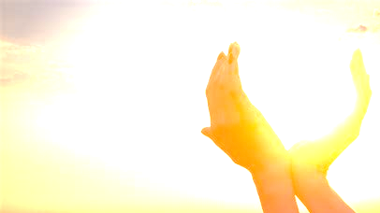
Deuteronomy 28:10-13
¹⁰ And all people of the earth shall see that thou art called by the name of the Lord; and they shall be afraid of thee.
¹¹ And the Lord shall make thee plenteous in goods, in the fruit of thy body, and in the fruit of thy cattle, and in the fruit of thy ground, in the land which the Lord sware unto thy fathers to give thee.
¹² The Lord shall open unto thee his good treasure, the heaven to give the rain unto thy land in his season, and to bless all the work of thine hand: and thou shalt lend unto many nations, and thou shalt not borrow.
¹³ And the Lord shall make thee the head, and not the tail; and thou shalt be above only, and thou shalt not be beneath; if that thou hearken unto the commandments of the Lord thy God, which I command thee this day, to observe and to do them:

Slide 4
Romans 8:16-18
From Lesson 8:
¹⁶ The Spirit itself beareth witness with our spirit, that we are the children of God:
¹⁷ And if children, then heirs; heirs of God, and joint-heirs with Christ; if so be that we suffer with him, that we may be also glorified together.
¹⁸ For I reckon that the sufferings of this present time are not worthy to be compared with the glory which shall be revealed in us.

Slide 5
Praise Always
From Lesson 9:
Philippians 4:4-7
⁴ Rejoice in the Lord always: and again I say, Rejoice.
⁵ Let your moderation be known unto all men. The Lord is at hand.
⁶ Be careful for nothing; but in every thing by prayer and supplication with thanksgiving let your requests be made known unto God.
⁷ And the peace of God, which passeth all understanding, shall keep your hearts and minds through Christ Jesus.

Slide 6
Isaiah 40:27-31
From Lesson 8:
²⁷ Why sayest thou, O Jacob, and speakest, O Israel, My way is hid from the Lord, and my judgment is passed over from my God?
²⁸ Hast thou not known? hast thou not heard, that the everlasting God, the Lord, the Creator of the ends of the earth, fainteth not, neither is weary? there is no searching of his understanding.

Slide 7
Isaiah 40:27-31
From Lesson 8:
²⁹ He giveth power to the faint; and to them that have no might he increaseth strength.
³⁰ Even the youths shall faint and be weary, and the young men shall utterly fall:
³¹ But they that wait upon the Lord shall renew their strength; they shall mount up with wings as eagles; they shall run, and not be weary; and they shall walk, and not faint.

Slide 8
JESUS,
Our Ultimate
Example
²⁸ Come unto me, all ye that labour and are heavy laden, and I will give you rest.
²⁹ Take my yoke upon you, and learn of me; for I am meek and lowly in heart: and ye shall find rest unto your souls.
³⁰ For my yoke is easy, and my burden is light.
From Lesson 10:
MEEKNESS IN UNFAIRNESS:
Matthew 11:28-30

Slide 9
But all this abundance, glory, joy, peace, and power are conditional…
… on dying to self.

Slide 10
Steps to Christ, pg. 43
God's promise is, “Ye shall seek Me, and find Me, when ye shall search for Me with all your heart.” Jeremiah 29:13.
The whole heart must be yielded to God, or the change can never be wrought in us by which we are to be restored to His likeness. By nature we are alienated from God. The Holy Spirit describes our condition in such words as these: “Dead in trespasses and sins;” “the whole head is sick, and the whole heart faint;” “no soundness in it.” We are held fast in the snare of Satan, “taken captive by him at his will.” Ephesians 2:1; Isaiah 1:5, 6; 2 Timothy 2:26.

Slide 11
Steps to Christ, pg. 43
God desires to heal us, to set us free. But since this requires an entire transformation, a renewing of our whole nature, we must yield ourselves wholly to Him. The warfare against self is the greatest battle that was ever fought.
The yielding of self, surrendering all to the will of God, requires a struggle; but the soul must submit to God before it can be renewed in holiness.

Slide 12
Steps to Christ, pg. 44
In giving ourselves to God, we must necessarily give up all that would separate us from Him. Hence the Saviour says, “Whosoever he be of you that forsaketh not all that he hath, he cannot be My disciple.” Luke 14:33. Whatever shall draw away the heart from God must be given up. Mammon is the idol of many. The love of money, the desire for wealth, is the golden chain that binds them to Satan. Reputation and worldly honor are worshiped by another class. The life of selfish ease and freedom from responsibility is the idol of others. But these slavish bands must be broken. We cannot be half the Lord's and half the world's. We are not God's children unless we are such entirely.

Slide 13
Romans 8:11-13
Choices
From Lesson 8:
¹¹ But if the Spirit of him that raised up Jesus from the dead dwell in you, he that raised up Christ from the dead shall also quicken your mortal bodies by his Spirit that dwelleth in you.
¹² Therefore, brethren, we are debtors, not to the flesh, to live after the flesh.
¹³ For if ye live after the flesh, ye shall die: but if ye through the Spirit do mortify the deeds of the body, ye shall live.
Quicken = enliven, make alive

Slide 14
Romans 8:11-13
Choices
From Lesson 8:
Either our sins must die or we must. If they are allowed to live, we shall die. If they are put to death, we shall be saved. The gospel frees us from the condemnation of the law and from the destroying error of attempting to keep the law by our own efforts, but it does not free us from obedience to the will of God. No man can be saved in his sins. SDABC V6 pg. 565-6

Slide 15
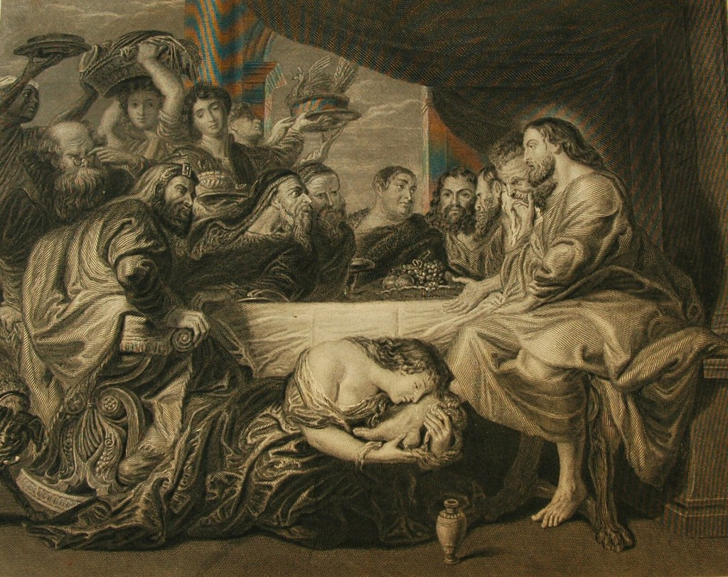
John 12:1-3
Context
12 Then Jesus six days before the passover came to Bethany, where Lazarus was, which had been dead, whom he raised from the dead.
² There they made him a supper; and Martha served: but Lazarus was one of them that sat at the table with him.

Slide 16
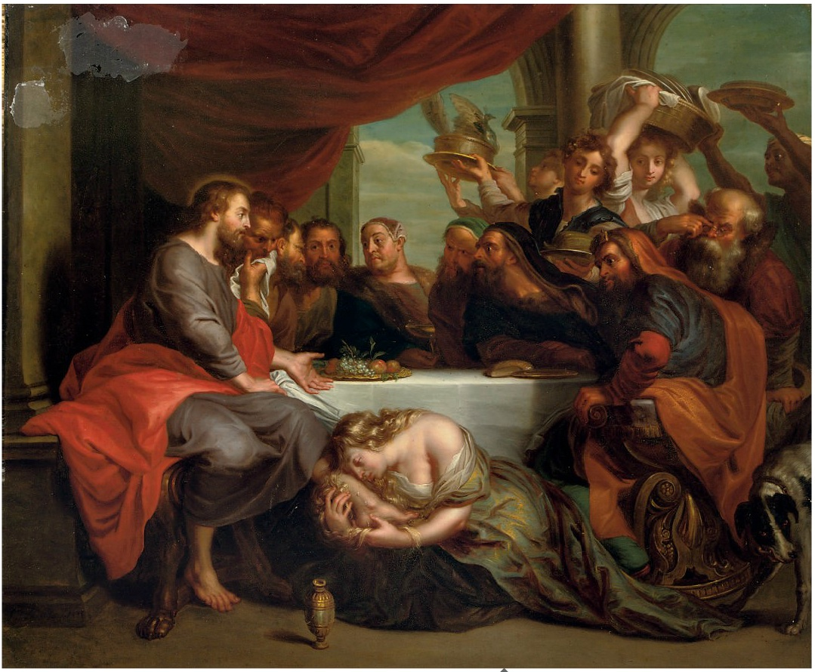
John 12:1-3
Context
³ Then took Mary a pound of ointment of spikenard, very costly, and anointed the feet of Jesus, and wiped his feet with her hair: and the house was filled with the odour of the ointment.
…

Slide 17
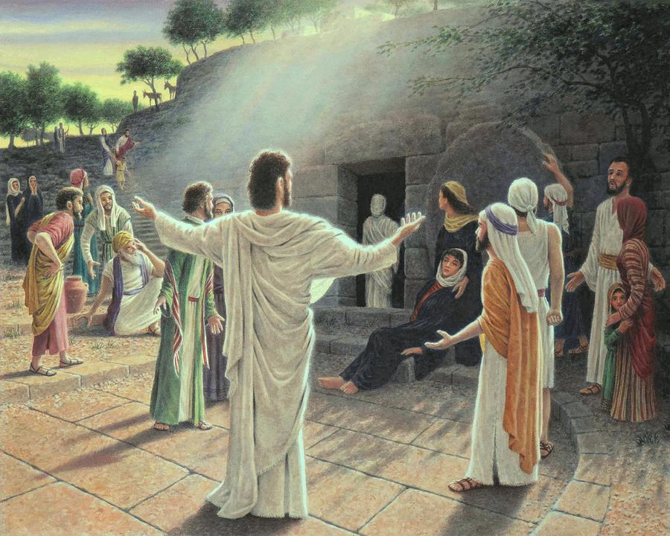
John 12:9-19
Context
⁹ Much people of the Jews therefore knew that he was there: and they came not for Jesus' sake only, but that they might see Lazarus also, whom he had raised from the dead.
¹⁰ But the chief priests consulted that they might put Lazarus also to death;

Slide 18
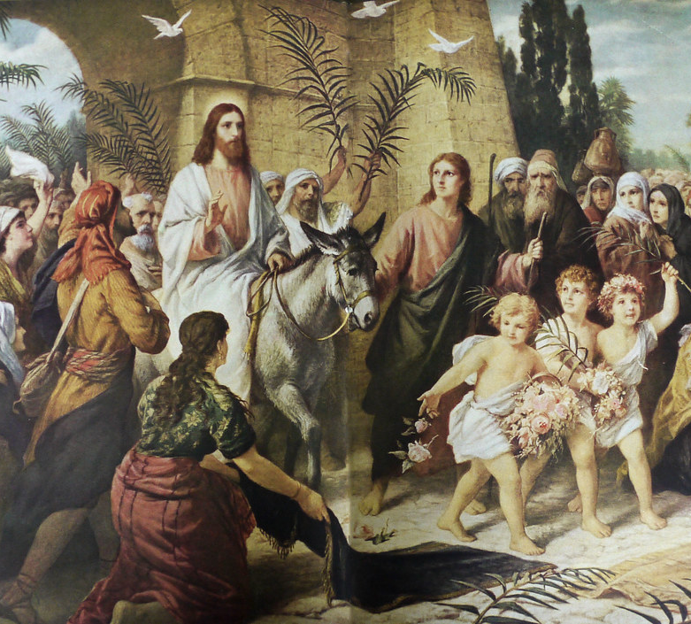
John 12:9-19
Context
¹¹ Because that by reason of him many of the Jews went away, and believed on Jesus.
¹² On the next day much people that were come to the feast, when they heard that Jesus as coming to Jerusalem,
¹³ Took branches of palm trees, and went forth to meet him, and cried, Hosanna: Blessed is the King of Israel that cometh in the name of the Lord.

Slide 19
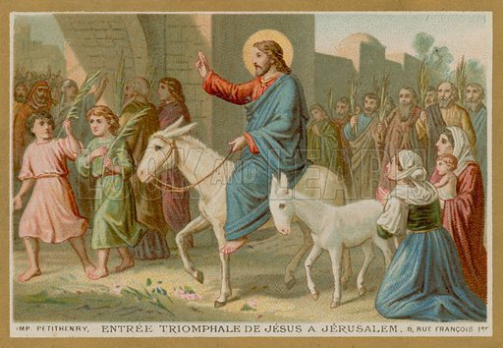
John 12:9-19
Context
¹⁴ And Jesus, when he had found a young ass, sat thereon; as it is written,
¹⁵ Fear not, daughter of Sion: behold, thy King cometh, sitting on an ass's colt.
¹⁶ These things understood not his disciples at the first: but when Jesus was glorified, then remembered they that these things were written of him, and that they had done these things unto him.

Slide 20
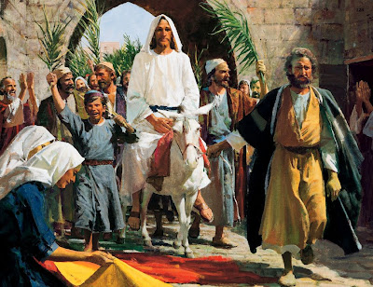
John 12:9-19
Context
¹⁷ The people therefore that was with him when he called Lazarus out of his grave, and raised him from the dead, bare record.
¹⁸ For this cause the people also met him, for that they heard that he had done this miracle.
¹⁹ The Pharisees therefore said among themselves, Perceive ye how ye prevail nothing? behold, the world is gone after him.

Slide 21
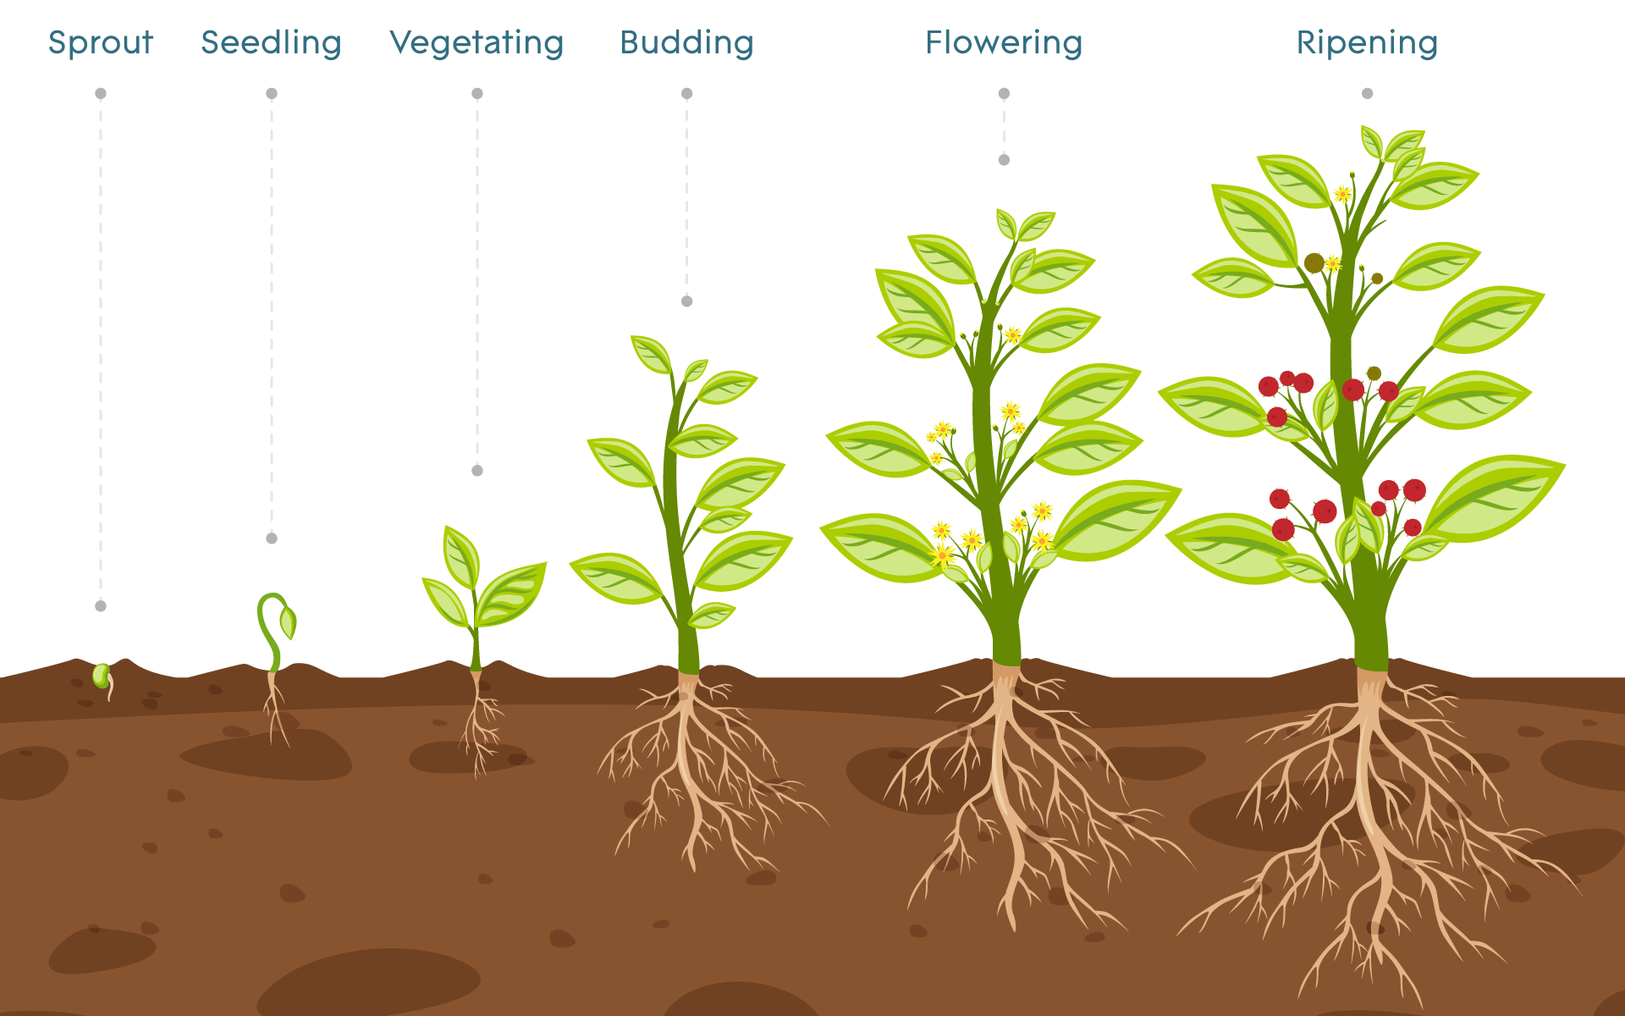
John 12:23-28
Our Example
²³ And Jesus answered them, saying, The hour is come, that the Son of man should be glorified.
²⁴ Verily, verily, I say unto you, Except a corn of wheat fall into the ground and die, it abideth alone: but if it die, it bringeth forth much fruit.

Slide 22
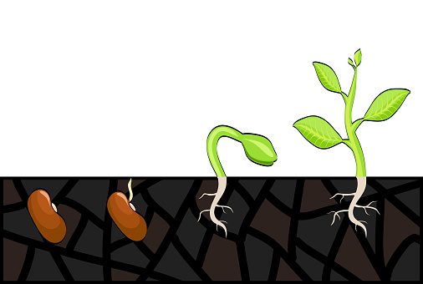
John 12:24
SDABC V5 pg. 1022
A wheat seed placed in the soil dies as a grain of wheat, but life is not destroyed. There is in the seed a germ of life that the dissolution of the seed cannot destroy. In the growth of the new plant the one seed becomes many seeds. However, such multiplication does not take place if the seed is not cast into the ground.

Slide 23
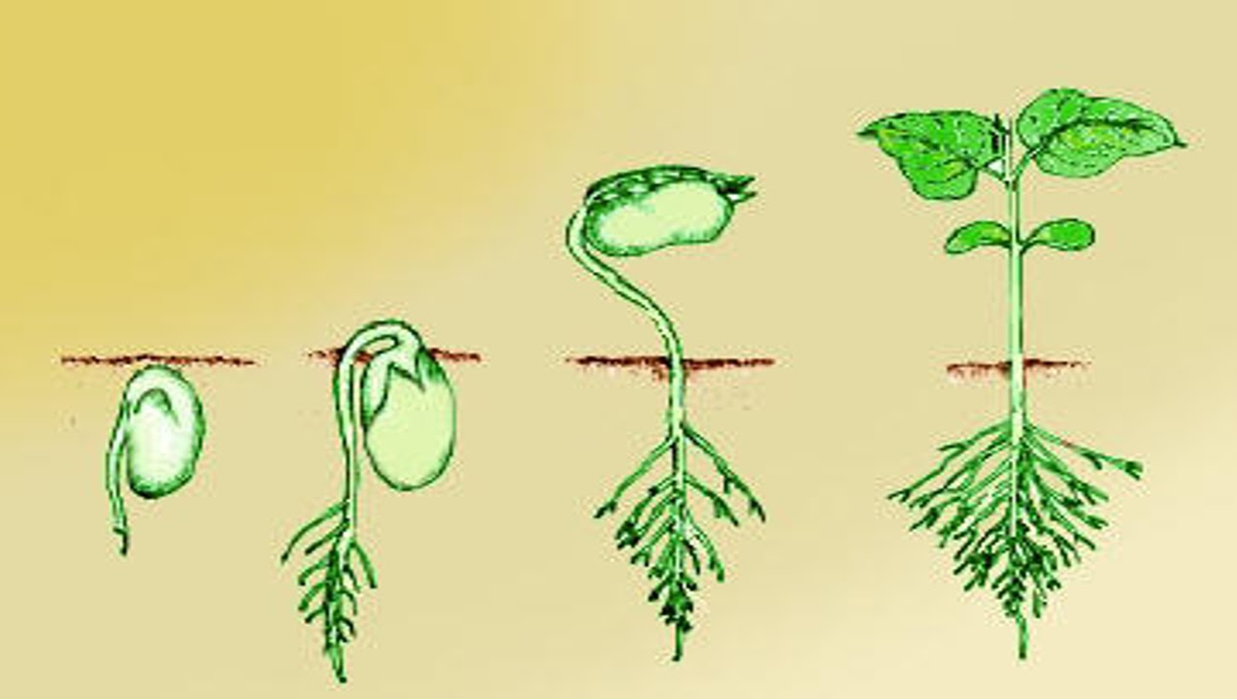
John 12:23-28
Our Example
²⁵ He that loveth his life shall lose it; and he that hateth his life in this world shall keep it unto life eternal.
²⁶ If any man serve me, let him follow me; and where I am, there shall also my servant be: if any man serve me, him will my Father honour.

Slide 24
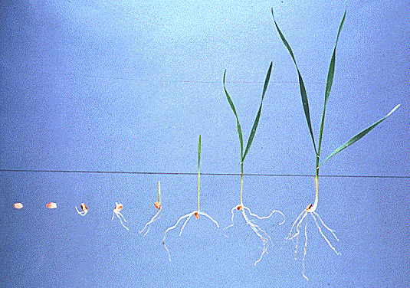
John 12:25
SDABC V5 pg. 1022-3
A person bent on saving and preserving his physical life here will lose his eternal life. He who is willing to sacrifice himself in service for God in this world will preserve his “soul” and enjoy life everlasting in the world to come. Thus the “law of self-sacrifice is the law of self-preservation; “the law of self-serving is the law of destruction” (DA 623-624). He who is ready to cast away everything most dear in this life that stands in the way of his spiritual growth will find at length that he has lost nothing worthwhile and that he has gained the true riches.

Slide 25
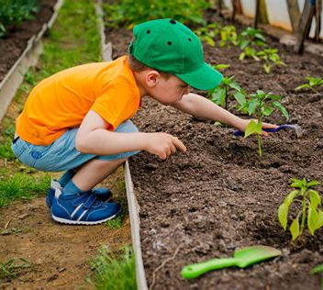
John 12:25
SDABC V5 pg. 1023
The world looks upon the way of self-denial and self-sacrifice as foolishness and waste, even as a small child might regard the casting of good grain into the ground a senseless waste. But the future world will reveal that the devotee of this present world was indeed foolish and the child of God was truly wise.

Slide 26
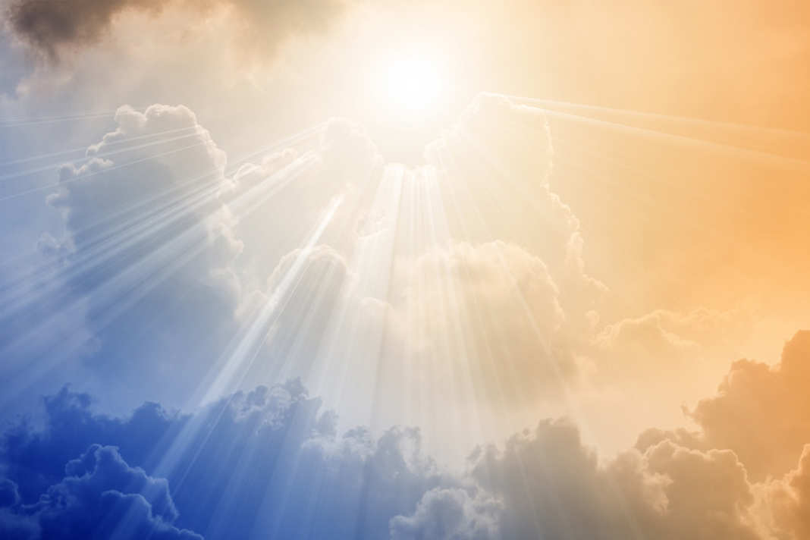
John 12:23-28
Our Example
²⁷ Now is my soul troubled; and what shall I say? Father, save me from this hour: but for this cause came I unto this hour.
²⁸ Father, glorify thy name. Then came there a voice from heaven, saying, I have both glorified it, and will glorify it again.

Slide 27
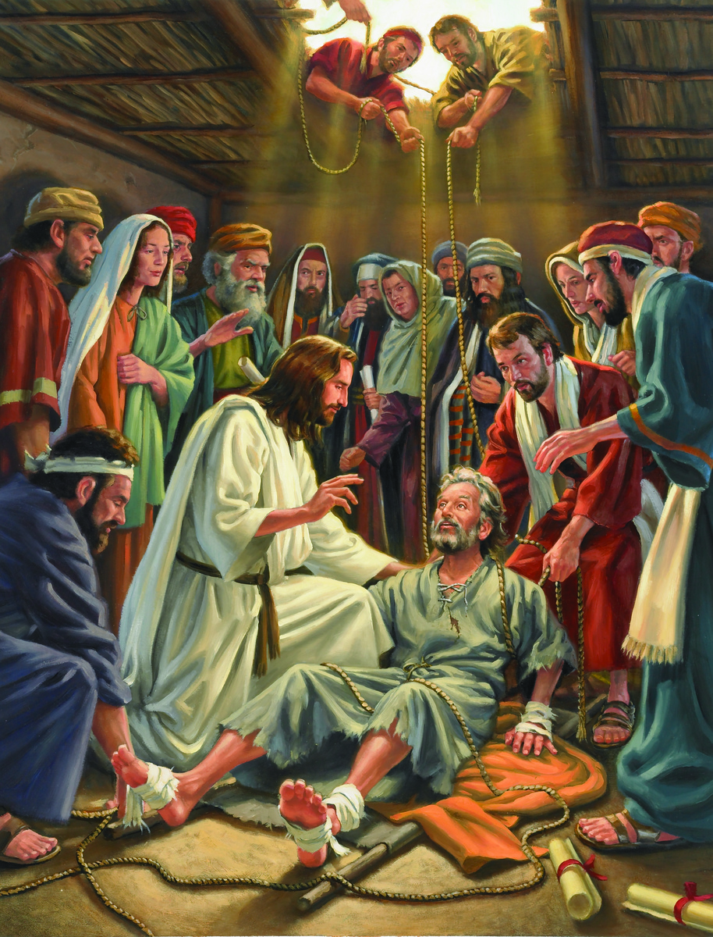
Philippians 2:3-11
Practical Crucifixion of Self
³ Let nothing be done through strife or vainglory; but in lowliness of mind let each esteem other better than themselves.
⁴ Look not every man on his own things, but every man also on the things of others.

Slide 28
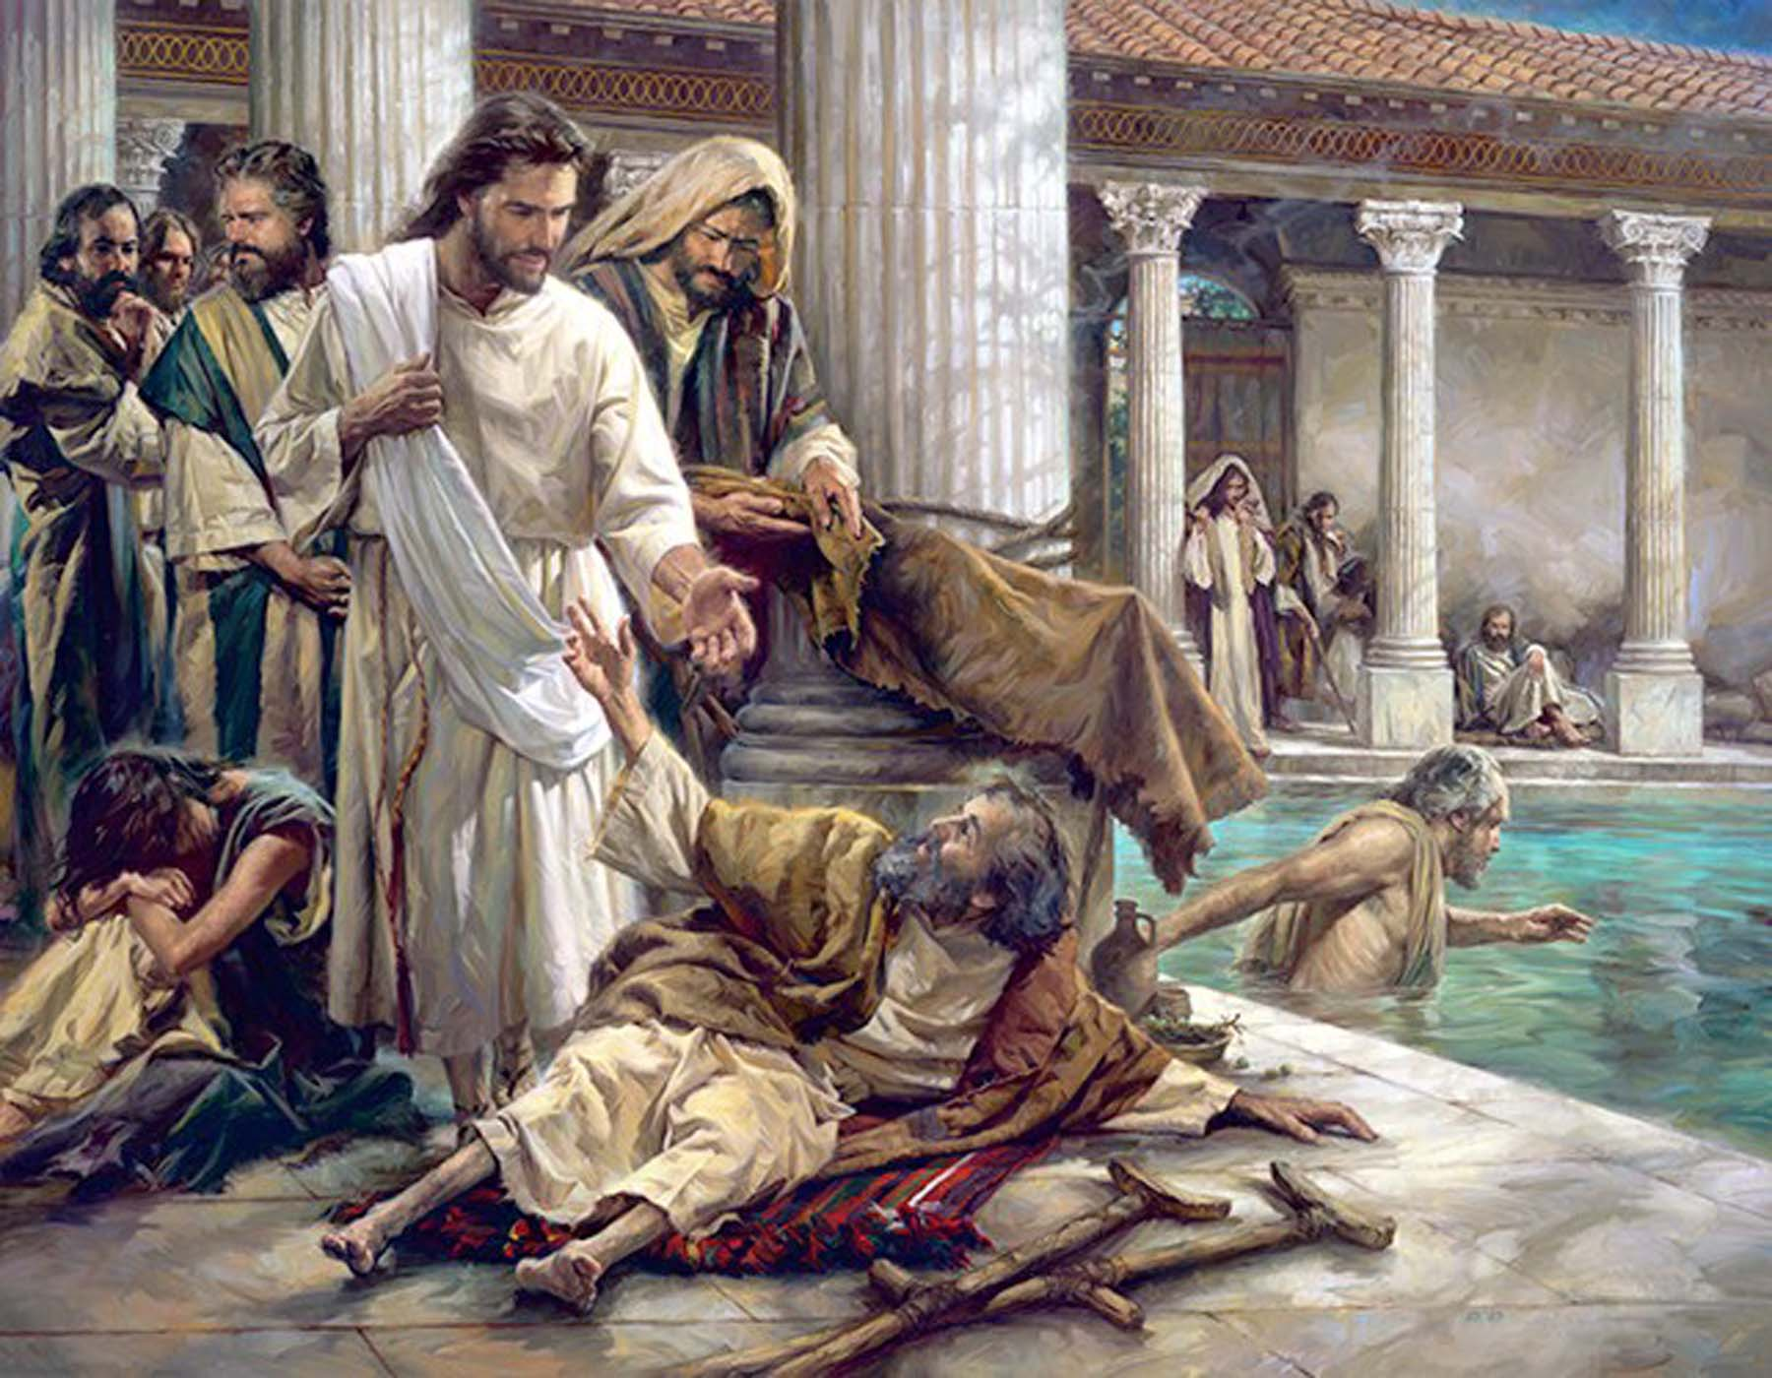
Philippians 2:3-11
Practical Crucifixion of Self
⁵ Let this mind be in you, which was also in Christ Jesus:
⁶ Who, being in the form of God, thought it not robbery to be equal with God:
⁷ But made himself of no reputation, and took upon him the form of a servant, and was made in the likeness of men:

Slide 29
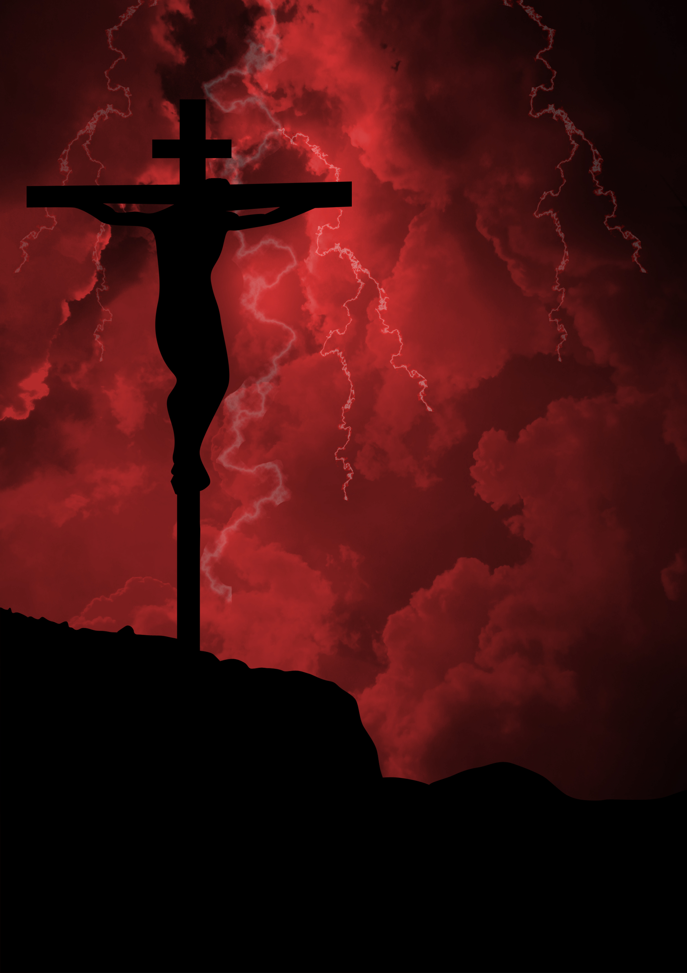
Philippians 2:3-11
Practical Crucifixion of Self
⁸ And being found in fashion as a man, he humbled himself, and became obedient unto death, even the death of the cross.
⁹ Wherefore God also hath highly exalted him, and given him a name which is above every name:

Slide 30
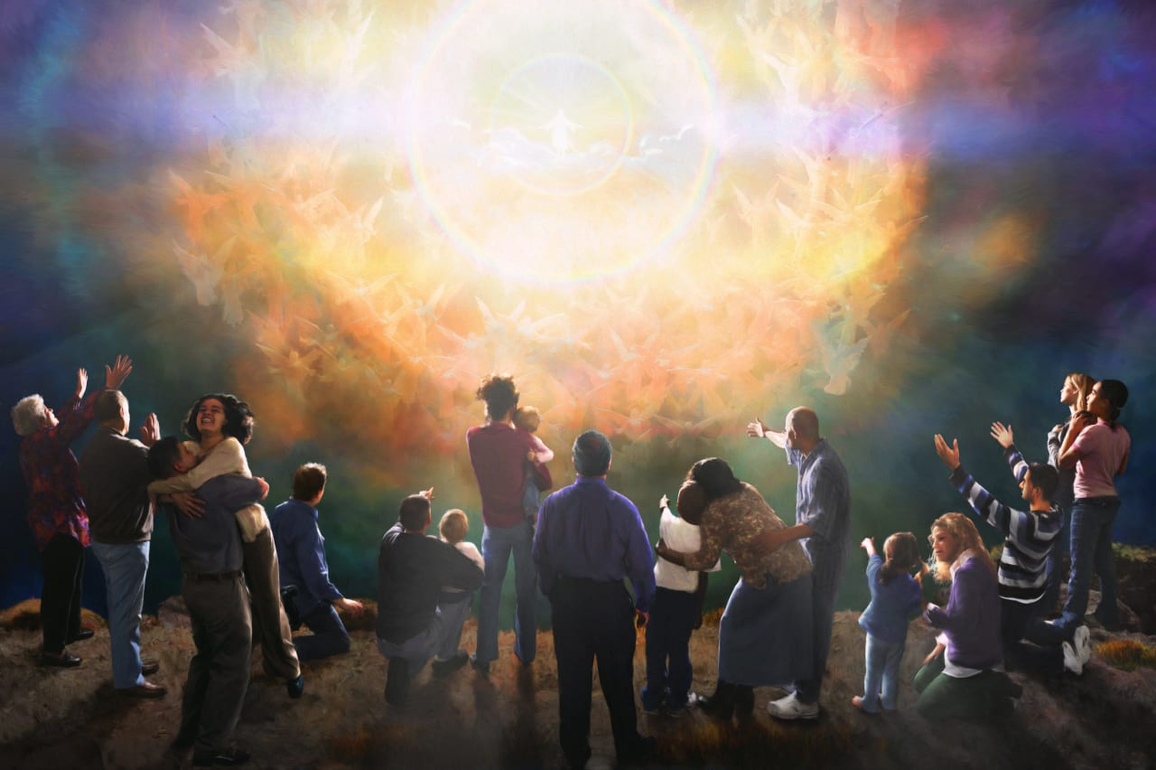
Philippians 2:3-11
Practical Crucifixion of Self
¹⁰ That at the name of Jesus every knee should bow, of things in heaven, and things in earth, and things under the earth;
¹¹ And that every tongue should confess that Jesus Christ is Lord, to the glory of God the Father.

Slide 31
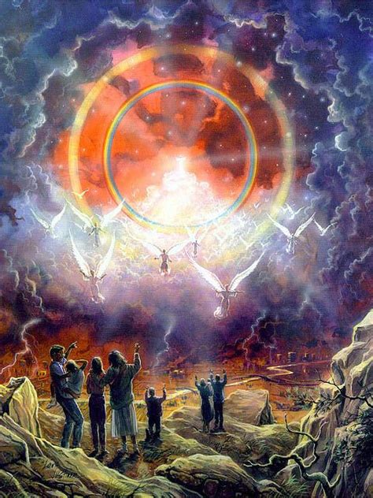
Philippians 3:8-9
Practical Crucifixion of Self
⁸ Yea doubtless, and I count all things but loss for the excellency of the knowledge of Christ Jesus my Lord: for whom I have suffered the loss of all things, and do count them but dung, that I may win Christ,
⁹ And be found in him, not having mine own righteousness, which is of the law, but that which is through the faith of Christ, the righteousness which is of God by faith:

Slide 32
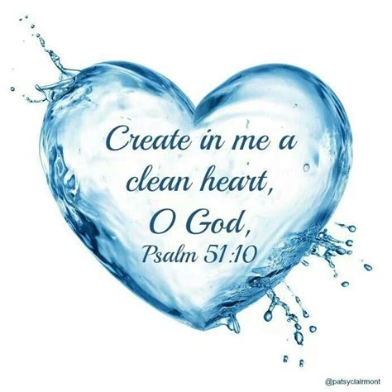
Romans 12:1-3
An appeal
12 I beseech you therefore, brethren, by the mercies of God, that ye present your bodies a living sacrifice, holy, acceptable unto God, which is your reasonable service.
² And be not conformed to this world: but be ye transformed by the renewing of your mind, that ye may prove what is that good, and acceptable, and perfect, will of God.
³ For I say, through the grace given unto me, to every man that is among you, not to think of himself more highly than he ought to think; but to think soberly, according as God hath dealt to every man the measure of faith.

Slide 33
Steps to Christ, pg. 47
REAL DIRECTIONS
Many are inquiring, “How am I to make the surrender of myself to God?” You desire to give yourself to Him, but you are weak in moral power, in slavery to doubt, and controlled by the habits of your life of sin. Your promises and resolutions are like ropes of sand. You cannot control your thoughts, your impulses, your affections. The knowledge of your broken promises and forfeited pledges weakens your confidence in your own sincerity, and causes you to feel that God cannot accept you; but you need not despair. What you need to understand is the true force of the will. This is the governing power in the nature of man, the power of decision, or of choice.

Slide 34
Steps to Christ, pg. 47
REAL DIRECTIONS
Everything depends on the right action of the will. The power of choice God has given to men; it is theirs to exercise. You cannot change your heart, you cannot of yourself give to God its affections; but you can choose to serve Him. You can give Him your will; He will then work in you to will and to do according to His good pleasure. Thus your whole nature will be brought under the control of the Spirit of Christ; your affections will be centered upon Him, your thoughts will be in harmony with Him.

Slide 35


Slide 36
Steps to Christ, pg. 47
REAL DIRECTIONS
Desires for goodness and holiness are right as far as they go; but if you stop here, they will avail nothing. Many will be lost while hoping and desiring to be Christians. They do not come to the point of yielding the will to God. They do not now choose to be Christians.
Through the right exercise of the will, an entire change may be made in your life. By yielding up your will to Christ, you ally yourself with the power that is above all principalities and powers. You will have strength from above to hold you steadfast, and thus through constant surrender to God you will be enabled to live the new life, even the life of faith.

Slide 37
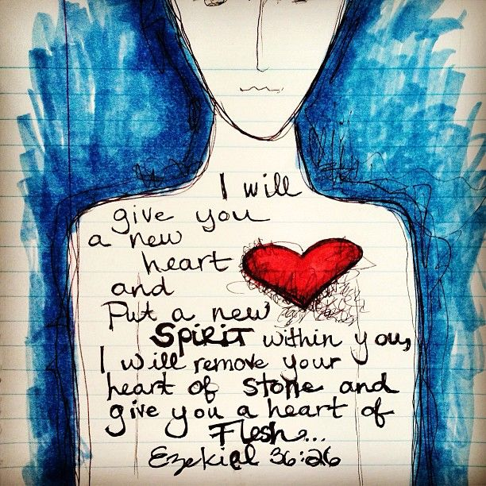
Steps to Christ, pg. 49
REAL DIRECTIONS
You have confessed your sins, and in heart put them away. You have resolved to give yourself to God. Now go to Him, and ask that He will wash away your sins and give you a new heart. Then believe that He does this because He has promised. This is the lesson which Jesus taught while He was on earth, that the gift which God promises us, we must believe we do receive, and it is ours.

Slide 38
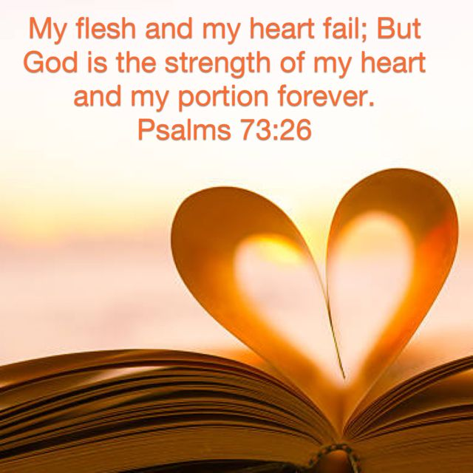
Steps to Christ, pg. 52
REAL DIRECTIONS
Now that you have given yourself to Jesus, do not draw back, do not take yourself away from Him, but day by day say, “I am Christ's; I have given myself to Him;” and ask Him to give you His Spirit and keep you by His grace. As it is by giving yourself to God, and believing Him, that you become His child, so you are to live in Him. The apostle says, “As ye have therefore received Christ Jesus the Lord, so walk ye in Him.” Colossians 2:6.

Slide 39
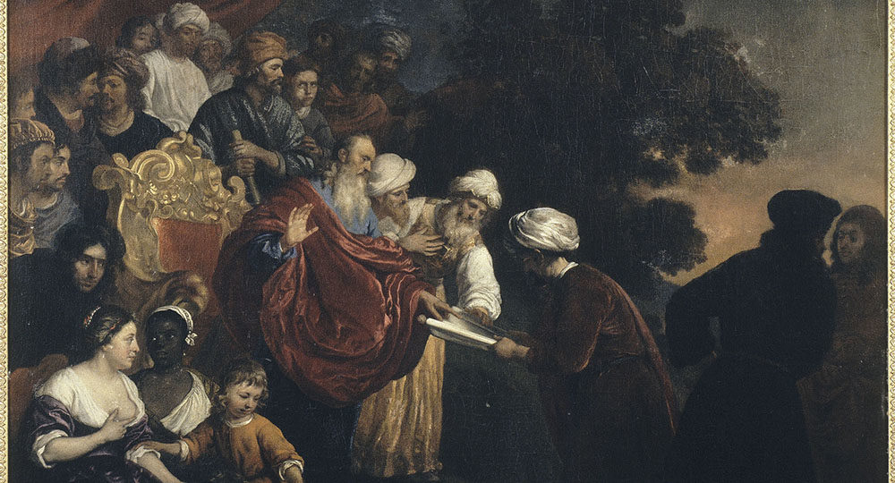
Ezra 3:8
An Example: Overcomers
⁸ Now in the second year of their coming unto the house of God at Jerusalem, in the second month, began Zerubbabel the son of Shealtiel, and Jeshua the son of Jozadak, and the remnant of their brethren the priests and the Levites, and all they that were come out of the captivity unto Jerusalem; and appointed the Levites, from twenty years old and upward, to set forward the work of the house of the Lord.

Slide 40
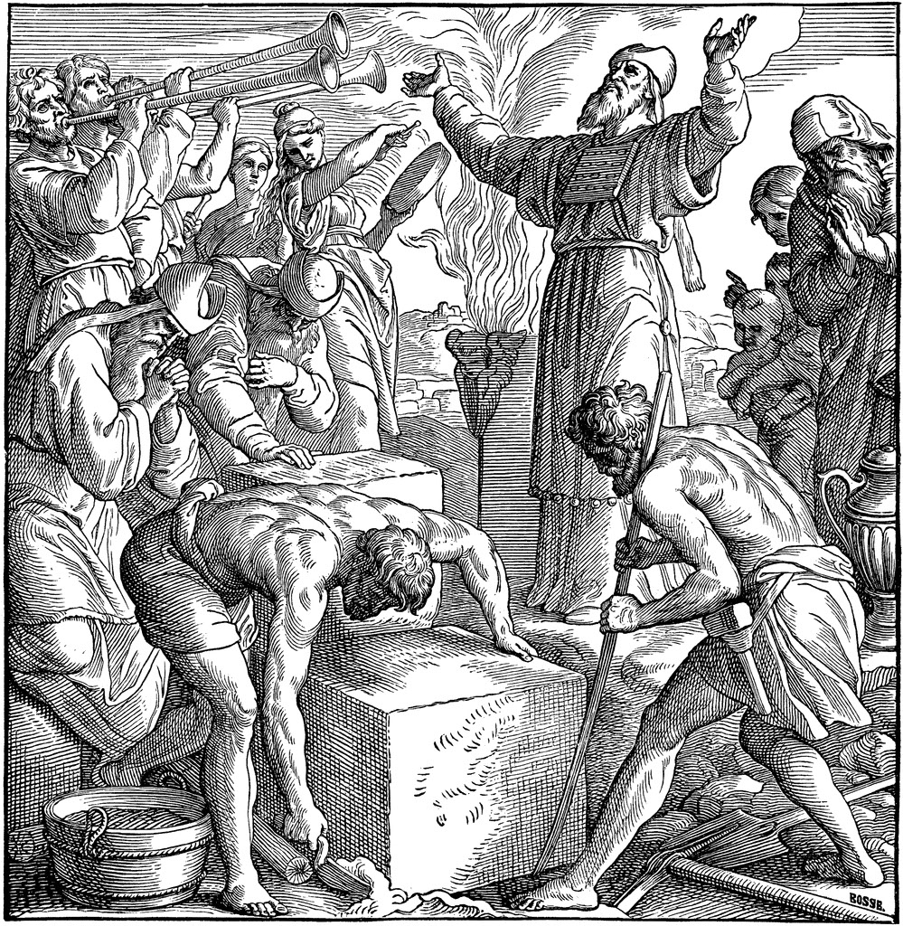
Ezra 4:1-16
An Example: Overcomers
4 Now when the adversaries of Judah and Benjamin heard that the children of the captivity builded the temple unto the Lord God of Israel;
² Then they came to Zerubbabel, and to the chief of the fathers, and said unto them, Let us build with you: for we seek your God, as ye do; and we do sacrifice unto him since the days of Esarhaddon king of Assur, which brought us up hither.

Slide 41
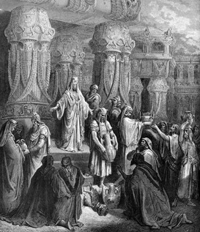
Ezra 4:1-16
An Example: Overcomers
³ But Zerubbabel, and Jeshua, and the rest of the chief of the fathers of Israel, said unto them, Ye have nothing to do with us to build an house unto our God; but we ourselves together will build unto the Lord God of Israel, as king Cyrus the king of Persia hath commanded us.

Slide 42
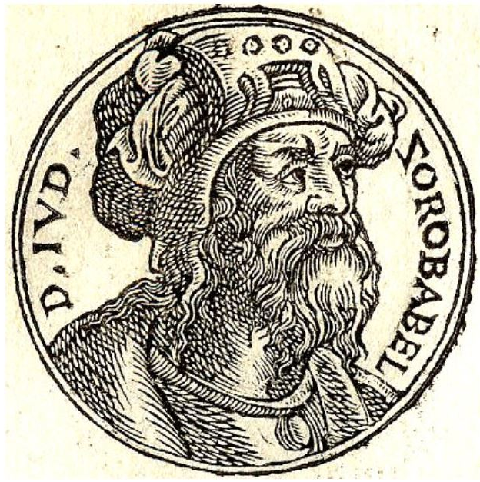
Ezra 4:1-16 (Trouble)
An Example: Overcomers
⁴ Then the people of the land weakened the hands of the people of Judah, and troubled them in building,
⁵ And hired counsellors against them, to frustrate their purpose, all the days of Cyrus king of Persia, even until the reign of Darius king of Persia.
⁶ And in the reign of Ahasuerus, in the beginning of his reign, wrote they unto him an accusation against the inhabitants of Judah and Jerusalem.

Slide 43
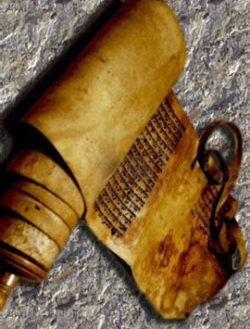
Ezra 4:1-16 (The Letter of Complaint)
An Example: Overcomers
⁷ And in the days of Artaxerxes wrote Bishlam, Mithredath, Tabeel, and the rest of their companions, unto Artaxerxes king of Persia; and the writing of the letter was written in the Syrian tongue, and interpreted in the Syrian tongue.
⁸ Rehum the chancellor and Shimshai the scribe wrote a letter against Jerusalem to Artaxerxes the king in this sort:
⁹ Then wrote Rehum the chancellor, and Shimshai the scribe, and the rest of their companions; the Dinaites, the Apharsathchites, the Tarpelites, the Apharsites, the Archevites, the Babylonians, the Susanchites, the Dehavites, and the Elamites,

Slide 44
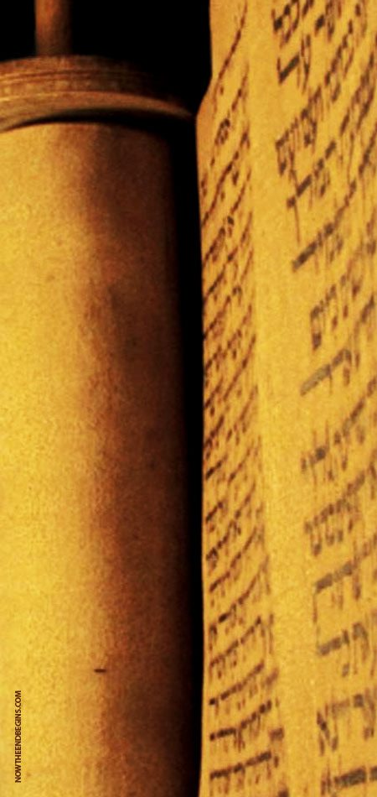
Ezra 4:1-16 (The Letter of Complaint)
An Example: Overcomers
¹⁰ And the rest of the nations whom the great and noble Asnapper brought over, and set in the cities of Samaria, and the rest that are on this side the river, and at such a time.
¹¹ This is the copy of the letter that they sent unto him, even unto Artaxerxes the king; Thy servants the men on this side the river, and at such a time.
¹² Be it known unto the king, that the Jews which came up from thee to us are come unto Jerusalem, building the rebellious and the bad city, and have set up the walls thereof, and joined the foundations.

Slide 45
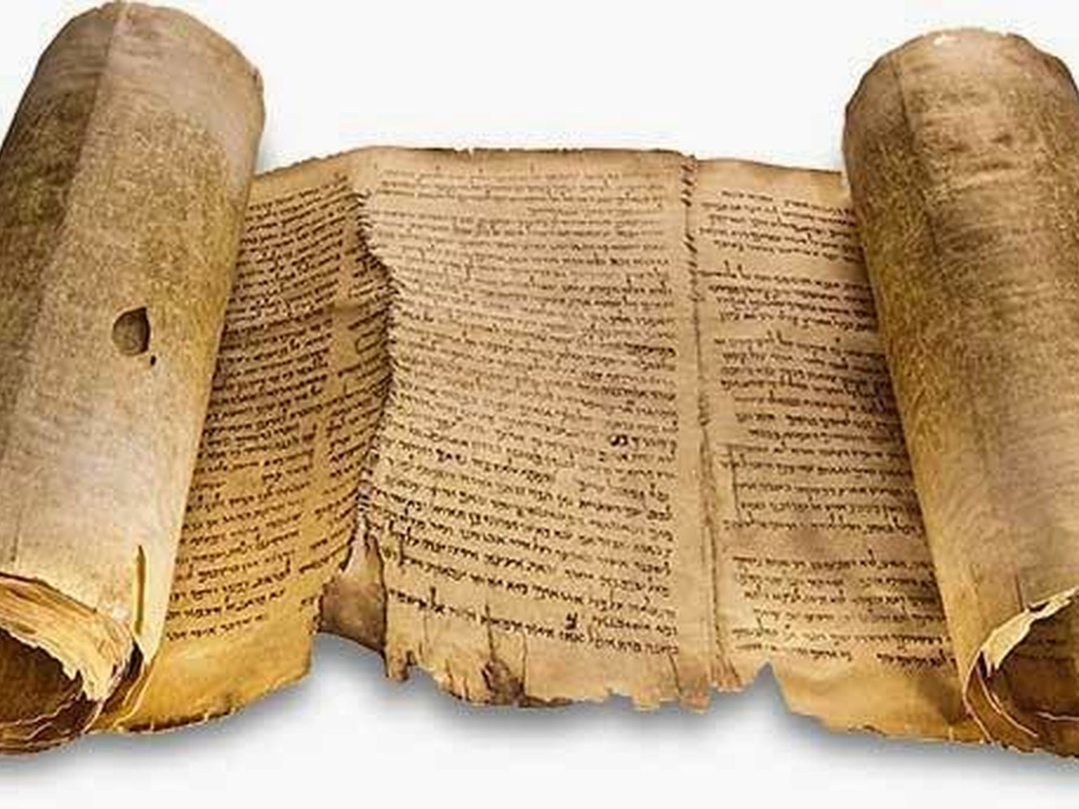
Ezra 4:1-16 (The Letter of Complaint)
An Example: Overcomers
¹³ Be it known now unto the king, that, if this city be builded, and the walls set up again, then will they not pay toll, tribute, and custom, and so thou shalt endamage the revenue of the kings.
¹⁴ Now because we have maintenance from the king's palace, and it was not meet for us to see the king's dishonour, therefore have we sent and certified the king;

Slide 46
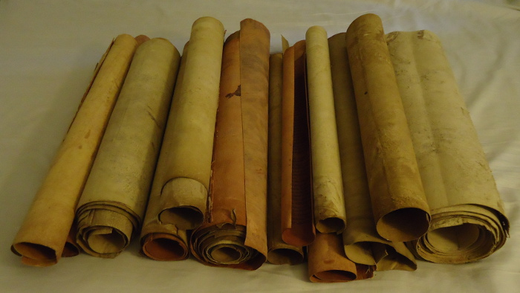
Ezra 4:1-16 (The Letter of Complaint)
An Example: Overcomers
¹⁵ That search may be made in the book of the records of thy fathers: so shalt thou find in the book of the records, and know that this city is a rebellious city, and hurtful unto kings and provinces, and that they have moved sedition within the same of old time: for which cause was this city destroyed.
¹⁶ We certify the king that, if this city be builded again, and the walls thereof set up, by this means thou shalt have no portion on this side the river.

Slide 47
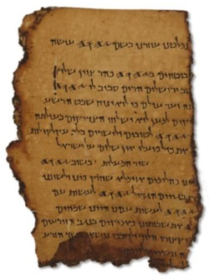
Ezra 4:21-24 (Artaxerxes’ answer)
An Example: Overcomers
²¹ Give ye now commandment to cause these men to cease, and that this city be not builded, until another commandment shall be given from me.
²² Take heed now that ye fail not to do this: why should damage grow to the hurt of the kings?

Slide 48
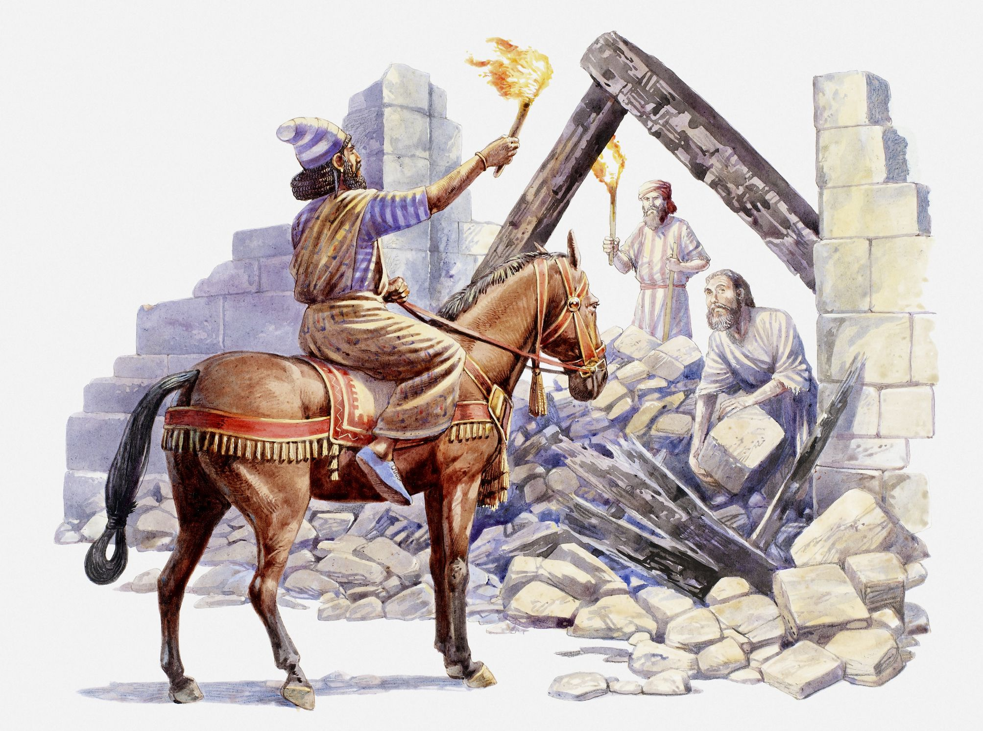
Ezra 4:21-24 (Interference)
An Example: Overcomers
²³ Now when the copy of king Artaxerxes' letter was read before Rehum, and Shimshai the scribe, and their companions, they went up in haste to Jerusalem unto the Jews, and made them to cease by force and power.
²⁴ Then ceased the work of the house of God which is at Jerusalem. So it ceased unto the second year of the reign of Darius king of Persia.

Slide 49
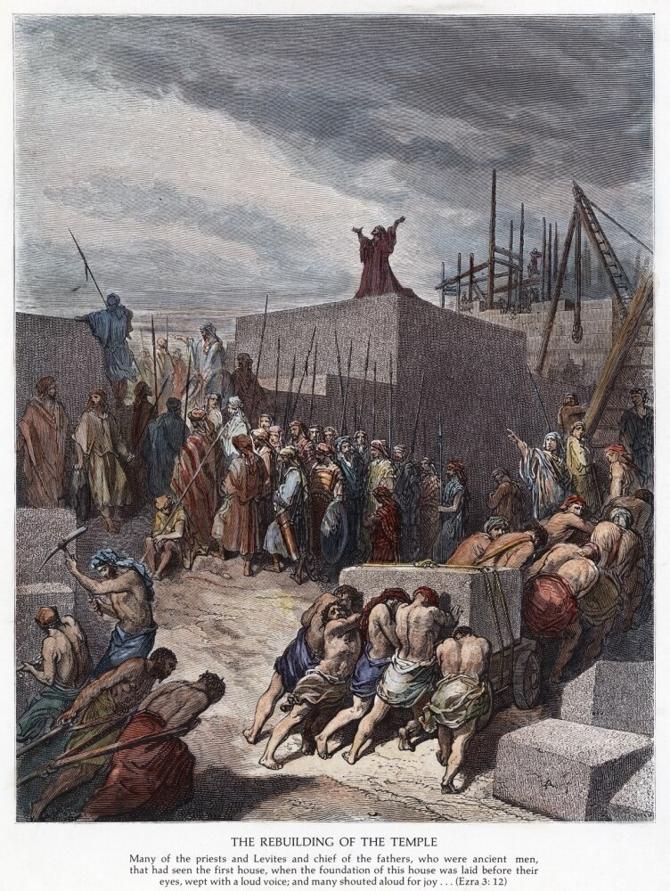
Ezra 5:1-5 (Making Progress)
An Example: Overcomers
5 Then the prophets, Haggai the prophet, and Zechariah the son of Iddo, prophesied unto the Jews that were in Judah and Jerusalem in the name of the God of Israel, even unto them.
² Then rose up Zerubbabel the son of Shealtiel, and Jeshua the son of Jozadak, and began to build the house of God which is at Jerusalem: and with them were the prophets of God helping them.

Slide 50
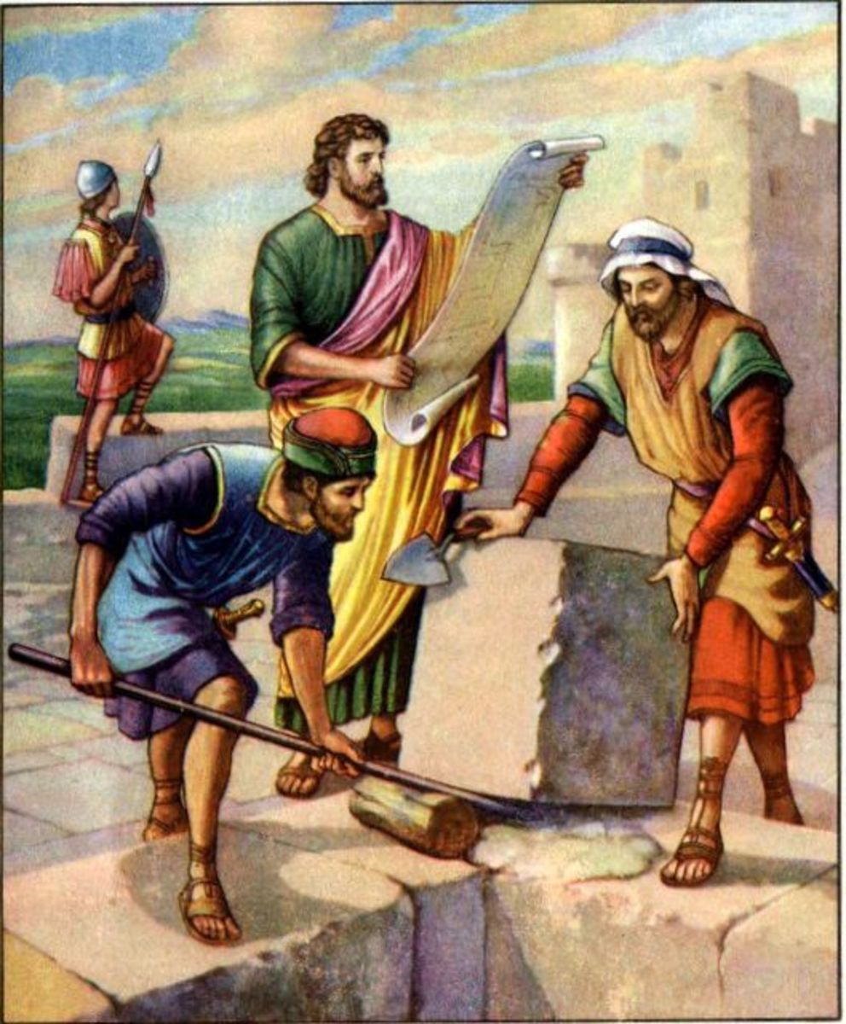
Ezra 5:1-5 (Making Progress)
An Example: Overcomers
³ At the same time came to them Tatnai, governor on this side the river, and Shetharboznai and their companions, and said thus unto them, Who hath commanded you to build this house, and to make up this wall?
⁴ Then said we unto them after this manner, What are the names of the men that make this building?
⁵ But the eye of their God was upon the elders of the Jews, that they could not cause them to cease, till the matter came to Darius: and then they returned answer by letter concerning this matter.

Slide 51
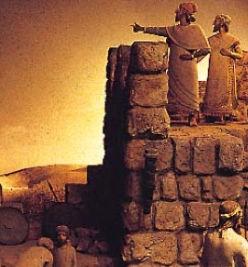
Zechariah 4:6-10
An Example: Overcomers
⁶ Then he answered and spake unto me, saying, This is the word of the Lord unto Zerubbabel, saying, Not by might, nor by power, but by my spirit, saith the Lord of hosts.
⁷ Who art thou, O great mountain? before Zerubbabel thou shalt become a plain: and he shall bring forth the headstone thereof with shoutings, crying, Grace, grace unto it.

Slide 52
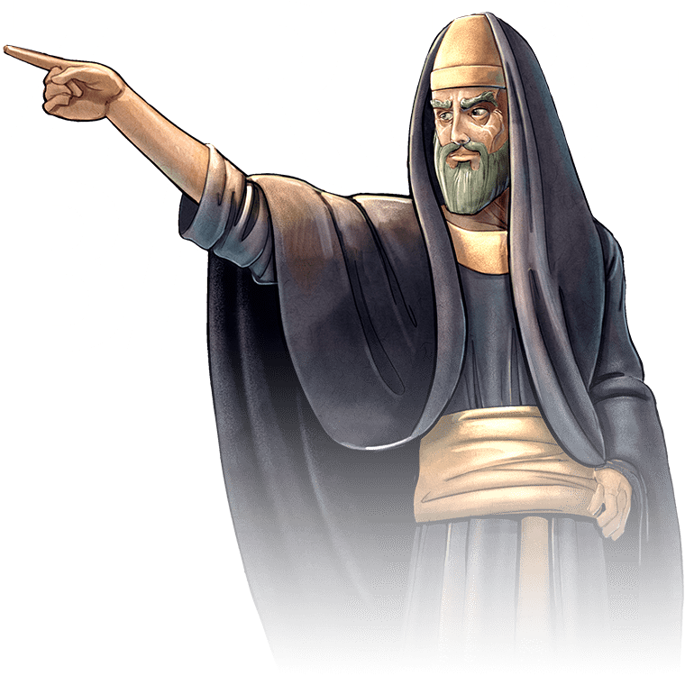
Zechariah 4:6-10
An Example: Overcomers
⁸ Moreover the word of the Lord came unto me, saying,
⁹ The hands of Zerubbabel have laid the foundation of this house; his hands shall also finish it; and thou shalt know that the Lord of hosts hath sent me unto you.
¹⁰ For who hath despised the day of small things? for they shall rejoice, and shall see the plummet in the hand of Zerubbabel with those seven; they are the eyes of the Lord, which run to and fro through the whole earth.

Slide 53
Overcomers
Divine grace alone could overcome all the obstacles that confronted the rebuilders of Jerusalem. Zerubbabel and his companions were depressed by their feeble ability and scant resources to carry on the work of restoration against the opposition of their enemies. The vision showed that God’s purposes for Israel would not be attained by human “might” or “power” but by His own Spirit and His own power. SDABC V4 pg. 1094
But the Zerubbabel and company still had to put forth the effort and work at the task given them! There’s a relationship here between human will and divine power. And this isn’t the only example of it!

Slide 54
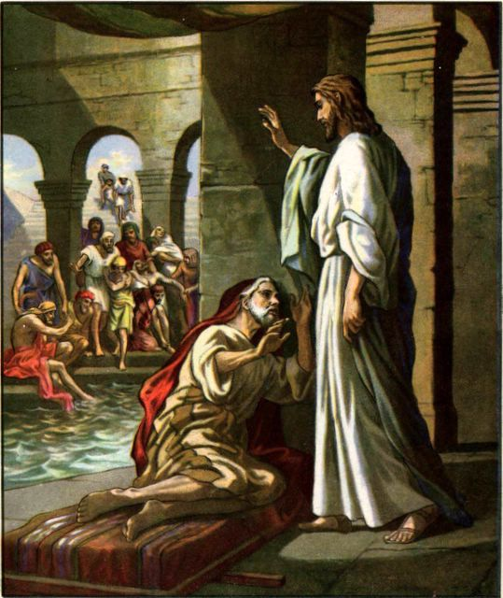
Steps to Christ, pg. 50
Blessed Assurance
Let us turn to the story of the paralytic at Bethesda. The poor sufferer was helpless; he had not used his limbs for thirty-eight years. Yet Jesus bade him, “Rise, take up thy bed, and walk.” The sick man might have said, “Lord, if Thou wilt make me whole, I will obey Thy word.” But, no, he believed Christ's word, believed that he was made whole, and he made the effort at once; he willed to walk, and he did walk. He acted on the word of Christ, and God gave the power. He was made whole.

Slide 55
Steps to Christ, pg. 51
Blessed Assurance
In like manner you are a sinner. You cannot atone for your past sins; you cannot change your heart and make yourself holy. But God promises to do all this for you through Christ. You believe that promise. You confess your sins and give yourself to God. You will to serve Him. Just as surely as you do this, God will fulfill His word to you. If you believe the promise,—believe that you are forgiven and cleansed,—God supplies the fact; you are made whole, just as Christ gave the paralytic power to walk when the man believed that he was healed. It is so if you believe it.
Do not wait to feel that you are made whole, but say, “I believe it; it is so, not because I feel it, but because God has promised.”

Slide 56

Steps to Christ, pg. 52
Blessed Assurance
Here is where thousands fail; they do not believe that Jesus pardons them personally, individually. They do not take God at His word. It is the privilege of all who comply with the conditions to know for themselves that pardon is freely extended for every sin. Put away the suspicion that God's promises are not meant for you. They are for every repentant transgressor.

Slide 57
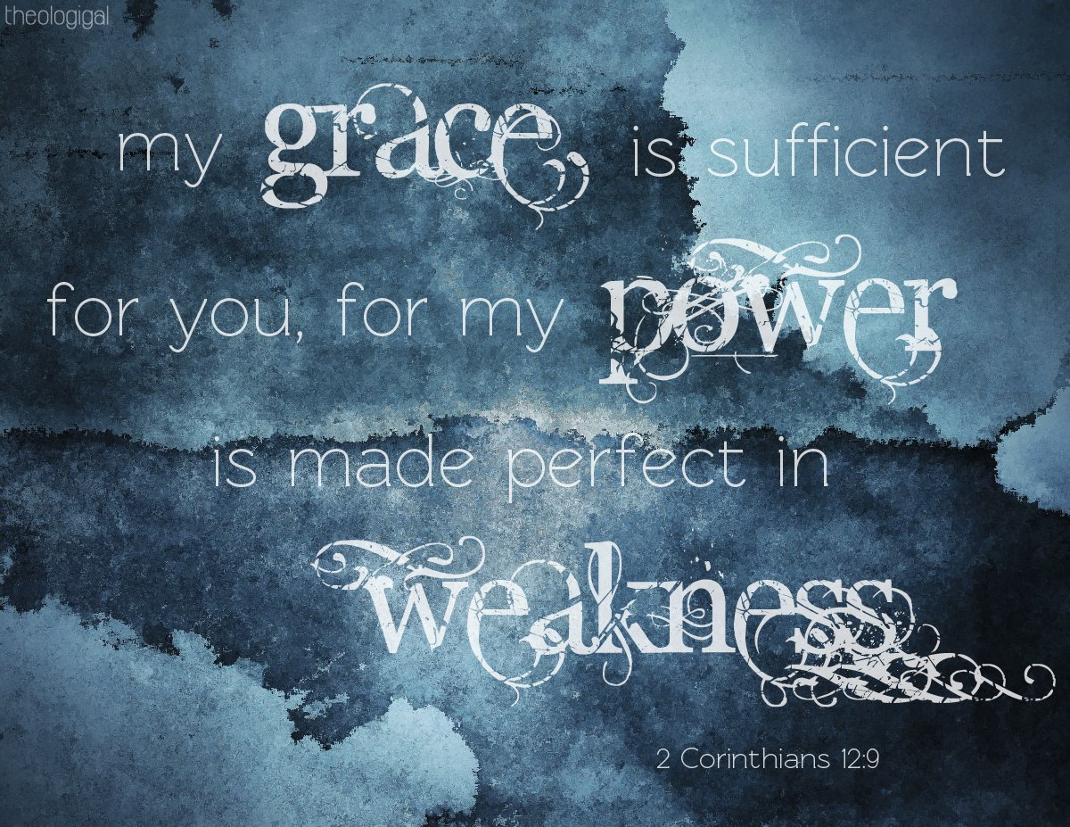
Steps to Christ, pg. 52
Blessed Assurance
Strength and grace have been provided through Christ to be brought by ministering angels to every believing soul. None are so sinful that they cannot find strength, purity, and righteousness in Jesus, who died for them. He is waiting to strip them of their garments stained and polluted with sin, and to put upon them the white robes of righteousness; He bids them live and not die.

Slide 58
Thank you!
Happy Sabbath!

