Slide 1
Rejection and Rejoicing
Isaiah 53, Luke 4, James 5
Lesson 13, 3rd Quarter, 2022

Slide 2
Isaiah 53:1-3
53 Who hath believed our report? and to whom is the arm of the Lord revealed?
² For he shall grow up before him as a tender plant, and as a root out of a dry ground: he hath no form nor comeliness; and when we shall see him, there is no beauty that we should desire him.
³ He is despised and rejected of men; a man of sorrows, and acquainted with grief: and we hid as it were our faces from him; he was despised, and we esteemed him not.

Slide 3
Isaiah 53:4-6
⁴ Surely he hath borne our griefs, and carried our sorrows: yet we did esteem him stricken, smitten of God, and afflicted.
⁵ But he was wounded for our transgressions, he was bruised for our iniquities: the chastisement of our peace was upon him; and with his stripes we are healed.
⁶ All we like sheep have gone astray; we have turned every one to his own way; and the Lord hath laid on him the iniquity of us all.

Slide 4
Isaiah 53:7-8
⁷ He was oppressed, and he was afflicted, yet he opened not his mouth: he is brought as a lamb to the slaughter, and as a sheep before her shearers is dumb, so he openeth not his mouth.
⁸ He was taken from prison and from judgment: and who shall declare his generation? for he was cut off out of the land of the living: for the transgression of my people was he stricken.

Slide 5
Isaiah 53:9-11
⁹ And he made his grave with the wicked, and with the rich in his death; because he had done no violence, neither was any deceit in his mouth.
¹⁰ Yet it pleased the Lord to bruise him; he hath put him to grief: when thou shalt make his soul an offering for sin, he shall see his seed, he shall prolong his days, and the pleasure of the Lord shall prosper in his hand.
¹¹ He shall see of the travail of his soul, and shall be satisfied: by his knowledge shall my righteous servant justify many; for he shall bear their iniquities.

Slide 6
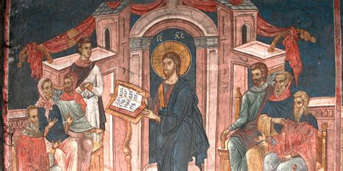
Luke 4:14-16
¹⁴ And Jesus returned in the power of the Spirit into Galilee: and there went out a fame of him through all the region round about.
¹⁵ And he taught in their synagogues, being glorified of all.
¹⁶ And he came to Nazareth, where he had been brought up: and, as his custom was, he went into the synagogue on the sabbath day, and stood up for to read.

Slide 7
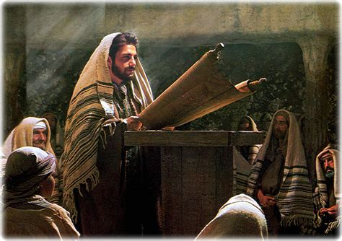
Luke 4:21-22
²¹ And he began to say unto them, This day is this scripture fulfilled in your ears.
²² And all bare him witness, and wondered at the gracious words which proceeded out of his mouth. And they said, Is not this Joseph's son?

Slide 8
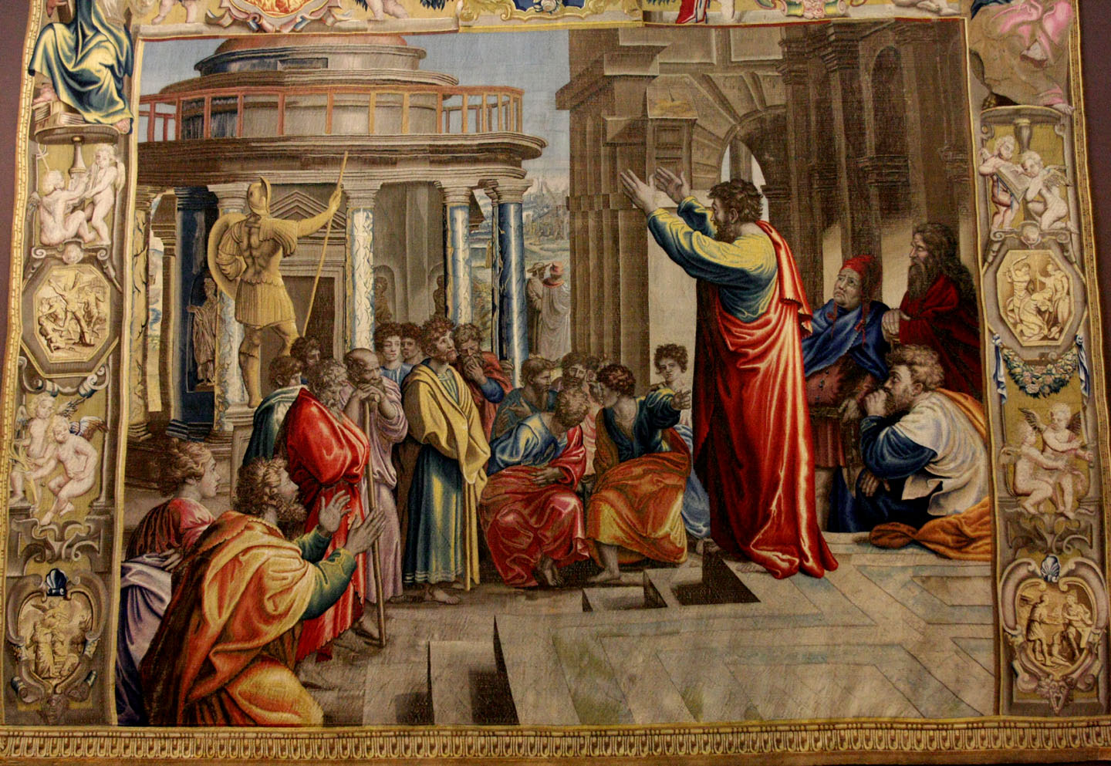
Luke 4:23-24
²³ And he said unto them, Ye will surely say unto me this proverb, Physician, heal thyself: whatsoever we have heard done in Capernaum, do also here in thy country.
²⁴ And he said, Verily I say unto you, No prophet is accepted in his own country.

Slide 9
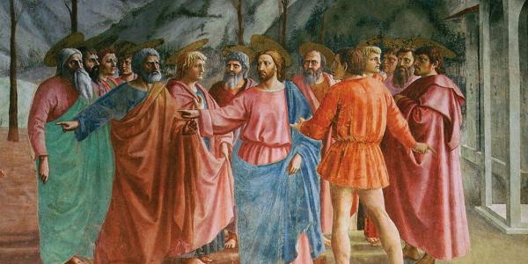
Luke 4:28-29
²⁸ And all they in the synagogue, when they heard these things, were filled with wrath,
²⁹ And rose up, and thrust him out of the city, and led him unto the brow of the hill whereon their city was built, that they might cast him down headlong.

Slide 10
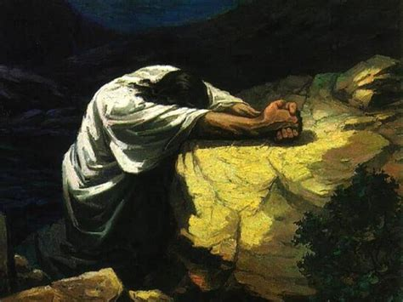
Matthew 26:38-39
³⁸ Then saith he unto them, My soul is exceeding sorrowful, even unto death: tarry ye here, and watch with me.
³⁹ And he went a little farther, and fell on his face, and prayed, saying, O my Father, if it be possible, let this cup pass from me: nevertheless not as I will, but as thou wilt.

Slide 11
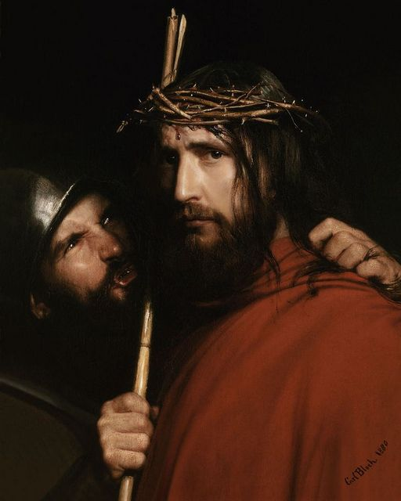
Luke 2:63-65
⁶³ And the men that held Jesus mocked him, and smote him.
⁶⁴ And when they had blindfolded him, they struck him on the face, and asked him, saying, Prophesy, who is it that smote thee?
⁶⁵ And many other things blasphemously spake they against him.

Slide 12
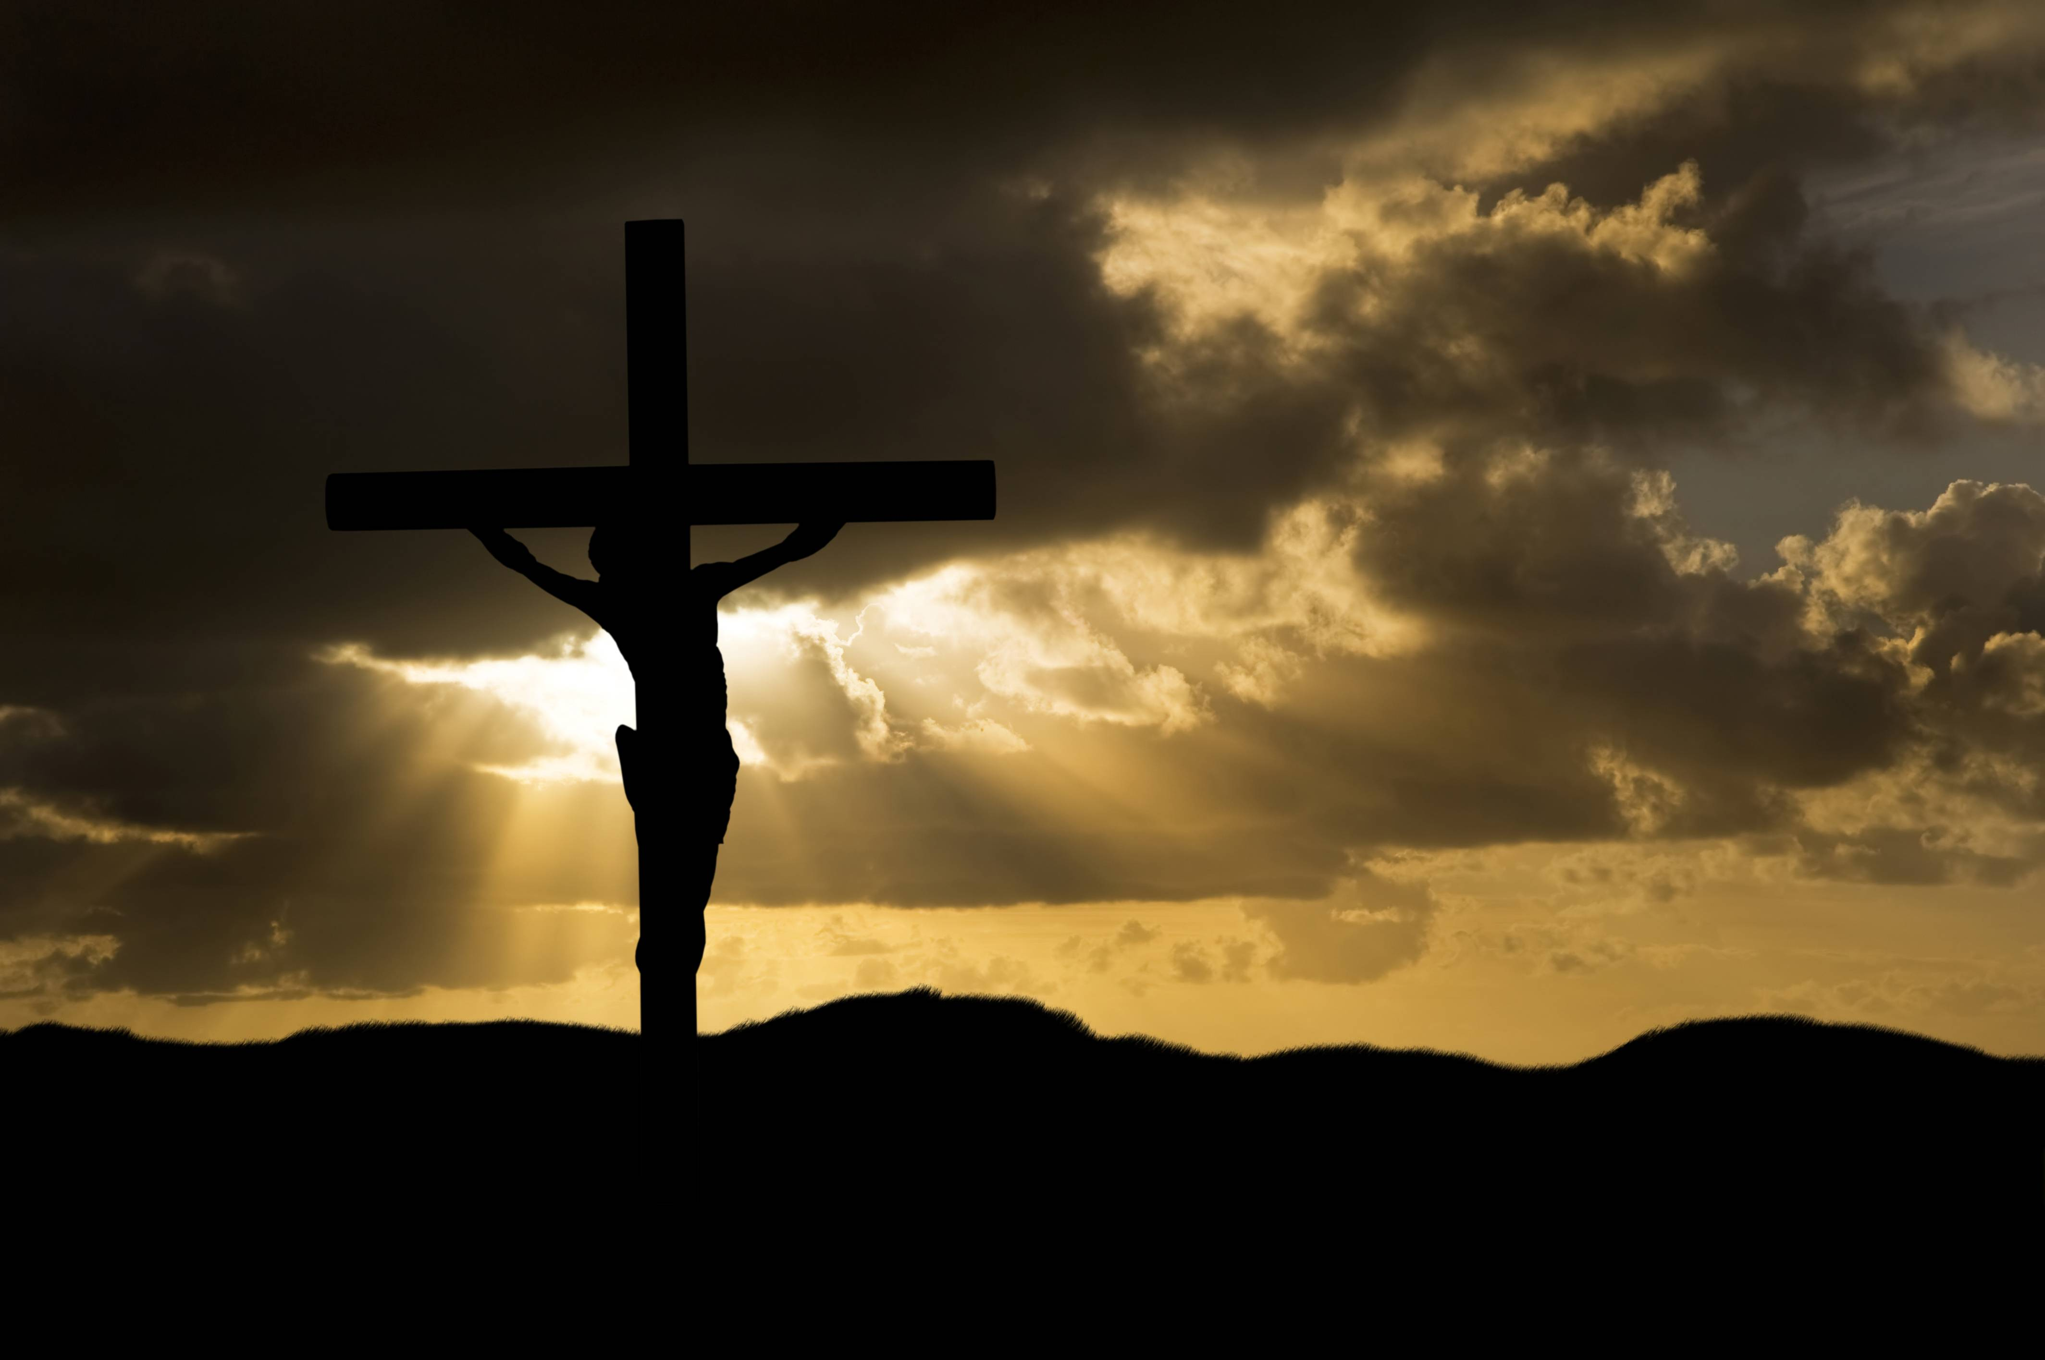
Matthew 27:46
⁴⁶ And about the ninth hour Jesus cried with a loud voice, saying, Eli, Eli, lama sabachthani? that is to say, My God, my God, why hast thou forsaken me?

Slide 13
Whether by leaders, or even by the common people, Jesus’ life, acts, and teachings were constantly misunderstood, leading to rejection and hatred by people He came to save. In a certain sense it must be like a parent who sees a wayward child in need of help, and though the parent is willing to give everything for that child, the child spurns the parent, heaping scorn and rejection upon perhaps the only person who can spare that child from utter ruin.
SDA Quarterly, Monday Sept. 19

Slide 14
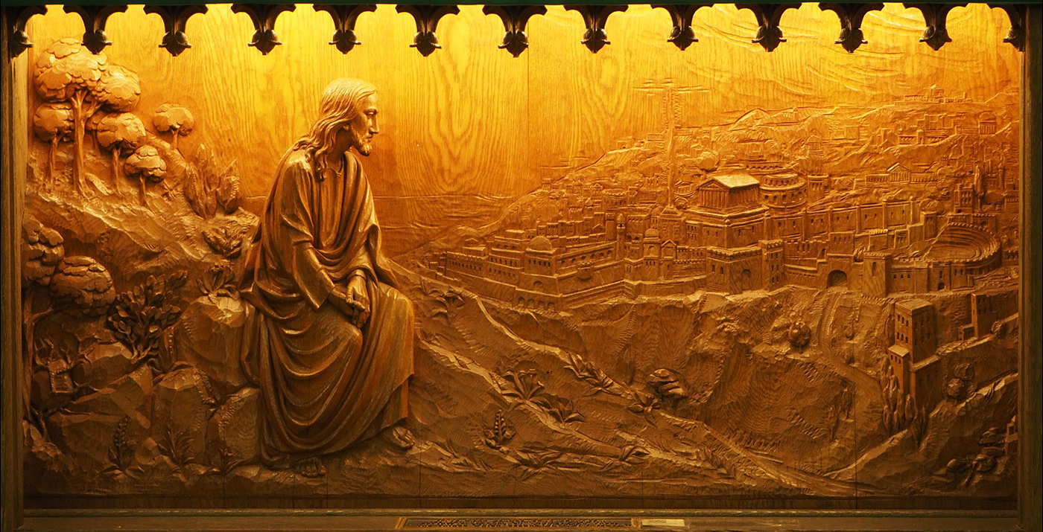
Jesus was utterly and repeatedly rejected by the very people for whom He worked and suffered. But consider His reaction! See Matthew 23:37-39.

Slide 15
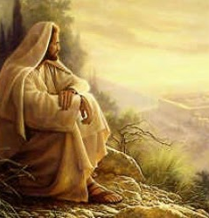
Matthew 23:37-39
³⁷ O Jerusalem, Jerusalem, thou that killest the prophets, and stonest them which are sent unto thee, how often would I have gathered thy children together, even as a hen gathereth her chickens under her wings, and ye would not!
³⁸ Behold, your house is left unto you desolate.
³⁹ For I say unto you, Ye shall not see me henceforth, till ye shall say, Blessed is he that cometh in the name of the Lord.

Slide 16
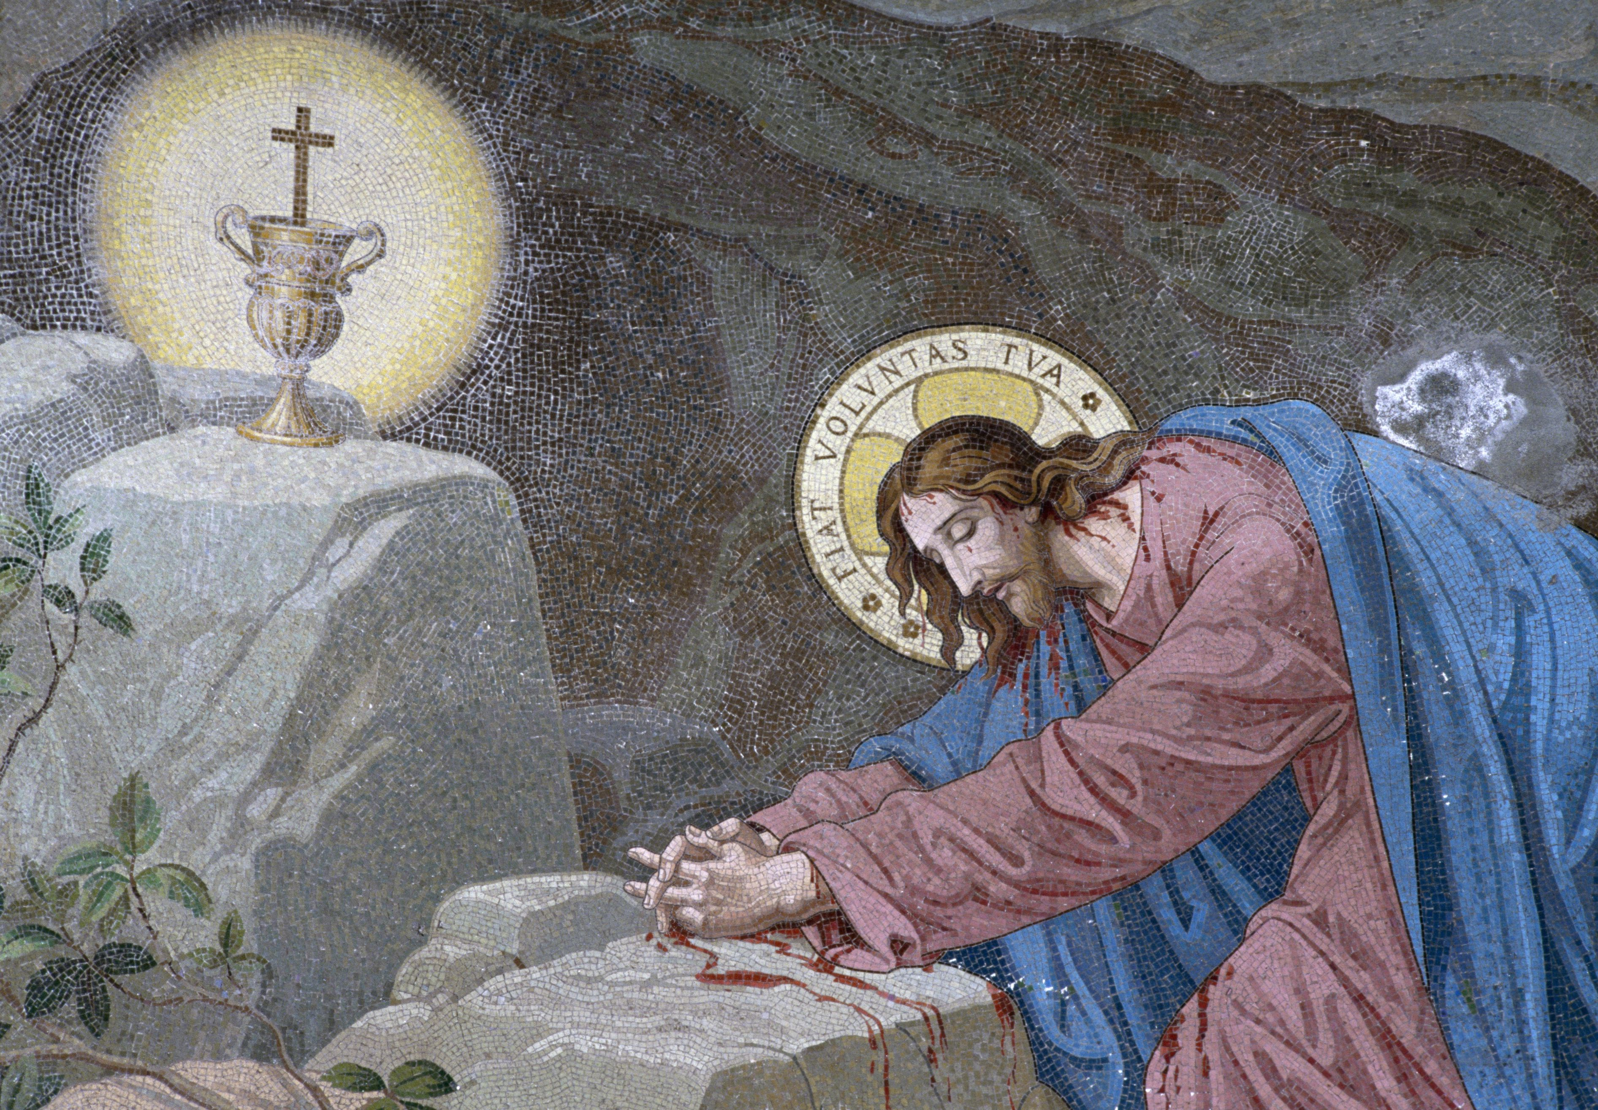
Matthew 27:39-40
³⁹ And they that passed by reviled him, wagging their heads,
⁴⁰ And saying, Thou that destroyest the temple, and buildest it in three days, save thyself. If thou be the Son of God, come down from the cross.

Slide 17
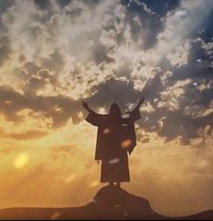
“No more poignant or tender expression of solicitude ever came from the lips of Jesus. With the same tender yearning Heaven looks upon all the lost. The time was at hand when God must reject the Jews as His chosen people, yet how reluctantly Heaven abandoned them to their own perverse way and to their tragic fate!”
SDABC V5 pg. 493

Slide 18
We’ve all felt the sting of rejection, and maybe our pain was similar to Christ’s in that it was unselfish: We were pained, not because we were rejected, but because of what the rejection would mean for the one who was rejecting us (perhaps someone we care about who refuses to accept salvation in Christ). Imagine, though, how it must have felt to Jesus, who was fully aware of what He was to face in order to save them, and at the same time fully aware of what the consequences of their rejection would be. “It was because of His innocence that He [Christ] felt so keenly the assaults of Satan.” — EGW, SM3 pg. 129
SDA Quarterly, Monday Sept. 19

Slide 19
Our great Example was continuously persecuted and rejected, particularly by those who had the most pressing obligations to embrace Him! In the face of such evidence we can hardly expect to escape persecution and rejection ourselves. As He said:
¹⁵ For I have given you an example, that ye should do as I have done to you.
¹⁶ Verily, verily, I say unto you, The servant is not greater than his lord; neither he that is sent greater than he that sent him.
John 13:15-16

Slide 20
1 Corinthians 4:9-14
⁹ For I think that God hath set forth us the apostles last, as it were appointed to death: for we are made a spectacle unto the world, and to angels, and to men.
¹⁰ We are fools for Christ's sake, but ye are wise in Christ; we are weak, but ye are strong; ye are honourable, but we are despised.
¹¹ Even unto this present hour we both hunger, and thirst, and are naked, and are buffeted, and have no certain dwellingplace;

Slide 21
1 Corinthians 4:9-14
¹² And labour, working with our own hands: being reviled, we bless; being persecuted, we suffer it:
¹³ Being defamed, we intreat: we are made as the filth of the world, and are the offscouring of all things unto this day.
¹⁴ I write not these things to shame you, but as my beloved sons I warn you.

Slide 22
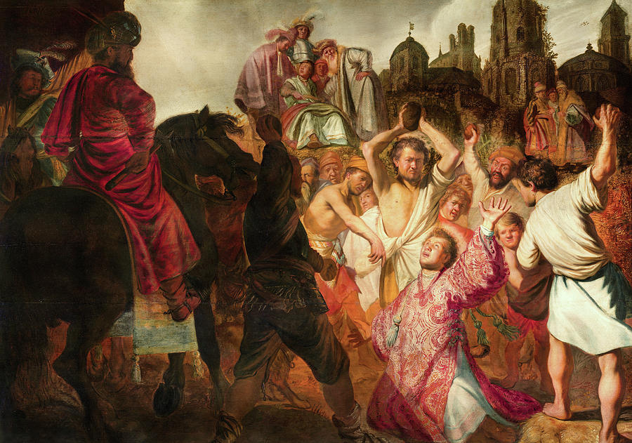
Acts 14:22
²² Confirming the souls of the disciples, and exhorting them to continue in the faith, and that we must through much tribulation enter into the kingdom of God.
The Stoning of Stephen

Slide 23
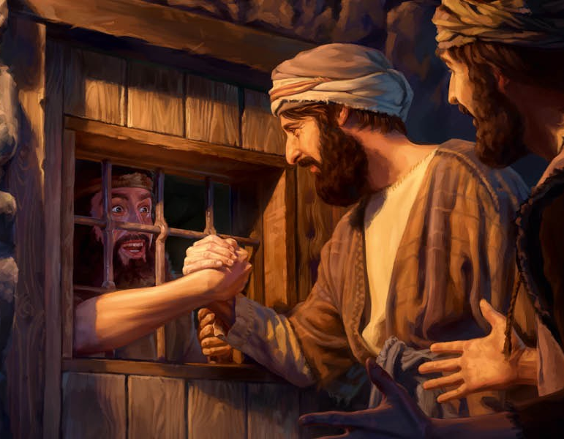
2 Timothy 3:11-14
¹¹ Persecutions, afflictions, which came unto me at Antioch, at Iconium, at Lystra; what persecutions I endured: but out of them all the Lord delivered me.
¹² Yea, and all that will live godly in Christ Jesus shall suffer persecution.
¹³ But evil men and seducers shall wax worse and worse, deceiving, and being deceived.
¹⁴ But continue thou in the things which thou hast learned and hast been assured of, knowing of whom thou hast learned them;

Slide 24
But this fact, that persecution and rejection are necessarily part of a Christian life, should never be a source of dejection or gloom! We’re given very specific directions in 1 Thessalonians 5:16-18!
¹⁶ Rejoice evermore. ¹⁷ Pray without ceasing. ¹⁸ In every thing give thanks: for this is the will of God in Christ Jesus concerning you.

Slide 25
John 16:1-3
16 These things have I spoken unto you, that ye should not be offended.
² They shall put you out of the synagogues: yea, the time cometh, that whosoever killeth you will think that he doeth God service.
³ And these things will they do unto you, because they have not known the Father, nor me.
Discouraged, weakened in faith

Slide 26
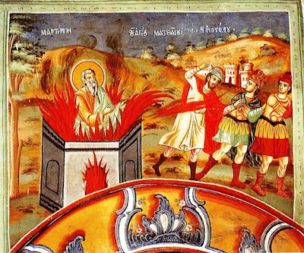
Philippians 1:28-29
²⁸ And in nothing terrified by your adversaries: which is to them an evident token of perdition, but to you of salvation, and that of God.
²⁹ For unto you it is given in the behalf of Christ, not only to believe on him, but also to suffer for his sake;

Slide 27
“Even though their adversaries do not acknowledge it, the fact that the church is unterrified is an evidence of the future destruction of their enemies. It shows that the Christians are supported by supernatural power, and implies that opponents will eventually be called into judgment on account of their persecuting activities.”
SDABC V7, pg. 150

Slide 28
SDABC V7, pg. 150
“The Christian religion has sanctified suffering that is endured for righteousness’ sake. Here [in Philippians 1] the undergoing of suffering for Christ is presented as a gracious gift, which gift the Christian may be proud to receive. The suffering that so frequently seems the lot of the Christian is used by God to perfect character and to prepare its recipient for future glory.”

Slide 29
Acts 5:40-42
⁴⁰ And to him they agreed: and when they had called the apostles, and beaten them, they commanded that they should not speak in the name of Jesus, and let them go.
⁴¹ And they departed from the presence of the council, rejoicing that they were counted worthy to suffer shame for his name.
⁴² And daily in the temple, and in every house, they ceased not to teach and preach Jesus Christ.

Slide 30
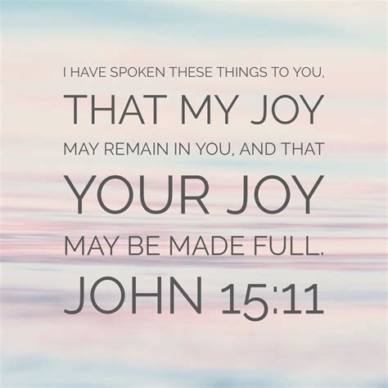
1 Peter 3:14-15
¹⁴ But and if ye suffer for righteousness' sake, happy are ye: and be not afraid of their terror, neither be troubled;
¹⁵ But sanctify the Lord God in your hearts: and be ready always to give an answer to every man that asketh you a reason of the hope that is in you with meekness and fear:

Slide 31
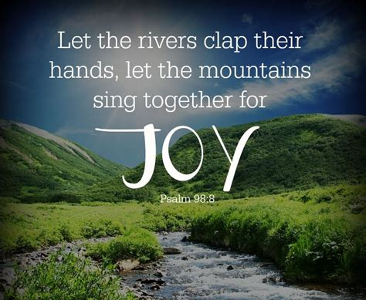
1 Peter 4:12-14
¹² Beloved, think it not strange concerning the fiery trial which is to try you, as though some strange thing happened unto you:
¹³ But rejoice, inasmuch as ye are partakers of Christ's sufferings; that, when his glory shall be revealed, ye may be glad also with exceeding joy.
¹⁴ If ye be reproached for the name of Christ, happy are ye; for the spirit of glory and of God resteth upon you: on their part he is evil spoken of, but on your part he is glorified.

Slide 32
“Faithful Christians, from apostolic times onward, have been glad to suffer for the Master’s sake. Those who face the trials of the last days must possess that same true sense of values. Severe as were the tests of Peter and his associates, they were little compared with those of the last great times of trouble. Only one thoroughly persuaded that it is the highest of honors and the greatest of blessings to be permitted to suffer for Christ’s sake will persevere through times when the unrestrained fury of Satan is unleashed.”
SDABC V7, pg. 150

Slide 33
“The calm strength and assurance of the true Christian in the face of the severest opposition or persecution is one of God’s ways of revealing Himself to us. It serves as a pledge of the full salvation that He has provided.”
SDABC V7, pg. 150

Slide 34
Romans 8:16-18
¹⁶ The Spirit itself beareth witness with our spirit, that we are the children of God:
¹⁷ And if children, then heirs; heirs of God, and joint-heirs with Christ; if so be that we suffer with him, that we may be also glorified together.
¹⁸ For I reckon that the sufferings of this present time are not worthy to be compared with the glory which shall be revealed in us.

Slide 35
2 Corinthians 1:3-5
³ Blessed be God, even the Father of our Lord Jesus Christ, the Father of mercies, and the God of all comfort;
⁴ Who comforteth us in all our tribulation, that we may be able to comfort them which are in any trouble, by the comfort wherewith we ourselves are comforted of God.
⁵ For as the sufferings of Christ abound in us, so our consolation also aboundeth by Christ.

Slide 36
James 5:7-13 SDABC V7 p. 538
In view of the ultimate vindication of the righteous at the return of Christ, James urges his fellow believers to be long-suffering under provocation and not lose their courage. After the seed has been planted, the farmer can do no more than patiently wait for the growth of the seed. He must be patient for both rains, for without either there would be no crop. The Christian must expect to have troubles and trials, even as the farmer has his troubles and trials in raising the crop.
⁷ Be patient therefore, brethren, unto the coming of the Lord. Behold, the husbandman waiteth for the precious fruit of the earth, and hath long patience for it, until he receive the early and latter rain.

Slide 37
SDABC V7 p. 539 James 5:7-13
The “Judge” here is Jesus Himself. The Father has committed the judgment of this world to Him. The Greek implies that the Lord is standing, at this very moment, at the door. James here emphasizes the immediacy of the advent and that times demand a prepared character to meet the Lord. There is no time for finding fault with others.
⁸ Be ye also patient; stablish your hearts: for the coming of the Lord draweth nigh.
⁹ Grudge not one against another, brethren, lest ye be condemned: behold, the judge standeth before the door.

Slide 38
James 5:7-13 SDABC V7 p. 539
The persistent courage of others who endured faithfully under similar hardships brings encouragement to those who follow. Constant faithfulness amid the problems of life reveals an undivided loyalty to God and becomes a requisite for eternal life. When church members are called to endure hardships, they can claim the same blessings.
¹⁰ Take, my brethren, the prophets, who have spoken in the name of the Lord, for an example of suffering affliction, and of patience.
¹¹ Behold, we count them happy which endure. Ye have heard of the patience of Job, and have seen the end of the Lord; that the Lord is very pitiful, and of tender mercy.

Slide 39
SDABC V7 p. 540 James 5:7-13
Instead of murmuring in affliction or bursting forth with an oath, the proper response is prayer. Prayer imparts balance and perspective to both suffering and joy. The Lord expects us to call upon Him when in adversity. It is God’s plan that church members should live serene, joyful lives. Amid the problems of life Christians can be certain of God’s sustaining grace and comfort.
¹² But above all things, my brethren, swear not, neither by heaven, neither by the earth, neither by any other oath: but let your yea be yea; and your nay, nay; lest ye fall into condemnation.
¹³ Is any among you afflicted? let him pray. Is any merry? let him sing psalms.

Slide 40
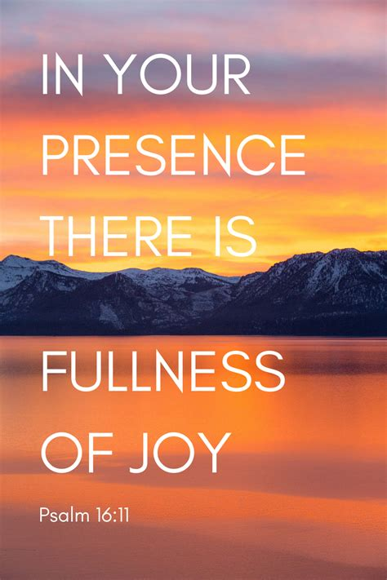
The apostles truly rejoiced when they suffered for Jesus’ sake, because they were filled with His Spirit. And that same privilege can be extended to us!
⁹ And my soul shall be joyful in the Lord: it shall rejoice in his salvation.
-Psalm 35:9

Slide 41
With great power gave the apostles witness of the resurrection of the Lord Jesus: and great grace was upon them all.” Acts 4:33. Under their labors were added to the church chosen men, who, receiving the word of truth, consecrated their lives to the work of giving to others the hope that filled their hearts with peace and joy. They could not be restrained or intimidated by threatenings. The Lord spoke through them, and as they went from place to place, the poor had the gospel preached to them, and miracles of divine grace were wrought. So mightily can God work when men give themselves up to the control of His Spirit.
The Acts of the Apostles pg. 48-49

Slide 42
The lapse of time has wrought no change in Christ's parting promise to send the Holy Spirit as His representative. It is not because of any restriction on the part of God that the riches of His grace do not flow earthward to men. If the fulfillment of the promise is not seen as it might be, it is because the promise is not appreciated as it should be. If all were willing, all would be filled with the Spirit. Wherever the need of the Holy Spirit is a matter little thought of, there is seen spiritual drought, spiritual darkness, spiritual declension and death. Whenever minor matters occupy the attention, the divine power which is necessary for the growth and prosperity of the church, and which would bring all other blessings in its train, is lacking, though offered in infinite plenitude.
The Acts of the Apostles pg. 50

Slide 43

²² And ye shall be hated of all men for my name's sake: but he that endureth to the end shall be saved.
Matthew 10:22

Slide 44
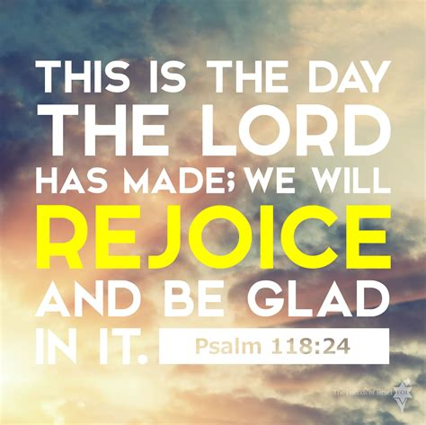
Matthew 5:10-12
¹⁰ Blessed are they which are persecuted for righteousness' sake: for theirs is the kingdom of heaven.
¹¹ Blessed are ye, when men shall revile you, and persecute you, and shall say all manner of evil against you falsely, for my sake.
¹² Rejoice, and be exceeding glad: for great is your reward in heaven: for so persecuted they the prophets which were before you.

Slide 45
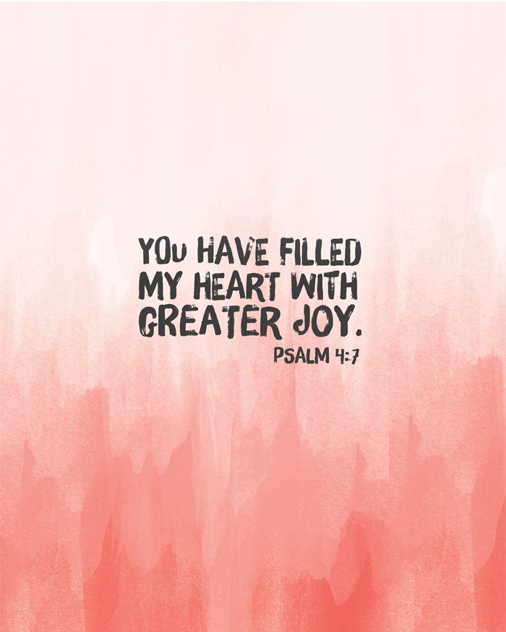
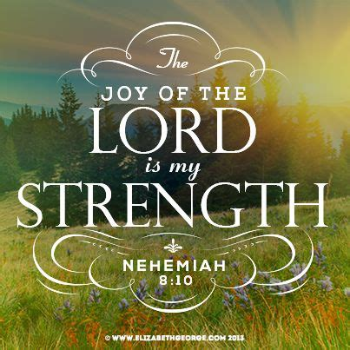
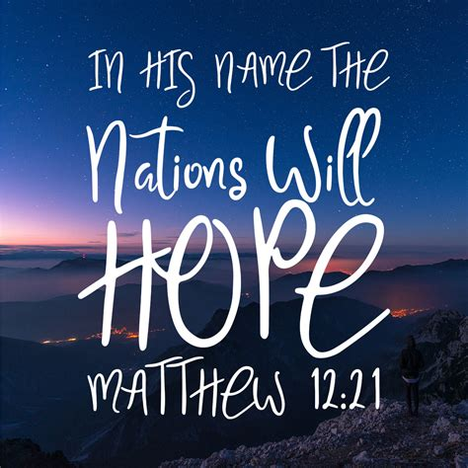
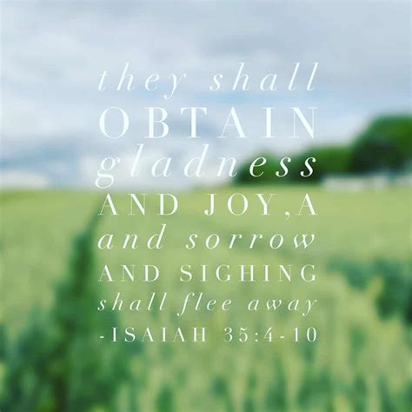



Slide 46
Thank you!
Happy Sabbath!

