Slide 1

Two Laws of Living
1 John 4, Ezekiel 28, Revelation 12
Lesson 1, 4th Quarter, 2022

Slide 2

God’s Law
³Thou shalt have no other gods before me.

Slide 3
Romans 8:35-39
³⁵ Who shall separate us from the love of Christ? shall tribulation, or distress, or persecution, or famine, or nakedness, or peril, or sword?
³⁶ As it is written, For thy sake we are killed all the day long; we are accounted as sheep for the slaughter.
³⁷ Nay, in all these things we are more than conquerors through him that loved us.

Slide 4
Romans 8:38-39
³⁸ For I am persuaded, that neither death, nor life, nor angels, nor principalities, nor powers, nor things present, nor things to come,
³⁹ Nor height, nor depth, nor any other creature, shall be able to separate us from the love of God, which is in Christ Jesus our Lord.

Slide 5
Patriarchs and Prophets pg. 33
“Every manifestation of creative power is an expression of infinite love. The sovereignty of God involves fullness of blessing to all created beings.”

Slide 6
1 John 4:7-12
⁷ Beloved, let us love one another: for love is of God; and every one that loveth is born of God, and knoweth God.
⁸ He that loveth not knoweth not God; for God is love.
⁹ In this was manifested the love of God toward us, because that God sent his only begotten Son into the world, that we might live through him.

Slide 7
1 John 4:7-12
¹⁰ Herein is love, not that we loved God, but that he loved us, and sent his Son to be the propitiation for our sins.
¹¹ Beloved, if God so loved us, we ought also to love one another.
¹² No man hath seen God at any time. If we love one another, God dwelleth in us, and his love is perfected in us.

Slide 8
God’s Law is the
Law of Love
He that loveth not knoweth not God; for God is love.

Slide 9
Isaiah 42:5-8
⁵ Thus saith God the Lord, he that created the heavens, and stretched them out; he that spread forth the earth, and that which cometh out of it; he that giveth breath unto the people upon it, and spirit to them that walk therein:
⁶ I the Lord have called thee in righteousness, and will hold thine hand, and will keep thee, and give thee for a covenant of the people, for a light of the Gentiles;

Slide 10
Isaiah 42:7-8
⁷ To open the blind eyes, to bring out the prisoners from the prison, and them that sit in darkness out of the prison house.
⁸ I am the Lord: that is my name: and my glory will I not give to another, neither my praise to graven images.

Slide 11
Psalm 89:13-18
¹³ Thou hast a mighty arm: strong is thy hand, and high is thy right hand.
¹⁴ Justice and judgment are the habitation of thy throne: mercy and truth shall go before thy face.
¹⁵ Blessed is the people that know the joyful sound: they shall walk, O Lord, in the light of thy countenance.
¹⁶ In thy name shall they rejoice all the day: and in thy righteousness shall they be exalted.
¹⁷ For thou art the glory of their strength: and in thy favour our horn shall be exalted.
¹⁸ For the Lord is our defence; and the Holy One of Israel is our king.

Slide 12
God created this world in love, and wants to hold our hand! He wishes closeness with us, and to do good things for us. But we must first learn to work with Him in righteousness. That is, to follow His law.

Slide 13
The Great Controversy pg. 493
“The law of love being the foundation of the government of God, the happiness of all created beings depended upon their perfect accord with its great principles of righteousness. God desires from all His creatures the service of love—homage that springs from an intelligent appreciation of His character. He takes no pleasure in a forced allegiance, and to all He grants freedom of will, that they may render Him voluntary service.”

Slide 14
Mark 12:29-31
²⁹ And Jesus answered him, The first of all the commandments is, Hear, O Israel; The Lord our God is one Lord:
³⁰ And thou shalt love the Lord thy God with all thy heart, and with all thy soul, and with all thy mind, and with all thy strength: this is the first commandment.
³¹ And the second is like, namely this, Thou shalt love thy neighbour as thyself. There is none other commandment greater than these.

Slide 15
God’s Law is the
Law of Love…
And its very first requirement is that we put God first.

Slide 16
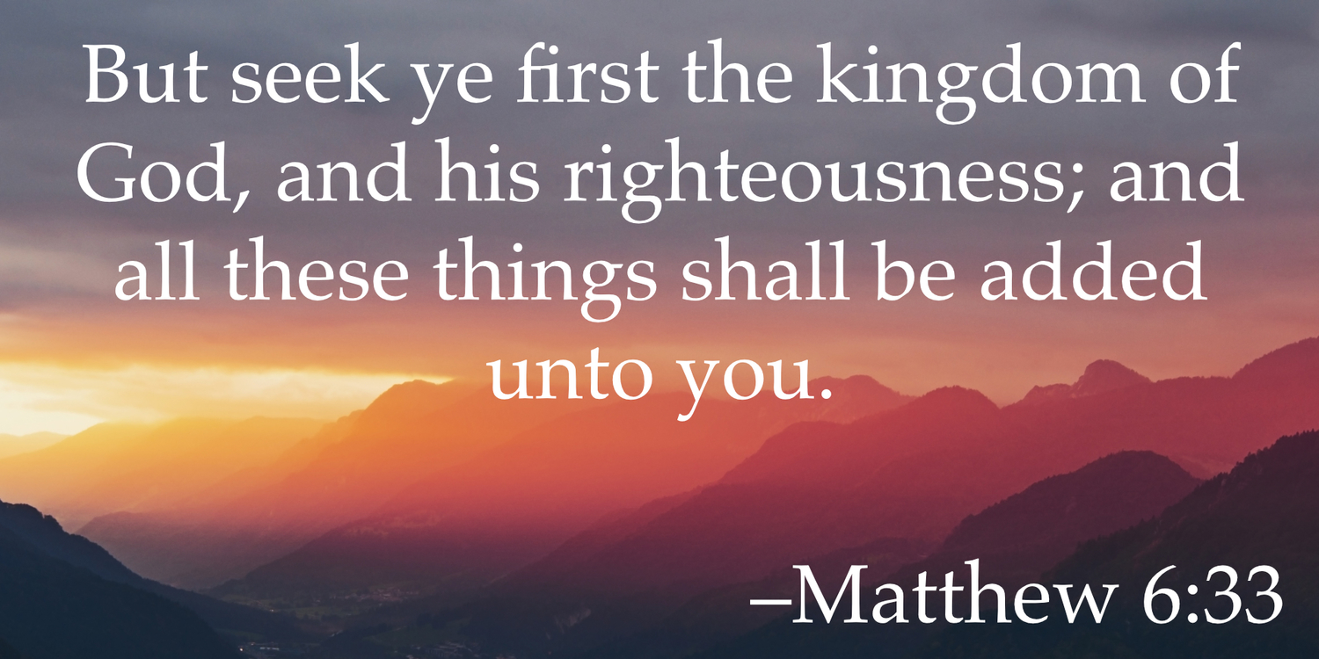
Matthew 6:33

Slide 17
God’s Law:
GOD FIRST

Slide 18
1 John 4: 13-21
¹³ Hereby know we that we dwell in him, and he in us, because he hath given us of his Spirit.
¹⁴ And we have seen and do testify that the Father sent the Son to be the Saviour of the world.
¹⁵ Whosoever shall confess that Jesus is the Son of God, God dwelleth in him, and he in God.
¹⁶ And we have known and believed the love that God hath to us. God is love; and he that dwelleth in love dwelleth in God, and God in him.

Slide 19
1 John 4: 17-21
¹⁷ Herein is our love made perfect, that we may have boldness in the day of judgment: because as he is, so are we in this world.
¹⁸ There is no fear in love; but perfect love casteth out fear: because fear hath torment. He that feareth is not made perfect in love.
¹⁹ We love him, because he first loved us.

Slide 20
1 John 4: 17-21
²⁰ If a man say, I love God, and hateth his brother, he is a liar: for he that loveth not his brother whom he hath seen, how can he love God whom he hath not seen?
²¹ And this commandment have we from him, That he who loveth God love his brother also.

Slide 21
Placing the love of God first in our lives results also in love for the rest of God’s creation!
We revisit Isaiah 42:5-8…

Slide 22
Isaiah 42:5-8
⁵ Thus saith God the Lord, he that created the heavens, and stretched them out; he that spread forth the earth, and that which cometh out of it; he that giveth breath unto the people upon it, and spirit to them that walk therein:
⁶ I the Lord have called thee in righteousness, and will hold thine hand, and will keep thee, and give thee for a covenant of the people, for a light of the Gentiles;

Slide 23
Isaiah 42:7-8
⁷ To open the blind eyes, to bring out the prisoners from the prison, and them that sit in darkness out of the prison house.
⁸ I am the Lord: that is my name: and my glory will I not give to another, neither my praise to graven images.

Slide 24
Notice that putting God first is the CAUSE and that love for others is the EFFECT! Loving others is not the beginning of Christianity, but its consequence.

Slide 25
To live as God’s people we must keep His law and put Him first!

Slide 26
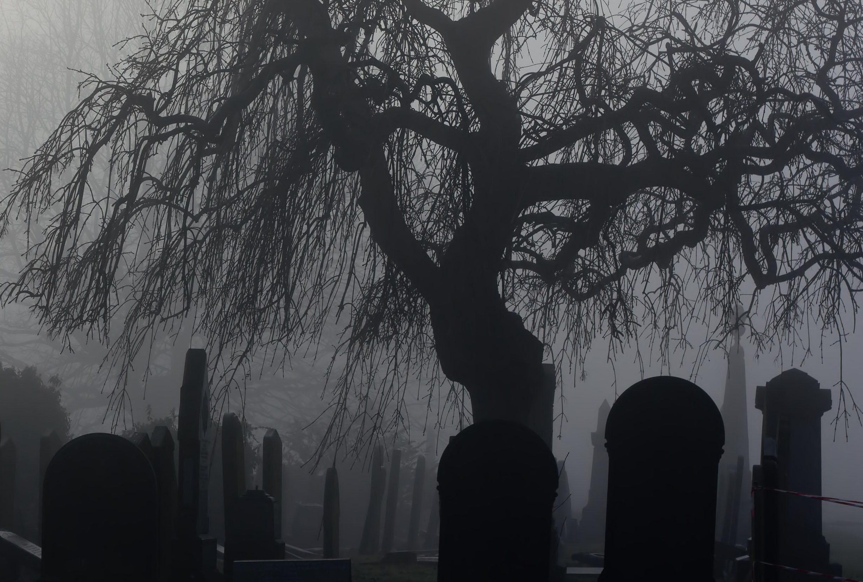
There are only two options:
Living by God’s Law,
the Law of Love:
God First
Living in Opposition to God

Slide 27
Another Law:
Living in Opposition to God
(And that law of living has a leader.)

Slide 28
Isaiah 14:12-15
¹² How art thou fallen from heaven, O Lucifer, son of the morning! how art thou cut down to the ground, which didst weaken the nations!
¹³ For thou hast said in thine heart, I will ascend into heaven, I will exalt my throne above the stars of God: I will sit also upon the mount of the congregation, in the sides of the north:

Slide 29
Isaiah 14:12-15
¹⁴ I will ascend above the heights of the clouds; I will be like the most High.
¹⁵ Yet thou shalt be brought down to hell, to the sides of the pit.

Slide 30
Lucifer is the leader of the faction opposing God’s law of love, as he was the first creature to do evil.

Slide 31
The Great Controversy, pg. 494
The law in opposition to God: Self Exaltation
“Lucifer might have remained in favor with God, beloved and honored by all the angelic host, exercising his noble powers to bless others and to glorify his Maker. But, says the prophet, “Thine heart was lifted up because of thy beauty, thou hast corrupted thy wisdom by reason of thy brightness.” Little by little, Lucifer came to indulge a desire for self-exaltation. Instead of seeking to make God supreme in the affections and allegiance of His creatures, it was Lucifer's endeavor to win their service and homage to himself.”

Slide 32
Ezekiel 28:12-19
¹² Son of man, take up a lamentation upon the king of Tyrus, and say unto him, Thus saith the Lord God; Thou sealest up the sum, full of wisdom, and perfect in beauty.
¹³ Thou hast been in Eden the garden of God; every precious stone was thy covering, the sardius, topaz, and the diamond, the beryl, the onyx, and the jasper, the sapphire, the emerald, and the carbuncle, and gold: the workmanship of thy tabrets and of thy pipes was prepared in thee in the day that thou wast created.

Slide 33
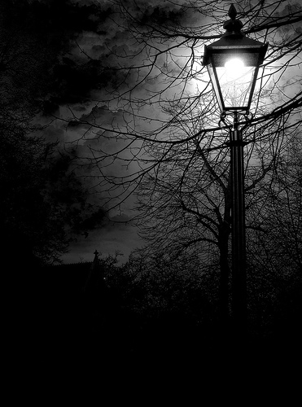
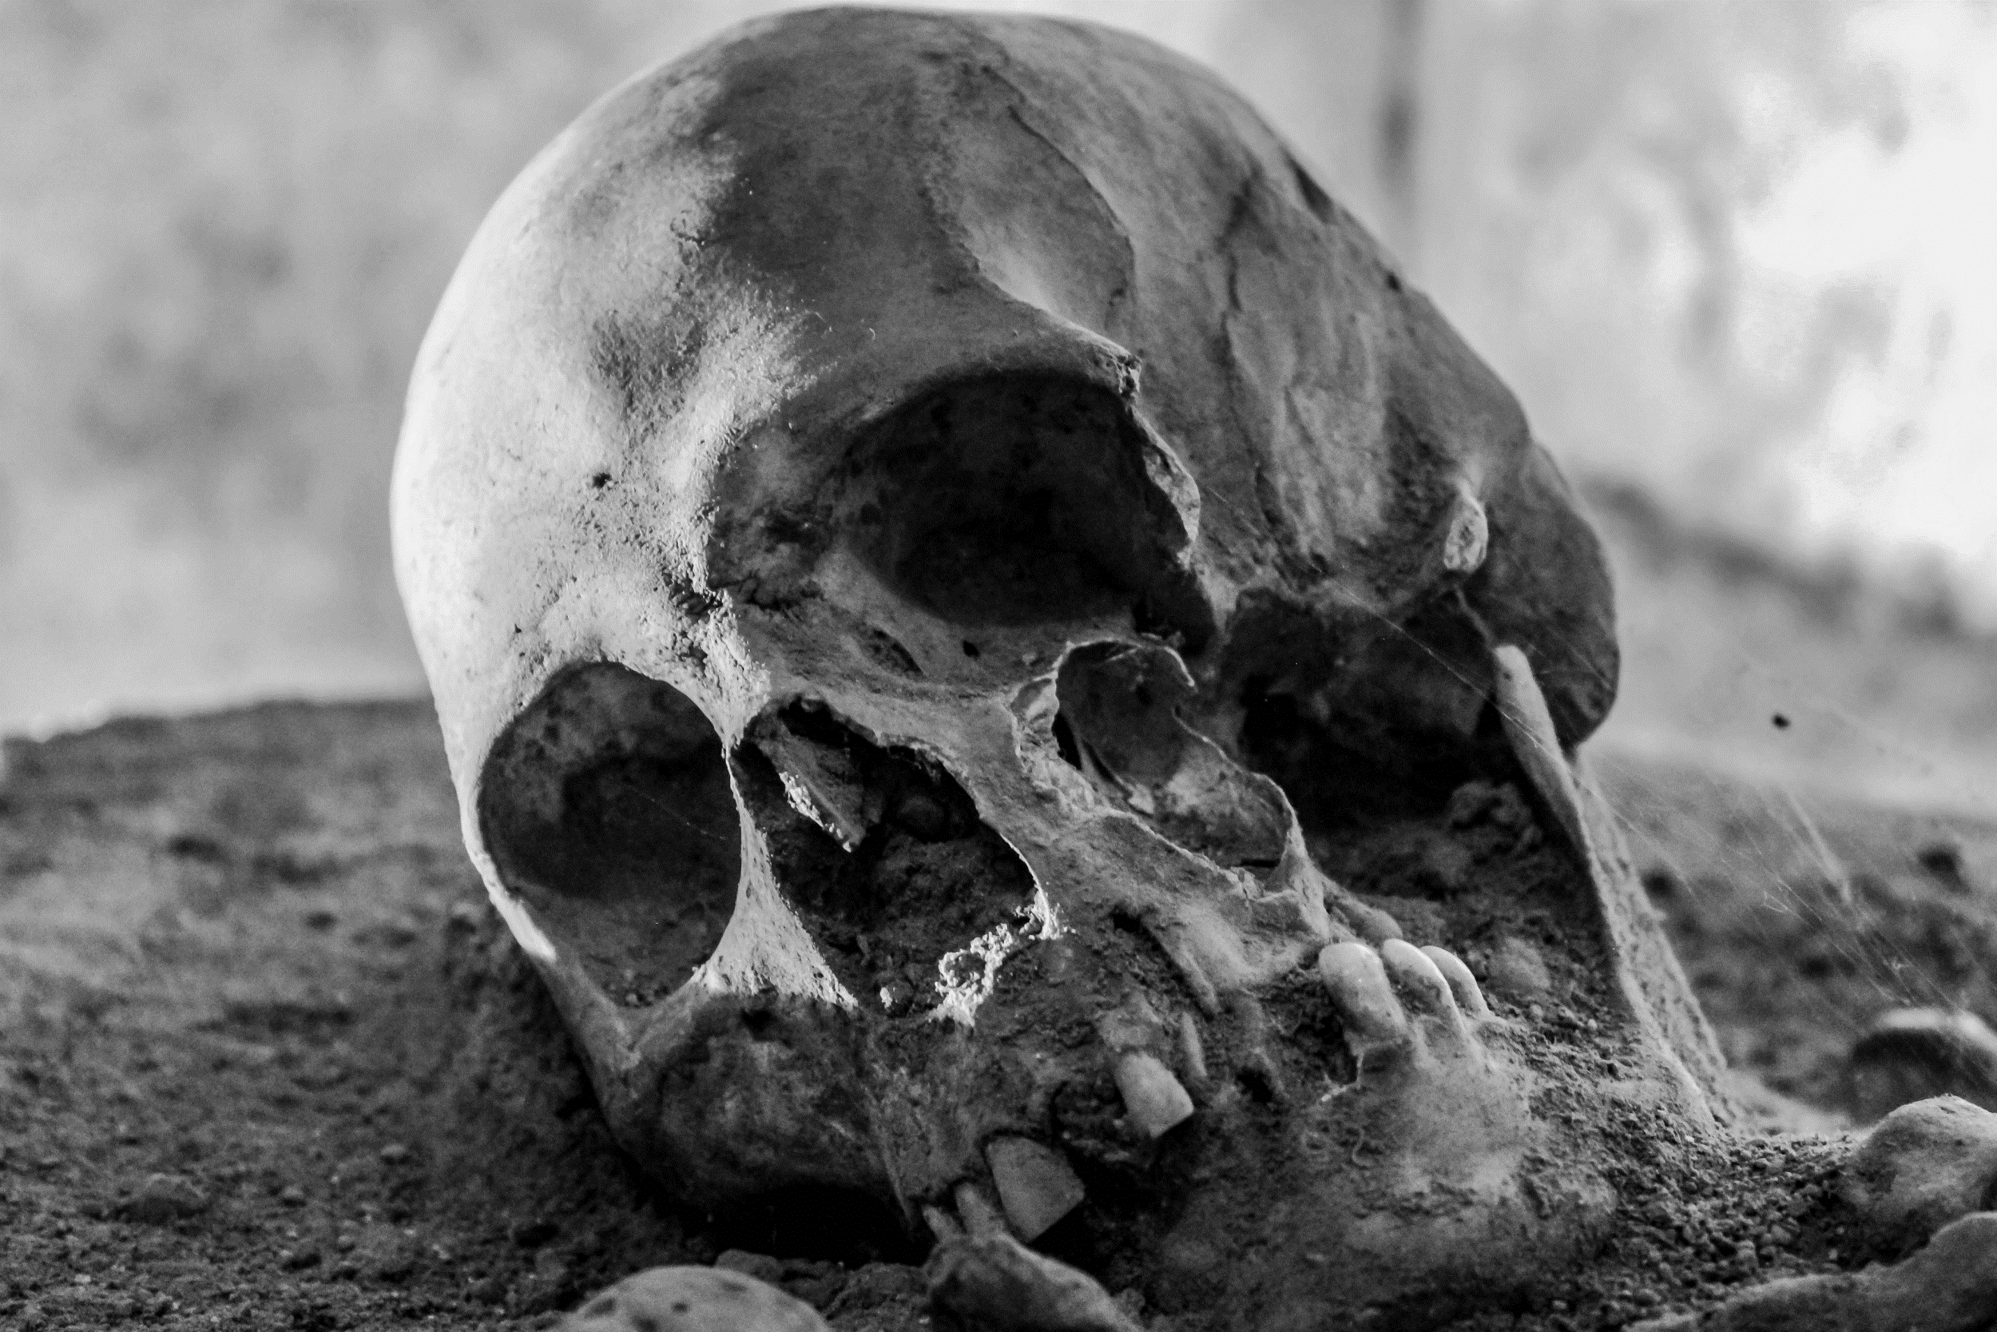
The King of Tyre
Though presented as a dirge upon the king of Tyrus, these verses can hardly be limited in their application to the Tyrian prince. These statements are clearly applicable to a heavenly being and not a human prince, however evil.
It thus appears simpler to consider the passage as digressing from a prophecy upon the prince of Tyre to present a history of him who was indeed the real king of Tyrus, Satan himself.
So understood, this passage provides us with a history of the origin, initial position, and downfall of the angel who later became known as the devil and Satan.

Slide 34
Ezekiel 28:12-19
¹⁴ Thou art the anointed cherub that covereth; and I have set thee so: thou wast upon the holy mountain of God; thou hast walked up and down in the midst of the stones of fire.
¹⁵ Thou wast perfect in thy ways from the day that thou wast created, till iniquity was found in thee.

Slide 35
Ezekiel 28:12-19
¹⁶ By the multitude of thy merchandise they have filled the midst of thee with violence, and thou hast sinned: therefore I will cast thee as profane out of the mountain of God: and I will destroy thee, O covering cherub, from the midst of the stones of fire.
¹⁷ Thine heart was lifted up because of thy beauty, thou hast corrupted thy wisdom by reason of thy brightness: I will cast thee to the ground, I will lay thee before kings, that they may behold thee.

Slide 36
Ezekiel 28:12-19
¹⁸ Thou hast defiled thy sanctuaries by the multitude of thine iniquities, by the iniquity of thy traffick; therefore will I bring forth a fire from the midst of thee, it shall devour thee, and I will bring thee to ashes upon the earth in the sight of all them that behold thee.
¹⁹ All they that know thee among the people shall be astonished at thee: thou shalt be a terror, and never shalt thou be any more.

Slide 37
The Great Controversy, pg. 495
“Pride in his own glory nourished the desire for supremacy. The high honors conferred upon Lucifer were not appreciated as the gift of God, and called forth no gratitude to the Creator. He gloried in his brightness and exaltation, and aspired to be equal with God... “Why,” questioned this mighty angel, “should Christ have the supremacy? Why is he thus honored above Lucifer?”

Slide 38
The Great Controversy, pg. 495
“Lucifer himself did not at first see whither he was drifting; he did not understand the real nature of his feelings. But as his dissatisfaction was proved to be without cause, Lucifer was convinced that he was in the wrong, that the divine claims were just, and that he ought to acknowledge them as such before all Heaven. Had he done this, he might have saved himself and many angels... But pride forbade him to submit. He persistently defended his own course, maintained that he had no need of repentance, and fully committed himself, in the great controversy, against his Maker.”

Slide 39
Satan’s Law:
ME FIRST

Slide 40
There are only two options:
Living by God’s Law,
the Law of Love:
God First
Living by Satan’s Law, the law of opposition:
ME FIRST
Every choice boils down to one of these two possibilities!

Slide 41
Case Study: Matthew 4:1-11
4 Then was Jesus led up of the Spirit into the wilderness to be tempted of the devil.
² And when he had fasted forty days and forty nights, he was afterward an hungred.
³ And when the tempter came to him, he said, If thou be the Son of God, command that these stones be made bread.
⁴ But he answered and said, It is written, Man shall not live by bread alone, but by every word that proceedeth out of the mouth of God.
GOD FIRST!!

Slide 42
Case Study: Matthew 4:5-11
⁵ Then the devil taketh him up into the holy city, and setteth him on a pinnacle of the temple,
⁶ And saith unto him, If thou be the Son of God, cast thyself down: for it is written, He shall give his angels charge concerning thee: and in their hands they shall bear thee up, lest at any time thou dash thy foot against a stone.
⁷ Jesus said unto him, It is written again, Thou shalt not tempt the Lord thy God.
GOD FIRST!!

Slide 43
Case Study: Matthew 4:8-11
⁸ Again, the devil taketh him up into an exceeding high mountain, and sheweth him all the kingdoms of the world, and the glory of them;
⁹ And saith unto him, All these things will I give thee, if thou wilt fall down and worship me.
¹⁰ Then saith Jesus unto him, Get thee hence, Satan: for it is written, Thou shalt worship the Lord thy God, and him only shalt thou serve.
¹¹ Then the devil leaveth him, and, behold, angels came and ministered unto him.
GOD FIRST!!

Slide 44
Case Study: Acts 5:1-10
5 But a certain man named Ananias, with Sapphira his wife, sold a possession,
² And kept back part of the price, his wife also being privy to it, and brought a certain part, and laid it at the apostles' feet.
³ But Peter said, Ananias, why hath Satan filled thine heart to lie to the Holy Ghost, and to keep back part of the price of the land?
⁴ Whiles it remained, was it not thine own? and after it was sold, was it not in thine own power? why hast thou conceived this thing in thine heart? thou hast not lied unto men, but unto God.

Slide 45
Case Study: Acts 5:5-10
⁵ And Ananias hearing these words fell down, and gave up the ghost: and great fear came on all them that heard these things.
⁶ And the young men arose, wound him up, and carried him out, and buried him.
⁷ And it was about the space of three hours after, when his wife, not knowing what was done, came in.
⁸ And Peter answered unto her, Tell me whether ye sold the land for so much? And she said, Yea, for so much.

Slide 46
Case Study: Acts 5:5-10
⁹ Then Peter said unto her, How is it that ye have agreed together to tempt the Spirit of the Lord? behold, the feet of them which have buried thy husband are at the door, and shall carry thee out.
¹⁰ Then fell she down straightway at his feet, and yielded up the ghost: and the young men came in, and found her dead, and, carrying her forth, buried her by her husband.
Ananias and Sapphira: ME FIRST!!

Slide 47
Case Study: Luke 9:48-50
⁴⁸ And said unto them, Whosoever shall receive this child in my name receiveth me: and whosoever shall receive me receiveth him that sent me: for he that is least among you all, the same shall be great.
⁴⁹ And John answered and said, Master, we saw one casting out devils in thy name; and we forbad him, because he followeth not with us.
⁵⁰ And Jesus said unto him, Forbid him not: for he that is not against us is for us.
Disciples: ME FIRST!! (Pride)
Jesus: GOD FIRST!!

Slide 48
Case Study: Luke 9:48-50
⁵⁷ And it came to pass, that, as they went in the way, a certain man said unto him, Lord, I will follow thee whithersoever thou goest.
⁵⁸ And Jesus said unto him, Foxes have holes, and birds of the air have nests; but the Son of man hath not where to lay his head.
⁵⁹ And he said unto another, Follow me. But he said, Lord, suffer me first to go and bury my father.
⁶⁰ Jesus said unto him, Let the dead bury their dead: but go thou and preach the kingdom of God.
⁶¹ And another also said, Lord, I will follow thee; but let me first go bid them farewell, which are at home at my house.
⁶² And Jesus said unto him, No man, having put his hand to the plough, and looking back, is fit for the kingdom of God.
Potential Disciples: ME FIRST!!

Slide 49
Case Study: Matthew 4:18-22
¹⁸ And Jesus, walking by the sea of Galilee, saw two brethren, Simon called Peter, and Andrew his brother, casting a net into the sea: for they were fishers.
¹⁹ And he saith unto them, Follow me, and I will make you fishers of men.
²⁰ And they straightway left their nets, and followed him.
²¹ And going on from thence, he saw other two brethren, James the son of Zebedee, and John his brother, in a ship with Zebedee their father, mending their nets; and he called them.
²² And they immediately left the ship and their father, and followed him.
Potential Disciples: GOD FIRST!!

Slide 50
Case Study: John 12:23-26
²³ And Jesus answered them, saying, The hour is come, that the Son of man should be glorified.
²⁴ Verily, verily, I say unto you, Except a corn of wheat fall into the ground and die, it abideth alone: but if it die, it bringeth forth much fruit.
²⁵ He that loveth his life shall lose it; and he that hateth his life in this world shall keep it unto life eternal.
²⁶ If any man serve me, let him follow me; and where I am, there shall also my servant be: if any man serve me, him will my Father honour.
GOD FIRST!!

Slide 51
The End of the Story: Revelation 12:7-11
⁷ And there was war in heaven: Michael and his angels fought against the dragon; and the dragon fought and his angels,
⁸ And prevailed not; neither was their place found any more in heaven.
⁹ And the great dragon was cast out, that old serpent, called the Devil, and Satan, which deceiveth the whole world: he was cast out into the earth, and his angels were cast out with him.

Slide 52
The End of the Story: Revelation 12:10-11
¹⁰ And I heard a loud voice saying in heaven, Now is come salvation, and strength, and the kingdom of our God, and the power of his Christ: for the accuser of our brethren is cast down, which accused them before our God day and night.
¹¹ And they overcame him by the blood of the Lamb, and by the word of their testimony; and they loved not their lives unto the death.

Slide 53
The point: 1 John 5:1-4
5 Whosoever believeth that Jesus is the Christ is born of God: and every one that loveth him that begat loveth him also that is begotten of him.
² By this we know that we love the children of God, when we love God, and keep his commandments.
³ For this is the love of God, that we keep his commandments: and his commandments are not grievous.
⁴ For whatsoever is born of God overcometh the world: and this is the victory that overcometh the world, even our faith.

Slide 54

GOD FIRST!! Then everything else follows: obedience, love of others, and victory over sin and self. But it starts with God FIRST!

Slide 55

Thank You
Happy
Sabbath!

