Slide 1
Hope After the Fall
Genesis 3, 2 Corinthians 5, Romans 5
Lesson 2, 4th Quarter, 2022

Slide 2

Creation: “The Story of Redemption,” p. 20
“The earth came forth from the hand of the Creator exceedingly beautiful. There were mountains and hills and plains; and interspersed among them were rivers and bodies of water…

Slide 3

Creation: “The Story of Redemption,” p. 20
“The hills, mountains, and very beautiful plains were adorned with plants and flowers and tall, majestic trees of every description, which were many times larger and much more beautiful than trees now are. The air was pure and healthful, and the earth seemed like a noble palace. Angels beheld and rejoiced at the wonderful and beautiful works of God.”

Slide 4
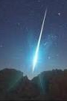
The Snake: SDA Quarterly, Sabbath Afternoon
“Having been cast out of heaven, Satan decided “to destroy the happiness of Adam and Eve” on earth and thereby “cause grief in heaven.” He imagined that “if he could in any way beguile them [Adam and Eve] to disobedience, God would make some provision whereby they might be pardoned, and then himself and all the fallen angels would be in a fair way to share with them of God’s mercy.” — Ellen G. White, The Story of Redemption, p. 27.”

Slide 5

Deceit: Genesis 3:1-4
3 Now the serpent was more subtil than any beast of the field which the Lord God had made. And he said unto the woman, Yea, hath God said, Ye shall not eat of every tree of the garden?
² And the woman said unto the serpent, We may eat of the fruit of the trees of the garden:
³ But of the fruit of the tree which is in the midst of the garden, God hath said, Ye shall not eat of it, neither shall ye touch it, lest ye die.
⁴ And the serpent said unto the woman, Ye shall not surely die:

Slide 6
The Snake: SDA Quarterly, Sunday
“From the perspective of human logic, the argument of the serpent sounded much more convincing than did the word of God. First of all, there was no evidence in the natural world, so far, for the existence of sin and death. Second, the serpent was actually eating the forbidden fruit and enjoying it very much. So, why should Eve restrain herself from doing the same? God’s command seemed to be too restrictive and senseless.”

Slide 7
The Snake: SDA Quarterly, Sunday
“Unfortunately, in deciding between the two conflicting statements, Eve ignored three basic principles: 1. human reason is not always the safest way to evaluate spiritual matters; 2. the Word of God can appear to be illogical and senseless to us, but it is always right and trustworthy; and 3 . there are things that are not evil or wrong in themselves, but God has chosen them as tests of obedience.”

Slide 8
The Snake: SDA Quarterly, Sunday
“We should realize that the experience of Eve in the Garden of Eden is not a single case in time. Every day and every moment we need to decide between the Word of God (which for many can be unpopular) and the seductive appeals of our surrounding culture. Our choice will have eternal consequences.”

Slide 9
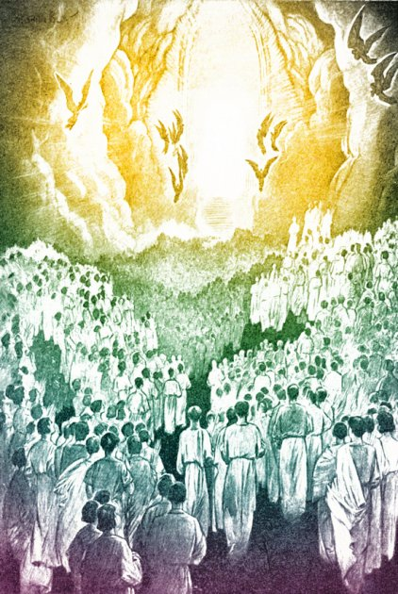
The Plan: The Story of Redemption, p. 42
“Sorrow filled heaven, as it was realized that man was lost and that world which God had created was to be filled with mortals doomed to misery, sickness, and death, and there was no way of escape for the offender. The whole family of Adam must die. I saw the lovely Jesus and beheld an expression of sympathy and sorrow upon His countenance. Soon I saw Him approach the exceeding bright light which enshrouded the Father. Said my accompanying angel, He is in close converse with His Father. The anxiety of the angels seemed to be intense while Jesus was communing with His Father.”

Slide 10
The Plan: Patriarchs and Prophets, p. 63
The Son of God, heaven's glorious Commander, was touched with pity for the fallen race. His heart was moved with infinite compassion as the woes of the lost world rose up before Him. But divine love had conceived a plan whereby man might be redeemed. The broken law of God demanded the life of the sinner. In all the universe there was but one who could, in behalf of man, satisfy its claims. Since the divine law is as sacred as God Himself, only one equal with God could make atonement for its transgression. None but Christ could redeem fallen man from the curse of the law and bring him again into harmony with Heaven.

Slide 11
The Plan: Patriarchs and Prophets, p. 63
Christ would take upon Himself the guilt and shame of sin—sin so offensive to a holy God that it must separate the Father and His Son. Christ would reach to the depths of misery to rescue the ruined race. Before the Father He pleaded in the sinner's behalf, while the host of heaven awaited the result with an intensity of interest that words cannot express. Long continued was that mysterious communing—“the counsel of peace” (Zechariah 6:13) for the fallen sons of men.

Slide 12
The Plan: Patriarchs and Prophets, p. 63
The plan of salvation had been laid before the creation of the earth; for Christ is “the Lamb slain from the foundation of the world” (Revelation 13:8); yet it was a struggle, even with the King of the universe, to yield up His Son to die for the guilty race. But “God so loved the world, that He gave His only-begotten Son, that whosoever believeth in Him should not perish, but have everlasting life.” John 3:16. Oh, the mystery of redemption! the love of God for a world that did not love Him! Who can know the depths of that love which “passeth knowledge”? Through endless ages immortal minds, seeking to comprehend the mystery of that incomprehensible love, will wonder and adore.

Slide 13
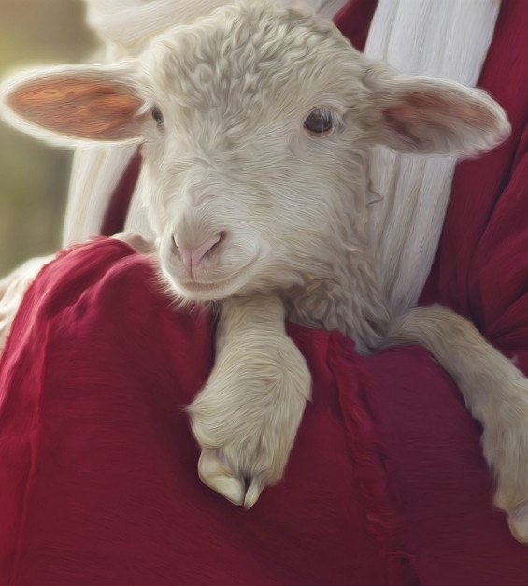
The Plan: Revelation 13:7-9
⁷ And it was given unto him to make war with the saints, and to overcome them: and power was given him over all kindreds, and tongues, and nations.
⁸ And all that dwell upon the earth shall worship him, whose names are not written in the book of life of the Lamb slain from the foundation of the world.
⁹ If any man have an ear, let him hear.

Slide 14
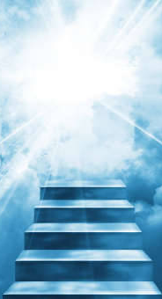
The Plan: The Story of Redemption, p. 42
“Three times He was shut in by the glorious light about the Father, and the third time He came out from the Father, His person could be seen. His countenance was calm, free from all perplexity and doubt, and shone with benevolence and loveliness, such as words cannot express.
He then made known to the angelic host that a way of escape had been made for lost man. He told them that He had been pleading with His Father, and had offered to give His life a ransom, to take the sentence of death upon Himself, that through Him man might find pardon; that through the merits of His blood, and obedience to the law of God, they could have the favor of God and be brought into the beautiful garden and eat of the fruit of the tree of life.”

Slide 15
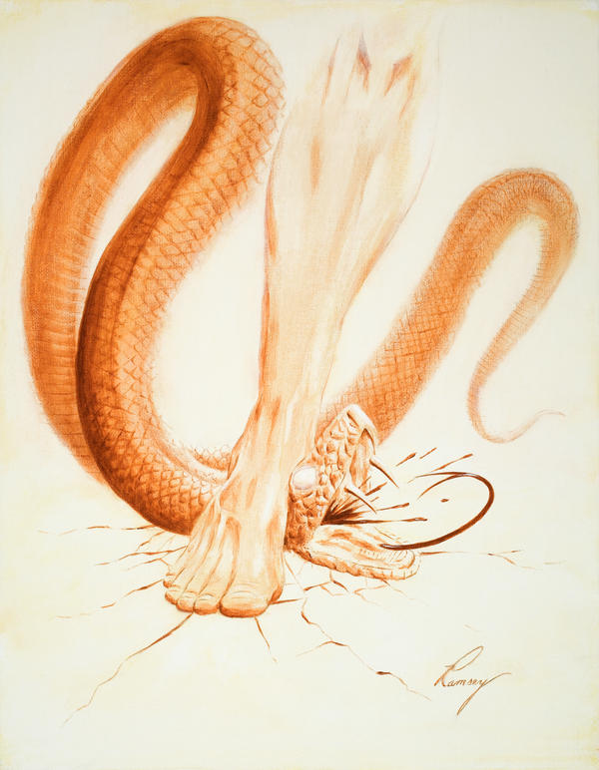
The Prophecy: Genesis 3:14-15
¹⁴ And the Lord God said unto the serpent, Because thou hast done this, thou art cursed above all cattle, and above every beast of the field; upon thy belly shalt thou go, and dust shalt thou eat all the days of thy life:
¹⁵ And I will put enmity between thee and the woman, and between thy seed and her seed; it shall bruise thy head, and thou shalt bruise his heel.

Slide 16
The Prophecy: SDABC V1 p. 233
“In this pronouncement is compressed the record of the great controversy between Christ and Satan, a battle that began in heaven (Rev. 12:7-9), was continued on earth, where Christ again defeated him (Heb. 2:14), and will terminate finally with Satan’s destruction at the end of the millennium (Rev. 20:10). Christ did not emerge from this battle unscathed. The nail marks in His hands and feet and the scar in His side will be eternal reminders of the fierce strife in which the serpent bruised the woman’s seed (John 20:25; Zech. 13:6; EW 53).”

Slide 17
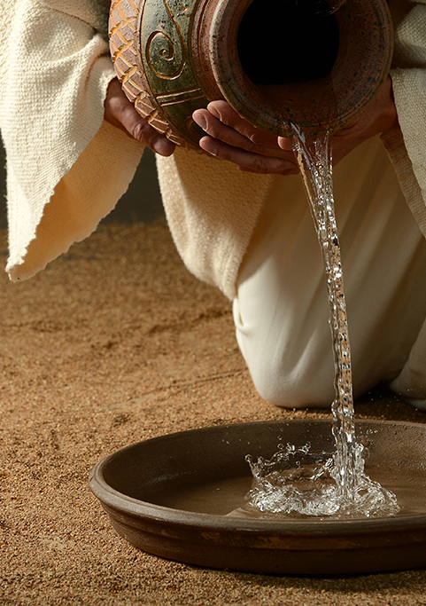
The Prophecy: Isaiah 53:4-6
⁴ Surely he hath borne our griefs, and carried our sorrows: yet we did esteem him stricken, smitten of God, and afflicted.
⁵ But he was wounded for our transgressions, he was bruised for our iniquities: the chastisement of our peace was upon him; and with his stripes we are healed.
⁶ All we like sheep have gone astray; we have turned every one to his own way; and the Lord hath laid on him the iniquity of us all.

Slide 18
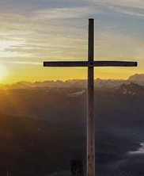
The Triumph: Matthew 27:50-54
⁵⁰ Jesus, when he had cried again with a loud voice, yielded up the ghost.
⁵¹ And, behold, the veil of the temple was rent in twain from the top to the bottom; and the earth did quake, and the rocks rent;
⁵² And the graves were opened; and many bodies of the saints which slept arose,

Slide 19
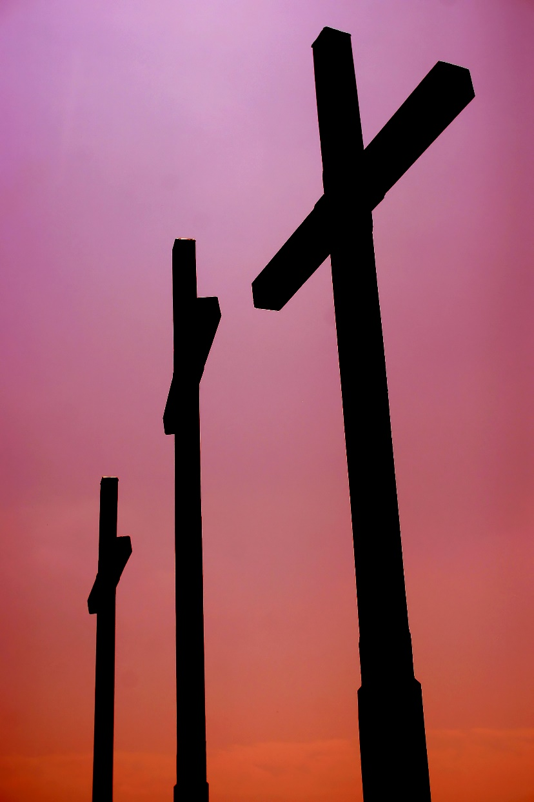
The Triumph: Matthew 27:53-54
⁵³ And came out of the graves after his resurrection, and went into the holy city, and appeared unto many.
⁵⁴ Now when the centurion, and they that were with him, watching Jesus, saw the earthquake, and those things that were done, they feared greatly, saying, Truly this was the Son of God.

Slide 20
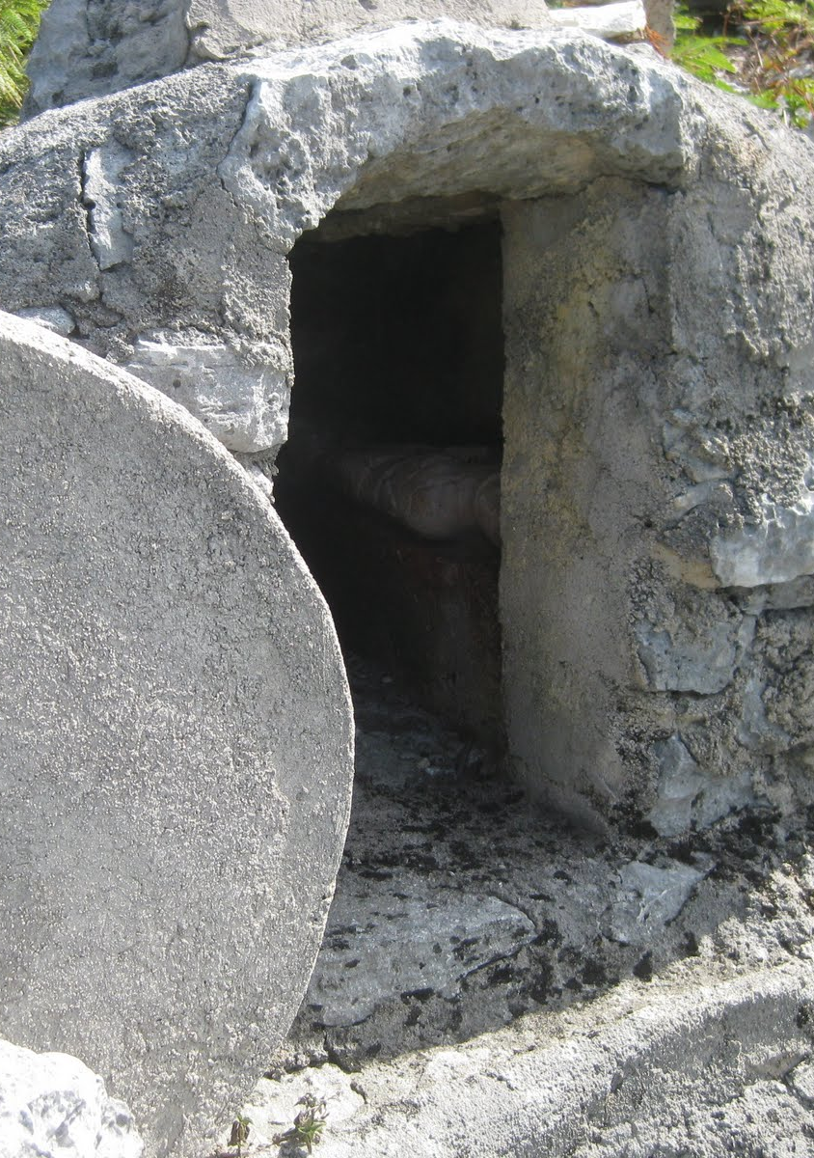
The Triumph: Matthew 28:1-9
28 In the end of the sabbath, as it began to dawn toward the first day of the week, came Mary Magdalene and the other Mary to see the sepulchre.
² And, behold, there was a great earthquake: for the angel of the Lord descended from heaven, and came and rolled back the stone from the door, and sat upon it.

Slide 21
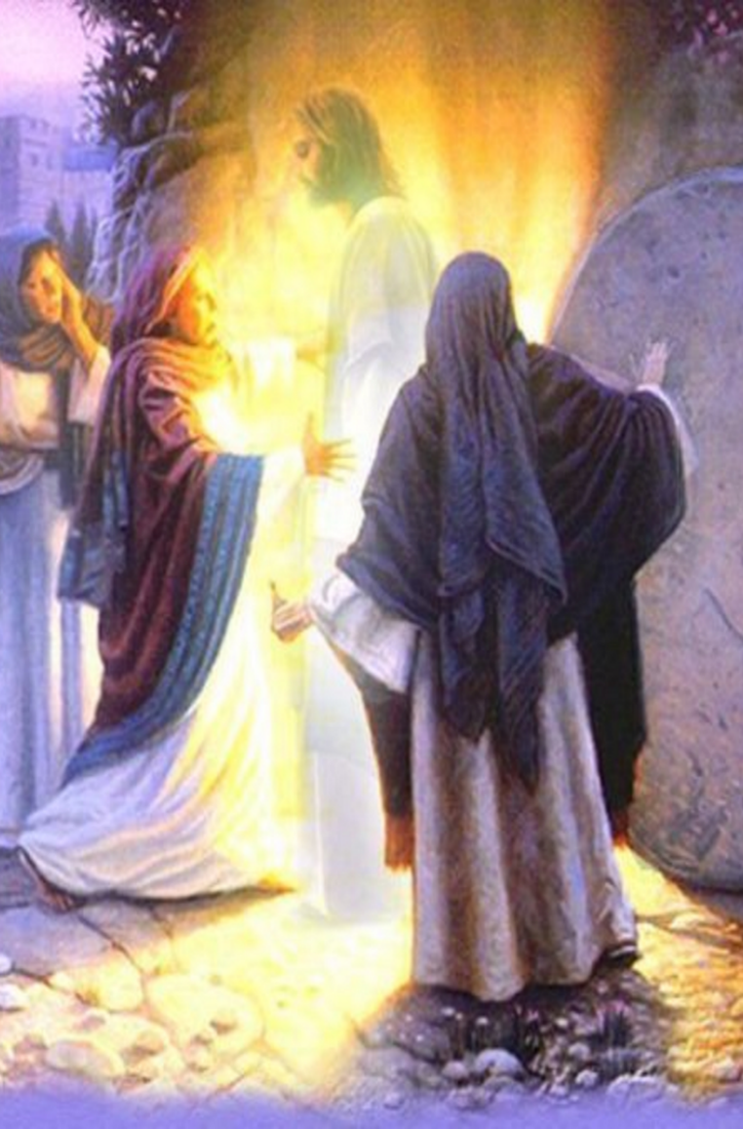
The Triumph: Matthew 28:3-9
³ His countenance was like lightning, and his raiment white as snow:
⁴ And for fear of him the keepers did shake, and became as dead men.
⁵ And the angel answered and said unto the women, Fear not ye: for I know that ye seek Jesus, which was crucified.

Slide 22
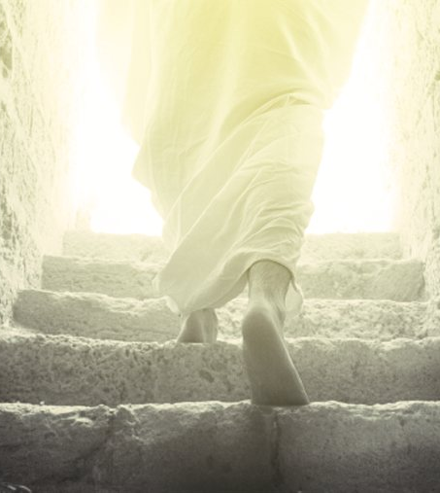
The Triumph: Matthew 28:6-9
⁶ He is not here: for he is risen, as he said. Come, see the place where the Lord lay.
⁷ And go quickly, and tell his disciples that he is risen from the dead; and, behold, he goeth before you into Galilee; there shall ye see him: lo, I have told you.

Slide 23
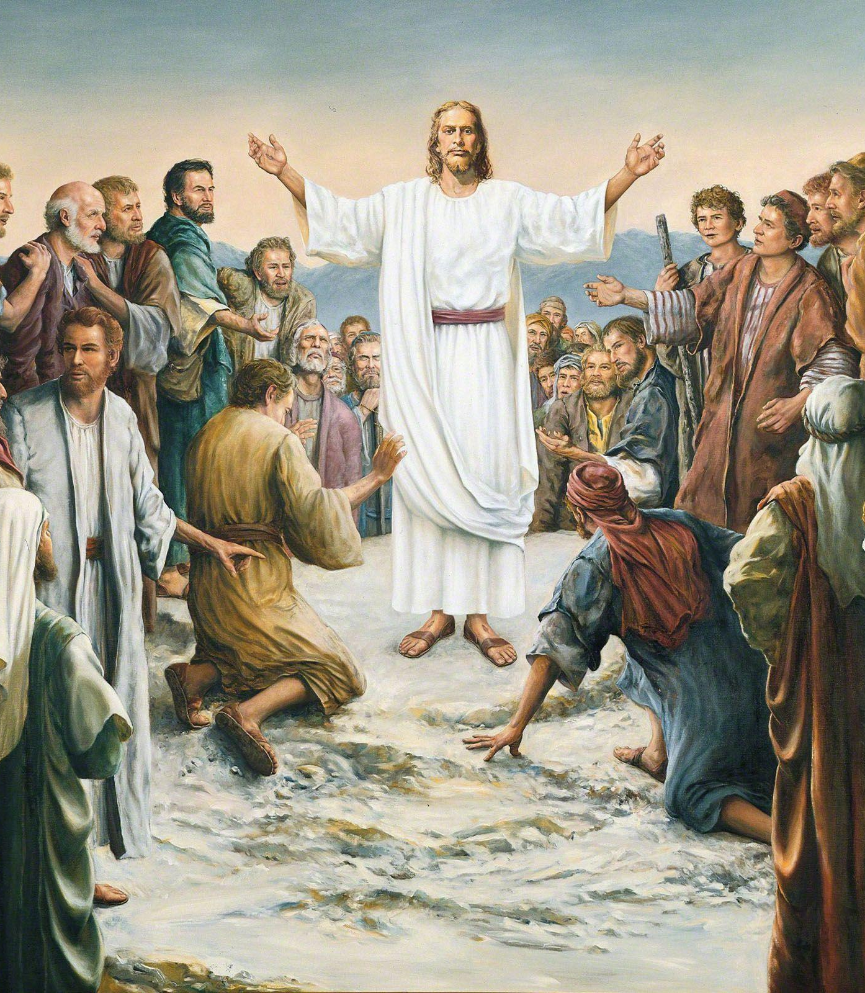
The Triumph: Matthew 28:8-9
⁸ And they departed quickly from the sepulchre with fear and great joy; and did run to bring his disciples word.
⁹ And as they went to tell his disciples, behold, Jesus met them, saying, All hail. And they came and held him by the feet, and worshipped him.

Slide 24
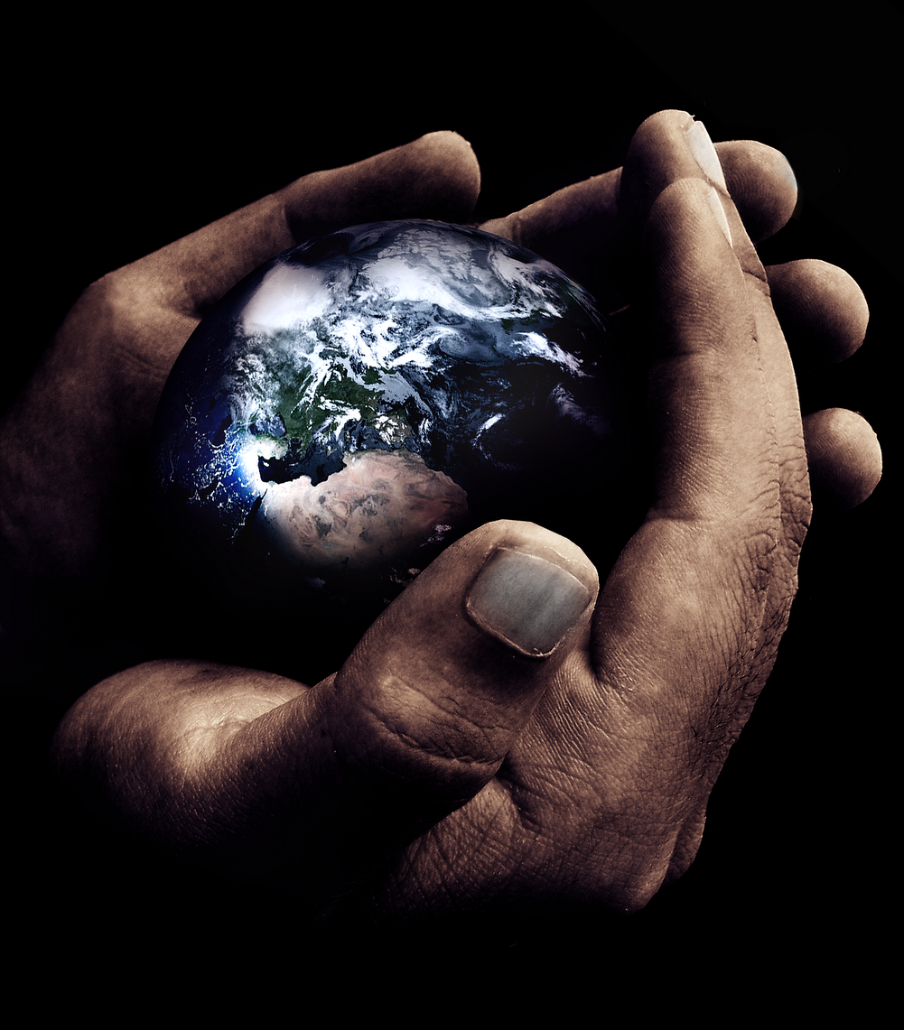
The Hope: Steps to Christ, p. 13
“But this great sacrifice was not made in order to create in the Father's heart a love for man, not to make Him willing to save. No, no! “God so loved the world, that He gave His only-begotten Son.” John 3:16…”

Slide 25
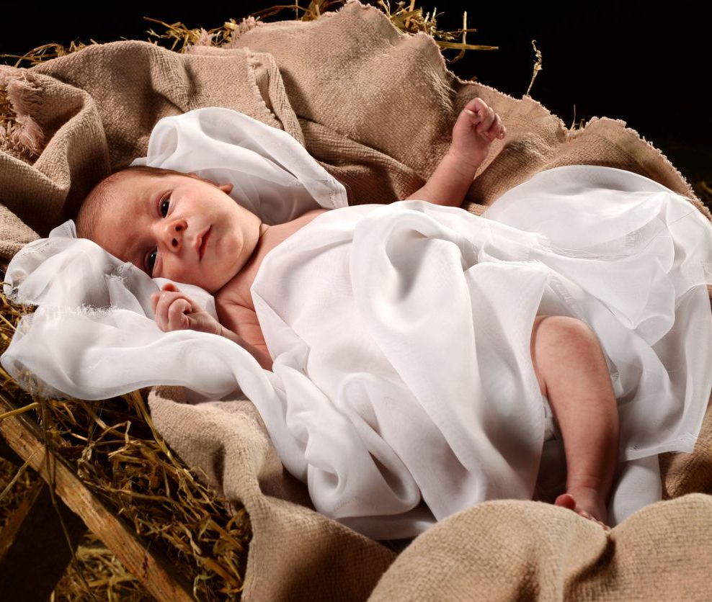
The Hope: Steps to Christ, p. 13
“The Father loves us, not because of the great propitiation, but He provided the propitiation because He loves us. Christ was the medium through which He could pour out His infinite love upon a fallen world. “God was in Christ, reconciling the world unto Himself.” 2 Corinthians 5:19...”

Slide 26
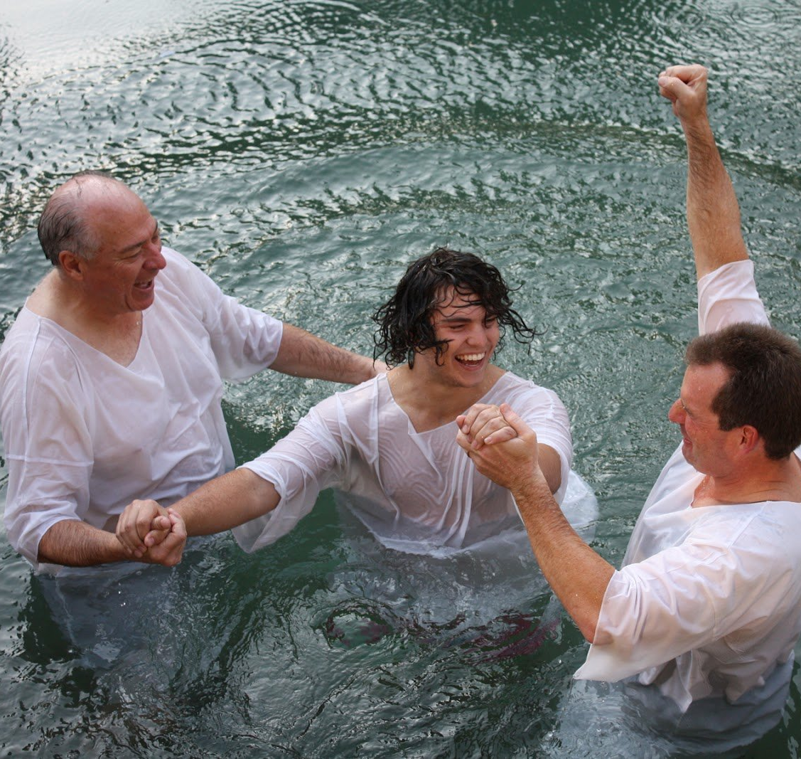
The Hope: 2 Corinthians 5:17-21
¹⁷ Therefore if any man be in Christ, he is a new creature: old things are passed away; behold, all things are become new.
¹⁸ And all things are of God, who hath reconciled us to himself by Jesus Christ, and hath given to us the ministry of reconciliation;
¹⁹ To wit, that God was in Christ, reconciling the world unto himself, not imputing their trespasses unto them; and hath committed unto us the word of reconciliation.

Slide 27

The Hope: SDABC V6 p. 869
The idea of reconciliation to God implies that in the past God and man enjoyed a state of fellowship, that there now exists a state of separation, that God has taken the initiative to terminate this state, and that it is therefore again possible for man to enjoy fellowship with God. Men sometimes conceive of God as a stern judge, angry with sinners, hard to be placated, unmerciful, ready to condemn. This characterization misrepresents Him and is an affront to Him.

Slide 28
The Hope: SDABC V6 p. 869
Christ did not have to go to the cross in order to appease God, but as a demonstration of His love. God did not demand the death of His son, but gave Him out of a heart of infinite love. On the other hand, God cannot set aside His law and avert the consequences that follow its violation without denying His own character, of which His law is an expression. God has always hated sin. He cannot, in fairness, treat good and evil alike. The atonement did not change the law; it changes the enmity that resulted from its violation.

Slide 29
The Hope: SDABC V6 p. 869
Reconciliation removes the enmity by means of a substitutionary fulfillment of the law’s requirements. The trespasses are there on the record, charged against those who committed them, but divine mercy and justice have found a way to deal with the offenders as though they were not guilty. Sin is a debt for which the sinner must someday render an account. But God will not impute sin to those who have been reconciled to Him through Christ.

Slide 30
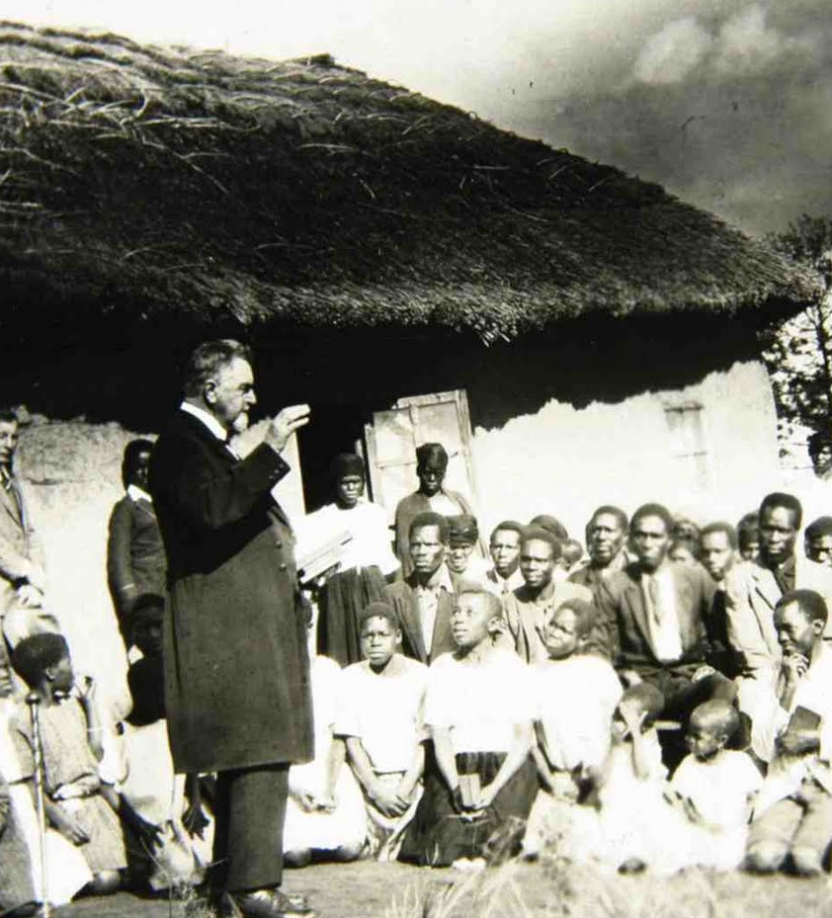
The Hope: 2 Corinthians 5:20-21
²⁰ Now then we are ambassadors for Christ, as though God did beseech you by us: we pray you in Christ's stead, be ye reconciled to God.
²¹ For he hath made him to be sin for us, who knew no sin; that we might be made the righteousness of God in him.

Slide 31
The Hope: SDABC V6 p. 870
It is the ambassador for Christ who speaks the “word of reconciliation.” God speaks to men through His ambassadors, even as He reconciled the world to Him through Christ… The guilt of all the sins of the world was reckoned to Him as if it were all His own. “He was numbered with the transgressors” (Mark 15:28). Christ became identified with sin; He took it to Himself in a real sense and felt the horror of separation from God. As our sins were reckoned to Christ, as if they were His, so His righteousness is reckoned to us as if it were ours.

Slide 32
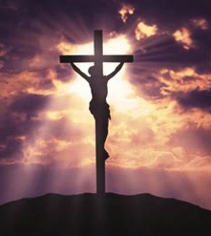
The Hope: Steps to Christ, p. 13-14
“God suffered with His Son. In the agony of Gethsemane, the death of Calvary, the heart of Infinite Love paid the price of our redemption. Jesus said, “Therefore doth My Father love Me, because I lay down My life, that I might take it again.” John 10:17…

Slide 33
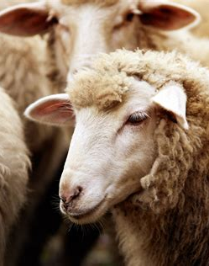
The Hope: John 10:11-18
¹¹ I am the good shepherd: the good shepherd giveth his life for the sheep.
¹² But he that is an hireling, and not the shepherd, whose own the sheep are not, seeth the wolf coming, and leaveth the sheep, and fleeth: and the wolf catcheth them, and scattereth the sheep.
¹³ The hireling fleeth, because he is an hireling, and careth not for the sheep.

Slide 34
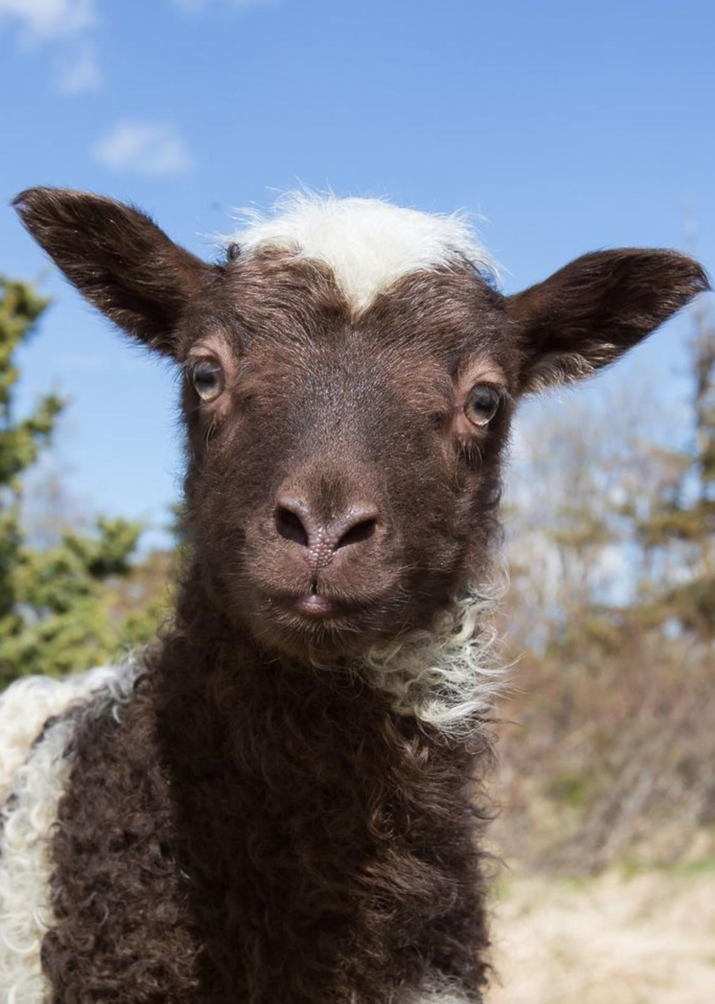
The Hope: John 10:14-18
¹⁴ I am the good shepherd, and know my sheep, and am known of mine.
¹⁵ As the Father knoweth me, even so know I the Father: and I lay down my life for the sheep.
¹⁶ And other sheep I have, which are not of this fold: them also I must bring, and they shall hear my voice; and there shall be one fold, and one shepherd.

Slide 35
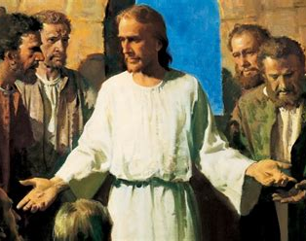
The Hope: John 10:17-18
¹⁷ Therefore doth my Father love me, because I lay down my life, that I might take it again.
¹⁸ No man taketh it from me, but I lay it down of myself. I have power to lay it down, and I have power to take it again. This commandment have I received of my Father.

Slide 36
The Hope: SDABC V5 p. 1006
Demonstrations of unselfish love such as Jesus’ voluntary offering of Himself to redeem mankind became added reasons for the Father’s love. The plan of salvation had been laid before the creation of the earth. The resurrection of Jesus was as much a part of the eternal plan as the crucifixion. Jesus would pass under the dominion of death for but a brief period and then come forth glorified to be the resurrection and the life and to be man’s intercessor.

Slide 37
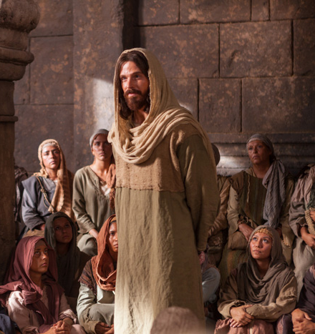
The Hope: Steps to Christ, p. 14
That is, “My Father has so loved you that He even loves Me more for giving My life to redeem you. In becoming your Substitute and Surety, by surrendering My life, by taking your liabilities, your transgressions, I am endeared to My Father; for by My sacrifice, God can be just, and yet the Justifier of him who believeth in Jesus.”

Slide 38
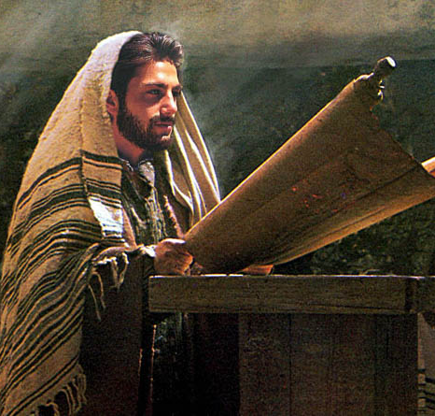
The Hope: Steps to Christ, p. 14
None but the Son of God could accomplish our redemption; for only He who was in the bosom of the Father could declare Him. Only He who knew the height and depth of the love of God could make it manifest. Nothing less than the infinite sacrifice made by Christ in behalf of fallen man could express the Father's love to lost humanity.

Slide 39
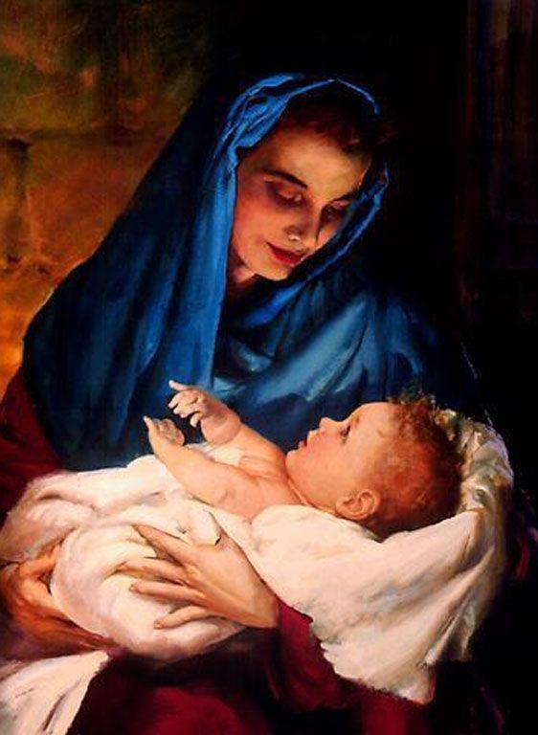
The Hope: Steps to Christ, p. 14
“God so loved the world, that He gave His only-begotten Son.” He gave Him not only to live among men, to bear their sins, and die their sacrifice. He gave Him to the fallen race. Christ was to identify Himself with the interests and needs of humanity. He who was one with God has linked Himself with the children of men by ties that are never to be broken. Jesus is “not ashamed to call them brethren” (Hebrews 2:11);

Slide 40
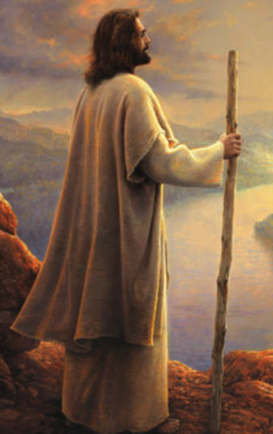
The Hope: Hebrews 2:6-12
⁶ But one in a certain place testified, saying, What is man, that thou art mindful of him? or the son of man that thou visitest him?
⁷ Thou madest him a little lower than the angels; thou crownedst him with glory and honour, and didst set him over the works of thy hands:
⁸ Thou hast put all things in subjection under his feet. For in that he put all in subjection under him, he left nothing that is not put under him. But now we see not yet all things put under him.

Slide 41
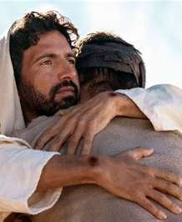
The Hope: Hebrews 2:9-12
⁹ But we see Jesus, who was made a little lower than the angels for the suffering of death, crowned with glory and honour; that he by the grace of God should taste death for every man.
¹⁰ For it became him, for whom are all things, and by whom are all things, in bringing many sons unto glory, to make the captain of their salvation perfect through sufferings.

Slide 42
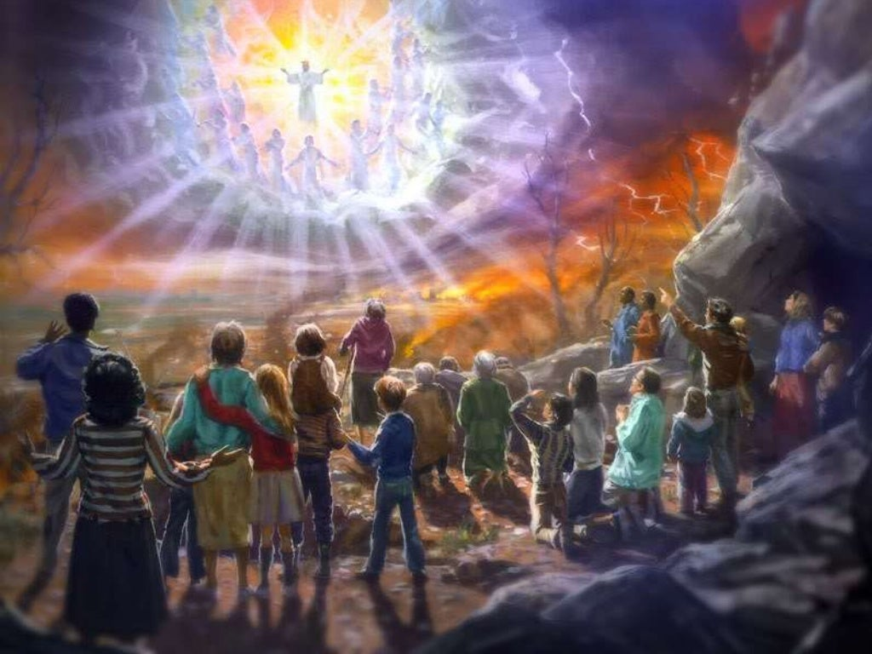
The Hope: Hebrews 2:11-12
¹¹ For both he that sanctifieth and they who are sanctified are all of one: for which cause he is not ashamed to call them brethren,
¹² Saying, I will declare thy name unto my brethren, in the midst of the church will I sing praise unto thee.

Slide 43
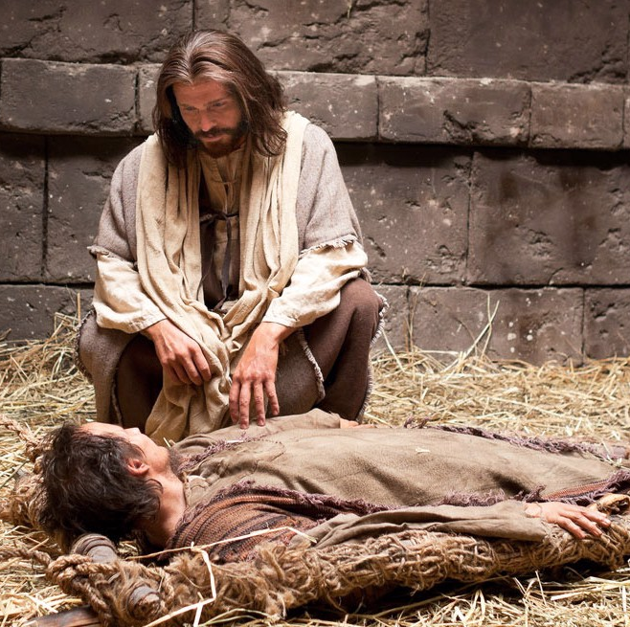
The Hope: Steps to Christ, p. 14
He is our Sacrifice, our Advocate, our Brother, bearing our human form before the Father's throne, and through eternal ages one with the race He has redeemed—the Son of man. And all this that man might be uplifted from the ruin and degradation of sin that he might reflect the love of God and share the joy of holiness.

Slide 44
The Hope: Steps to Christ, p. 15
The price paid for our redemption, the infinite sacrifice of our heavenly Father in giving His Son to die for us, should give us exalted conceptions of what we may become through Christ. As the inspired apostle John beheld the height, the depth, the breadth of the Father's love toward the perishing race, he was filled with adoration and reverence; and, failing to find suitable language in which to express the greatness and tenderness of this love, he called upon the world to behold it. “Behold, what manner of love the Father hath bestowed upon us, that we should be called the sons of God.” 1 John 3:1.

Slide 45
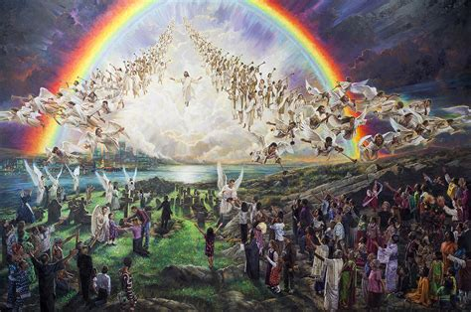
The Hope: 1 John 2:28-29
²⁸ And now, little children, abide in him; that, when he shall appear, we may have confidence, and not be ashamed before him at his coming.
²⁹ If ye know that he is righteous, ye know that every one that doeth righteousness is born of him.

Slide 46
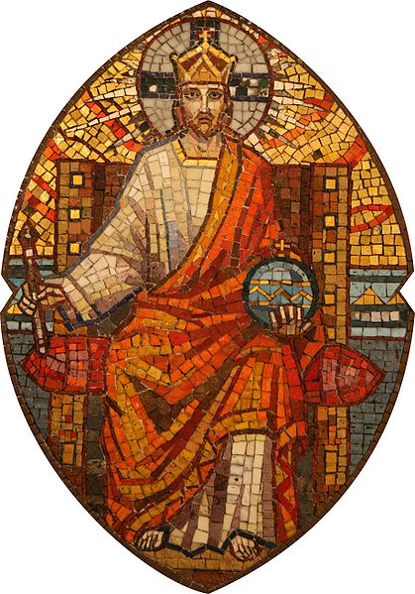
The Hope: 1 John 3:1-3
3 Behold, what manner of love the Father hath bestowed upon us, that we should be called the sons of God: therefore the world knoweth us not, because it knew him not.
² Beloved, now are we the sons of God, and it doth not yet appear what we shall be: but we know that, when he shall appear, we shall be like him; for we shall see him as he is.
³ And every man that hath this hope in him purifieth himself, even as he is pure.

Slide 47

The Hope: Patriarchs and Prophets, p. 65
Then joy, inexpressible joy, filled heaven. The glory and blessedness of a world redeemed, outmeasured even the anguish and sacrifice of the Prince of life. Through the celestial courts echoed the first strains of that song which was to ring out above the hills of Bethlehem—“Glory to God in the highest, and on earth peace, good will toward men.” Luke 2:14. With a deeper gladness now than in the rapture of the new creation, “the morning stars sang together, and all the sons of God shouted for joy.” Job 38:7.

Slide 48
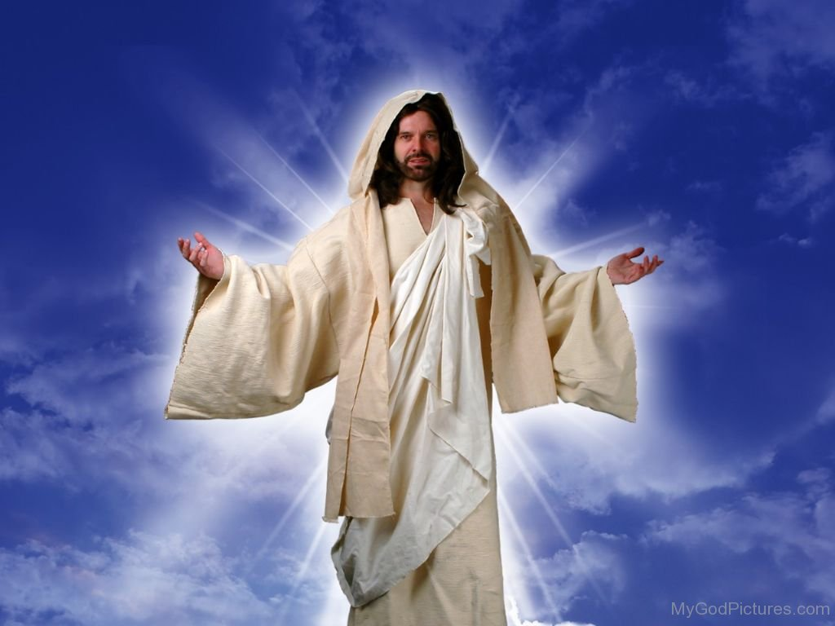
The Hope: Romans 5:11-21
¹¹ And not only so, but we also joy in God through our Lord Jesus Christ, by whom we have now received the atonement.
¹² Wherefore, as by one man sin entered into the world, and death by sin; and so death passed upon all men, for that all have sinned:

Slide 49
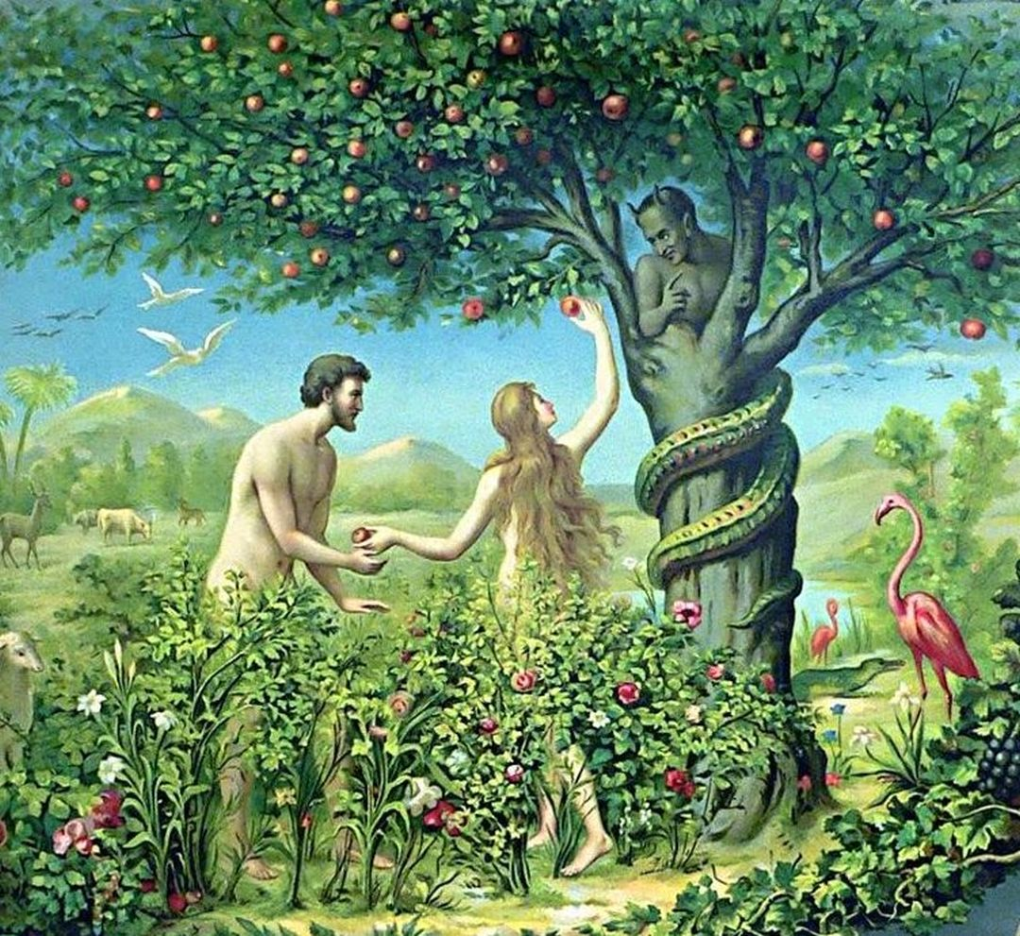
The Hope: Romans 5:13-21
¹³ (For until the law sin was in the world: but sin is not imputed when there is no law.
¹⁴ Nevertheless death reigned from Adam to Moses, even over them that had not sinned after the similitude of Adam's transgression, who is the figure of him that was to come.

Slide 50
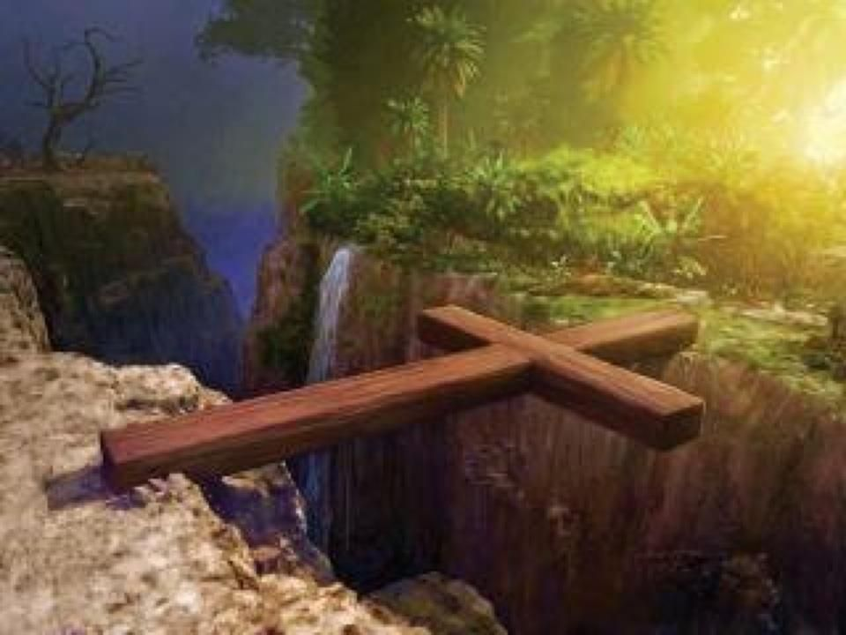
The Hope: Romans 5:15-21
¹⁵ But not as the offence, so also is the free gift. For if through the offence of one many be dead, much more the grace of God, and the gift by grace, which is by one man, Jesus Christ, hath abounded unto many.
¹⁶ And not as it was by one that sinned, so is the gift: for the judgment was by one to condemnation, but the free gift is of many offences unto justification.

Slide 51
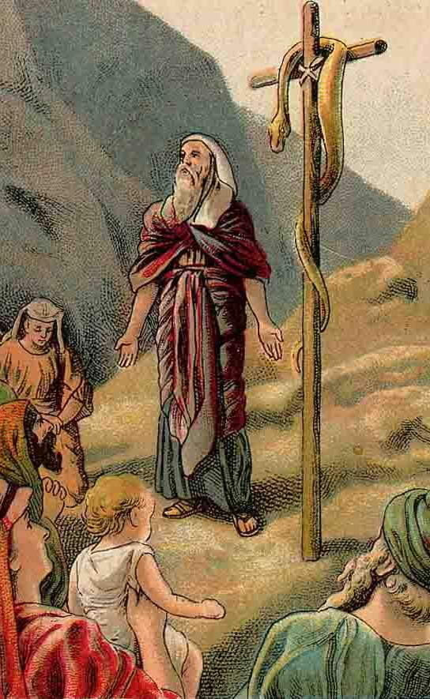
The Hope: Romans 5:17-21
¹⁷ For if by one man's offence death reigned by one; much more they which receive abundance of grace and of the gift of righteousness shall reign in life by one, Jesus Christ.)
¹⁸ Therefore as by the offence of one judgment came upon all men to condemnation; even so by the righteousness of one the free gift came upon all men unto justification of life.

Slide 52

The Hope: Romans 5:19-21
¹⁹ For as by one man's disobedience many were made sinners, so by the obedience of one shall many be made righteous.
²⁰ Moreover the law entered, that the offence might abound. But where sin abounded, grace did much more abound:
²¹ That as sin hath reigned unto death, even so might grace reign through righteousness unto eternal life by Jesus Christ our Lord.

Slide 53
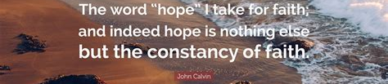
The Assurance: Hebrews 6:11-12
¹¹ And we desire that every one of you do shew the same diligence to the full assurance of hope unto the end:
¹² That ye be not slothful, but followers of them who through faith and patience inherit the promises.

Slide 54

The Assurance: Romans 8:24-25
²⁴ For we are saved by hope: but hope that is seen is not hope: for what a man seeth, why doth he yet hope for?
²⁵ But if we hope for that we see not, then do we with patience wait for it.

Slide 55
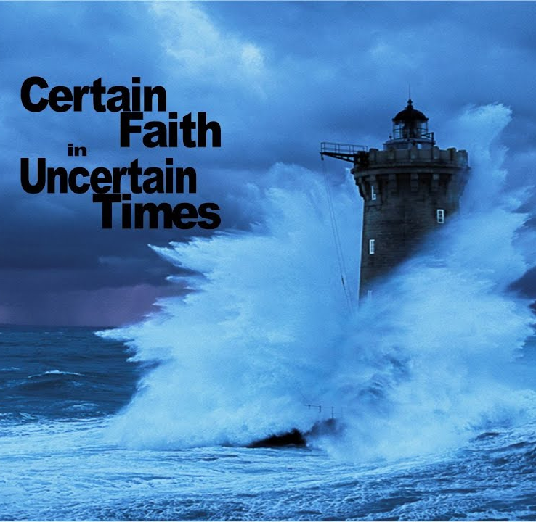
The Assurance: Counsels for the Church, p. 162
“Jesus will be the helper of all who put their trust in Him. Those who are connected with Christ have happiness at their command. They follow in the path where their Saviour leads, for His sake crucifying self with the affections and lusts. These persons have built their hopes on Christ, and the storms of earth are powerless to sweep them from the sure foundation.”

Slide 56
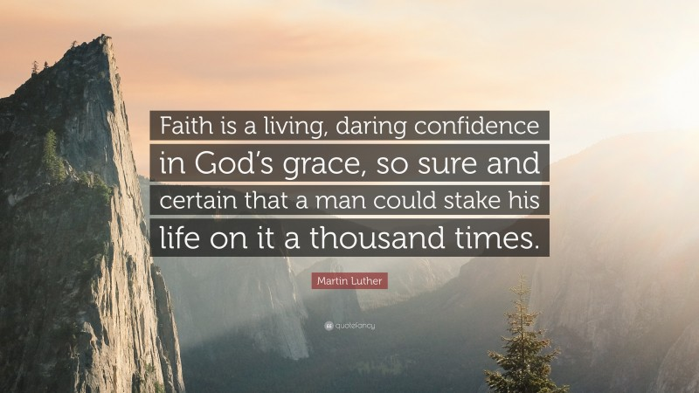

Slide 57
Thank you!
Happy Sabbath!!

