Slide 1
Death and Taxes
Psalm 139, Ecclesiastes 3, Isaiah 40
Lesson 3, 4th Quarter 2022

Slide 2

Psalm 139:1-16
139 O lord, thou hast searched me, and known me.
² Thou knowest my downsitting and mine uprising, thou understandest my thought afar off.
³ Thou compassest my path and my lying down, and art acquainted with all my ways.
⁴ For there is not a word in my tongue, but, lo, O Lord, thou knowest it altogether.

Slide 3
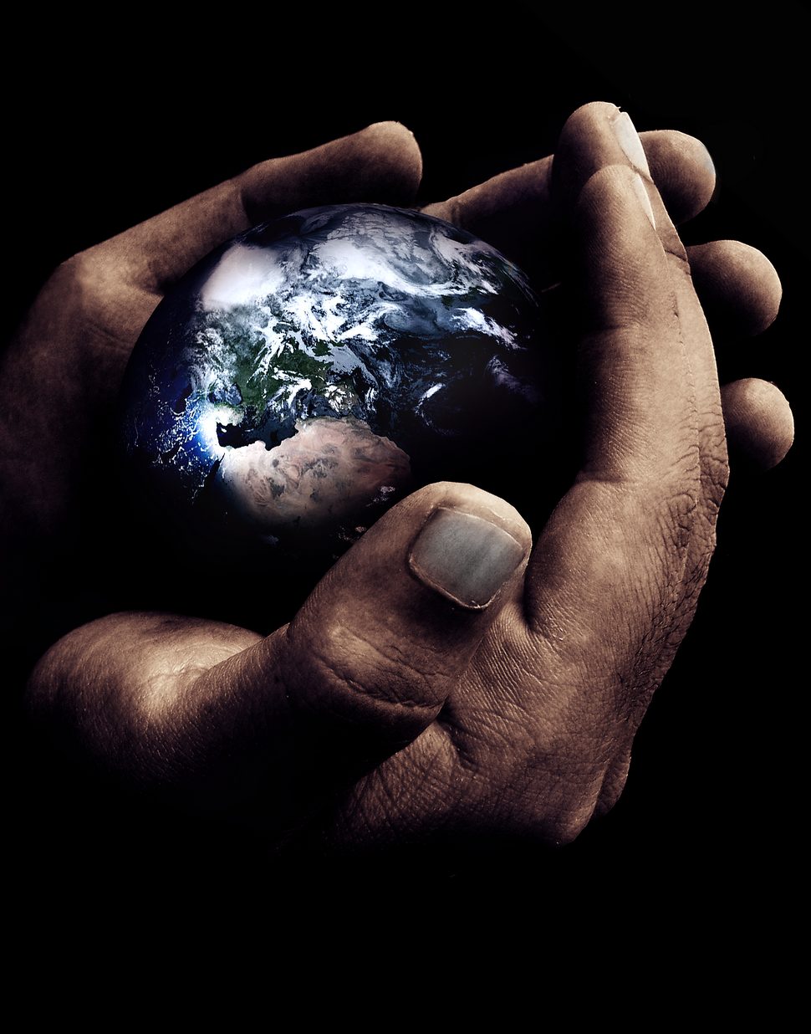
Psalm 139:5-16
⁵ Thou hast beset me behind and before, and laid thine hand upon me.
⁶ Such knowledge is too wonderful for me; it is high, I cannot attain unto it.
⁷ Whither shall I go from thy spirit? or whither shall I flee from thy presence?
⁸ If I ascend up into heaven, thou art there: if I make my bed in hell, behold, thou art there.
“she’ol,” the grave. A figurative expression denoting the place where men go at death.

Slide 4
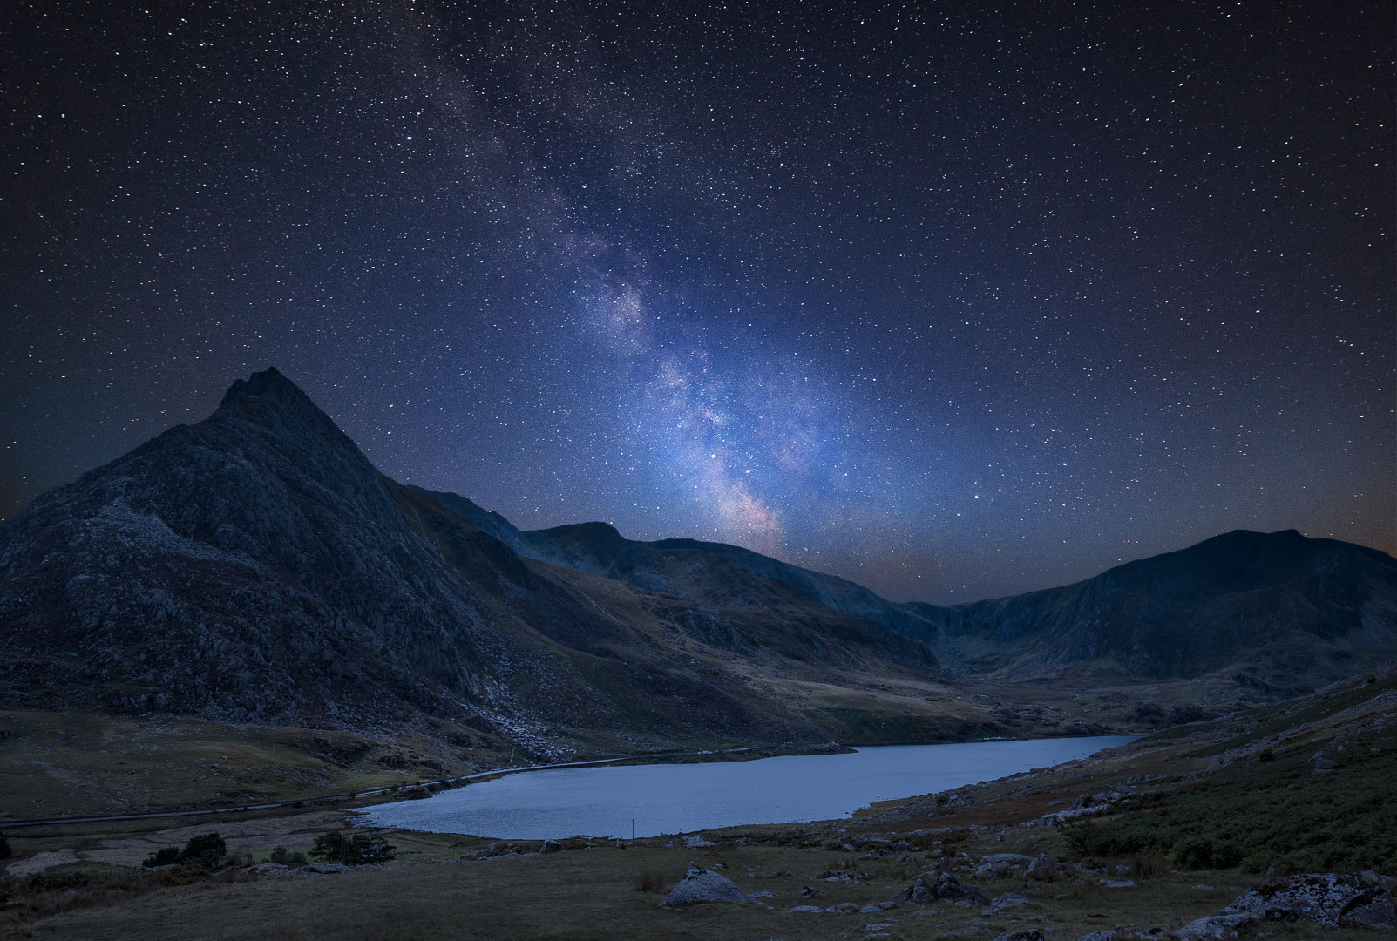
Psalm 139:9-16
⁹ If I take the wings of the morning, and dwell in the uttermost parts of the sea;
¹⁰ Even there shall thy hand lead me, and thy right hand shall hold me.
¹¹ If I say, Surely the darkness shall cover me; even the night shall be light about me.
¹² Yea, the darkness hideth not from thee; but the night shineth as the day: the darkness and the light are both alike to thee.

Slide 5
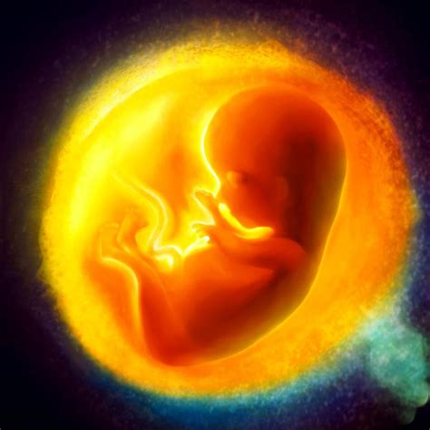
Psalm 139:13-16
¹³ For thou hast possessed my reins: thou hast covered me in my mother's womb.
¹⁴ I will praise thee; for I am fearfully and wonderfully made: marvellous are thy works; and that my soul knoweth right well.
¹⁵ My substance was not hid from thee, when I was made in secret, and curiously wrought in the lowest parts of the earth.
¹⁶ Thine eyes did see my substance, yet being unperfect; and in thy book all my members were written, which in continuance were fashioned, when as yet there was none of them.

Slide 6
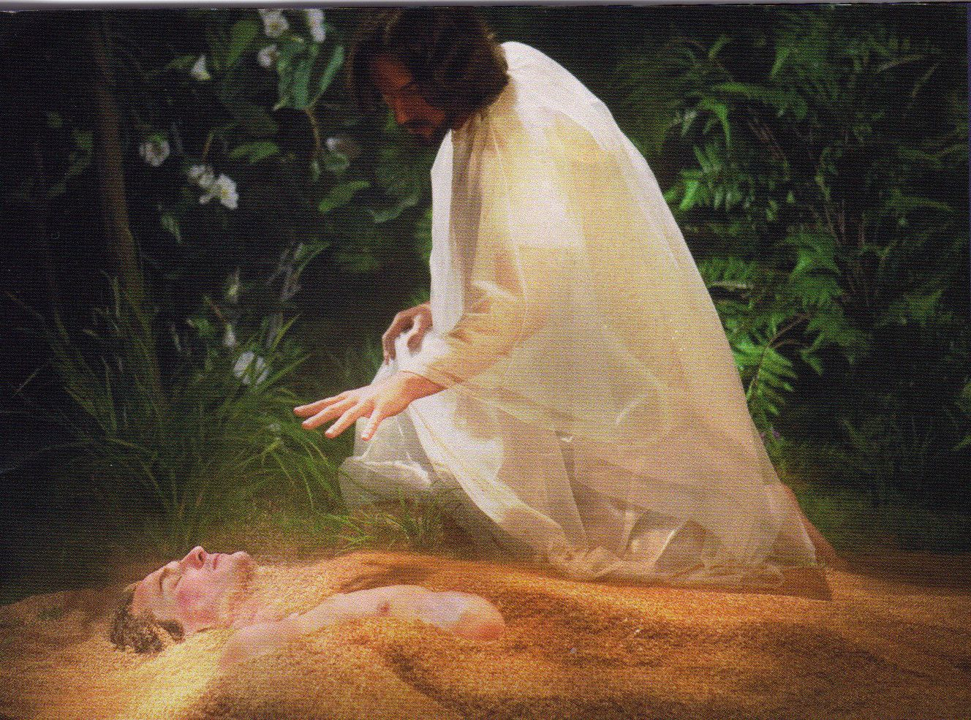
Genesis 2:7
⁷ And the Lord God formed man of the dust of the ground, and breathed into his nostrils the breath of life; and man became a living soul.

Slide 7
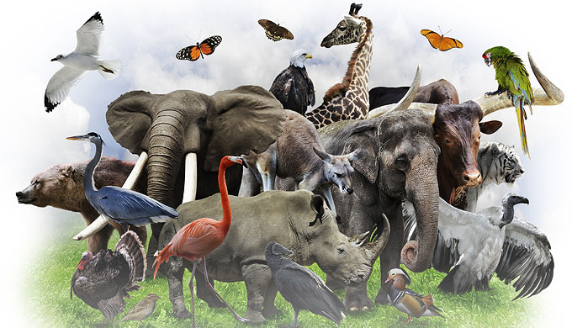
Genesis 2:19
¹⁹ And out of the ground the Lord God formed every beast of the field, and every fowl of the air; and brought them unto Adam to see what he would call them: and whatsoever Adam called every living creature, that was the name thereof.

Slide 8
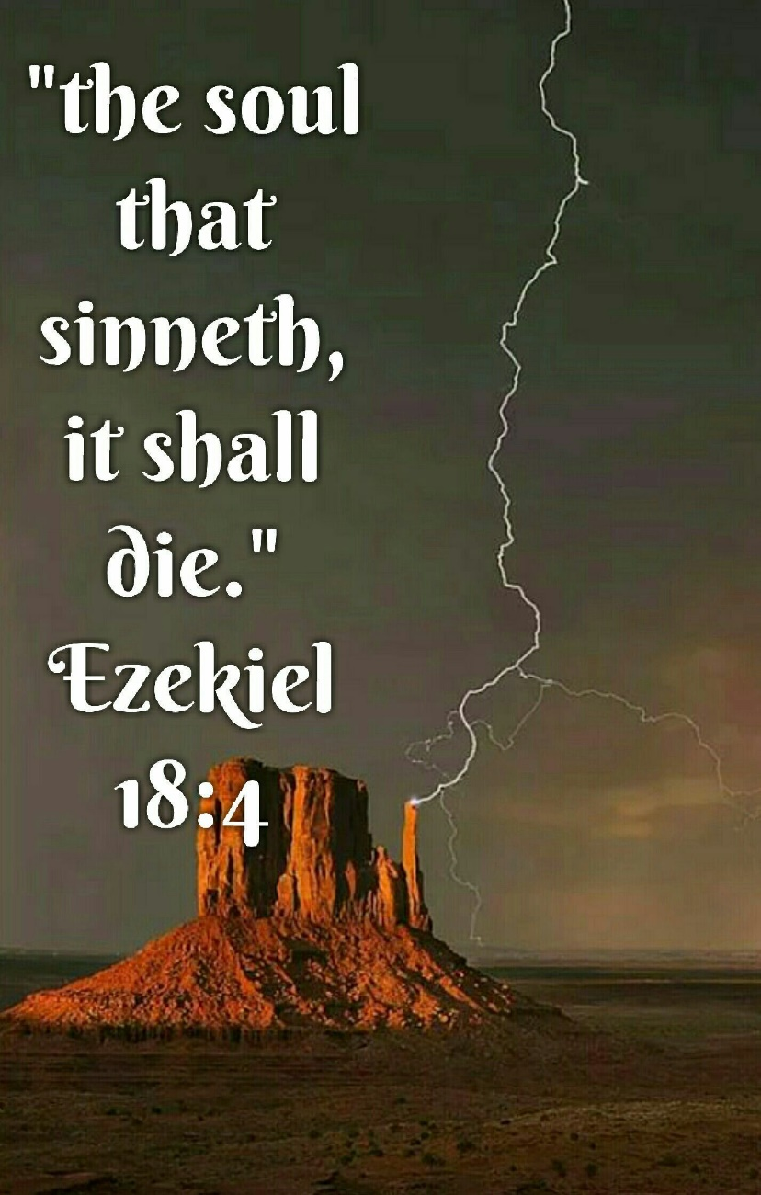
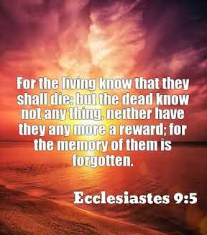
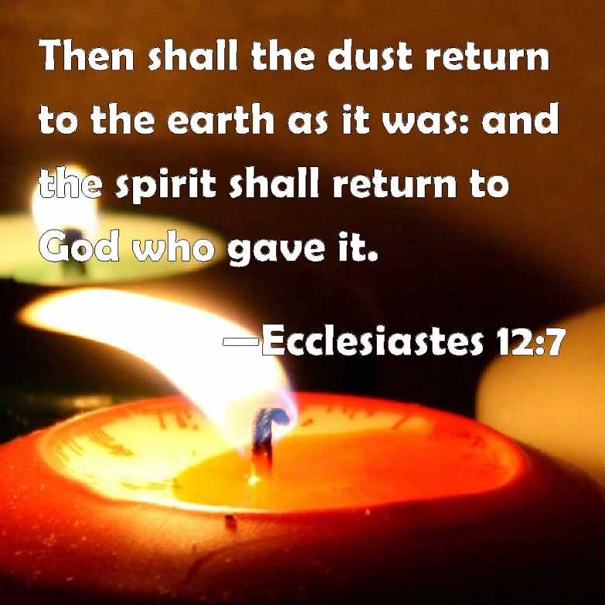
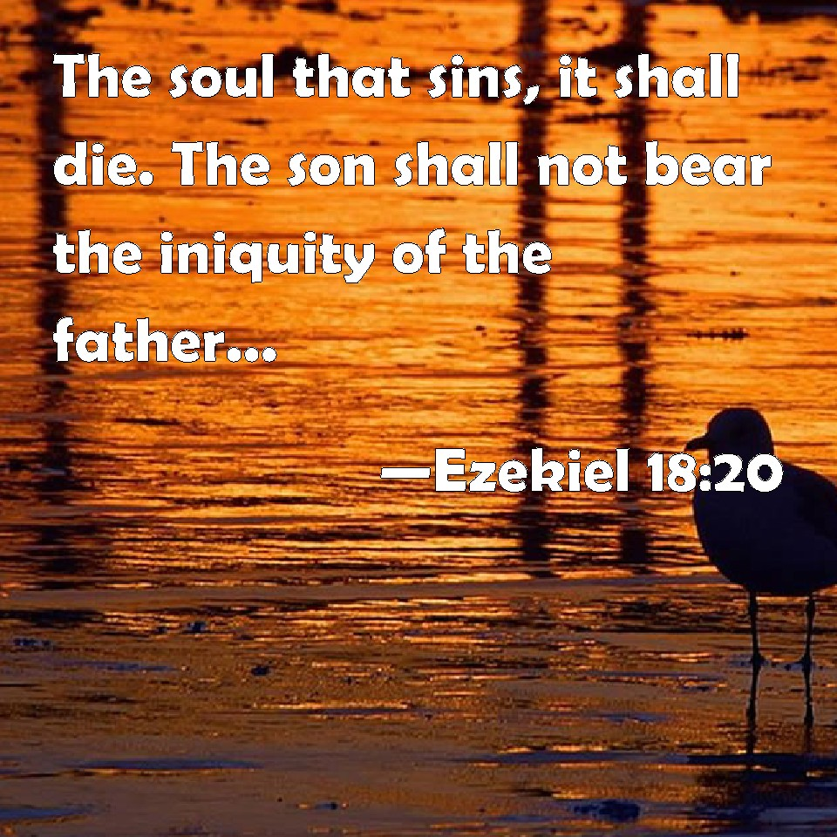
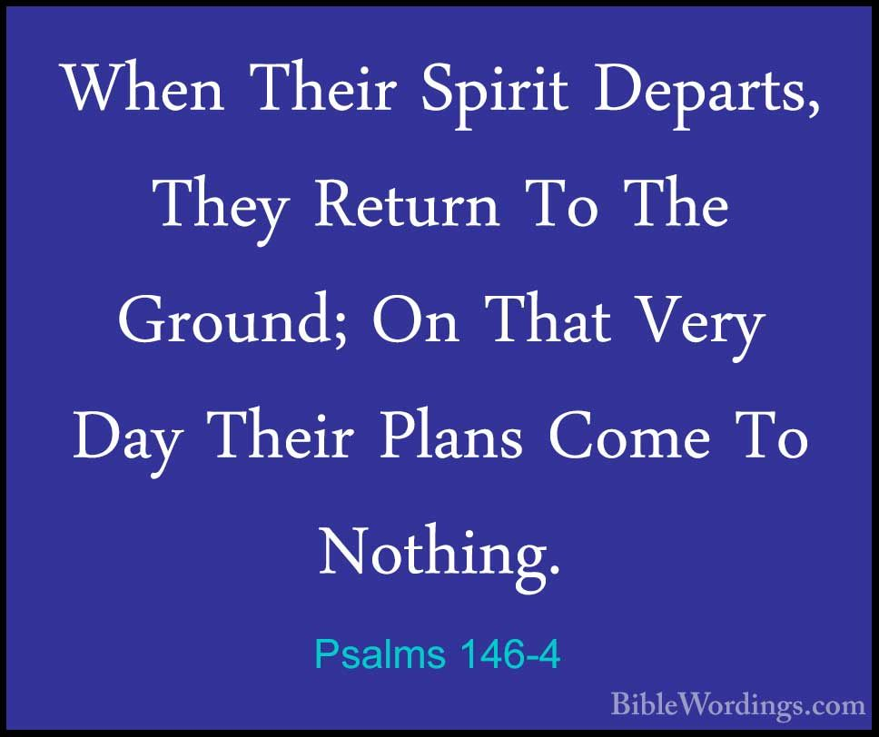
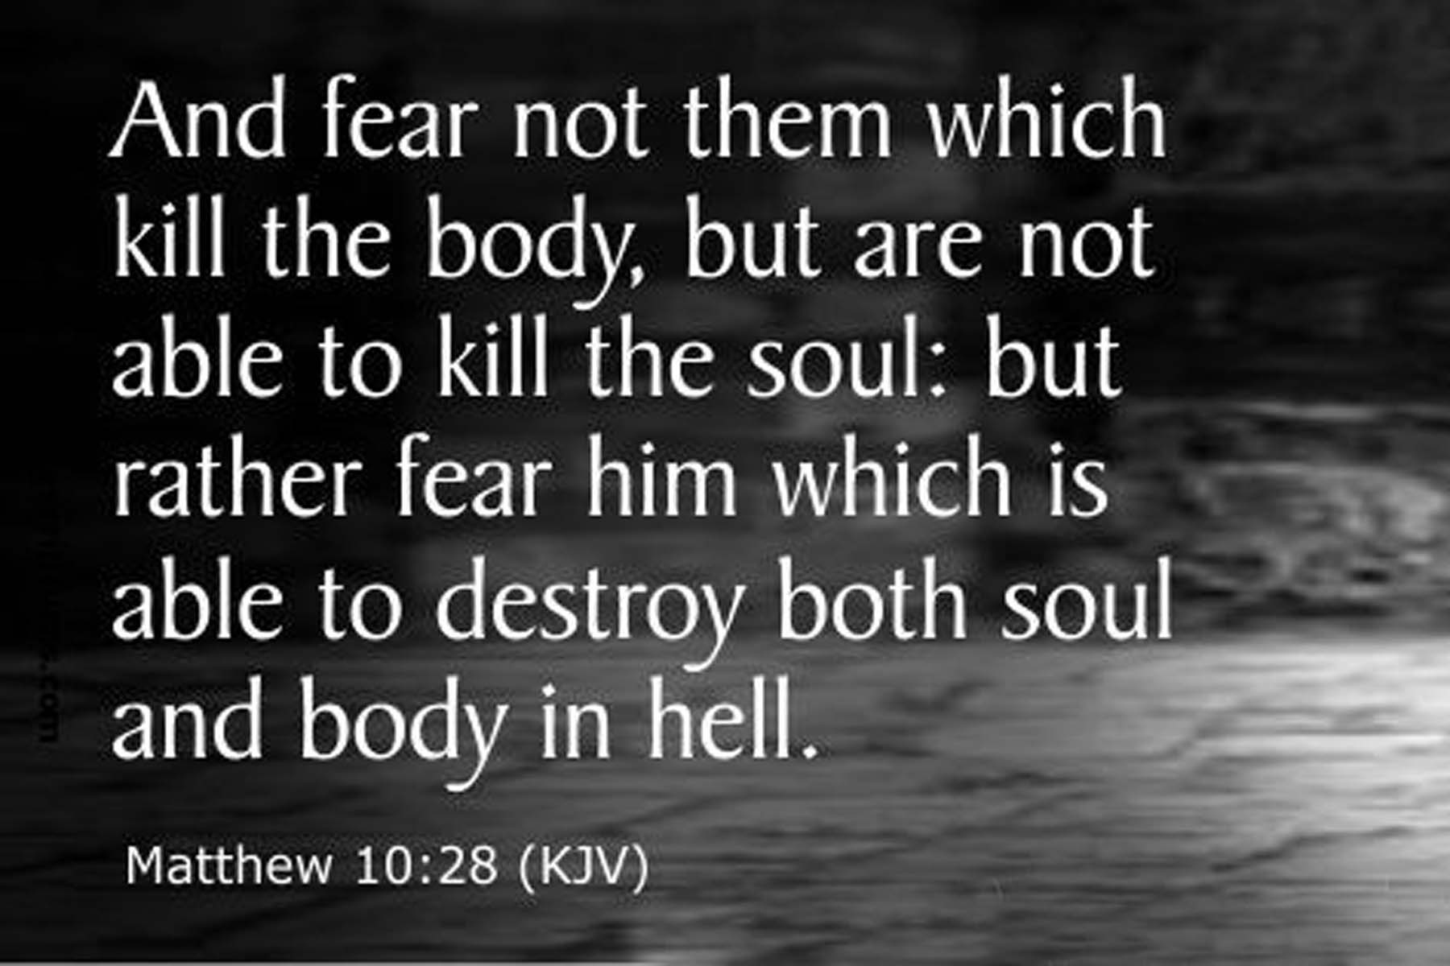
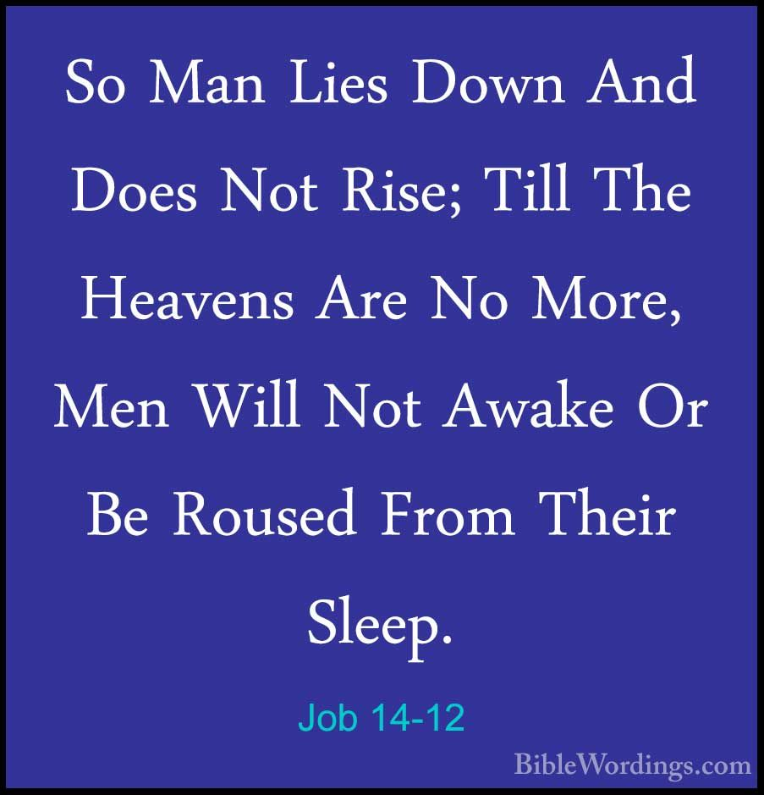
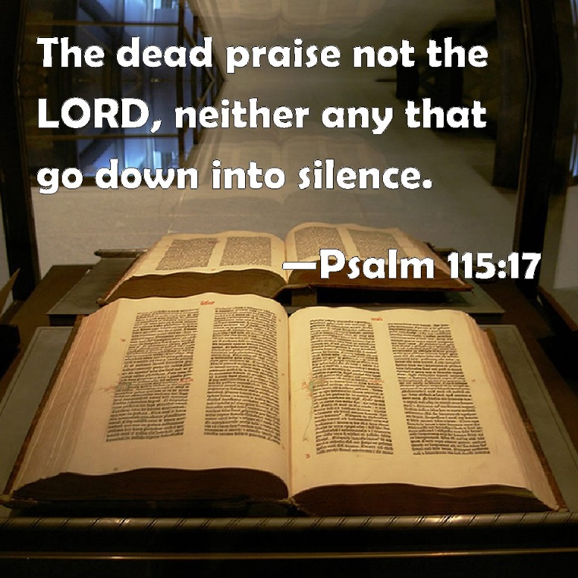

Slide 9
A Comparison: Who can you believe?
Genesis 2:16-17
Genesis 3:4
¹⁶ And the Lord God commanded the man, saying, Of every tree of the garden thou mayest freely eat:
¹⁷ But of the tree of the knowledge of good and evil, thou shalt not eat of it: for in the day that thou eatest thereof thou shalt surely die.
⁴ And the serpent said unto the woman, Ye shall not surely die:

Slide 10
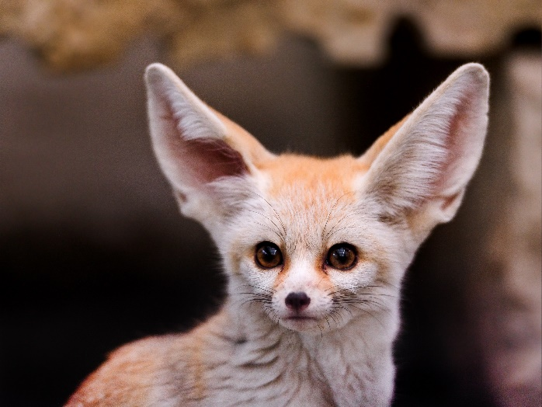
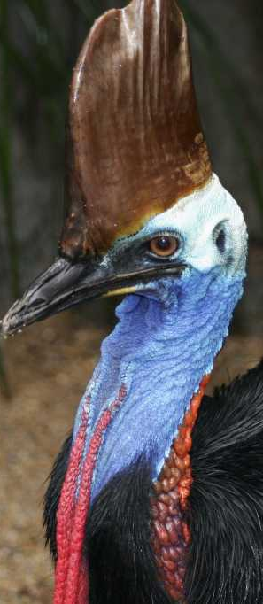
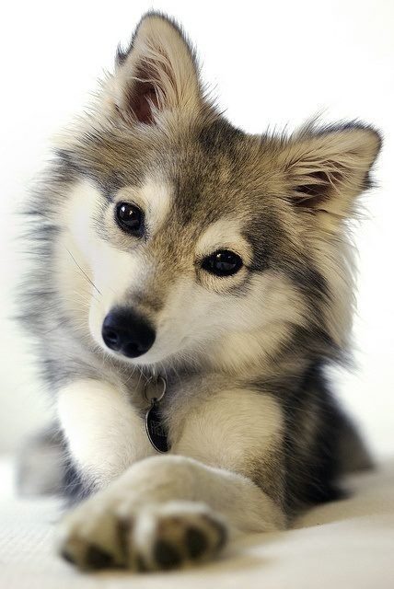
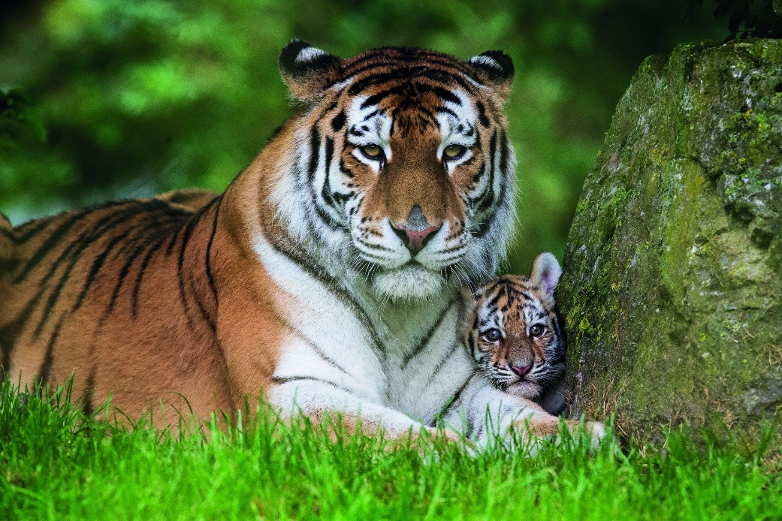
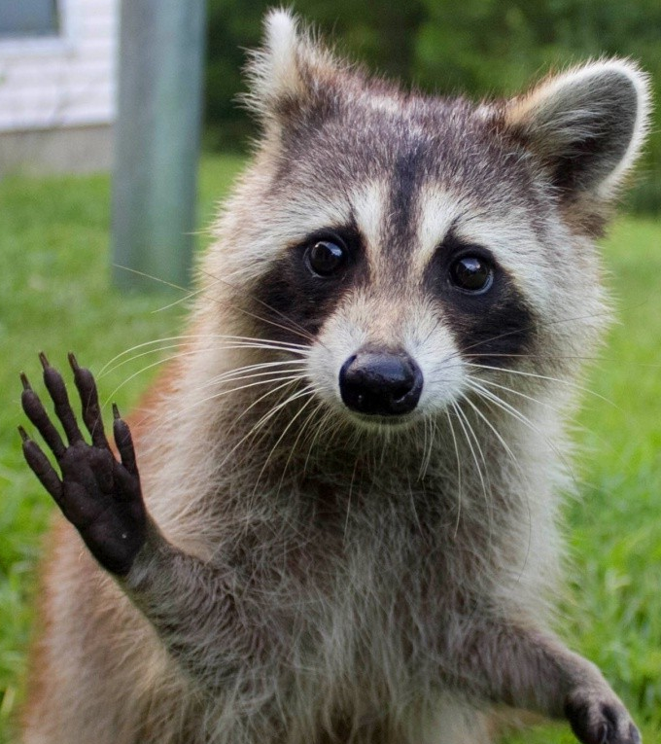
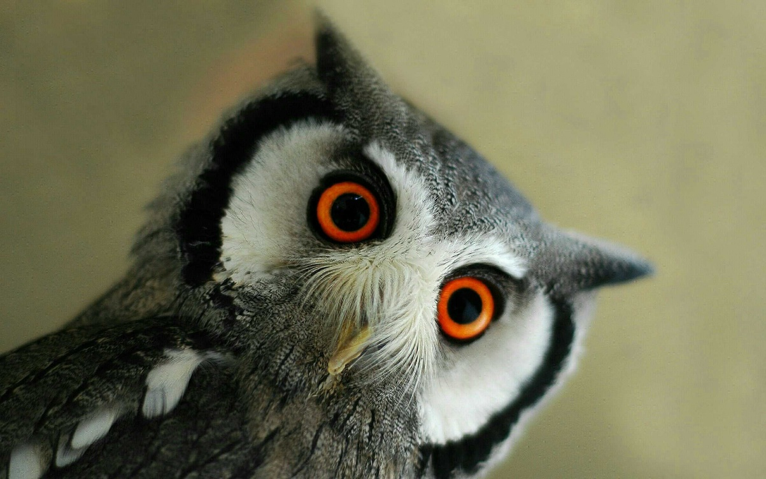
Job 12:7-10
⁷ But ask now the beasts, and they shall teach thee; and the fowls of the air, and they shall tell thee:
⁸ Or speak to the earth, and it shall teach thee: and the fishes of the sea shall declare unto thee.
⁹ Who knoweth not in all these that the hand of the Lord hath wrought this?
¹⁰ In whose hand is the soul of every living thing, and the breath of all mankind.

Slide 11

Ecclesiastes 3:1-21
3 To every thing there is a season, and a time to every purpose under the heaven:
² A time to be born, and a time to die; a time to plant, and a time to pluck up that which is planted;
³ A time to kill, and a time to heal; a time to break down, and a time to build up;
⁴ A time to weep, and a time to laugh; a time to mourn, and a time to dance;

Slide 12

Ecclesiastes 3:5-21
⁵ A time to cast away stones, and a time to gather stones together; a time to embrace, and a time to refrain from embracing;
⁶ A time to get, and a time to lose; a time to keep, and a time to cast away;
⁷ A time to rend, and a time to sew; a time to keep silence, and a time to speak;
⁸ A time to love, and a time to hate; a time of war, and a time of peace.

Slide 13
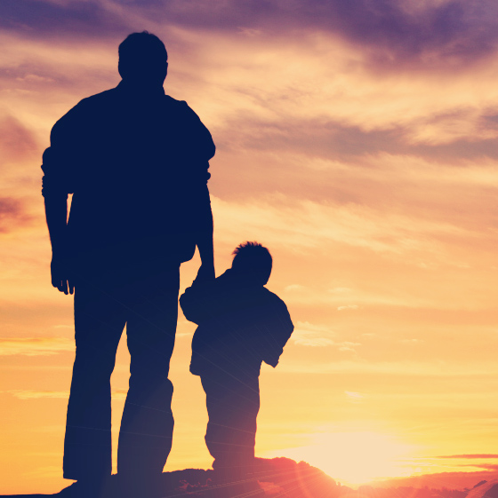
Ecclesiastes 3:9-21
No one can really work it all out for themselves! We need our Heavenly Father’s help to succeed. He alone can teach us the mysteries of nature as well as those of eternal life in Him.
⁹ What profit hath he that worketh in that wherein he laboureth?
¹⁰ I have seen the travail, which God hath given to the sons of men to be exercised in it.
¹¹ He hath made every thing beautiful in his time: also he hath set the world in their heart, so that no man can find out the work that God maketh from the beginning to the end.
¹² I know that there is no good in them, but for a man to rejoice, and to do good in his life.

Slide 14
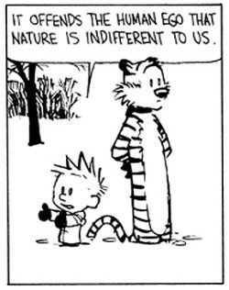
Ecclesiastes 3:13-21
¹³ And also that every man should eat and drink, and enjoy the good of all his labour, it is the gift of God.
¹⁴ I know that, whatsoever God doeth, it shall be for ever: nothing can be put to it, nor any thing taken from it: and God doeth it, that men should fear before him.
¹⁵ That which hath been is now; and that which is to be hath already been; and God requireth that which is past.

Slide 15
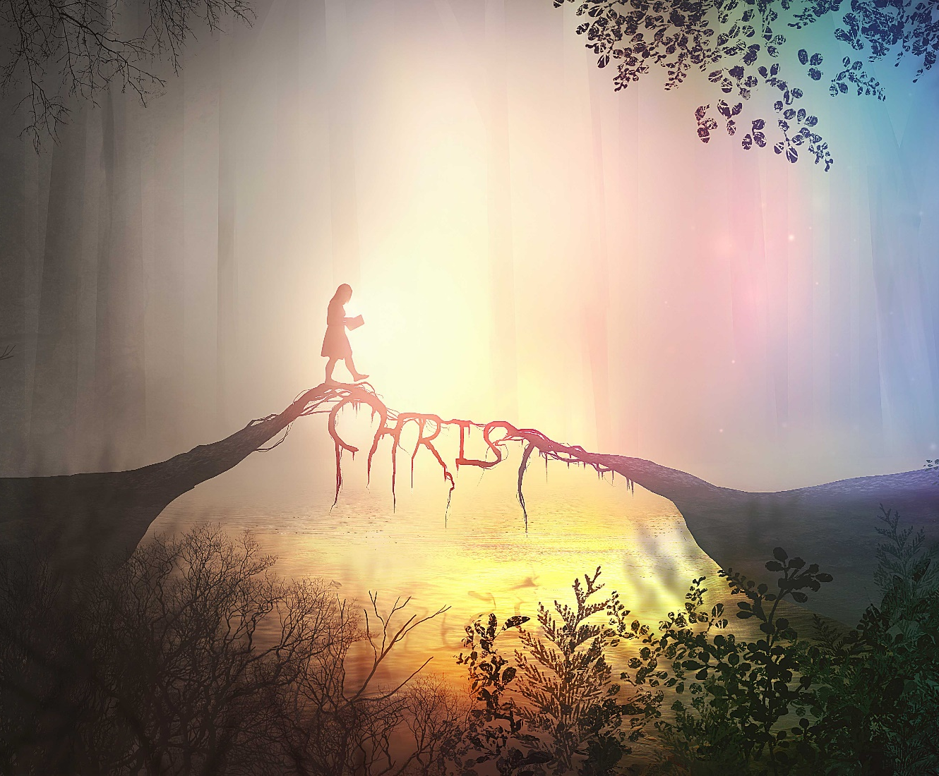
Ecclesiastes 3:16-21
¹⁶ And moreover I saw under the sun the place of judgment, that wickedness was there; and the place of righteousness, that iniquity was there.
¹⁷ I said in mine heart, God shall judge the righteous and the wicked: for there is a time there for every purpose and for every work.

Slide 16
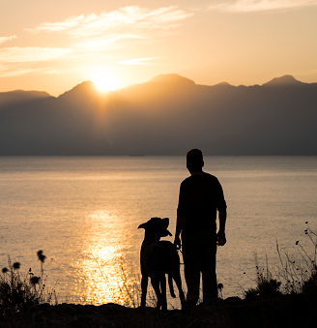
Ecclesiastes 3:18-21
¹⁸ I said in mine heart concerning the estate of the sons of men, that God might manifest them, and that they might see that they themselves are beasts.
¹⁹ For that which befalleth the sons of men befalleth beasts; even one thing befalleth them: as the one dieth, so dieth the other; yea, they have all one breath; so that a man hath no preeminence above a beast: for all is vanity.

Slide 17
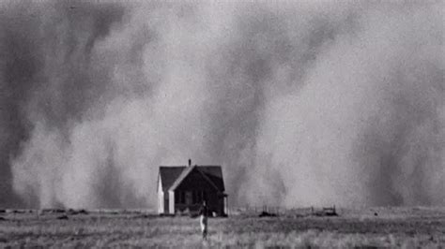
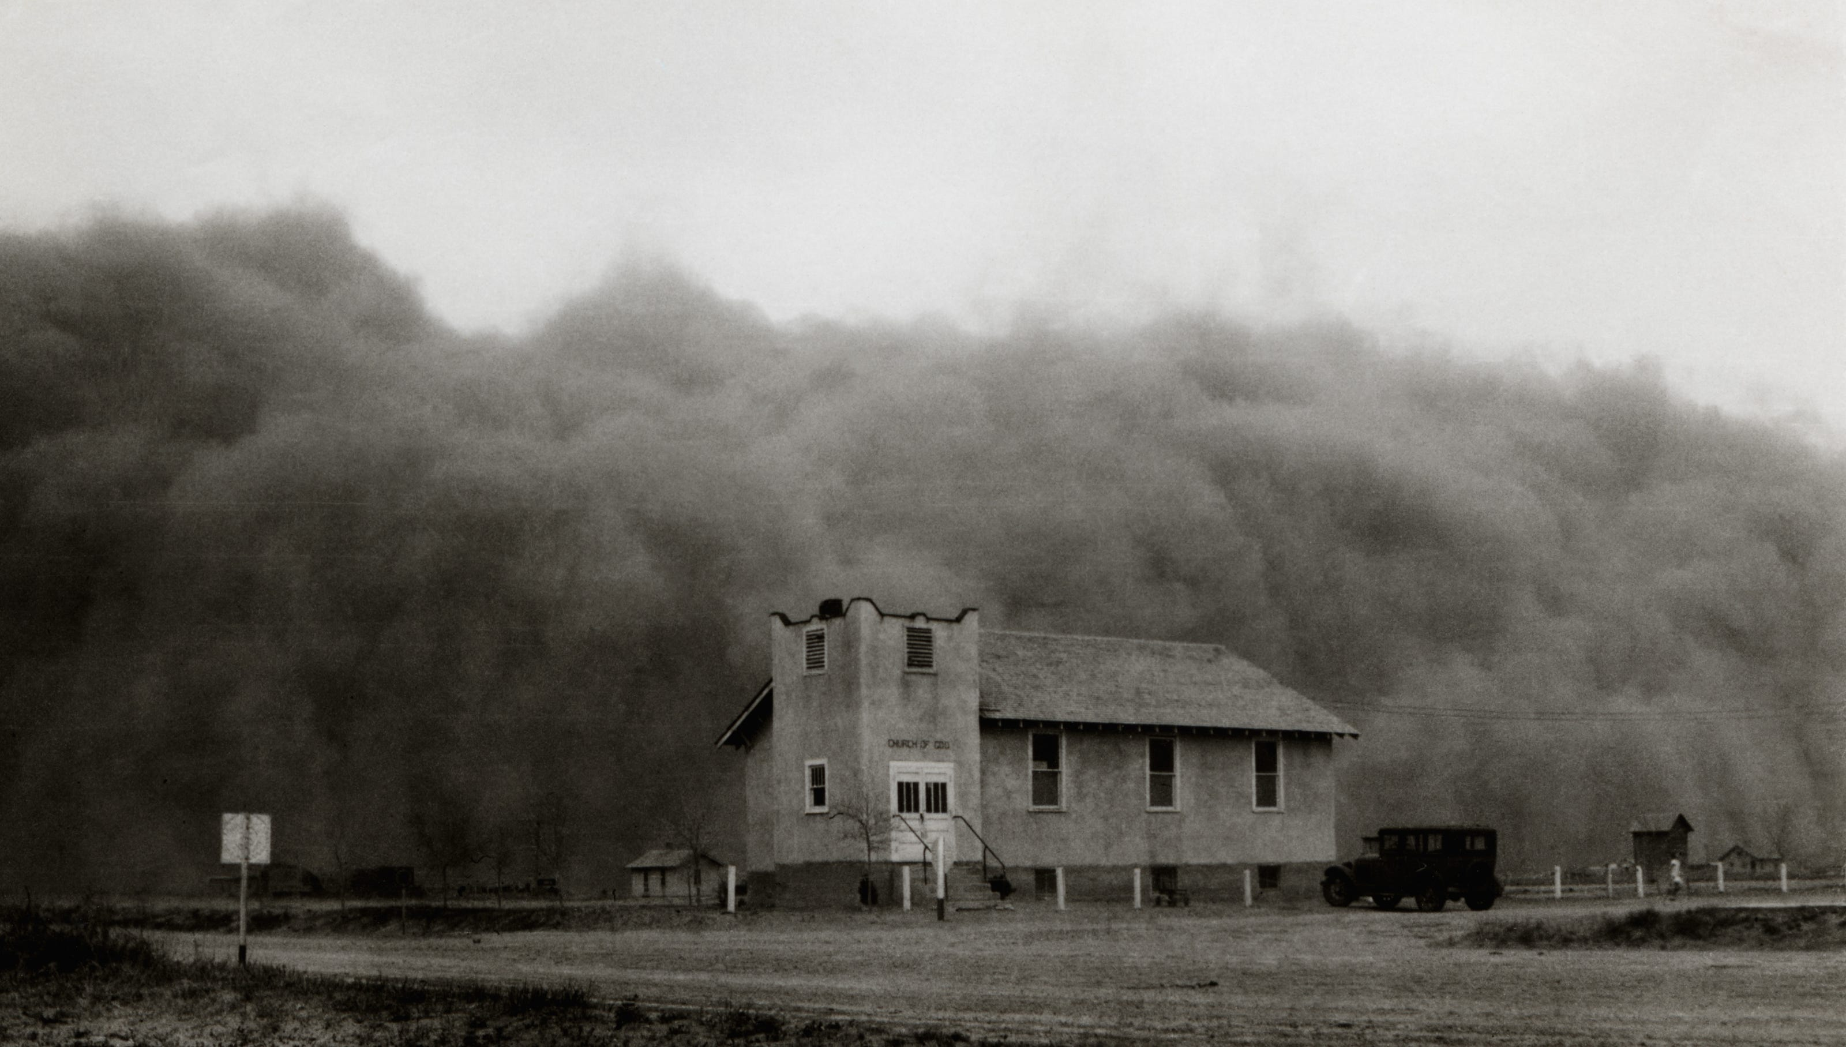
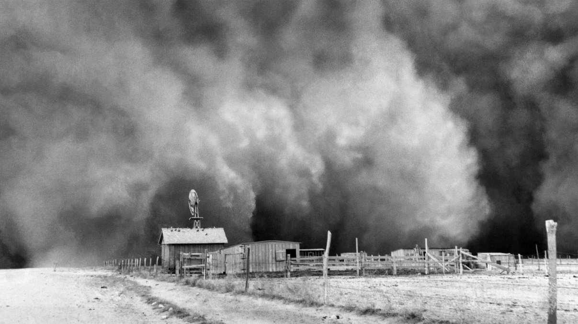
Ecclesiastes 3:20-21
²⁰ All go unto one place; all are of the dust, and all turn to dust again.
²¹ Who knoweth the spirit of man that goeth upward, and the spirit of the beast that goeth downward to the earth?

Slide 18
Ecclesiastes 3:22-4:3
²² Wherefore I perceive that there is nothing better, than that a man should rejoice in his own works; for that is his portion: for who shall bring him to see what shall be after him?
4 So I returned, and considered all the oppressions that are done under the sun: and behold the tears of such as were oppressed, and they had no comforter; and on the side of their oppressors there was power; but they had no comforter.
² Wherefore I praised the dead which are already dead more than the living which are yet alive.
³ Yea, better is he than both they, which hath not yet been, who hath not seen the evil work that is done under the sun.

Slide 19
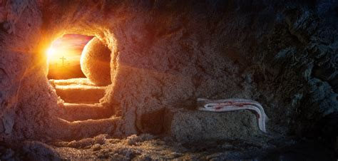
So what are we to conclude? That death is better than living and that best of all is never to have been born? Well that’s the limit of our human experience and human logic, perhaps.
Certainly what lies beyond the grave is beyond the scope of human knowledge, just as it is beyond human power to revive a dead person. But God is a God of the living, and the “sons of God” will live again.
There is something beyond the limits of human logic: God. And He gave us a whole book full of explanations when our own knowledge isn’t enough to get us there.

Slide 20
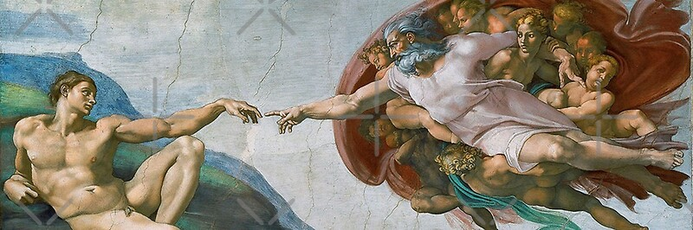
Matthew 22:31-32
³¹ But as touching the resurrection of the dead, have ye not read that which was spoken unto you by God, saying,
³² I am the God of Abraham, and the God of Isaac, and the God of Jacob? God is not the God of the dead, but of the living.

Slide 21
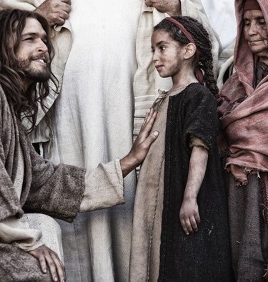
1 John 3:1-3
3 Behold, what manner of love the Father hath bestowed upon us, that we should be called the sons of God: therefore the world knoweth us not, because it knew him not.
² Beloved, now are we the sons of God, and it doth not yet appear what we shall be: but we know that, when he shall appear, we shall be like him; for we shall see him as he is.
³ And every man that hath this hope in him purifieth himself, even as he is pure.

Slide 22
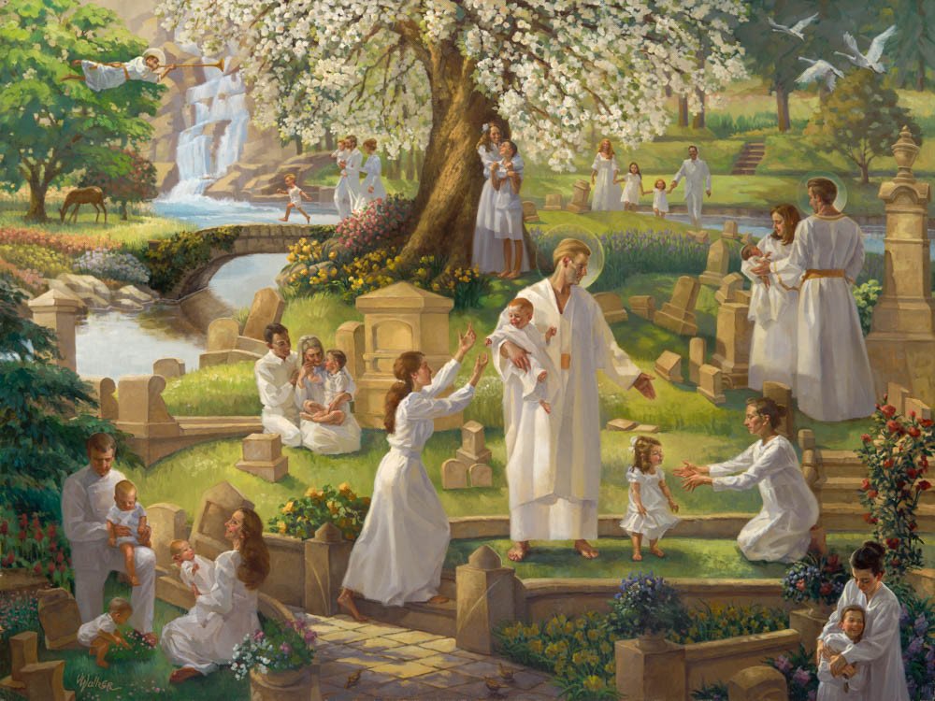
John 6:39-40
³⁹ And this is the Father's will which hath sent me, that of all which he hath given me I should lose nothing, but should raise it up again at the last day.
⁴⁰ And this is the will of him that sent me, that every one which seeth the Son, and believeth on him, may have everlasting life: and I will raise him up at the last day.

Slide 23
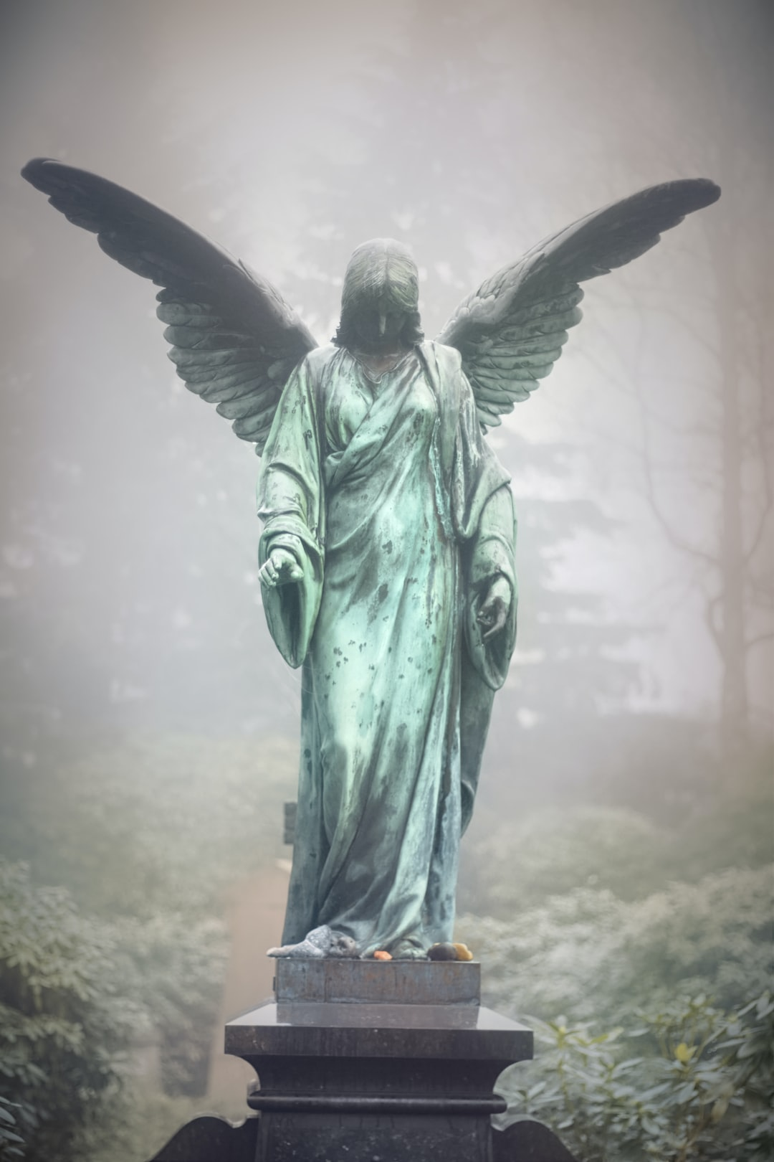
The Great Controversy, pg. 539
If it were true that the souls of all men passed directly to heaven at the hour of dissolution, then we might well covet death rather than life. Many have been led by this belief to put an end to their existence. When overwhelmed with trouble, perplexity, and disappointment, it seems an easy thing to break the brittle thread of life and soar away into the bliss of the eternal world.

Slide 24
The Great Controversy, pg. 539
God has given in His word decisive evidence that He will punish the transgressors of His law. Those who flatter themselves that He is too merciful to execute justice upon the sinner, have only to look to the cross of Calvary. The death of the spotless Son of God testifies that “the wages of sin is death,” that every violation of God's law must receive its just retribution. Christ the sinless became sin for man. He bore the guilt of transgression, and the hiding of His Father's face, until His heart was broken and His life crushed out. All this sacrifice was made that sinners might be redeemed. In no other way could man be freed from the penalty of sin. And every soul that refuses to become a partaker of the atonement provided at such a cost must bear in his own person the guilt and punishment of transgression.

Slide 25
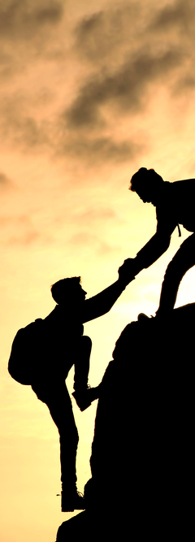
The Great Controversy, pg. 540
Let us consider what the Bible teaches further concerning the ungodly and unrepentant, whom the Universalist places in heaven as holy, happy angels.
“I will give unto him that is athirst of the fountain of the water of life freely.” Revelation 21:6. This promise is only to those that thirst. None but those who feel their need of the water of life, and seek it at the loss of all things else, will be supplied. “He that overcometh shall inherit all things; and I will be his God, and he shall be My son.” Verse 7. Here, also, conditions are specified. In order to inherit all things, we must resist and overcome sin.

Slide 26

Solomon continues in Ecclesiastes 8:12-13
¹² Though a sinner do evil an hundred times, and his days be prolonged, yet surely I know that it shall be well with them that fear God, which fear before him:
¹³ But it shall not be well with the wicked, neither shall he prolong his days, which are as a shadow; because he feareth not before God.

Slide 27

Isaiah 3:10-11
¹⁰ Say ye to the righteous, that it shall be well with him: for they shall eat the fruit of their doings.
¹¹ Woe unto the wicked! it shall be ill with him: for the reward of his hands shall be given him.

Slide 28
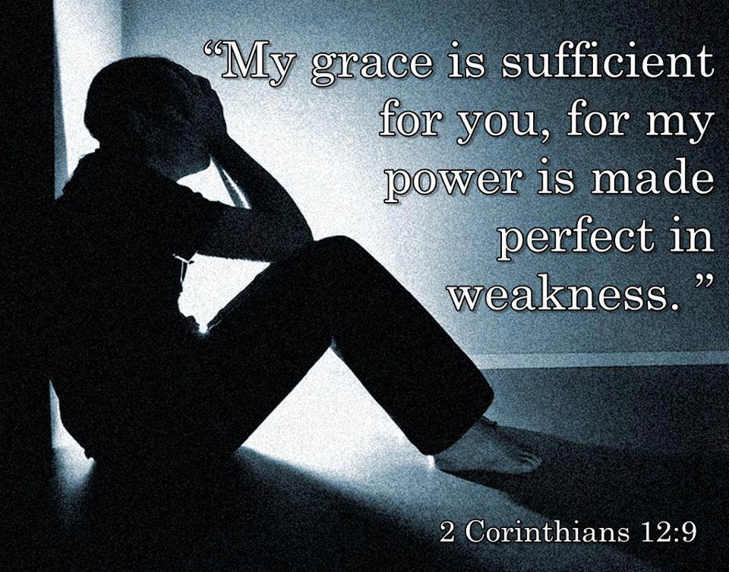
Isaiah 40:1-11
40 Comfort ye, comfort ye my people, saith your God.
² Speak ye comfortably to Jerusalem, and cry unto her, that her warfare is accomplished, that her iniquity is pardoned: for she hath received of the Lord's hand double for all her sins.
³ The voice of him that crieth in the wilderness, Prepare ye the way of the Lord, make straight in the desert a highway for our God.

Slide 29
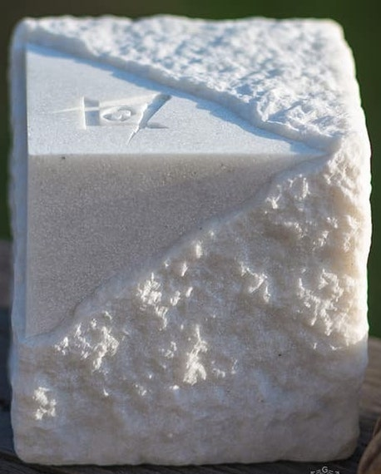
Isaiah 40:4-11
⁴ Every valley shall be exalted, and every mountain and hill shall be made low: and the crooked shall be made straight, and the rough places plain:
⁵ And the glory of the Lord shall be revealed, and all flesh shall see it together: for the mouth of the Lord hath spoken it.

Slide 30
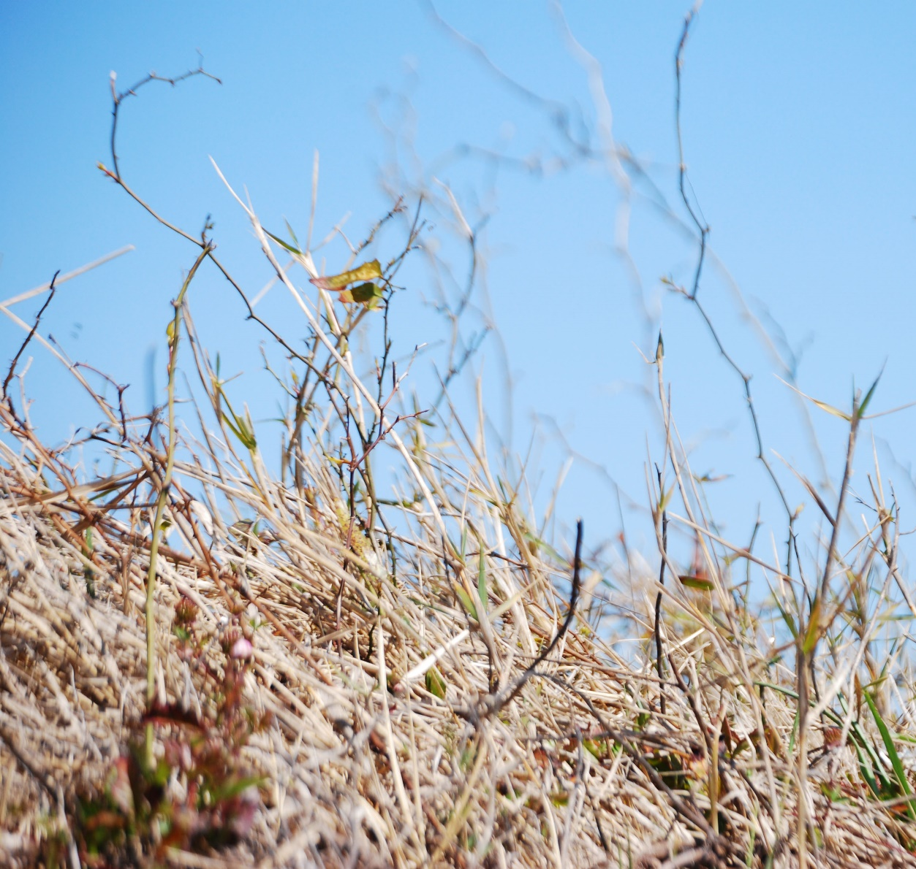
Isaiah 40:6-11
⁶ The voice said, Cry. And he said, What shall I cry? All flesh is grass, and all the goodliness thereof is as the flower of the field:
⁷ The grass withereth, the flower fadeth: because the spirit of the Lord bloweth upon it: surely the people is grass.
⁸ The grass withereth, the flower fadeth: but the word of our God shall stand for ever.

Slide 31

Isaiah 40:9-11
⁹ O Zion, that bringest good tidings, get thee up into the high mountain; O Jerusalem, that bringest good tidings, lift up thy voice with strength; lift it up, be not afraid; say unto the cities of Judah, Behold your God!

Slide 32
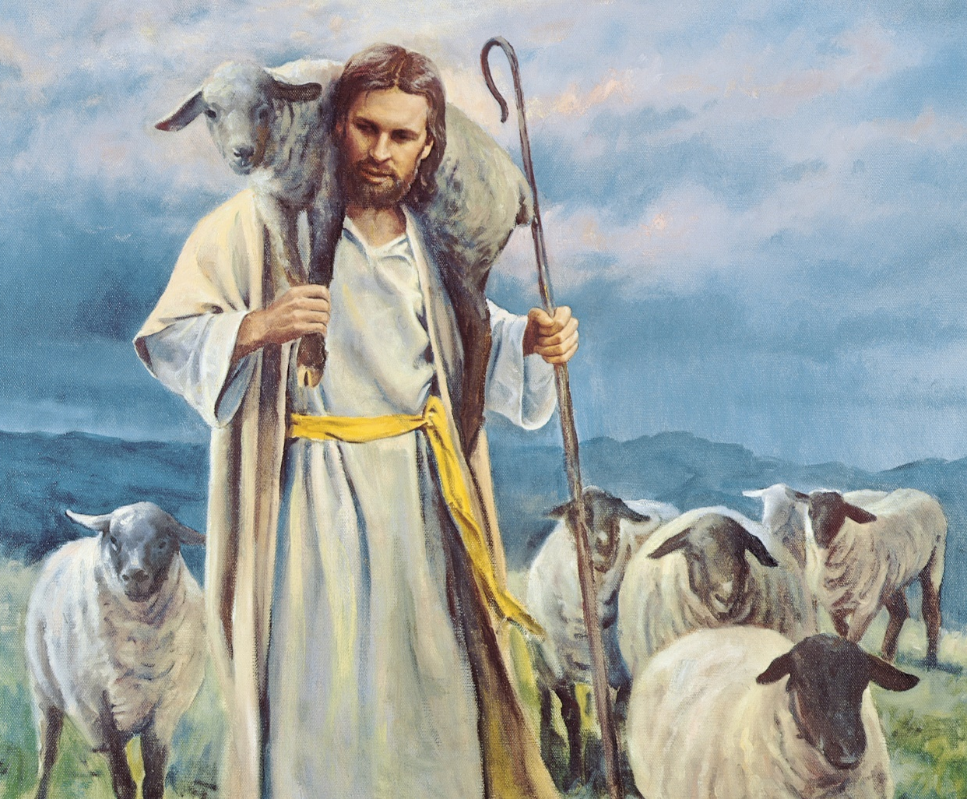
Isaiah 40:10-11
¹⁰ Behold, the Lord God will come with strong hand, and his arm shall rule for him: behold, his reward is with him, and his work before him.
¹¹ He shall feed his flock like a shepherd: he shall gather the lambs with his arm, and carry them in his bosom, and shall gently lead those that are with young.

Slide 33
On their own, people are both weak and doomed to death. “All flesh is grass, and all the goodliness thereof is as the flower of the field: The grass withereth, the flower fadeth.”
But that isn’t the end of the story! Jesus Himself told John the Revelator (Revelation 1:18) “I am he that liveth, and was dead; and, behold, I am alive for evermore, Amen; and have the keys of hell and of death.”
“The grass withereth, the flower fadeth: but the word of our God shall stand for ever.”

Slide 34
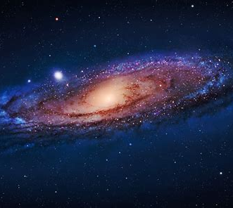
Isaiah 40:12-18
¹² Who hath measured the waters in the hollow of his hand, and meted out heaven with the span, and comprehended the dust of the earth in a measure, and weighed the mountains in scales, and the hills in a balance?
¹³ Who hath directed the Spirit of the Lord, or being his counsellor hath taught him?

Slide 35
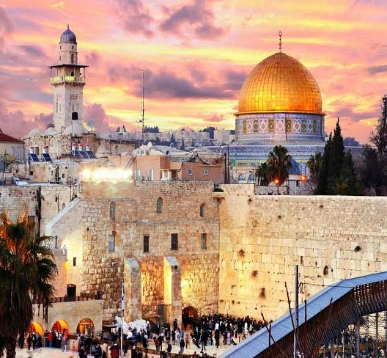
Isaiah 40:14-18
¹⁴ With whom took he counsel, and who instructed him, and taught him in the path of judgment, and taught him knowledge, and shewed to him the way of understanding?
¹⁵ Behold, the nations are as a drop of a bucket, and are counted as the small dust of the balance: behold, he taketh up the isles as a very little thing.

Slide 36
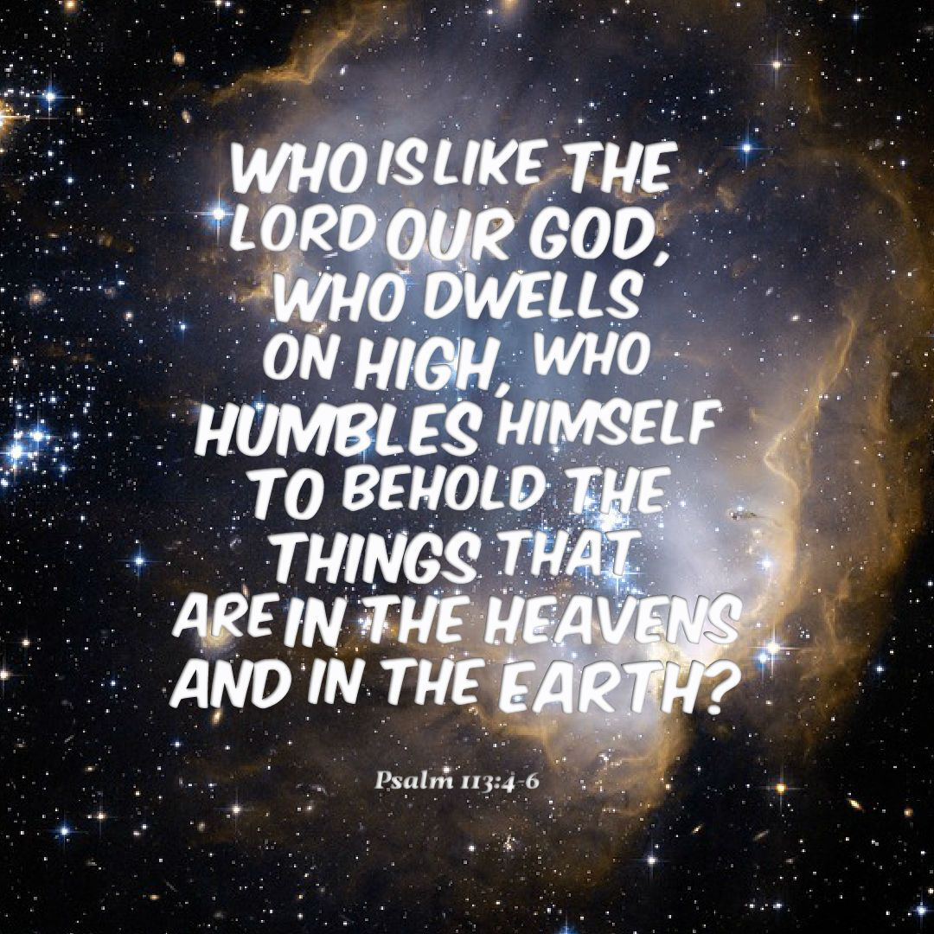
Isaiah 40:16-18
¹⁶ And Lebanon is not sufficient to burn, nor the beasts thereof sufficient for a burnt offering.
¹⁷ All nations before him are as nothing; and they are counted to him less than nothing, and vanity.
¹⁸ To whom then will ye liken God? or what likeness will ye compare unto him?

Slide 37
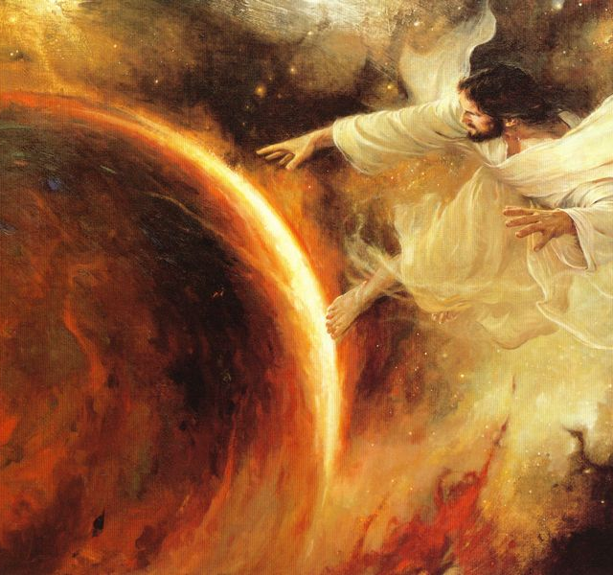
Isaiah 40:21-31
²¹ Have ye not known? have ye not heard? hath it not been told you from the beginning? have ye not understood from the foundations of the earth?
²² It is he that sitteth upon the circle of the earth, and the inhabitants thereof are as grasshoppers; that stretcheth out the heavens as a curtain, and spreadeth them out as a tent to dwell in:

Slide 38
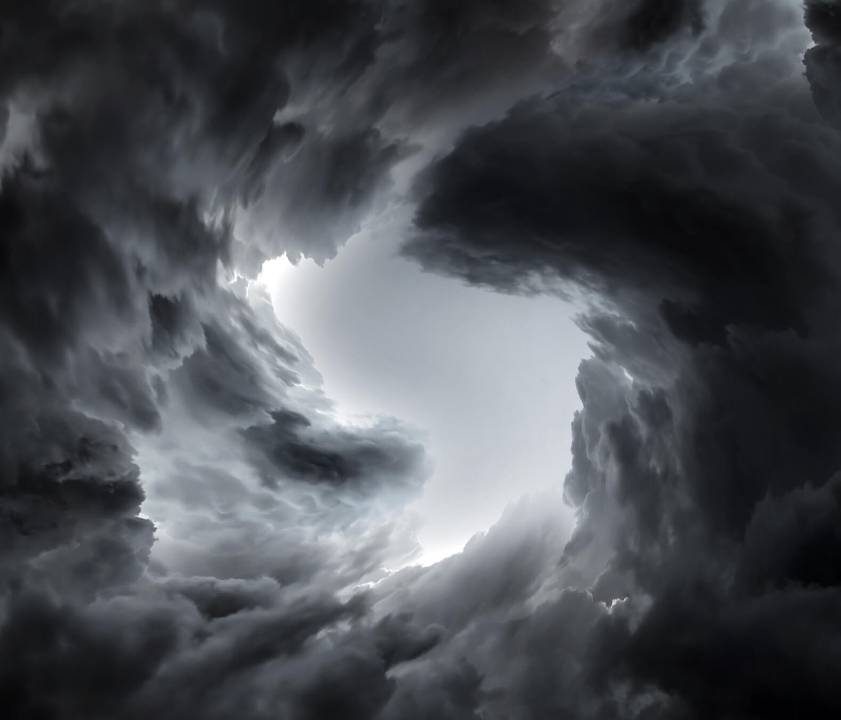
Isaiah 40:23-31
²³ That bringeth the princes to nothing; he maketh the judges of the earth as vanity.
²⁴ Yea, they shall not be planted; yea, they shall not be sown: yea, their stock shall not take root in the earth: and he shall also blow upon them, and they shall wither, and the whirlwind shall take them away as stubble.

Slide 39
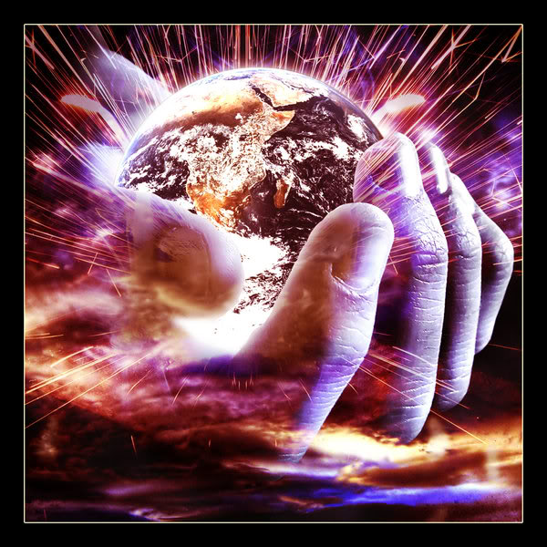
Isaiah 40:25-31
²⁵ To whom then will ye liken me, or shall I be equal? saith the Holy One.
²⁶ Lift up your eyes on high, and behold who hath created these things, that bringeth out their host by number: he calleth them all by names by the greatness of his might, for that he is strong in power; not one faileth.

Slide 40
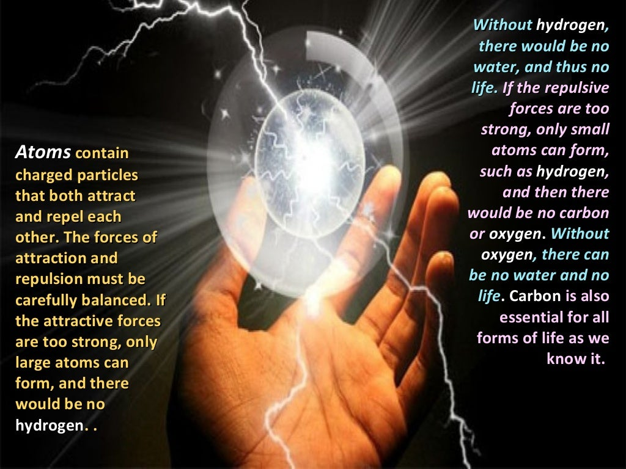
Isaiah 40:27-31
²⁷ Why sayest thou, O Jacob, and speakest, O Israel, My way is hid from the Lord, and my judgment is passed over from my God?

Slide 41
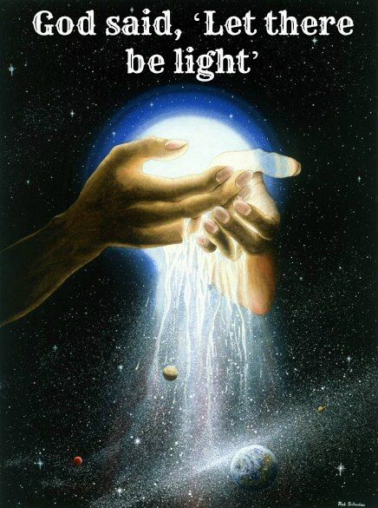
Isaiah 40:28-31
²⁸ Hast thou not known? hast thou not heard, that the everlasting God, the Lord, the Creator of the ends of the earth, fainteth not, neither is weary? there is no searching of his understanding.
²⁹ He giveth power to the faint; and to them that have no might he increaseth strength.

Slide 42
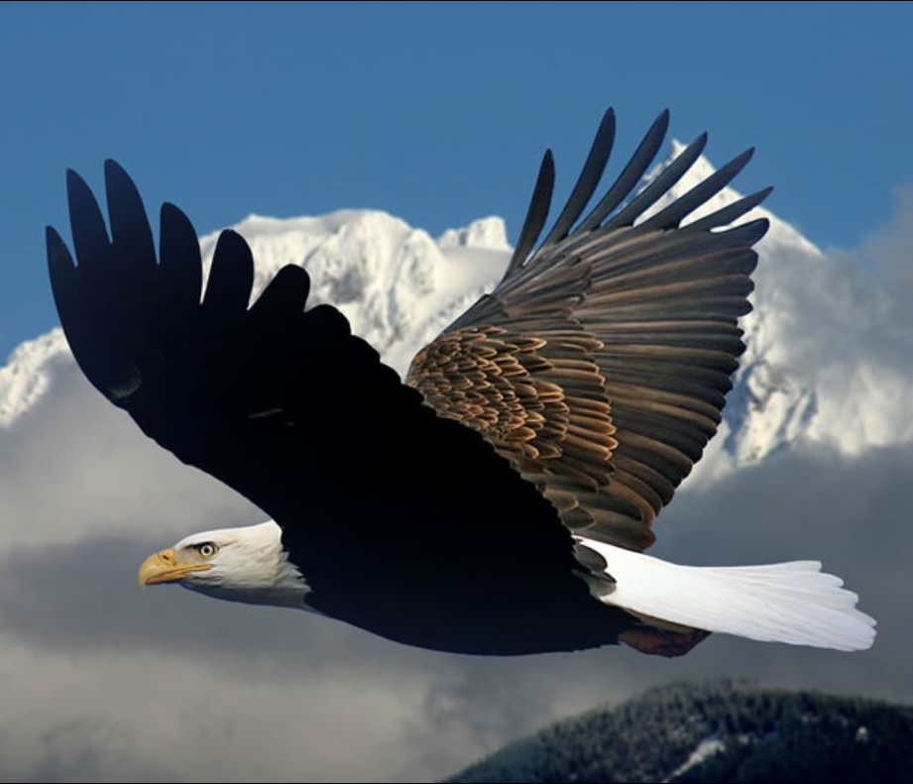
Isaiah 40:30-31
³⁰ Even the youths shall faint and be weary, and the young men shall utterly fall:
³¹ But they that wait upon the Lord shall renew their strength; they shall mount up with wings as eagles; they shall run, and not be weary; and they shall walk, and not faint.

Slide 43
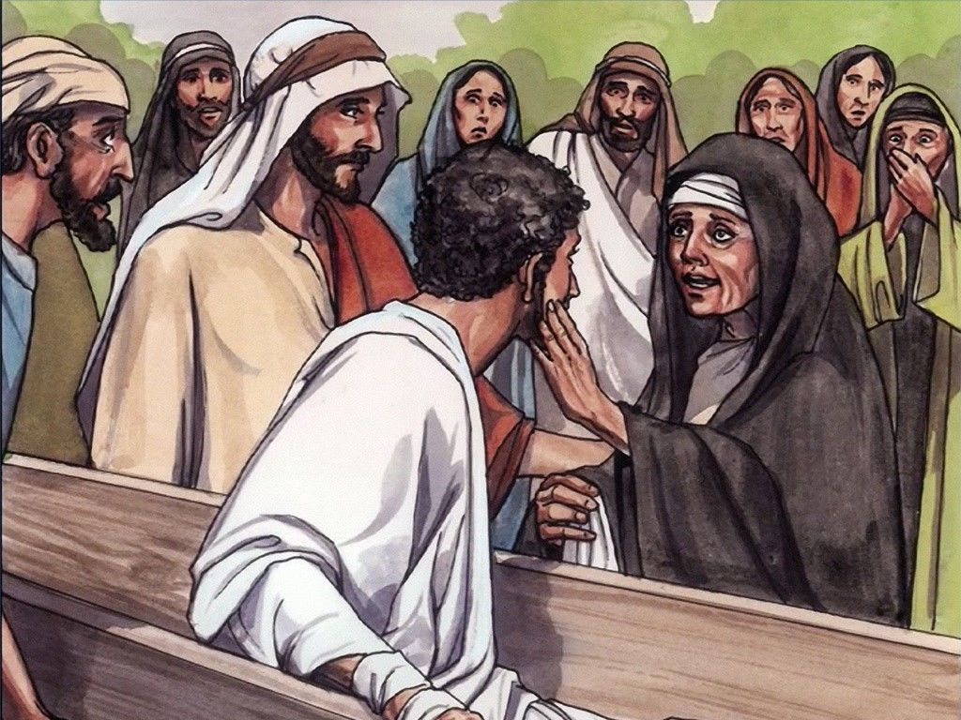
A Specific Example: The Widow’s Son Luke 7:13-5
¹³ And when the Lord saw her, he had compassion on her, and said unto her, Weep not.
¹⁴ And he came and touched the bier: and they that bare him stood still. And he said, Young man, I say unto thee, Arise.
¹⁵ And he that was dead sat up, and began to speak. And he delivered him to his mother.

Slide 44
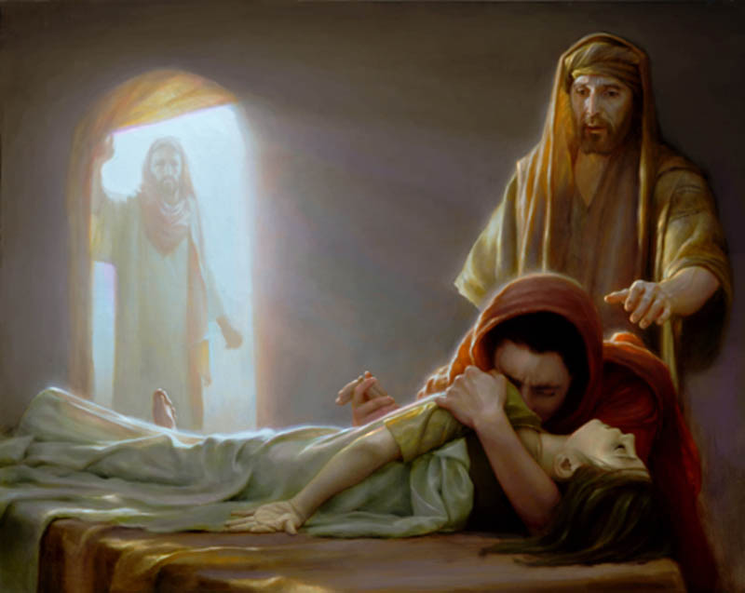
A Specific Example: Jairus’ Daughter Mark 5:35-42
³⁵ While he yet spake, there came from the ruler of the synagogue's house certain which said, Thy daughter is dead: why troublest thou the Master any further?
³⁶ As soon as Jesus heard the word that was spoken, he saith unto the ruler of the synagogue, Be not afraid, only believe.
³⁷ And he suffered no man to follow him, save Peter, and James, and John the brother of James.

Slide 45
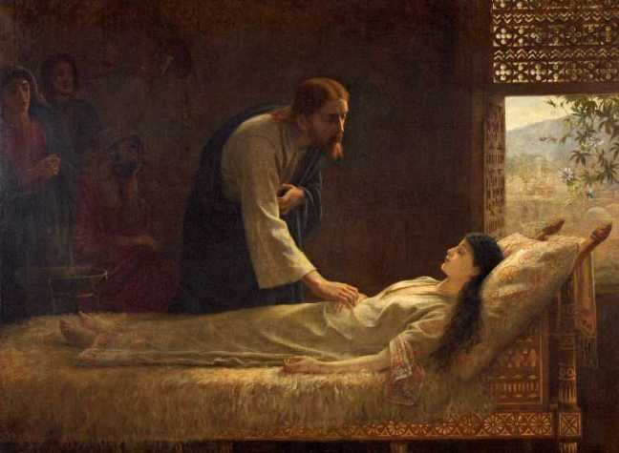
A Specific Example: Jairus’ Daughter Mark 5:38-42
³⁹ And when he was come in, he saith unto them, Why make ye this ado, and weep? the damsel is not dead, but sleepeth.
⁴⁰ And they laughed him to scorn. But when he had put them all out, he taketh the father and the mother of the damsel, and them that were with him, and entereth in where the damsel was lying.

Slide 46
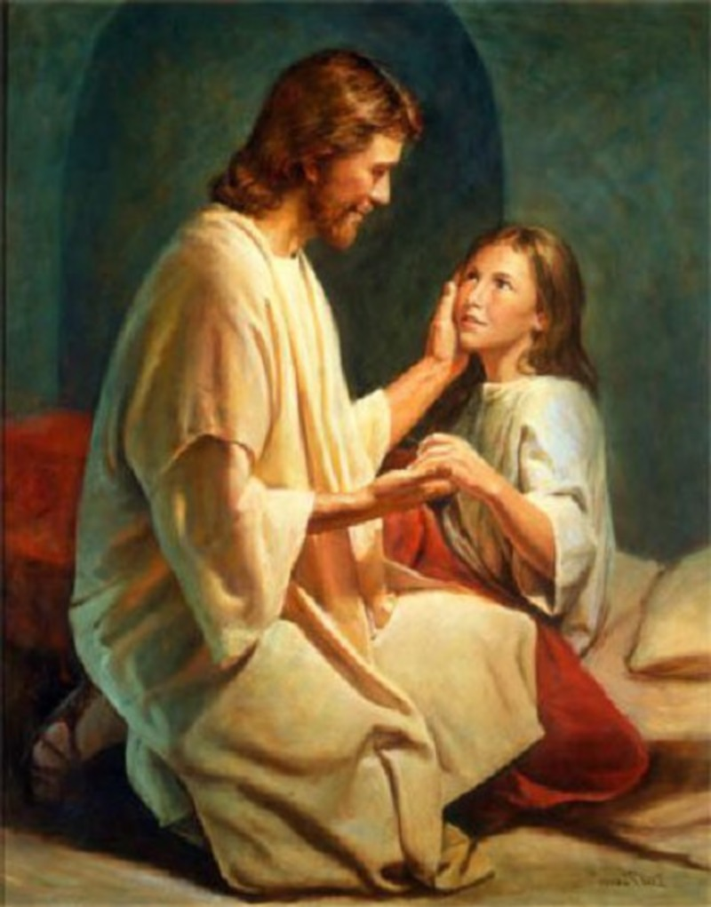
A Specific Example: Jairus’ Daughter Mark 5:41-42
⁴¹ And he took the damsel by the hand, and said unto her, Talitha cumi; which is, being interpreted, Damsel, I say unto thee, arise.
⁴² And straightway the damsel arose, and walked; for she was of the age of twelve years. And they were astonished with a great astonishment.

Slide 47
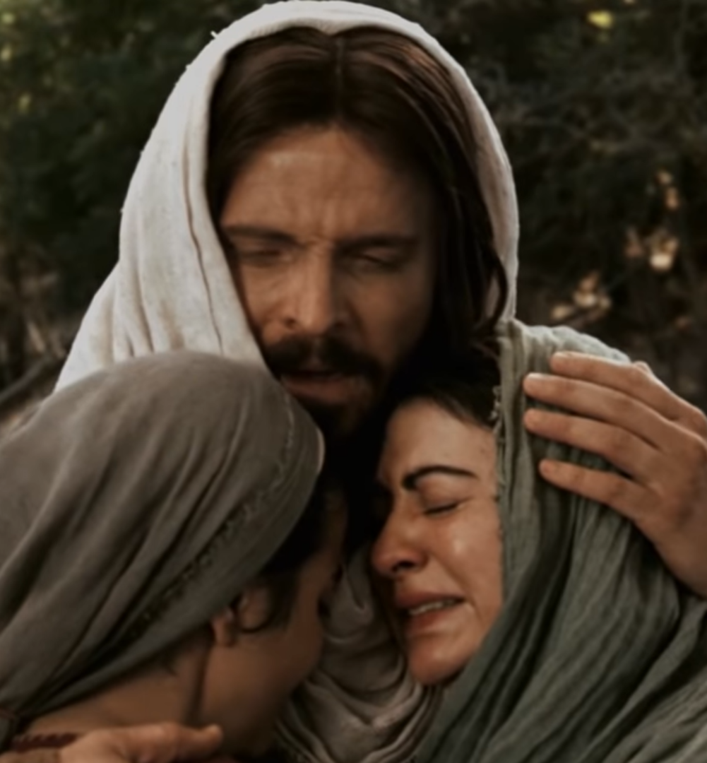
A Specific Example: Lazarus John 11:21-27, 40-44
²¹ Then said Martha unto Jesus, Lord, if thou hadst been here, my brother had not died.
²² But I know, that even now, whatsoever thou wilt ask of God, God will give it thee.
²³ Jesus saith unto her, Thy brother shall rise again.
²⁴ Martha saith unto him, I know that he shall rise again in the resurrection at the last day.

Slide 48

John 11:21-27, 40-44
²⁵ Jesus said unto her, I am the resurrection, and the life: he that believeth in me, though he were dead, yet shall he live:
²⁶ And whosoever liveth and believeth in me shall never die. Believest thou this?
²⁷ She saith unto him, Yea, Lord: I believe that thou art the Christ, the Son of God, which should come into the world.

Slide 49

John 11:40-44
⁴⁰ Jesus saith unto her, Said I not unto thee, that, if thou wouldest believe, thou shouldest see the glory of God?
⁴¹ Then they took away the stone from the place where the dead was laid. And Jesus lifted up his eyes, and said, Father, I thank thee that thou hast heard me.
⁴² And I knew that thou hearest me always: but because of the people which stand by I said it, that they may believe that thou hast sent me.

Slide 50

John 11:43-44
⁴³ And when he thus had spoken, he cried with a loud voice, Lazarus, come forth.
⁴⁴ And he that was dead came forth, bound hand and foot with graveclothes: and his face was bound about with a napkin. Jesus saith unto them, Loose him, and let him go.

Slide 51

Great Controversy, pg. 549
In the very day when the silver cord is loosed and the golden bowl broken (Ecclesiastes 12:6), man's thoughts perish. They that go down to the grave are in silence. They know no more of anything that is done under the sun. Job 14:21. Blessed rest for the weary righteous! Time, be it long or short, is but a moment to them. They sleep; they are awakened by the trump of God to a glorious immortality.

Slide 52

Great Controversy, pg. 549
“For the trumpet shall sound, and the dead shall be raised incorruptible.... So when this corruptible shall have put on incorruption, and this mortal shall have put on immortality, then shall be brought to pass the saying that is written, Death is swallowed up in victory.” 1 Corinthians 15:52-54.

Slide 53

Great Controversy, pg. 549
As they are called forth from their deep slumber they begin to think just where they ceased. The last sensation was the pang of death; the last thought, that they were falling beneath the power of the grave. When they arise from the tomb, their first glad thought will be echoed in the triumphal shout: “O death, where is thy sting? O grave, where is thy victory?” Verse 55.

Slide 54
THANK YOU,
AND Happy Sabbath!!

