Slide 1

In What
Can we TRUST?
Psalms 49 & 71, Daniel 12
Lesson 4, 4th Quarter 2022
Notes:
To use this title animation slide with a new image simply 1) move the top semi-transparent shape to the side, 2) delete placeholder image,
3) click on the picture icon to add a new picture, 4) Move semi-transparent shape back to original position, 5) Update text on slide.

Slide 2
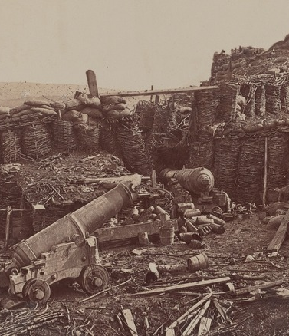
Bad things happen
Even to good people.
And good things happen to bad people!
This isn’t new! Ever since the fall there’s been senseless evil and unnecessary grief in the world. Today there are wars and riots, bombings and school shootings, and much more. But the world has been a place of grief and violence for a long, long time.

Slide 3
⁶ Know now that God hath overthrown me, and hath compassed me with his net.
⁷ Behold, I cry out of wrong, but I am not heard: I cry aloud, but there is no judgment.
⁸ He hath fenced up my way that I cannot pass, and he hath set darkness in my paths.
⁹ He hath stripped me of my glory, and taken the crown from my head.
¹⁰ He hath destroyed me on every side, and I am gone: and mine hope hath he removed like a tree.
¹¹ He hath also kindled his wrath against me, and he counteth me unto him as one of his enemies.
—Job 19: 7-11

Slide 4
¹² Behold, these are the ungodly, who prosper in the world; they increase in riches.
¹³ Verily I have cleansed my heart in vain, and washed my hands in innocency.
¹⁴ For all the day long have I been plagued, and chastened every morning.
—Psalm 73:12-14

Slide 5
¹⁴ Ye have said, It is vain to serve God: and what profit is it that we have kept his ordinance, and that we have walked mournfully before the Lord of hosts?
¹⁵ And now we call the proud happy; yea, they that work wickedness are set up; yea, they that tempt God are even delivered.
—Malachi 3:14-15

Slide 6
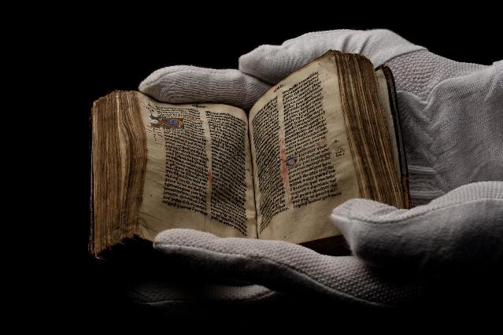
WHERE DO WE TURN?
49 Hear this, all ye people; give ear, all ye inhabitants of the world:
² Both low and high, rich and poor, together.
Others have had the same question!
Turn to Psalm 49
³ My mouth shall speak of wisdom; and the meditation of my heart shall be of understanding.
⁴ I will incline mine ear to a parable: I will open my dark saying upon the harp.
⁵ Wherefore should I fear in the days of evil, when the iniquity of my heels shall compass me about?

Slide 7
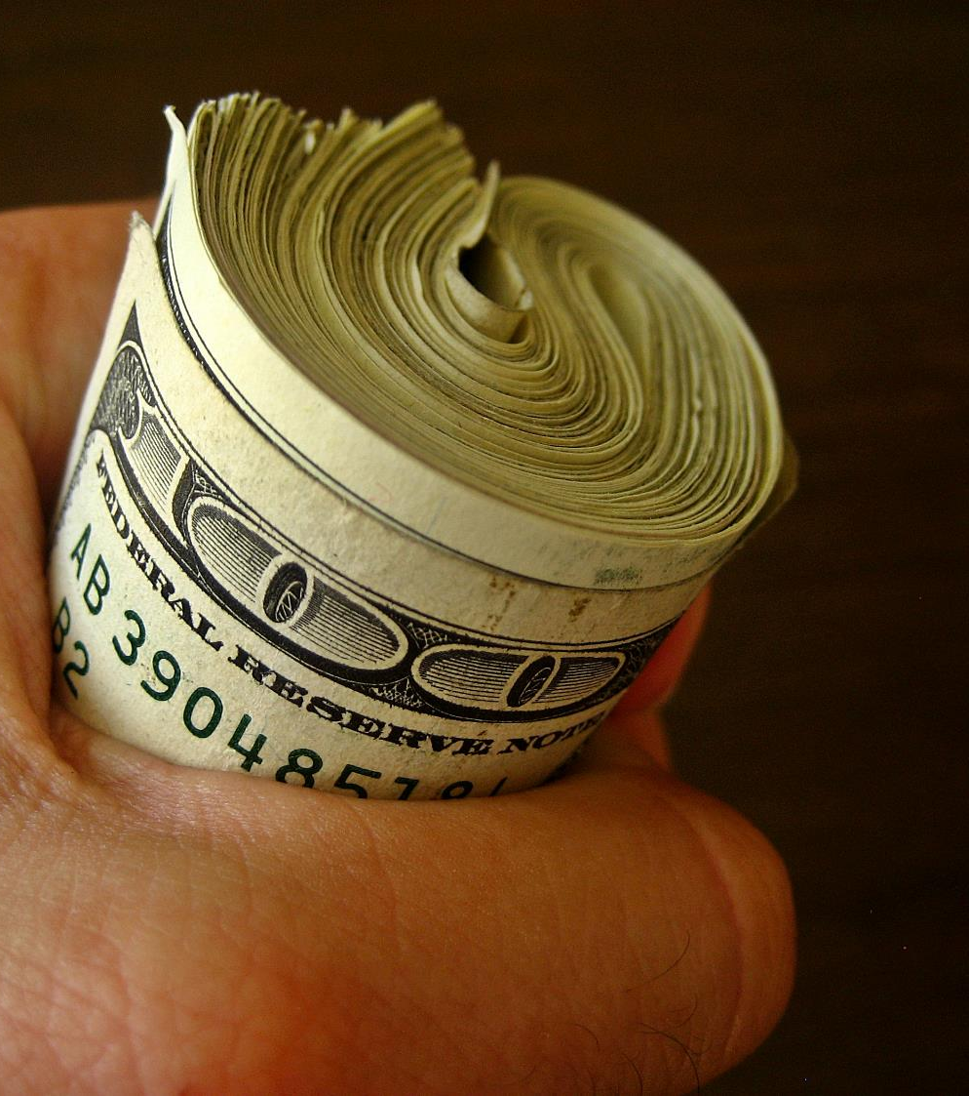
Some trust in $$$
⁶ They that trust in their wealth, and boast themselves in the multitude of their riches;
⁷ None of them can by any means redeem his brother, nor give to God a ransom for him:
⁸ (For the redemption of their soul is precious, and it ceaseth for ever:)
⁹ That he should still live for ever, and not see corruption.

Slide 8
⁴ Labour not to be rich: cease from thine own wisdom.
⁵ Wilt thou set thine eyes upon that which is not? for riches certainly make themselves wings; they fly away as an eagle toward heaven.
—Proverbs 23:4-5

Slide 9
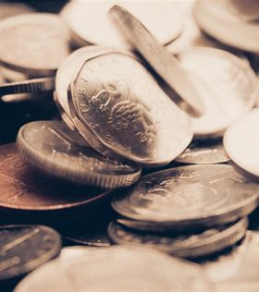
Matthew 6:19-21
¹⁹ Lay not up for yourselves treasures upon earth, where moth and rust doth corrupt, and where thieves break through and steal:
²⁰ But lay up for yourselves treasures in heaven, where neither moth nor rust doth corrupt, and where thieves do not break through nor steal:
²¹ For where your treasure is, there will your heart be also.

Slide 10
¹⁷ Charge them that are rich in this world, that they be not highminded, nor trust in uncertain riches, but in the living God, who giveth us richly all things to enjoy;
¹⁸ That they do good, that they be rich in good works, ready to distribute, willing to communicate;
—1 Timothy 6:17-18

Slide 11
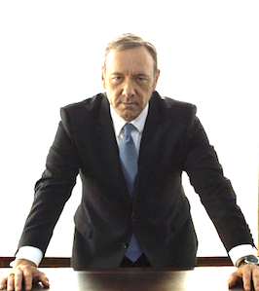
Psalm 49:10
Some trust in their own wisdom
¹⁰ For he seeth that wise men die, likewise the fool and the brutish person perish, and leave their wealth to others.

Slide 12
¹² There is a way which seemeth right unto a man, but the end thereof are the ways of death.
—Proverbs 14:12

Slide 13
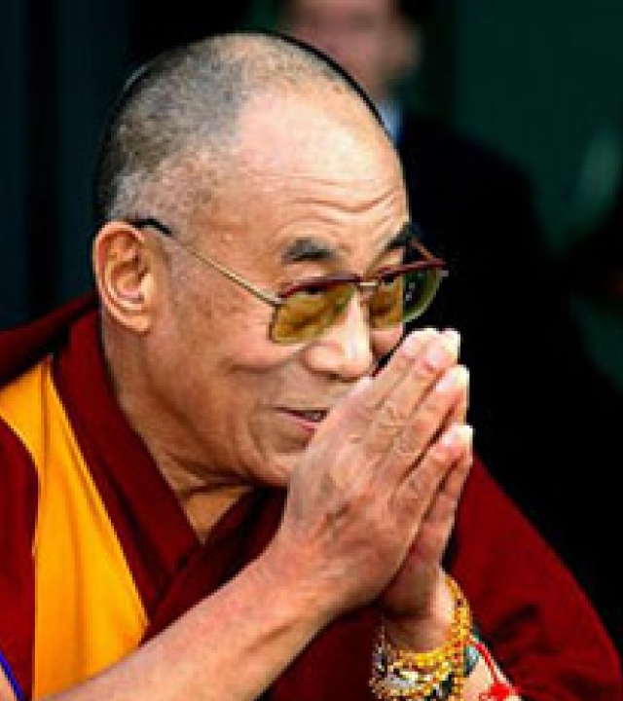
1 Corinthians 3:18-20
¹⁸ Let no man deceive himself. If any man among you seemeth to be wise in this world, let him become a fool, that he may be wise.
¹⁹ For the wisdom of this world is foolishness with God. For it is written, He taketh the wise in their own craftiness.
²⁰ And again, The Lord knoweth the thoughts of the wise, that they are vain.

Slide 14
⁵ Trust in the Lord with all thine heart; and lean not unto thine own understanding.
⁶ In all thy ways acknowledge him, and he shall direct thy paths.
⁷ Be not wise in thine own eyes: fear the Lord, and depart from evil.
Proverbs 3:5-7

Slide 15
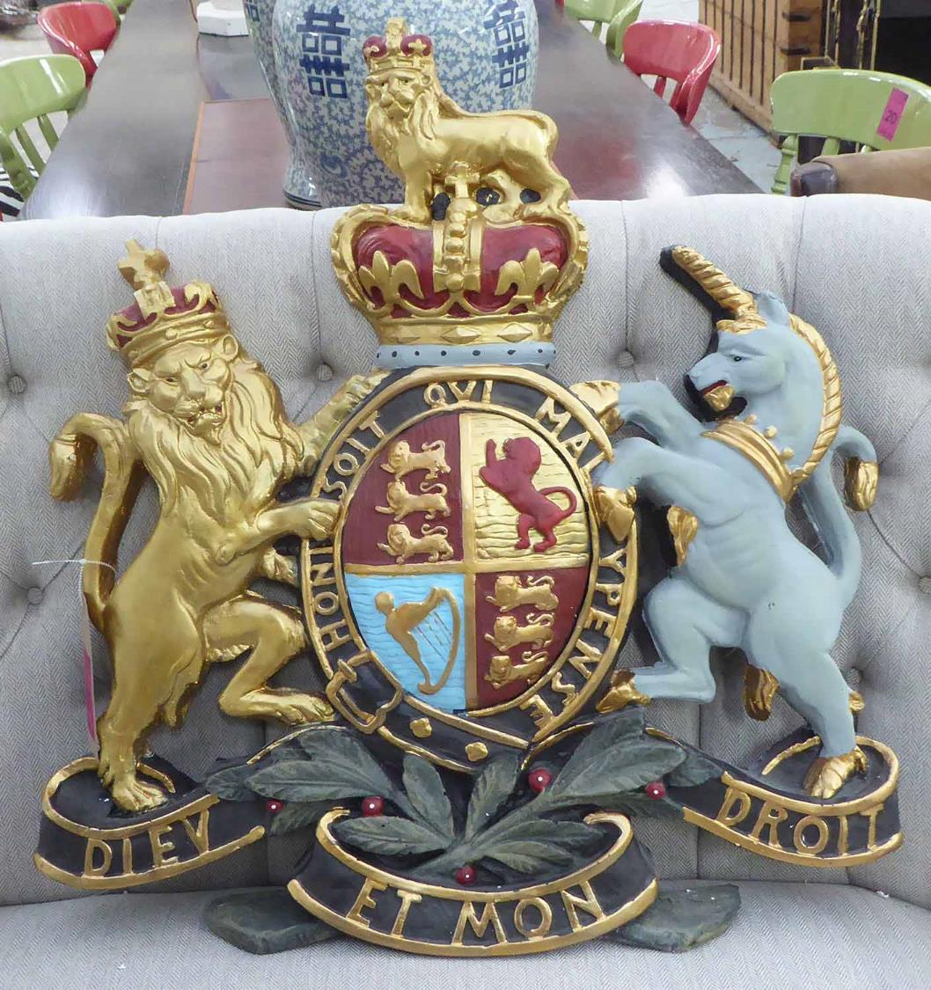
Psalm 49:11-13
Others trust in nobility, power, or fame
¹¹ Their inward thought is, that their houses shall continue for ever, and their dwelling places to all generations; they call their lands after their own names.
¹² Nevertheless man being in honour abideth not: he is like the beasts that perish.
¹³ This their way is their folly: yet their posterity approve their sayings. Selah.

Slide 16
⁴⁵ Then in the audience of all the people he said unto his disciples,
⁴⁶ Beware of the scribes, which desire to walk in long robes, and love greetings in the markets, and the highest seats in the synagogues, and the chief rooms at feasts;
⁴⁷ Which devour widows' houses, and for a shew make long prayers: the same shall receive greater damnation.
—Luke 20:45-47

Slide 17
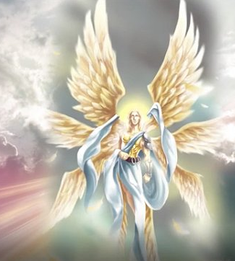
Ezekiel 28:12-15
¹² Son of man, take up a lamentation upon the king of Tyrus, and say unto him, Thus saith the Lord God; Thou sealest up the sum, full of wisdom, and perfect in beauty.
¹³ Thou hast been in Eden the garden of God; every precious stone was thy covering, the sardius, topaz, and the diamond, the beryl, the onyx, and the jasper, the sapphire, the emerald, and the carbuncle, and gold: the workmanship of thy tabrets and of thy pipes was prepared in thee in the day that thou wast created.
¹⁴ Thou art the anointed cherub that covereth; and I have set thee so: thou wast upon the holy mountain of God; thou hast walked up and down in the midst of the stones of fire.
¹⁵ Thou wast perfect in thy ways from the day that thou wast created, till iniquity was found in thee.

Slide 18
¹⁵ Love not the world, neither the things that are in the world. If any man love the world, the love of the Father is not in him.
¹⁶ For all that is in the world, the lust of the flesh, and the lust of the eyes, and the pride of life, is not of the Father, but is of the world.
¹⁷ And the world passeth away, and the lust thereof: but he that doeth the will of God abideth for ever.
1 John 2:15-17

Slide 19
YOU CANNOT TRUST IN YOURSELF!
Proverbs 28:26
²⁶ He that trusteth in his own heart is a fool: but whoso walketh wisely, he shall be delivered.
We are always tempted to rely on ourselves-our talents or resources- but it just isn’t safe to do so!
2 Corinthians 1:9
⁹ But we had the sentence of death in ourselves, that we should not trust in ourselves, but in God which raiseth the dead:
Jeremiah 17:9
⁹ The heart is deceitful above all things, and desperately wicked: who can know it?
Psalm 40:4
⁴ Blessed is that man that maketh the Lord his trust, and respecteth not the proud, nor such as turn aside to lies.

Slide 20
Ezekiel 28:12-15
¹² Son of man, take up a lamentation upon the king of Tyrus, and say unto him, Thus saith the Lord God; Thou sealest up the sum, full of wisdom, and perfect in beauty.
¹³ Thou hast been in Eden the garden of God; every precious stone was thy covering, the sardius, topaz, and the diamond, the beryl, the onyx, and the jasper, the sapphire, the emerald, and the carbuncle, and gold: the workmanship of thy tabrets and of thy pipes was prepared in thee in the day that thou wast created.
¹⁴ Thou art the anointed cherub that covereth; and I have set thee so: thou wast upon the holy mountain of God; thou hast walked up and down in the midst of the stones of fire.
¹⁵ Thou wast perfect in thy ways from the day that thou wast created, till iniquity was found in thee.

Slide 21
¹⁶ Be not thou afraid when one is made rich, when the glory of his house is increased;
¹⁷ For when he dieth he shall carry nothing away: his glory shall not descend after him.
¹⁸ Though while he lived he blessed his soul: and men will praise thee, when thou doest well to thyself.
¹⁹ He shall go to the generation of his fathers; they shall never see light.
²⁰ Man that is in honour, and understandeth not, is like the beasts that perish.
Trusting in Self
!

Slide 22
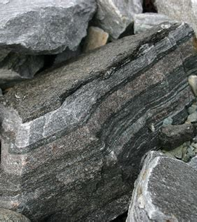
Trust in God: Psalm 71
71 In thee, O Lord, do I put my trust: let me never be put to confusion.
² Deliver me in thy righteousness, and cause me to escape: incline thine ear unto me, and save me.
³ Be thou my strong habitation, whereunto I may continually resort: thou hast given commandment to save me; for thou art my rock and my fortress.
⁴ Deliver me, O my God, out of the hand of the wicked, out of the hand of the unrighteous and cruel man.

Slide 23
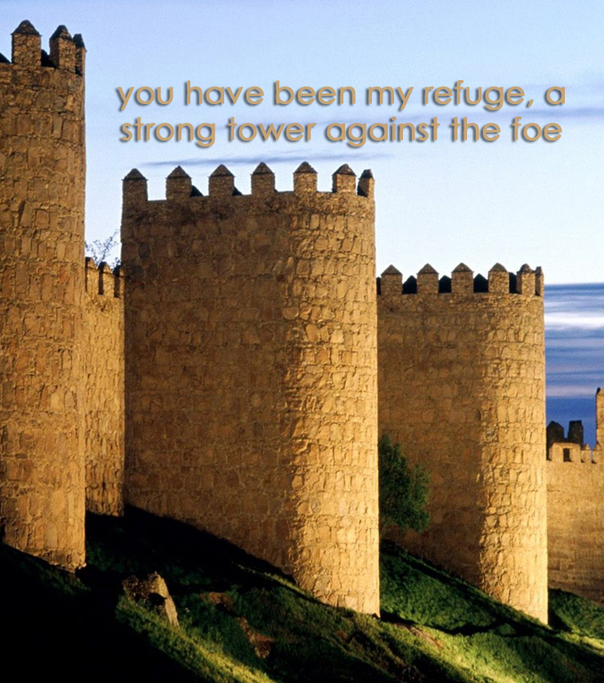
Psalm 71:5-8
Security from birth…
⁵ For thou art my hope, O Lord God: thou art my trust from my youth.
⁶ By thee have I been holden up from the womb: thou art he that took me out of my mother's bowels: my praise shall be continually of thee.
⁷ I am as a wonder unto many; but thou art my strong refuge.
⁸ Let my mouth be filled with thy praise and with thy honour all the day.

Slide 24
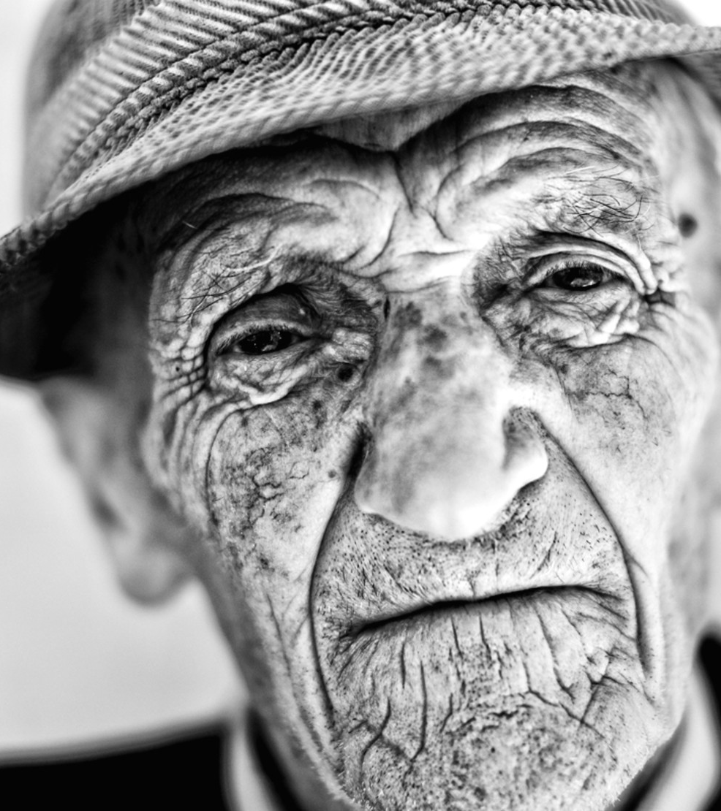
Psalm 71:9-12
⁹ Cast me not off in the time of old age; forsake me not when my strength faileth.
¹⁰ For mine enemies speak against me; and they that lay wait for my soul take counsel together,
¹¹ Saying, God hath forsaken him: persecute and take him; for there is none to deliver him.
¹² O God, be not far from me: O my God, make haste for my help.

Slide 25
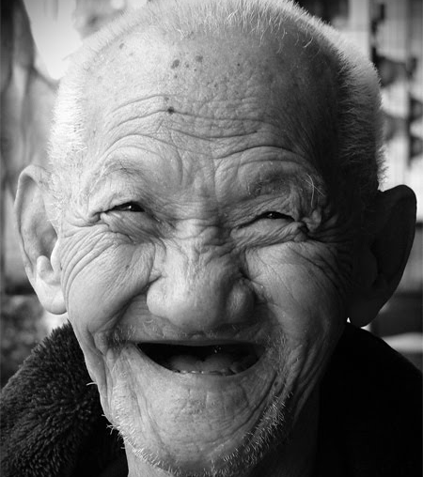
Psalm 71:13-15
… through old age!
¹³ Let them be confounded and consumed that are adversaries to my soul; let them be covered with reproach and dishonour that seek my hurt.
¹⁴ But I will hope continually, and will yet praise thee more and more.
¹⁵ My mouth shall shew forth thy righteousness and thy salvation all the day; for I know not the numbers thereof.

Slide 26

Psalm 71:16-19
¹⁶ I will go in the strength of the Lord God: I will make mention of thy righteousness, even of thine only.
¹⁷ O God, thou hast taught me from my youth: and hitherto have I declared thy wondrous works.
¹⁸ Now also when I am old and greyheaded, O God, forsake me not; until I have shewed thy strength unto this generation, and thy power to every one that is to come.
¹⁹ Thy righteousness also, O God, is very high, who hast done great things: O God, who is like unto thee!

Slide 27
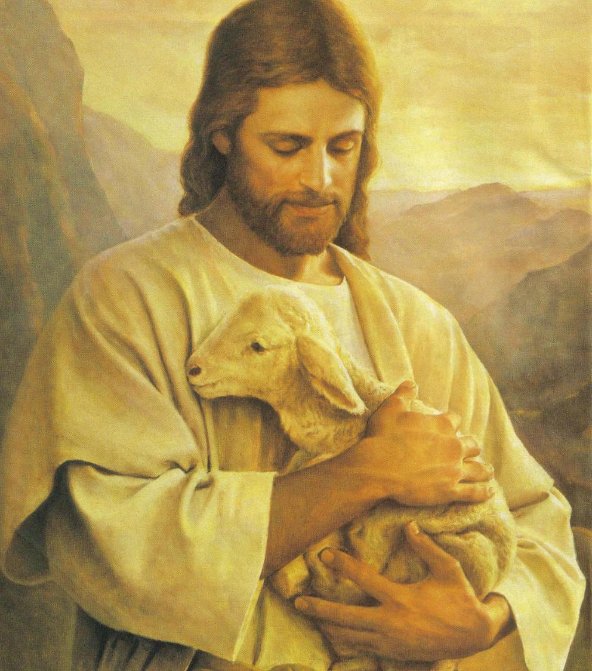
Psalm 71:20-22
Praise God for His care!
²⁰ Thou, which hast shewed me great and sore troubles, shalt quicken me again, and shalt bring me up again from the depths of the earth.
²¹ Thou shalt increase my greatness, and comfort me on every side.
²² I will also praise thee with the psaltery, even thy truth, O my God: unto thee will I sing with the harp, O thou Holy One of Israel.

Slide 28
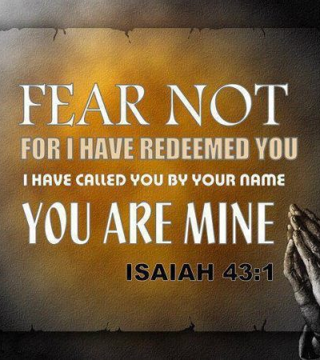
Psalm 71:23-24
²³ My lips shall greatly rejoice when I sing unto thee; and my soul, which thou hast redeemed.
²⁴ My tongue also shall talk of thy righteousness all the day long: for they are confounded, for they are brought unto shame, that seek my hurt.

Slide 29
Despite great challenges, Job maintained his trust in his Lord
²³ Oh that my words were now written! oh that they were printed in a book!
²⁴ That they were graven with an iron pen and lead in the rock for ever!
²⁵ For I know that my redeemer liveth, and that he shall stand at the latter day upon the earth:
²⁶ And though after my skin worms destroy this body, yet in my flesh shall I see God:
²⁷ Whom I shall see for myself, and mine eyes shall behold, and not another; though my reins be consumed within me.
—Job 19:23-27

Slide 30
It’s pretty tempting to trust in ourselves! We have to do so on a daily basis. Faith is hard! But the retirement plan is awesome.
God has a plan to gift His people with life eternal in a perfect, re-created world. We can read about the plan in many places in the Bible, but let’s check it out in Daniel 12.
The
PLAN

Slide 31
12 And at that time shall Michael stand up, the great prince which standeth for the children of thy people: and there shall be a time of trouble, such as never was since there was a nation even to that same time: and at that time thy people shall be delivered, every one that shall be found written in the book.
Daniel 12:1

Slide 32
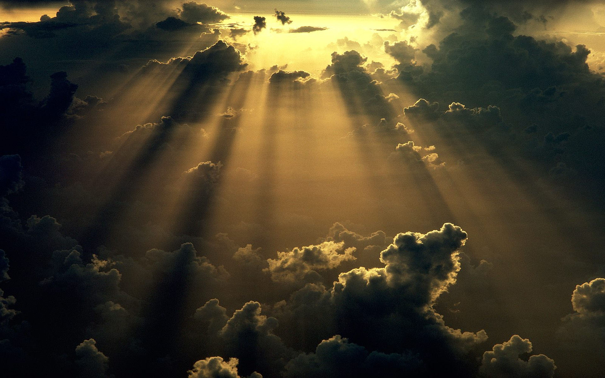
Who is “MICHAEL”?
Michael:
Hebrew, Mika’el, literally, “who [is] like God?”
We know he is “the great prince which standeth for the children of thy people” from here in Daniel 12:1, but there are some other references!
Turn to Jude 9
Notes:
Tip:
When using complex image as full-bleed background add a transparency (70%-90%) fill layer to give contrast to text.

Slide 33
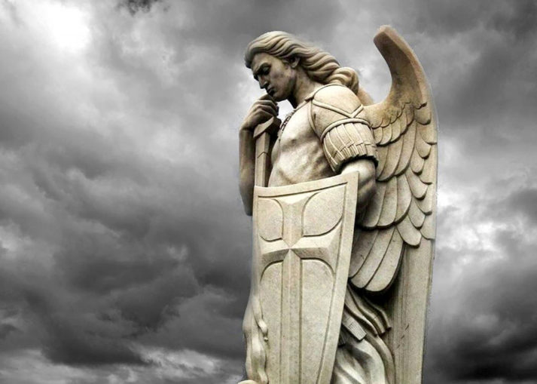
Jude 9
⁹ Yet Michael the archangel, when contending with the devil he disputed about the body of Moses, durst not bring against him a railing accusation, but said, The Lord rebuke thee.
So Michael is “the Archangel”! What do we know about the Archangel?

Slide 34
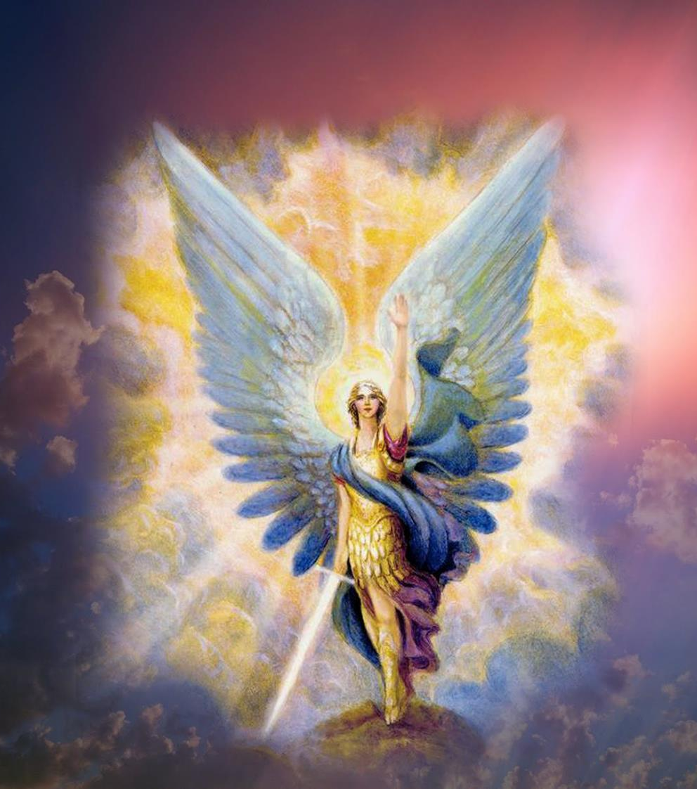
1 Thessalonians 4:16
¹⁶ For the Lord himself shall descend from heaven with a shout, with the voice of the archangel, and with the trump of God: and the dead in Christ shall rise first:
      So the voice of the Archangel is associated with the resurrection of the saints at the coming of Christ.

Slide 35
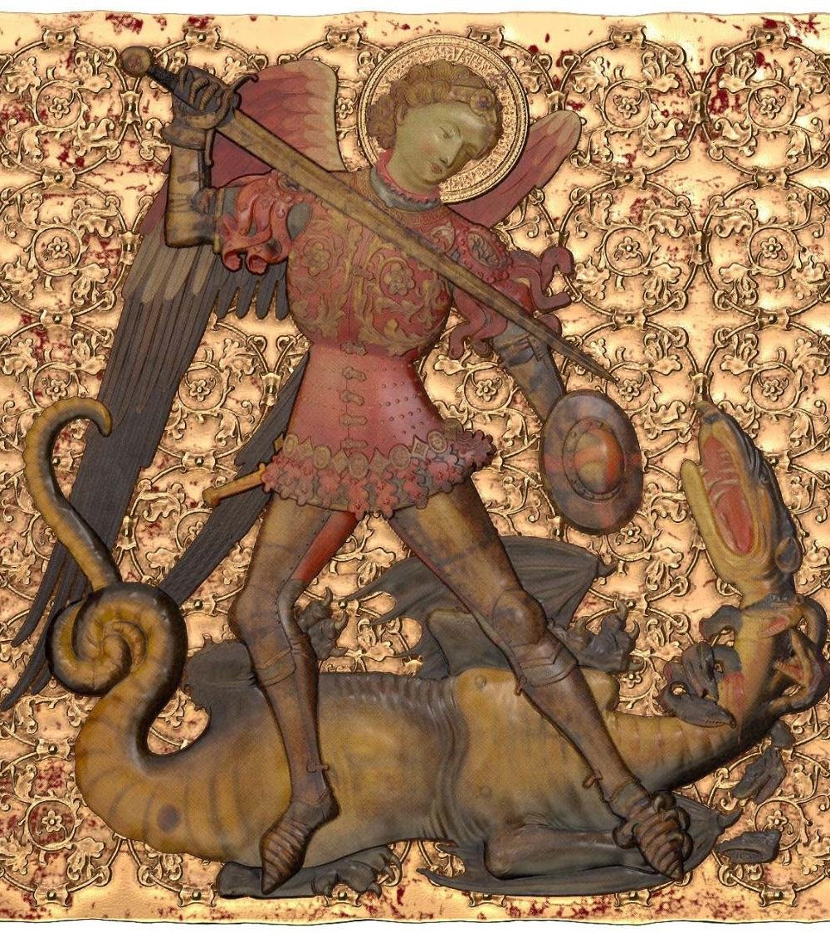
John 5:25-29
²⁵ Verily, verily, I say unto you, The hour is coming, and now is, when the dead shall hear the voice of the Son of God: and they that hear shall live.
²⁶ For as the Father hath life in himself; so hath he given to the Son to have life in himself;
²⁷ And hath given him authority to execute judgment also, because he is the Son of man.

Slide 36
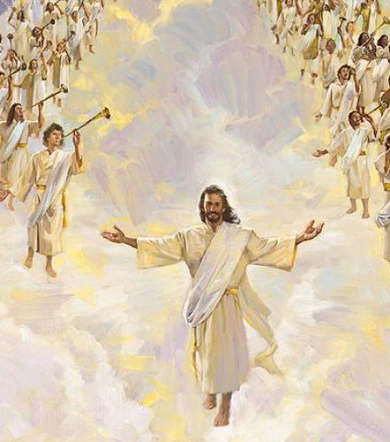
²⁸ Marvel not at this: for the hour is coming, in the which all that are in the graves shall hear his voice,
²⁹ And shall come forth; they that have done good, unto the resurrection of life; and they that have done evil, unto the resurrection of damnation.
We know that the dead will come forth from their graves when they hear the voice of the Son of Man.

Slide 37
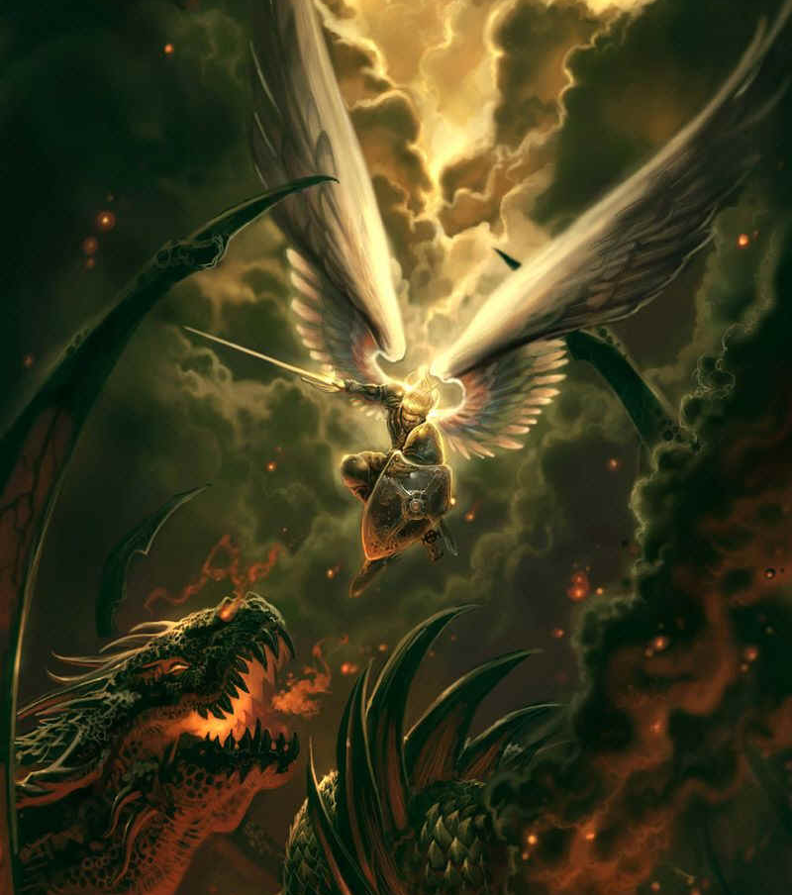
Daniel 10:13
¹² Then said he unto me, Fear not, Daniel: for from the first day that thou didst set thine heart to understand, and to chasten thyself before thy God, thy words were heard, and I am come for thy words.
¹³ But the prince of the kingdom of Persia withstood me one and twenty days: but, lo, Michael, one of the chief princes, came to help me; and I remained there with the kings of Persia.
      So the “prince of Persia” resisted the angel for 21 days, until Michael came to help him.

Slide 38
Prophets and Kings pg. 571
Through the prophet Daniel we are given a glimpse of this mighty struggle between the forces of good and the forces of evil. For three weeks Gabriel wrestled with the powers of darkness, seeking to counteract the influences at work on the mind of Cyrus; and before the contest closed, Christ Himself came to Gabriel's aid. “The prince of the kingdom of Persia withstood me one and twenty days,” Gabriel declares; “but, lo, Michael, one of the chief princes, came to help me; and I remained there with the kings of Persia.” Daniel 10:13.

Slide 39
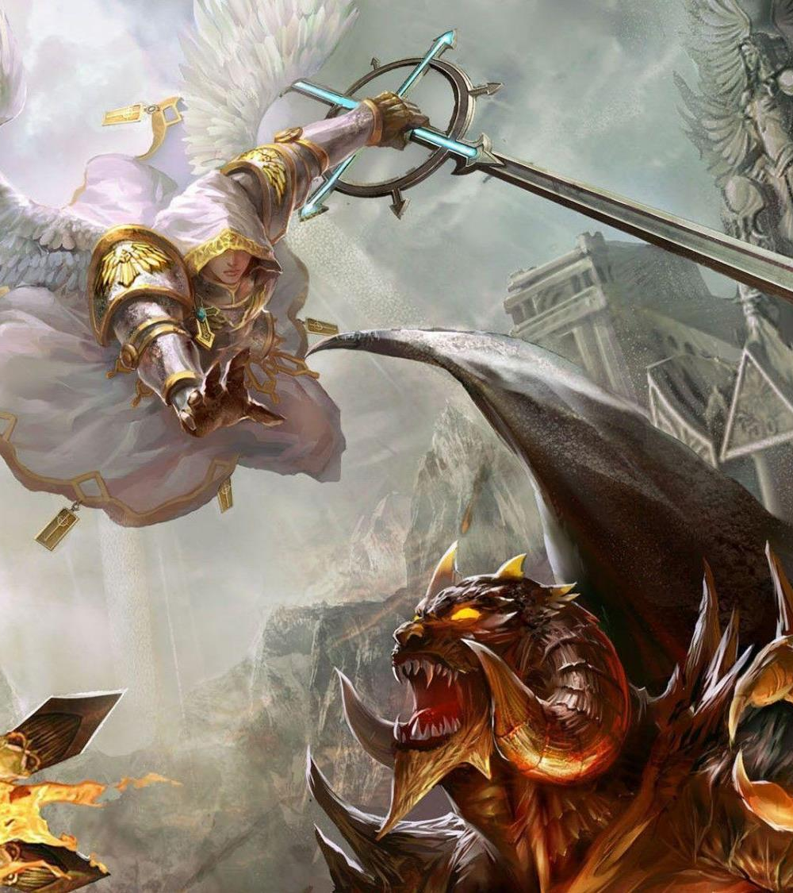
The Archangel Michael
The name Michael as he name of a heavenly being appears in the Bible only in apocalyptic passages (Dan. 10:13, 21; 12:1; Jude 9; Rev. 12:7), in instances where Christ is in direct conflict with Satan. The name in Hebrew, “who is like God?” is at once a question and a challenge. In view of the fact that Satan’s rebellion is essentially an attempt to install himself on the throne of God and “be like the Most High,” the name Michael is a most fitting one for Him who has undertaken to vindicate the character of God and disprove Satan’s claims.

Slide 40
12 And at that time shall Michael stand up, the great prince which standeth for the children of thy people: and there shall be a time of trouble, such as never was since there was a nation even to that same time: and at that time thy people shall be delivered, every one that shall be found written in the book.
Daniel 12:1

Slide 41
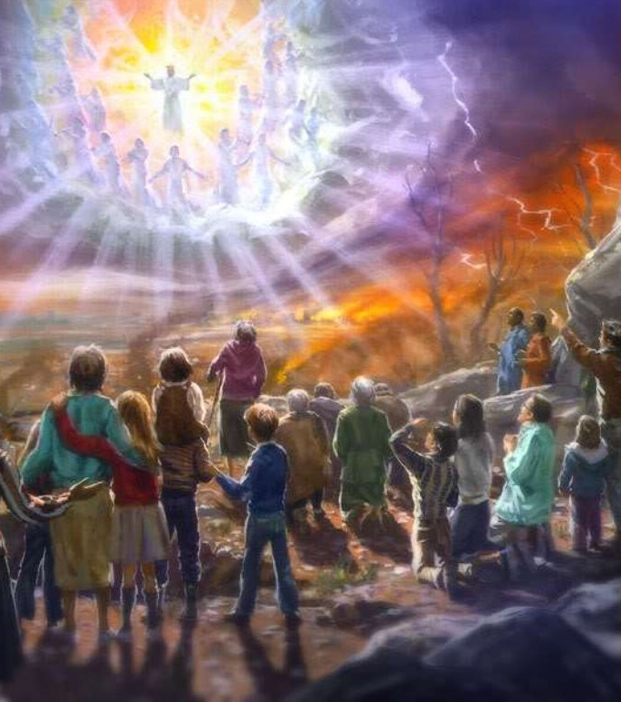
Daniel 12:2-13
² And many of them that sleep in the dust of the earth shall awake, some to everlasting life, and some to shame and everlasting contempt.
³ And they that be wise shall shine as the brightness of the firmament; and they that turn many to righteousness as the stars for ever and ever.
⁴ But thou, O Daniel, shut up the words, and seal the book, even to the time of the end: many shall run to and fro, and knowledge shall be increased.

Slide 42
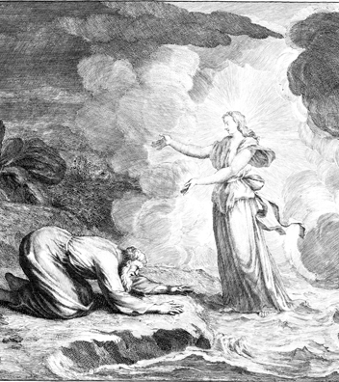
Daniel 12:5-13
⁵ Then I Daniel looked, and, behold, there stood other two, the one on this side of the bank of the river, and the other on that side of the bank of the river.
⁶ And one said to the man clothed in linen, which was upon the waters of the river, How long shall it be to the end of these wonders?

Slide 43
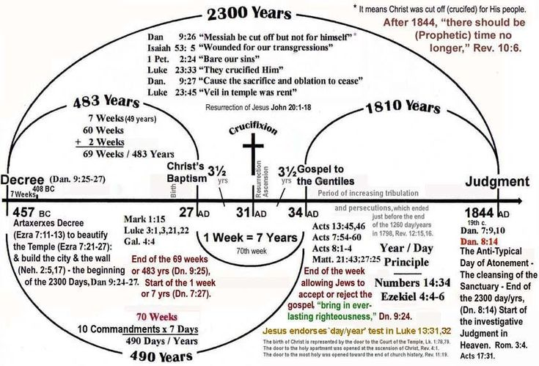

Slide 44
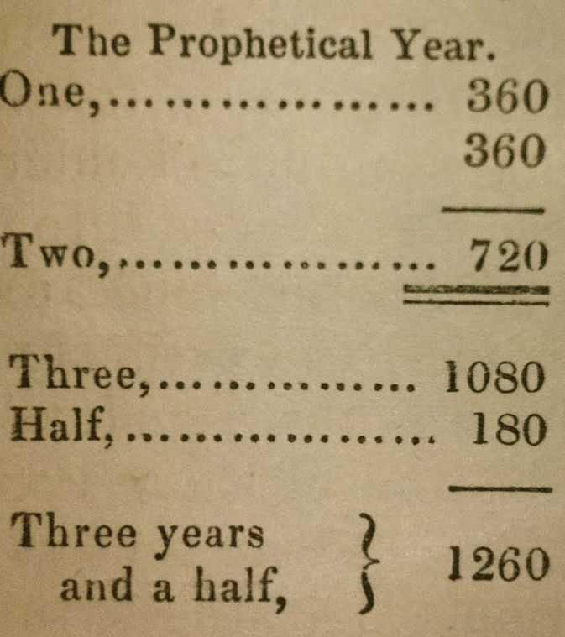
Daniel 12:7-13
⁷ And I heard the man clothed in linen, which was upon the waters of the river, when he held up his right hand and his left hand unto heaven, and sware by him that liveth for ever that it shall be for a time, times, and an half; and when he shall have accomplished to scatter the power of the holy people, all these things shall be finished.
⁸ And I heard, but I understood not: then said I, O my Lord, what shall be the end of these things?
⁹ And he said, Go thy way, Daniel: for the words are closed up and sealed till the time of the end.

Slide 45
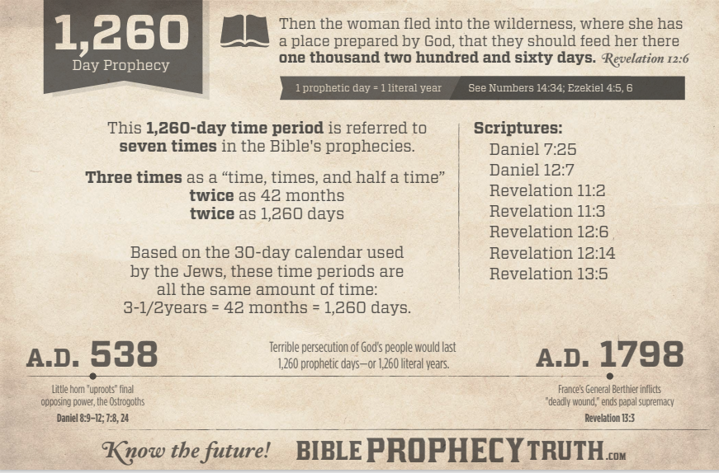

Slide 46
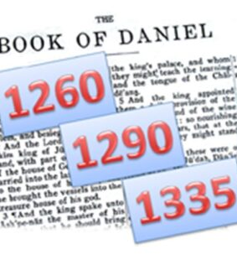
Daniel 12:10-13
¹⁰ Many shall be purified, and made white, and tried; but the wicked shall do wickedly: and none of the wicked shall understand; but the wise shall understand.
¹¹ And from the time that the daily sacrifice shall be taken away, and the abomination that maketh desolate set up, there shall be a thousand two hundred and ninety days.

Slide 47
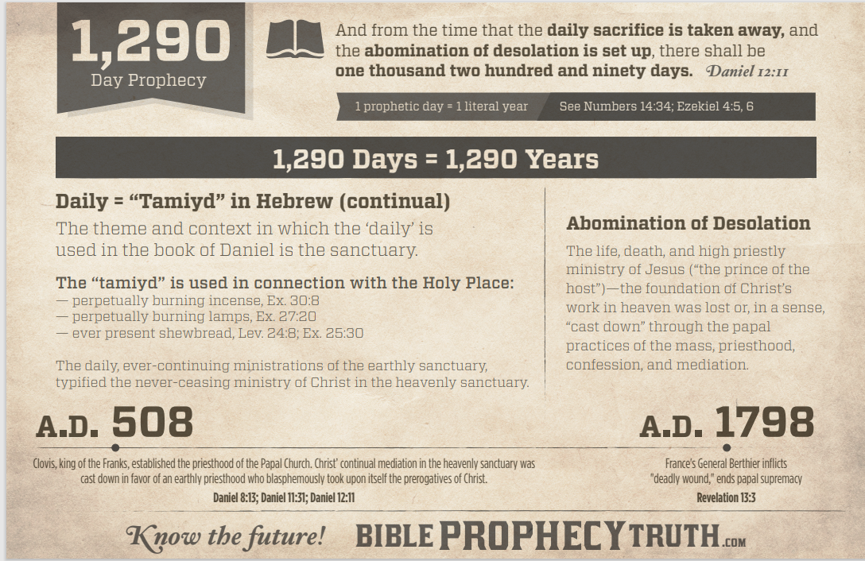

Slide 48
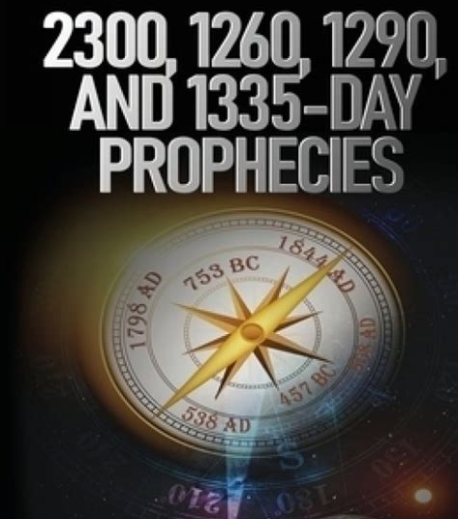
Daniel 12:12-13
¹² Blessed is he that waiteth, and cometh to the thousand three hundred and five and thirty days.
¹³ But go thou thy way till the end be: for thou shalt rest, and stand in thy lot at the end of the days.

Slide 49
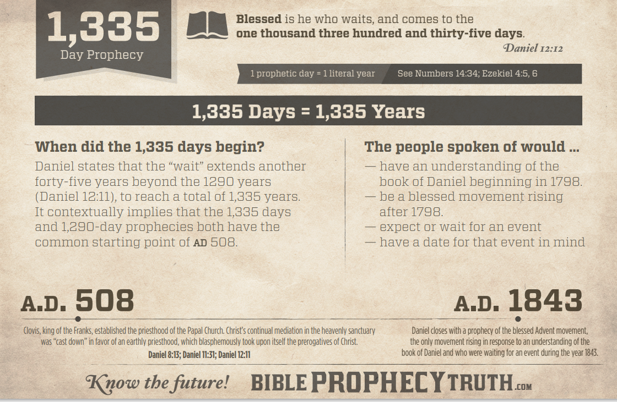

Slide 50
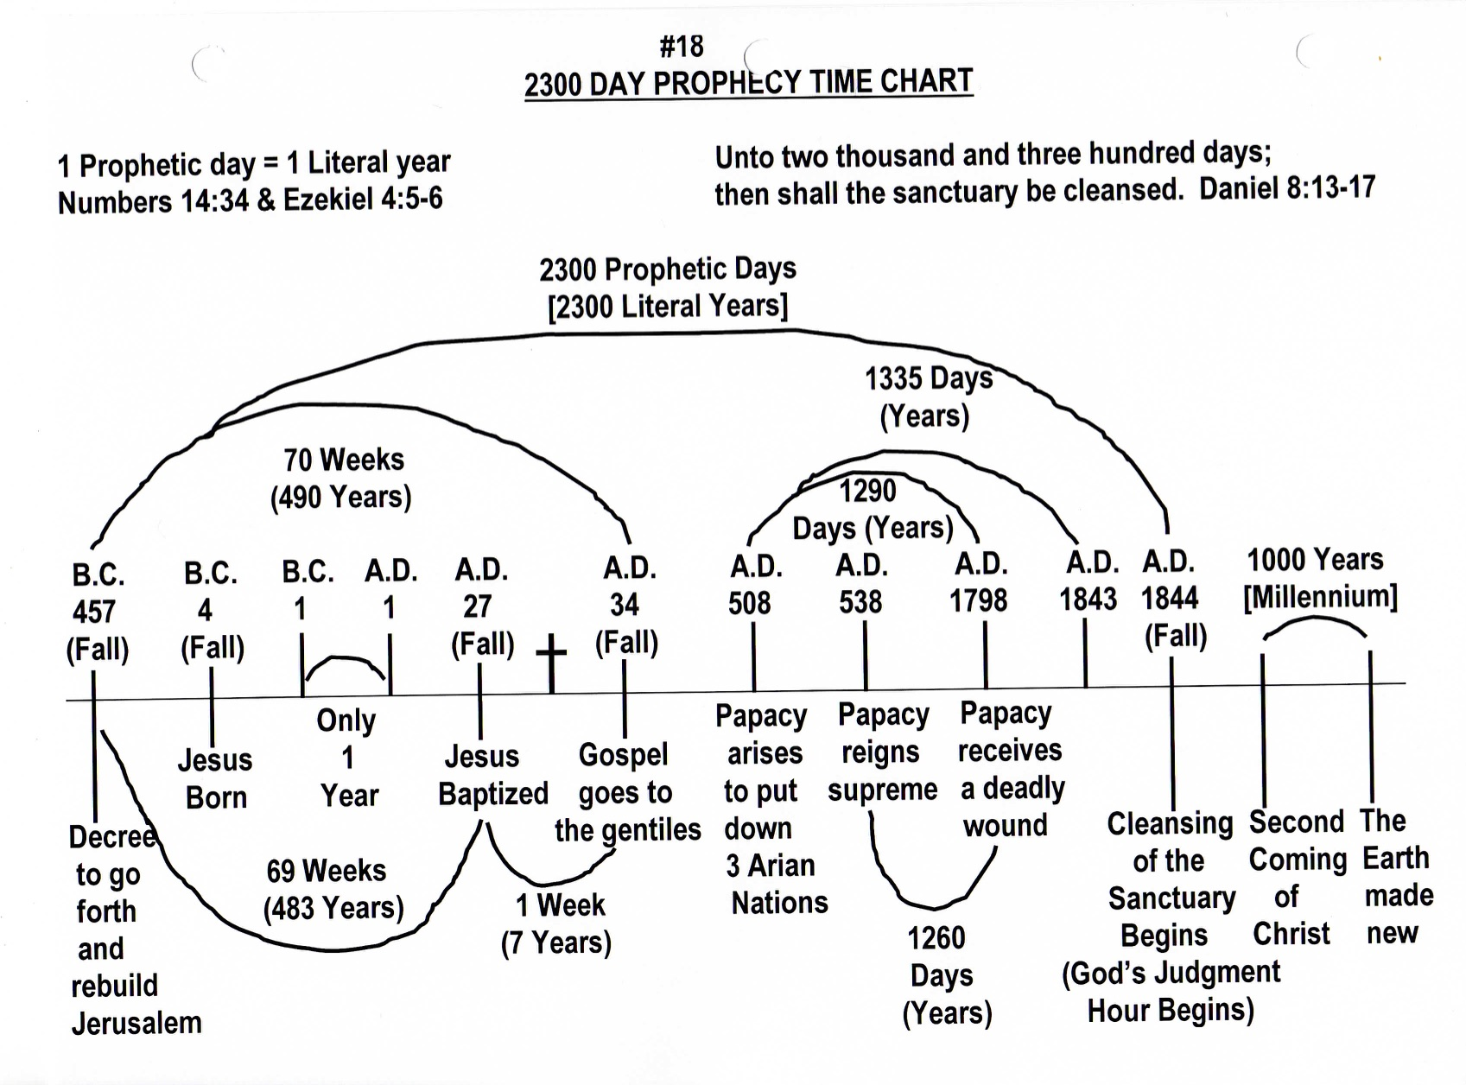

Slide 51
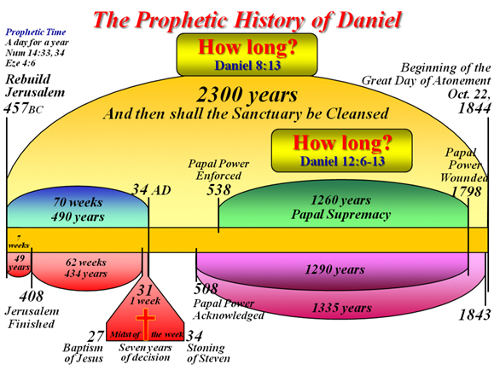
God’s plan to cleanse the sanctuary and bring His people into alignment with Him in the great day of At-One-Ment.

Slide 52
12 And in that day thou shalt say, O Lord, I will praise thee: though thou wast angry with me, thine anger is turned away, and thou comfortedst me.
² Behold, God is my salvation; I will trust, and not be afraid: for the Lord Jehovah is my strength and my song; he also is become my salvation.
³ Therefore with joy shall ye draw water out of the wells of salvation.
⁴ And in that day shall ye say, Praise the Lord, call upon his name, declare his doings among the people, make mention that his name is exalted.
⁵ Sing unto the Lord; for he hath done excellent things: this is known in all the earth.
—Isaiah 12:1-5

Slide 53
⁷ Blessed is the man that trusteth in the Lord, and whose hope the Lord is.
⁸ For he shall be as a tree planted by the waters, and that spreadeth out her roots by the river, and shall not see when heat cometh, but her leaf shall be green; and shall not be careful in the year of drought, neither shall cease from yielding fruit.
—Jeremiah 17:7-8

Slide 54
¹¹ For I know the thoughts that I think toward you, saith the Lord, thoughts of peace, and not of evil, to give you an expected end.
¹² Then shall ye call upon me, and ye shall go and pray unto me, and I will hearken unto you.
¹³ And ye shall seek me, and find me, when ye shall search for me with all your heart.
—Jeremiah 29:11-13

Slide 55
⁹ The Lord also will be a refuge for the oppressed, a refuge in times of trouble.
¹⁰ And they that know thy name will put their trust in thee: for thou, Lord, hast not forsaken them that seek thee.
—Psalm 9:9-10

Slide 56

Psalm 28:7-9
⁷ The Lord is my strength and my shield; my heart trusted in him, and I am helped: therefore my heart greatly rejoiceth; and with my song will I praise him.
⁸ The Lord is their strength, and he is the saving strength of his anointed.
⁹ Save thy people, and bless thine inheritance: feed them also, and lift them up for ever.

Slide 57
HAPPY
SABBATH!
THANK YOU

