Slide 1

Paul and the Ephesians
Lesson 1, 3rd Quarter 2023
Acts 18-20

Slide 2

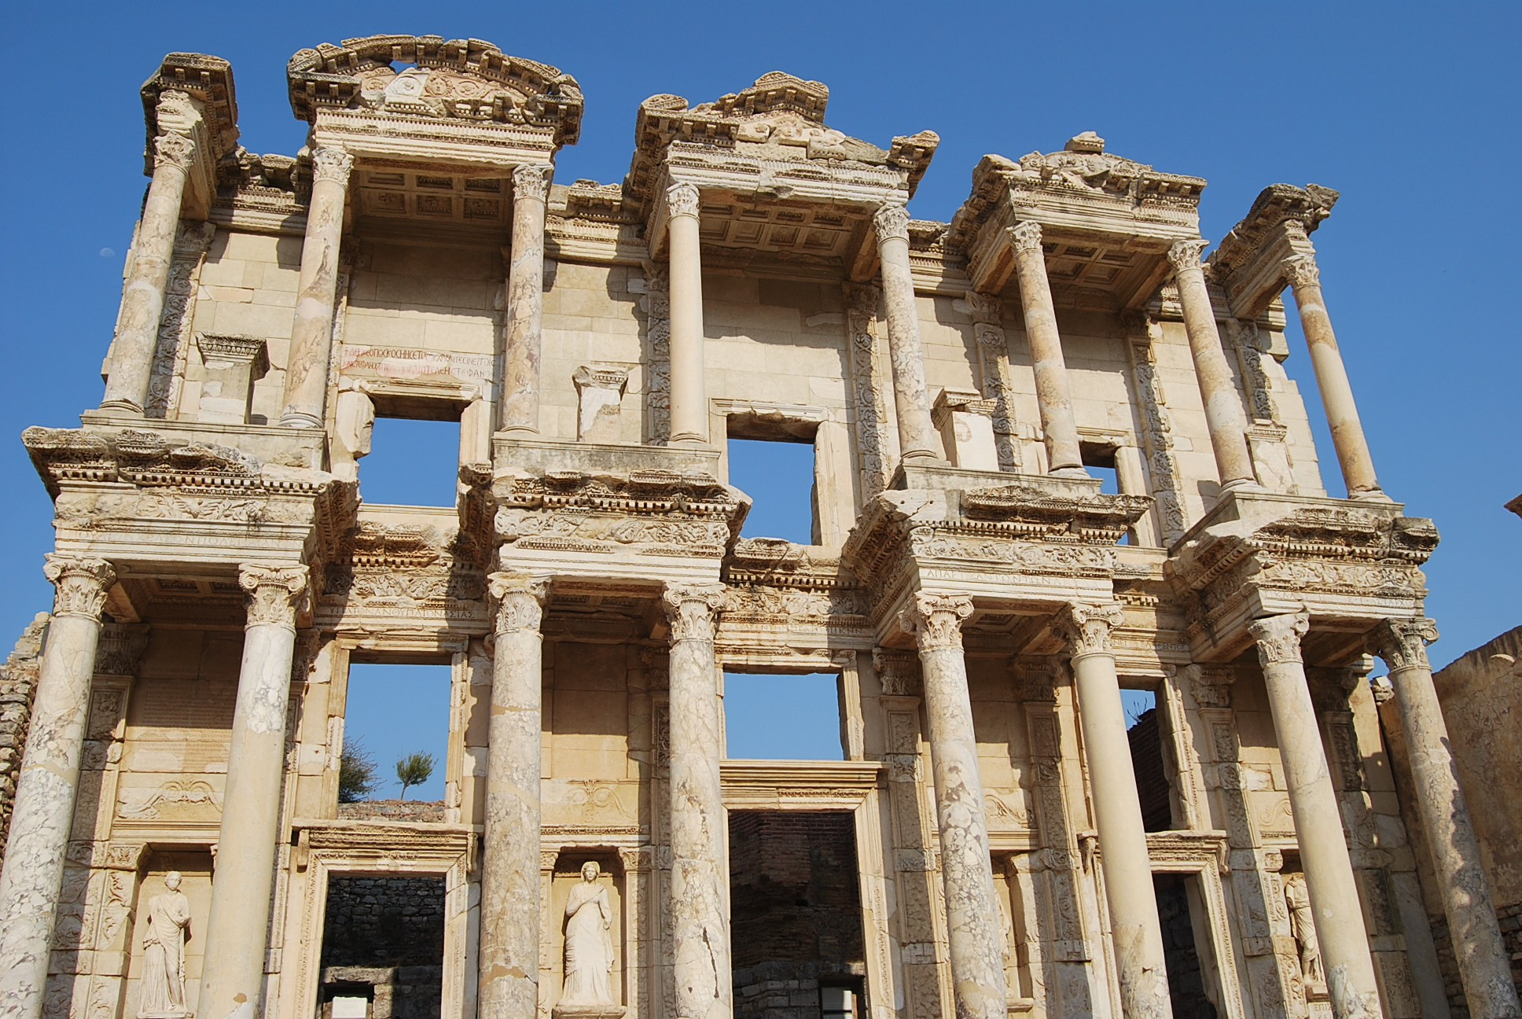
Ephesus
had been an early Greek settlement on the western coast of Asia Minor, but in the 6th century B.C. it fell under the power of the kings of Lydia.
Library of Celsus in Ephesus

Slide 3
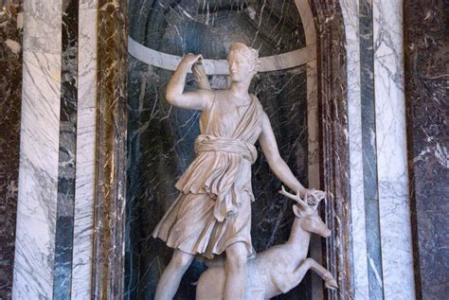
From the
first it had been a center for the worship of Artemis (the Roman Diana), the goddess of the hunt, the wilderness, wild animals, nature, vegetation, childbirth, care of children, and chastity.
Artemis the Huntress

Slide 4
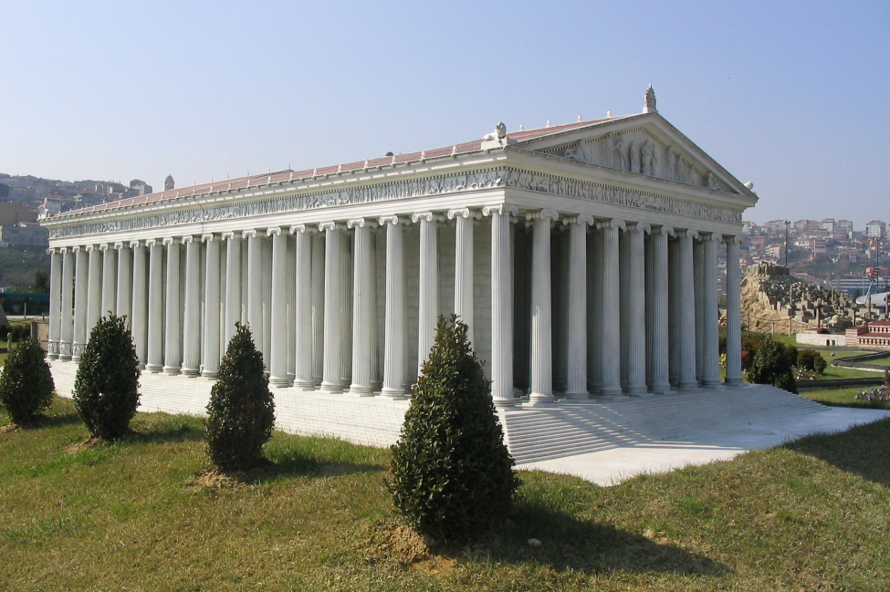
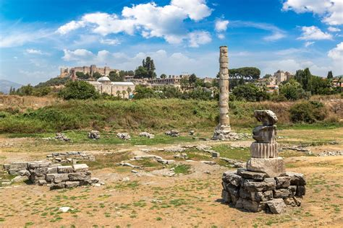
Ephesus
was famous in its day for the Temple of Artemis (completed around 550 BC), which has been designated one of the Seven Wonders of the Ancient World.
Temple of Artemis

Slide 5
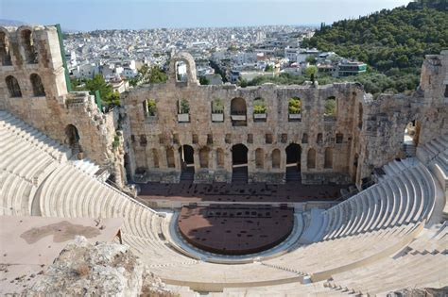
Its many
monumental buildings included the Library of Celsus and a theatre capable of holding 24,000 spectators.
The Odeon of Ephesus

Slide 6
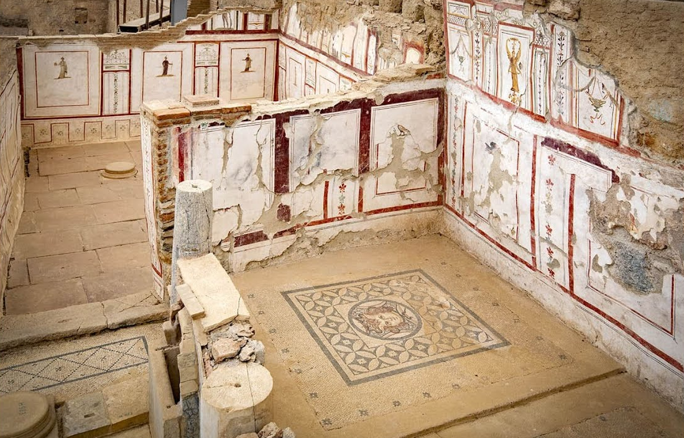
Ephesus,
as part of the kingdom of Pergamon, became a subject of the Roman Republic in 129 BC after the revolt of Eumenes III was suppressed.
Terrace house in Ephesus from Roman period

Slide 7

Paul and Ephesus
Ephesus was an important center for Early Christianity from the A.D. 50s. A tentative chronology of Paul’s relationship to Ephesus is suggested by the Quarterly as follows:
A.D. 62
Paul writes Ephesians from prison in Rome
A.D. 57
Paul meets with Ephesian Elders while in Miletus
A.D. 53-56
Paul’s 3 year Ephesian ministry
A.D. 52
Paul’s initial visit to Ephesus

Slide 8
Paul and Ephesus
Ephesus was an important center for Early Christianity from the A.D. 50s. A tentative chronology of Paul’s relationship to Ephesus is suggested by the Quarterly as follows:
A.D. 62
Paul writes Ephesians from prison in Rome
A.D. 52
Paul’s initial visit to Ephesus
A.D. 57
Paul meets with Ephesian Elders while in Miletus
A.D. 53-56
Paul’s 3 year Ephesian ministry
Acts 18:18-21

Slide 9
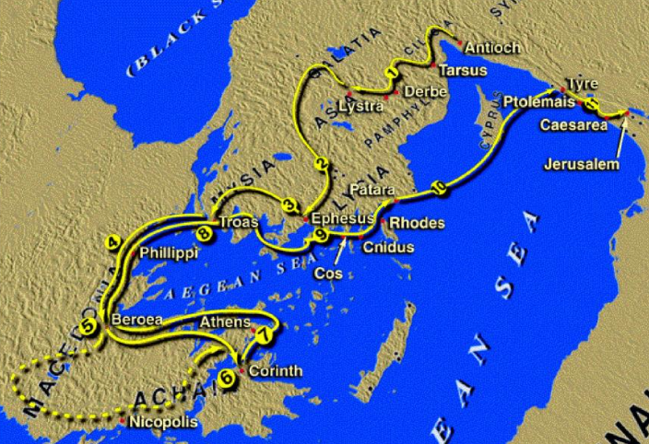
The First Brief Visit:
Acts 18:18-21
Paul had been working in Corinth. Although he had encountered some fierce opposition from the Jewish population, he persisted working in Corinth for a year and a half.

Slide 10
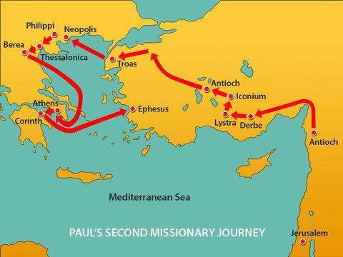

Slide 11
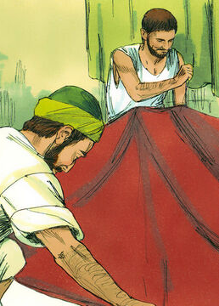
The First Brief Visit:
Acts 18:2-21
² And found a certain Jew named Aquila, born in Pontus, lately come from Italy, with his wife Priscilla; (because that Claudius had commanded all Jews to depart from Rome:) and came unto them.
³ And because he was of the same craft, he abode with them, and wrought: for by their occupation they were tentmakers.

Slide 12
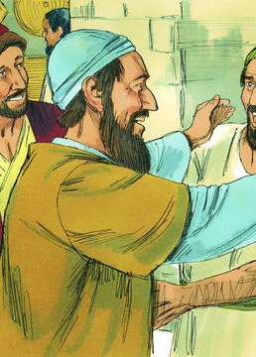
The First Brief Visit:
Acts 18:4-21
⁴ And he reasoned in the synagogue every sabbath, and persuaded the Jews and the Greeks.
⁵ And when Silas and Timotheus were come from Macedonia, Paul was pressed in the spirit, and testified to the Jews that Jesus was Christ.

Slide 13
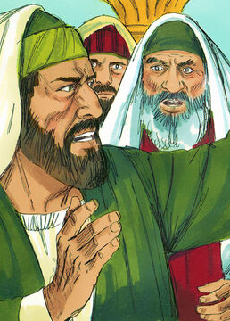
The First Brief Visit:
Acts 18:6-21
⁶ And when they opposed themselves, and blasphemed, he shook his raiment, and said unto them, Your blood be upon your own heads; I am clean; from henceforth I will go unto the Gentiles.

Slide 14
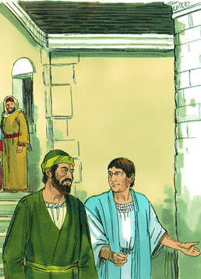
The First Brief Visit:
Acts 18:7-21
⁷ And he departed thence, and entered into a certain man's house, named Justus, one that worshipped God, whose house joined hard to the synagogue.

Slide 15
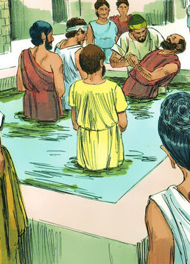
The First Brief Visit:
Acts 18:8-21
⁸ And Crispus, the chief ruler of the synagogue, believed on the Lord with all his house; and many of the Corinthians hearing believed, and were baptized.

Slide 16
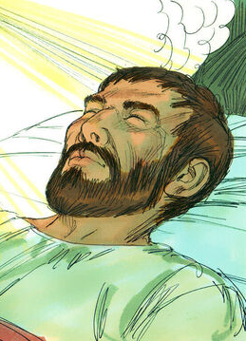
The First Brief Visit:
Acts 18:9-21
⁹ Then spake the Lord to Paul in the night by a vision, Be not afraid, but speak, and hold not thy peace:
¹⁰ For I am with thee, and no man shall set on thee to hurt thee: for I have much people in this city.

Slide 17
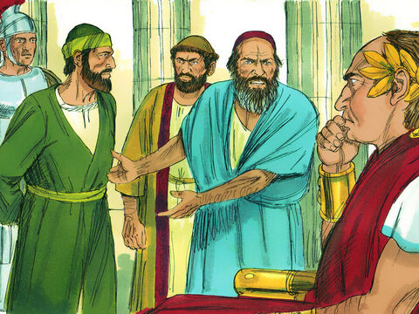
The First Brief Visit:
Acts 18:11-21
¹¹ And he continued there a year and six months, teaching the word of God among them.
¹² And when Gallio was the deputy of Achaia, the Jews made insurrection with one accord against Paul, and brought him to the judgment seat,

Slide 18
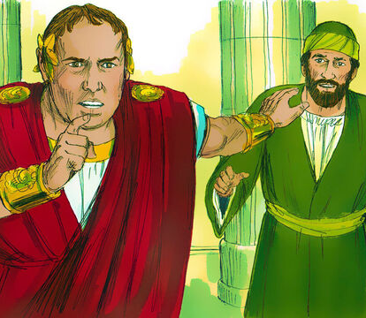
The First Brief Visit:
Acts 18:13-21
¹³ Saying, This fellow persuadeth men to worship God contrary to the law.
¹⁴ And when Paul was now about to open his mouth, Gallio said unto the Jews, If it were a matter of wrong or wicked lewdness, O ye Jews, reason would that I should bear with you:

Slide 19
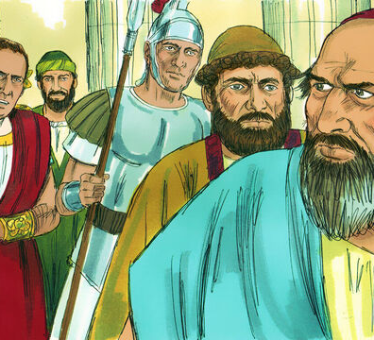
The First Brief Visit:
Acts 18:15-21
¹⁵ But if it be a question of words and names, and of your law, look ye to it; for I will be no judge of such matters.
¹⁶ And he drave them from the judgment seat.

Slide 20
The First Brief Visit:
Acts 18:17-21
¹⁷ Then all the Greeks took Sosthenes, the chief ruler of the synagogue, and beat him before the judgment seat. And Gallio cared for none of those things.

Slide 21
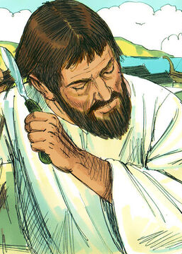
The First Brief Visit:
Acts 18:18-21
¹⁸ And Paul after this tarried there yet a good while, and then took his leave of the brethren, and sailed thence into Syria, and with him Priscilla and Aquila; having shorn his head in Cenchrea: for he had a vow.

Slide 22
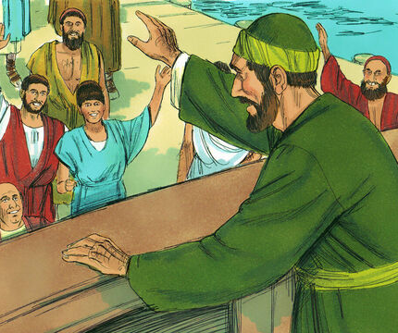
The First Brief Visit:
Acts 18:19-21
¹⁹ And he came to Ephesus, and left them there: but he himself entered into the synagogue, and reasoned with the Jews.

Slide 23
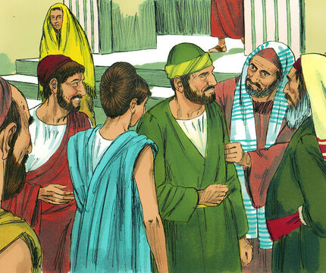
The First Brief Visit:
Acts 18:20-21
²⁰ When they desired him to tarry longer time with them, he consented not;

Slide 24
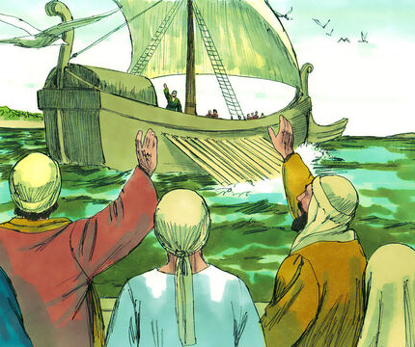
The First Brief Visit:
Acts 18:21
²¹ But bade them farewell, saying, I must by all means keep this feast that cometh in Jerusalem: but I will return again unto you, if God will. And he sailed from Ephesus.

Slide 25
Paul and Ephesus
Paul seems to have had a better reception at Ephesus than he had at Corinth, as the Ephesians wanted him to stay longer. It may be that the cosmopolitan character of the Ephesian population had something to do with this difference in attitude. In any case, it suggested a fruitful future to come!
A.D. 62
Paul writes Ephesians from prison in Rome
A.D. 57
Paul meets with Ephesian Elders while in Miletus
A.D. 53-56
Paul’s 3 year Ephesian ministry
A.D. 52
Paul’s initial visit to Ephesus

Slide 26
Paul and Ephesus
Paul seems to have had a better reception at Ephesus than he had at Corinth, as the Ephesians wanted him to stay longer. It may be that the cosmopolitan character of the Ephesian population had something to do with this difference in attitude. In any case, it suggested a fruitful future to come!
A.D. 62
Paul writes Ephesians from prison in Rome
A.D. 57
Paul meets with Ephesian Elders while in Miletus
A.D. 53-56
Paul’s 3 year Ephesian ministry
A.D. 52
Paul’s initial visit to Ephesus
Acts 19:-20:1

Slide 27
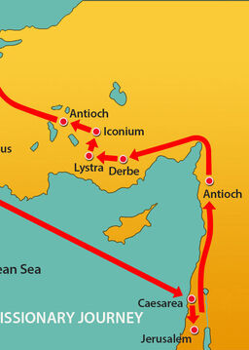
The 3-year ministry:
Acts 18:22-20:1
²² And when he had landed at Caesarea, and gone up, and saluted the church, he went down to Antioch.
²³ And after he had spent some time there, he departed, and went over all the country of Galatia and Phrygia in order, strengthening all the disciples.

Slide 28
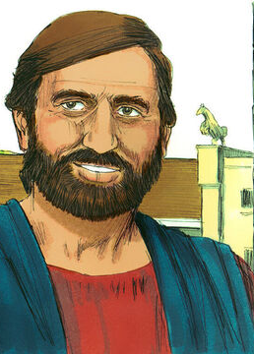
The 3-year ministry:
Acts 18:24-20:1
²⁴ And a certain Jew named Apollos, born at Alexandria, an eloquent man, and mighty in the scriptures, came to Ephesus.
²⁵ This man was instructed in the way of the Lord; and being fervent in the spirit, he spake and taught diligently the things of the Lord, knowing only the baptism of John.

Slide 29
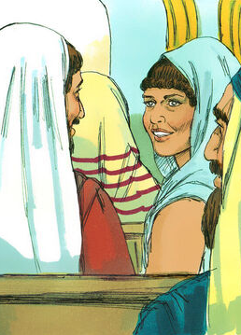
The 3-year ministry:
Acts 18:26-20:1
²⁶ And he began to speak boldly in the synagogue: whom when Aquila and Priscilla had heard, they took him unto them, and expounded unto him the way of God more perfectly.

Slide 30
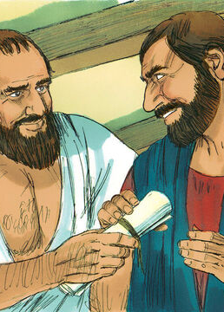
The 3-year ministry:
Acts 18:27-20:1
²⁷ And when he was disposed to pass into Achaia, the brethren wrote, exhorting the disciples to receive him: who, when he was come, helped them much which had believed through grace:

Slide 31
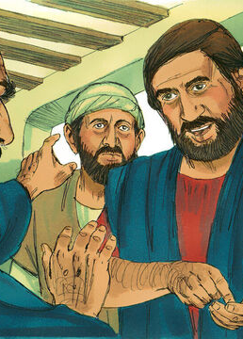
The 3-year ministry:
Acts 18:28-20:1
²⁸ For he mightily convinced the Jews, and that publicly, shewing by the scriptures that Jesus was Christ.

Slide 32
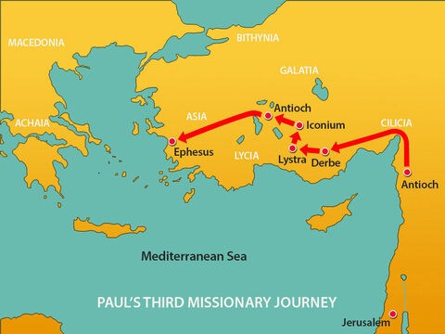

Slide 33
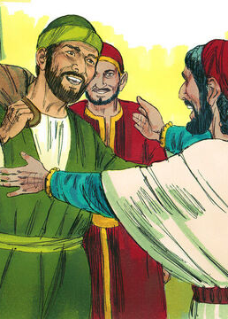
The 3-year ministry:
Acts 19:1-20:1
19 And it came to pass, that, while Apollos was at Corinth, Paul having passed through the upper coasts came to Ephesus: and finding certain disciples,

Slide 34
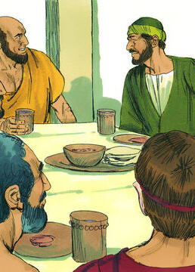
The 3-year ministry:
Acts 19:2-20:1
² He said unto them, Have ye received the Holy Ghost since ye believed? And they said unto him, We have not so much as heard whether there be any Holy Ghost.
³ And he said unto them, Unto what then were ye baptized? And they said, Unto John's baptism.

Slide 35
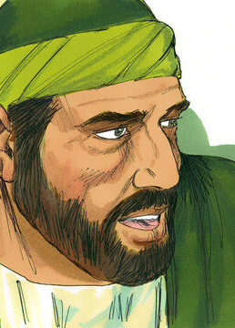
The 3-year ministry:
Acts 19:4-20:1
⁴ Then said Paul, John verily baptized with the baptism of repentance, saying unto the people, that they should believe on him which should come after him, that is, on Christ Jesus.
⁵ When they heard this, they were baptized in the name of the Lord Jesus.

Slide 36
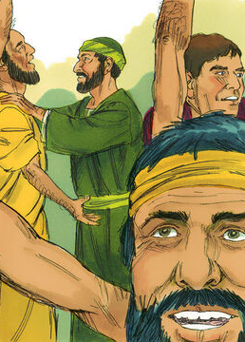
The 3-year ministry:
Acts 19:6-20:1
⁶ And when Paul had laid his hands upon them, the Holy Ghost came on them; and they spake with tongues, and prophesied.
⁷ And all the men were about twelve.

Slide 37
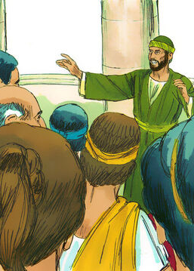
The 3-year ministry:
Acts 19:8-20:1
⁸ And he went into the synagogue, and spake boldly for the space of three months, disputing and persuading the things concerning the kingdom of God.
⁹ But when divers were hardened, and believed not, but spake evil of that way before the multitude, he departed from them, and separated the disciples, disputing daily in the school of one Tyrannus.

Slide 38


The 3-year ministry: Acts 19:9
SDABC V. 6 p.
The hardened and disobedient were speaking evilly of Christians and Christianity. The unbelieving Jews acted at Ephesus as their fellows had at Thessalonica. They probably displayed their hatred of Paul by attempting to turn the Gentiles against him.
⁹ But when divers were hardened, and believed not, but spake evil of that way before the multitude, he departed from them, and separated the disciples, disputing daily in the school of one Tyrannus.

Slide 39
The 3-year ministry: Acts 19:9
SDABC V. 6 p.
The Christian part of the congregation in the synagogue was withdrawn, along with any of the Jews who had become interested in Paul’s teaching. This is the first recorded time when the entire group of Christian believers severed their connection with the Jewish synagogue.
⁹ But when divers were hardened, and believed not, but spake evil of that way before the multitude, he departed from them, and separated the disciples, disputing daily in the school of one Tyrannus.

Slide 40
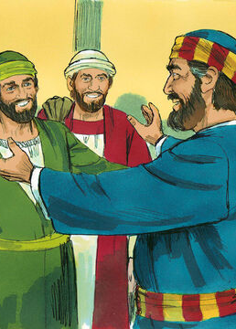
The 3-year ministry:
Acts 19:10-20:1
¹⁰ And this continued by the space of two years; so that all they which dwelt in Asia heard the word of the Lord Jesus, both Jews and Greeks.

Slide 41
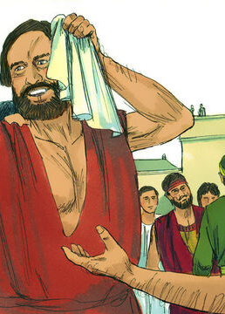
The 3-year ministry:
Acts 19:11-20:1
¹¹ And God wrought special miracles by the hands of Paul:
¹² So that from his body were brought unto the sick handkerchiefs or aprons, and the diseases departed from them, and the evil spirits went out of them.

Slide 42
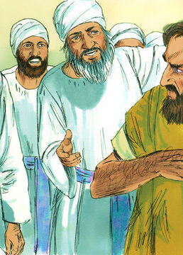
The 3-year ministry:
Acts 19:13-20:1
¹³ Then certain of the vagabond Jews, exorcists, took upon them to call over them which had evil spirits the name of the Lord Jesus, saying, We adjure you by Jesus whom Paul preacheth.
¹⁴ And there were seven sons of one Sceva, a Jew, and chief of the priests, which did so.

Slide 43
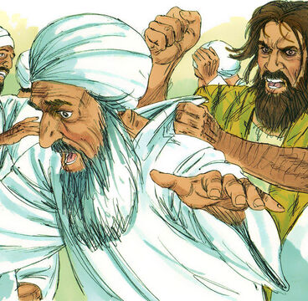
The 3-year ministry:
Acts 19:15-20:1
¹⁵ And the evil spirit answered and said, Jesus I know, and Paul I know; but who are ye?
¹⁶ And the man in whom the evil spirit was leaped on them, and overcame them, and prevailed against them, so that they fled out of that house naked and wounded.

Slide 44
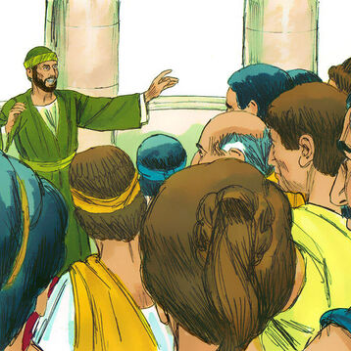
The 3-year ministry:
Acts 19:17-20:1
¹⁷ And this was known to all the Jews and Greeks also dwelling at Ephesus; and fear fell on them all, and the name of the Lord Jesus was magnified.
¹⁸ And many that believed came, and confessed, and shewed their deeds.

Slide 45
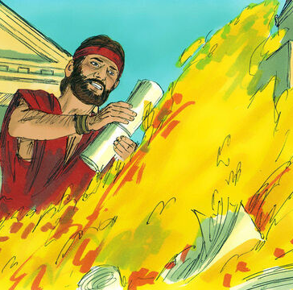
The 3-year ministry:
Acts 19:19-20:1
¹⁹ Many of them also which used curious arts brought their books together, and burned them before all men: and they counted the price of them, and found it fifty thousand pieces of silver.
²⁰ So mightily grew the word of God and prevailed.

Slide 46
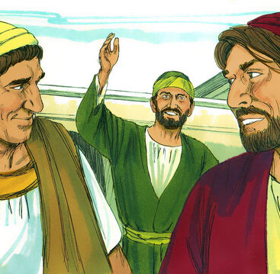
The 3-year ministry:
Acts 19:21-20:1
²¹ After these things were ended, Paul purposed in the spirit, when he had passed through Macedonia and Achaia, to go to Jerusalem, saying, After I have been there, I must also see Rome.
²² So he sent into Macedonia two of them that ministered unto him, Timotheus and Erastus; but he himself stayed in Asia for a season.

Slide 47

Paul enjoyed outstanding success in Ephesus! Many were converted to Christianity, made “more perfect” in “the way,” and even healed. Paul composes 1 Corinthians near the end of his stay there. He writes in the sixteenth chapter of his (first) letter to the church at Corinth:
⁵ Now I will come unto you, when I shall pass through Macedonia: for I do pass through Macedonia.
⁶ And it may be that I will abide, yea, and winter with you, that ye may bring me on my journey whithersoever I go.

Slide 48
⁷ For I will not see you now by the way; but I trust to tarry a while with you, if the Lord permit.
⁸ But I will tarry at Ephesus until Pentecost.
⁹ For a great door and effectual is opened unto me, and there are many adversaries.
… indeed, there was another big conflict in Ephesus before Paul could travel onward to Corinth in Macedonia, and ultimately to Rome (where he would write Ephesians!).

Slide 49
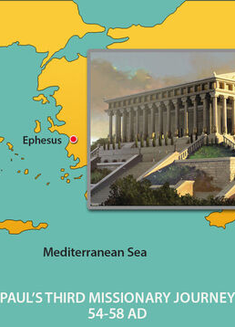
The 3-year ministry:
Acts 19:23-20:1
²³ And the same time there arose no small stir about that way.
²⁴ For a certain man named Demetrius, a silversmith, which made silver shrines for Diana, brought no small gain unto the craftsmen;

Slide 50
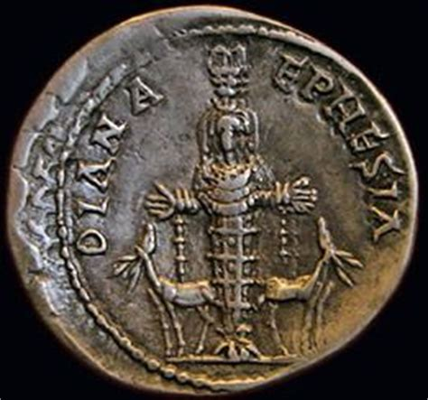
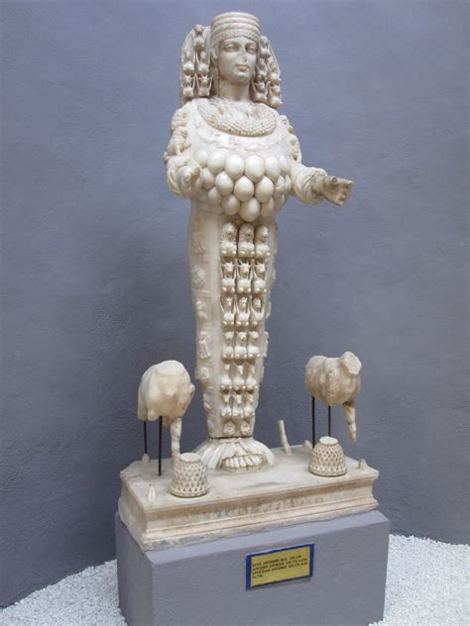

Slide 51
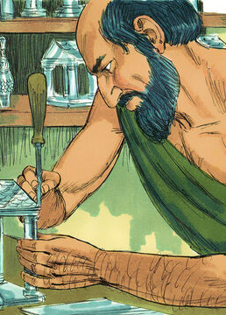
The 3-year ministry:
Acts 19:26-20:1
²⁵ Whom he called together with the workmen of like occupation, and said, Sirs, ye know that by this craft we have our wealth.
²⁶ Moreover ye see and hear, that not alone at Ephesus, but almost throughout all Asia, this Paul hath persuaded and turned away much people, saying that they be no gods, which are made with hands:

Slide 52
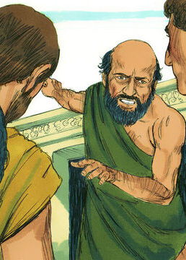
The 3-year ministry:
Acts 19:27-20:1
²⁷ So that not only this our craft is in danger to be set at nought; but also that the temple of the great goddess Diana should be despised, and her magnificence should be destroyed, whom all Asia and the world worshippeth.

Slide 53
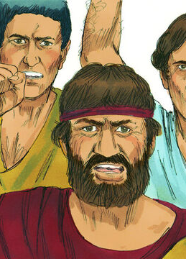
The 3-year ministry:
Acts 19:28-20:1
²⁸ And when they heard these sayings, they were full of wrath, and cried out, saying, Great is Diana of the Ephesians.

Slide 54
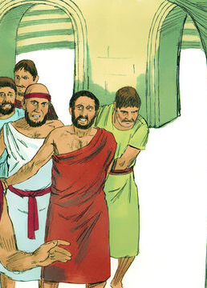
The 3-year ministry:
Acts 19:29-20:1
²⁹ And the whole city was filled with confusion: and having caught Gaius and Aristarchus, men of Macedonia, Paul's companions in travel, they rushed with one accord into the theatre.

Slide 55
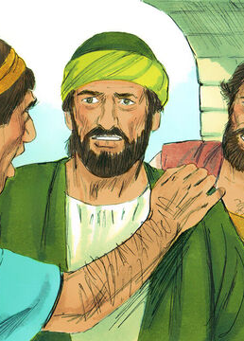
The 3-year ministry:
Acts 19:30-20:1
³⁰ And when Paul would have entered in unto the people, the disciples suffered him not.

Slide 56
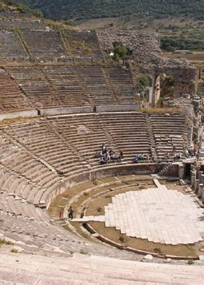
The 3-year ministry:
Acts 19:31-20:1
³¹ And certain of the chief of Asia, which were his friends, sent unto him, desiring him that he would not adventure himself into the theatre.

Slide 57
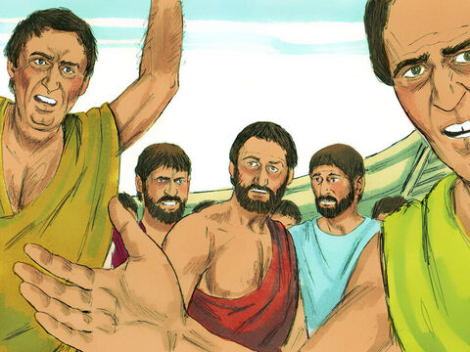
The 3-year ministry:
Acts 19:32-20:1
³² Some therefore cried one thing, and some another: for the assembly was confused: and the more part knew not wherefore they were come together.

Slide 58
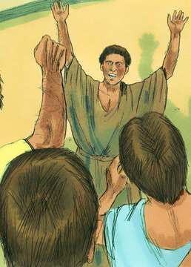
The 3-year ministry:
Acts 19:32-20:1
³³ And they drew Alexander out of the multitude, the Jews putting him forward. And Alexander beckoned with the hand, and would have made his defence unto the people.

Slide 59
The 3-year ministry:
Acts 19:34-20:1
³⁴ But when they knew that he was a Jew, all with one voice about the space of two hours cried out, Great is Diana of the Ephesians.

Slide 60

The 3-year ministry:
Acts 19:35-20:1
³⁵ And when the townclerk had appeased the people, he said, Ye men of Ephesus, what man is there that knoweth not how that the city of the Ephesians is a worshipper of the great goddess Diana, and of the image which fell down from Jupiter?

Slide 61

The 3-year ministry:
Acts 19:36-20:1
³⁶ Seeing then that these things cannot be spoken against, ye ought to be quiet, and to do nothing rashly.
³⁷ For ye have brought hither these men, which are neither robbers of churches, nor yet blasphemers of your goddess.

Slide 62

The 3-year ministry:
Acts 19:38-20:1
³⁸ Wherefore if Demetrius, and the craftsmen which are with him, have a matter against any man, the law is open, and there are deputies: let them implead one another.
³⁹ But if ye enquire any thing concerning other matters, it shall be determined in a lawful assembly.

Slide 63

The 3-year ministry:
Acts 19:40-20:1
⁴⁰ For we are in danger to be called in question for this day's uproar, there being no cause whereby we may give an account of this concourse.
⁴¹ And when he had thus spoken, he dismissed the assembly.

Slide 64

The 3-year ministry:
Acts 20:1
20 And after the uproar was ceased, Paul called unto him the disciples, and embraced them, and departed for to go into Macedonia.

Slide 65
Paul and Ephesus
There is a gap here in the narrative of Acts that can be supplied with information from the Corinthian epistles. During this tour of Macedonia Paul wrote 2 Corinthians. His intended path changed often as Jewish detractors plotted to kill him.
A.D. 62
Paul writes Ephesians from prison in Rome
A.D. 57
Paul meets with Ephesian Elders while in Miletus
A.D. 53-56
Paul’s 3 year Ephesian ministry
A.D. 52
Paul’s initial visit to Ephesus

Slide 66
Paul and Ephesus
There is a gap here in the narrative of Acts that can be supplied with information from the Corinthian epistles. During this tour of Macedonia Paul wrote 2 Corinthians. His intended path changed often as Jewish detractors plotted to kill him.
A.D. 57
Paul meets with Ephesian Elders while in Miletus
A.D. 62
Paul writes Ephesians from prison in Rome
A.D. 53-56
Paul’s 3 year Ephesian ministry
A.D. 52
Paul’s initial visit to Ephesus
Acts 20:17-38

Slide 67

Meeting with the Elders:
Acts 20:2-38
² And when he had gone over those parts, and had given them much exhortation, he came into Greece,
³ And there abode three months. And when the Jews laid wait for him, as he was about to sail into Syria, he purposed to return through Macedonia.

Slide 68

Meeting with the Elders:
Acts 20:4-38
⁴ And there accompanied him into Asia Sopater of Berea; and of the Thessalonians, Aristarchus and Secundus; and Gaius of Derbe, and Timotheus; and of Asia, Tychicus and Trophimus.
⁵ These going before tarried for us at Troas.

Slide 69

Meeting with the Elders:
Acts 20:6-38
⁶ And we sailed away from Philippi after the days of unleavened bread, and came unto them to Troas in five days; where we abode seven days.

Slide 70

Meeting with the Elders:
Acts 20:7-38
⁷ And upon the first day of the week, when the disciples came together to break bread, Paul preached unto them, ready to depart on the morrow; and continued his speech until midnight.

Slide 71

Meeting with the Elders:
Acts 20:8-38
⁸ And there were many lights in the upper chamber, where they were gathered together.

Slide 72

Meeting with the Elders:
Acts 20:9-38
⁹ And there sat in a window a certain young man named Eutychus, being fallen into a deep sleep: and as Paul was long preaching, he sunk down with sleep, and fell down from the third loft, and was taken up dead.
¹⁰ And Paul went down, and fell on him, and embracing him said, Trouble not yourselves; for his life is in him.

Slide 73

Meeting with the Elders:
Acts 20:11-38
¹¹ When he therefore was come up again, and had broken bread, and eaten, and talked a long while, even till break of day, so he departed.
¹² And they brought the young man alive, and were not a little comforted.

Slide 74

Meeting with the Elders:
Acts 20:13-38
¹³ And we went before to ship, and sailed unto Assos, there intending to take in Paul: for so had he appointed, minding himself to go afoot.
¹⁴ And when he met with us at Assos, we took him in, and came to Mitylene.

Slide 75

Meeting with the Elders:
Acts 20:15-38
¹⁵ And we sailed thence, and came the next day over against Chios; and the next day we arrived at Samos, and tarried at Trogyllium; and the next day we came to Miletus.
¹⁶ For Paul had determined to sail by Ephesus, because he would not spend the time in Asia: for he hasted, if it were possible for him, to be at Jerusalem the day of Pentecost.

Slide 76

Meeting with the Elders:
Acts 20:17-38
¹⁷ And from Miletus he sent to Ephesus, and called the elders of the church.
¹⁸ And when they were come to him, he said unto them, Ye know, from the first day that I came into Asia, after what manner I have been with you at all seasons,

Slide 77

Meeting with the Elders:
Acts 20:19-38
¹⁹ Serving the Lord with all humility of mind, and with many tears, and temptations, which befell me by the lying in wait of the Jews:
²⁰ And how I kept back nothing that was profitable unto you, but have shewed you, and have taught you publicly, and from house to house,

Slide 78

Meeting with the Elders:
Acts 20:21-38
²¹ Testifying both to the Jews, and also to the Greeks, repentance toward God, and faith toward our Lord Jesus Christ.
²² And now, behold, I go bound in the spirit unto Jerusalem, not knowing the things that shall befall me there:
²³ Save that the Holy Ghost witnesseth in every city, saying that bonds and afflictions abide me.

Slide 79

Meeting with the Elders:
Acts 20:24-38
²⁴ But none of these things move me, neither count I my life dear unto myself, so that I might finish my course with joy, and the ministry, which I have received of the Lord Jesus, to testify the gospel of the grace of God.

Slide 80

Meeting with the Elders:
Acts 20:25-38
²⁵ And now, behold, I know that ye all, among whom I have gone preaching the kingdom of God, shall see my face no more.
²⁶ Wherefore I take you to record this day, that I am pure from the blood of all men.

Slide 81

Meeting with the Elders:
Acts 20:27-38
²⁷ For I have not shunned to declare unto you all the counsel of God.
²⁸ Take heed therefore unto yourselves, and to all the flock, over the which the Holy Ghost hath made you overseers, to feed the church of God, which he hath purchased with his own blood.

Slide 82

Meeting with the Elders:
Acts 20:29-38
²⁹ For I know this, that after my departing shall grievous wolves enter in among you, not sparing the flock.
³⁰ Also of your own selves shall men arise, speaking perverse things, to draw away disciples after them.

Slide 83

Meeting with the Elders:
Acts 20:31-38
³¹ Therefore watch, and remember, that by the space of three years I ceased not to warn every one night and day with tears.
³² And now, brethren, I commend you to God, and to the word of his grace, which is able to build you up, and to give you an inheritance among all them which are sanctified.

Slide 84

Meeting with the Elders:
Acts 20:33-38
³³ I have coveted no man's silver, or gold, or apparel.
³⁴ Yea, ye yourselves know, that these hands have ministered unto my necessities, and to them that were with me.

Slide 85

Meeting with the Elders:
Acts 20:35-38
³⁵ I have shewed you all things, how that so labouring ye ought to support the weak, and to remember the words of the Lord Jesus, how he said, It is more blessed to give than to receive.
³⁶ And when he had thus spoken, he kneeled down, and prayed with them all.

Slide 86

Meeting with the Elders:
Acts 20:37-38
³⁷ And they all wept sore, and fell on Paul's neck, and kissed him,
³⁸ Sorrowing most of all for the words which he spake, that they should see his face no more. And they accompanied him unto the ship.

Slide 87
Paul and Ephesus
Paul wrote Ephesians to be read aloud in the house churches of believers in greater Ephesus. In the intervening years since Paul’s departure, the Christian movement in Ephesus had grown, and the number of house churches had multiplied.
A.D. 62
Paul writes Ephesians from prison in Rome
A.D. 57
Paul meets with Ephesian Elders while in Miletus
A.D. 53-56
Paul’s 3 year Ephesian ministry
A.D. 52
Paul’s initial visit to Ephesus

Slide 88
Paul and Ephesus
Paul wrote Ephesians to be read aloud in the house churches of believers in greater Ephesus. In the intervening years since Paul’s departure, the Christian movement in Ephesus had grown, and the number of house churches had multiplied.
A.D. 62
Paul writes Ephesians from prison in Rome
A.D. 57
Paul meets with Ephesian Elders while in Miletus
A.D. 53-56
Paul’s 3 year Ephesian ministry
A.D. 52
Paul’s initial visit to Ephesus
Ephesians

Slide 89

Key Ideas: Outlining Ephesians
For those early believers, it would have been an important event to have Tychicus, the personal representative of the founding apostle Paul, stand among them and share a letter from him. As suggested by the epistle itself, the assembled group likely included members of the host household — father, mother, children, and slaves. At the time, a household included others as well — clients (free persons who depended on the householder for support) and even customers. So these may be present too, as well as members of other households.

Slide 90
Key Ideas: Outlining Ephesians
Opening Greeting (Eph. 1:1, 2)
Introductory Blessing (Eph. 1:3-14)
Praying for Believers to Receive Christ-Focused Wisdom (Eph. 1:15-23)
Once Spiritually Dead; Now Exalted With Christ (Eph. 2:1-10)

Slide 91
Key Ideas: Outlining Ephesians
Christ’s Creation of the Church Out of Jews and Gentiles (Eph. 2:11-22)
Paul as Preacher of Christ to the Gentiles (Eph. 3:1-13)
Praying for Believers to Experience the Love of Christ (Eph. 3:14-21)

Slide 92
Key Ideas: Outlining Ephesians
Hold On to the Spirit-Inspired Unity of the Church (Eph. 4:1-16)
Live the New, Unity-Nurturing Life (Eph. 4:17-32)
Walk in Love, Light, and Wisdom (Eph. 5:1-20)

Slide 93
Key Ideas: Outlining Ephesians
Practice Christ-Shaped Life in the Christian Household (Eph. 5:21-6:9)
Stand Together: The Church as the Army of God (Eph. 6:10-20)
Closing Greeting (Eph. 6:21-24)

Slide 94
Do you notice any over-arching messages in this outline? What key themes seem to come through in this letter?
-Quarterly Thought Question
Does anything jump out at you?

Slide 95
Key Ideas
⁹ Having made known unto us the mystery of his will, according to his good pleasure which he hath purposed in himself:
¹⁰ That in the dispensation of the fulness of times he might gather together in one all things in Christ, both which are in heaven, and which are on earth; even in him:
The quarterly also suggests reading Ephesians 1:9-10

Slide 96
Key Ideas: Quarterly, Thurs June 29
“As Ephesians 1:9, 10 proclaims, the unity God has in mind is centered in Christ. So it is no surprise to discover that Ephesians is a Christ-drenched letter that everywhere praises the actions of God in Christ and celebrates the access of believers to the spiritual resources offered them in Christ. Paul employs the phrase “in Christ” and similar phrases more than thirty times, and everywhere lifts up Jesus. As you read the letter, watch for these phrases and stay alert to the many ways Paul focuses on Jesus.”

Slide 97
Key Ideas: Quarterly, Thurs June 29
“Paul seeks to reignite the spiritual commitment of believers in Ephesus by reminding them that they are part of the church, which is at the heart of God’s plan to unify all things in Christ. When he uses the word “church” in the letter, he means the “universal” church or the church at large (rather than a local congregation).”

Slide 98
Key Ideas: Outlining Ephesians
Paul uses four vivid specific metaphors when describing the church in his letter to the Ephesians. You may want to note, as we study the letter, the ways in which these metaphors are used:

Slide 99
Key Ideas: Outlining Ephesians
The church as a body (Eph. 1:22, 23; Eph. 2:16; Eph. 3:6; Eph. 4:1-16, 25; Eph. 5:23, 29, 30).
The church as a building/temple (Eph. 2:19-22).
The church as a bride (Eph. 5:22-27).
The church as an army (Eph. 6:10-20).

Slide 100
Each one of these images, in its own way, reveals what God’s purpose and intention for His church is.
-Quarterly Comment Thursday June 29
Consider our question once more. Does this overview suggest any key themes to your mind? What is Paul’s overarching message here?

Slide 101

Key Ideas
Consider going back to Paul’s words to the Ephesian elders—what Paul presumably thought might be his last words to them. Does this suggest anything?

Slide 102
Key Ideas: Acts 20:25-35
²⁵ And now, behold, I know that ye all, among whom I have gone preaching the kingdom of God, shall see my face no more.
²⁶ Wherefore I take you to record this day, that I am pure from the blood of all men.
²⁷ For I have not shunned to declare unto you all the counsel of God.

Slide 103
Key Ideas: Acts 20:28-35
²⁸ Take heed therefore unto yourselves, and to all the flock, over the which the Holy Ghost hath made you overseers, to feed the church of God, which he hath purchased with his own blood.
²⁹ For I know this, that after my departing shall grievous wolves enter in among you, not sparing the flock.

Slide 104
Key Ideas: Acts 20:30-35
³⁰ Also of your own selves shall men arise, speaking perverse things, to draw away disciples after them.
³¹ Therefore watch, and remember, that by the space of three years I ceased not to warn every one night and day with tears.

Slide 105
Key Ideas: Acts 20:32-35
³² And now, brethren, I commend you to God, and to the word of his grace, which is able to build you up, and to give you an inheritance among all them which are sanctified.
³³ I have coveted no man's silver, or gold, or apparel.

Slide 106
Key Ideas: Acts 20:34-35
³⁴ Yea, ye yourselves know, that these hands have ministered unto my necessities, and to them that were with me.
³⁵ I have shewed you all things, how that so labouring ye ought to support the weak, and to remember the words of the Lord Jesus, how he said, It is more blessed to give than to receive.

Slide 107

Key Ideas:
In view of Paul’s departure and of what he is about to tell them, the elders are to watch with care, first of all in regard to themselves (see v. 30), and then to the flock.

Slide 108

Key Ideas:
Peculiar dangers and temptations beset religious leaders, in personal conduct, in respect to religious stability and constancy in doctrine, and even to dangers from without, which will increase as time moves to its end.

Slide 109

Key Ideas:
The church is the body of Christ, the temple of God, and the bride of her Lord. But it is also, and very intimately, the flock of God. As such, it is to be led, not driven, to be fed, not exploited.

Slide 110

Key Ideas:
Paul had been a guardian to the churches he had gathered together. Their danger would increase in his absence. So Israel was faithful during the days of Joshua and of the elders who outlived him (Judges 2:7), but afterward came apostasy.

Slide 111
Thank you!
And Happy Sabbath!!

