Slide 1

God’s Grand, Christ-centered Plan
Lesson 2, 3rd Quarter 2023
Ephesians 1:1-14

Slide 2
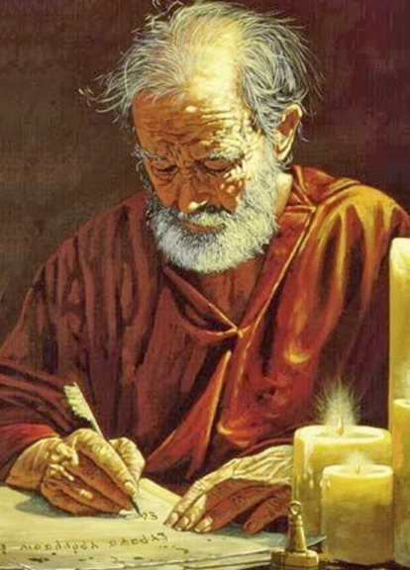
Memory Text:
Ephesians 1:3
³ Blessed be the God and Father of our Lord Jesus Christ, who hath blessed us with all spiritual blessings in heavenly places in Christ:

Slide 3

Paul and Ephesus
Having exercised his rights as a Roman citizen and appealed to Caesar, Paul was sent to Rome, where he probably arrived in the spring of A.D. 61 . Here he was a prisoner for two years. Thus it is likely that this epistle was written about A.D. 62.
A.D. 62
Paul writes Ephesians from prison in Rome
A.D. 52
Paul’s initial visit to Ephesus
A.D. 57
Paul meets with Ephesian Elders while in Miletus
A.D. 53-56
Paul’s 3 year Ephesian ministry

Slide 4

Key Ideas: Outlining Ephesians
Opening Greeting (Eph. 1:1, 2)
Introductory Blessing (Eph. 1:3-14)
Praying for Believers to Receive Christ-Focused Wisdom (Eph. 1:15-23)
Once Spiritually Dead; Now Exalted With Christ (Eph. 2:1-10)

Slide 5
Key Ideas: Outlining Ephesians
Opening Greeting (Eph. 1:1, 2)
Introductory Blessing (Eph. 1:3-14)
Praying for Believers to Receive Christ-Focused Wisdom (Eph. 1:15-23)
Once Spiritually Dead; Now Exalted With Christ (Eph. 2:1-10)

Slide 6
Key Ideas: Outlining Ephesians
Christ’s Creation of the Church Out of Jews and Gentiles (Eph. 2:11-22)
Paul as Preacher of Christ to the Gentiles (Eph. 3:1-13)
Praying for Believers to Experience the Love of Christ (Eph. 3:14-21)

Slide 7
Key Ideas: Outlining Ephesians
Hold On to the Spirit-Inspired Unity of the Church (Eph. 4:1-16)
Live the New, Unity-Nurturing Life (Eph. 4:17-32)
Walk in Love, Light, and Wisdom (Eph. 5:1-20)

Slide 8
Key Ideas: Outlining Ephesians
Practice Christ-Shaped Life in the Christian Household (Eph. 5:21-6:9)
Stand Together: The Church as the Army of God (Eph. 6:10-20)
Closing Greeting (Eph. 6:21-24)

Slide 9


Theme: SDABC V.6 p.995
The subject of Ephesians is unity in Christ. He was writing to a church (or churches) consisting of Jews and Gentiles, Asiatics and Europeans, slaves and freemen — all symbols of a disrupted world that was to be restored to unity in Christ. This would necessitate unity of person, family, church, and race.

Slide 10

Theme: SDABC V.6 p.995
The apostle announces his theme in a tone of high spiritual exaltation, and urges upon all the highest character and conduct, for the purpose of unity not only in doctrine and organization but in Christ the head, and in the church, the mystical body of Christ.

Slide 11

Theme: SDABC V.6 p.995
Although “in Christ” is the key phrase, it is difficult to select a key verse, for there is scarcely a verse that does not present in one form or another the basic theme. Election, forgiveness, predestination, home relationships — all are “in Christ.”

Slide 12

Theme: SDABC V.6 p.995
The apostle has less to say about faith than about grace. In his earlier writings he stressed the relation of the individual to salvation; here he stresses the group, the church, the body, and he speaks of being “in Christ” rather than of things accomplished “through Christ”; of Christ living in the believer rather than of Christ crucified.

Slide 13
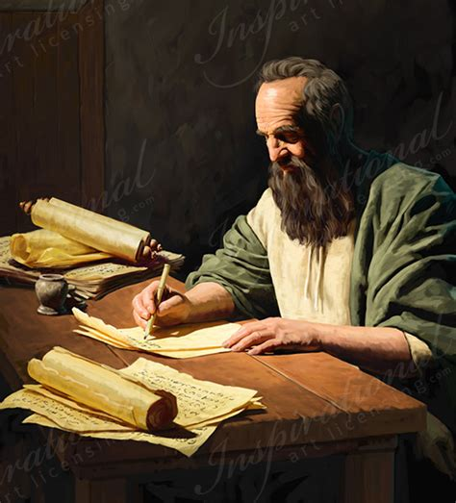
Theme: SDABC V.6 p.995
Paul does not develop his theme as a formal argument or proposition. He speaks simply of what came to him by revelation, not because of any superior intellect or insight, but because he was an instrument of God’s grace to whom had been granted a vision of the essential spiritual unity of the kingdom.

Slide 14
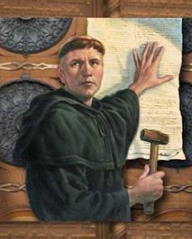
Theme: SDABC V.6 p.995
It may be asserted that what the books of Galatians and Romans were to the 16th century and the Protestant Reformation, Ephesians is to the church of today. What does Christianity have to say regarding the relations of the individual to the family, of the family to the nation, of the nation to the race, and of all to the church and to God?

Slide 15

Theme: SDABC V.6 p.995
Paul answers by presenting Christ as the center and end of all things, working out His purposes through the church, gathering “together in one all things in Christ” (ch. 1:10).

Slide 16
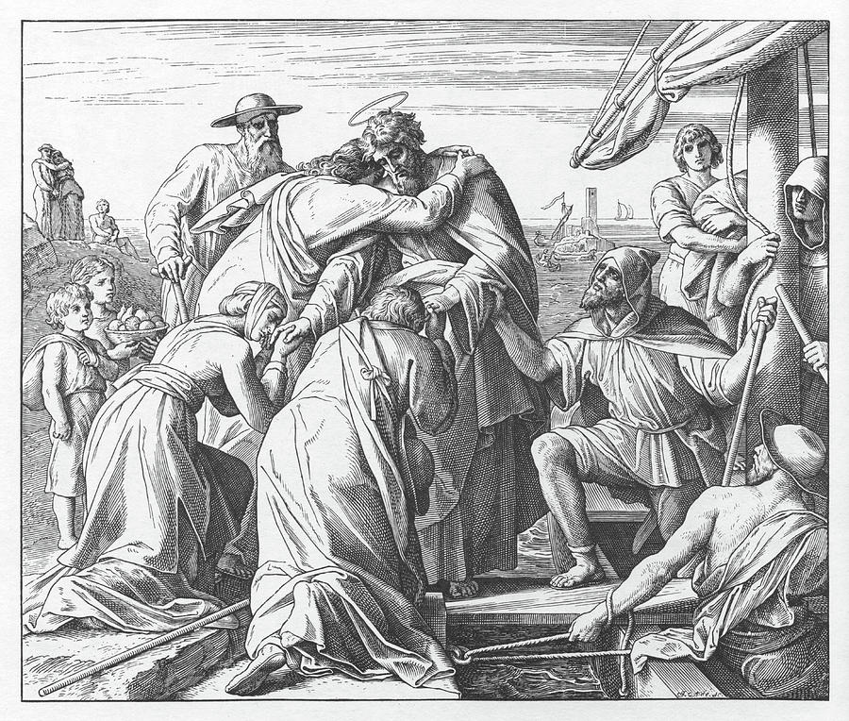
Greetings: Ephesians 1:1-2
1 Paul, an apostle of Jesus Christ by the will of God, to the saints which are at Ephesus, and to the faithful in Christ Jesus:
² Grace be to you, and peace, from God our Father, and from the Lord Jesus Christ.

Slide 17
Grace and peace: I Corinthians 1:1-3
1 Paul called to be an apostle of Jesus Christ through the will of God, and Sosthenes our brother,
² Unto the church of God which is at Corinth, to them that are sanctified in Christ Jesus, called to be saints, with all that in every place call upon the name of Jesus Christ our Lord, both their's and our's:
³ Grace be unto you, and peace, from God our Father, and from the Lord Jesus Christ.

Slide 18

Grace and peace: 2 Corinthians 1:1-2
1 Paul, an apostle of Jesus Christ by the will of God, and Timothy our brother, unto the church of God which is at Corinth, with all the saints which are in all Achaia:
² Grace be to you and peace from God our Father, and from the Lord Jesus Christ.

Slide 19
Grace and peace: Galatians 1:1-3
1 Paul, an apostle, (not of men, neither by man, but by Jesus Christ, and God the Father, who raised him from the dead;)
² And all the brethren which are with me, unto the churches of Galatia:
³ Grace be to you and peace from God the Father, and from our Lord Jesus Christ,

Slide 20
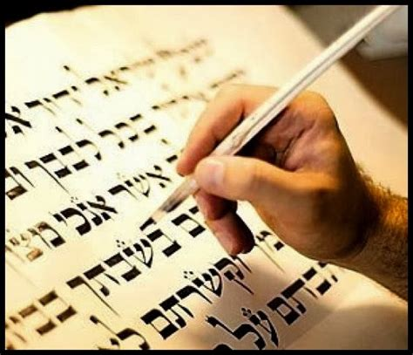
Grace and peace: Philippians 1:1-2
1 Paul and Timotheus, the servants of Jesus Christ, to all the saints in Christ Jesus which are at Philippi, with the bishops and deacons:
² Grace be unto you, and peace, from God our Father, and from the Lord Jesus Christ.

Slide 21
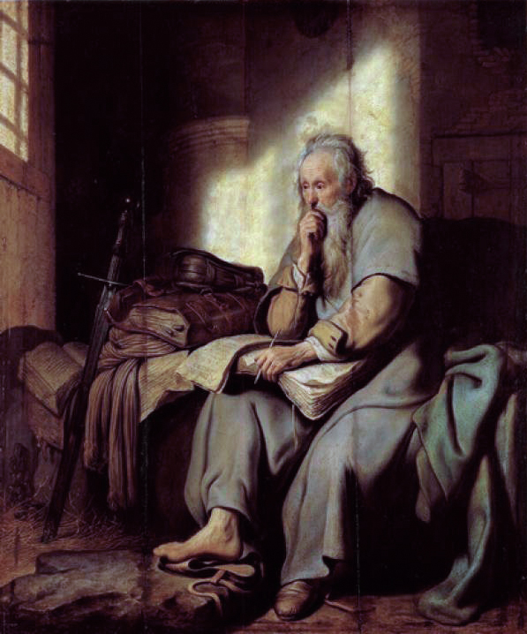
Grace and peace: Colossians 1:1-2
1 Paul, an apostle of Jesus Christ by the will of God, and Timotheus our brother,
² To the saints and faithful brethren in Christ which are at Colosse: Grace be unto you, and peace, from God our Father and the Lord Jesus Christ.

Slide 22
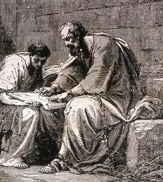
Grace and peace: 1 Thessalonians 1:1
1 Paul, and Silvanus, and Timotheus, unto the church of the Thessalonians which is in God the Father and in the Lord Jesus Christ: Grace be unto you, and peace, from God our Father, and the Lord Jesus Christ.

Slide 23
Grace and peace: Philemon 1-3
¹ Paul, a prisoner of Jesus Christ, and Timothy our brother, unto Philemon our dearly beloved, and fellowlabourer,
² And to our beloved Apphia, and Archippus our fellowsoldier, and to the church in thy house:
³ Grace to you, and peace, from God our Father and the Lord Jesus Christ.

Slide 24
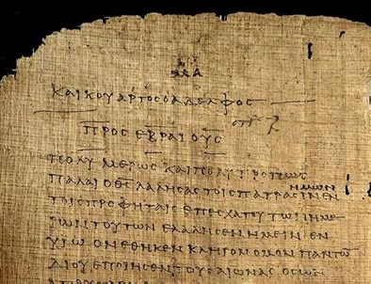
Grace and peace: 2 Thessalonians 1:1-2
1 Paul, and Silvanus, and Timotheus, unto the church of the Thessalonians in God our Father and the Lord Jesus Christ:
² Grace unto you, and peace, from God our Father and the Lord Jesus Christ.

Slide 25
Grace and peace: SDABC V.6 p.473
The Greek charis, “good will,” (here translated as ‘grace’) is not the usual word of greeting used in a Greek letter. The ordinary term was chairein, which expressed a wish for health and prosperity. Chairein occurs in the NT in the letter of Lysias to the Roman governor Felix; (Acts 23:26), and in James’s epistle (James 1:1). In each of these instances it is translated “greeting.”

Slide 26
Grace and peace: SDABC V.6 p.473
Chairein, as used in 2 John 10 (“God speed,” KJV), indicates that Christians were accustomed to greeting one another in this manner (see Matt. 26:49; 27:29; 28:9; Mark 15:18; Luke 1:28; John 19:3, where chaire and chairete are translated “hail”).But instead of chairein, “greeting,” with its prevailing idea of temporal prosperity, Paul used charis, “grace,” a word that was beginning to take on a uniquely Christian meaning.

Slide 27
Grace: SDABC V.6 p.503
GRACE (the Greek charis):
Occurs some 150 times in the New Testament.
Paul made more use of this significant term than any other NT writer, there being some 100 occurrences in his epistles.
Luke, used the word about 25 times in Luke and Acts, these two men thereby accounting for about five sixths of all the New Testament occurrences.

Slide 28
Grace: SDABC V.6 p.503
“Grace” was by no means a new word invented by the apostles; the term was widely used in a variety of associated meanings in the LXX and in classical and later Greek literature. However, the NT often seems to attach a special significance to “grace” that is not found fully elsewhere.

Slide 29
Grace: SDABC V.6 p.503
Primarily “grace” means “that which gives joy or pleasure.”
“Grace is poured into thy lips” (Ps. 45:2).
When Jesus spoke in Nazareth, His hearers “wondered at the gracious words [literally, “the words of grace”] which proceeded out of his mouth” (Luke 4:22).
Paul counseled the believers at Colossae that their speech should “be alway with grace” (Col. 4:6).

Slide 30
Grace: SDABC V.6 p.503
“Grace” also carried the idea of an agreeable sentiment, such as kindness, favor, good will.
Joseph found “favour,” literally, “grace,” in the sight of Pharaoh (Acts 7:10; cf. v. 46).
As the disciples preached they had “favour,” literally, “grace,” with all the people (Acts 2:47).
While Jesus was a boy “the grace of God was upon him” (Luke 2:40).

Slide 31
Grace: SDABC V.6 p.503
Certainly the definition, “unmerited favor,” that is often assigned to the word is unsuitable for these instances. “Grace” should be understood here in the sense of Luke 2:52, “in favour with God and man,” literally, “in grace with God and man.”

Slide 32
Grace: SDABC V.6 p.503
As an expression of the sentiment of good will, “grace” was also used of thankfulness. Thus, “Doth he thank that servant?” (Luke 17:9) is, literally, “Does he have grace toward the servant?” “Grace” is frequently used in this sense in the expression “thanks be to God,” literally, “grace be to God.” Certainly this is not “unmerited favor” offered by mortals to God.

Slide 33
Grace: SDABC V.6 p.503
As an expression of the sentiment of good will, “grace” was also used of thankfulness.
“Doth he thank that servant?” (Luke 17:9) is, literally, “Does he have grace toward the servant?”
“Grace” is frequently used in this sense in the expression “thanks be to God,” literally, “grace be to God.” Certainly this is not “unmerited favor” offered by mortals to God.

Slide 34
Grace: SDABC V.6 p.503
As a substantial expression of good will, “grace” was also used of a gift, a favor done, a boon.
The Jews came to Festus and desired “favour,” literally, “grace,” against Paul (Acts 25:3).
Paul speaks of the gift that the churches had gathered for the poor at Jerusalem as, literally, “the grace.”

Slide 35
Grace: SDABC V.6 p.503-4
None of the above usages is different from those found in other Greek literature.
The distinctive meaning attached to the term “grace” in the NT, and especially in the writings of Paul, is that of the abundant, saving love of God toward sinners as revealed in Jesus Christ.

Slide 36
Grace: SDABC V.6 p.504
Obviously, since all men have sinned and are destitute of the glory of God (Rom. 3:23), such favor and loving-kindness on God’s part are wholly undeserved and unmerited by sinful man.
Men have lived in hatred and rebellion against God (Rom. 1:21, 30, 32),
have perverted His truth (vs. 18, 25),

Slide 37
Grace: SDABC V.6 p.504
have preferred to worship beasts and reptiles (v. 23),
have defiled His image in their own bodies (vs. 24-27),
have blasphemed His name (ch. 2:24),
and have even despised God for His patience and forbearance (v. 4).
Finally, they murdered His Son, sent to save them (Acts 7:52).

Slide 38
Grace: SDABC V.6 p.504
Yet through it all God has continued to regard man with love and kindness, that the revelation of His goodness may lead men to repentance (Rom. 2:4). This is the grace of God in its peculiar NT sense. It is not merely God’s favor toward those who might merit His approval, it is His unlimited, all-inclusive, transforming love toward sinful men and women; and the good news of this grace, as revealed in Jesus Christ, is “the power of God unto salvation” (Rom. 1 : 16).

Slide 39
Grace: SDABC V.6 p.504
It is not merely God’s mercy and willingness to forgive, it is an active, energizing, transforming power to save.
Thus it may fill a person (John 1:14),
it may be given (Rom. 12:3, 6),
it is all-sufficient (2 Cor. 12:9; cf. Rom. 5:20),

Slide 40
Grace: SDABC V.6 p.504
it reigns (Rom. 5:21),
it teaches (Titus 2:11, 12),
it establishes the heart (Heb. 13:9).
In some instances “grace” seems almost to be equivalent to “gospel” (Col. 1:6) and to the working of God generally (Acts 11:23; 1 Peter 5:12).

Slide 41
Grace: 1 Timothy 1:8-9
⁸ Be not thou therefore ashamed of the testimony of our Lord, nor of me his prisoner: but be thou partaker of the afflictions of the gospel according to the power of God;
⁹ Who hath saved us, and called us with an holy calling, not according to our works, but according to his own purpose and grace, which was given us in Christ Jesus before the world began,

Slide 42
Grace: SDABC V.6 p.504
“Divine grace is the great element of saving power” (GW 70).
“Christ gave His life to make it possible for man to be restored to the image of God. It is the power of His grace that draws men together in obedience to the truth” (CT 249).

Slide 43
Grace and peace: SDABC V.6 p.473
The usual Hebrew form of greeting was shalom, “peace,” or shalom leka, “peace to you.” Jesus so greeted His assembled disciples after the resurrection.
The life, death, and resurrection of Christ had brought new meaning to both these old familiar terms. “Grace” was now understood as the redeeming love of God in Christ.

Slide 44

Grace and peace: SDABC V.6 p. 473
“Peace” was now peace with God through redemption. With this Christian significance, “grace” and “peace” became Paul’s customary greeting in all his epistles. Peter and John also used similar greetings.

Slide 45
Peace: Romans 5:1-2
5 Therefore being justified by faith, we have peace with God through our Lord Jesus Christ:
² By whom also we have access by faith into this grace wherein we stand, and rejoice in hope of the glory of God.

Slide 46
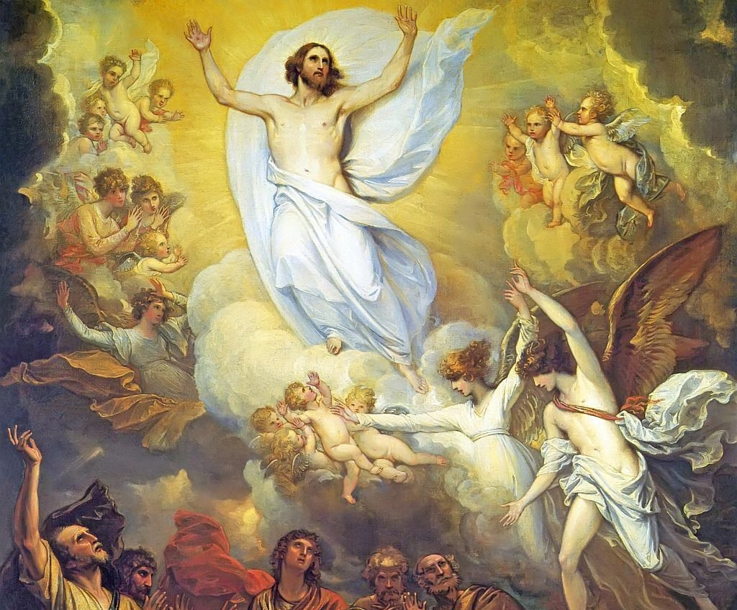
Blessings: Ephesians 1:3-14
³ Blessed be the God and Father of our Lord Jesus Christ, who hath blessed us with all spiritual blessings in heavenly places in Christ:

Slide 47
Praise: SDABC V.6 p.997
This expression of praise introduces one of the most sublime passages of Scripture, sometimes called the “gateway of praise.” Verses 3-14 survey the course of the revelation of divine grace and set forth promises of God’s redeeming love and the glorious privileges of the church. These verses may be regarded as the plan of salvation in outline.

Slide 48
Heavenly Places: SDABC V.6 p.997-8
The Greek phrase, en tois epouraniois, “in the heavenly [places]” is peculiar to Ephesians, being used five times in the epistle (Ephesians 1:3, 1:20; 2:6; 3:10; and 6:12). In Ephesians 6:12 the phrase is translated “in high places.”

Slide 49
Heavenly Places: SDABC V.6 p.998
In Eph. 1:20 the phrase is apparently used as a synonym for heaven, for it is the place where Christ sits on the right hand of the Father.
This seems to be its meaning also in Eph. 2:6. If we are raised together with Christ, and are “in Christ Jesus,” and Christ is at the right hand of God in heaven, then we, in that sense, are sitting with Him in heaven.

Slide 50
Heavenly Places: SDABC V.6 p.998
In Eph.3:10 en tois epouraniois describes the dwelling place of angel powers, probably of good angels,
and in Eph. 6:12 of evil angels.
But here in Eph. 1 :3 the phrase seems to qualify “spiritual blessings” by designating heaven as the source of them.

Slide 51
Blessings: Ephesians 1:3-14
³ Blessed be the God and Father of our Lord Jesus Christ, who hath blessed us with all spiritual blessings in heavenly places in Christ:

Slide 52

Blessings: Ephesians 1:4-14
⁴ According as he hath chosen us in him before the foundation of the world, that we should be holy and without blame before him in love:

Slide 53

Blessings: Ephesians 1:5-14
⁵ Having predestinated us unto the adoption of children by Jesus Christ to himself, according to the good pleasure of his will,

Slide 54
Chosen: SDABC V.6 p.575
To predestinate is in Greek proorizo “to mark off beforehand.” The word is translated “determined before” in Acts 4:28, and “ordained” in 1 Cor. 2:7. God predestinated those whom He foreknew. As God foresaw, and thus foreknew, each generation of men that would come upon the stage of this world’s action, He coupled immediately with His foreknowledge the decision to predestinate them all to be saved.

Slide 55
Chosen: SDABC V.6 p.575
God never had any other purpose than salvation for the members of the human family.
For God “will have all men to be saved, and to come unto the knowledge of the truth” (1 Tim. 2:4).
He is “not willing that any should perish, but that all should come to repentance” (2 Peter 3:9).

Slide 56
Chosen: SDABC V.6 p.575
“As I live, saith the Lord God, I have no pleasure in the death of the wicked; but that the wicked turn from his way and live” (Eze. 33:11).
Christ said, “Come unto me, all ye that labour and are heavy laden, and I will give you rest” (Matt. 1 1 :28).
“Whosoever will, let him take the water of life freely” (Rev. 22:1 7).

Slide 57
Chosen: SDABC V.6 p.575
“For God so loved the world, that he gave his only begotten Son, that whosoever believeth in him should not perish, but have everlasting life” (John 3:16).
Salvation is offered freely to all. But not all accept the gospel invitation.
“Many are called, but few are chosen” (Matt. 22:14; cf. ch. 20:16).

Slide 58
Chosen: SDABC V.6 p.575
Salvation is not forced upon us against our will. If we choose to oppose and resist God’s purpose, we shall be lost. Divine foreknowledge and divine predestination in no way exclude human liberty. Nowhere does Paul, or any other Bible writer, suggest that God has predestined certain men to be saved and certain others to be lost, regardless of their own choice in the matter.

Slide 59

Blessings: Ephesians 1:6-14
⁶ To the praise of the glory of his grace, wherein he hath made us accepted in the beloved.

Slide 60
Glory of Grace: SDABC V.6 p.999
As a result of the revelation of God’s grace in the adoption, the universe will gain a true conception of the character and purposes of God and respond with expressions of praise. One of the purposes of the plan of salvation is the vindication of the character of God before the universe.

Slide 61
Made us Accepted: SDABC V.6 p.999
“Made us accepted” here is the Greek charitod, “to endow with grace,” “to make graceful.” Here the former meaning obviously applies. The idea is of grace freely bestowed, by which we have been enriched or beautified. God’s mercy, favor, gracious disposition to us, permit a relationship to Him that would otherwise be impossible.

Slide 62
In the beloved: SDABC V.6 p.999
Another form of the key phrase of this epistle (In Christ). The designation of the Son as the Beloved is appropriate here. We are brought nigh to God by the Beloved One, and in turn may be called beloved children (ch. 5:1). Those whom God endows with His grace are loved by Him in the same way that He loves His own Son.

Slide 63
Blessings: Ephesians 1:6-14
⁶ To the praise of the glory of his grace, wherein he hath made us accepted in the beloved.

Slide 64
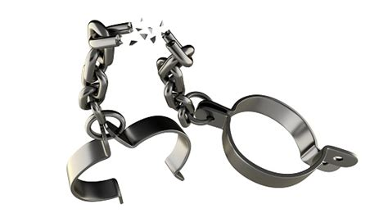
Blessings: Ephesians 1:7-14
⁷ In whom we have redemption through his blood, the forgiveness of sins, according to the riches of his grace;

Slide 65
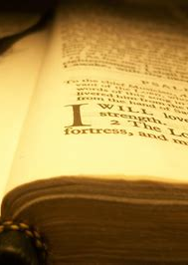
Blessings: Ephesians 1:8-14
⁸ Wherein he hath abounded toward us in all wisdom and prudence;
⁹ Having made known unto us the mystery of his will, according to his good pleasure which he hath purposed in himself:

Slide 66
Wisdom and Prudence: SDABC V.6 p.999
The phrase “in all wisdom and prudence” may be connected with either the foregoing or the following.
If it is considered as part of v. 8, it states the sphere in which God’s free gift of grace is lavished upon us; “wisdom” and “prudence” are His gifts to us.

Slide 67
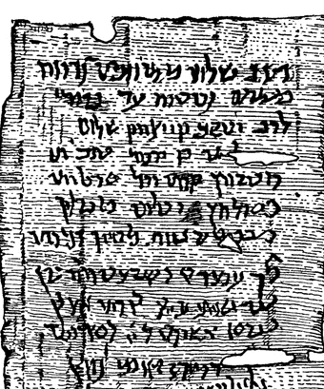
Wisdom and Prudence: SDABC V.6 p.999
If the phrase is considered as the first part of v. 9, then it refers to qualities of God Himself.
The unpunctuated, ancient manuscripts allow either interpretation.

Slide 68
Wisdom and Prudence:
That is, either we have:
In whom we have redemption through his blood, the forgiveness of sins, according to the riches of his grace, wherein he hath abounded toward us in all wisdom and prudence. Having made known unto us the mystery of his will, according to his good pleasure which he hath purposed in himself:

Slide 69
Wisdom and Prudence:
In which case we understand that God’s free gift of grace is lavished on us specifically by the gifts of wisdom and prudence, which He supplies to us.
We know that wisdom and prudence are indeed gifts that God provides to men from other Bible passages, especially Proverbs 1 &2.

Slide 70
Wisdom and Prudence:
Or, alternately, we may read verses 7-9 differently punctuated as follows:
In whom we have redemption through his blood, the forgiveness of sins, according to the riches of his grace, wherein he hath abounded toward us. In all wisdom and prudence, having made known unto us the mystery of his will, according to his good pleasure which he hath purposed in himself:

Slide 71
Wisdom and Prudence:
In which case we understand that God’s actions in making His will known to us were undertaken in all wisdom and prudence, which are qualities belonging to God.
Since wisdom and prudence come from God, as we read in Prov. 1&2, we know that these qualities are certainly aspects of His character.

Slide 72
Blessings: Ephesians 1:10-14
¹⁰ That in the dispensation of the fulness of times he might gather together in one all things in Christ, both which are in heaven, and which are on earth; even in him:

Slide 73

All things in Christ: SDABC V.6 p.1000
This is the divine purpose — the restoration of a lost unity. It must necessarily be in Christ, because He is the center of all things.

Slide 74
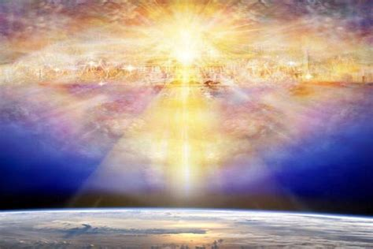
All things in Christ: SDABC V.6 p.1000
All things were made by Him;
He upholds all things by the word of His power;
He is the center of the church and its supreme hope.

Slide 75
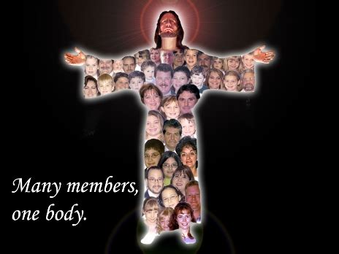
All things in Christ: SDABC V.6 p.1000
The Christian life is no solitary adventure into the kingdom of God; the Christian is a member of a community, the body of Christ, the church.

Slide 76

All things in Christ: SDABC V.6 p.1000
The unity of God’s universe had been broken by sin. The mystery of God’s will was His plan to restore this unity when the occasion was ready, a restoration to be accomplished through Christ.

Slide 77
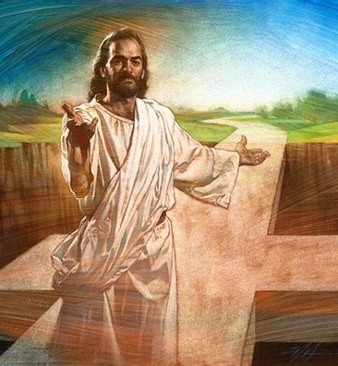
All things in Christ: SDABC V.6 p.1000
That mystery will find its culmination at the end of the great controversy, when all things in heaven and on earth will be united in Christ, and the character of the Godhead will have been vindicated.

Slide 78
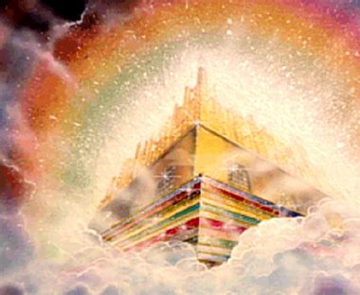
Blessings: Ephesians 1:11-14
¹¹ In whom also we have obtained an inheritance, being predestinated according to the purpose of him who worketh all things after the counsel of his own will:

Slide 79

Blessings: Ephesians 1:12-14
¹² That we should be to the praise of his glory, who first trusted in Christ.

Slide 80
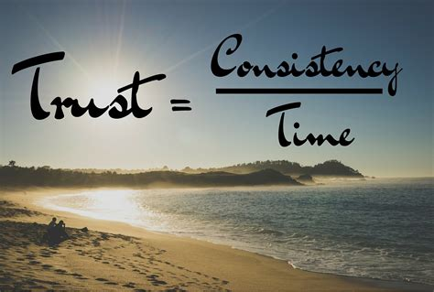
First Trusted: SDABC V.6 p.1001
The phrase “who first trusted in Christ” may be literally rendered, “who have hoped before [and still hope] in Christ.”

Slide 81
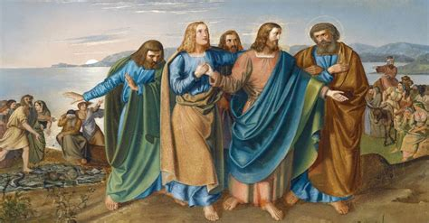
m
First Trusted: SDABC V.6 p.1001
These words have special application to the Jewish Christians, who, through their fathers, were the first to be partakers of the inheritance, for even from Abraham’s time the Jews had looked forward to the Messiah.

Slide 82

First Trusted: SDABC V.6 p.1001
They were highly privileged that they might live and labor “to the praise of his glory,” even as Christians who hold the gospel truth today are stewards of His grace in relation to the heathen world.

Slide 83
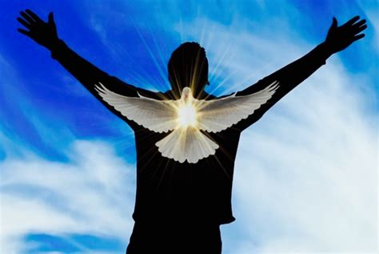
Blessings: Ephesians 1:13-14
¹³ In whom ye also trusted, after that ye heard the word of truth, the gospel of your salvation: in whom also after that ye believed, ye were sealed with that holy Spirit of promise,

Slide 84

Word of Truth: SDABC V.6 p.1001
The word of truth is here defined as the “gospel of your salvation” (cf. Rom. 1:16). We are urged to
take heed to that word (Mark 4:24),
to receive it with meekness (James 1 :21), and with faith (Heb. 4:2), for it is the means to eternal life.

Slide 85

Word of Truth: SDABC V.6 p.1001
The truth is more than a collection of statements of fact, which would have no salvation in them as such; the truth must finally bring us to Him who is “the way, the truth, and the life” (John 14:6).

Slide 86

Word of Truth: SDABC V.6 p.1001
Every noble impulse that arises in any man’s soul, Christian or heathen, springs from that one Source. Indeed, the influence of the Holy Spirit is necessary to the effective reception of the truth (1 Cor. 2:12-15).

Slide 87

Word of Truth: SDABC V.6 p.1001
Like the seed that fell on poor soil, the written or spoken word has no power to change the life except it be accompanied by the Living Word.

Slide 88
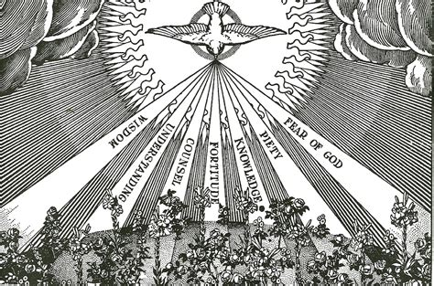
Spirit of Promise: SDABC V.6 p.1001
It is the Spirit of promise who seals, or identifies, those who are His own (2 Tim. 2:19), and secures them until the day of redemption (Eph. 4:30).

Slide 89

Spirit of Promise: SDABC V.6 p.1001
He is identified here as the agent of the sealing. Those who are sealed have the witness within themselves that they are the children of God (1 John 5:10).

Slide 90
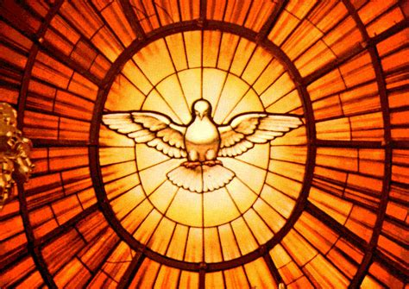
Spirit of Promise: SDABC V.6 p.1001-2
The Holy spirit assures us that the promises of God are true, and it is this conviction that largely distinguishes believers from nonbelievers. The seal is placed upon all who choose to become saints.

Slide 91
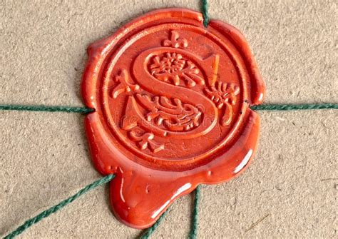
Blessings: Ephesians 1:14
¹⁴ Which is the earnest of our inheritance until the redemption of the purchased possession, unto the praise of his glory.

Slide 92
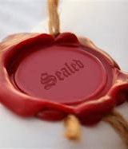
Earnest: SDABC V.6 p.1002
The thought of the whole passage is that the Holy Spirit had been promised in God’s Word, and when that Word was believed the Holy Spirit was received and the believers were sealed, that sealing being a further promise of the ultimate fulfillment of all God’s promises to men.

Slide 93
Earnest: SDABC V.6 p.1002
The child of God has the privilege even now of tasting the heavenly joys, and, indeed, he may well question his experience if he does not do so. He may be deeply assured of the resurrection of the body, the return of the Lord, the gift of immortality, and all the eternal realities. The promise is certain, since it is guaranteed by God Himself through the Divine Spirit.

Slide 94

Praise of His Glory: SDABC V.6 p.1002
On this exalted note ends the remarkable introduction to this epistle. As Paul’s thought ranges from “before the foundation of the world” to “the redemption of the purchased possession,” he sees Christ as the center of it all. Everything is “in him.”

Slide 95
Praise of His Glory: SDABC V.6 p.1002
Paul presents this idea, not as a theological abstraction, but as a matter of the most practical concern. He is not weaving a philosophy or writing a treatise on the problem of predestination and free will. He sees Christ harmonizing every intellectual and moral problem that men have to face.

Slide 96


Slide 97
Take a few moments to prepare for Sabbath school next week!
We’ll be looking at the rest of Ephesians 1,
That is, Ephesians 1:15-23

Slide 98
Thank you!
And Happy Sabbath!!

