Slide 1

The Power of the Exalted Jesus
Lesson 3, 3rd Quarter 2023
Ephesians 1:15-23; 3:14-21

Slide 2
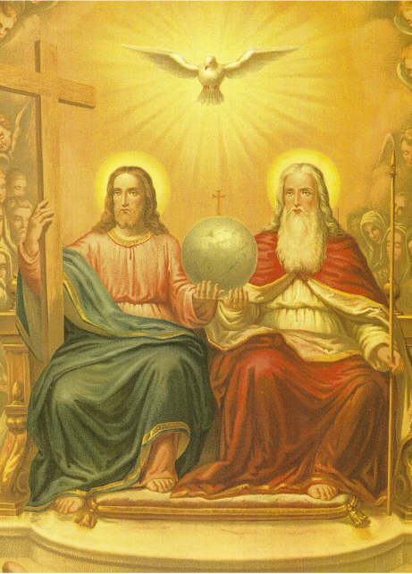
Memory Text:
Ephesians 1:19-20
¹⁹ And what is the exceeding greatness of his power to us-ward who believe, according to the working of his mighty power,
²⁰ Which he wrought in Christ, when he raised him from the dead, and set him at his own right hand in the heavenly places,

Slide 3

Key Ideas: Outlining Ephesians
Opening Greeting (Eph. 1:1, 2)
Introductory Blessing (Eph. 1:3-14)
Praying for Believers to Receive Christ-Focused Wisdom (Eph. 1:15-23)
Once Spiritually Dead; Now Exalted With Christ (Eph. 2:1-10)
Christ’s Creation of the Church Out of Jews and Gentiles (Eph. 2:11-22)
Paul as Preacher of Christ to the Gentiles (Eph. 3:1-13)
Praying for Believers to Experience the Love of Christ (Eph. 3:14-21)
II. Part 1: The Doctrinal Section (Ephesians 1:3 to 3:21)

Slide 4
Key Ideas: Outlining Ephesians
Christ’s Creation of the Church Out of Jews and Gentiles (Eph. 2:11-22)
Paul as Preacher of Christ to the Gentiles (Eph. 3:1-13)
Praying for Believers to Experience the Love of Christ (Eph. 3:14-21)
Hold On to the Spirit-Inspired Unity of the Church (Eph. 4:1-16)
Live the New, Unity-Nurturing Life (Eph. 4:17-32)
Walk in Love, Light, and Wisdom (Eph. 5:1-20)
Practice Christ-Shaped Life in the Christian Household (Eph. 5:21-6:9)
Stand Together: The Church as the Army of God (Eph. 6:10-20)
Part 2: The Practical Section (Ephesians 4:1 to 6:20)
Closing Greeting (Ephesians 6:21-24)
Closing Greeting (Eph. 6:21-24)

Slide 5
Key Ideas: Outlining Ephesians
Opening Greeting (Eph. 1:1, 2)
Part 1: The Doctrinal Section (Eph. 1:3-3:21)
Part 2: The Practical Section (Eph. 4:1-6:20)
Closing Greeting (Ephesians 6:21-24)

Slide 6
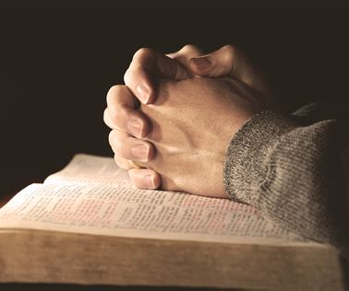
Prayer & Thanksgiving:
Quarterly Sun. July 9
Sometimes our default tone in prayer can be doleful, mourning over this challenge or that problem. Paul’s prayer reports in Ephesians suggest that thanksgiving is the native language of prayer.

Slide 7

Prayer & Thanksgiving:
Quarterly Sun. July 9
We gather up the blessings of God and thank Him for them. We seek to perceive God at work in difficult circumstances and praise Him for His transforming presence in our lives.

Slide 8

Prayer & Thanksgiving:
Quarterly Sun. July 9
Celebrating the grace and power of the exalted Jesus (Eph. 1:20-23), we thank Him for blessing those in our circle of influence. Here is Paul’s transforming secret for prayer: prayer is the key of praise and thanksgiving.

Slide 9
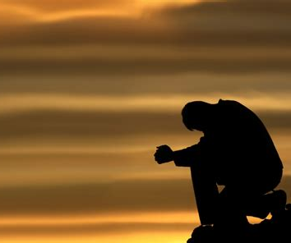
Prayer & Thanksgiving:
Paul writes passionately concerning prayer! We’re going to focus on Paul’s prayers as recorded in Ephesians, but he wrote down his prayers in many other places.

Slide 10
Prayer and Thanksgiving: Paul’s prayers
(Romans)
Rom 1:8-10
Rom 10:1
Rom 12:12
Rom 15:5-6
Rom 15:13
Rom 15:30-33

Slide 11
Prayer and Thanksgiving: Paul’s prayers
(1&2 Corinthians)
1 Cor 1:4-9
1 Cor 16:23
2 Cor 1:3-7
2 Cor 2:14-16
2 Cor 9:12-15
2 Cor 12:7-9
2 Cor 13:7-9

Slide 12
Prayer and Thanksgiving: Paul’s prayers
(Galatians, Ephesians, Philippians)
Gal 6:18
Eph 1:3
Eph 1:15-23
Eph 3:14-21
Eph 6:19-20
Phil 1:3-6
Phil 1:9-11
Phil 4:6-7
Phil 4:23

Slide 13
Prayer and Thanksgiving: Paul’s prayers
(Colossians, 1 Thessalonians)
Col 1:3-14
Col 4:2-4
1 Thess 1:2-3
1 Thess 2:13-16
1 Thess 3:9-13
1 Thess 5:23-24
1 Thess 5:28

Slide 14
Prayer and Thanksgiving: Paul’s prayers (2 Thessalonians, 1 Timothy)
2 Thess 1:3
2 Thess 1:11-12
2 Thess 2:16-17
2 Thess 3:2-5
2 Thess 3:16
1 Tim 1:12
1 Tim 2:1

Slide 15
Prayer and Thanksgiving: Paul’s prayers
(2 Timothy, Titus, Philemon)
2 Tim 1:3-7
2 Tim 1:16-18
2 Tim 4:22
Titus 3:15
Philemon 1:4-7
Philemon 1:25

Slide 16
Ephesians 1:15-23
¹⁵ Wherefore I also, after I heard of your faith in the Lord Jesus, and love unto all the saints,
¹⁶ Cease not to give thanks for you, making mention of you in my prayers;
¹⁷ That the God of our Lord Jesus Christ, the Father of glory, may give unto you the spirit of wisdom and revelation in the knowledge of him:

Slide 17
Ephesians 1:18-23
¹⁸ The eyes of your understanding being enlightened; that ye may know what is the hope of his calling, and what the riches of the glory of his inheritance in the saints,
¹⁹ And what is the exceeding greatness of his power to us-ward who believe, according to the working of his mighty power,
²⁰ Which he wrought in Christ, when he raised him from the dead, and set him at his own right hand in the heavenly places,

Slide 18
Ephesians 1:21-23
²¹ Far above all principality, and power, and might, and dominion, and every name that is named, not only in this world, but also in that which is to come:
²² And hath put all things under his feet, and gave him to be the head over all things to the church,
²³ Which is his body, the fulness of him that filleth all in all.

Slide 19
Ephesians 3:14-21
¹⁴ For this cause I bow my knees unto the Father of our Lord Jesus Christ,
¹⁵ Of whom the whole family in heaven and earth is named,
¹⁶ That he would grant you, according to the riches of his glory, to be strengthened with might by his Spirit in the inner man;
¹⁷ That Christ may dwell in your hearts by faith; that ye, being rooted and grounded in love,

Slide 20
Ephesians 3:18-21
¹⁸ May be able to comprehend with all saints what is the breadth, and length, and depth, and height;
¹⁹ And to know the love of Christ, which passeth knowledge, that ye might be filled with all the fulness of God.
²⁰ Now unto him that is able to do exceeding abundantly above all that we ask or think, according to the power that worketh in us,
²¹ Unto him be glory in the church by Christ Jesus throughout all ages, world without end. Amen.

Slide 21
Do you notice any commonalities between these two prayers? Some differences?
There are too many Pauline prayers for us to examine all of them today, but I’ve picked out a few common ideas between these two in Ephesians which are also referenced in Paul’s other prayers and writings.

Slide 22
Paul’s Prayers: Prayer and Practice
Notice that when looking at the prayers of Paul is it is not always clear where his teachings stop and his prayers begin. They intertwine seamlessly. For instance, as we read the beginning of Ephesians, we find an awe-inspiring description of God and who He is towards us. Paul starts by declaring praise to the God and Father of our Lord Jesus Christ (Ephesians 1:3). It’s a record of one of his prayers, but he also manages to give a summary of the plan of salvation… at the same time! So we have an example of prayer, but it also covers some serious theology.

Slide 23
Paul’s Prayers: Ideas in common
Praying with gratitude and joy
Prayer for wisdom founded in love
Prayer for an understanding of our hope
Prayer for spiritual power
Prayer in Christ’s name, recognizing His dominion

Slide 24
Paul’s Prayers: Ideas in common
Praying with gratitude and joy
Prayer for wisdom founded in love
Prayer for an understanding of our hope
Prayer for spiritual power
Prayer in Christ’s name, recognizing His dominion

Slide 25
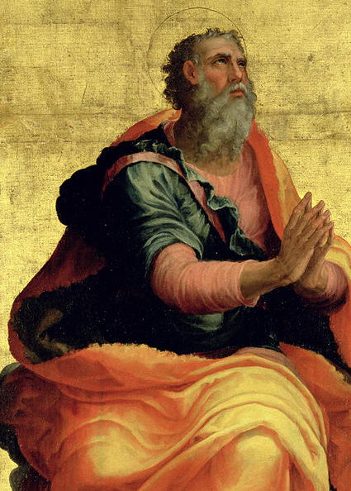
Prayer, Gratitude and Joy:
Ephesians 1:15-16
¹⁵ Wherefore I also, after I heard of your faith in the Lord Jesus, and love unto all the saints,
¹⁶ Cease not to give thanks for you, making mention of you in my prayers;

Slide 26
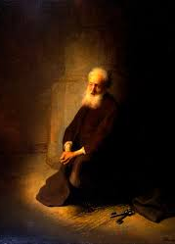
Prayer, Gratitude and Joy:
SDABC V.6 p.1002
During his imprisonment Paul frequently received messages from, and concerning, the churches he had raised up, and he was both pleased and saddened at the things he heard. The faith of the Ephesians was a source of great encouragement to him.

Slide 27
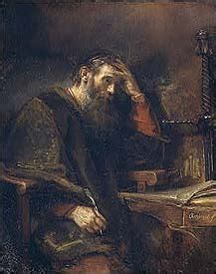
Prayer, Gratitude and Joy:
SDABC V.6 p.1002
Similar statements of thanksgiving are found in Rom. 1 :8; 1 Cor. 1:4; Phil. 1:3; Col. 1:3; 1 Thess. 1:2; 2 Thess. 1:3; 2 Tim. 1:3; Philemon 4, 5. Paul’s spirit of gratitude was “without ceasing,” and found expression on many occasions.

Slide 28
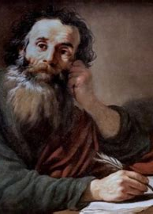
Prayer, Gratitude and Joy:
SDABC V.6 p.1002
The frequency of Paul’s outbursts of thanksgiving is an indication of the joyous and radiant nature of his spirit, without which he could never have endured his various sufferings. The note of joy and thanksgiving is sadly lacking in many Christian lives; the remedy is partly to be found in the sharing of happy experiences in the religious life.

Slide 29

Prayer, Gratitude and Joy:
1 Thessalonians 5:16-18
¹⁶ Rejoice evermore.
¹⁷ Pray without ceasing.
¹⁸ In every thing give thanks: for this is the will of God in Christ Jesus concerning you.

Slide 30

Prayer, Gratitude and Joy:
Philippians 4:6
⁶ Be careful for nothing; but in every thing by prayer and supplication with thanksgiving let your requests be made known unto God.

Slide 31

Prayer, Gratitude and Joy:
1 Corinthians 1:4
⁴ I thank my God always on your behalf, for the grace of God which is given you by Jesus Christ;

Slide 32

Prayer, Gratitude and Joy:
1 Thessalonians 1:2
² We give thanks to God always for you all, making mention of you in our prayers;

Slide 33

Prayer, Gratitude and Joy:
Ephesians 5:19-20
¹⁹ Speaking to yourselves in psalms and hymns and spiritual songs, singing and making melody in your heart to the Lord;
²⁰ Giving thanks always for all things unto God and the Father in the name of our Lord Jesus Christ;

Slide 34
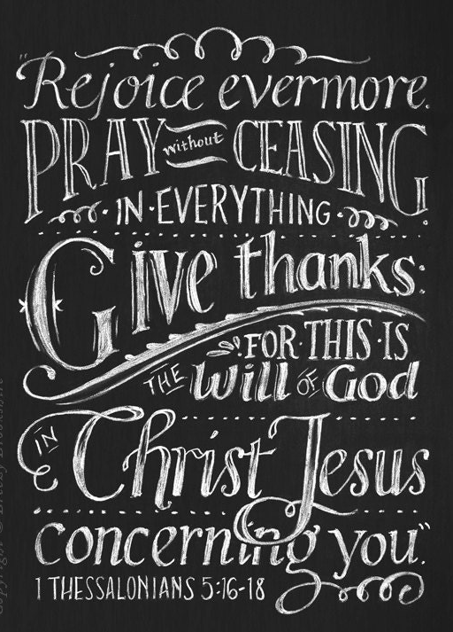
Prayer, Gratitude and Joy:
SDABC V.7 p.255
Paul placed value on the ability to be happy. Whether from possession of present good or anticipation of future happiness, the Christian has abundant reason for rejoicing. With forgiveness of his sins his conscience is free, and peace fills his soul. He knows that “all things work together for good” to him. Why should he ever be downcast? Those who are constantly complaining do not have genuine religion (MH 251).

Slide 35
Prayer, Gratitude and Joy:
SDABC V.7 p.255
There should be a constant spirit of prayer breathing through the Christian’s life. Never must the connection with Heaven be broken. Paul labored “night and day” (1 Thess. 2:9); he also prayed “night and day” (ch. 3:10). His many activities did not crowd out his prayers. Active connection with his heavenly Father was always maintained. So it should be with us!

Slide 36
Prayer, Gratitude and Joy:
SDABC V.7 p.255
We must also give thanks in all circumstances, whether of joy or sorrow. Here we have definite assurance that even those things which appear to be against us may work out for our good; for God would not ask us to be thankful for that which would harm us (MH 255). Paul himself has left a striking example of being thankful under the most adverse circumstances. Thanksgiving should be the Christian’s rule; health and joy are promoted by it (MH 251).

Slide 37
Paul’s Prayers: Ideas in common
Praying with gratitude and joy
Prayer for wisdom founded in love
Prayer for an understanding of our hope
Prayer for spiritual power
Prayer in Christ’s name, recognizing His dominion

Slide 38

Wisdom and Love:
Ephesians 1:17-18
¹⁷ That the God of our Lord Jesus Christ, the Father of glory, may give unto you the spirit of wisdom and revelation in the knowledge of him:
¹⁸ The eyes of your understanding being enlightened; that ye may know what is the hope of his calling, and what the riches of the glory of his inheritance in the saints,

Slide 39

Wisdom and Love:
SDABC V.6 p.1003
“Eyes of your understanding” my be literally read, “eyes of your heart.” This striking phrase occurs nowhere else in the New Testament. By “heart” the Hebrews represented the seat of the thoughts, will, and emotions. This seems to be Paul’s use of the expression here.

Slide 40
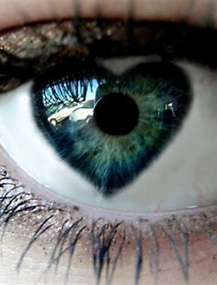
Wisdom and Love:
SDABC V.6 p.1003
“Eyes” represent insight, and enlightened eyes, spiritual awareness and moral comprehension. “Eye hath not seen, nor ear heard” what the spiritually opened eyes see. A new and deep illumination takes place that affects the innermost personality. It is not a new faculty or gift; it is a new vision or insight.

Slide 41

Wisdom and Love:
Colossians 1:9
⁹ For this cause we also, since the day we heard it, do not cease to pray for you, and to desire that ye might be filled with the knowledge of his will in all wisdom and spiritual understanding;

Slide 42

Wisdom and Love:
Philippians 1:9-10
⁹ And this I pray, that your love may abound yet more and more in knowledge and in all judgment;
¹⁰ That ye may approve things that are excellent; that ye may be sincere and without offence till the day of Christ.

Slide 43
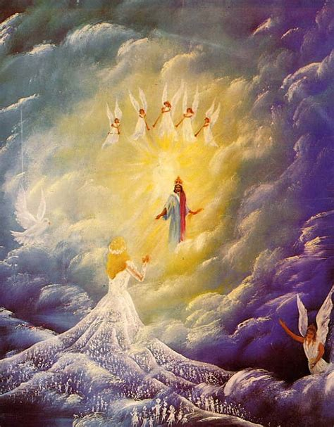
Wisdom and Love:
2 Thessalonians 1:11-12
¹¹ Wherefore also we pray always for you, that our God would count you worthy of this calling, and fulfil all the good pleasure of his goodness, and the work of faith with power:
¹² That the name of our Lord Jesus Christ may be glorified in you, and ye in him, according to the grace of our God and the Lord Jesus Christ.

Slide 44
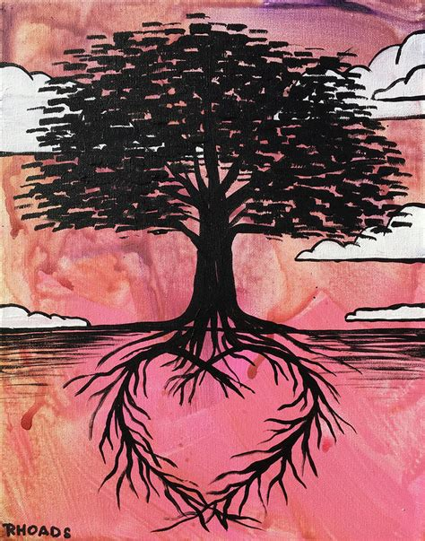
Wisdom and Love:
Ephesians 3:17-19
¹⁷ That Christ may dwell in your hearts by faith; that ye, being rooted and grounded in love,
¹⁸ May be able to comprehend with all saints what is the breadth, and length, and depth, and height;
¹⁹ And to know the love of Christ, which passeth knowledge, that ye might be filled with all the fulness of God.

Slide 45

Wisdom and Love:
SDABC V.6 p.1018
In the Greek the words “in love” from Eph. 3:17 are in the emphatic beginning position. Thus they may be understood as connected with the first part of v. 17, reading literally, “that Christ may dwell through faith in your hearts in love.” Or they may be understood as connected with the words “rooted and grounded,” as the reading “rooted and grounded in love” implies.

Slide 46
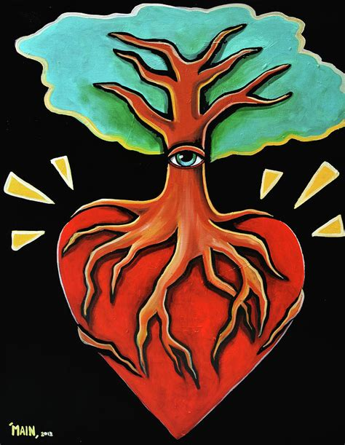
Wisdom and Love:
SDABC V.6 p.1018
Love that is “rooted” goes down deep into the soil of the soul, engaging all the faculties of the mind, while love that is “grounded” is the firm foundation on which a our relationships exist. There is no argument against love of this kind, for there is nothing greater (1 Cor. 13). Love springs directly from the experience of possessing the indwelling Christ, and becomes the rooting and grounding of the unity between God and man, and between man and his fellow man.

Slide 47

Wisdom and Love:
SDABC V.6 p.1018
The subject to be grasped is beyond ordinary comprehension; therefore Paul prays that his hearers may receive a special enabling power for the attainment of it. Christ’s love is beyond the knowledge of human kind because it is infinite and free, never exhausted, and ever presenting new fields of understanding. It is the fountain of our own growing experience of love (1 John 4:19). Men have but touched with their finger tips the power for living to be found in experiencing fully the love of Christ.

Slide 48
Paul’s Prayers: Ideas in common
Praying with gratitude and joy
Prayer for wisdom founded in love
Prayer for an understanding of our hope
Prayer for spiritual power
Prayer in Christ’s name, recognizing His dominion

Slide 49
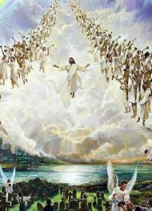
Understanding HOPE:
Ephesians 1:18
¹⁸ The eyes of your understanding being enlightened; that ye may know what is the hope of his calling, and what the riches of the glory of his inheritance in the saints,

Slide 50
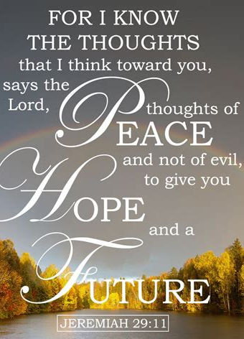
Understanding HOPE:
SDABC V.6 p. 1003
Some commentators believe that in this present passage Paul refers, not to the thing hoped for, but to the principle of hope in the life that is inspired by the divine calling. To have that hope is to have something precious beyond measure.

Slide 51
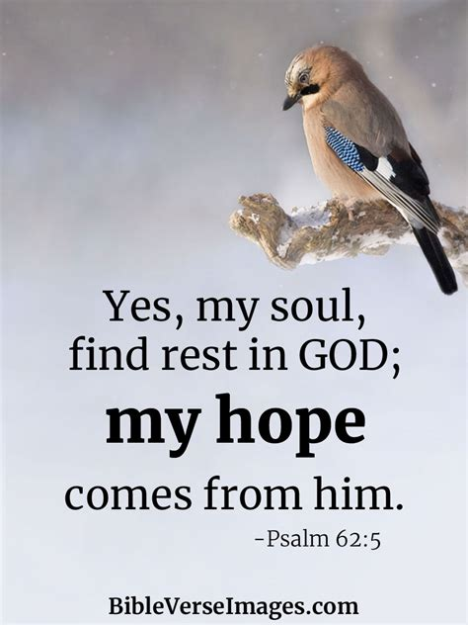
Understanding HOPE:
SDABC V.6 p. 1003
Paul’s readers still did not comprehend the full meaning of their calling, and he was anxious that they should see that the Christian’s hope is based on the facts of redemption, “Christ in you, the hope of glory” (Col. 1 :27, 28). They had forgiveness of sins, they were children of God, but still their understanding was limited.

Slide 52

Understanding HOPE:
SDABC V.6 p. 1003
He wanted them to have the hope that would suggest to them more than they had dreamed of. Hope is a mixture of faith and assurance, but it looks to the future for its completion. The believer may know that if he is called by God through the Spirit, his whole life will become suffused with the blessed hope.

Slide 53

Understanding HOPE:
SDABC V.6 p. 1003
Other commentators hold that by “hope” Paul refers to the end objective of the call of God — the heights of spiritual attainment to which He calls His saints, and the ultimate glorification which will see the saints restored to the estate from which man has fallen.

Slide 54
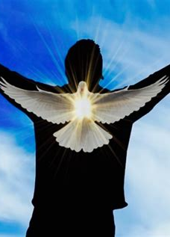
Understanding HOPE:
Romans 5:3-5
³ And not only so, but we glory in tribulations also: knowing that tribulation worketh patience;
⁴ And patience, experience; and experience, hope:
⁵ And hope maketh not ashamed; because the love of God is shed abroad in our hearts by the Holy Ghost which is given unto us.

Slide 55
Understanding HOPE:
SDABC V.6 p. 525
The word “hope” I take for faith; and indeed, hope is nothing else but the constancy of faith.
-John Calvin
Patient endurance of tribulation tests, confirms, and refines the Christian’s faith. Out of this comes ever more confident hope. It is the believer’s initial hope of sharing in the glory of God that nerves him to endure, he gains a steady, calm assurance. Hope and faith grow as they are tested and exercised.

Slide 56
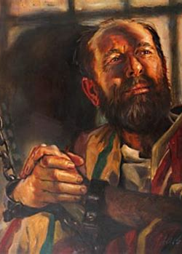
Understanding HOPE:
SDABC V.6 p. 525
The experience of Job illustrates how the severe discipline of character can strengthen the faith and hope of a sincere believer. The Christian hope never disgraces, never dishonors. Paul may have been thinking of Ps. 22:5: “They trusted in thee, and were not confounded.”

Slide 57
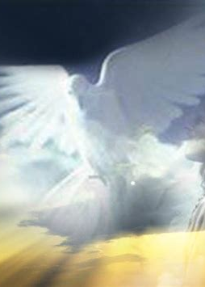
Understanding HOPE:
SDABC V.6 p. 525
This is no ordinary hope, for hope is often disappointed. This is the hope that is founded on the consciousness of justification and is endorsed by the presence of the Holy Spirit in the heart (Rom. 8:16). Such hope cannot disappoint or put to shame.

Slide 58
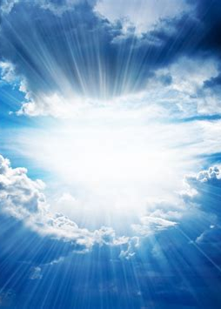
Understanding HOPE:
Romans 15:13-14
¹³ Now the God of hope fill you with all joy and peace in believing, that ye may abound in hope, through the power of the Holy Ghost.
¹⁴ And I myself also am persuaded of you, my brethren, that ye also are full of goodness, filled with all knowledge, able also to admonish one another.

Slide 59
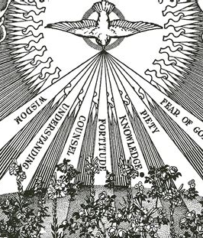
Understanding HOPE:
Colossians 1:27
²⁷ To whom God would make known what is the riches of the glory of this mystery among the Gentiles; which is Christ in you, the hope of glory:

Slide 60
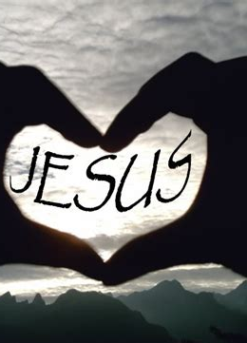
Understanding HOPE:
Ephesians 3:17
¹⁷ That Christ may dwell in your hearts by faith; that ye, being rooted and grounded in love,

Slide 61
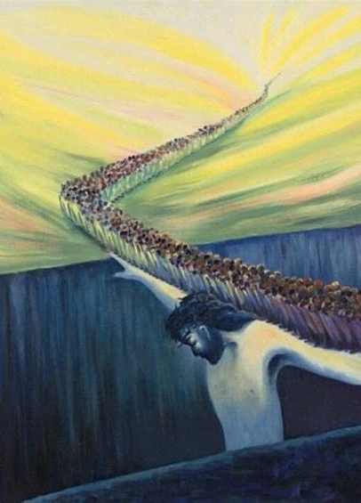
Understanding HOPE:
SDABC V.6 p.1016-1017
It is faith that opens up the heart of Christ. Faith is a confident trust in God and His promises, and is a continuously sustaining principle of life . We come to Christ in the first instance by faith, and we continue, by faith, to live the life that is called for. We can come to God with boldness only on the basis that we have faith in Christ as our mediator. He has been the only One to bridge the gulf that has separated man from God since the entrance of sin (Isa. 59:1, 2).

Slide 62
Paul’s Prayers: Ideas in common
Praying with gratitude and joy
Prayer for wisdom founded in love
Prayer for an understanding of our hope
Prayer for spiritual power
Prayer in Christ’s name, recognizing His dominion

Slide 63

Power and Praise:
Ephesians 1:19
¹⁹ And what is the exceeding greatness of his power to us-ward who believe, according to the working of his mighty power,

Slide 64

Power and Praise
SDABC V.6 p.1004
In addition to knowledge of the “hope” and of the “riches” (v. 18), the apostle prays for experimental knowledge of the power of God in the life. Our feeble natures are revivified and transformed by divine energy in conversion and sanctification. The holding out of “the hope of his calling” (v. 18) would be most tantalizing and unsatisfactory were it not for the accompanying power.

Slide 65
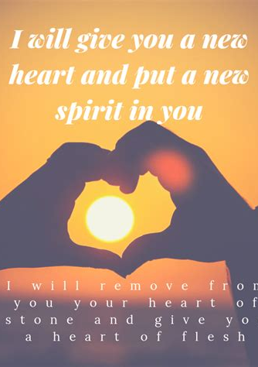
Power and Praise
SDABC V.6 p.1004
Faith is the channel that makes possible the working of divine power. God’s mighty power is displayed in the transformation of a sinner into a saint. This remarkable change is not accomplished by psychology, education, or good works; it is an act of divine grace and power.

Slide 66

Power and Praise:
2 Timothy 1:6-7
⁶ Wherefore I put thee in remembrance that thou stir up the gift of God, which is in thee by the putting on of my hands.
⁷ For God hath not given us the spirit of fear; but of power, and of love, and of a sound mind.

Slide 67
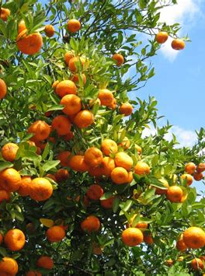
Power and Praise:
Colossians 1:10-11
¹⁰ That ye might walk worthy of the Lord unto all pleasing, being fruitful in every good work, and increasing in the knowledge of God;
¹¹ Strengthened with all might, according to his glorious power, unto all patience and longsuffering with joyfulness;

Slide 68
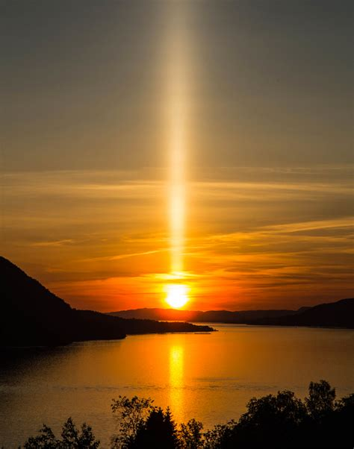
Power and Praise:
Philippians 4:19-20
¹⁹ But my God shall supply all your need according to his riches in glory by Christ Jesus.
²⁰ Now unto God and our Father be glory for ever and ever. Amen.

Slide 69
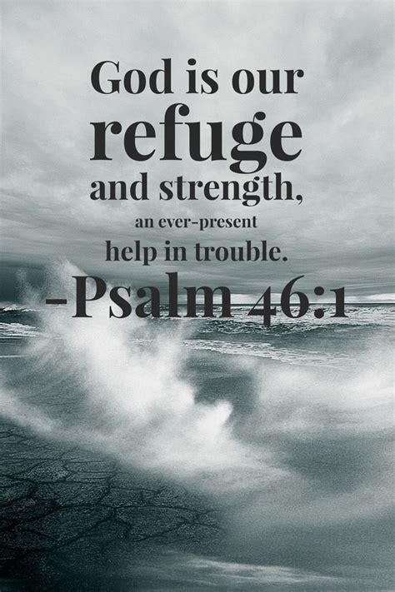
Power and Praise:
Ephesians 3:14-16
¹⁴ For this cause I bow my knees unto the Father of our Lord Jesus Christ,
¹⁵ Of whom the whole family in heaven and earth is named,
¹⁶ That he would grant you, according to the riches of his glory, to be strengthened with might by his Spirit in the inner man;

Slide 70

Power and Praise
SDABC V.6 p.1017
The “riches of His glory” is the standard by which God bestows His blessings upon mankind, hence the limitless resources available to the child of God. Man measures by his own weakness and insignificance; God by His unlimited riches and glory. Paul is not satisfied that his converts should become merely nominal Christians.

Slide 71

Power and Praise
SDABC V.6 p.1017
He wants them to receive abundantly of the graces, to plumb the depths and scale the heights of spiritual life, to partake of the glorious riches of the kingdom of God.
The might that strengthens is the power of God. The power is conveyed through the operation of the Holy Spirit.

Slide 72
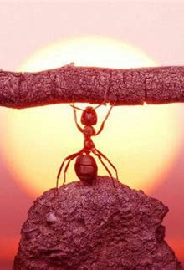
Power and Praise
SDABC V.6 p.1017
The same power that converts men must continue in them if there is to be Christian growth. Here is where many Christians fail. They do not recognize that spiritual endurance requires as much of the grace of God as did the initial conversion.

Slide 73
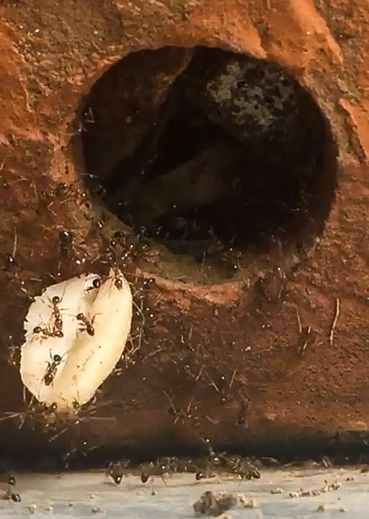
Power and Praise
SDABC V.6 p.1017
The vital spiritual powers within a man do not spring from his own nature; he has nothing of his own to offer, nothing of his own of which to boast. Strength comes from a living connection to God.
As the physical strength is increased by food and the intellectual life by thought, so the spiritual life is sustained by the immediate presence and power of the Holy Spirit.

Slide 74
Paul’s Prayers: Ideas in common
Praying with gratitude and joy
Prayer for wisdom founded in love
Prayer for an understanding of our hope
Prayer for spiritual power
Prayer in Christ’s name, recognizing His dominion

Slide 75
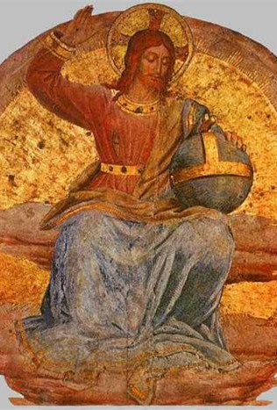
Christ’s Dominion:
Ephesians 1:20-23
²⁰ Which he wrought in Christ, when he raised him from the dead, and set him at his own right hand in the heavenly places,
²¹ Far above all principality, and power, and might, and dominion, and every name that is named, not only in this world, but also in that which is to come:

Slide 76
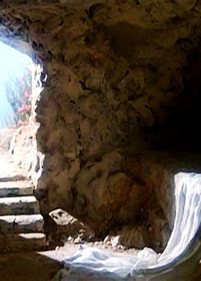
Christ’s Dominion:
SDABC V.6 p.1004
It is a marvelous fact that the same power that wrought the resurrection of Christ now works in the hearts of believers. It was upon Christ’s dead body that the power operated, and it is upon those who are “dead in trespasses and sins” that it again works.

Slide 77
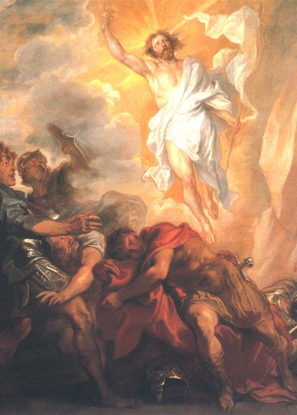
Christ’s Dominion:
SDABC V.6 p.1004
Christ came forth with a glorified body, and assumed authority at the right hand of God. His resurrection is a pledge of the resurrection of the saints (Rom. 4:25; 1 Cor. 15:20-22), and His exaltation a pledge of the final exaltation of the saints.

Slide 78
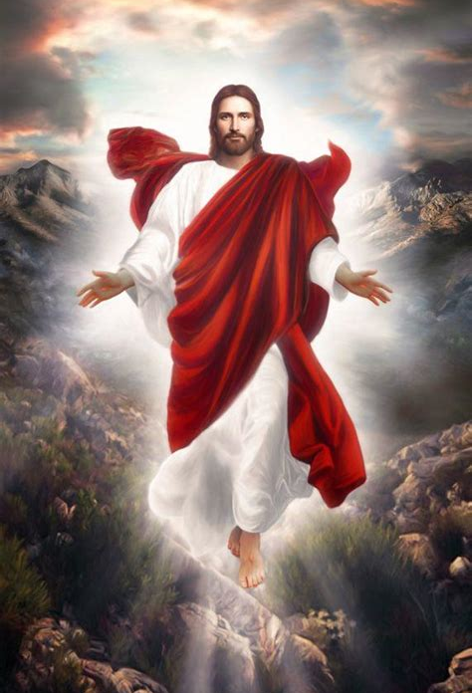
Christ’s Dominion:
SDABC V.6 p.1004
Christ is superior to all powers, both heavenly and earthly. He is Sovereign Lord, with supreme and universal authority. Paul is anxious at all times to make clear that Christ should not be regarded as a sub-deity, a concept that might easily be accepted in view of the growing influence of the Gnostic heresy.

Slide 79

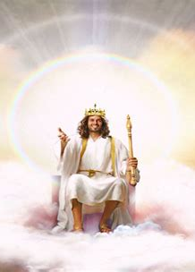
Christ’s Dominion:
SDABC V.6 p.1004
Apocrypha (NOT BIBLE): Enoch 61:10
“And He will summon all the host of the heavens, and all the holy ones above, and the host of God, the Cherubin, Seraphin and Ophannin, and all the angels of power, and all the angels of principalities, and the Elect One, and the other powers on the earth (and) over the water. ”
He uses the terms already familiar in current Jewish teachings (see the apocryphal work Enoch 61:10) and sets forth the truth that Christ is above all other beings, no matter what their real or supposed rank might be.

Slide 80
Christ’s Dominion:
SDABC V.6 p.1004
He uses the terms already familiar in current Jewish teachings (see the apocryphal work Enoch 61:10) and sets forth the truth that Christ is above all other beings, no matter what their real or supposed rank might be.

Slide 81
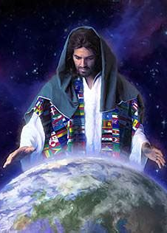
Christ’s Dominion:
SDABC V.6 p.1004
As a result of His humiliation and His exaltation Christ will be acknowledged as universally supreme not only in this age but also in the age to come. There is no name that can be compared with His because there is no being who can be compared with Him.

Slide 82
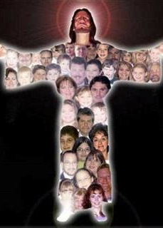
Christ’s Dominion:
Ephesians 1:22-23
²² And hath put all things under his feet, and gave him to be the head over all things to the church,
²³ Which is his body, the fulness of him that filleth all in all.

Slide 83
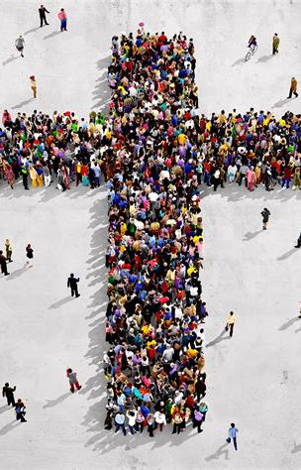
Christ’s Dominion:
SDABC V.6 p.1004
This relationship implies more than rulership. Headship, as used in this epistle, includes the idea of vital union and relationship (Eph. 4:15, 16; Col. 2:19). The head is the active center of all the operations of the body. Paul is emphasizing the idea of unity, well illustrated in the close relationship that exists between the head and the body.

Slide 84
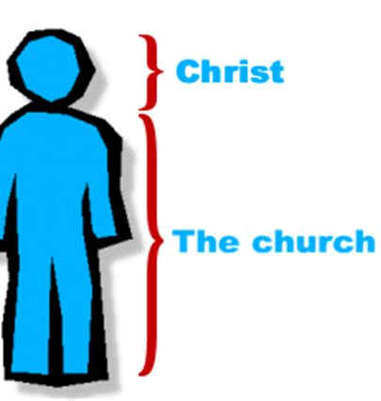
Christ’s Dominion:
SDABC V.6 p.1004
Christ the Head, is the seat of all authority for the church. The analogy of the church and the human body is very close. While the body is one and the church is one, both are made up of various members, each having his own gifts and temperaments.

Slide 85
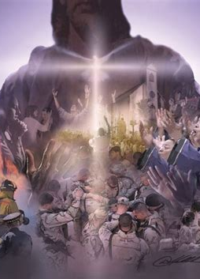
Christ’s Dominion:
SDABC V.6 p.1004-1005
Although there is a great diversity of gifts, that does not preclude harmonious association and operation. In fact, the members can perform their proper functions only when they do work together.
Paul sees the church as the body of Christ filled with the fullness of God (Eph. 3:19). Christ has poured His fullness, His qualities, into the church, filling it with holy life; indeed, with abounding life.

Slide 86
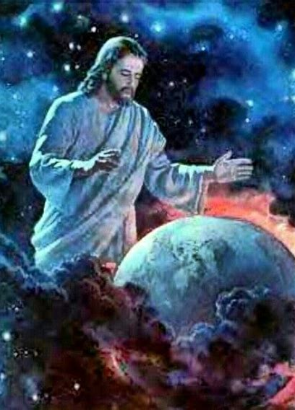
Christ’s Dominion:
Colossians 1:16-20
¹⁶ For by him were all things created, that are in heaven, and that are in earth, visible and invisible, whether they be thrones, or dominions, or principalities, or powers: all things were created by him, and for him:
¹⁷ And he is before all things, and by him all things consist.

Slide 87
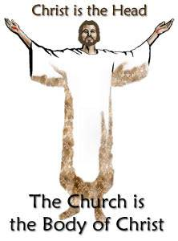
Christ’s Dominion:
Colossians 1:16-20
¹⁸ And he is the head of the body, the church: who is the beginning, the firstborn from the dead; that in all things he might have the preeminence.
¹⁹ For it pleased the Father that in him should all fulness dwell;

Slide 88
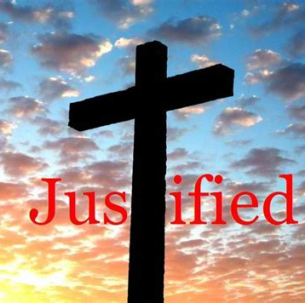
Christ’s Dominion:
Colossians 1:16-20
²⁰ And, having made peace through the blood of his cross, by him to reconcile all things unto himself; by him, I say, whether they be things in earth, or things in heaven.

Slide 89
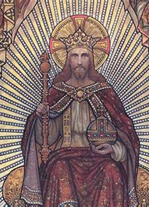
Christ’s Dominion:
Colossians 2:8-10
⁸ Beware lest any man spoil you through philosophy and vain deceit, after the tradition of men, after the rudiments of the world, and not after Christ.
⁹ For in him dwelleth all the fulness of the Godhead bodily.
¹⁰ And ye are complete in him, which is the head of all principality and power:

Slide 90
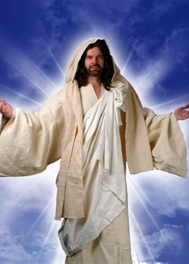
Christ’s Dominion:
Ephesians 3:20-21
²⁰ Now unto him that is able to do exceeding abundantly above all that we ask or think, according to the power that worketh in us,
²¹ Unto him be glory in the church by Christ Jesus throughout all ages, world without end. Amen.

Slide 91
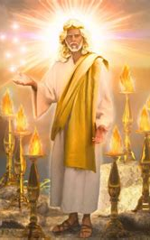
Christ’s Dominion:
SDABC V.6 p.1019
To God alone belongs the credit, recognition, and honor for the saving work of grace. There is no place for the assumption of virtue and glory on the part of the church or its members. The reasons, then, for praising God are found in these two places: in the church, because there His glory is reflected; in Christ, because He is the head of the body, the church.

Slide 92
Take a few moments to prepare for Sabbath school next week!
We’ll be looking at the first part of Ephesians 2,
That is, Ephesians 2:1-10

Slide 93
Thank you!
And Happy Sabbath!!

