Slide 1

How God Rescues us
Lesson 4, 3rd Quarter 2023
Ephesians 2:1-10

Slide 2

Memory Text:
Ephesians 2:4-5
⁴ But God, who is rich in mercy, for his great love wherewith he loved us,
⁵ Even when we were dead in sins, hath quickened us together with Christ, (by grace ye are saved;)

Slide 3

Key Ideas: Outlining Ephesians
Opening Greeting (Eph. 1:1, 2)
Part 1: The Doctrinal Section (Eph. 1:3-3:21)
Part 2: The Practical Section (Eph. 4:1-6:20)
Closing Greeting (Ephesians 6:21-24)

Slide 4

Dead in our Trespasses
Ephesians 2:1
2 And you hath he quickened, who were dead in trespasses and sins;

Slide 5
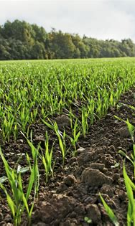
Quickened: SDABC V6 p1007
Gr. suzdopoied “to make alive together”. This word is used in the NT only here and in Col. 2:13. It and its simpler form, zoopoieo, “to make alive,” are used 14 times in the NT, and refer to a change from death to life, a rebirth, a new life. As Christ was quickened from the grave, so man is quickened from spiritual death. It is God’s purpose to bring man into a new sphere, a new relationship in which he is governed by new principles.

Slide 6
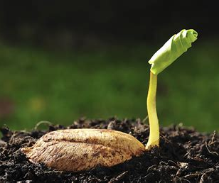
1 Corinthians 15:36
³⁶ Thou fool, that which thou sowest is not quickened, except it die:

Slide 7
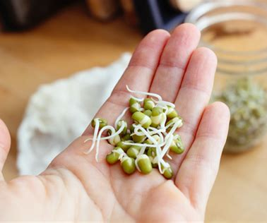
Colossians 2:13
¹³ And you, being dead in your sins and the uncircumcision of your flesh, hath he quickened together with him, having forgiven you all trespasses;

Slide 8
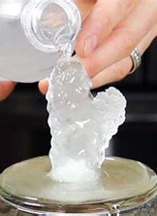
“Quickened” or “Converted”:
“Convert” is an intransitive verb
To change (something) into another form, substance, state, or product; transform.
To change (something) from one use, function, or purpose to another; adapt to a new or different purpose.

Slide 9
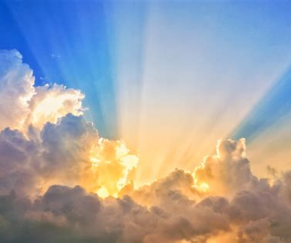
Quickened:
Christianity is supremely a religion of conversion. Everything we say and everything we believe is built upon one fundamental and revolutionary premise: You don’t have to stay the way you are. Your life can be radically changed by God.
https://www.keepbelieving.com/sermon/how-a-terrorist-became-an-evangelist-the-amazing-story-of-pauls-conversion/

Slide 10
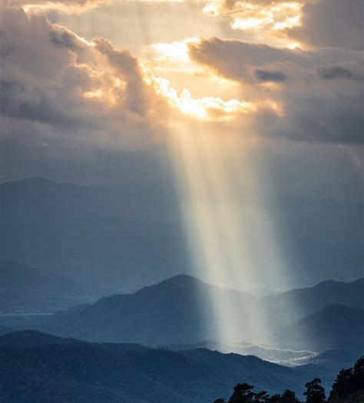
Quickened:
Conversion is a miracle that happens when God is accepted into a human life. Once God enters the picture, your life will never be the same again. Until then, you may be religious and you may be sort of a good person and you may think you’re obeying some set of behavioral guidelines, but you have not been converted.
https://www.keepbelieving.com/sermon/how-a-terrorist-became-an-evangelist-the-amazing-story-of-pauls-conversion/

Slide 11
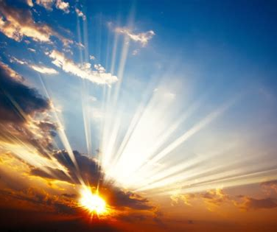
Quickened:
Religion is one thing; conversion is something else entirely. It is the conviction that long-held prejudices can be overcome, lifetime habits can be broken, and deeply ingrained patterns of sin can be erased over time.
https://www.keepbelieving.com/sermon/how-a-terrorist-became-an-evangelist-the-amazing-story-of-pauls-conversion/

Slide 12
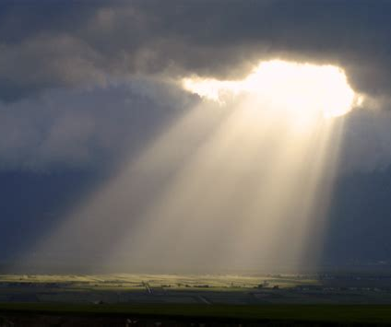
Quickened:
Conversion is the certainty that what you were does not determine what you are, and what you are does not determine what you will be. You can be changed, you can be different, your life can move in an entirely new direction.
https://www.keepbelieving.com/sermon/how-a-terrorist-became-an-evangelist-the-amazing-story-of-pauls-conversion/

Slide 13

Quickened:
If you take that truth away from Christianity, it ceases to be a supernatural religion. If the possibility of real change is gone, then we have nothing to offer but a set of rules. Can the leopard change his spots?
https://www.keepbelieving.com/sermon/how-a-terrorist-became-an-evangelist-the-amazing-story-of-pauls-conversion/

Slide 14
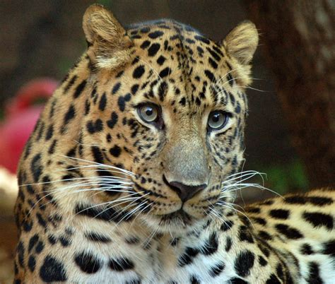
Quickened:
In himself and by himself, the leopard can never change his spots, but with God all things are possible.
https://www.keepbelieving.com/sermon/how-a-terrorist-became-an-evangelist-the-amazing-story-of-pauls-conversion/

Slide 15
The three sections of Ephesians 2:1-10 are summarized neatly in the phrases of Ephesians 2:5:
“we were dead in our trespasses”;
God “made us alive together with Christ”;
“by grace you have been saved”.

Slide 16
The three sections of Ephesians 2:1-10 are summarized neatly in the phrases of Ephesians 2:5:
“we were dead in our trespasses”;
God “made us alive together with Christ”;
“by grace you have been saved”.

Slide 17
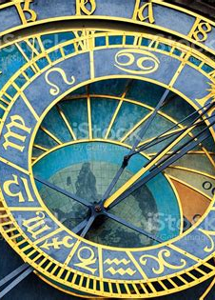
Dead in our Trespasses
Ephesians 2:1-3
2 And you hath he quickened, who were dead in trespasses and sins;
² Wherein in time past ye walked according to the course of this world, according to the prince of the power of the air, the spirit that now worketh in the children of disobedience:

Slide 18
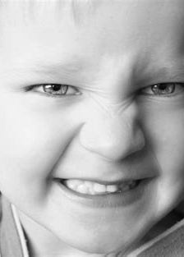
Dead in our Trespasses
Ephesians 2:3
³ Among whom also we all had our conversation in times past in the lusts of our flesh, fulfilling the desires of the flesh and of the mind; and were by nature the children of wrath, even as others.

Slide 19
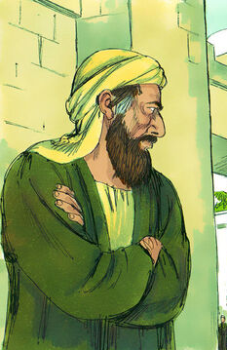
Dead in our Trespasses (AA 112)
Prominent among the Jewish leaders who became thoroughly aroused by the success attending the proclamation of the gospel, was Saul of Tarsus. A Roman citizen by birth, Saul was nevertheless a Jew by descent and had been educated in Jerusalem by the most eminent of the rabbis. “Of the stock of Israel, of the tribe of Benjamin,” Saul was “a Hebrew of the Hebrews;

Slide 20
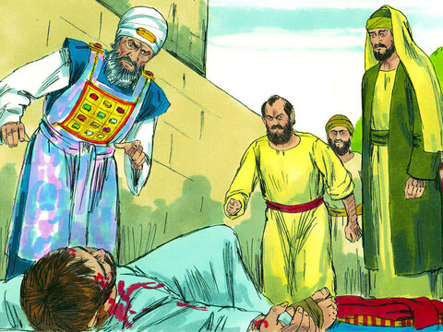
Dead in our Trespasses (AA 112)
… as touching the law, a Pharisee; concerning zeal, persecuting the church; touching the righteousness which is in the law, blameless.” Philippians 3:5, 6. He was regarded by the rabbis as a young man of great promise, and high hopes were cherished concerning him as an able and zealous defender of the ancient faith. His elevation to membership in the Sanhedrin council placed him in a position of power.

Slide 21
Dead in our Trespasses (AA 112)
Saul had taken a prominent part in the trial and conviction of Stephen, and the striking evidences of God's presence with the martyr had led Saul to doubt the righteousness of the cause he had espoused against the followers of Jesus. His mind was deeply stirred. In his perplexity he appealed to those in whose wisdom and judgment he had full confidence.

Slide 22
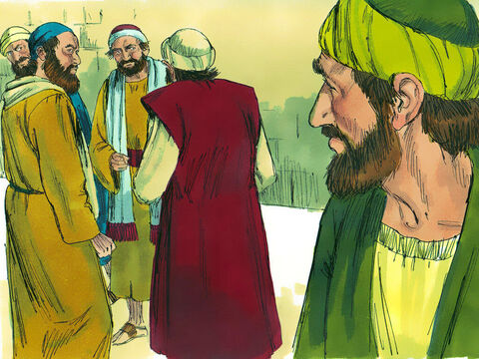
Dead in our Trespasses (AA 112)
The arguments of the priests and rulers finally convinced him that Stephen was a blasphemer, that the Christ whom the martyred disciple had preached was an impostor, and that those ministering in holy office must be right.

Slide 23
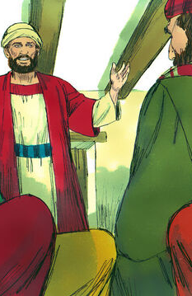
Dead in our Trespasses (AA 113)
Not without severe trial did Saul come to this conclusion. But in the end his education and prejudices, his respect for his former teachers, and his pride of popularity braced him to rebel against the voice of conscience and the grace of God. And having fully decided that the priests and scribes were right, Saul became very bitter in his opposition to the doctrines taught by the disciples of Jesus.

Slide 24
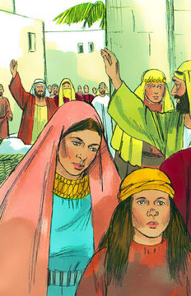
Dead in our Trespasses (AA 113)
His activity in causing holy men and women to be dragged before tribunals, where some were condemned to imprisonment and some even to death, solely because of their faith in Jesus, brought sadness and gloom to the newly organized church, and caused many to seek safety in flight.

Slide 25
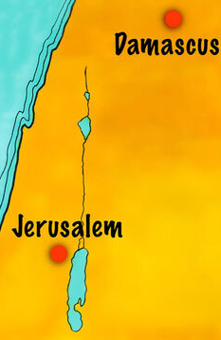
Dead in our Trespasses (AA 113)
The priests and rulers had hoped that by vigilant effort and stern persecution the heresy might be suppressed. Now they felt that they must carry forward in other places the decided measures taken in Jerusalem against the new teaching. For the special work that they desired to have done at Damascus, Saul offered his services. “Breathing out threatenings and slaughter against the disciples of the Lord,” he “went unto the high priest, and

Slide 26
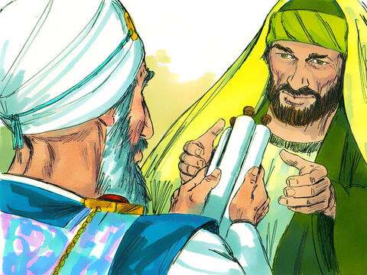
Dead in our Trespasses (AA 113)
… desired of him letters to Damascus to the synagogues, that if he found any of this way, whether they were men or women, he might bring them bound unto Jerusalem.” Thus “with authority and commission from the chief priests” (Acts 26:12), Saul of Tarsus, in the strength and vigor of manhood, and fired with mistaken zeal, set out on that memorable journey, the strange occurrences of which were to change the whole current of his life.

Slide 27
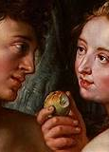
Dead in our Trespasses
Romans 5:12
¹² Wherefore, as by one man sin entered into the world, and death by sin; and so death passed upon all men, for that all have sinned:

Slide 28
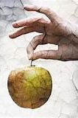
Dead in our Trespasses
Romans 6:21-23
²¹ What fruit had ye then in those things whereof ye are now ashamed? for the end of those things is death.
²² But now being made free from sin, and become servants to God, ye have your fruit unto holiness, and the end everlasting life.
²³ For the wages of sin is death; but the gift of God is eternal life through Jesus Christ our Lord.

Slide 29
The three sections of Ephesians 2:1-10 are summarized neatly in the phrases of Ephesians 2:5:
“we were dead in our trespasses”;
God “made us alive together with Christ”;
“by grace you have been saved”.

Slide 30
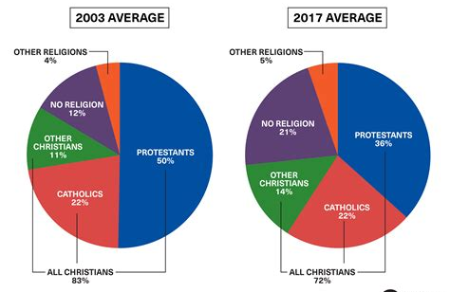

Slide 31
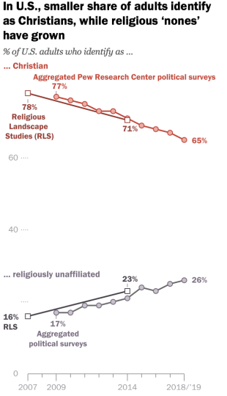

Slide 32
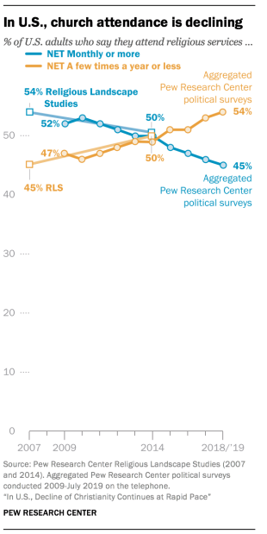

Slide 33
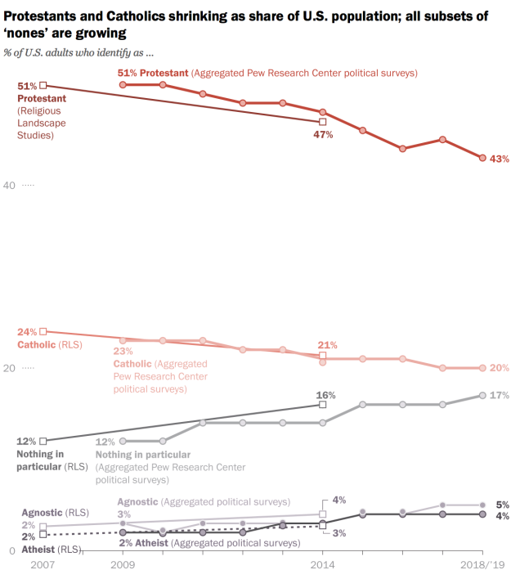

Slide 34
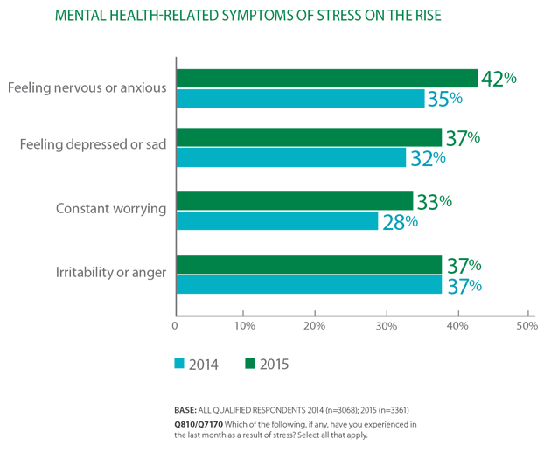

Slide 35
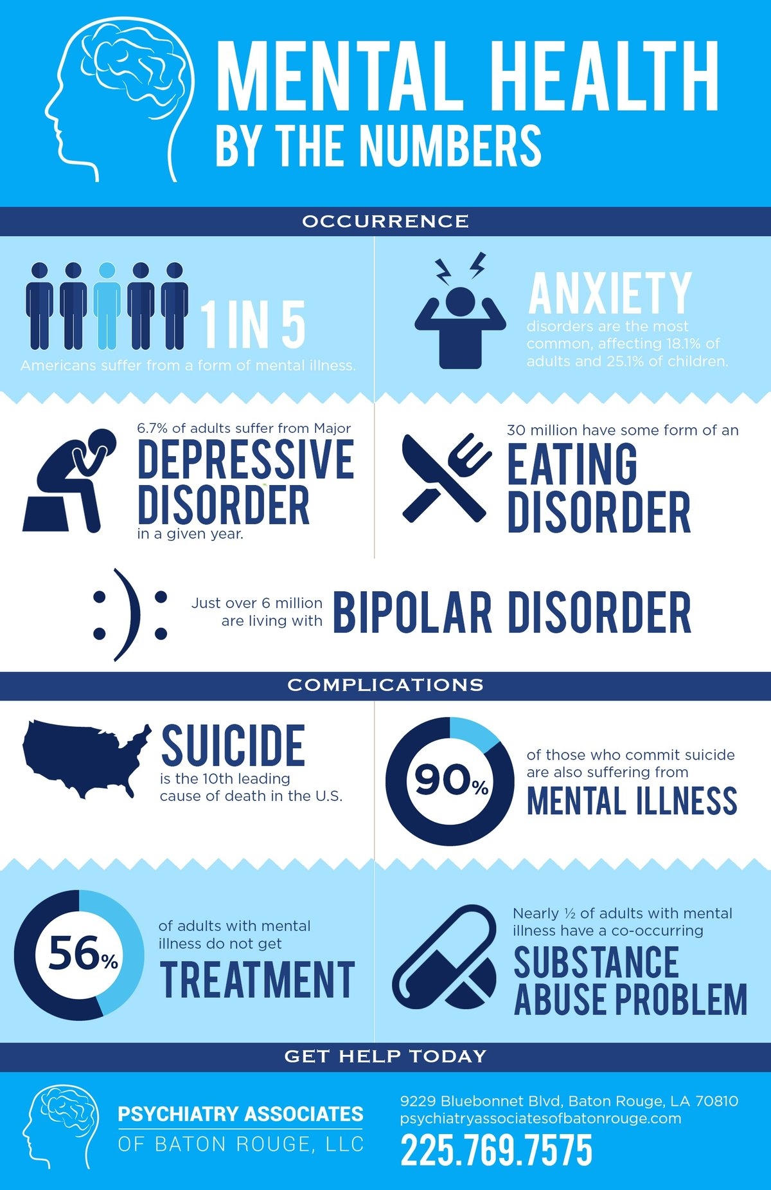

Slide 37
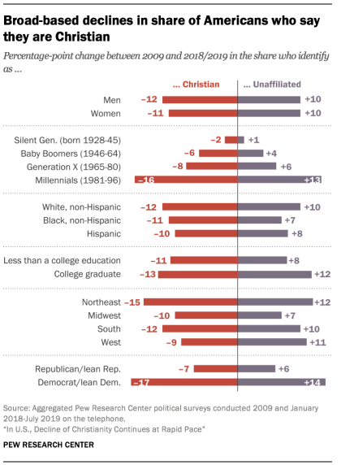

Slide 39
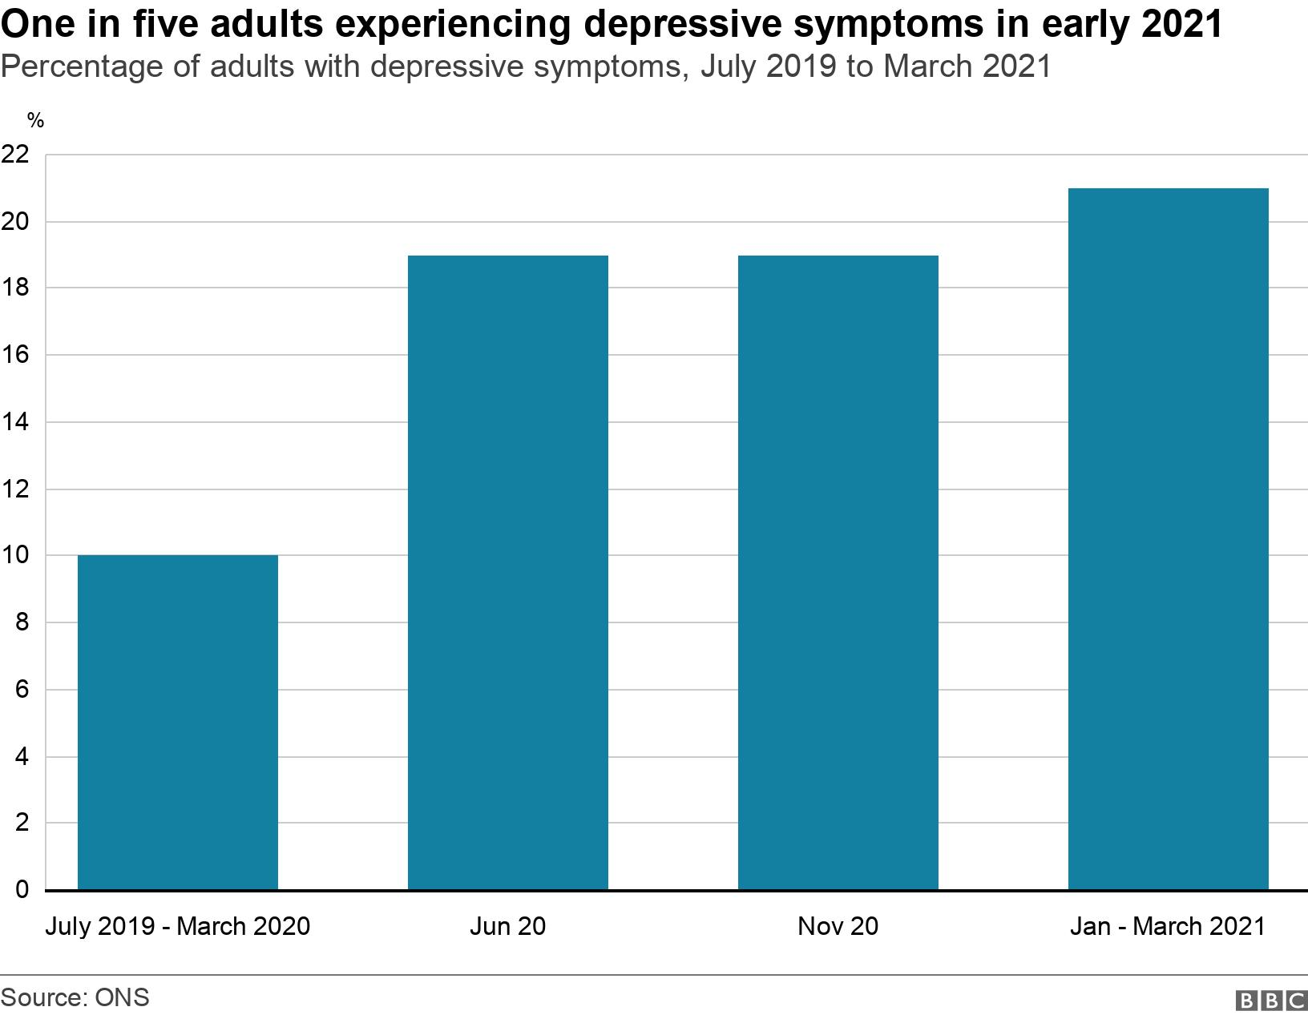

Slide 40
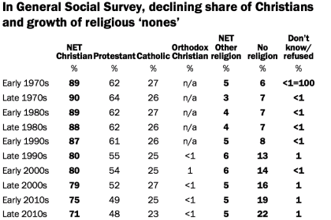

Slide 41
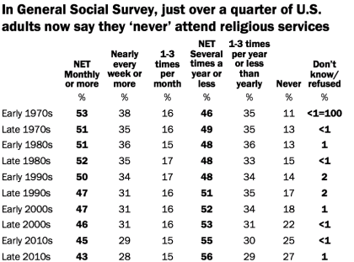

Slide 42
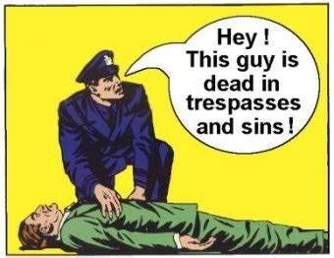

Slide 43
The three sections of Ephesians 2:1-10 are summarized neatly in the phrases of Ephesians 2:5:
“we were dead in our trespasses”;
God “made us alive together with Christ”;
“by grace you have been saved”.

Slide 44
The three sections of Ephesians 2:1-10 are summarized neatly in the phrases of Ephesians 2:5:
“we were dead in our trespasses”;
God “made us alive together with Christ”;
“by grace you have been saved”.

Slide 45
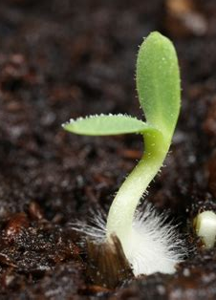
Alive Together With Christ
Ephesians 2:4-6
⁴ But God, who is rich in mercy, for his great love wherewith he loved us,
⁵ Even when we were dead in sins, hath quickened us together with Christ, (by grace ye are saved;)

Slide 46
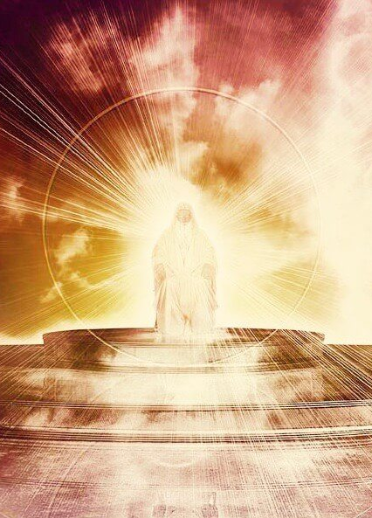
Alive Together With Christ
Ephesians 2:4-6
⁶ And hath raised us up together, and made us sit together in heavenly places in Christ Jesus:

Slide 47
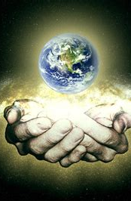
God Chose to Rescue Us before the foundation of the world!
Galatians 1:3-4
³ Grace be to you and peace from God the Father, and from our Lord Jesus Christ,
⁴ Who gave himself for our sins, that he might deliver us from this present evil world, according to the will of God and our Father:

Slide 48
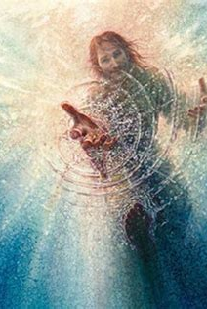
God Chose to Rescue Us before the foundation of the world!
Ephesians 1:4, 5, 11
⁴ According as he hath chosen us in him before the foundation of the world, that we should be holy and without blame before him in love:
⁵ Having predestinated us unto the adoption of children by Jesus Christ to himself, according to the good pleasure of his will,

Slide 49
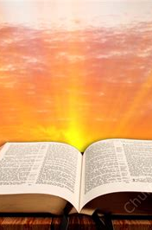
God Chose to Rescue Us before the foundation of the world!
Ephesians 1:4, 5, 11
¹¹ In whom also we have obtained an inheritance, being predestinated according to the purpose of him who worketh all things after the counsel of his own will:

Slide 50
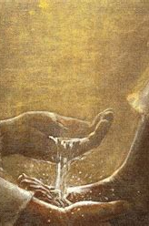
Quickening
Romans 5:16-18
¹⁶ Know ye not, that to whom ye yield yourselves servants to obey, his servants ye are to whom ye obey; whether of sin unto death, or of obedience unto righteousness?

Slide 51
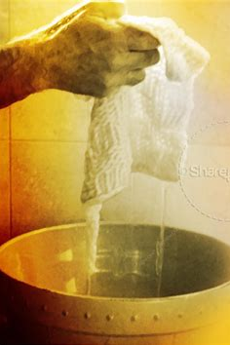
Quickening
Romans 5:16-18
¹⁷ But God be thanked, that ye were the servants of sin, but ye have obeyed from the heart that form of doctrine which was delivered you.
¹⁸ Being then made free from sin, ye became the servants of righteousness.

Slide 52
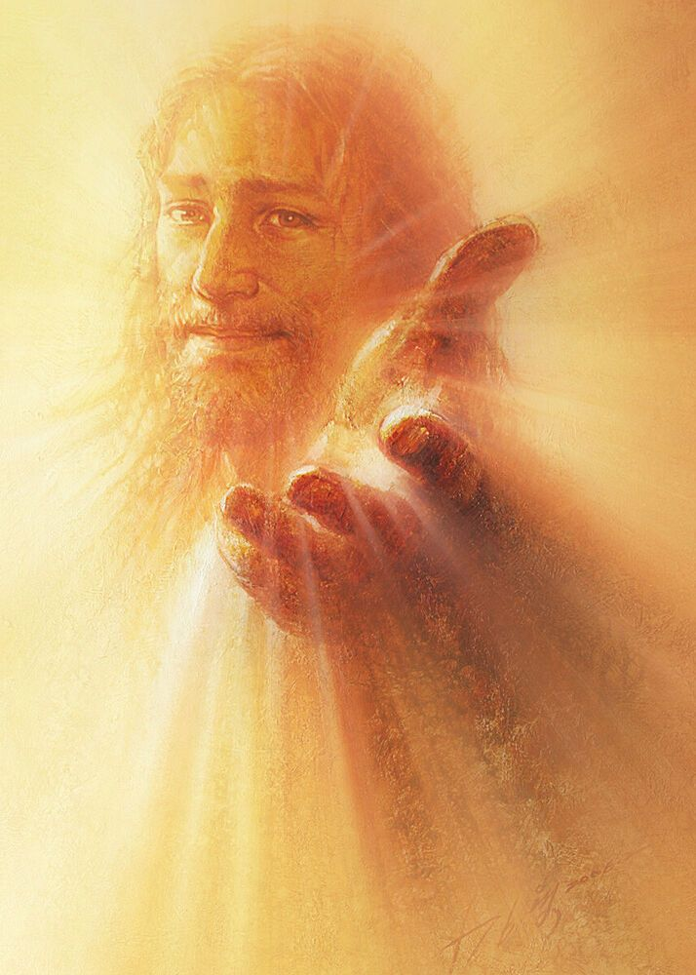
Quickening
Isaiah 55:6-9
⁶ Seek ye the Lord while he may be found, call ye upon him while he is near:
⁷ Let the wicked forsake his way, and the unrighteous man his thoughts: and let him return unto the Lord, and he will have mercy upon him; and to our God, for he will abundantly pardon.

Slide 53
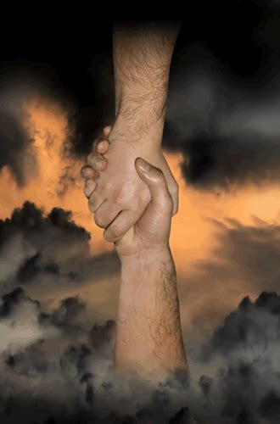
Quickening
Isaiah 55:6-9
⁸ For my thoughts are not your thoughts, neither are your ways my ways, saith the Lord.
⁹ For as the heavens are higher than the earth, so are my ways higher than your ways, and my thoughts than your thoughts.

Slide 54
Alive Together With Christ (AA 114)
On the last day of the journey, “at midday,” as the weary travelers neared Damascus, they came within full view of broad stretches of fertile lands, beautiful gardens, and fruitful orchards, watered by cool streams from the surrounding mountains. After the long journey over desolate wastes such scenes were refreshing indeed. While Saul, with his companions, gazed with admiration on the fruitful plain and the fair city below…

Slide 55
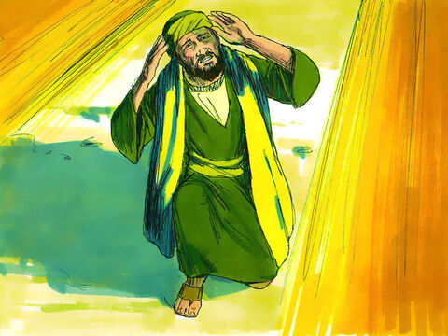
Alive Together With Christ (AA 114)
Suddenly,” as he afterward declared, there shone “round about me and them which journeyed with me” “a light from heaven, above the brightness of the sun” (Acts 26:13), too glorious for mortal eyes to bear. Blinded and bewildered, Saul fell prostrate to the ground.
While the light continued to shine round about them, Saul heard, “a voice speaking ... in the Hebrew tongue” (Acts 26:14)…

Slide 56
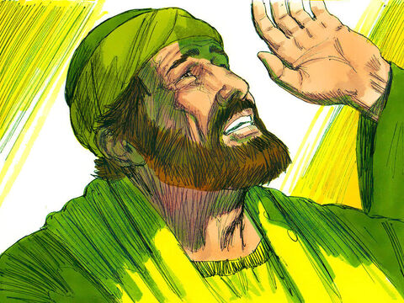
Alive Together With Christ (AA 114-115)
…“Saying unto him, Saul, Saul, why persecutest thou Me? And he said, Who art Thou, Lord? And the Lord said, I am Jesus whom thou persecutest: it is hard for thee to kick against the pricks.”
Filled with fear, and almost blinded by the intensity of the light, the companions of Saul heard a voice, but saw no man.

Slide 57
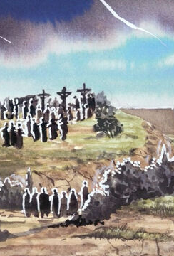
Alive Together With Christ (AA 115)
But Saul understood the words that were spoken, and to him was clearly revealed the One who spoke—even the Son of God. In the glorious Being who stood before him he saw the Crucified One. Upon the soul of the stricken Jew the image of the Saviour's countenance was imprinted forever. The words spoken struck home to his heart with appalling force.

Slide 58
Alive Together With Christ (AA 115)
Into the darkened chambers of his mind there poured a flood of light, revealing the ignorance and error of his former life and his present need of the enlightement of the Holy Spirit.
Saul now saw that in persecuting the followers of Jesus he had in reality been doing the work of Satan.

Slide 59
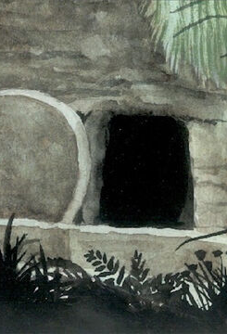
Alive Together With Christ (AA 115)
He saw that his convictions of right and of his own duty had been based largely on his implicit confidence in the priests and rulers. He had believed them when they told him that the story of the resurrection was an artful fabrication of the disciples. Now that Jesus Himself stood revealed, Saul was convinced of the truthfulness of the claims made by the disciples.

Slide 60
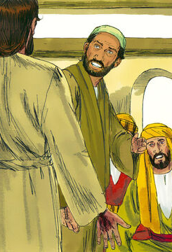
Alive Together With Christ (AA 115)
In that hour of heavenly illumination Saul's mind acted with remarkable rapidity. The prophetic records of Holy Writ were opened to his understanding. He saw that the rejection of Jesus by the Jews, His crucifixion, resurrection, and ascension, had been foretold by the prophets and proved Him to be the promised Messiah.

Slide 61
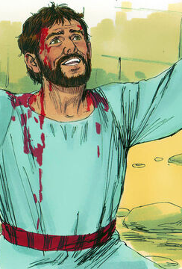
Alive Together With Christ (AA 115)
Stephen's sermon at the time of his martyrdom was brought forcibly to Saul's mind, and he realized that the martyr had indeed beheld “the glory of God” when he said, “Behold, I see the heavens opened, and the Son of man standing on the right hand of God.” Acts 7:55, 56. The priests had pronounced these words blasphemy, but Saul now knew them to be truth.

Slide 62
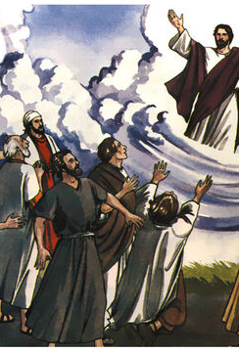
Alive Together With Christ (AA 116)
What a revelation was all this to the persecutor! Now Saul knew for a certainty that the promised Messiah had come to this earth as Jesus of Nazareth and that He had been rejected and crucified by those whom He came to save. He knew also that the Saviour had risen in triumph from the tomb and had ascended into the heavens.

Slide 63
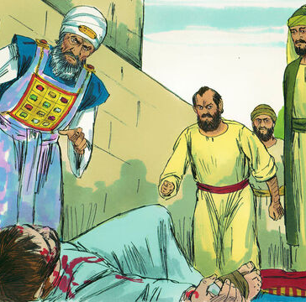
Alive Together With Christ (AA 116)
In that moment of divine revelation Saul remembered with terror that Stephen, who had borne witness of a crucified and risen Saviour, had been sacrificed by his consent, and that later, through his instrumentality, many other worthy followers of Jesus had met their death by cruel persecution.

Slide 64
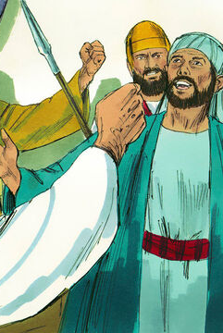
Alive Together With Christ (AA 116)
The Saviour had spoken to Saul through Stephen, whose clear reasoning could not be controverted. The learned Jew had seen the face of the martyr reflecting the light of Christ's glory—appearing as if “it had been the face of an angel.” Acts 6:15. He had witnessed Stephen's forbearance toward his enemies and his forgiveness of them.

Slide 65
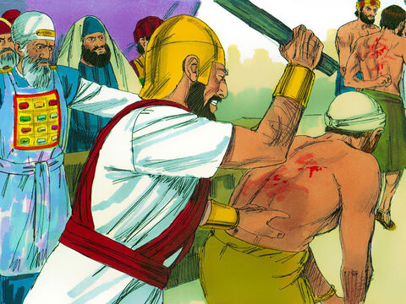
Alive Together With Christ (AA 116)
He had also witnessed the fortitude and cheerful resignation of many whom he had caused to be tormented and afflicted. He had seen some yield up even their lives with rejoicing for the sake of their faith.
All these things had appealed loudly to Saul and at times had thrust upon his mind an almost overwhelming conviction that Jesus was the promised Messiah.

Slide 66

Alive Together With Christ (AA 116-117)
At such times he had struggled for entire nights against this conviction, and always he had ended the matter by avowing his belief that Jesus was not the Messiah and that His followers were deluded fanatics.
Now Christ had spoken to Saul with His own voice, saying, “Saul, Saul, why persecutest thou Me?”

Slide 67
Alive Together With Christ (AA 117)
And the question, “Who art Thou, Lord?” was answered by the same voice, “I am Jesus whom thou persecutest.” Christ here identifies Himself with His people. In persecuting the followers of Jesus, Saul had struck directly against the Lord of heaven. In falsely accusing and testifying against them, he had falsely accused and testified against the Saviour of the world.

Slide 68
Alive Together With Christ (AA 117)
No doubt entered the mind of Saul that the One who spoke to him was Jesus of Nazareth, the long-looked-for Messiah, the Consolation and Redeemer of Israel. “Trembling and astonished,” he inquired, “Lord, what wilt Thou have me to do? And the Lord said unto him, Arise, and go into the city, and it shall be told thee what thou must do.”

Slide 69

Alive together with Christ
2 Peter 3:9
⁹ The Lord is not slack concerning his promise, as some men count slackness; but is longsuffering to us-ward, not willing that any should perish, but that all should come to repentance.

Slide 70

Alive together with Christ
Acts 3:19-20
¹⁹ Repent ye therefore, and be converted, that your sins may be blotted out, when the times of refreshing shall come from the presence of the Lord.
²⁰ And he shall send Jesus Christ, which before was preached unto you:

Slide 71

Alive together with Christ
Ezekiel 18:30-32
³⁰ Therefore I will judge you, O house of Israel, every one according to his ways, saith the Lord God. Repent, and turn yourselves from all your transgressions; so iniquity shall not be your ruin.

Slide 72

Alive together with Christ
Ezekiel 18:30-32
³¹ Cast away from you all your transgressions, whereby ye have transgressed; and make you a new heart and a new spirit: for why will ye die, O house of Israel?
³² For I have no pleasure in the death of him that dieth, saith the Lord God: wherefore turn yourselves, and live ye.

Slide 73


Slide 74
Alive together with Christ
The Great Controversy P. 461
Wherever the word of God has been faithfully preached, results have followed that attested its divine origin. The Spirit of God accompanied the message of His servants, and the word was with power. Sinners felt their consciences quickened. The “light which lighteth every man that cometh into the world” illumined the secret chambers of their souls, and the hidden things of darkness were made manifest. Deep conviction took hold upon their minds and hearts.

Slide 75
Alive together with Christ
The Great Controversy P. 461
They were convinced of sin and of righteousness and of judgment to come. They had a sense of the righteousness of Jehovah and felt the terror of appearing, in their guilt and uncleanness, before the Searcher of hearts. In anguish they cried out: “Who shall deliver me from the body of this death?” As the cross of Calvary, with its infinite sacrifice for the sins of men, was revealed, they saw that nothing but the merits of Christ could suffice to atone for their transgressions;

Slide 76
Alive together with Christ
The Great Controversy P. 461
…this alone could reconcile man to God. With faith and humility they accepted the Lamb of God, that taketh away the sin of the world. Through the blood of Jesus they had “remission of sins that are past.”
These souls brought forth fruit meet for repentance. They believed and were baptized, and rose to walk in newness of life—new creatures in Christ Jesus; not to fashion themselves according to the former lusts, but by the faith of the Son of God to follow in His steps, to reflect His character, and to purify themselves even as He is pure.

Slide 77
Alive together with Christ
The Great Controversy P. 355
A great religious awakening under the proclamation of Christ's soon coming is foretold in the prophecy of the first angel's message of Revelation 14. An angel is seen flying “in the midst of heaven, having the everlasting gospel to preach unto them that dwell on the earth, and to every nation, and kindred, and tongue, and people.” “With a loud voice” he proclaims the message: “Fear God, and give glory to Him; for the hour of His judgment is come: and worship Him that made heaven, and earth, and the sea, and the fountains of waters.” Verses 6, 7.

Slide 78
The three sections of Ephesians 2:1-10 are summarized neatly in the phrases of Ephesians 2:5:
“we were dead in our trespasses”;
God “made us alive together with Christ”;
“by grace you have been saved”.

Slide 79
The three sections of Ephesians 2:1-10 are summarized neatly in the phrases of Ephesians 2:5:
“we were dead in our trespasses”;
God “made us alive together with Christ”;
“by grace you have been saved”.

Slide 80

Saved By Grace
Ephesians 2:7-10
⁷ That in the ages to come he might shew the exceeding riches of his grace in his kindness toward us through Christ Jesus.
⁸ For by grace are ye saved through faith; and that not of yourselves: it is the gift of God:

Slide 81

Saved By Grace
Ephesians 2:7-10
⁹ Not of works, lest any man should boast.
¹⁰ For we are his workmanship, created in Christ Jesus unto good works, which God hath before ordained that we should walk in them.

Slide 82

Saved by Grace
2 Corinthians 5:17-18
¹⁷ Therefore if any man be in Christ, he is a new creature: old things are passed away; behold, all things are become new.
¹⁸ And all things are of God, who hath reconciled us to himself by Jesus Christ, and hath given to us the ministry of reconciliation;

Slide 83

Saved by Grace
Romans 3:24-25
²⁴ Being justified freely by his grace through the redemption that is in Christ Jesus:
²⁵ Whom God hath set forth to be a propitiation through faith in his blood, to declare his righteousness for the remission of sins that are past, through the forbearance of God;

Slide 84

Saved by Grace
Galatians 2:20
²⁰ I am crucified with Christ: nevertheless I live; yet not I, but Christ liveth in me: and the life which I now live in the flesh I live by the faith of the Son of God, who loved me, and gave himself for me.

Slide 85

Saved By Grace (AA 117)
When the glory was withdrawn, and Saul arose from the ground, he found himself totally deprived of sight. The brightness of Christ's glory had been too intense for his mortal eyes; and when it was removed, the blackness of night settled upon his vision. He believed that this blindness was a punishment from God for his cruel persecution of the followers of Jesus.

Slide 86

Saved By Grace (AA 117)
In terrible darkness he groped about, and his companions, in fear and amazement, “led him by the hand, and brought him into Damascus.”
On the morning of that eventful day, Saul had neared Damascus with feelings of self-satisfaction because of the confidence that had been placed in him by the chief priest.

Slide 87
Saved By Grace (AA 117)
To him had been entrusted grave responsibilities. He was commissioned to further the interests of the Jewish religion by checking, if possible, the spread of the new faith in Damascus. He had determined that his mission should be crowned with success and had looked forward with eager anticipation to the experiences that he expected were before him.

Slide 88

Saved By Grace (AA 118)
But how unlike his anticipations was his entrance into the city! Stricken with blindness, helpless, tortured by remorse, knowing not what further judgment might be in store for him, he sought out the home of the disciple Judas, where, in solitude, he had ample opportunity for reflection and prayer.
For three days Saul was “without sight, and neither did eat nor drink.”

Slide 89
Saved By Grace (AA 118)
These days of soul agony were to him as years. Again and again he recalled, with anguish of spirit, the part he had taken in the martyrdom of Stephen. With horror he thought of his guilt in allowing himself to be controlled by the malice and prejudice of the priests and rulers, even when the face of Stephen had been lighted up with the radiance of heaven.

Slide 90
Saved By Grace (AA 118)
In sadness and brokenness of spirit he recounted the many times he had closed his eyes and ears against the most striking evidences and had relentlessly urged on the persecution of the believers in Jesus of Nazareth.
These days of close self-examination and of heart humiliation were spent in lonely seclusion.

Slide 91

Saved By Grace (AA 118)
The believers, having been given warning of the purpose of Saul in coming to Damascus, feared that he might be acting a part, in order the more readily to deceive them; and they held themselves aloof, refusing him their sympathy. He had no desire to appeal to the unconverted Jews, with whom he had planned to unite in persecuting the believers; for he knew that they would not even listen to his story.

Slide 92

Saved By Grace (AA 118-119)
Thus he seemed to be shut away from all human sympathy. His only hope of help was in a merciful God, and to Him he appealed in brokenness of heart.
During the long hours when Saul was shut in with God alone, he recalled many of the passages of Scripture referring to the first advent of Christ. Carefully he traced down the prophecies, with a memory sharpened by the conviction that had taken possession of his mind.

Slide 93

Saved By Grace (AA 119)
As he reflected on the meaning of these prophecies he was astonished at his former blindness of understanding and at the blindness of the Jews in general, which had led to the rejection of Jesus as the promised Messiah. To his enlightened vision all now seemed plain. He knew that his former prejudice and unbelief had clouded his spiritual perception and had prevented him from discerning in Jesus of Nazareth the Messiah of prophecy.

Slide 94

Saved By Grace (AA 119)
As Saul yielded himself fully to the convicting power of the Holy Spirit, he saw the mistakes of his life and recognized the far-reaching claims of the law of God. He who had been a proud Pharisee, confident that he was justified by his good works, now bowed before God with the humility and simplicity of a little child, confessing his own unworthiness and pleading the merits of a crucified and risen Saviour.

Slide 95
Saved By Grace (AA 119)
Saul longed to come into full harmony and communion with the Father and the Son; and in the intensity of his desire for pardon and acceptance he offered up fervent supplications to the throne of grace.

Slide 96

Saved By Grace (AA 120)
The prayers of the penitent Pharisee were not in vain. The inmost thoughts and emotions of his heart were transformed by divine grace; and his nobler faculties were brought into harmony with the eternal purposes of God. Christ and His righteousness became to Saul more than the whole world.

Slide 97

Saved By Grace (AA 120)
The conversion of Saul is a striking evidence of the miraculous power of the Holy Spirit to convict men of sin. He had verily believed that Jesus of Nazareth had disregarded the law of God and had taught His disciples that it was of no effect. But after his conversion, Saul recognized Jesus as the one who had come into the world for the express purpose of vindicating His Father's law.

Slide 98

Saved By Grace (AA 120)
He was convinced that Jesus was the originator of the entire Jewish system of sacrifices. He saw that at the crucifixion type had met antitype, that Jesus had fulfilled the Old Testament prophecies concerning the Redeemer of Israel.

Slide 99

Saved By Grace (AA 123)
After his baptism, Paul broke his fast and remained “certain days with the disciples which were at Damascus. And straightway he preached Christ in the synagogues, that He is the Son of God.” Boldly he declared Jesus of Nazareth to be the long-looked-for Messiah, who “died for our sins according to the Scriptures; ... was buried, and ... rose again the third day,” after which He was seen by the Twelve and by others.

Slide 100

Saved By Grace (AA 123)
“And last of all,” Paul added, “He was seen of me also, as of one born out of due time.” 1 Corinthians 15:3, 4, 8. His arguments from prophecy were so conclusive, and his efforts were so manifestly attended by the power of God, that the Jews were confounded and unable to answer him.

Slide 101

Saved By Grace (AA 124)
Paul had formerly been known as a zealous defender of the Jewish religion and an untiring persecutor of the followers of Jesus. Courageous, independent, persevering, his talents and training would have enabled him to serve in almost any capacity.

Slide 102

Saved By Grace (AA 124)
He could reason with extraordinary clearness, and by his withering sarcasm could place an opponent in no enviable light. And now the Jews saw this young man of unusual promise united with those whom he formerly persecuted, and fearlessly preaching in the name of Jesus.

Slide 103

Saved by Grace
2 Corinthians 12:17-18
⁹ And he said unto me, My grace is sufficient for thee: for my strength is made perfect in weakness. Most gladly therefore will I rather glory in my infirmities, that the power of Christ may rest upon me.

Slide 104

Saved by Grace
2 Corinthians 12:17-18
¹⁰ Therefore I take pleasure in infirmities, in reproaches, in necessities, in persecutions, in distresses for Christ's sake: for when I am weak, then am I strong.

Slide 105

Saved by Grace
James 4:6-10
⁶ But he giveth more grace. Wherefore he saith, God resisteth the proud, but giveth grace unto the humble.
⁷ Submit yourselves therefore to God. Resist the devil, and he will flee from you.

Slide 106

Saved by Grace
James 4:6-10
⁸ Draw nigh to God, and he will draw nigh to you. Cleanse your hands, ye sinners; and purify your hearts, ye double minded.
⁹ Be afflicted, and mourn, and weep: let your laughter be turned to mourning, and your joy to heaviness.
¹⁰ Humble yourselves in the sight of the Lord, and he shall lift you up.

Slide 107
Take a few moments to prepare for Sabbath school next week!
We’ll be looking at the Second part of Ephesians 2,
That is, Ephesians 2:11-22

Slide 108
Thank you!
And Happy Sabbath!!

