Slide 1

Horizontal Atonement:
The Cross and the Church
Lesson 5, 3rd Quarter 2023
Ephesians 2:11-22

Slide 2
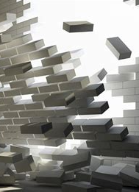
Memory Text:
Ephesians 2:13-14
¹³ But now in Christ Jesus ye who sometimes were far off are made nigh by the blood of Christ.
¹⁴ For he is our peace, who hath made both one, and hath broken down the middle wall of partition between us;

Slide 3

Ephesians So Far:
Paul and the Ephesians
Eph. 1:1-14—Prayer of Gratitude for God’s Grace
Eph. 1:15-23—Gratitude and Joy in Christ
Eph. 2:1-10—Quickened by God’s Grace
Eph. 2:11-22—One Body by the Cross

Slide 4
Having No Hope:
Ephesians 2:2-3
Ephesians 2:11-12
² Wherein in time past ye walked according to the course of this world, according to the prince of the power of the air, the spirit that now worketh in the children of disobedience:
³ Among whom also we all had our conversation in times past in the lusts of our flesh, fulfilling the desires of the flesh and of the mind; and were by nature the children of wrath, even as others.
¹¹ Wherefore remember, that ye being in time past Gentiles in the flesh, who are called Uncircumcision by that which is called the Circumcision in the flesh made by hands;
¹² That at that time ye were without Christ, being aliens from the commonwealth of Israel, and strangers from the covenants of promise, having no hope, and without God in the world:

Slide 5
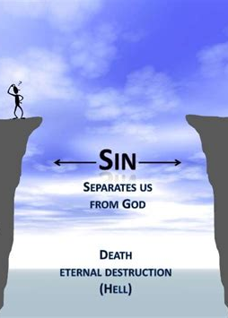
Having no Hope:
Isaiah 59:2
² But your iniquities have separated between you and your God, and your sins have hid his face from you, that he will not hear.

Slide 6
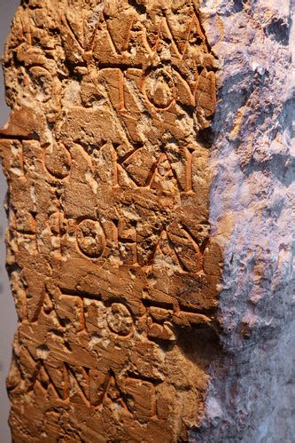
SDA Quarterly Sun. July 23
In their past existence, Gentiles were caught up in a grand feud between themselves and the Jews. Paul gives a sense of this entrenched hatred by referring to one symptom of it, name-calling. Jews referred to Gentiles with derision as “the uncircumcision” and Gentiles referred to Jews with equal disdain as “the circumcision” (Eph. 2:11).

Slide 7
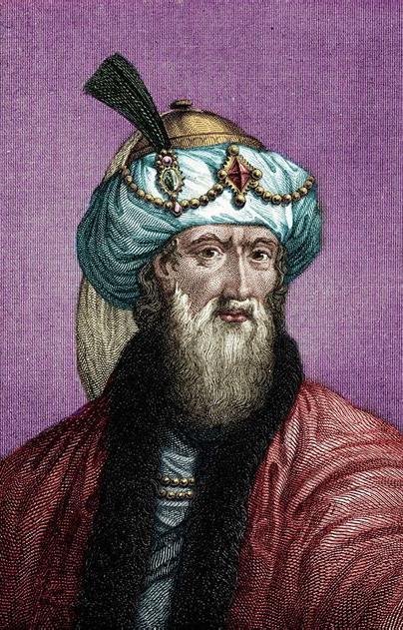
Josephus, Antiquities 13:245-247
“But the Jews, although they were content with the other conditions, did not agree to admit the garrison, because they could not associate with other people, nor converse with them…”

Slide 8
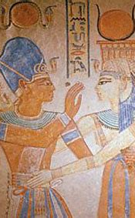
Joseph and Asenath
In an apocryphal re-telling of the story of Joseph known as Joseph and Asenath (written between 100 BC and 100 AD) we are told that “Joseph never ate with the Egyptians, for this was an abomination to him” (7:1). In fact, he refuses to even kiss the lovely Egyptian Asenath because her lips have touched unclean food.

Slide 9
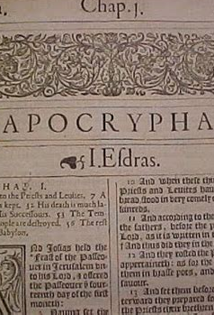
Apocrypha, Jubilees 22:16
“And you also, my son, Jacob, remember my words, and keep the commandments of Abraham, your father. Separate yourself from the Gentiles, and do not eat with them, and do not perform deeds like theirs. And do not become associates of theirs. Because their deeds are defiled, and all their ways are contaminated, and despicable, and abominable.

Slide 10
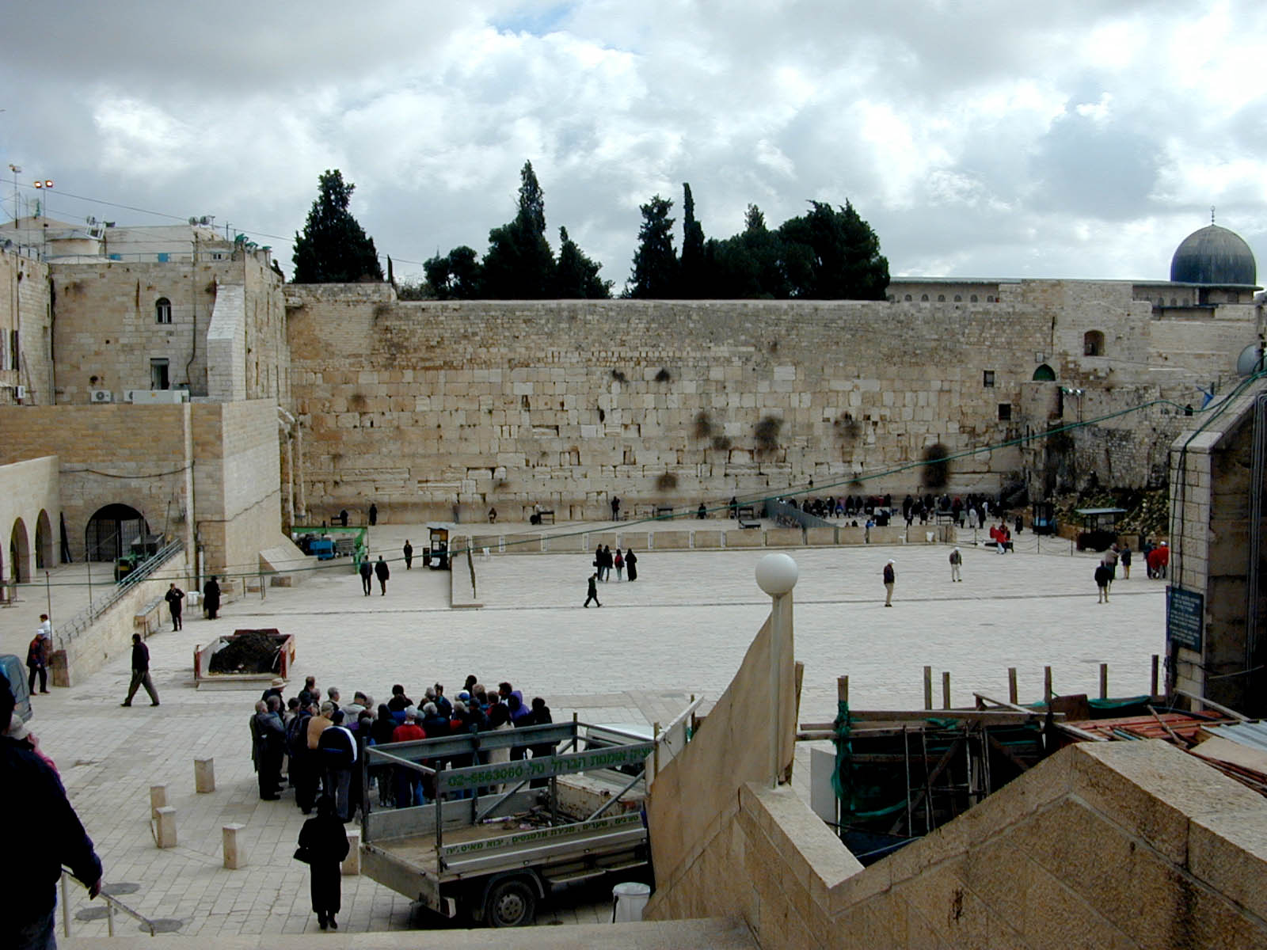

Slide 11
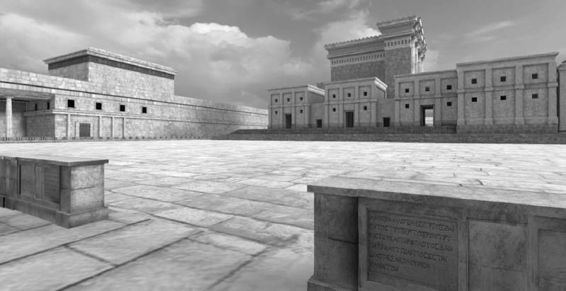

Slide 13
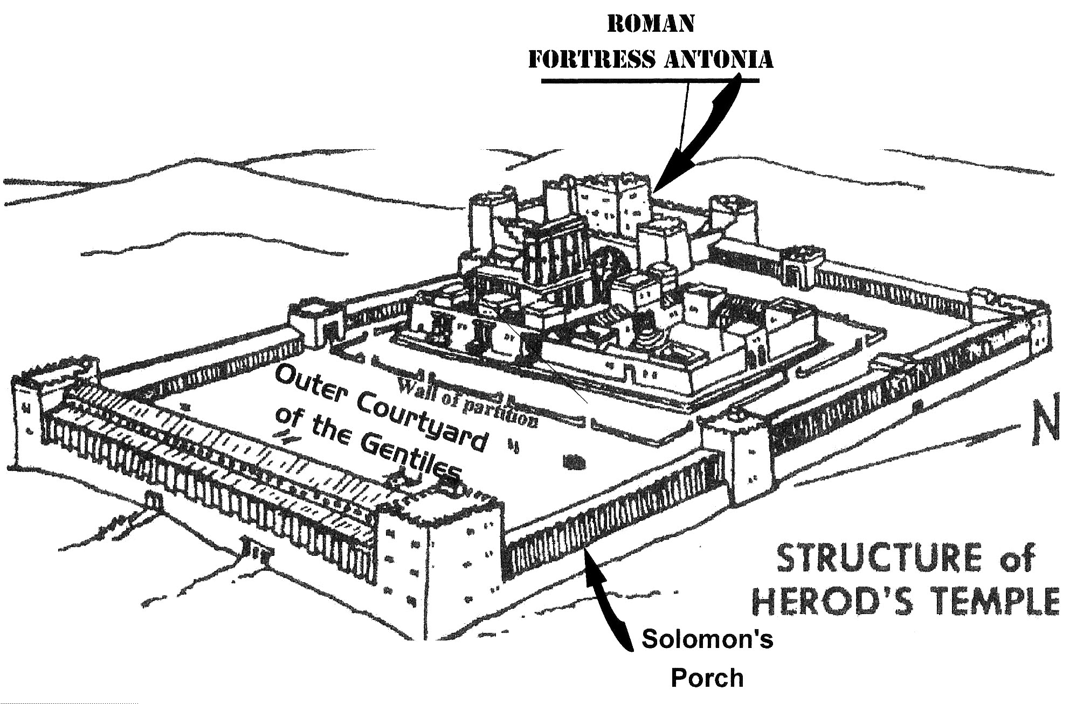

Slide 15
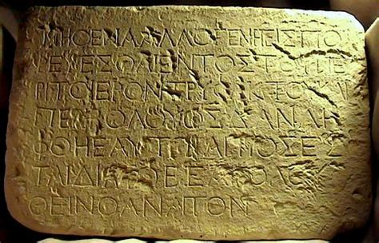

Slide 16
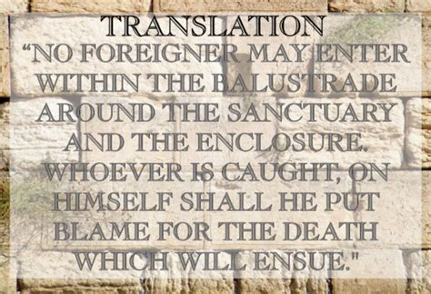

Slide 17
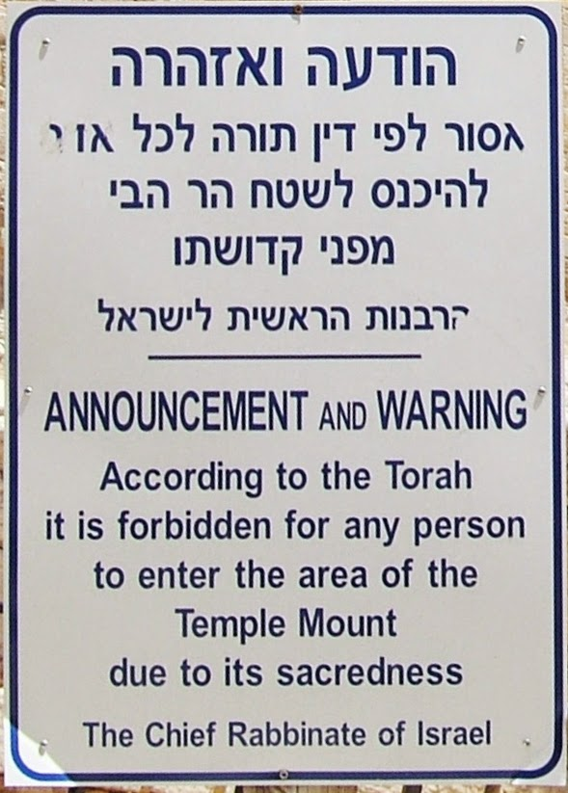

Slide 18
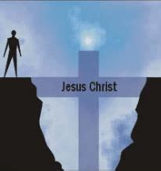
Reconciled Unto God
Ephesians 2:13
¹³ But now in Christ Jesus ye who sometimes were far off are made nigh by the blood of Christ.

Slide 19
Reconciled Unto God
Ephesians 2:13
¹³ But now in Christ Jesus ye who sometimes were far off are made nigh by the blood of Christ.

Slide 20
Reconcile:
To reestablish a close relationship between.
To settle or resolve.
To bring (oneself) to accept.

Slide 21
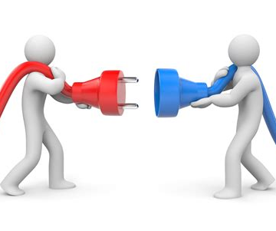
reconciled by His blood
Romans 5:10
¹⁰ For if, when we were enemies, we were reconciled to God by the death of his Son, much more, being reconciled, we shall be saved by his life.

Slide 22

reconciled by His blood
2 Corinthians 5:19
¹⁹ To wit, that God was in Christ, reconciling the world unto himself, not imputing their trespasses unto them; and hath committed unto us the word of reconciliation.

Slide 23
Redeem:
To recover ownership of by paying a specified sum.
To pay off (a promissory note, for example).
To turn in (coupons, for example) and receive something in exchange.

Slide 24
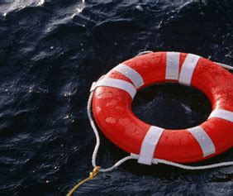
Redeemed by His blood
Colossians 1:13-14
¹³ Who hath delivered us from the power of darkness, and hath translated us into the kingdom of his dear Son:
¹⁴ In whom we have redemption through his blood, even the forgiveness of sins:

Slide 25
Justify:
To demonstrate or prove to be just, right, or valid.
To free (a human) of the guilt and penalty attached to grievous sin.
To demonstrate sufficient legal reason for (an action taken).

Slide 26
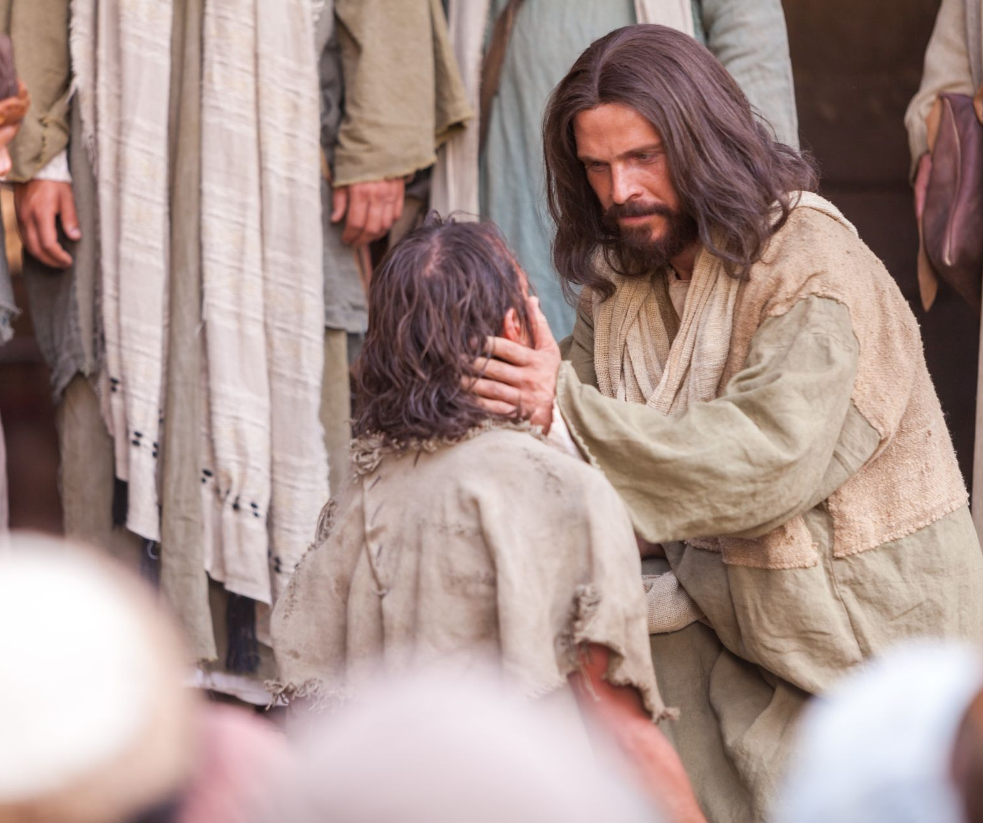
Justified by His blood
Romans 5:8-9
⁸ But God commendeth his love toward us, in that, while we were yet sinners, Christ died for us.
⁹ Much more then, being now justified by his blood, we shall be saved from wrath through him.

Slide 27
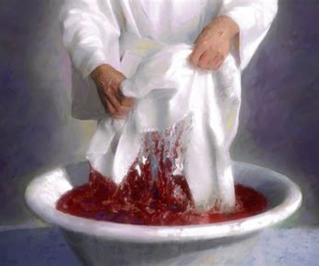
Cleansed by His blood
1 John 1:7
⁷ But if we walk in the light, as he is in the light, we have fellowship one with another, and the blood of Jesus Christ his Son cleanseth us from all sin.

Slide 28
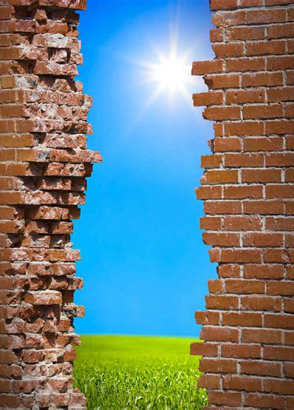
Reconciled Unto God
Ephesians 2:14
¹⁴ For he is our peace, who hath made both one, and hath broken down the middle wall of partition between us;

Slide 29
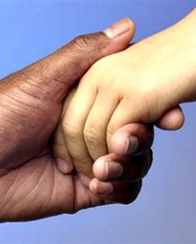
Reconciled: Galatians 3:27-29
²⁷ For as many of you as have been baptized into Christ have put on Christ.
²⁸ There is neither Jew nor Greek, there is neither bond nor free, there is neither male nor female: for ye are all one in Christ Jesus.
²⁹ And if ye be Christ's, then are ye Abraham's seed, and heirs according to the promise.

Slide 30

Reconciled Unto God: SDABC V.6 p.1009
Christ is not only the peacemaker; He Himself is peace, the bond of union and of peace. In Him all the divisions of mankind are to be abolished. In the OT the idea of peace was often linked with that of the Messiah. By being their peace before God, Christ effected peace between Jew and Gentile.

Slide 31
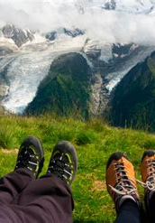
Reconciled Unto God: Isaiah 52:7
⁷ How beautiful upon the mountains are the feet of him that bringeth good tidings, that publisheth peace; that bringeth good tidings of good, that publisheth salvation; that saith unto Zion, Thy God reigneth!

Slide 32
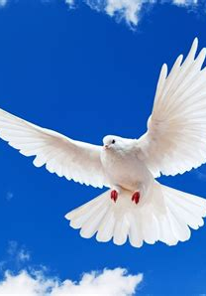
Reconciled Unto God: John 14:27
²⁷ Peace I leave with you, my peace I give unto you: not as the world giveth, give I unto you. Let not your heart be troubled, neither let it be afraid.

Slide 33

Reconciled Unto God
Ephesians 2:15
¹⁵ Having abolished in his flesh the enmity, even the law of commandments contained in ordinances; for to make in himself of twain one new man, so making peace;

Slide 34
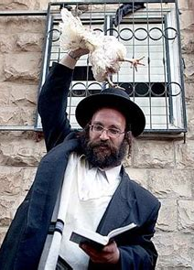
Reconciled Unto God: SDABC V.6 p. 1010
When the Jews rejected Christ, their status as the official representatives of the true religion was taken away from them and given to the Christian church. After the crucifixion it was no longer necessary for the child of God to engage in the ritual of Judaism.

Slide 35

Reconciled Unto God: SDABC V.6 p. 1010
At first the distinction between Christianity and Judaism was not too clearly understood. Many Jewish converts believed that Christianity was simply Judaism to which had been added belief in Jesus as the Messiah. They maintained that the Gentiles should be circumcised and conform to…

Slide 36
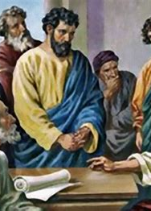
Reconciled Unto God: SDABC V.6 p. 1010
the Jewish legal system in addition to their acceptance of Jesus Christ. The Jerusalem Council convened to settle the question (Acts 15). The council ruled against the claims of these men. However, not all seemed willing to accept the decisions of the council. A strong party developed, which continued to insist…

Slide 37
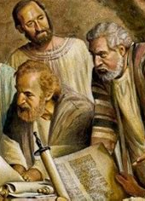
Reconciled Unto God: SDABC V.6 p.1010
that Gentiles should accept Judaism along with Christianity. A group of zealots from this party upset the churches in Galatia, a situation that gave rise to the Epistle of Paul to the Galatians, in which he clearly set forth that the system of Judaism was now obsolete.

Slide 38

Reconciled Unto God: SDABC V.6 p. 1010
This same transition from Judaism to Christianity is Paul’s theme in this present verse. Judaism, with its involved system of commands and decrees, was abolished. With their acceptance of Christ and the removal of this barrier, Gentiles who were “far off’ were “made nigh.”

Slide 39
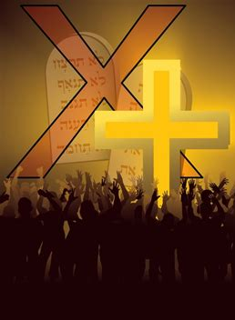
Reconciled Unto God: Quarterly Tues. July 25
Some believe that Ephesians 2:14, 15 teaches that the Ten Commandments, inclusive of the Sabbath commandment, are “abolished” or “set aside” by the cross. However, in Ephesians, Paul demonstrates profound respect for the Ten Commandments as a resource for shaping Christian discipleship.

Slide 40
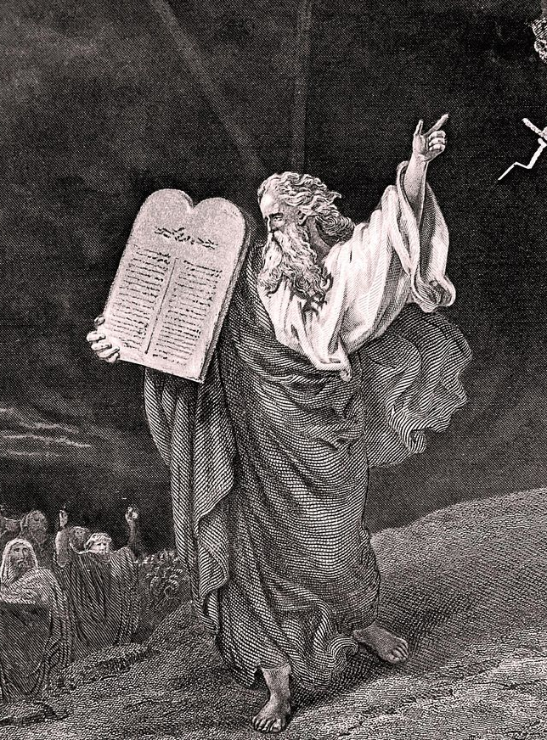
Reconciled Unto God: Romans 3:31
³¹ Do we then make void the law through faith? God forbid: yea, we establish the law.

Slide 41
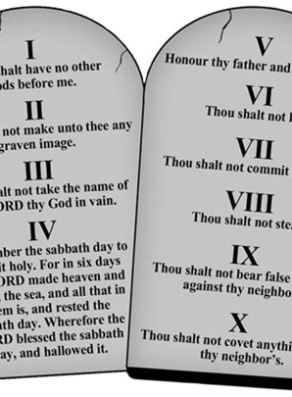
Reconciled Unto God: Romans 7:12
¹² Wherefore the law is holy, and the commandment holy, and just, and good.

Slide 42
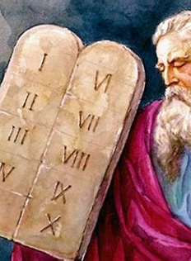
Reconciled Unto God: Matthew 5:17-18
¹⁷ Think not that I am come to destroy the law, or the prophets: I am not come to destroy, but to fulfil.
¹⁸ For verily I say unto you, Till heaven and earth pass, one jot or one tittle shall in no wise pass from the law, till all be fulfilled.

Slide 43
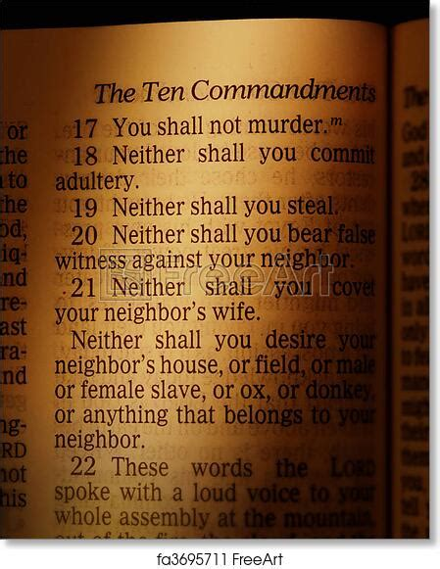
Reconciled Unto God: Early Writings p. 215
Satan could not hinder the plan of salvation. Jesus was crucified, and rose again the third day. But Satan told his angels that he would make the crucifixion and resurrection tell to his advantage. He was willing that those who professed faith in Jesus should believe that the laws regulating the Jewish sacrifices...

Slide 44
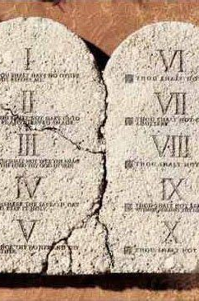
Reconciled Unto God: Early Writings p. 215
and offerings ceased at the death of Christ, if he could push them farther and make them believe that the law of ten commandments also died with Christ.
I saw that many readily yielded to this device of Satan. All heaven was moved with indignation as they saw the holy law of God trampled…

Slide 45
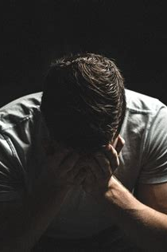
Reconciled Unto God: Early Writings p. 215
underfoot. Jesus and all the heavenly host were acquainted with the nature of God's law; they knew that He would not change or abrogate it. The hopeless condition of man after the fall caused the deepest sorrow in heaven, and moved Jesus to offer to die for the transgressors of God's holy law.

Slide 46
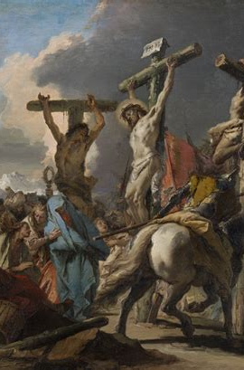
Reconciled Unto God: Early Writings p. 215
But if that law could be abrogated, man might have been saved without the death of Jesus. Consequently His death did not destroy the law of His Father, but magnified and honored it and enforced obedience to all its holy precepts.

Slide 47
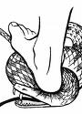
Reconciled Unto God
Ephesians 2:16
¹⁶ And that he might reconcile both unto God in one body by the cross, having slain the enmity thereby:

Slide 48
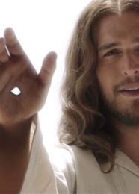
Reconciled Unto God: SDABC V.6 p. 1010, 1011
Discord in the family, party strife, national animosity, denominational jealousies, and personal tensions and conflicts — all these are healed when human beings become sons and daughters of God, and thus “one in Christ.”

Slide 49
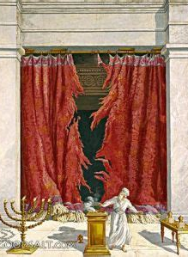
Reconciled Unto God: Early Writings p. 209
Satan rejoiced that the Jews were safe in his snare. They still continued their useless forms, their sacrifices, and ordinances. As Jesus hung upon the cross and cried, “It is finished,” the veil of the temple was rent in twain from top to bottom, to signify that God would no longer meet with the priests in the temple…

Slide 50
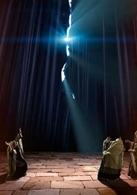
Reconciled Unto God: Early Writings p. 209
to accept their sacrifices and ordinances, and also to show that the partition wall between the Jews and the Gentiles was broken down. Jesus had made an offering of Himself for both, and if saved at all, both must believe in Him as the only offering for sin, the Saviour of the world.

Slide 51
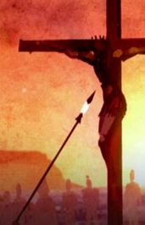
Reconciled Unto God: Early Writings p. 209
When the soldier pierced the side of Jesus as He hung upon the cross, there came out two distinct streams, one of blood, the other of water. The blood was to wash away the sins of those who should believe in His name, and the water was to represent that living water which is obtained from Jesus to give life to the believer.

Slide 52
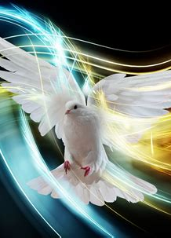
Reconciled Unto God
Ephesians 2:17
¹⁷ And came and preached peace to you which were afar off, and to them that were nigh.

Slide 53

Reconciled Unto God: Isaiah 57:19
¹⁹ I create the fruit of the lips; Peace, peace to him that is far off, and to him that is near, saith the Lord; and I will heal him.

Slide 54
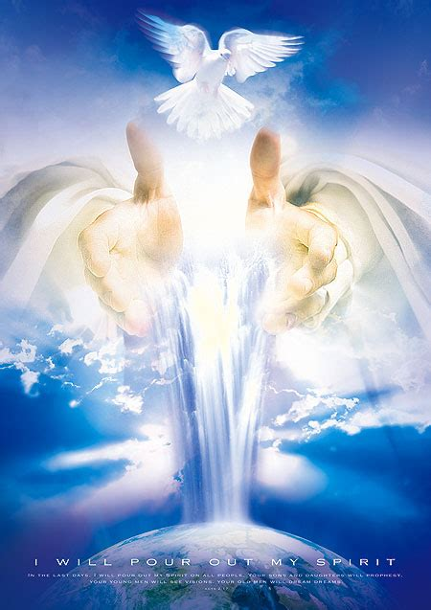
Reconciled Unto God
Ephesians 2:18
¹⁸ For through him we both have access by one Spirit unto the Father.

Slide 55
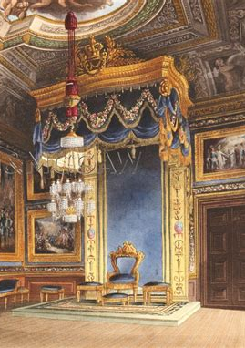
Reconciled Unto God: SDABC V.6 p.1011, 523
The three persons in the Godhead are all presented are all presented in this verse: Him (Christ), the Spirit, the Father.
The idea suggested is that of a king’s audience chamber, into which the subjects may not enter alone but must be introduced by someone in authority.

Slide 56
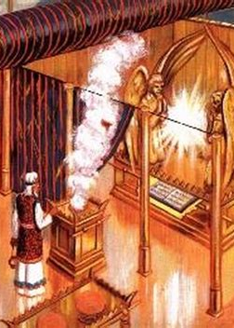
Reconciled Unto God: SDABC V.6 p.523
In this case, Jesus is the One who introduces us. We cannot enter, by ourselves, the audience chamber of God, for our sins have come between us and God and separated us from Him (Isa. 59:2).

Slide 57
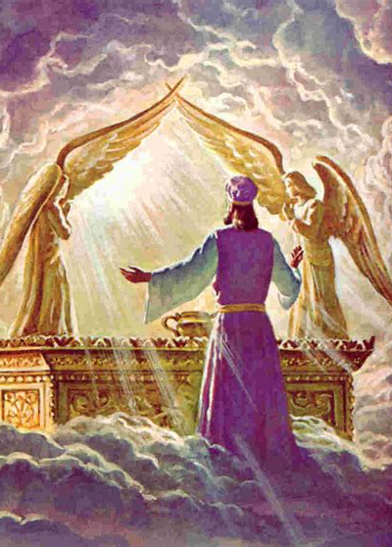
Reconciled Unto God: SDABC V.6 p. 523
But Christ, by virtue of His sacrifice, is able to bring us back to God and to introduce us to the glorious state of grace and favor in which we now stand (see Heb. 10:19).It is through Christ that we make our first approach to God, and it is through Christ that the privilege is continued to us.

Slide 58
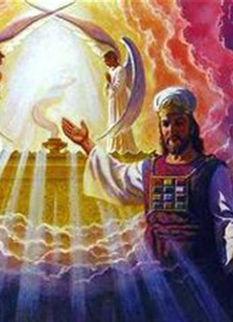
Reconciled Unto God: SDABC V.6 p.523
And this access to God, this introduction to His divine presence, is to be considered a lasting privilege. We are not brought to God for the purpose of an interview, but to remain with Him.

Slide 59
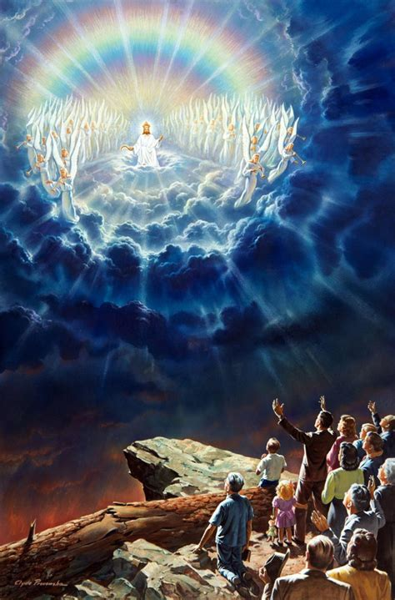
Reconciled Unto God: Zechariah 3:7
⁷ Thus saith the Lord of hosts; If thou wilt walk in my ways, and if thou wilt keep my charge, then thou shalt also judge my house, and shalt also keep my courts, and I will give thee places to walk among these that stand by.

Slide 60
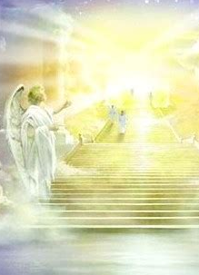
Reconciled Unto God: Hebrews 4:16
¹⁶ Let us therefore come boldly unto the throne of grace, that we may obtain mercy, and find grace to help in time of need.

Slide 61
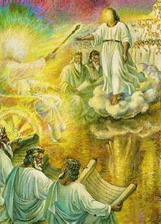
Builded Together
Ephesians 2:19
¹⁹ Now therefore ye are no more strangers and foreigners, but fellowcitizens with the saints, and of the household of God;

Slide 62
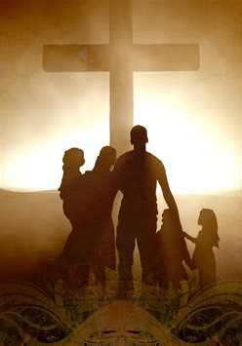
Builded Together: SDABC V.6 p.1011
The Gentiles who accept Christ have the right to all the privileges of citizenship in the new commonwealth of the Christian church. All are members of the family, kinsfolk. They have the privileges of protection, sustenance, and fellowship. God is at once King of the citizens and Father of the family. They are no longer sojourners or guests; they are now permanent residents.

Slide 63
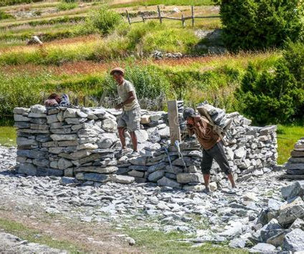
Builded Together:
SDABC V.6 P.1011
The figure changes, in a manner characteristic of Paul, from the persons in the house to the structure itself.

Slide 64
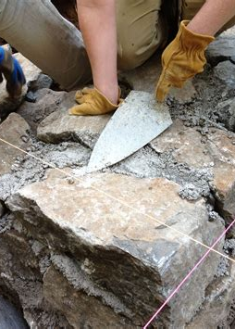
Builded Together
Ephesians 2:20
²⁰ And are built upon the foundation of the apostles and prophets, Jesus Christ himself being the chief corner stone;

Slide 65
Builded Together:
1 Corinthians 3:9-11
Ephesians 2:20-22
⁹ For we are labourers together with God: ye are God's husbandry, ye are God's building.
¹⁰ According to the grace of God which is given unto me, as a wise masterbuilder, I have laid the foundation, and another buildeth thereon. But let every man take heed how he buildeth thereupon.
¹¹ For other foundation can no man lay than that is laid, which is Jesus Christ.
²⁰ And are built upon the foundation of the apostles and prophets, Jesus Christ himself being the chief corner stone;
²¹ In whom all the building fitly framed together groweth unto an holy temple in the Lord:
²² In whom ye also are builded together for an habitation of God through the Spirit.

Slide 66
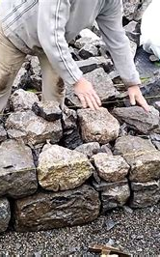
Builded Together:
Psalm 118:21-23
²¹ I will praise thee: for thou hast heard me, and art become my salvation.
²² The stone which the builders refused is become the head stone of the corner.
²³ This is the Lord's doing; it is marvellous in our eyes.

Slide 67

Builded Together: SDABC V.6 p. 1011
The prophets to whom God revealed the riches of His grace and the apostles, the special evangels of this grace, constitute the foundation. Other Christians make up the structure of the building.

Slide 68

Builded Together:
1 Peter 2:4-6
⁴ To whom coming, as unto a living stone, disallowed indeed of men, but chosen of God, and precious,
⁵ Ye also, as lively stones, are built up a spiritual house, an holy priesthood, to offer up spiritual sacrifices, acceptable to God by Jesus Christ.
⁶ Wherefore also it is contained in the scripture, Behold, I lay in Sion a chief corner stone, elect, precious: and he that believeth on him shall not be confounded.

Slide 69

Builded Together: Desire of Ages P.413
“Other foundation can no man lay than that is laid, which is Jesus Christ.” 1 Corinthians 3:11. “Upon this rock,” said Jesus, “I will build My church.” In the presence of God, and all the heavenly intelligences, in the presence of the unseen army of hell, Christ founded His church upon the living Rock.

Slide 70

Builded Together: Desire of Ages P.413
That Rock is Himself,—His own body, for us broken and bruised. Against the church built upon this foundation, the gates of hell shall not prevail.
How feeble the church appeared when Christ spoke these words!

Slide 71

Builded Together: Desire of Ages P.413
There was only a handful of believers, against whom all the power of demons and evil men would be directed; yet the followers of Christ were not to fear. Built upon the Rock of their strength, they could not be overthrown.

Slide 72

Builded Together: SDABC V.6 p. 1011
For the purpose of the figure, the cornerstone is viewed as that which holds together an edifice. Christ holds together the various parts of the spiritual house, giving shape and unity to it.

Slide 73
Builded Together: SDABC V.6 p. 1011
For the purpose of the figure, the cornerstone is viewed as that which holds together an edifice. Christ holds together the various parts of the spiritual house, giving shape and unity to it.

Slide 74

Builded Together
Ephesians 2:21
²¹ In whom all the building fitly framed together groweth unto an holy temple in the Lord:
²² In whom ye also are builded together for an habitation of God through the Spirit.

Slide 75

Builded Together: SDABC V.6 p. 1012
The church is not a pile of stones come together by accident; it has form and coherence. Each stone has its proper place. The stability of the structure depends on careful planning.

Slide 76

Builded Together: the Acts of the Apostles p.596
The apostles built upon a sure foundation, even the Rock of Ages. To this foundation they brought the stones that they quarried from the world. Not without hindrance did the builders labor. Their work was made exceedingly difficult by the opposition of the enemies of Christ. They had to contend against the bigotry, prejudice, and hatred of those who were building upon a false foundation.

Slide 77

Builded Together: the Acts of the Apostles p.596
Many who wrought as builders of the church could be likened to the builders of the wall in Nehemiah's day, of whom it is written: “They which builded on the wall, and they that bare burdens, with those that laded, everyone with one of his hands wrought in the work, and with the other hand held a weapon.” Nehemiah 4:17.

Slide 78

Builded Together: the Acts of the Apostles p.597
Kings and governors, priests and rulers, sought to destroy the temple of God. But in the face of imprisonment, torture, and death, faithful men carried the work forward; and the structure grew, beautiful and symmetrical. At times the workmen were almost blinded by the mists of superstition that settled around them. At times they were almost overpowered by the violence of their opponents. But with unfaltering faith and unfailing courage they pressed on with the work.

Slide 79

Builded Together: the Acts of the Apostles p.597
One after another the foremost of the builders fell by the hand of the enemy. Stephen was stoned; James was slain by the sword; Paul was beheaded; Peter was crucified; John was exiled. Yet the church grew. New workers took the place of those who fell, and stone after stone was added to the building. Thus slowly ascended the temple of the church of God.

Slide 80

Builded Together: the Acts of the Apostles p.597
Centuries of fierce persecution followed the establishment of the Christian church, but there were never wanting men who counted the work of building God's temple dearer than life itself. Of such it is written: “Others had trial of cruel mockings and scourgings, yea, moreover of bonds and imprisonment: they were stoned, they were sawn asunder, were tempted…

Slide 81

Builded Together: the Acts of the Apostles p.597
…were slain with the sword: they wandered about in sheepskins and goatskins; being destitute, afflicted, tormented; (of whom the world was not worthy:) they wandered in deserts, and in mountains, and in dens and caves of the earth.” Hebrews 11:36-38.

Slide 82

Builded Together: the Acts of the Apostles p.598
The enemy of righteousness left nothing undone in his effort to stop the work committed to the Lord's builders. But God “left not Himself without witness.” Acts 14:17. Workers were raised up who ably defended the faith once delivered to the saints. History bears record to the fortitude and heroism of these men. Like the apostles, many of them fell at their post, but the building of the temple went steadily forward.

Slide 83

Builded Together: the Acts of the Apostles p.598
Through the ages that have passed since the days of the apostles, the building of God's temple has never ceased. We may look back through the centuries and see the living stones of which it is composed gleaming like jets of light through the darkness of error and superstition.

Slide 84

Builded Together: the Acts of the Apostles p.598
Throughout eternity these precious jewels will shine with increasing luster, testifying to the power of the truth of God. The flashing light of these polished stones reveals the strong contrast between light and darkness, between the gold of truth and the dross of error.

Slide 85

Builded Together: the Acts of the Apostles p.599
Paul and the other apostles, and all the righteous who have lived since then, have acted their part in the building of the temple. But the structure is not yet complete. We who are living in this age have a work to do, a part to act. We are to bring to the foundation material that will stand the test of fire—

Slide 86

Builded Together: the Acts of the Apostles p.599
gold, silver, and precious stones, “polished after the similitude of a palace.” Psalm 144:12. To those who thus build for God, Paul speaks words of encouragement and warning: “If any man's work abide which he hath built thereupon, he shall receive a reward…

Slide 87

Builded Together: the Acts of the Apostles p.599
If any man's work shall be burned, he shall suffer loss: but he himself shall be saved; yet so as by fire.” 1 Corinthians 3:14, 15. The Christian who faithfully presents the word of life, leading men and women into the way of holiness and peace, is bringing to the foundation material that will endure, and in the kingdom of God he will be honored as a wise builder.

Slide 88

Builded Together: the Acts of the Apostles p.599
Of the apostles it is written, “They went forth, and preached everywhere, the Lord working with them, and confirming the word with signs following.” Mark 16:20. As Christ sent forth His disciples, so today He sends forth the members of His church. The same power that the apostles had is for them. If they will make God their strength, He will work with them, and they shall not labor in vain.

Slide 89

Builded Together: the Acts of the Apostles p.599
Let them realize that the work in which they are engaged is one upon which the Lord has placed His signet. God said to Jeremiah, “Say not, I am a child: for thou shalt go to all that I shall send thee, and whatsoever I command thee thou shalt speak. Be not afraid of their faces: for I am with thee to deliver thee.”

Slide 90

Builded Together: the Acts of the Apostles p.599
Then the Lord put forth His hand and touched His servant's mouth, saying, “Behold, I have put My words in thy mouth.” Jeremiah 1:7-9. And He bids us go forth to speak the words He gives us, feeling His holy touch upon our lips.

Slide 91

Builded Together: the Acts of the Apostles p.600
Christ has given to the church a sacred charge. Every member should be a channel through which God can communicate to the world the treasures of His grace, the unsearchable riches of Christ. There is nothing that the Saviour desires so much as agents who will…

Slide 92

Builded Together: the Acts of the Apostles p.600
…represent to the world His Spirit and His character. There is nothing that the world needs so much as the manifestation through humanity of the Saviour's love. All heaven is waiting for men and women through whom God can reveal the power of Christianity.

Slide 93

Builded Together
Revelation 18:4
⁴ And I heard another voice from heaven, saying, Come out of her, my people, that ye be not partakers of her sins, and that ye receive not of her plagues.

Slide 94
Matthew 28:18-20
¹⁸ And Jesus came and spake unto them, saying, All power is given unto me in heaven and in earth.
¹⁹ Go ye therefore, and teach all nations, baptizing them in the name of the Father, and of the Son, and of the Holy Ghost:
²⁰ Teaching them to observe all things whatsoever I have commanded you: and, lo, I am with you always, even unto the end of the world. Amen.

Slide 95
Take a few moments to prepare for Sabbath school next week!
We’ll be looking at Ephesians 3!
So read it for next week!

Slide 96
Thank you!
And Happy Sabbath!!

