Slide 1

The Mystery of the Gospel
Lesson 6, 3rd Quarter 2023
Ephesians 3:1-21

Slide 2
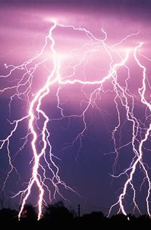
Memory Text:
Ephesians 3:20-21
²⁰ Now unto him that is able to do exceeding abundantly above all that we ask or think, according to the power that worketh in us,
²¹ Unto him be glory in the church by Christ Jesus throughout all ages, world without end. Amen.

Slide 3

Ephesians So Far:
Paul and the Ephesians
Eph. 1:1-14—Prayer of Gratitude for God’s Grace
Eph. 1:15-23—Gratitude and Joy in Christ
Eph. 2:1-10—Quickened by God’s Grace
Eph. 2:11-22—One Body by the Cross
Eph. 3—A Prisoner of Christ

Slide 4
Key Ideas: Outlining Ephesians
Opening Greeting (Eph. 1:1, 2)
Part 1: The Doctrinal Section (Eph. 1:3-3:21)
Part 2: The Practical Section (Eph. 4:1-6:20)
Closing Greeting (Ephesians 6:21-24)

Slide 5
Paraphrasing a letter:
Ephesians 3:1-21 (KJV)
Paraphrase
3 For this cause I Paul, the prisoner of Jesus Christ for you Gentiles,
3 So I, Paul, am a prisoner belonging to Christ Jesus because of my work for you Gentiles—

Slide 6
Paraphrasing a letter:
Ephesians 3:2-21 (KJV)
Paraphrase
² If ye have heard of the dispensation of the grace of God which is given me to you-ward:
(² If you’ve been paying attention, you know that God has given me a special work in showing that God has granted grace to you who are Gentiles:

Slide 7
Paraphrasing a letter:
Ephesians 3:3-21 (KJV)
Paraphrase
³ How that by revelation he made known unto me the mystery; (as I wrote afore in few words,
⁴ Whereby, when ye read, ye may understand my knowledge in the mystery of Christ)
³ And how God has shown to me His astounding and wondrous plan for mercy (which I’ve already written a little about,
⁴ So if you read what I wrote, you will recognize where I received this knowledge of God’s plan.)

Slide 8
Paraphrasing a letter:
Ephesians 3:5-21 (KJV)
Paraphrase
⁵ Which in other ages was not made known unto the sons of men, as it is now revealed unto his holy apostles and prophets by the Spirit;
⁵ In previous times, of course, God did not plainly share this plan with humanity, but now He has revealed it by the Holy Spirit to His apostles and prophets.

Slide 9
Paraphrasing a letter:
Ephesians 3:6-21 (KJV)
Paraphrase
⁶ That the Gentiles should be fellowheirs, and of the same body, and partakers of his promise in Christ by the gospel:
⁶ And this is the plan: that the Gentiles will also be heirs, with the Jews, in all the blessings of salvation. They will likewise be sons of Abraham, belonging to the body of God’s people, and joint sharers in the promise of salvation provided by Christ’s sacrifice.

Slide 10
Paraphrasing a letter:
Ephesians 3:7-21 (KJV)
Paraphrase
⁷ Whereof I was made a minister, according to the gift of the grace of God given unto me by the effectual working of his power.
⁷ God has given me the wonderful privilege of telling everyone about the gospel: that men need not be lost, that they have eternal salvation. God has gifted me with His grace and His effective power to spread this message.

Slide 11
Paraphrasing a letter:
Ephesians 3:8-21 (KJV)
Paraphrase
⁸ Unto me, who am less than the least of all saints, is this grace given, that I should preach among the Gentiles the unsearchable riches of Christ;
⁸ Just think! Though I did nothing to deserve it, and though I am the most useless Christian there is, yet I was the one chosen for this special joy of telling the Gentiles the Glad News of the endless treasures available to them in Christ;

Slide 12
Paraphrasing a letter:
Ephesians 3:9-21 (KJV)
Paraphrase
⁹ And to make all men see what is the fellowship of the mystery, which from the beginning of the world hath been hid in God, who created all things by Jesus Christ:
⁹ and to explain to everyone the fellowship that is inherent in God’s wonderful plan, which, although we did not understand it, has been God’s plan from the very beginning, since He created all things together with Jesus Christ.

Slide 13
Paraphrasing a letter:
Ephesians 3:10-21 (KJV)
Paraphrase
¹⁰ To the intent that now unto the principalities and powers in heavenly places might be known by the church the manifold wisdom of God,
¹⁰ And His reason? To show to all the inhabitants of the worlds, to all the powers of the evil one, and to everyone else, the complex depths of God’s wisdom by His church, which, being built of the righteous and redeemed, is the living example of God’s wisdom.

Slide 14
Paraphrasing a letter:
Ephesians 3:11-21 (KJV)
Paraphrase
¹¹ According to the eternal purpose which he purposed in Christ Jesus our Lord:
¹² In whom we have boldness and access with confidence by the faith of him.
¹¹ This is just the way he had always planned it through Jesus Christ our Lord.
¹² Now we can come fearlessly right into God’s presence, assured of his glad welcome when we come with Christ and trust in him.

Slide 15
Paraphrasing a letter:
Ephesians 3:13-21 (KJV)
Paraphrase
¹³ Wherefore I desire that ye faint not at my tribulations for you, which is your glory.
¹³ So I ask you not to be discouraged because of what is happening to me. My sufferings are for your benefit—for your encouragement and ultimate glory.)

Slide 16
Paraphrasing a letter:
Ephesians 3:14-21 (KJV)
Paraphrase
¹⁴ For this cause I bow my knees unto the Father of our Lord Jesus Christ,
¹⁵ Of whom the whole family in heaven and earth is named,
¹⁴ When I think of the wisdom and scope of his plan, I fall down on my knees and pray to the Father of our Lord Jesus Christ,
¹⁵ The whole family of God—in heaven and on earth—gets its identity from Him.

Slide 17
Paraphrasing a letter:
Ephesians 3:16-21 (KJV)
Paraphrase
¹⁶ That he would grant you, according to the riches of his glory, to be strengthened with might by his Spirit in the inner man;
¹⁷ That Christ may dwell in your hearts by faith; that ye, being rooted and grounded in love,
¹⁶ I ask the Father that out of his glorious, unlimited resources He will give you the mighty inner strengthening of His Holy Spirit,
¹⁷ And that Christ will live within you as you trust in Him. I pray that your life will be strong in love and be built on love.

Slide 18
Paraphrasing a letter:
Ephesians 3:18-21 (KJV)
Paraphrase
¹⁸ May be able to comprehend with all saints what is the breadth, and length, and depth, and height;
¹⁸ and may you be able to feel and understand, as all God’s children understand, how wide, how long, how deep, and how high;

Slide 19
Paraphrasing a letter:
Ephesians 3:19-21 (KJV)
Paraphrase
¹⁹ And to know the love of Christ, which passeth knowledge, that ye might be filled with all the fulness of God.
¹⁹and to experience the love of Christ, though it is so great that you can never fully know or understand it. And so at last you will be filled up with everything God has for you.

Slide 20
Paraphrasing a letter:
Ephesians 3:20-21 (KJV)
Paraphrase
²⁰ Now unto him that is able to do exceeding abundantly above all that we ask or think, according to the power that worketh in us,
²⁰ Now glory be to God, who by His mighty power at work within us is able to do far more than we would ever dare to ask or even dream of—infinitely beyond our highest prayers, desires, thoughts, or hopes.

Slide 21
Paraphrasing a letter:
Ephesians 3:21 (KJV)
Paraphrase
²¹ Unto him be glory in the church by Christ Jesus throughout all ages, world without end. Amen.
²¹ May He be given glory forever and ever through endless ages by His church through the righteousness that we find in Jesus Christ, and the eternity that is made possible through Him. Amen.

Slide 22
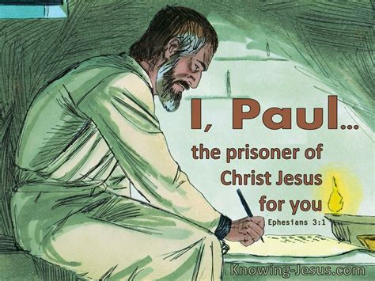
An Affirmation of Culture:

Slide 23
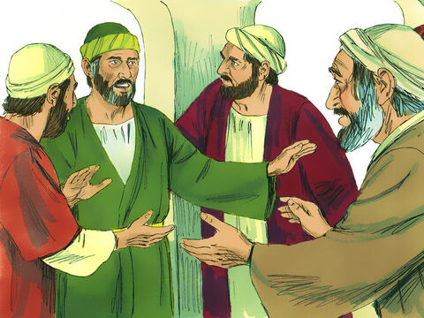
AN Affirmation of Culture:
Acts 21:18-36
¹⁸ And the day following Paul went in with us unto James; and all the elders were present.
¹⁹ And when he had saluted them, he declared particularly what things God had wrought among the Gentiles by his ministry.

Slide 24
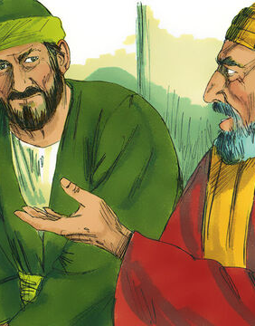
AN Affirmation of Culture:
Acts 21:20-36
²⁰ And when they heard it, they glorified the Lord, and said unto him, Thou seest, brother, how many thousands of Jews there are which believe; and they are all zealous of the law:
²¹ And they are informed of thee, that thou teachest all the Jews which are among the Gentiles to forsake Moses, saying that they ought not to circumcise their children, neither to walk after the customs.

Slide 25
AN Affirmation of Culture:
Acts 21:22-36
²² What is it therefore? the multitude must needs come together: for they will hear that thou art come.

Slide 26
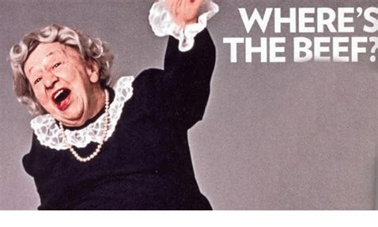
What is the concern of these Christian leaders in Jerusalem?
Of what has Paul been accused?

Slide 27
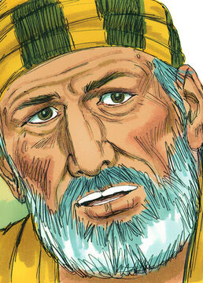
AN Affirmation of Culture:
Acts 21:23-36
²³ Do therefore this that we say to thee: We have four men which have a vow on them;
²⁴ Them take, and purify thyself with them, and be at charges with them, that they may shave their heads: and all may know that those things, whereof they were informed concerning thee, are nothing; but that thou thyself also walkest orderly, and keepest the law.

Slide 28
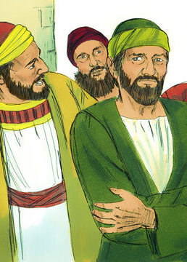
AN Affirmation of Culture:
Acts 21:25-36
²⁵ As touching the Gentiles which believe, we have written and concluded that they observe no such thing, save only that they keep themselves from things offered to idols, and from blood, and from strangled, and from fornication.

Slide 29

What do the Christian leaders in Jerusalem propose?
Why?
Do you think it’s a good idea?

Slide 30

An Affirmation of Culture: AA 403
This was the golden opportunity for all the leading brethren to confess frankly that God had wrought through Paul, and that at times they had erred in permitting the reports of his enemies to arouse their jealousy and prejudice. But instead of uniting in an effort to do justice to the one who had been injured, they gave him counsel which showed that they still cherished a feeling that Paul should be…

Slide 31
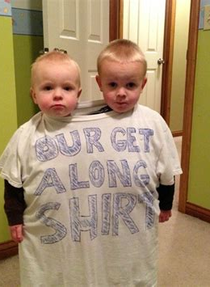
An Affirmation of Culture: AA 403
held largely responsible for the existing prejudice. They did not stand nobly in his defense, endeavoring to show the disaffected ones where they were wrong, but sought to effect a compromise by counseling him to pursue a course which in their opinion would remove all cause for misapprehension.

Slide 32

An Affirmation of Culture: AA 404
The brethren hoped that Paul, by following the course suggested, might give a decisive contradiction to the false reports concerning him. They assured him that the decision of the former council concerning the Gentile converts and the ceremonial law, still held good. But the advice now given was not consistent with that decision. The Spirit of God did not prompt this instruction; it was the fruit of cowardice.

Slide 33
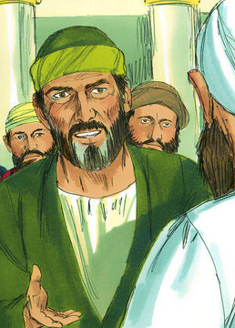
AN Affirmation of Culture:
Acts 21:26-36
²⁶ Then Paul took the men, and the next day purifying himself with them entered into the temple, to signify the accomplishment of the days of purification, until that an offering should be offered for every one of them.

Slide 34
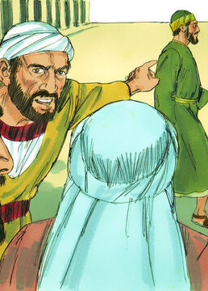
AN Affirmation of Culture:
Acts 21:27-36
²⁷ And when the seven days were almost ended, the Jews which were of Asia, when they saw him in the temple, stirred up all the people, and laid hands on him,

Slide 35
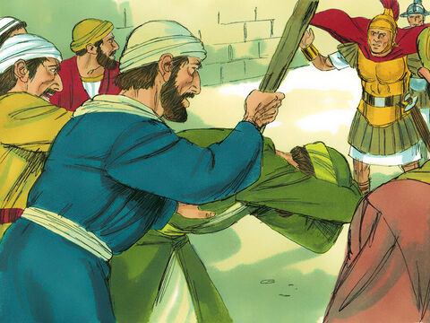
AN Affirmation of Culture:
Acts 21:28-36
²⁸ Crying out, Men of Israel, help: This is the man, that teacheth all men every where against the people, and the law, and this place: and further brought Greeks also into the temple, and hath polluted this holy place.

Slide 36
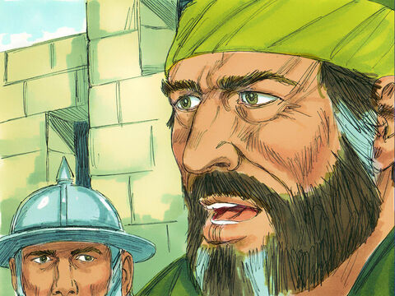
AN Affirmation of Culture:
Acts 21:28-36
²⁹ (For they had seen before with him in the city Trophimus an Ephesian, whom they supposed that Paul had brought into the temple.)
³⁰ And all the city was moved, and the people ran together: and they took Paul, and drew him out of the temple: and forthwith the doors were shut.

Slide 37
AN Affirmation of Culture:
Acts 21:31-36
³¹ And as they went about to kill him, tidings came unto the chief captain of the band, that all Jerusalem was in an uproar.
³² Who immediately took soldiers and centurions, and ran down unto them: and when they saw the chief captain and the soldiers, they left beating of Paul.

Slide 38
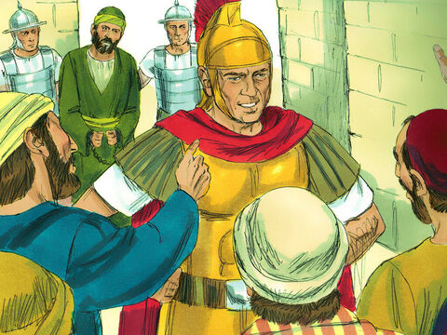
AN Affirmation of Culture:
Acts 21:33-36
³³ Then the chief captain came near, and took him, and commanded him to be bound with two chains; and demanded who he was, and what he had done.
³⁴ And some cried one thing, some another, among the multitude: and when he could not know the certainty for the tumult, he commanded him to be carried into the castle.

Slide 39
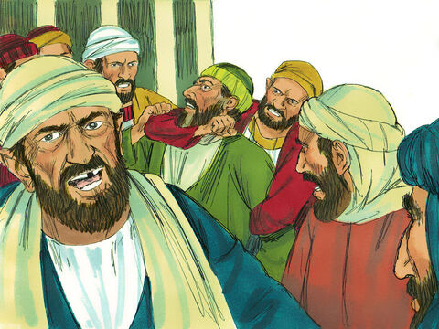
AN Affirmation of Culture:
Acts 21:35-36
³⁵ And when he came upon the stairs, so it was, that he was borne of the soldiers for the violence of the people.
³⁶ For the multitude of the people followed after, crying, Away with him.

Slide 40

What is Paul’s offense? Why are the Jewish men so angry?

Slide 41

An Affirmation of Culture: AA 405
When we think of Paul's great desire to be in harmony with his brethren, his tenderness toward the weak in the faith, his reverence for the apostles who had been with Christ, and for James, the brother of the Lord, and his purpose to become all things to all men so far as he could without sacrificing principle—

Slide 42

An Affirmation of Culture: AA 405
When we think of all this, it is less surprising that he was constrained to deviate from the firm, decided course that he had hitherto followed. But instead of accomplishing the desired object, his efforts for conciliation only precipitated the crisis, hastened his predicted sufferings, and resulted in separating him from his brethren, depriving the church of one of its strongest pillars, and bringing sorrow to Christian hearts in every land.

Slide 43
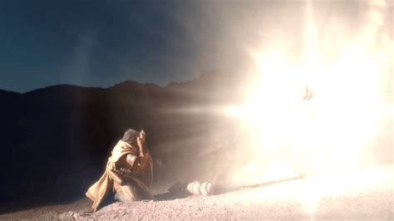
Blinded by the Light:

Slide 44
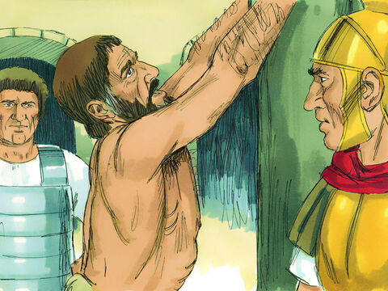
Blinded by the Light:
Acts 21:37-40
³⁷ And as Paul was to be led into the castle, he said unto the chief captain, May I speak unto thee? Who said, Canst thou speak Greek?
³⁸ Art not thou that Egyptian, which before these days madest an uproar, and leddest out into the wilderness four thousand men that were murderers?

Slide 45
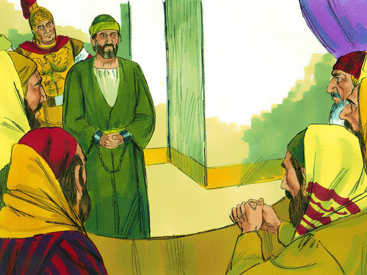
Blinded by the Light:
Acts 21:39-40
³⁹ But Paul said, I am a man which am a Jew of Tarsus, a city in Cilicia, a citizen of no mean city: and, I beseech thee, suffer me to speak unto the people.

Slide 46
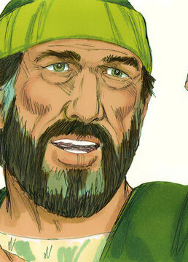
Blinded by the Light:
Acts 21:40
⁴⁰ And when he had given him licence, Paul stood on the stairs, and beckoned with the hand unto the people. And when there was made a great silence, he spake unto them in the Hebrew tongue, saying,

Slide 47
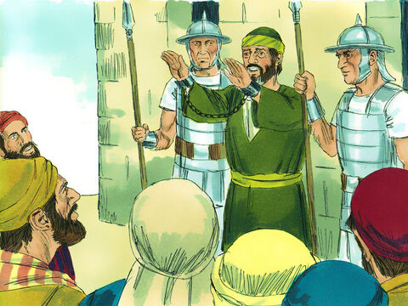
Blinded by the Light:
Acts 22:1-30
22 Men, brethren, and fathers, hear ye my defence which I make now unto you.
² (And when they heard that he spake in the Hebrew tongue to them, they kept the more silence: and he saith,)

Slide 48
Blinded by the Light:
Acts 22:3-30
³ I am verily a man which am a Jew, born in Tarsus, a city in Cilicia, yet brought up in this city at the feet of Gamaliel, and taught according to the perfect manner of the law of the fathers, and was zealous toward God, as ye all are this day.
⁴ And I persecuted this way unto the death, binding and delivering into prisons both men and women.

Slide 49
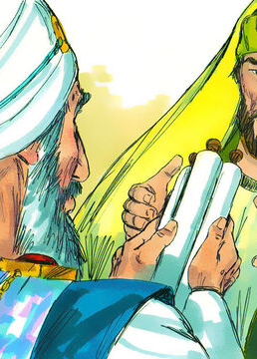
Blinded by the Light:
Acts 22:5-30
⁵ As also the high priest doth bear me witness, and all the estate of the elders: from whom also I received letters unto the brethren, and went to Damascus, to bring them which were there bound unto Jerusalem, for to be punished.

Slide 50
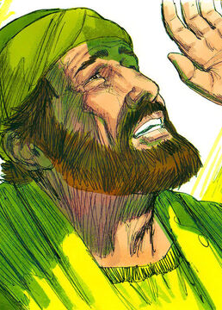
Blinded by the Light:
Acts 22:6-30
⁶ And it came to pass, that, as I made my journey, and was come nigh unto Damascus about noon, suddenly there shone from heaven a great light round about me.
⁷ And I fell unto the ground, and heard a voice saying unto me, Saul, Saul, why persecutest thou me?

Slide 51
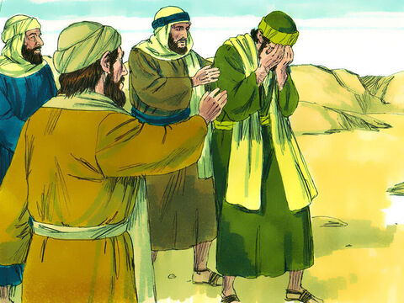
Blinded by the Light:
Acts 22:8-30
⁸ And I answered, Who art thou, Lord? And he said unto me, I am Jesus of Nazareth, whom thou persecutest.
⁹ And they that were with me saw indeed the light, and were afraid; but they heard not the voice of him that spake to me.

Slide 52
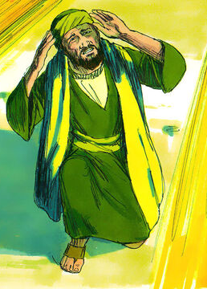
Blinded by the Light:
Acts 22:10-30
¹⁰ And I said, What shall I do, Lord? And the Lord said unto me, Arise, and go into Damascus; and there it shall be told thee of all things which are appointed for thee to do.
¹¹ And when I could not see for the glory of that light, being led by the hand of them that were with me, I came into Damascus.

Slide 53
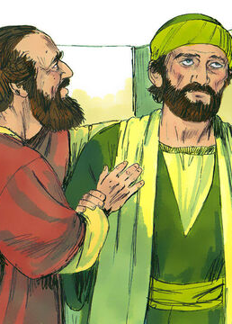
Blinded by the Light:
Acts 22:12-30
¹² And one Ananias, a devout man according to the law, having a good report of all the Jews which dwelt there,
¹³ Came unto me, and stood, and said unto me, Brother Saul, receive thy sight. And the same hour I looked up upon him.

Slide 54
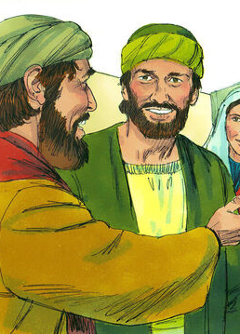
Blinded by the Light:
Acts 22:14-30
¹⁴ And he said, The God of our fathers hath chosen thee, that thou shouldest know his will, and see that Just One, and shouldest hear the voice of his mouth.
¹⁵ For thou shalt be his witness unto all men of what thou hast seen and heard.

Slide 55
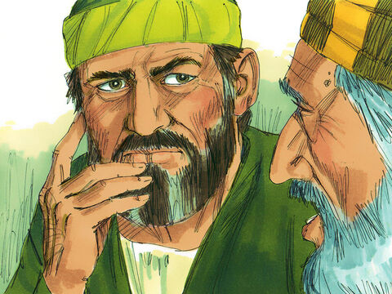
Blinded by the Light:
Acts 22:16-30
¹⁶ And now why tarriest thou? arise, and be baptized, and wash away thy sins, calling on the name of the Lord.
¹⁷ And it came to pass, that, when I was come again to Jerusalem, even while I prayed in the temple, I was in a trance;

Slide 56
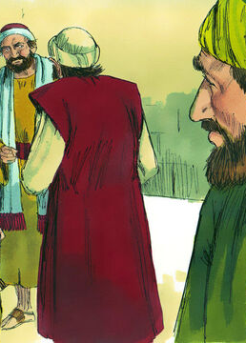
Blinded by the Light:
Acts 22:18-30
¹⁸ And saw him saying unto me, Make haste, and get thee quickly out of Jerusalem: for they will not receive thy testimony concerning me.
¹⁹ And I said, Lord, they know that I imprisoned and beat in every synagogue them that believed on thee:

Slide 57
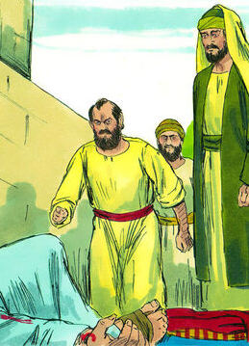
Blinded by the Light:
Acts 22:20-30
²⁰ And when the blood of thy martyr Stephen was shed, I also was standing by, and consenting unto his death, and kept the raiment of them that slew him.
²¹ And he said unto me, Depart: for I will send thee far hence unto the Gentiles.

Slide 58
Blinded by the Light:
Acts 22:22-30
²² And they gave him audience unto this word, and then lifted up their voices, and said, Away with such a fellow from the earth: for it is not fit that he should live.
²³ And as they cried out, and cast off their clothes, and threw dust into the air,

Slide 59

What (specifically) has set these Jewish folks off this time?

Slide 60
Blinded by the Light:
After receiving permission from the tribune, Paul addressed the mob in Aramaic, urging them to listen to his defense. Paul told the story of his conversion, which Luke has already narrated (9:1-19). The crowd listened until Paul said that God had sent him to the Gentiles.

Slide 61
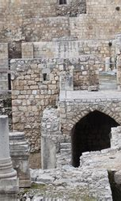
Blinded by the Light:
Over the north-west corner of the temple loomed the Antonia Fortress, built by Herod the Great. A cohort (600) of Roman troops was stationed here to maintain order. Paul was saved from lynching by the intervention of the military tribune in charge of the cohort, Claudius Lysias, probably a Greek who had bought his Roman citizenship during the reign of Claudius. The tribune tried to find out why the Jews were trying to lynch Paul.

Slide 62
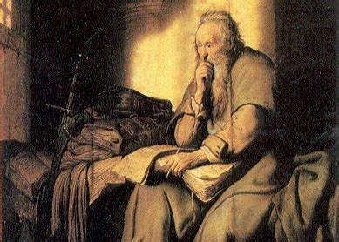
The Tribune, Claudius Lysias:

Slide 63
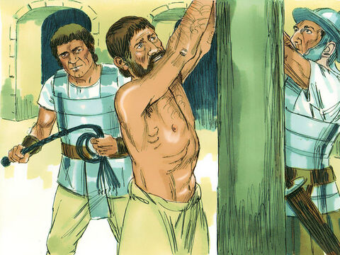
The Tribune, Claudius Lysias:
Acts 22:24-30
²⁴ The chief captain commanded him to be brought into the castle, and bade that he should be examined by scourging; that he might know wherefore they cried so against him.
²⁵ And as they bound him with thongs, Paul said unto the centurion that stood by, Is it lawful for you to scourge a man that is a Roman, and uncondemned?

Slide 64
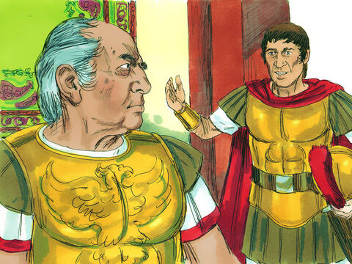
The Tribune, Claudius Lysias:
Acts 22:26-30
²⁶ When the centurion heard that, he went and told the chief captain, saying, Take heed what thou doest: for this man is a Roman.
²⁷ Then the chief captain came, and said unto him, Tell me, art thou a Roman? He said, Yea.

Slide 65
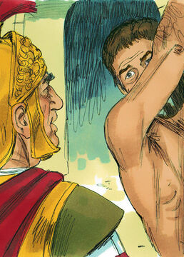
The Tribune, Claudius Lysias:
Acts 22:28-30
²⁸ And the chief captain answered, With a great sum obtained I this freedom. And Paul said, But I was free born.
²⁹ Then straightway they departed from him which should have examined him: and the chief captain also was afraid, after he knew that he was a Roman, and because he had bound him.

Slide 66
The Tribune, Claudius Lysias:
The tribune again apprehended Paul, ordering him to be taken inside the Fortress to be interrogated by scourging. The scourge was a set of leather thongs, embedded with sharp metal and bone shards, attached to a wooden handle. Roman citizens were legally exempt from the flagellum. The tribune was alarmed to find he had bound and nearly scourged a Roman citizen who was his superior.

Slide 67
The Tribune, Claudius Lysias:
Acts 22:30
³⁰ On the morrow, because he would have known the certainty wherefore he was accused of the Jews, he loosed him from his bands, and commanded the chief priests and all their council to appear, and brought Paul down, and set him before them.

Slide 68
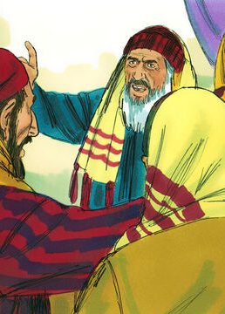
The Tribune, Claudius Lysias:
Acts 23:1-24
23 And Paul, earnestly beholding the council, said, Men and brethren, I have lived in all good conscience before God until this day.
² And the high priest Ananias commanded them that stood by him to smite him on the mouth.

Slide 69
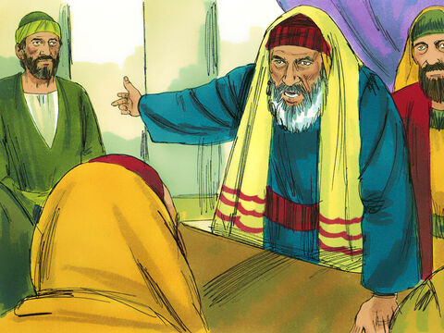
The Tribune, Claudius Lysias:
Acts 23:3-24
³ Then said Paul unto him, God shall smite thee, thou whited wall: for sittest thou to judge me after the law, and commandest me to be smitten contrary to the law?
⁴ And they that stood by said, Revilest thou God's high priest?

Slide 70
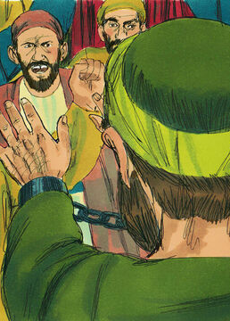
The Tribune, Claudius Lysias:
Acts 23:5-24
⁵ Then said Paul, I wist not, brethren, that he was the high priest: for it is written, Thou shalt not speak evil of the ruler of thy people.

Slide 71
The Tribune, Claudius Lysias:
Acts 23:6-24
⁶ But when Paul perceived that the one part were Sadducees, and the other Pharisees, he cried out in the council, Men and brethren, I am a Pharisee, the son of a Pharisee: of the hope and resurrection of the dead I am called in question.

Slide 72
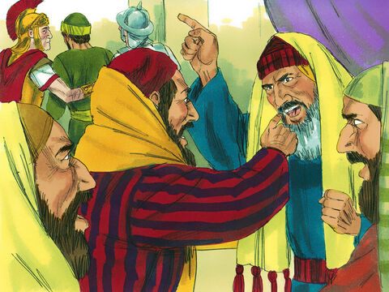
The Tribune, Claudius Lysias:
Acts 23:7-24
⁷ And when he had so said, there arose a dissension between the Pharisees and the Sadducees: and the multitude was divided.
⁸ For the Sadducees say that there is no resurrection, neither angel, nor spirit: but the Pharisees confess both.

Slide 73
The Tribune, Claudius Lysias:
Acts 23:9-24
⁹ And there arose a great cry: and the scribes that were of the Pharisees' part arose, and strove, saying, We find no evil in this man: but if a spirit or an angel hath spoken to him, let us not fight against God.
¹⁰ And when there arose a great dissension, the chief captain, fearing lest Paul should have been pulled in pieces of them, commanded the soldiers to go down, and to take him by force from among them, and to bring him into the castle.

Slide 74

The calm and learned men of the Sanhedrin appear to have lost their cool. What upset them?
Why?

Slide 75
The Tribune, Claudius Lysias:
Still trying to find out why the Jews were so upset with Paul, the tribune arranged for Paul to appear before the Sanhedrin. Taking advantage of the rivalry between Pharisees and Sadducees, Paul pitted them against each other over the issue of resurrection. The tribune again had to rescue Paul.

Slide 76
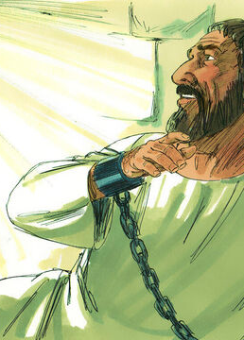
The Tribune, Claudius Lysias:
Acts 23:11-24
¹¹ And the night following the Lord stood by him, and said, Be of good cheer, Paul: for as thou hast testified of me in Jerusalem, so must thou bear witness also at Rome.
¹² And when it was day, certain of the Jews banded together, and bound themselves under a curse, saying that they would neither eat nor drink till they had killed Paul.

Slide 77
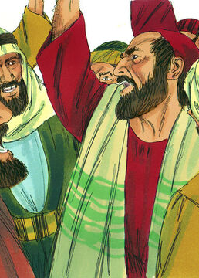
The Tribune, Claudius Lysias:
Acts 23:13-24
¹³ And they were more than forty which had made this conspiracy.
¹⁴ And they came to the chief priests and elders, and said, We have bound ourselves under a great curse, that we will eat nothing until we have slain Paul.

Slide 78
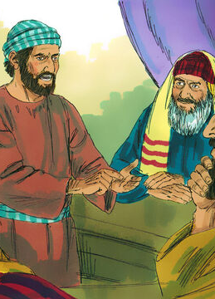
The Tribune, Claudius Lysias:
Acts 23:15-24
¹⁵ Now therefore ye with the council signify to the chief captain that he bring him down unto you to morrow, as though ye would enquire something more perfectly concerning him: and we, or ever he come near, are ready to kill him.
¹⁶ And when Paul's sister's son heard of their lying in wait, he went and entered into the castle, and told Paul.

Slide 79
The Tribune, Claudius Lysias:
Acts 23:17-24
¹⁷ Then Paul called one of the centurions unto him, and said, Bring this young man unto the chief captain: for he hath a certain thing to tell him.
¹⁸ So he took him, and brought him to the chief captain, and said, Paul the prisoner called me unto him, and prayed me to bring this young man unto thee, who hath something to say unto thee.

Slide 80
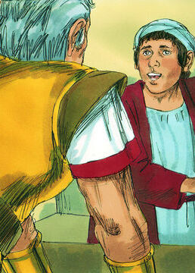
The Tribune, Claudius Lysias:
Acts 23:19-24
¹⁹ Then the chief captain took him by the hand, and went with him aside privately, and asked him, What is that thou hast to tell me?
²⁰ And he said, The Jews have agreed to desire thee that thou wouldest bring down Paul to morrow into the council, as though they would enquire somewhat of him more perfectly.

Slide 81
The Tribune, Claudius Lysias:
Acts 23:21-24
²¹ But do not thou yield unto them: for there lie in wait for him of them more than forty men, which have bound themselves with an oath, that they will neither eat nor drink till they have killed him: and now are they ready, looking for a promise from thee.
²² So the chief captain then let the young man depart, and charged him, See thou tell no man that thou hast shewed these things to me.

Slide 82
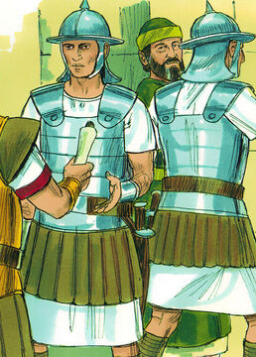
The Tribune, Claudius Lysias:
Acts 23:23-24
²³ And he called unto him two centurions, saying, Make ready two hundred soldiers to go to Caesarea, and horsemen threescore and ten, and spearmen two hundred, at the third hour of the night;
²⁴ And provide them beasts, that they may set Paul on, and bring him safe unto Felix the governor.

Slide 83
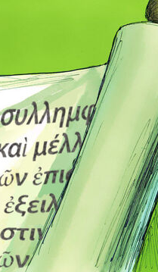
The Tribune, Claudius Lysias:
Paul’s nephew warned Paul and then the tribune of a plot against Paul’s life. The tribune sent Paul to Caesarea under heavy protection. At Antipatris (35 miles from Jerusalem, 27 from Caesarea), the soldiers turned back, while the cavalry escorted Paul to Caesarea. They took with them a letter from the tribune to the governor, explaining that Paul was a Roman citizen and seemed without guilt under Roman law.

Slide 84
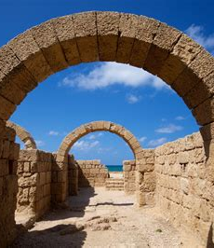
The Governor Felix:
Caesarea was the seat of the governor of the Roman province of Judea, who was under the authority of the imperial legate of Syria.

Slide 85
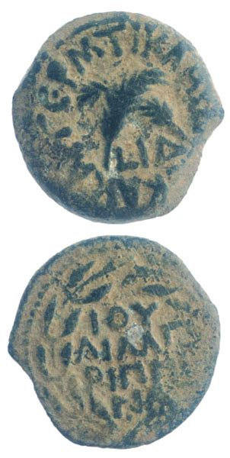
The Governor Felix:
Antonius Felix, procurator AD 52-59, was a freedman of emperor Claudius’ mother Antonia. He owed his position to his brother Pallas, also a freedman of Antonia, who had great influence at Claudius’ court. Felix “exercised the power of a king with the mind of a slave” (Tacitus, Histories 5.9). His third wife was Drusilla, a Jewess, the youngest daughter of Agrippa I. In 59 Felix was recalled, due to his heavy-handed response to Jewish-Gentile strife in Caesarea.

Slide 86
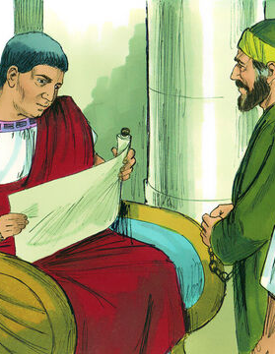
The Governor Felix:
The governor Felix kept Paul in Herod’s judgement hall until his accusers could arrive to make their case. The high priest Ananias, with the “orator” Tertullus and certain supporters, accuse Paul of “sedition” and rabble-rousing. Paul explains that he’s been arrested for believing in the resurrection o the dead. Felix defers judgment, waiting for the tribune Claudius Lysias’ testimony.

Slide 87
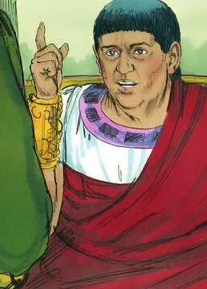
The Governor Felix:
Acts 24:23-27
²³ And he commanded a centurion to keep Paul, and to let him have liberty, and that he should forbid none of his acquaintance to minister or come unto him.

Slide 88
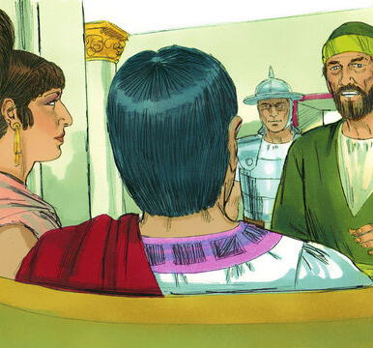
The Governor Felix:
Acts 24:24-27
²⁴ And after certain days, when Felix came with his wife Drusilla, which was a Jewess, he sent for Paul, and heard him concerning the faith in Christ.
²⁵ And as he reasoned of righteousness, temperance, and judgment to come, Felix trembled, and answered, Go thy way for this time; when I have a convenient season, I will call for thee.

Slide 89
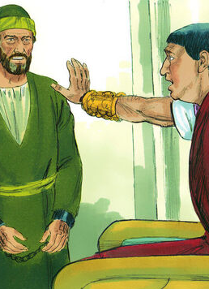
The Governor Felix:
Acts 24:26-27
²⁶ He hoped also that money should have been given him of Paul, that he might loose him: wherefore he sent for him the oftener, and communed with him.
²⁷ But after two years Porcius Festus came into Felix' room: and Felix, willing to shew the Jews a pleasure, left Paul bound.

Slide 90
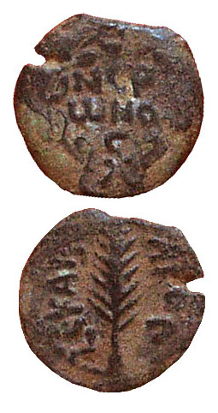
The Governor Festus:
Porcius Festus (60-62) was a much better governor than Felix. He died in office. The newly-arrived Festus, on a familiarization trip to Jerusalem, refused the Jewish leaders’ request to bring Paul to Jerusalem, instead summoning them to Caesarea. After a brief hearing in Caesarea, Festus wanted to take Paul to Jerusalem in order to earn favor with the Jews. It was in order to avoid this fate that Paul appealed to Caesar (Nero).

Slide 91

The Governor Festus:
Acts 25:1-12
25 Now when Festus was come into the province, after three days he ascended from Caesarea to Jerusalem.
² Then the high priest and the chief of the Jews informed him against Paul, and besought him,

Slide 92
The Governor Festus:
Acts 25:3-12
³ And desired favour against him, that he would send for him to Jerusalem, laying wait in the way to kill him.
⁴ But Festus answered, that Paul should be kept at Caesarea, and that he himself would depart shortly thither.

Slide 93

The Governor Festus:
Acts 25:5-12
⁵ Let them therefore, said he, which among you are able, go down with me, and accuse this man, if there be any wickedness in him.
⁶ And when he had tarried among them more than ten days, he went down unto Caesarea; and the next day sitting on the judgment seat commanded Paul to be brought.

Slide 94

The Governor Festus:
Acts 25:7-12
⁷ And when he was come, the Jews which came down from Jerusalem stood round about, and laid many and grievous complaints against Paul, which they could not prove.
⁸ While he answered for himself, Neither against the law of the Jews, neither against the temple, nor yet against Caesar, have I offended any thing at all.

Slide 95
The Governor Festus:
Acts 25:9-12
⁹ But Festus, willing to do the Jews a pleasure, answered Paul, and said, Wilt thou go up to Jerusalem, and there be judged of these things before me?
¹⁰ Then said Paul, I stand at Caesar's judgment seat, where I ought to be judged: to the Jews have I done no wrong, as thou very well knowest.

Slide 96

The Governor Festus:
Acts 25:11-12
¹¹ For if I be an offender, or have committed any thing worthy of death, I refuse not to die: but if there be none of these things whereof these accuse me, no man may deliver me unto them. I appeal unto Caesar.
¹² Then Festus, when he had conferred with the council, answered, Hast thou appealed unto Caesar? unto Caesar shalt thou go.

Slide 97

The Governor Festus:
Paul had the opportunity to speak with Festus quite often. He was even introduced to other dignitaries, particularly King Agrippa. But eventually, Paul was sent to Rome aboard a ship under the authority of one Julius, a centurion. The journey was interrupted when the ship was wrecked on an island. But with Paul’s prophetic guidance, all the passengers survived.

Slide 98

The Governor Festus:
On the island, Paul was bitten by a poisonous snake, but showed no symptoms, which caused the “barbarians” to think he was a god. Paul was able to pray for the father of the chief man of the island, and God healed him along with many others who were sick. Finally the island people gave Paul and his shipmates many honors and necessary supplies to continue their voyage.

Slide 99

On the Road to Rome:

Slide 100

On the Road to Rome:
Acts 28:16-31
¹⁶ And when we came to Rome, the centurion delivered the prisoners to the captain of the guard: but Paul was suffered to dwell by himself with a soldier that kept him.

Slide 101

On the Road to Rome:
Acts 28:17-31
¹⁷ And it came to pass, that after three days Paul called the chief of the Jews together: and when they were come together, he said unto them, Men and brethren, though I have committed nothing against the people, or customs of our fathers, yet was I delivered prisoner from Jerusalem into the hands of the Romans.

Slide 102

On the Road to Rome:
Acts 28:18-31
¹⁸ Who, when they had examined me, would have let me go, because there was no cause of death in me.
¹⁹ But when the Jews spake against it, I was constrained to appeal unto Caesar; not that I had ought to accuse my nation of.

Slide 103

On the Road to Rome:
Acts 28:20-31
²⁰ For this cause therefore have I called for you, to see you, and to speak with you: because that for the hope of Israel I am bound with this chain.
²¹ And they said unto him, We neither received letters out of Judaea concerning thee, neither any of the brethren that came shewed or spake any harm of thee.

Slide 104

On the Road to Rome:
Acts 28:22-31
²² But we desire to hear of thee what thou thinkest: for as concerning this sect, we know that every where it is spoken against.
²³ And when they had appointed him a day, there came many to him into his lodging; to whom he expounded and testified the kingdom of God, persuading them concerning Jesus, both out of the law of Moses, and out of the prophets, from morning till evening.

Slide 105

On the Road to Rome:
Acts 28:24-31
²⁴ And some believed the things which were spoken, and some believed not.
²⁵ And when they agreed not among themselves, they departed, after that Paul had spoken one word, Well spake the Holy Ghost by Esaias the prophet unto our fathers,

Slide 106

On the Road to Rome:
Acts 28:24-31
²⁶ Saying, Go unto this people, and say, Hearing ye shall hear, and shall not understand; and seeing ye shall see, and not perceive:
²⁷ For the heart of this people is waxed gross, and their ears are dull of hearing, and their eyes have they closed; lest they should see with their eyes, and hear with their ears, and understand with their heart, and should be converted, and I should heal them.

Slide 107

On the Road to Rome:
Acts 28:24-31
²⁸ Be it known therefore unto you, that the salvation of God is sent unto the Gentiles, and that they will hear it.
²⁹ And when he had said these words, the Jews departed, and had great reasoning among themselves.

Slide 108

On the Road to Rome:
Acts 28:24-31
³⁰ And Paul dwelt two whole years in his own hired house, and received all that came in unto him,
³¹ Preaching the kingdom of God, and teaching those things which concern the Lord Jesus Christ, with all confidence, no man forbidding him.

Slide 109

AFTER ACTS:
Luke concludes his account in Acts at this point. But Paul’s astounding journey isn’t quite finished yet!

Slide 110

After Acts:
On July 19, AD 64, a fire broke out in Rome, destroying ten of the city’s fourteen districts. The inferno raged for six days and seven nights, flaring sporadically for an additional three days. Though the fire probably started accidentally in an oil warehouse, rumors swirled that Emperor Nero had ordered the inferno so he could rebuild Rome according to his own liking.

Slide 111

After Acts:
Nero tried to stamp out the rumors—but to no avail. He then looked for a scapegoat. And since two of the districts untouched by the fire were disproportionally populated by Christians, he shifted the blame to them.
Roman historian Tacitus tells the story:

Slide 112

After Acts:
“ But all human efforts, all the lavish gifts of the emperor, and the propitiations of the gods, did not banish the sinister belief that the conflagration was the result of an order. Consequently, to get rid of the report, Nero fastened the guilt and inflicted the most exquisite tortures on a class hated for their abominations, called Christians by the populace. . . .

Slide 113

After Acts:
Accordingly, an arrest was first made of all who pleaded guilty [of being Christians]; then, upon their information, an immense multitude was convicted, not so much for the crime of firing the city, as of hatred against mankind.”
Paul was re-arrested during the persecution following the fire.

Slide 114

After Acts:
This imprisonment was much harsher. Tradition suggests that Paul was imprisoned in the Mamertine Prison. Few prisons were as dim, dank, and dirty as the lower chamber Paul is thought to have occupied. Known in earlier times as the Tullianum dungeon, its “neglect, darkness, and stench” gave it “a hideous and terrifying appearance,” according to Roman historian Sallust.

Slide 115

After Acts:
Paul wrote four Captivity Epistles: Ephesians, Philippians, Colossians, Philemon; the last three are from Paul and Timothy. Some scholars argue that Paul wrote these letters while imprisoned in Ephesus or in Caesarea Maritima (57-59), but there is no evidence of an Ephesian imprisonment.

Slide 116

After Acts:
The majority opinion is that they were written while Paul was under house arrest in Rome (60-62) pending his trial before Caesar.
Yet Paul’s mention of his “suffering” (Eph. 3:13), and his later mention of his chains (Eph. 6:20), make it possible that he is not under relatively comfortable house arrest, but is in prison.
And his final trial is coming up.

Slide 117
After Acts: Acts of the Apostles, p.493
Paul before Nero—how striking the contrast! The haughty monarch before whom the man of God was to answer for his faith, had reached the height of earthly power, authority, and wealth, as well as the lowest depths of crime and iniquity. In power and greatness he stood unrivaled. … The name of Nero made the world tremble. To incur his displeasure was to lose property, liberty, life; and his frown was more to be dreaded than a pestilence.

Slide 118
After Acts: Acts of the Apostles, p.494
The Jews brought against Paul the old charges of sedition and heresy, and both Jews and Romans accused him of instigating the burning of the city. While these accusations were urged against him, Paul preserved an unbroken serenity. The people and the judges looked at him in surprise. They had been present at many trials and had looked upon many a criminal, but never had they seen a man wear a look of such holy calmness as did the prisoner before them. …When he was permitted to speak in his own behalf, all listened with eager interest.

Slide 119
After Acts: Acts of the Apostles, p.494
Once more Paul has an opportunity to uplift before a wondering multitude the banner of the cross. As he gazes upon the throng before him,—Jews, Greeks, Romans, with strangers from many lands,—his soul is stirred with an intense desire for their salvation. He loses sight of the occasion, of the perils surrounding him, of the terrible fate that seems so near. He sees only Jesus, the Intercessor, pleading before God in behalf of sinful men.

Slide 120
After Acts: Acts of the Apostles, p.494
With more than human eloquence and power, Paul presents the truths of the gospel. He points his hearers to the sacrifice made for the fallen race. He declares that an infinite price has been paid for man's redemption. Provision has been made for him to share the throne of God. By angel messengers, earth is connected with heaven, and all the deeds of men, whether good or evil, are open to the eye of Infinite Justice.

Slide 121
After Acts: Acts of the Apostles, p.500
Through his long term of service, Paul had never faltered in his allegiance to his Saviour. Wherever he was—whether before scowling Pharisees, or Roman authorities; before the furious mob at Lystra, or the convicted sinners in the Macedonian dungeon; whether reasoning with the panic-stricken sailors on the shipwrecked vessel, or standing alone before Nero to plead for his life—he had never been ashamed of the cause he was advocating.

Slide 122
After Acts: Acts of the Apostles, p.500
The one great purpose of his Christian life had been to serve Him whose name had once filled him with contempt; and from this purpose no opposition or persecution had been able to turn him aside. His faith, made strong by effort and pure by sacrifice, upheld and strengthened him.

Slide 123

AFTER ACTS: 2 TIMOTHY 4:7-8
⁷ I have fought a good fight, I have finished my course, I have kept the faith:
⁸ Henceforth there is laid up for me a crown of righteousness, which the Lord, the righteous judge, shall give me at that day: and not to me only, but unto all them also that love his appearing.

Slide 124
Paraphrasing a letter:
Ephesians 3:1-21 (KJV)
Paraphrase
3 For this cause I Paul, the prisoner of Jesus Christ for you Gentiles,
3 So I, Paul, am a prisoner belonging to Christ Jesus because of my work for you Gentiles—

Slide 125
Paraphrasing a letter:
Ephesians 3:2-21 (KJV)
Paraphrase
² If ye have heard of the dispensation of the grace of God which is given me to you-ward:
(² If you’ve been paying attention, you know that God has given me a special work in showing that God has granted grace to you who are Gentiles:

Slide 126
Paraphrasing a letter:
Ephesians 3:3-21 (KJV)
Paraphrase
³ How that by revelation he made known unto me the mystery; (as I wrote afore in few words,
⁴ Whereby, when ye read, ye may understand my knowledge in the mystery of Christ)
³ And how God has shown to me His astounding and wondrous plan for mercy (which I’ve already written a little about,
⁴ So if you read what I wrote, you will recognize where I received this knowledge of God’s plan.)

Slide 127
Paraphrasing a letter:
Ephesians 3:5-21 (KJV)
Paraphrase
⁵ Which in other ages was not made known unto the sons of men, as it is now revealed unto his holy apostles and prophets by the Spirit;
⁵ In previous times, of course, God did not plainly share this plan with humanity, but now He has revealed it by the Holy Spirit to His apostles and prophets.

Slide 128
Paraphrasing a letter:
Ephesians 3:6-21 (KJV)
Paraphrase
⁶ That the Gentiles should be fellowheirs, and of the same body, and partakers of his promise in Christ by the gospel:
⁶ And this is the plan: that the Gentiles will also be heirs, with the Jews, in all the blessings of salvation. They will likewise be sons of Abraham, belonging to the body of God’s people, and joint sharers in the promise of salvation provided by Christ’s sacrifice.

Slide 129
Paraphrasing a letter:
Ephesians 3:7-21 (KJV)
Paraphrase
⁷ Whereof I was made a minister, according to the gift of the grace of God given unto me by the effectual working of his power.
⁷ God has given me the wonderful privilege of telling everyone about the gospel: that men need not be lost, that they have eternal salvation. God has gifted me with His grace and His effective power to spread this message.

Slide 130
Paraphrasing a letter:
Ephesians 3:8-21 (KJV)
Paraphrase
⁸ Unto me, who am less than the least of all saints, is this grace given, that I should preach among the Gentiles the unsearchable riches of Christ;
⁸ Just think! Though I did nothing to deserve it, and though I am the most useless Christian there is, yet I was the one chosen for this special joy of telling the Gentiles the Glad News of the endless treasures available to them in Christ;

Slide 131
Paraphrasing a letter:
Ephesians 3:9-21 (KJV)
Paraphrase
⁹ And to make all men see what is the fellowship of the mystery, which from the beginning of the world hath been hid in God, who created all things by Jesus Christ:
⁹ and to explain to everyone the fellowship that is inherent in God’s wonderful plan, which, although we did not understand it, has been God’s plan from the very beginning, since He created all things together with Jesus Christ.

Slide 132
Paraphrasing a letter:
Ephesians 3:10-21 (KJV)
Paraphrase
¹⁰ To the intent that now unto the principalities and powers in heavenly places might be known by the church the manifold wisdom of God,
¹⁰ And His reason? To show to all the inhabitants of the worlds, to all the powers of the evil one, and to everyone else, the complex depths of God’s wisdom by His church, which, being built of the righteous and redeemed, is the living example of God’s wisdom.

Slide 133
Paraphrasing a letter:
Ephesians 3:11-21 (KJV)
Paraphrase
¹¹ According to the eternal purpose which he purposed in Christ Jesus our Lord:
¹² In whom we have boldness and access with confidence by the faith of him.
¹¹ This is just the way he had always planned it through Jesus Christ our Lord.
¹² Now we can come fearlessly right into God’s presence, assured of his glad welcome when we come with Christ and trust in him.

Slide 134
Paraphrasing a letter:
Ephesians 3:13-21 (KJV)
Paraphrase
¹³ Wherefore I desire that ye faint not at my tribulations for you, which is your glory.
¹³ So I ask you not to be discouraged because of what is happening to me. My sufferings are for your benefit—for your encouragement and ultimate glory.)

Slide 135
Paraphrasing a letter:
Ephesians 3:14-21 (KJV)
Paraphrase
¹⁴ For this cause I bow my knees unto the Father of our Lord Jesus Christ,
¹⁵ Of whom the whole family in heaven and earth is named,
¹⁴ When I think of the wisdom and scope of his plan, I fall down on my knees and pray to the Father of our Lord Jesus Christ,
¹⁵ The whole family of God—in heaven and on earth—gets its identity from Him.

Slide 136
Paraphrasing a letter:
Ephesians 3:16-21 (KJV)
Paraphrase
¹⁶ That he would grant you, according to the riches of his glory, to be strengthened with might by his Spirit in the inner man;
¹⁷ That Christ may dwell in your hearts by faith; that ye, being rooted and grounded in love,
¹⁶ I ask the Father that out of his glorious, unlimited resources He will give you the mighty inner strengthening of His Holy Spirit,
¹⁷ And that Christ will live within you as you trust in Him. I pray that your life will be strong in love and be built on love.

Slide 137
Paraphrasing a letter:
Ephesians 3:18-21 (KJV)
Paraphrase
¹⁸ May be able to comprehend with all saints what is the breadth, and length, and depth, and height;
¹⁸ and may you be able to feel and understand, as all God’s children understand, how wide, how long, how deep, and how high;

Slide 138
Paraphrasing a letter:
Ephesians 3:19-21 (KJV)
Paraphrase
¹⁹ And to know the love of Christ, which passeth knowledge, that ye might be filled with all the fulness of God.
¹⁹and to experience the love of Christ, though it is so great that you can never fully know or understand it. And so at last you will be filled up with everything God has for you.

Slide 139
Paraphrasing a letter:
Ephesians 3:20-21 (KJV)
Paraphrase
²⁰ Now unto him that is able to do exceeding abundantly above all that we ask or think, according to the power that worketh in us,
²⁰ Now glory be to God, who by His mighty power at work within us is able to do far more than we would ever dare to ask or even dream of—infinitely beyond our highest prayers, desires, thoughts, or hopes.

Slide 140
Paraphrasing a letter:
Ephesians 3:21 (KJV)
Paraphrase
²¹ Unto him be glory in the church by Christ Jesus throughout all ages, world without end. Amen.
²¹ May He be given glory forever and ever through endless ages by His church through the righteousness that we find in Jesus Christ, and the eternity that is made possible through Him. Amen.

Slide 141

Memory Text:
Ephesians 3:20-21
²⁰ Now unto him that is able to do exceeding abundantly above all that we ask or think, according to the power that worketh in us,
²¹ Unto him be glory in the church by Christ Jesus throughout all ages, world without end. Amen.

Slide 142
Take a few moments to prepare for Sabbath school next week!
We’ll be looking at the First part of Ephesians 4,
That is, Ephesians 4:1-16

Slide 143
Thank you!
And Happy Sabbath!!

