Slide 1

The Unified Body of Christ
Lesson 7, 3rd Quarter 2023
Ephesians 4:1-16

Slide 2
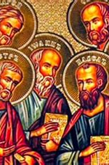
Memory Text:
Ephesians 4:11-12
¹¹ And he gave some, apostles; and some, prophets; and some, evangelists; and some, pastors and teachers;
¹² For the perfecting of the saints, for the work of the ministry, for the edifying of the body of Christ:

Slide 3

Ephesians So Far:
Paul and the Ephesians
Eph. 1:1-14—Prayer of Gratitude for God’s Grace
Eph. 1:15-23—Gratitude and Joy in Christ
Eph. 2:1-10—Quickened by God’s Grace
Eph. 2:11-22—One Body by the Cross
Eph. 3—A Prisoner of Christ
Eph. 4:1-16—One Accord

Slide 4
Key Ideas: Outlining Ephesians
Opening Greeting (Eph. 1:1, 2)
Part 1: The Doctrinal Section (Eph. 1:3-3:21)
Part 2: The Practical Section (Eph. 4:1-6:20)
Closing Greeting (Ephesians 6:21-24)

Slide 5

To Walk Worthy:

Slide 6
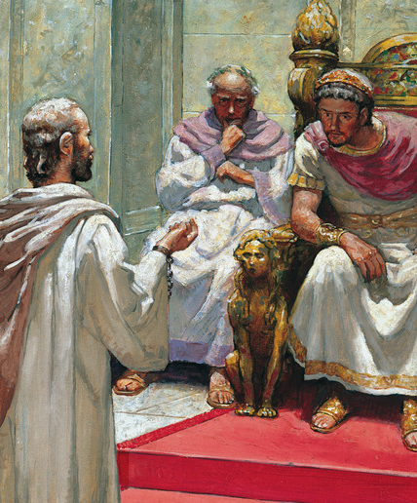
To Walk Worthy: AA 493
Paul before Nero—how striking the contrast! The haughty monarch before whom the man of God was to answer for his faith, had reached the height of earthly power, authority, and wealth, as well as the lowest depths of crime and iniquity.

Slide 7
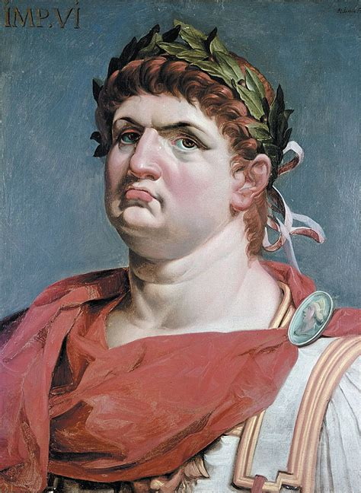
To Walk Worthy: AA 493
In power and greatness he stood unrivaled. … The name of Nero made the world tremble. To incur his displeasure was to lose property, liberty, life; and his frown was more to be dreaded than a pestilence.

Slide 8
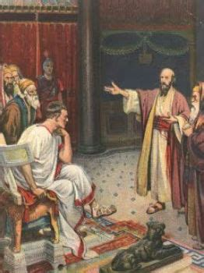
To Walk Worthy: AA 494
Once more Paul has an opportunity to uplift before a wondering multitude the banner of the cross. As he gazes upon the throng before him,—Jews, Greeks, Romans, with strangers from many lands,—his soul is stirred with an intense desire for their salvation.

Slide 9
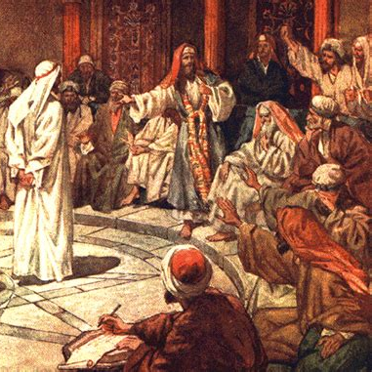
To Walk Worthy: AA 494
He loses sight of the occasion, of the perils surrounding him, of the terrible fate that seems so near. He sees only Jesus, the Intercessor, pleading before God in behalf of sinful men.

Slide 10
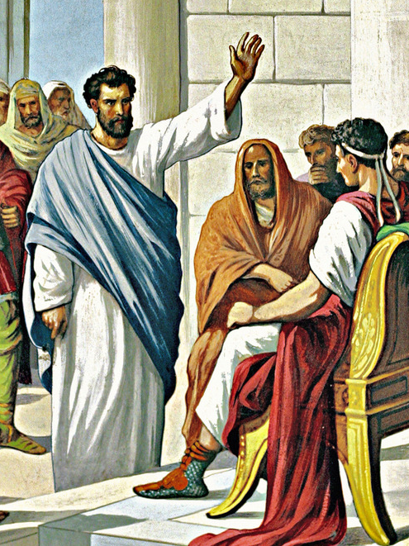
To Walk Worthy: AA 494
With more than human eloquence and power, Paul presents the truths of the gospel. He points his hearers to the sacrifice made for the fallen race. He declares that an infinite price has been paid for man's redemption.

Slide 11
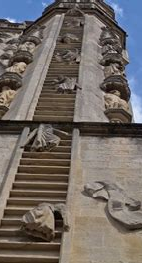
To Walk Worthy: AA 494
Provision has been made for him to share the throne of God. By angel messengers, earth is connected with heaven, and all the deeds of men, whether good or evil, are open to the eye of Infinite Justice.

Slide 12
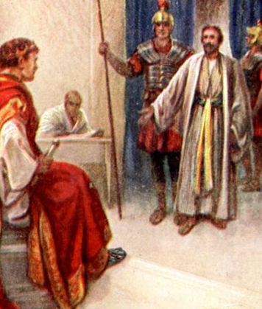
To Walk Worthy: AA 495
Thus pleads the advocate of truth. Faithful among the faithless, loyal among the disloyal, he stands as God's representative, and his voice is as a voice from heaven. There is no fear, no sadness, no discouragement in word or look.

Slide 13
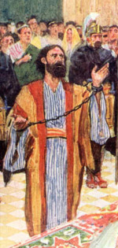
To Walk Worthy: AA 495
Strong in a consciousness of innocence, clothed in the panoply of truth, he rejoices that he is a son of God. His words are as a shout of victory above the roar of battle.

Slide 14
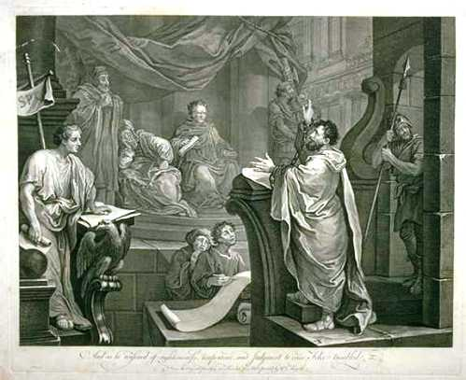
To Walk Worthy: AA 495
He declares the cause to which he has devoted his life, to be the only cause that can never fail. Though he may perish, the gospel will not perish. God lives, and His truth will triumph.
Many who that day looked upon him “saw his face as it had been the face of an angel.” Acts 6:15.

Slide 15
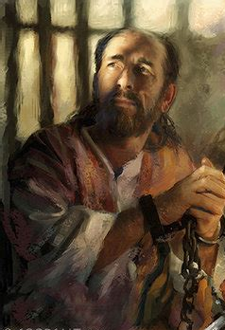
To Walk Worthy: AA 498
From the judgment hall of Caesar, Paul returned to his cell, realizing that he had gained for himself only a brief respite. He knew that his enemies would not rest until they had compassed his death.

Slide 16
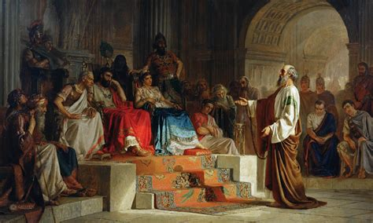
To Walk Worthy: AA 498
But he knew also that for a time truth had triumphed. To have proclaimed a crucified and risen Saviour before the vast crowd who had listened to him, was in itself a victory.

Slide 17
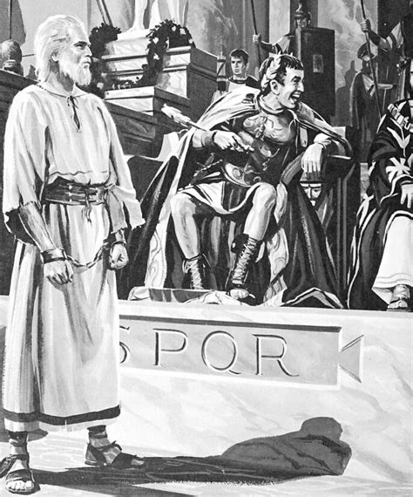
To Walk Worthy: AA 498
That day a work had begun which would grow and strengthen, and which Nero and all other enemies of Christ would seek in vain to hinder or destroy.

Slide 18

To Walk Worthy:
Ephesians 4:1-16
4 I therefore, the prisoner of the Lord, beseech you that ye walk worthy of the vocation wherewith ye are called,

Slide 19

To Walk Worthy: Colossians 1:9-12
⁹ For this cause we also, since the day we heard it, do not cease to pray for you, and to desire that ye might be filled with the knowledge of his will in all wisdom and spiritual understanding;
¹⁰ That ye might walk worthy of the Lord unto all pleasing, being fruitful in every good work, and increasing in the knowledge of God;

Slide 20

To Walk Worthy: Colossians 1:11-12
¹¹ Strengthened with all might, according to his glorious power, unto all patience and longsuffering with joyfulness;
¹² Giving thanks unto the Father, which hath made us meet to be partakers of the inheritance of the saints in light:

Slide 21
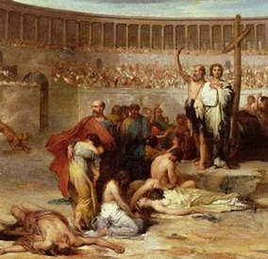
To Walk Worthy: AA 507
What the church needs in these days of peril is an army of workers who, like Paul, have educated themselves for usefulness, who have a deep experience in the things of God, and who are filled with earnestness and zeal.

Slide 22
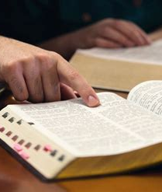
To Walk Worthy: AA 507
Sanctified, self-sacrificing men are needed; men who will not shun trial and responsibility; men who are brave and true; men in whose hearts Christ is formed “the hope of glory,” and who with lips touched with holy fire will “preach the word.”

Slide 23
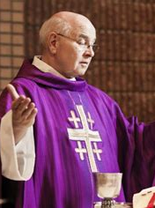
To Walk Worthy: AA 507
For want of such workers the cause of God languishes, and fatal errors, like a deadly poison, taint the morals and blight the hopes of a large part of the human race.

Slide 24
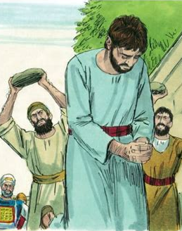
To Walk Worthy: AA 507
As the faithful, toilworn standard-bearers are offering up their lives for the truth's sake, who will come forward to take their place? Will our young men accept the holy trust at the hands of their fathers?

Slide 25
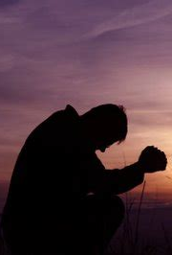
To Walk Worthy: AA 507
Are they preparing to fill the vacancies made by the death of the faithful? Will the apostle's charge be heeded, the call to duty be heard, amidst the incitements to selfishness and ambition that allure the youth?

Slide 26
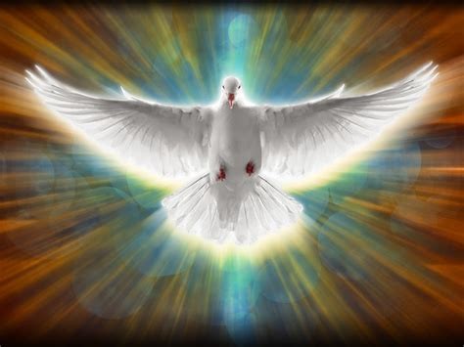
Unity of the Spirit:

Slide 27
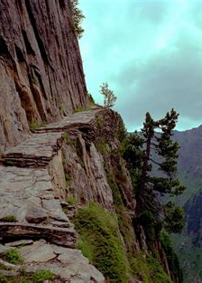
Unity of the Spirit:
Ephesians 4:1-16
4 I therefore, the prisoner of the Lord, beseech you that ye walk worthy of the vocation wherewith ye are called,

Slide 28
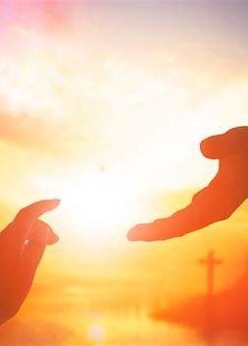
Unity of the Spirit:
Ephesians 4:2-16
² With all lowliness and meekness, with longsuffering, forbearing one another in love;

Slide 29
Unity of the Spirit:
Ephesians 4:2-16
² With all lowliness and meekness, with longsuffering, forbearing one another in love;
The idea of “lowliness” has not been held in high esteem among non-Christian peoples. In non-Biblical writings this “lowliness” signified abasement of spirit, but Christianity elevated it to mean unselfish humility. The command to walk with all lowliness is a hard saying to the unconverted heart, for it runs counter to every natural impulse of the human spirit.

Slide 30
Unity of the Spirit:
Ephesians 4:2-16
² With all lowliness and meekness, with longsuffering, forbearing one another in love;
The man who is meek accepts the injuries done to him by others, submits to the trials of life. This quality is essential to the unity of the church; without it division soon appears. Meekness, being the denial of self-assertion even under provocation, cannot exist without lowliness.

Slide 31
Unity of the Spirit:
Ephesians 4:2-16
² With all lowliness and meekness, with longsuffering, forbearing one another in love;
Patience under any and all conditions and for all reasons is the essence of long-suffering. It is a divine quality that God has exhibited throughout the millenniums of the sinful rebellion of angels and men, and it comes to man as a fruit of the Spirit.

Slide 32
Unity of the Spirit:
Ephesians 4:2-16
Bearing with someone, exhibiting tolerance and restraint in the face of provocation, is the essence of forbearance. This quality is manifested only by a heart that loves.
² With all lowliness and meekness, with longsuffering, forbearing one another in love;

Slide 33
Unity of the Spirit:
Ephesians 4:2-16
² With all lowliness and meekness, with longsuffering, forbearing one another in love;

Slide 34

Unity of the Spirit:
Ephesians 4:3-16
³ Endeavouring to keep the unity of the Spirit in the bond of peace.

Slide 35

Unity of the Spirit: SDABC V.6 p.1021
Paul is assuming that this condition of oneness, given by the Spirit, already exists, and he is urging that it be maintained by the exercise of the virtues he has enumerated. Now he proceeds to seven particulars in which this unity consists, a unity of which peace is the “bond,” or “band.”

Slide 36

Oneness:

Slide 37

Oneness:
1 Corinthians 12:4-7
⁴ Now there are diversities of gifts, but the same Spirit.
⁵ And there are differences of administrations, but the same Lord.
⁶ And there are diversities of operations, but it is the same God which worketh all in all.
⁷ But the manifestation of the Spirit is given to every man to profit withal.

Slide 38
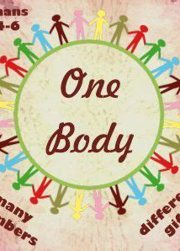
Oneness:
1 Corinthians 12:20-22
²⁰ But now are they many members, yet but one body.
²¹ And the eye cannot say unto the hand, I have no need of thee: nor again the head to the feet, I have no need of you.
²² Nay, much more those members of the body, which seem to be more feeble, are necessary:

Slide 39
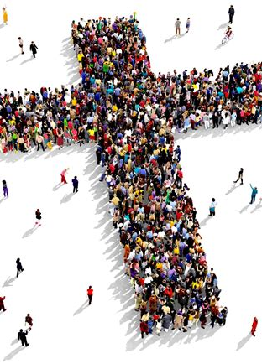
Oneness:
1 Corinthians 12:27-31
²⁷ Now ye are the body of Christ, and members in particular.
²⁸ And God hath set some in the church, first apostles, secondarily prophets, thirdly teachers, after that miracles, then gifts of healings, helps, governments, diversities of tongues.

Slide 40
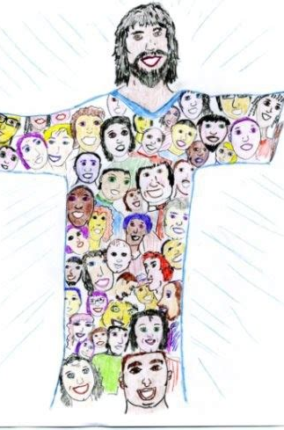
Oneness:
1 Corinthians 12:29-31
²⁹ Are all apostles? are all prophets? are all teachers? are all workers of miracles?
³⁰ Have all the gifts of healing? do all speak with tongues? do all interpret?
³¹ But covet earnestly the best gifts: and yet shew I unto you a more excellent way.

Slide 41
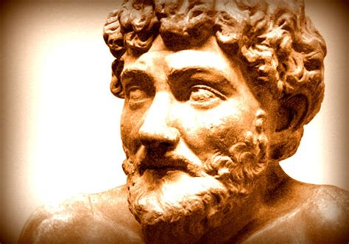
Aesop’s Fables:
Aesop's Fables is a collection of fables credited to Aesop, a slave and storyteller who lived in ancient Greece between 620 and 564 BC.
Apollonius of Tyana, a 1st-century philosopher, is recorded as having said about Aesop:
“like those who dine well off the plainest dishes, he made use of humble incidents to teach great truths, and after serving up a story he adds to it the advice to do a thing or not to do it.”

Slide 42
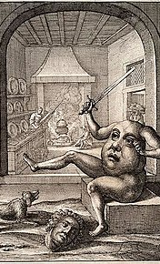

The Belly and the Members (A Fable of Aesop)
In former days, it happened that the Members of the human body, taking some offence at the conduct of the Belly, resolved no longer to grant it the usual supplies. The Tongue first, in a seditious speech, aggravated their grievances;

Slide 43

The Belly and the Members (A Fable of Aesop)
and after highly extolling the activity and diligence of the Hands and Feet, set forth how hard and unreasonable it was, that the fruits of their labour should be squandered away upon the insatiable cravings of a fat and indolent paunch.

Slide 44

The Belly and the Members (A Fable of Aesop)
In short, it was resolved for the future to strike off his allowance, and let him shift for himself as well as he could. The Hands protested they would not lift a Finger to keep him from starving; and the Teeth refused to chew a single morsel more for his use.

Slide 45
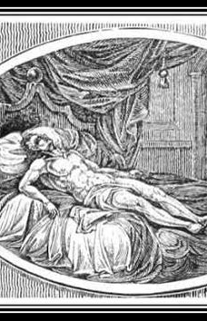
The Belly and the Members (A Fable of Aesop)
In this distress, the Belly remonstrated with them in vain; for during the clamour of passion the voice of reason is always disregarded. This unnatural resolution was kept as long as any thing of that kind can be kept, which was, until each of…

Slide 46
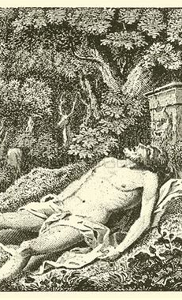
The Belly and the Members (A Fable of Aesop)
… the rebel members pined away to the skin and bone, and could hold out no longer. Then they found there was no doing without the Belly, and, that idle and insatiable as it seemed, it contributed as much to the welfare of all the other parts, as they in their several stations did towards its maintenance.

Slide 47
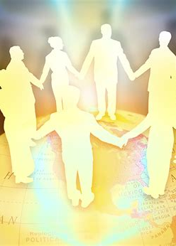
Oneness:
Ephesians 4:4-16
⁴ There is one body, and one Spirit, even as ye are called in one hope of your calling;

Slide 48
Oneness:
Ephesians 4:4-16
⁴ There is one body, and one Spirit, even as ye are called in one hope of your calling;
There are many members, but one body. The Christian is not a solitary pilgrim; he belongs to a vital organism, the family of God. This unit replaces the state, the club, and even the human family as the supreme object of his attachment.

Slide 49
Oneness:
Ephesians 4:4-16
⁴ There is one body, and one Spirit, even as ye are called in one hope of your calling;
This is the same Spirit referred to in v. 3, the same Spirit who was the regenerating power recommended to Nicodemus (John 3 :5). All the gifts, fruits, and graces of the Christian life come from the Spirit’s dwelling in the personal lives of believers and thus in the church.

Slide 50
Oneness:
Ephesians 4:4-16
Hope sprang up with God’s appeal to men’s hearts — the hope of salvation and the appearance of the Lord (Titus 2:13). It is the hope of the final consummation of the kingdom that gives a substantial basis for peace and joy, courage and good cheer. The Spirit validates this hope, which, in turn, unifies believers and becomes, indeed, a “lively hope” (1 Peter 1 :3). Such a hope necessarily leads to the transformed life, for “every man that hath this hope in him purifieth himself’ (1 John 3:3).
⁴ There is one body, and one Spirit, even as ye are called in one hope of your calling;

Slide 51
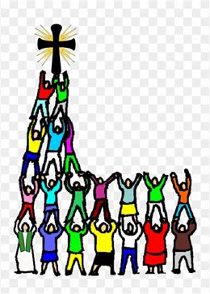
Oneness:
Ephesians 4:5-16
⁵ One Lord, one faith, one baptism,
⁶ One God and Father of all, who is above all, and through all, and in you all.

Slide 52
Oneness:
Ephesians 4:5-16
⁵ One Lord, one faith, one baptism,
⁶ One God and Father of all, who is above all, and through all, and in you all.
Here is the supreme object of loyalty. Those who give complete submission and allegiance to the same Lord are not at enmity with one another. He is Lord by creation and by re-creation, and all authority rests with Him. Utter surrender to Him is a requirement, but such a surrender may be the Christian’s greatest joy. “We do know that we know him, if we keep his commandments” (1 John 2:3).

Slide 53
Oneness:
Ephesians 4:5-16
⁵ One Lord, one faith, one baptism,
⁶ One God and Father of all, who is above all, and through all, and in you all.
Baptism by water aptly symbolizes death and resurrection. Also, it signifies cleansing and separation, and is a public announcement of union with the body of Christ. Those thus initiated into the visible church grow together into the likeness of Christ’s death and resurrection.

Slide 54
Oneness:
Ephesians 4:5-16
The common Father is the source of all unity. The greatest fact that the human heart can discover is that God is a father who can be trusted, one who is a friend to man. Through the ages men have yearned for someone to whom they might turn in what appeared to be an unfriendly world.
⁵ One Lord, one faith, one baptism,
⁶ One God and Father of all, who is above all, and through all, and in you all.

Slide 55
Oneness:
Ephesians 4:5-16
The common Father is the source of all unity. The greatest fact that the human heart can discover is that God is a father who can be trusted, one who is a friend to man. Through the ages men have yearned for someone to whom they might turn in what appeared to be an unfriendly world.
⁵ One Lord, one faith, one baptism,
⁶ One God and Father of all, who is above all, and through all, and in you all.

Slide 56
Oneness:
Ephesians 4:5-16
⁵ One Lord, one faith, one baptism,
⁶ One God and Father of all, who is above all, and through all, and in you all.

Slide 57

Gifts of God:

Slide 58

Gifts of God:
Ephesians 4:7-16
⁷ But unto every one of us is given grace according to the measure of the gift of Christ.
⁸ Wherefore he saith, When he ascended up on high, he led captivity captive, and gave gifts unto men.

Slide 59
Gifts of God:
Ephesians 4:7-16
There is manifest order and design in the allotment of work and talent to each person. Every gift contributes its value to the unity of the church. No room is left for pride on the part of those who have large gifts, because more will be expected of them; neither is there place for jealousy on the part of those who have received lesser talents, because they are responsible for developing only what they have.
⁷ But unto every one of us is given grace according to the measure of the gift of Christ.
⁸ Wherefore he saith, When he ascended up on high, he led captivity captive, and gave gifts unto men.

Slide 60
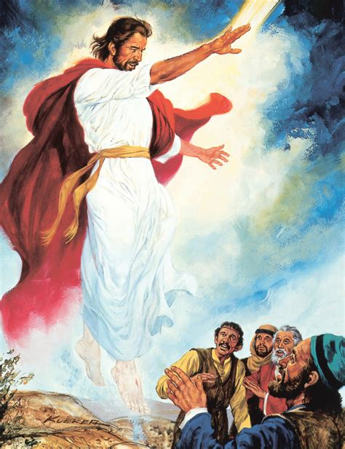
Gifts of God:
Ephesians 4:9-16
⁹ (Now that he ascended, what is it but that he also descended first into the lower parts of the earth?
¹⁰ He that descended is the same also that ascended up far above all heavens, that he might fill all things.)

Slide 61
Gifts of God:
Ephesians 4:9-16
⁹ (Now that he ascended, what is it but that he also descended first into the lower parts of the earth?
¹⁰ He that descended is the same also that ascended up far above all heavens, that he might fill all things.)
Paul sees the church as the body of Christ filled with the fullness of God (Eph. 3:19). Christ has poured His fullness, His qualities, into the church, filling it with holy life; indeed, with abounding life.

Slide 62
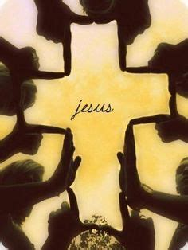
Gifts of God:
Ephesians 4:11-16
¹¹ And he gave some, apostles; and some, prophets; and some, evangelists; and some, pastors and teachers;

Slide 63
Gifts of God:
Ephesians 4:11-16
¹¹ And he gave some, apostles; and some, prophets; and some, evangelists; and some, pastors and teachers;
Paul is not so much saying that certain gifts were given to men in order that they might become apostles, as that they who had received the gift were themselves being given to the church. The church was receiving to its ministry men who were properly equipped for their functions.

Slide 64

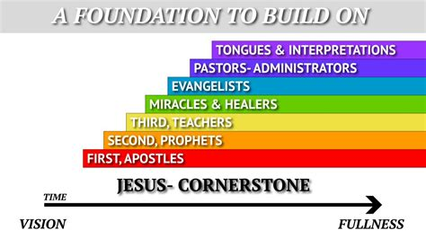
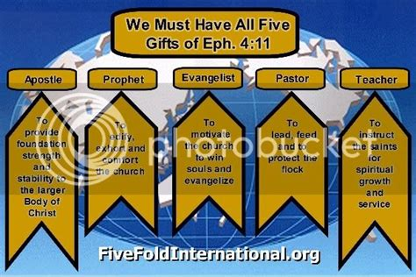

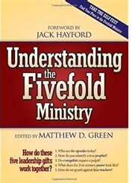

A stunning number of books, programs, and television specials have been created based on the supposed “five-fold” ministry description from this verse.

Slide 65
Gifts of God:
Ephesians 4:11-16
The structure of the phrase “pastors and teachers” in the Greek, suggests that Paul intends to speak of two phases of one office. Any effective ministry is a teaching ministry. The Master Himself was the great pastor-teacher, shepherding the flock and teaching them.
¹¹ And he gave some, apostles; and some, prophets; and some, evangelists; and some, pastors and teachers;

Slide 66

Gifts of God:
Ephesians 4:12-16
¹² For the perfecting of the saints, for the work of the ministry, for the edifying of the body of Christ:

Slide 67
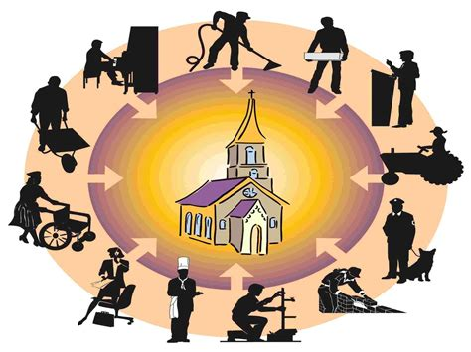
Gifts of God:
Ephesians 4:13-16
¹³ Till we all come in the unity of the faith, and of the knowledge of the Son of God, unto a perfect man, unto the measure of the stature of the fulness of Christ:

Slide 68
Gifts of God:
Ephesians 4:13-16
This refers not so much to the individual as to the church, which is to come to a state of organic unity, completeness, and maturity as contrasted with the childish immaturity suggested in v. 14. For both the individual and the church, likeness to Christ is the goal to be reached. The refusal to grow is a greater sin than immaturity itself, and is the outcome of self-satisfaction and low ideals.
¹³ Till we all come in the unity of the faith, and of the knowledge of the Son of God, unto a perfect man, unto the measure of the stature of the fulness of Christ:

Slide 69
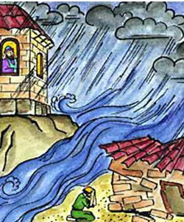
Gifts of God:
Ephesians 4:14-16
¹⁴ That we henceforth be no more children, tossed to and fro, and carried about with every wind of doctrine, by the sleight of men, and cunning craftiness, whereby they lie in wait to deceive;

Slide 70
Gifts of God:
Ephesians 4:15-16
¹⁵ But speaking the truth in love, may grow up into him in all things, which is the head, even Christ:

Slide 71
Gifts of God:
Ephesians 4:15-16
¹⁵ But speaking the truth in love, may grow up into him in all things, which is the head, even Christ:
Love and the truth are inseparable. Truth must be not only accurate in idea but loving in manner. Love, however, does not imply the condoning of sin. None of the apostles was more specific in his denunciation of evil-doers than was Paul, but love was the inner state of his heart while he spoke the truth; love demanded that the truth be spoken.

Slide 72

Gifts of God:
Ephesians 4:16
¹⁶ From whom the whole body fitly joined together and compacted by that which every joint supplieth, according to the effectual working in the measure of every part, maketh increase of the body unto the edifying of itself in love.

Slide 73
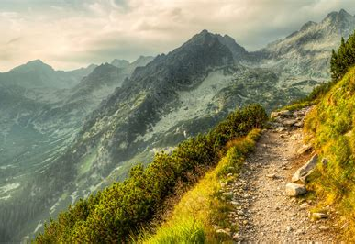
Walking Worthy (An Example):

Slide 74

Walking Worthy (An Example):
Acts 2:1-47
2 And when the day of Pentecost was fully come, they were all with one accord in one place.
² And suddenly there came a sound from heaven as of a rushing mighty wind, and it filled all the house where they were sitting.

Slide 75
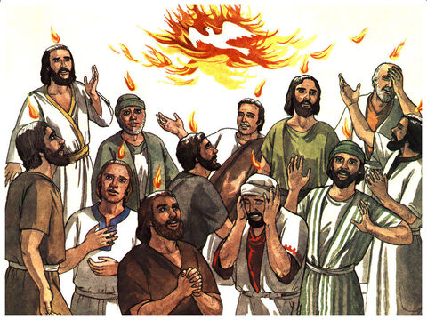
Walking Worthy (An Example):
Acts 2:3-47
³ And there appeared unto them cloven tongues like as of fire, and it sat upon each of them.
⁴ And they were all filled with the Holy Ghost, and began to speak with other tongues, as the Spirit gave them utterance.

Slide 76
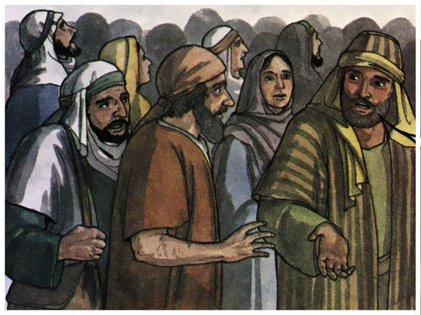
Walking Worthy (An Example):
Acts 2:5-47
⁵ And there were dwelling at Jerusalem Jews, devout men, out of every nation under heaven.
⁶ Now when this was noised abroad, the multitude came together, and were confounded, because that every man heard them speak in his own language.

Slide 77
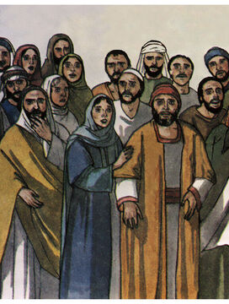
Walking Worthy (An Example):
Acts 2:7-47
⁷ And they were all amazed and marvelled, saying one to another, Behold, are not all these which speak Galilaeans?
⁸ And how hear we every man in our own tongue, wherein we were born?

Slide 78
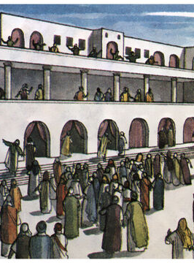
Walking Worthy (An Example):
Acts 2:9-47
⁹ Parthians, and Medes, and Elamites, and the dwellers in Mesopotamia, and in Judaea, and Cappadocia, in Pontus, and Asia,
¹⁰ Phrygia, and Pamphylia, in Egypt, and in the parts of Libya about Cyrene, and strangers of Rome, Jews and proselytes,

Slide 79
Walking Worthy (An Example):
Acts 2:11-47
¹¹ Cretes and Arabians, we do hear them speak in our tongues the wonderful works of God.
¹² And they were all amazed, and were in doubt, saying one to another, What meaneth this?
¹³ Others mocking said, These men are full of new wine.

Slide 80
Walking Worthy (An Example): Peter
John 18:25
Acts 2:14
²⁵ And Simon Peter stood and warmed himself. They said therefore unto him, Art not thou also one of his disciples? He denied it, and said, I am not.
¹⁴ But Peter, standing up with the eleven, lifted up his voice, and said unto them, Ye men of Judaea, and all ye that dwell at Jerusalem, be this known unto you, and hearken to my words:

Slide 81
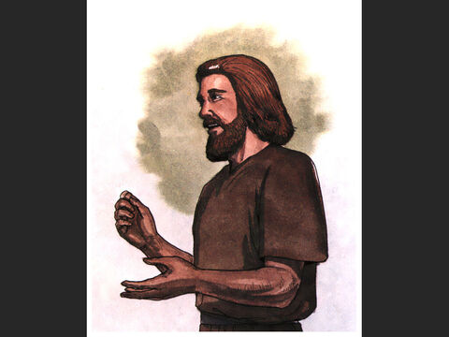
Walking Worthy (An Example): Peter
A remarkable change has come over the apostle during the few weeks since his denial. He has been converted. His mind has been opened by the Lord’s instruction so that he can understand the Scriptures (Luke 24:45).

Slide 82
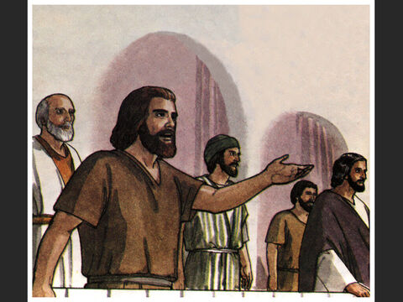
Walking Worthy (An Example): Peter
He has been endued with insight and power by the Holy Spirit. As a result, he stands forth as a sanctified leader of men. Instead of uncertainty, there is conviction; instead of fear, boldness; instead of hasty words, as in the Gospels, there is a detailed, well-reasoned discourse.

Slide 83
Walking Worthy (An Example): Peter
The prophecies concerning Christ are unfolded with method and clarity. Here is an unstudied proof of genuineness. An inventor of tales would hardly have dared to show such a change in character as Luke shows in Peter.

Slide 84
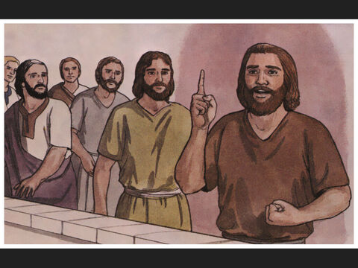
Walking Worthy (An Example): Peter
Note that Peter is not speaking in isolation. He stands as a representative of his brethren. Yet he speaks with personal conviction and by individual inspiration of the Holy Spirit. Peter’s unity with his brethren comes from unity with Christ.

Slide 85
Walking Worthy (An Example):
Acts 2:14-47
¹⁴ But Peter, standing up with the eleven, lifted up his voice, and said unto them, Ye men of Judaea, and all ye that dwell at Jerusalem, be this known unto you, and hearken to my words:

Slide 86
Walking Worthy (An Example):
Acts 2:15-47
¹⁵ For these are not drunken, as ye suppose, seeing it is but the third hour of the day.
¹⁶ But this is that which was spoken by the prophet Joel;

Slide 87
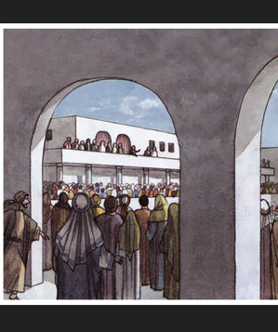
Walking Worthy (An Example): Peter
Peter makes no timid approach to his subject. He boldly identifies the preaching as a fulfillment of prophecy. He can afford to do this, since he has been taught by the Lord and is inspired by the Spirit.

Slide 88
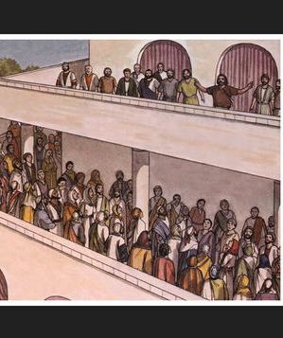
Walking Worthy (An Example): Peter
Under this twofold guidance he begins the first public exposition of the life and works of the Messiah since His ascension. The verses that follow amply testify to the apostle’s new-found ability.

Slide 89
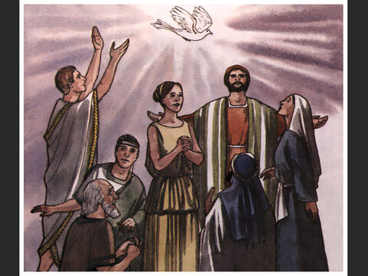
Walking Worthy (An Example):
Acts 2:17-47
¹⁷ And it shall come to pass in the last days, saith God, I will pour out of my Spirit upon all flesh: and your sons and your daughters shall prophesy, and your young men shall see visions, and your old men shall dream dreams:

Slide 90
Walking Worthy (An Example):
Acts 2:18-47
¹⁸ And on my servants and on my handmaidens I will pour out in those days of my Spirit; and they shall prophesy:
¹⁹ And I will shew wonders in heaven above, and signs in the earth beneath; blood, and fire, and vapour of smoke:

Slide 91
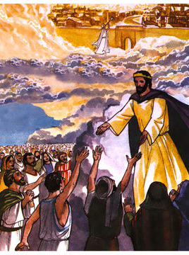
Walking Worthy (An Example):
Acts 2:20-47
²⁰ The sun shall be turned into darkness, and the moon into blood, before the great and notable day of the Lord come:
²¹ And it shall come to pass, that whosoever shall call on the name of the Lord shall be saved.

Slide 92
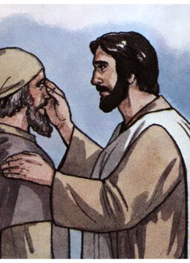
Walking Worthy (An Example):
Acts 2:22-47
²² Ye men of Israel, hear these words; Jesus of Nazareth, a man approved of God among you by miracles and wonders and signs, which God did by him in the midst of you, as ye yourselves also know:

Slide 93

Walking Worthy (An Example):
Acts 2:23-47
²³ Him, being delivered by the determinate counsel and foreknowledge of God, ye have taken, and by wicked hands have crucified and slain:

Slide 94

Walking Worthy (An Example):
Acts 2:24-47
²⁴ Whom God hath raised up, having loosed the pains of death: because it was not possible that he should be holden of it.
²⁵ For David speaketh concerning him, I foresaw the Lord always before my face, for he is on my right hand, that I should not be moved:

Slide 95

Walking Worthy (An Example):
Acts 2:26-47
²⁶ Therefore did my heart rejoice, and my tongue was glad; moreover also my flesh shall rest in hope:
²⁷ Because thou wilt not leave my soul in hell, neither wilt thou suffer thine Holy One to see corruption.
²⁸ Thou hast made known to me the ways of life; thou shalt make me full of joy with thy countenance.

Slide 96

Walking Worthy (An Example):
Acts 2:29-47
²⁹ Men and brethren, let me freely speak unto you of the patriarch David, that he is both dead and buried, and his sepulchre is with us unto this day.
³⁰ Therefore being a prophet, and knowing that God had sworn with an oath to him, that of the fruit of his loins, according to the flesh, he would raise up Christ to sit on his throne;

Slide 97

Walking Worthy (An Example):
Acts 2:31-47
³¹ He seeing this before spake of the resurrection of Christ, that his soul was not left in hell, neither his flesh did see corruption.
³² This Jesus hath God raised up, whereof we all are witnesses.

Slide 98

Walking Worthy (An Example):
Acts 2:33-47
³³ Therefore being by the right hand of God exalted, and having received of the Father the promise of the Holy Ghost, he hath shed forth this, which ye now see and hear.
³⁴ For David is not ascended into the heavens: but he saith himself, The Lord said unto my Lord, Sit thou on my right hand,
³⁵ Until I make thy foes thy footstool.

Slide 99

Walking Worthy (An Example):
Acts 2:36-47
³⁶ Therefore let all the house of Israel know assuredly, that God hath made the same Jesus, whom ye have crucified, both Lord and Christ.
³⁷ Now when they heard this, they were pricked in their heart, and said unto Peter and to the rest of the apostles, Men and brethren, what shall we do?

Slide 100

What shall we Do? AA 42
Some of those who listened to the apostles had taken an active part in the condemnation and death of Christ. Their voices had mingled with the rabble in calling for His crucifixion.

Slide 101

What shall we Do? AA 42
When Jesus and Barabbas stood before them in the judgment hall and Pilate asked, “Whom will ye that I release unto you?” they had shouted, “Not this Man, but Barabbas!” Matthew 27:17; John 18:40.

Slide 102

What shall we Do? AA 42
When Pilate delivered Christ to them, saying, “Take ye Him, and crucify Him: for I find no fault in Him;” “I am innocent of the blood of this just Person,” they had cried, “His blood be on us, and on our children.” John 19:6; Matthew 27:24, 25.

Slide 103

What shall we Do? AA 43
Now they heard the disciples declaring that it was the Son of God who had been crucified. Priests and rulers trembled. Conviction and anguish seized the people. “They were pricked in their heart, and said unto Peter and to the rest of the…

Slide 104
What shall we Do? AA 43
…apostles, Men and brethren, what shall we do?” Among those who listened to the disciples were devout Jews, who were sincere in their belief. The power that accompanied the words of the speaker convinced them that Jesus was indeed the Messiah.

Slide 105

Walking Worthy (An Example):
Acts 2:38-47
³⁸ Then Peter said unto them, Repent, and be baptized every one of you in the name of Jesus Christ for the remission of sins, and ye shall receive the gift of the Holy Ghost.
³⁹ For the promise is unto you, and to your children, and to all that are afar off, even as many as the Lord our God shall call.

Slide 106

Walking Worthy (An Example):
Acts 2:40-47
⁴⁰ And with many other words did he testify and exhort, saying, Save yourselves from this untoward generation.
⁴¹ Then they that gladly received his word were baptized: and the same day there were added unto them about three thousand souls.

Slide 107

Walking Worthy (An Example):
Acts 2:42-47
⁴² And they continued stedfastly in the apostles' doctrine and fellowship, and in breaking of bread, and in prayers.
⁴³ And fear came upon every soul: and many wonders and signs were done by the apostles.

Slide 108

Walking Worthy (An Example):
Acts 2:44-47
⁴⁴ And all that believed were together, and had all things common;
⁴⁵ And sold their possessions and goods, and parted them to all men, as every man had need.

Slide 109

Walking Worthy (An Example):
Acts 2:46-47
⁴⁶ And they, continuing daily with one accord in the temple, and breaking bread from house to house, did eat their meat with gladness and singleness of heart,

Slide 110

Walking Worthy (An Example):
Acts 2:47
⁴⁷ Praising God, and having favour with all the people. And the Lord added to the church daily such as should be saved.

Slide 111

Walking Worthy (An Example): AA 50
The lapse of time has wrought no change in Christ's parting promise to send the Holy Spirit as His representative. It is not because of any restriction on the part of God that the riches of His grace do not flow earthward to men.

Slide 112

Walking Worthy (An Example): AA 50
If the fulfillment of the promise is not seen as it might be, it is because the promise is not appreciated as it should be. If all were willing, all would be filled with the Spirit.

Slide 113

Walking Worthy (An Example): AA 51
It is not a conclusive evidence that a man is a Christian because he manifests spiritual ecstasy under extraordinary circumstances. Holiness is not rapture: it is an entire surrender of the will to God; it is living by every word that proceeds from the mouth of God;

Slide 114

Walking Worthy (An Example): AA 51
it is doing the will of our heavenly Father; it is trusting God in trial, in darkness as well as in the light; it is walking by faith and not by sight; it is relying on God with unquestioning confidence, and resting in His love.

Slide 115

Walking Worthy (An Example): AA 52
Having brought conviction of sin, and presented before the mind the standard of righteousness, the Holy Spirit withdraws the affections from the things of this earth and fills the soul with a desire for holiness. “He will guide you into all truth,” the Saviour declared.

Slide 116

Walking Worthy (An Example): AA 52
If men are willing to be molded, there will be brought about a sanctification of the whole being. The Spirit will take the things of God and stamp them on the soul. By His power the way of life will be made so plain that none need err therein.

Slide 117
Take a few moments to prepare for Sabbath school next week!
We’ll be looking at the Second part of Ephesians 4,
That is, Ephesians 4:17-32

Slide 118
Thank you!
And Happy Sabbath!!

